Slide 1
HTCondor Command Line Monitoring Tool
Vipul Davda

Slide 2
Checking HTCondor Submitted Jobs
condor_q displays information about jobs in the HTCondor job queue.
Useful options:
-global Show jobs submitted to all the schedulers
-wide Do not truncate long lines.
-analyze <job_id> Analyse a specific job and show the reason why it is in its current state
-better-analyze <job_id> Analyse a specific job and show the reason why it is in its current state, giving extended info
-long <job_id> Show all information of the job.
-run Show information about running jobs.
-hold Show only jobs in the "on hold" state.
-af <attr1> <attr2> <...> List specific attributes of jobs, using automatic formatting.
Notes:
Condor_q is the basic supplied command

Slide 3
HTCondor Online/Offline Worker Nodes
To offline a worker node:
condor_config_val –name <worker node> -startd –set “StartJobs = False”
sleeps 2
condor_reconfig –name <worker node>
To online a worker node:
condor_config_val –name <worker node> -startd –set “StartJobs = True”
sleeps 2
condor_reconfig –name <worker node>
Notes:
The above is the standard way of doing things which is a bit clunky

Slide 4
HTCondor List Online Worker Nodes
To list online worker nodes:
condor_status –server –wide|grep slot1@|awk ‘{print $1}’|awk –F@ ‘{print $2}’|sort
To list offline worker nodes:
???
Notes:
Is there a way to list offline nodes??

Slide 5
HTCondor List Jobs on a Worker Nodes
To list jobs on a worker node:
condor_q –constraint ‘RemoteHost == “slot1@<worker node>”’

Slide 6
condor_wn
condor_wn
a python script which gives a snapshot view of what is running on the cluster.
Uses the below additional python modules:
  htcondor and classad – (https://htcondor-python.readthedocs.io/en/latest/) to look at the inventory in the pool
  prettytable - to get the pretty output
  yaml - to read values from a configuration file
Notes:
Home grown script to simplify things…..

Slide 7
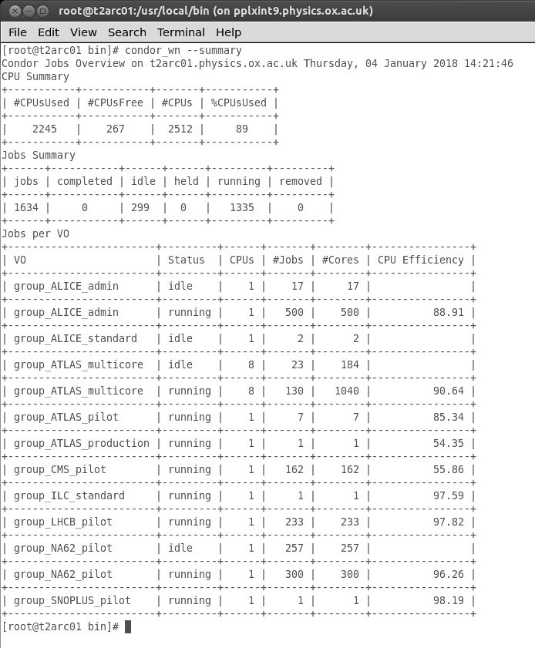
condor_wn – summary tables
condor_wn --summary
displays summary tables:
  CPU Summary
  Number of Jobs
  Jobs per VO
  Idle Jobs (displayed if the jobs in the idle queue are more than 1 day old)*
  Held Jobs (displayed if the jobs in the held queue are more than 1 day old)*
  Long Running Jobs (displayed if the jobs in the running queue are more than 4 days old)*
* The default value can be changed in the condor_wn.yaml config file
Notes:
Example
Condor_wn script is in /usr/local/bin
Idle in Condor speak is equivalent to Queued in Torque terminology
Yaml file is in /usr/local/etc

Slide 8
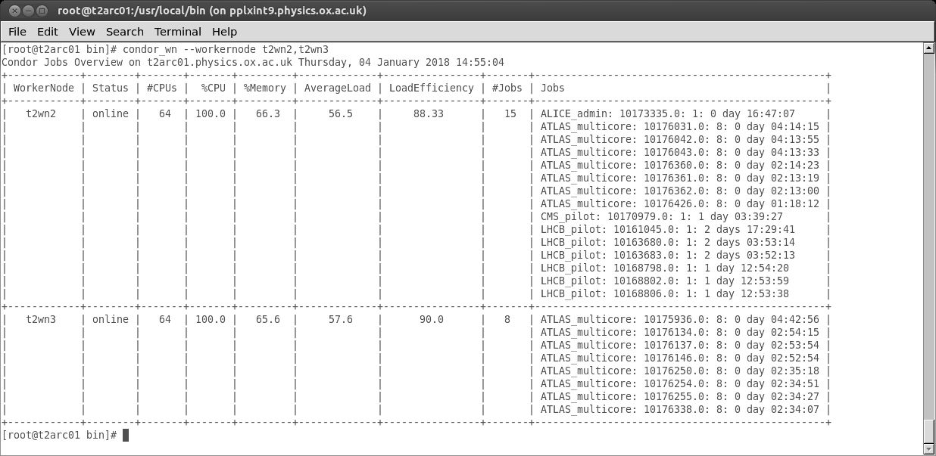
condor_wn – list jobs on workernodes
condor_wn --workernode t2wn2,t2wn3 - displays jobs on worker node(s)
Notes:
Note memory is allocated 1.5 times

Slide 9
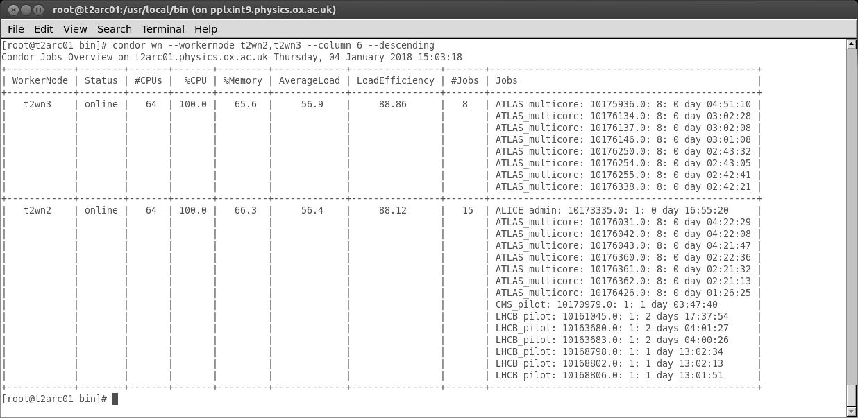
condor_wn – list jobs on workernodes
condor_wn --workernode t2wn2,t2wn3 –column 6 --descending - displays jobs on worker nodes, sorted by column 6 (AverageLoad) and descending order.
Notes:
Also can use short option version ie –w and –c and -d

Slide 10
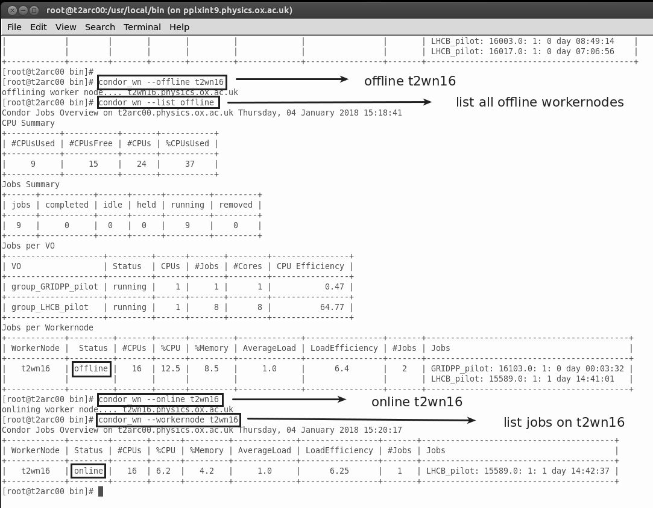
condor_wn – online/offline worker nodes
condor_wn --offline t2wn16
offline worker node t2wn16
condor_wn --list offline
list all offline worker nodes
condor_wn --online t2wn16
online worker node t2wn16
Putting All worker nodes online/offline
condor_wn --offline ALL
Are you sure that you want to put ALL workernodes offline [y/N] y
Are you REALLY sure that you want to put ALL workernodes offline [y/N] N
Notes:
Need to be on collector demon node
Eg t2condor01 for Oxford’s production cluster.

Slide 11
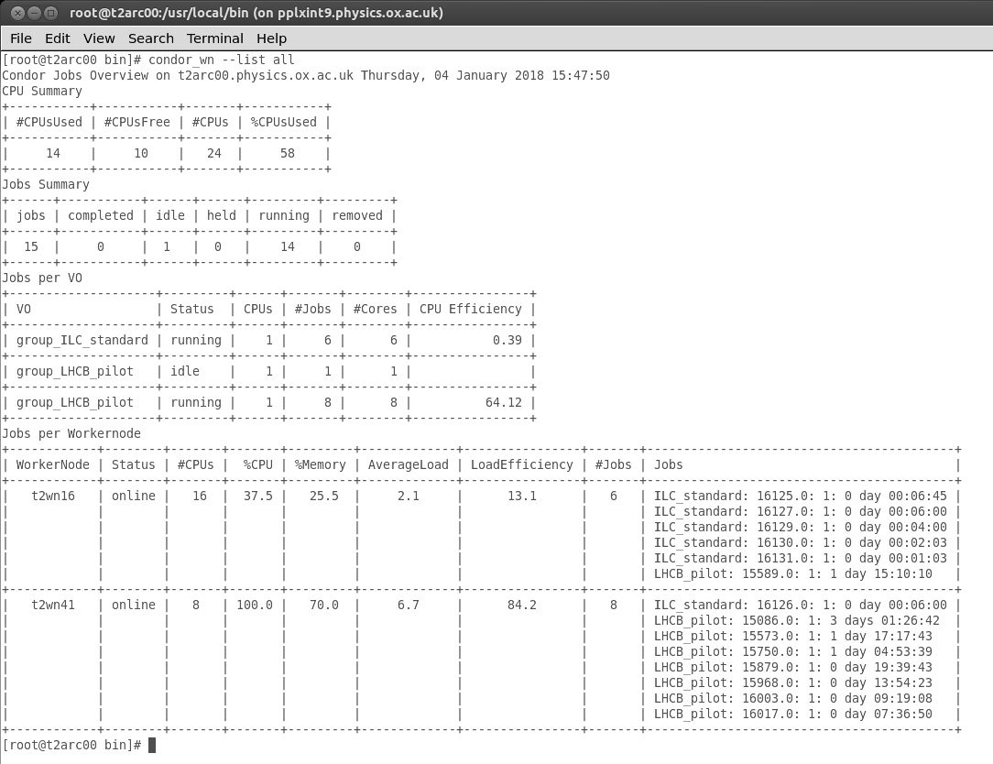
condor_wn – list
condor_wn --list offline
list all offline worker nodes
condor_wn --list online
list all online worker nodes
condor_wn --list multicore
list all multicore jobs
condor_wn --list all
list all worker nodes

Slide 12
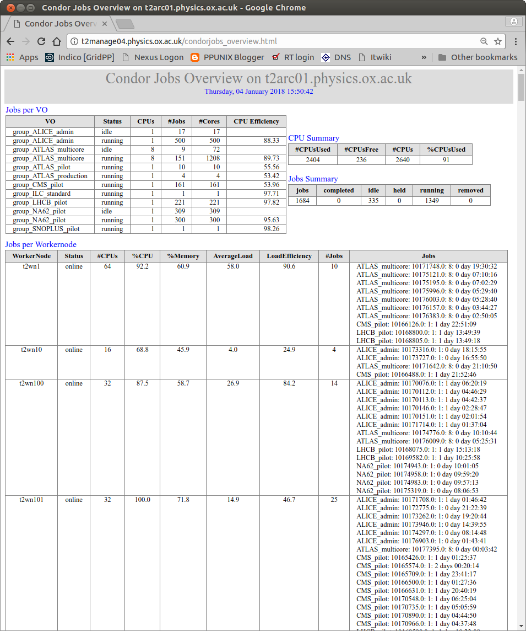
condor_wn – html
condor_wn --list all --html
list all worker nodes and create an html output
If you don’t like the layout of the tables, the template for the output is defined in condor_wn.yaml file
To avoid copying the html file to a webserver
Install HTCondor RPMs on the webserver
Copy configuration files:
  pool_password
  condor_config
  condor_config.local
  10_security.config
Make sure:
  SCHEDD_HOST is defined in 10_security.config
    SCHEDD_HOST = <scheduler server>
  Do not start any htcondor daemons
Notes:
Can direct the output into an html file.
The format is customizable.
Can enable the web server to run the command locally by following the steps listed above.
Scheduler is t2arc01 for example

Slide 13
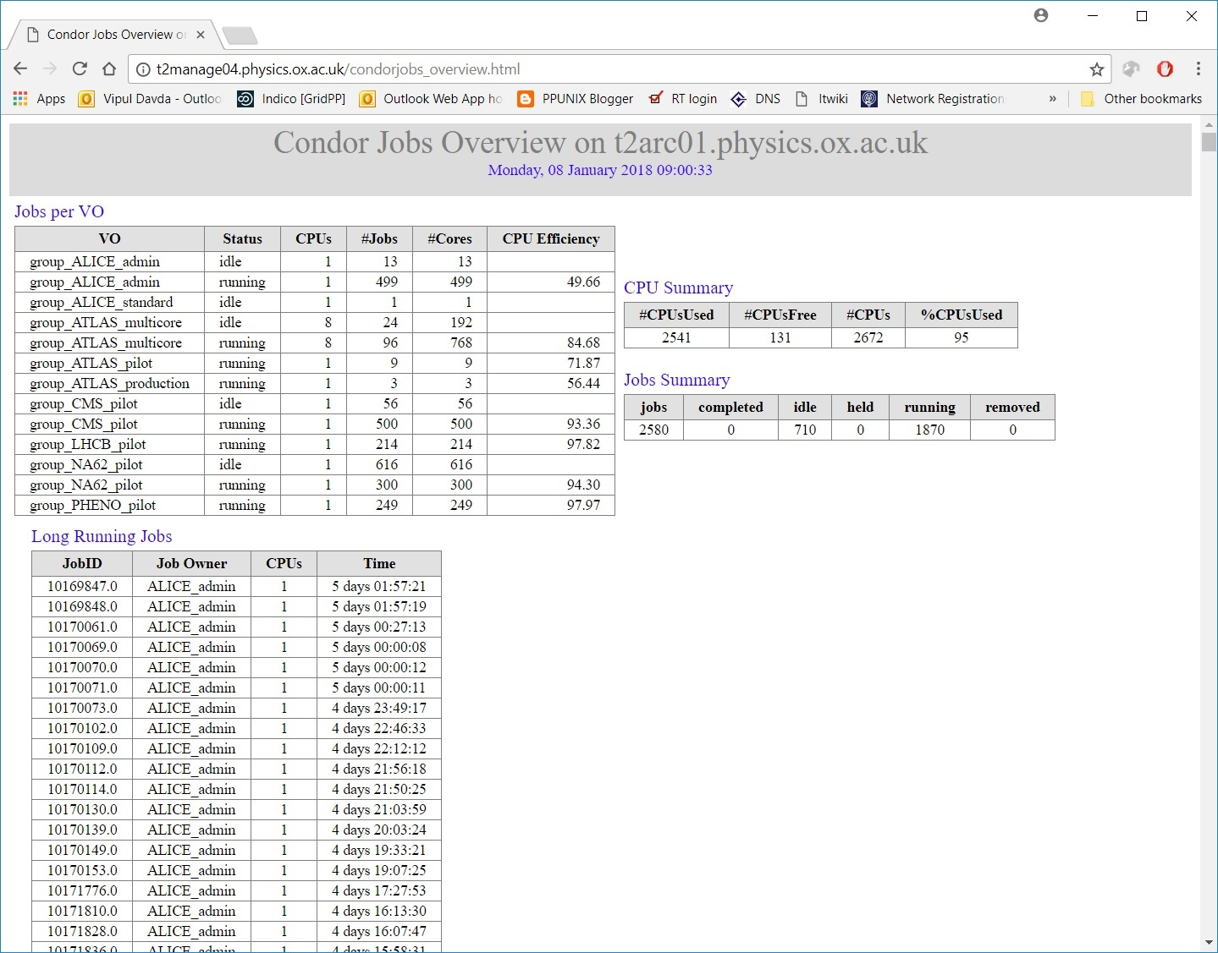
condor_wn – html
If a “Long Running Jobs” criteria is met, a table listing the jobs ids will be displayed.
Notes:
In this example the extra Long Job table appears as there is data.
Script will be provided on the GridPP github.

Slide 14
Questions
QUESTIONS?

