Slide 1
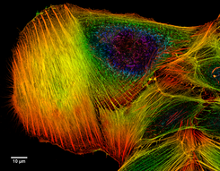


Deconvolution of Photon Strength
Richard B. Firestone
Department of Nuclear Engineering
University of California, Berkeley CA 94720 USA
Deconvolution - a process of resolving something into its constituent elements or removing complication in order to clarify it.
                Example of a deconvolved
                microscope image.
In mathematics, deconvolution is an algorithm-based process used to reverse the effects of convolution on recorded data
14th Nordic Meeting on Nuclear Physics,
May 22, 2018 - May 25, 2018, Longyearbyen

Slide 2
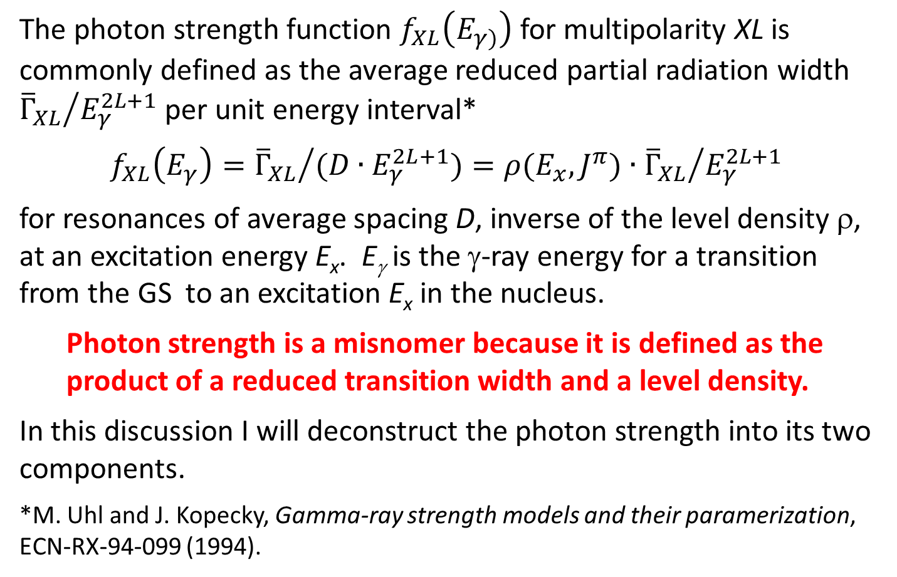
Introduction
The photon strength function $f_{XL}\left(E_{γ)}\right)$ for multipolarity XL is commonly defined as the average reduced partial radiation width ${{\overline{Γ}}_{XL}}/{E_{γ}^{2L+1}}$ per unit energy interval*
$$f_{XL}\left(E_{γ}\right)={{\overline{Γ}}_{XL}}/{{(D∙E}_{γ}^{2L+1}})=ρ(E_{x},J^{π})∙{{\overline{Γ}}_{XL}}/{E_{γ}^{2L+1}}$$
for resonances of average spacing D, inverse of the level density ρ, at an excitation energy E_{x}. E_{γ} is the γ-ray energy for a transition from the GS to an excitation E_{x} in the nucleus.
  Photon strength is a misnomer because it is defined as the product of a reduced transition width and a level density.
In this discussion I will deconstruct the photon strength into its two components.
*M. Uhl and J. Kopecky, Gamma-ray strength models and their paramerization, ECN-RX-94-099 (1994).

Slide 3
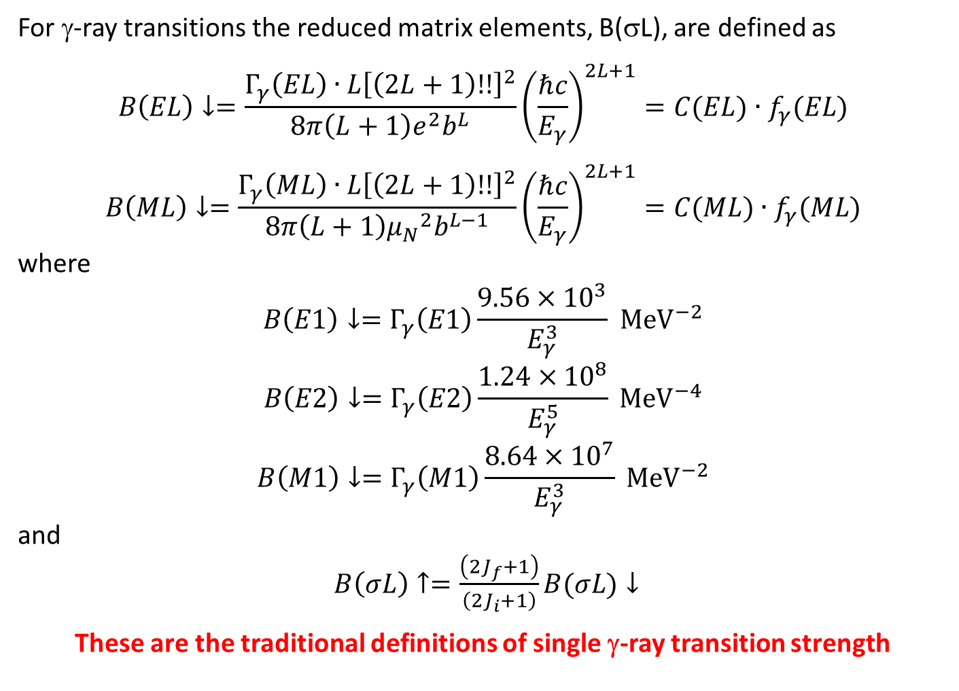
Reduced Transition Probabilities
For γ-ray transitions the reduced matrix elements, B(σL), are defined as
$$B\left(EL\right)↓=\frac{Γ_{γ}\left(EL\right)∙L{\left[\left(2L+1\right)!!\right]}^{2}}{8π\left(L+1\right)e^{2}b^{L}}{\left(\frac{ℏc}{E_{γ}}\right)}^{2L+1}=C(EL)∙f_{γ}(EL)$$
$$B\left(ML\right)↓=\frac{Γ_{γ}\left(ML\right)∙L{\left[\left(2L+1\right)!!\right]}^{2}}{8π\left(L+1\right){μ_{N}}^{2}b^{L−1}}{\left(\frac{ℏc}{E_{γ}}\right)}^{2L+1}=C(ML)∙f_{γ}(ML)$$
where
$$B\left(E1\right)↓=Γ_{γ}\left(E1\right)\frac{9.56×{10}^{3}}{E_{γ}^{3}}{ MeV}^{−2}$$
$$B\left(E2\right)↓=Γ_{γ}\left(E2\right)\frac{1.24×{10}^{8}}{E_{γ}^{5}} {MeV}^{−4}$$
$$B\left(M1\right)↓=Γ_{γ}\left(M1\right)\frac{8.64×{10}^{7}}{E_{γ}^{3}} {MeV}^{−2}$$
and
$B\left(σL\right)↑=\frac{\left(2J_{f}+1\right)}{\left(2J_{i}+1\right)}B(σL)↓$
These are the traditional definitions of single γ-ray transition strength

Slide 4
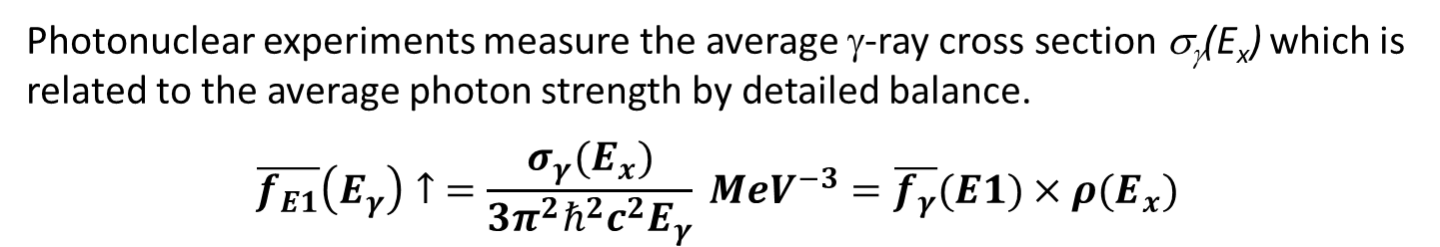
Photonuclear data
Photon strength f_{E1}(E_{γ}) was originally defined to describe (γ,n) photonuclear cross section data which is dominated by E1 multipolarity.
J,J±1
E_{x}
E_{γ}↑ σ_{γ}(E_{x})
J
0
^{A}Z
Photonuclear experiments measure the average γ-ray cross section σ_{γ}(E_{x}) which is related to the average photon strength by detailed balance.
$$\overline{f_{E1}}\left(E_{γ}\right)↑ =\frac{σ_{γ}{(E}_{x})}{3π^{2}ℏ^{2}c^{2}E_{γ}} {MeV}^{−3}=\overline{f_{γ}}(E1)×ρ(E_{x})$$

Slide 5
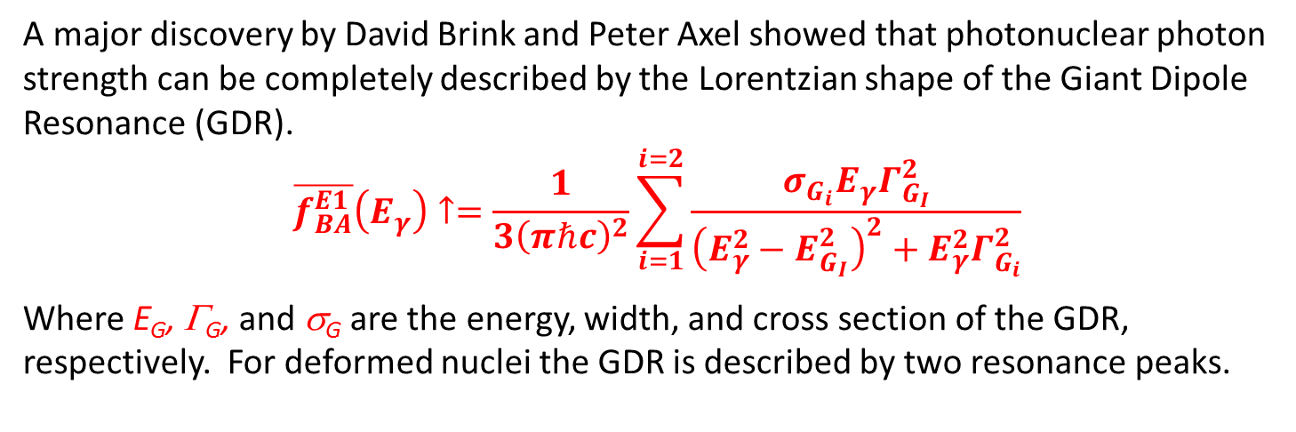
Brink-Axel Photon Strength
A major discovery by David Brink and Peter Axel showed that photonuclear photon strength can be completely described by the Lorentzian shape of the Giant Dipole Resonance (GDR).
$$\overline{f_{BA}^{E1}}\left(E_{γ}\right)↑=\frac{1}{3{\left(πℏc\right)}^{2}}\sum_{i=1}^{i=2}{\frac{σ_{G_{i}}E_{γ}Γ_{G_{I}}^{2}}{{\left(E_{γ}^{2}−E_{G_{I}}^{2}\right)}^{2}+E_{γ}^{2}Γ_{G_{i}}^{2}}}$$
Where E_{G}, Γ_{G}, and σ_{G} are the energy, width, and cross section of the GDR, respectively. For deformed nuclei the GDR is described by two resonance peaks.
⁹⁸Mo GDR data are fit to the parameters E_{G}=17.0 MeV, Γ_{G}=7.4 MeV, and σ_{G}=230 mb. Data fall below the BA prediction at low energies where γ-ray emission competes with neutron decay and above BA predictions at high energy where multiple neutron emission occurs.
These are average E1 photon strengths whose values vary in a Porter-Thomas distribution.

Slide 6
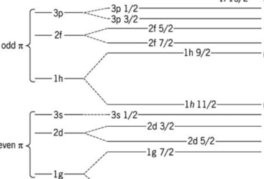
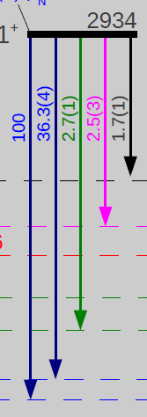
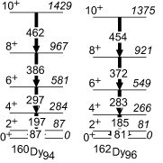

Other simple γ-ray transitions
Near and below the neutron separation energy, S_{n}, simple γ-ray transitions can be observed. These transitions do not follow a Porter-Thomas distribution.
Shell model transitions
Single particle M1 shell model transitions occur in shells neat the GS and S_{n}.
E1 (pygmy) and M1 (spin-flip) transitions occur between adjacent shells. Their strength is divided into many transitions between multiparticle configurations.
S.P.
Pygmy
Spin Flip
S.P.
Scissors
Counterrotation of a proton/neutron fluid.
Collective transitions
Rotational
Deformed nuclei have strong M1, E2 transitions confined to rotational bands.
1241
1182
996
815
681
123
¹⁵⁴Gd
0

Slide 7
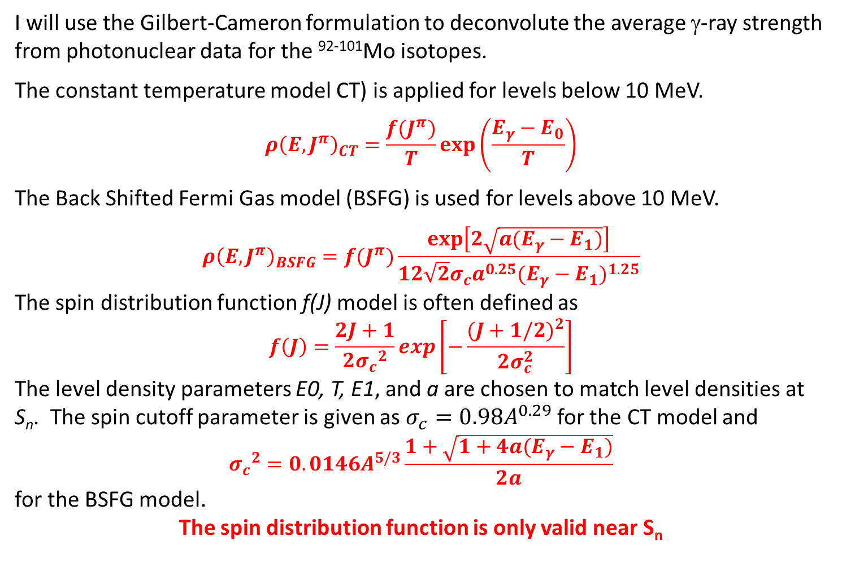
Level Density Formulas
I will use the Gilbert-Cameron formulation to deconvolute the average γ-ray strength from photonuclear data for the ⁹²⁻¹⁰¹Mo isotopes.
The constant temperature model CT) is applied for levels below 10 MeV.
$${ρ\left(E,J^{π}\right)}_{CT}=\frac{f(J^{π})}{T}exp\left(\frac{E_{γ}−E_{0}}{T}\right)$$
The Back Shifted Fermi Gas model (BSFG) is used for levels above 10 MeV.
$${ρ\left(E,J^{π}\right)}_{BSFG}=f(J^{π})\frac{exp\left[2\sqrt{a(E_{γ}−E_{1})}\right]}{12\sqrt{2}σ_{c}a^{0.25}{(E_{γ}−E_{1})}^{1.25}}$$
The spin distribution function f(J) model is often defined as
$$f\left(J\right)=\frac{2J+1}{2{σ_{c}}^{2}}exp\left[−\frac{{(J+1/2)}^{2}}{2σ_{c}^{2}}\right]$$
The level density parameters E0, T, E1, and a are chosen to match level densities at S_{n}. The spin cutoff parameter is given as $σ_{c}=0.98A^{0.29}$ for the CT model and
$${σ_{c}}^{2}=0.0146A^{5/3}\frac{1+\sqrt{1+4a(E_{γ}−E_{1})}}{2a}$$
for the BSFG model.
The spin distribution function is only valid near S_{n}

Slide 8
Spin distribution
Photonuclear reactions populate a small subset of spins and parities so we need to determine f(J^{π}). At low excitation energies the spin distribution function is invalid so a new model is needed.
RIPL-3 HFB Calculations - nuclear level density obtained within the HFB plus combinatorial model* at the ground state deformation or all J^{π}.
CT-JPI Model (RBF) – separate CT or BSFG model equation or each J^{π} value where E₀=E₁=E_{yrast}(J^{π}) and T(J^{π}) can vary for each spin and parity. T(J^{π}) is constrained so that the s-wave and p-wave level spacing at Sn are consistent with D0 and D1.
* S. Goriely, S. Hilaire, and A.J. Koning, Improved microscopic nuclear level densities within the Hartree-Fock-Bogoliubov plus combinatorial method, Phys. Rev. C78 (2008) 064307.

Slide 9
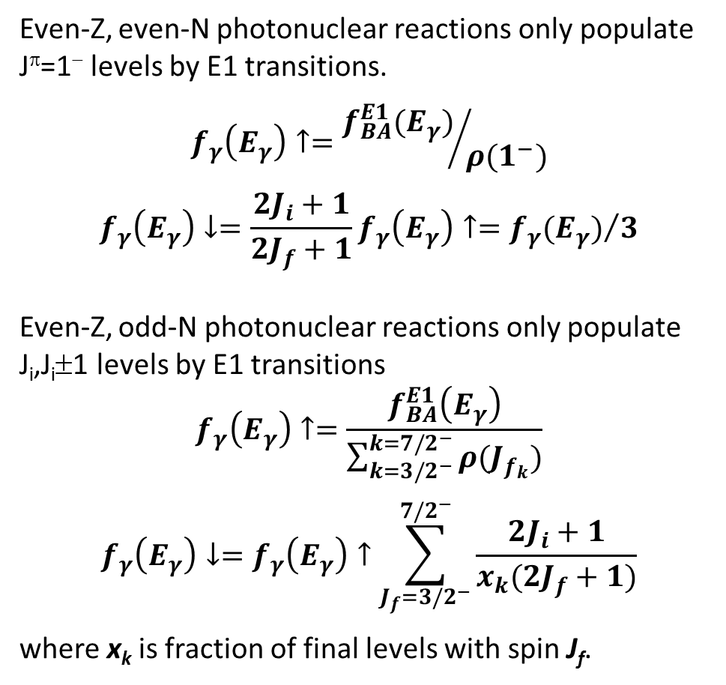
Deconvoluting the γ-ray strength
Even-Z, even-N photonuclear reactions only populate J^{π}=1⁻ levels by E1 transitions.
$$f_{γ}\left(E_{γ}\right)↑={f_{BA}^{E1}(E_{γ})}/{ρ(1^{−})}$$
$$f_{γ}\left(E_{γ}\right)↓=\frac{2J_{i}+1}{2J_{f}+1}f_{γ}\left(E_{γ}\right)↑={f_{γ}(E_{γ})}/3$$
Even-Z, odd-N photonuclear reactions only populate J_{i},J_{i}±1 levels by E1 transitions
$$f_{γ}\left(E_{γ}\right)↑=\frac{f_{BA}^{E1}\left(E_{γ}\right)}{\sum_{k=3/2^{−}}^{k=7/2^{−}}{ρ(J_{f_{k}}})}$$
$$f_{γ}\left(E_{γ}\right)↓=f_{γ}\left(E_{γ}\right)↑\sum_{J_{f}=3/2^{−}}^{7/2^{−}}{\frac{2J_{i}+1}{x_{k}(2J_{f}+1)}}$$
where x_{k} is fraction of final levels with spin J_{f}.
J_{f}=1⁻
γ(0⁺→1⁻)
J_{i}=0⁺
⁹⁸Mo
J_{f}=(3/2,5/2,7/2)⁻
γ[5/2⁺→(3/2,5/2,7/2)⁻]
J_{i}=5/2⁺
⁹⁵Mo

Slide 10
Continuous γ-ray strength function
GDR
Association of GDR with γ-ray strength is an artifact of this analysis.

Slide 11
Mo γ-ray strength with CT-JPI level density

Slide 12
Mo γ-ray strength with HB level density

Slide 13
Comparison with (n,γ) primary γ-ray strength
S_{n}
Thermal (n,γ) data is clearly inconsistent photonuclear γ-ray strength.

Slide 14
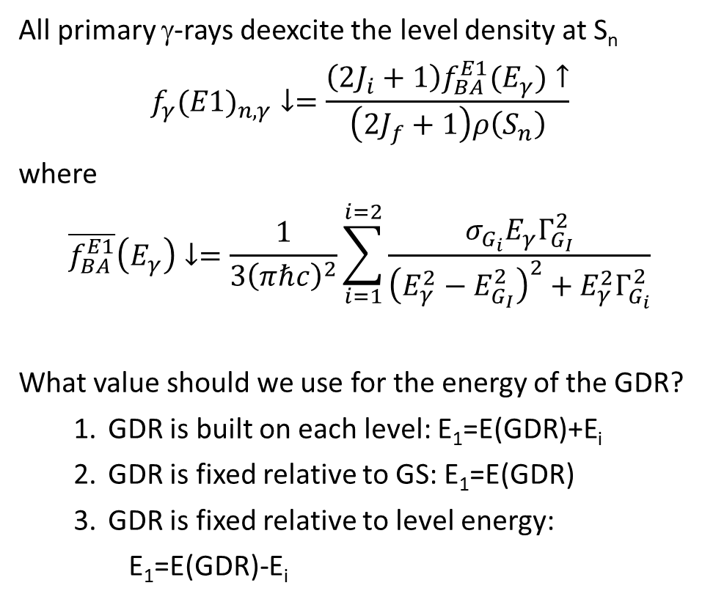
(n,γ) primary γ-ray strengths
S_{n}
All primary γ-rays deexcite the level density at S_{n}
$$f_{γ}(E1)_{n,γ}↓=\frac{{\left(2J_{i}+1\right)f}_{BA}^{E1}(E_{γ})↑}{\left(2J_{f}+1\right)ρ\left(S_{n}\right)}$$
where
$$\overline{f_{BA}^{E1}}\left(E_{γ}\right)↓=\frac{1}{3{\left(πℏc\right)}^{2}}\sum_{i=1}^{i=2}{\frac{σ_{G_{i}}E_{γ}Γ_{G_{I}}^{2}}{{\left(E_{γ}^{2}−E_{G_{I}}^{2}\right)}^{2}+E_{γ}^{2}Γ_{G_{i}}^{2}}}$$
What value should we use for the energy of the GDR?
  GDR is built on each level: E₁=E(GDR)+E_{i}
  GDR is fixed relative to GS: E₁=E(GDR)
  GDR is fixed relative to level energy:
    E₁=E(GDR)-E_{i}
E₅
E₄₄
E₃
E₂
E₁
0
^{A}Z
Primary (n,γ) γ-rays can be binned to give average γ-ray strengths.

Slide 15
(n,γ) primary γ-ray strengths
Consistent with E(GDR) energy fixed with respect to GS. Anomalous low values are unexplained.

Slide 16
Comparison with Γ₀ and Γ₁ at S_{n}
For CT-JPI LD model the level densities are fit to exactly reproduce D0 and D1. This is not true for the HFB LD model.
 | Sn | D0 | D1 |  | Γ₀ (eV) |  |  | Γ₁ (eV)
 | (MeV) | (eV) |  |  | Atlas | Calc | M1_{exp}* | Atlas | Calc
⁹³Mo | 8.08981 | 2800 |  | 780 | 0.155 | 0.031 | 0.069 | 0.240 | 0.038
⁹⁵Mo | 7.3691 | 1690 |  | 508 | 0.128 | 0.076 | 0.050 | 0.188 | 0.039
⁹⁶Mo | 9.15432 | 81 |  | 37.7 | 0.162 | 0.019 | 0.056 | 0.210 | 0.175
⁹⁷Mo | 6.82125 | 1170 |  | 324 | 0.096 | 0.057 | 0.036 | 0.125 | 0.026
⁹⁸Mo | 8.6426 | 46.5 |  | 21.9 | 0.130 | 0.054 | 0.050 | - | 0.317
⁹⁹Mo | 5.92544 | 970 |  | 286 | 0.072 | 0.029 | 0.033 | 0.107 | 0.011
¹⁰¹Mo | 5.39824 | 617 |  | 236 | 0.064 | 0.016 | 0.013 | 0.093 | 0.007
* Observed (n,γ) M1 width.

Slide 17
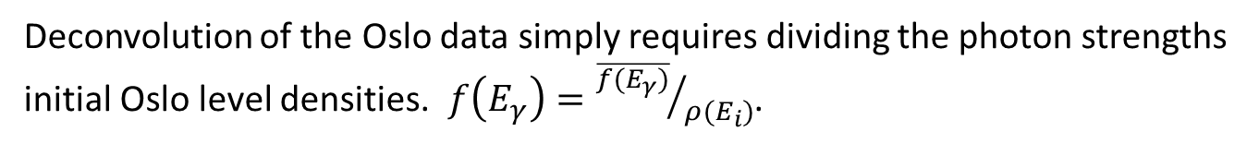
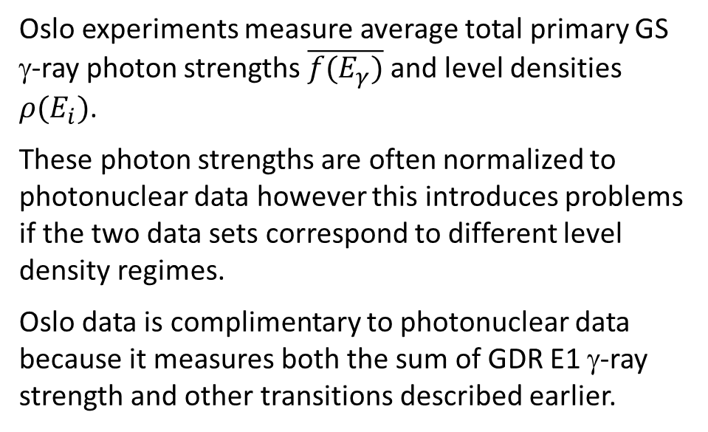
Deconvolution of Reaction (Oslo) Data
Oslo experiments measure average total primary GS γ-ray photon strengths $\overline{f(E_{γ})}$ and level densities $ρ(E_{i})$.
These photon strengths are often normalized to photonuclear data however this introduces problems if the two data sets correspond to different level density regimes.
Oslo data is complimentary to photonuclear data because it measures both the sum of GDR E1 γ-ray strength and other transitions described earlier.
E₁
E₂
E₃
E₄
E₅
0
^{A}Z
Deconvolution of the Oslo data simply requires dividing the photon strengths initial Oslo level densities. $f\left(E_{γ}\right)={\overline{f(E_{γ})}}/{ρ(E_{i})}$.

Slide 18
Comparison of Oslo data with GDR E1

Slide 19
Comparison of Oslo data with GDR E1

Slide 20
Comparison of Oslo data with GDR E1

Slide 21
Comparison of Oslo data with GDR E1

Slide 22
Oslo γ-ray strengths

Slide 23
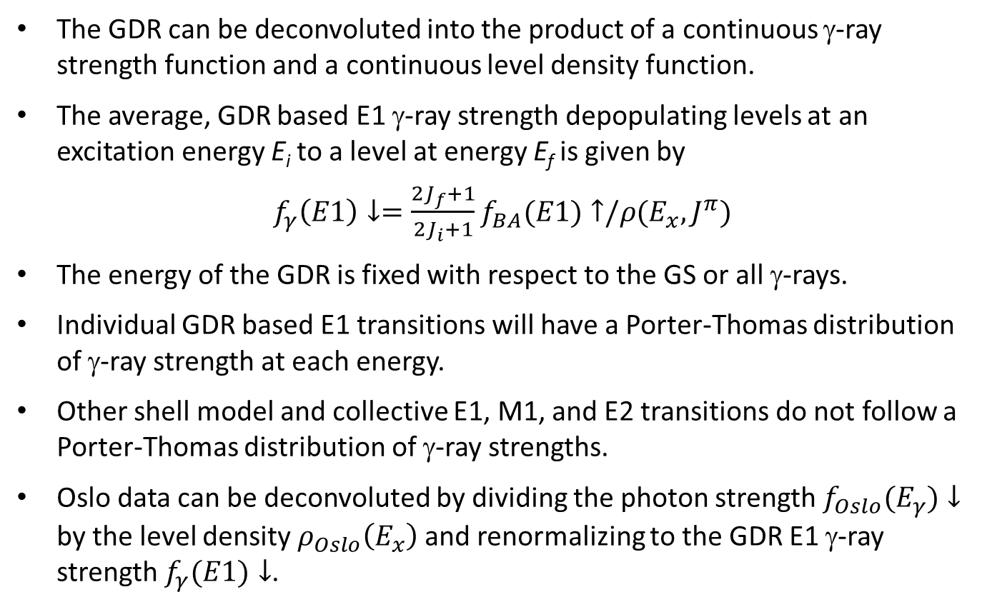
Conclusions
The GDR can be deconvoluted into the product of a continuous γ-ray strength function and a continuous level density function.
The average, GDR based E1 γ-ray strength depopulating levels at an excitation energy E_{i} to a level at energy E_{f} is given by
$f_{γ}\left(E1\right)↓=\frac{2J_{f}+1}{2J_{i}+1}f_{BA}(E1)↑/ρ(E_{x},J^{π})$
The energy of the GDR is fixed with respect to the GS or all γ-rays.
Individual GDR based E1 transitions will have a Porter-Thomas distribution of γ-ray strength at each energy.
Other shell model and collective E1, M1, and E2 transitions do not follow a Porter-Thomas distribution of γ-ray strengths.
Oslo data can be deconvoluted by dividing the photon strength $f_{Oslo}(E_{γ})↓$ by the level density $ρ_{Oslo}\left(E_{x}\right)$ and renormalizing to the GDR E1 γ-ray strength $f_{γ}(E1)↓$.

Slide 24

Thank you for your attention

Slide 25
HFB LD Model fails to reproduce D0, D1
 | ρ0=1/D0 |  | ρ1=1/D1
 | Atlas | HFB | Atlas | HFB
⁹³Mo | 357 | 551 | 1282 | 1601
⁹⁵Mo | 590 | 1630 | 1969 | 4860
⁹⁶Mo | 12346 | 66554 | 26525 | 127400
⁹⁷Mo | 855 | 882 | 3086 | 2445
⁹⁸Mo | 21505 | 39216 | 45662 | 72085
⁹⁹Mo | 1031 | 490 | 3497 | 1351
¹⁰¹Mo | 1521 | 637 | 4237 | 1710

