Slide 1

Spectroscopy, Production and Exotica in Heavy Flavour in ATLAS
Roger Jones
On behalf of the ATLAS Collaboration
ICHEP 2018
Seoul, July 2018
Notes:
1

Slide 2
Outline
ATLAS detector, (multi-,) muon triggers
Focus on recent results
bb correlation with J/ψ+μ JHEP 11 (2017) 62
X(3872) production measurement, prompt and non-prompt JHEP 01 (2017) 117
B_{s}π states PRL 120 (2018) 202007
Summary and perspectives

Slide 3
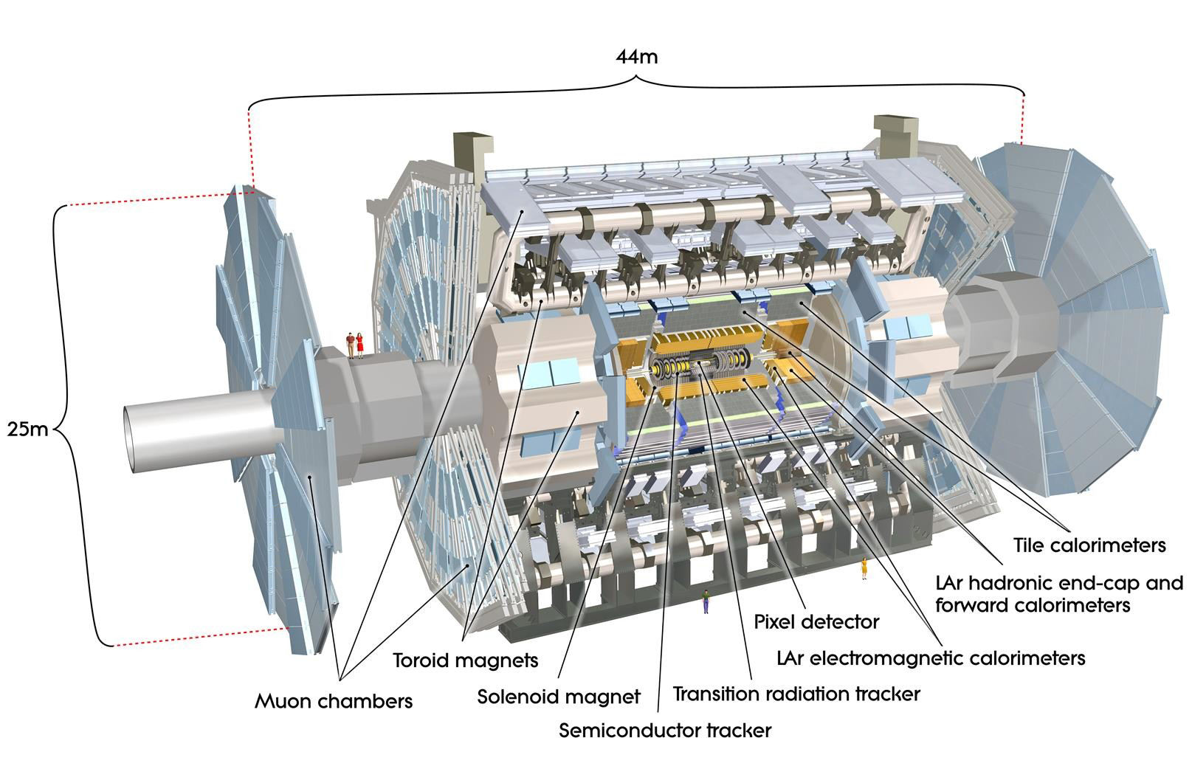
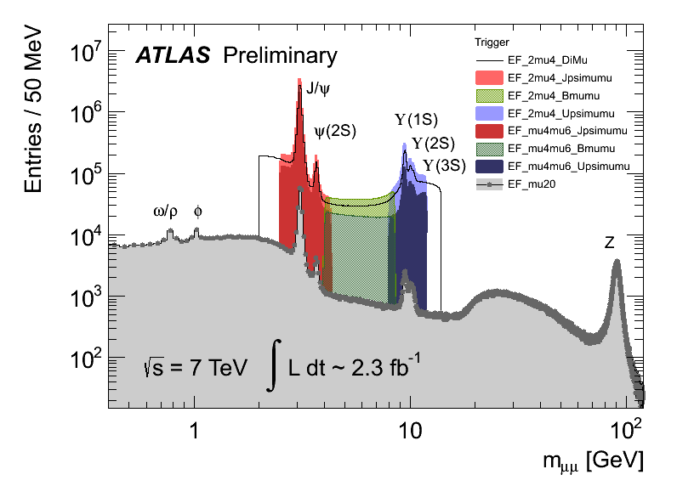
The ATLAS detector at LHC
Inner Detector
|η|<2.5, Solenoid B=2T
σ/pT ~ 3.4x10-4 pT + 0.015 for (|η|<1.5)
Used for Tracking and Vertexing:
Precise momentum
and lifetime measurements
Muon Spectrometer
|η|<2.7
Toroid B-Field, average ~0.5T
Muon Momentum resolution
σ/p< 10% up to ~ 1 TeV

Slide 4
Muon and dimuon triggers in ATLAS
Muon trigger for these analyses:
  2 muons, p_{T} > 4 GeV, |η| < 2.5
History of 20th century particle physics in one plot

Slide 5
bb production at the LHC
Needed for H➔bb and new physics searches
Flavour creation Gluon splitting Flavour Excitation
Need to tag both b’s without losses when colinear
Large Δφ, back-2-back pT balance
Small Δφ, colinear
Large Δη, broad Δφ
Unlike methods using b-jets, J/ψ+μ works for large and small separations

Slide 6
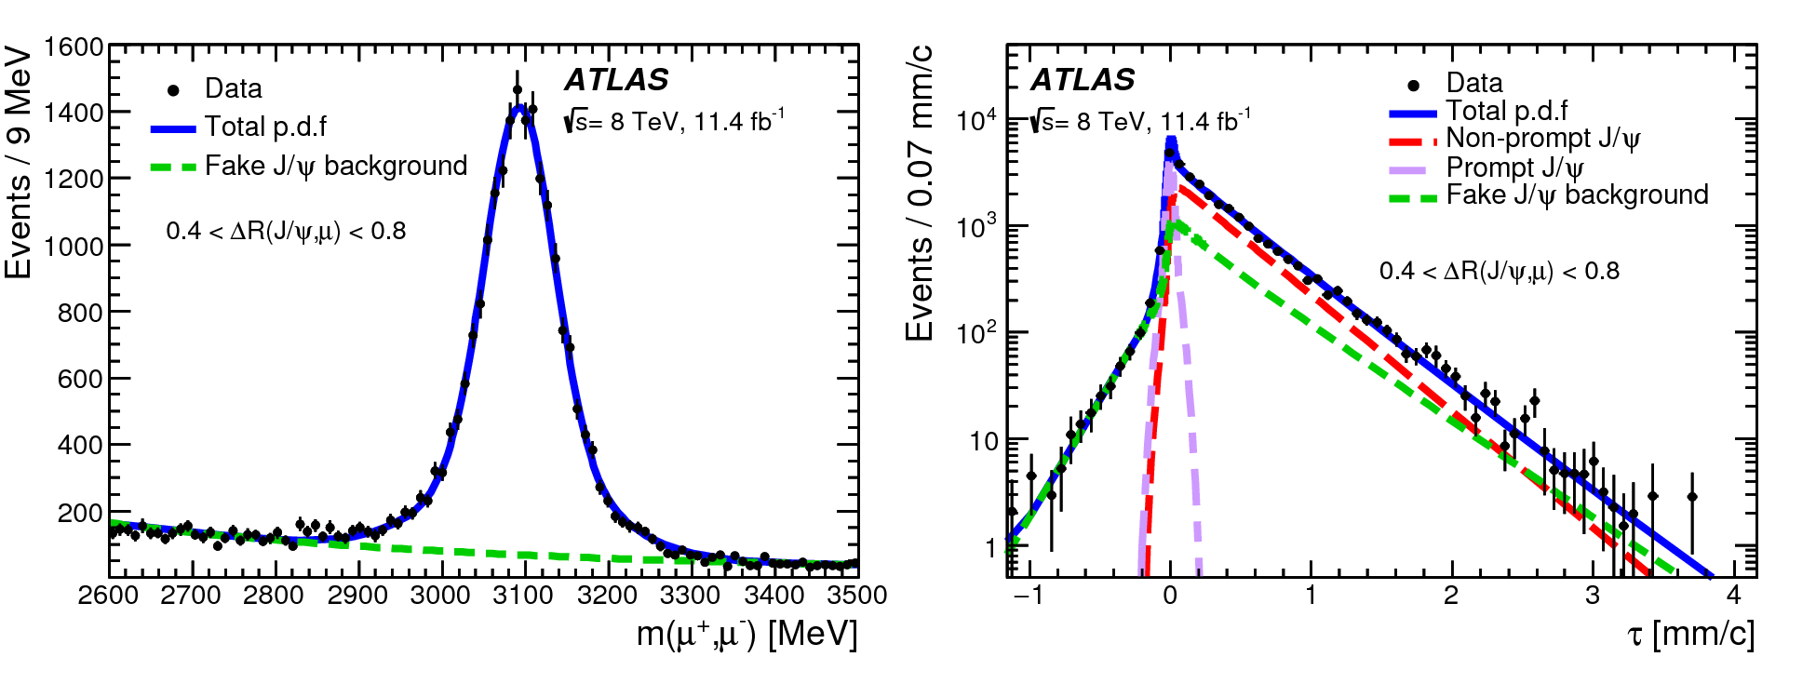
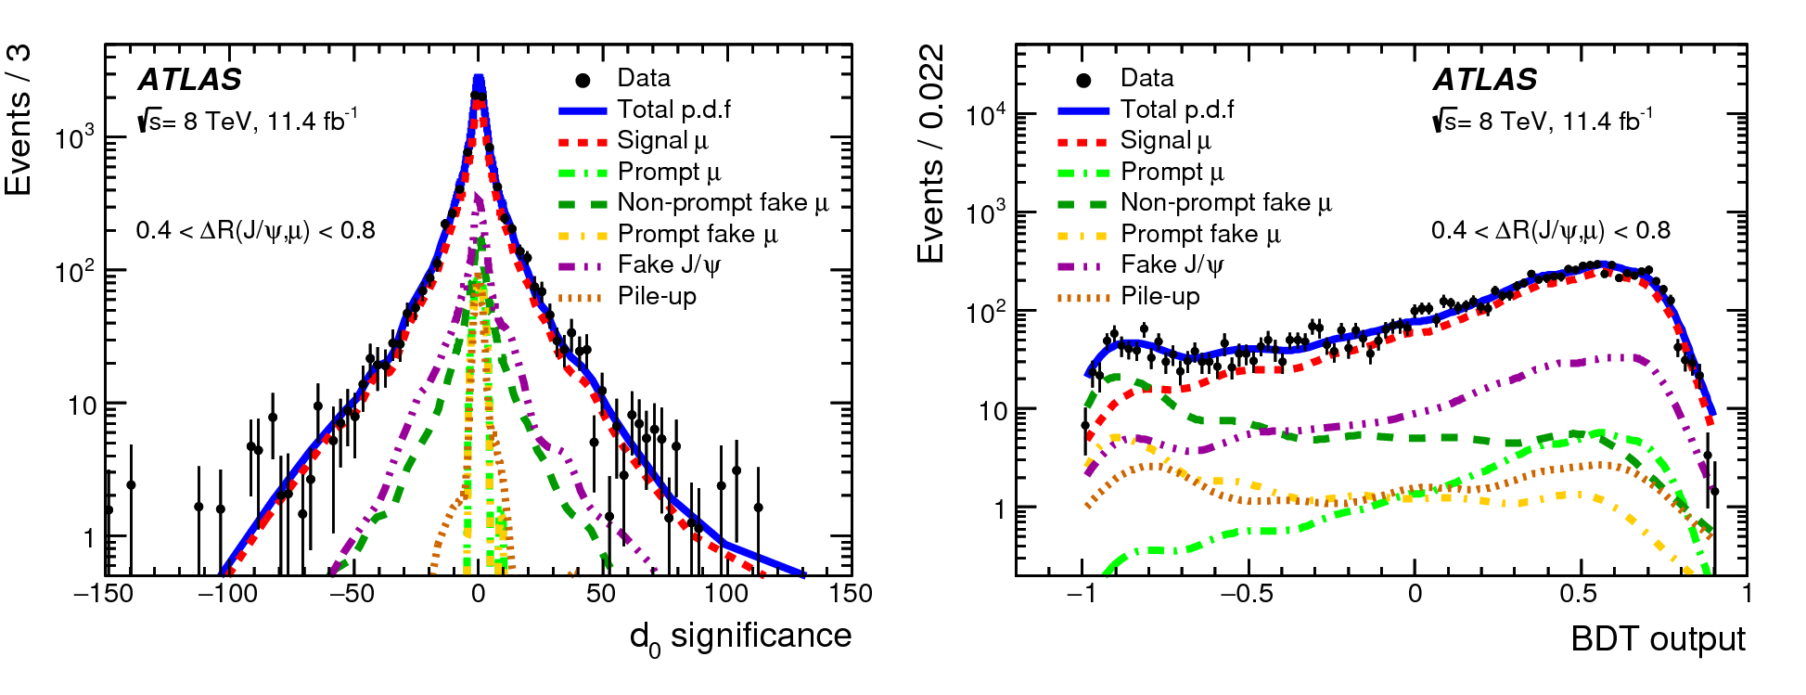
bb Event selection & analysis
J/ψ muons:
  |η| < 2.3
  2.6 < m(μμ) < 3.5 GeV
Additional muons
  |η| < 2.5
  ‘Fakes’ mainly J/ψ+K, control with BDT trained on Monte Carlo
1.9 M J/ψ candidates
τ_{eff} = L_{xy} m(μμ)
c p_{T}(μμ)
Use pseudo proper lifetime of J/ψ to separate prompt/non prompt J/ψ & background, in mass/lifetime fit
L_{xy} = L . p_{T}(μμ)
p_{T}(μμ)
Use 3rd muon impact parameter and BDT to templates from MC to extract signal/prompt/fake contributions

Slide 7
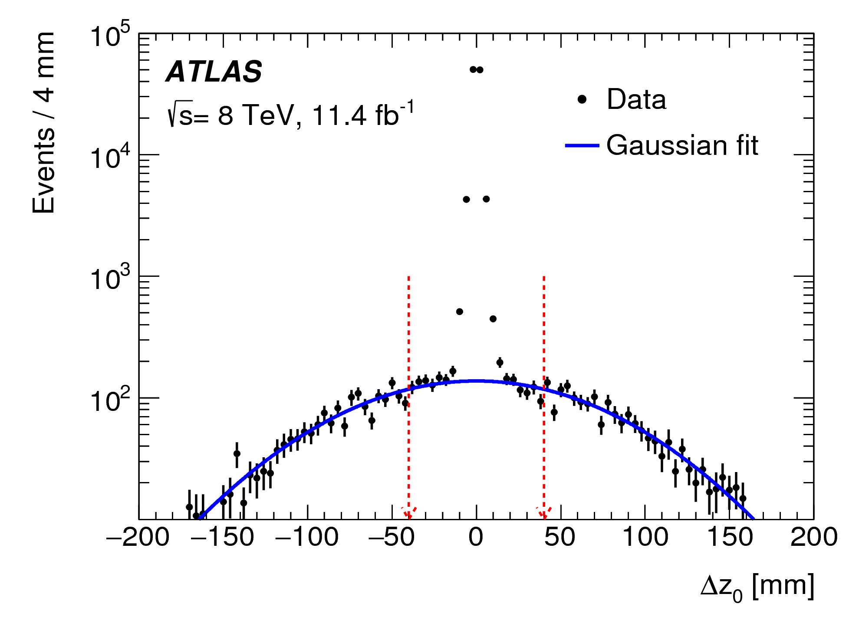
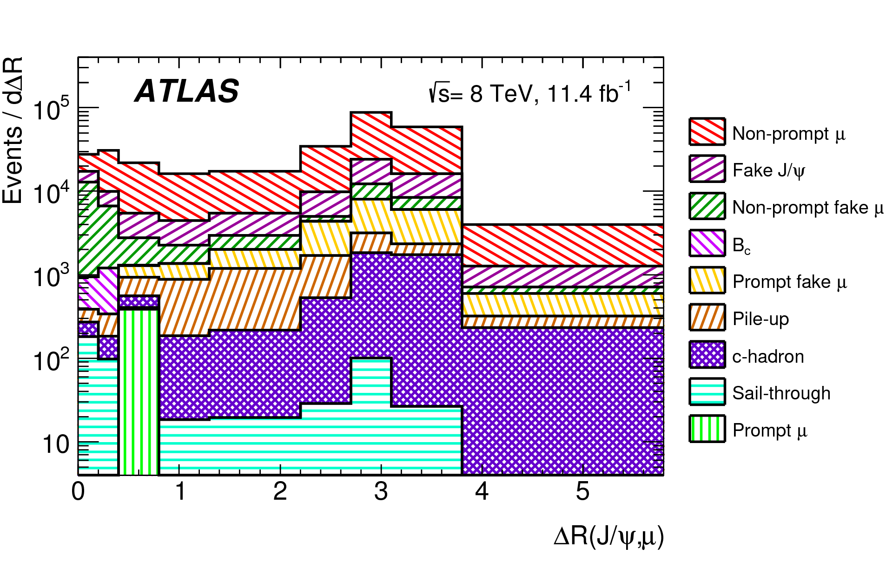
Backgrounds and Corrections
The mean number of pp interactions pre crossing (pileup) at 8 TeV was 20.7
Spread along the z axis, so fit Δz between the third and either of J/ψ muons to control pile-up and for control sample for BDT etc
Irreducible backgrounds:
B_{c}/B_{s}➔J/ψ+μ+X (control with 4μ sample & MC)
Punch through (control with fake μ sample & MC)
B+D➔J/ψ+μ+X (MC)
Standard efficiency correction maps from tag and probe and MC to scale between energies
Additional (small) corrections for overlapping muon RoIs

Slide 8
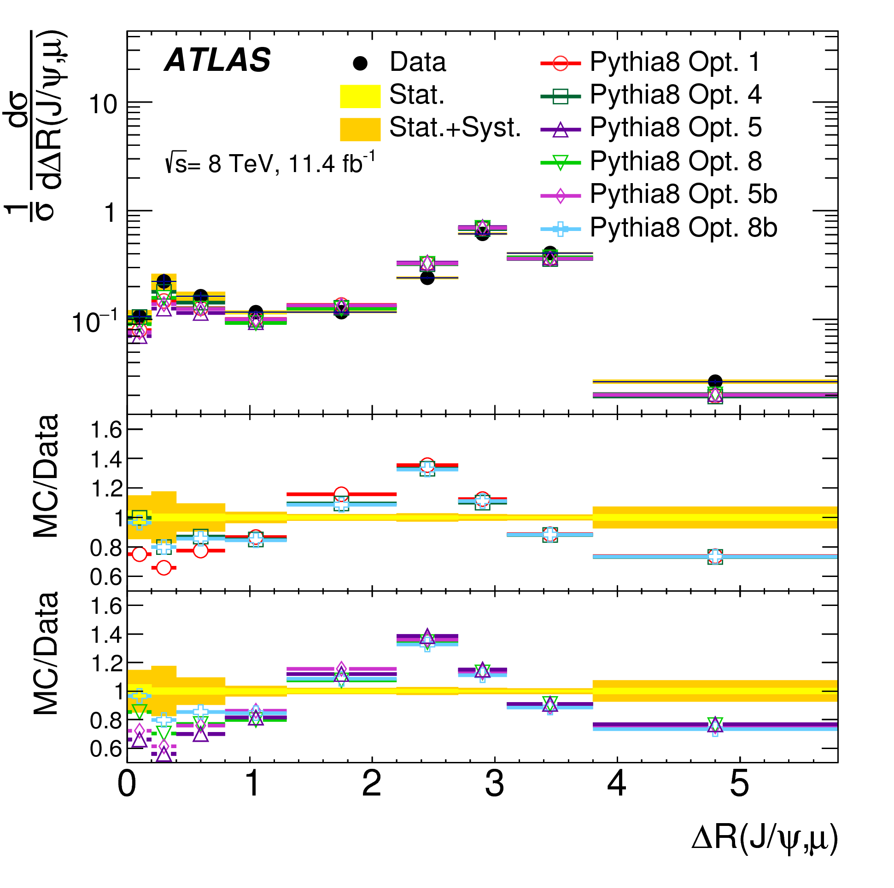
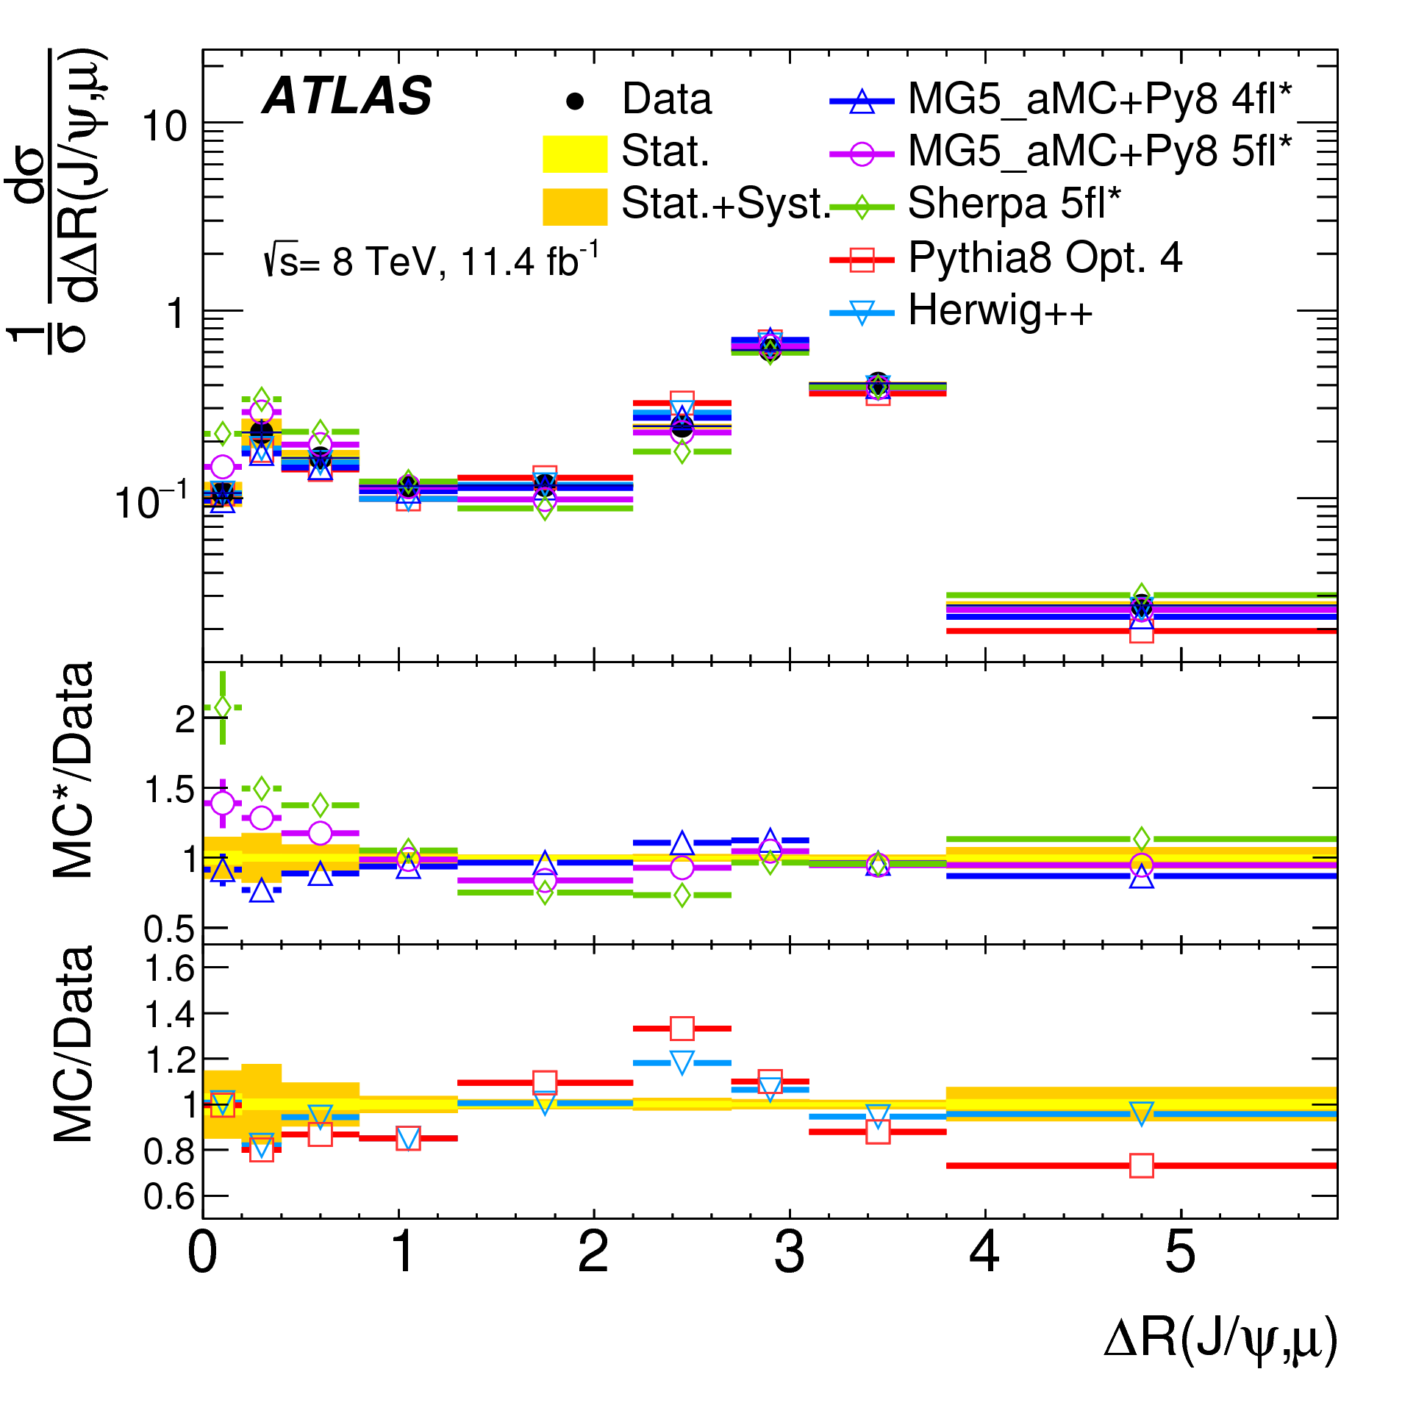
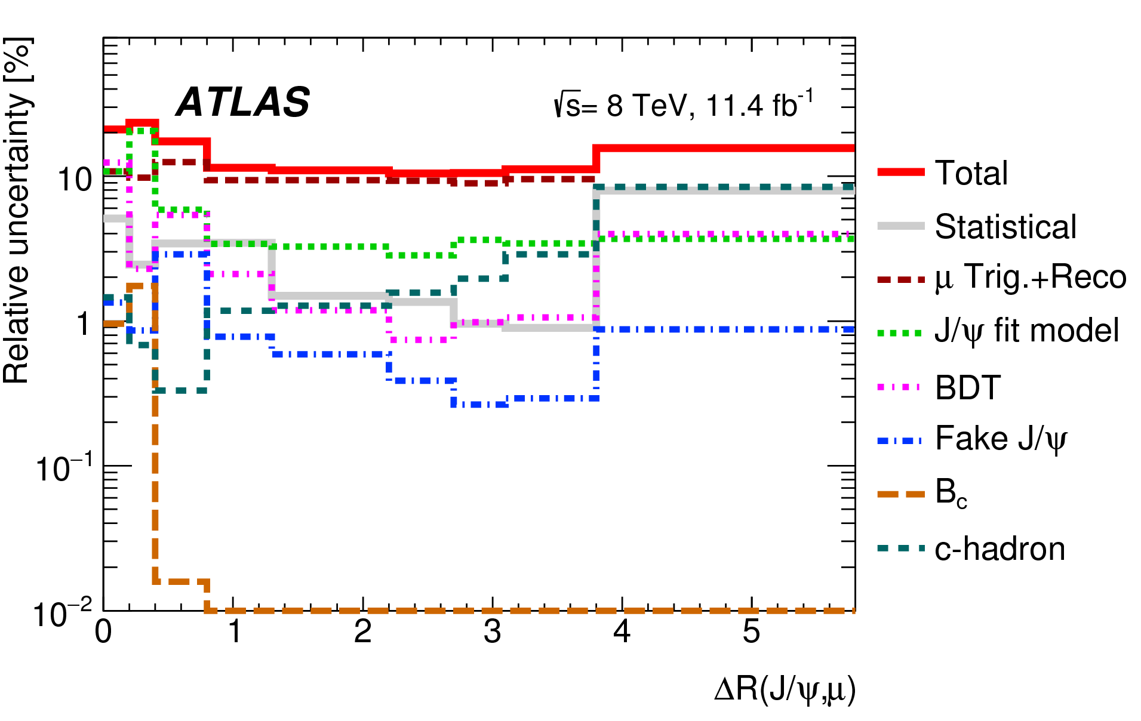
Comparisons with Models
Choose ΔR as an example – many more observables studied
Pythia 8 poorly reproduces shape of the angular distributions
The pT-based scale splitting kernels give better description at low ΔR – Opt 4 best overall
Herwig++ is better than Pythia 8 for the ΔR
4- and 5-flavour MadGraph5 predictions sit either side of the data; 4-flavour is closer
5-flavour SHERPA & MadGraph similar
Good understanding of systematics
Fiducial cross section is also measured
17.7± 0.1 (stat) ± 2.0 (syst) nb

Slide 9
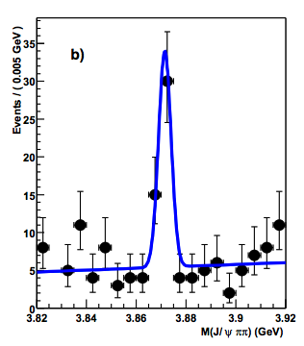
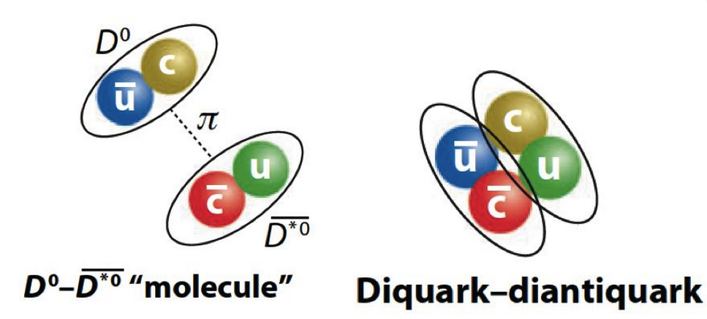
What is X(3872)?
‘Exotic’ resonance first observed by Belle in 2003 in J/ψπ⁺π⁻ final state
Subsequently confirmed by BaBar, CDF, D0 and now LHC experiments
Current world average X(3872) mass very close to the D⁰ D⁰* threshold
What is it? No clear picture yet!
  Loosely bound D⁰ – D⁰* molecule? Unlikely: NRQCD with this premise over-predicts production compared to CMS 2011 measurement
  New excited charmonium state? Unlikely: LHCb measured J^{PC} = 1⁺⁺, no such state expected around that mass
  A mix of these two, χ_{c1}(2P) -(D⁰ D⁰*), with hadronic decays dominated by the χ_{c1}(2P) component? Maybe, if the mixture is determined through fit to CMS results (PRD 96, 074014 (2017))
  Tetraquark (diquark – diantiquark)? Possible, but hard to make any solid predictions
hep-ex/0309032
  Belle
  Measuring X(3872) and the well-studied ψ(2S) in the same analysis and in the same final state J/ψπ⁺π⁻ helps reduce systematics for various ratios and comparisons

Slide 10
Outline of the X(3872) Analysis
Analysis performed for |y| < 0.75 for the J/ψπ⁺π⁻ system, for optimal tracking resolution
Each J/ψπ⁺π⁻ candidate weighted to correct for trigger/reconstruction/acceptance losses
For each p_{T} and lifetime bin, binned minimum χ² fit in the J/ψπ⁺π⁻ invariant mass to determine ψ(2S) and X(3872) signal yields
For each p_{T} bin, the yields in individual lifetime windows are subsequently fitted:
to determine lifetime dependence and hence separate the signal into prompt and non-prompt components
The lifetime fits are performed separately for ψ(2S) and X(3872)
Mass narrow/wide Gaussian ratio common for the two states

Slide 11
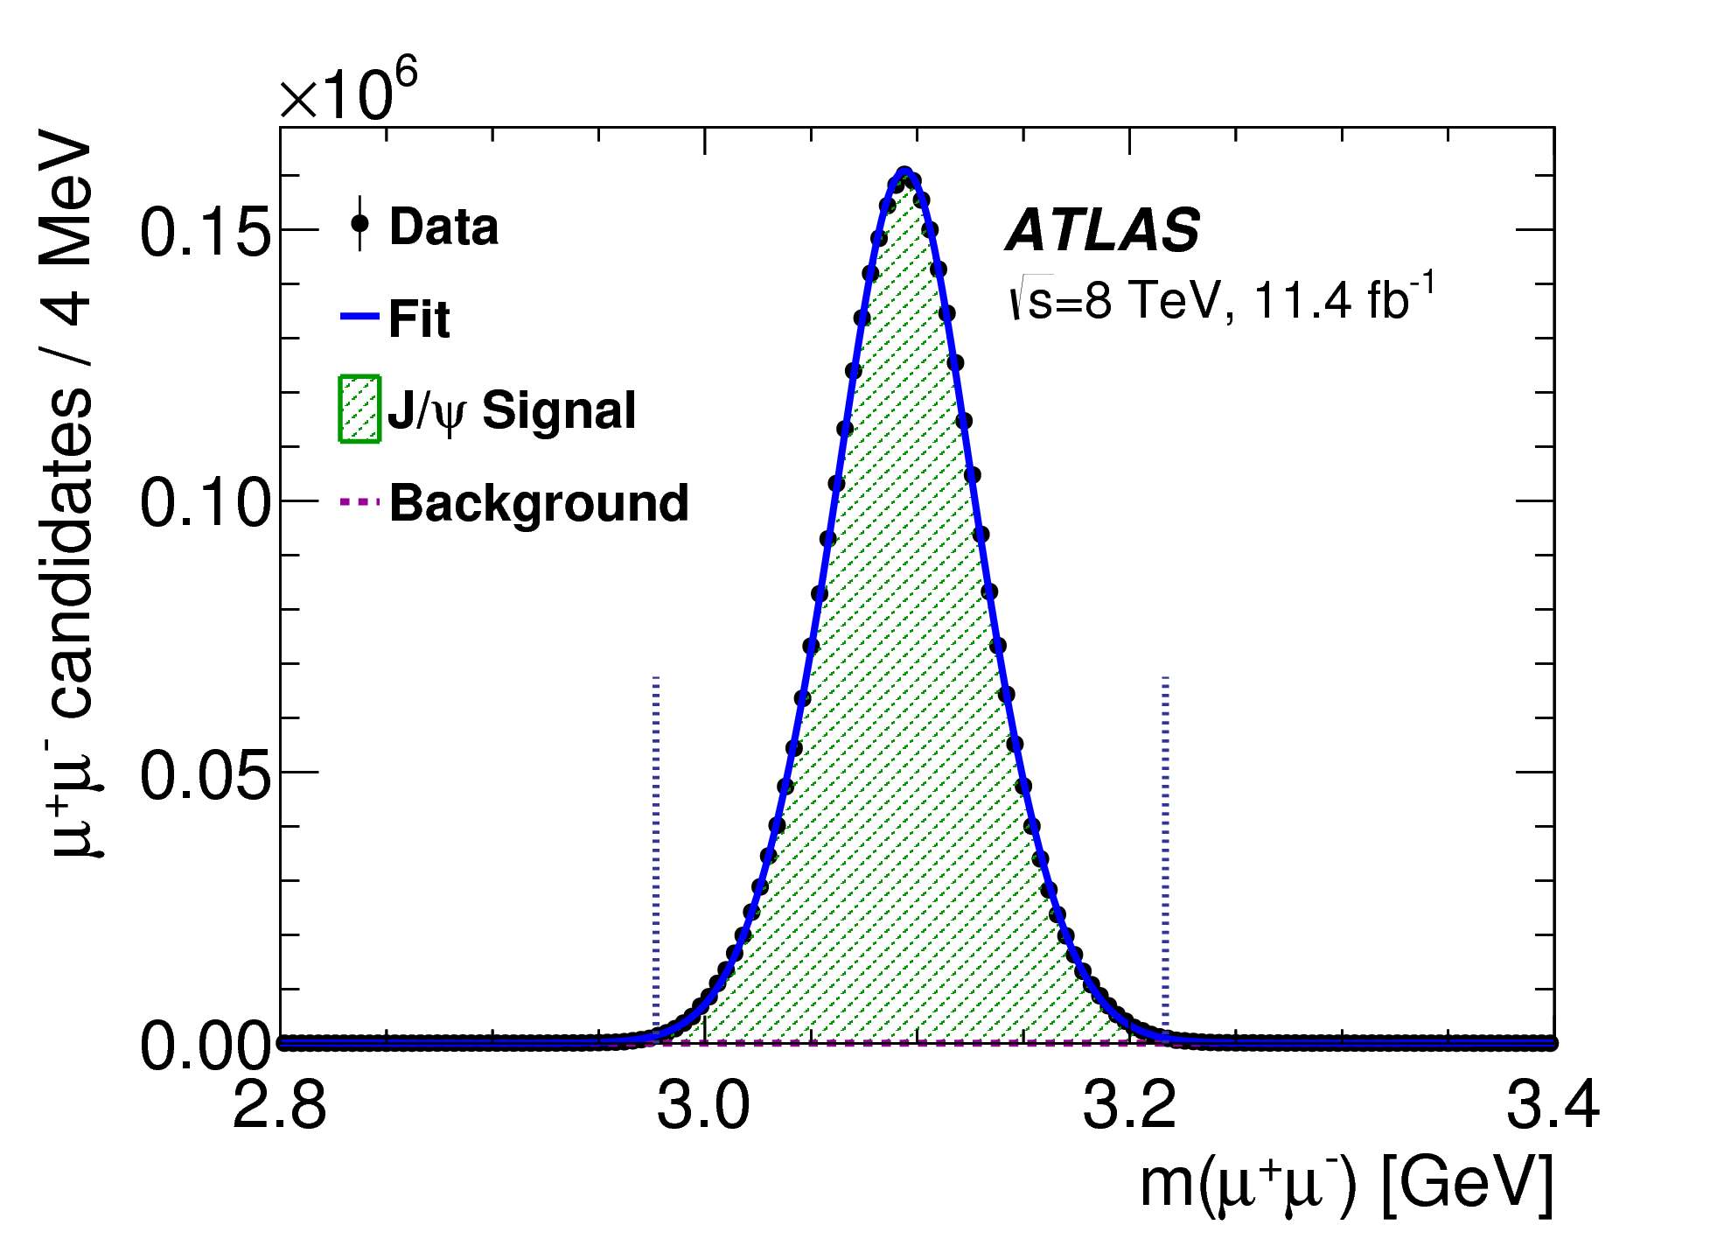
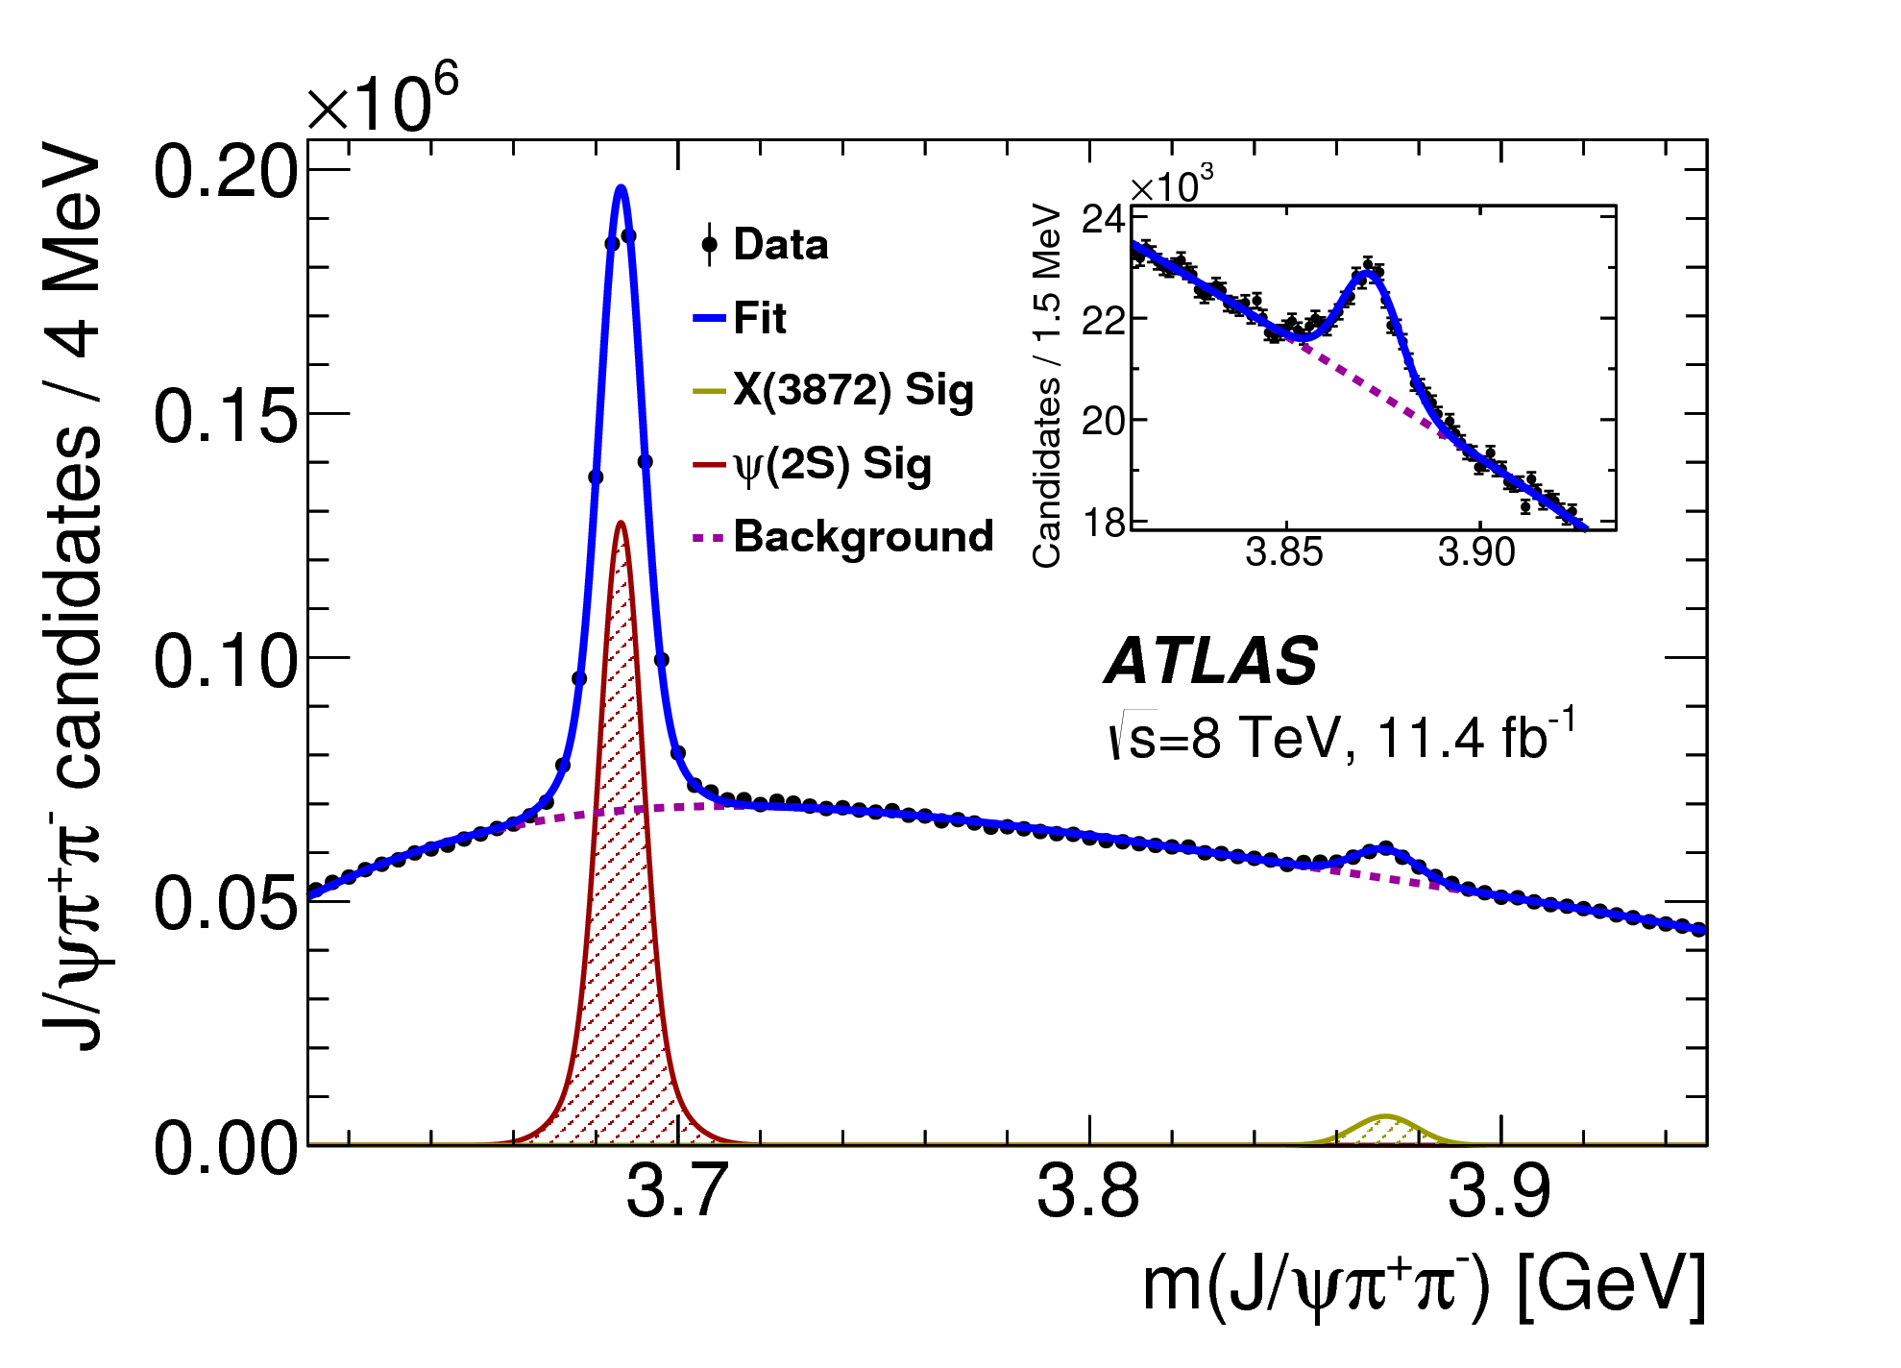
Event selection
11.4 fb⁻¹ at 8 TeV
Muon cuts:
  Opposite sign `combined’ muons
  p_{T} > 4 GeV, |η| < 2.3
3.6 M J/ψ candidates
J/ψ cuts:
  χ²_{dimu_vtx} < 200, p_{T} > 8 GeV & |y| < 2.3
  | m(J/ψ) - m(J/ψ)_{PDG} | < 120 MeV
Use kinematic and vertex fits combined with mass and opening angle cuts to select signal and reject background
Pion cuts
  Opposite sign, p_{T} > 600 MeV, |η| < 2.4
Constrained vertex fit on each μ⁺μ⁻π⁺π⁻ candidate:
  di-muon (2.8 < m_{μμ} < 3.4) GeV fit to a single vertex
  di-muon mass constrained to the J/ψ mass
  pion mass hypothesis used for the other two tracks
370 k ψ(2S) 30 k X(3872)
J/ψπ⁺π⁻ background suppression cuts
  P(χ²_{J/ψππ}) > 4%
  Opening angle ΔR(J/ψ, π±) < 0.5
  Q = m(J/ψπ⁺π⁻) - m(J/ψ)_{PDG} – m(π⁺π⁻) < 300 MeV

Slide 12
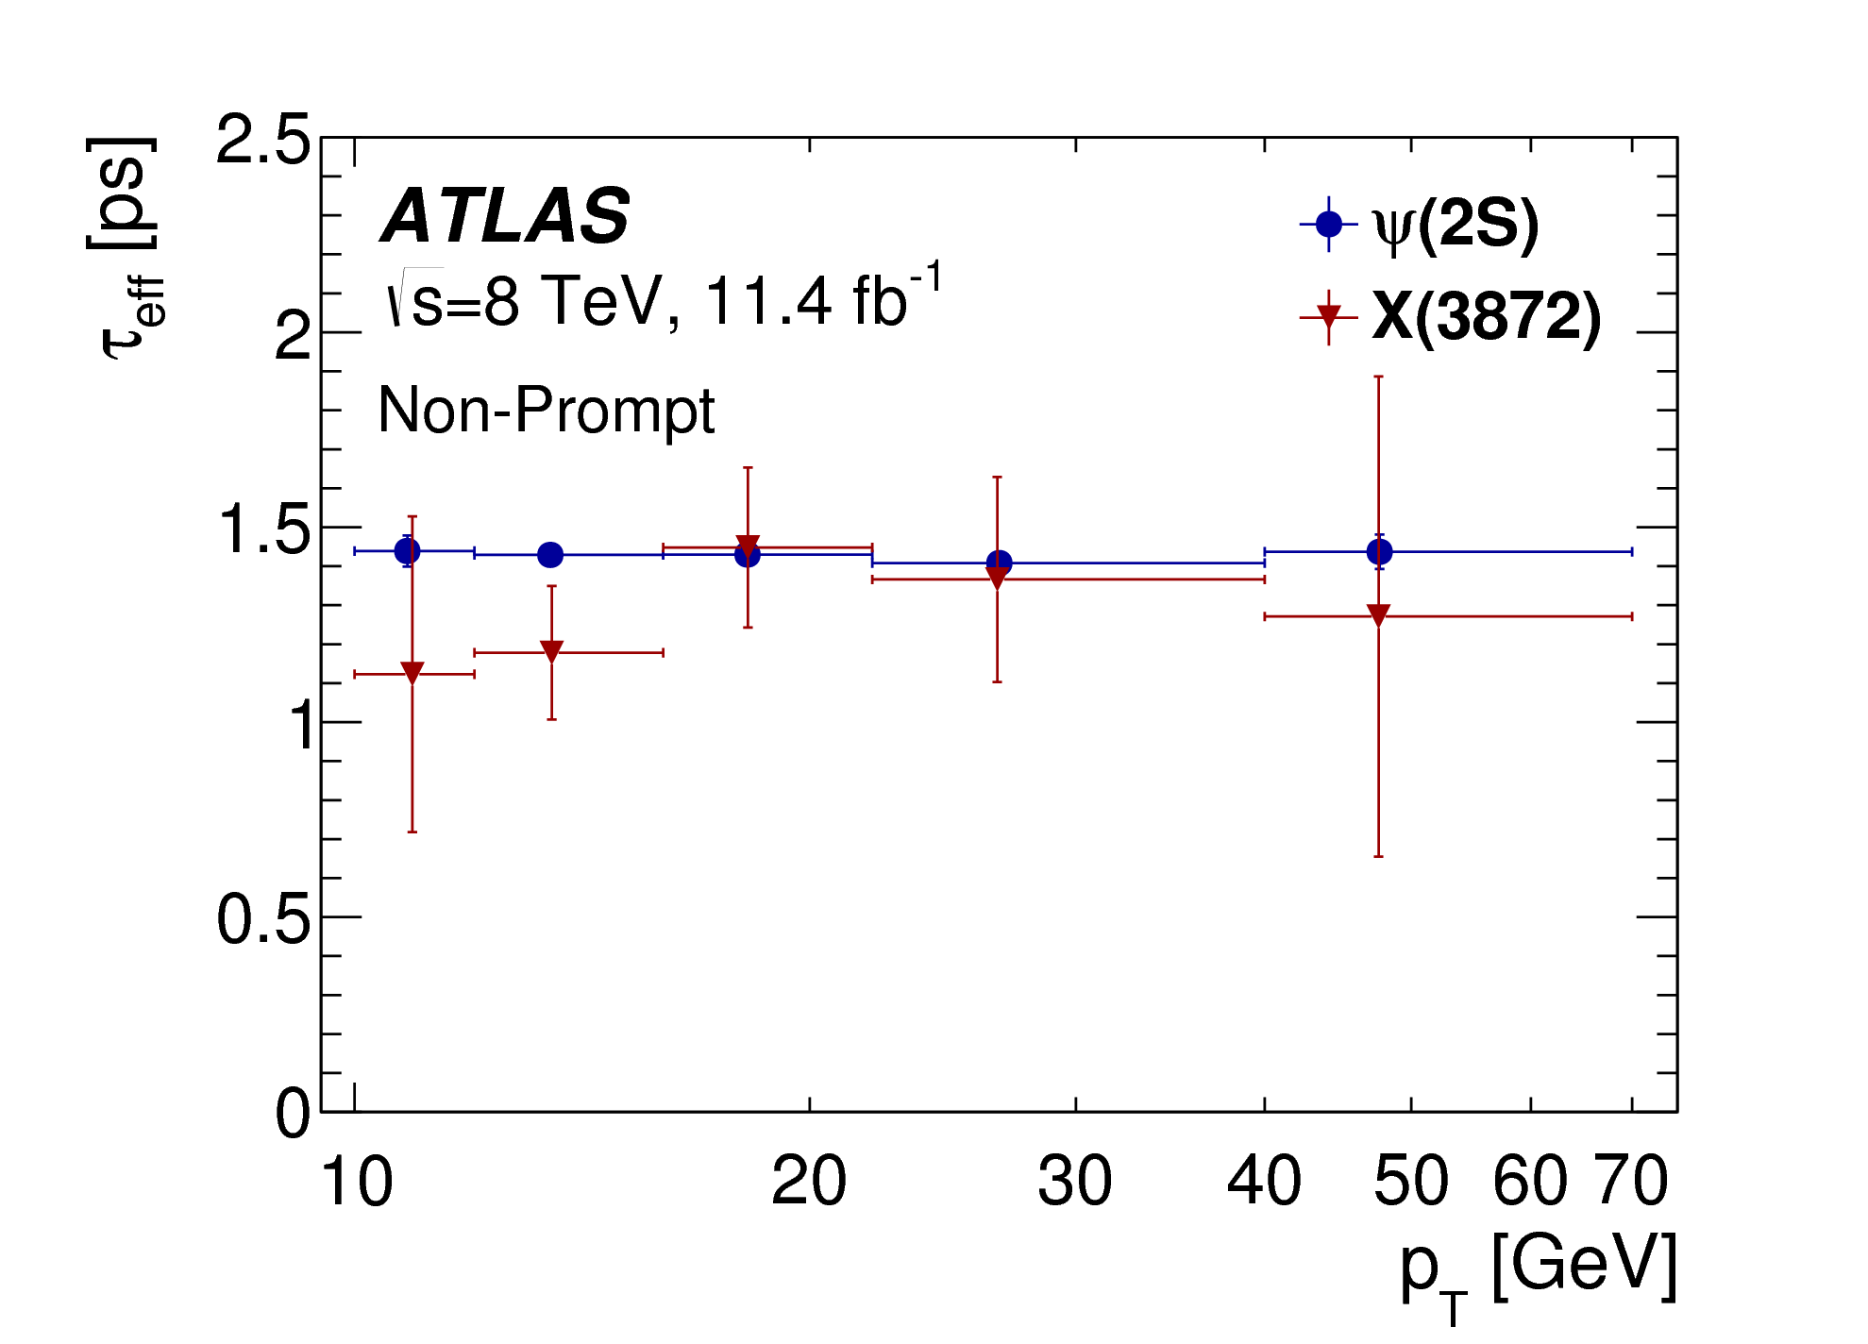
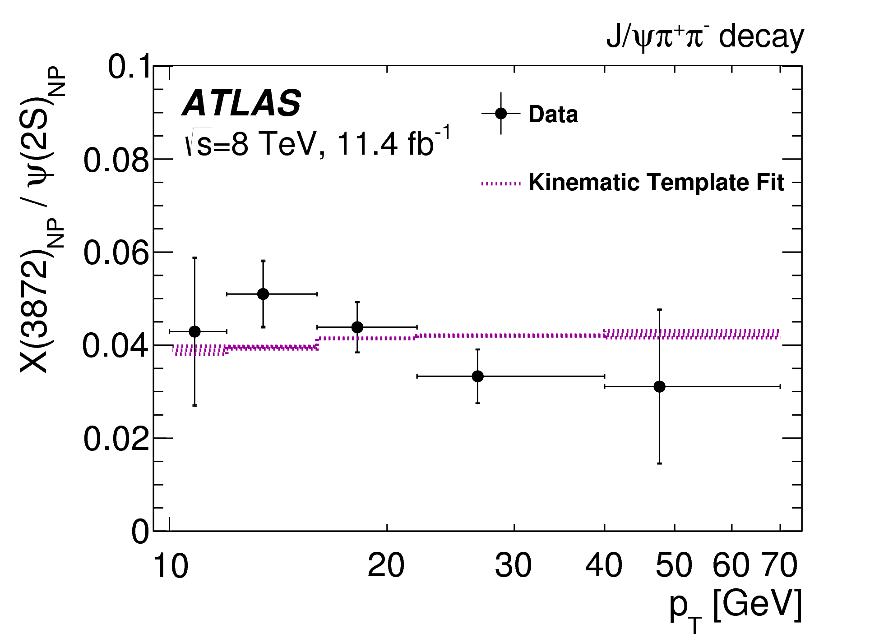
Single or Double lifetime hypothesis
Single: Assumes non-prompt ψ(2S) and X(3872) are produced from the same mix of parent b-hadrons:
- same lifetimes for ψ(2S) and X(3872) in each p_{T} bin
- pT spectra of ψ(2S) and X(3872) linked through kinematics
➔Effective lifetimes for ψ(2S) consistent with single component independent of p_{T} ;
X(3872) possibly slightly shorter in low p_{T} bins (from B_{c}?)
➔Double lifetime fit:
τ_{LL} = 1.45±0.05 ps determined from fits to ψ(2S), allowing for some SL contribution
τ_{SL}=0.40±0.05ps obtained from simulation, varying B_{c} decay mode
In either case, X(3872):ψ(2S) ratio vrs pT extracted
Fit to kinematic (p_{T}) templates obtained from simulations of various
b-hadron decays into ψ(2S) and X(3872)
➔Extract overall non- prompt X(3872) : ψ(2S) ratio
Non-prompt, single lifetime
Two-lifetime fit results quoted from now on, unless stated otherwise

Slide 13
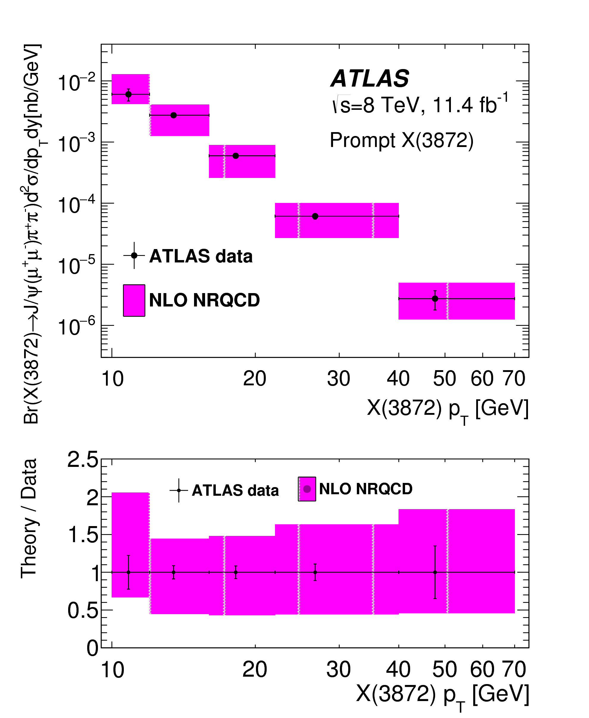
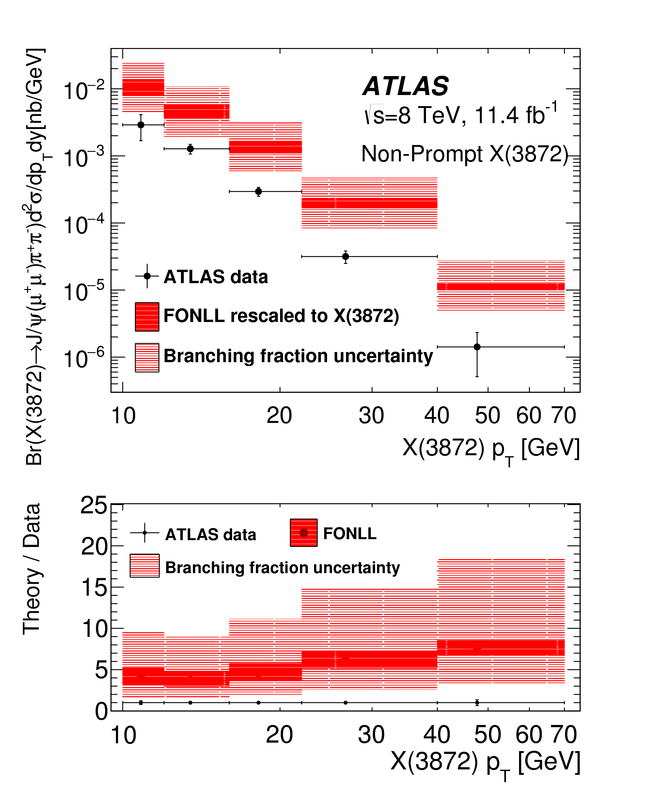

X(3872) cross sections
Prompt: Described well by NLO NRQCD
assumes X(3872) is a mix χ_{c1}(2P) - (D⁰ D⁰*)
with χ_{c1}(2P) dominant (production
parameters fitted to CMS data)
not surprising, CMS and ATLAS consistent
Non prompt:
use the fitted kinematic template
to recalculate from FONLL ψ(2S)
prediction
PBR not measured – estimate
from Artoisenet, Braaten
based on Tevatron data [hep-ph:0911.2016]
= 18±8 %
Clearly overshoots the data:
factor of 4 to 8, increasing with pT
Prompt
Non-Prompt

Slide 14
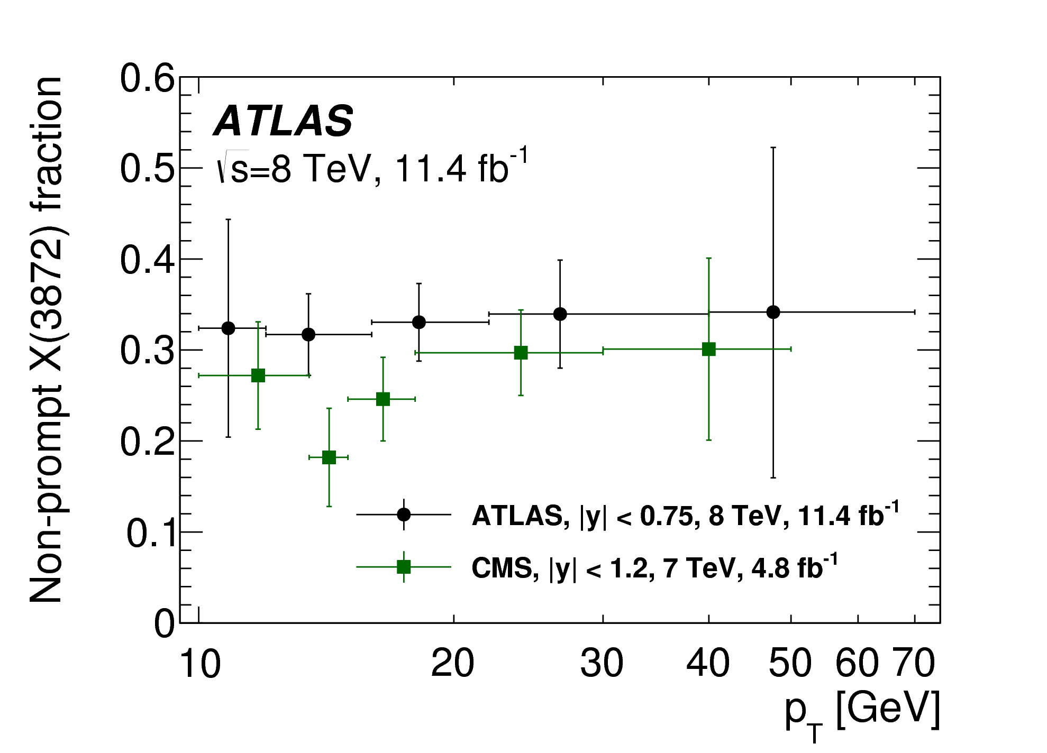
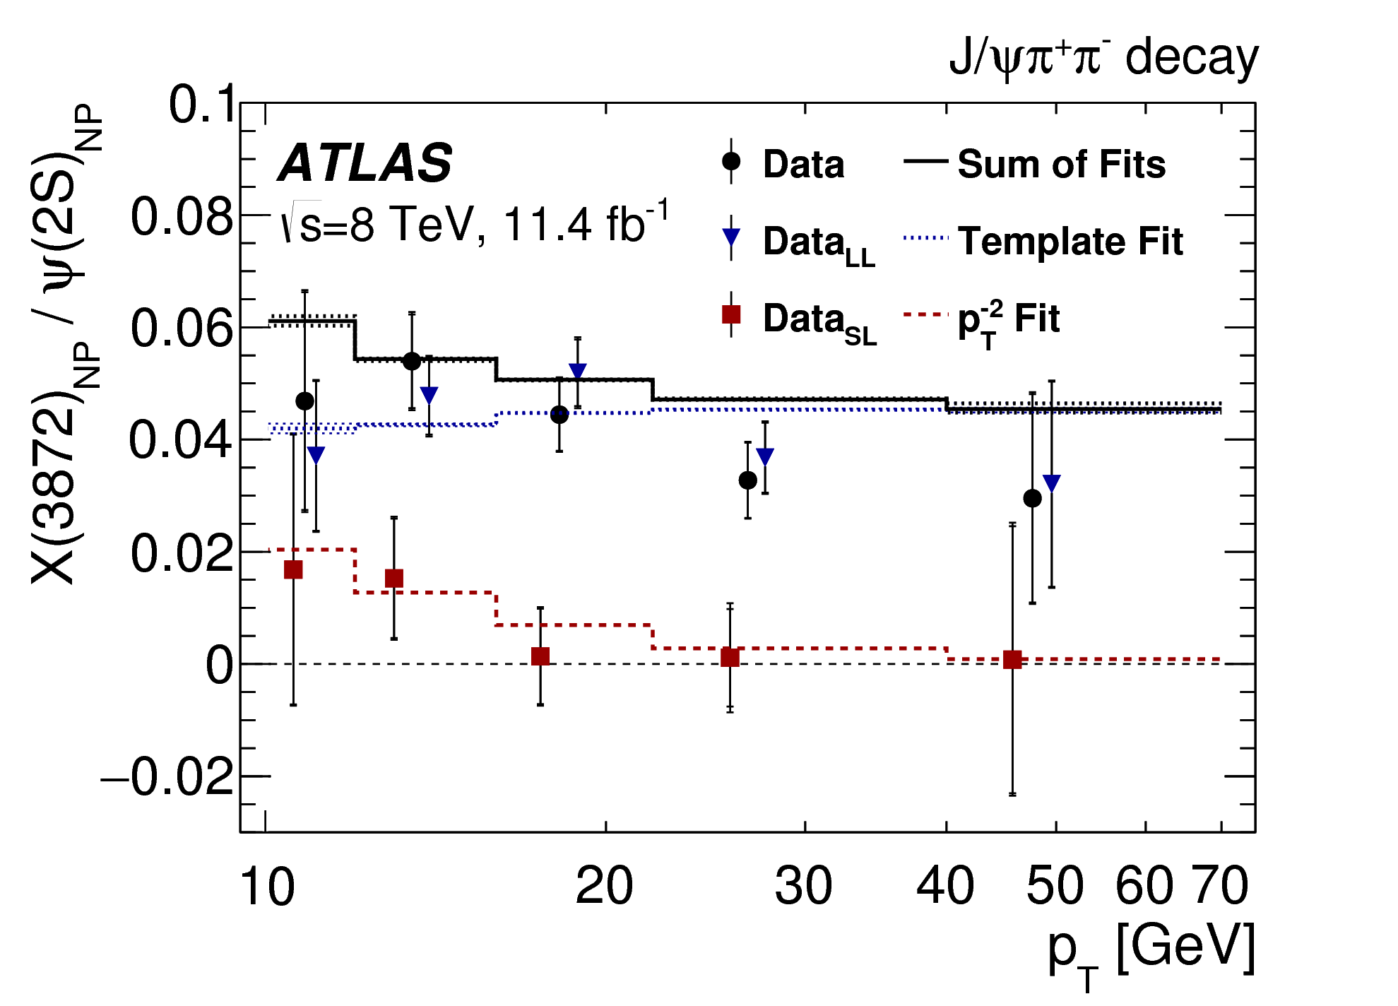
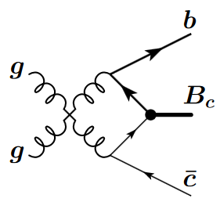
Non-prompt fraction and ratio
:
Non-prompt fraction of X(3872):
- no visible p_{T} dependence
- consistent with CMS result within errors
- Very unlike J/ψ’s strong p_{T} dependence
Ratio of non-prompt X(3872) : ψ(2S)
- long-lived part fitted to kinematic template
- short-lived part: assuming non-fragmentation B_{c}
dominate at low p_{T} [Berezhnoy, arXiv:1309.1979]
- fit with a· p_{T}⁻² relative to fragmentation production
- integrate the fits to determine the fraction of
non-prompt X(3872) that is short-lived,
for pT>10 GeV:
B_{c} small fraction of b-hadrons at LHC => Indication X(3872) production enhanced in B_{c} decays

Slide 15
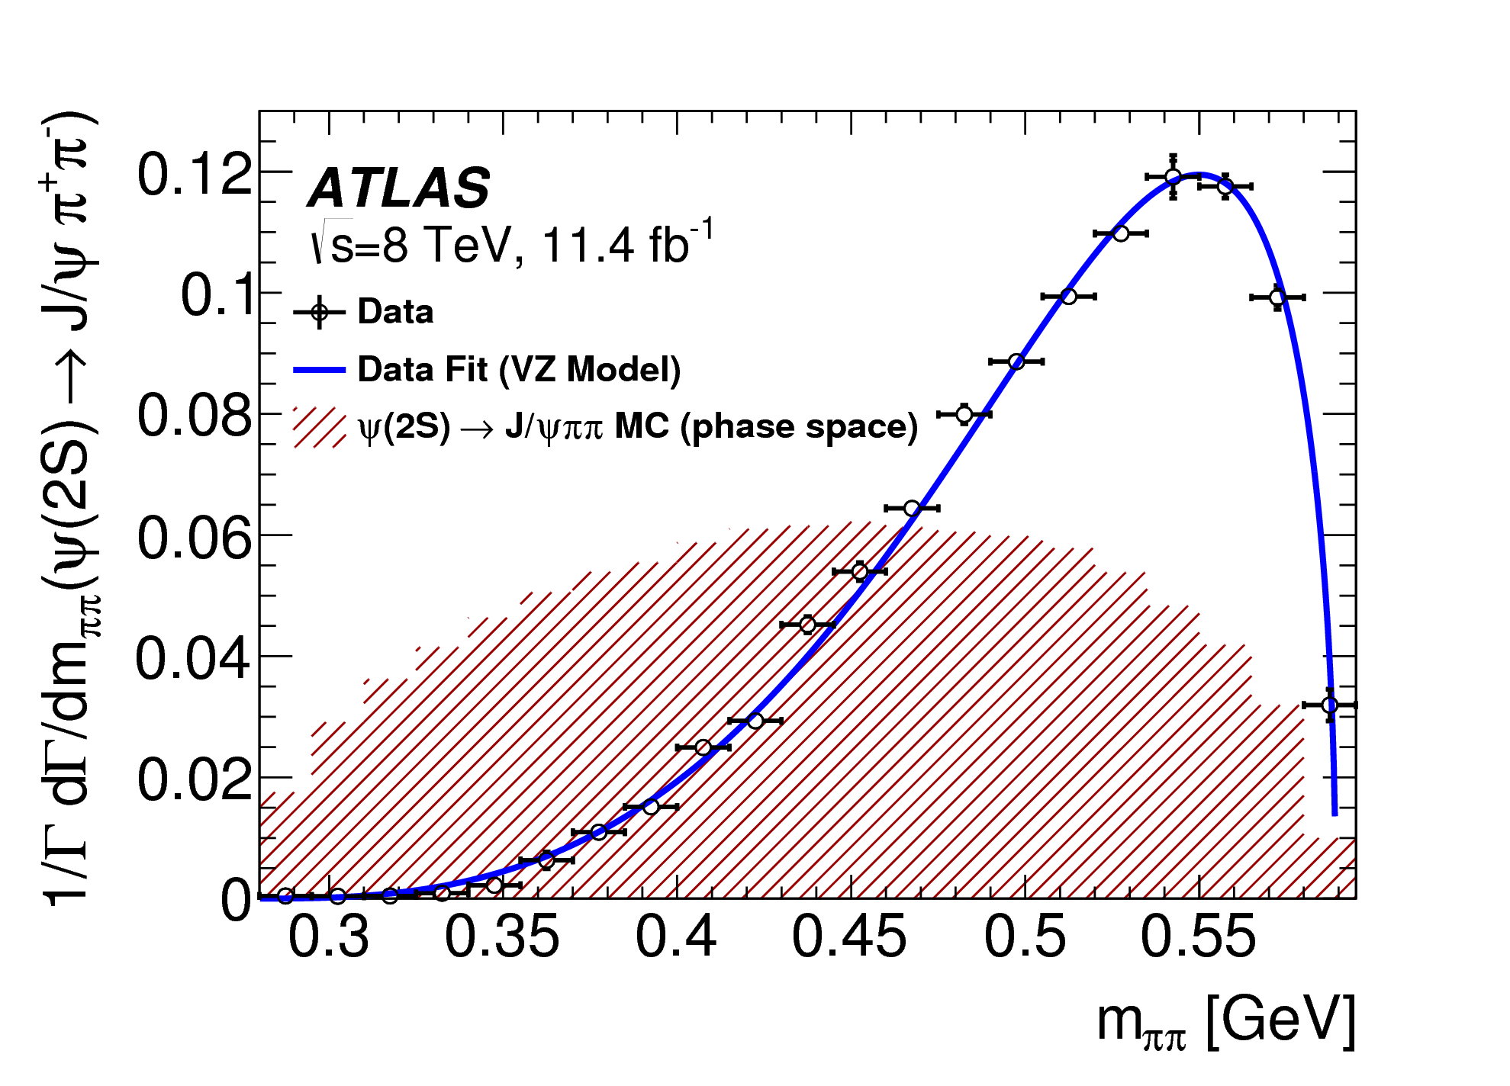

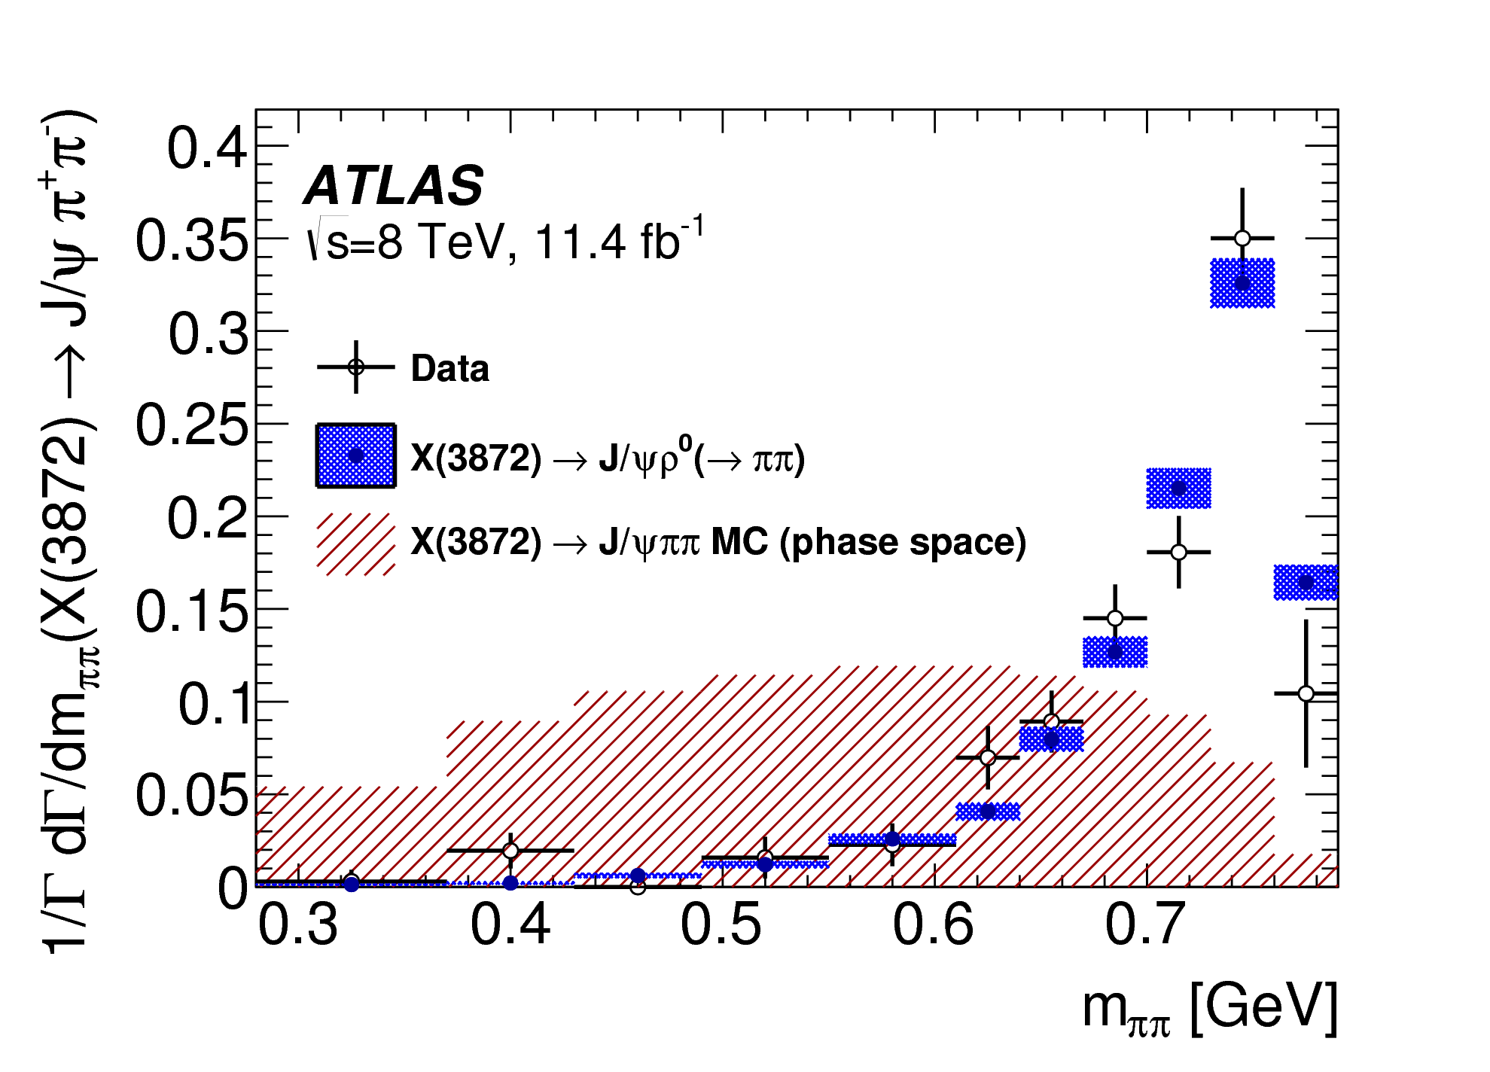
Di-pion mass distributions: results
In ψ(2S) to J/ψπ⁺π⁻ decays
- dipion mass distribution peaks at high masses
- fit to Voloshin-Zakharov function
- found λ = 4.16 ± 0.06(stat) ± 0.03(syst)
- in agreement with previous measurements
In X(3872) to J/ψπ⁺π⁻ decays
- dipion mass distribution has an even sharper peak at high masses
- in agreement with simulation where the di-pion
system is produced via ρ⁰ meson decay

Slide 16
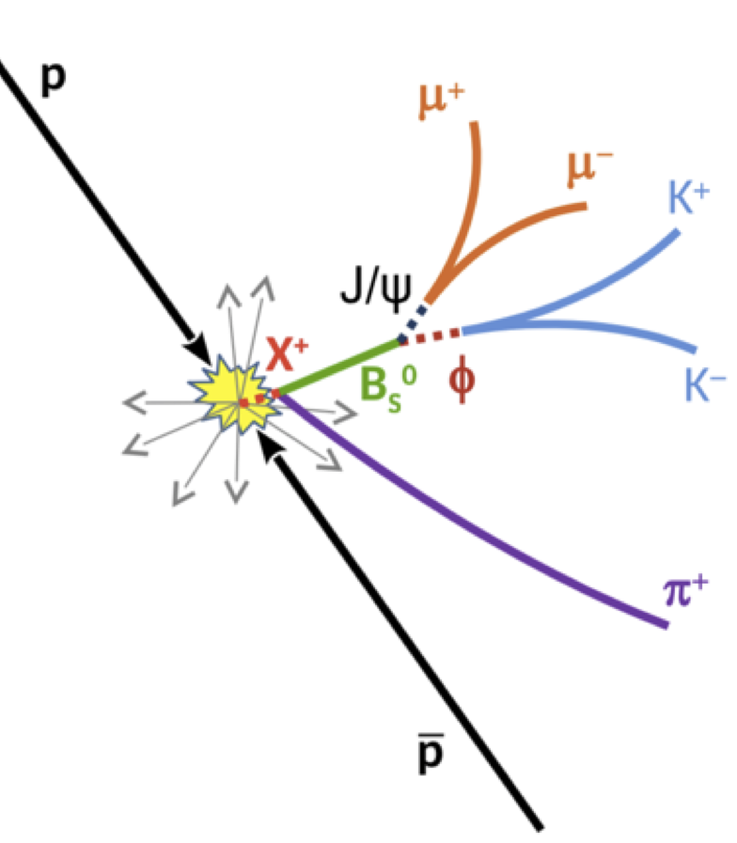
Structure in the B_{s}⁰π± Spectrum?
D-Zero published evidence for X(5568) in B_{s}⁰π± spectrum
  B_{s}⁰ → J/ψφ, B_{s}⁰ →μ∓D_{s}± (φπ±)X
  m=5566.9^{+3.2}_{-3.1}(stat)^{+0.6}₋1.2(syst) MeV
Significance 6.7σ, bsud state?
PRL 117 (2016) 022003; PRD 97 (2018) 092004
ATLAS B_{s}⁰→ J/Ψ(μμ) ɸ (KK)
PRL 120 (2018) 202007
4.9 fb⁻¹ at 7 TeV
19.5 fb⁻¹ at 8 TeV
M_{fit}(B_{s}⁰)=5366.6±0.1 MeV
N(B_{s}⁰)=52750±280 (stat)

Slide 17
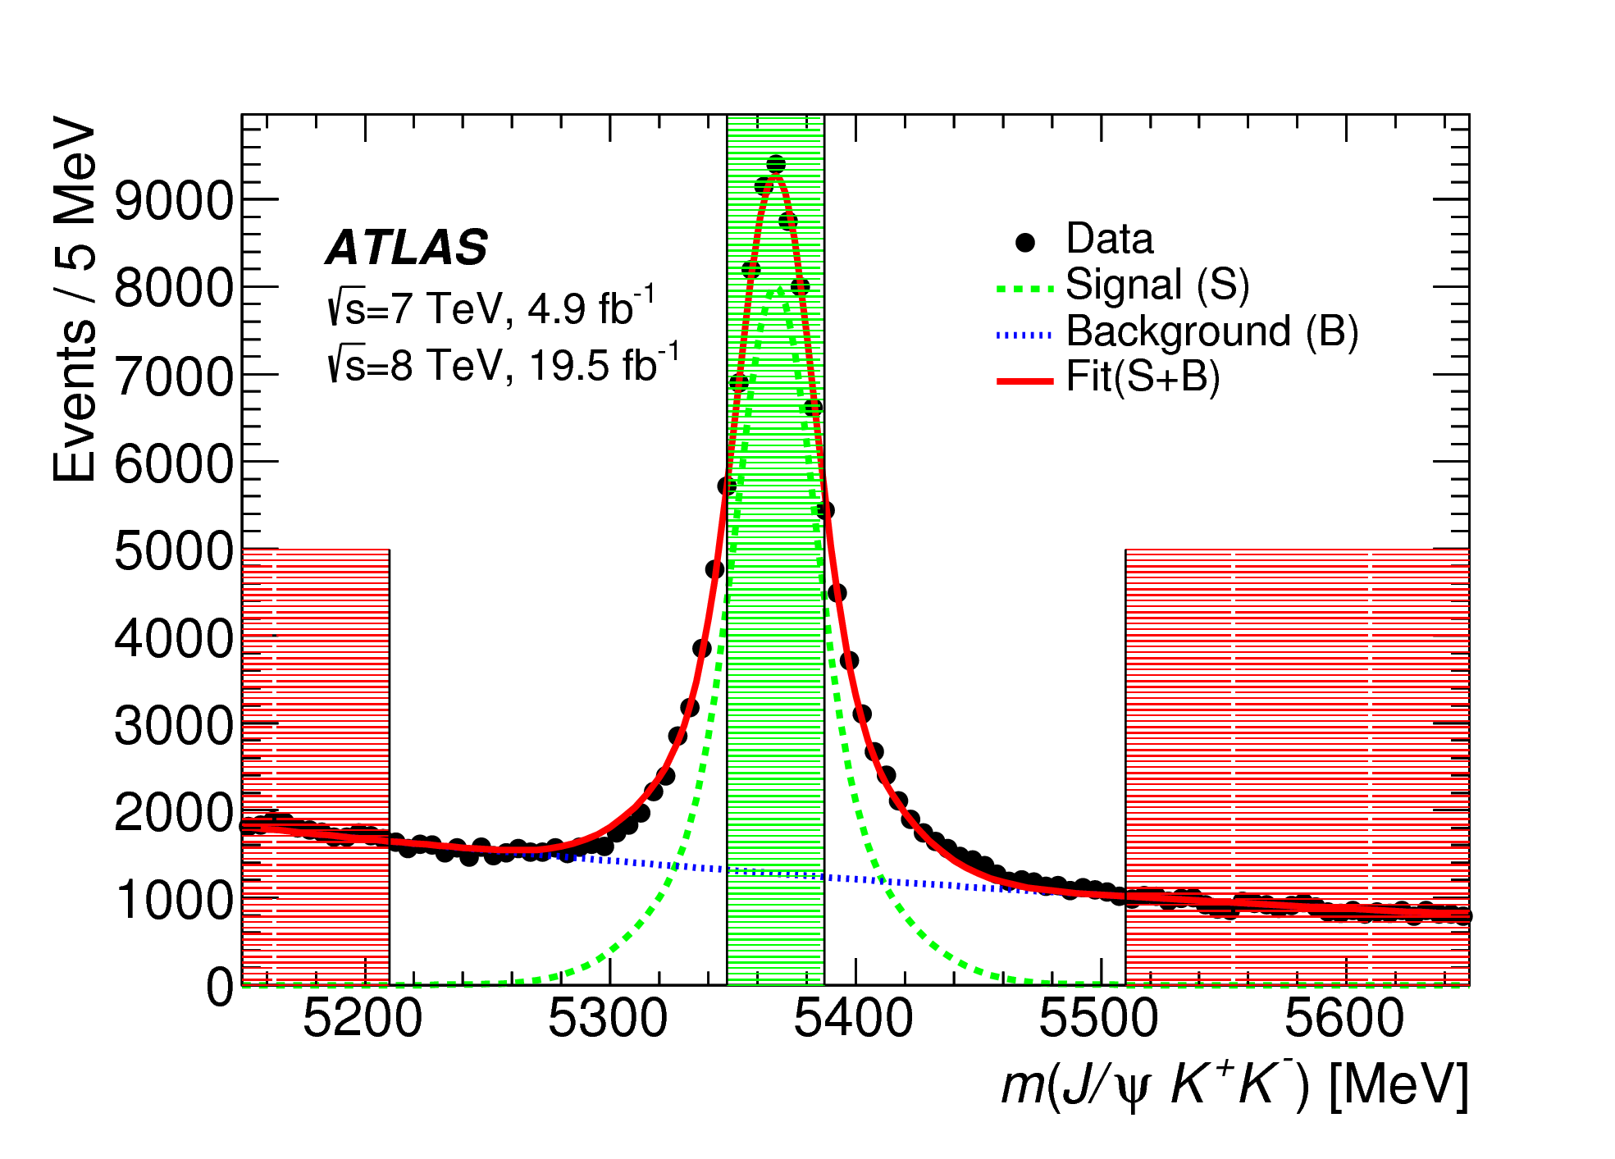
B_{s}⁰ Selection
J/ψ candidates selected as before
Φ from oppositely charged kaon candidates
Fit to common vertex assuming J/ψ mass using unbinned max likelihood for B_{s}
  Mass fit model: double gaussian signal
Exponential background
Signal range 5346.6-5386.6 MeV
➔Select B_{s} with τ>0.2 ps
M_{fit}(B_{s}⁰)=5366.6±0.1 MeV
N(B_{s}⁰)=52750±280 (stat)

Slide 18
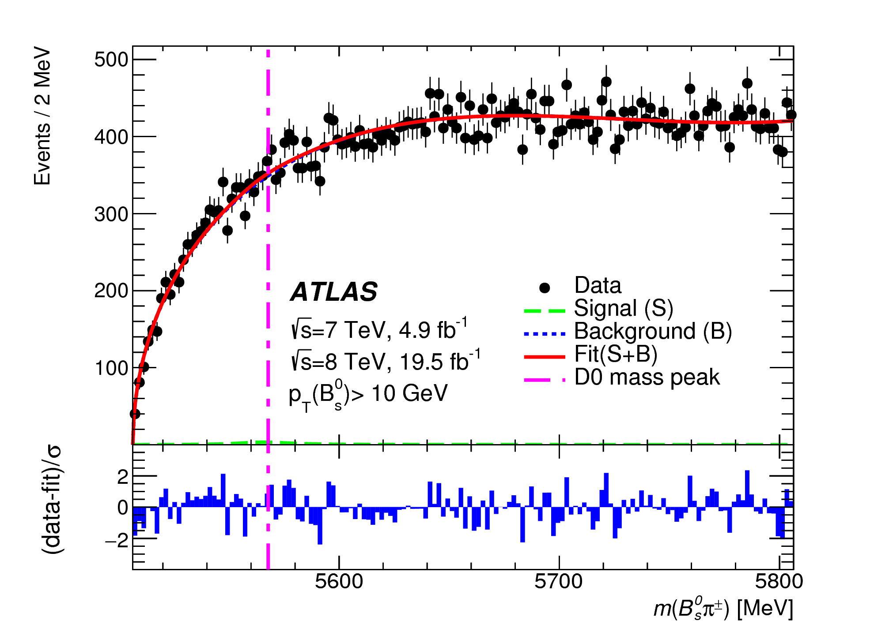
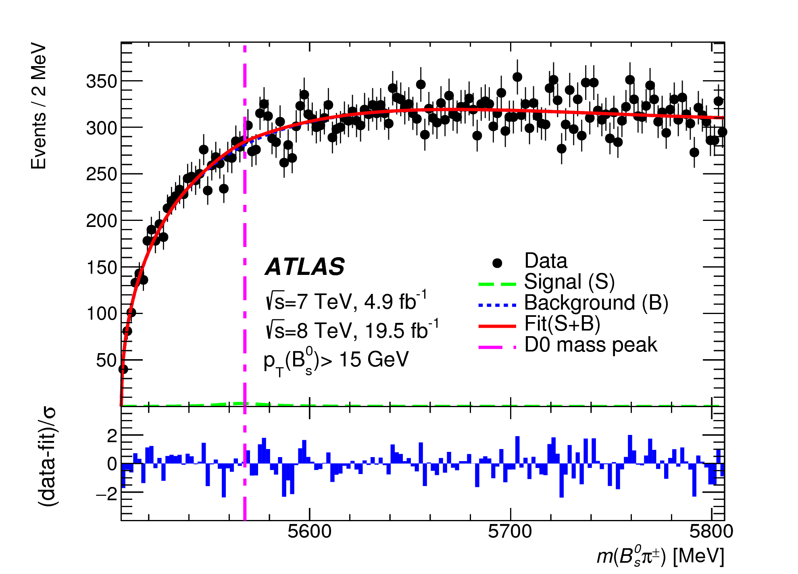
Study of B_{s}⁰π± Candidates
Combine B_{s} candidates with tracks from same primary vertex
  Pion hypothesis, p_{T}>500MeV
  Extended unbinned fit:
m(B_{s}π) =
m(J/ψKKπ)-m(J/ψKK)+m_{fit}(B_{s})
Consider
  p_{T}(B)>10GeV
  p_{T}(B)>15GeV

Slide 19
Setting Limits
D0 signal
No significant X(5568) signal
Fitted X(5568) yields & Limits:
p_{T}(B) > 10 GeV:
  N(X) = 60 ±140 (stat)
  N(X) < 382 @95% CL
p_{T}(B) > 15 GeV:
  N(X) = -30 ±150 (stat)
  N(X) < 356 (@95% CL)

Slide 20
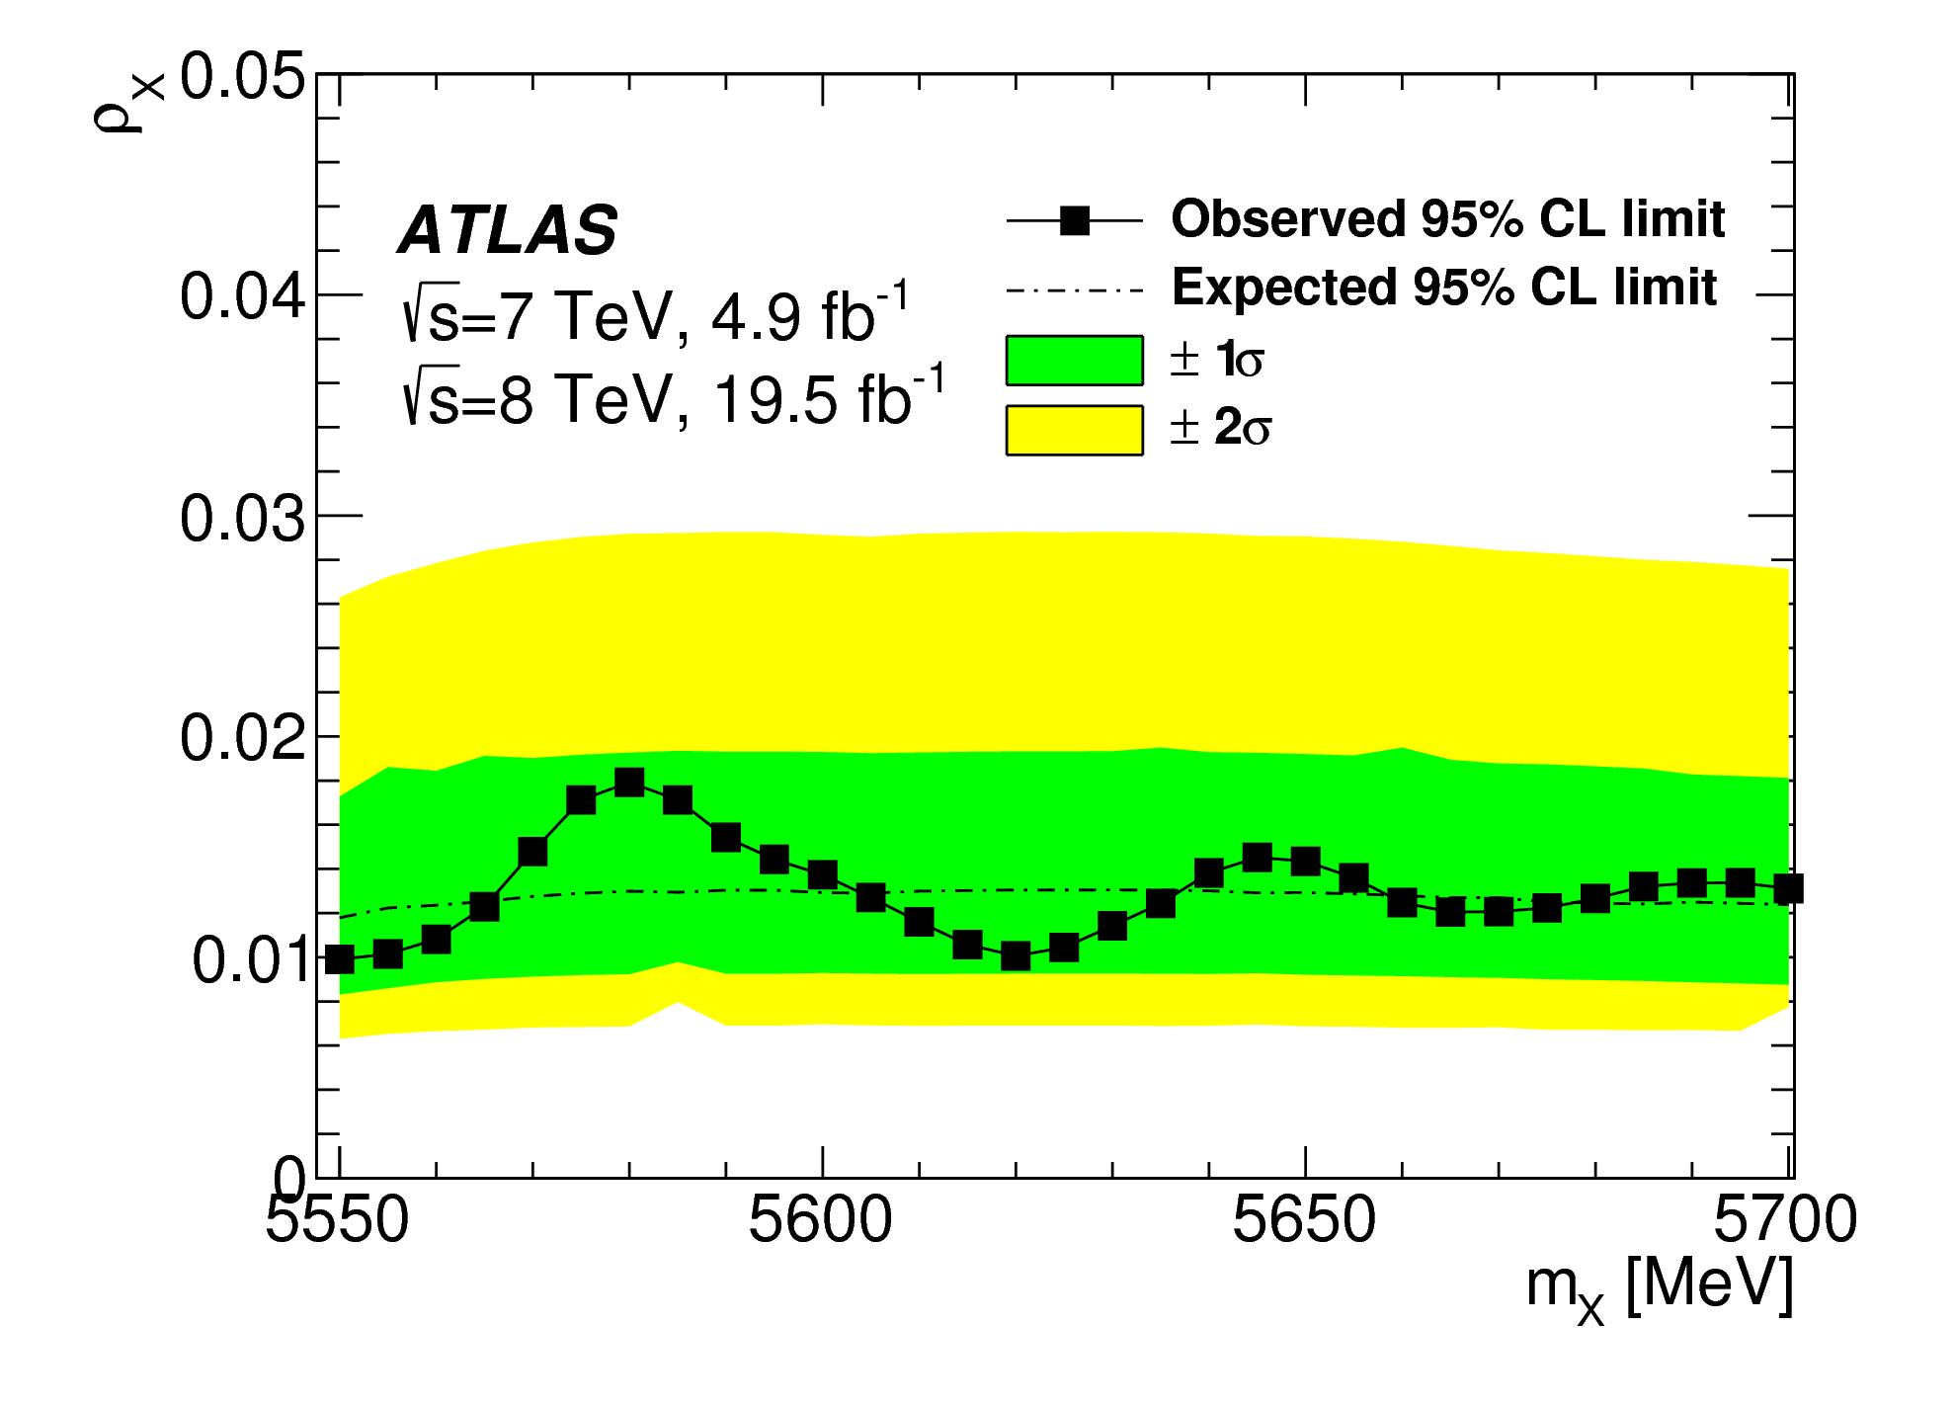
Relative Production Limits
Extract 95% CL upper limit on production
Measure relative to B_{s} > given p_{T}(Bs)
Signal: Breit-Wigner from D0 observation
Scan range 5550 – 5700 MeV
Systematic uncertainties includes
Event by event resolutions and relative efficiencies needed
p_{T}(B) > 10 GeV:
  ρ_{X} < 0.015 @95% CL
p_{T}(B) > 15 GeV:
  ρ_{X} < 0.016 @95% CL

Slide 21
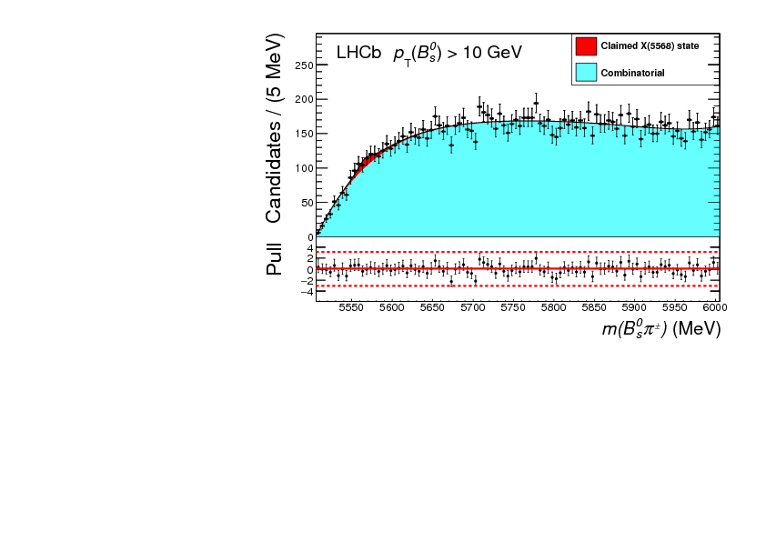
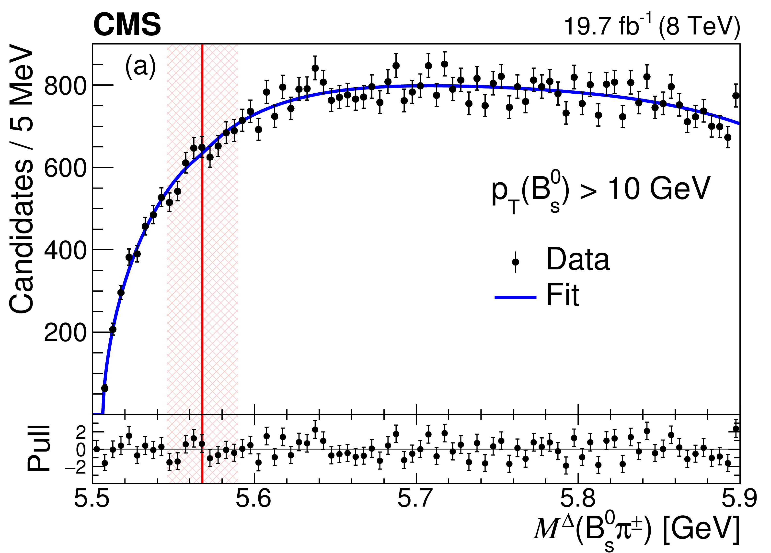
Other recent searches eslewhere
 | ρ_{X} (p_{T}>10 GeV)
D-Zero | (8.6±1.9±1.4)%
ATLAS | <1.5%
CMS | <1.1%
LHCb | <2.4%
CDF | <6.7%
CDF
No significant X(5568) signal observed

Slide 22
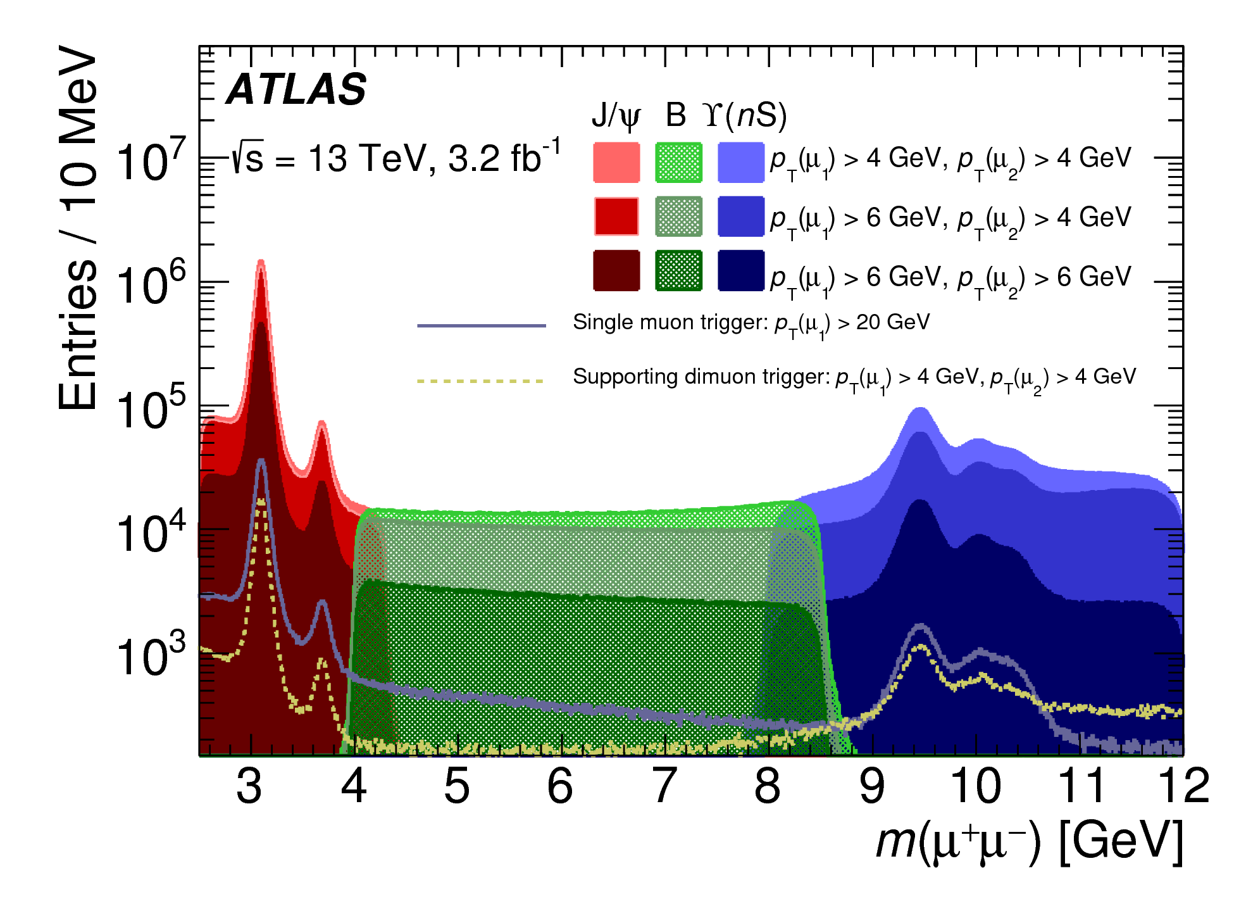
Perspectives
ATLAS is a “general purpose” experiment, and, due to the universality of the detector and ingenuity of analysers, a number of important contributions to heavy quark physics can be made
Studies of bb production important for model building
X(3872) production have been studied in some detail, with potentially interesting results
No evidence for the X(5568) in the B_{s}(J/ψφ)π channel, upper limit set
A large amount of data collected at 13 TeV are still being studied, with new challenges related to increasing trigger thresholds and increased high pileup

Slide 23
THANK YOU!

Slide 24
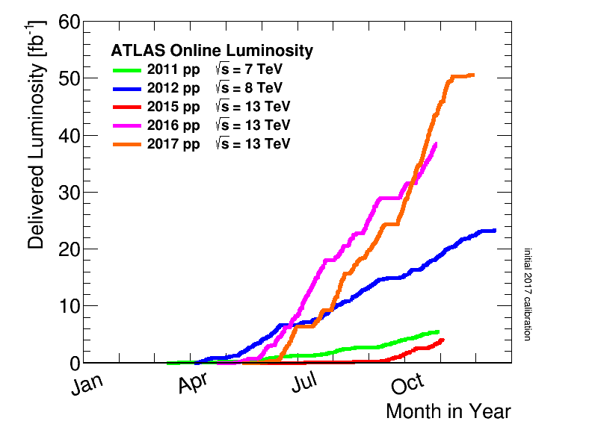
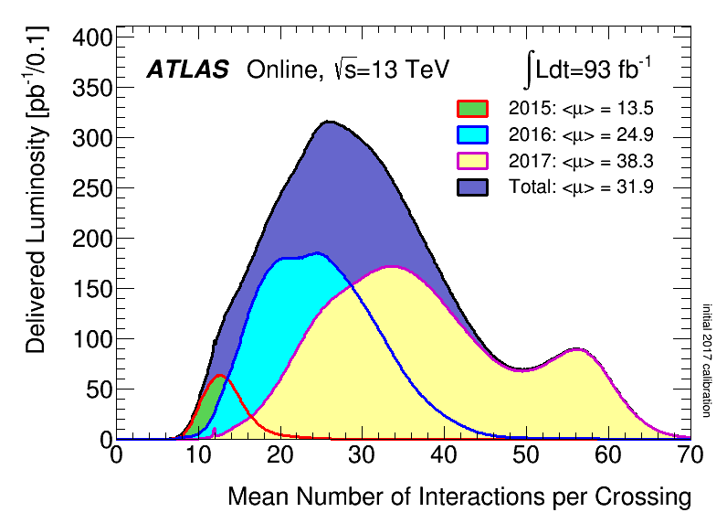
LHC luminosity over the years
ATLAS as a detector is optimised for “high pT” physics – Higgs and BSM searches
In early years of LHC luminosity was not as high, could afford dimuon triggers with low thresholds
Many quarkonium-related measurements made, including some rather unexpected “first observations
In Run 2 many successful low-pT dimuon triggers are heavily prescaled, and muon trigger thresholds creep higher and higher
Need to be more and more creative and inventive to maintain interest in the area of heavy flavour physics

Slide 25
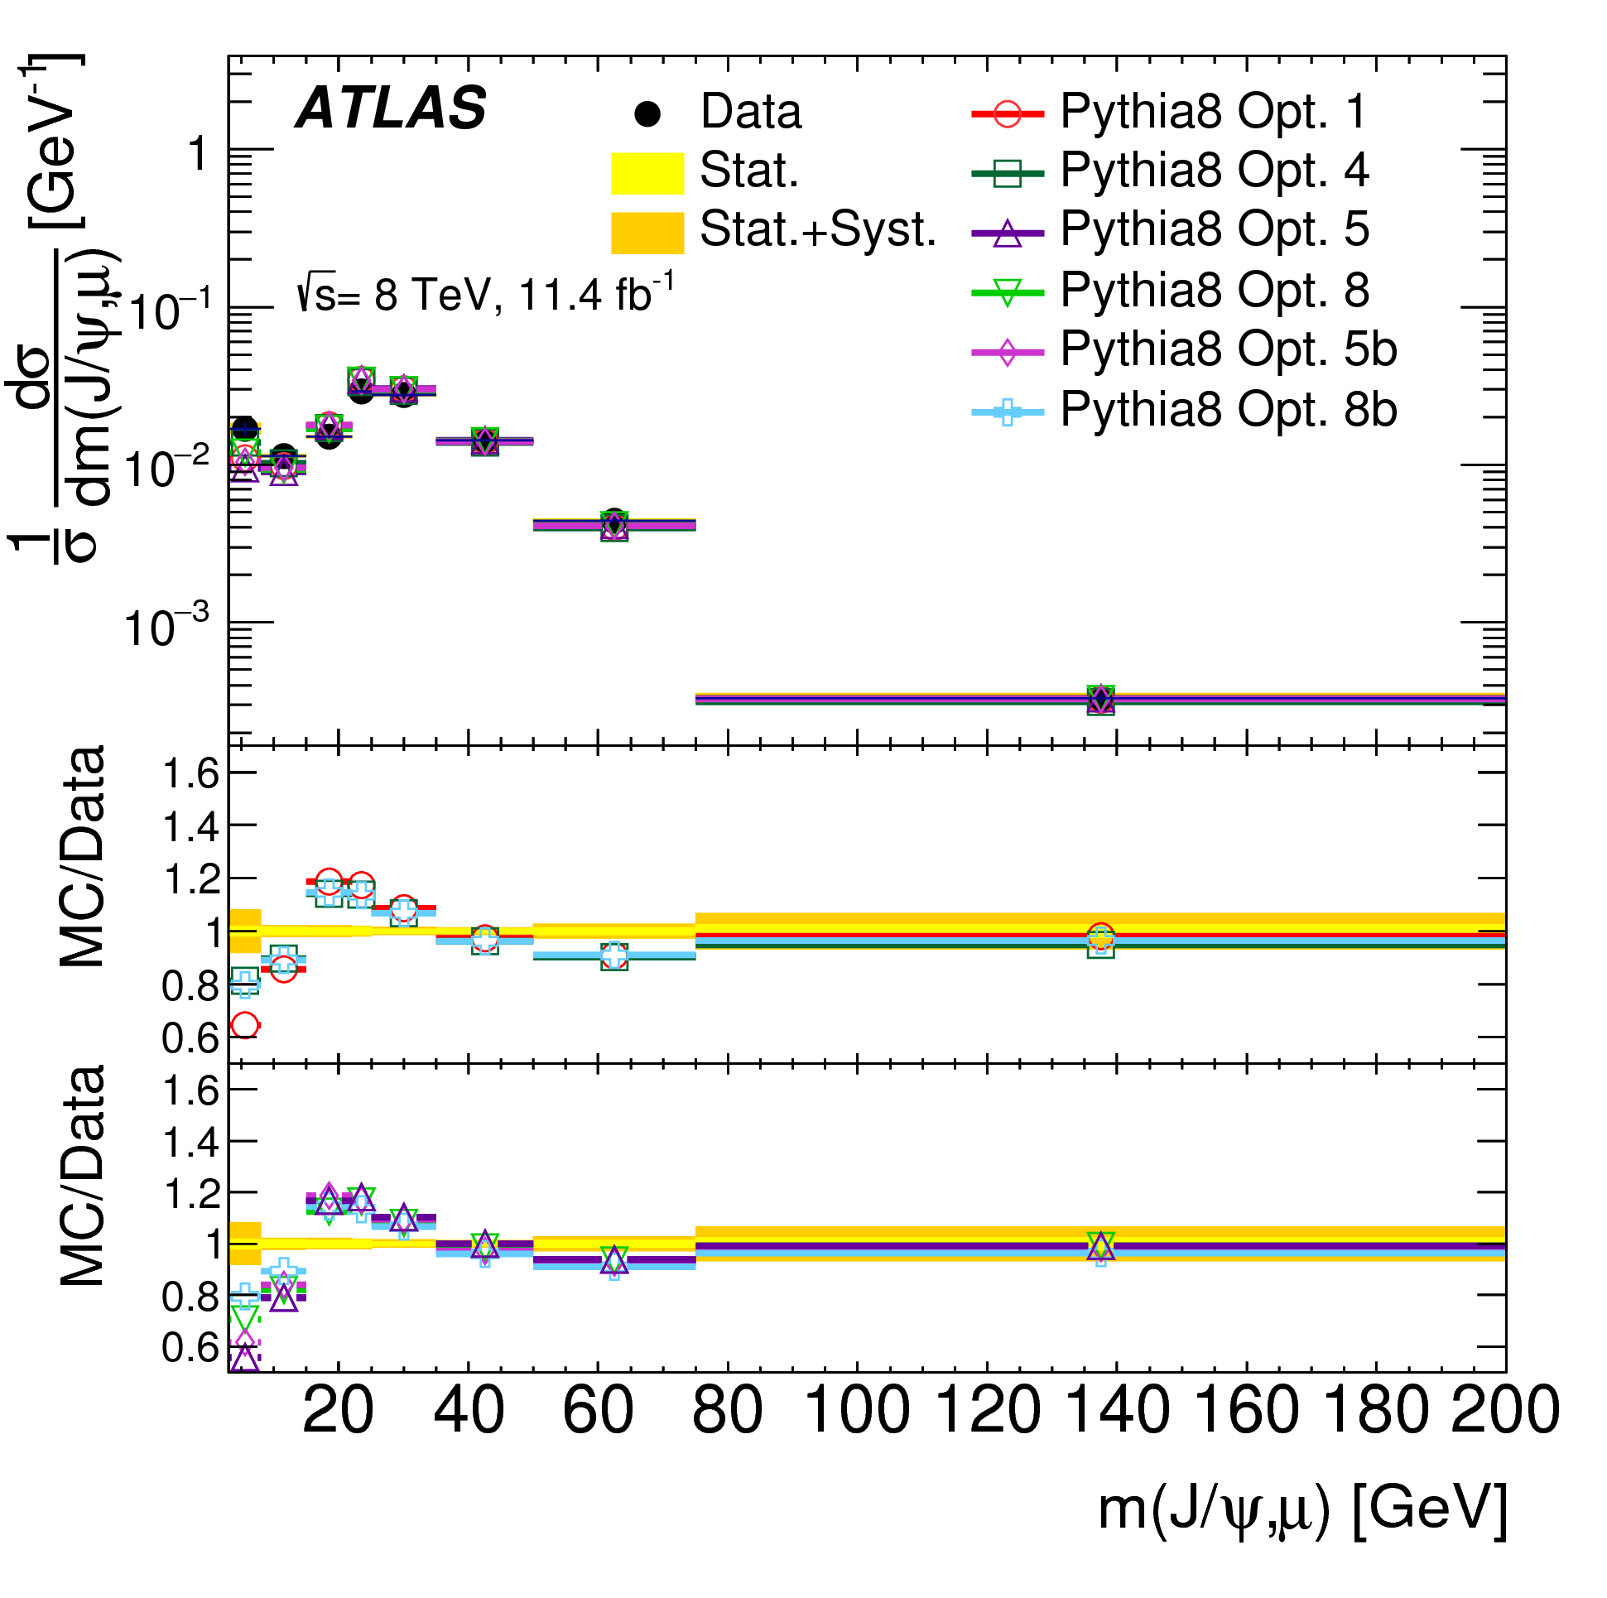
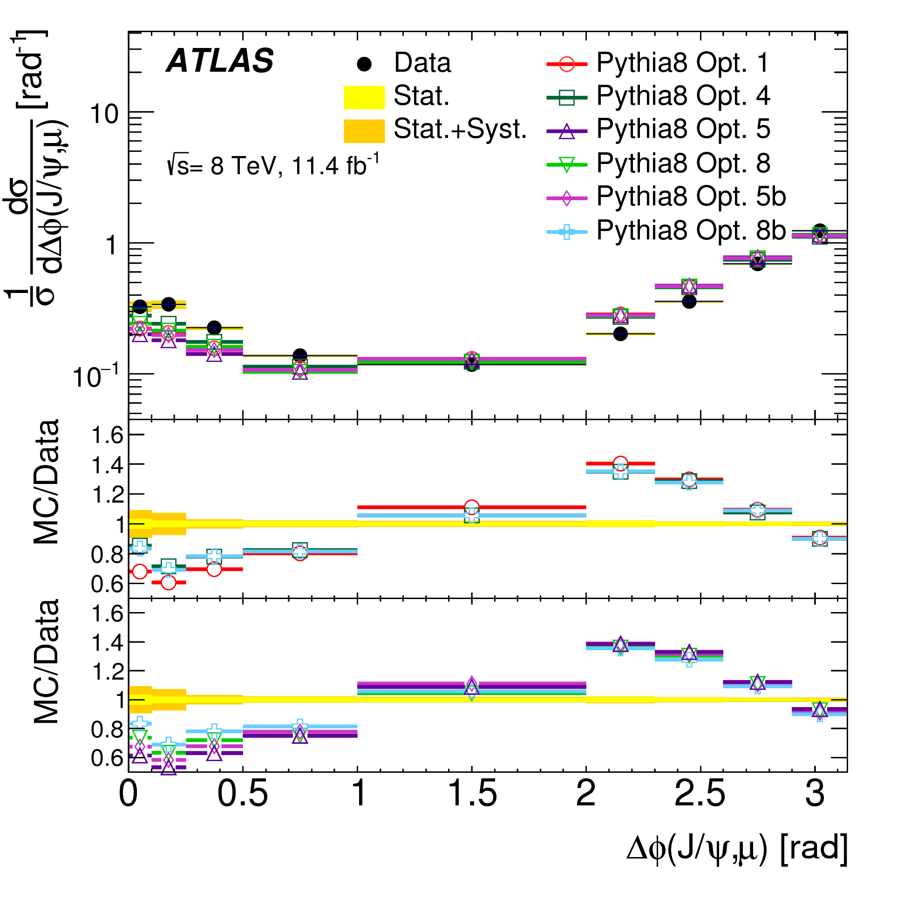
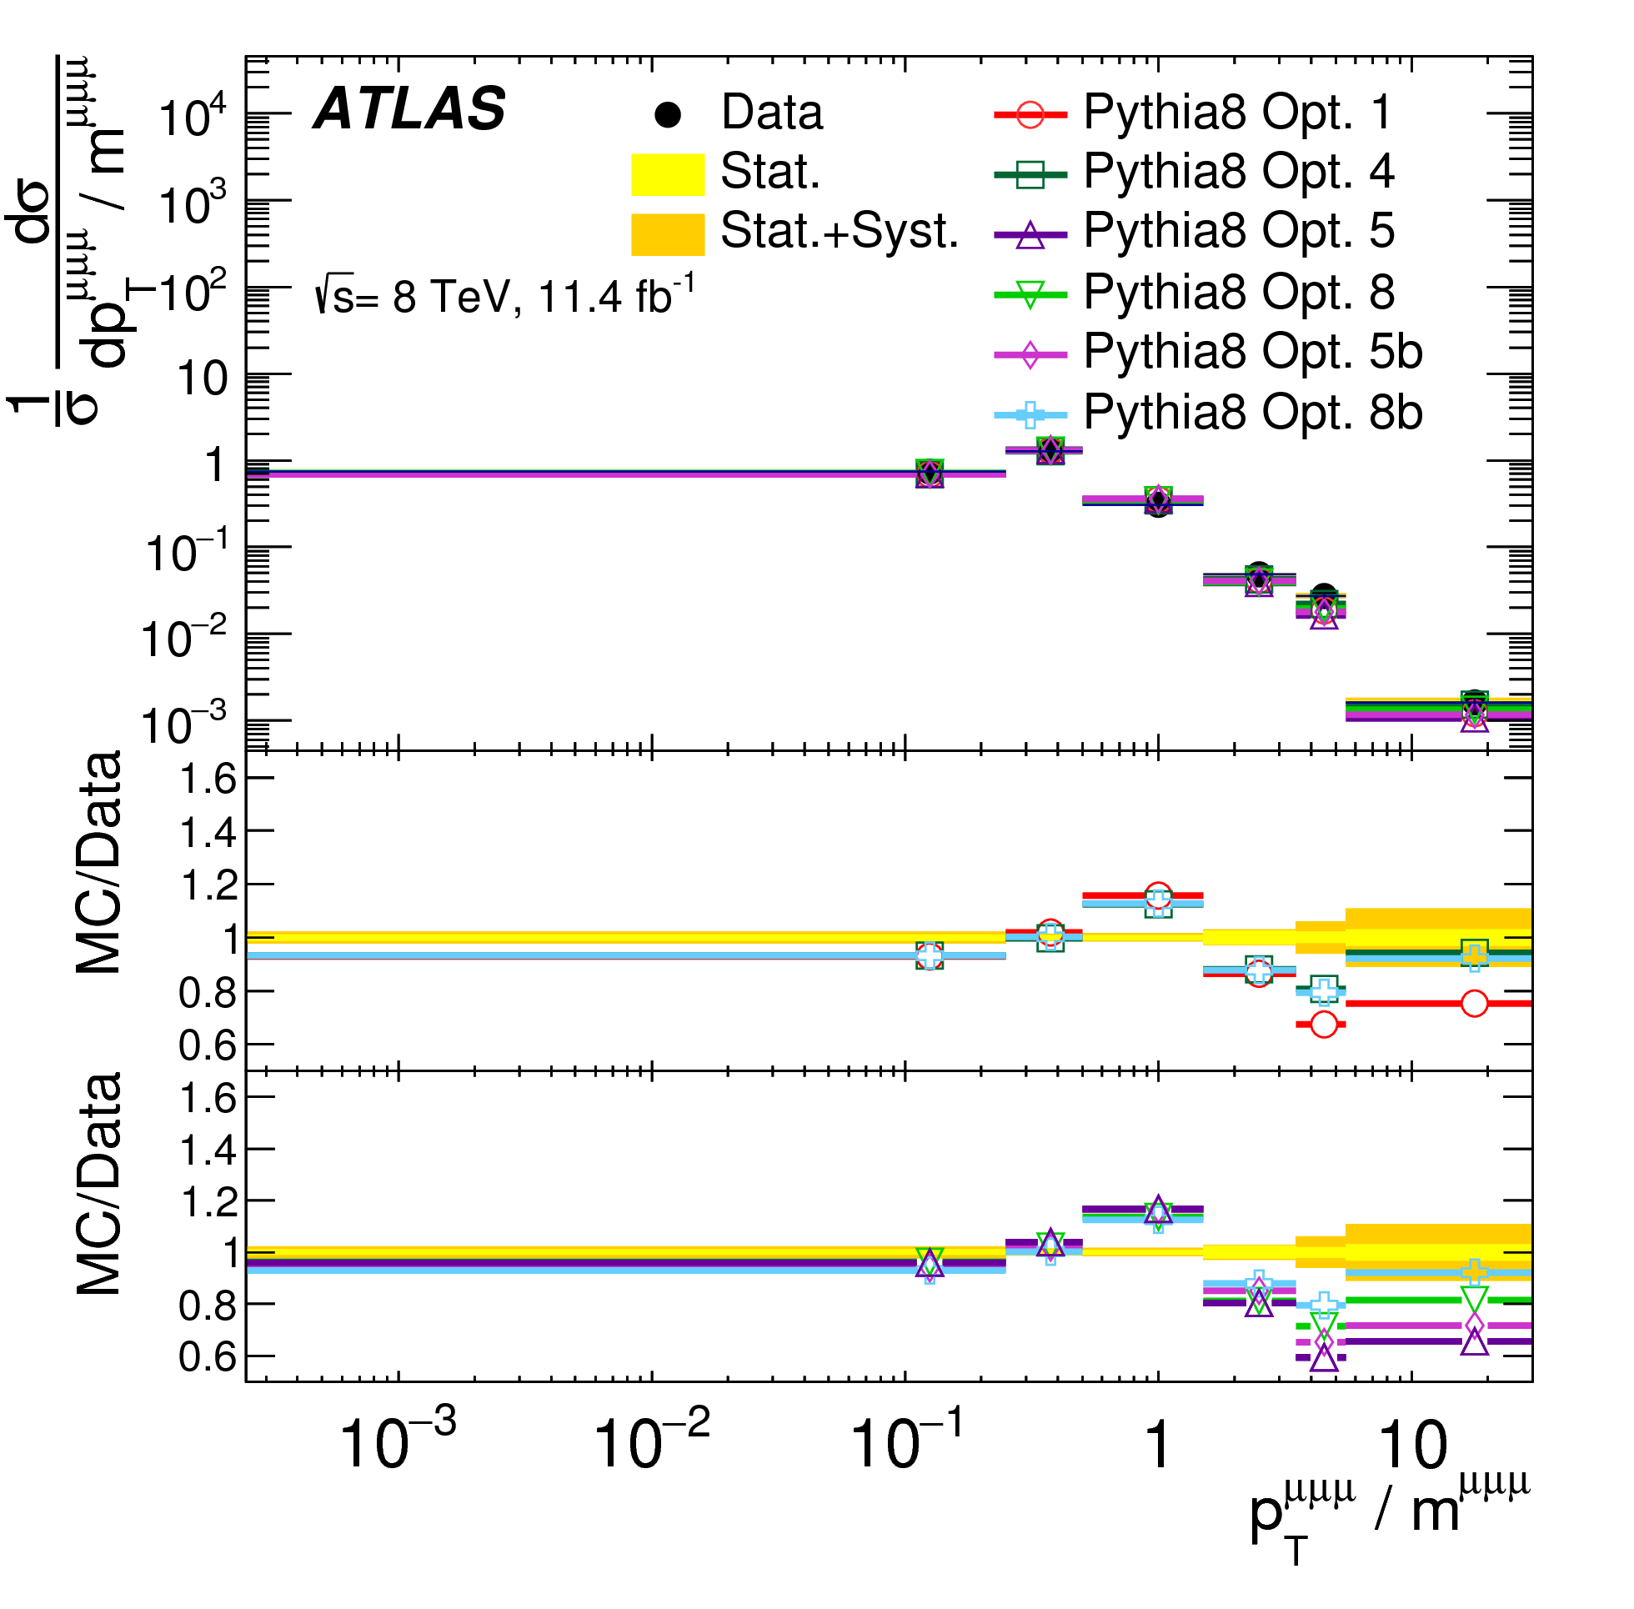
Comparisons with Pythia
Pythia 8 does not reproduce well the shape of the angular distributions
The pT-based scale splitting kernels (Opt 1 and 4) give a better description at low ΔR
Overall the kernel of Opt 4 does best

Slide 26
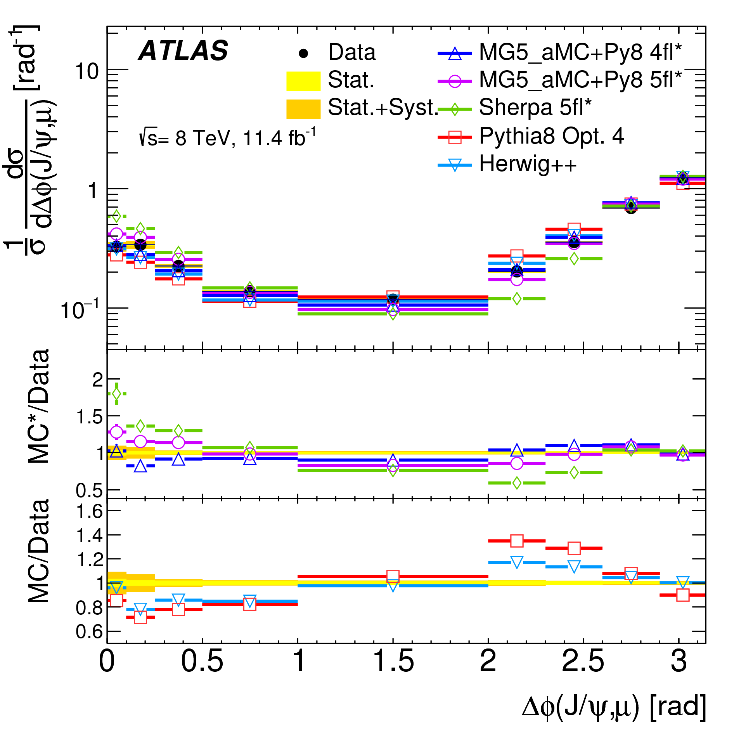
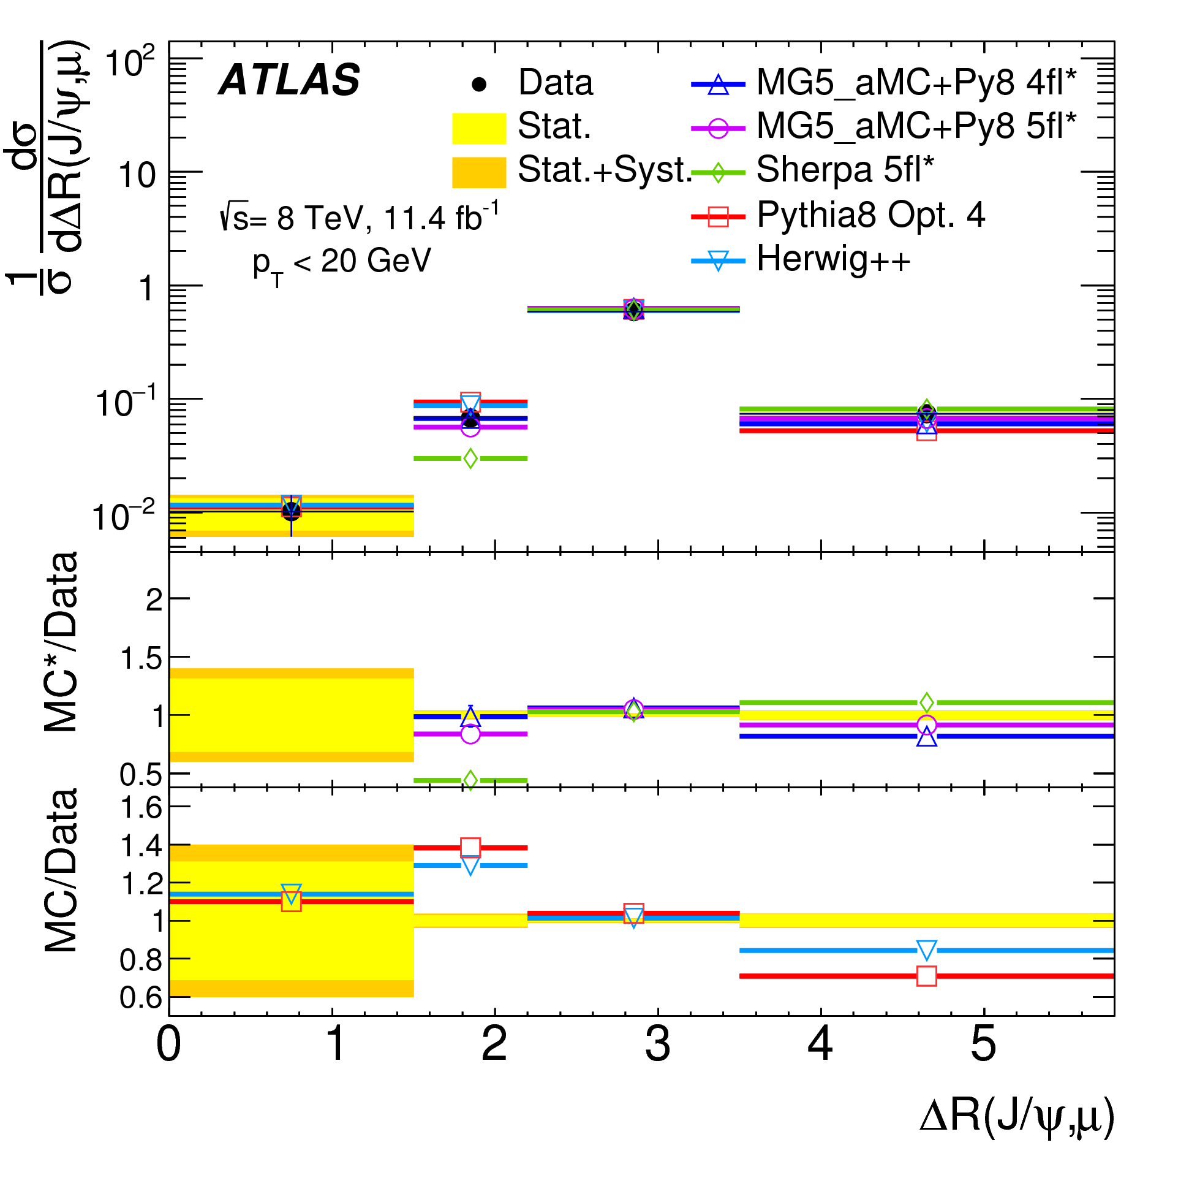
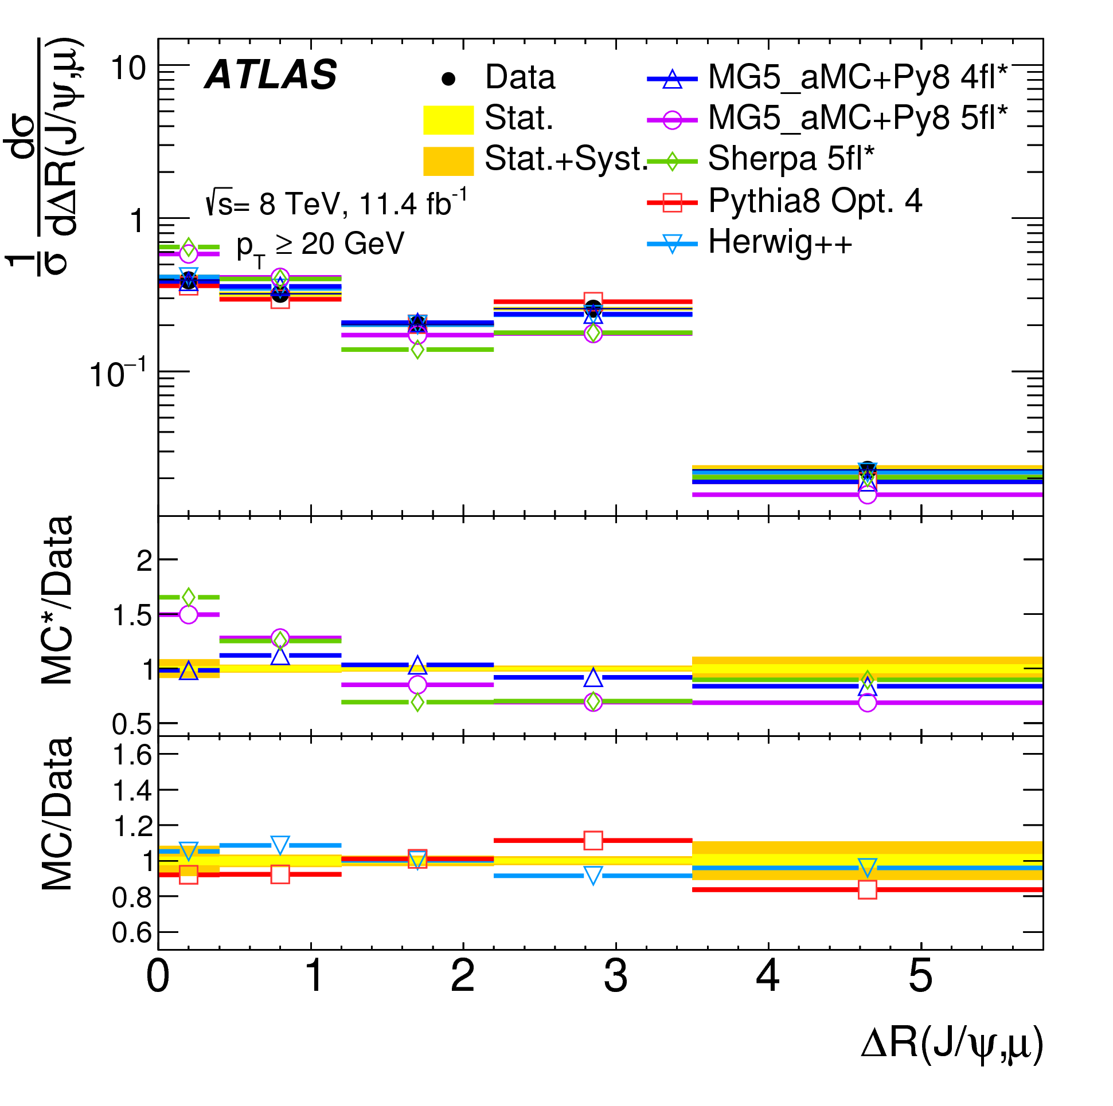
Comparisons with Other Models
Herwig++ is better than Pythia 8 for the ΔR
4- and 5-flavour MadGraph5 predictions sit either side of the data; the 4-flavour prediction is closer
The 5-flavour Sherpa prediction is similar (but worse) than madGraph5
Difference between 4-flavour and 5-flavour predictions are larger in the high-pT ΔR distribution; the 4-flavour version is still closer to data

Slide 27
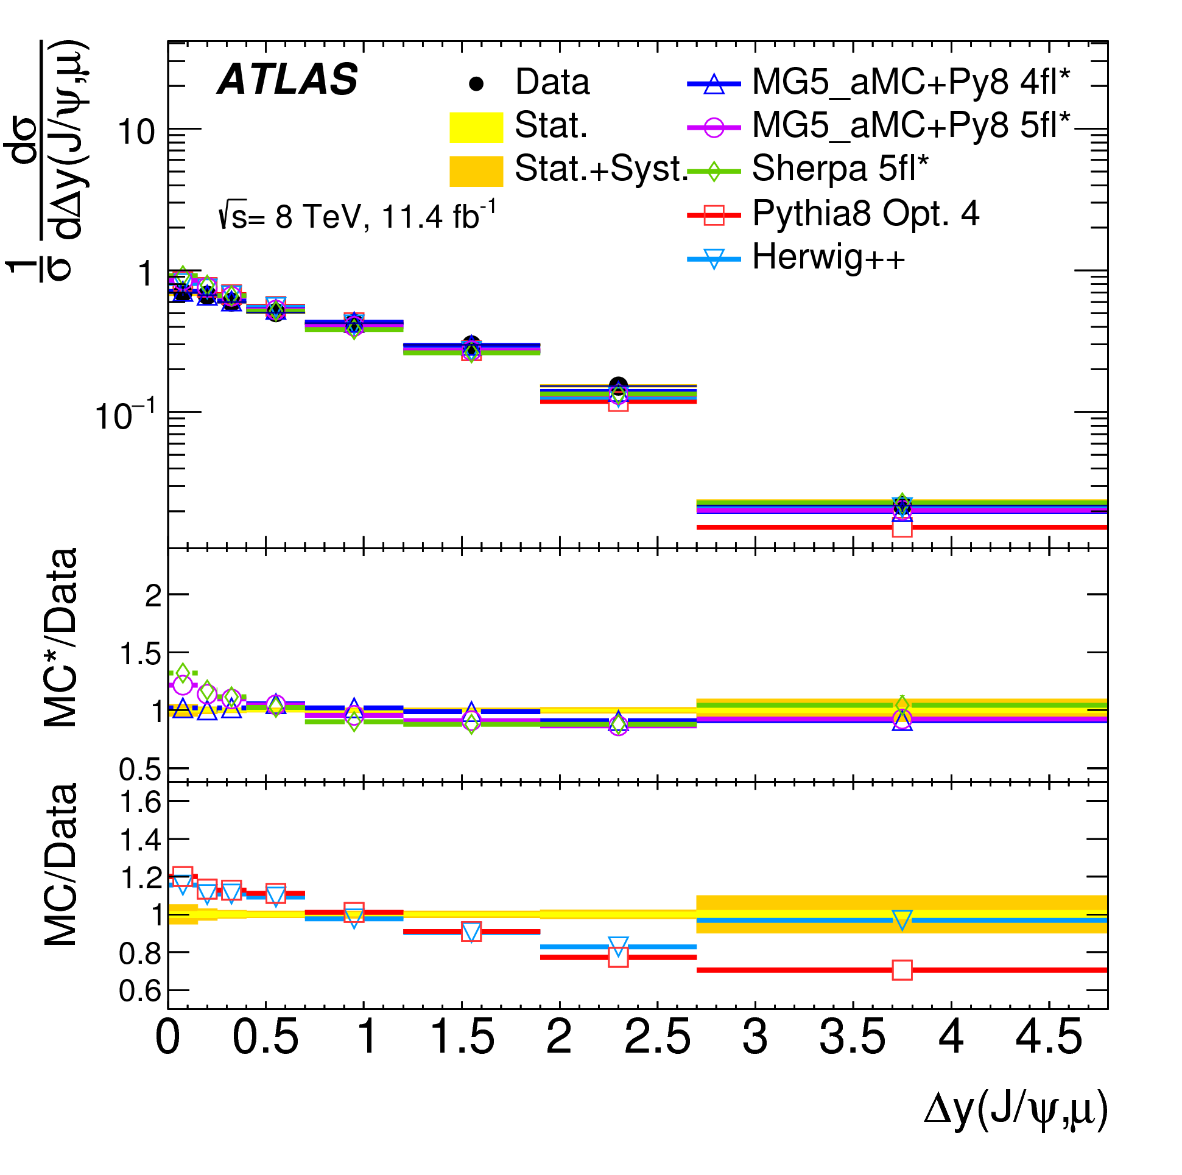
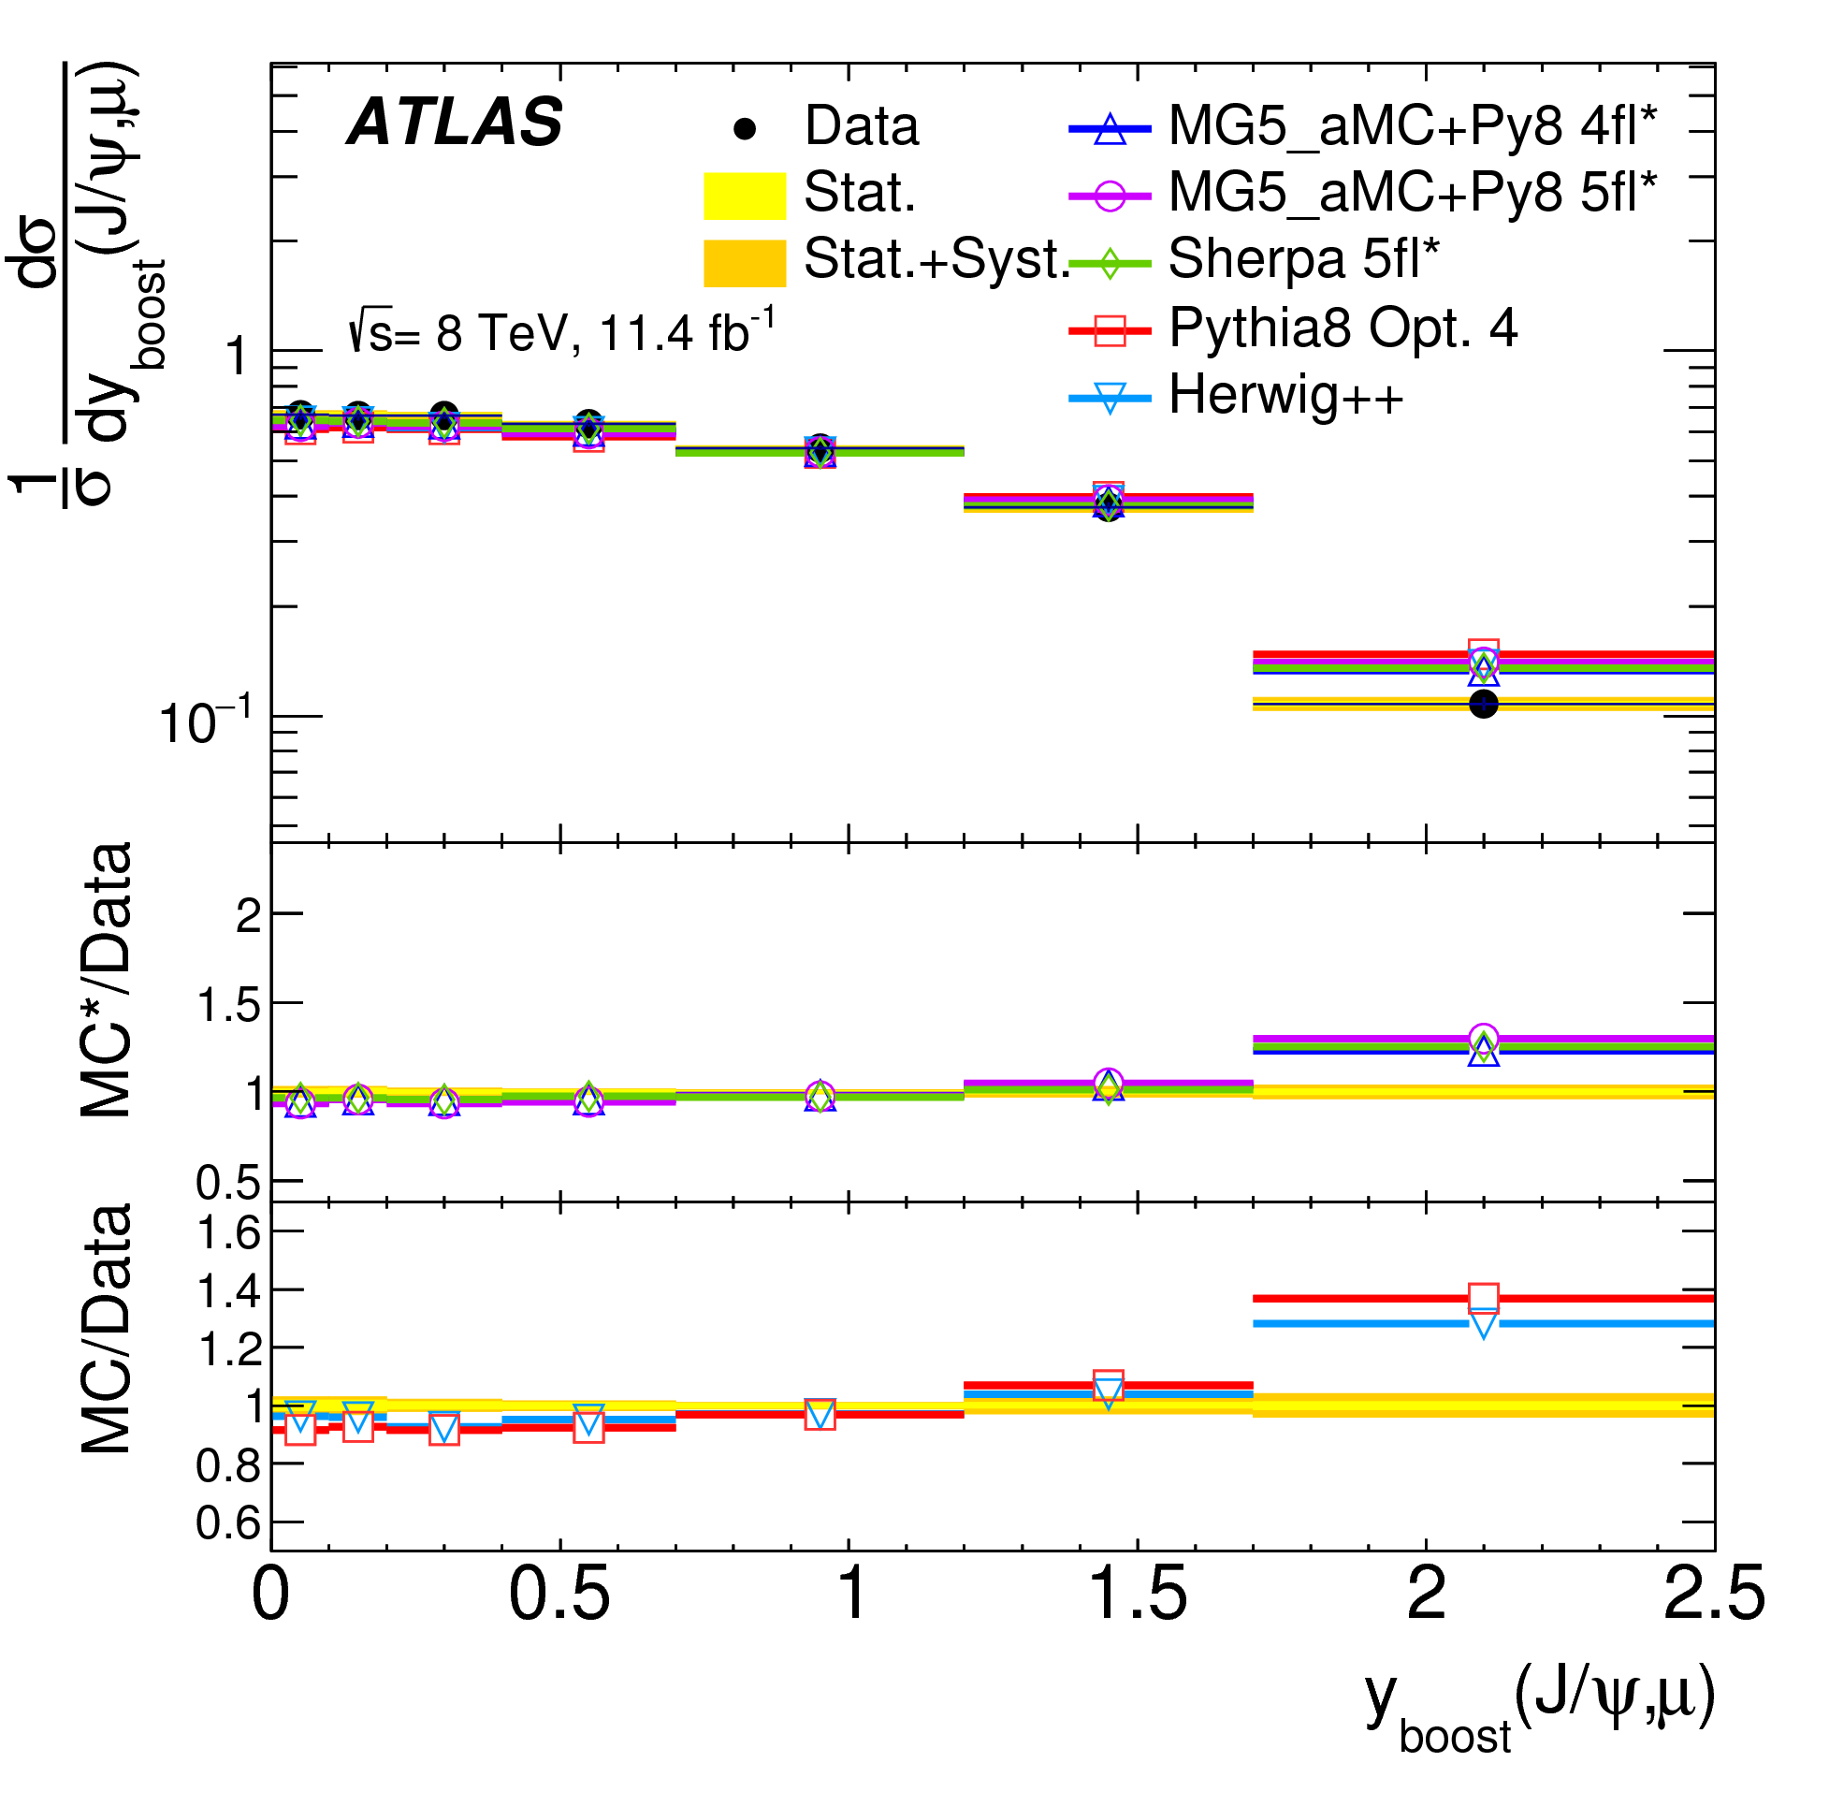
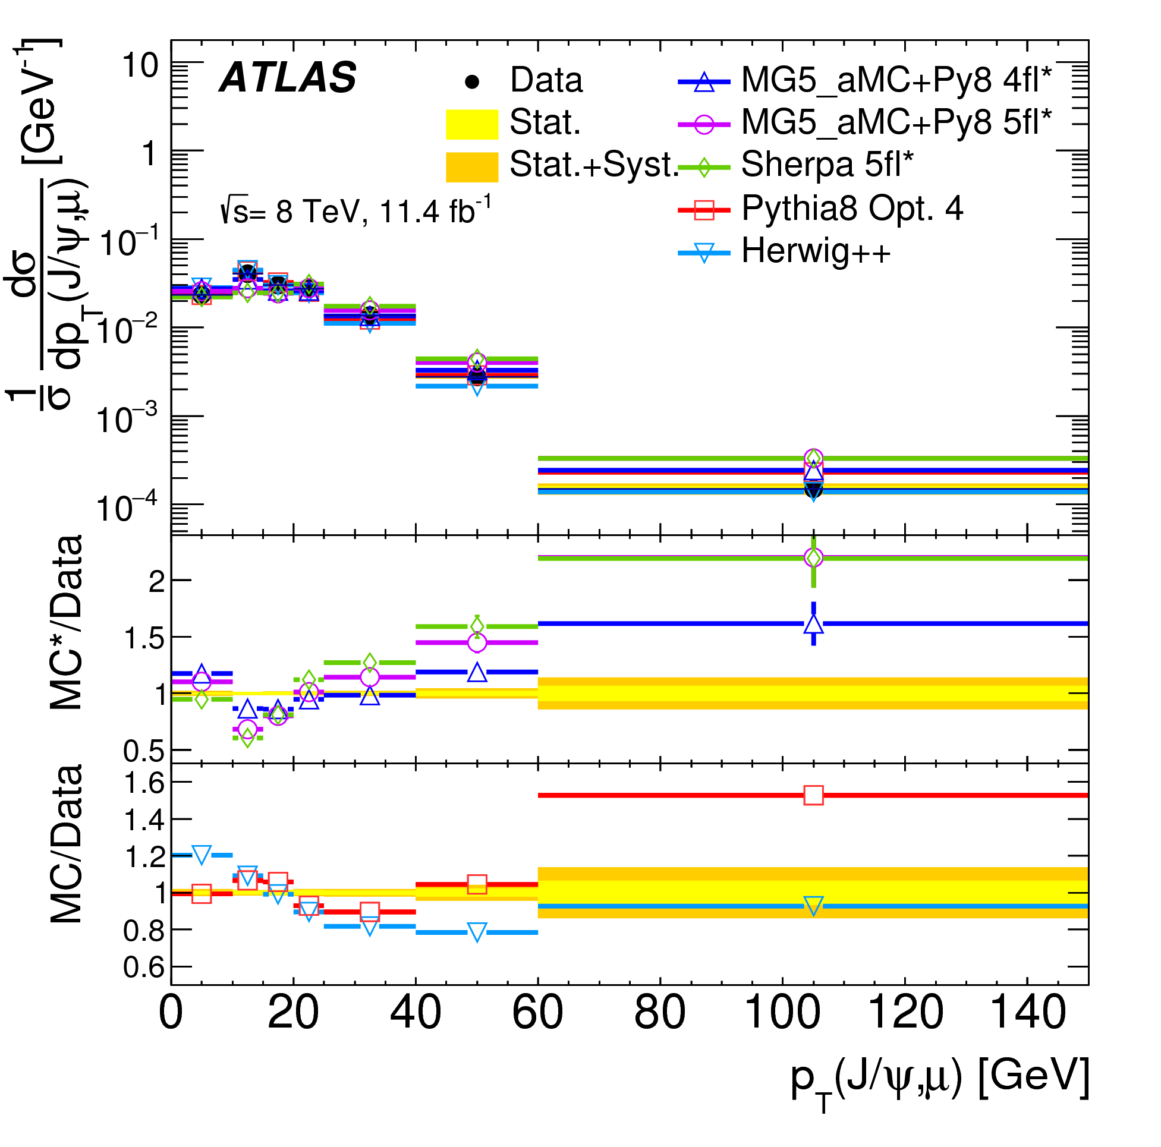
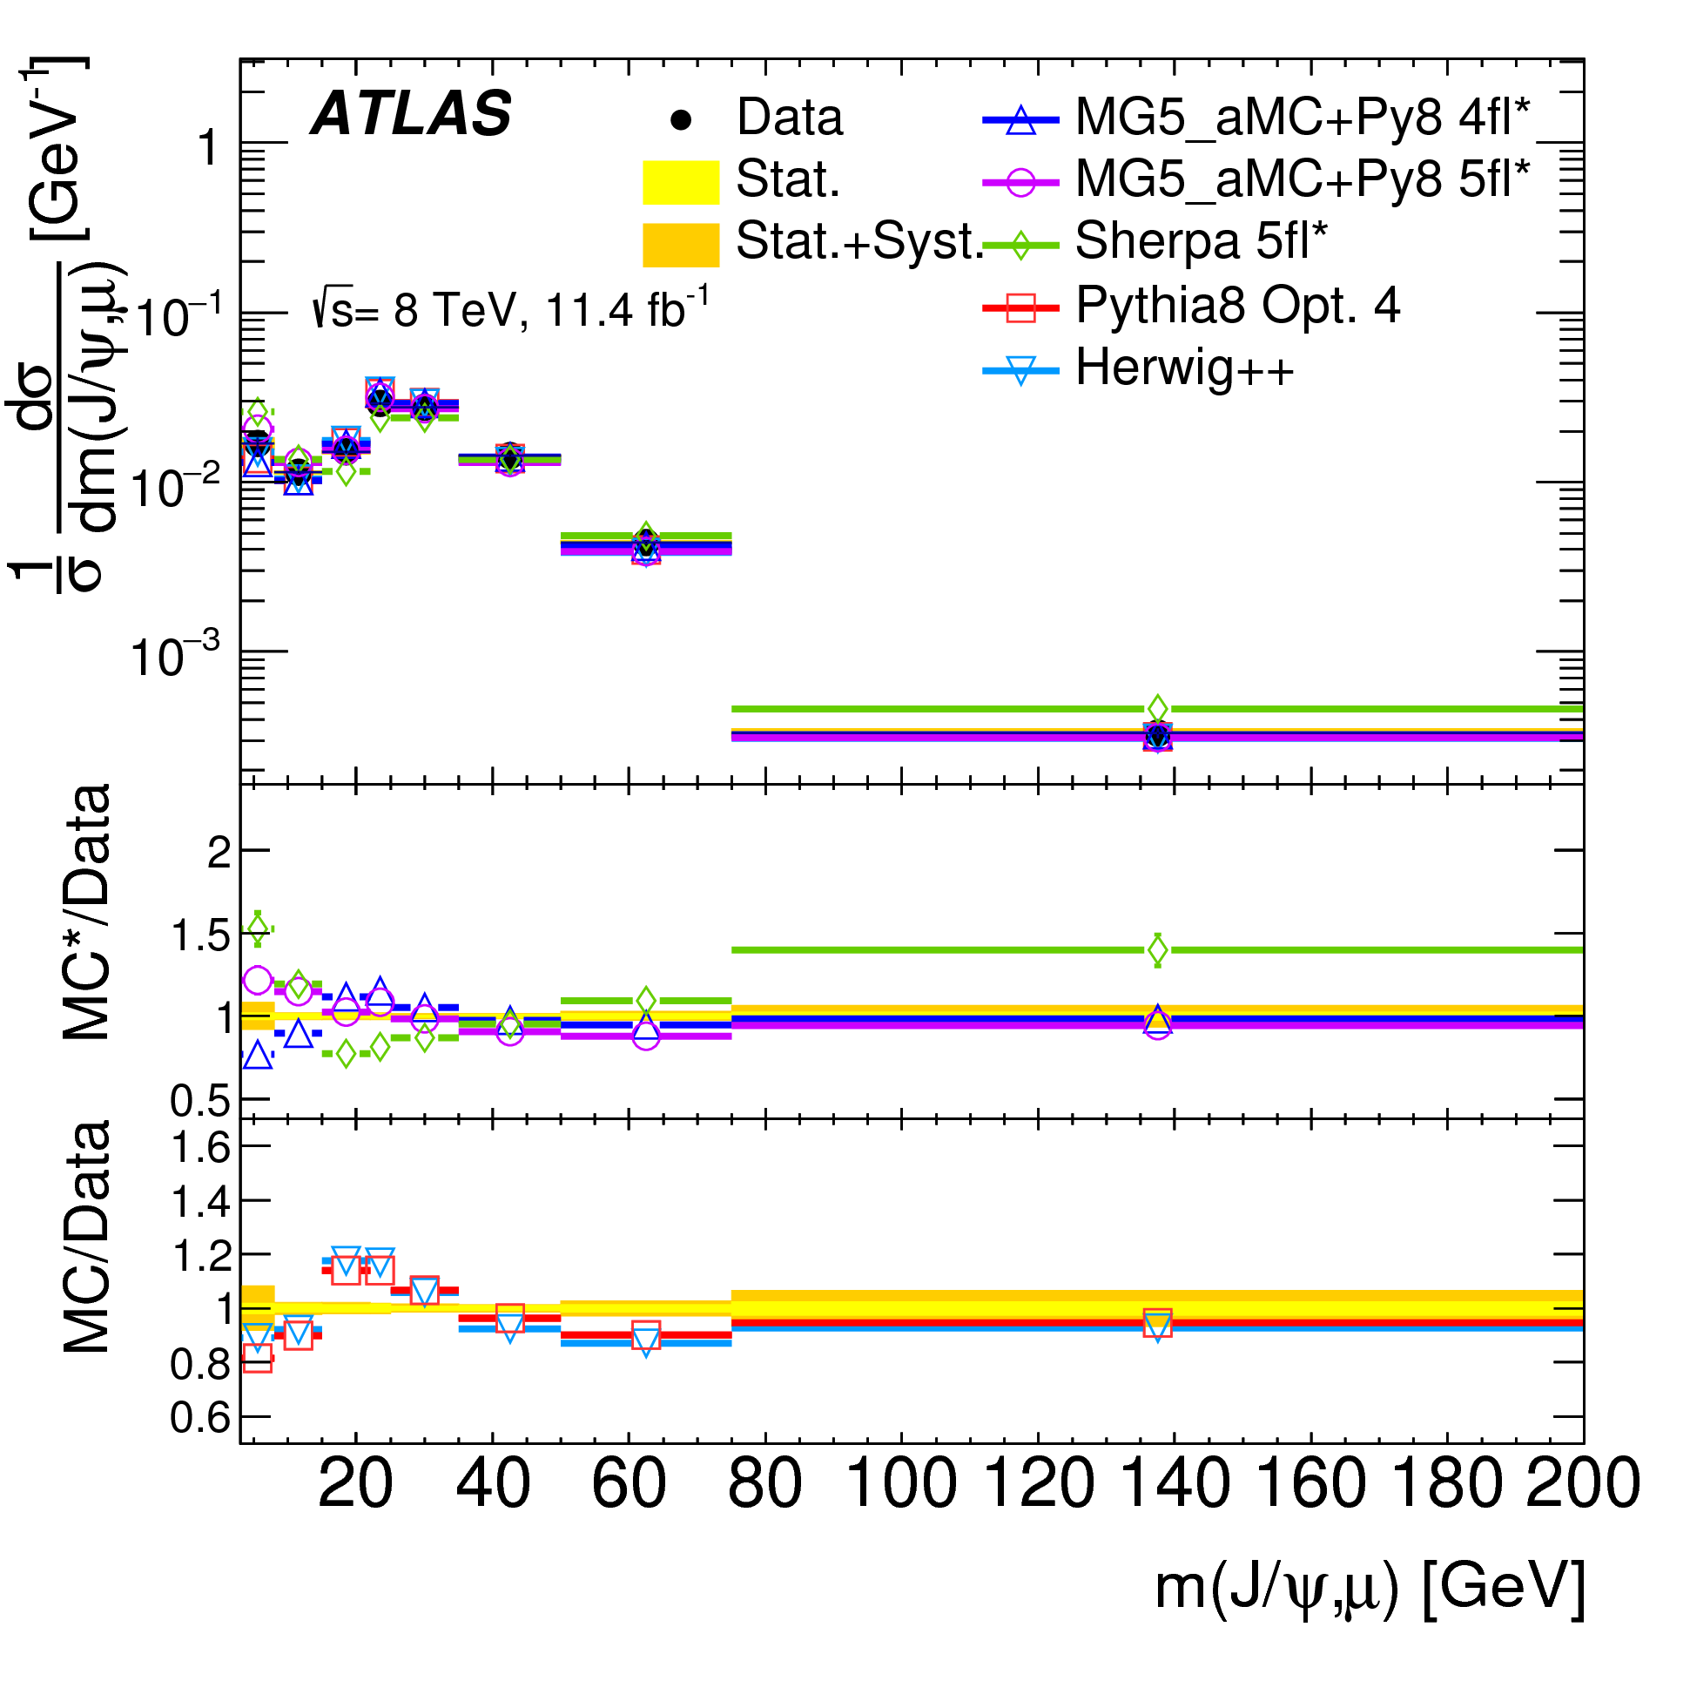
Other results
Similar picture for rapidities, pT, mass etc
Fiducial cross section is also measured
17.7± 0.1 (stat) ± 2.0 (syst) nb
Good understanding of systematics

Slide 28
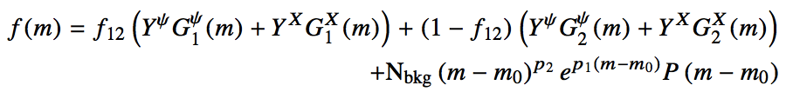
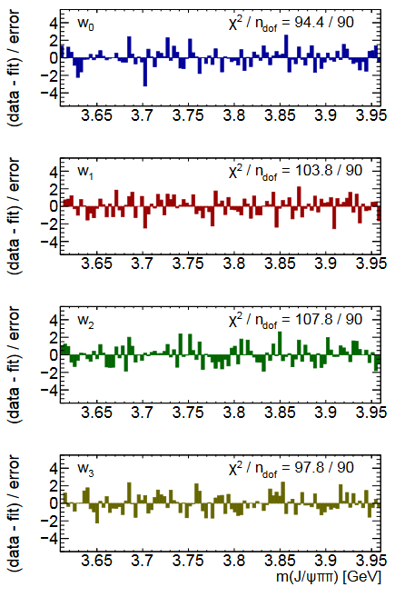

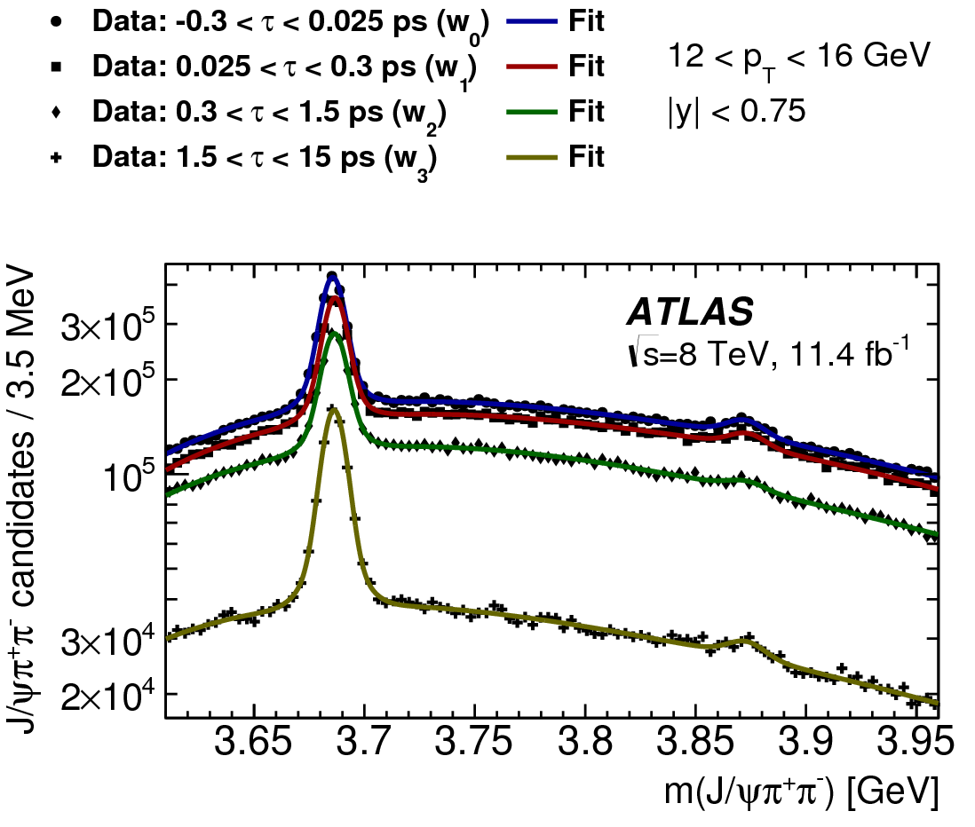
Mass fits in lifetime windows
Mass fits: double-Gaussian signal peaks on a smooth background:
Fraction of narrow Gaussian f₁₂ shared between
ψ(2S) and X(3872)
Resolution parameters linked by
Values of parameters f₁₂ and κ determined from global fits
Verified with MC and varied during systematic studies
p_{T}: 12-16 GeV
Pull distributions

Slide 29
Single lifetime fit - results
Assumption: non-prompt ψ(2S) and X(3872) are produced from the same mix of parent b-hadrons:
- same lifetimes for ψ(2S) and X(3872) in each p_{T} bin
- pT spectra of ψ(2S) and X(3872) linked through kinematics
Effective lifetimes
- for ψ(2S) independent of p_{T}
- for X(3872) possibly slightly shorter in low p_{T} bins
Kinematic template obtained from simulations of various
b-hadron decays into ψ(2S) and X(3872)
- takes into account mass difference and
- possible variation in mass of hadronic association
Non- prompt X(3872) : ψ(2S) ratio
- fit to kinematic template

Slide 30
Two-lifetime fits
Alternative lifetime model: two-lifetime fit
- non-prompt component presented as a sum of short-lived and long-lived
- two single-sided exponentials smeared with the same resolution function
- f_{SL} is a fraction of short-lived within non-prompt – supposedly from B_{c} decays
- statistical power of data does not allow determination of two free lifetimes
- the two lifetimes fixed, the fraction of short-lived contribution left free in the fit
Fixing the two lifetimes
- effective pseudo-proper lifetime depends on
parent’s lifetime and decay kinematics
- τ_{LL} determined from fits to ψ(2S), allowing for some SL contribution
- τ_{SL} obtained from simulation, varying B_{c} decay mode
(low mass association gives shorter effective lifetime)
- both varied within limits shown during systematic studies
Two-lifetime fit results quoted from now on, unless stated otherwise
τ(B±) = 1.638 ± 0.004 ps
τ(B⁰) = 1.525 ± 0.009 ps
τ(B_{s}⁰) = 1.465 ± 0.031 ps
τ(Λ_{b}) = 1.451 ± 0.013 ps
τ_{LL} = 1.45 ± 0.05 ps
τ(B_{c}) 0.507 +/-0.009 ps
τ_{SL} = 0.40 ± 0.05 ps

Slide 31
Summary of X(3872) results
Prompt production is described reasonably well by NRQCD with previously determined Long Distance MEs.
Two lifetime models for non-prompt production:
single-lifetime model (with fitted effective lifetime)
two-lifetime model (two fixed lifetimes, fitted fraction), needed for X(3872)
Cross section results, non-prompt fractions largely indifferent to lifetime model
Branching fraction ratios measured in the two models are only slightly different:
Both smaller than 18 ± 8 % estimated from Tevatron data, implicit same-parent-mix assumption.
Two-lifetime model allows for a significant fraction of non-prompt X(3872) to be produced in decays of B_{c}, which have shorter lifetime and expected to have steeper p_{T} dependence.
In this model the fraction of non-prompt X(3872) produced from B_{c} decays is measured to be (for pT>10 GeV)

Slide 32
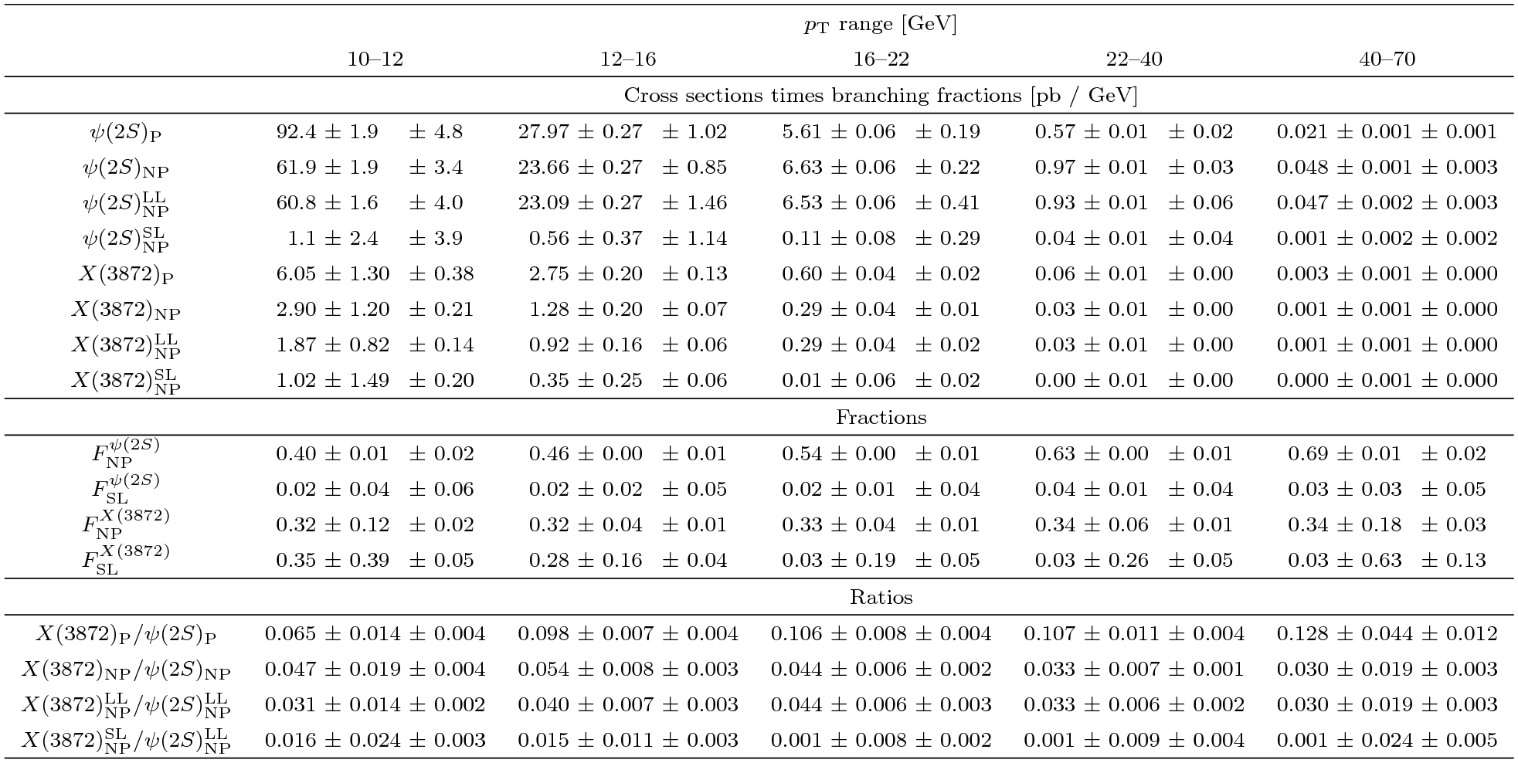
Backup: Table of results for ψ(2S) and X(3872)

