Slide 1

CEPC Injector Linac Design
环形正负电子对撞机
Circular Electron Positron Collider
Xiaoping Li, Cai Meng, Guoxi Pei, Jingru Zhang,,
Dou Wang, Chenghui Yu, Jie Gao, Shilun Pei, Yunlong Chi
Institute of High Energy Physics, CAS, Beijing

Slide 2
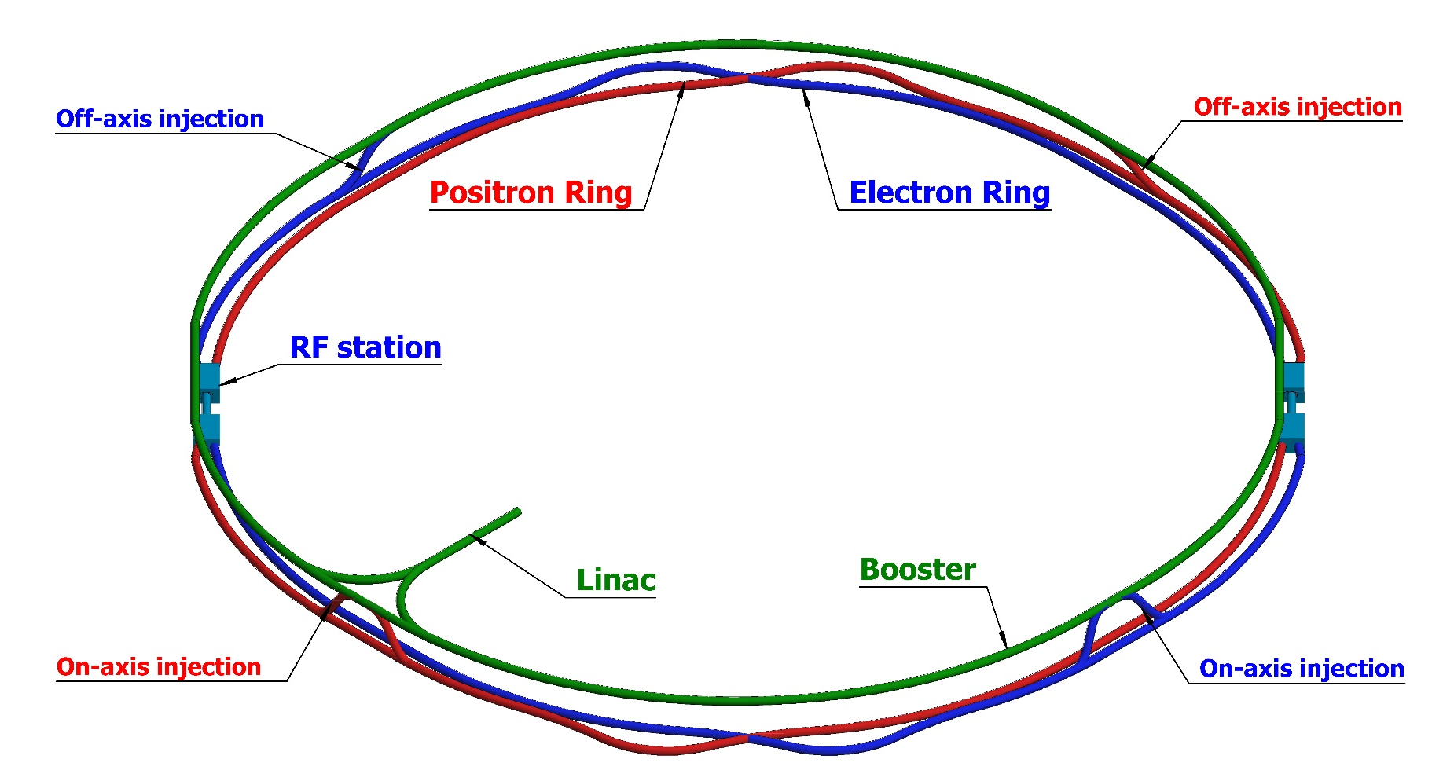
Outline
Introduction
  Main parameters
  Layout of Linac
Source design
  Electron source
  Positron source
Linac design
  Electron/Positron mode
  Error study
Summary

Slide 3
Outline
Introduction
  Main parameters
  Layout of Linac
Source design
  Electron source
  Positron source
Linac design
  Electron/Positron mode
  Error study
Summary

Slide 4
Introduction
  Main parameters
Linac design goal
  High Availability and Reliability
    Simple structure and mature technology: S-band accelerating structure as baseline(2856.75MHz)
  Always should provide beams that can meet requirements of Booster
  Should be have potential to meet the higher requirements and updates in the future
Parameter | Symbol | Unit | Value | Potential
e⁻ /e⁺ beam energy | E_{e-}/E_{e+} | GeV | 10 | >10
Repetition rate | f_{rep} | Hz | 100
e⁻ /e⁺ bunch population | Ne-/Ne+ |  | >9.4×10⁹ | >1.9×10¹⁰
 |  | nC | >1.5 | >3
Energy spread (e⁻ /e⁺ ) | σ_{E} |  | <2×10⁻³
Emittance (e⁻ /e⁺ ) | ε_{r} | nm | <120 | <40
e⁻ beam energy on Target |  | GeV | 4
e⁻ bunch charge on Target |  | nC | 10

Slide 5
Introduction
Layout of Linac
Positron Linac
ESBS
PSPAS
DR
FAS
SAS
TAS
50MeV
4GeV
200MeV
1.1GeV
4GeV
10GeV
ESBS ( Electron Source and Bunching System)
  50 MeV && 11nC for positron production
SAS (the Second Accelerating Section)
  Positron beam to 4 GeV && 3 nC
DR (Damping Ring)
  Positron beam 1.1GeV, 60m
FAS (the First Accelerating Section)
  Electron beam to 4 GeV && 10nC for positron production
TAS (the Third Accelerating Section)
  Positron beam to 10 GeV && 3 nC
PSPAS (Positron Source and Pre-Accelerating Section)
  Positron beam larger than 200 MeV && larger than 3 nC

Slide 6
Introduction
Layout of Linac
Electron Linac
EBTL
ESBS
PSPAS
DR
FAS
SAS
TAS
50MeV
4GeV
200MeV
1.1GeV
4GeV
10GeV
ESBS ( Electron Source and Bunching System)
  50 MeV && 3 nC
EBTL (Electron Bypass Transport Line)
  Electron beam @ 4 GeV && 3 nC
FAS (the First Accelerating Section)
  Electron beam to 4 GeV && 3 nC
TAS (the Third Accelerating Section)
  Electron beam to 10 GeV && 3 nC

Slide 7
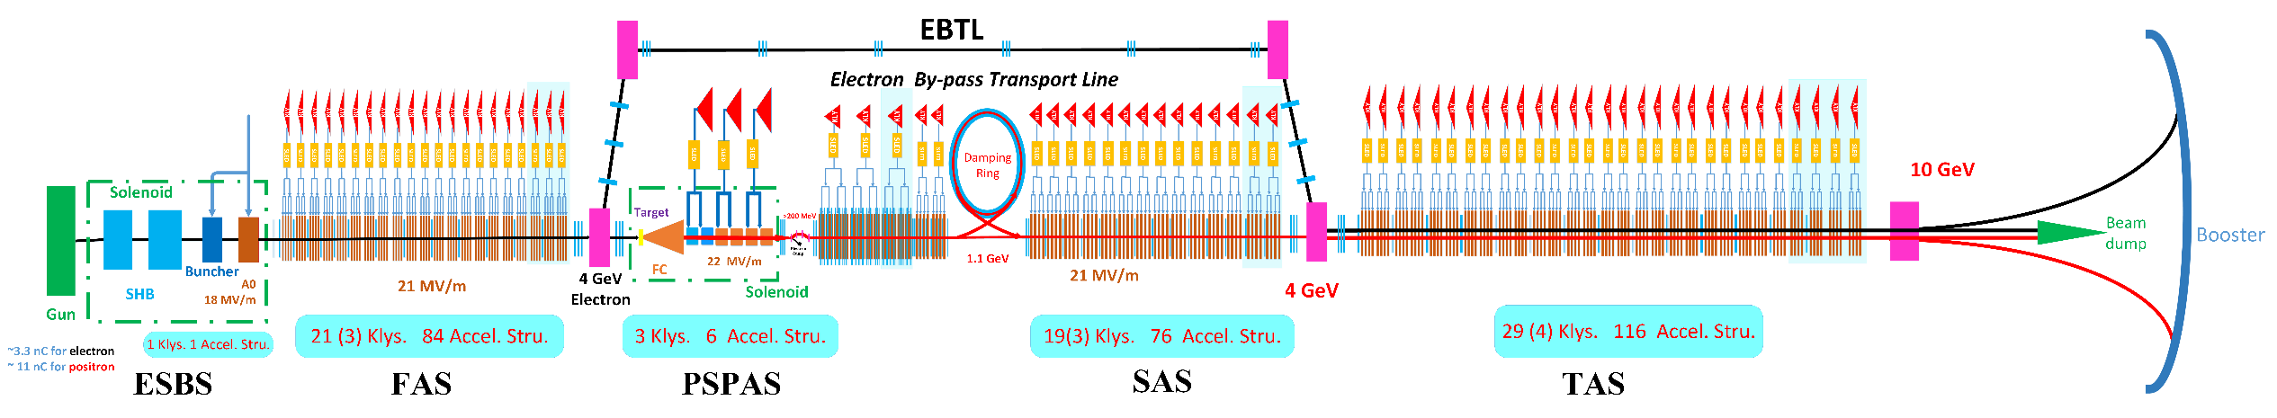
Introduction
Layout of Linac
EBTL
ESBS
DR
FAS
PSPAS
SAS
TAS
50MeV
4GeV
200MeV
1.1GeV
4GeV
10GeV

Slide 8
Outline
Introduction
  Main parameters
  Layout of Linac
Source design
  Electron source
  Positron source
Linac design
  Electron/Positron mode
  Error study
Summary

Slide 9
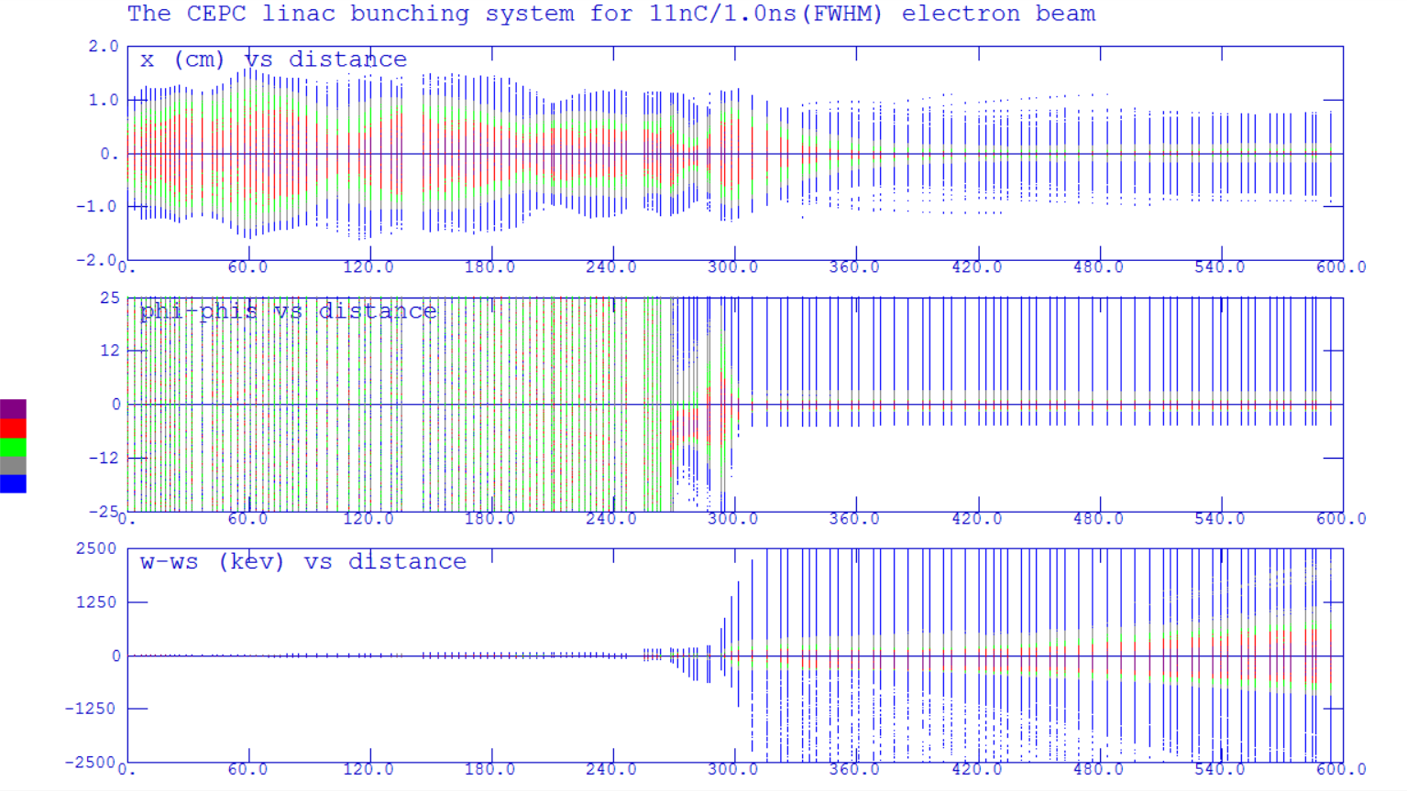
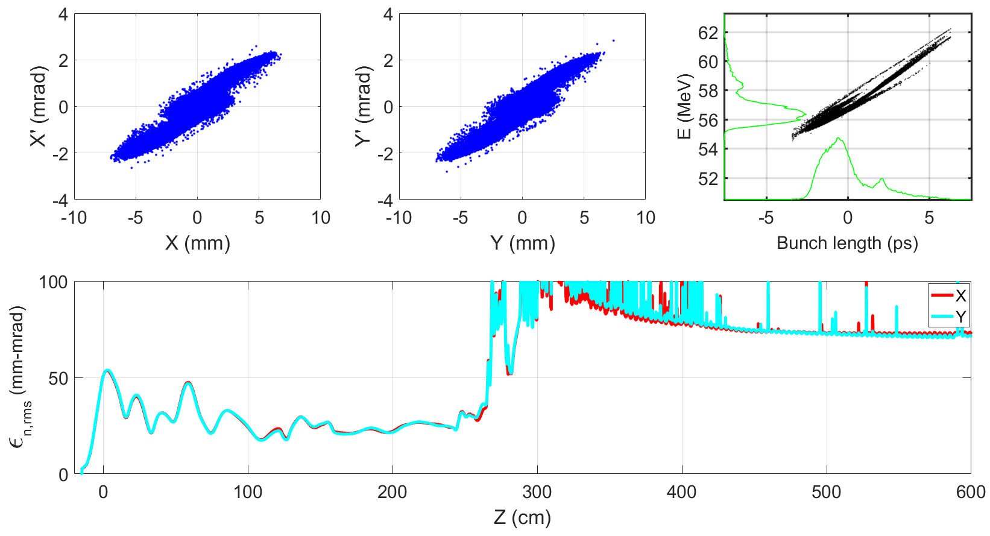
Source design
Electron source
Thermionic Triode electron gun
Sub-harmonic pre-buncher
  142.8375 MHz
  571.35 MHz
Buncher & A0
  2856.75 MHz
Emittance
  <100 mm-mrad (Norm.Rms) @11nC
Transmission
  ~90%
Parmela

Slide 10
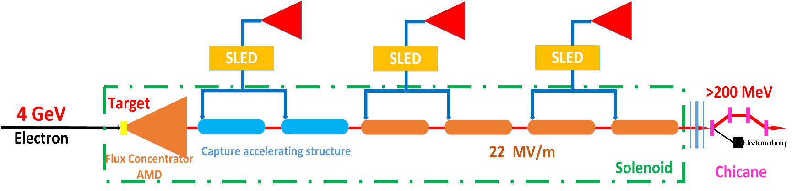
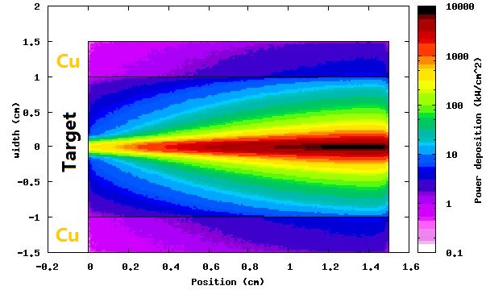
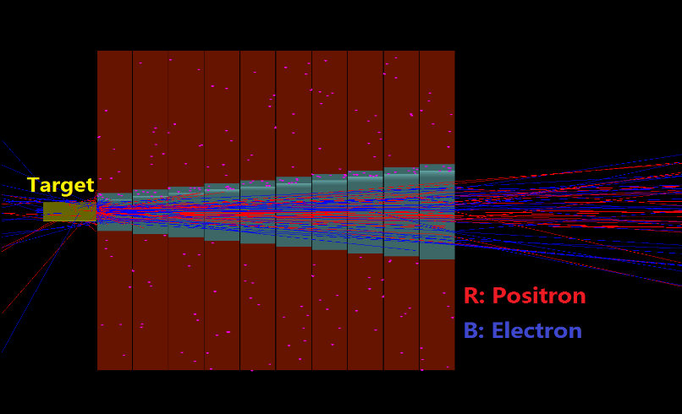
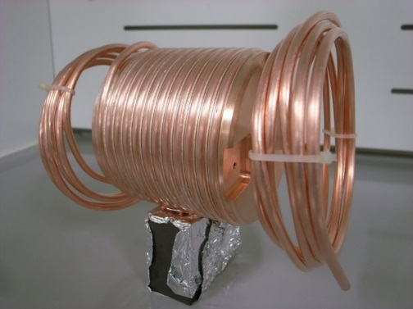
Source design
Positron source
Layout of positron source
  Target (Conventional)
    tungsten@15 mm
    Beam size: 0.5 mm
  Electron Beam
    4GeV/10nC/100Hz
    Beam power 4kW
  Energy deposition
    0.784 GeV/e- @ FLUKA
    784 W → water cooling
  AMD (Adiabatic Matching Device)
    Flux Concentrator
    Length: 100mm
    Aperture: 8mm→26mm
    Magnetic field: (5.5T→0T) + 0.5T
Notes:
.

Slide 11
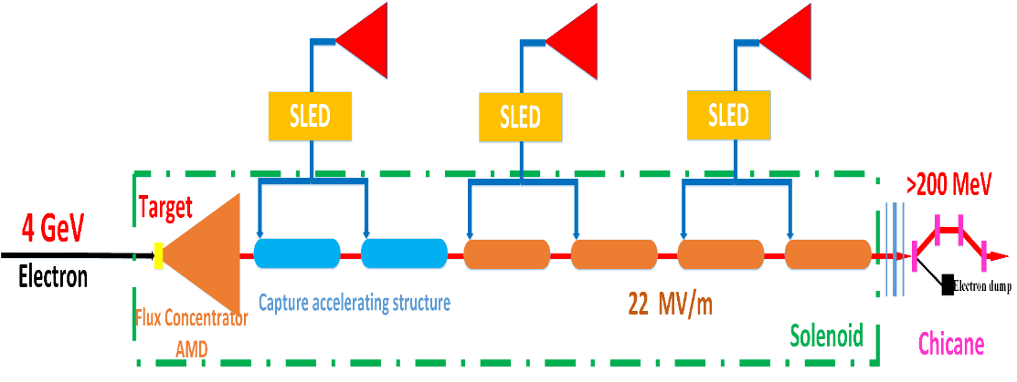
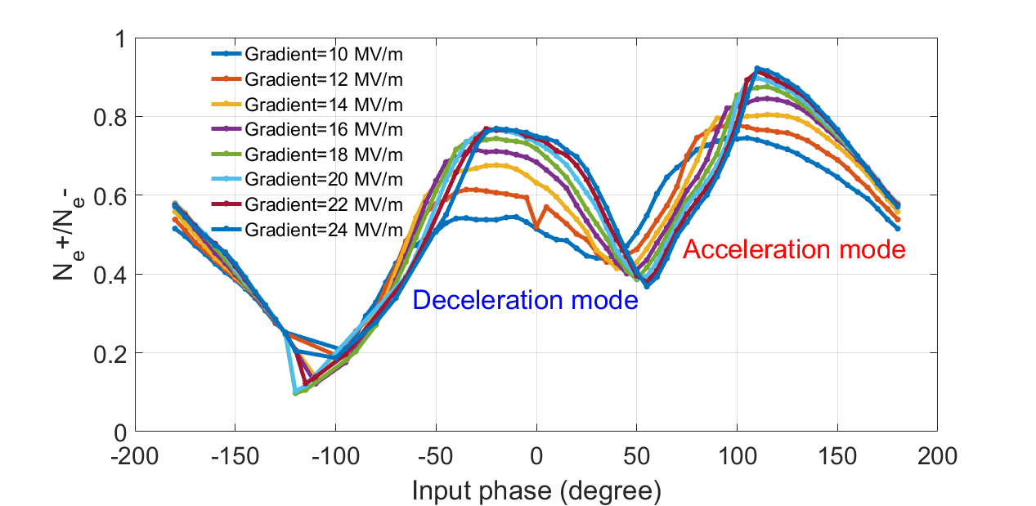
Source design
Positron source
Layout of positron source
  Capture & Pre-accelerating structure
    Length:2 m
    Aperture: 25 mm
    Gradient: 22 MV/m
  Chicane
    Wasted electron separation
  Norm. RMS. Emittance
    ~2400 mm-mrad→~120nm@10GeV
  Energy: >200 MeV
  Positron yield
    Ne+/Ne- > 0.5 @ [-8°,12°,235MeV, 265MeV]

Slide 12
Outline
Introduction
  Main parameters
  Layout of Linac
Source design
  Electron source
  Positron source
Linac design
  Electron/Positron mode
  Error study
Summary

Slide 13
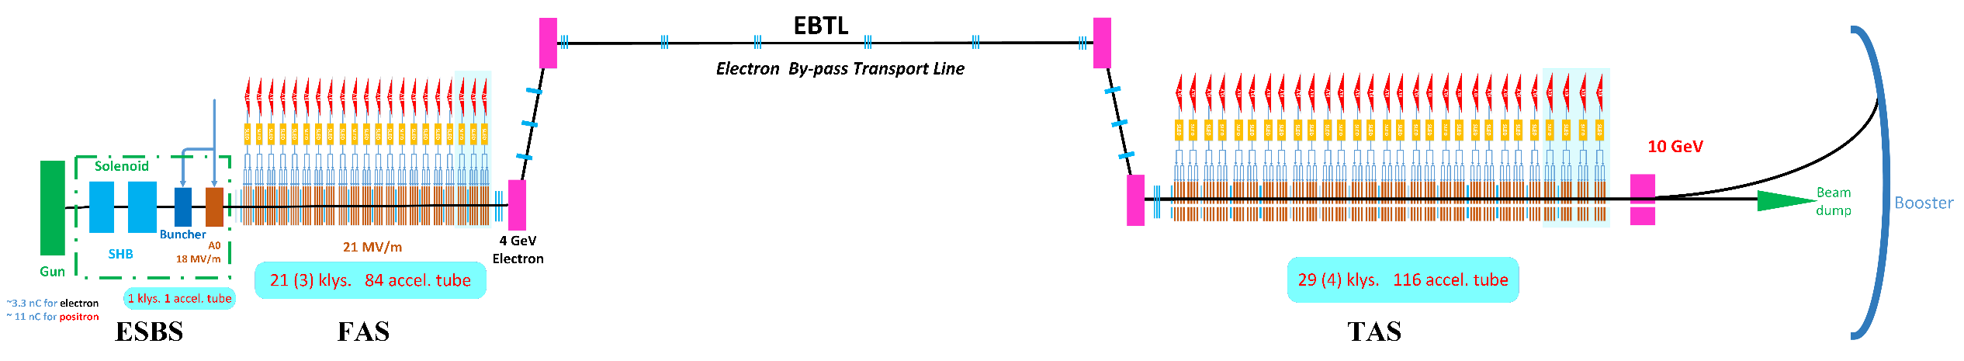
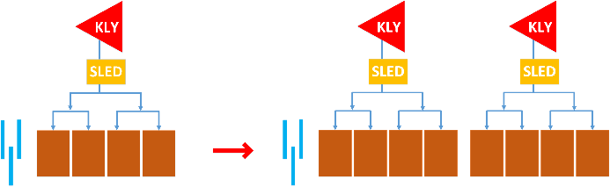
Linac design
Electron linac
Focusing device: Triplet
  1 triplet+4 Acc. Stru.→1 triplet+8 Acc. Stru.
Operation mode :
  High charge mode (positron production)
    4GeV & 10 nC
    ESBS+FAS
  Low charge mode (electron injection)
    10 GeV & 3 nC
    ESBS+FAS+EBTL+TAS

Slide 14
Linac design
Electron linac→ Electron injection
Low charge mode
  10 GeV with 3 nC charge
  Energy spread (rms): 0.15%
  Emittance (rms): 5 nm

Slide 15
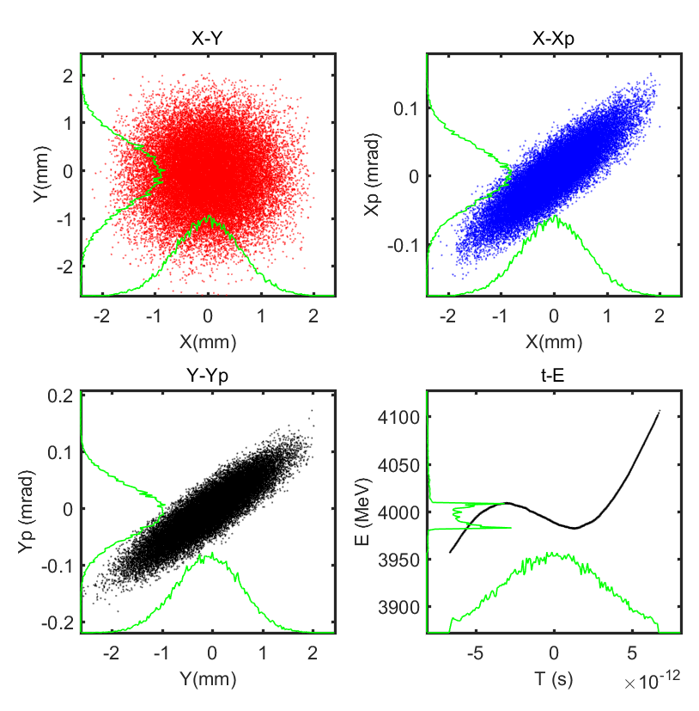
Linac design
Electron linac→ Positron production
High charge mode
  4 GeV with 10 nC charge
  Energy spread (rms): 0.6%

Slide 16
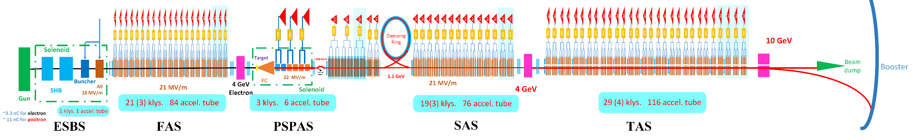
Linac design
Positron linac
PSPAS→SAS (DR) +TAS
  SAS: 200 MeV→4 GeV
  Damping Ring @ 1.1 GeV
  TAS: 4GeV→10 GeV
Transverse focusing devices
  FODO structure at low energy
  Triplet at high energy

Slide 17
Linac design
Positron linac
Positron linac
  10 GeV with 3 nC charge
  Energy spread (rms): 0.16%
  Emittance with DR (rms): 40(H)/24nm(V)

Slide 18
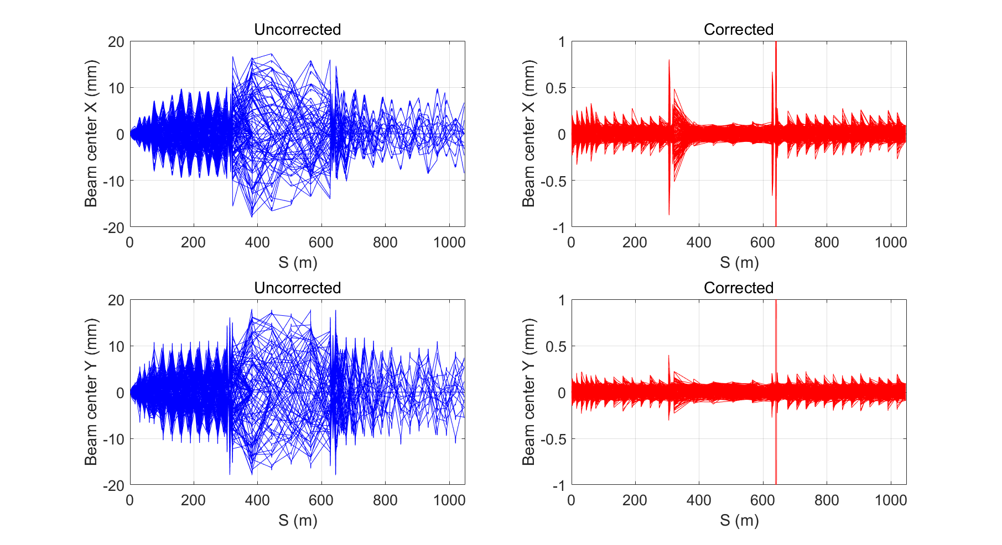
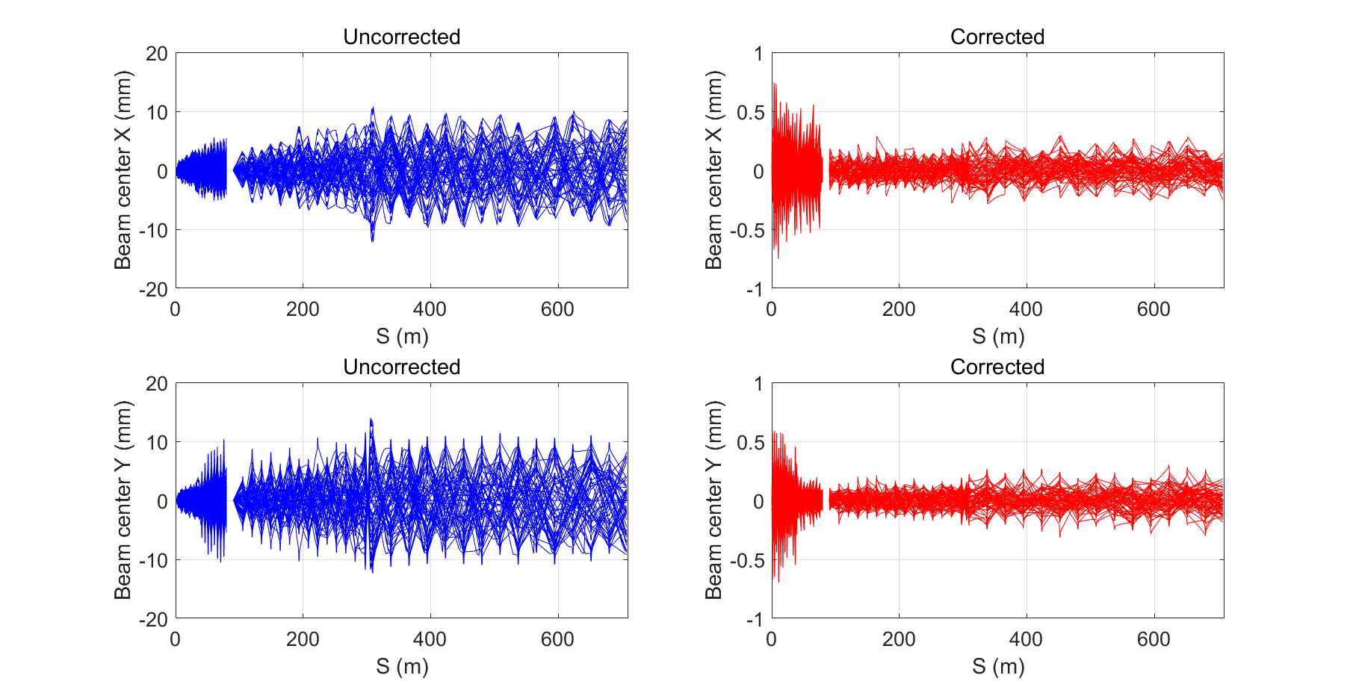
Linac design
Misalignment errors with correction
Whole Linac
  One-to-one correction method for both e- and e+
  Errors: Gaussian distribution, 3σ truncated
Beam orbit
  <1mm
  <0.5mm at high energy region
e-
Error description | Unit | Value
Translational error | mm | 0.1
Rotation error | mrad | 0.2
Magnetic element field error | % | 0.1
BPM uncertainty | mm | 0.1
e+

Slide 19
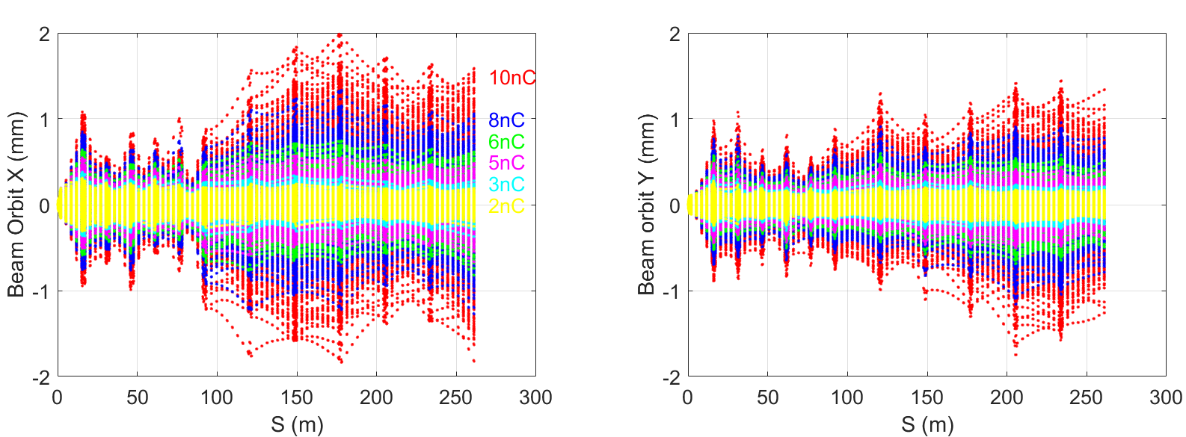
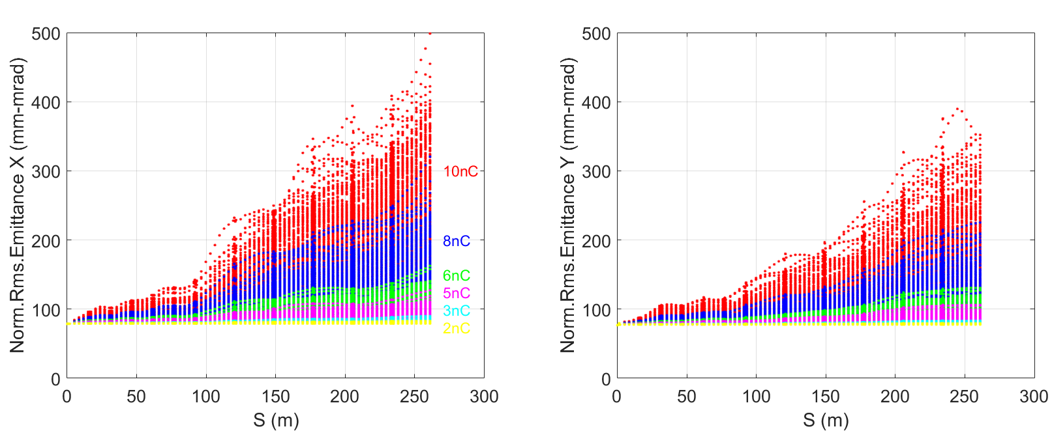
Linac design
Misalignment errors with correction
4GeV Electron Linac with high charge
  Method: First orbit correction + multi-particles simulation
  Low charge
    Beam orbit can be controlled well
  High charge
    Misalignments of Acc. Tubes
    Wakefield
  In a real operation, correction is based on multi-particles orbit, so the orbit and emittance growth can be controlled better.

Slide 20
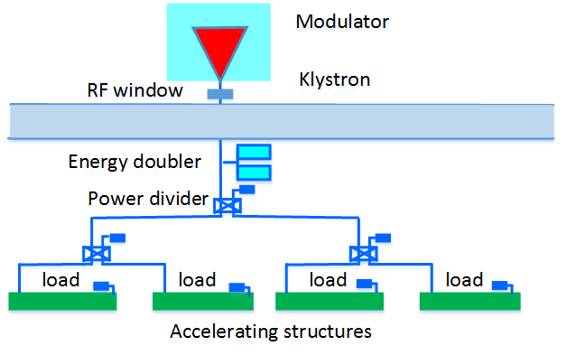
Linac design
Field errors
Simulation condition
  5000 seeds
  Accelerating structure
    phase errors and amp errors
    4 accelerating structures in one KLY
    3σ--Gaussian
Energy jitter: 0.2%
Energy spread < 0.2%
  Phase errors: 0.5 degree (rms)
  Grad. errors: 0.5% (rms)

Slide 21
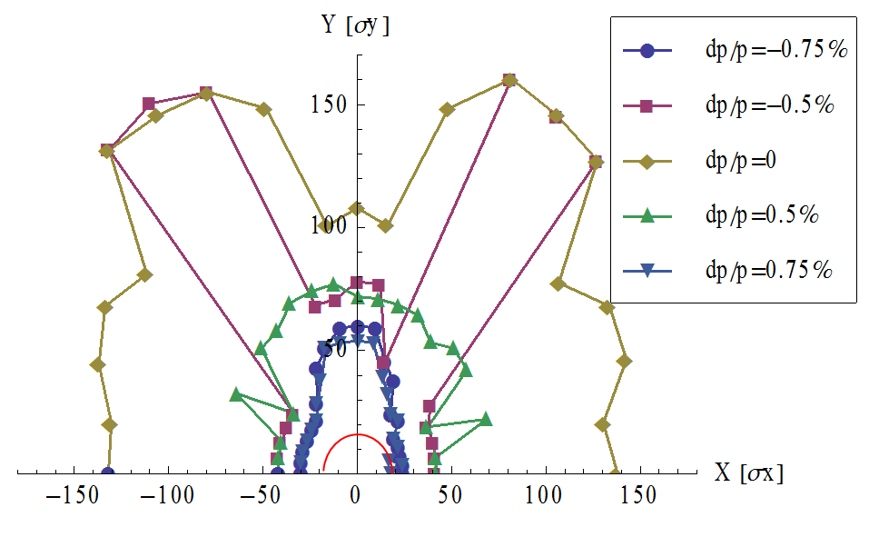
Linac design
Damping Ring
@ D. Wang
DR V1.0 | Unit | Value
Energy | GeV | 1.1
Circumference | M | 58.5
Repetition frequency | Hz | 100
Bending radius | M | 3.62
Dipole strength B₀ | T | 1.01
U₀ | keV | 35.8
Damping time x/y/z | ms | 12/12/6
δ₀ | % | 0.05
ε₀ | mm.mrad | 287.4
Nature σ_{z} | mm | 7 (23ps)
ε_{inj} | mm.mrad | 2500
ε_{ext x/y} | mm.mrad | 704/471
δ_{inj} /δ_{ext} | % | 0.3/0.06
Energy acceptance by RF | % | 1.0
f_{RF} | MHz | 650
V_{RF} | MV | 1.8

Slide 22
Outline
Introduction
  Main parameters
  Layout of Linac
Source design
  Electron source
  Positron source
Linac design
  Electron/Positron mode
  Error study
Summary
Notes:
Next is the linac design

Slide 23
Summary
The CEPC linac works with 100 Hz repetition, 10 GeV and one-bunch-per-pulse, which can meet the requirements of Booster;
The linac have the potential to provide positron beam and electron beam with bunch charge larger than 3nC;
One preliminary damping ring is proposed, the emittance with DR is smaller than 40 nm;
Up to now, there’s no bottleneck in linac design and further works continues.

Slide 24
Thank you!

Slide 25
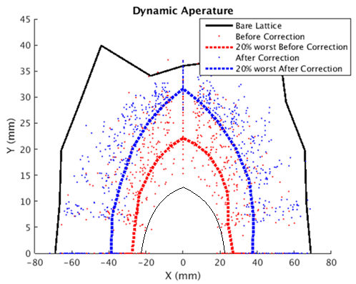
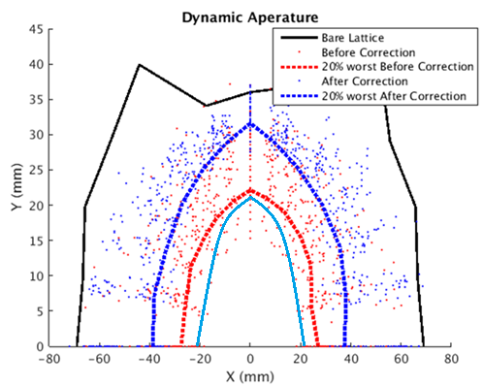
Dynamic aperture with errors
With only COD corrections, DA is nearly two thirds of bare lattice
At 120GeV, radiative damping was considered.
DA requirement @ 10GeV determined by the beam stay clear region
DA requirement @ 120GeV: 1) H- quantum lifetime, 2) V- re-injection process from the collider in the on-axis injection scheme
10GeV
120GeV
BSC
w damping
 | DA requirement |  | DA results
 | H | V | H | V
10GeV (ε_{x}= ε_{y} =120nm) | 4σ_{x} +5mm | 4σ_{y} +5mm | 7.7σ_{x} +5mm | 14.3σ_{y} +5mm
120GeV (ε_{x}=3.57nm, ε_{y}= ε_{x*}0.005) | 6σ_{x} +3mm | 49σ_{y} +3mm | 21.8σ_{x} +3mm | 779σ_{y} +3mm
Requirement for linac emittance: < 150nm, otherwise BSC > beam pipe

