Slide 1
Progress on CEPC High Efficiency Klystron
Shengchang Wang
On behalf of CEPC klystron development team
Institute of High Energy Physics
July 5th 2018

Slide 2
Outline
Strategy and plan
Goal：650MHz/800kW meets CEPC project demands;
Much higher efficiency, less energy consumption;
Evaluation target: >80% efficiency;
1st prototype development progress
Beam dynamic, beam optic and cooling system;
Mechanical design, infrastructure preparation;
High efficiency consideration(2nd&3rd)
Different method comparation;
3 kind of gun schemes;
MBK

Slide 3
Strategy and plan from 2016 to 2018
3 klystron prototypes in 6 FYs
FY 2016: done
  Finalize the gun and the collector design of the 1st conventional klystron prototype
  Initialize the dynamics design
FY 2017: done
  Finalize the cavity chain design of 1st tube
  Preliminary mechanical design
FY 2018: being carried out
  Infrastructure construction
  Finalize the mechanical design and fabrication
  Design studies on the 2nd and 3rd high efficiency klystron

Slide 4
Strategy and plan from 2019 to 2021
FY 2019
  1st tube high power test
  2nd tube fabrication
  Finalize design of the 3rd high efficiency klystron
FY 2020
  2nd tube high power test(>70% expected efficiency)
  Finalize the mechanical design of 3rd tube and start to fabrication
FY 2021
  3rd tube high power test(>80% expected efficiency)
  More klystron prototypes or klystron industrialization

Slide 5
Parameters for 1st tube
Conventional method based on 2nd harmonic cavity to investigate the design and manufacture technologies for high power CW klystron
Main parameters | Goal
Frequency (MHz) | 650
Vk (kV) | 81.5
Ik (A) | 15.1
Perveance (µPerv) | 0.65
Efficiency (%) | >60
Saturated gain (dB) | >45
Output power (kW) | 800
1dB bandwidth (MHz) | ±0.5
Brillouin magnetic field (Gs) | 106.7
Reduced plasma wavelength(m) | 3.47
N cavities | 6
Normalized drift tube radius | 0.63
Normalized beam radius | 0.41
Filling factor | 0.65

Slide 6
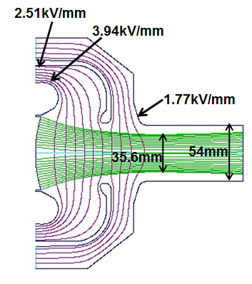
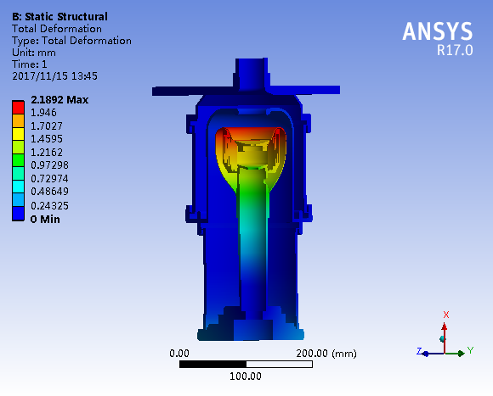
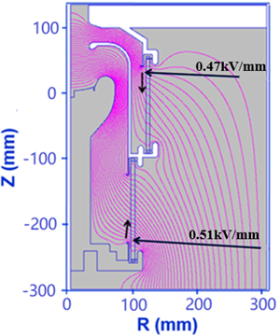
Electron gun for 1st tube
Different codes results for beam optics and thermal structure analysis
Main parameters | DGUN | EGUN | MAGIC2D | CST | Design goal
Beam waist radius (mm) | 17.8 | 17.48 | 17.48 | 17.64 | 17.5
Perveance (µPerv) | 0.64 | 0.64 | 0.65 | 0.64 | 0.65
Current density | <0.45 | 0.39~0.43 |  |  | <0.5
Current uniformity |  | 9.8% |  |  | <10%
Beam optics
Thermal deformation
Electric field distribution

Slide 7
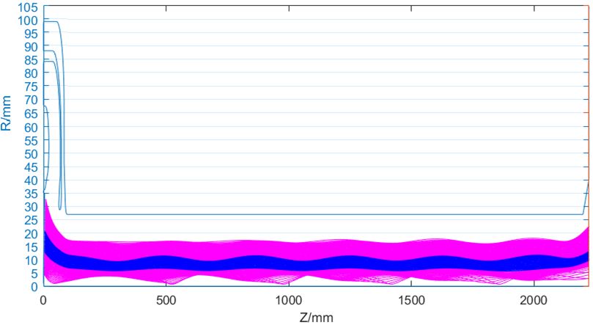
Beam optics for 1st tube
Good trajectory laminarity from the gun to the collector
Ripple rate less than 5%
Electron beam trajectory without RF drive

Slide 8
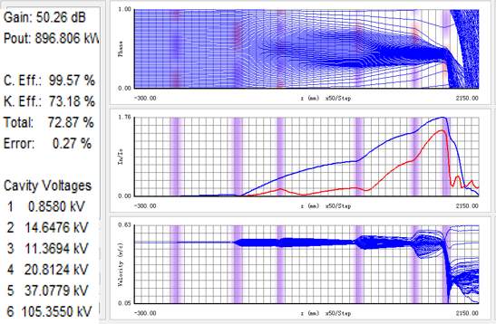
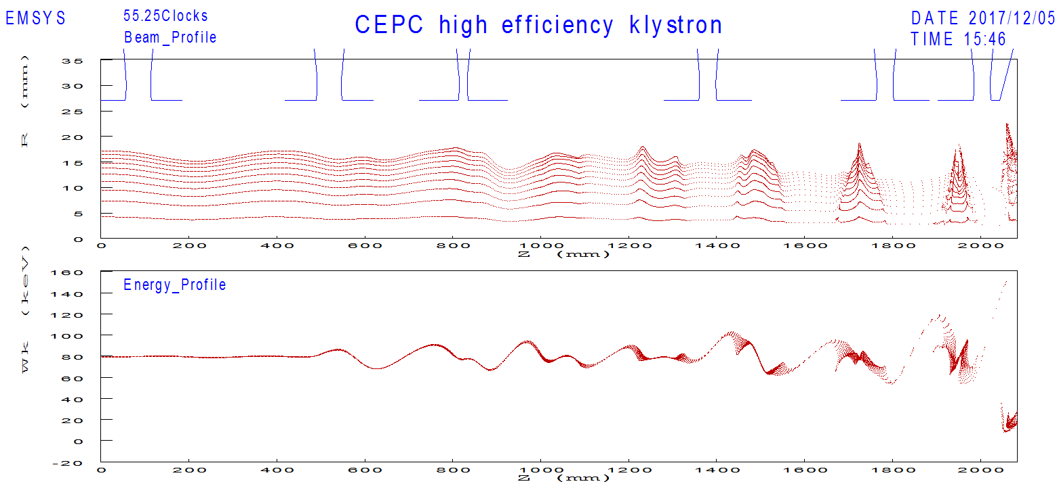
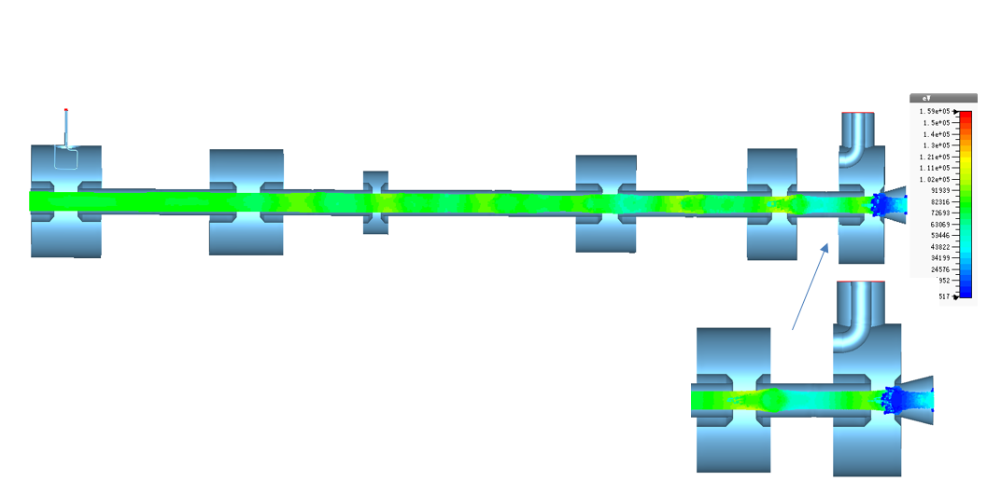
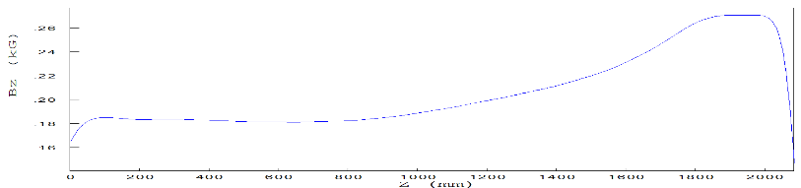
Dynamics for 1st tube
1D optimization on the dynamics and cross checked by 2D&3D
73%/68%/65% efficiencies for 1D/2D/3D
AJDISK
EMSYS
CST

Slide 9
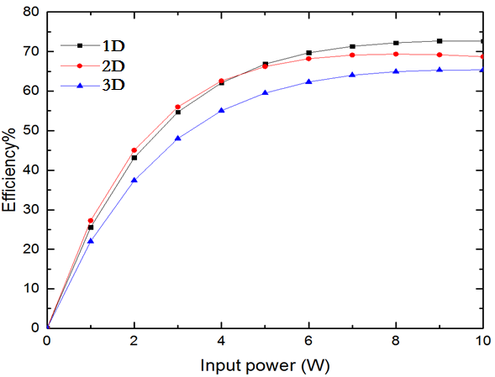
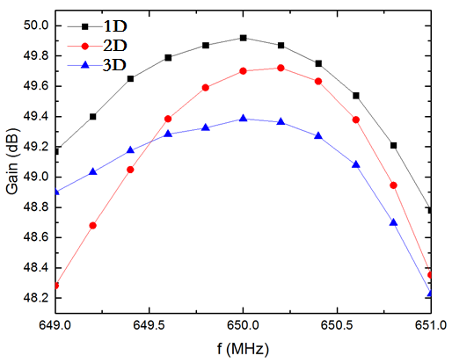
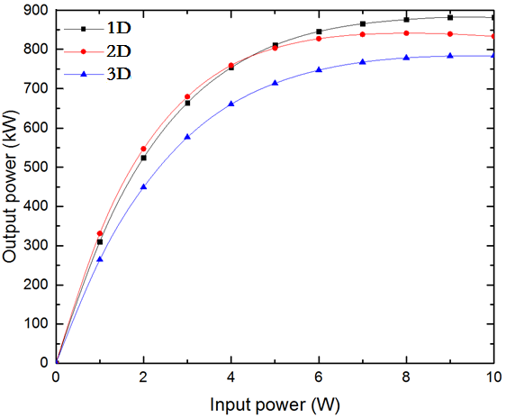
Dynamics for 1st tube
1dB bandwidth larger than ±1MHz
Saturated gain around 48dB
Klystron efficiency curve
Klystron gain curve
Klystron transfer curve

Slide 10
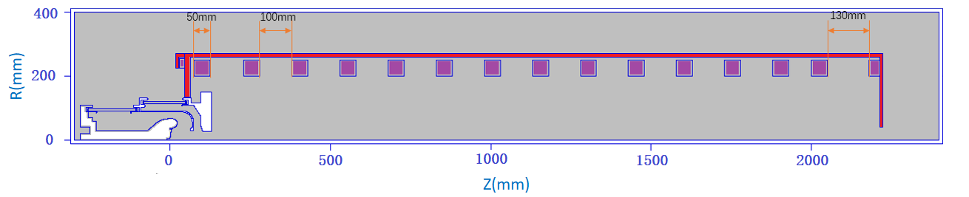
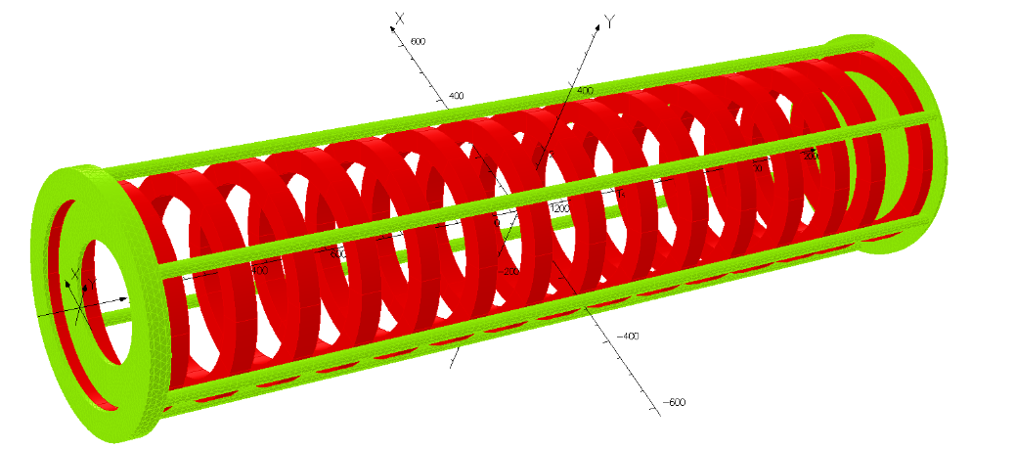
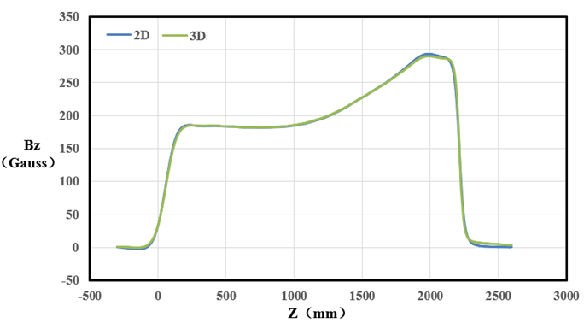
Coils for 1st tube
Designed by 2D and cross checked by 3D, very good consistency
15 regular coils with 1 bucking coil near the gun
Cathode: 32 Gauss, Gain cavity: 180 Gauss, Output cavity: 280 Gauss
2D solenoid model
3D solenoid model
On-axis magnetic field

Slide 11
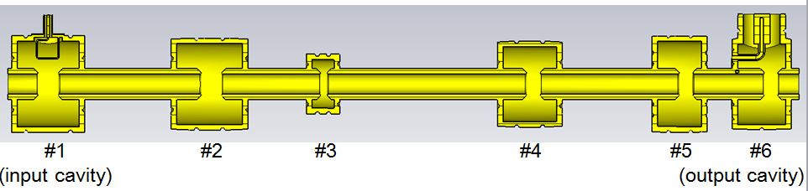
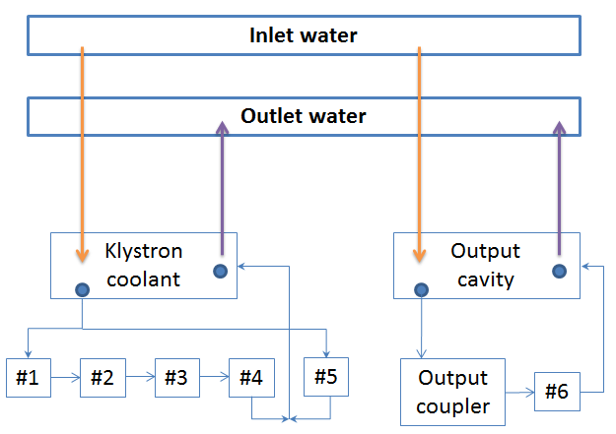
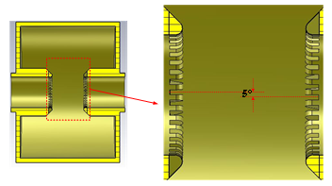
Cavity chain for 1st tube
RF design and cooling analysis conducted
Grooved nose cone for each cavity to suppress the multi-pacting effect
Cavity chain
Grooved nose cone for each cavity
Klystron cavity chain cooling scheme

Slide 12
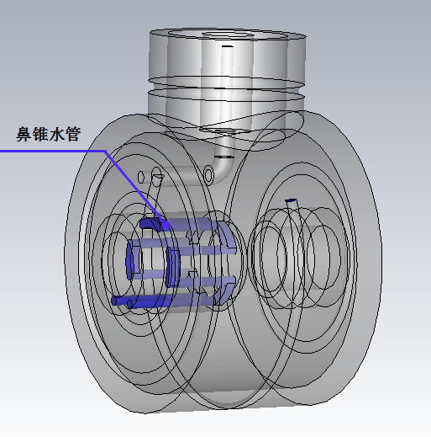
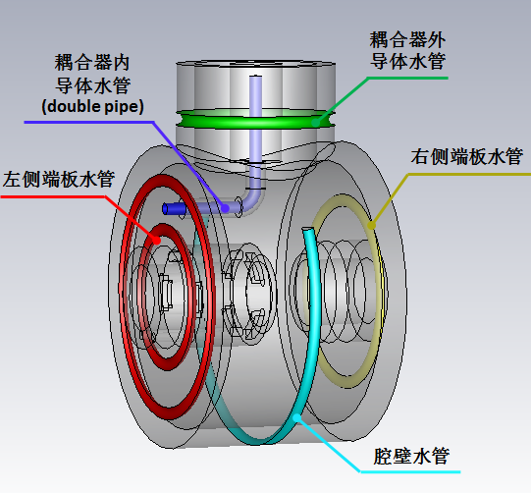
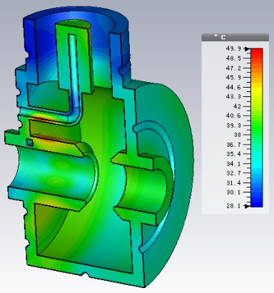
Output cavity cooling
87% of the total power loss for the cavity chain located at the output cavity
Theoretical power loss around 3.9kW, cooling capability designed to be 8kW
Cooling pipes distribution
Temperature distribution

Slide 13
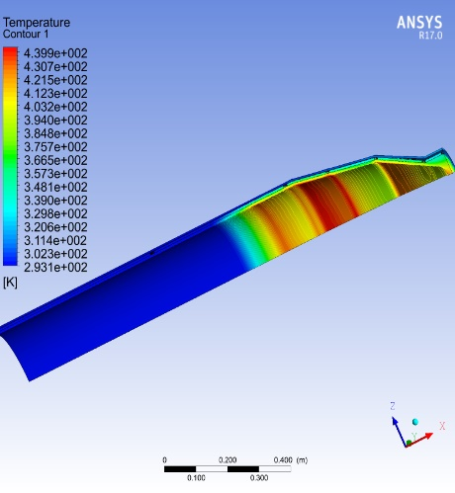
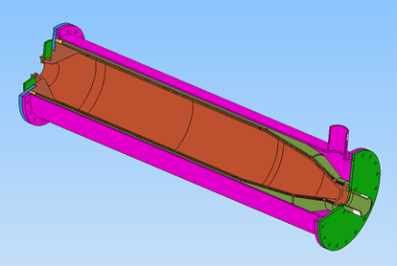
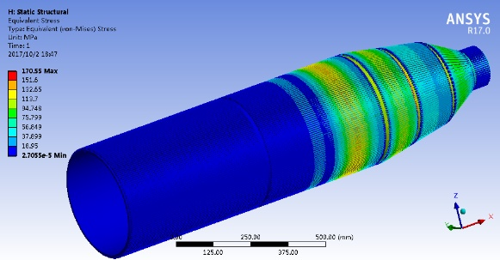
Collector for 1st tube
~1.8m long collector to sustain 1.23MW full beam power
Temperature distribution
Mechanical design
thermal stress distribution
Duty factor (%) | Max. heat flux (W/cm²) | Max. stress (Mpa) | Max. temperature (ºC)
100 | 300 | 170.5 | 169.8

Slide 14
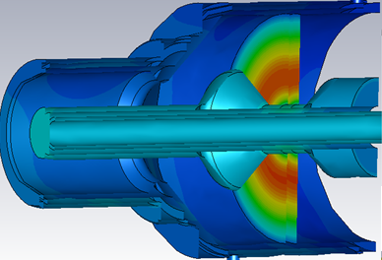
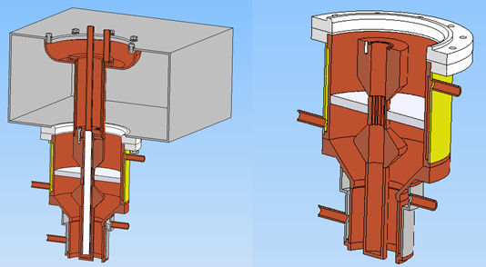
Output window for 1st tube
Relatively simple design with door knob to facilitate the fabrication
>800kW sustainable CW RF power @ 650MHz
<1.05 VSWR @ 650±0.5MHz
Temperature distribution
Mechanical design

Slide 15
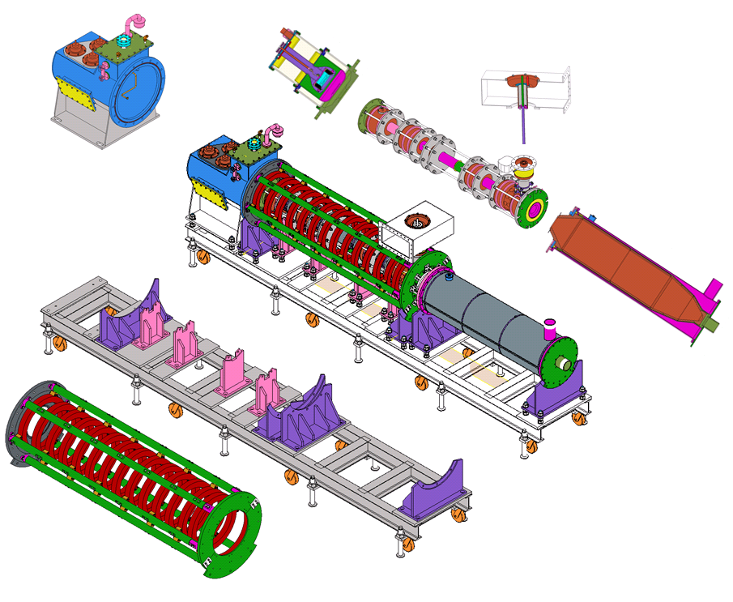
Mechanical design for 1st tube
Mechanical design achieved (L×W×H: 5.12m×0.87m×1.56m)
Discussion on the manufacturing details being conducted

Slide 16
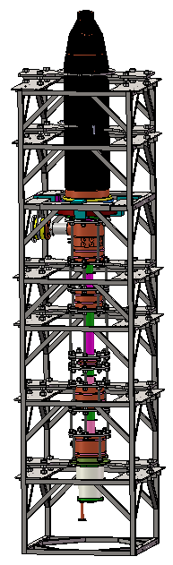
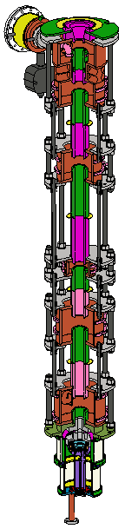
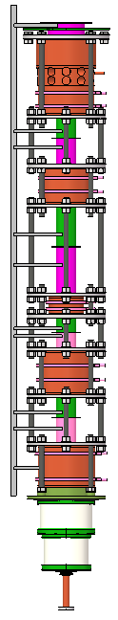
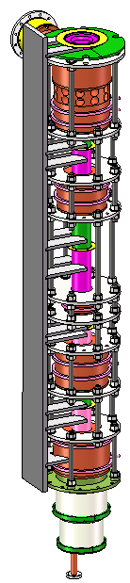
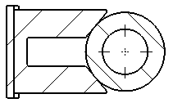

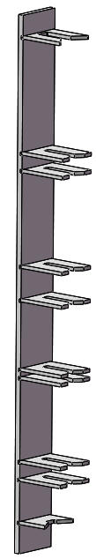
Assembly sequence
Support
Collector
Cavities
Gun
center

Slide 17
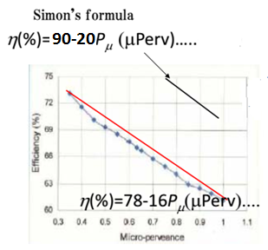
High Efficiency Consideration
3 design schemes
  Scheme 1：optimize cavity chain by using the same gun as 1st tube
  Scheme 2 ：with high voltage gun (110kV/9.1A), low perveance
  Scheme 3：MBK, 54kV/20A electron gun
Parameter | Scheme1 | Scheme2 | Scheme3
Freq (MHz) | 650 | 650 | 650
Voltage (kV) | 81.5 | 110 | 54
Current (A) | 15.1 | 9.1 | 20(2.5×8)
Beam No. | 1 | 1 | 8
Perveance (µP) | 0.65 | 0.25 | 1.6(0.2×8)
Efficency (%) | >70 | >80 | >80
Power(kW) | 800 | 800 | 800(100×8)

Slide 18
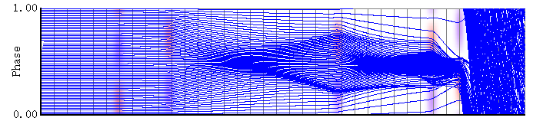
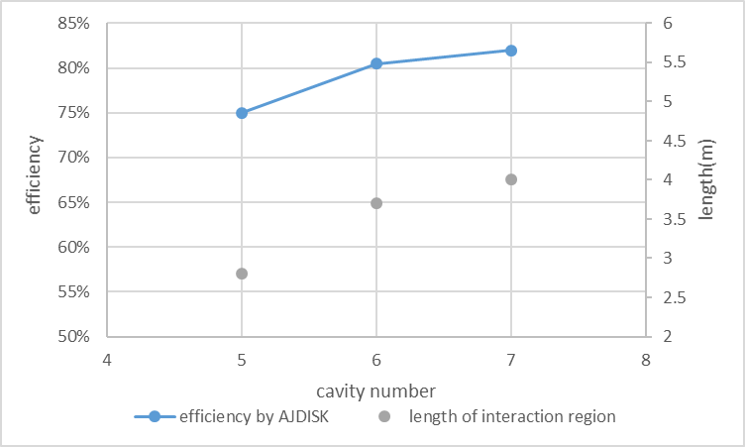
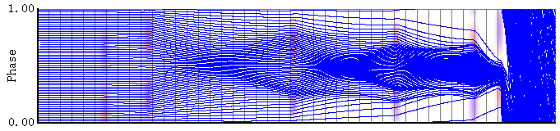
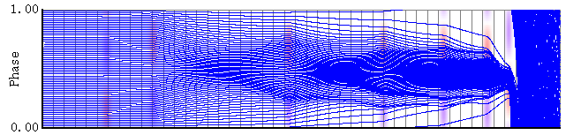
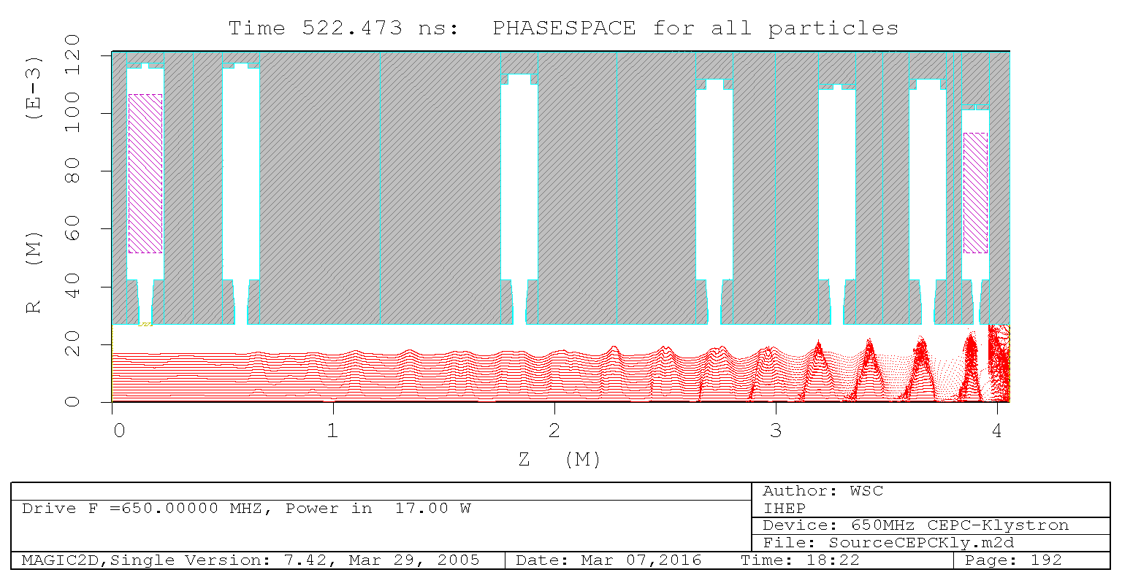
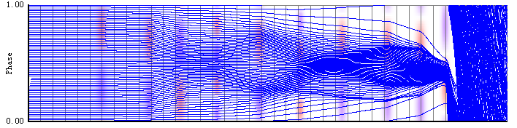
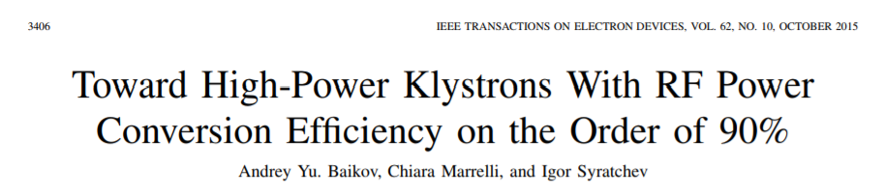
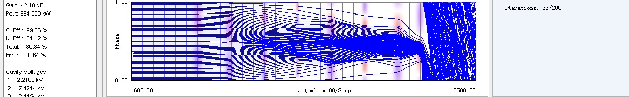
Progress on scheme 1
  Same electron gun with the 1st tube
  COM
5 CAV / 75% / 2.8m
6 CAV / 80% / 3.7m
7 CAV / 82% / 4.0m
MAGIC_2D 74%
10 CAV /2 2nd harmonic CAV / 80% /2.9m
8 CAV/ 2 2nd harmonic cavities / 1 3rd harmonic cavity / 80% / 2.2m

Slide 19
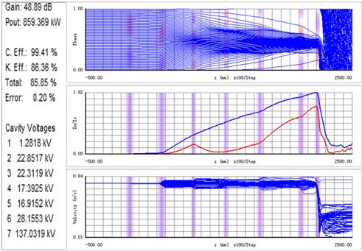
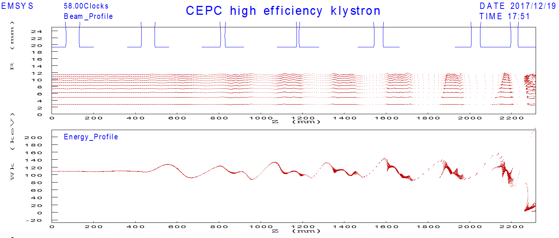
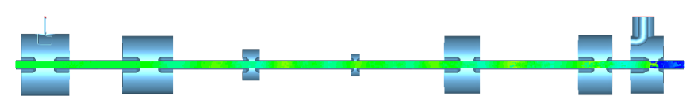
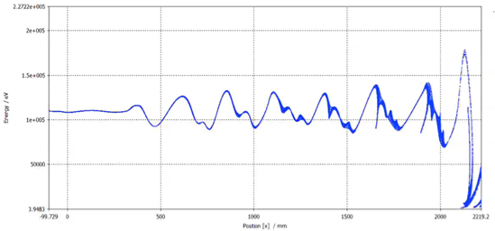
Progress on scheme 2
Based on CSM，with 2nd and 3rd harmonic cavities
Better bunching with shorter length
AJDISK/EMSYS/CST 86%/81%/77%
AJDISK
EMSYS
CST

Slide 20
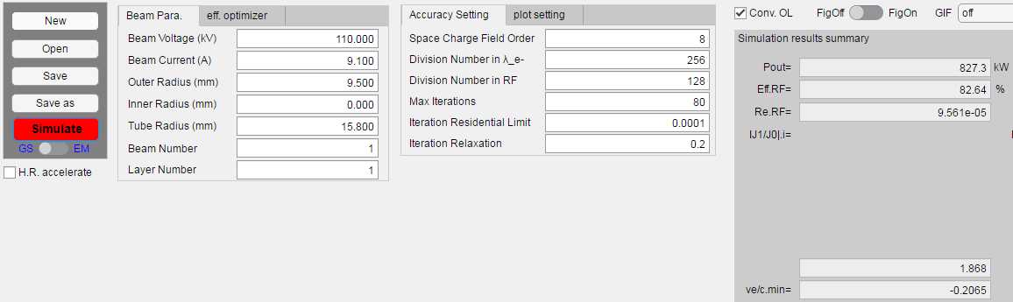
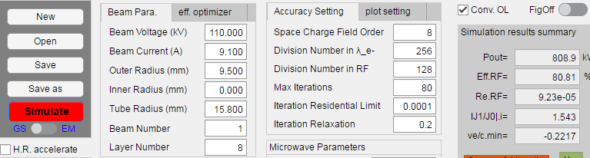
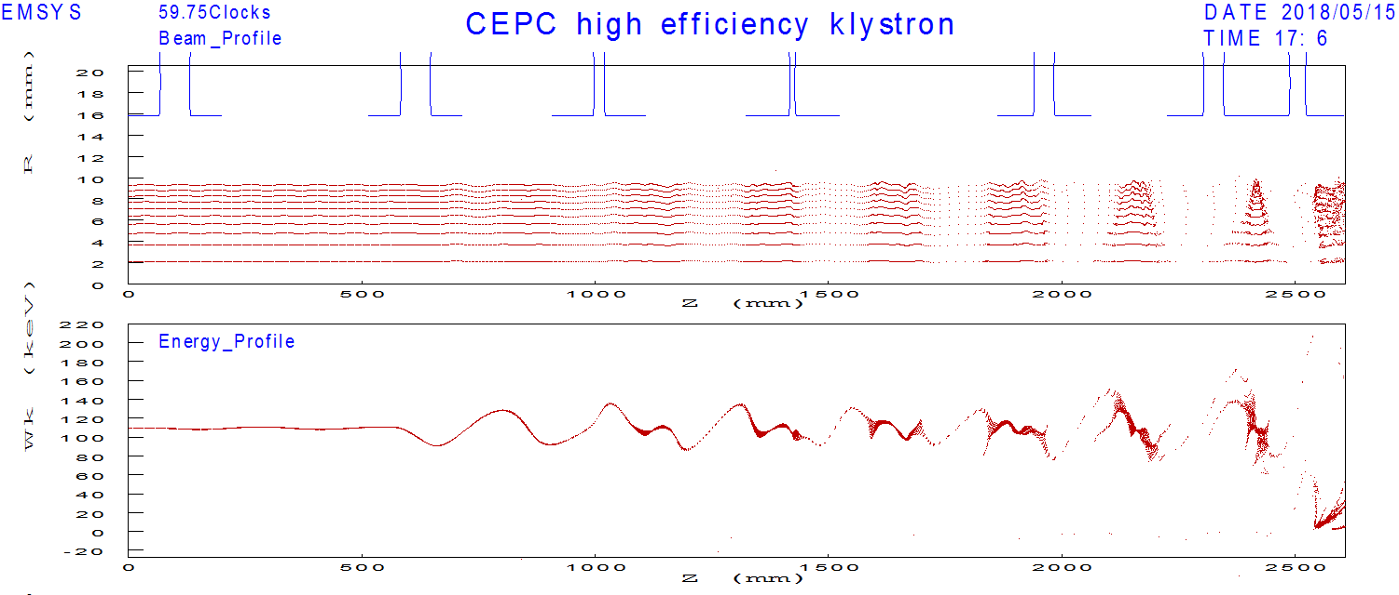
Progress on scheme 2
Based on CSM，reduce the beam aperture and beam size(from 19.3mm/11.6mm to 15.8mm/9.5mm)
KLYC 1D/ KLYC 2D/ EMSYS 82.6%/80.8%/81%
KLYC 1D
KLYC 2D
EMSYS

Slide 21
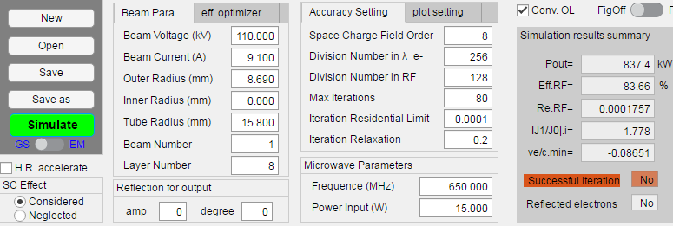
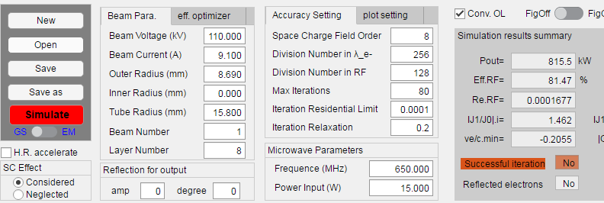
Progress on scheme 2
Based on CSM，reduce the beam size again (from 9.5mm to 8.69mm), KLYC 1D/ KLYC 2D 83.6%/81.5%
KLYC 1D
KLYC 2D

Slide 22



Progress on scheme 2
130kV beam tester, to investigate the technical limit of electron gun for a low perveance CW-klystron
Main parameters | value
Beam power(MW) | 1.0
Vk (kV) | 130
Ik (A) | 7.7
300 Gauss
800 Gauss

Slide 23






Progress on scheme 3
Parameter | Value
Freq. (MHz) | 650
Voltage (kV) | 54
Current(A) | 20(2.5×8)
Beam No. | 8
Pervence (µP) | 1.6(0.2×8)
Beam size(mm) | 7.5
Drift tube (mm) | 12
Power(kW) | 800(100×8)
650MHz
1300MHz
1950MHz

Slide 24








Progress on scheme 3
Based on COM and CSM，Dynamics on 54kV/2.5A
COM: 5~8 CAV / 2.6~4.3m / 80.7%~88.9%
CSM: 8 CAV / 2.4m / 88.5%
CSM: 7 CAV / 1.8m / 87.6%

Slide 25
Summary
Mechanic design on 1st prototype has been finished.
The manufacture of the 1st tube will be completed this year and high power test will be started at the beginning of next year.
The 3 schemes for the high efficiency design are ongoing based on 3 different gun design.
The manufacture of the 2nd prototype will be started based on the successful high power test of the 1st prototype.
MBK design will be gradually stepped up in the near future.

Slide 26
Thanks for your attention!

