Slide 1

Superconducting RF Cavities R&D Towards Future High Energy Accelerators
Mattia Checchin

Slide 2
Outline
Introduction
High Q-factor
High accelerating gradient
New directions
Conclusions

Slide 3
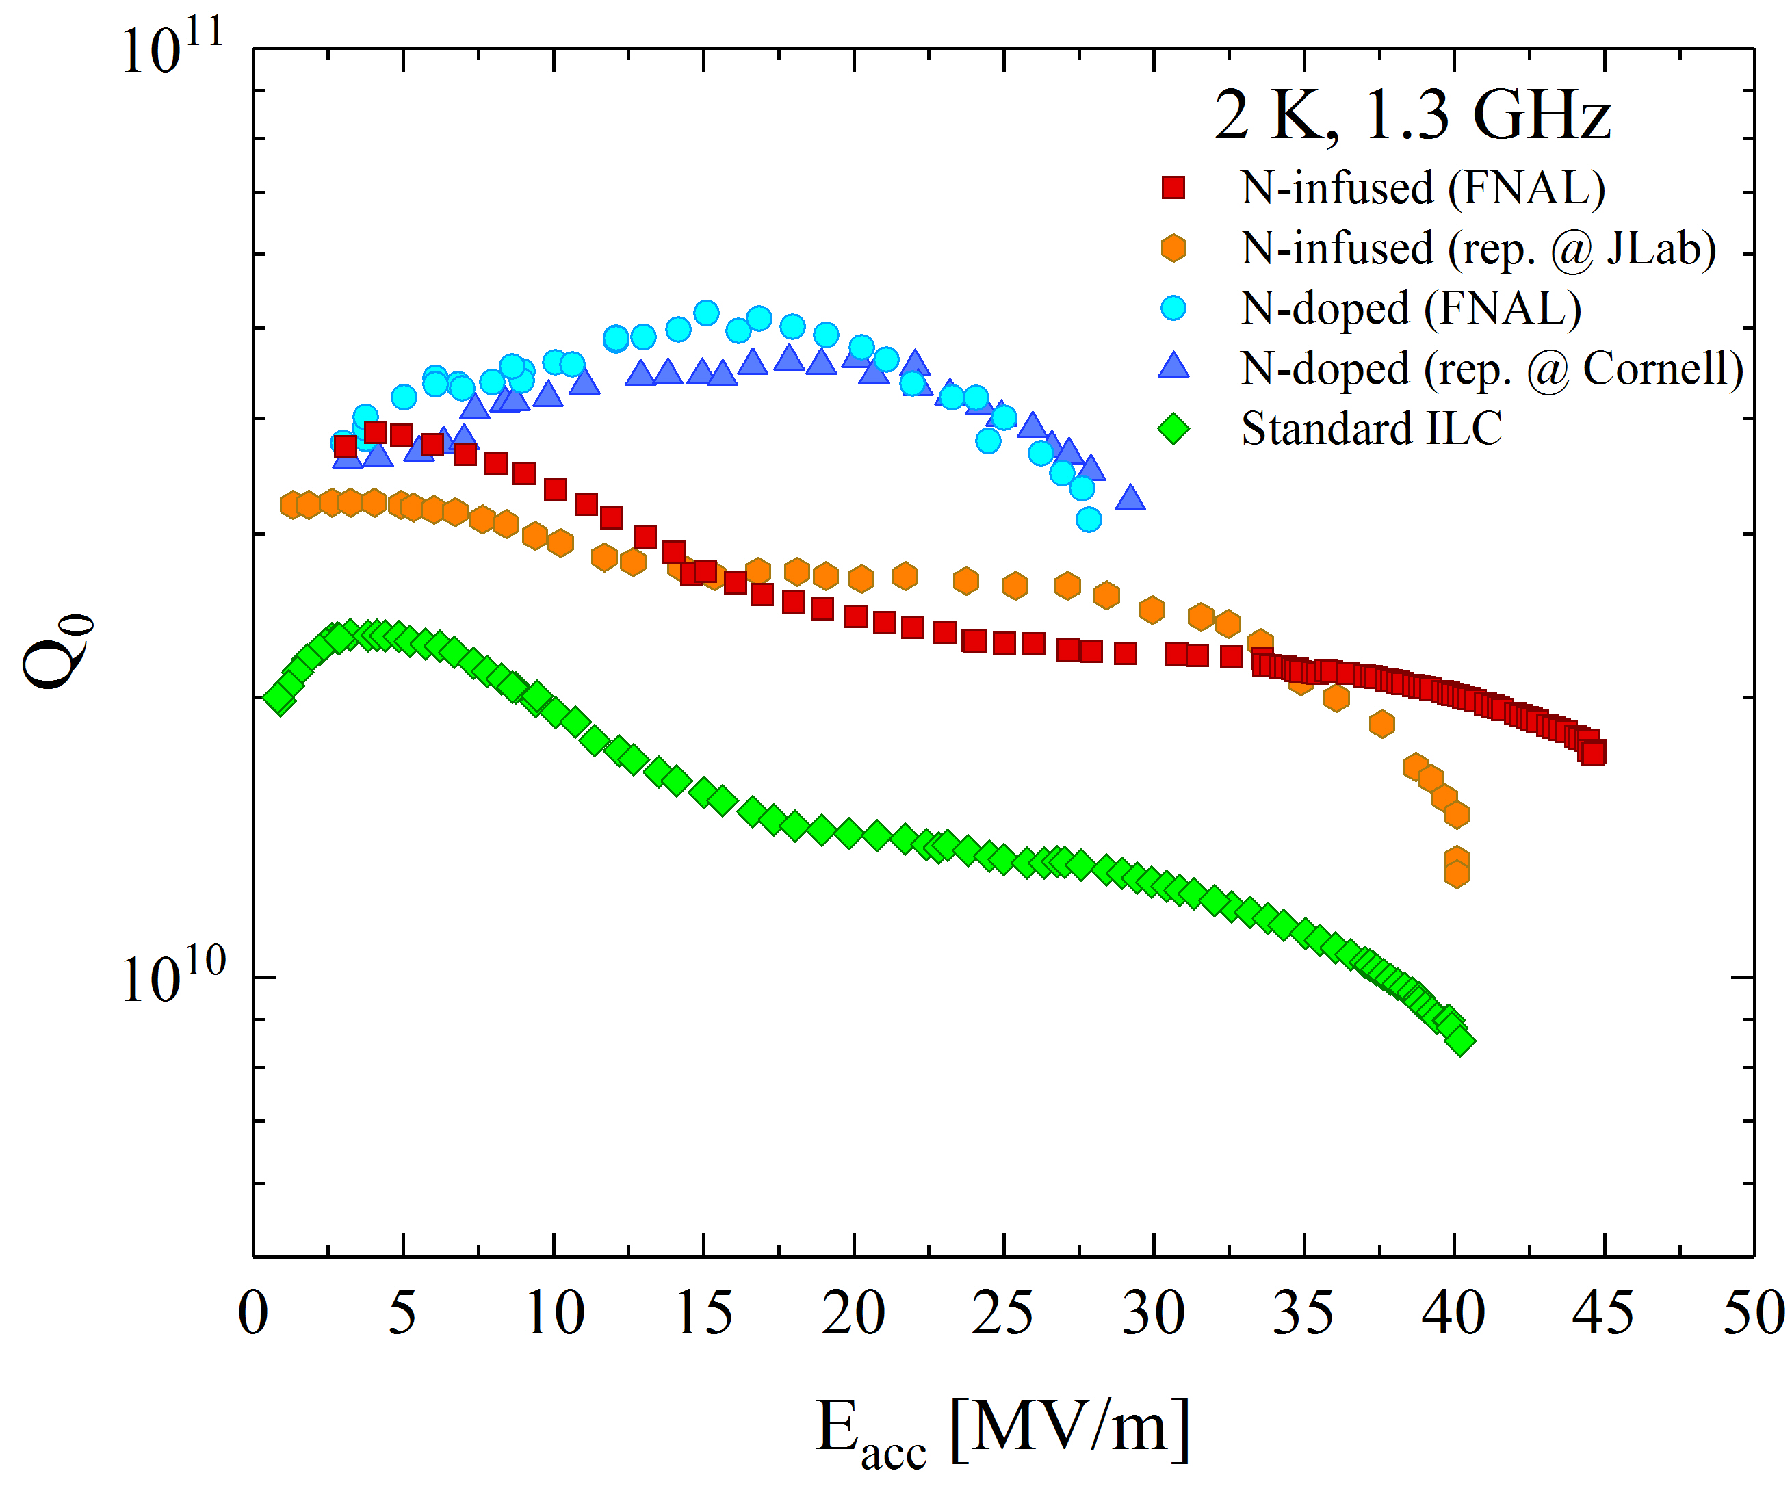
State-of-the-art treatments
High-Q₀
High-E_{acc}
(e.g. ILC)
High-Q₀
(e.g. LCLS-II)
High-E_{acc}
(e.g. ILC)

Slide 4

What are we seeking for HE colliders?
Enabling future efficient and affordable High Energy Machines
5 MV/m
Thermal Breakdown
20 - 25 MV/m
Q-SLOPE
Q > 5e10
At medium field !!
E_{acc} > 100 MV/m
Q > 5e10
3 – 4 MV/m
Multipacting
10 – 15 MV/m
Field Emission
Q > 2e10
At high field
35 – 40 MV/m
?

Slide 5
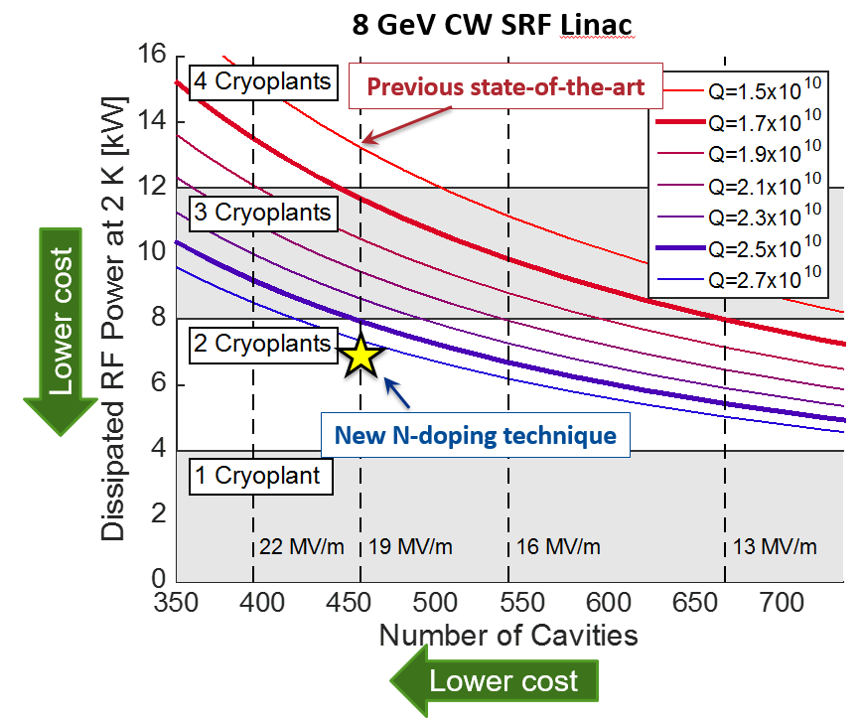
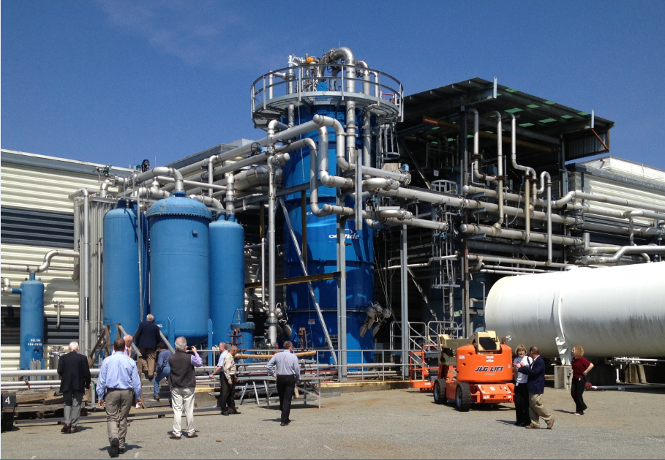
Why high Q?
8 GeV CW SRF Linac
$$P_{diss}\sim {E_{acc}}/{Q_{0}}$$
$$12 kW$$
$$8 kW$$
$$4 kW$$
courtesy of A. Grassellino

Slide 6
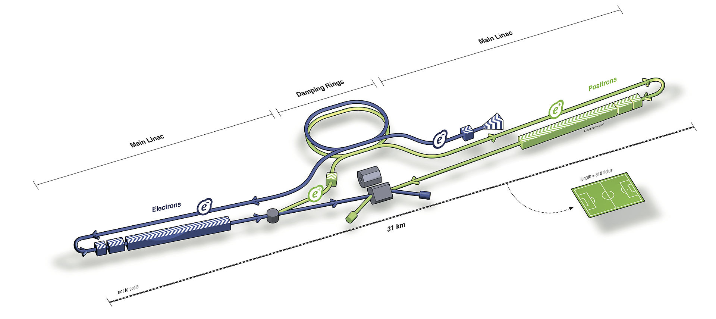

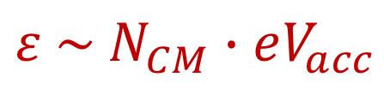
Why high gradient?
For example, the ILC:
From the ILC TDR: “[the cost] is dominated by the SRF components and related systems, together with the conventional facilities. These two elements account for 73% of the total. The main linac itself corresponds to 67% of the total project.”
Increasing the gradient, the number of CMs to reach the design center-of-mass energy is lower $→$ cost reduction!
$$ε \sim N_{CM}∙eV_{acc}$$
Main linac cost breakdown from ILC TDR
Mattia Checchin | ICHEP 2018, Seoul, South Korea

Slide 7
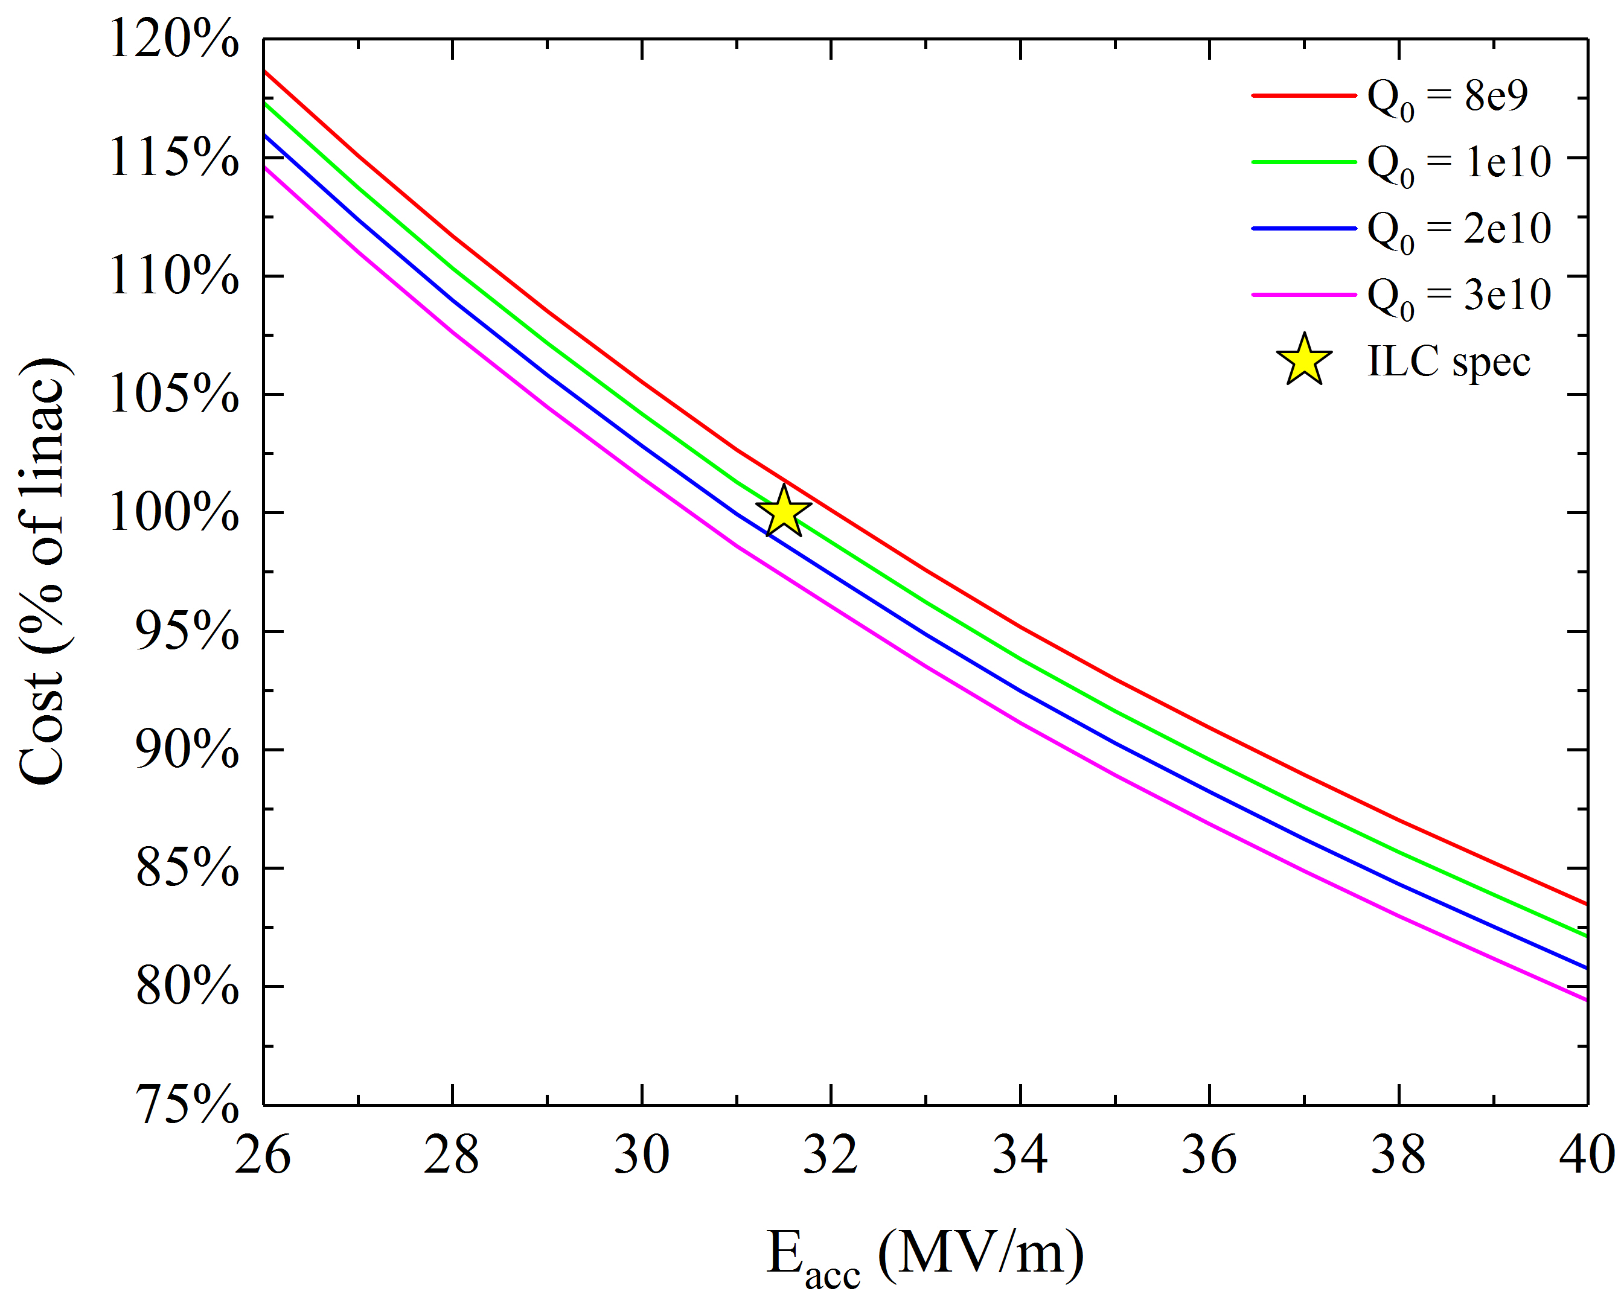
ILC cost reduction – cost model and R&D pathways
A cost model has been developed based on the ILC TDR and new progress in the SRF technology on cavity achievable efficiency (Q) and acceleration (E_{acc})
Achievable cavity Q and acceleration are among the main cost drivers
Improving simultaneously Q and gradient can give substantial cost cut >10% of the total linac cost
~ 10%
~ 15%
Mattia Checchin | ICHEP 2018, Seoul, South Korea

Slide 8
High Q-factor:
Doping and efficient management of trapped flux

Slide 9
Nitrogen doping of Nb cavities (N-doping)
Q-factor improvement after N-doping – up to 4 times higher Q than standard Nb cavities
Typical Q vs Eacc curve obtained with 120C bake (standard ILC treatment)
Anti-Q-slope
Average Q at 16MV/m:
Standard ILC treatment:
$$\left\langle Q\right\rangle \sim 1.7∙{10}^{10}$$
N-doping:
$$\left\langle Q\right\rangle \sim 3.5∙{10}^{10}$$
A. Grassellino et al., Supercond. Sci. Technol. 26, 102001 (2013) – Rapid Communications

Slide 10
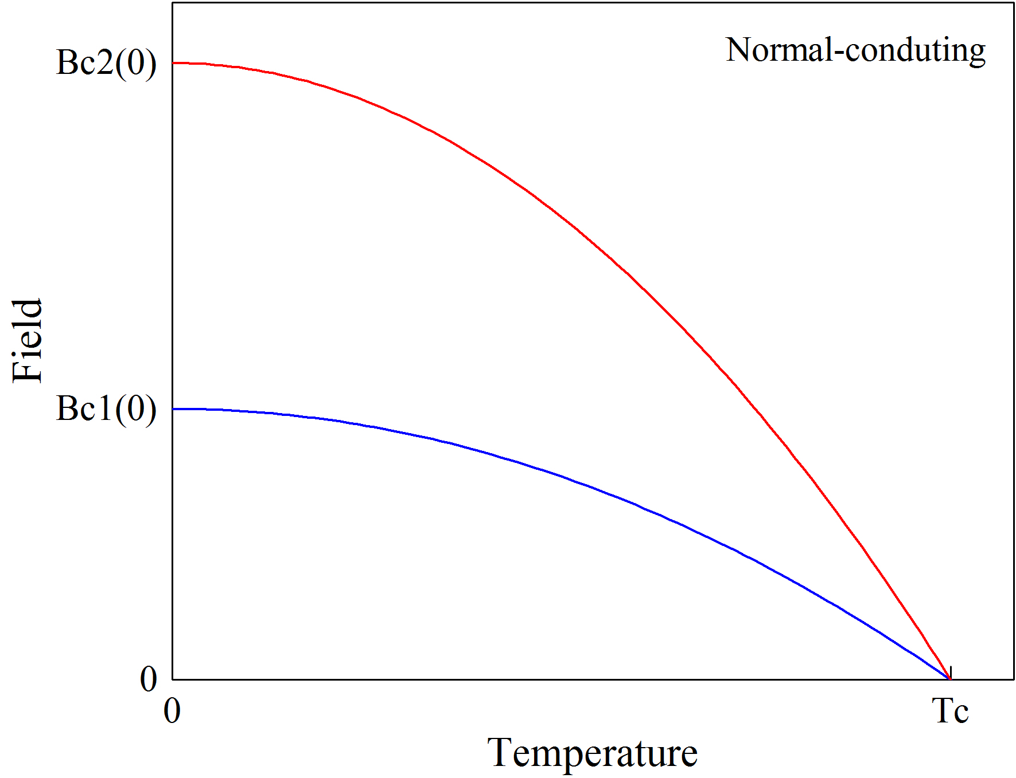
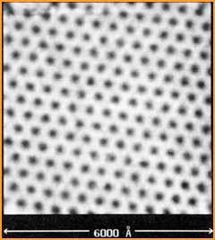

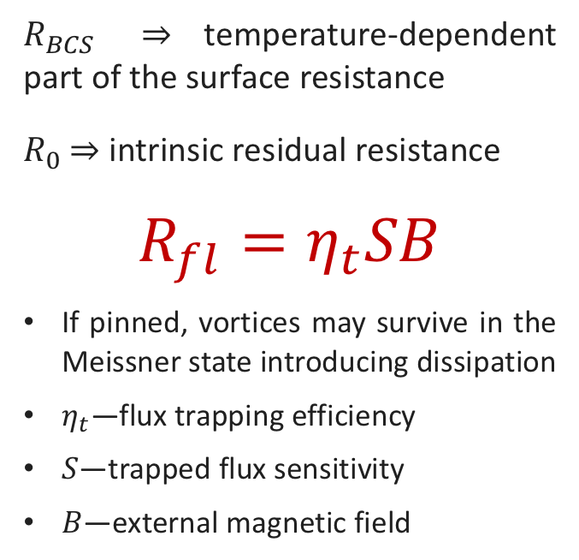





Trapped flux surface resistance
H. F. Hess et al., Phys. Rev. Lett. 62, 214 (1989)
$$R_{s}\left(T, B\right)=R_{BCS}\left(T\right)+R_{fl}\left(B\right)+R_{0}$$
$R_{BCS}$ ⇒ temperature-dependent part of the surface resistance
$R_{0}$ ⇒ intrinsic residual resistance
$$R_{fl}=η_{t}SB$$
If pinned, vortices may survive in the Meissner state introducing dissipation
$η_{t}$—flux trapping efficiency
$S$—trapped flux sensitivity
$B$—external magnetic field
$$B$$
Cooldown
$$y$$
Pinning points
$$T_{c_{1}}$$
$$T_{c_{2}}$$
$$x$$
Trapped vortices

Slide 11
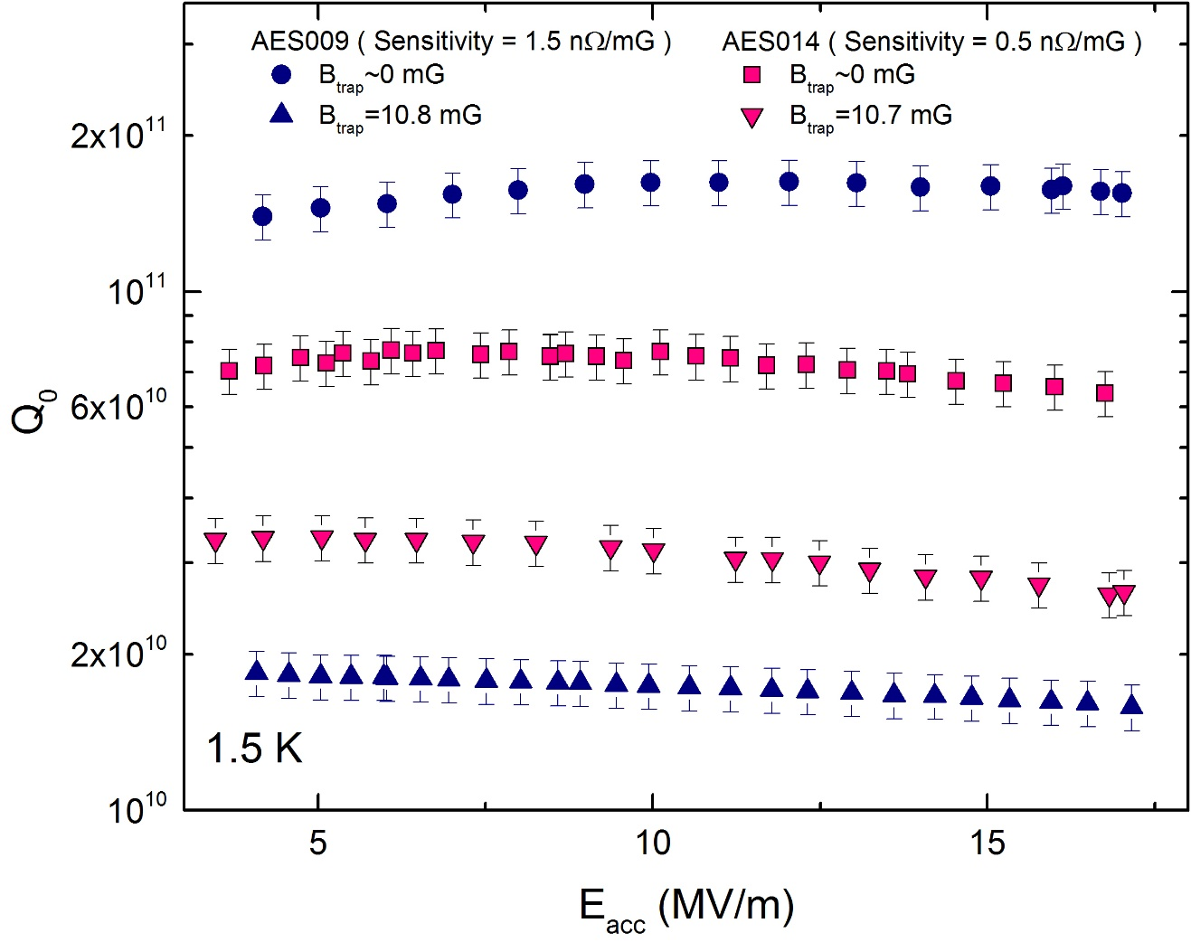
Example: no field trapped
Courtesy of M. Martinello

Slide 12
Example: 10 mG fully trapped
B_{trap}=10.8 mG
S=1.5 nΩ/mG
B_{trap}=10.7 mG
Courtesy of M. Martinello

Slide 13
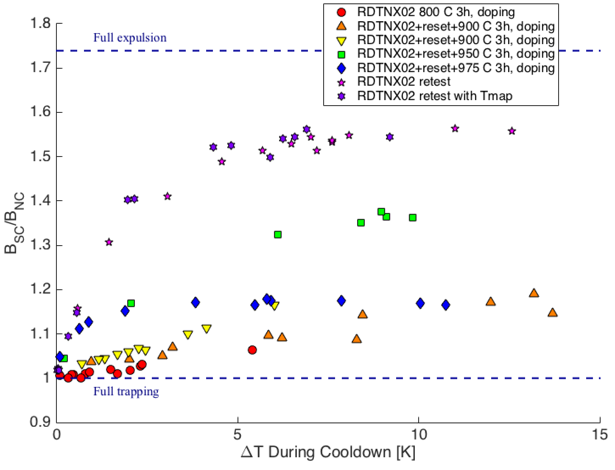
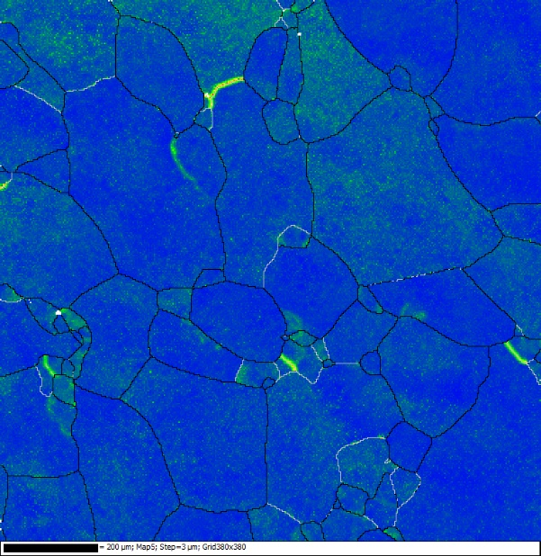
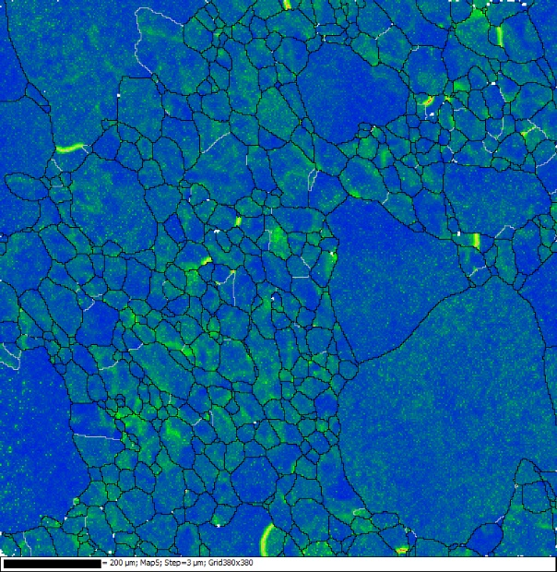
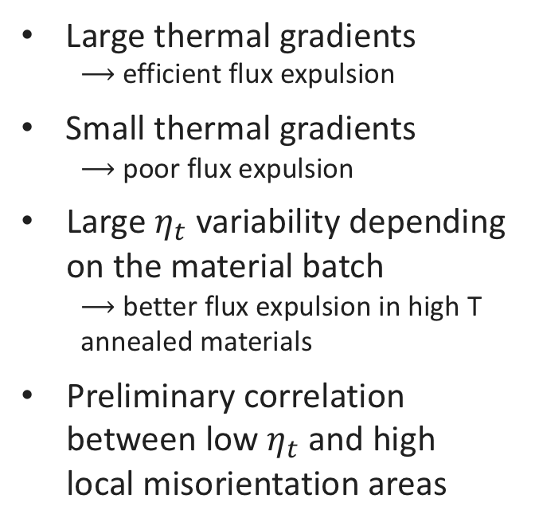
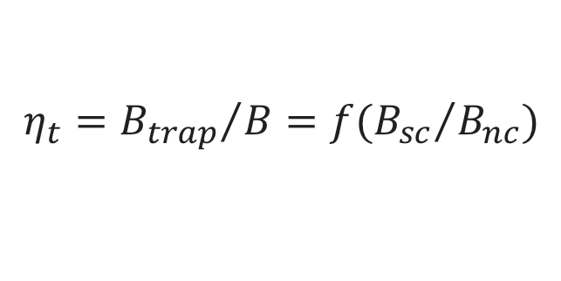
Flux trapping efficiency
$$η_{t}={B_{trap}}/B=f({B_{sc}}/{B_{nc}})$$
Large thermal gradients
  $⟶$efficient flux expulsion
Small thermal gradients
  $⟶$ poor flux expulsion
Large $η_{t}$ variability depending on the material batch
  $⟶$ better flux expulsion in high T annealed materials
Preliminary correlation between low $η_{t}$ and high local misorientation areas
Good expulsion
Bad expulsion
M. Martinello, TTC Workshop, RIKEN, Japan (2018)
S. Posen, TTC Workshop, Milan, Italy (2018)
S. Posen et al., J. Appl. Phys. 119, 213903 (2016)
A. Romanenko et al., Appl. Phys. Lett. 105, 234103 (2014)
A. Romanenko et al., J. Appl. Phys. 115, 184903 (2014)

Slide 14
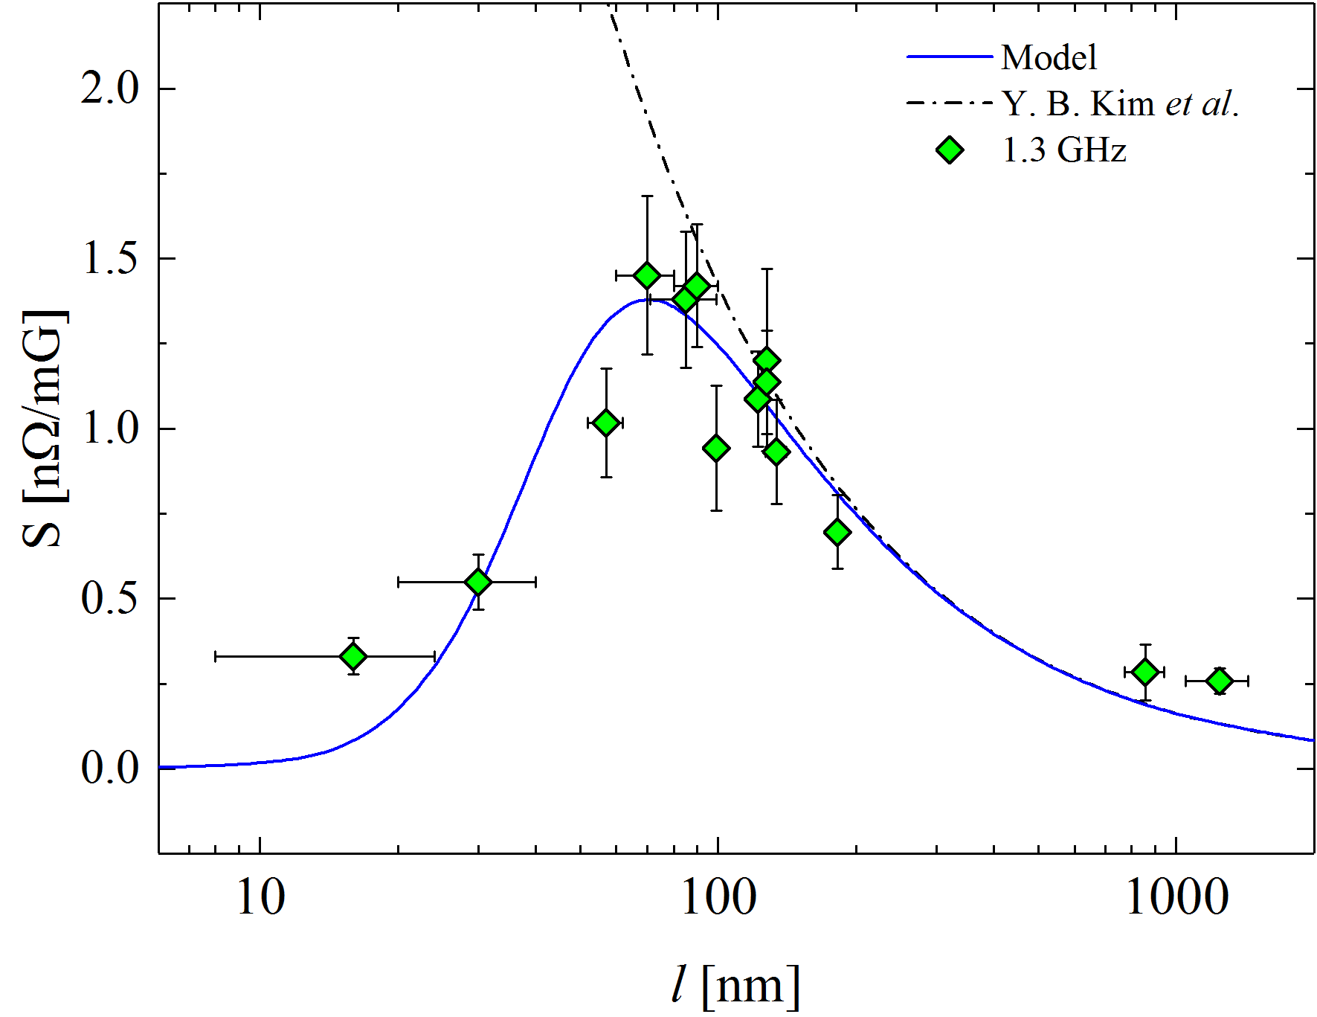
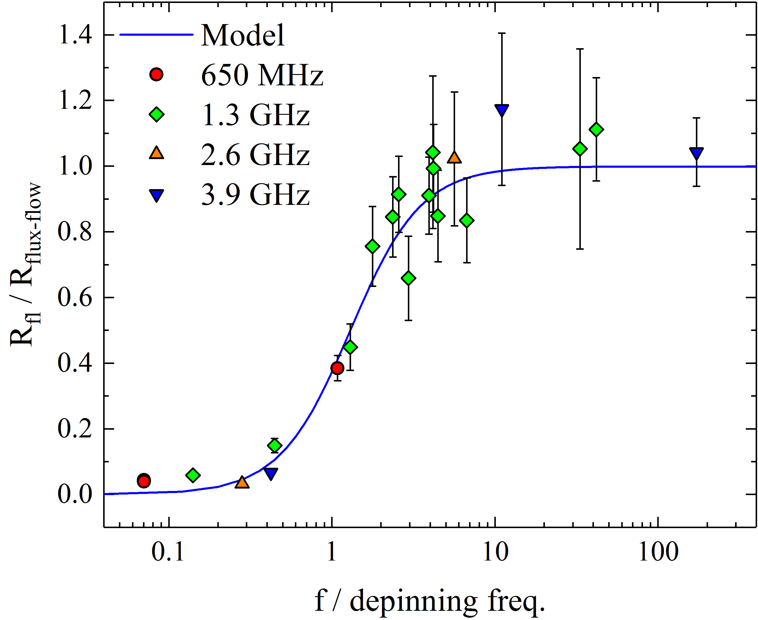
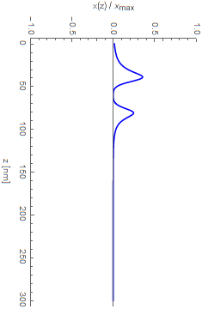
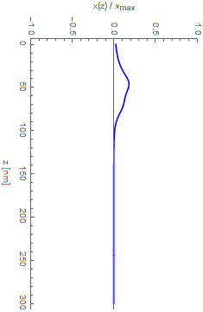
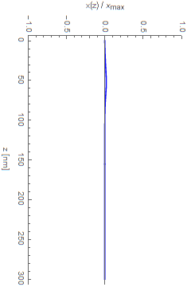

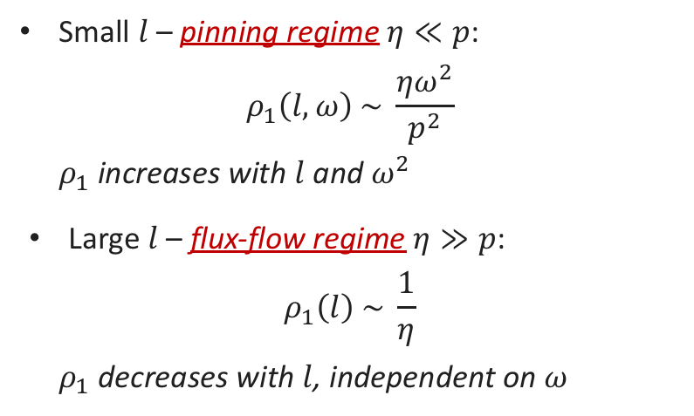


Trapped flux sensitivity
Pinning
regime
Flux-flow
regime
Small $l$– pinning regime $η≪p$:
$$ρ_{1}\left(l,ω\right) \sim \frac{ηω^{2}}{p^{2}}$$
  $ρ_{1}$ increases with $l$ and $ω^{2}$
Large $l$– flux-flow regime $η≫p$:
$$ρ_{1}\left(l\right) \sim \frac{1}{η}$$
  $ρ_{1}$ decreases with $l$, independent on $ω$
$$l = 5 nm$$
$$l = 70 nm$$
$$l = 500 nm$$
Pinning
Pinning
regime
Flux-flow
regime
  M. Checchin et al., Appl. Phys. Lett. 112, 072601 (2018)
  M. Checchin et al., Supercond. Sci. Technol. 30, 034003 (2017)
  M. Martinello et al., App. Phys. Lett. 109, 062601 (2016)

Slide 15
High accelerating gradient:
Engineering of the first ~ 100 nm of RF surface

Slide 16
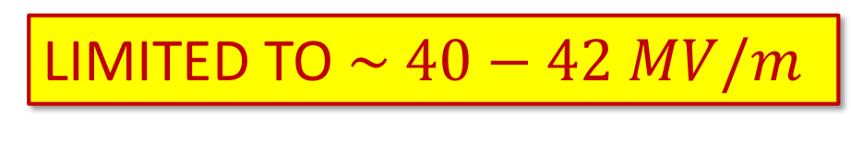
120 C baking
LIMITED TO $\sim 40−42 MV/m$

Slide 17
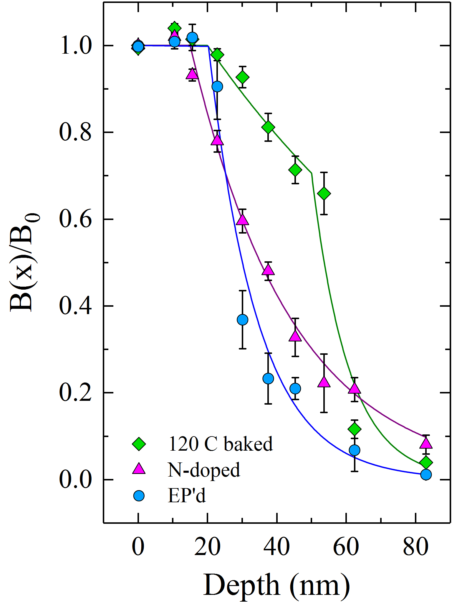
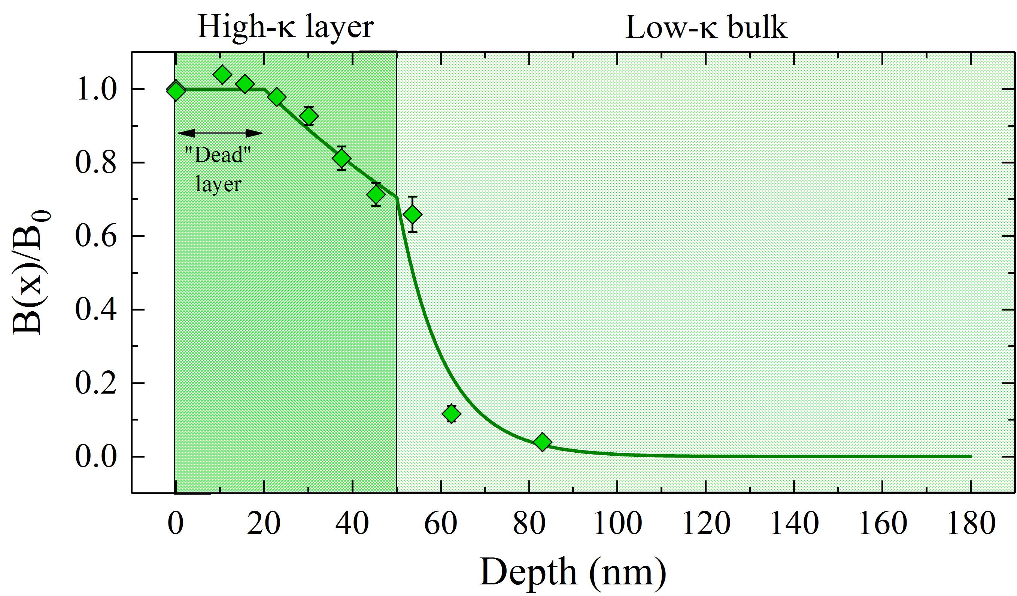
LE-$μ$SR data on 120 C baked cavities cut-outs
120 C baked cavities show a high $κ$ layer at the surface
A. Romanenko et al., Appl. Phys. Lett. 104, 072601 (2014)

Slide 18
120 C N-infusion
LIMITED TO $\sim 45 MV/m$
$\sim 2.5$ times higher Q-factor
$\sim 1.2$ times higher gradient
A. Grassellino et al., Supercond. Sci. Technol. 30, 094004 (2017)

Slide 19
Impurity profiles in cavity cutouts by TOF-SIMS
Comparing EP cavity cutout with EP + 120 C 48h N-infused cavity cutout
N-infused cavities are an example of layered superconductors
N-enriched layer in the first ~ 20 nm
Oxide
Nitrogen diffuses within ~ 20 nm
A. Romanenko et al., IPAC 2018, Vancouver, Canada
M. Checchin et al., IPAC 2018, Vancouver, Canada

Slide 20

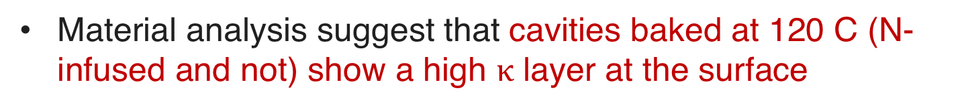

Summary
Material analysis suggest that cavities baked at 120 C (N-infused and not) show a high $κ$ layer at the surface
120 C baked
120 C N-infused
EP/BCP
N-doped
High $κ$ layer
Constant $κ$ bulk
$$J_{RF}$$
$$J_{RF}$$
Low $κ$ bulk

Slide 21
Summary
Material analysis suggest that cavities baked at 120 C (N-infused and not) show a high $κ$ layer at the surface
120 C baked
120 C N-infused
EP/BCP
N-doped
What do we expect in terms of vortex penetration and maximum field limit for high-𝜅 layered materials?
High $κ$ layer
Constant $κ$ bulk
$$J_{RF}$$
$$J_{RF}$$
Low $κ$ bulk

Slide 22
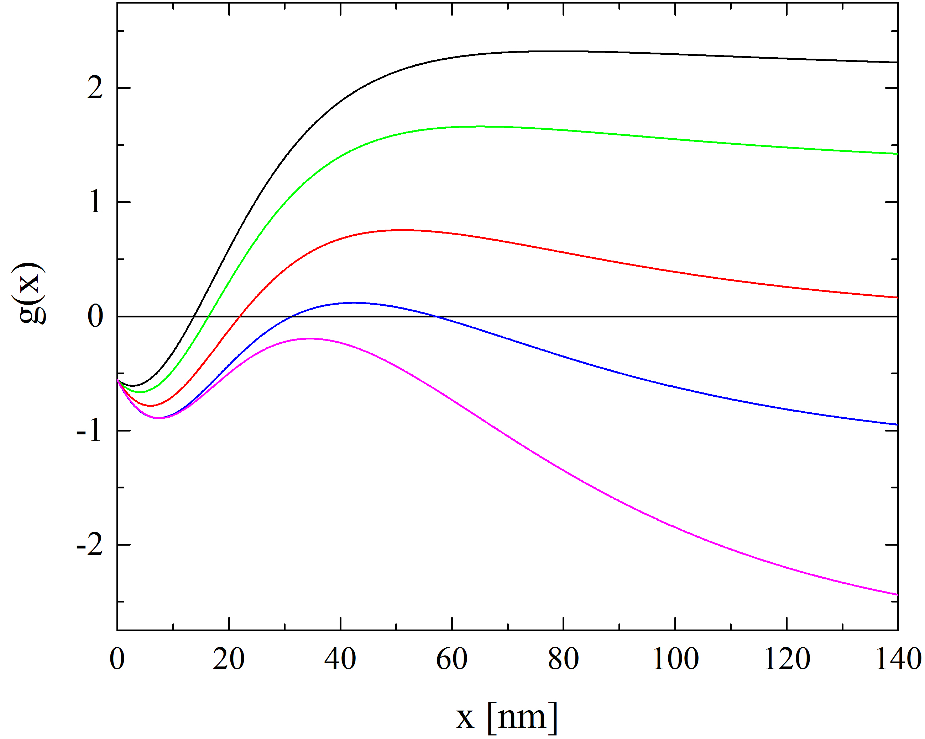
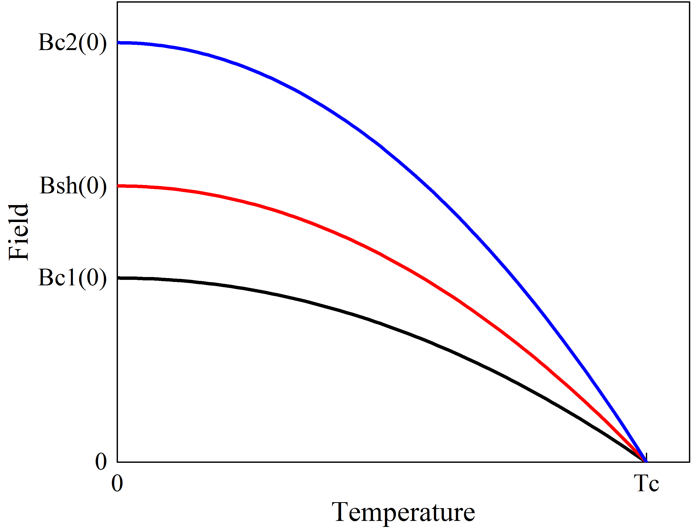
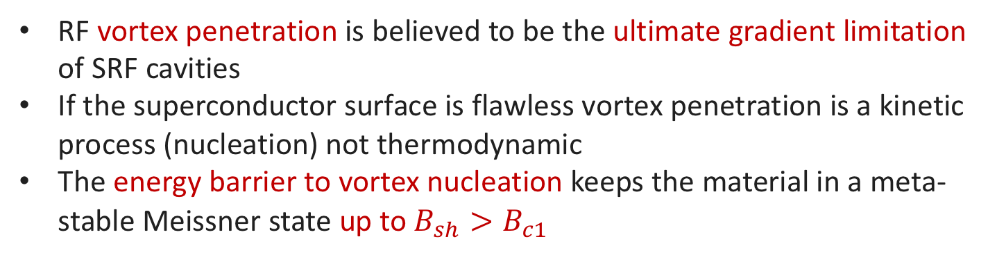
Energy barrier to vortex nucleation
RF vortex penetration is believed to be the ultimate gradient limitation of SRF cavities
If the superconductor surface is flawless vortex penetration is a kinetic process (nucleation) not thermodynamic
The energy barrier to vortex nucleation keeps the material in a meta-stable Meissner state up to $B_{sh}>B_{c1}$
Normal-conducting
Field rise
Mixed
Meta-stable
Meissner
Field rise
Meissner
C. P. Bean and J. D. Livingston, Phys. Rev. Lett. 12, 14 (1964)

Slide 23
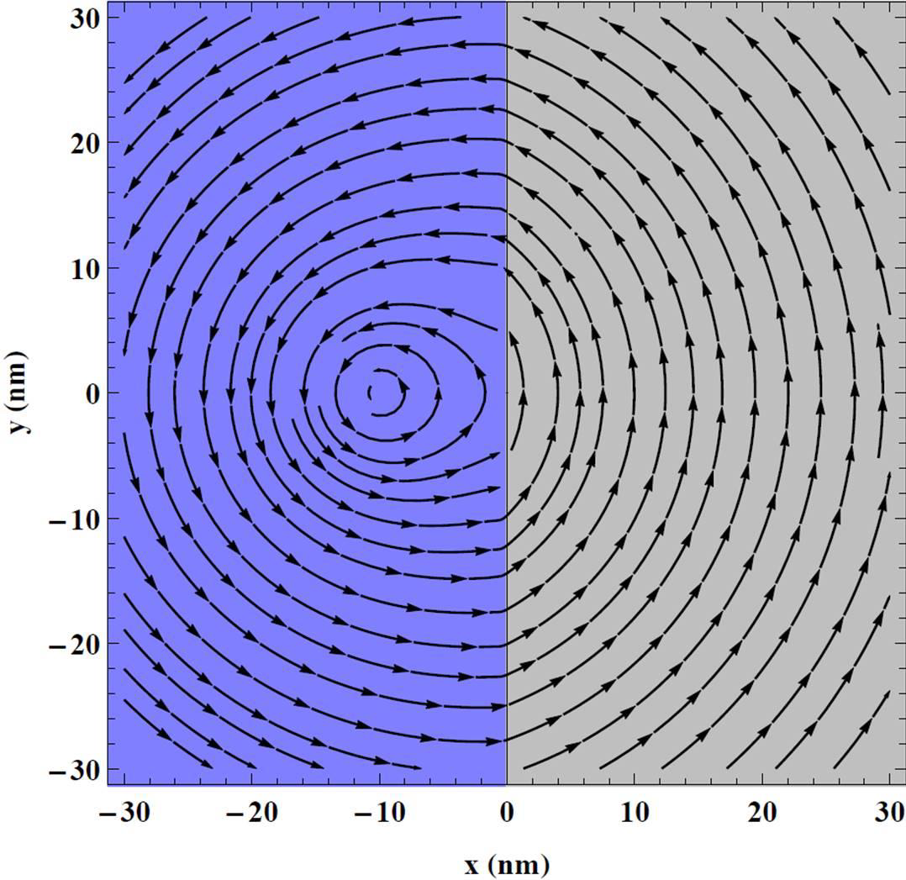
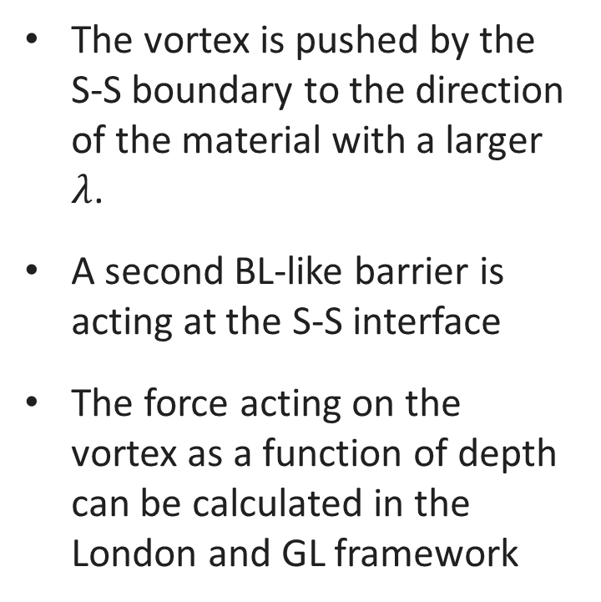



What does happen if another interface is added?
Vacuum-S
interface
S-S
interface
The vortex is pushed by the S-S boundary to the direction of the material with a larger $λ$.
A second BL-like barrier is acting at the S-S interface
The force acting on the vortex as a function of depth can be calculated in the London and GL framework
$$λ_{1}$$
$$λ_{2}$$
$$λ_{1}>λ_{2}$$
T. Kubo, in proceedings of LINAC14, Geneva, Switzerland (2014)
G. S. Mkrtchyan et al., Zh. Eksp. Theor. Fiz. 63, 667 (1972)

Slide 24
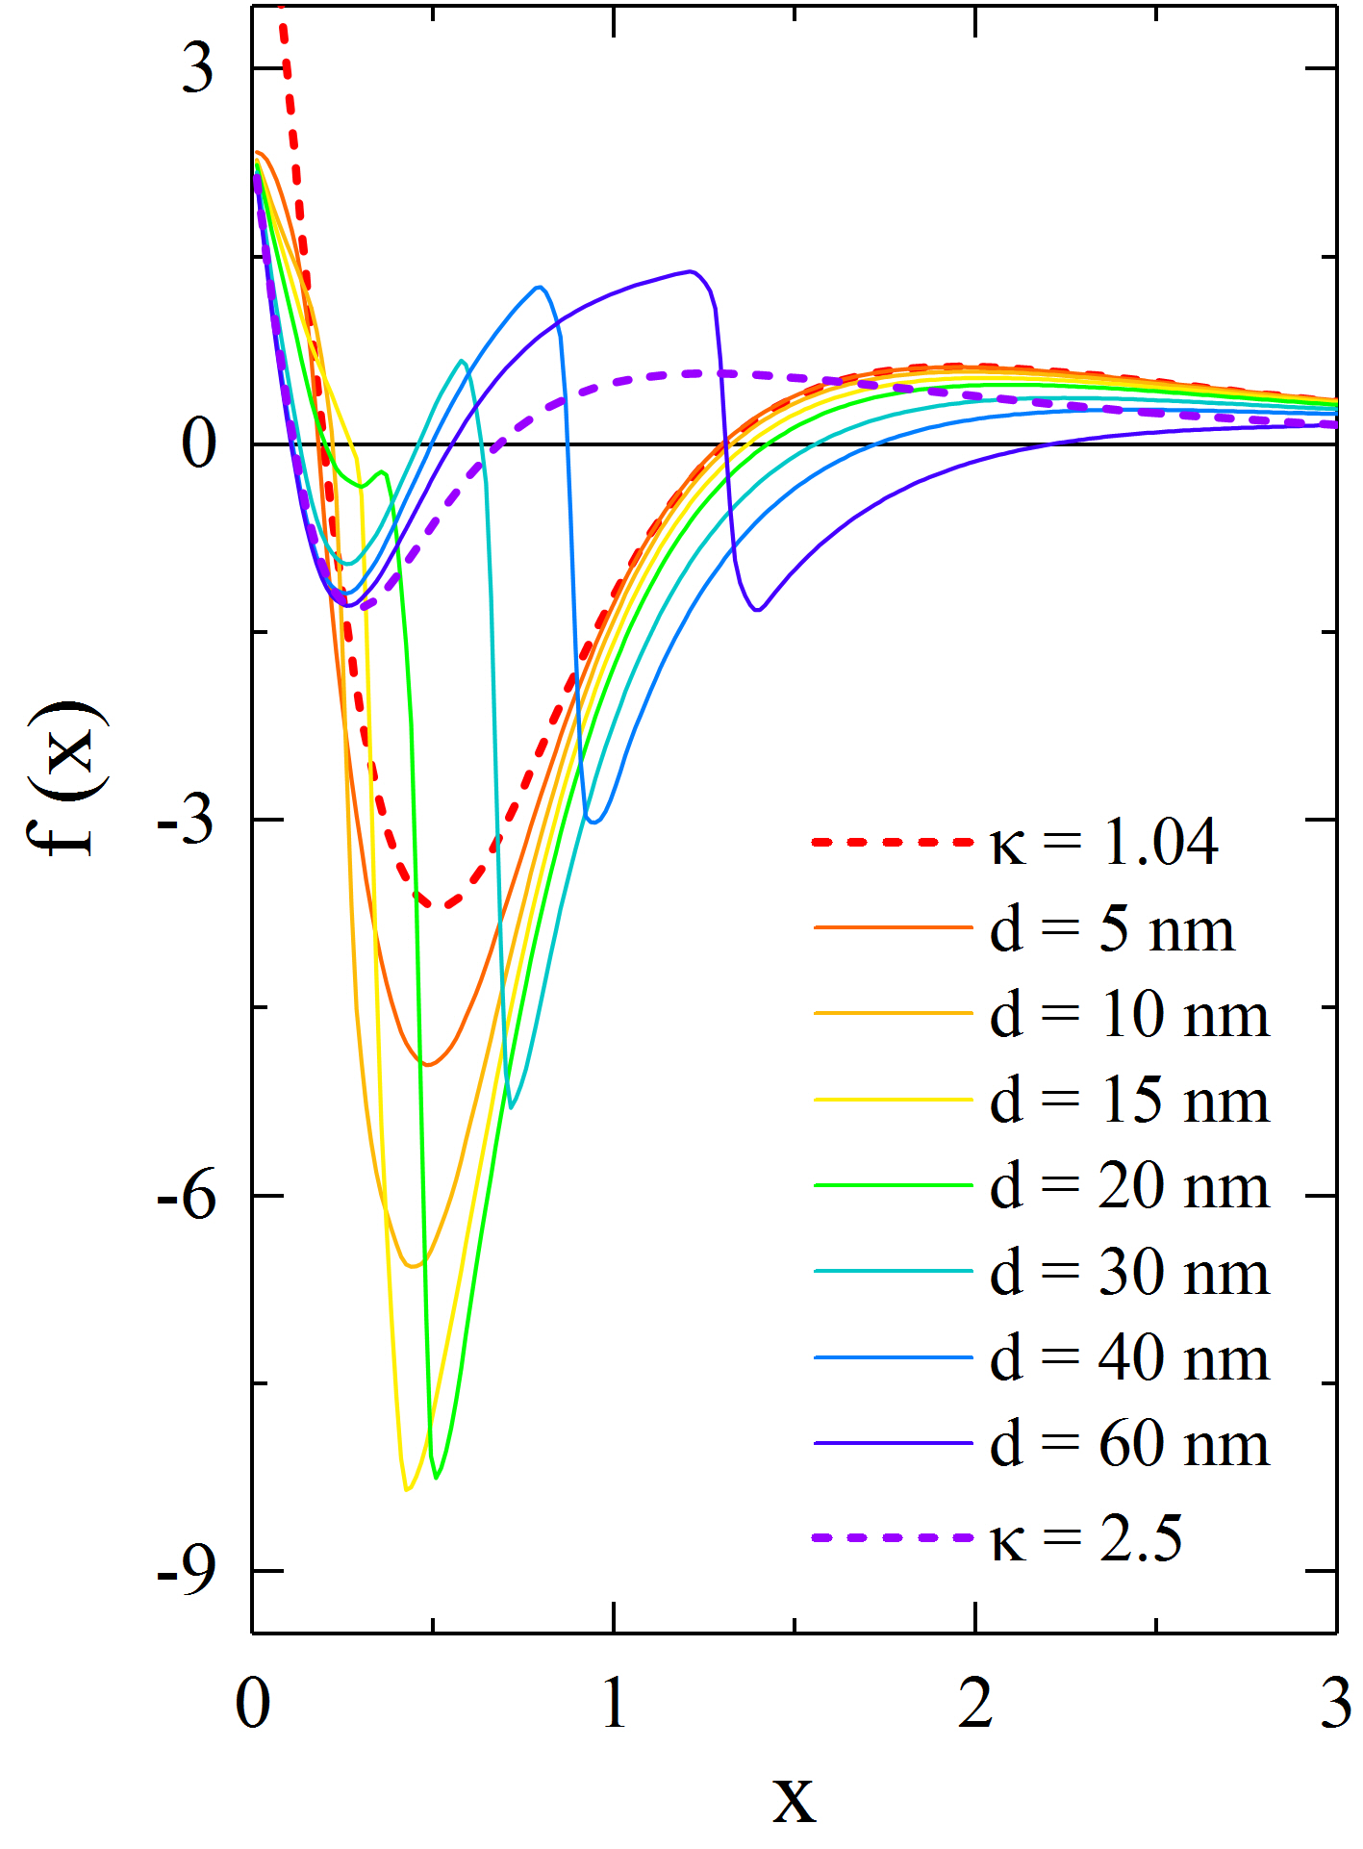
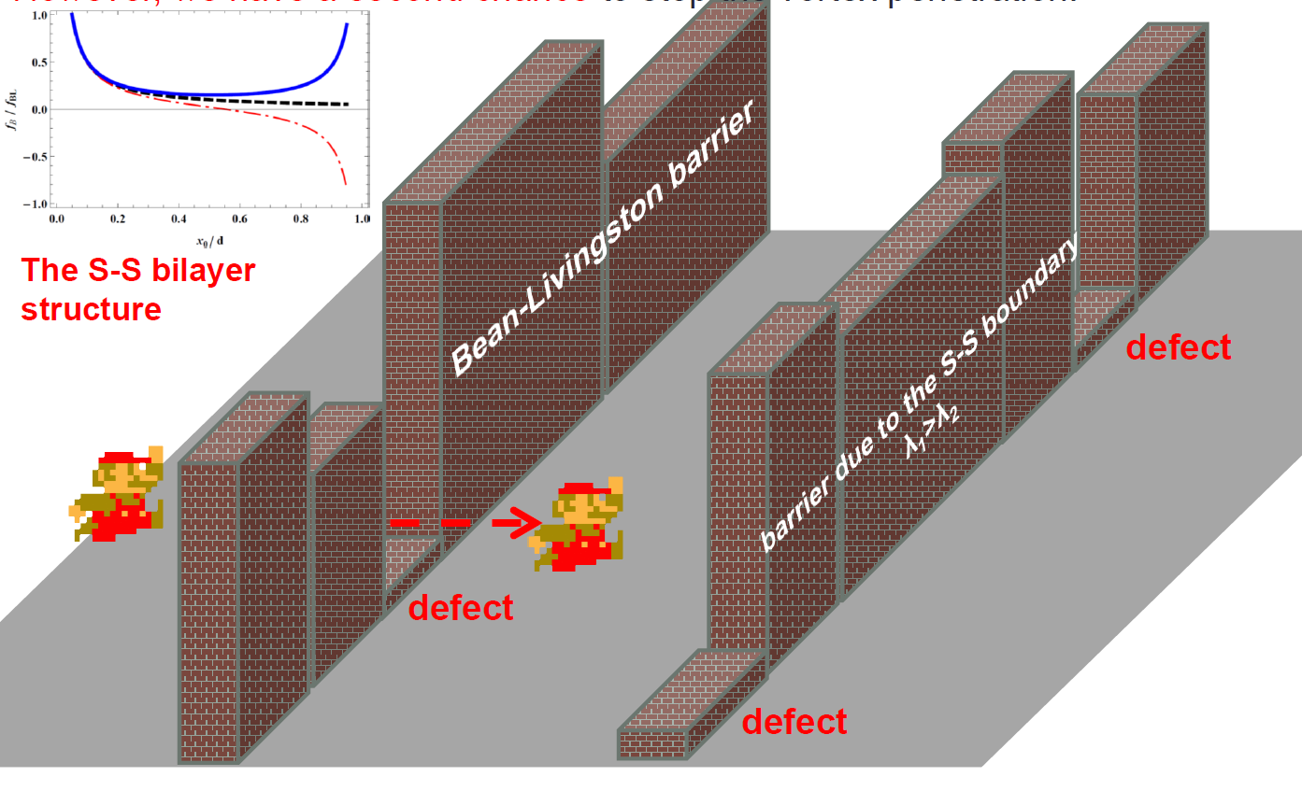
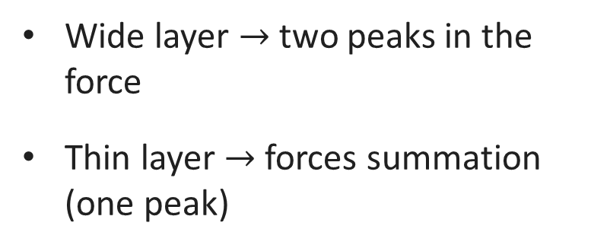
Layer thickness dependence
BL
S-S
Wide layer $→$ two peaks in the force
Thin layer $→$ forces summation (one peak)
Courtesy of T. Kubo
M. Checchin et al., in proceedings of LINAC16, MSU, East Lansing, USA (2016)
T. Kubo, LINAC 2014, Geneva, Switzerland (2014)

Slide 25
Modeling of the maximum gradient
QPs energy, momentum and occupation
Adapted from: V. Ngampruetikorn, TTC Workshop, RIKEN, Japan (2018)

Slide 26
Current density distribution in the superconductor
V. Ngampruetikorn, TTC Workshop, RIKEN, Japan (2018)

Slide 27

Enhancement of the accelerating gradient
$$E_{acc}\left[\frac{MV}{m}\right]=\frac{B\left[mT\right]}{4.26}$$
V. Ngampruetikorn, TTC Workshop, RIKEN, Japan (2018)

Slide 28
New directions:
Nb₃Sn and layered superconductors

Slide 29
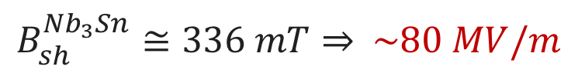

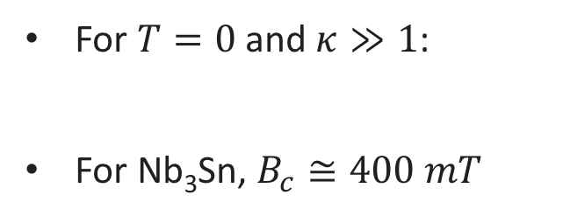
Why Nb₃Sn?
Higher operational temperature
Higher superheating field
For $T=0$ and $κ≫1$:
For Nb₃Sn, $B_{c}≅400 mT$
$B_{sh}≅0.84$ $B_{c}$
$B_{sh}^{{Nb}_{3}Sn}≅336 mT⇒$ $\sim 80 MV/m$
Adapted from: S. Posen, FCC week, Berlin, Germany (2017)
$$\text{G}\text{. }\text{Catelani} \text{and} \text{J}\text{. }\text{P}\text{. }\text{Sethna}\text{, }\text{Phys}\text{. }\text{Rev}\text{. }\text{B} \text{78}\text{, 224509 (2008)}$$

Slide 30
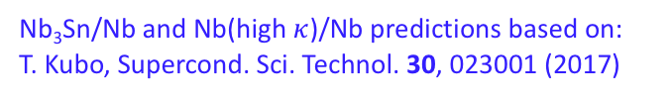

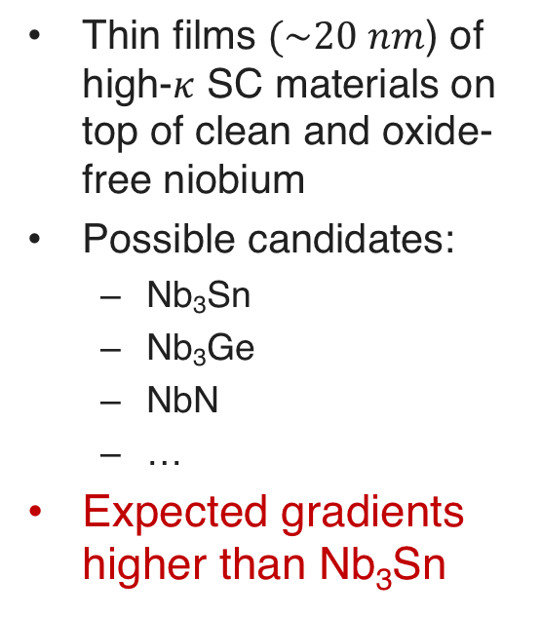
Why layered superconductors?
Thin films $(\sim 20 nm$) of high-$κ$ SC materials on top of clean and oxide-free niobium
Possible candidates:
  Nb₃Sn
  Nb₃Ge
  NbN
  …
Expected gradients higher than Nb₃Sn
$$\sim 120 MV/m$$
Nb₃Sn/Nb and Nb(high $κ$)/Nb predictions based on:
T. Kubo, Supercond. Sci. Technol. 30, 023001 (2017)

Slide 31
Conclusions

Slide 32
Conclusions
High Q-factors enable affordable CW accelerators
  N-doping decreases T-dependent surface resistance
  Trapped flux surface resistance is tunable by acting on sensitivity and expulsion
High gradients enable affordable HE accelerators
  120 C baked and N-infused cavities show high gradients and dirty layer at the surface
  Engineering of the first ~ 50 nm of material seems beneficial in terms of gradient enhancement

Slide 33

New exciting results!
UP TO $\sim 49 MV/m$ in ILC-type single-cell cavities
$\sim 1.3$ times higher gradient
A. Grassellino et al., to be published

Slide 34
Thank you for your attention
Acknowledgments:
M. Martinello, A. Grassellino, A. Romanenko, S. Posen, A. Melnychuck, D. A. Sergatskov, S. Aderhold, D. Bice, S. Chandrasekaran, Z.-H. Sung, S. Belomestnykh (Fermi National Accelerator Laboratory),
V. Ngampruetikorn, J. Sauls (Northwestern University)

Slide 35
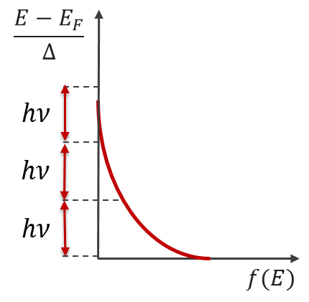
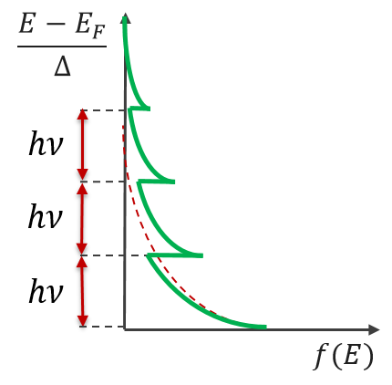
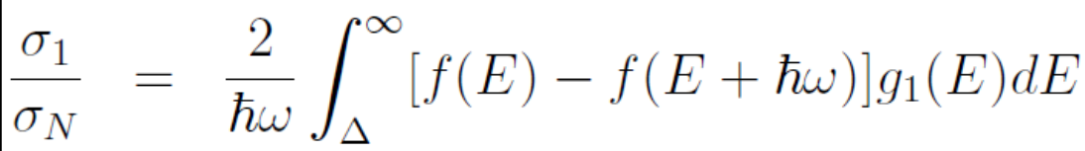
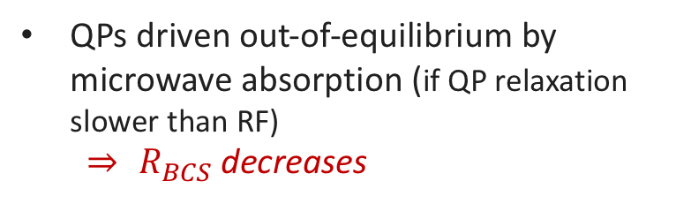
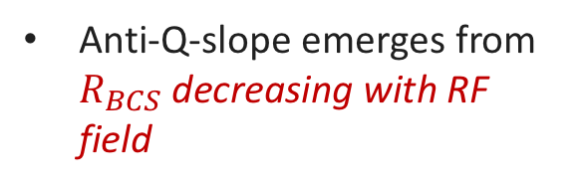


Qualitative description of the anti-Q-slope
$$R_{s}\left(T\right)=R_{BCS}\left(T\right)+R_{res}$$
Anti-Q-slope emerges from $R_{BCS}$decreasing with RF field
QPs driven out-of-equilibrium by microwave absorption (if QP relaxation slower than RF)
  $⇒$ $R_{BCS}$decreases
Equilibrium distribution of QPs
Non-equilibrium distribution of QPs
$$f\left(E\right)−f(E+ℏω)$$
$$f\left(E\right)−f(E+ℏω)$$
M. Martinello et al., arXiv:1707.07582v1
A. Grassellino et al., Supercond. Sci. Technol. 26 102001 (2013)
A. Romanenko and A. Grassellino, Appl. Phys. Lett. 102, 252603 (2013)
Smaller with non-equilibrium QPs distribution

Slide 36
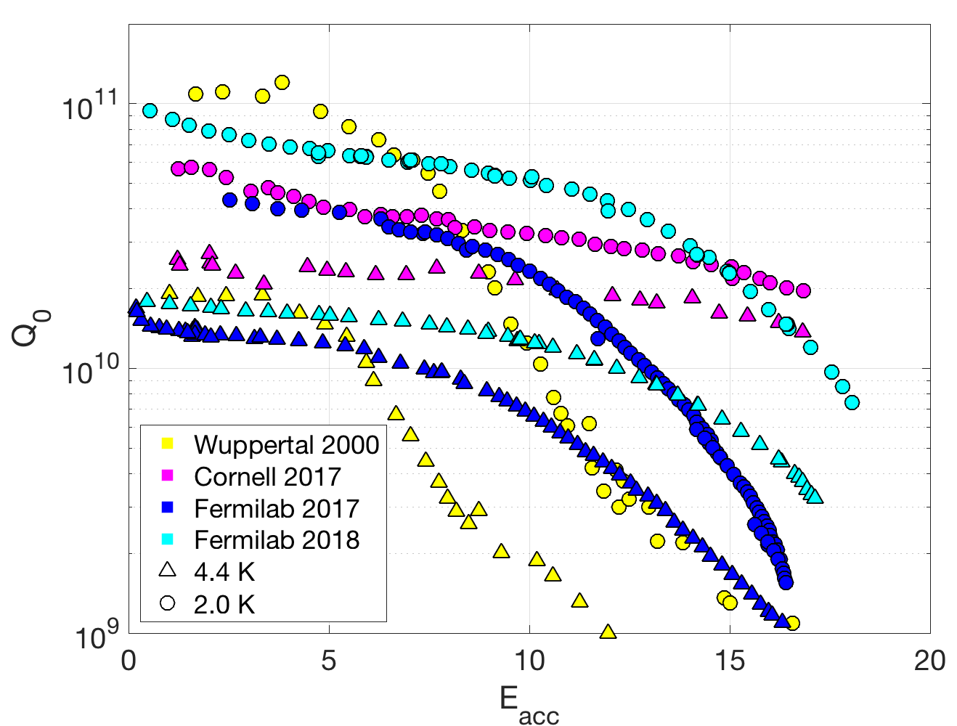
Latest Nb₃Sn results at Fermilab
Substantial improvement in our second year of coating
Still some Q-slope, not yet flat Q₀ like Cornell
Very high Q₀ at 2.0 K, similar to Wuppertal
S. Posen, TTC Workshop, RIKEN, Japan (2018)
Mattia Checchin | ICHEP 2018, Seoul, South Korea

