Slide 1


ICHEP 2018
833 [5 Jul , 09:40]
Dark Matter Axion Search Experiments Using 18T HTS Magnet at CAPP/IBS in KAIST
Byeong Hun Min
Center for Axion and Precision Physics Research
IBS

Slide 2
Outline
Axion as dark matter
Important factors for Axion search
  HTS Magnet (18T)
  Cryostat (4K)
  Cavity
  DAQ system
3. Results from our present setup
4. Factors improvement
  Dilution refrigerator (~20 mK) with 18 T magnet
  JPC : First stage amplifier
  Cancellation magnet
Our Project

Slide 3
Axion as a Dark Matter
Invented to solve the strong-CP problem in QCD
• Non-thermal mechanism of producing
axion dark matter in the early Universe
• The initial axial angle Θ determines
the potential energy to be released.
• The potential energy density
(order of ΛQCD⁴) is converted into
cold dark matter
• Axion dark matter mass is determined
by the harmonic oscillator frequency
ma ≃ ΛQCD²/fa < 10⁻³ eV !
ΛQCD⁴
VEV : fa > 10⁹GeV

Slide 4
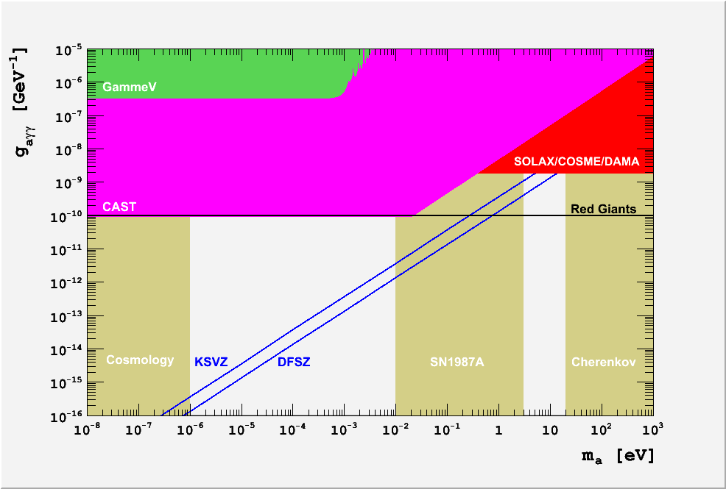


Axion Dark Matter Search
Axionic
Dark Matter
playground
Warm
dark matter
Ωa>1
NN➜NNa
DFSZ
Axion potential energy decays at time t~1/ma.
If this is too late (too small ma) in cosmological time
the dark matter can be overproduced relative to the photons

Slide 5
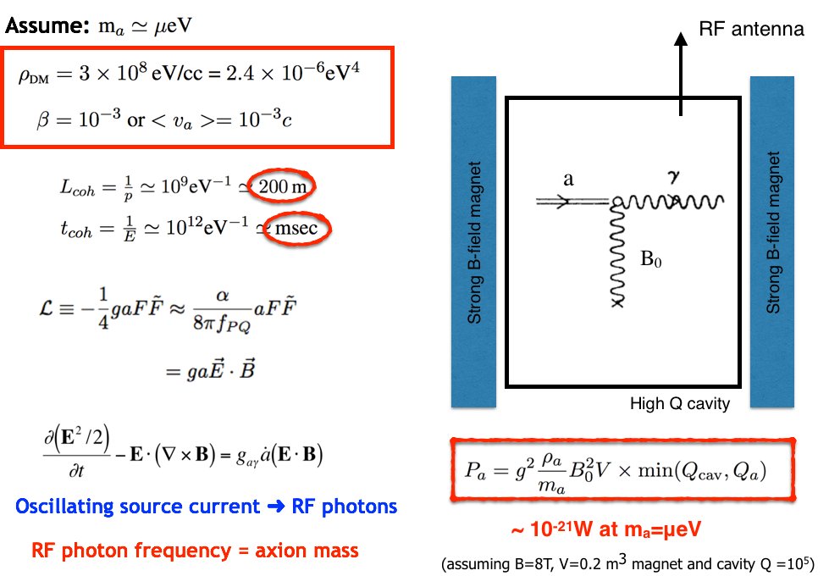
Axion Haloscope

Slide 6

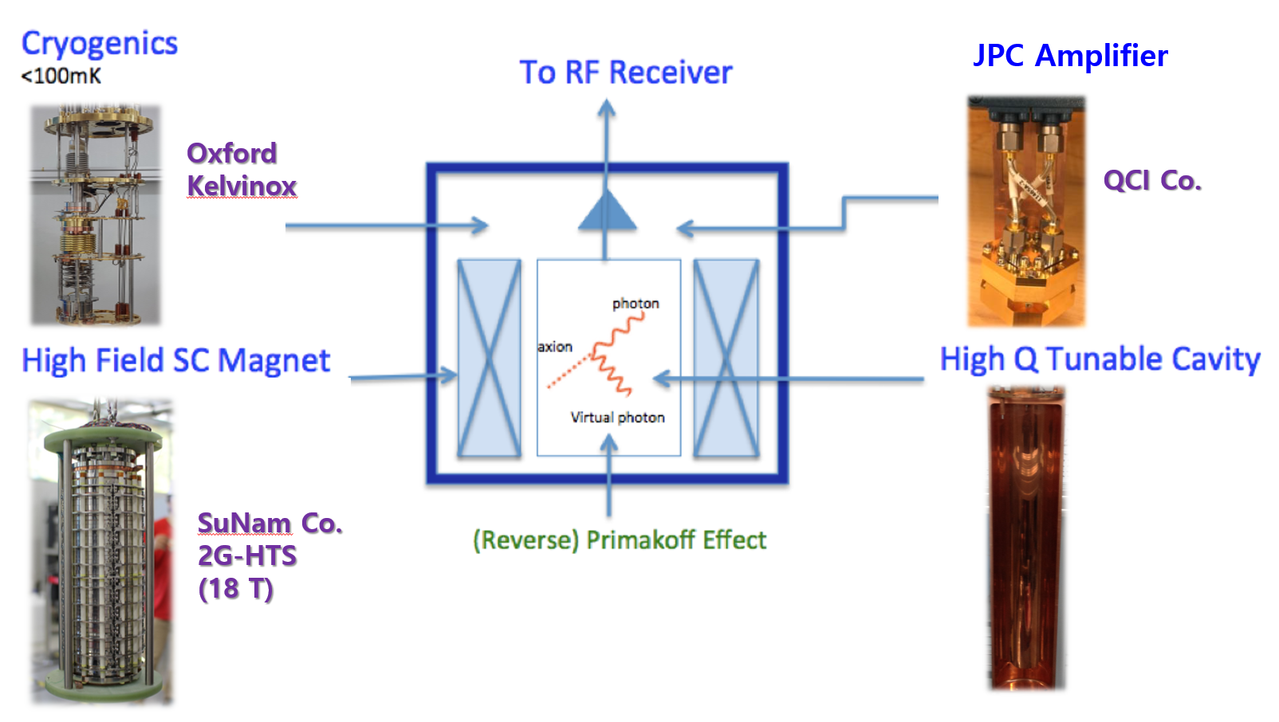
CAPP’s Dark Matter Axion Search Strategy
Strong magnetic field (18T)
Lower the thermal noise temperature
of first stage amplifier
High Q cavity (Q~10⁶)

Slide 7

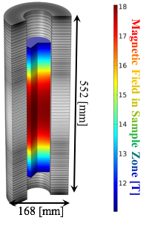
18T HTS Magnet (7cm Bore)
A strong B-field and large bore
HTS magnet can be commercially
produced by SuNAM Co. Ltd.
2G HTS Superconducting Magnet
Magnetic field : 18 Tesla
Dimension: 70 mm ID / 168mm OD
200 mm uniform field (>90%)
552 mm length
Quench free design (No-Insulation winding)
Compact and easy to operate
The magnet delivery by summer 2017
Initial DM axion mass range to probe:
17 to 36 μeV
(Later we will apply multiple cavity method
to probe higher mass range search)

Slide 8
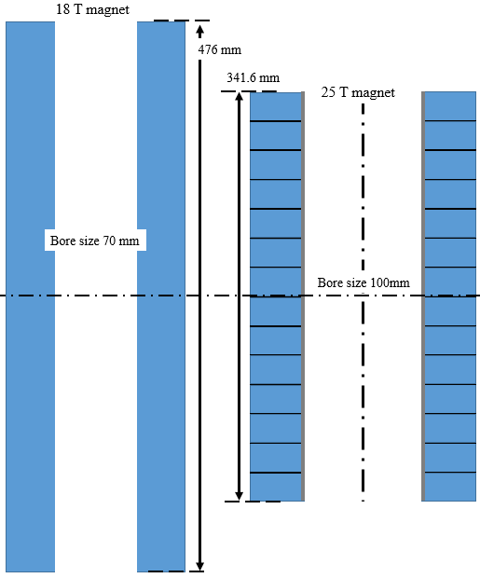
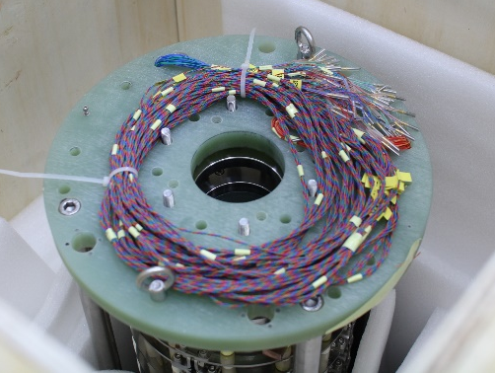
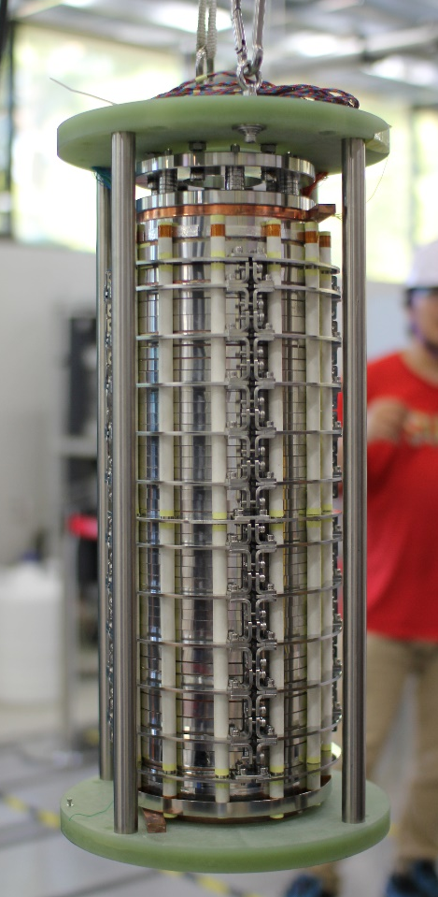
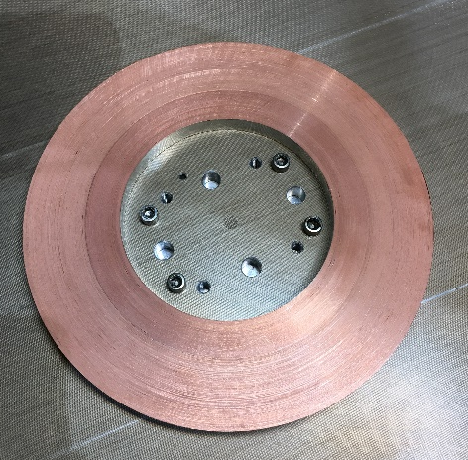
18 T no insulation magnet
18 Tesla magnet
non insulation type
No quench in LHe
476 mm
25 Tesla magnet
1st coil
for 25 T magnet
to be delivered in 2020
44 double pancake coils
18 T was delivered in 2017.

Slide 9
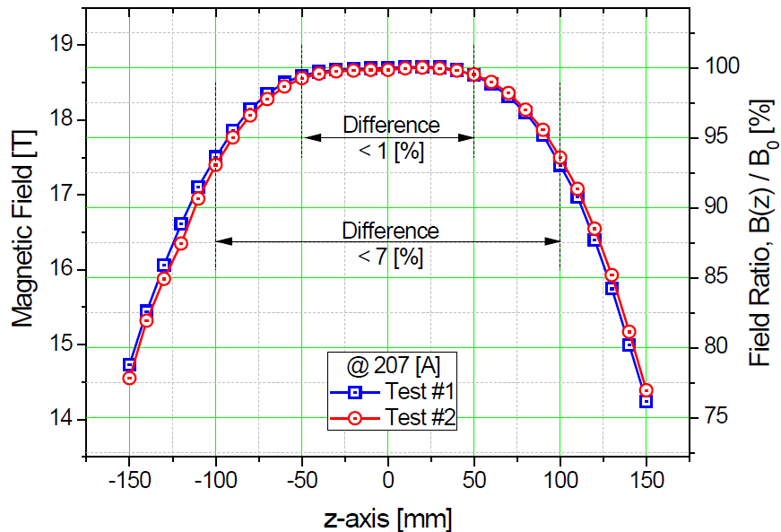
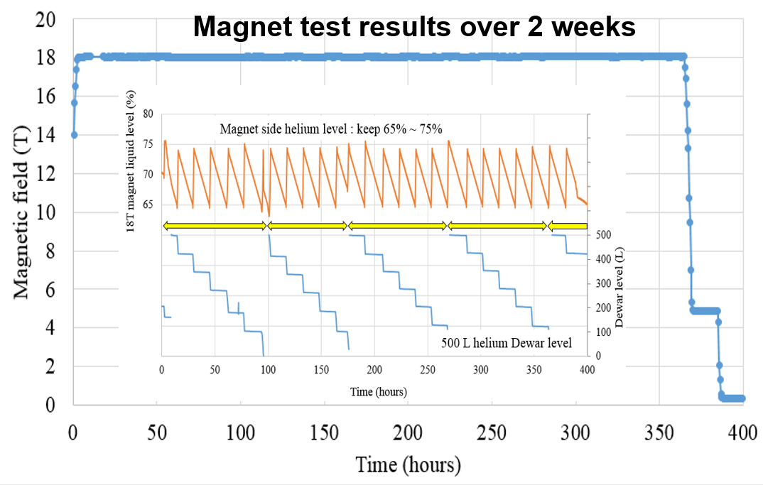
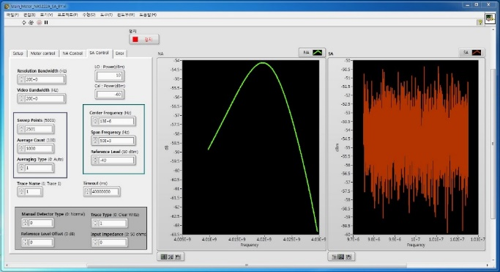
18T HTS Magnet with 4 K Cryostat
Measurement program
Uniformity: 93%(±100 mm)
Stability: <0.05% in 2 weeks
The cavity resonance frequency is tuned by tuning rod which is controlled by stepper motor
Very high quality of our HTS magnet.
Related Poster : JongKuk Kim( 6 July 2018, 18:30)

Slide 10
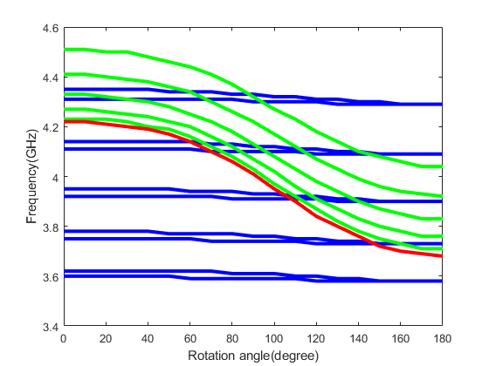
Simulation of frequency in cavity
The third factor for axion search is high Q-value cavity
Dielectric rod
Conducting rod
Red :TM 010
Red :TM 010
Green : TM 01m
Blue : TE11m
The dielectric rod has lower frequency than conducting rod .
We use the red line (TM010 mode )for axion search.
Related Poster : YoungJae Lee (6 July 2018, 18:30)

Slide 11
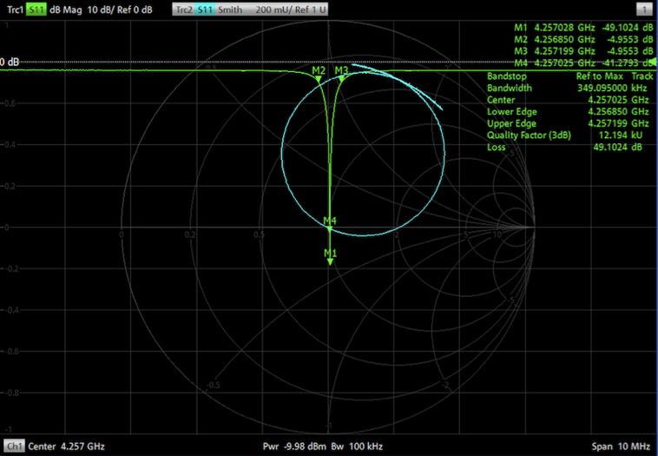
Cavity
● Scanning Rate vs. Length of Cavity
Q(300K)=~24,000
Q(4K)=~73,000
assuming
uniform C
max rate
Scan Rate
Detailed
simulation
of E and B
length of
magnet
(467.8mm)
0
100
200
300
400
500
600
Length of Cavity [mm]

Slide 12
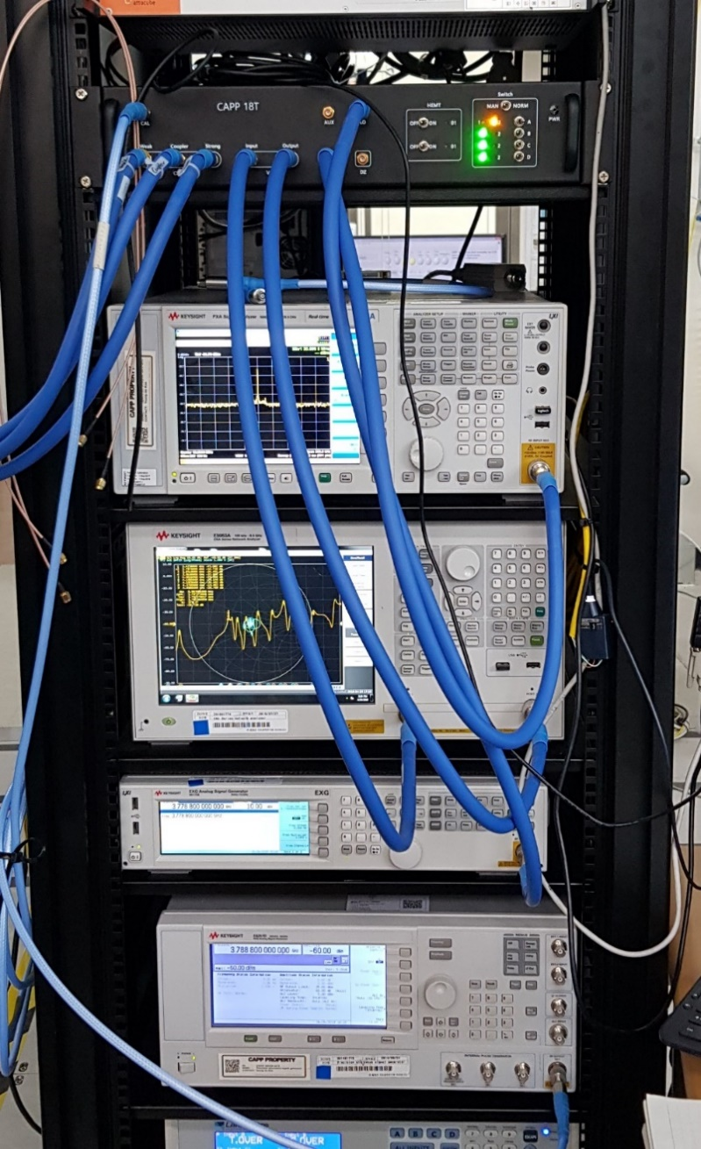
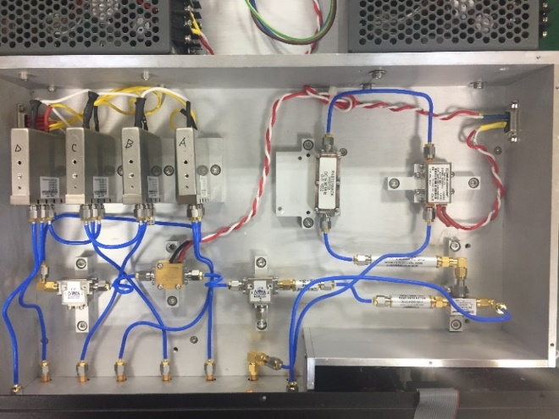
DAQ System
RF chain configuration
Cryo- and room temp. DAQ system
Room temperature(RT)-part
Room temperature amplifier
Signal
Genrator
(SG)
Network
Analyzer
(NA)
Spectrum
Analyzer
(SA)
Switch B
1
Input
Output
2
2
2
Intermediate frequency(IF)
Amplifier
Swtich A
1
Switch C
Weak
1
Band pass filter(BPF)
Coupling
Spectrum analyzer
Cryogenics-part
Local oscillator (LO)
Mixer
coupler
coupler
Band pass filter(BPF)
2
Isolator
Cavity
Circulator
Low noise amplifier
(LNA)
1
Network analyzer
Switch D
Radio frequency(RF)
Amplifier
Room T. amp.
It can be switched with 4 states by program (S11,S21,S22,SA)
Signal generator

Slide 13
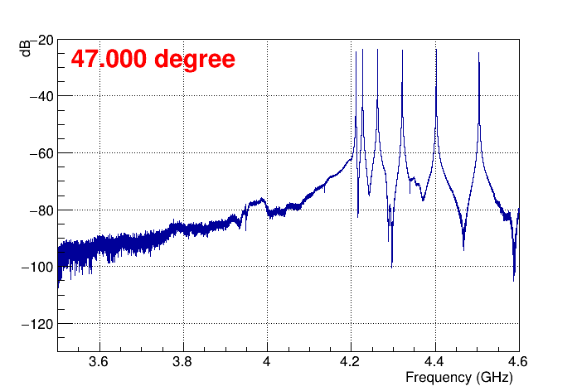
Measurement of the resonant frequency in the copper cavity
We measured the resonant frequency of our cavity with dielectric tuning rod.
Cavity cross section
Temp: 4 K
B : 18 T
Tuning rod

Slide 14
Background Noise at 4 K (under 18 T)
f = 4.227655 GHz
From signal generator(f)
T : 4 K
H : 18 T
Noise measure
(Down converted IF )

Slide 15
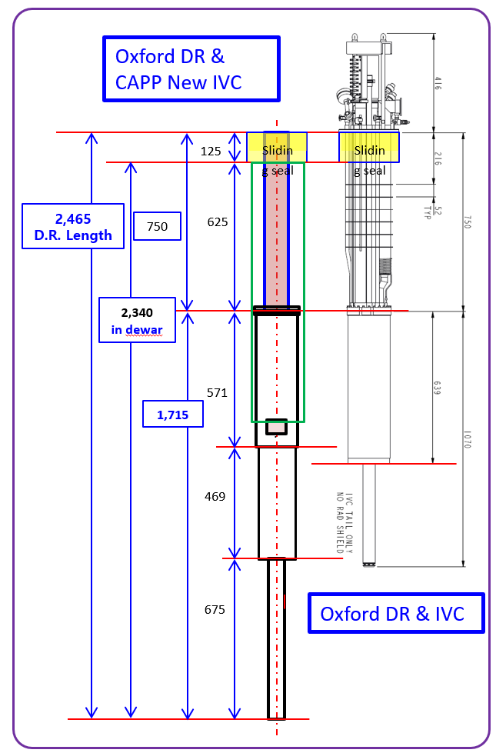
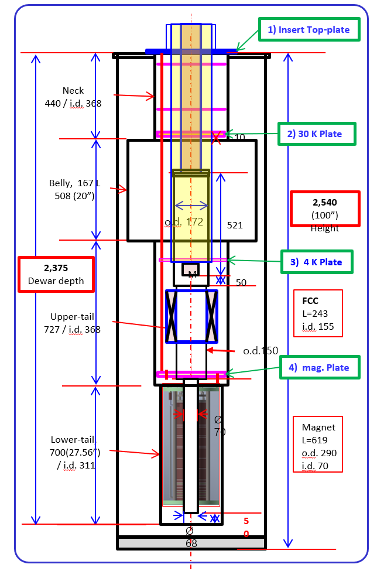
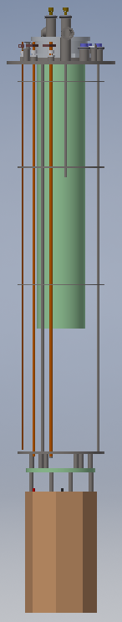
Combination of Dilution refrigerator and 18 T magnet
At present, we are going to improve our experimental setup.
the new IVC for dilution unit and cavity
the new cryostat

Slide 16
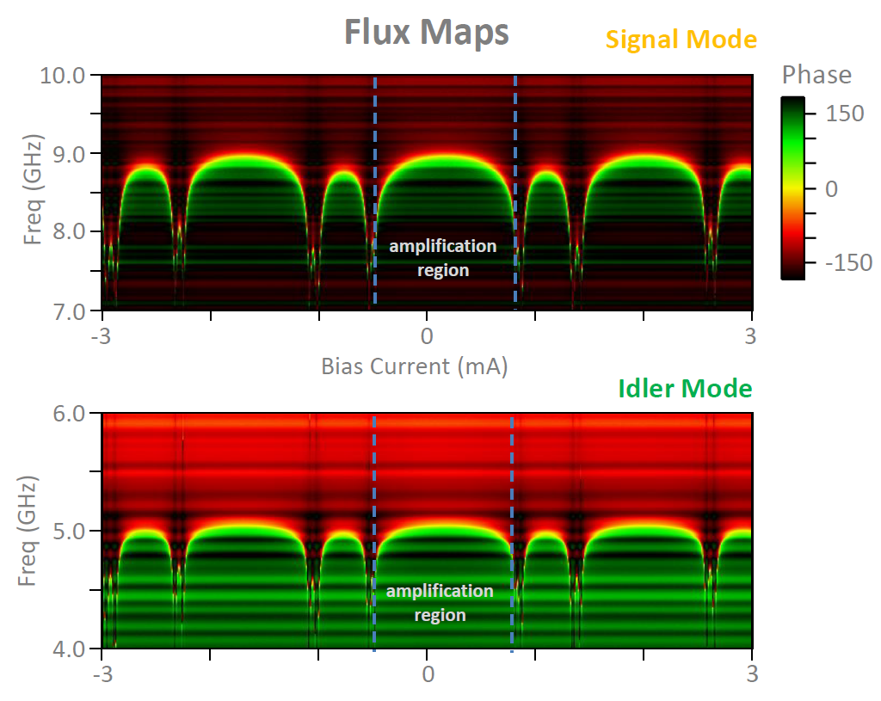
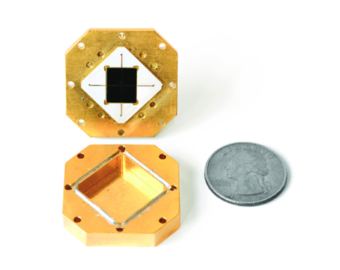
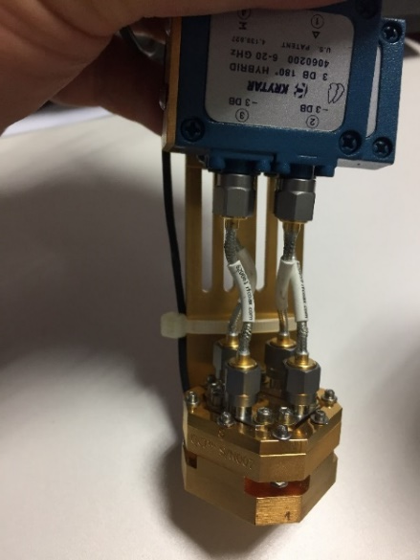
Josephson Parametric Converter (JPC : Quantum Limit Amplifier)
4 K exp. : HEMT amp.(2 K Noise Temp.)
Flux Maps
Improve the 1st stage amp.
High Frequency Mode
Inside
Bias current (mA)
Low Frequency Mode
Outside
JPC in hand
Bias current (mA)
From this maps, we find the two frequency range.
Gain(20 dB min) | F_{min} (GHz) | f_{max} (GHz)
High frequency | 7.72 | 8.802
Low frequency | 4.757 | 5.01
Delivered in May 2018
Flux maps were measured from our JPC.
Related Poster : JiYoung Lee
Next plan : Measure the noise temperature of JPC

Slide 17
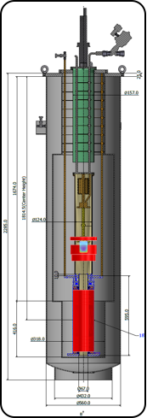
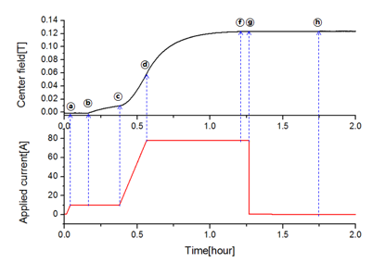
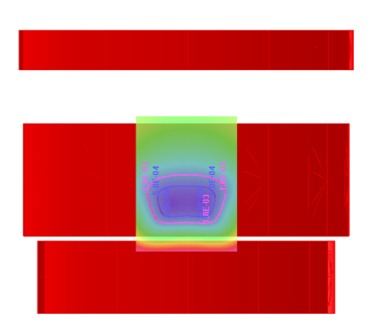
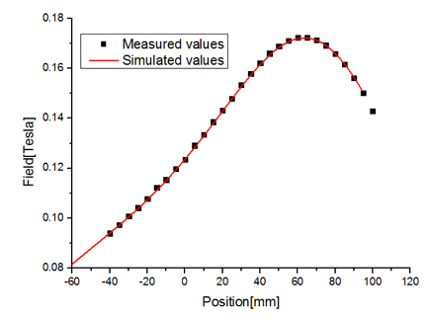

Cancellation Magnet Development
Need the cancellation magnet for JPC operation in 18 T
Delivered in Nov 2017
Cancellation Coil
● Cancel out ~kG of stray field to a few G
● Field stability ~25ppm/hr
● Field profile test & quench test passed
5 gauss
The main purpose of it is cancellation of magnetic field around the JPC
Field cancel region

Slide 18

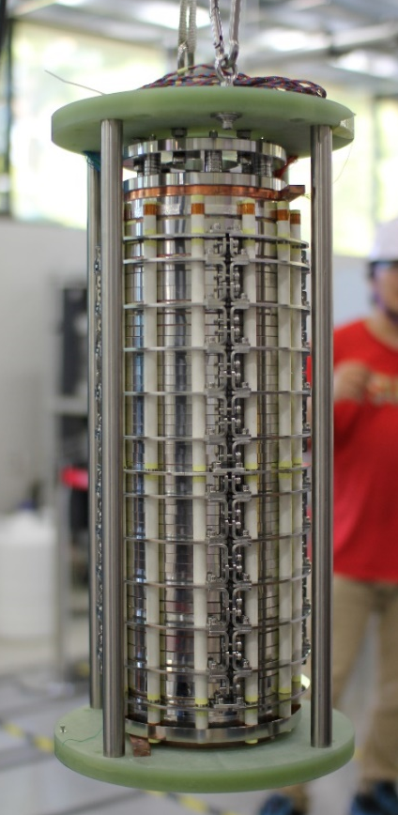
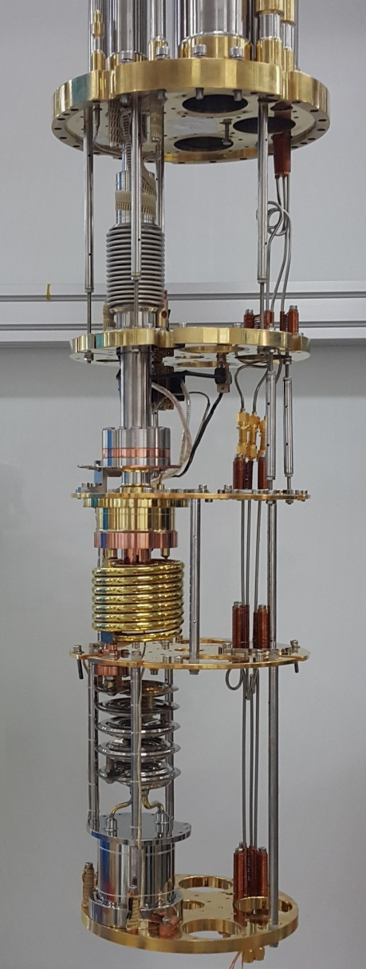

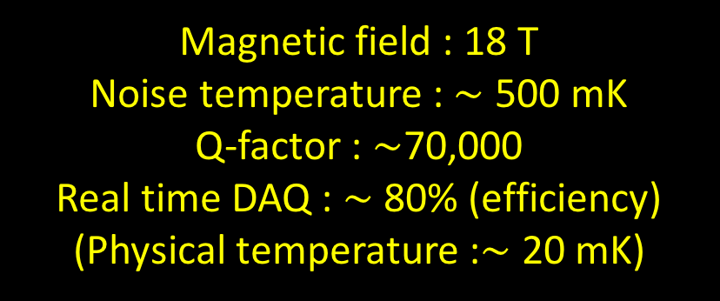
Installation of improvement factors for experiment
Our experimental setup will be installed with this condition.
Cancellation magnet
JPC
Dilution Refrigerator
Magnet
Magnetic field : 18 T
Noise temperature : $\sim$ 500 mK
Q-factor : $\sim$70,000
Real time DAQ : $\sim$ 80% (efficiency)
(Physical temperature :$\sim$ 20 mK)
DAQ
Cavity

Slide 19
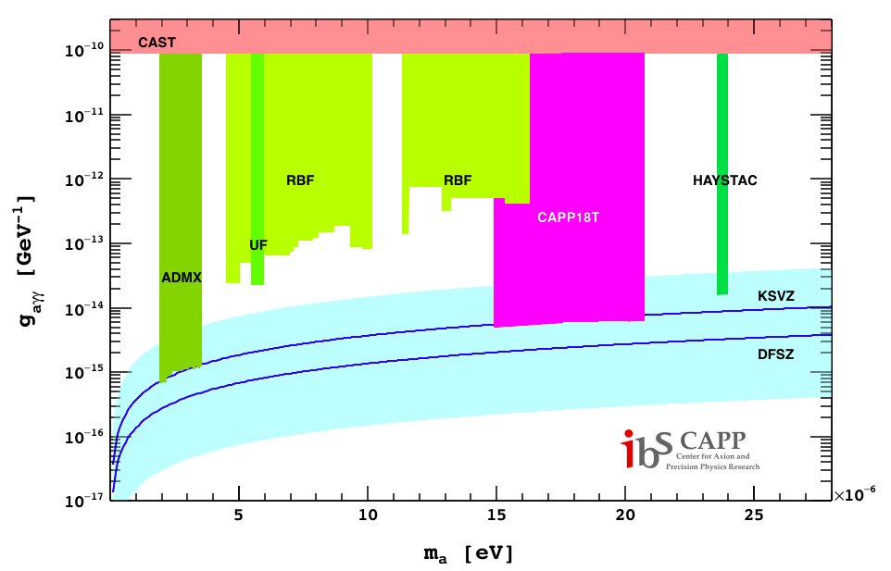
Projected Axion Search Goal
We will probe the axion with Dilution and JPC and so on.
CAPP18T
SQUID
JPA/JPC

Slide 20
Summary
We use 18 T HTS solenoid magnet for Axion Haloscope research.
We measured the TM modes in the cavity at 4 K(under 18 T)
We will install the dilution refrigerator and 18 T magnet in October.
We will sure probe the dark matter Axion in the range of 17 ̴ 36 μeV.
(f : 3.7 ̴ 8.8 GHz)

