Slide 1


ICHEP 2018
Seoul, Korea
at the FCC
P. Giacomelli
INFN Bologna

Slide 2
Overview
FCC complex and FCC-ee first stage
Higgs production at FCC-ee
Higgs width measurement
Higgs couplings
s-channel Higgs production
BSM Higgs searches
Higgs self-coupling
Synergy with FCC-hh
Conclusions
Acknowledgments
M. Klute and P. Janot for material and useful discussions

Slide 3
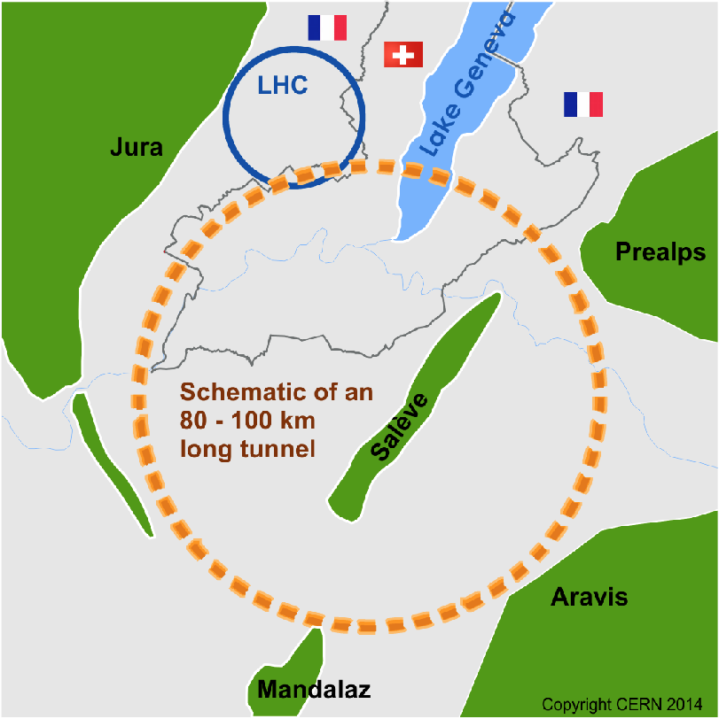
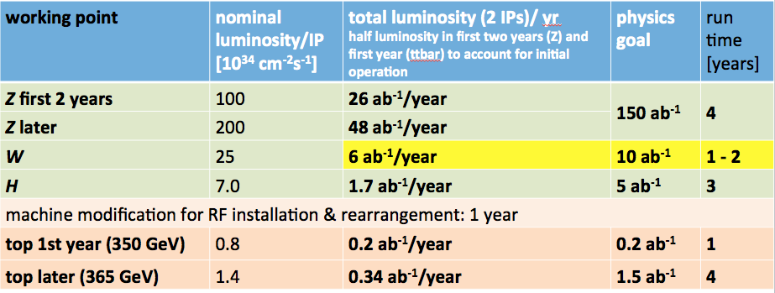

FCC complex
International FCC collaboration
pp-collider (FCC-hh)
  main emphasis, defining infrastructure requirements
  16 T ⇒ 100 TeV pp, L~2x10³⁵, Lint=2 ab⁻¹/yr
~100 km tunnel infrastructure
e⁺e⁻ collider (FCC-ee),√s=90-365 GeV, L~10³⁵ - 4x10³⁶, Lint=1-48 ab⁻¹/yr for H, Z as potential first step
HE-LHC with FCC-hh technology
p-e (FCC-he) option, √s=3.5 TeV, L~10³⁴
FCC-ee operation model

Slide 4
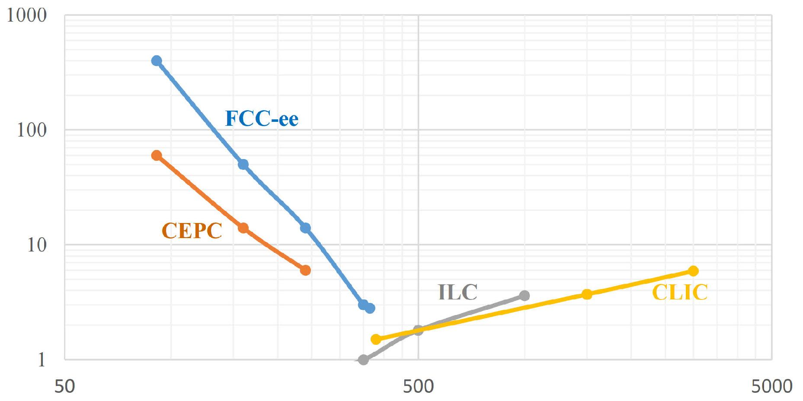
Future lepton colliders luminosities
Total luminosity
[10³⁴ cm⁻²s⁻¹]
Z
WW
HZ
tt
Circular colliders
Linear colliders
√s (GeV)
Significant advantage in luminosity for circular colliders vs. linear colliders, especially for FCC-ee.
Linear colliders (esp. CLIC) have higher energy reach, but less than FCC-hh.

Slide 5
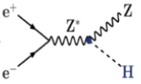

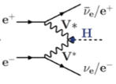

Higgs production at FCC-ee
FCC-ee
5 ab⁻¹@240 GeV
~1.5 ab⁻¹@365 GeV
 | FCC-ee 240 GeV | FCC-ee 365 GeV
Total Integrated Luminosity (ab⁻¹) | 5 | 1.5
# Higgs bosons from e⁺e⁻→HZ | 1,000,000 | 180,000
# Higgs bosons from fusion process | 25,000 | 45,000
Higgs Factory!

Slide 6
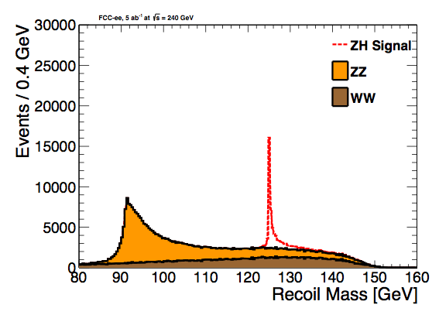
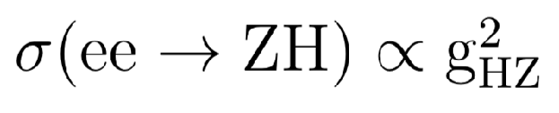
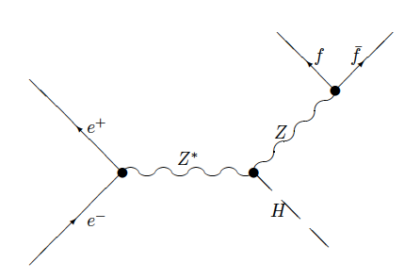

Higgs couplings to Z
Recoil method provides a unique opportunity for a decay-mode independent measurement of the HZ coupling
  Higgs events are tagged with the Z boson decays, independently of Higgs decay mode, mrecoil = mH
  Expected precision 0.5% at 240 GeV, 0.9% at 365 GeV on the ZH cross section
  Using only leptonic Z decays
Higgs-strahlung

Slide 7


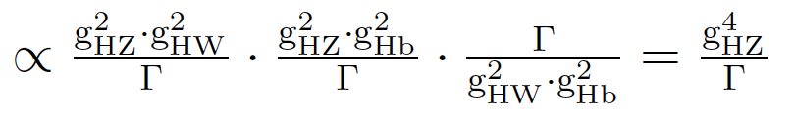
Higgs boson width
Total Higgs boson width can be extracted from a combination of measurements in a model independent way
  1) tagging Higgs final states
  2) measurements of vector boson fusion production at 350-365 GeV
  3) combination of all measurements
Precision obtainable on δΓH/ΓH ~ 1.6%

Slide 8
Higgs boson couplings
in % | FCC-ee 240 GeV | +FCC-ee 365 GeV | +HL-LHC
δgHZZ | 0.25 | 0.22 | 0.21
δgHWW | 1.3 | 0.47 | 0.44
δgHbb | 1.4 | 0.68 | 0.58
δgHcc | 1.8 | 1.23 | 1.20
δgHgg | 1.7 | 1.03 | 0.83
δgH𝛕𝛕 | 1.4 | 0.8 | 0.71
δgHμμ | 9.6 | 8.6 | 3.4
δgH𝛄𝛄 | 4.7 | 3.8 | 1.3
δgHtt |  |  | 3.3
δΓH | 2.8 | 1.56 | 1.3
Precision Higgs coupling measurements
  Absolute coupling measurements enabled by HZ cross section and total width measurement
  Data at 365 GeV constrain total width
  Tagging individual Higgs final states to extract various Higgs couplings
  Couplings extracted from model-independent fit
  Statistical uncertainties are shown for 5 ab⁻¹@240 GeV and 1.5 ab⁻¹@365 GeV (from FCC-ee CDR)
    all measurements are under review / are being redone
Several couplings (gHμμ, gH𝛄𝛄, gHtt) improve further by doing a combined fit with HL-LHC.
The combined fit makes the HL-LHC measurements model-independent.
relative meas., e.g. δgH/gH

Slide 9
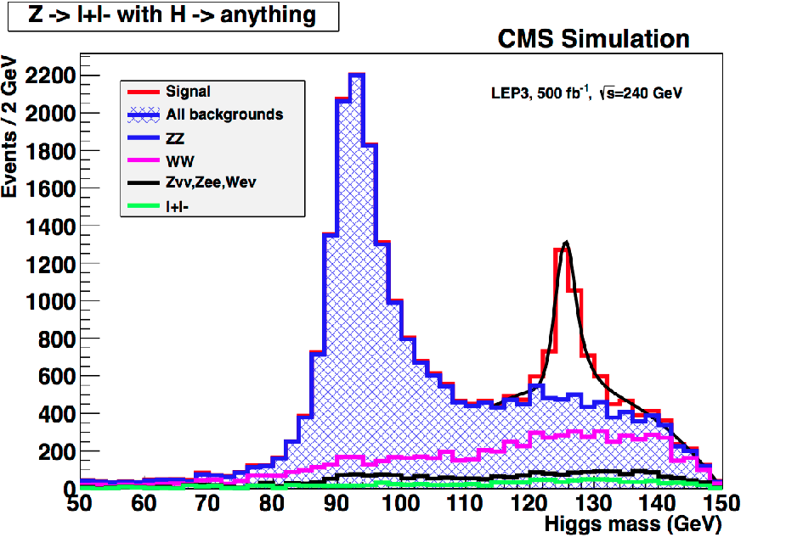
Higgs boson couplings, ZH→ℓℓX
Using CMS detector
Using CLD detector
C. Bernet
FCC week 2018
CLD: CLIC-inspired Lepton Detector, optimised for FCC-ee

Slide 10
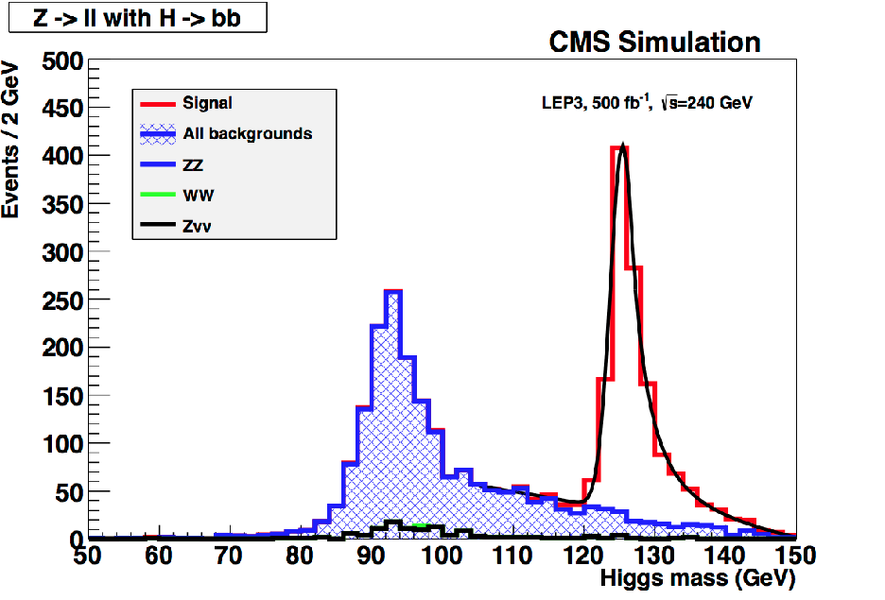
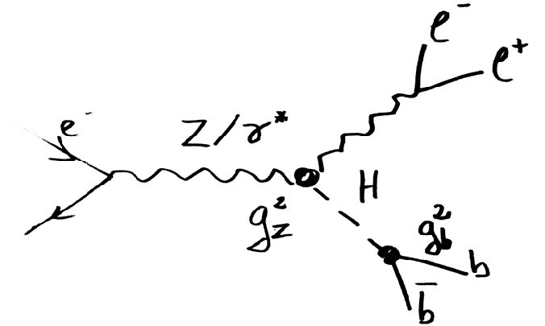
Higgs boson couplings, ZH→ℓℓbb
Using CMS detector
Using CLD detector
C. Bernet
FCC week 2018

Slide 11
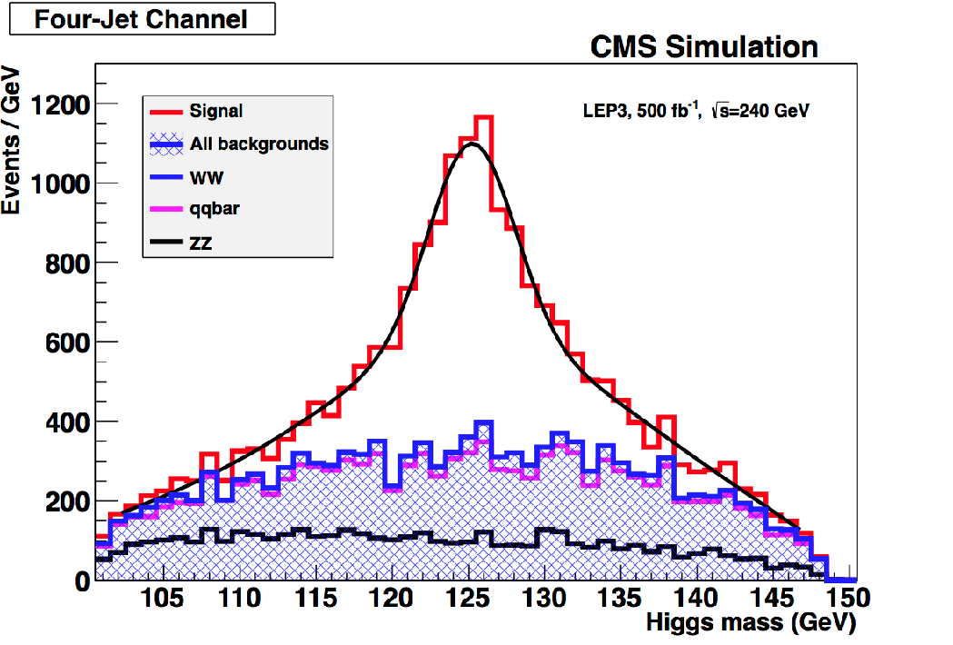
Higgs boson couplings, ZH→qqbb
Using CMS detector
Using CLD detector
C. Bernet
FCC week 2018

Slide 12
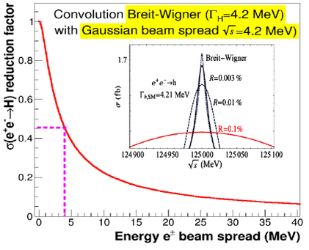
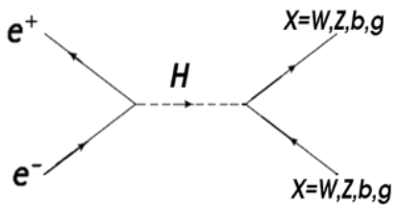
electron Yukawa coupling
s-channel Higgs production
  unique opportunity for measurement close to SM sensitivity
  highly challenging; σ(ee→H) = 1.6 fb;
  various Higgs decay channels studied
  studied monochromatization scenarios
    baseline: 6 MeV energy spread, L = 2 ab⁻¹
    optimized: 10 MeV energy spread, L = 7 ab⁻¹
    limit ~2.5 times SM in both cases

Slide 13
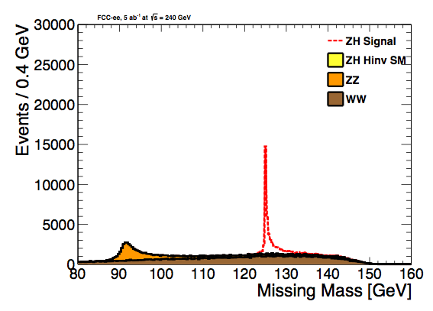
Higgs invisible decays
Higgs boson to invisible decays are predicted for instance in the Higgs-portal model of Dark Matter.
  Follows FCC-ee ZH cross section measurement, events with a Z and nothing else are selected
  for visualization BR(H->inv) = 100%
  95%CL upper limit using 5ab⁻¹ is 0.3% at 240 GeV, 0.6% with 1.5ab⁻¹ at 365 GeV
  Study using leptonic Z decays in Eur. Phys. J. C (2017) 77: 116
  Hadronic Z decays also included

Slide 14
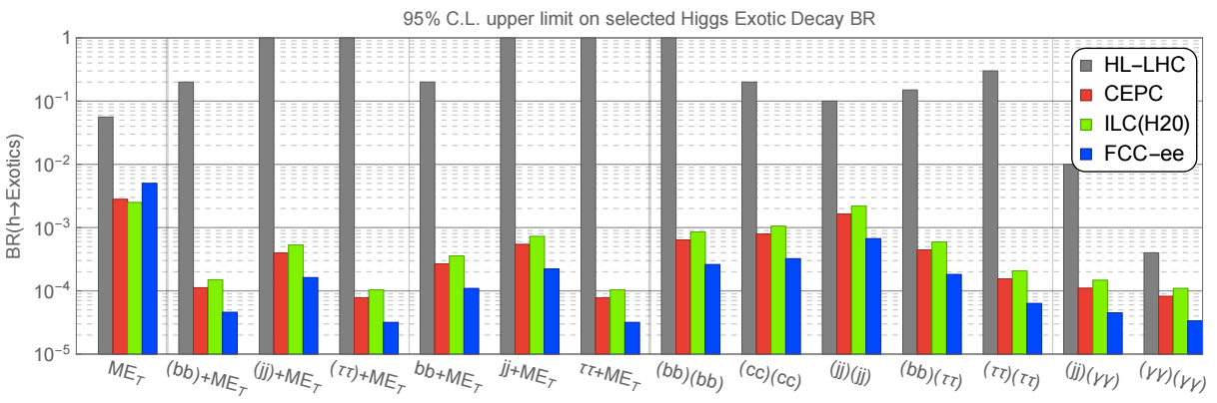
BSM Higgs
Excellent opportunities for BSM Higgs searches
arXiv:1612.09284

Slide 15
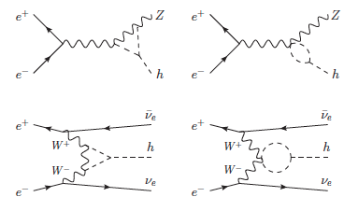
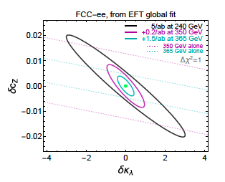
Higgs self-coupling
Very large HZ datasets allow σZH and σννH measurements of extreme precision at √s = 240, 350 and 365 GeV
Model-independent bounds obtained from global-fit on Higgs self coupling κλ and the coupling to SM bosons cZ
A precision on δκλ of ±40% can be achieved, and of ±35% in combination with HL-LHC.
If cZ if fixed to its SM value, then the precision on δκλ improves to ±20%

Slide 16
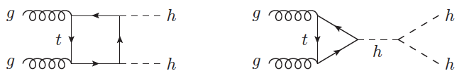
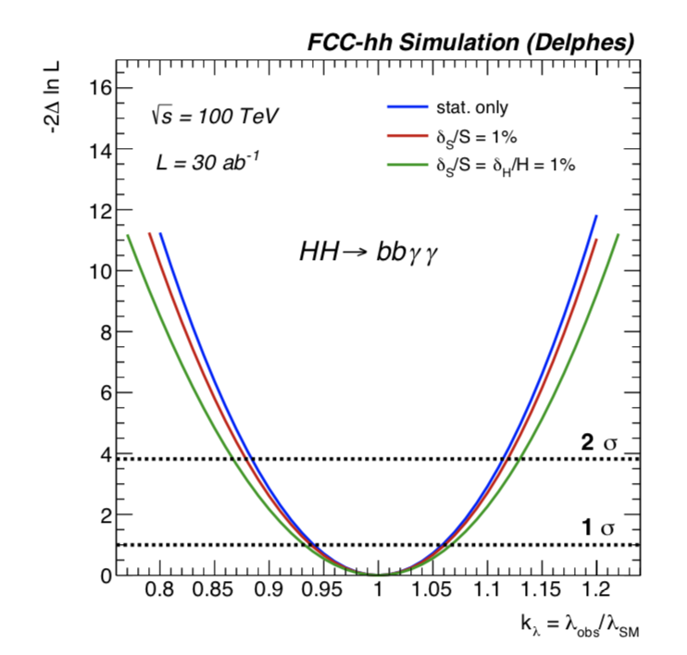

Higgs self-coupling at FCC-hh
Enormous di-Higgs samples produced at FCC-hh
  σ(100 TeV) / σ(14 TeV) ≅ 40
  L (FCC-hh) / L (HL-LHC) ≅ 10
  Naively, factor 20 smaller statistical uncertainty
Studied a number of final states
  bbɣɣ most sensitive channel
Per-cent level precision of HHH coupling
  Only possible at a 100 TeV hadron machine
  δκ 5% possible thanks also to precise BR measurements at FCC-ee
δμ ≅ 2-4%
δκ ≅ 5%
Details in arXiv:1606.09408 and arXiv1802.01607

Slide 17
Conclusions
Fantastic prospects to probe the Higgs sector with FCC
  Large Higgs samples open new possibilities
  Model-independent measurements of gZH and total width with FCC-ee
  Precision measurements of Higgs boson couplings, including self couplings, mass, CP
    sub-percent precision on several Higgs couplings only possible with FCC-ee
  BSM Higgs physics through direct and indirect measurements
  Synergy between FCC-ee and FCC-hh Higgs physics
  More precise Higgs measurements are foreseen for the FCC CDR.
  FCC-ee and FCC-hh will provide by far the best possible Higgs measurements of any accelerator.
  Stay tuned!

Slide 18
Backup

Slide 19
FCC-ee parameters
parameter | Z | WW | H (ZH) | ttbar
beam energy [GeV] | 45 | 80 | 120 | 182.5
beam current [mA] | 1390 | 147 | 29 | 5.4
no. bunches/beam | 16640 | 2000 | 393 | 48
bunch intensity [10¹¹] | 1.7 | 1.5 | 1.5 | 2.3
SR energy loss / turn [GeV] | 0.036 | 0.34 | 1.72 | 9.21
total RF voltage [GV] | 0.1 | 0.44 | 2.0 | 10.9
long. damping time [turns] | 1281 | 235 | 70 | 20
horizontal beta* [m] | 0.15 | 0.2 | 0.3 | 1
vertical beta* [mm] | 0.8 | 1 | 1 | 1.6
horiz. geometric emittance [nm] | 0.27 | 0.28 | 0.63 | 1.46
vert. geom. emittance [pm] | 1.0 | 1.7 | 1.3 | 2.9
bunch length with SR / BS [mm] | 3.5 / 12.1 | 3.0 / 6.0 | 3.3 / 5.3 | 2.0 / 2.5
luminosity per IP [10³⁴ cm⁻²s⁻¹] | >200 | >25 | >7 | >1.4
beam lifetime rad Bhabha / BS [min] | 68 / >200 | 49 / >1000 | 38 / 18 | 40 / 18

Slide 20
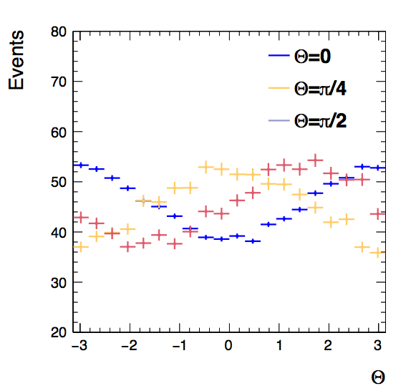

Higgs CP studies
H→𝛕𝛕 decay is a promising channel to study CP violation
  Tree level couplings to quarks and leptons
  CP-even and CP-odd couplings induced at the same order
CP violation can be probed through 𝛕 polarization
  𝛕 decays clean enough that the spin information is not washed out by hadronization effects
  pion emission preferred in the direction of the 𝛕 spin in rest frame
  exploring
  model using effective lagrangian
Andres Rios (MIT), Aram Apyan (FNAL)
following arXiv:1308.1094
920 signal event in 5 ab⁻¹
expected 68% CL
      0.17 radian (0.05 in GEN level study)
      9.7 degree (2.9 in GEN level study)

Slide 21

Higgs self-coupling at hadron colliders
Probing triple-Higgs coupling with double Higgs production
  Consistency of check of EWSB
  Reconstructing the Higgs potential
  Sensitivity through yields and kinematics
  Large enhancement through BSM possible
  Exhaustive program at the (HL-)LHC
EFT Lagrangian

