Slide 1
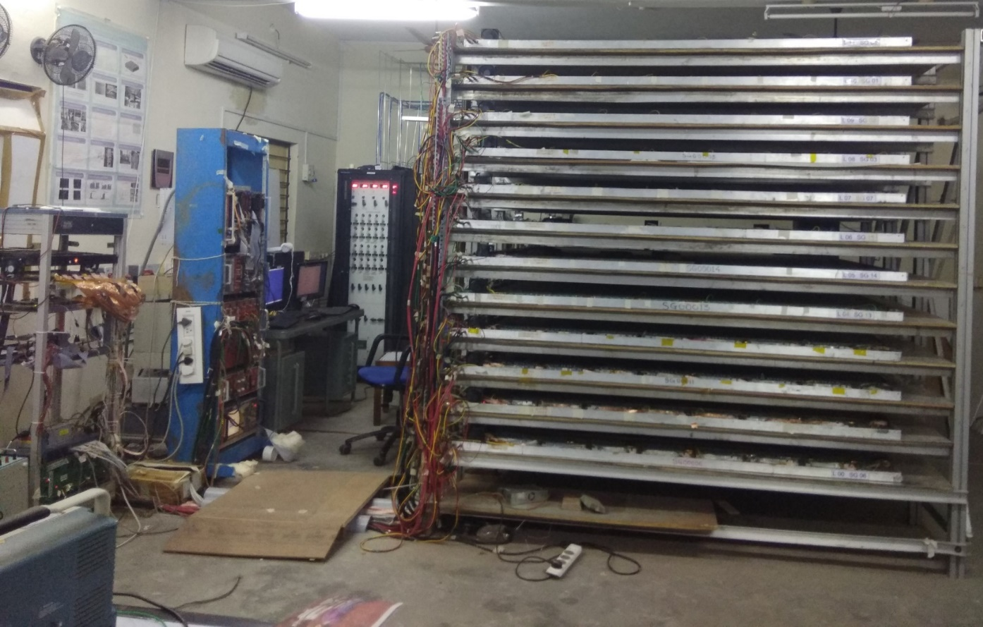
Design and construction of, and physics results from an INO RPC detector stack
Gobinda Majumder, TIFR, Mumbai
INO collaboration
Introduction
RPC detector and gas composition
Signal and noise in RPC
Muon trajectory
Zenith and azimuthal distribution of muon
Conclusion

Slide 2
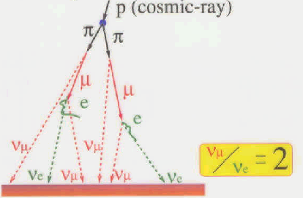
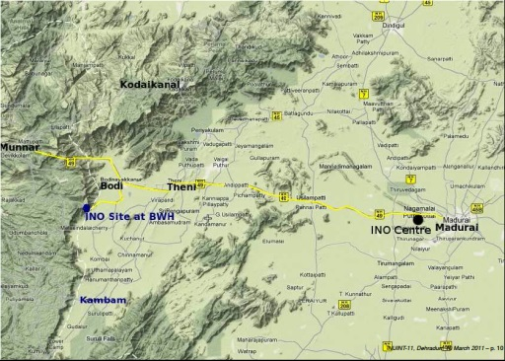
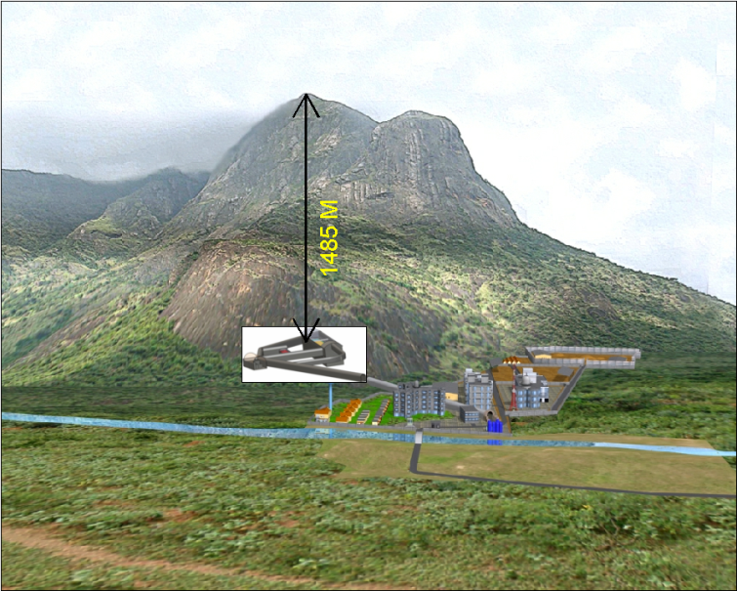
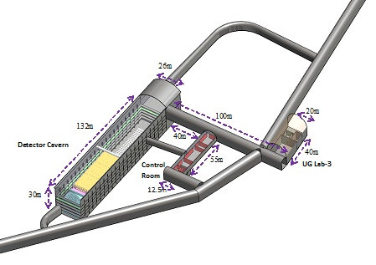
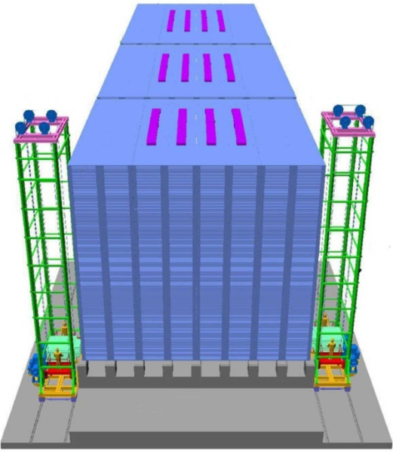
Introduction : India based neutrino observatory
Create experimental facility in the country where we can carry out experiments in the field of particle & astroparticle physics.
Underground laboratory with ~1 km all-round rock cover accessed through a 2 km long tunnel. A large and several smaller caverns to facilitate many experimental programmes.
Frontline neutrino issues e.g., mass parameters and other properties, will be explored in a manner complementary to ongoing efforts worldwide.
The ICAL detector, with its charge identification ability, will be able to address questions about the neutrino mass ordering.

Slide 3
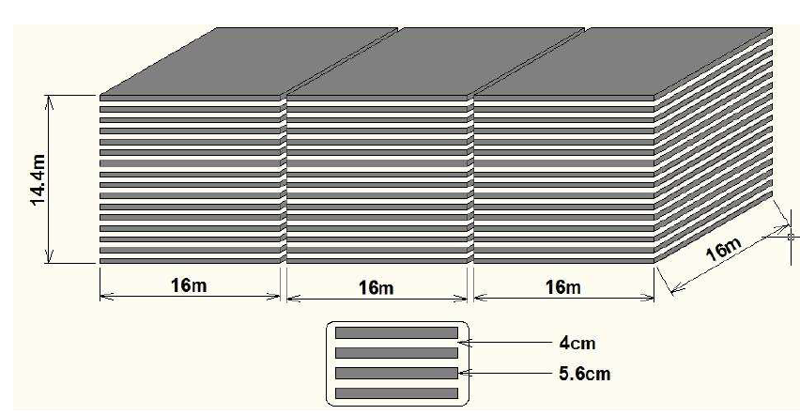
INO detector and Construction of RPC
Fast and precise timing information to identify up-down ambiguity of muon: RPC is a the best choice to have 1ns precision with low cost
3cm strip pitch & strip multiplicity : ~5mm position resolution (along with ~1.3T magnetic filed) to identify bending of +ve and −ve muon, very crucial for the determination of neutrino mass hierarchy
Total number of RPCs in the ICAL = 3 × 150 × 64 = 28,800
Total gas volume = 28,800 × 190cm × 190cm × 0.2cm ~ 214,531 litres
Total surface area = 28,800 × 1.9m × 1.9m ~ 104000 m²
Standard gas composition for the avalanche mode:
  R134a(C₂H₂F₄):Isobutane(C₄H₁₀):Sulphur Hexafluoride(SF₆)::95.5:4.3:0.2
  Operation on 2mbar pressure on top of atmospheric pressure, 6 sccm flow rate
Notes:
3

Slide 4
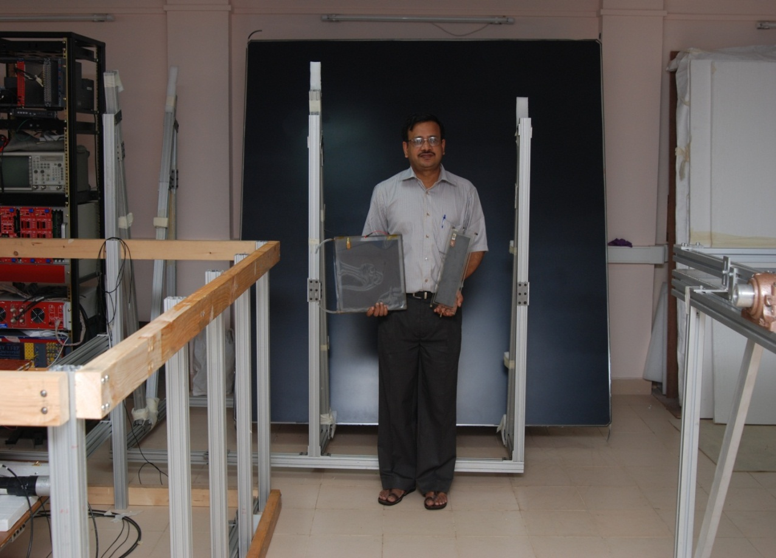
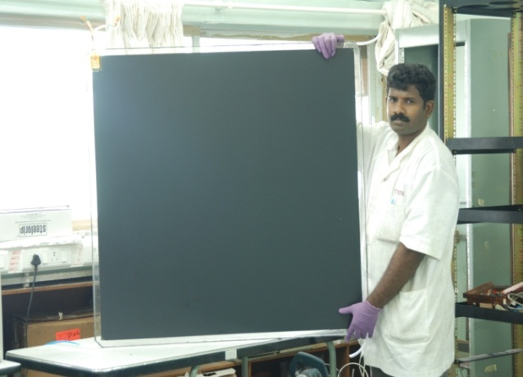
A journey through RPC road
200 cm × 200 cm
30 cm × 30 cm
10 cm × 30 cm
100 cm × 100 cm
Now with 200 cm × 200 cm Glass RPC in Avalanche mode

Slide 5
RPC embedded Electronics

Slide 6
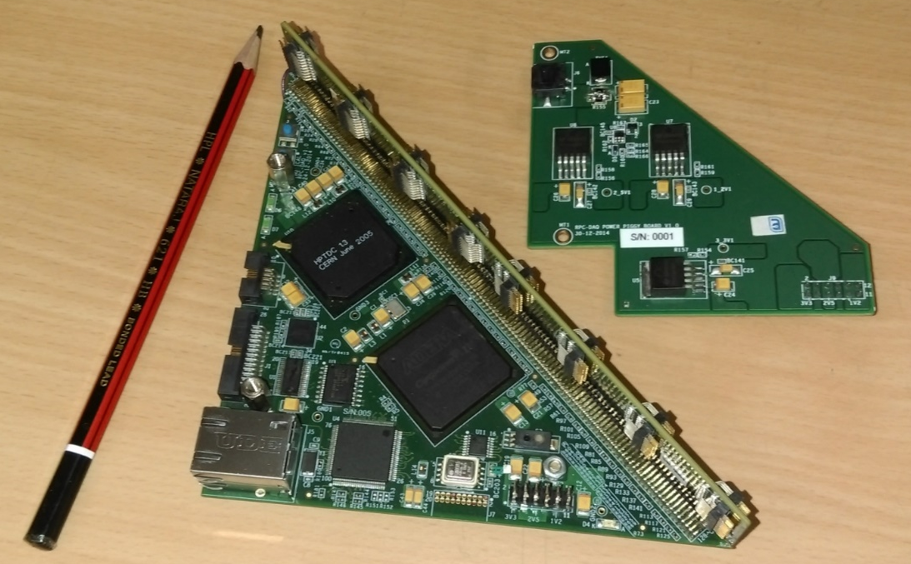
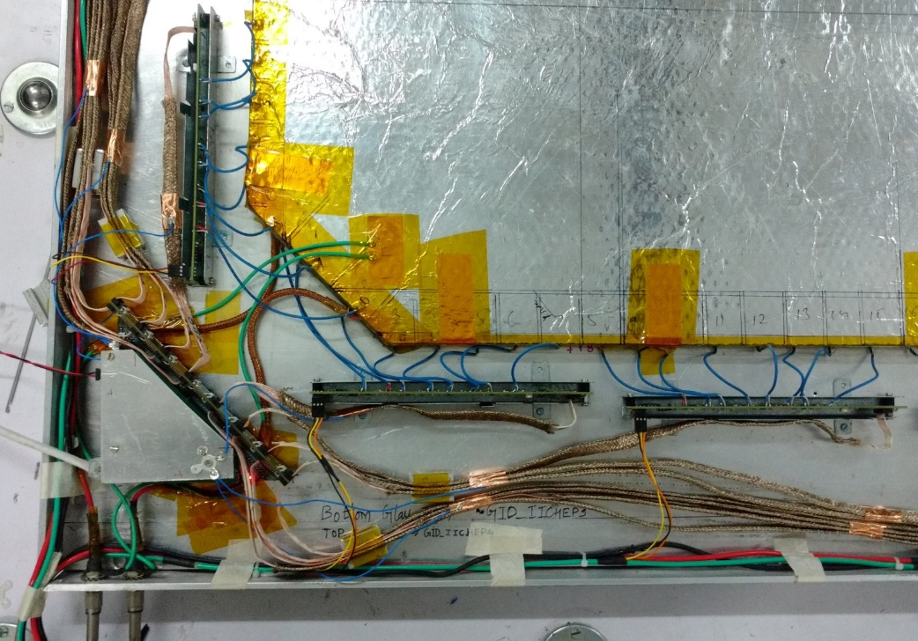
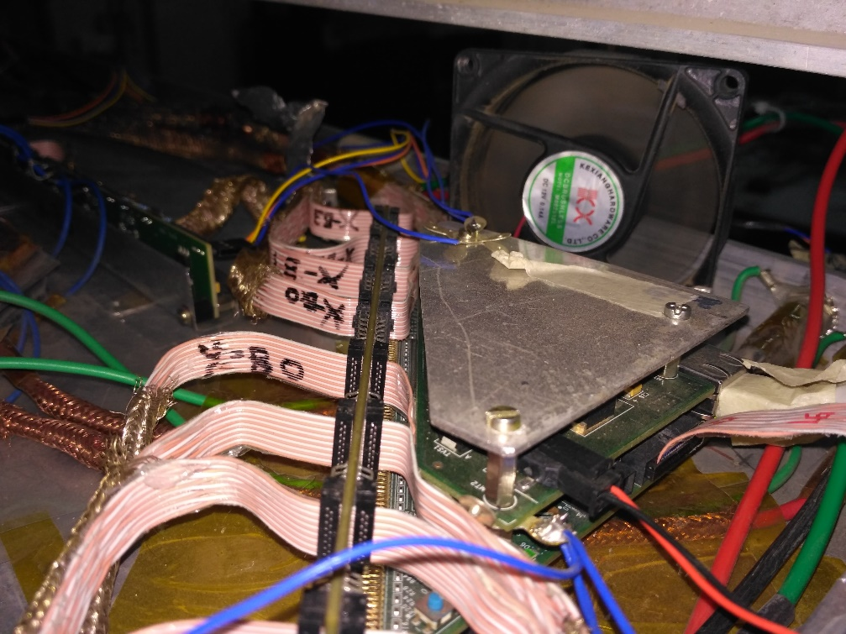
RPC with ICAL electronics

Slide 7
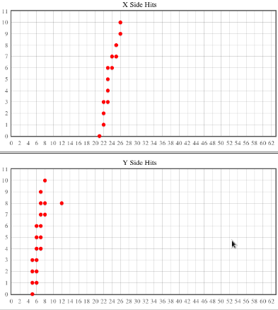
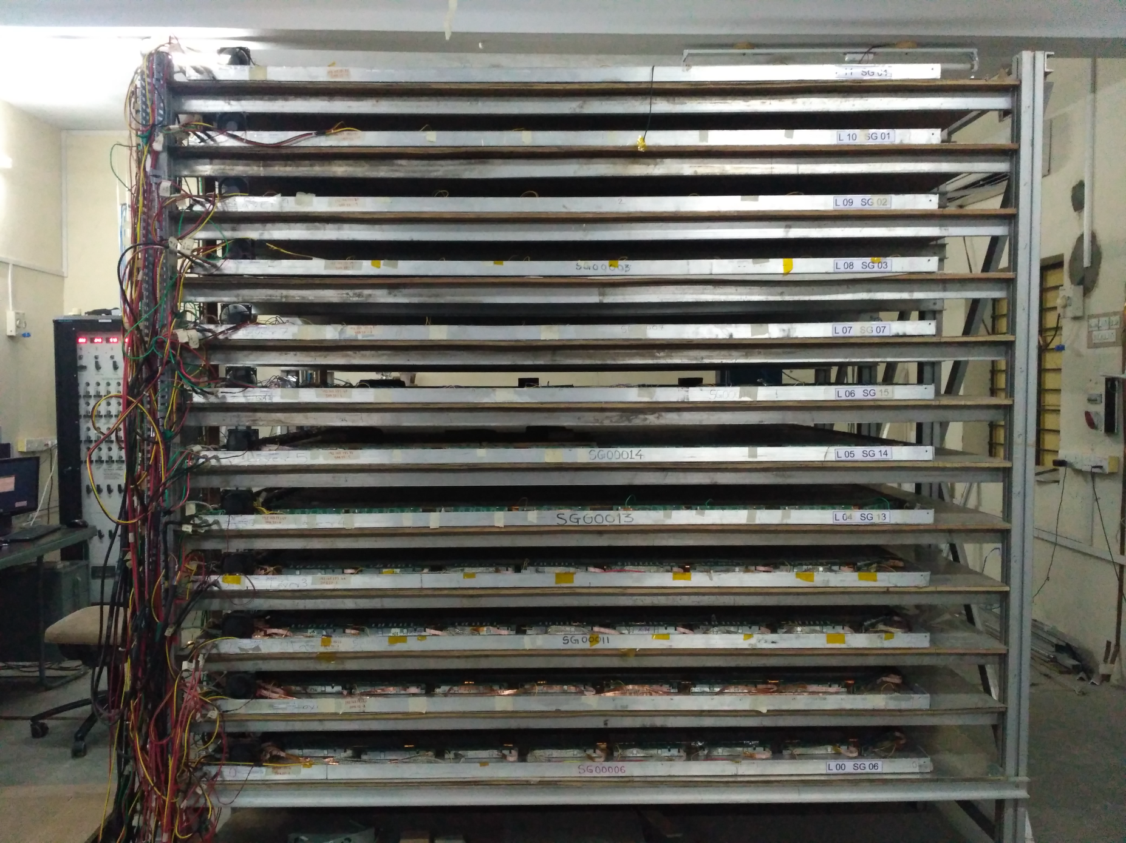
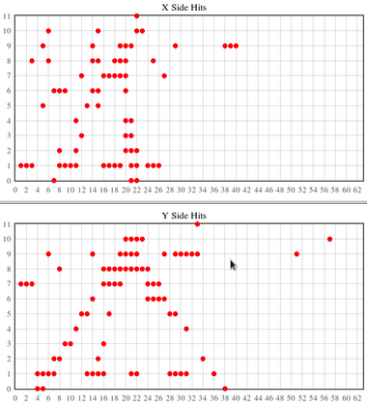
Twelve layer RPC stack at Inter institutional centre of HEP, Madurai
Clean Muon signal
L0…………..…L6……………… L11
Hadronic interaction
Tested many RPCs using this stack for the efficiency maps as well as for studying their performance.
One way to validate the production of RPCs for ICAL

Slide 8
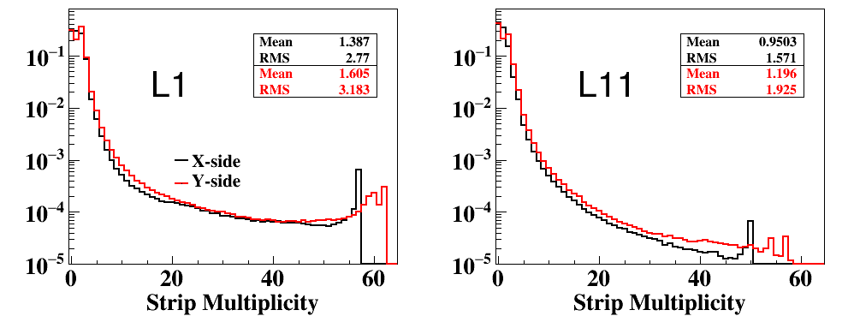
Strip multiplicity in all events
Trigger condition : At least one strip in Layer-7,8,9&10 has signal more than V_{th}
Strip multiplicities is about 1.5
Multiplicity 0 : inefficiency
Multiplicities : 1- ~4, Avalanche signal in RPC
Multiplicities : ~5 - ~20, Streamer mode signal in RPC
Multiplicities : >20, mainly due to correlated electronic noise

Slide 9
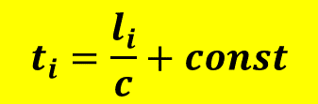
Basic principle to analyse muon data
Fit X-Z/Y-Z trajectory of a muon excluding the layer under study (Lxy)
Extrapolate muon trajectory in the layer Lxy
Calculate extrapolated point in strip co-ordinate (-0.5 to 0.5)
Look for multiplicities as a function of this co-ordinate
Expected single strip hit for trajectory passing through the center (all induced charge in one strip)
Same region, double strip hit, which passed through the boundary; also inefficiency
x
x
x
x
x
x
x
x
x
x
x
x
x
x
x
x
x
−0.5 0 0.5
x
x
x
x
x
x
x

Slide 10
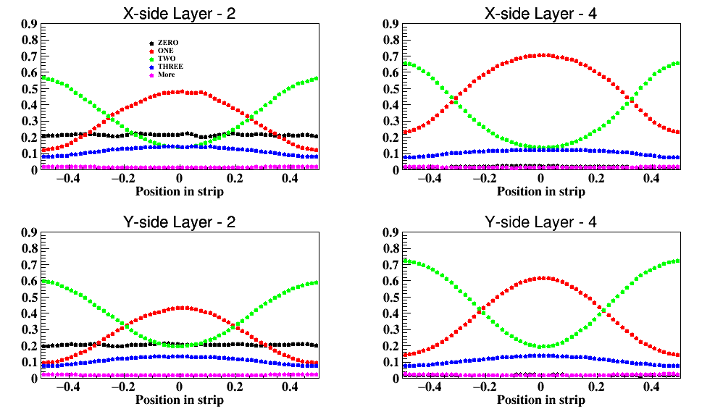
Strip multiplicity
Ensure our alignment correction is working properly
ZERO multiplicity : Inefficiency
Single strip : while muon passed through the centre of the strip
Double strip : while passed though the boundary of two strip

Slide 11
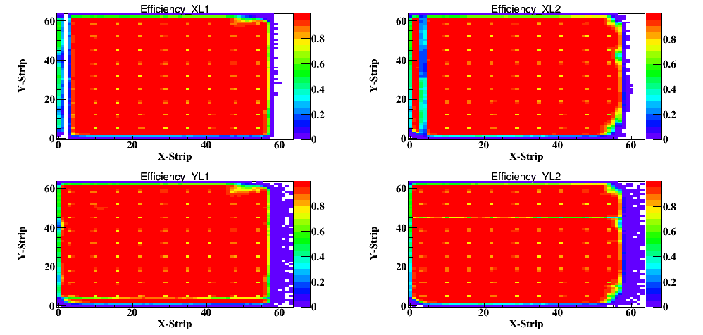
Efficiency in different layers
Button spacers are clearly visible
Inefficiency band is due to electronics associated with strip(s)
Inefficiency areas are due to improper graphite coating and/or larger gap

Slide 12
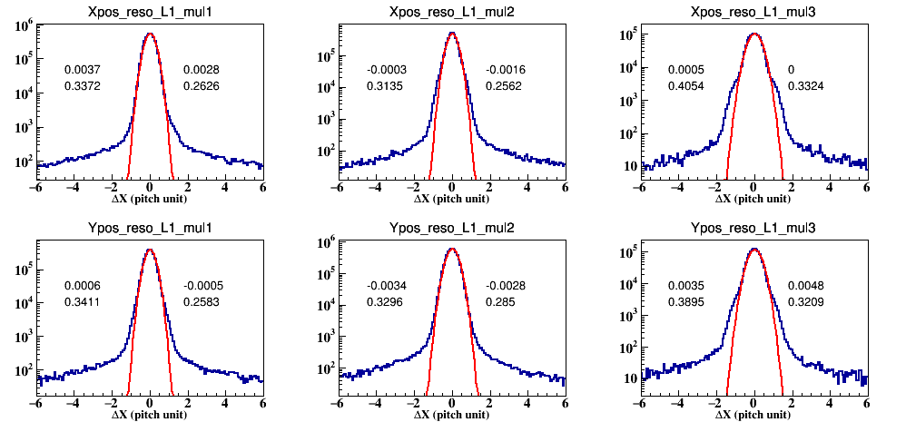
Position resolution (×3cm) for multiplicity 1,2&3
Almost independent of multiplicity upto 2, beyond three the resolution is too large due to streamer pulse
Tail is mainly due to large RPC signals (streamer) and inefficient strips/electronics

Slide 13
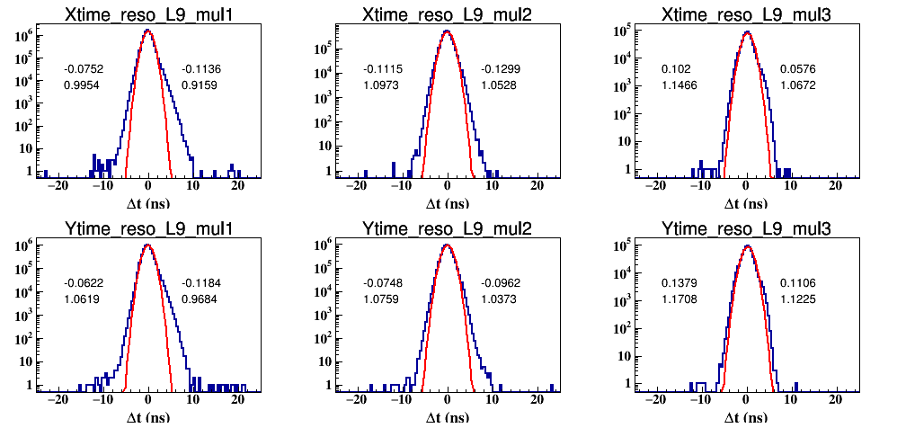
Time resolution (in ns) for multiplicity 1,2&3
Almost independent of multiplicity upto 2, but beyond that the resolution is deteriorating due to streamer pulse
Asymmetry (particularly in single multiplicity) is due to lower gain. Tail in lower side is due to large signal near button spacers

Slide 14
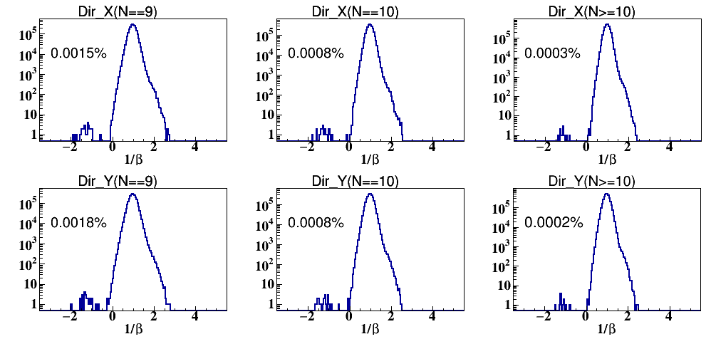
Muon direction : t_{i} = l_{i}/βc + α
Fraction of muon with −ve value of β are also quoted
−ve value of β implies upward muon, whose probability is negligible and considered as mismeasurement of muon direction.
With more than 9 layer hits, direction of most of the muon is unambiguous, one of the requirement of INO physics

Slide 15
Cosmic muon spectrum from this result
I = I₀ cos^{n}θ
PRL 83 (1999) 4241
No measurement of momentum without magnetic field.
But, total flux (I₀) and exponent term (n) can be measured with this data.
Need to do GEANT4 detector simulation of stack including root (even beam of the roof), support lead brick in few places etc.
During reconstruct include noise, inefficiency, multiplicity, time resolution etc.
Due to geometric acceptance criteria, observed value I₀ and n need to be corrected using information of MC simulated sample.

Slide 16
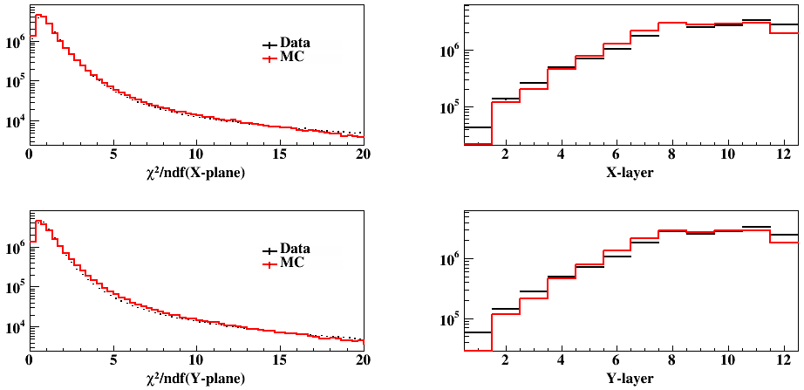
Comparison of MC and Data
Lower multiplicity is due hadronic shower in data
Data and MC are matched well

Slide 17
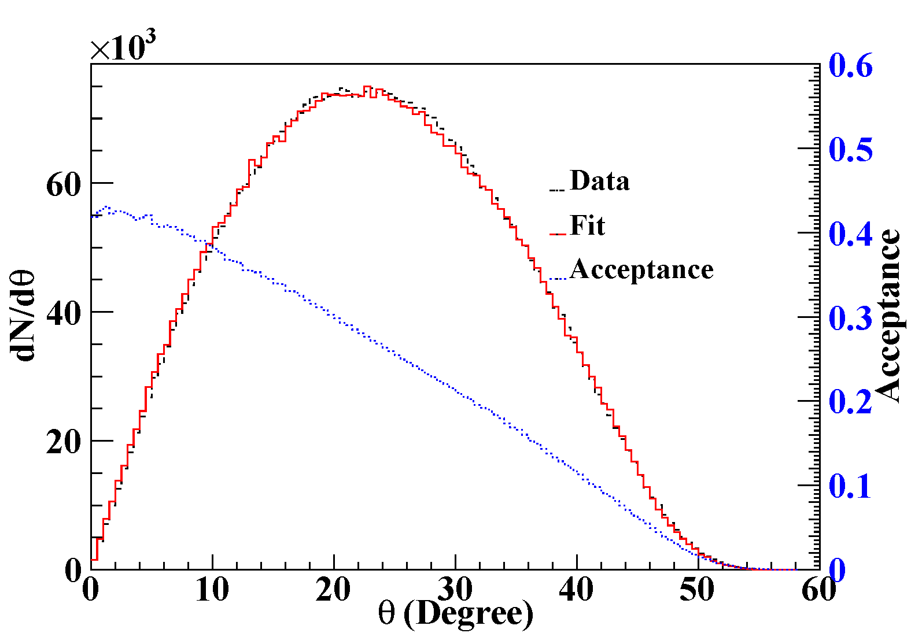
Cosmic muon spectrum at Madurai stack
I = I₀ cos^{n}θ
Incorporated noise, inefficiency, trigger in Geant4 MC sample to compare with data and obtain “n” and “I₀”
Very good agreement with other results : Lower flux for lower Geomagnetic latitude

Slide 18
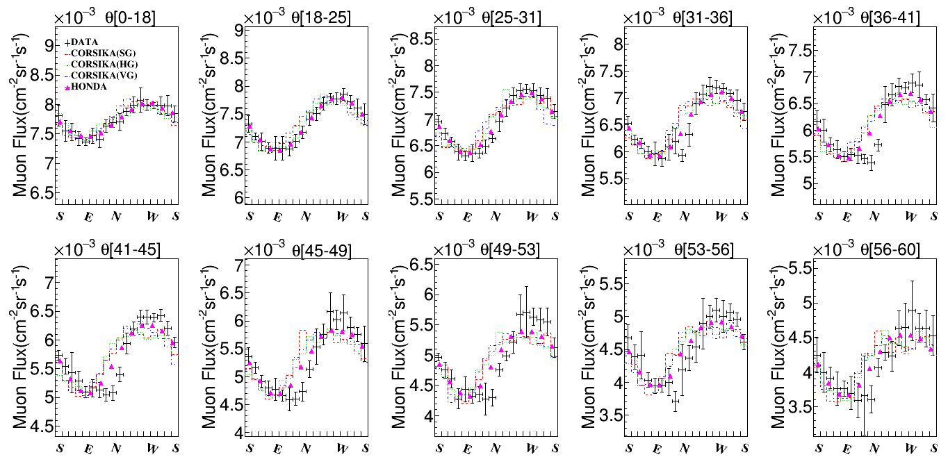
Azimuthal angle of muon
More or less matched with simulated and theoretical models, except from “North” direction.

Slide 19
Summary
We have successfully tested large sized RPCs with final electronics at Madurai detector stack
Detector efficiencies and time resolutions are more or less matched with expected values
Observed muon flux at Madurai is matched with prediction except flux rate from “North” direction.

