Slide 1
Direct and Indirect Measurements of the Top Quark Mass in pp Collisions
Stefan Söldner-Rembold
The University of Manchester
On behalf of the DØ Collaboration

Slide 2
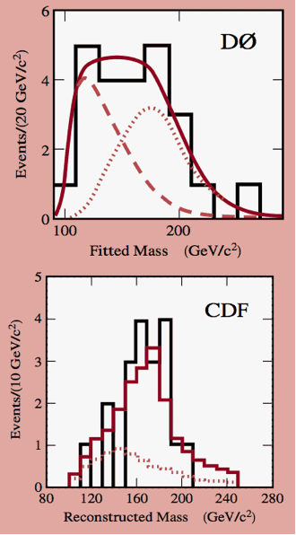
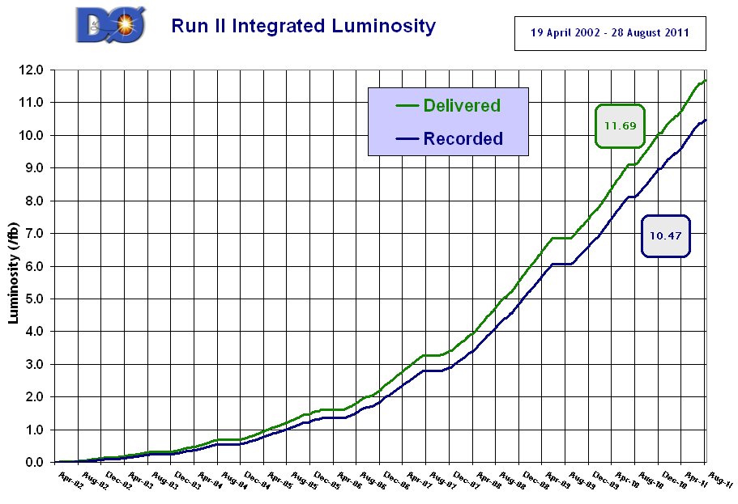
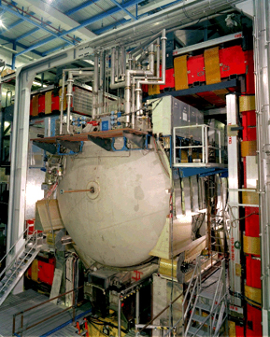
The TevatrOn Particle
1995
17 events
19 events
All results based on full Tevatron data set

Slide 3
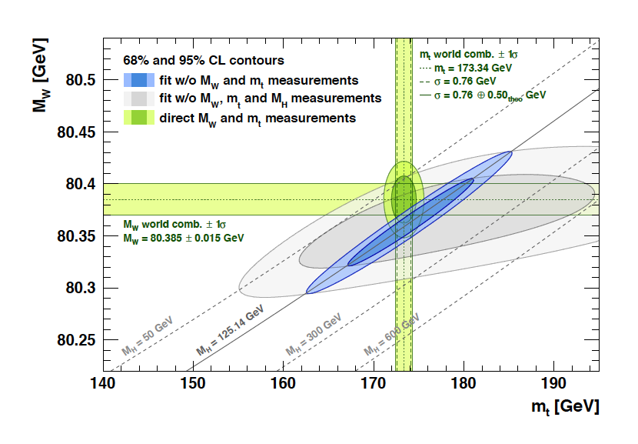
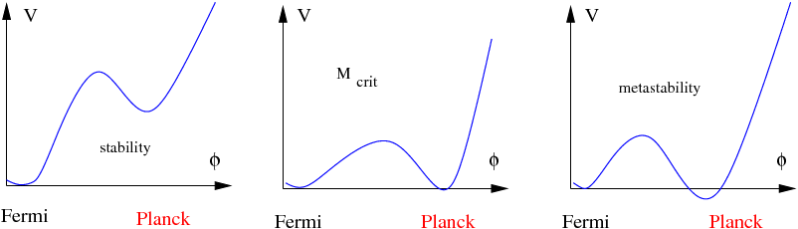
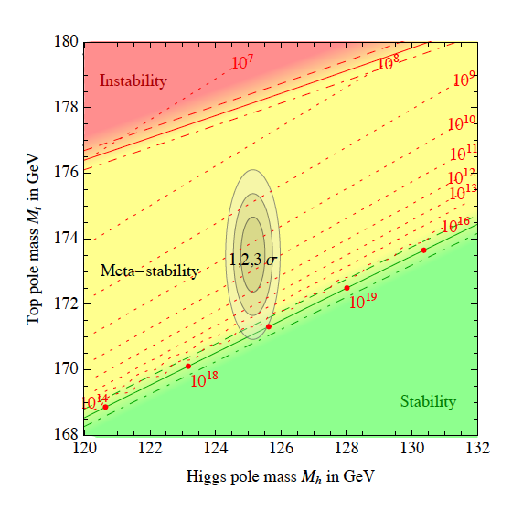
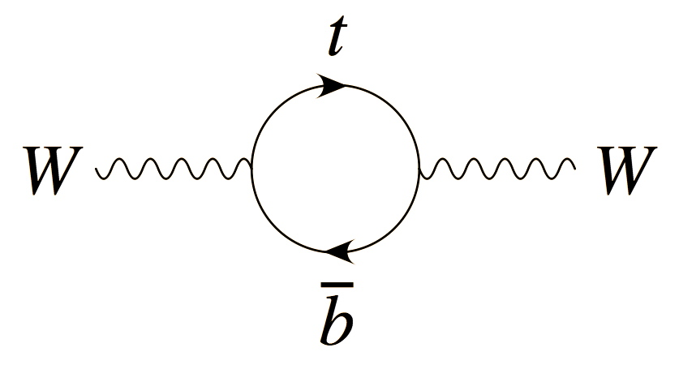
Motivation
M. Shaposhnikov, EPS 2013
Gfitter, EPJC 74, 3046 (2014)
D. Buttazzo et al., JHEP 12, 89 (2013)
Top mass important for self-consistency check of SM and for determining stability of EW vacuum.
Requires a theoretically rigorous definition of top mass (pole mass).
Difference between “MC mass” and pole mass expected to be of order 0.4 GeV.
(M. Butenschoen et al., PRL 117, 232001 (2016))

Slide 4
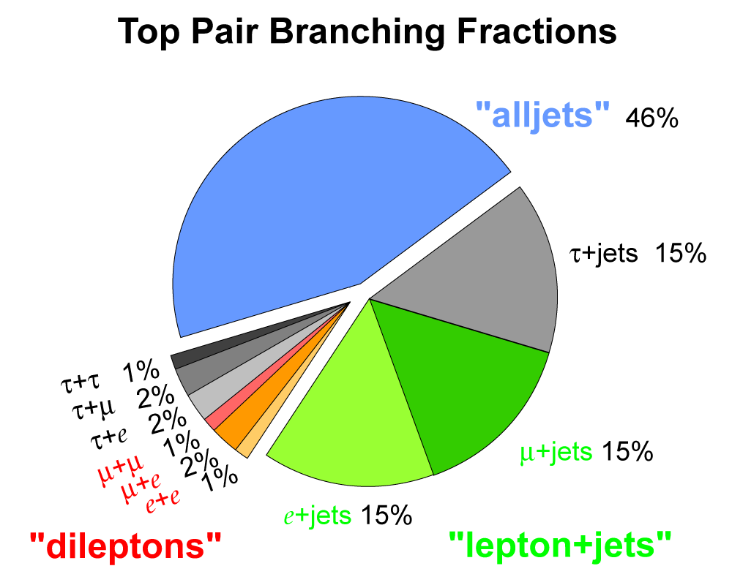
Top Pair Final States
Br(t→W⁺b)=100%
Lepton + jets
1 isolated lepton
Missing E_{T} from neutrino
≥ 4 jets (2 b jets)
Dilepton
2 isolated leptons
Large Missing E_{T} from neutrino
2 b jets
Not used in combination
All-jets channel
Tau channels
W boson decays

Slide 5
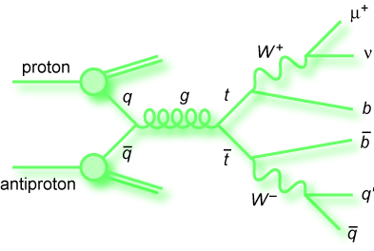
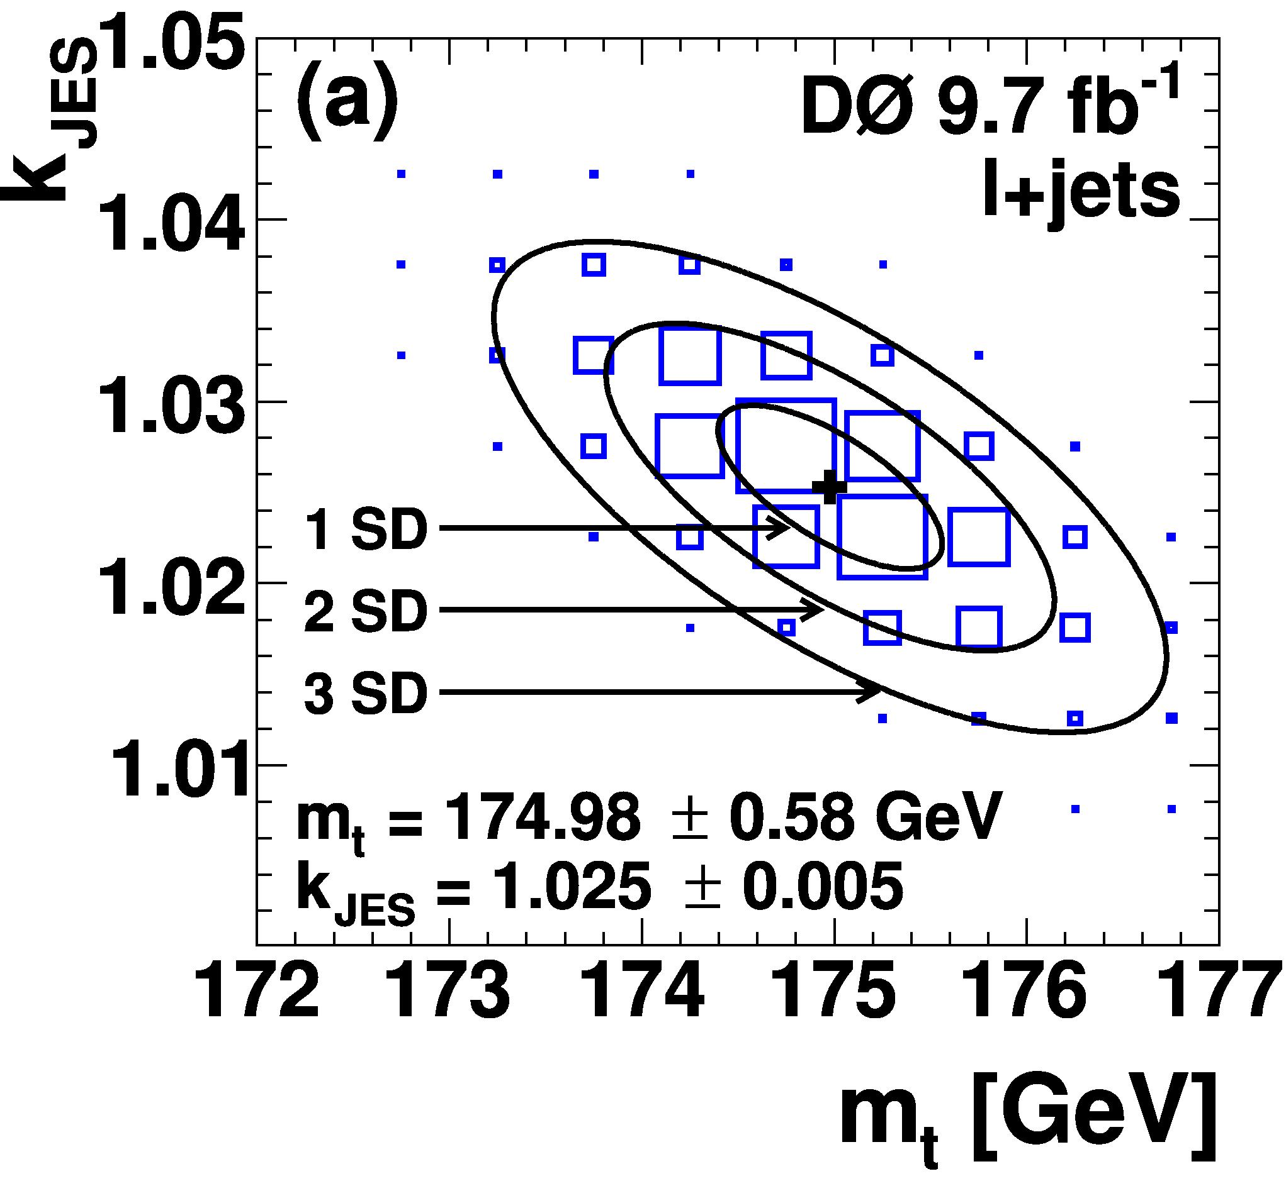

Top Mass and Jet Energy Scale (JES)
Production dominated by quark-antiquark
annihilation (85%)
Joint fit of JES and top mass in lepton+jets measurement, using W mass as constraint.
This JES is then used for the di-lepton channel.
Uses matrix element method
PRL 113,
032002 (2014)
Most precise Tevatron single top mass measurement

Slide 6
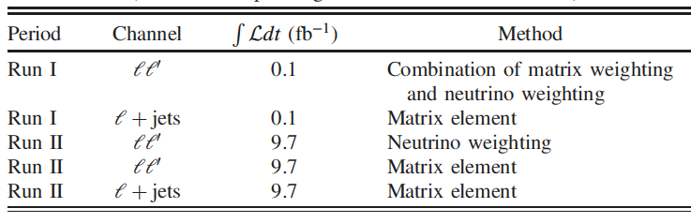
DØ Combination
Combination of Run I and Run II direct top mass measurements in leptons+jets and dilepton channels
Analyses use matrix element and neutrino weighting
Direct top mass reconstruction measures MC mass parameter of the parton shower.

Slide 7
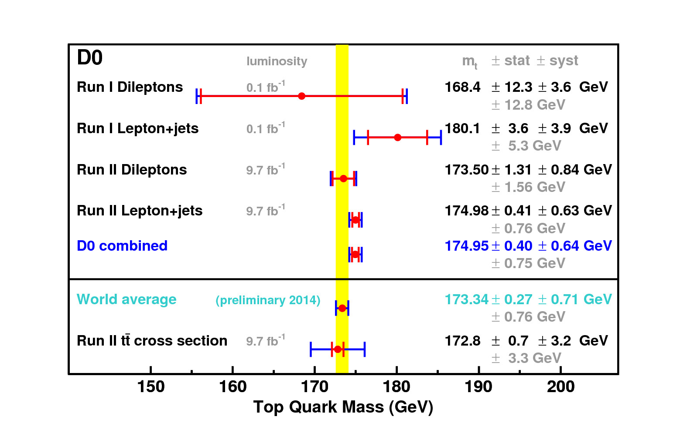

DØ Combination
Combination takes into account all uncertainties and their correlations.
Uses BLUE (Best Linear Unbiased Estimate) method.
Combined direct mass
Dominant systematic uncertainty from in-situ light-jet calibration (0.4 GeV).
Good consistency:
𝜒²/NDF = 0.8, Probability = 0.47
Phys. Rev. D 95, 112004 (2017)
DØ about 2-3 standard deviations higher than world average

Slide 8
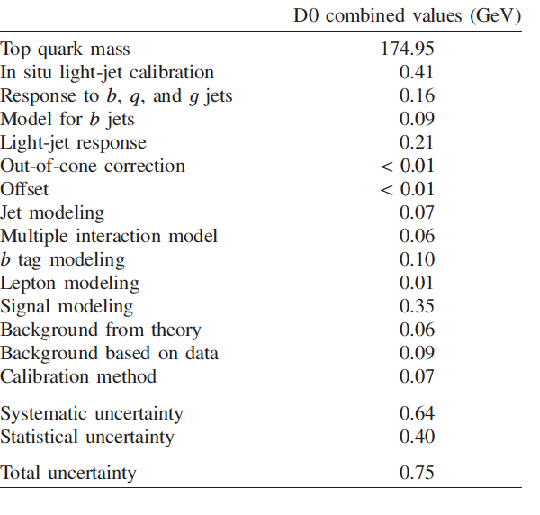
DØ Combination
Combination takes into account all uncertainties and their correlations.
Uses BLUE (Best Linear Unbiased Estimate) method.
Combined direct mass
Dominant systematic uncertainty from in-situ light-jet calibration (0.4 GeV).
Good consistency:
𝜒²/NDF = 0.8, Probability = 0.47
Phys. Rev. D 95, 112004 (2017)

Slide 9
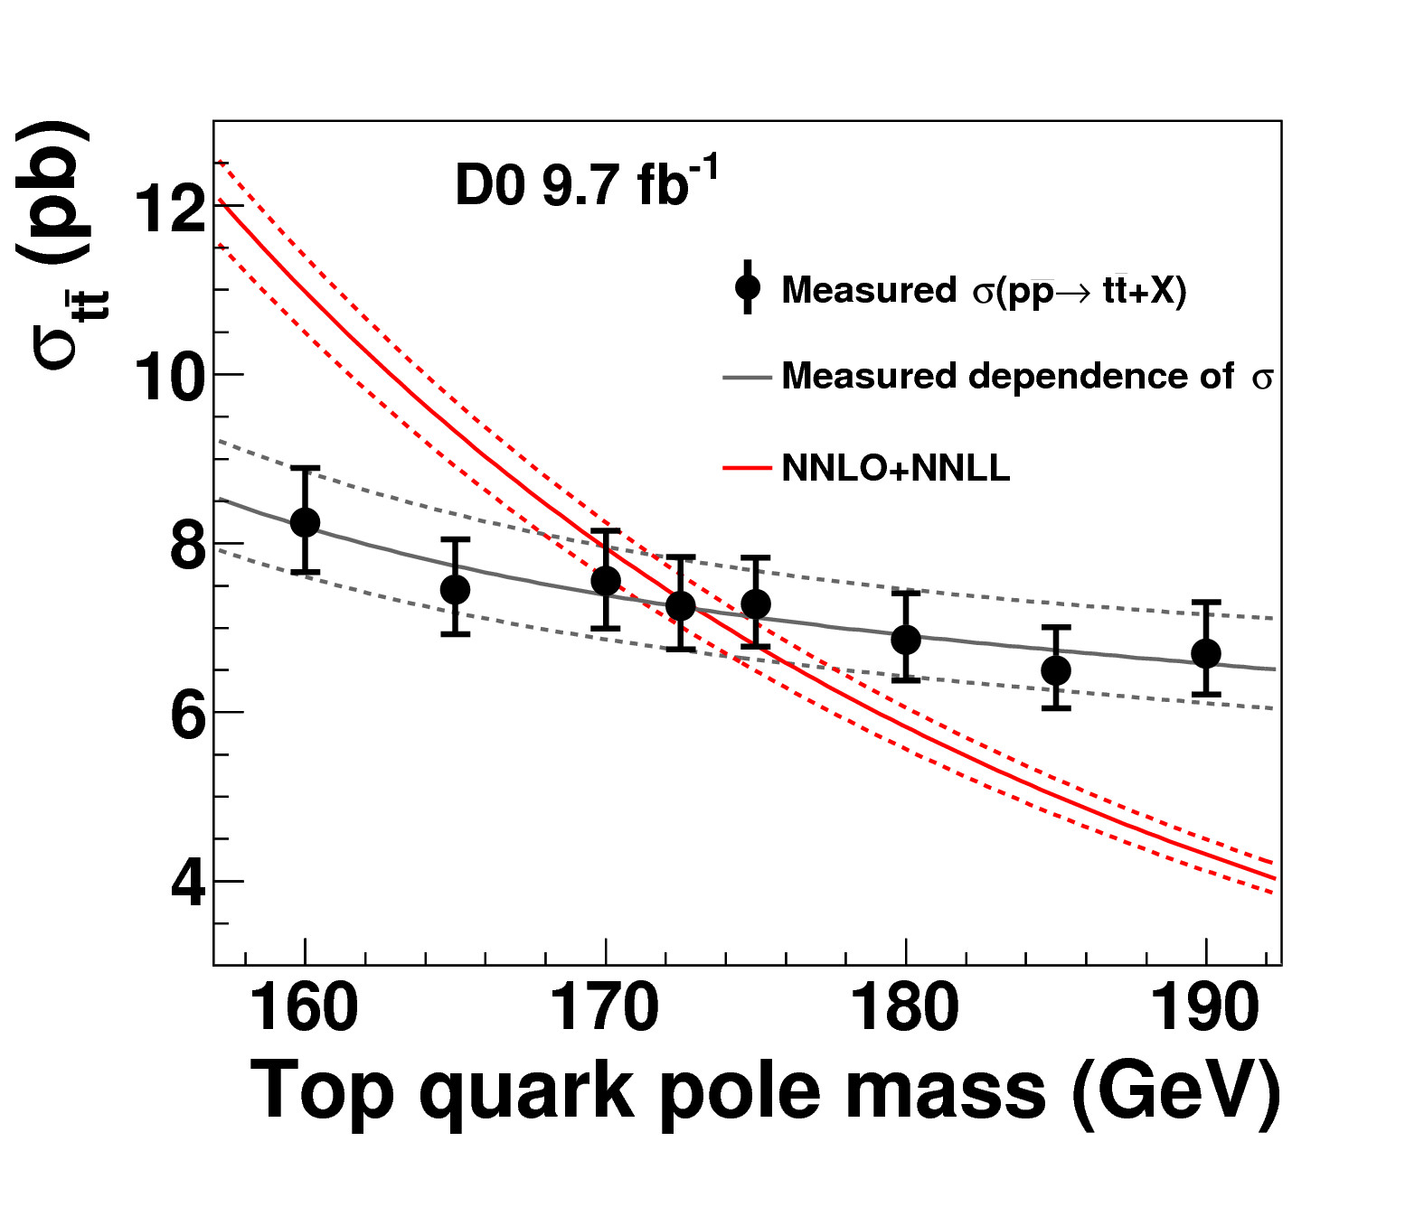
Top Pole Mass from Total Cross Section
Total cross section depends on pole mass.
Pole mass is the real part of the pole in the top-quark propagator – theoretically well defined.
Measured cross section shows (weaker) top mass dependence due to acceptance variation.
Use Bayesian flat prior for top mass.
Extract pole mass (with MSTW2008):
Phys. Rev. D 94, 092004 (2016)

Slide 10
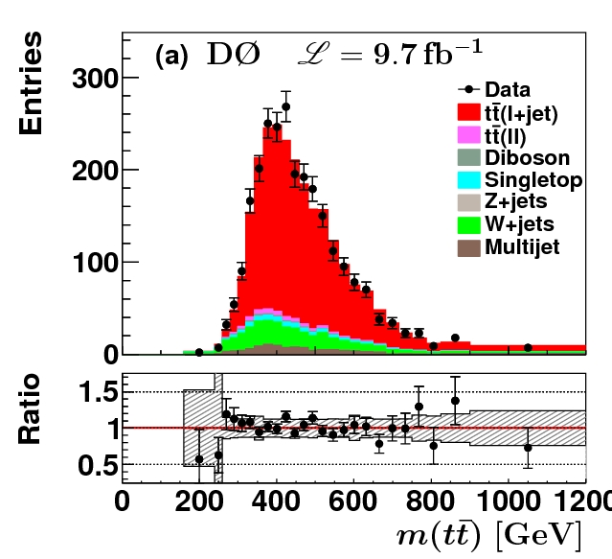
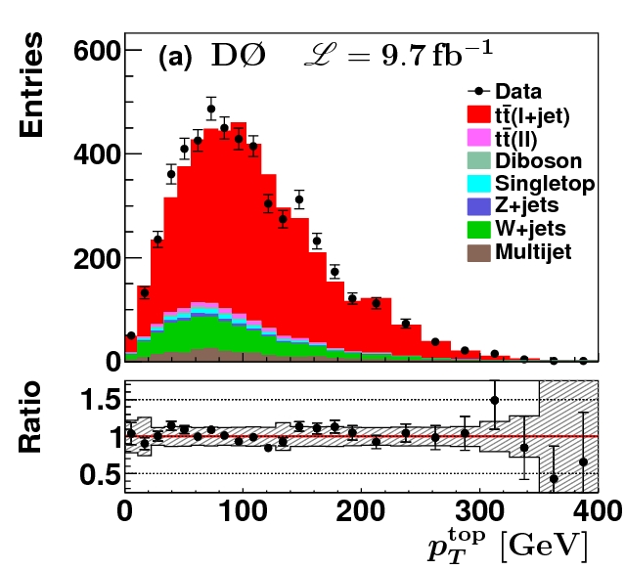
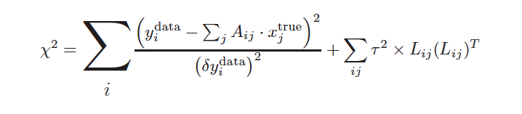
Top Mass from Differential Cross Section
Variables used
  Mass of di-top system, m(tt)
  Top transverse momenta, p_{T}(t)
Data taken from published lepton+jets measurement (PRD 90, 092006 (2014))
Need background subtracted and unfolded differential cross section to compare to theory calculations
Use regularized matrix unfolding
Combined lepton+jets sample
PRD 90, 092006 (2014)

Slide 11
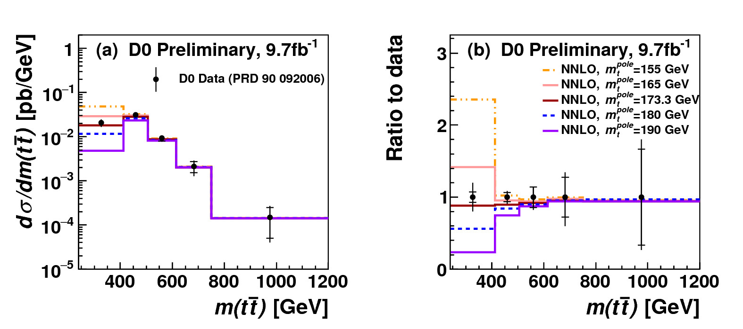
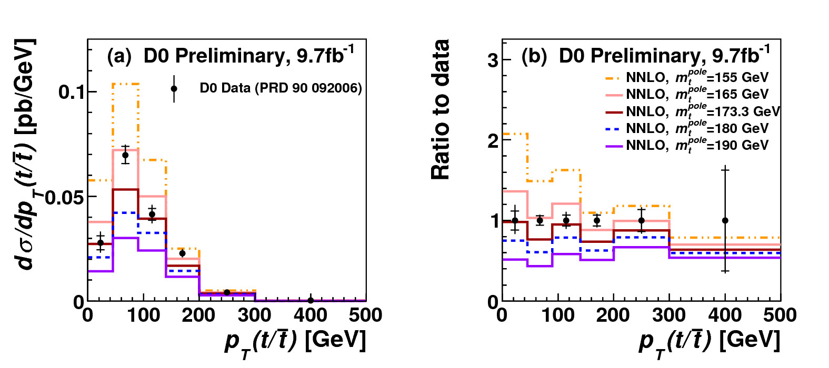
Top Mass from Differential Cross Section
Data taken from published lepton+jets measurement (PRD 90, 092006 (2014))
Pole mass is extracted for both NLO and NNLO PDF sets from MSTW2008, CT10, NNPDF2.3 and HERAPDF
Here compared to NNLO pQCD calculations (Czakon, Fiedler, Heymes, Mitov, JHEP, 1605, 034 (2016)) with MSTW 2008.
Sensitivity mainly at the threshold in m(tt) and for lower p_{T}(t)

Slide 12
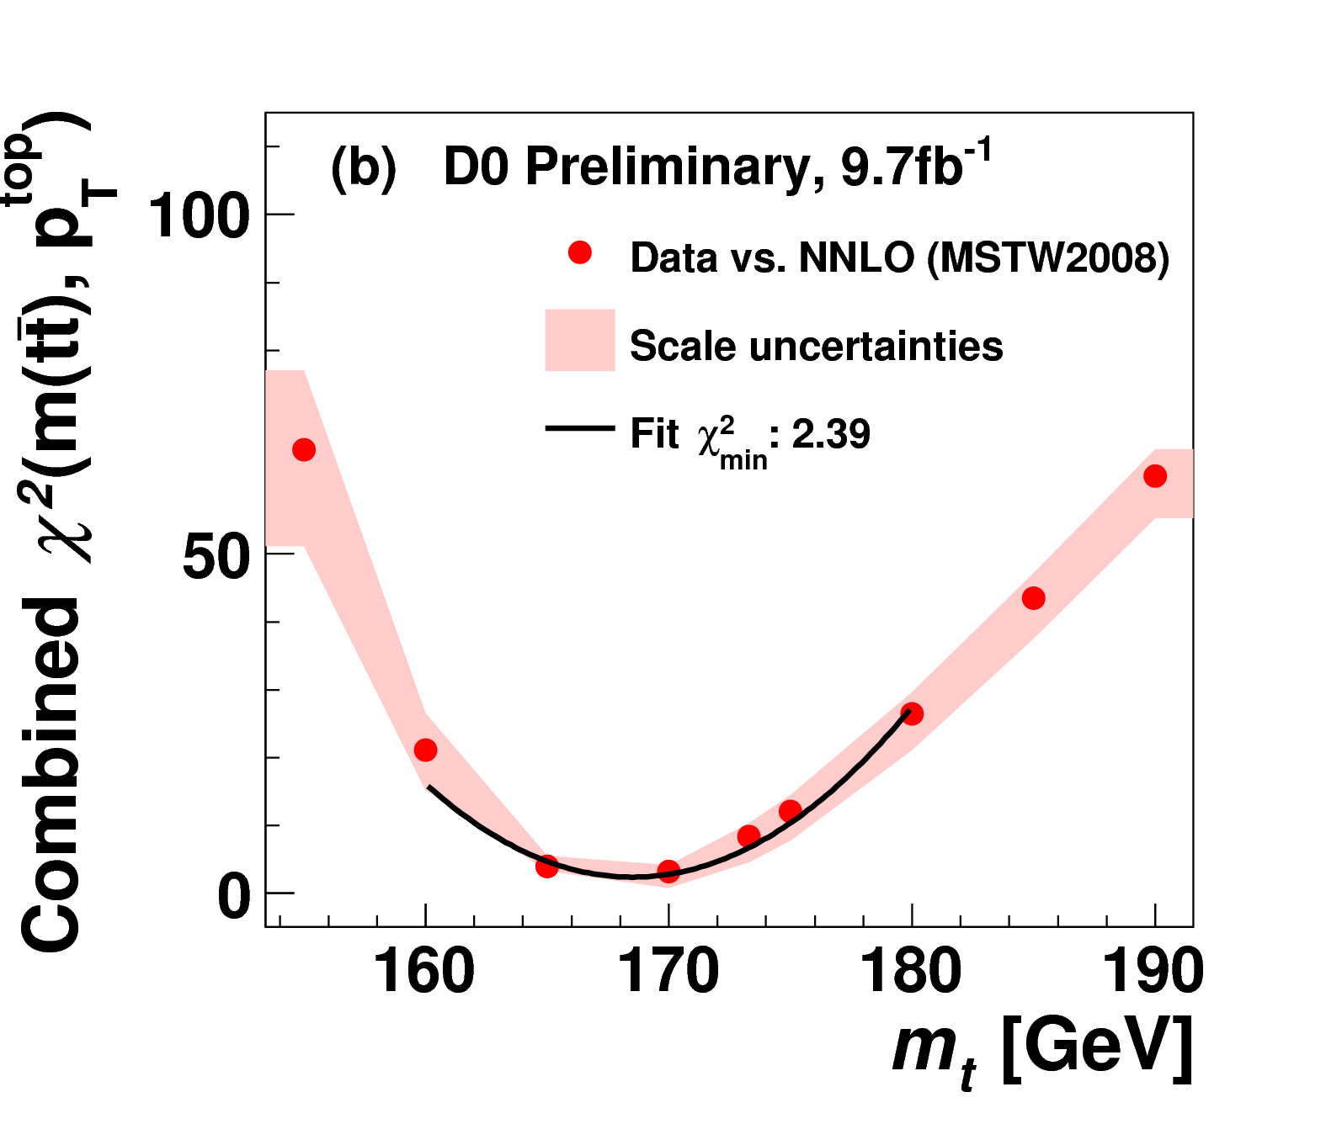

Top Mass from Differential Cross Section
Mass extracted from fit to unfolded data, using correlation matrix.
𝜒²(data-theory) minimized to determine mass and uncertainty using parton level calculations.

Slide 13
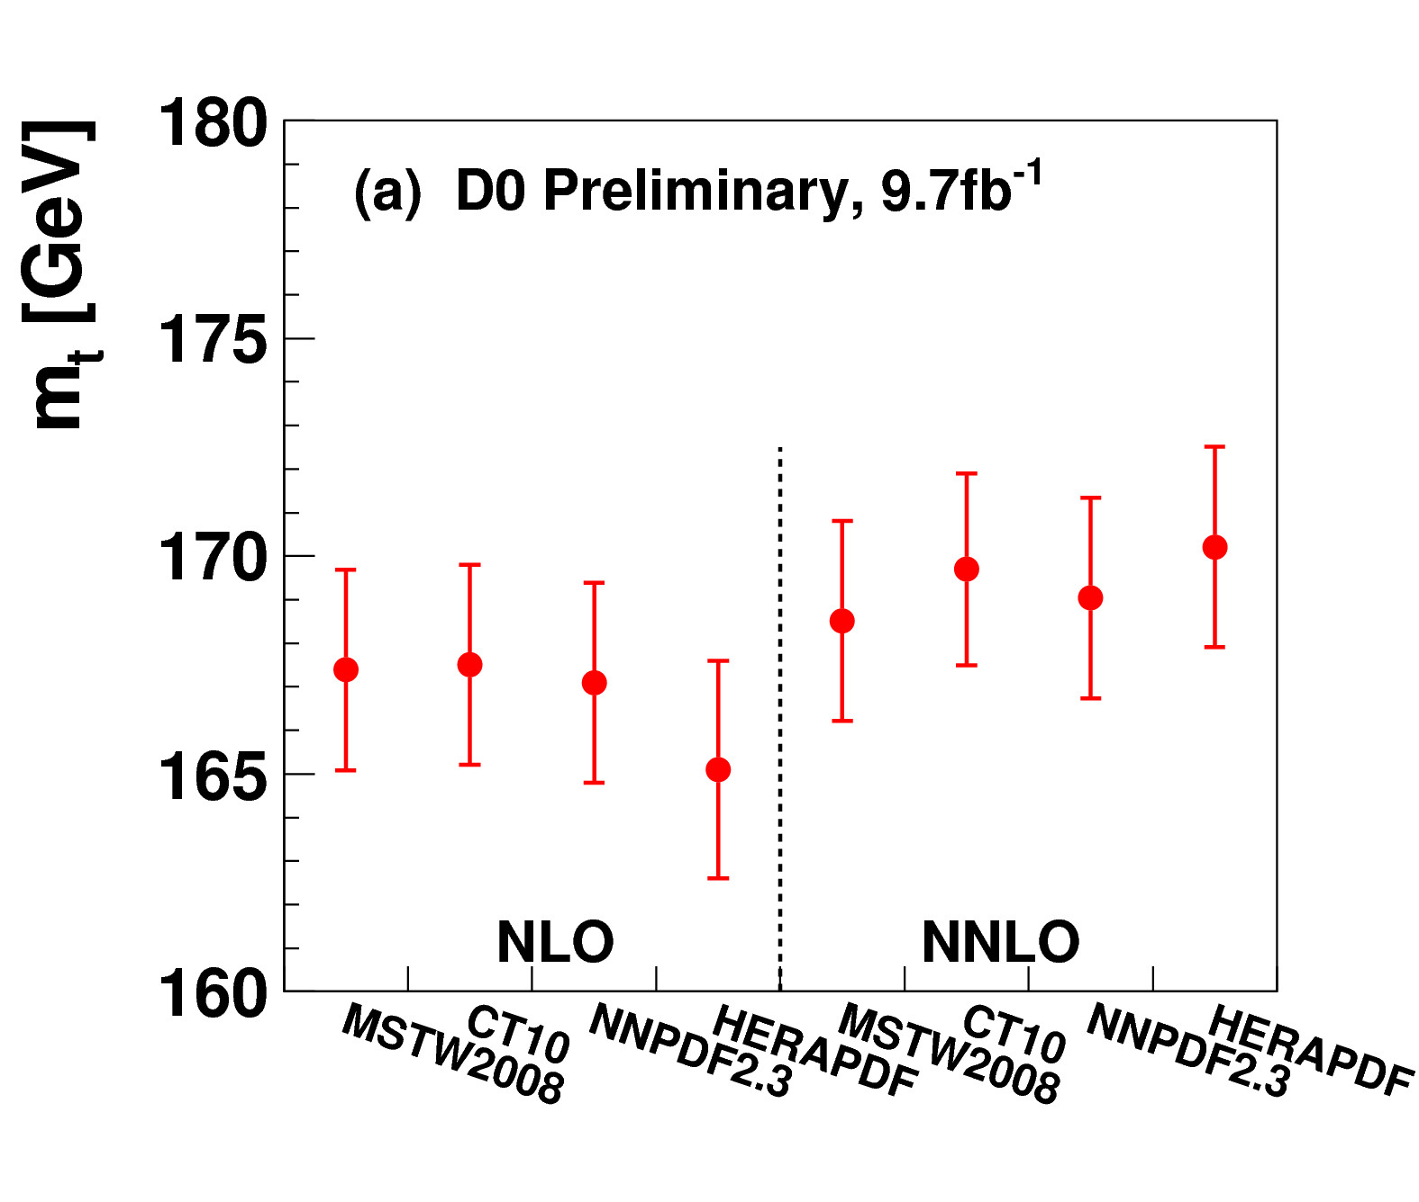
Top Mass from Differential Cross Section
Scale and PDF are varied to obtain systematic uncertainty.
Result is average of global PDFs (MSTW2008, CT10, NNPDF2.3).
Extracted top mass
m_{t} = 169.1 ± 2.5 GeV
Final result is imminent with smaller uncertainties and slightly shifted central value.
Higher NNLO cross section leads to higher m_{t}

Slide 14
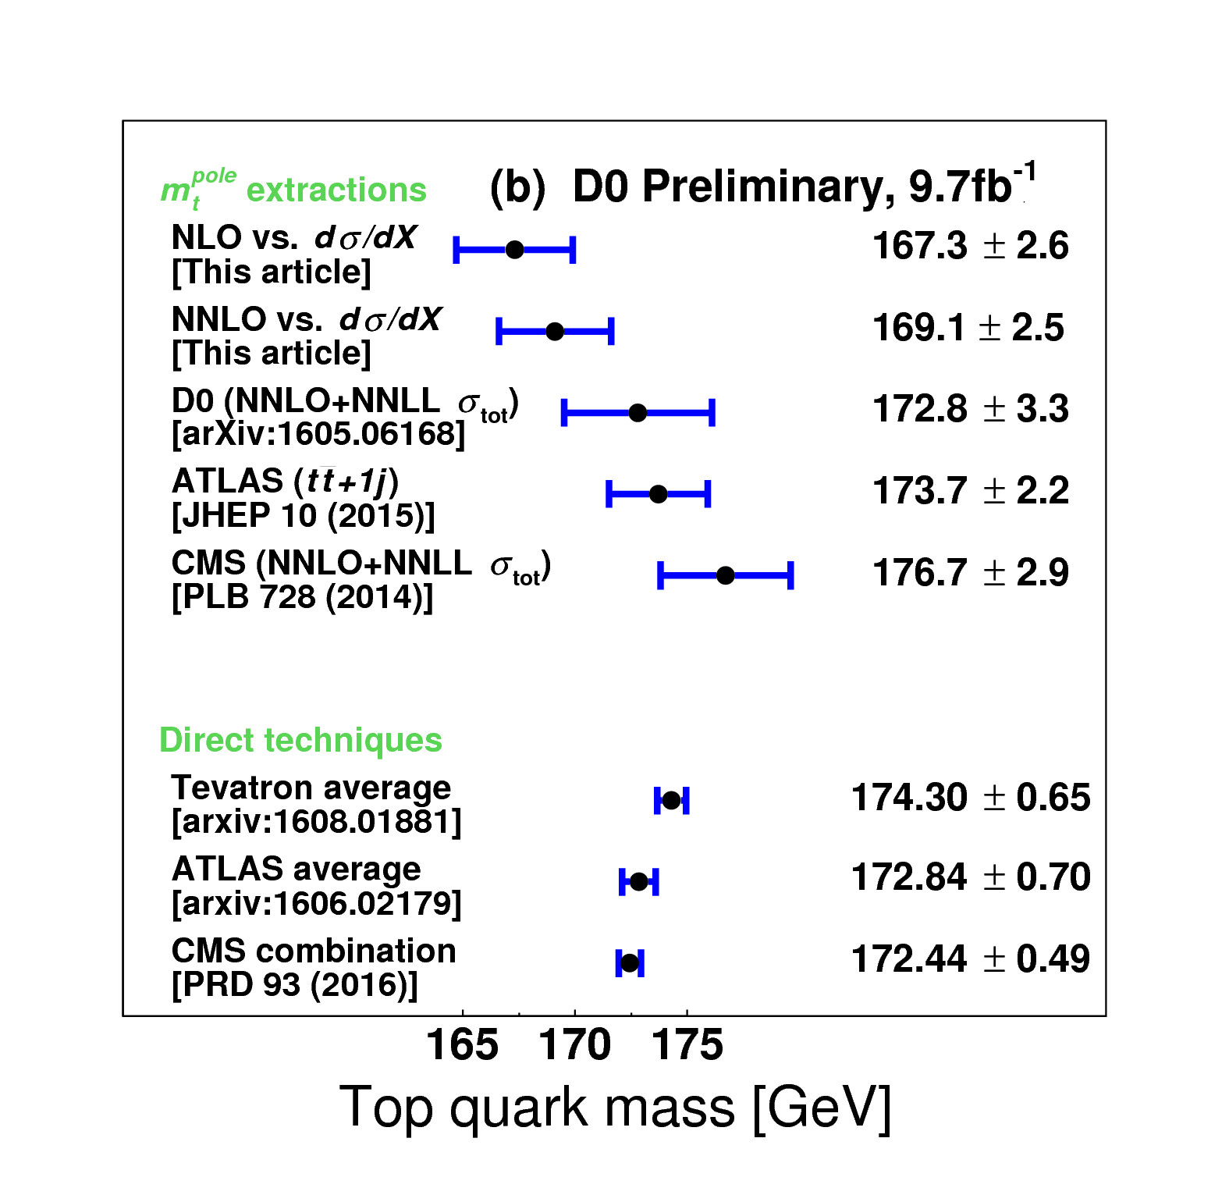
Comparison of Results
Good agreement observed within uncertainties.
Tevatron top mass slightly higher than LHC average.
No significant difference between direct mass and pole mass.
Final pole mass result for total differential cross section expected soon.

