Slide 1
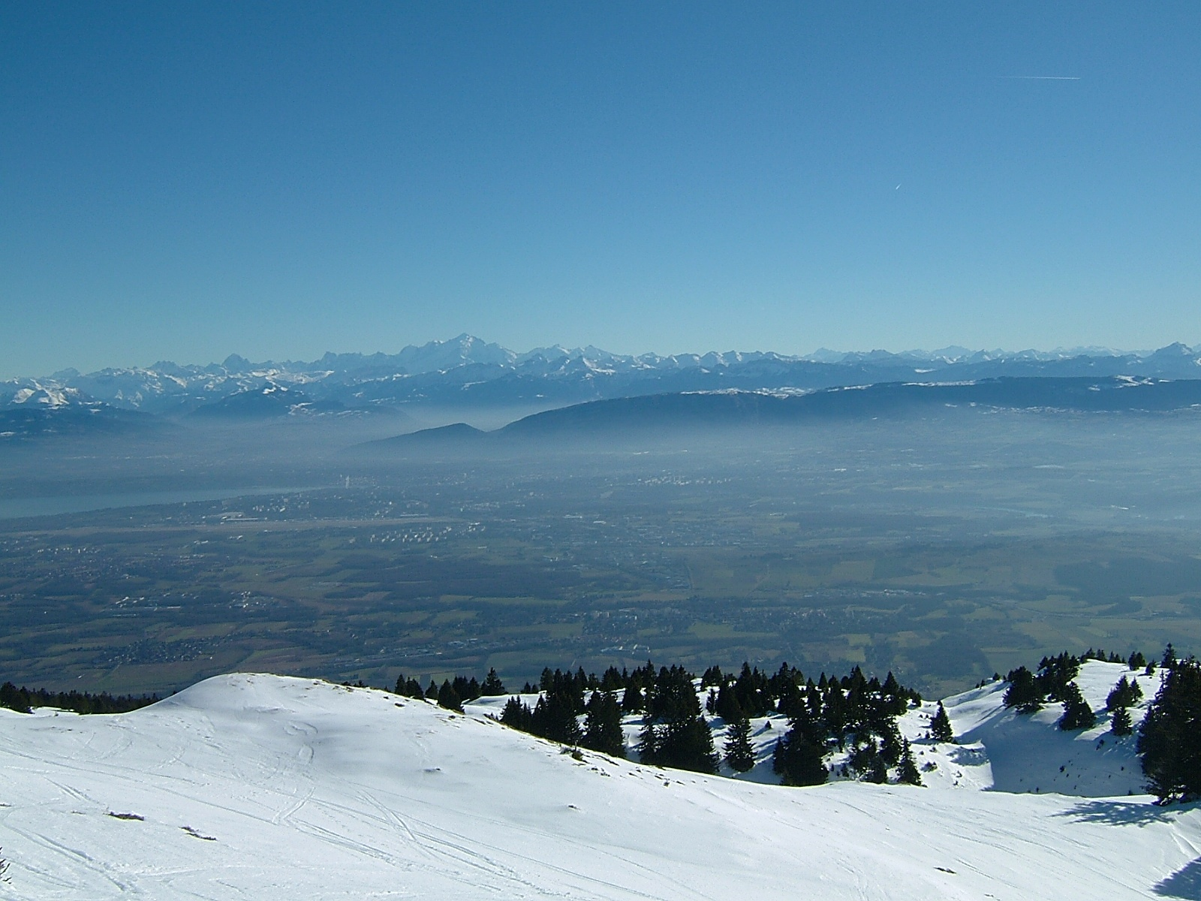
The Hunt for right-Handed Neutrinos
Alain Blondel University of Geneva
with many thanks to
S. Antusch, E. Graverini, P. Mermod, N. Serra, M. Shaposhnikov, O. Fischer, E. Cazzatto
P. Hernandez, and many others
courtesy J. Wenninger
Basel, Geneva, Lausanne, Zürich…

Slide 2
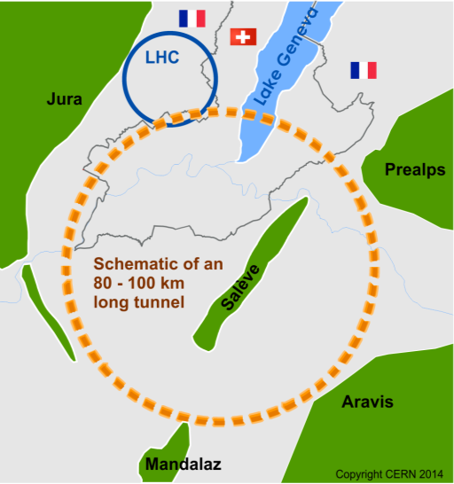
The Future Circular Colliders
CDR and cost review to appear Q4 2018 for ESU
International collaboration to Study Colliders fitting in a new ~100 km infrastructure, fitting in the Genevois
Ultimate goal:
100 TeV pp-collider (FCC-hh)
→ defining infrastructure requirements
Two possible first steps:
e⁺e⁻ collider (FCC-ee)
High Lumi, E_{CM} =90-400 GeV
HE-LHC 16T ⇒ 28 TeV
in LEP/LHC tunnel
Possible addition:
p-e (FCC-he) option
~16 T magnets
From what we know today :
the way by FCC-ee is probably the fastest and cheapest way to 100 TeV.
That combination also produces the most physics. It is the assumption in the following.
also a good start for μC!
From European Strategy in 2013: “ambitious post-LHC accelerator project”
Study kicked-off in Geneva Feb 2014

Slide 3
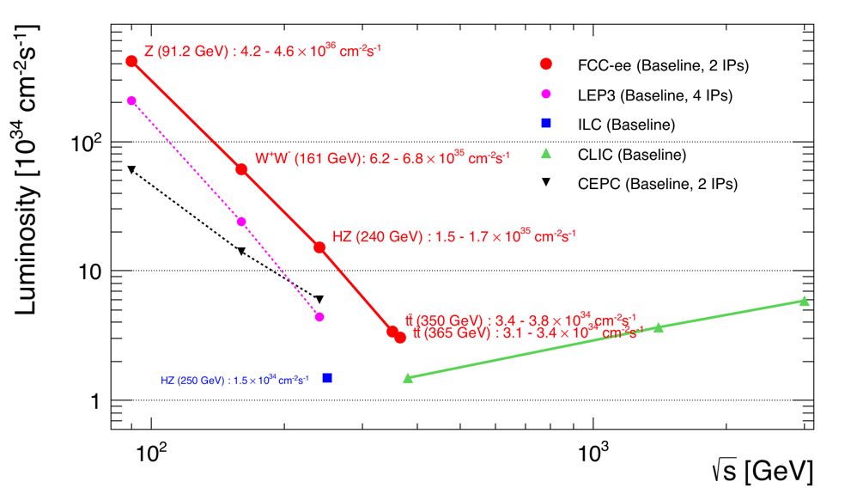
FCC-ee
Z WW HZ tt
LEPx10⁵!
Event statistics :
E_{CM} errors:
Z peak E_{cm} : 91 GeV 5 10¹² e+e- → Z
WW threshold E_{cm} : 161 GeV 10⁸ e+e- → WW
ZH threshold E_{cm} : 240 GeV 10⁶ e+e- → ZH
‾tt threshold E_{cm} : 350 GeV 10⁶ e+e- →‾tt
LEP x 10⁵
LEP x 2.10³
Never done
Never done
100 keV
300 keV
1 MeV
2 MeV
Great energy range for the heavy particles of the Standard Model.

Slide 4
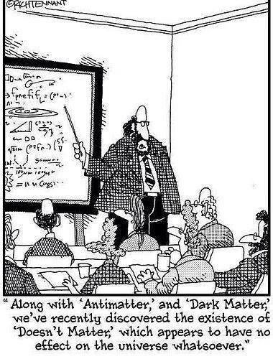









Electroweak eigenstates
$$\left({e \atop v_{e}}\right)$$
$$\left({ \atop v_{μ}}\right)$$
$$\left({ \atop v_{τ}}\right)$$
$$\left(e\right)$$
$$\left(\right)$$
$$\left(\right)$$
Q= -1
R
R
R
L
L
L
$$\left(_{e}\right)$$
$$\left(_{μ}\right)$$
$$\left(_{τ}\right)$$
Q= 0
R
R
R
I = 1/2
I = 0
Right handed neutrinos
are singlets
no weak interaction
no EM interaction
no strong interaction
can’t produce them
can’t detect them
-- so why bother? –
Also called ‘sterile’

Slide 5


Adding masses to the Standard model neutrino 'simply' by adding a Dirac mass term
implies adding a right-handed neutrino.
Nothing prevents adding then a term like
and this simply means that a neutrino turns into a antineutrino
(the charge conjugate of a right handed antineutrino is a left handed neutrino!)
this does not violate spin conservation since a left handed field has a component
of the opposite helicity (and vice versa)
ν_{L} ≈ ν₋ + ν₊ m/E (mass is what allows to flip the helicity)

Slide 6

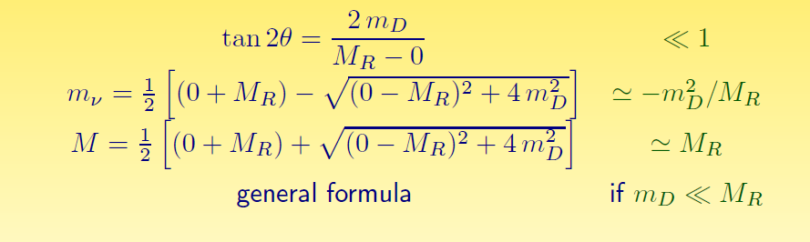
Mass eigenstates
See-saw type I :
M_{R} ≠ 0
m_{D} ≠ 0
Dirac + Majorana
mass terms
see-saw
M_{R} = 0
m_{D} ≠ 0
Dirac only, (like e- vs e+):
ν_{L} ν_{R} ‾ν_{L} ‾ν_{R}
½ 0 ½ 0
4 states of equal masses
M_{R} ≠ 0
m_{D} = 0
Majorana only
ν_{L} ‾ν_{R}
½ ½
2 states of equal masses
M_{R} > m_{D} ≠ 0
Dirac + Majorana
ν N ‾ν ‾N
½ 0 ½ 0
4 states , 2 mass levels
m
m
m
I_{weak}=
dominantly:
I_{weak}=
I_{weak}=
Some have I=1/2 (active)
Some have I=0 (sterile)
All have I=1/2 (active)
m₁ have ~I=1/2 (~active)
m₂ have ~I=0 (~sterile)

Slide 7


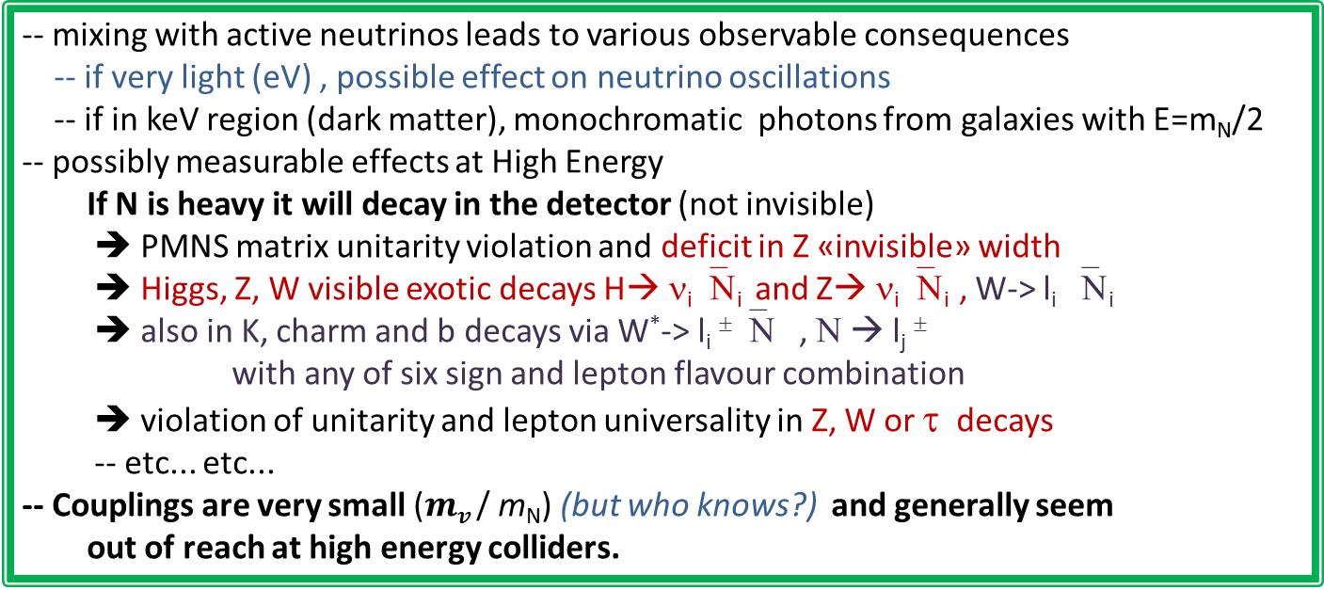
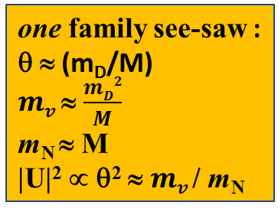
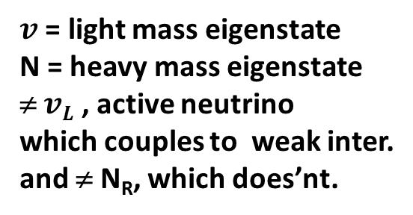

Manifestations of right handed neutrinos
$v$ = light mass eigenstate
N = heavy mass eigenstate
≠ $vL$ , active neutrino
which couples to weak inter.
and ≠ N_{R}, which does’nt.
one family see-saw :
θ ≈ (m_{D}/M)
$mv$ ≈ $\frac{mD2}{M}$
m_{N} ≈ M
|U|² ∝ θ² ≈ $mv$/ m_{N}
$v= vL$ cosθ - ${Nc}_{R }^{} sin$θ
$N=N_{R}^{} \text{cos}\text{θ}+ vL$ ^{c} sinθ
what is produced in W, Z decays is:
$vL= v$ cosθ + $N_{ }^{}sin$θ
-- mixing with active neutrinos leads to various observable consequences
-- if very light (eV) , possible effect on neutrino oscillations
-- if in keV region (dark matter), monochromatic photons from galaxies with E=m_{N}/2
-- possibly measurable effects at High Energy
If N is heavy it will decay in the detector (not invisible)
➔ PMNS matrix unitarity violation and deficit in Z «invisible» width
➔ Higgs, Z, W visible exotic decays H→ ν_{i}‾Ν_{i} and Z→ ν_{i}‾Ν_{i} , W-> l_{i} ‾Ν_{i}
➔ also in K, charm and b decays via W*-> l_{i} ±‾Ν , Ν → l_{j} ±
with any of six sign and lepton flavour combination
➔ violation of unitarity and lepton universality in Z, W or τ decays
-- etc... etc...
-- Couplings are very small ($mv$/ m_{N}) (but who knows?) and generally seem
out of reach at high energy colliders.

Slide 8
The Future Circular Colliders
CDR and cost review to appear Q4 2018 for ESU
International collaboration to Study Colliders fitting in a new ~100 km infrastructure, fitting in the Genevois
Ultimate goal:
100 TeV pp-collider (FCC-hh)
→ defining infrastructure requirements
Two possible first steps:
e⁺e⁻ collider (FCC-ee)
High Lumi, E_{CM} =90-400 GeV
HE-LHC 16T ⇒ 28 TeV
in LEP/LHC tunnel
Possible addition:
p-e (FCC-he) option
~16 T magnets
From what we know today :
the way by FCC-ee is probably the fastest and cheapest way to 100 TeV.
That combination also produces the most physics. It is the assumption in the following.
also a good start for μC!
From European Strategy in 2013: “ambitious post-LHC accelerator project”
Study kicked-off in Geneva Feb 2014

Slide 9
FCC-ee
Z WW HZ tt
LEPx10⁵!
Event statistics :
E_{CM} errors:
Z peak E_{cm} : 91 GeV 5 10¹² e+e- → Z
WW threshold E_{cm} : 161 GeV 10⁸ e+e- → WW
ZH threshold E_{cm} : 240 GeV 10⁶ e+e- → ZH
‾tt threshold E_{cm} : 350 GeV 10⁶ e+e- →‾tt
LEP x 10⁵
LEP x 2.10³
Never done
Never done
100 keV
300 keV
1 MeV
2 MeV
Great energy range for the heavy particles of the Standard Model.

Slide 10
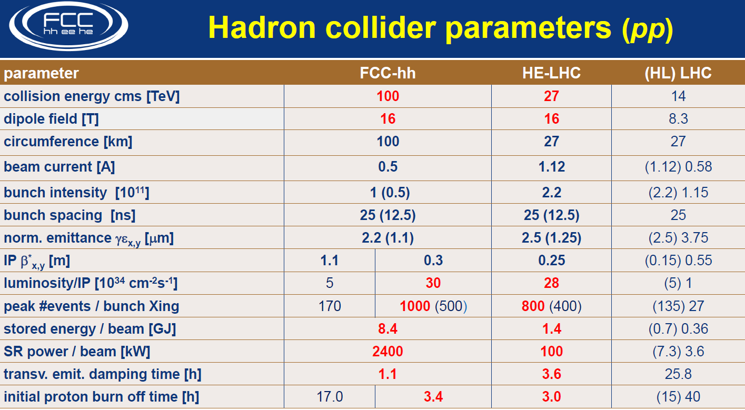

Slide 11
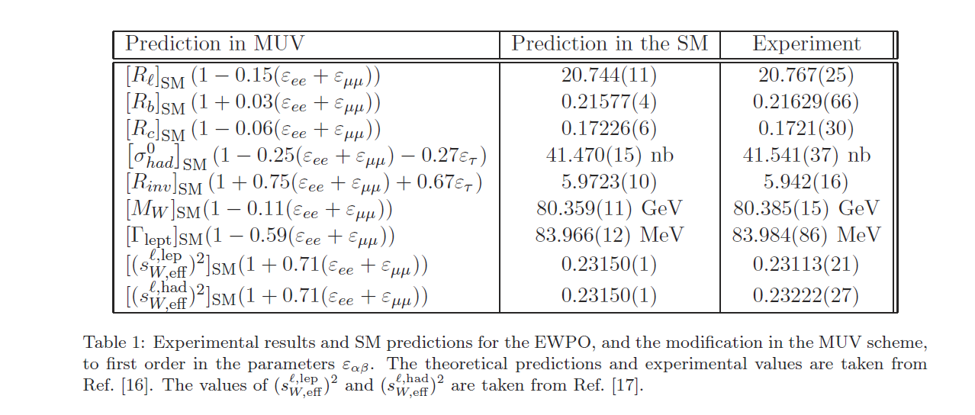
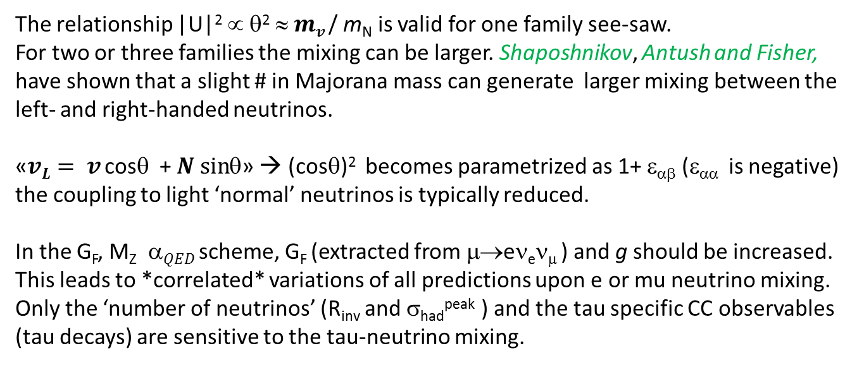
(indirect) Effect of right handed neutrinos on EW precision observables
The relationship |U|² ∝ θ² ≈ $mv$/ m_{N} is valid for one family see-saw.
For two or three families the mixing can be larger. Shaposhnikov, Antush and Fisher,
have shown that a slight # in Majorana mass can generate larger mixing between the
left- and right-handed neutrinos.
«$vL= v$ cosθ + $N_{ }^{}sin$θ» → (cosθ)² becomes parametrized as 1+ ε_{αβ} (ε_{αα} is negative)
the coupling to light ‘normal’ neutrinos is typically reduced.
In the G_{F}, M_{Z} $ QED$ scheme, G_{F} (extracted from μ→eν_{e}ν_{μ} ) and g should be increased.
This leads to *correlated* variations of all predictions upon e or mu neutrino mixing.
Only the ‘number of neutrinos’ (R_{inv} and σ_{had}^{peak} ) and the tau specific CC observables
(tau decays) are sensitive to the tau-neutrino mixing.
NB this is not decoupling

Slide 12
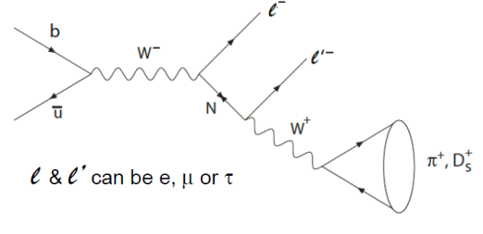
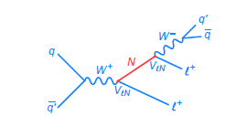
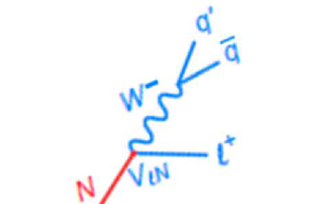
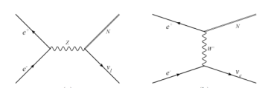
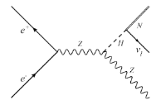
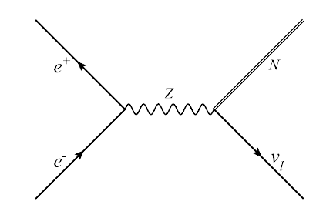
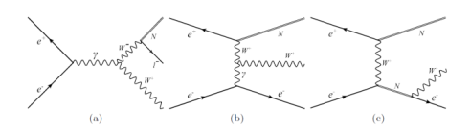
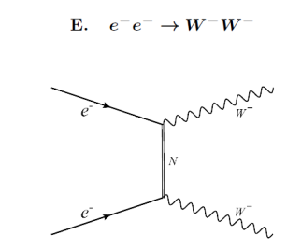
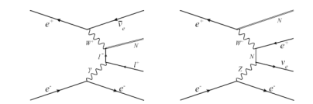
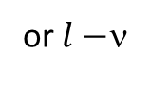
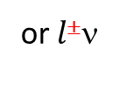

Detection of heavy right-handed neutrinos in collider experiments.
B factories
Hadron colliders
+
or$l$±ν
+
(*)
-
Z factory (FCC-ee, Tera-Z)
HE Lepton Collider (LEP2, CEPC, CLIC, FCC-ee, ILC, μμ)
arXiv:1411.5230
or$l−$ν
or$l$±ν
Phys. Rev. D 92, 075002 (2015)
arXiv:1503.05491

Slide 13
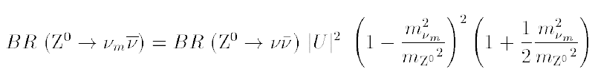
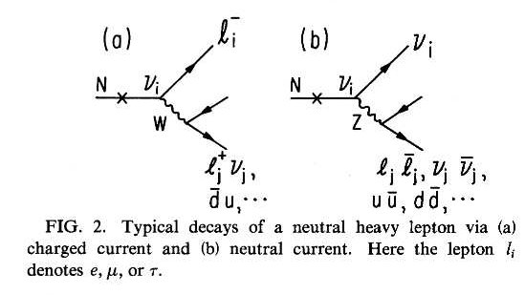

RH neutrino production in Z decays
Production:
multiply by 2 for antineutrino and add contributions of 3 neutrino species (with different |U|²)
Decay
Decay length:
cm
NB CC decay always leads to
≥ 2 charged tracks
Backgrounds : four fermion: e+e- → W*⁺ W*⁻ e+e- → Z*(vv) + (Z/γ)*
Long life time → detached vertex for ~<M_{Z}

Slide 14
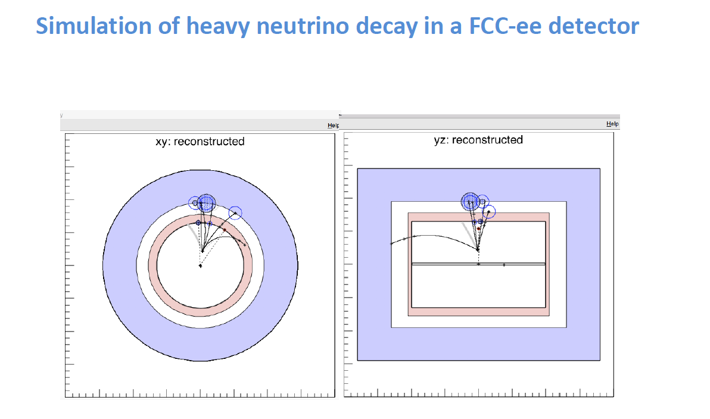

Slide 15
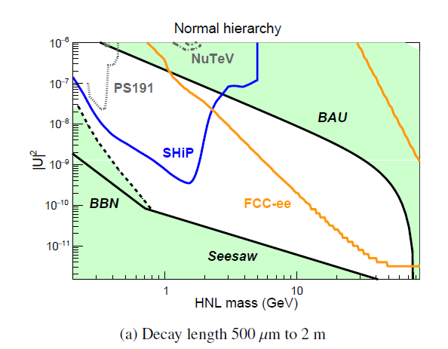
E. Graverini et al
with 5 10¹² Z

Slide 16
Outlook for FCC-hh
We have seen that the Z factory offers a clean method
for detection of Heavy Right-Handed neutrinos
Ws are less abundant at the lepton colliders
At the 100 TeV pp W is the dominant particle,
Expect 10¹³ real W’s.
There is a lot of /pile-up/backgrounds/lifetime/trigger issues which need to be investigated.
BUT.... in the regime of long lived HNLs the simultaneous presence of
-- the initial lepton from W decays
-- the detached vertex with kinematically constrained decay
allows for a significant background reduction.
But it allows also a characterization both in flavour and charge of the produced neutrino, thus
information of the flavour sensitive mixing angles and a test of the fermion violating nature
of the intermediate (Majorana) particle.
VERY interesting...

Slide 17
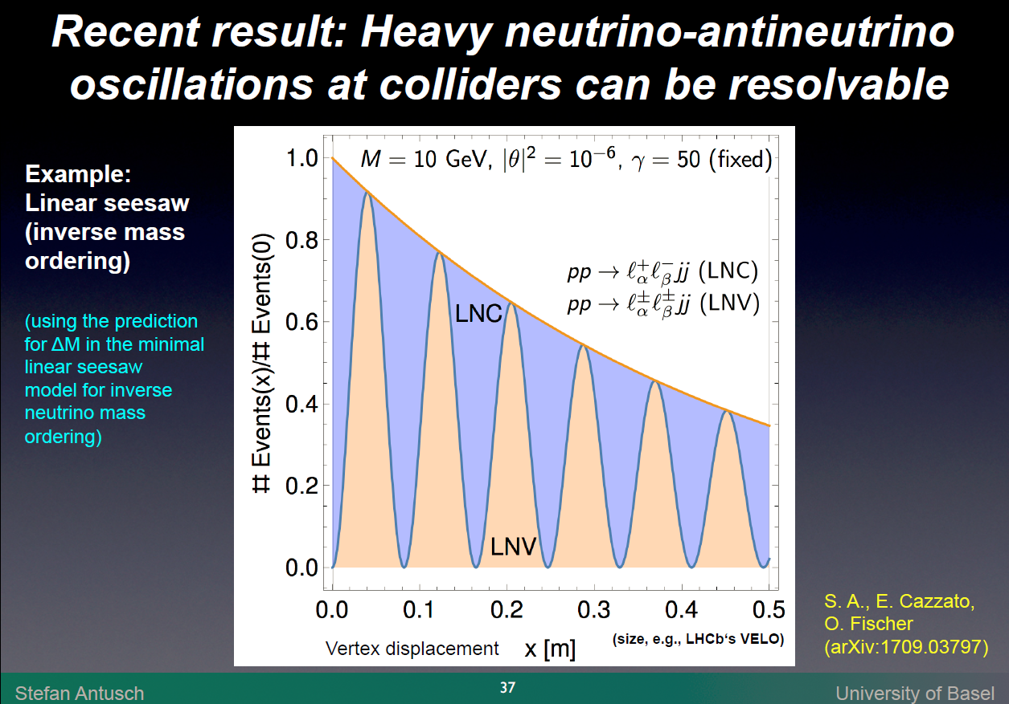

Slide 18
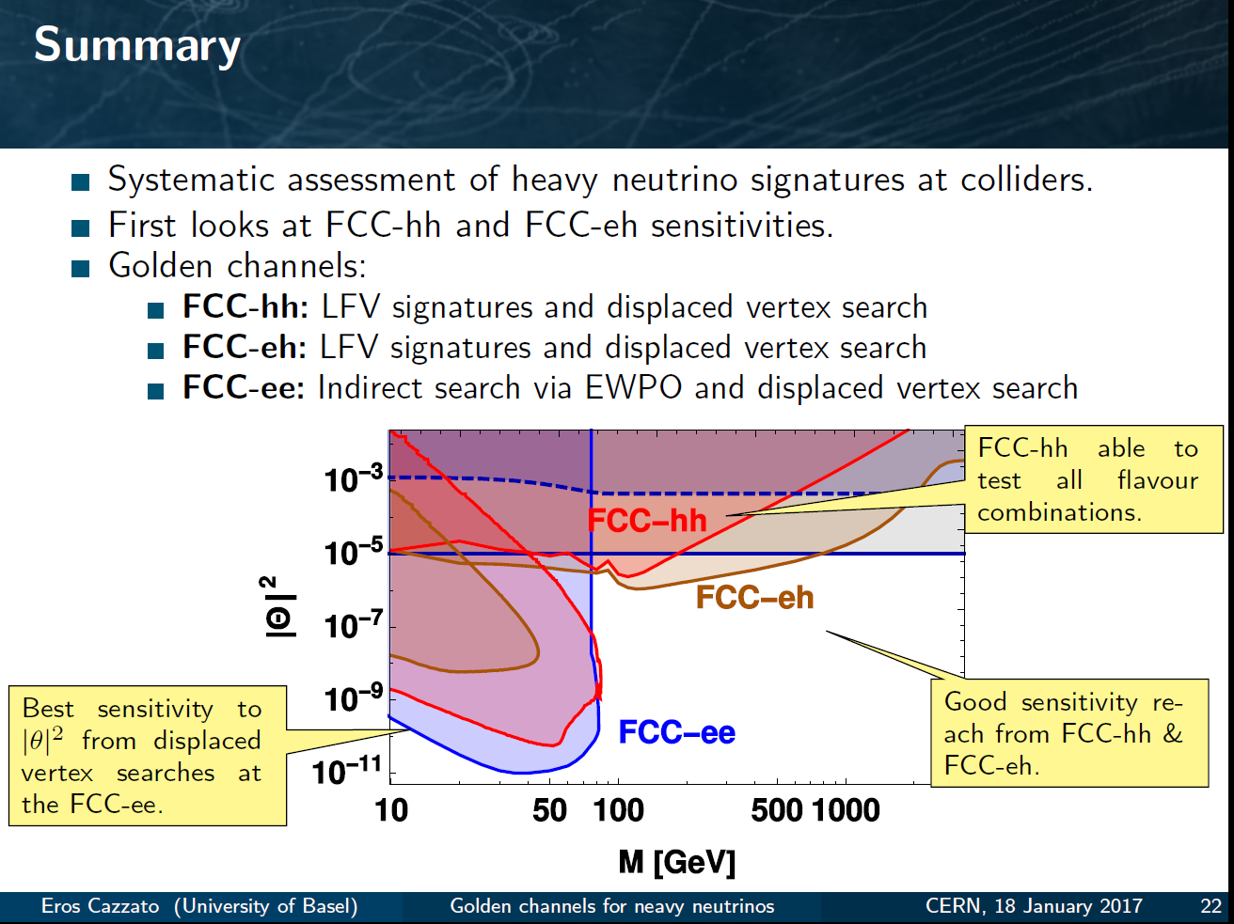
Another example of Synergy
while ee covers a large part of space very cleanly ,
its either ‘white’ in lepton flavour or the result of EWPOs etc
Observation at FCC –hh or eh would test flavour mixing matrix!
EWPO
detailed study required for all FCCs – especially FCC-hh to understand feasibility at all

Slide 19

CONCLUSIONS
CONCLUSIONS
-- The FCC design study is establishing the feasibility or the path to feasibility of an ambitious set of colliders after LEP/LHC, at the cutting edge of knowledge and technology.
-- Both FCC-ee and FCC-hh have outstanding physics cases
-- each in their own right
-- the sequential implementation of FCC-ee, FCC-hh,
would maximise the physics reach
-- The right-handed neutrino search and study is not, as we thought
5 years ago, desperate. It is also a very interesting example of complementarity between the FCCs.
-- Attractive scenarios of staging and implementation (budget!) cover more than 50 years of exploratory physics, taking full advantage of the synergies and complementarities.

