Slide 1


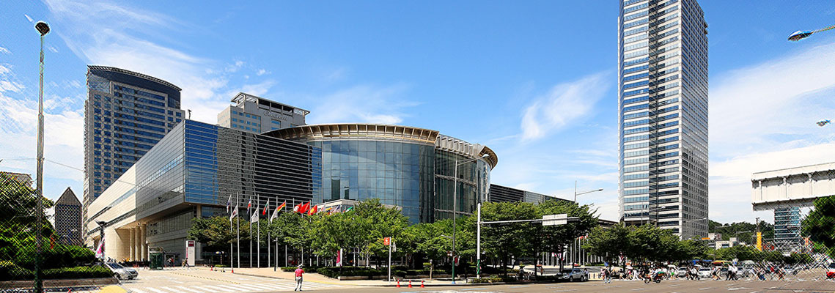

$Λ_{c}^{+}$ physics with BESIII threshold data
Hai-ping Peng
penghp@ustc.edu.cn
State Key Laboratory of Particle Detection and Electronics (SKLPE)
University of Science and Technology of China (USTC)
(On behalf BESIII Collaboration)
ICHEP 2018, July 4th-11th, Seoul Korea

Slide 2
Outline
Introduction
Recent BESIII results
Hadronic decay
Semi-leptonic decay
Inclusive decay
Production
BESIII prospects
Summary

Slide 3
Introduction

Slide 4
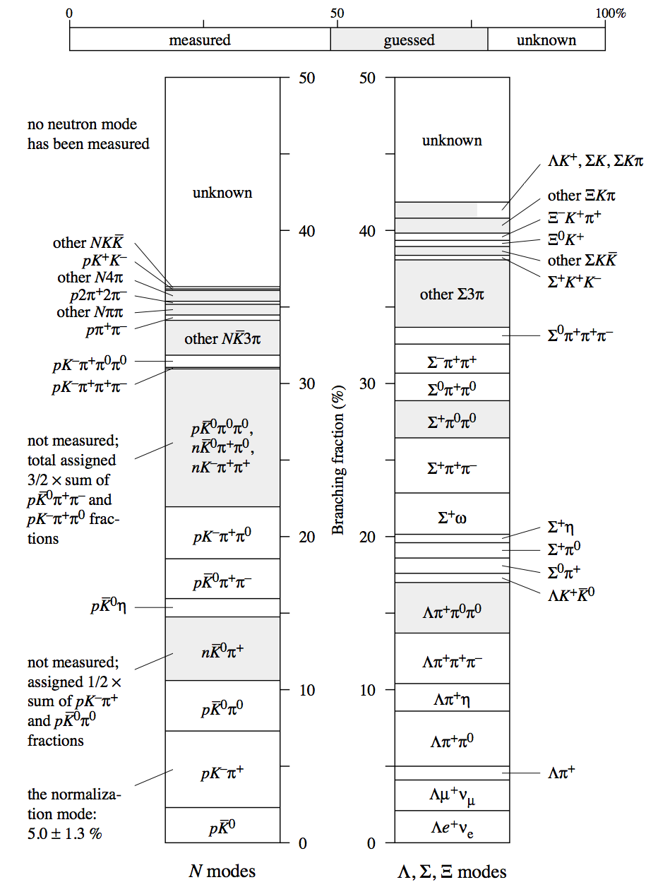
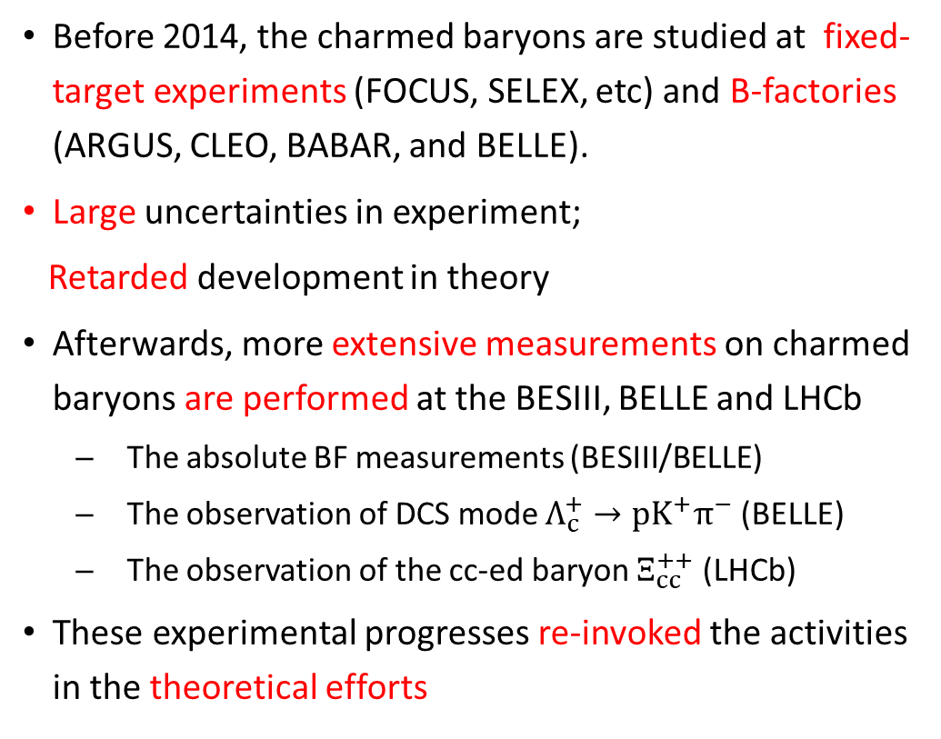
The studies of Charmed Baryons
Charmed Baryons may provide complementary powerful test on internal dynamics to charmed meson does
Before 2014, the charmed baryons are studied at fixed-target experiments (FOCUS, SELEX, etc) and B-factories (ARGUS, CLEO, BABAR, and BELLE).
Large uncertainties in experiment;
Retarded development in theory
Afterwards, more extensive measurements on charmed baryons are performed at the BESIII, BELLE and LHCb
The absolute BF measurements (BESIII/BELLE)
The observation of DCS mode $Λ_{c}^{+}→pK^{+}π^{−}$ (BELLE)
The observation of the cc-ed baryon $Ξ_{cc}^{++}$ (LHCb)
These experimental progresses re-invoked the activities in the theoretical efforts

Slide 5
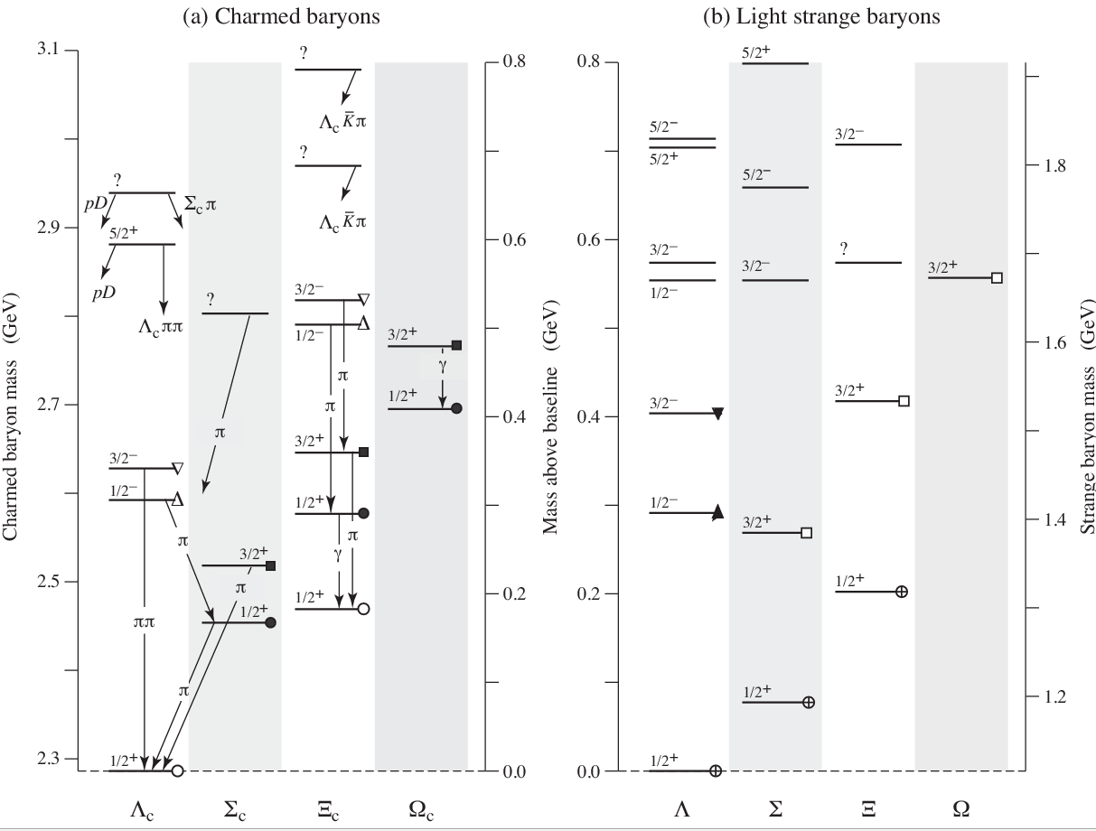
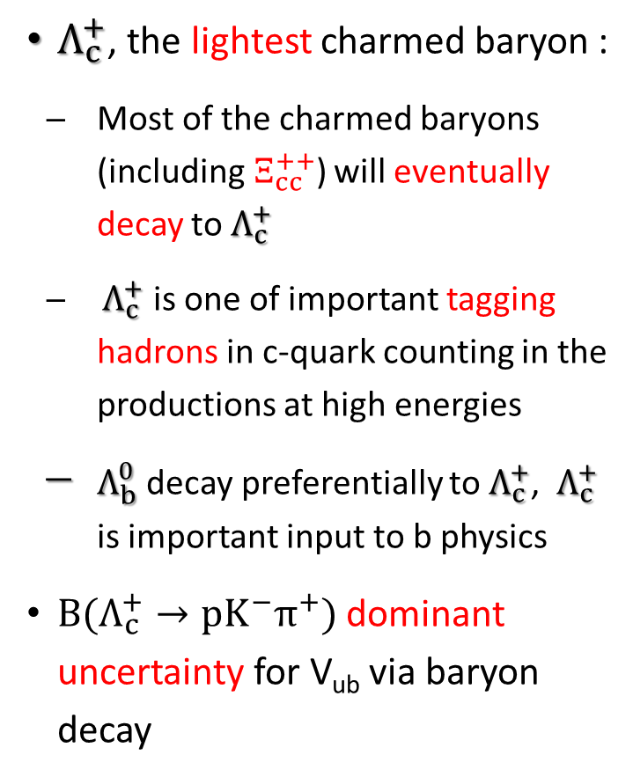
Cornerstone of charmed baryon Spectroscopy
$Λ_{c}^{+}$, the lightest charmed baryon :
Most of the charmed baryons (including${ Ξ}_{cc}^{++}$) will eventually decay to $Λ_{c}^{+}$
$Λ_{c}^{+}$ is one of important tagging hadrons in c-quark counting in the productions at high energies
$Λ_{b}^{0}$ decay preferentially to $Λ_{c}^{+}$, $Λ_{c}^{+}$ is important input to b physics
${B(Λ}_{c}^{+}→pK^{−}π^{+})$ dominant uncertainty for V_{ub} via baryon decay
5/2⁺
Ξ_{c}(3080)
??
Ξ_{c}(2980)
Λ_{c}(2940)
Λ_{c}(2880)
3/2⁻
Ξ_{c}(2815)
Σ_{c}(2800)
Ξ_{c}(2790)
Ω_{c}(2770)
Λ_{c}(2625)
Ξ_{c}(2645)
Λ_{c}(2595)
Ξ’_{c}
Σ_{c}(2520)

Slide 6
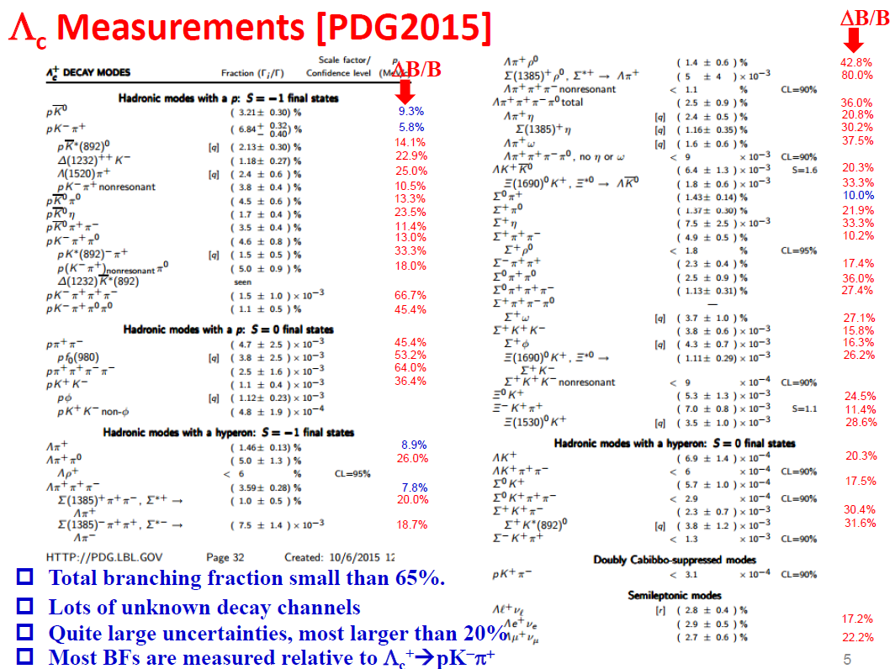

The $Λ_{c}^{+}$ Decays

Slide 7


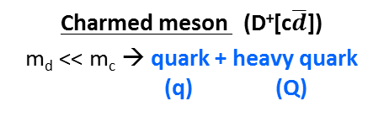
$Λ_{c}^{+}$ component & weak Decays
$Λ_{c}^{+}$: a heavy quark (c) with an unexcited spin-zero diquark (u-d)
u
u d
$$\overline{d}$$
d
s
c
c
Charmed meson (D⁺[c$\overline{d}$])
m_{d} << m_{c} → quark + heavy quark
(q) (Q)
Strange baryons (L[uds])
m_{u}, m_{d} ≈ m_{s} → (qqq) uniform
Charmed baryon (L_{c}[udc])
m_{u}, m_{d} << m_{c} → diquark + quark
(qq) (Q)
$Λ_{c}^{+} weak decay$receive sizable non-factorization W-exchange contribution
Two distinct internal W emission diagrams, three different W exchange diagrams
Need information of decay asym. to extract s- and p-wave amplitudes separately

Slide 8
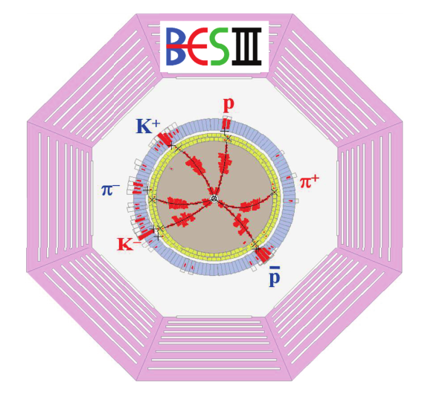
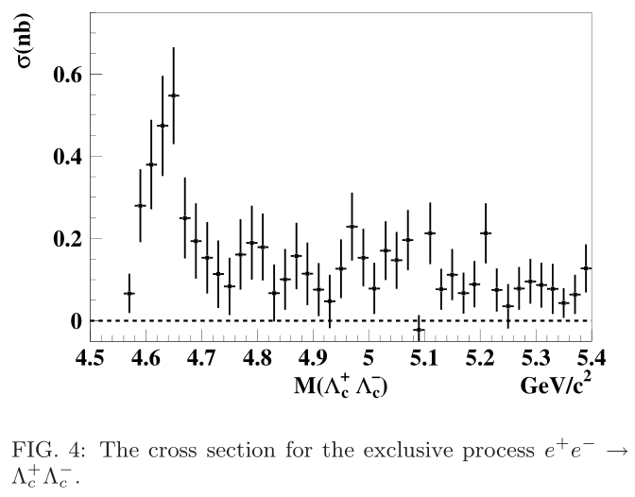


Near Threshold production at BESIII
For the first time, BEPCII run around 4.6 GeV, near $Λ_{c}^{+}$ $Λ_{c}^{−}$ threshold, with excellent performance. Marvelous achievement of BEPCII
data set at BESIII
PRL 101 (2008) 172001
Energy(GeV) | lum.(1/pb)
4.575 | ~48
4.580 | ~8.5
4.590 | ~8.1
4.600 | ~567
First time to systematically study charmed baryon at threshold!

Slide 9
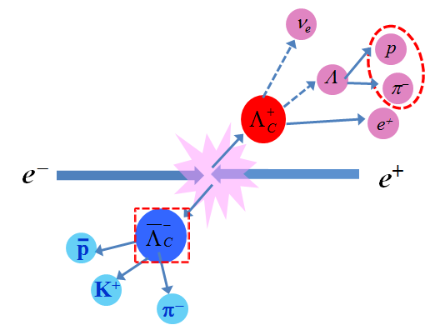

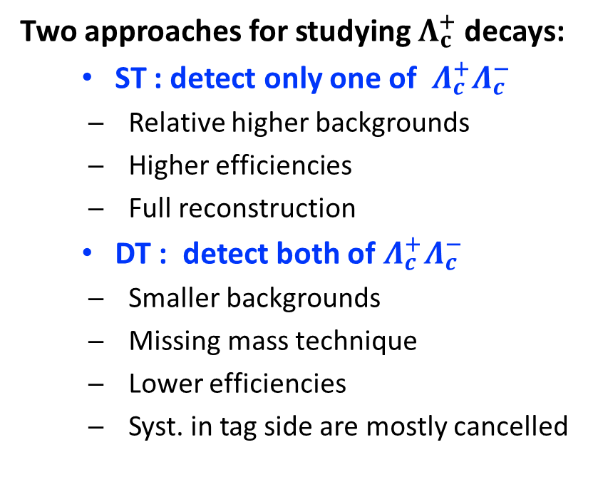

Analysis Technique
$Λ_{c}^{+}$ $Λ_{c}^{−}$production at e⁺e⁻ annihilations near threshold,
no additional hadron in final states,
the most simple and straightforward measurement -- Unique
Two approaches for studying $Λ_{c}^{+}$ decays:
  ST : detect only one of $Λ_{c}^{+}Λ_{c}^{−}$
  Relative higher backgrounds
  Higher efficiencies
  Full reconstruction
  DT : detect both of $Λ_{c}^{+}Λ_{c}^{−}$
  Smaller backgrounds
  Missing mass technique
  Lower efficiencies
  Syst. in tag side are mostly cancelled
ΔE=E_{beam}-E_{h}; $\vec{p}miss$= $\vec{p}Λc$- $\vec{p}h$
M_{BC}=$\sqrt{E_{beam}^{2}−|\vec{p}Λc|2}$
$\vec{p}Λc$= - $\vec{p}tag$・$\sqrt{E_{beam}^{2}−m_{Λc}^{2}}$
U_{miss}=E_{miss}-| $\vec{p}miss$|
$M_{miss}^{2}=E_{miss}^{2}−|\vec{p}miss|2$

Slide 10
Hadronic Decay

Slide 11
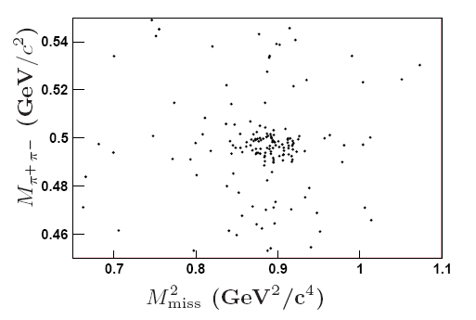
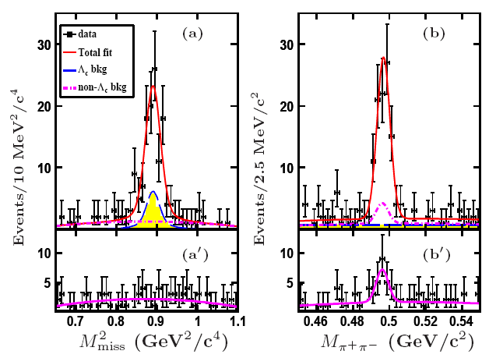
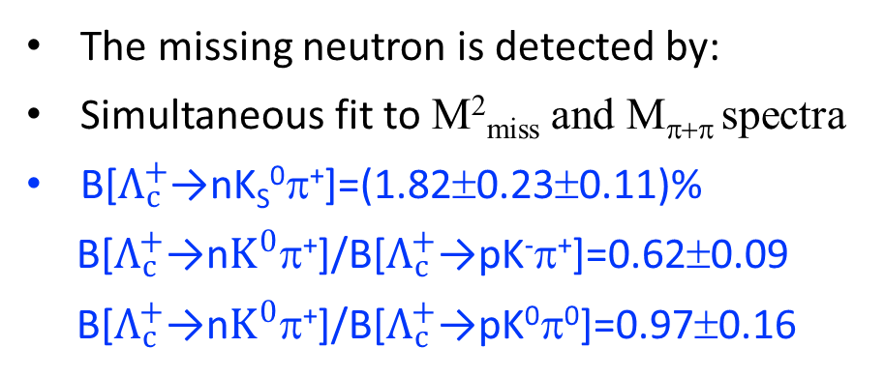

Observation of ${ Λ}_{c}^{+}→$ nK_{S}⁰π⁺
First observation of ${ Λ}_{c}^{+}$ decays involving the neutron in final states.
PRL118,112001(2017)
83±11 events
The missing neutron is detected by:
Simultaneous fit to M²_{miss} and M_{π+π} spectra
B[$Λ_{c}^{+}$→nK_{S}⁰π⁺]=(1.82±0.23±0.11)%
B[$Λ_{c}^{+}$→n$K^{0}$π⁺]/B[$Λ_{c}^{+}$→pK⁻π⁺]=0.62±0.09
B[$Λ_{c}^{+}$→n$K^{0}$π⁺]/B[$Λ_{c}^{+}$→pK⁰π⁰]=0.97±0.16
The relative BF of neutron-involved to proton-involved modes is essential to test the isospin symmetry and extract the strong phases of different final states.

Slide 12
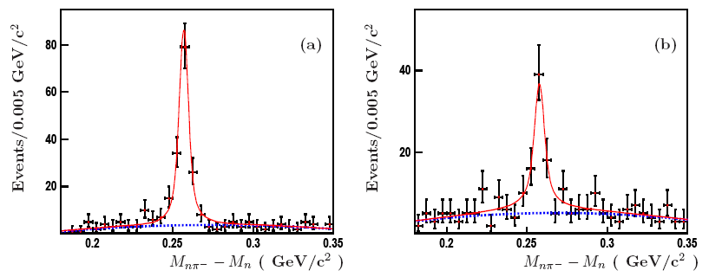
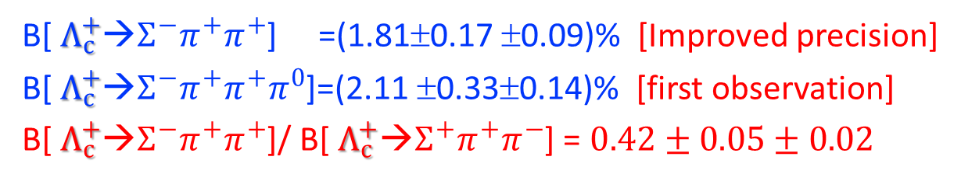
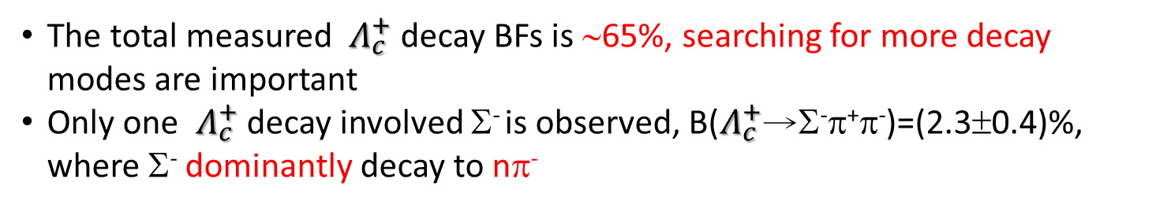
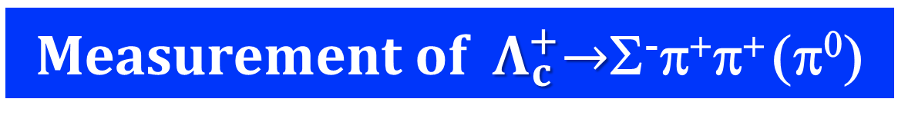


Measurement of ${ Λ}_{c}^{+}→$Σ⁻π⁺π⁺ (π⁰)
The total measured ${ Λ}_{c}^{+}$ decay BFs is ∼65%, searching for more decay modes are important
Only one ${ Λ}_{c}^{+}$ decay involved Σ⁻ is observed, B($Λ_{c}^{+}$→Σ⁻π⁺π⁻)=(2.3±0.4)%, where Σ⁻ dominantly decay to nπ⁻
DT method : 11 ST modes, 11415±159 ${ Λ}_{c}^{+}$ tagged candidates
${ Λ}_{c}^{+}$→Σ⁻π⁺π⁺
$Λ_{c}^{+}$→Σ⁻π⁺π⁺π⁰
PLB 772, 388 (2017)
161.3±15.2
Events
88.1±13.9
Events
B[${ Λ}_{c}^{+}$→$Σ^{−}π^{+}π^{+}$] =(1.81±0.17 ±0.09)% [Improved precision]
B[${ Λ}_{c}^{+}$→$Σ^{−}π^{+}π^{+}π^{0}$]=(2.11 ±0.33±0.14)% [first observation]
B[${ Λ}_{c}^{+}$→$Σ^{−}π^{+}π^{+}$]/ B[${ Λ}_{c}^{+}$→$Σ^{+}π^{+}π^{−}$] = $0.42±0.05±0.02$

Slide 13
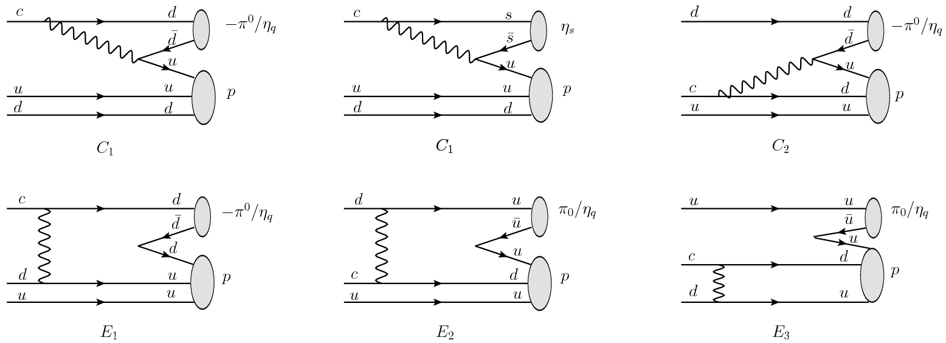

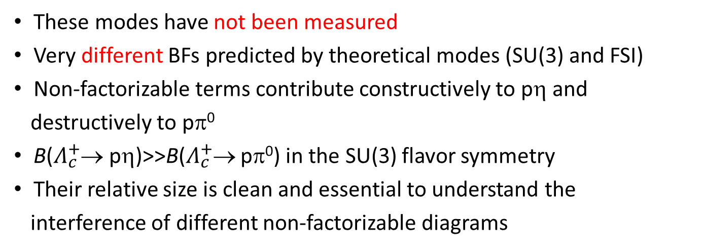
SCS decays of $Λ_{c}^{+}$→pπ⁰ and $Λ_{c}^{+}$→pη
These modes have not been measured
Very different BFs predicted by theoretical modes (SU(3) and FSI)
Non-factorizable terms contribute constructively to pη and destructively to pπ⁰
B($Λ_{c}^{+}$→ pη)>>B($Λ_{c}^{+}$→ pπ⁰) in the SU(3) flavor symmetry
Their relative size is clean and essential to understand the interference of different non-factorizable diagrams

Slide 14
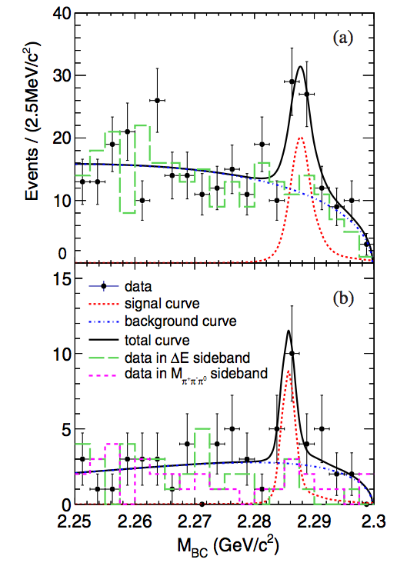
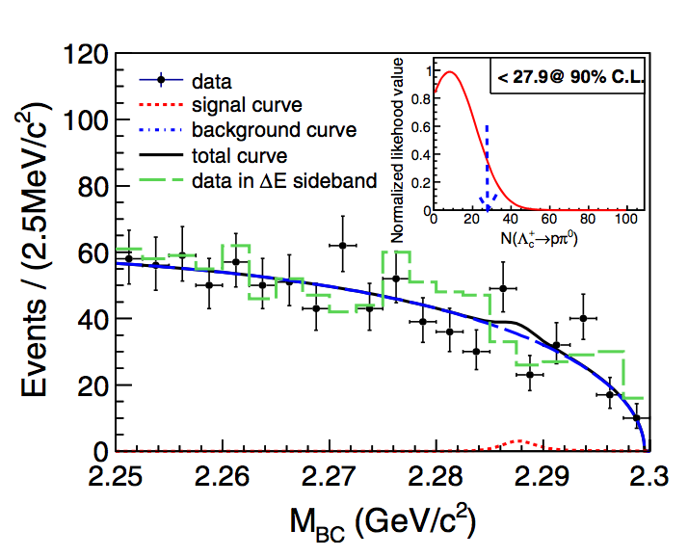
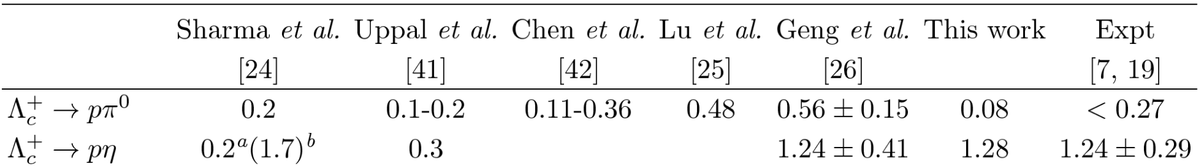
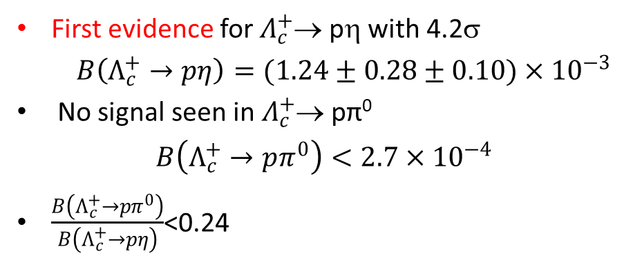




SCS decays of $Λ_{c}^{+}$→pπ⁰ and $Λ_{c}^{+}$→pη
$Λ_{c}^{+}$→ pη(η→γγ)
PRD111102(R) (2017)
ST method
$Λ_{c}^{+}$→ pπ⁰
$Λ_{c}^{+}$→ pη(η→π⁺π⁻π⁰)
First evidence for $Λ_{c}^{+}$→ pη with 4.2σ
$B\left(Λ_{c}^{+}→pη\right)=(1.24±0.28±0.10)×{10}^{−3}$
No signal seen in $Λ_{c}^{+}$→ pπ⁰
$$B\left(Λ_{c}^{+}→pπ^{0}\right)<2.7×{10}^{−4}$$
$\frac{B\left(Λ_{c}^{+}→pπ^{0}\right)}{B\left(Λ_{c}^{+}→pη\right)}$<0.24
arXiv:1801.08625
(10⁻³ )
Cheng et al.
SU(3) QM Fac. SU(3) SU(3) C.A.

Slide 15
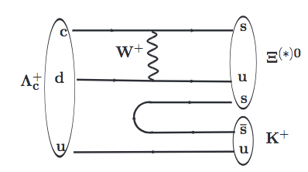
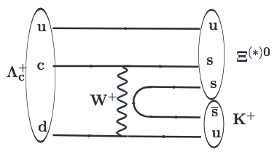
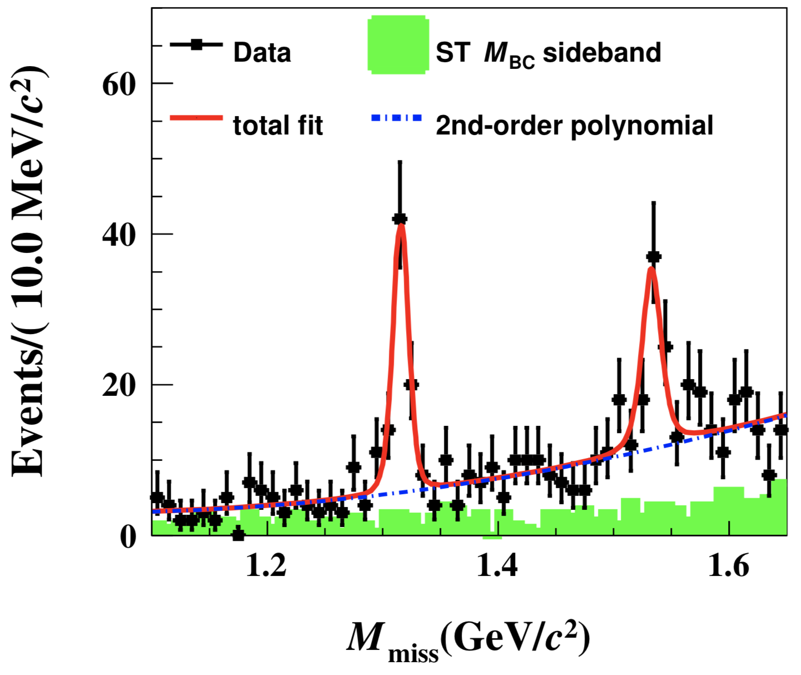
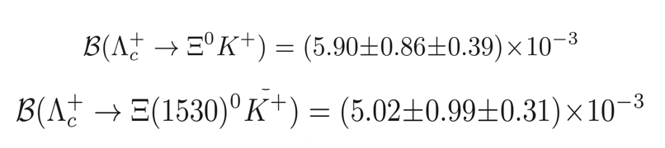

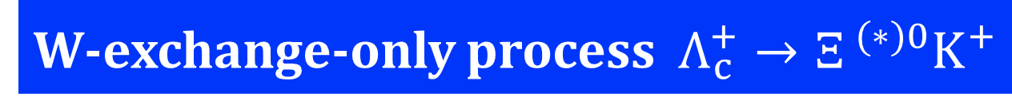
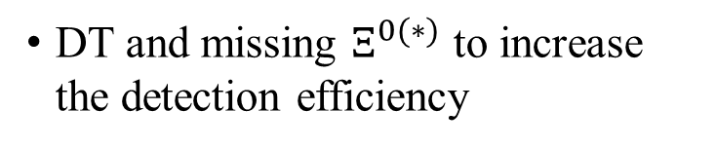

W-exchange-only process $Λ_{c}^{+}→Ξ^{ (∗)0}K^{+}$
W-exchange diagram is non-factorizable in theoretical calculation
This measurement helps in calibration of the W-exchange process in the charmed baryon sector
The previous measurements have poor precision
arXiv:1803.04299
DT and missing $Ξ^{0(∗)}$ to increase the detection efficiency
10.3σ
6.4σ
$$68.2±9.9$$
$$60±12$$
First absolute measurement of BF with improved precision, no models can accommodate the results

Slide 16
Semi-Leptonic Decay

Slide 17



Semi-Leptonic ${decay Λ}_{c}^{+}→$ Λl⁺ν_{l}
Benchmark channel via the CF transition c→sl⁺$ν_{l}$
Provides stringent test for nonperturbative aspects of strong interaction
Important inputs for implementing and calibrating the LQCD calculations.
Before 2015, no directly measurement, combine with the τ($Λ_{c}^{+}$) and the assumption of form factors
Theoretical calculation on the BFs ranges from 1.4% to 9.2%, precisely experimental measurement on BF is desirable.
PDG 2015

Slide 18
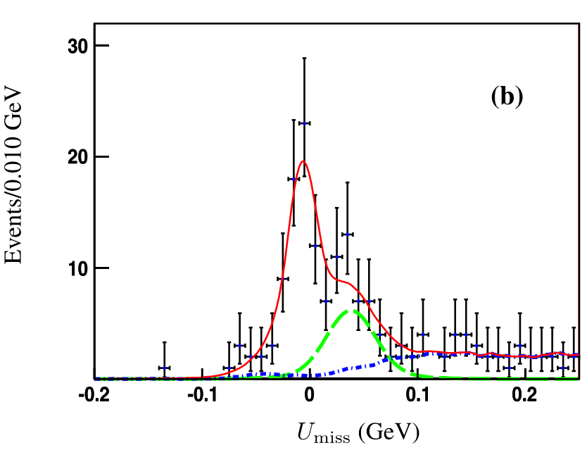
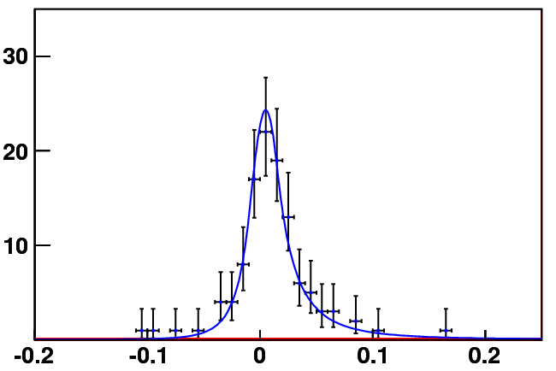
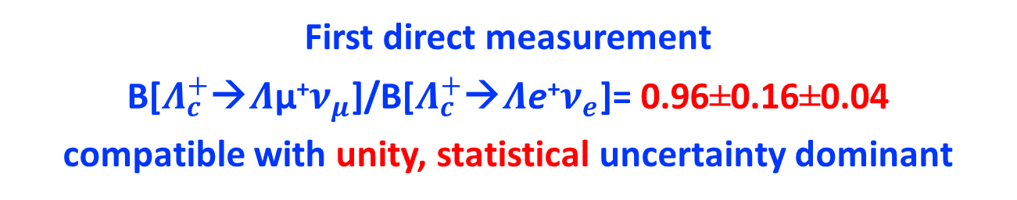

Semi-Leptonic ${decay Λ}_{c}^{+}→$ Λl⁺ν_{l}
DT mothed and Missing neutrino : 11 ST modes, 14415±159 ST events
B[Λ_{c}⁺→Λμ⁺ν_{μ}]=(3.49±0.46±0.26)%
PRL 115, 221805 (2015)
PLB 767, 42 (2017)
Events /0.010 (GeV)
79±11 Events
104±11 Events
$Λ_{c}^{+}$→$Λ$π⁺π⁰
U_{miss} (GeV)
First direct measurement
B[$Λ_{c}^{+}$→$Λ$μ⁺$ν_{μ}$]/B[$Λ_{c}^{+}$→$Λ$e⁺$ν_{e}$]= 0.96±0.16±0.04
compatible with unity, statistical uncertainty dominant

Slide 19
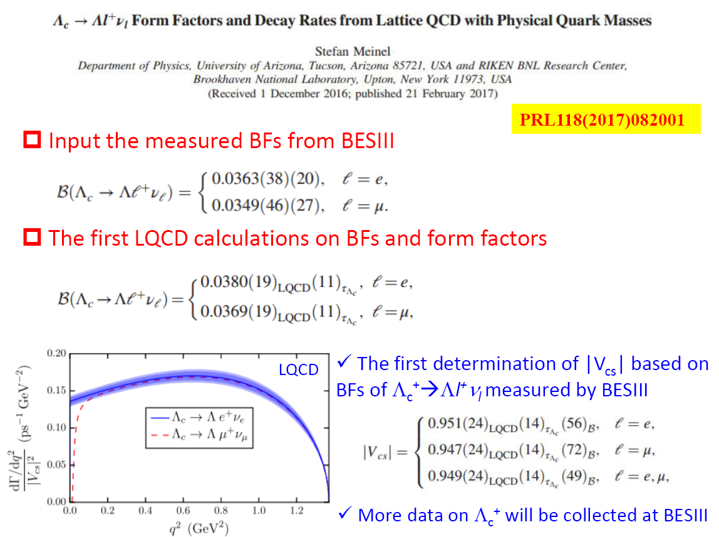

Semi-Leptonic ${decay Λ}_{c}^{+}→$ Λl⁺ν_{l}

Slide 20
Inclusive Decay

Slide 21

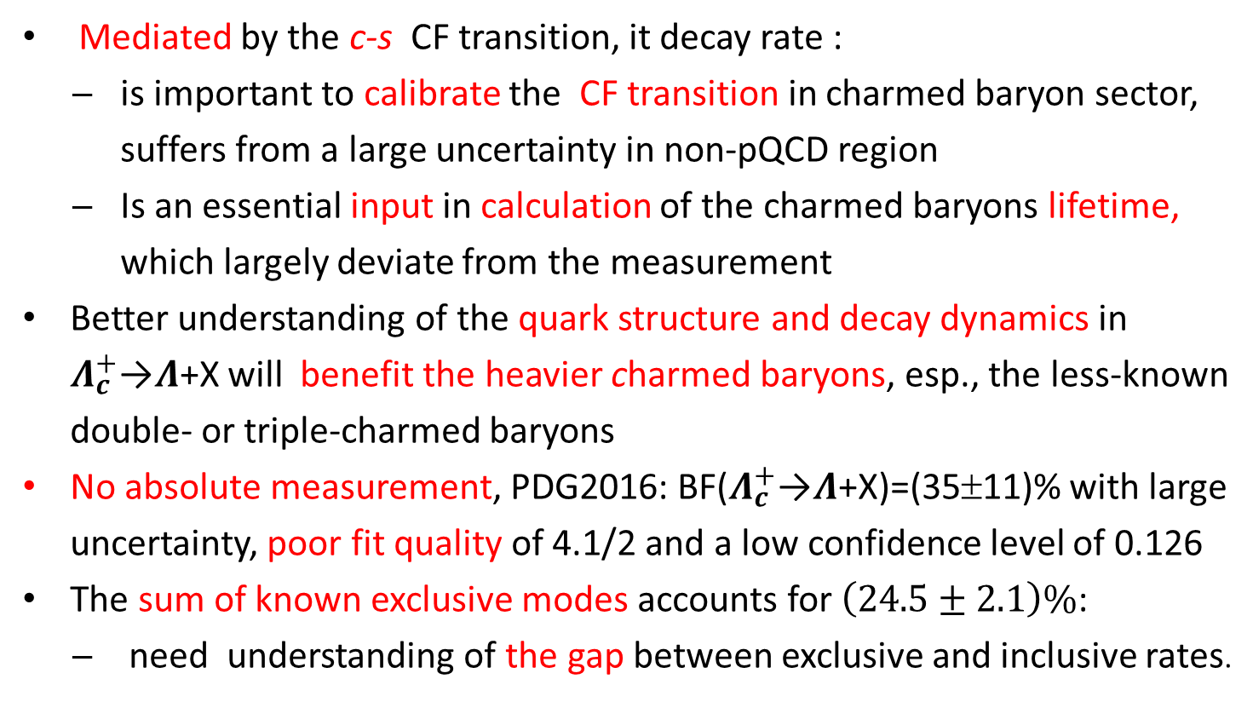
The inclusive decay $Λ_{c}^{+}$→$Λ$+X
Mediated by the c-s CF transition, it decay rate :
is important to calibrate the CF transition in charmed baryon sector, suffers from a large uncertainty in non-pQCD region
Is an essential input in calculation of the charmed baryons lifetime, which largely deviate from the measurement
Better understanding of the quark structure and decay dynamics in $Λ_{c}^{+}$→$Λ$+X will benefit the heavier charmed baryons, esp., the less-known double- or triple-charmed baryons
No absolute measurement, PDG2016: BF($Λ_{c}^{+}$→$Λ$+X)=(35±11)% with large uncertainty, poor fit quality of 4.1/2 and a low confidence level of 0.126
The sum of known exclusive modes accounts for $\left(24.5±2.1\right)\%$:
need understanding of the gap between exclusive and inclusive rates.

Slide 22
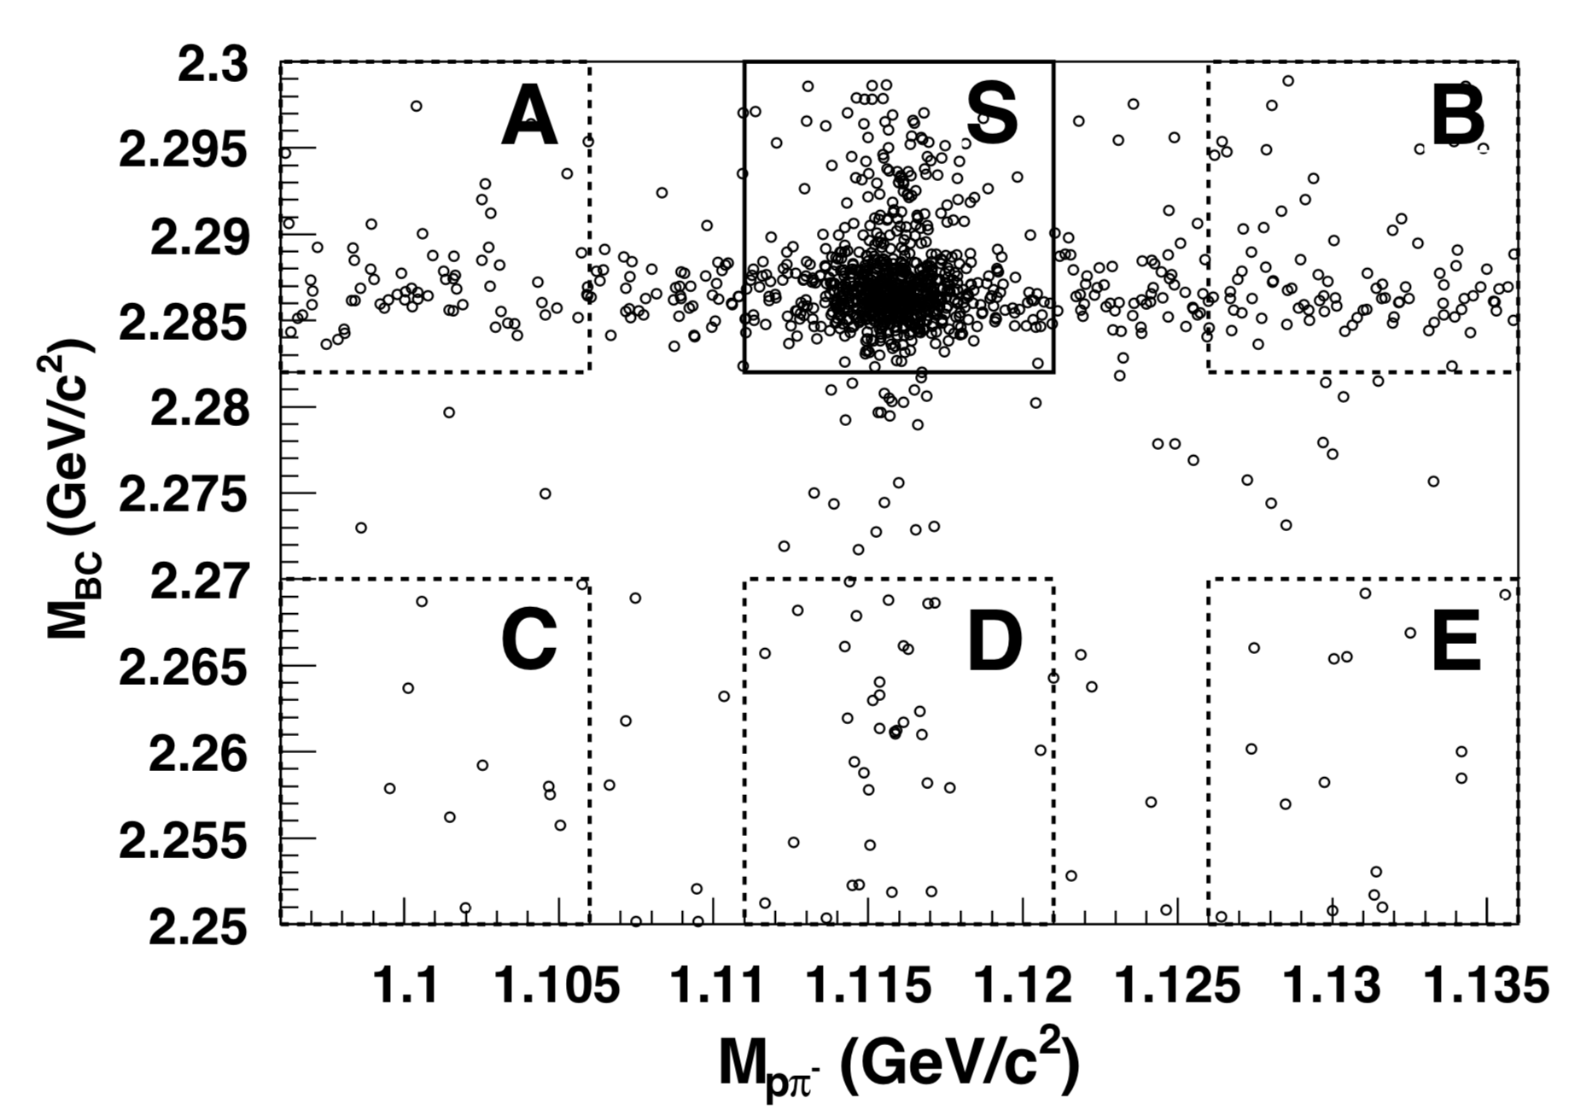
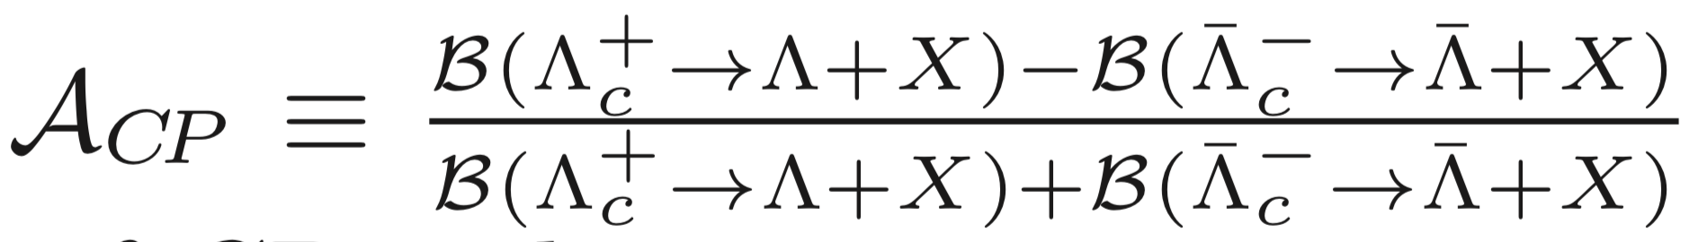
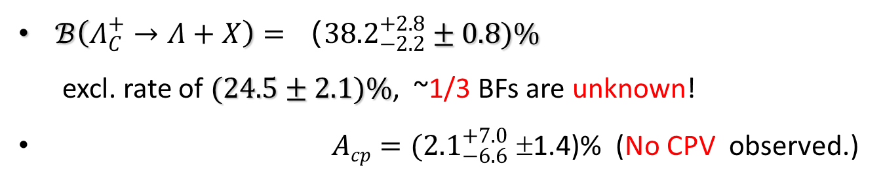
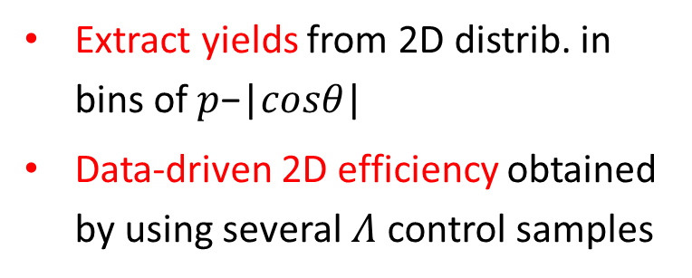
The inclusive decay $Λ_{c}^{+}$→$Λ$+X
DT method with ST modes : $Λ_{c}^{+}$→pK⁻π⁺ and p$K_{s}^{0}$
Extract yields from 2D distrib. in bins of 𝑝−|𝑐𝑜𝑠𝜃|
Data-driven 2D efficiency obtained by using several $Λ$ control samples
arXiv:1803.05706
$ℬ\left(Λ_{C}^{+}→Λ+X\right)={（38.2}_{−2.2}^{+2.8}±0.8)\%$
  excl. rate of $(24.5±2.1)\%$, ~1/3 BFs are unknown!
$Acp{=(2.1}_{−6.6}^{+7.0}\text{±1.4}\text{)\%}$(No CPV observed.)

Slide 23
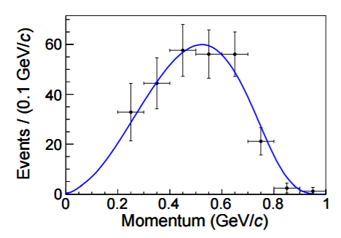

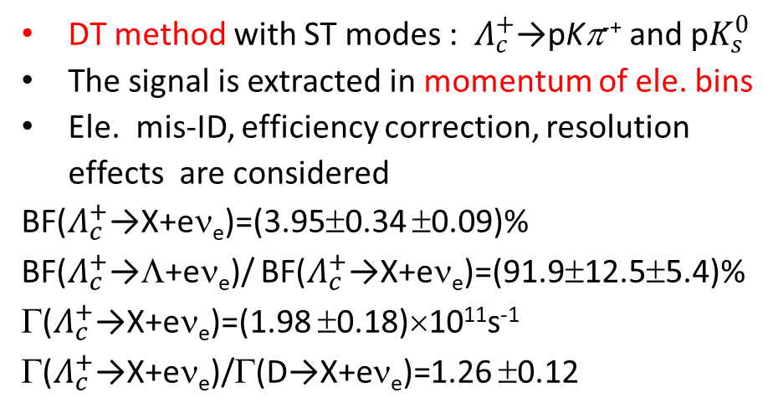
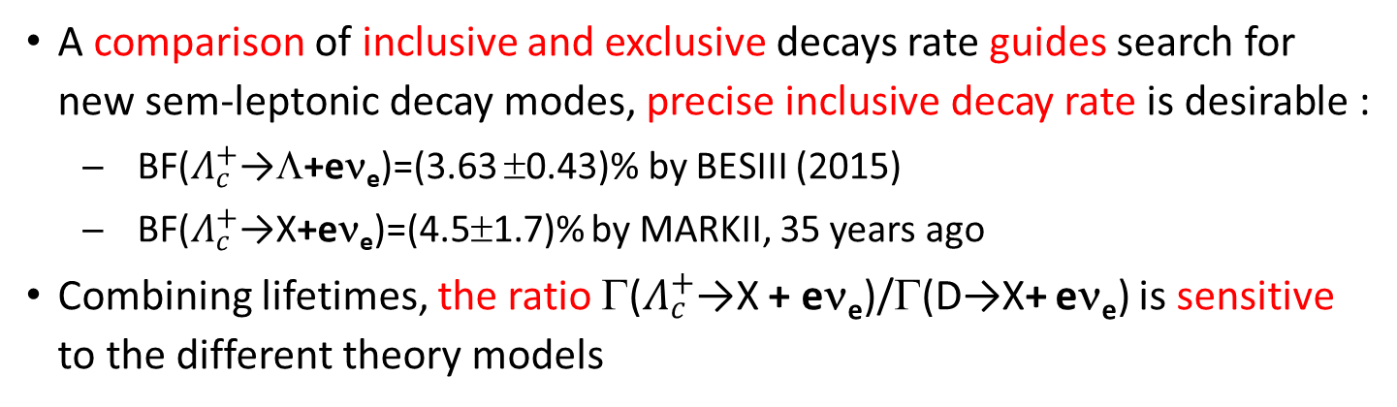
The inclusive decay $Λ_{c}^{+}$→X + eν_{e}
A comparison of inclusive and exclusive decays rate guides search for new sem-leptonic decay modes, precise inclusive decay rate is desirable :
BF($Λ_{c}^{+}$→Λ+eν_{e})=(3.63 ±0.43)% by BESIII (2015)
BF($Λ_{c}^{+}$→X+eν_{e})=(4.5±1.7)% by MARKII, 35 years ago
Combining lifetimes, the ratio Γ($Λ_{c}^{+}$→X + eν_{e})/Γ(D→X+ eν_{e}) is sensitive to the different theory models
arXiv:1805.09060
DT method with ST modes : $Λ_{c}^{+}$→pKπ⁻⁺ and p$K_{s}^{0}$
The signal is extracted in momentum of ele. bins
Ele. mis-ID, efficiency correction, resolution effects are considered
BF($Λ_{c}^{+}$→X+eν_{e})=(3.95±0.34 ±0.09)%
BF($Λ_{c}^{+}$→Λ+eν_{e})/ BF($Λ_{c}^{+}$→X+eν_{e})=(91.9±12.5±5.4)%
Γ($Λ_{c}^{+}$→X+eν_{e})=(1.98 ±0.18)×10¹¹s⁻¹
Γ($Λ_{c}^{+}$→X+eν_{e})/Γ(D→X+eν_{e})=1.26 ±0.12

Slide 24
Production

Slide 25
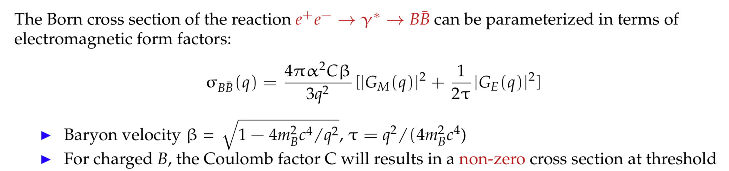
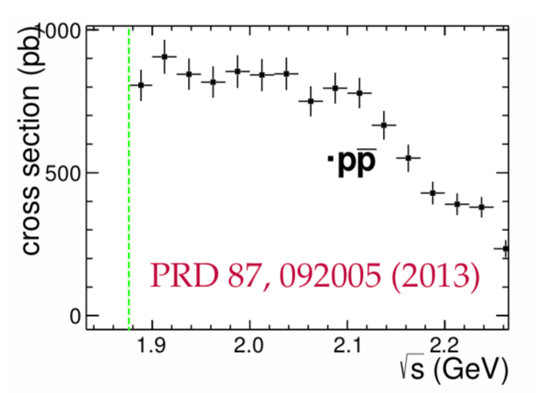
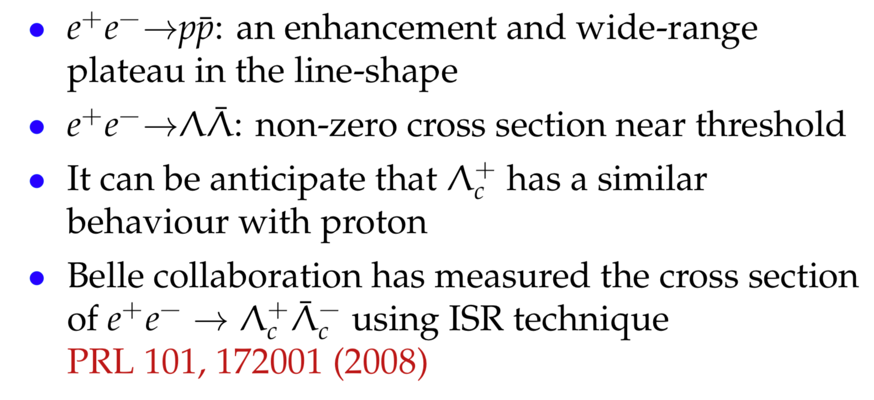
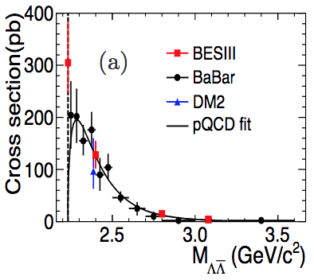
The production x-sec of baryon pair
One of the most basic observables that related to the internal structure of the nucleon.
PRD 97, 032013 (2018)

Slide 26
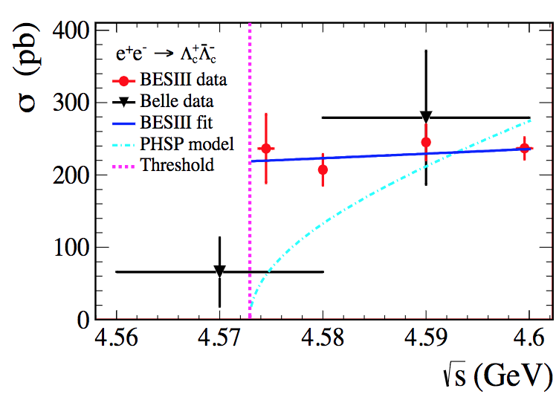
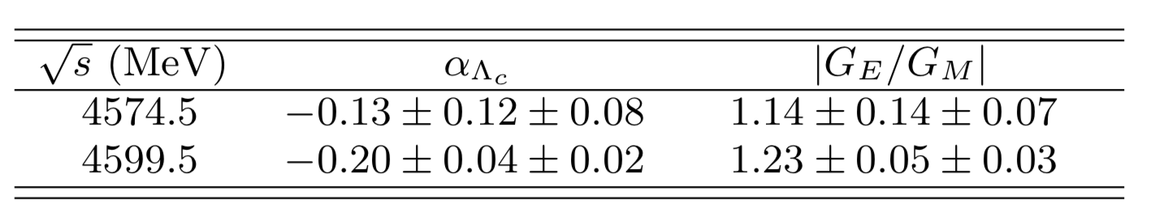





Study of e⁺e⁻→ $Λ_{c}^{+}Λ_{c}^{−}$ near threshold
The x-sec. are measured with high precision
Enhance x-sec. near threshold is discerned for the first time
The Coulomb enhanced factor?
PRL 120, 132001 (2018)
First measurement of EM FFs of $Λ_{c}^{+},$ a powerful tool in understanding the structure of nucleons.

Slide 27
BESIII Prospects
BEPCII increase of the maximum energy funded:
4.6 GeV → 4.7 GeV (~2018 summer) → 4.9 GeV (~2020)
Era of precision study of the Λ_{c} decays at BESIII
with 2 year data taking, provide 10 times data
  hadronic decays:
  to explore as-yet-unmeasured channels and understand full picture of intermediate structures
  more semi-leptonic decays: Σπl⁺n, pK⁻l⁺n, pπ⁻l⁺n, …
  understand internal dynamics
  CPV in charmed baryon:
  BP and BV decay asymmetry, charge-dependent rate of SCS ph⁺h⁻
  Rare decays: LFV, BNV, FCNC
Establishment of absolute BFs for Ξ_{c} and Ω_{c} decays?
Many more results are expected in the coming future years.

Slide 28


Summary
The precisions of $Λ_{c}^{+}$ decay rates is reaching to the level of charmed mesons!
 | Golden hadronic mode | ΔB/B | Golden SL mode | ΔB/B
D⁰ | B(Kπ)=(3.88±0.05)% | 1.3% | B(Kev)=(3.55±0.05)% | 1.4%
D⁺ | B(Kππ)=(9.13±0.19)% | 2.1% | B(K⁰ev)=(8.83±0.22)% | 2.5%
D_{s} | B(KKpi)=(5.39±0.21)% | 3.9% | B(ɸev)=(2.49±0.14)% | 5.6%
$$Λ_{c}^{+}$$ | B(pKπ)=(5.0±1.3)%(PDG2014) =(6.8±0.36)% (BELLE) =(5.84±0.35)% (BESII) =(6.46±0.24)% (HFAG) | 26% 5.3% 6.0% 3.7% | B(Λev)=(2.1±0.6)%(PDG2014) =(3.63±0.43)% (BESIII) =(3.18±0.32)% (HFAG) | 29% 12% 10%
BEPCII/BESIII open a new and unique territory to study the charmed baryons
BESIII and B factories will be complementary in the study of $Λ_{c}^{+}$decays and provide the precise measurements in the future several years.

Slide 29
Thanks !

Slide 30






History of $Λ_{c}^{+}$
PRL 37 (1976) 882
PRL44 (1980) 10
$Λ_{c}^{+}$ →pK⁻π⁺
$Λ_{c}^{−}$→Lπ⁻π⁺π⁻
First observed of at Fermi Lab in 1976
Established at Mark II in 1980.
Progress Relatively slow comparing to charmed mesons

Slide 31




W-exchange-only process $Λ_{c}^{+}→Ξ^{ (∗)0}K^{+}$
PDG:
(5.0±1.2)$×{10}^{−3}$
PDG:
(4.0±1.0)$×{10}^{−3}$
BESIII Results

Slide 32






Semi-Leptonic ${decay Λ}_{c}^{+}→$ Λl⁺ν_{l}
ARGUS first measurement :
CLEO improved measurement :
Combined with the τ($Λ_{c}^{+}$) and the assumption of form factors
Phys. Lett. B 269, 234 (1991).
Phys. Lett. B 323, 219 (1994).
PDG 2015
Not a direct measurement!
Theoretical calculations on the BF ranges from 1.4% to 9.2%

Slide 33
Quark Model
$Λ_{c}^{+}$: a heavy quark (c) with an unexcited spin-zero diquark (u-d)
u
u d
$$\overline{d}$$
d
s
c
c
Charmed meson (D⁺[c$\overline{d}$])
m_{d} << m_{c} → quark + heavy quark
(q) (Q)
Strange baryons (L[uds])
m_{u}, m_{d} ≈ m_{s} → (qqq) uniform
Charmed baryon (L_{c}[udc])
m_{u}, m_{d} << m_{c} → diquark + quark
(qq) (Q)
Heavy Quark Effective Theory :
diquark correlation is enhanced by weak Color Magnetic Interaction with a heavy quark
More reliable prediction of heavy-light quark transition without dealing with light degrees of freedom that have net spin or isospin.

Slide 34

$Λ_{c}^{+}$ weak Decays
Contrary to charmed meson, receive sizable non-factorization W-exchange contribution
Two distinct internal W emission diagrams, three different W exchange diagrams
Need information of decay asymmetry to extract s-wave and p-wave amplitudes separately
Exotic search in${ Λ}_{c}^{+}→φpπ^{0}$: an analog to Pc states in${ Λ}_{b}^{0}→J/ψpK^{−}$

