Slide 1
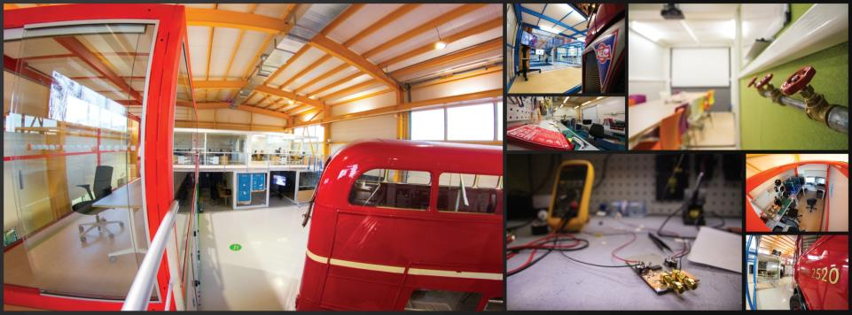
CERN Ideasquare
Markus Nordberg
Head of Resources Development
Development and Innovation
INTRODUCTION
Porto&NTUA 8, 2018

Slide 2
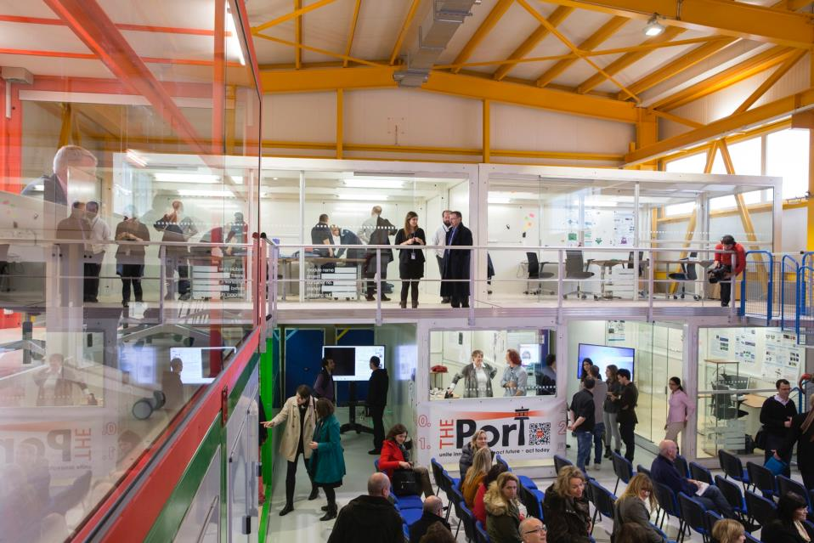
IDEASQUARE IN BRIEF
“Ideasquare is an Experiment that brings together researchers, engineers, industrial partners and cross-disciplinary student teams to work together on detector upgrade R&D technologies. The dual purpose is to co-develop new technologies for research purposes and create a fruitful environment for socially and globally relevant new product ideas and innovation.”

Slide 3
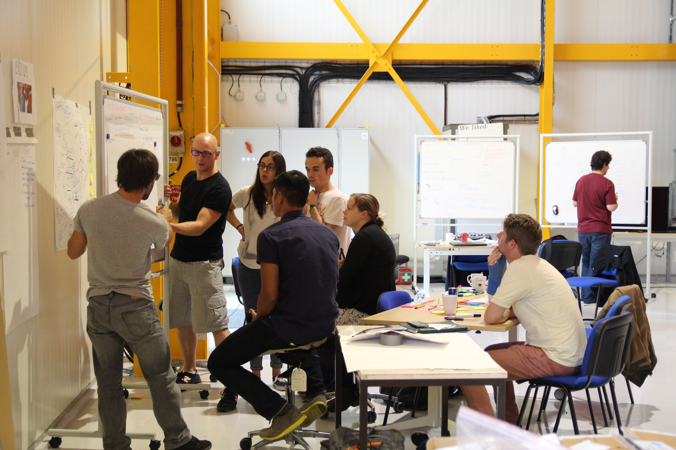

IDEASQUARE IS
Project with a dedicated building, hosting:
  Detector upgrade R&D projects
  Innovation events, workshops, hackathons
  Multidisciplinary master level student programs
...to prototype, test and iterate new forms of collaboration and co-creation in the areas or Research, Education and Technology - RET
Research
Education
Technology

Slide 4
HOW DO THESE PROJECTS DIFFER?
Detector R&D
Projects
Hi
Time period (physically) at IdeaSquare
(3-5 year marathon)
Short duration
innovation events
“Hacks”
MSc-Level Student Programs
Lo
(1-5 days sprint)
(6 month run)
Lo
Hi
Level of complexity/required integration

Slide 5

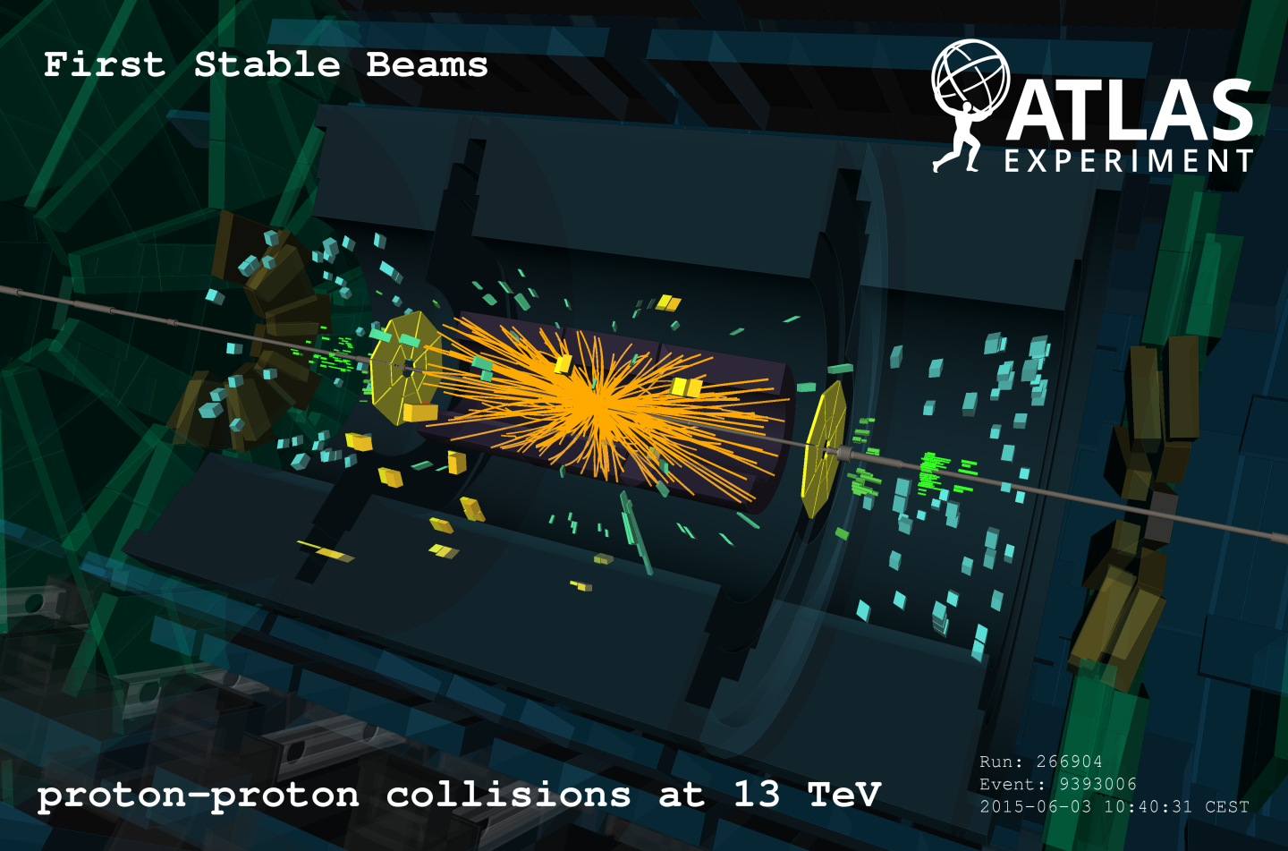


WHAT IS THE MOST INTERESTING LINK FOR NEW INNOVATION?
Detector R&D
Projects
Defined/closed
Technology
MSc-Level Student Programs, Hacks etc.
Initially undefined/open
Product
Process
Focus

Slide 6
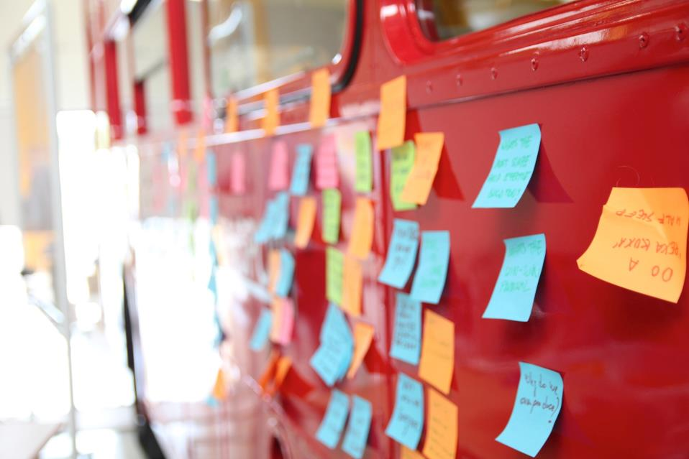
HOW DOES IT WORK?
Bringing different people together. Empowering them. Putting people first.
  Information doesn’t radiate (communication deprived at 4m distance, goes to nearly zero at 20m) (TJ Allen, 1976)
  Single disciplinary teams do not radiate (single mindset leads thus far, but not beyond the rainbow)
People from different backgrounds are amazed by each others skills... but only when they see them!
Innovation is 1% about ideas, 99% execution & iteration: finding ways in which people can collaborate and co-create efficiently

Slide 7
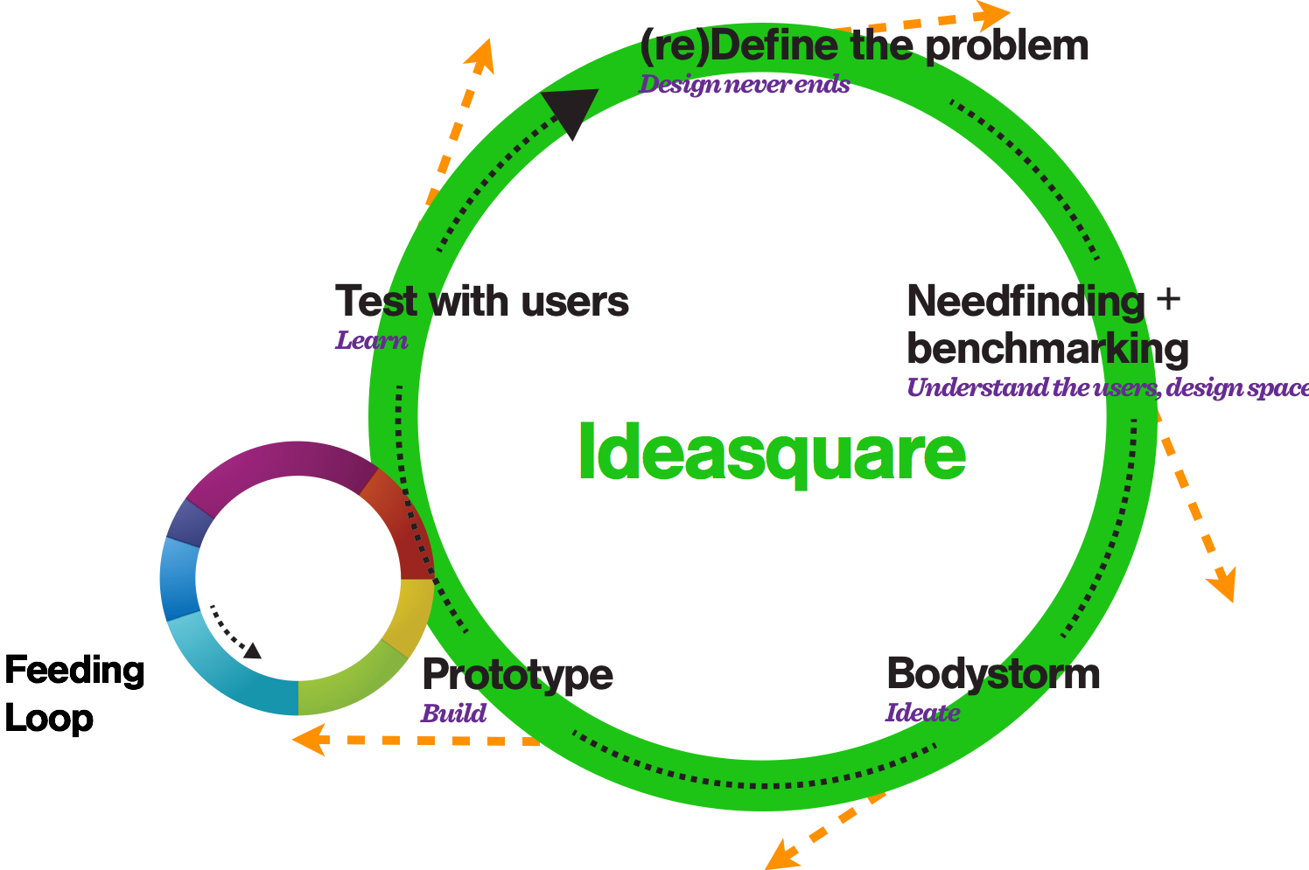
IDEASQUARE
The Large Human Collider

Slide 8
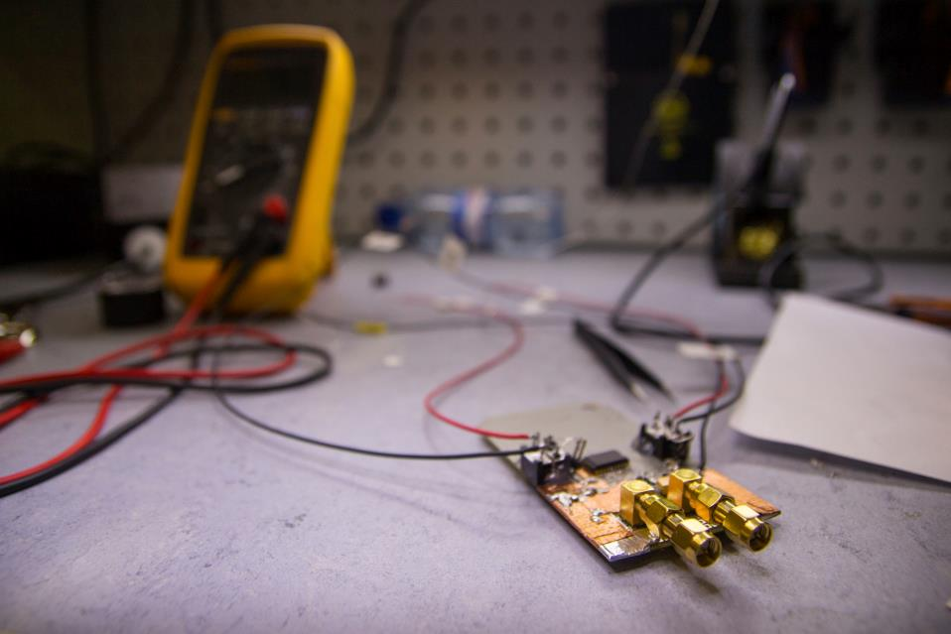
IDEASQUARE OUTPUT
Education of future scientists and innovators
Creating talent for both basic research and entrepreneurship (iterative prototyping, new business concepts)
Sharing of ideas, spaces and resources improved in and between versatile development projects in a high-tech environment
Societal value from basic research
Shared experimental data on innovation processes
  (http://cij-ei.web.cern.ch/cij-ei/)
Demonstrator for ATTRACT (www.attract-eu.org) to create local entrepreneurial ecosystems using centers like CERN as engines of innovation (collaboration with prof. E. Autio/IC)

Slide 9

BUILDING SAFETY B3179
  In all inside areas of Building 3179 smoking is strictly forbidden.
  In Point1 areas (nearby Ideasquare) alcoholic beverages are strictly forbidden.
  Working is possible 24/7 with CERN access card, sleeping is prohibited in all CERN buildings.
  Eating, drinking, coffee breaks are encouraged in the kitchen area.
  Cameras, photos, posting in social media are highly encouraged :)

Slide 10
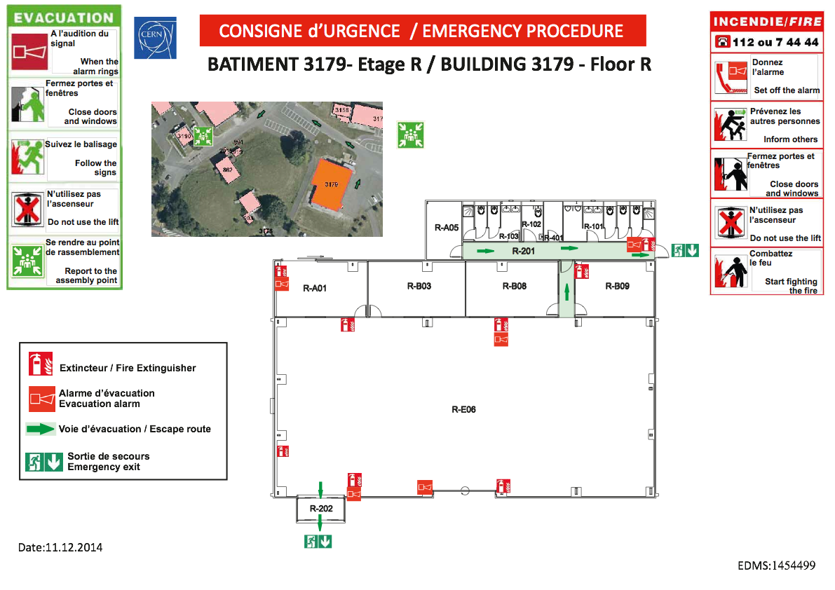
Emergency assembly
point is located next to
the Point1 access gate.

Slide 11
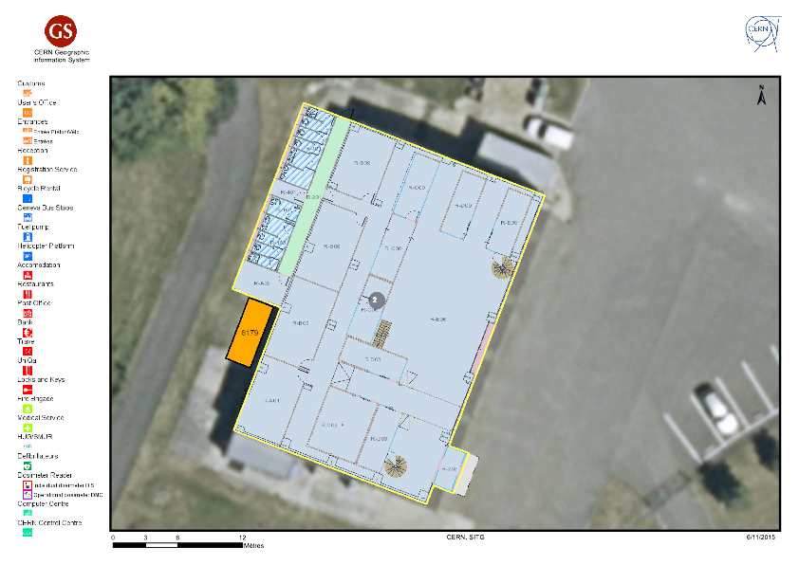
In case of an emergency
  If needed, press Fire Alarm (see map on next slide)
  If electric danger present, press Emergency Stop switch - located in each workshop area right next to the door
  Contact Fire Brigade, tel. 74444
  Go to the assembly point next to the Point 1 car gate, stay there until Fire Brigade gives you permission to leave.
  Notify immediately:
    TSO Johann Poirot, johann.poirot@cern.ch, tel. 168883
    Markus Nordberg, markus.nordberg@cern.ch, tel. 164452

Slide 12

Phone First aid & eye wash

Slide 13
WORKING AREA POLICY B3179
  Safety is first priority!
  In laboratory areas:
    Machineshop 3179-R-A01
    Electroshop 3179-R-B03 and
    3D Studio 3179-1-D01
  eating and drinking are strictly forbidden.
  For grey room (Light Lab 3179-R-B08) and dark room (3179-R-A06) areas access is restricted to authorised personnel only.

Slide 14
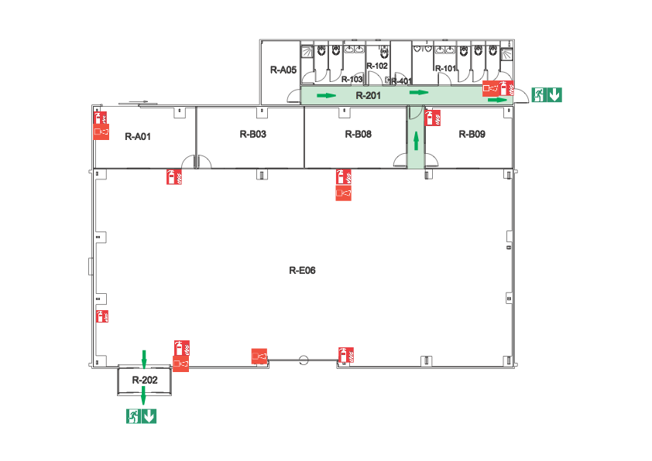
Machineshop
Electroshop
Light Lab
Kitchen
Free to use
1-D01
3D Studio
(2nd floor)
Work under
supervision
Restricted area

Slide 15
Keeping places tidy
This is a work environment, please respect our common workspace.
For CERN ways of working, see CERN Code of Conduct.
Please, please:
  Bring all coffee cups, plates, dishes to kitchen, put them in the machine.
  Help collaboratively to clean up the space at the end of the day.
  Thank you!!

Slide 16
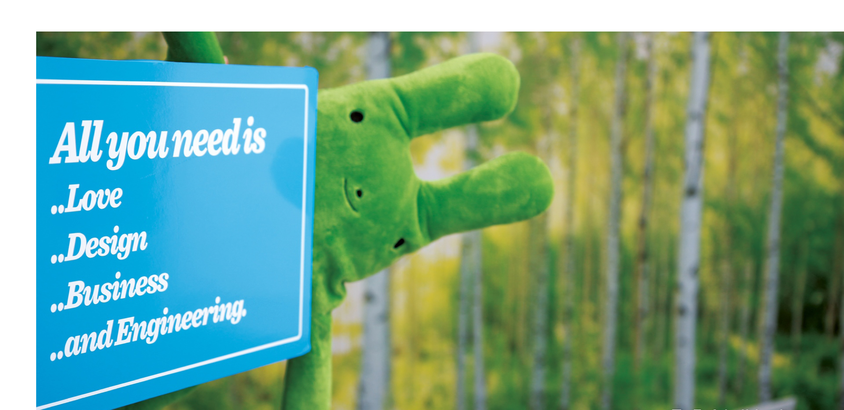

Questions? Comments?
Contact information:
Email
Skype
Let’s have a cup of coffee and make it happen!

