Slide 2
I want to work at CERN!
A glimpse of what it is like to work at CERN and the many ways to become a CERNois
Mélissa Gaillard
CERN IT Department Communications Officer

Slide 3
What it is like working at CERN?

Slide 4
My experience…

Slide 5

The recruitment team’s view…

Slide 6
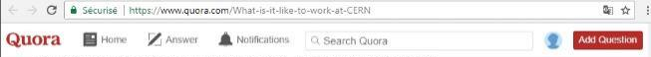

A colleague’s point of view…

Slide 7

CERN
What for?

Slide 8

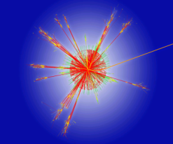
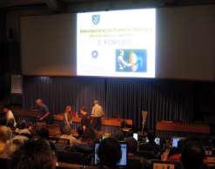
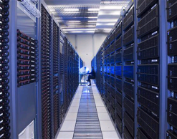
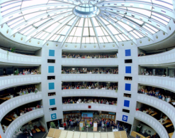
To provide a unique range of particle accelerator facilities that enable research at the forefront of human knowledge
To perform world-class research in fundamental physics
To unite people from all over the world to push the frontiers of science and technology, for the benefit of all.
CERN’s
Mission
Research
Education
Technology
Collaboration
Slide credit CERN HR-Talent Acquisition
Notes:
CERN’s goal is FUNDAMENTAL research, not APPLIED research.
CERN is not to improve the way electricity is produced or rockets are launched.
CERN is to help answering questions and for a better understanding of the Universe.
One of CERN goals is to educate: students of course by welcoming them at CERN for internships, but also the general public, by making its discoveries available and understandable. CERN is visited each year by 100’000 visitors on guided tours. And many more visit CERN’s permanent exhibitions. This presentation is part of CERN’s educational effort.
Technology:
In order to face all these questions and challenges, scientists need huge, complex and costly instruments.
Therefore international collaboration is the only way to answer these questions. CERN accounts for half of the world particle physicists.

Slide 9
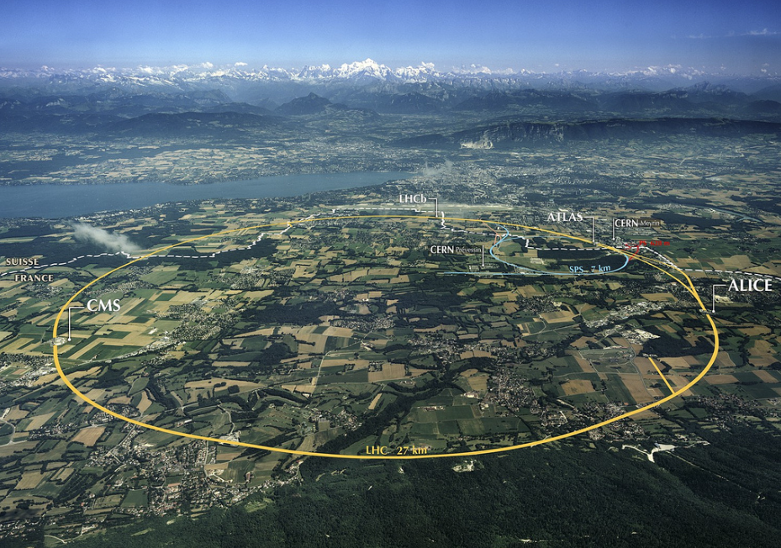
An aerial view
of
CERN
Slide credit CERN HR-Talent Acquisition

Slide 10
CERN
So what?
Notes:
That «how» we make research at CERN.
You may now wonder if this is useful for you in your everyday life?
The answer is simply… probably not.
As explained earlier, fundamental research is not made for practical applications. It is there
But…
To make its fundamental research, CERN had to organize the largest scientific collaborative project, build the largest machine on Earth, build the coldest place in the galaxy, make the highest vacuum, build the largest and heaviest experiments, build the largest computing grid…
All these technological challenges ended up in new technologies which can find application on a much shorter scale…
Let’s review some of them

Slide 11

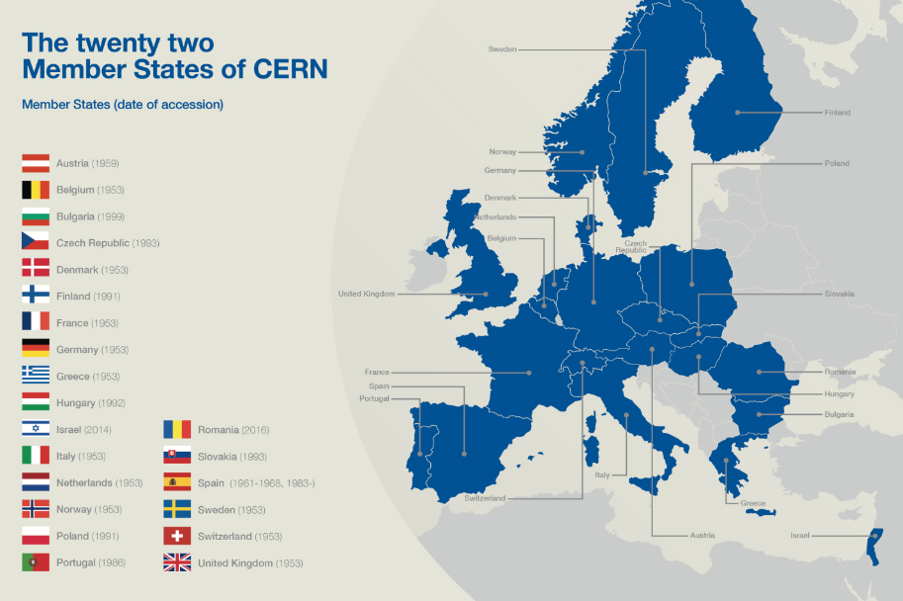
CERN
A Worldwide
collaboration
Funded by 22 Member
States
Slide credit CERN HR-Talent Acquisition

Slide 12
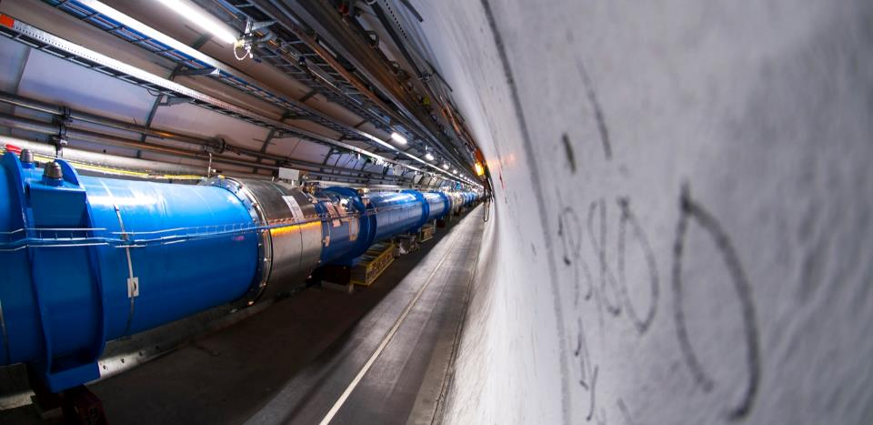

CERN FEATURES:
The
FASTEST RACETRACK
on the
Planet
Image credit: CERN
Slide credit CERN HR-Talent Acquisition
Notes:
Trillions of protons race around the 27km ring in opposite directions over 11,000 times a second, travelling at 99.9999991 per cent the speed of light.

Slide 13
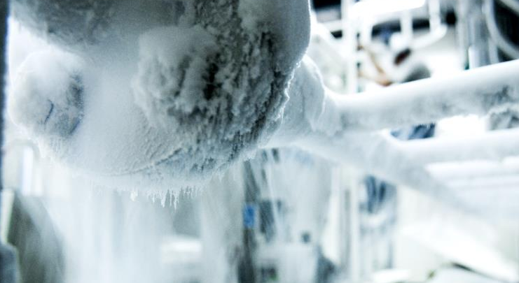

COLDER TEMPERATURES than outer space
Image credit: CERN
Slide credit CERN HR-Talent Acquisition
Notes:
With an operating temperature of about -271 degrees Celsius, just 1.9 degrees above absolute zero, the LHC is one of the coldest places in the universe

Slide 14
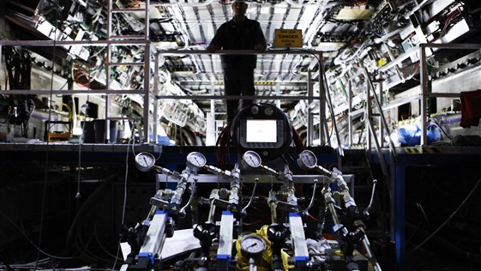

The Most SOPHISTICATED DETECTORS ever built
Image credit: CERN
Image credit: CERN
Slide credit CERN HR-Talent Acquisition
Notes:
To sample and record the debris from up to 1 billion proton collisions per second, scientists are building gargantuan devices that measure particles with micron precision.

Slide 15
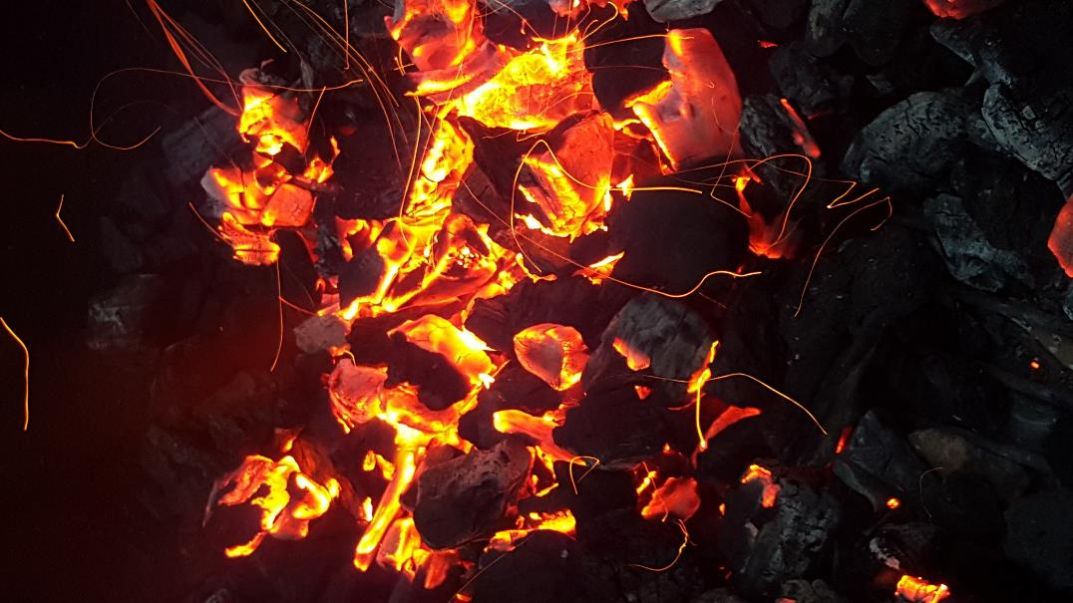

HOTTEST spots in the galaxy
Image credit: CERN
Image credit: David Tyner
Slide credit CERN HR-Talent Acquisition
Notes:
When two beams of protons collide, they generate temperatures 1000 million times hotter than the heart of the sun, but in a minuscule space.

Slide 16
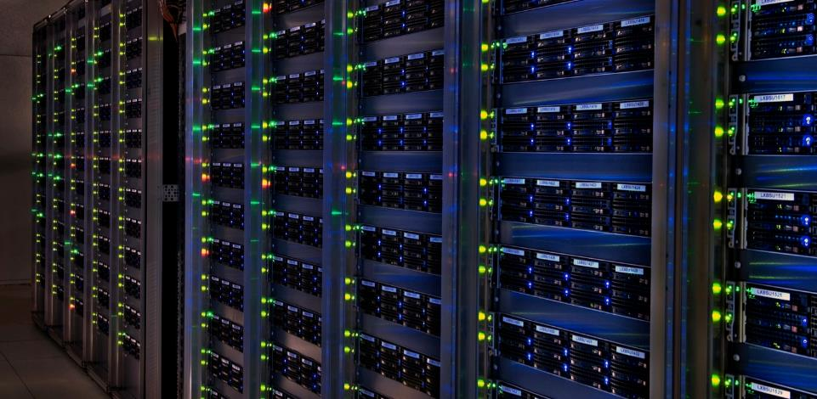

The
Birthplace of the
WORLD WIDE WEB
Image credit: CERN
Slide credit CERN HR-Talent Acquisition
Notes:
To analyse the data, tens of thousands of computers around the world are being harnessed in the Grid. The laboratory that gave the world the web, is now taking distributed computing a big step further.

Slide 17
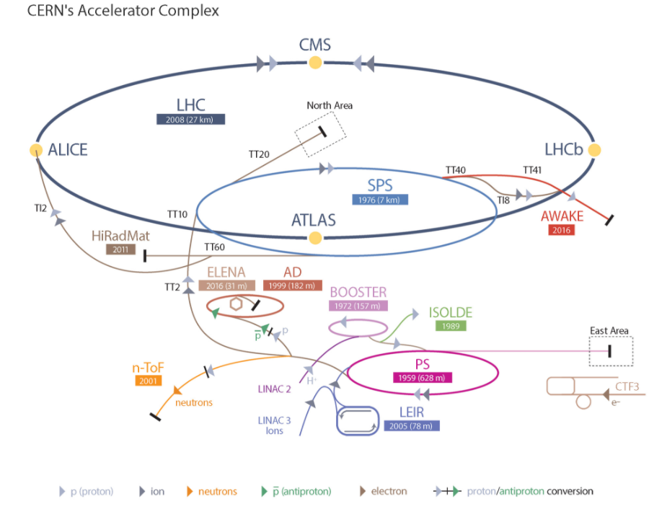

The EQUIPMENT
Accelerators
Are powerful machines capable of accelerating particles to very high energies before being collided with other particles
Detectors
Gigantic instruments that record particle collisions
Computers
To collect, store, distribute and analyze enormous quantities of data generated by detectors
Slide credit CERN HR-Talent Acquisition

Slide 18


ATLAS:
As Big as a
5
STOREY BUILDING
Image credit: CERN
Slide credit CERN HR-Talent Acquisition
Notes:
ATLAS brings experimental physics into new territory. Most exciting is the completely unknown - new processes and particles that would change our understanding of energy and matter. ATLAS will learn about the basic forces that have shaped our Universe since the beginning of time and will determine its fate.

Slide 19

CMS:
CMS
is
heavier
than the
HEAVIER
than the
EIFFEL TOWER
EIFFEL TOWER
Image credit: CERN
Slide credit CERN HR-Talent Acquisition
Notes:
Why so big?
because the particles flying out of the collisions have such high energies that it takes big distances to absorb them.
more accurate measurements
As a result of all of this, CMS is 15 metres in diameter and weighs around the same as 30 jumbo jets or 2,500 African elephants. And though it is the size of a cathedral, it contains detectors as precise as Swiss watches.

Slide 20
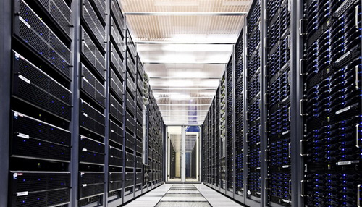
CERN
Data Centre
Image credit: CERN
Slide credit CERN HR-Talent Acquisition
Notes:
About 230 000 computer cores, 15 000 servers, 90 000 disks
More than 200 petabytes of data permanently archived in its tape libraries

Slide 21
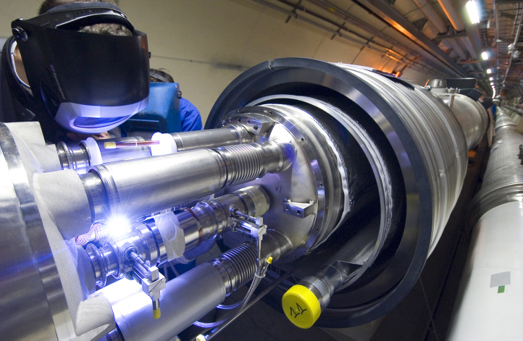

Computing/IT
Vacuum & cryogenics
Electronics
Electricity
Magnets
Mechanics
Material Science
Radiofrequency
Control Systems
Etc.
Radiofrequency
Computing / IT
Vacuum & Cryogenics
Magnets
CERN
Technology
Material Science
Mechanics
Electronics
Slide credit CERN HR-Talent Acquisition

Slide 22
The CERNois
Who are they?
Notes:
Who is behind CERN?

Slide 23
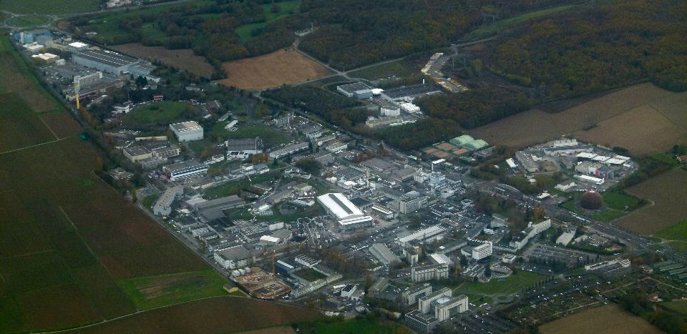

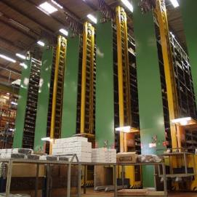

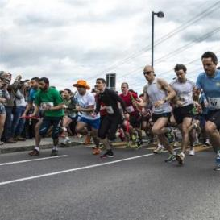
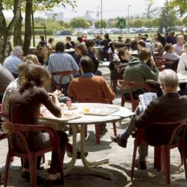
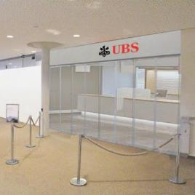
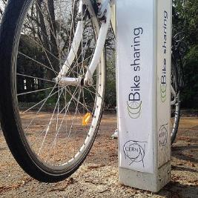
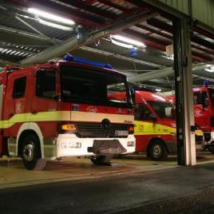
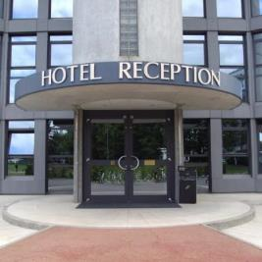
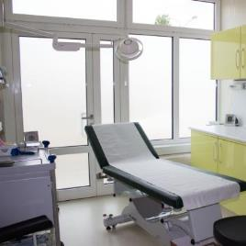
Like a small town
Mail, Stores…
Library
Hotels
Kindergarten
Clubs, Associations
Bank, Post Office,
Travel Agent
Medical Service
Fire Brigade
Tramway, bus, bikes
Restaurants
Slide credit: François Briard
Notes:
CERN has 2 main sites. The most populated one is Meryrin, straddling accross the French-Swiss border (unique in the World).
CERN’s territory, even though by Switzerland and France is under the control of the Organization. This means local French and Swiss authorities do not have access to it unless agreed by CERN’s Director General.
CERN is like a small town with various services you can find in a town. And also with the problems of a small town: mobility, parking, ageing of some buildings etc
There is even a demonym for the people working at CERN: «les Cernoises et les Cernois».

Slide 24






CERN
Population
810
Fellows
12,260
Users
Total of
17,794
711
Students &
trainees
2,618
Staff Members
1,395
Associates
Data: 1 Sept 2017
Slide credit CERN HR-Talent Acquisition
Notes:
Add stats according to the audience (country/profession/field of study…)

Slide 25
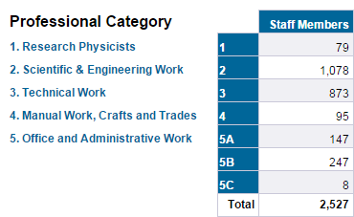




CERN
Professional Categorization
1129
Scientific & Engineering work
Total of
2,618
Members of Staff
Information Officer
Computing
Engineer
511
Office and Administrative
Electronics Engineer
892
Technical Work
Lawyer
Vacuum
Technician
Radioprotection
Engineer
Firefighter
57
Manual Work, Craft and Trade
Translator
86
Research Physicists
Machine Operator
Data: 1 Sept 2017
Physicist
Slide credit CERN HR-Talent Acquisition
Physicist
Notes:
Tony Shave: Total of 3000 Members of Staff

Slide 26

CERN
Examples of professions
Computer
Engineer
Radioprotec-
tion Engineer
Scientific & Engineering
work
Electronics
Engineer
Physicist
Technical
Engineer
(Electronics)
Total of
2,618
Members of Staff
Vacuum
Technician
Technical Work
Office and Administrative
Machine
Operator
Electrical
Technician
Manual Work, Craft and Trade
Technical
Engineer
(Electronics)
Administrative Assistant
Information
Officer
Firefighter
Lawyer
Other
Translator
Data: 1 Sept 2017
Slide credit CERN HR-Talent Acquisition

Slide 27

Slide credit CERN HR-Talent Acquisition

Slide 28
CERN
How to apply?
Notes:
Who is behind CERN?

Slide 29
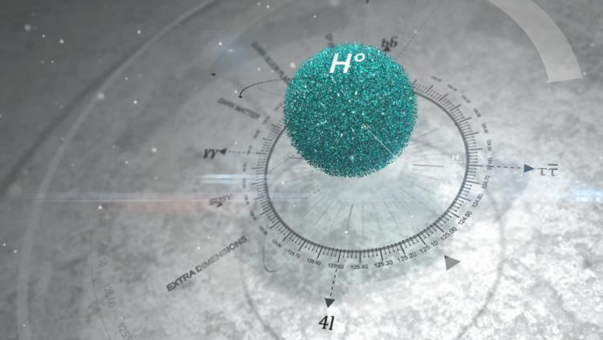
CERN
Opportunities for students
Slide credit CERN HR-Talent Acquisition

Slide 30

We offer ~
240
CERN
Technical Student Programme
positions
annually
‘’
It’s a great
place to start a career, it’s a great place to learn new skills and make
new friends
FIELDS: Applied physics, engineering, computing
LENGTH: 4 to 12 months
ELIGIBILITY: 18 months of technical undergraduate studies
FEATURES: A technical project with a CERN supervisor
A living allowance, incl. health insurance
‘’
Next application deadlines:
16 April 2018
cern.ch/tech
Slide credit CERN HR-Talent Acquisition
Notes:
For students looking for a practical training period or a place to do your final project

Slide 31
We offer ~
30
CERN
Admin Student Programme
positions
annually
‘’
My Admin
Studentship was a great experience
– I had exposure to more activities than I could have imagined
FIELDS: Translation, human resources, business administration, law, finance, librarianship, science communication, audiovisual, communication and public relations…
LENGTH: 2 to 12 months
ELIGIBILITY: 18 months of undergraduate studies
FEATURES: An administrative project with a CERN supervisor - a living allowance, incl. health insurance
‘’
Next application deadlines:
16 April 2018
cern.ch/admin
Slide credit CERN HR-Talent Acquisition
Notes:
For students looking for a practical training period or a place to do your final project

Slide 32
We offer ~
300
CERN
Summer Student Programme
positions
annually
‘’
FIELDS: physics, engineering, computing
ELIGIBILITY: 3 years of full-time studies at university level
LENGTH: 8 to 13 weeks, during the summer
FEATURES: High-quality lecture programs
A technical project with a CERN
supervisor, visits and workshops
Living allowance , incl. health insurance
Accommodation in CERN hostel
Can’t
imagine a better way
to spend my summer
‘’
Opening end 2017, next application deadline:
28th January 2018
Open to Non Member State students
cern.ch/summies
+ CERN openlab summer student programme – Deadline: 19 February 2018 – openlab.cern
Slide credit CERN HR-Talent Acquisition

Slide 33
We offer ~
80
CERN
Doctoral Students
positions
annually
‘’
FIELDS: applied physics, engineering, computing
LENGTH: 1-3 years
ELIGIBILITY: enrolled in a doctoral program in
a Member State university
FEATURES: a technical project, leading to a PhD thesis
co-supervised by the university thesis advisor and a CERN staff member
a living allowance incl. Health insurance
Gave me
the opportunity to meet important people, especially in the research fields
‘’
Next application deadlines:
16 April 2018
https://jobs.web.cern.ch/join-us/doctoral-student-programme
Slide credit CERN HR-Talent Acquisition
Notes:
CERN offers PhD subjects in collaboration with a University

Slide 34
CERN
Opportunities for Graduates
Slide credit CERN HR-Talent Acquisition

Slide 35
We offer ~
220
CERN
Fellowship & Graduate Engineering Training
positions
annually
‘’
An ideal place
to follow the most recent ideas in physics and start new collaborations
FIELDS: physics, engineering, computing
ELIGIBILITY: BSc, MSc or PhD
no more than 10 years relevant post-MSc experience
SELECTION: 2 selection committees per year
FEATURES: 2-3 year employment contract
- Attractive salary incl. social benefits
- Training possibilities
‘’
Next application deadline:
5 March 2018
cern.ch/fellows
Fellows are normally nationals of the Member States of CERN. There also exist a limited number of places for Fellows from non-Member States.
Slide credit CERN HR-Talent Acquisition
Notes:
Recent university graduates who typically come for a first work experience

Slide 36

CERN
Marie Sklodowska-Curie
For university graduates.
Non-member state nationals can apply!
FIELDS: physics, engineering, computing
DURATION: up to 3 years
ELIGIBILITY: MSc or PhD
≤5 years post-degree experience
FEATURES: - Funded by the European Commission
- An employment contract with CERN
- Specific Marie-Curie vacancies published on CERN web pages
- An attractive salary, social benefits, allowances
- The chance to build an international network
https://jobs.web.cern.ch/join-us/msc-actions
Slide credit CERN HR-Talent Acquisition

Slide 37
We offer ~
40
CERN
Technician Training Experience
positions
annually
‘’
FIELDS: Mechanics, electronics, electricity, etc.
ELIGIBILITY: Technical diploma (Note: applicants with higher qualifications, BSc, MSc or PhD are not eligible)
no more than 4 years relevant experience after finishing your diploma
SELECTION: All applications for TTE opportunities will be considered by a panel of CERN specialists. The panel meets once per year.
Successful applicants will be offered appointments which should begin within six months of the meeting.
FEATURES: An initial contract of one year renewable for a second year
Attractive salary include social benefits
On-the-job and formal training will be provided at CERN. There are also in-house language courses for English and French
I never imagined the possibilities CERN would offer me
‘’
Next application deadlines:
31 January 2018
cern.ch/tte
Slide credit CERN HR-Talent Acquisition
Notes:
You are a national of a CERN Member State.
You have a technical diploma in the field of mechanics, electro-mechanics, electricity or electronics.
You have no more than 4 years relevant experience after finishing your diploma.
Candidates who are currently preparing a diploma are eligible to apply. However, they are expected to have obtained their qualification by the time they take up their appointment at CERN.
Applicants with a higher level diploma (BSc, MSc..) are not eligible.
You should have at least a basic knowledge of English or French.

Slide 38
CERN
Opportunities for Professionals
Slide credit CERN HR-Talent Acquisition

Slide 39
We offer ~
CERN
Staff positions
100-150
positions
annually
‘’
Imagine
the answer suddenly becomes clear
EMPLOYED MEMBERS OF PERSONNEL RECRUITED
FROM OUR 22 MEMBER STATES
Eligibility: > from apprenticeship to PhD
Selection: > vacancies published on the WEB
Features: - Maximum 5 year contract
- Competitive salaries incl. social benefits
- Training possibilities (language courses, technical training)
‘’
Regular publications, posts open on
average 4 weeks
Slide credit CERN HR-Talent Acquisition
Notes:
The scientific and technical STAFF design and build the laboratory’s technological infrastructure and ensure its operation. They also help to prepare, run and analyze the scientific experiments.
Fields: Not only physicists, engineers, computer scientists but also technicians, technical engineers as well as administrators and assistants
Activities: ranging through the phases of Research and Development, Design, Production, Operation and Maintenance

Slide 40

CERN
Probably one of the most
incredible experiments in the world!
Ready to take part?
Slide credit CERN HR-Talent Acquisition

Slide 41

CERN
Application Process
Allocate time
A rushed application form is unlikely
to succeed!
Check it
An application form with basic spelling mistakes doesn’t bode well!
ALICE
Motivation
Think about why you are interested in the specific position for which you are applying
Be Honest
Only detail skills that you actually have, not that you may acquire in the future
Slide credit CERN HR-Talent Acquisition
Notes:
Allocate time
An application takes time, so only start your form once you have allocated a reasonable time-slot. Don’t worry if you don’t complete the form in one go – you can save it and come back to it later. However don’t rush your form – a rushed application form is unlikely to succeed.
Check it
Our system doesn’t have a built-in spell checker. Ideally have somebody else re-read your form, or at minimum copy/paste the text into a word processor with a spell-checker. Your application form is a reflection on your work ethic – so an application form which contains basic spelling mistakes or other doesn’t bode well.
Motivation
Think about your motivation for applying. Don’t leave this blank, but don’t just copy/paste some generic text about working at CERN. Think about why you are interested in the specific position for which you are applying.
Be Honest
Only detail skills that you actually have. Don’t list skills you think you may acquire in the future – you can always come back to your application form later and update it once you have demonstrated the skill.
CERN makes use of a diploma verification process so your diplomas will be verified by a third party.
Finally…
You are not ‘shopping’ at an on-line shop, so the web-interface is not going to be as glamorous and intuitive as other sites you are used to. It is not intended to be this way. Consider your ability to complete our online application process with an excellent result as a 1st assessment of your technical & communication skills & abilities :-)
You are potentially only one step towards being invited for an interview.

Slide 42
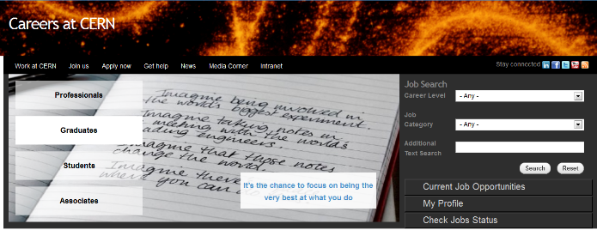
CERN
Careers Website
cern.ch/jobs
Slide credit CERN HR-Talent Acquisition

Slide 43





CERN
Employment
CERN offers opportunities in all fields
follow us :
CERNJOBS
@CERN_JOBS
CERNJOBSTV
Slide credit CERN HR-Talent Acquisition

Slide 44
Challenge Purpose Imagination Collaboration Quality of Life
CERN
What you will Experience
Be at the forefront of technology and physics
Collaborate with multicultural and multidisciplinary teams, without political or religious barriers
Follow experts in their technical domain
Be part of a dynamic environment with training opportunities
Benefit from an attractive remuneration package
Make valuable and long-lasting contacts from all over the world
Learn languages: CERN is a bi-lingual organization (English and French)
LHC b
Slide credit CERN HR-Talent Acquisition

Slide 45
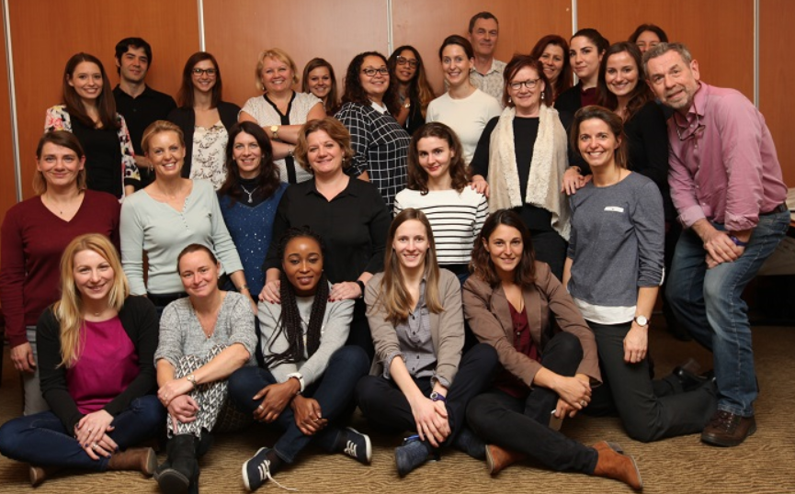
CERN
THANK YOU!
Questions?
Contact: recruitment.service@cern.ch
Slide credit CERN HR-Talent Acquisition

