Slide 1
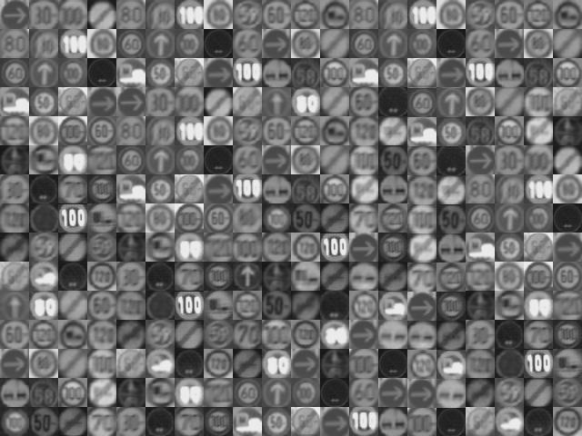
Multivariate Data Analysis with TMVA4
Jan Therhaag⁽*⁾ (University of Bonn)
ICCMSE09 Rhodes, 29. September 2009
⁽*⁾ On behalf of the present core developer team: A. Hoecker, P. Speckmayer, J. Stelzer, J. Therhaag, E. von Toerne, H. Voss
On the web: http://tmva.sourceforge.net/

Slide 2
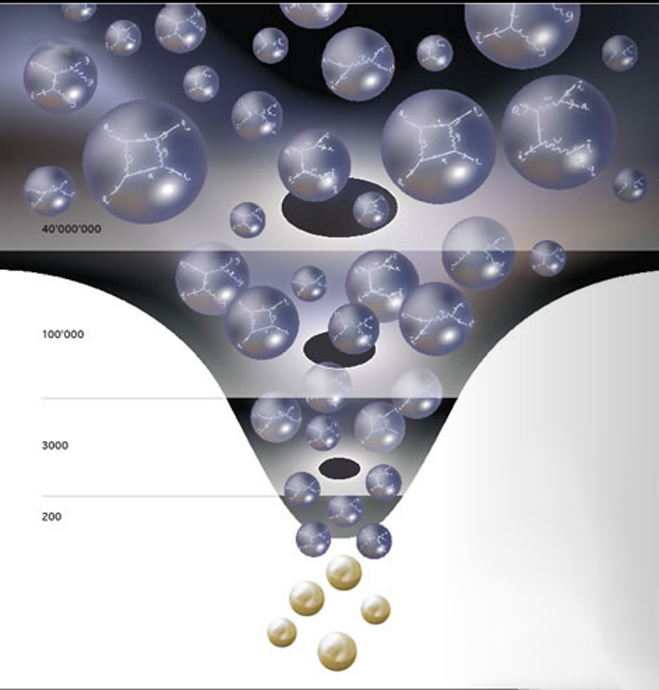
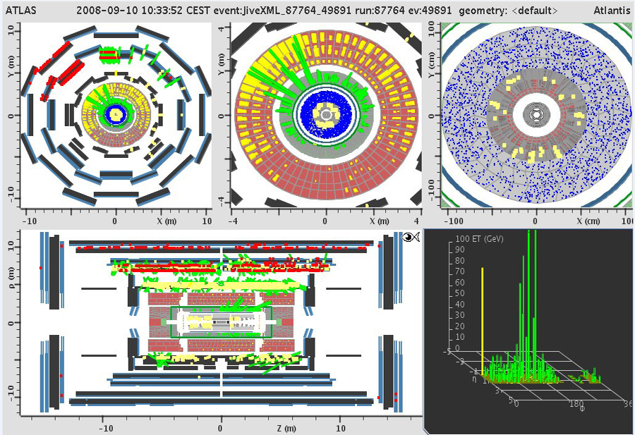
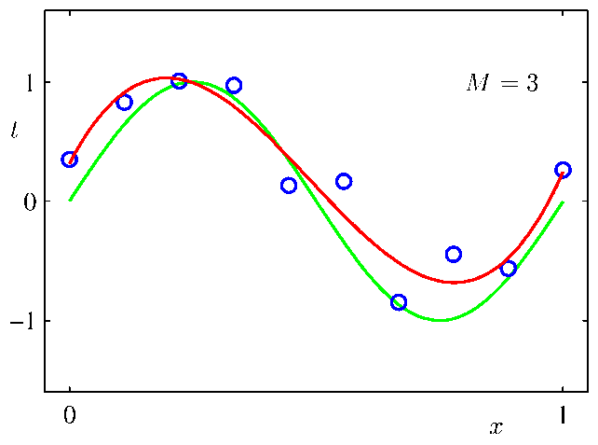
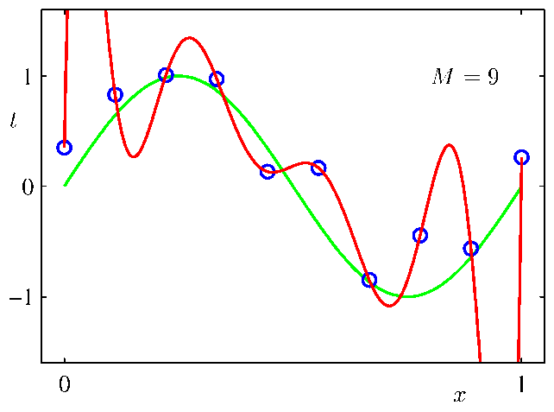
Classification and Regression Tasks in HEP
Classification of signal/background:
How to find the best decision boundary?
Regression: How to determine the
correct model and its parameters?
x₂
H₁
H₀
x₁
x₂
H₁
H₀
x₁
Can a machine learn that for you? Yes, with TMVA!

Slide 3
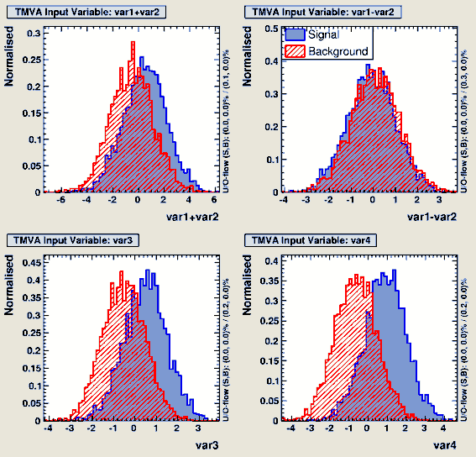
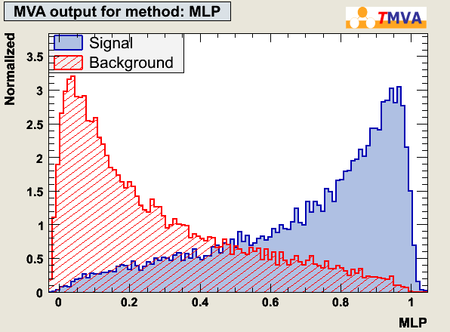
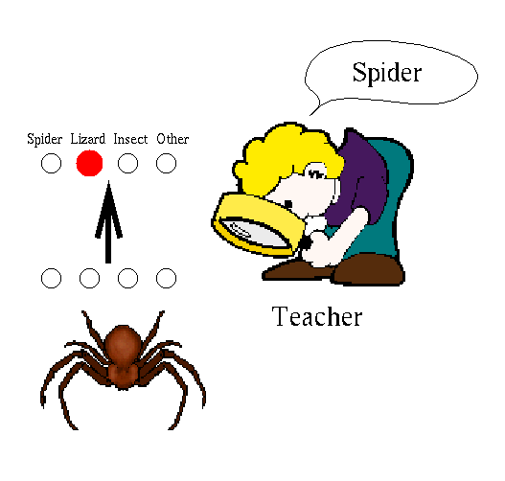
What is TMVA?
TMVA provides methods for multivariate analysis…
…based on supervised learning…
…and so much more:
  a common interface for all MVA techniques
  a common interface for classification and regression
  easy training and testing of all methods on the same datasets
    consistent evaluation and comparison
    common data preprocessing
  a complete user analysis framework and examples
  embedding in ROOT
  creation of standalone C++ classes (ROOT independent)
  an understandable Users Guide
Multivariate classifiers/regressors condense (correlated) multi-variable input information into a single scalar output variable
Supervised learning means learning by example: the program extracts patterns from training data

Slide 4
Overview
TMVA Classifiers / Regressors
The TMVA Workflow

Slide 5
The TMVA Classifiers
Cuts, Fisher, Likelihood, Functional Discriminant, kNN, Neural Networks, Support Vector Machine, Boosted Decision Trees, Rule Fit…

Slide 6
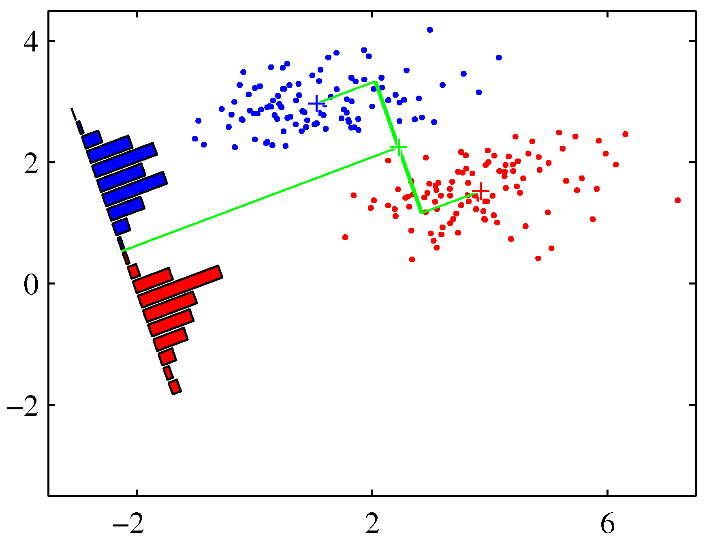

Linear Discriminant (Fisher)
Fisher‘s discriminant is a linear model which projects the data on the (hyper)plane of best separation
Advantages:
  easy to understand
  robust, fast
Disadvantages:
  not very flexible
  poor performace in
  complex settings
Performance |  | Speed |  | Robustness |  | Curse of Dim. | Transparency | Regression
No/linear correlations | Nonlinear correlations | Training | Response | Overtraining | Weak input vars |  |  | 1D | multi D
☺ | ☹ | ☺ | ☺ | ☺ | 😐 | ☺ | ☺

Slide 7
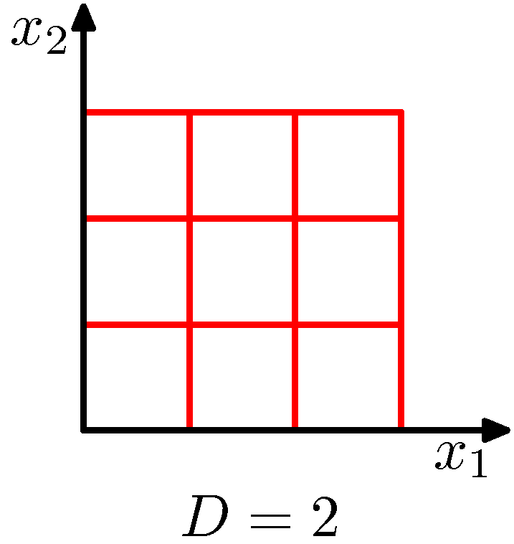
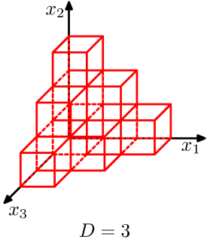
K-Nearest-Neighbour / Multidimensional PDE
Idea: Estimate the multidimensional probability densities by counting the events of each class in a predefined or adaptive volume
Advantages:
  reconstruction of PDFs possible
Disadvantages:
  „curse of dimensionality“
x₂
H₁
test event
H₀
x₁
Performance |  | Speed |  | Robustness |  | Curse of Dim. | Transparency | Regression
No/linear correlations | Nonlinear correlations | Training | Response | Overtraining | Weak input vars |  |  | 1D | multi D
☺ | ☺ | ☺ | ☹ | 😐 | ☹ | ☹ | 😐

Slide 8
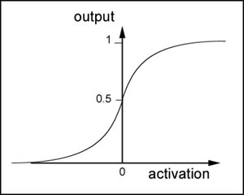
Artificial Neural Networks
Modelling of arbitrary nonlinear functions as a nonlinear combination of simple „neuron activation functions“
Advantages:
  very flexible,
  no assumption
  about the function
  necessary
Disadvantages:
  „black box“
  needs tuning
  seed dependent
1 input layer
k hidden layers
1 ouput layer
1
1
. . .
1
2 output classes (signal and background)
. . .
. . .
. . .
N_{var} discriminating input variables
i
j
M_{k}
Feed-forward Multilayer Perceptron
. . .
. . .
N
M₁
(“Activation” function)
with:
Performance |  | Speed |  | Robustness |  | Curse of Dim. | Transparency | Regression
No/linear correlations | Nonlinear correlations | Training | Response | Overtraining | Weak input vars |  |  | 1D | multi D
☺ | ☺ | 😐 | ☺ | 😐 | 😐 | 😐 | ☹

Slide 9
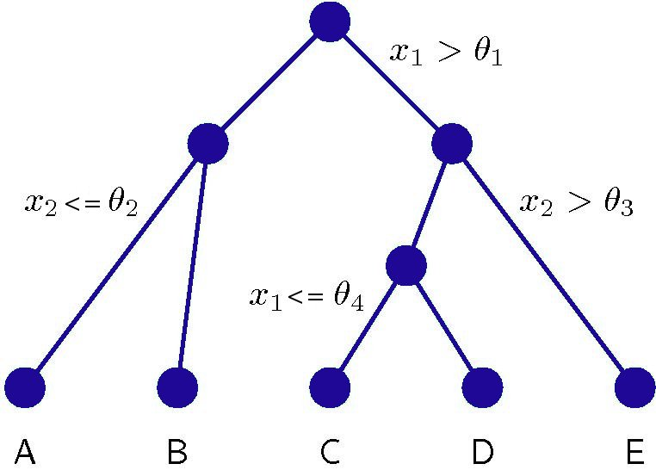
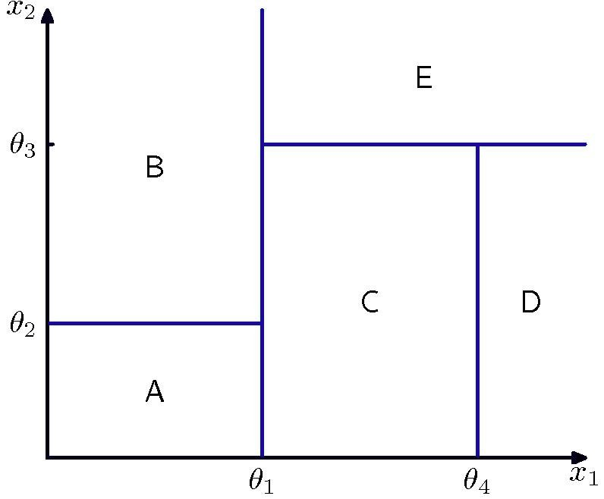
Boosted Decision Trees (AdaBoost, Bagging, GradBoost)
A decision tree is a set of binary splits of the input space
Grow a forest of decision trees and determine the event class/target by majority vote
Advantages:
  ignores weak
  variables
  works out of
  the box
Disadvantages:
  vulnerable to overtraining
Performance |  | Speed |  | Robustness |  | Curse of Dim. | Transparency | Regression
No/linear correlations | Nonlinear correlations | Training | Response | Overtraining | Weak input vars |  |  | 1D | multi D
☺ | ☺ | 😐 | 😐 | ☹ | ☺ | ☺ | 😐

Slide 10
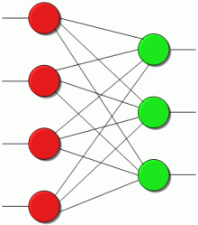
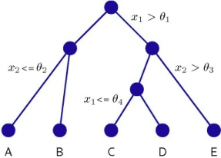

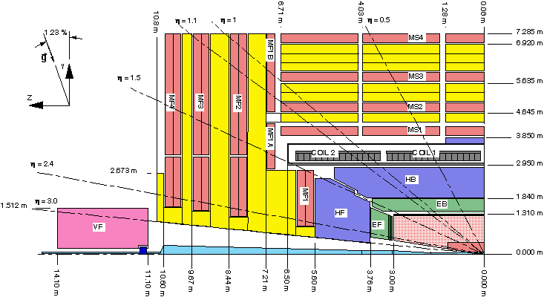
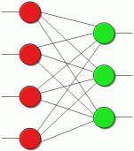

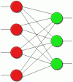
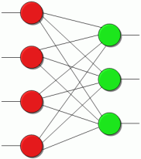
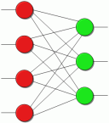
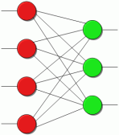

Metaclassifiers – Category Classifier and Boosting
The category classifier is custom-made for HEP
  Use different classifiers for different phase space regions and combine them into a single output
TMVA supports boosting for all classifiers
  Use a collection of “weak learners“ to improve their performace
  (boosted Fisher, boosted neural nets with few neurons each…)

Slide 11
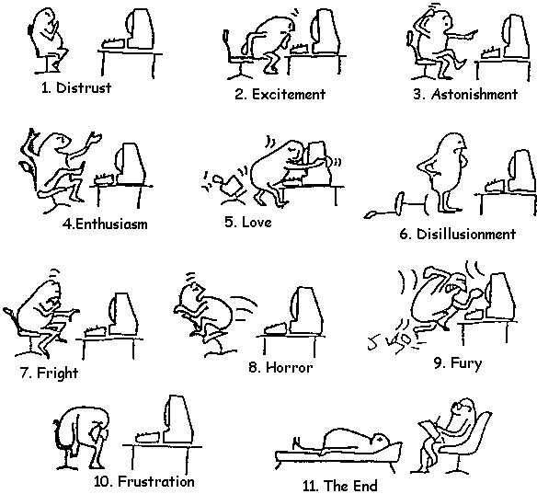
Using TMVA

Slide 12
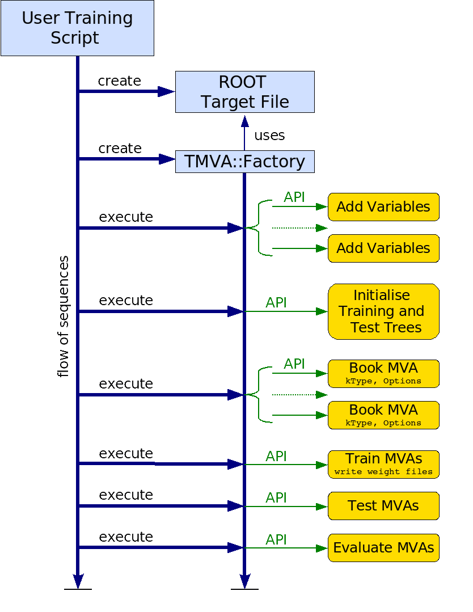
The TMVA Workflow – Training, Testing, Application
Training:
  Classification:
  Learn the features of the different
  event classes from a sample with
  known signal/background composition
  Regression:
  Learn the functional dependence
  between input variables and targets
Testing:
  Evaluate the performance of the trained
  classifier/regressor on an independent
  test sample
  Compare different methods
Application:
  Apply the classifier/regressor to real data

Slide 13
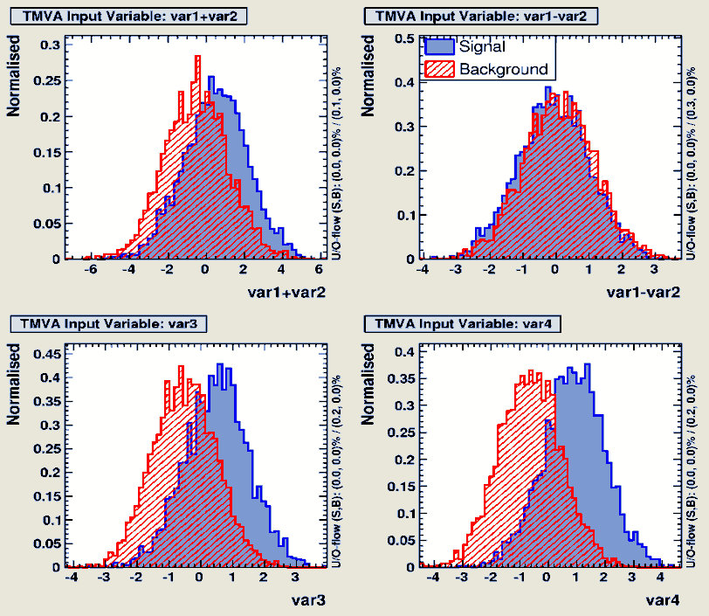
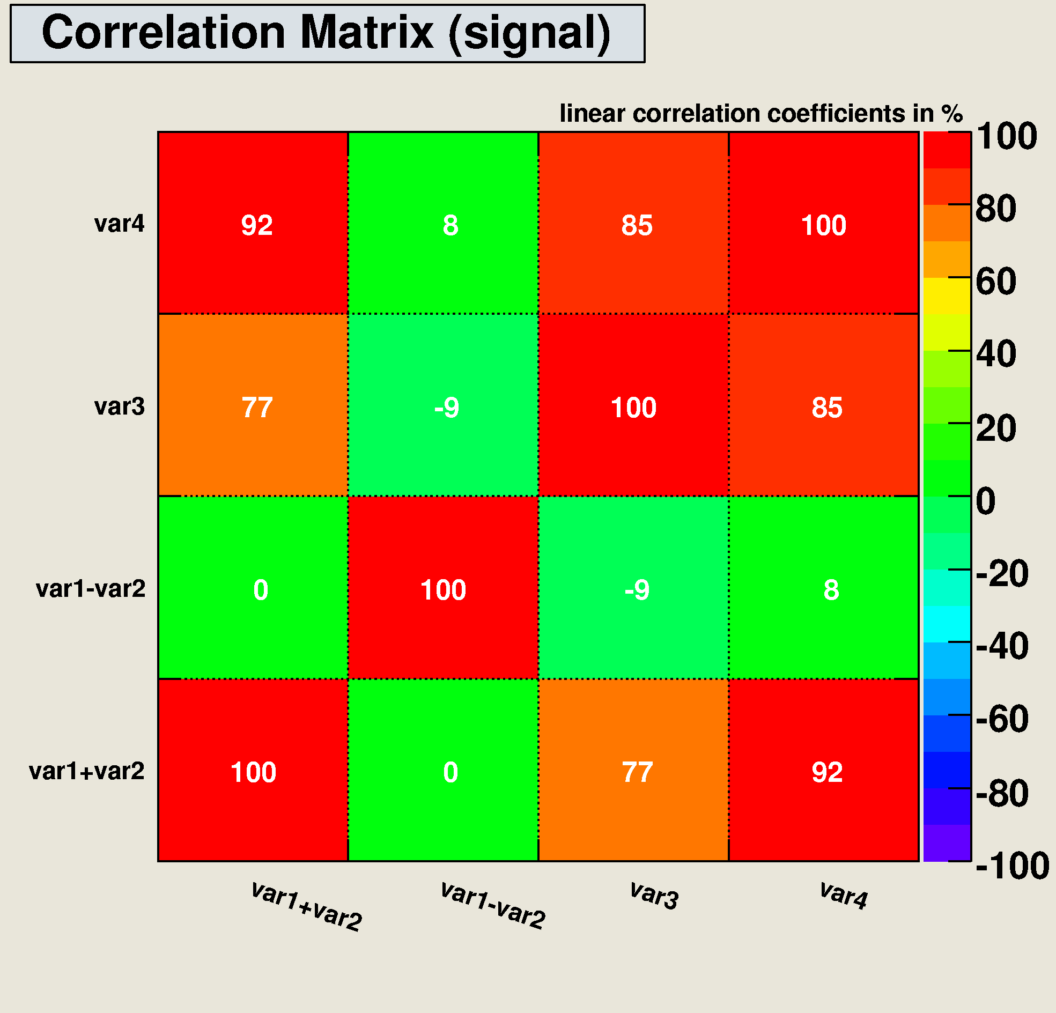
Selection of variables
TMVA supports…
  ROOT TTree or ASCII files as input
  any combination or function of available input variables (including TMath functions)
  independent signal/bg preselection cuts
  .any input variable as individual event weight
  various methods to split data into training/test trees

Slide 14
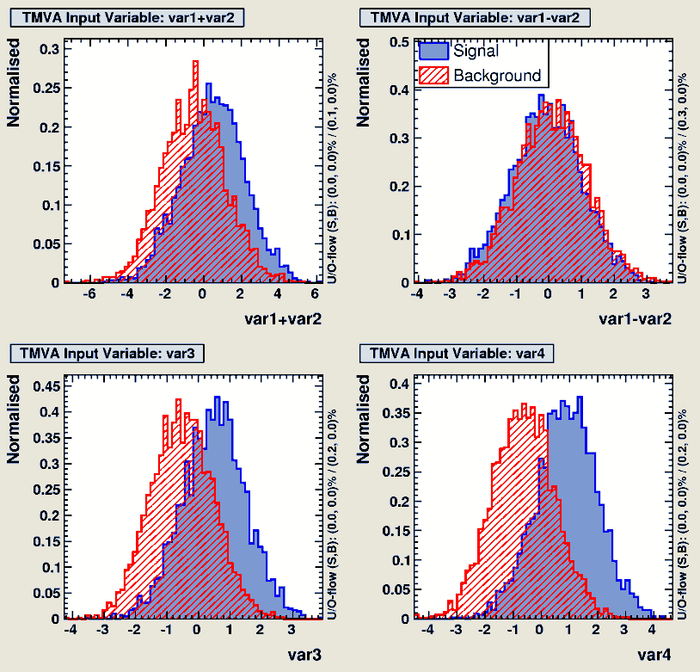
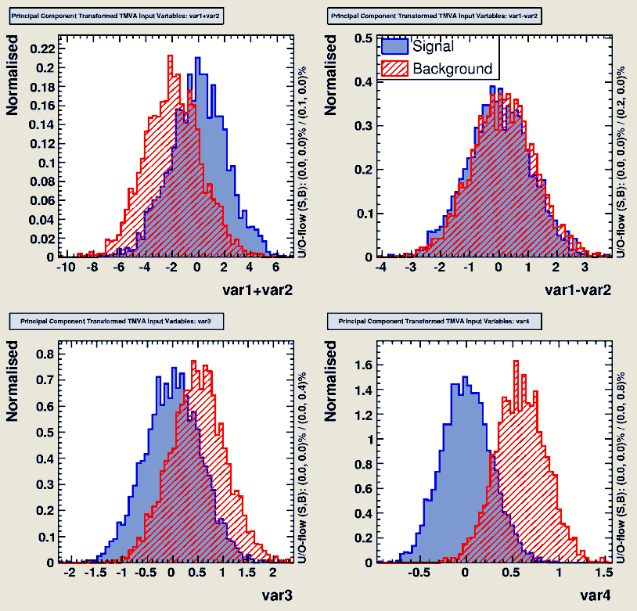
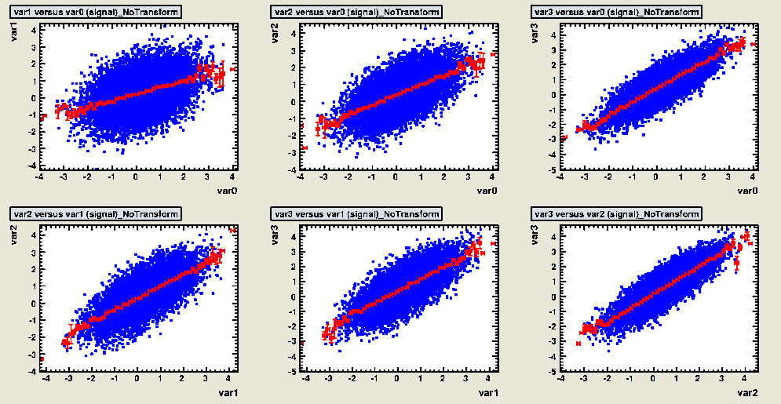
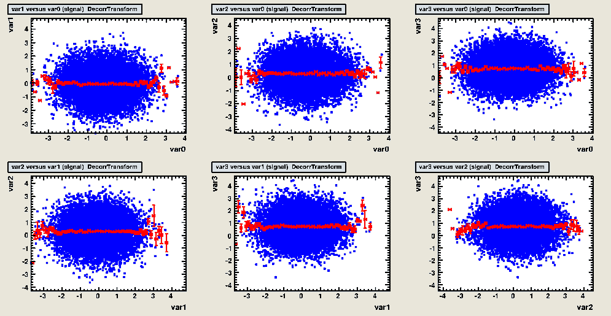
Data Preprocessing
Decorrelation may improve the performance of simple classifiers…
… but complex correlations call for more sophisticated classifiers
Note that in cases with non-Gaussian distributions and/or nonlinear correlations decorrelation may do more harm than any good

Slide 15
A complete TMVA training/testing session
void TMVAnalysis( )
{
TFile* outputFile = TFile::Open( "TMVA.root", "RECREATE" );
TMVA::Factory *factory = new TMVA::Factory( "MVAnalysis", outputFile,"!V");
TFile *input = TFile::Open("tmva_example.root");
factory->AddVariable("var1+var2", 'F');
factory->AddVariable("var1+var2", 'F'); //factory->AddTarget("tarval", 'F');
factory->AddSignalTree ( (TTree*)input->Get("TreeS"), 1.0 );
factory->AddBackgroundTree ( (TTree*)input->Get("TreeB"), 1.0 );
//factory->AddRegressionTree ( (TTree*)input->Get("regTree"), 1.0 );
factory->BookMethod( TMVA::Types::kLikelihood, "Likelihood",
"!V:!TransformOutput:Spline=2:NSmooth=5:NAvEvtPerBin=50" );
factory->BookMethod( TMVA::Types::kMLP, "MLP",
"!V:NCycles=200:HiddenLayers=N+1,N:TestRate=5" );
factory->TrainAllMethods(); // factory->TrainAllMethodsForRegression();
factory->TestAllMethods();
factory->EvaluateAllMethods();
outputFile->Close();
delete factory;
}
Create Factory,
the only object
the user needs!
Add variables/
targets
Initialize Trees
Book MVA methods
and transformations
Train, test and evaluate

Slide 16
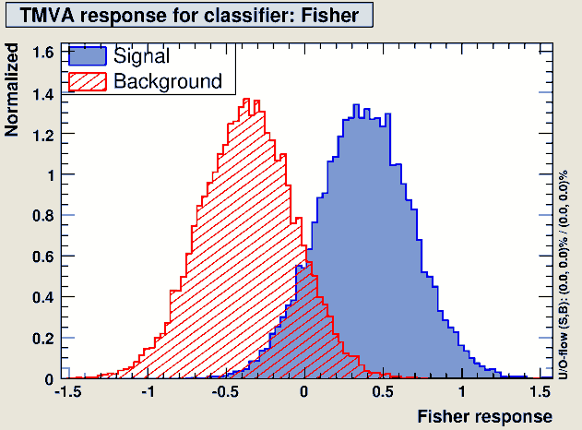
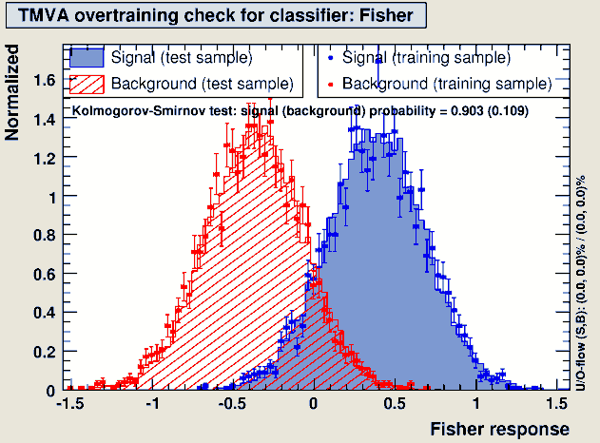
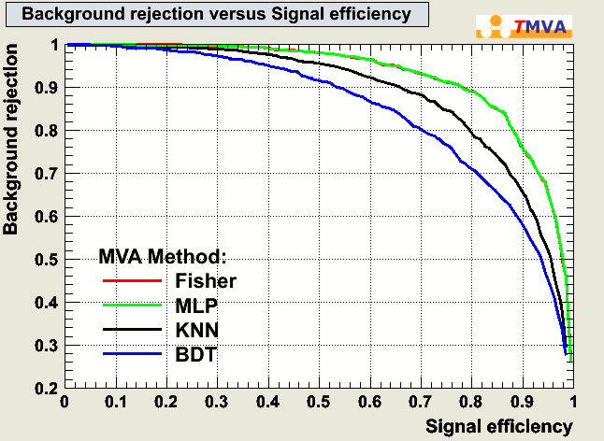
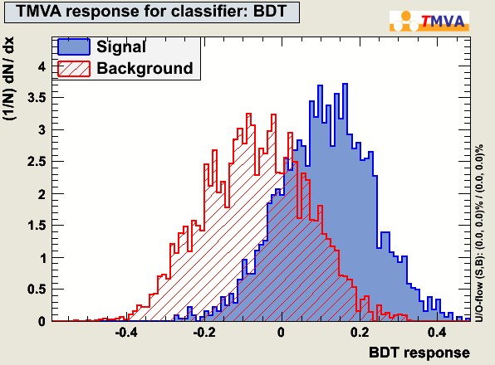
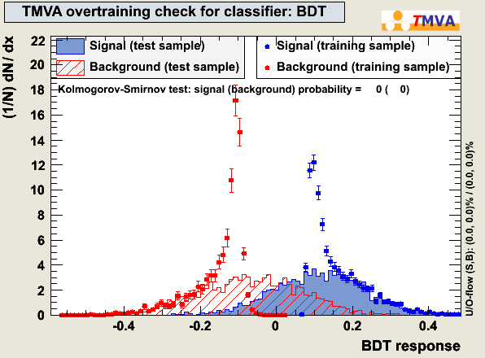
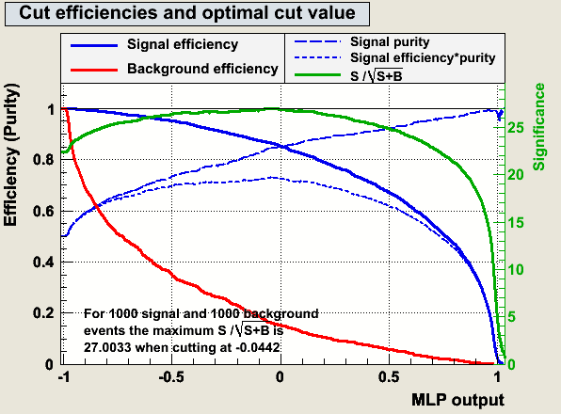
Evaluation of classification
Check for overtraining, compare classifier performance and select the optimal cut value for every classifier

Slide 17
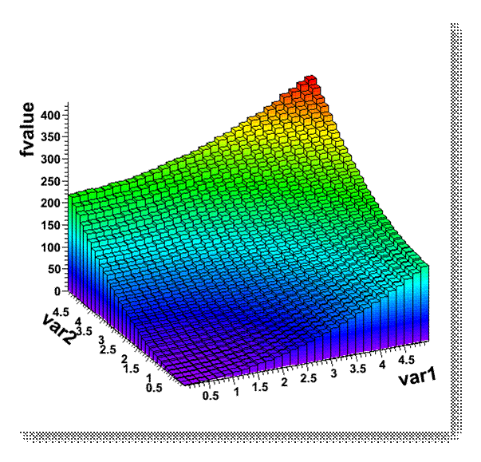
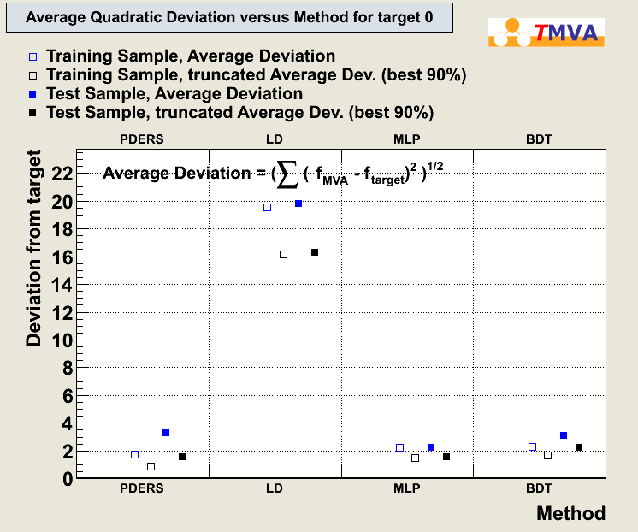
Evaluation of regression
Compare deviation from target for different methods

Slide 18





Functionality in preparation...
Multiclass classification
Automatic classifier tuning via cross validation
Advanced method combination
Bayesian classifiers
….
Class 3
Classifier2
Class 2
Classifier3
Class 4
Classifier1
Class 6
Combined Classifier
Class 5
Test
Train | Train | Train | Train | Train

Slide 19


Conclusion
TMVA is a powerful toolkit for both classification and regression in HEP
All MVA methods can be accessed through a common interface, data preprocessing can be applied
TMVA supports the user in the MVA selection process via a collection of evaluation scripts
TMVA is open source software and can be downloaded from http://tmva.sourceforge.net
Acknowledgments: The fast development of TMVA would not have been possible without the contribution and feedback from many developers and users to whom we are indebted. A full list of contributors is available in the TMVA User’s Guide ( http://tmva.sourceforge.net ).

Slide 20
Backup

Slide 21
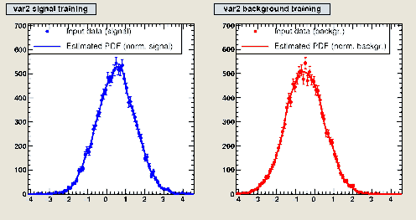
Projective likelihood (naive bayesian classifier)
Idea:
  create PDFs from
  variable distributions,
  then calculate likelihood
  ratio
Advantages:
  optimal when no
  correlations
Disadvantages:
  correlations not taken
  into account
Likelihood ratio for event i_{event}
PDFs
discriminating variables
Species: signal, background types
Performance |  | Speed |  | Robustness |  | Curse of Dim. | Transparency | Regression
No/linear correlations | Nonlinear correlations | Training | Response | Overtraining | Weak input vars |  |  | 1D | multi D
☺ | ☹ | ☺ | ☺ | 😐 | ☺ | ☺ | ☺

Slide 22
Support Vector Machines
x₂
Linearly separable data:
  find separating hyperplane (Fisher)
Non-separable data:
  fransform variables into a high dimensional
  space where linear separation is possible
Advantages:
  flexibility combined with robustness
Disadvantages:
  slow training
  complex algorithm
support vectors
Separable data
optimal hyperplane
margin
x₁
x₃
x₂
Non-separable data
φ(x₁,x₂)
x₁
x₁
Performance |  | Speed |  | Robustness |  | Curse of Dim. | Transparency | Regression
No/linear correlations | Nonlinear correlations | Training | Response | Overtraining | Weak input vars |  |  | 1D | multi D
☺ | ☺ | ☹ | 😐 | 😐 | 😐 | 😐 | ☹

Slide 23
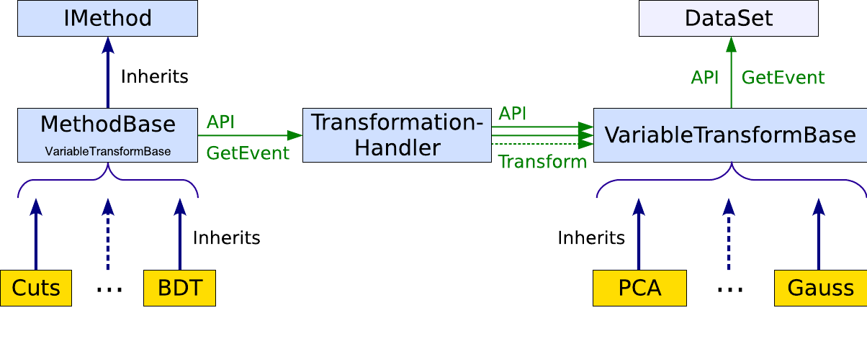
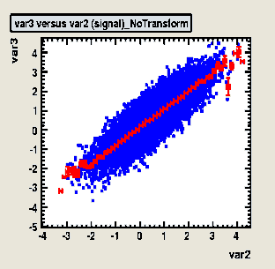
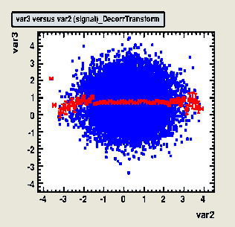
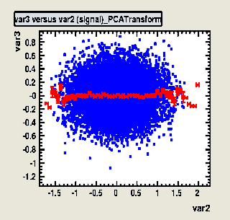
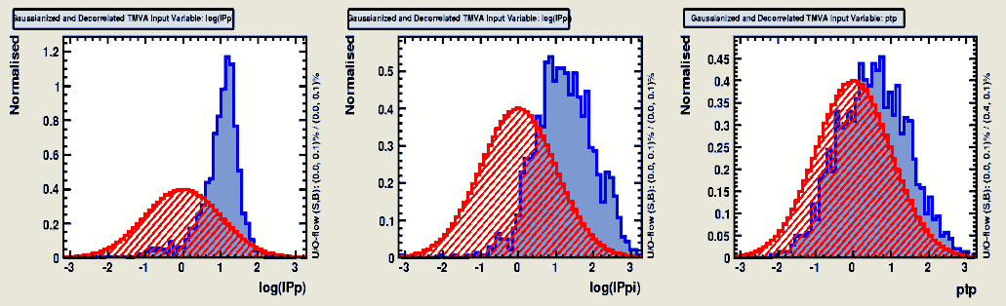
Data Preprocessing
original
SQRT derorr.
PCA derorr.
TMVA supports individual transformations for each method
  transformations can be chained
  transformations are calculated on the fly when the event is read
  TMVA supports decorrelation, Gaussianization and normalization

Slide 24
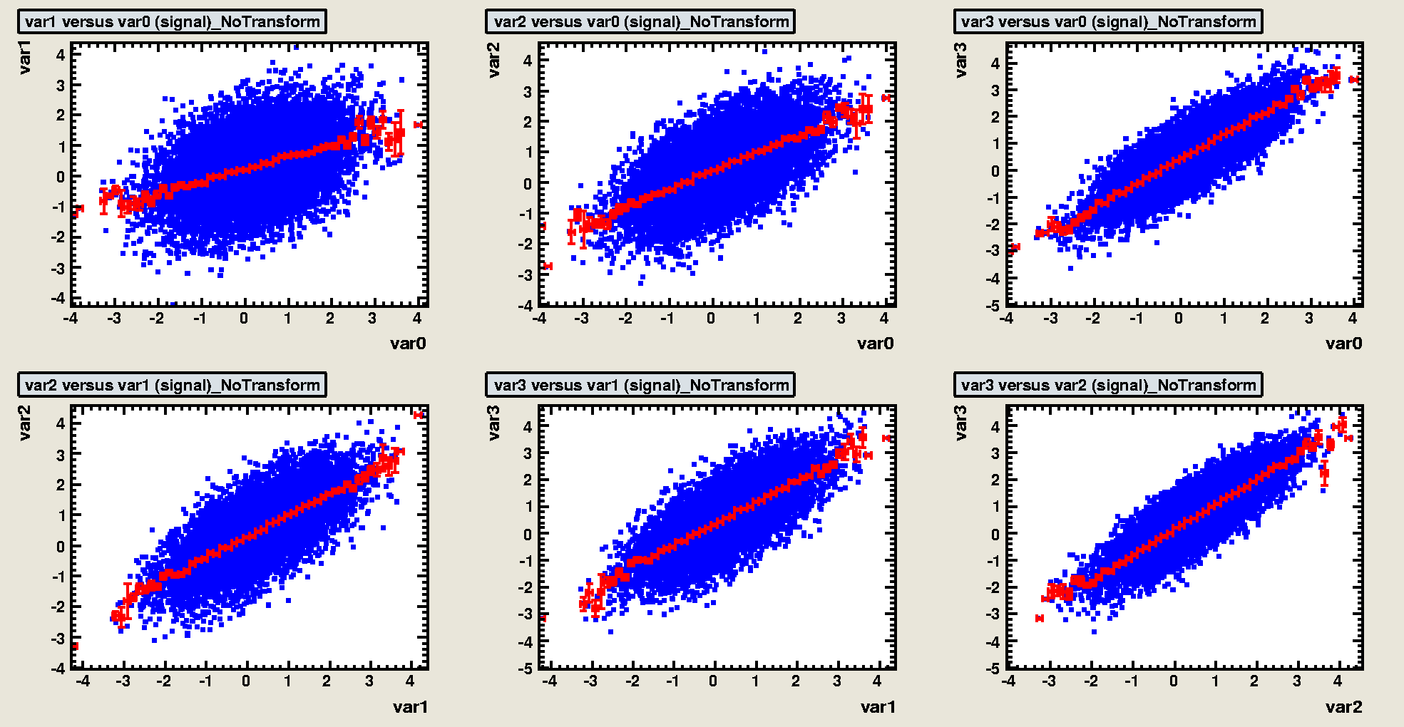
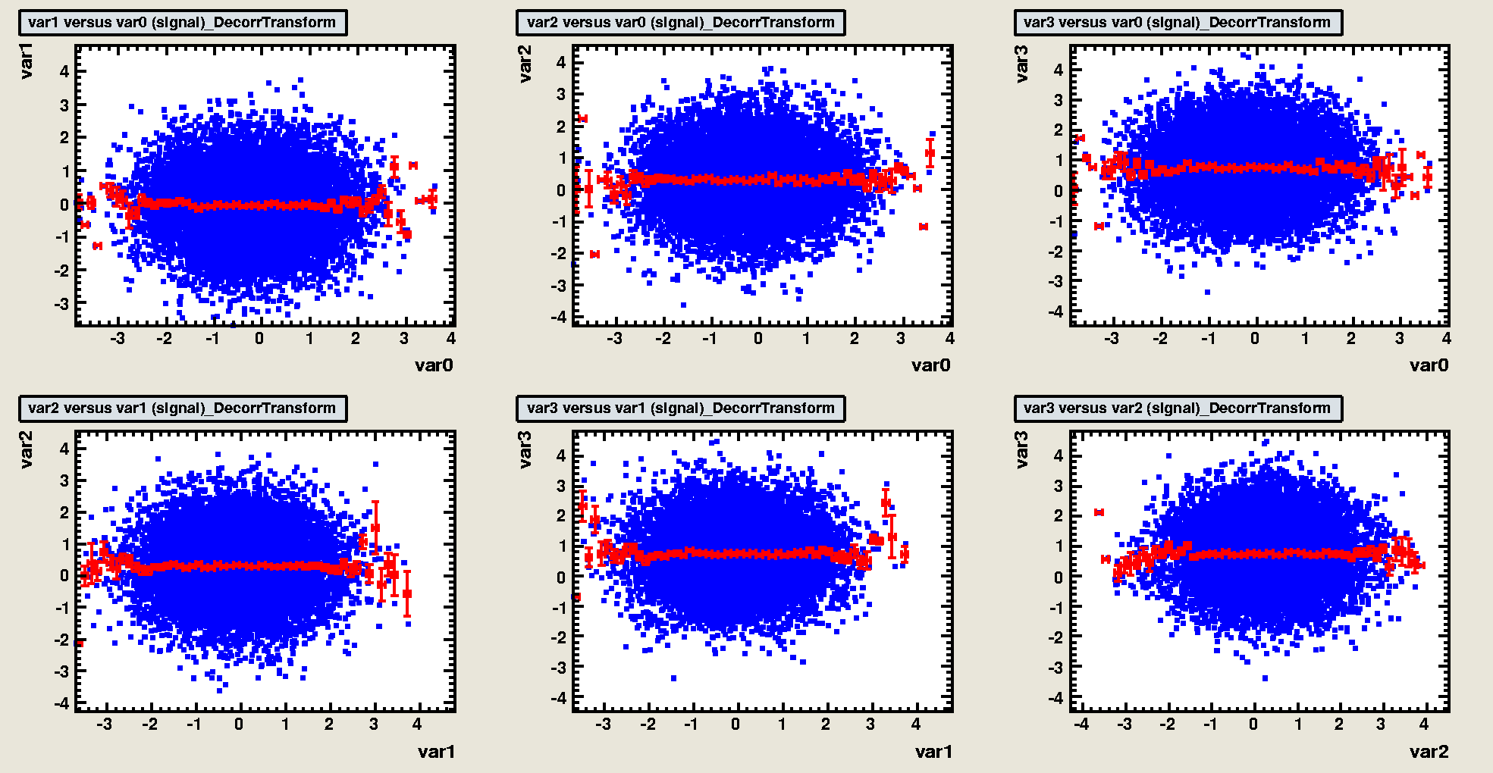
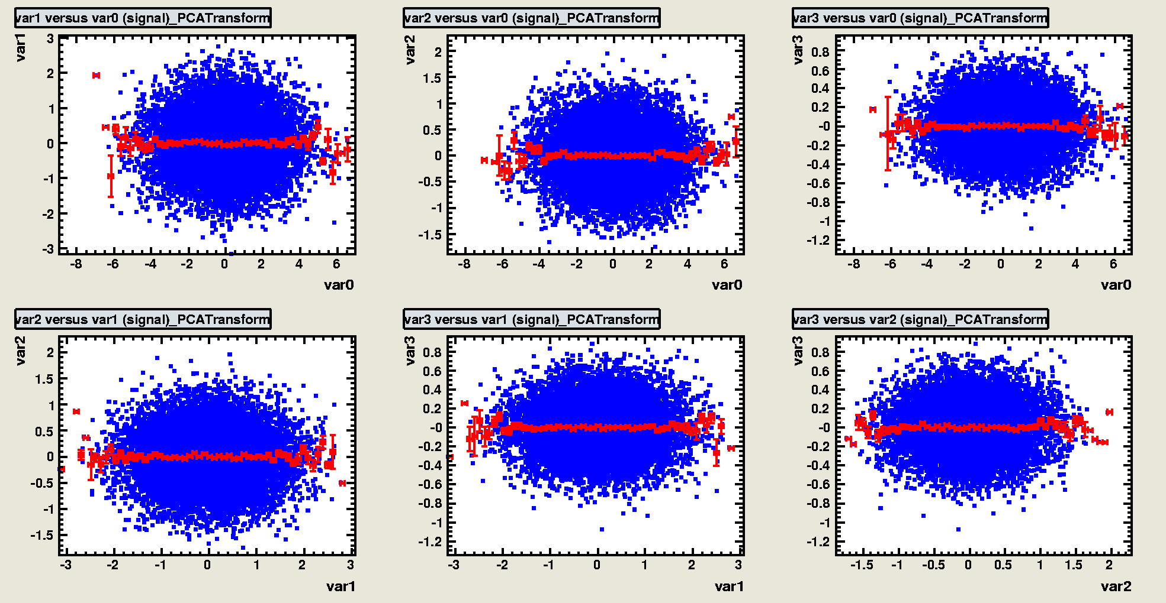
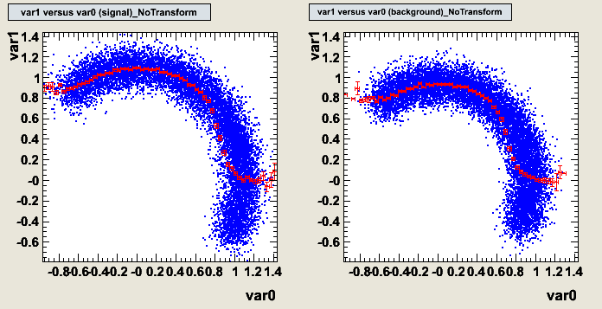
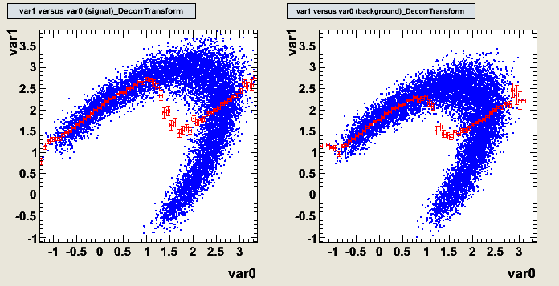
Decorrelation
Decorrelations can drastically improve the performance of the simple classifiers
But complex correlations call for more sophisticated classifiers…
original
SQRT derorr.
PCA derorr.

Slide 25
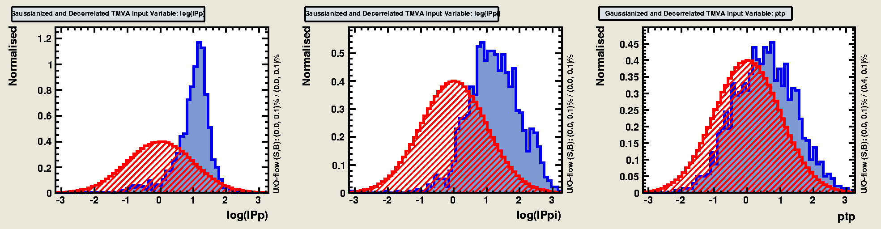
Gaussianisation
Decorrelation may improve by pre-Gaussianisation of the variables
  First step: obtain uniform distribution through Rarity transformation
  Second step: make Gaussian via inverse error function
Rarity transform of variable k
Measured value
PDF of variable k

Slide 26

Evaluation – The TMVA GUI
TMVA is not only a collection of classifiers, but also a complete MVA framework!
  a collection of evaluation macros can be accessed via the convenient GUI
Plot all signal (S) and background (B) input variables with and without pre-processing
Correlation scatters and linear coefficients for S & B
Classifier outputs (S & B) for test and training samples (spot overtraining)
Classifier significance with optimal cuts
B rejection versus S efficiency (ROC)
Classifier-specific plots:
Likelihood reference distributions
Classifier PDFs (for probability output and Rarity)
Network architecture, weights and convergence
Visualization of decision trees

Slide 27










Classifier specific evaluation
average no. of nodes before/after pruning: 4193 / 968

