Slide 1

de Laval Micro-nozzle comparison with simple geometry nozzle
CFD simulations in 2D
Przemysław Smakulski
Sławomir Pietrowicz
07-12-2017
Wrocław University of Science and Technology

Slide 2
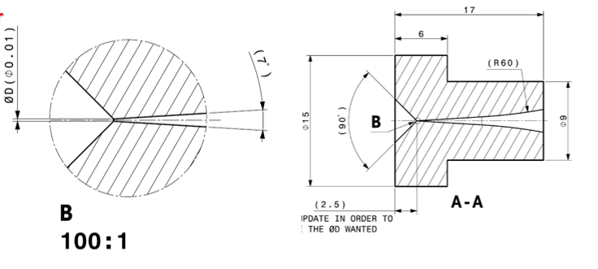
Specification
Dimensions for de Laval nozzle was taken from the file delivered from the CERN machine shop
In the present research has been shown the comparison between a „de Laval” nozzle and simple geometry nozzle (previos calculations given by Paolo)
Simulations were performed for nitrogen

Slide 3
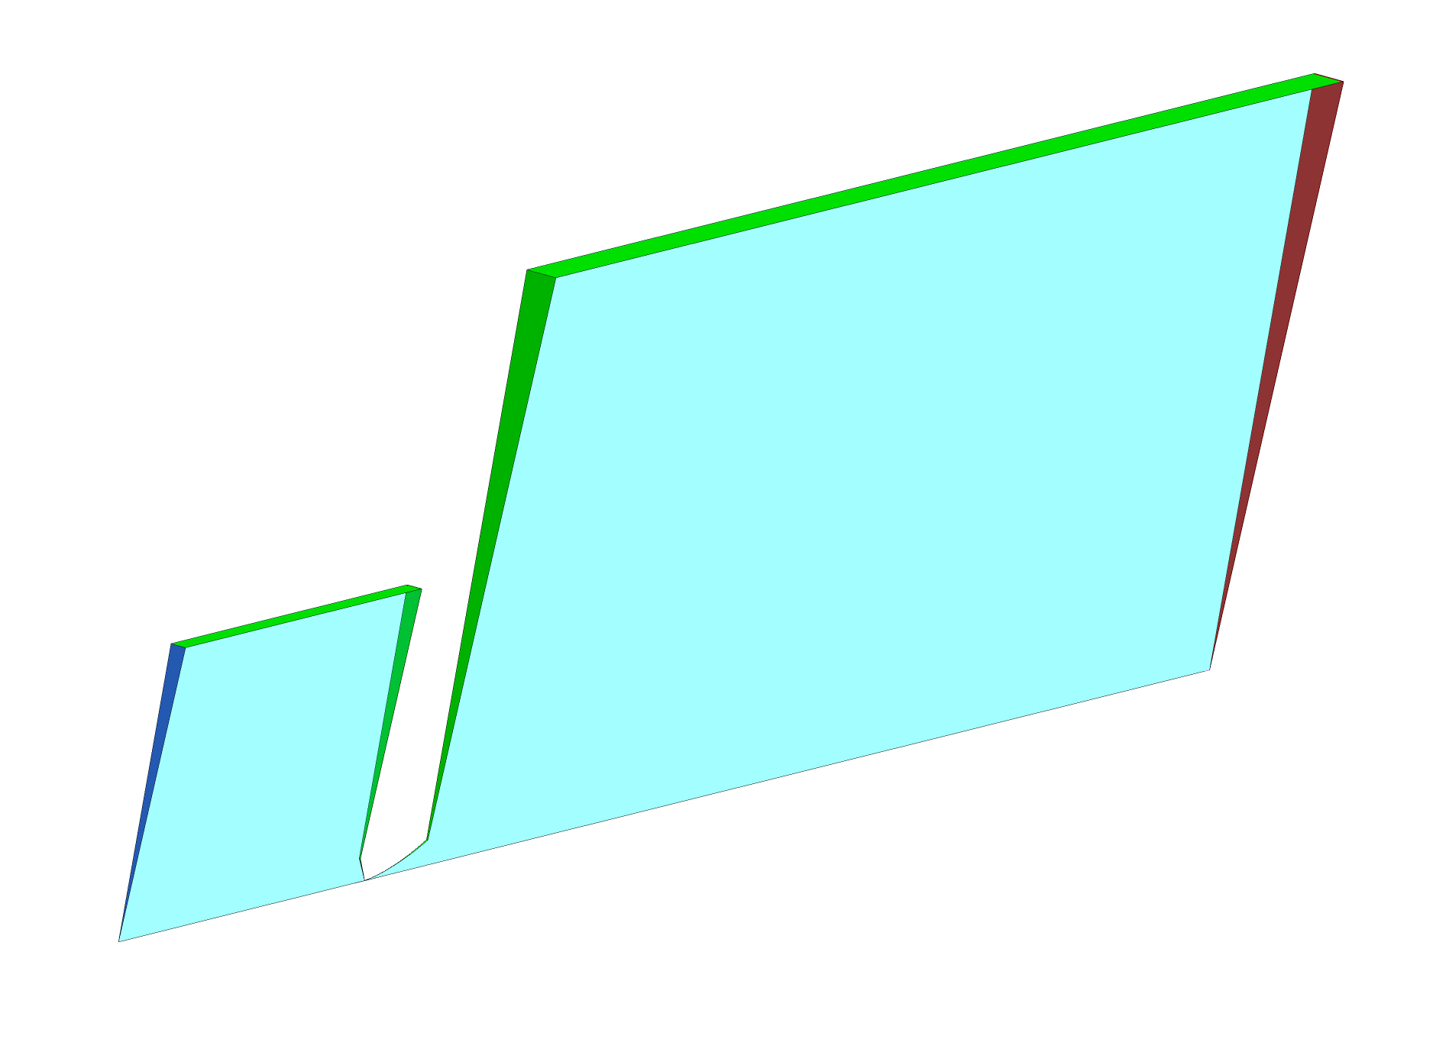
Numerical Domain: 2D simulation
Outlet
BC type: opening
Adiabatic wall
Inlet
BC type: opening
Rotational periodicity
Symmetry edge

Slide 4
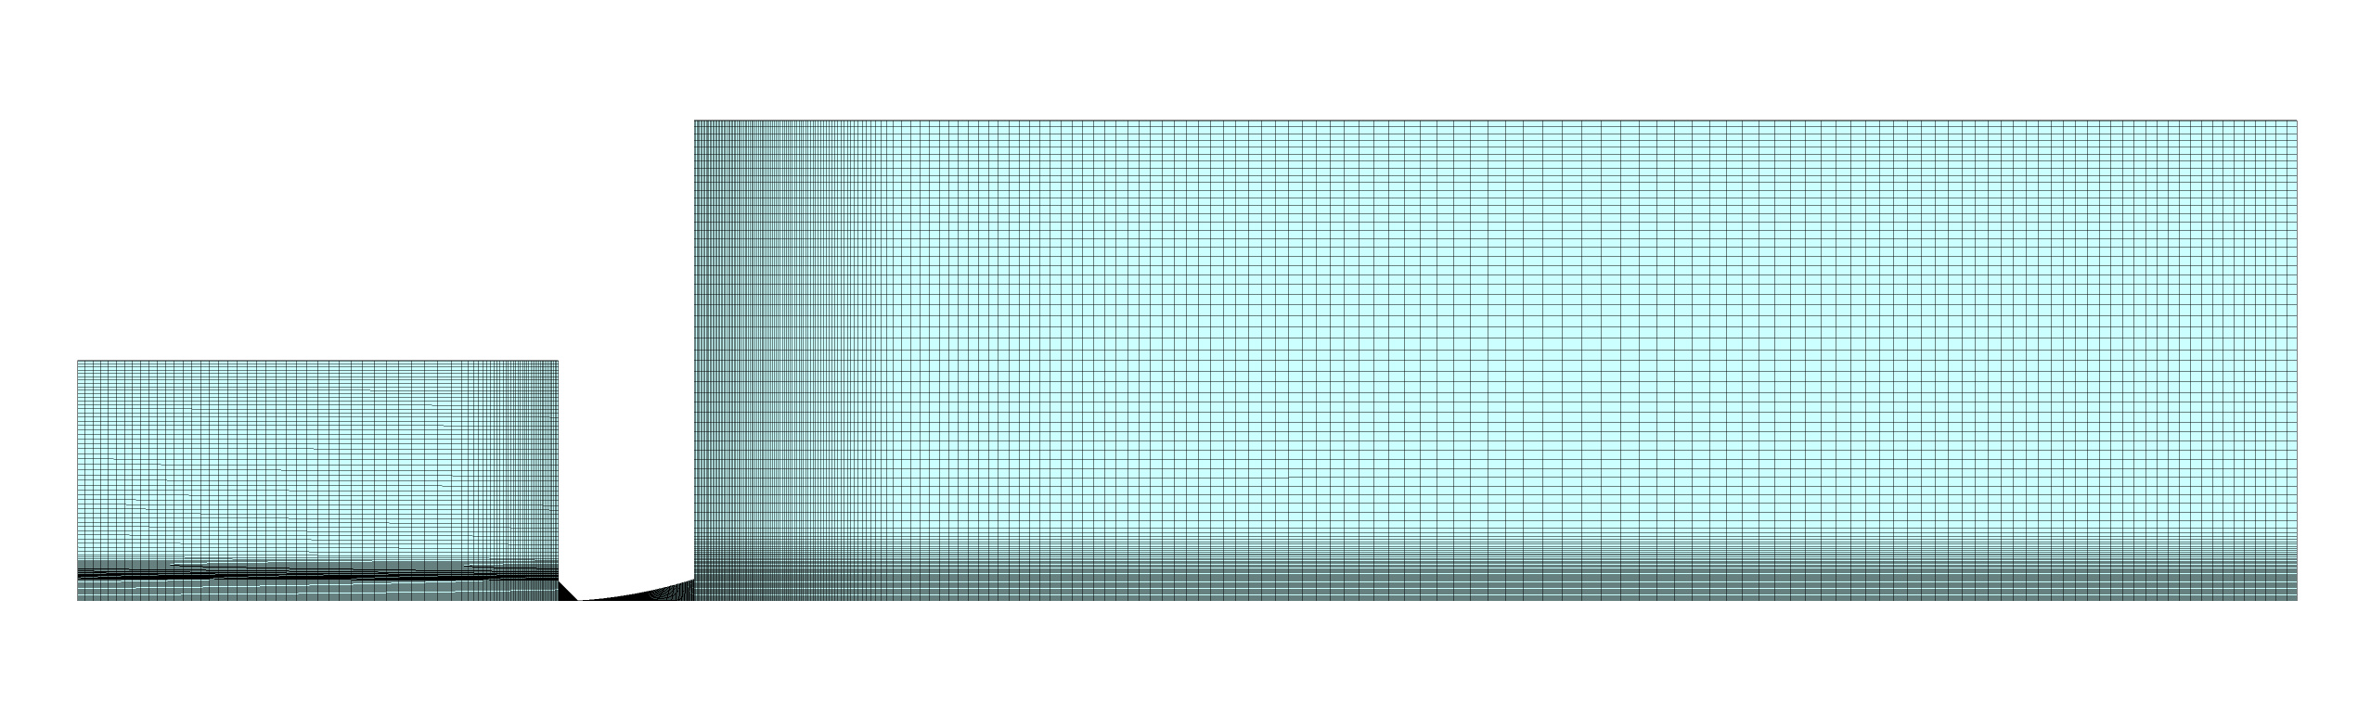
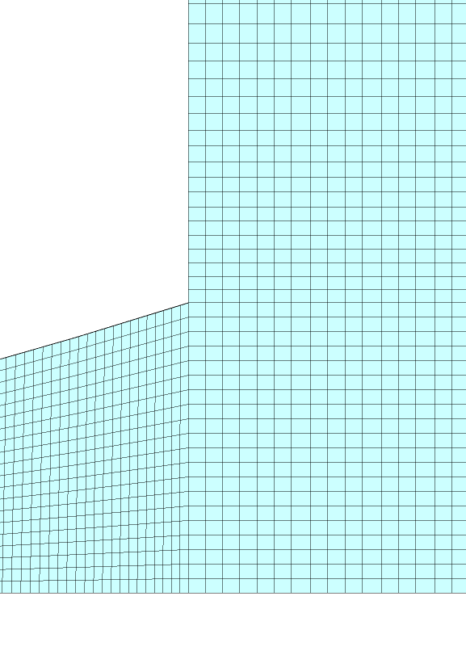
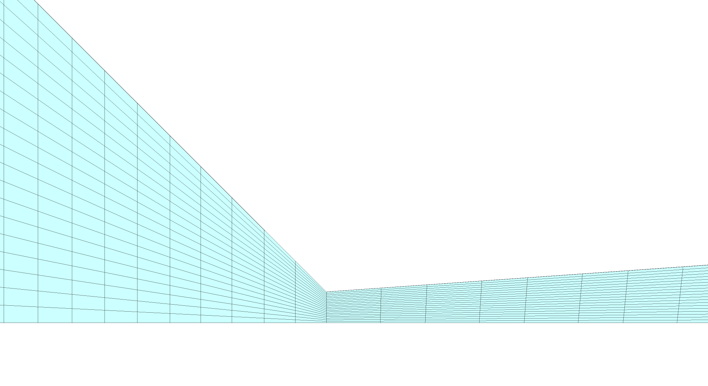
Numerical mesh
200 mm
60 mm
Mesh statistics:
Number of Nodes: 68418
Number of Elements: 33429
Hexahedra: 33429
D_{critical}
Detailed view on mesh close to neuralgic part of the domain

Slide 5
Boundary conditions
Case no. | Inlet |  | Outlet
 | Pressure* | Temperature | Pressure* | Temperature
D_{critical} = 10 microns
1 | 1 bar | 20ºC | 0 Pa | 20ºC
2 | 3 bar | 20ºC | 0 Pa | 20ºC
3 | 10 bar | 20ºC | 0 Pa | 20ºC
D_{critical} = 30 microns
4 | 10 bar | 20ºC | 0 Pa | 20ºC
* - absolute pressure

Slide 6
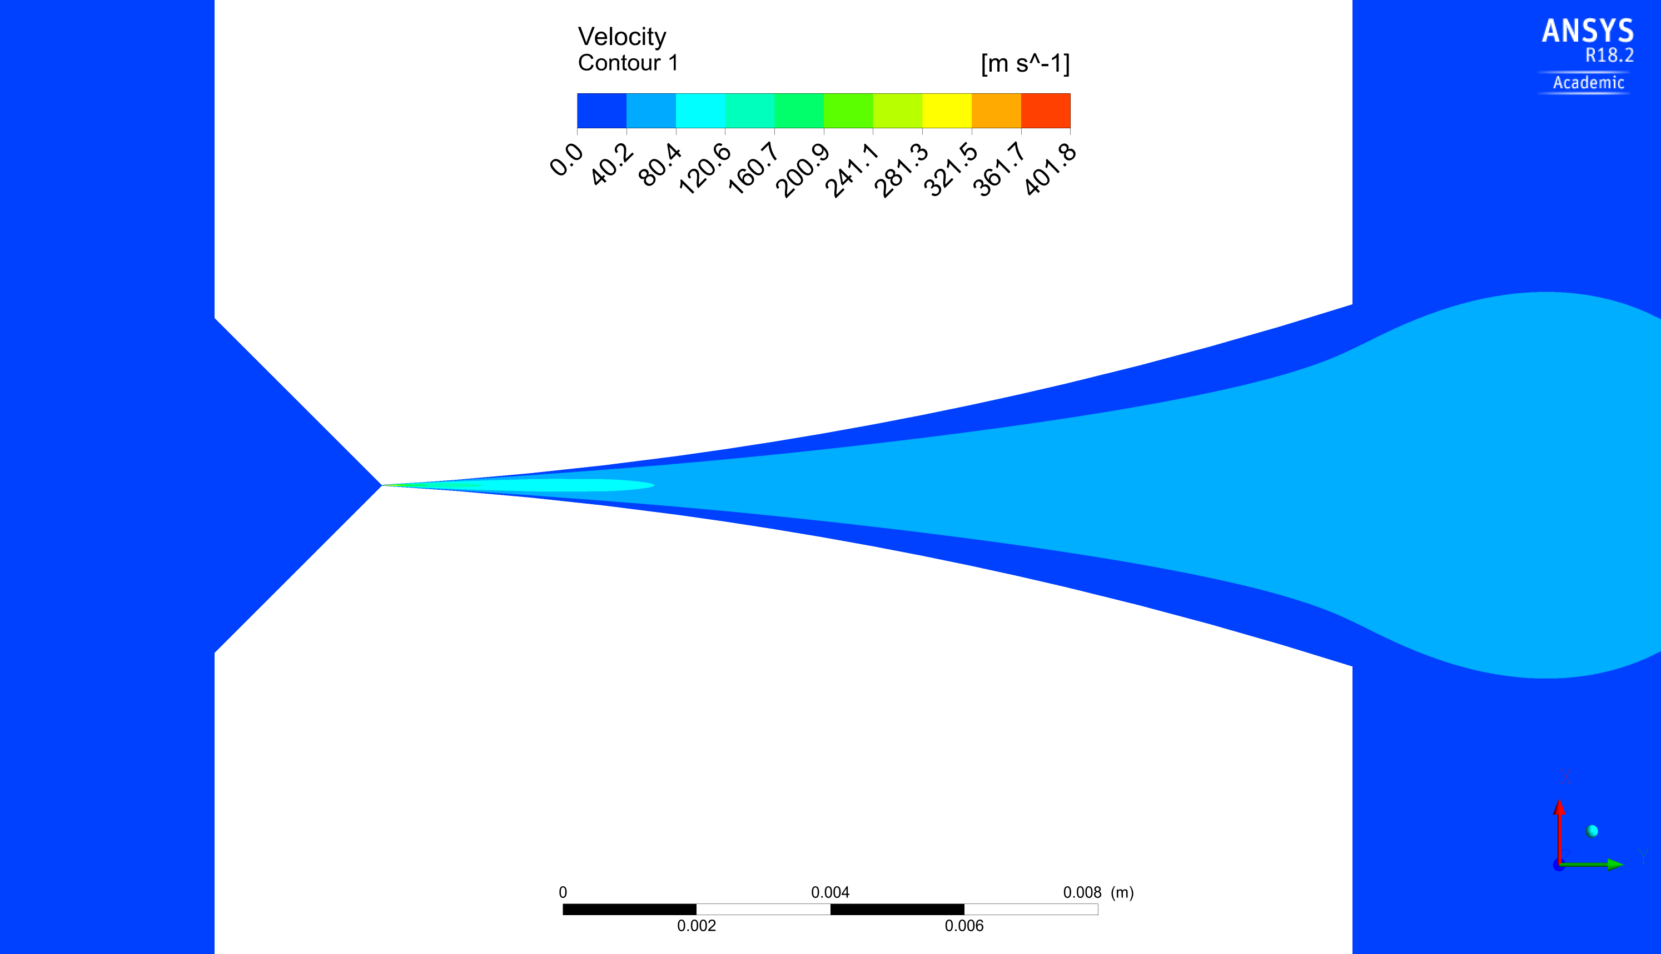

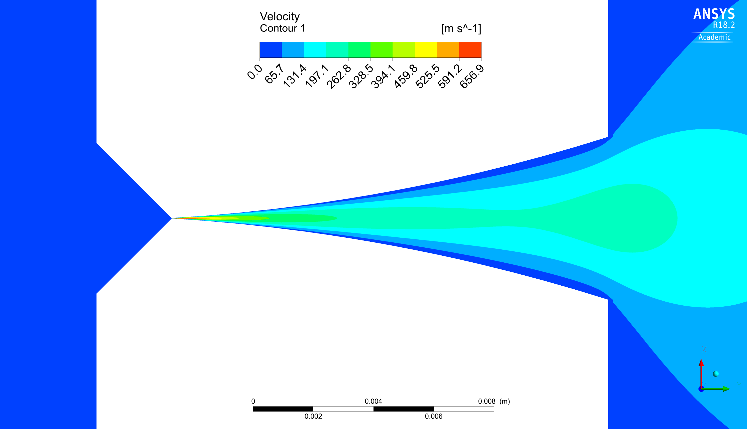
Velocity profile
D_{critical} = 10 microns
Case no.1
p_{_INLET} = 1 bar
Case no.2
p_{_INLET} = 3 bar
Case no.3
p_{_INLET} = 10 bar

Slide 7
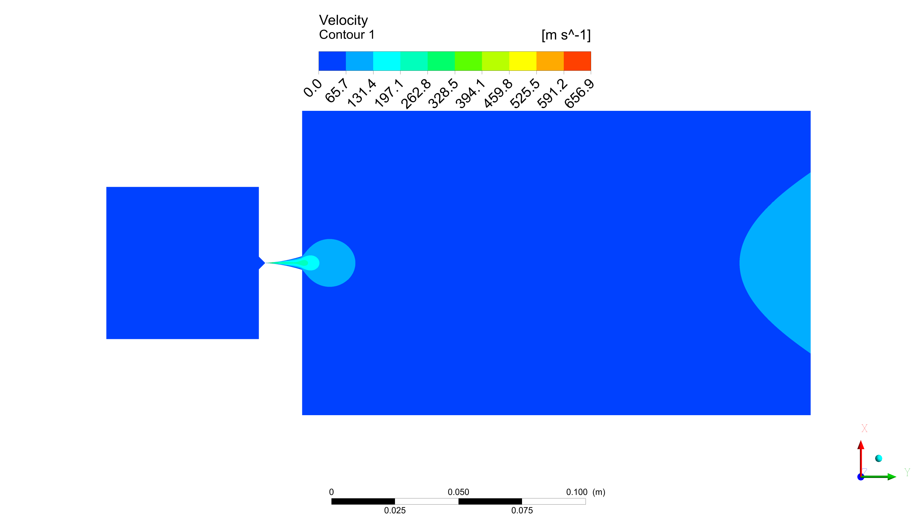
Velocity profile
D_{critical} = 10 microns
Case no.3
p_{_INLET} = 10 bar

Slide 8
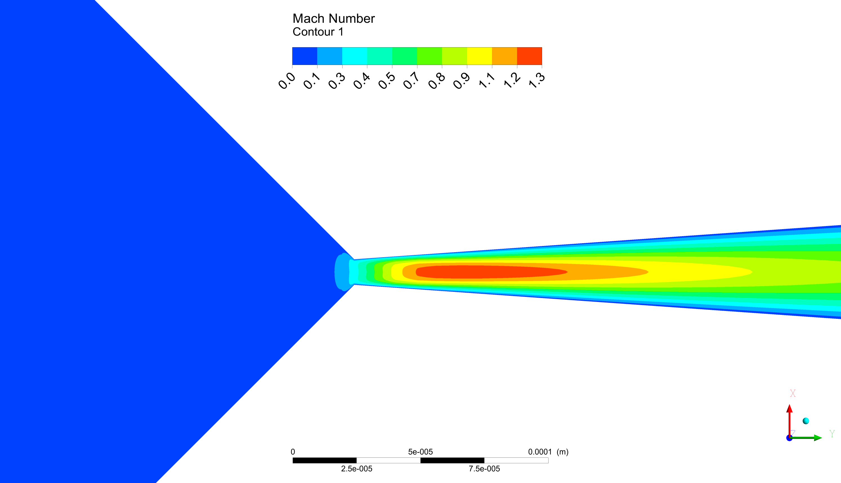
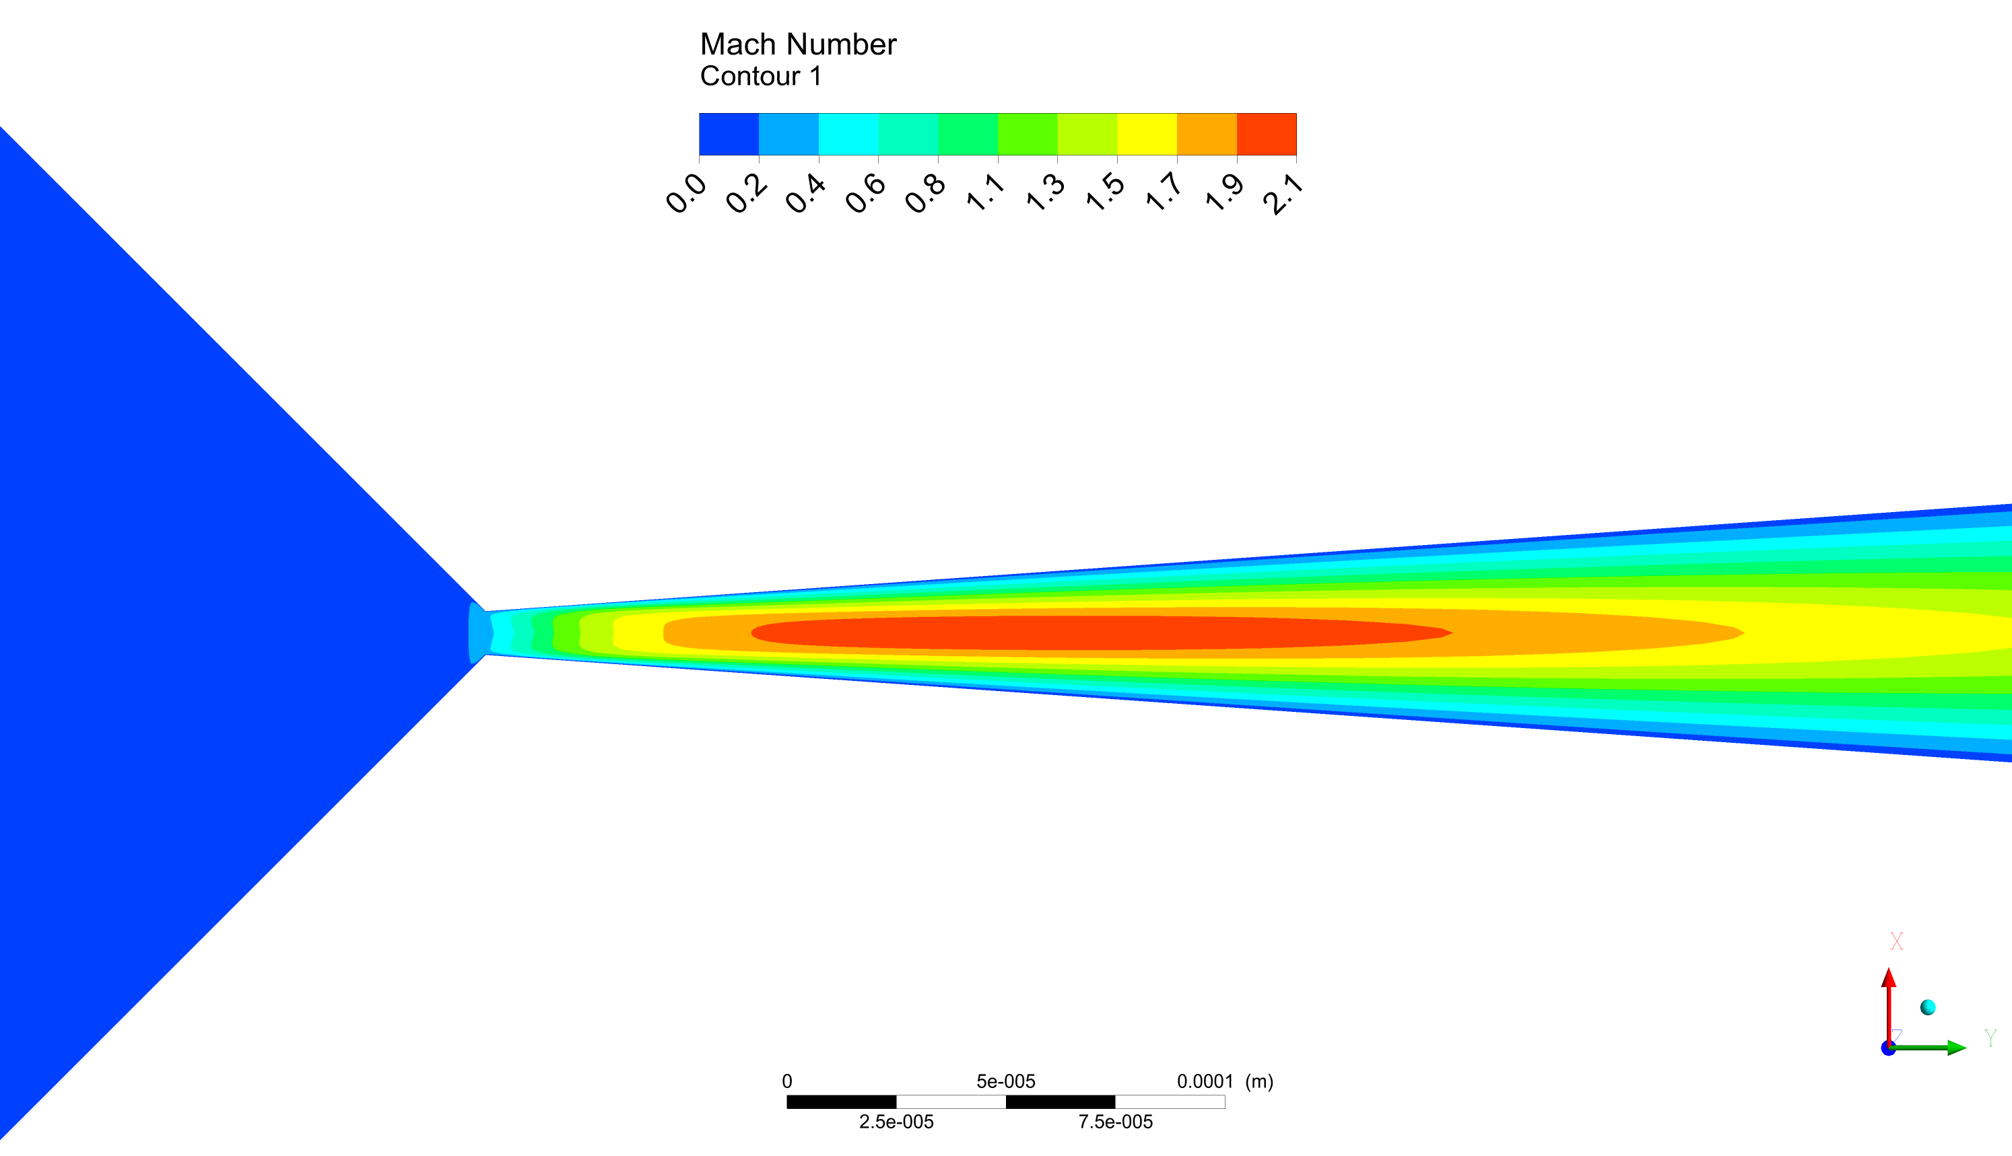
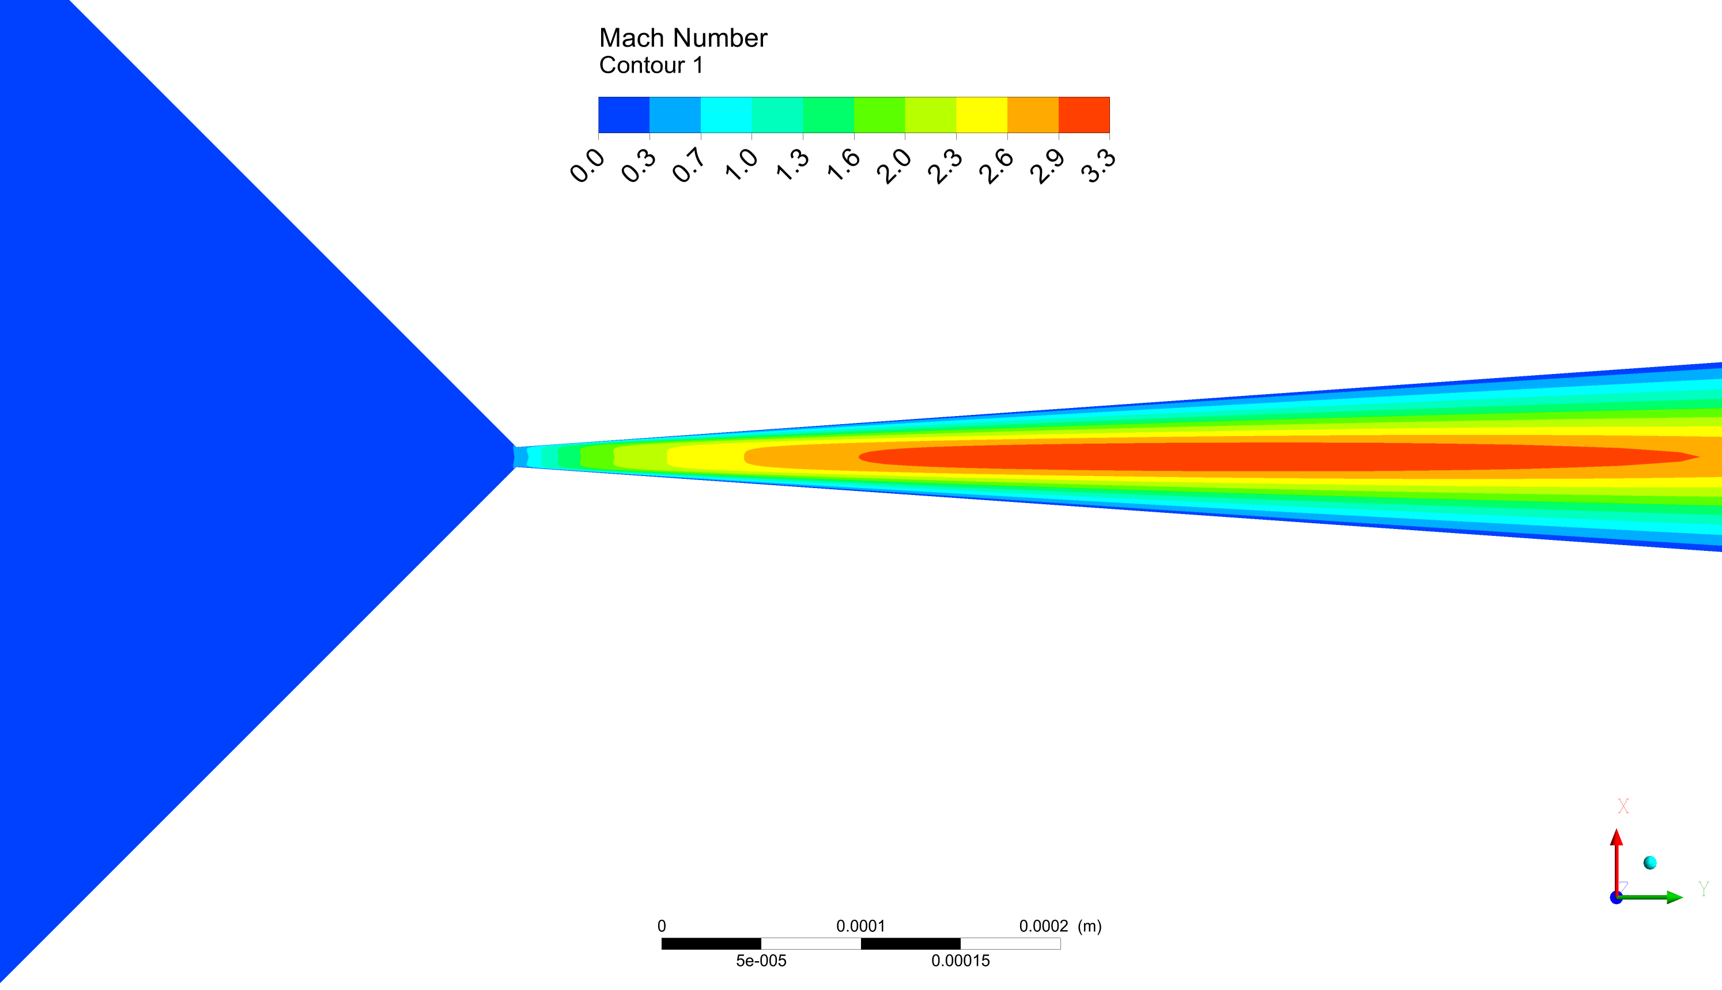
Mach number close to critical cross-section
D_{critical} = 10 microns
Case no.1
p_{_INLET} = 1 bar
Case no.2
p_{_INLET} = 3 bar
Case no.3
p_{_INLET} = 10 bar
subsonic
supersonic

Slide 9
Comparison with the simple geometry nozzle
For the comparison reson the critical diameter of the de Laval nozzle was increased from 10 microns to 30 microns. The same value of the critical diameter (30 microns) is presented in the simple geometry nozzle.
Test was performed with similar boundary conditions.

Slide 10
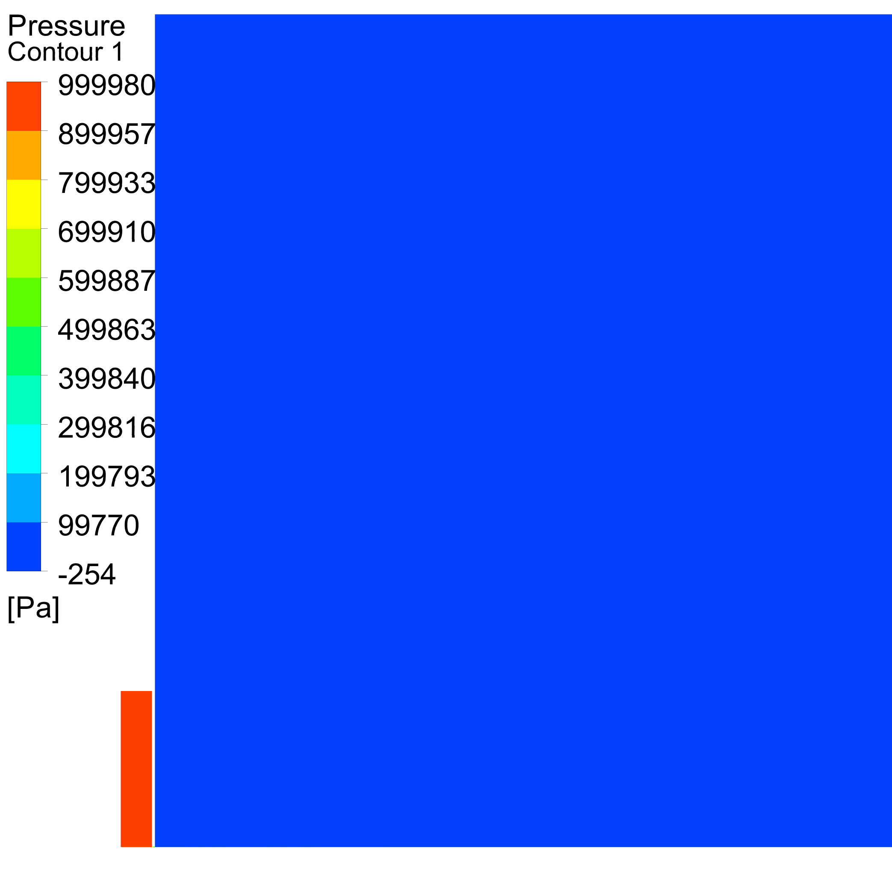
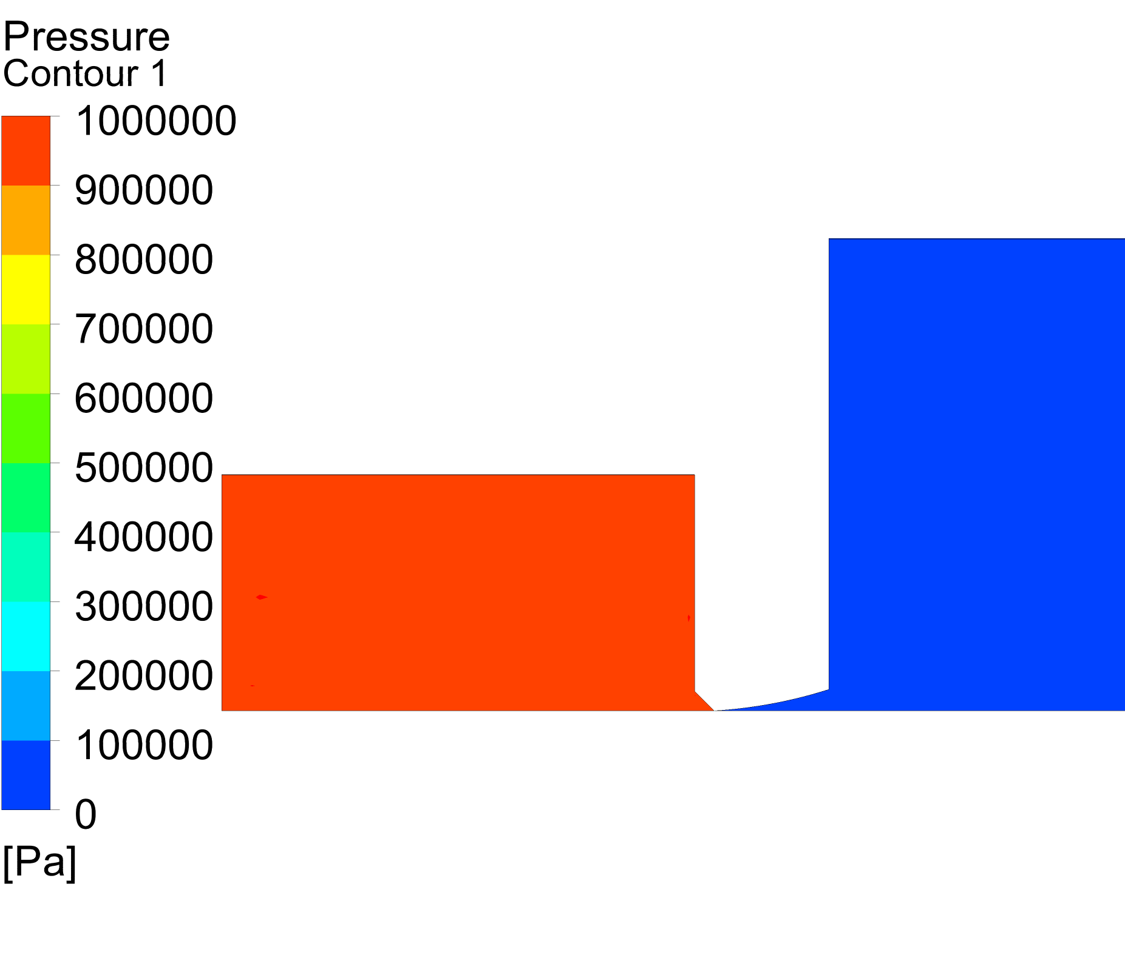
Simulations comparison: global pressure
Present simulation
D_critical = 30 microns
Previous simulation
Non

Slide 11
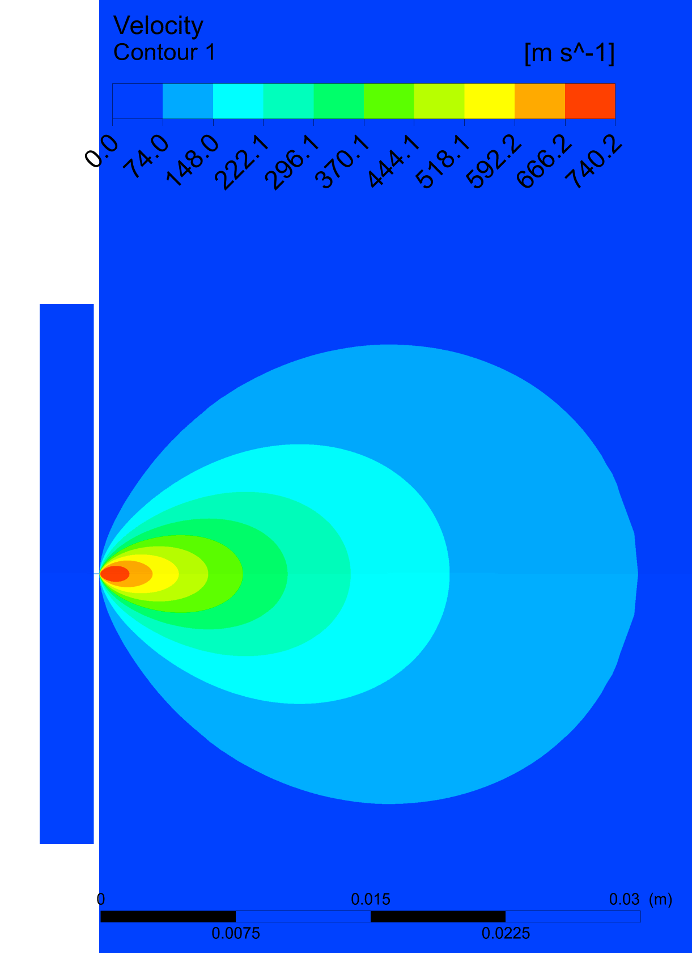
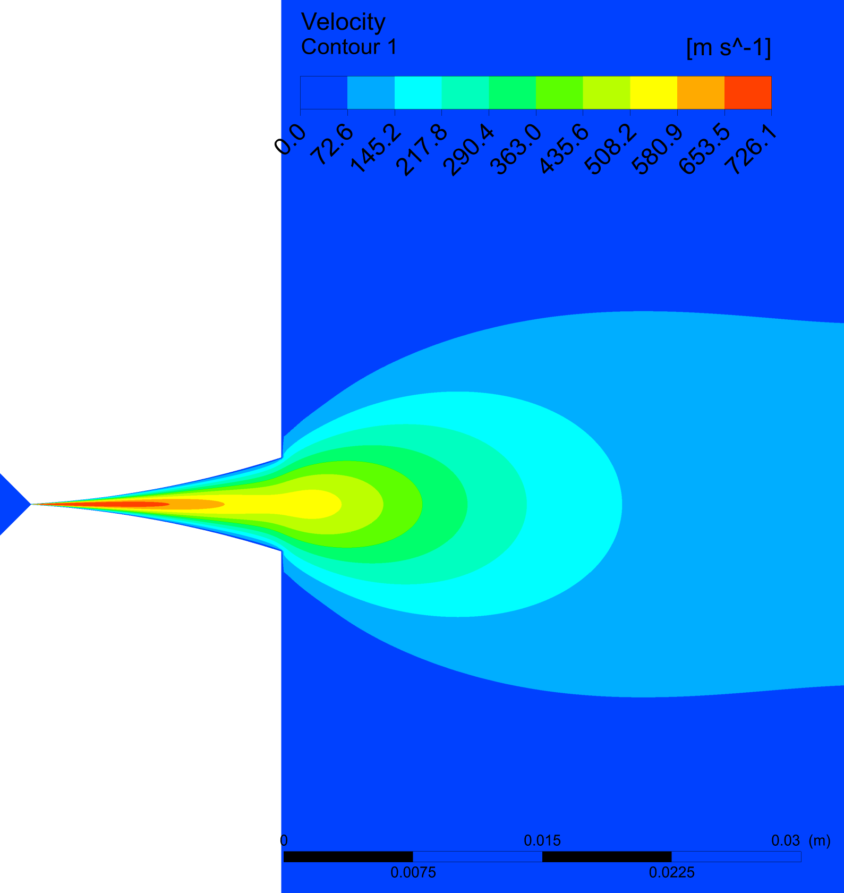
Velocity Profile
De Laval
Simple Geometry
Side view

Slide 12
Conclusions
The numerical simulation for the proposed de Laval nozzle with 10 microns critical diameter has been performed with high convergence level (under RMS factor 10⁻⁶)
De Laval construction of the nozzle provides better concentration of the beam and higher density in further distance from the nozzle outlet
Between planes C and D could be an optimal place for the placement of the 1st skimmer

Slide 13
Complementary post-processing

Slide 14
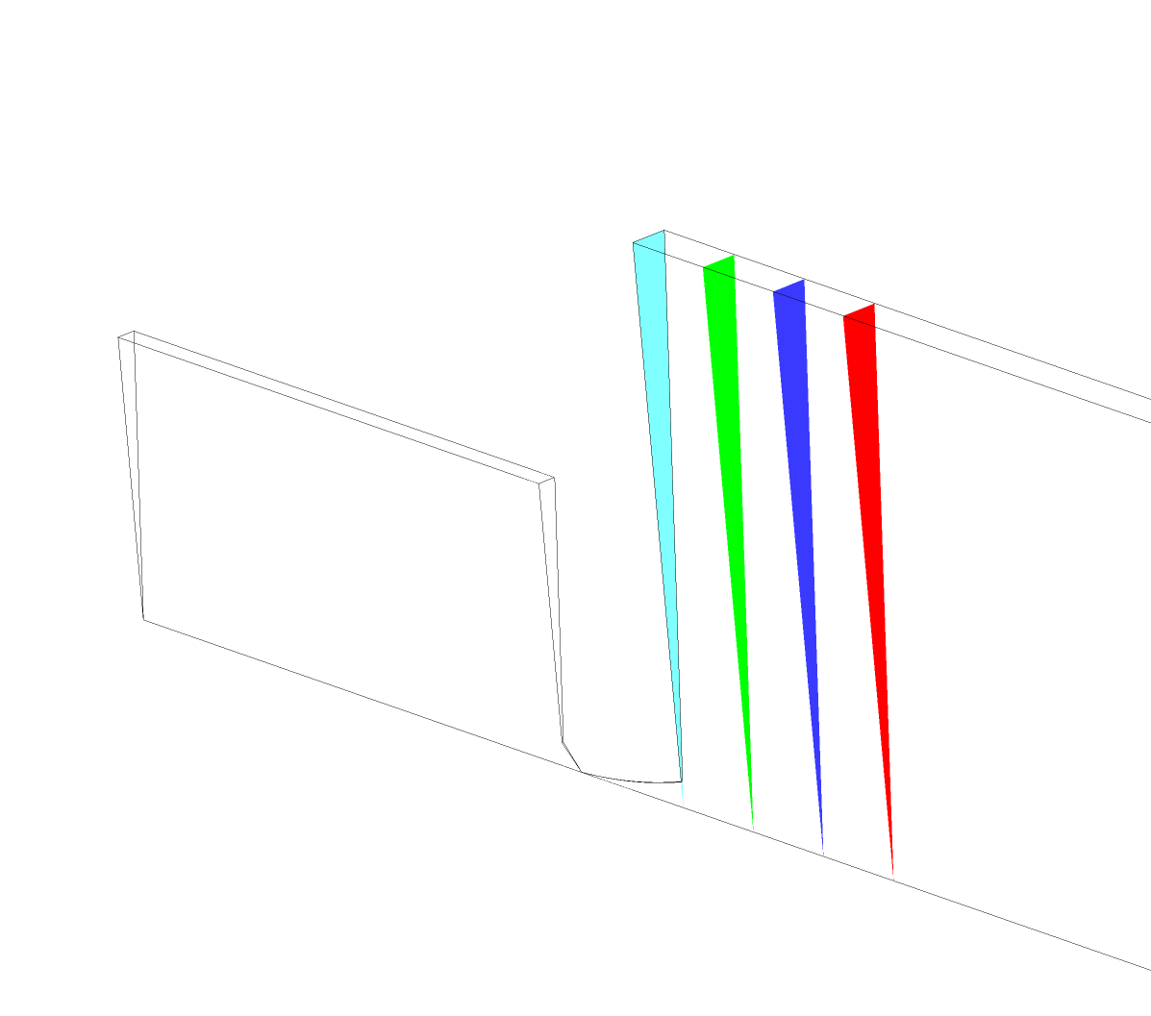
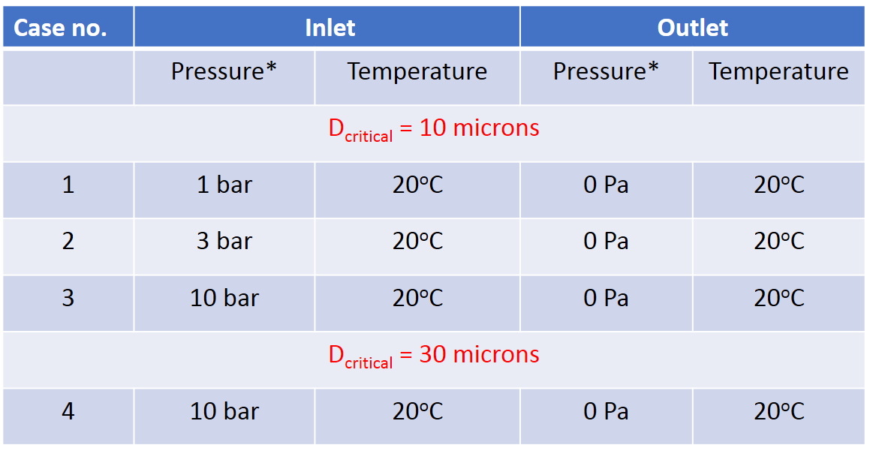
Profile planes position - de Laval nozzle
De Laval
nozzle throat 10 μm
14.5mm
10mm
10mm
10mm
Comparison between those two cases
A
B
Planes:
C
D

Slide 15
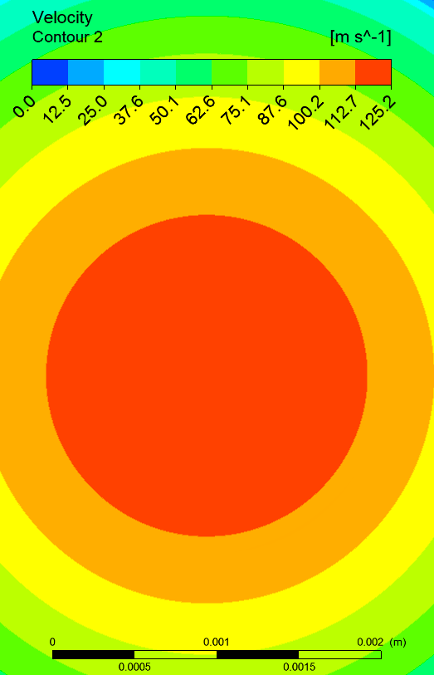
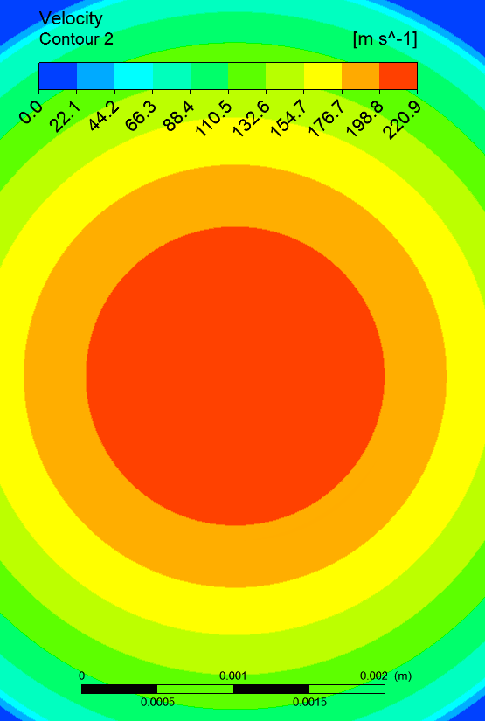
Velocity Profile
p_{_INLET} = 3 bar
p_{_INLET} = 10 bar
Plane A
1.9 mm
1.9 mm
nozzle throat 10 μm

Slide 16
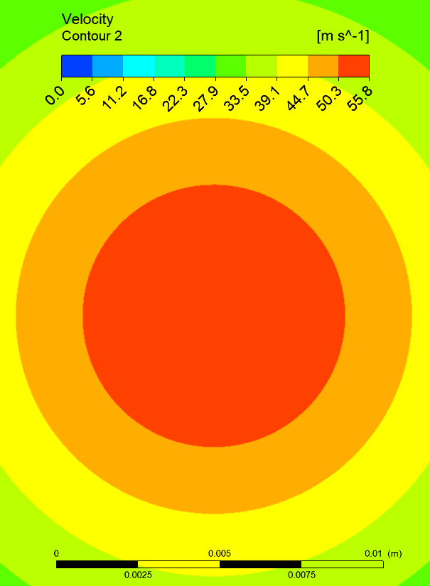
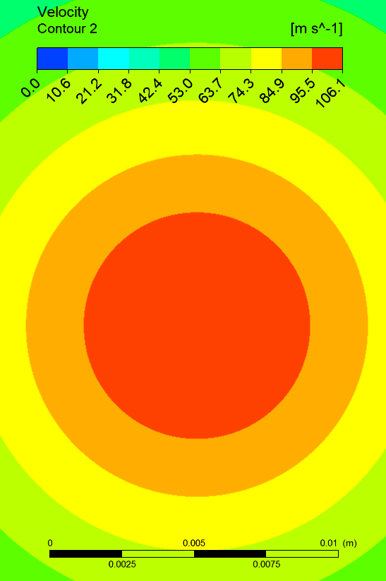
Velocity Profile
p_{_INLET} = 3 bar
p_{_INLET} = 10 bar
Plane B
8 mm
8 mm
nozzle throat 10 μm

Slide 17
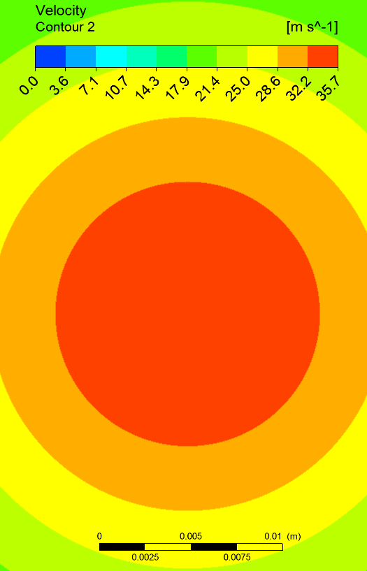
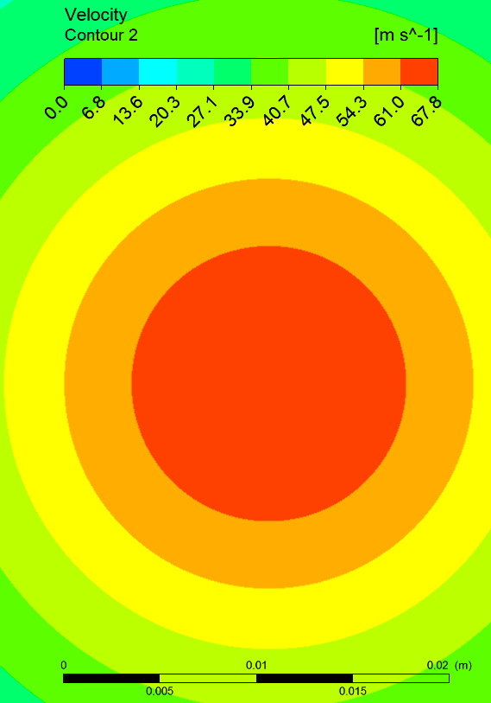
Velocity Profile
p_{_INLET} = 3 bar
p_{_INLET} = 10 bar
Plane C
14 mm
14 mm
nozzle throat 10 μm

Slide 18
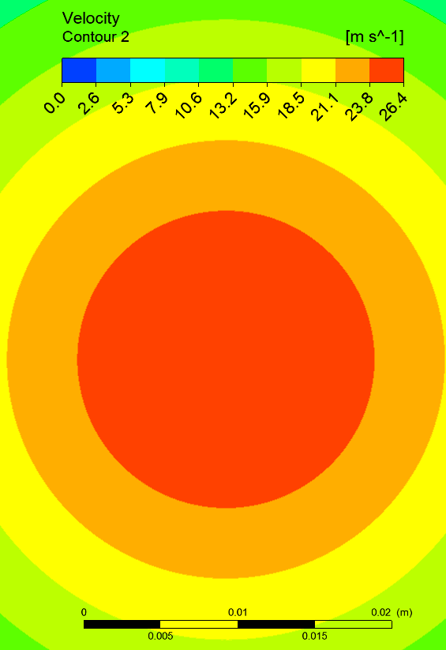
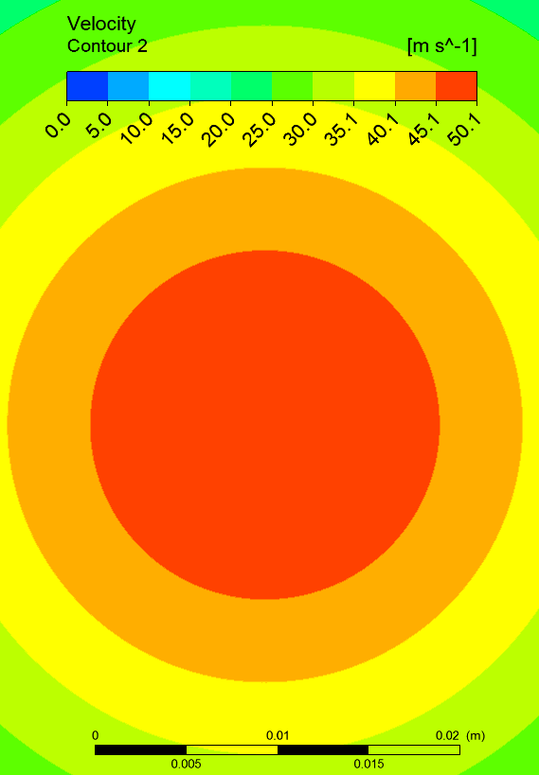
Velocity Profile
p_{_INLET} = 3 bar
p_{_INLET} = 10 bar
Plane D
18 mm
18 mm
nozzle throat 10 μm

Slide 19
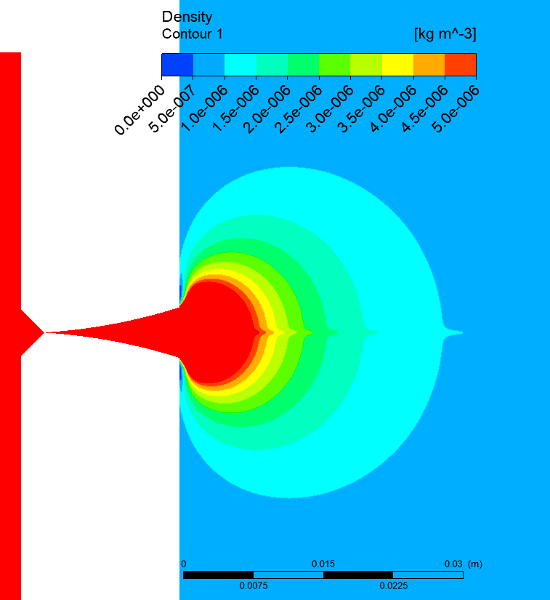
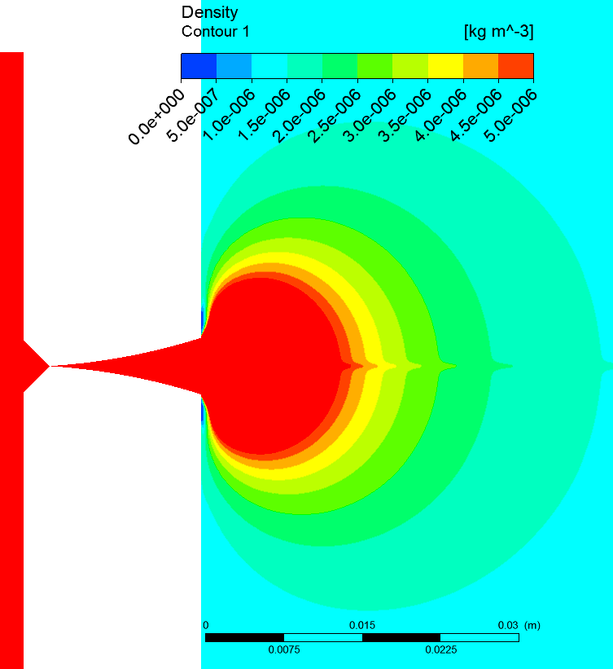
Density Profile
p_{_INLET} = 3 bar
p_{_INLET} = 10 bar
Side view
nozzle throat 10 μm

Slide 20
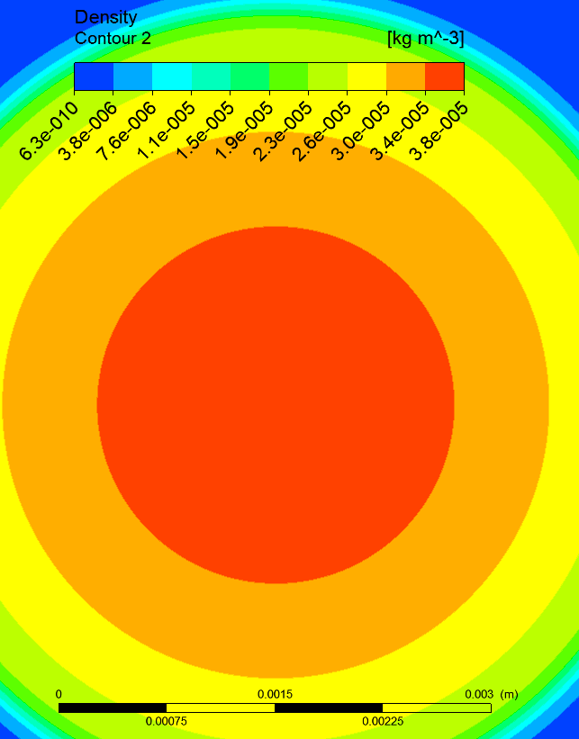
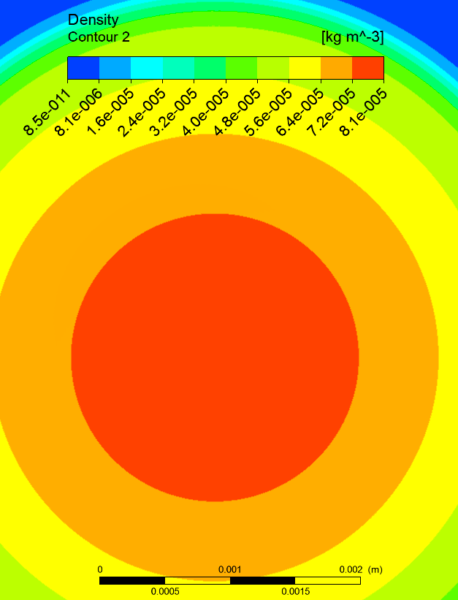
Density Profile
p_{_INLET} = 3 bar
p_{_INLET} = 10 bar
Plane A
2.3 mm
2.1 mm
nozzle throat 10 μm

Slide 21
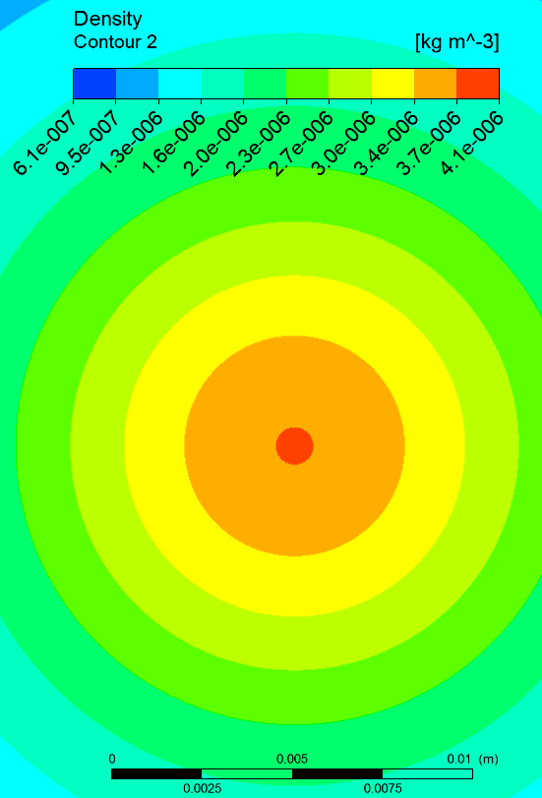
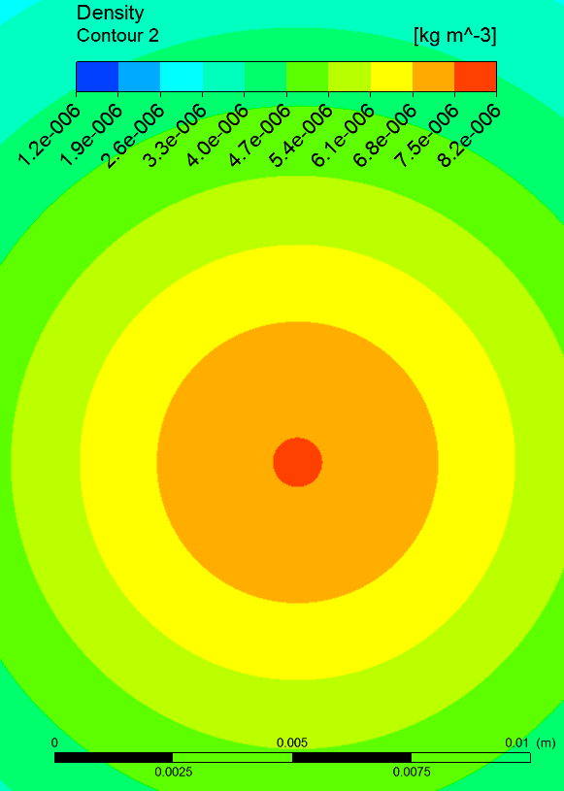
Density Profile
p_{_INLET} = 3 bar
p_{_INLET} = 10 bar
Plane B
6 mm
6 mm
nozzle throat 10 μm

Slide 22
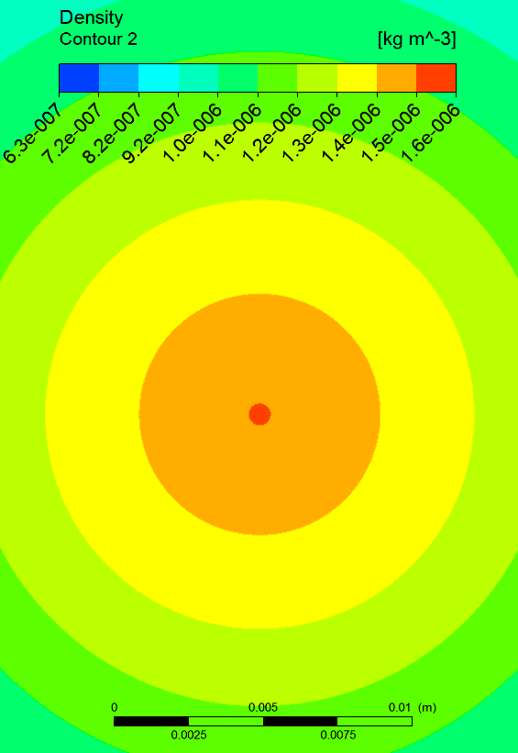
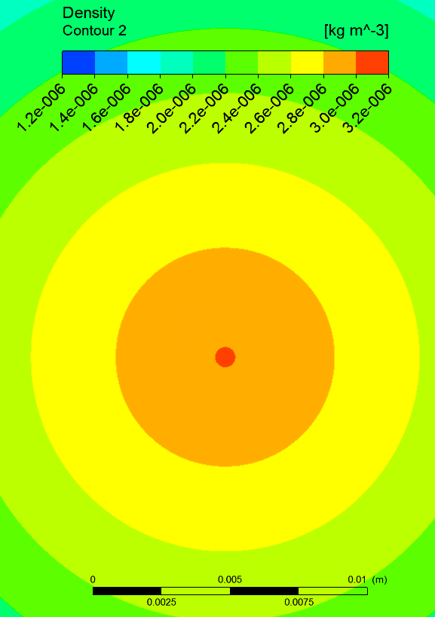
Density Profile
p_{_INLET} = 3 bar
p_{_INLET} = 10 bar
Plane C
8 mm
8 mm
nozzle throat 30 μm

Slide 23
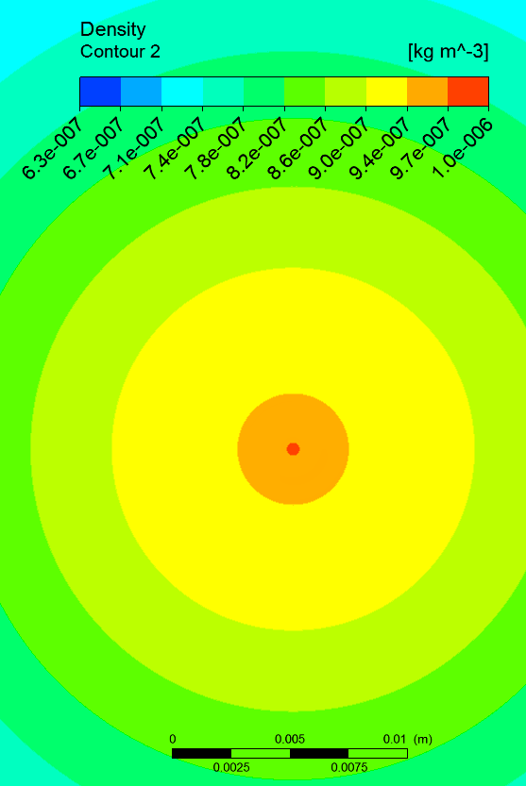
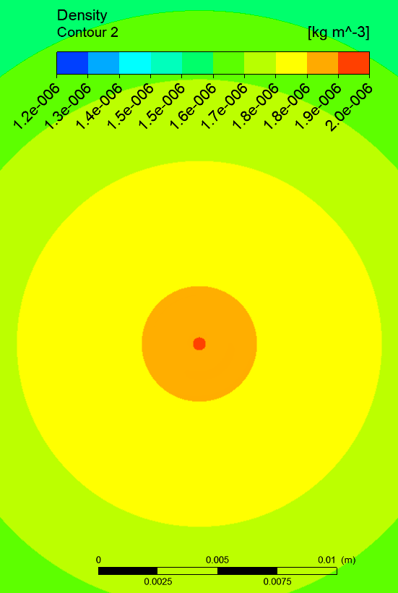
Density Profile
p_{_INLET} = 3 bar
p_{_INLET} = 10 bar
Plane D
4.5 mm
4.5 mm
nozzle throat 10 μm

Slide 24
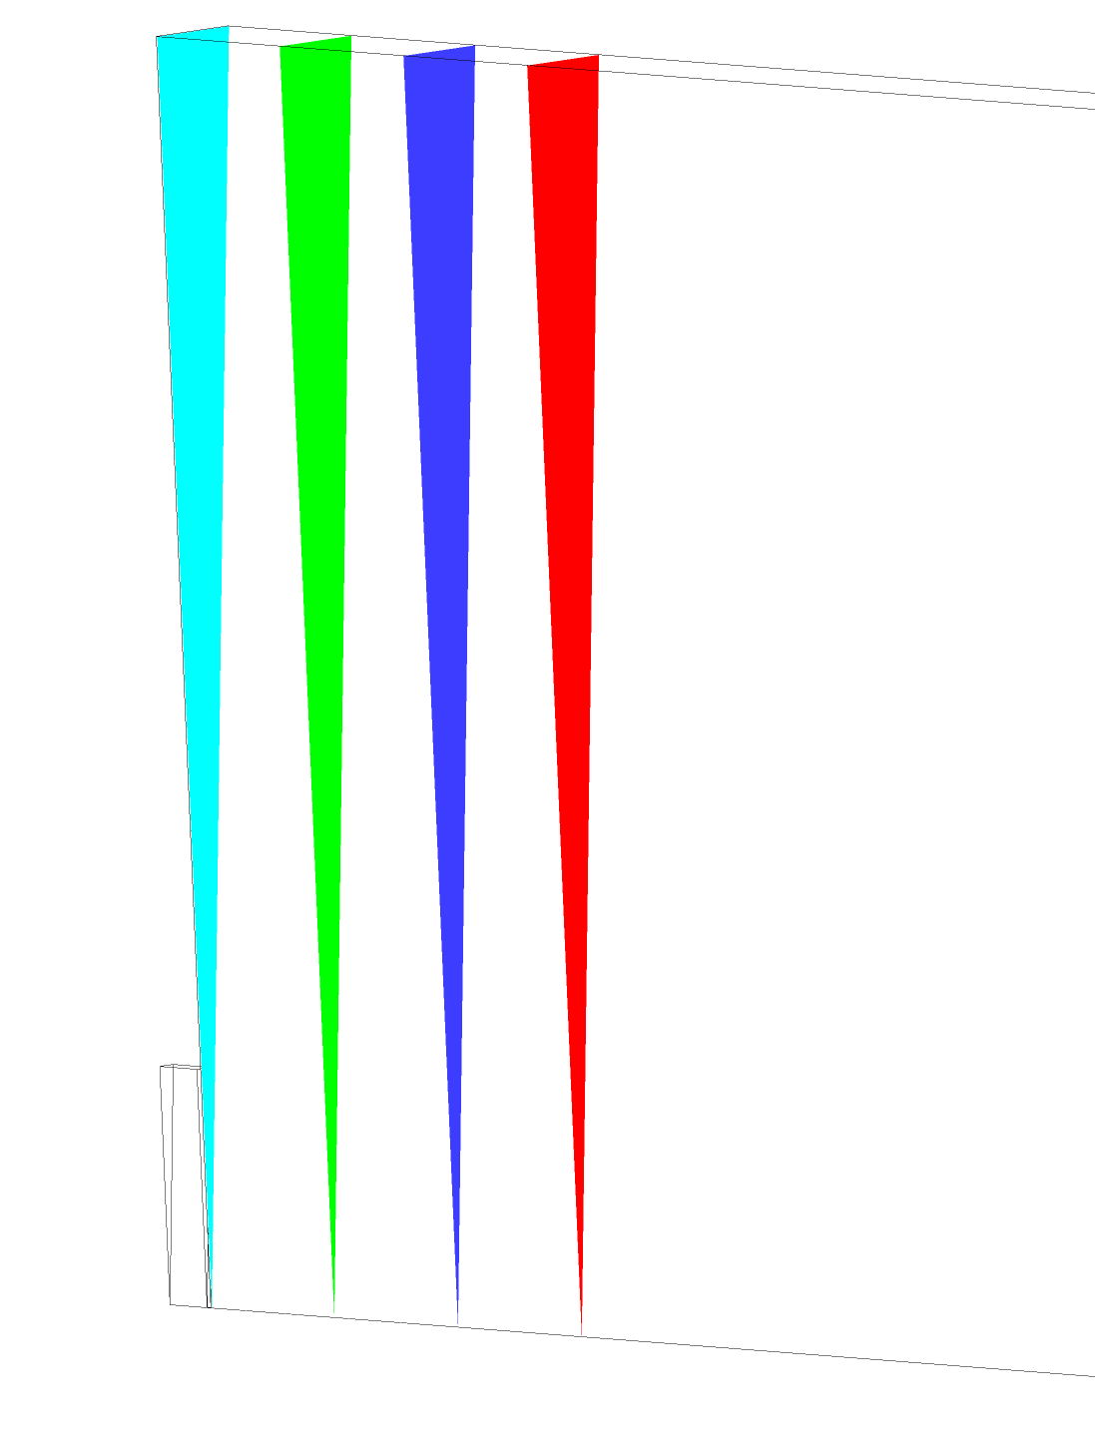
Profile planes position
De Laval
Simple Geometry
nozzle throat 30 μm
10mm
10mm
10mm
Comparison between
de Laval nozzle and simple geometry nozzle
p_{inlet} = 10 bar
14.5mm
10mm
10mm
10mm
A
B
Planes:
C
D
A
B
C
D

Slide 25
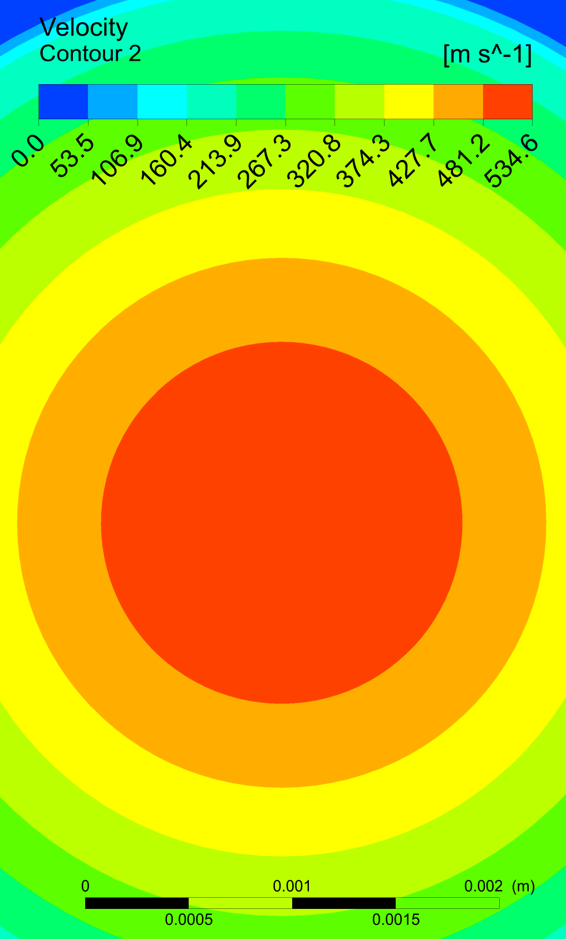
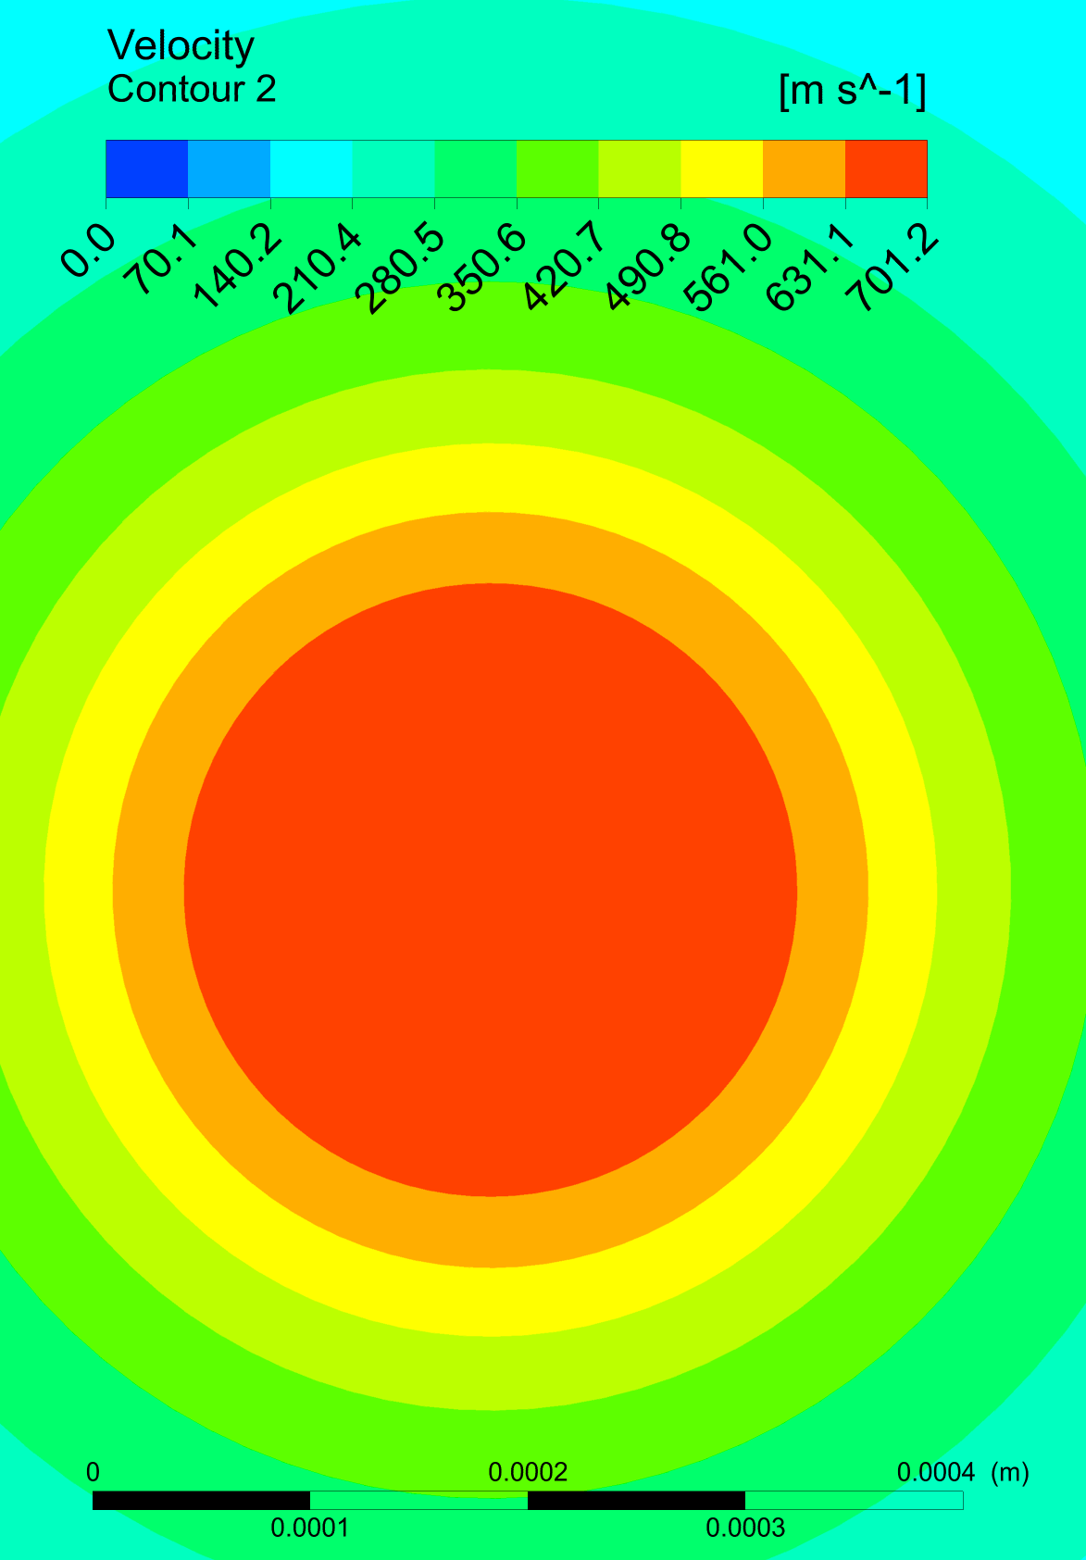
Velocity Profile
De Laval
Simple Geometry
Plane A
1.7 mm
0.29 mm
nozzle throat 30 μm

Slide 26
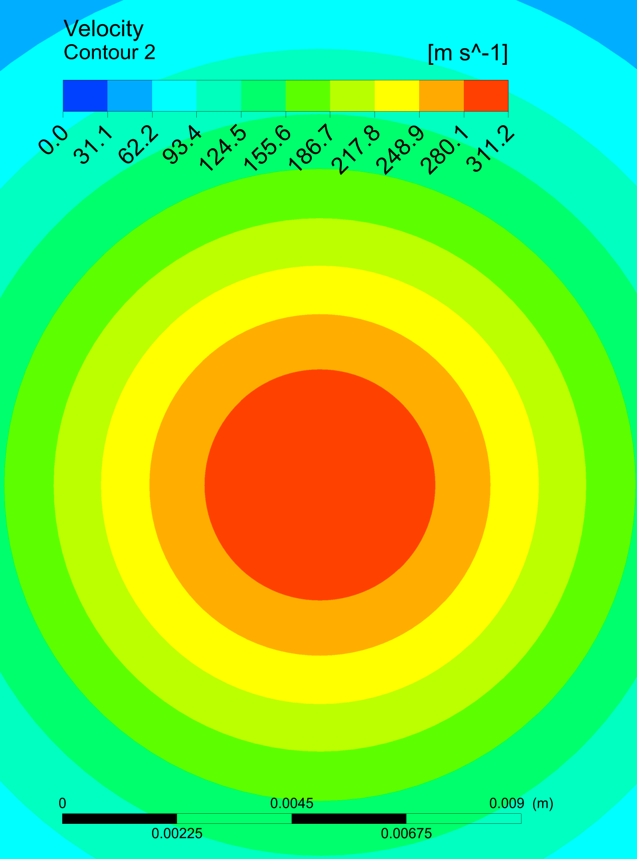
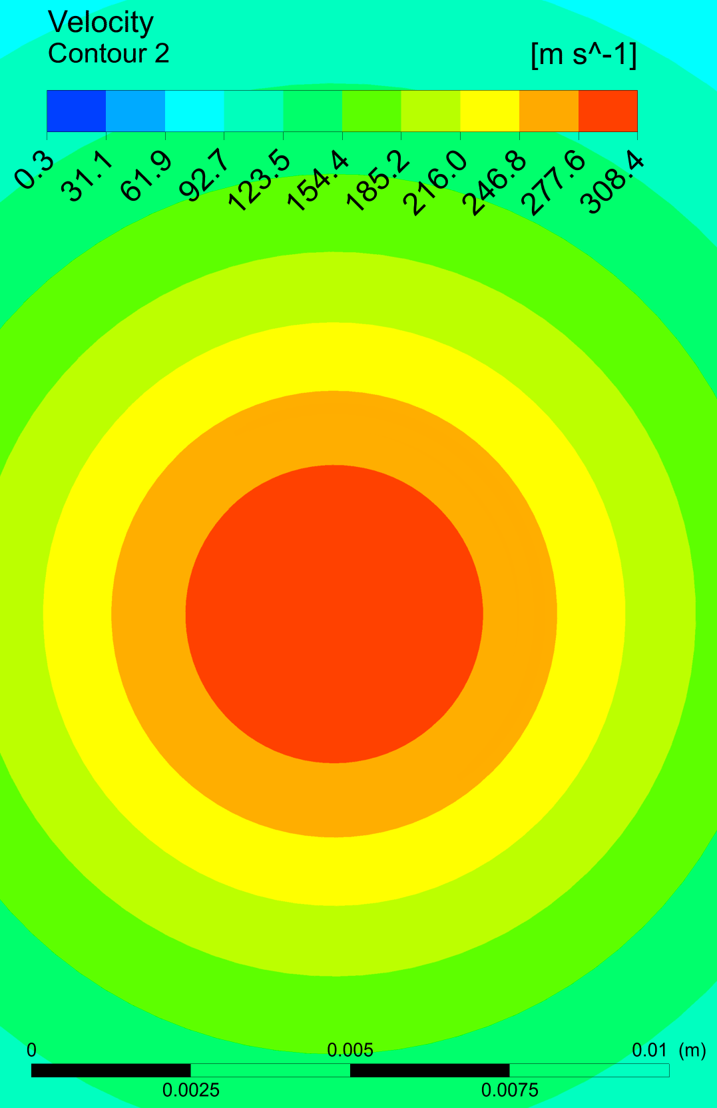
Velocity Profile
De Laval
Simple Geometry
Plane B
4.3 mm
4.7 mm
nozzle throat 30 μm

Slide 27
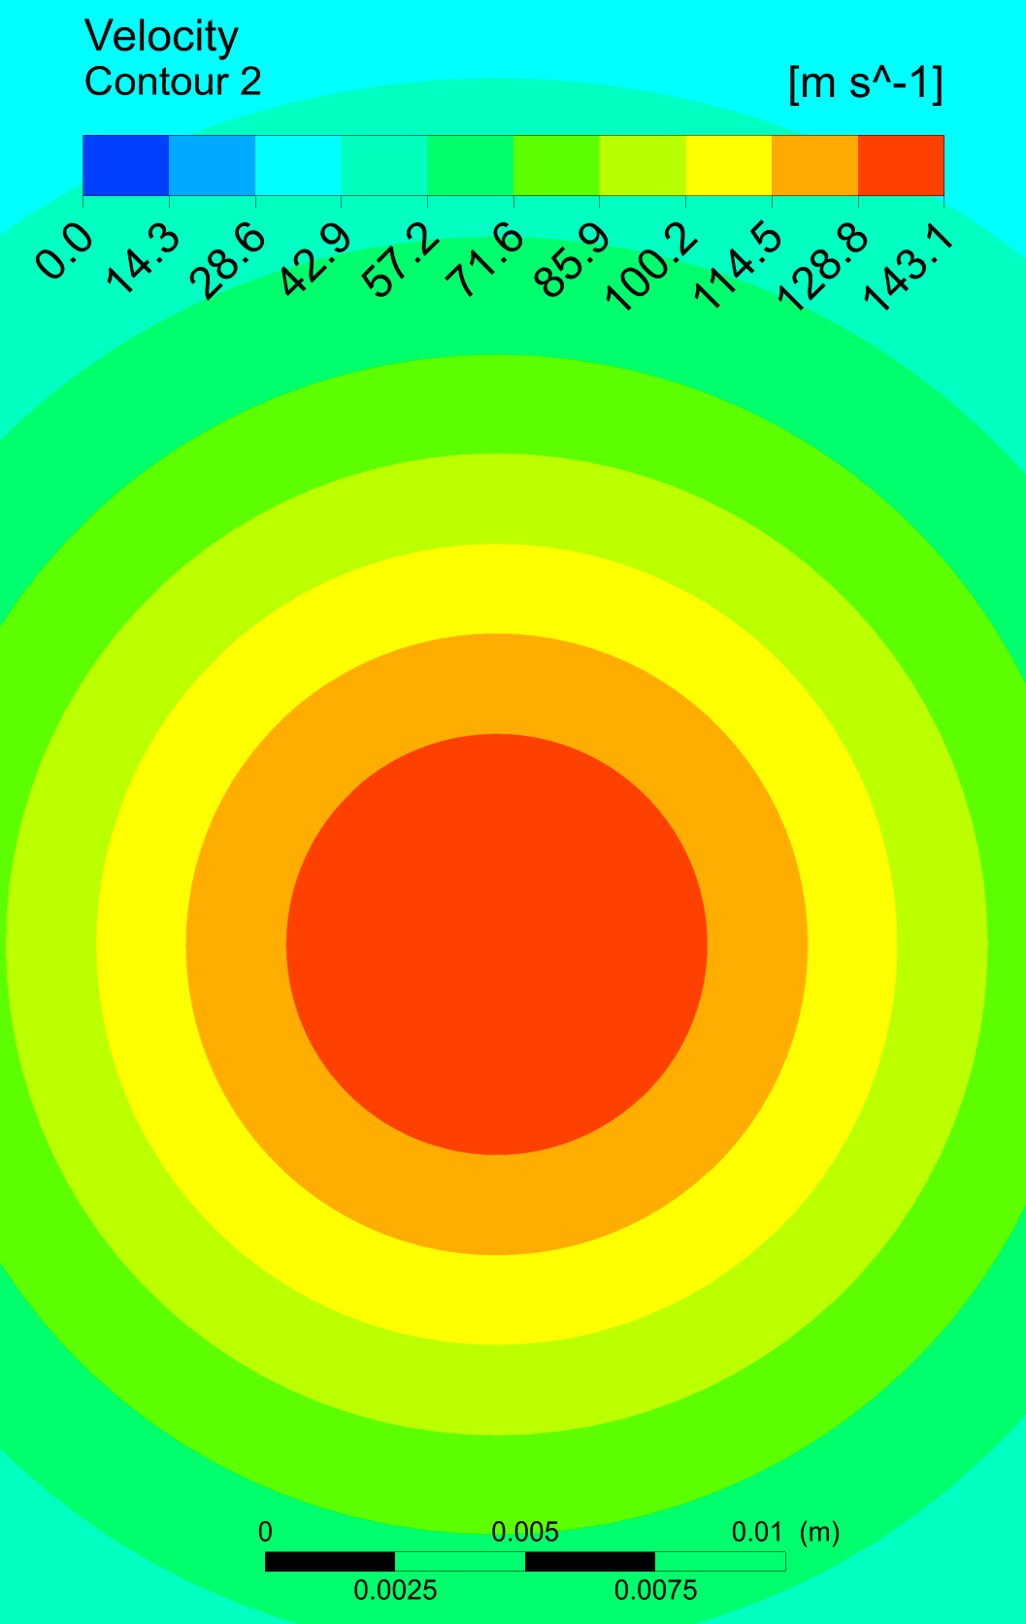
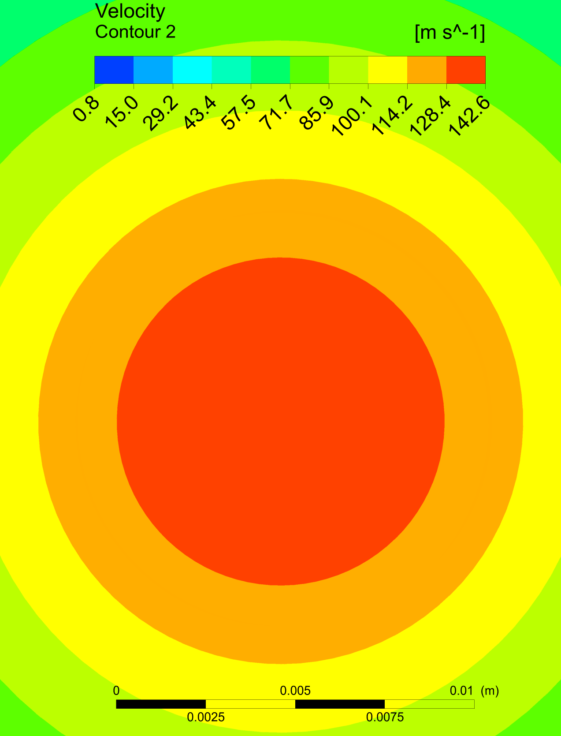
Velocity Profile
De Laval
Simple Geometry
Plane C
7.6 mm
9 mm
nozzle throat 30 μm

Slide 28
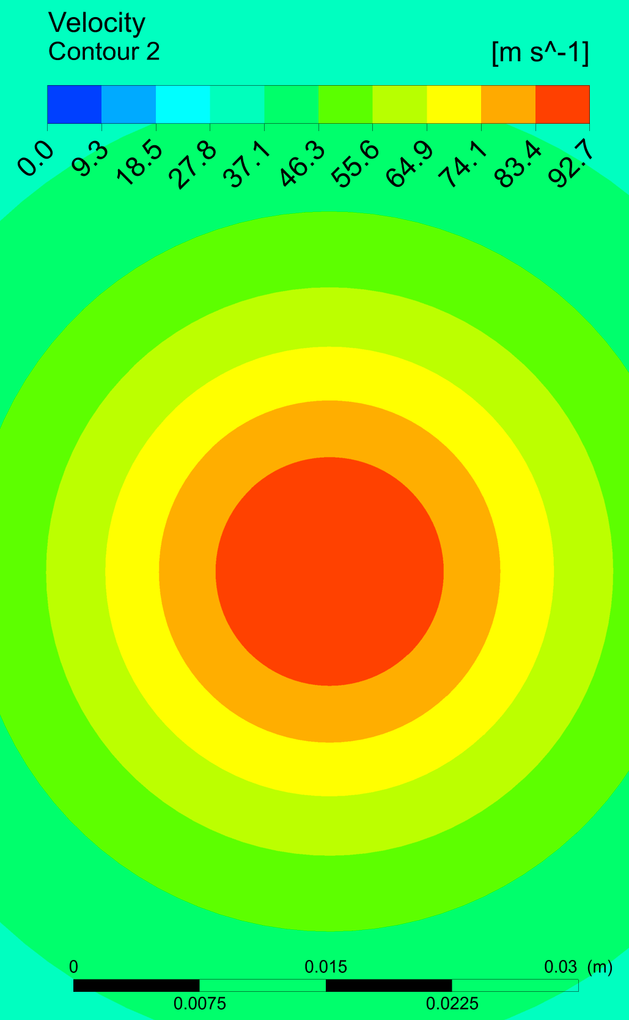
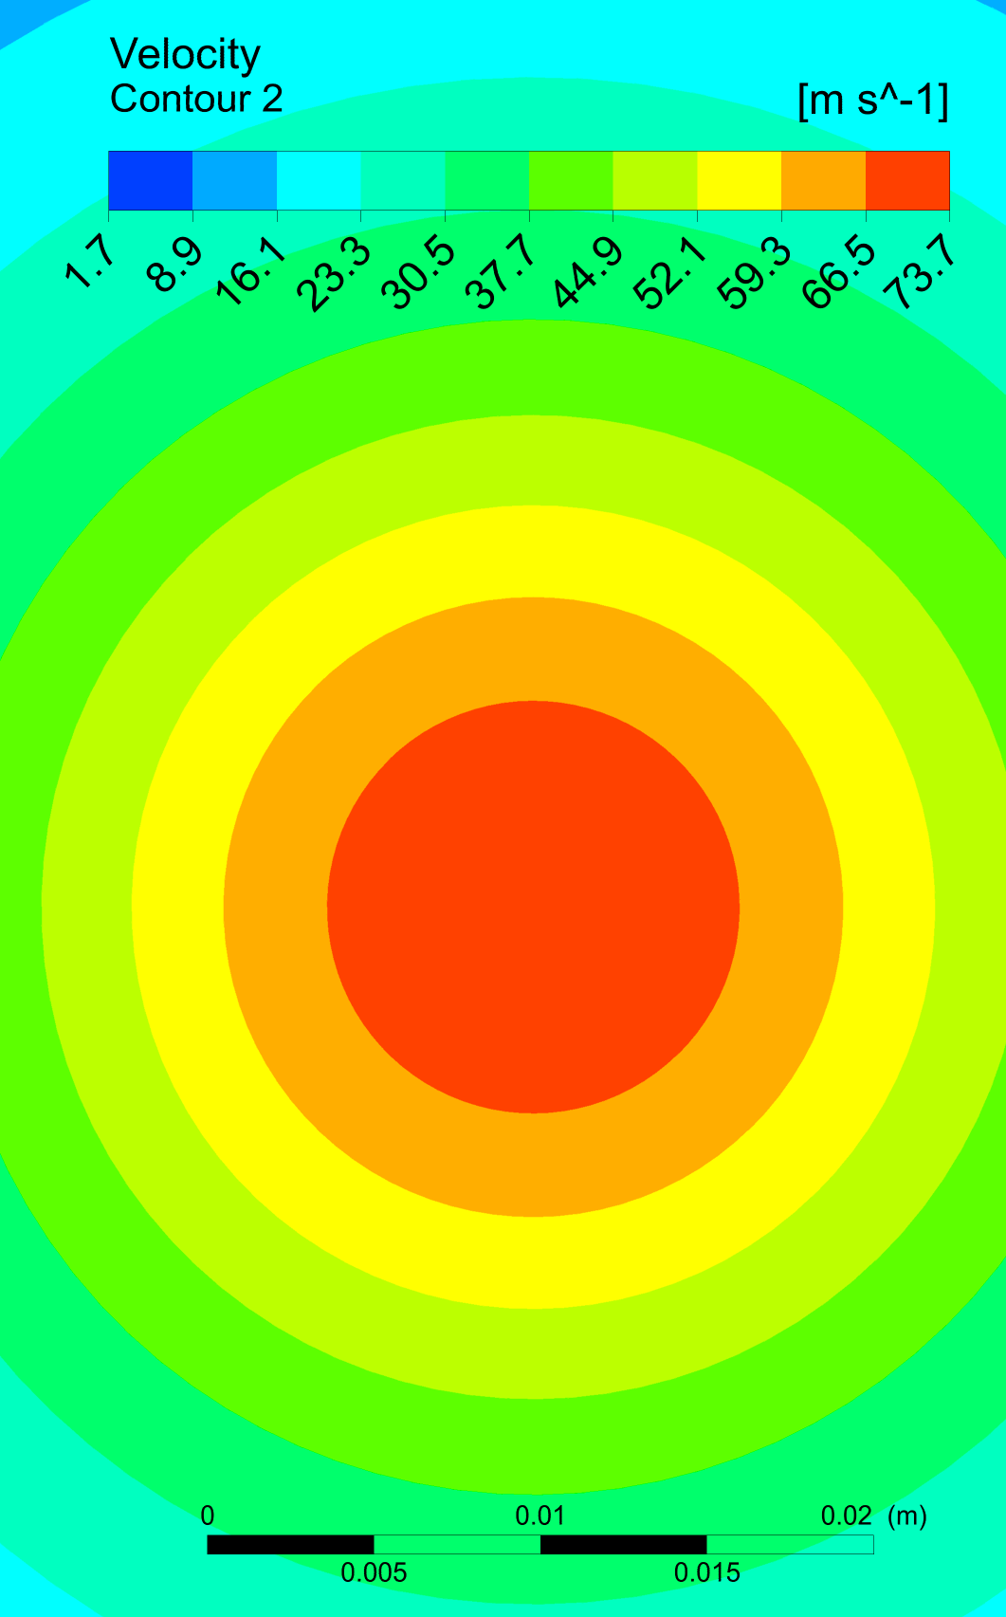
Velocity Profile
De Laval
Simple Geometry
Plane D
14 mm
12 mm
nozzle throat 30 μm

Slide 29
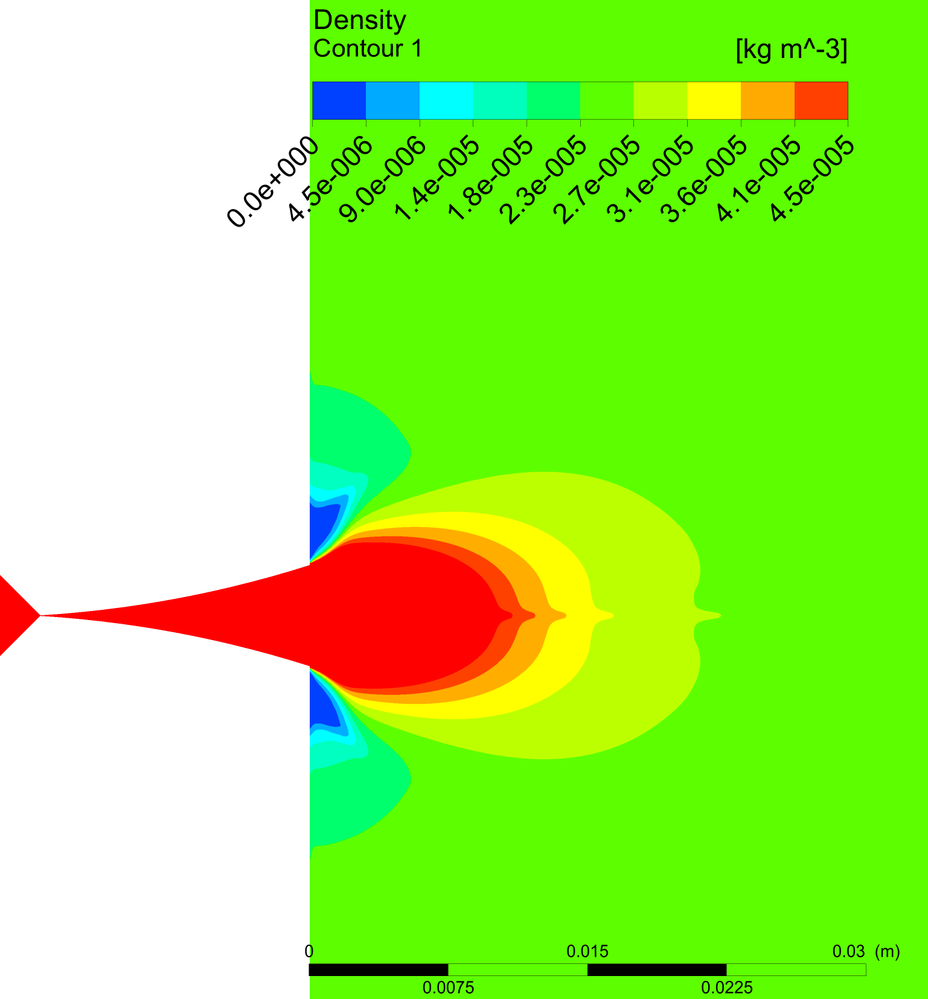
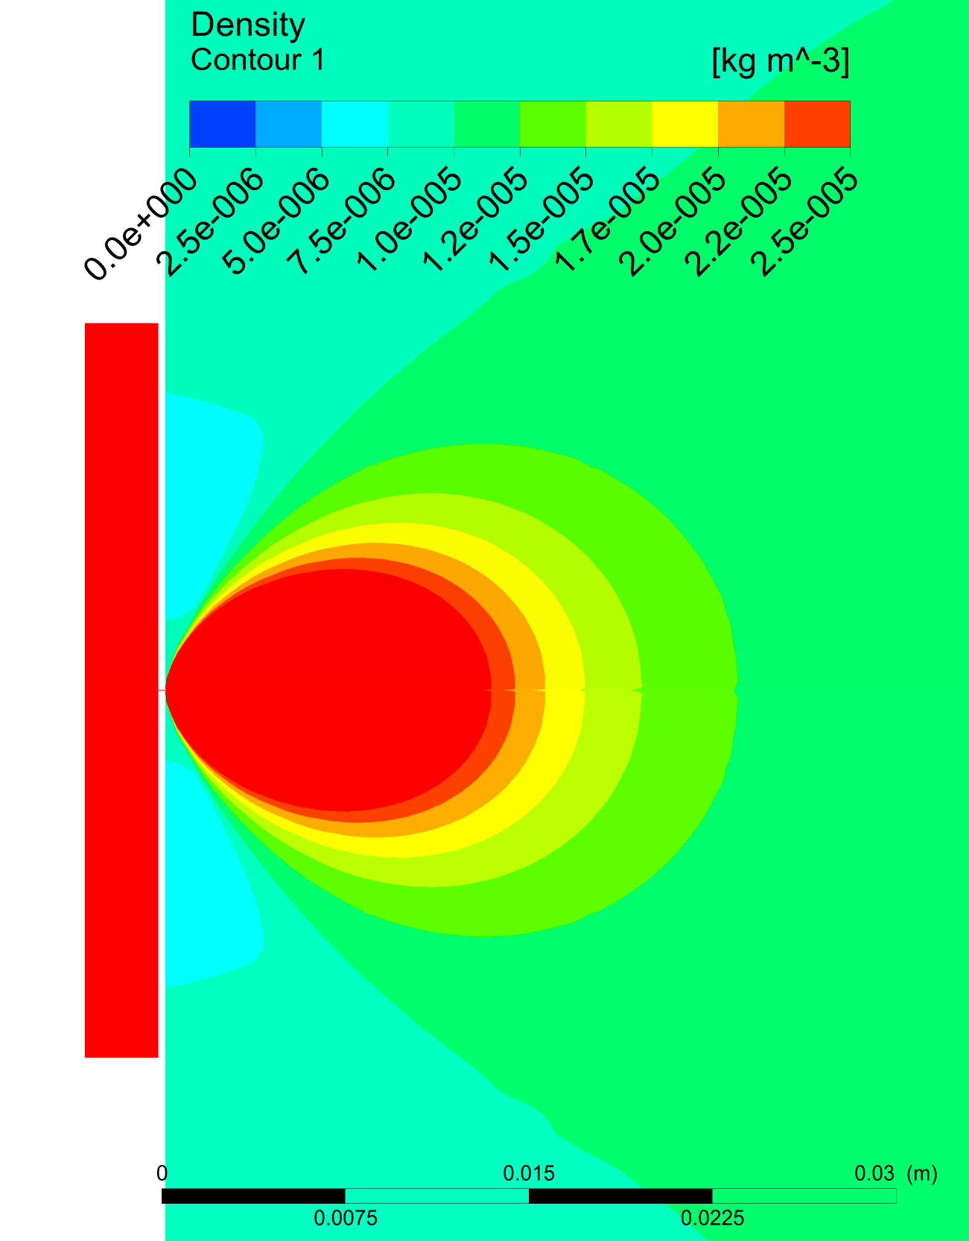
Density Profile
De Laval
Simple Geometry
Side view
nozzle throat 30 μm

Slide 30
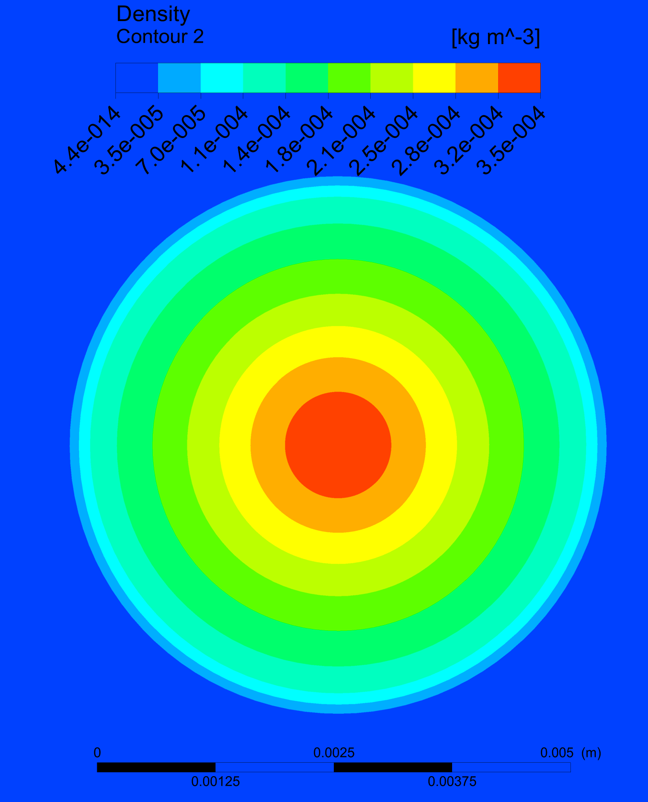
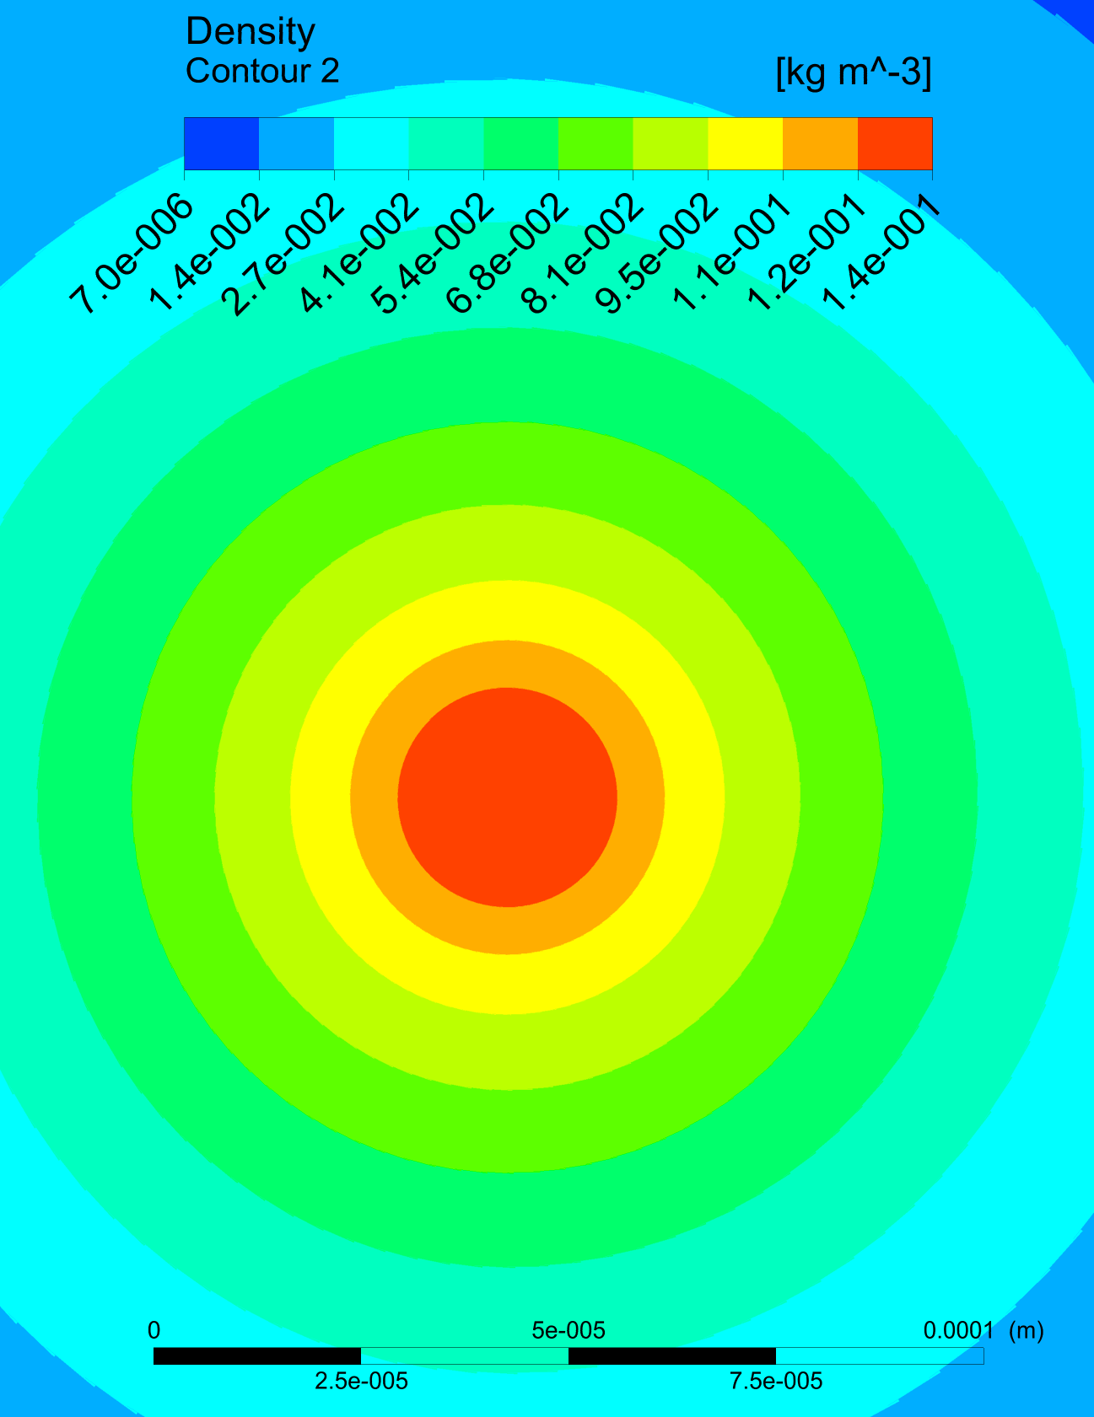
Density Profile
De Laval
Simple Geometry
Plane A
1.1mm
0.025mm
nozzle throat 30 μm

Slide 31
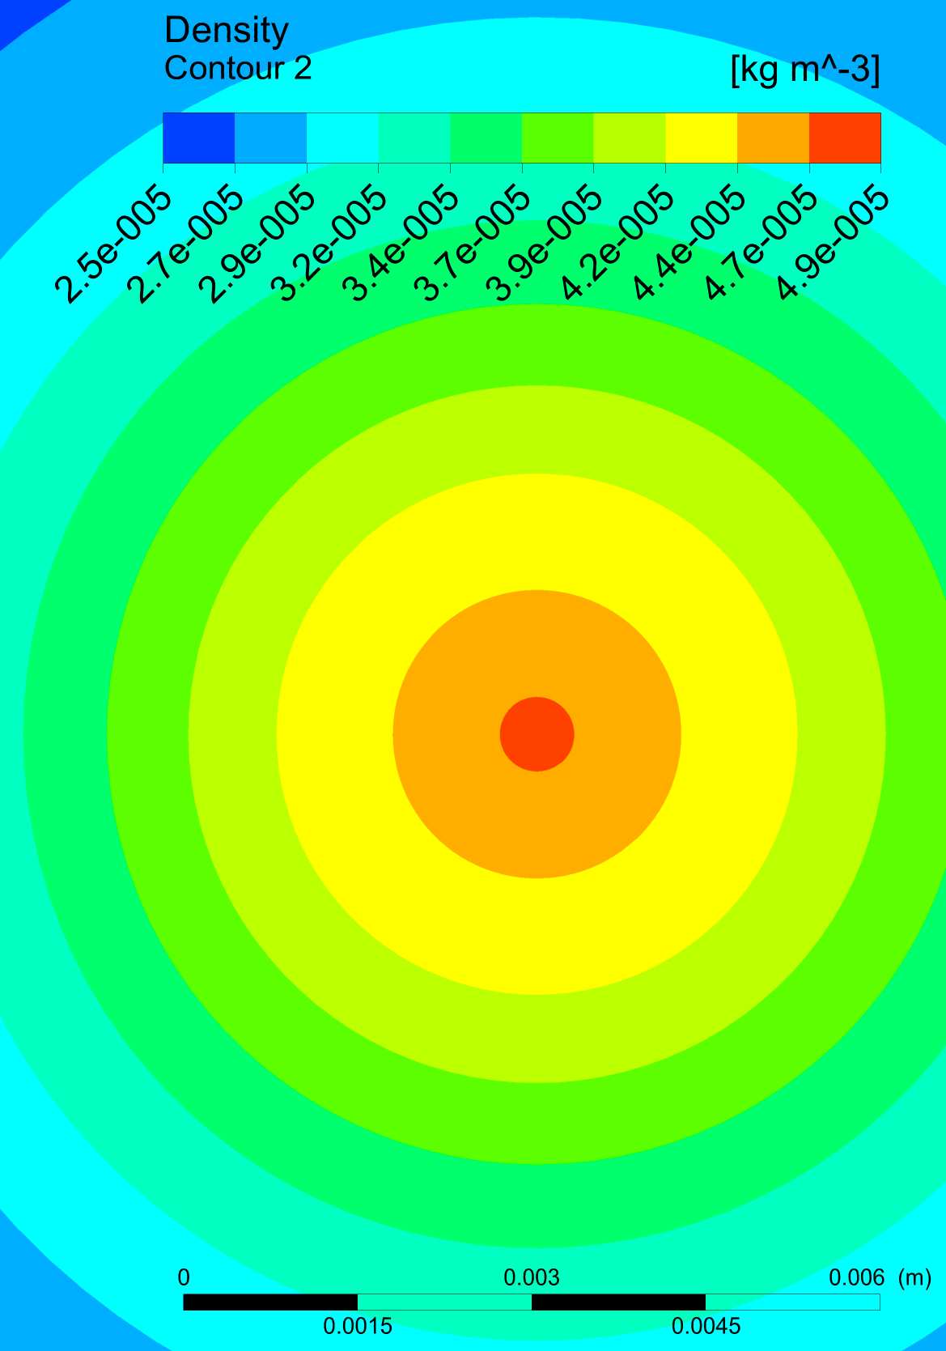
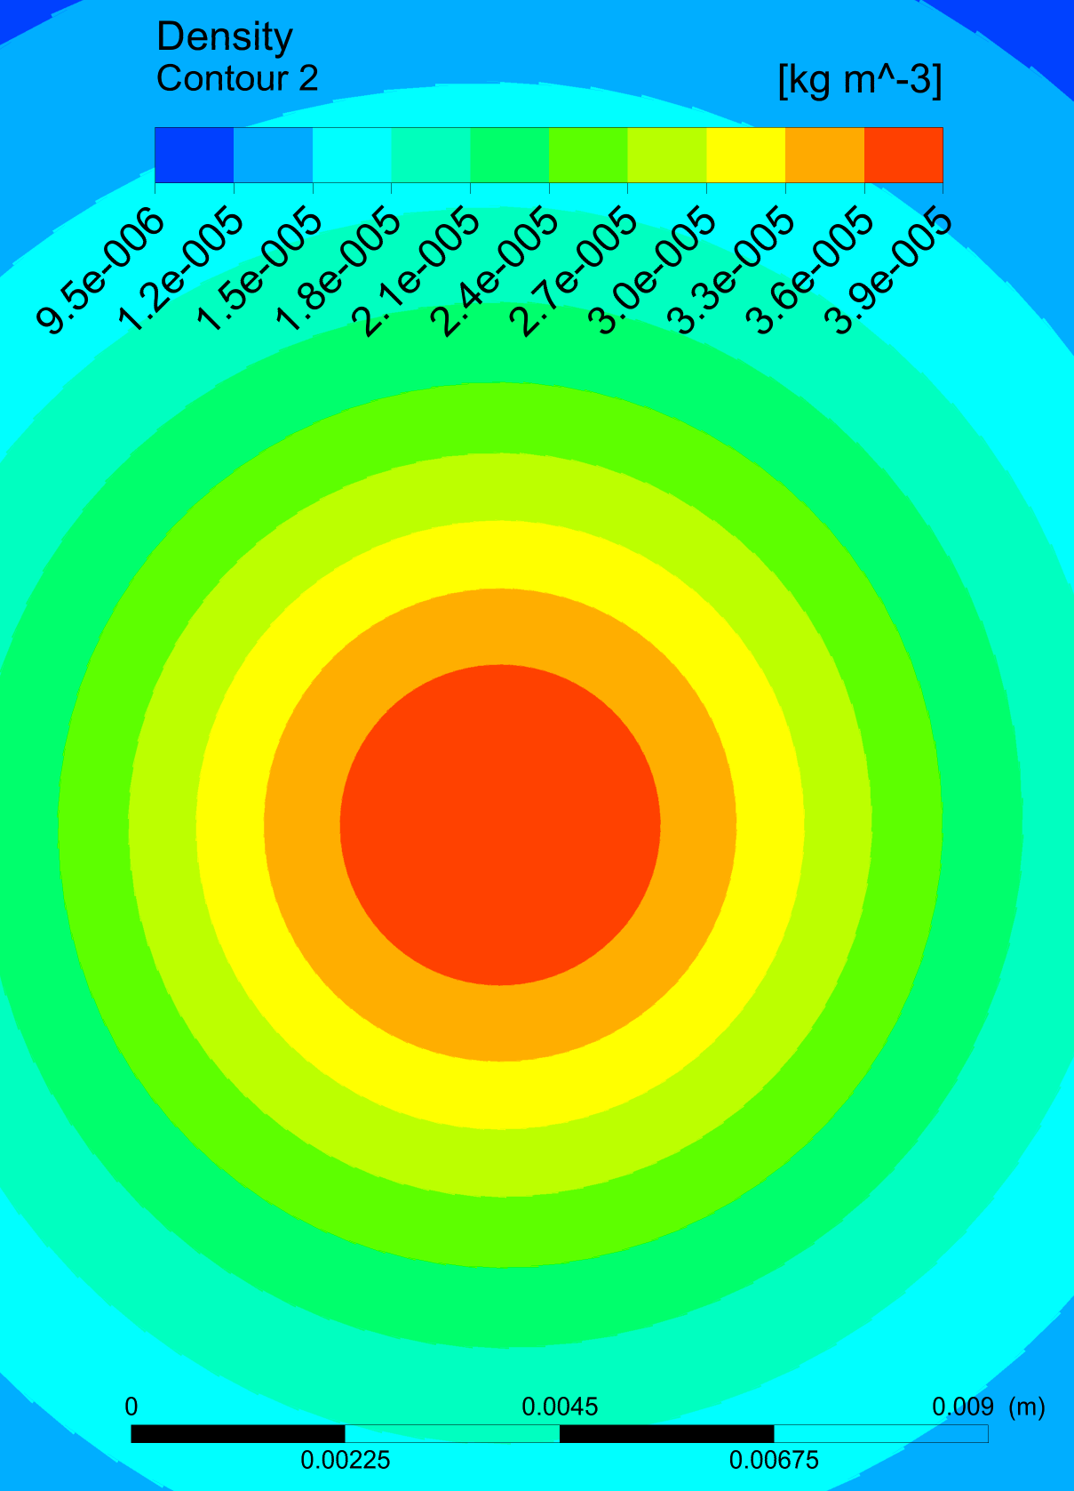
Density Profile
De Laval
Simple Geometry
Plane B
2.5 mm
3.2 mm
nozzle throat 30 μm

Slide 32


Density Profile
De Laval
Simple Geometry
Plane C
8 mm
6 mm
nozzle throat 30 μm

Slide 33


Density Profile
De Laval
Simple Geometry
Plane D
10 mm
9 mm
nozzle throat 30 μm

