Slide 1
BGC CERN Update
Tom Dodington, BE-BI-ML
20.12.2017

Slide 2
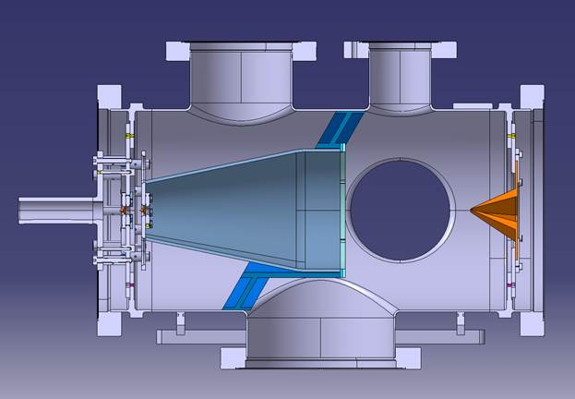
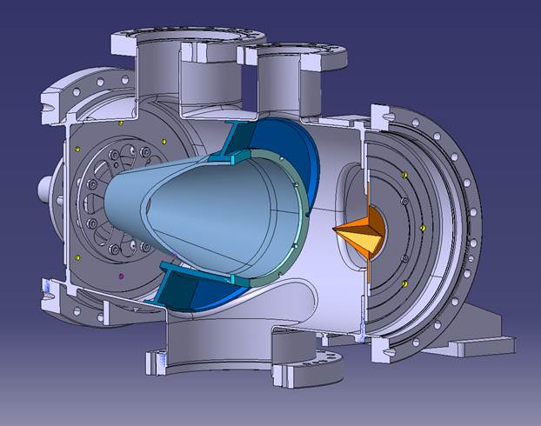
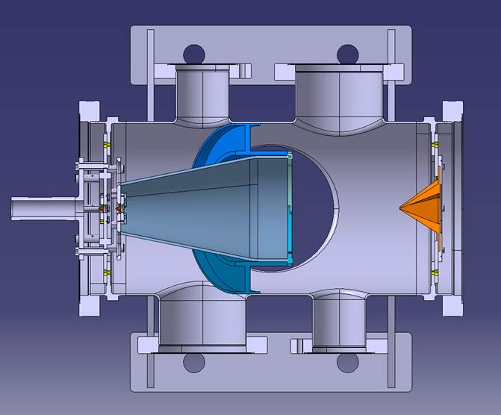
Gas Volume Partition
Idea to separate pumping between skimmer 1 & 2
Preliminary design by CERN Design Office
ST0923983_01
Candy Capelli, EN-MME

Slide 3
Optical Holder
Addressed issues discussed with Serban
Four pieces, ST0916376_01
Drawings complete, need to check
Will send to Hao for production

Slide 4
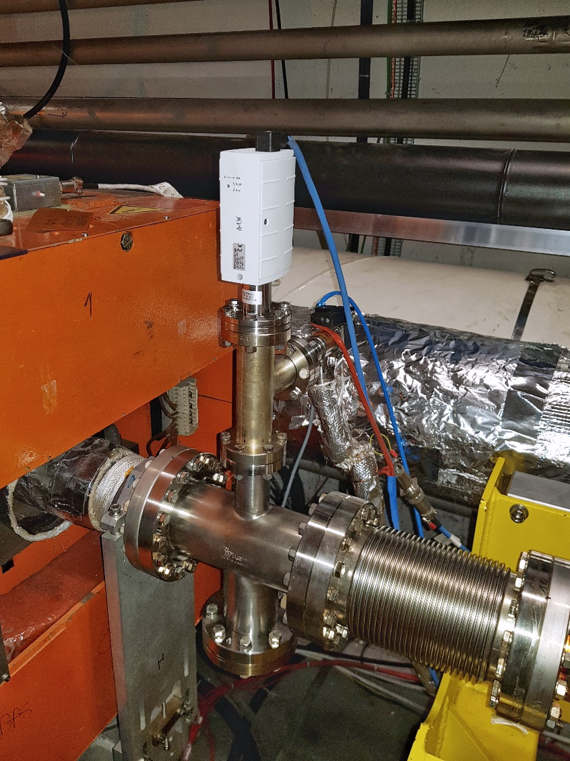
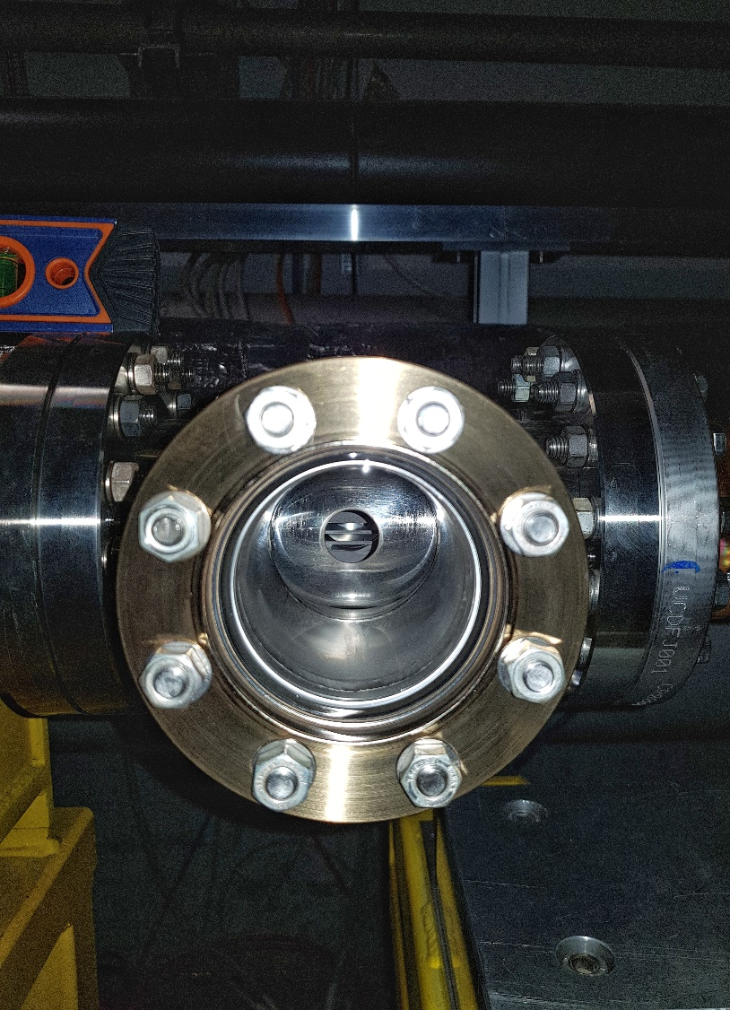
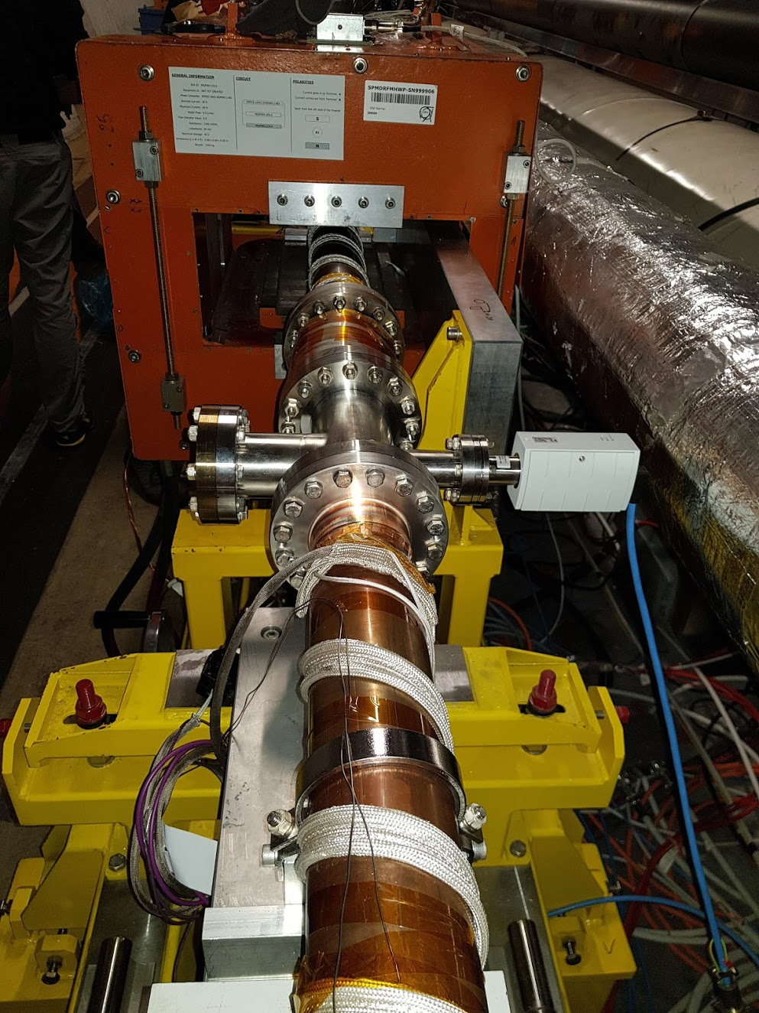
Fluorescence Monitor Installation

Slide 5
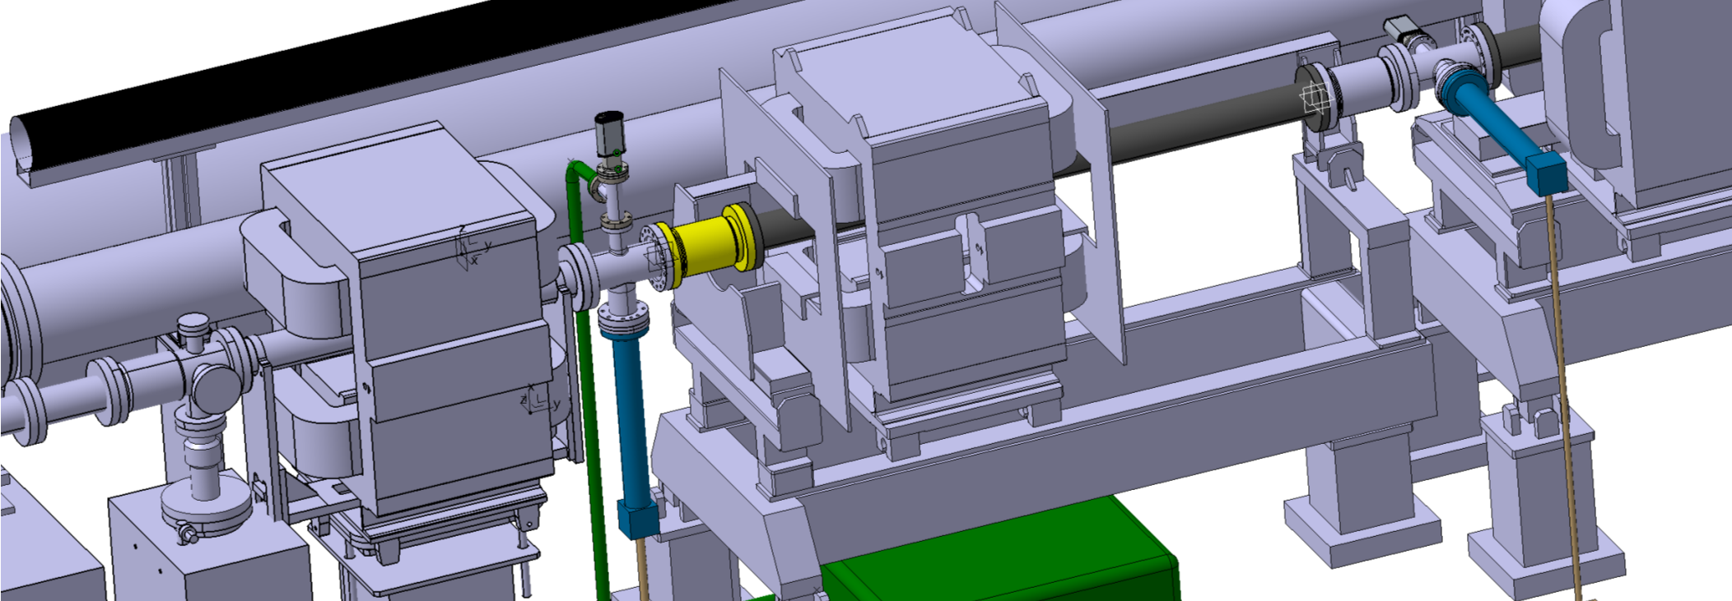
Fluorescence Monitor Optics
Ongoing design of supports for:
  Camera, Photon Counter
  Lenses, Filter Wheels, Black boxes for light shielding
For both fluorescence monitors.
Avoid floor drilling if possible

Slide 6
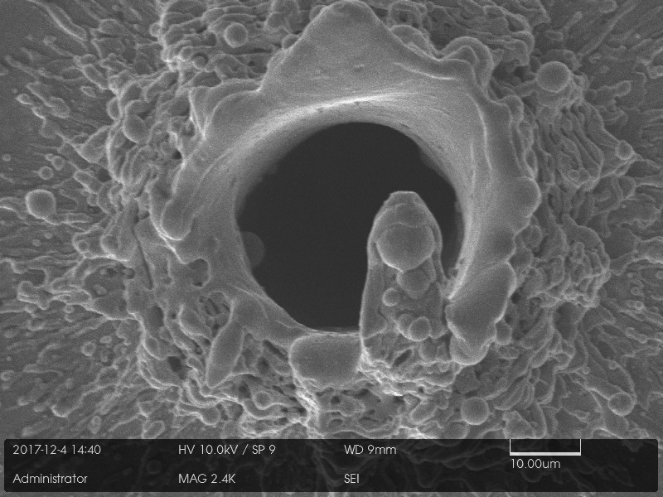
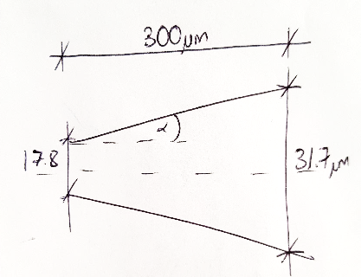
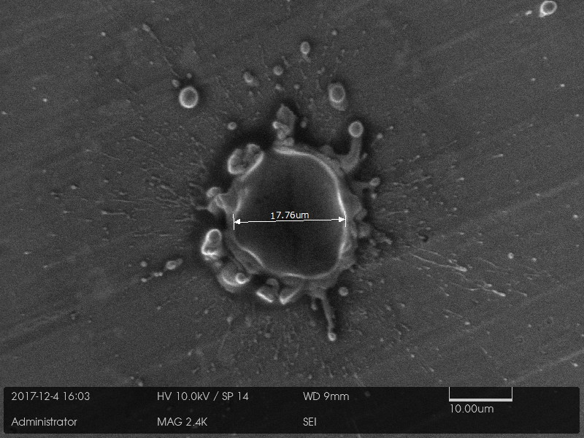
Hole Manufacture
20um laser drilled hole completed
30um machined hole drill bits being manufactured, results before 2018.
α = 1.33°
(previously
expected 2-3°
with laser)
Scitech, Rutherford Appleton Laboratories, UK

Slide 7
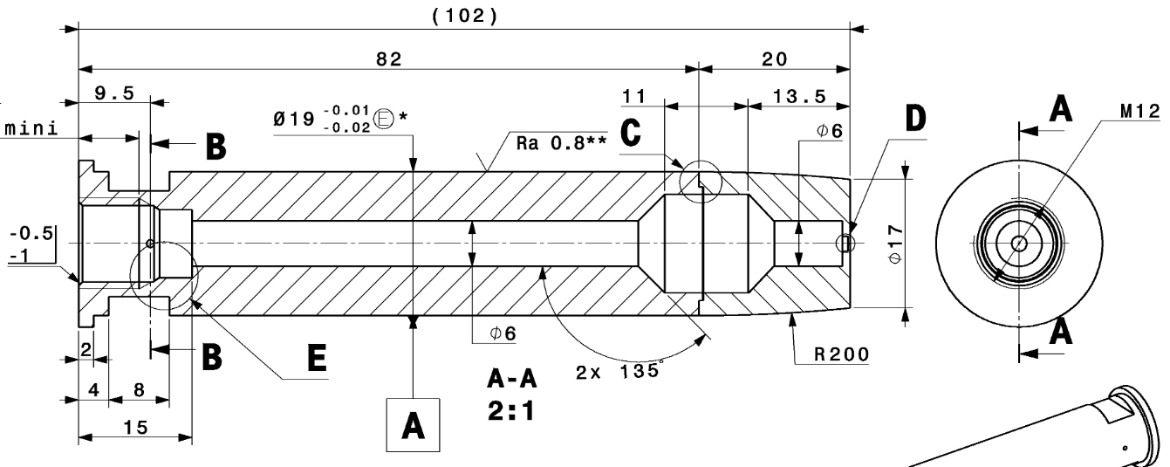
Nozzle Manufacture
Manufacture has begun at Scitech, Rutherford Appleton Labs, UK
We have to verify the weld will withstand the 10bar pressure
Vacuum brazing had been suggested, don’t want this
Final processes (hole manufacture and machining of 19mm outer diameter) dependant on outcome of hole tests. Decision in January?

Slide 8
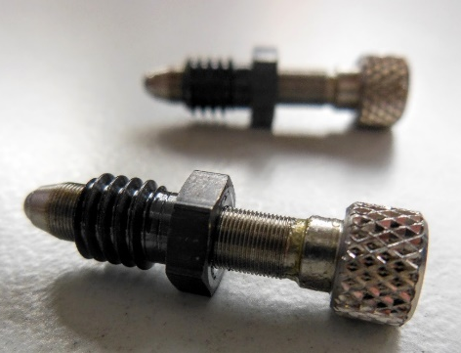
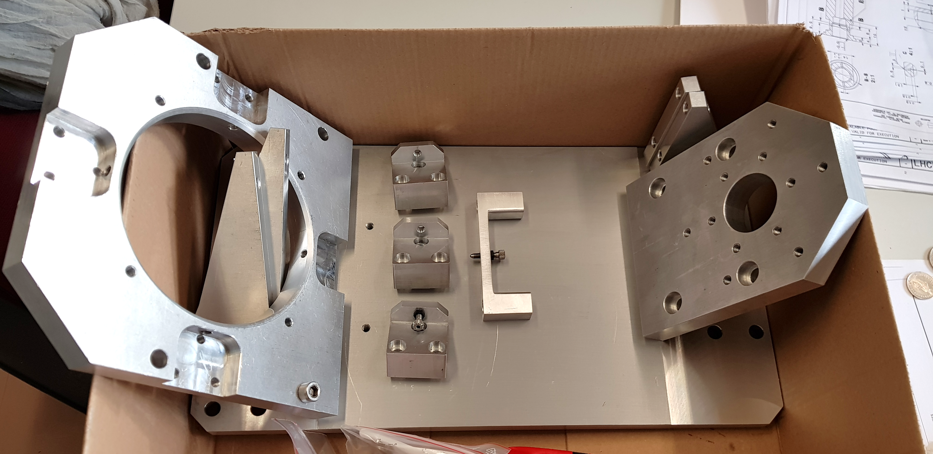
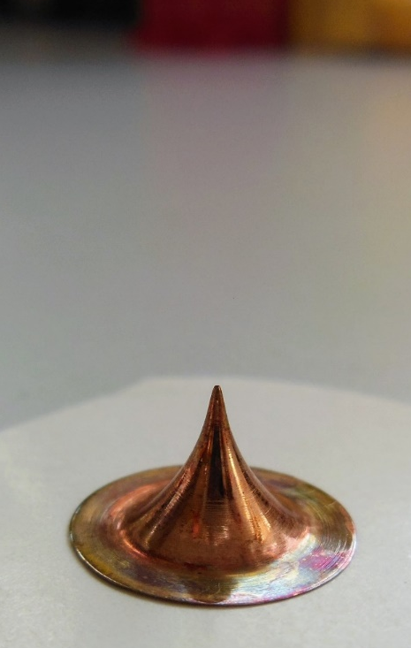
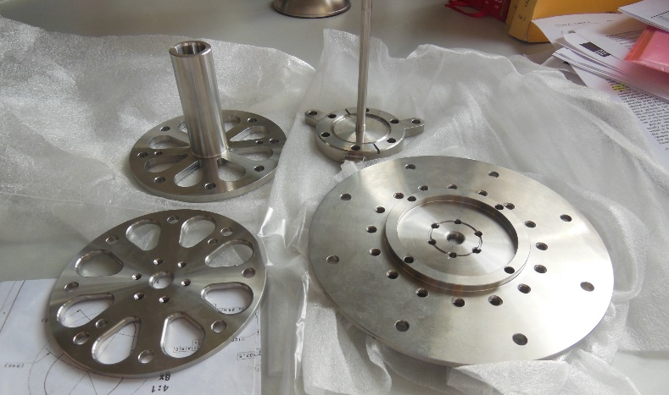
Alignment Progress
Stainless steel parts ✔
Skimmers ✔
Alignment Table ✔
Alignment laser & components ✔
Nozzle - ongoing
Next steps:
Assemble everything
Verify skimmer hole size with metrology
Align skimmers as best as possible
with current setup

Slide 9
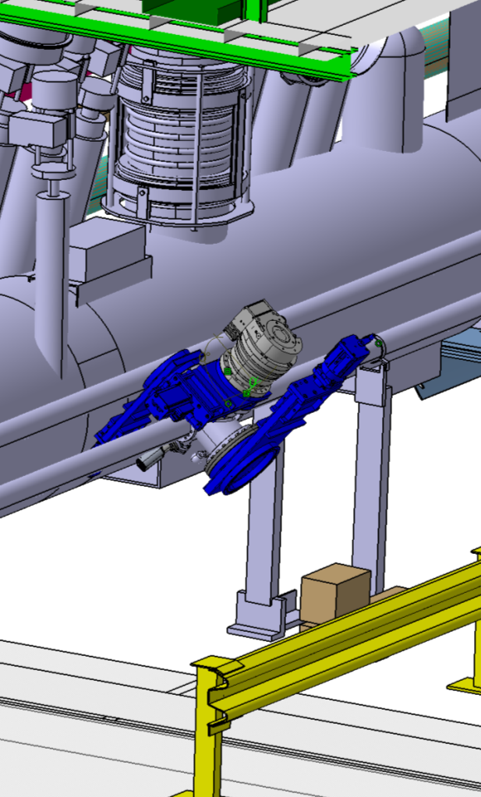
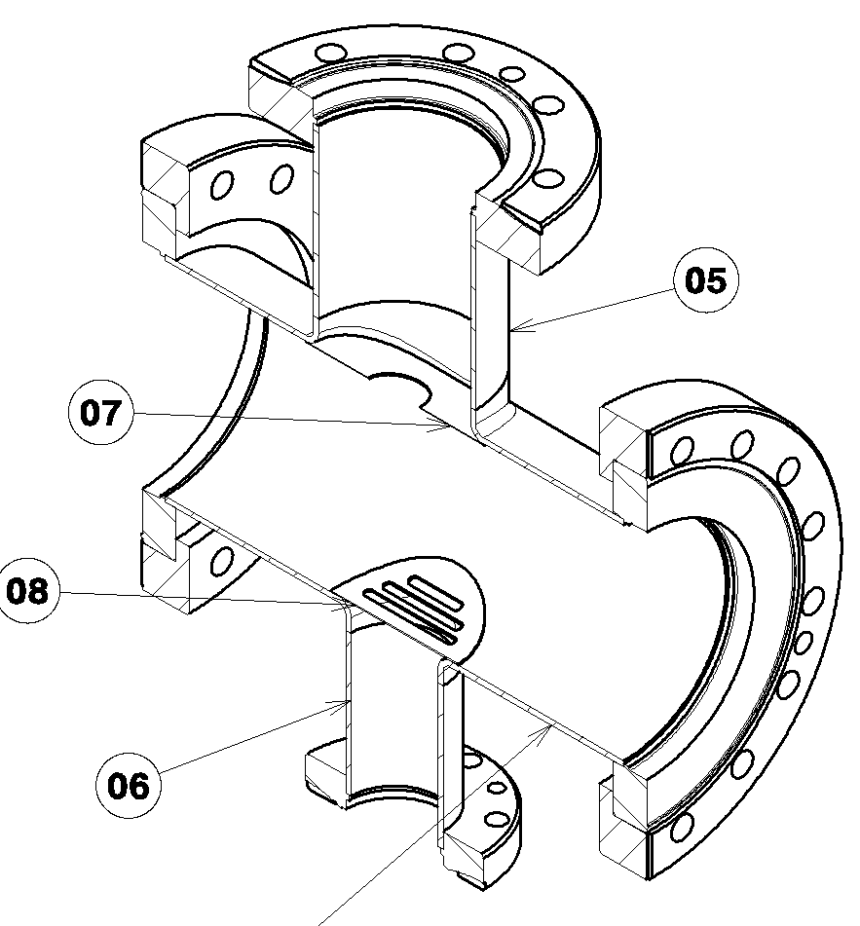
New LHC BGC Integration Chamber
ECR for new Integration chamber due in March 2018 for HiLumi technical review and LS2 integration
Some collaboration with EN-MME integration and design office.
Discussion with BE-APB for impedance analysis
Shielding with holes / slits to reduce effect of larger DN200 flanges

Slide 10

home.cern
Merry Christmas!

