Slide 2
LHC BIF test setup - update
S. Mazzoni, 20/12/2017

Slide 3
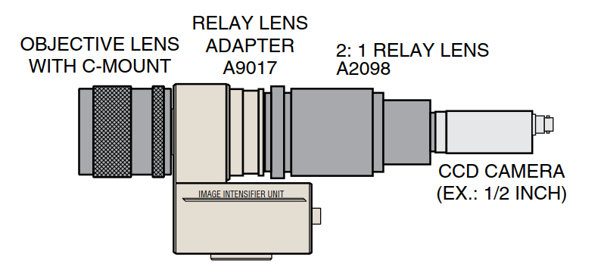
Optical instrument - old
3” dia, f= 200 mm from Edmund optics
Two-lens imaging. Maximise acceptance while keeping camera “far” from beam
3” achromat, 400 mm from source. Intermediate image at 1:1.
Optical acceptance 2.7 x 10⁻² Sr under the assumption that the lens is the entrance pupil.
Intensified CCD assembly from Hamamatsu (more info next slide)
For simulation purposes: end magnification 2:1
Intermediate image
Intensified CCD

Slide 4
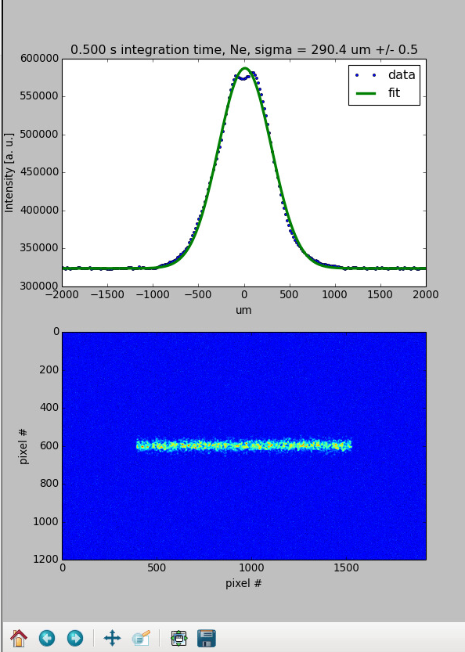
Optical instrument - new
Single lens setup. BK7 Bi-convex lens, 2” diameter
Mounted on 2” lens tube screwed onto the image intensifier
f = 100 mm, Distance 250 mm final magnification M = 0.33

Slide 5
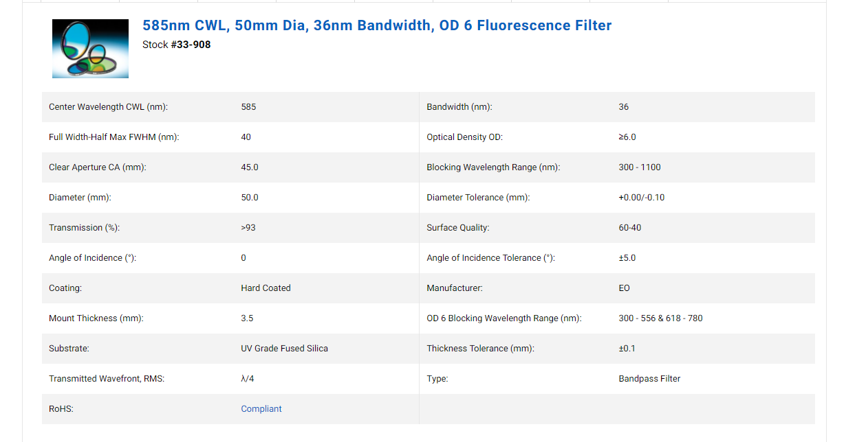
Bandpass filter

Slide 6

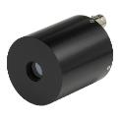


BIF setup – photon counting
1
2
HV from US45, existing
Signal out
3
Discriminator & counter
4
USB
To UA43, MM fibre, existing
To US45, Burndy 48 existing
Use BSRT motor control
Owis filter wheel available
Hamamatsu MCP PMT R5916U available
CAEN digitizer DT5720 to be ordered
Icron USB to fibre to be ordered

Slide 7
To be discussed
Intensifier will not at CERN by EYETs end > start with photon counting OK?
MCP-PMT requires water cooling (1-3 L/m, pressure below 0.3 MPa): available in LHC? URGENT
Optical enclosure: mechanical design (ideally with CATIA) with support from ML section? OK

Slide 8
LHC planning
https://lhc-commissioning.web.cern.ch/lhc-commissioning/schedule/2018-LHC-schedule_v0.3.pdf

