Slide 1
FCC addendum
Kick-off meeting:
FCC quad
C. Lorin
07 dec 2017 at CEA
Acknowledgements to H. Felice, D. Schoerling for inputs for this presentation

Slide 2
Genesis
Since 1st FCC week, Washington, 2015.
  Taking over M. Karppinen’s study
  Only electromagnetics
2nd FCC week, Rome, 2016.
  In line with ECC specifications (Jc, conductor, Hotspot, Stress,Load-line margin, material properties, etc)
  Work in collaboration with E. Todesco
  Mechanical and protection studies
3rd FCC week, Berlin, 2017.
  Design based on the ECC cosine-theta dipole cable
  Work in collaboration with Daniel Schoerling

Slide 3
Status of the work: cable parameters
Main idea: LHC approach
  → Use the MB outer cable as the MQ cable
Cable parameters of the cosine-theta* magnets (Early 2017)
 |  | HF cable | LF cable
Strand | (mm) | 1.1 | 0.7
Nb of strands | (-) | 22 | 36
Bare cable width | (mm) | 13.2 | 13.3
bare mid-thickness | (mm) | 1.95 | 1.26
keystone angle | (°) | 0.5 | 0.5
Copper/nonCopper | (-) | 0.8 | 2.1
*: V. Marinozzi & M. Sorbi (and all INFN ECC team)

Slide 4
Analytical starting point*
Baseline parameters of the analytical approach:
14 % margin on the load line (LL)
Cu/nonCu (cnc) between 1 and 2
Additional constraint on the designs presented in the following slides:
Hot spot temperature < 350 K
*Todesco et al, Semi-analytical approaches to magnet design, Wamsdo 2013
Rossi L., Todesco E. Electromagnetic design of superconducting quadrupoles, PRSTAB, 2006
eq. coil width
30°
25 mm

Slide 5
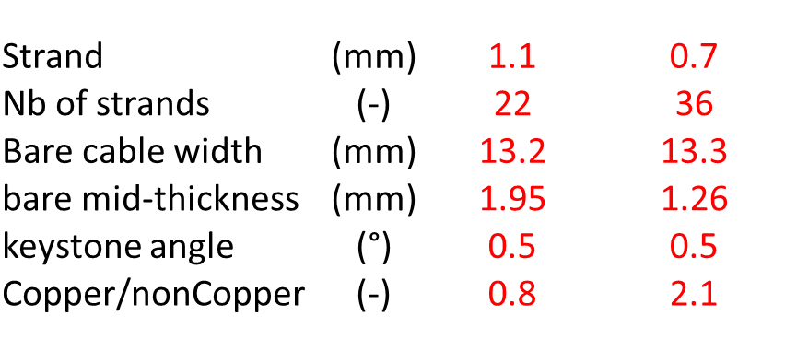
Designs using the dipole low field strand and cable
Case 1 Dipole Low Field strand & cable:
400 T/m
473 tons (integrated grd)
14% LL margin
300 K T_{hotspot}
Exploration from case 1:
Case 1a:
Reduction in conductor quantity: 420 tons
Same gradient: 399 T/m
Case 1b:
Increase in gradient: 412 T/m
Similar 2D cross-section
460 tons to achieve the same integrated gradient : 2275 T
1b
1a

Slide 6
Exploration of different cable size with low field strand
Case 2 Dipole Low Field strand :
32 and 40 strands
Cu/nonCu: from 1.7 to 2.3
T_{hotspot} ~ 350 K

Slide 7
Designs using the dipole high field strand and cable
Case 3 Dipole high Field strand & cable:
367 T/m
530 tons
25% LL margin
350 K T_{hotspot}
Exploration from case 3:
Case 3a:
Reduction in conductor quantity: 472 tons
Same gradient
Case 3b:
Increase in gradient: 412 T/m
Similar 2D conductor quantity
472 tons to achieve the same integrated gradient 2275 T
3b
3a

Slide 8
Conclusion of the parametric study
The cross-section using the dipole low field cable appears close to the optimum
Relevant cross-section as of MT25 (v4):
C. Lorin et al, Design of a Nb₃Sn 400 T/m quadrupole for the future circular collider, “under review”

Slide 9
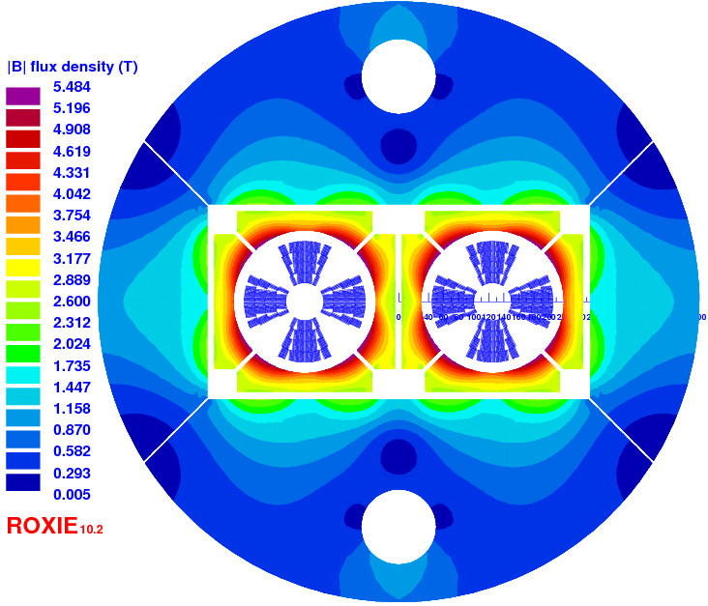
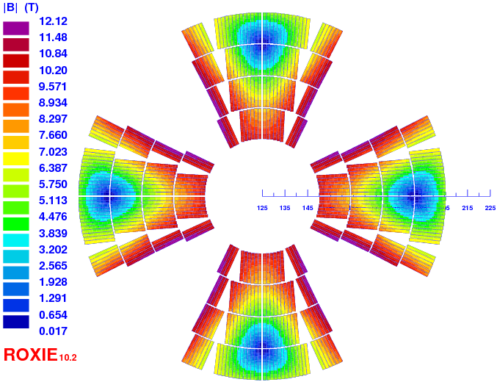
Magnetic 2-in-1 Design (V4)
Quantity | v4 | Unit
gradient | 400 | T/m
I_{nom} | 12285 | A
B_{peak} | 12.12 | T
LL margin (1.9 K) | 14.0 | %
Inductance diff. (2 ap) | 17.9 | mH/m
Stored energy (2 ap) | 1397 | kJ/m
Nb of turns | 56 = 9+12+16+19 | -
F_/_ & F // (per ½-coil) | 3.526* & 1.579 | MN/m
Hotspot | 307 | K
Midplane shim | 0.3 | mm
I/Ic max | 0.61 | -
length | 5.7 | m
Conductor area (2 ap) | 124.2 | cm²
Yoke outer diameter | 800
750 x length x 8.7 weight | 475 (dip ~7500 ) | tons
*0.55+0.8+1.1+1.1 MN/m per layer

Slide 10
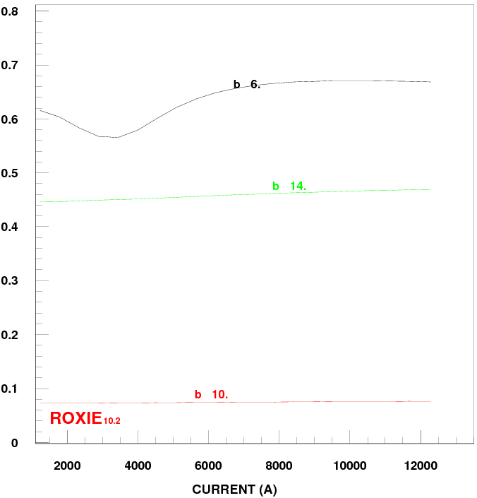
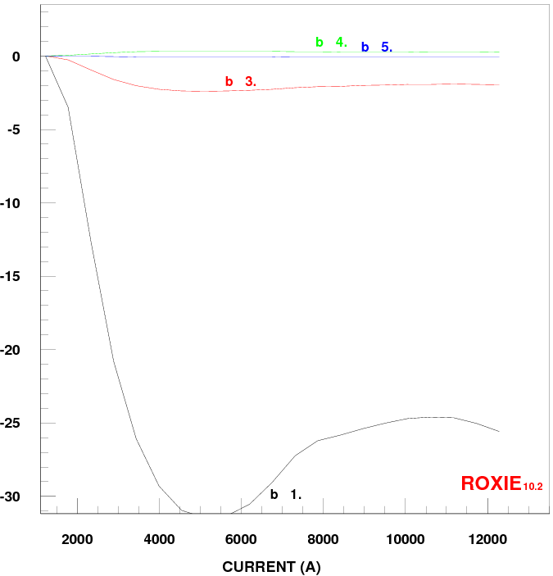
Field quality (V4)
beam injection
LHC 3.3 TeV
nominal
beam injection
LHC 3.3 Tev
nominal

Slide 11
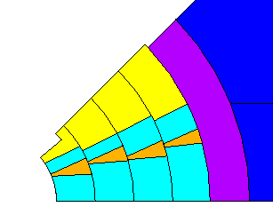
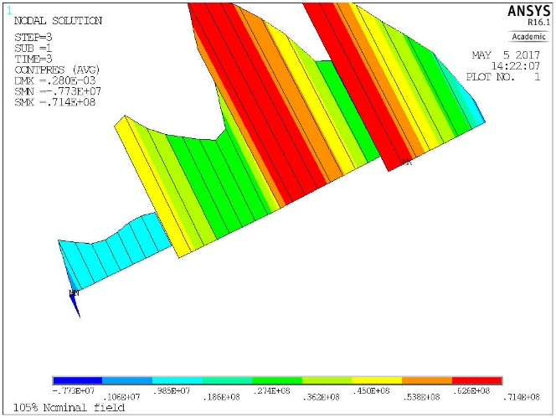
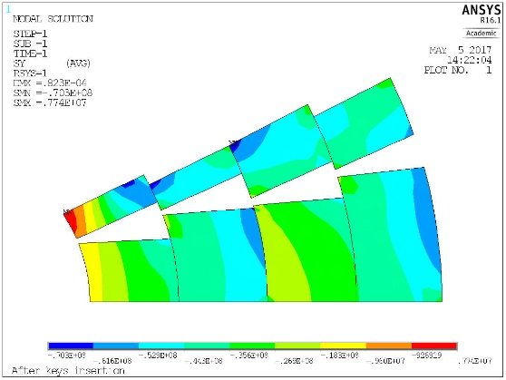
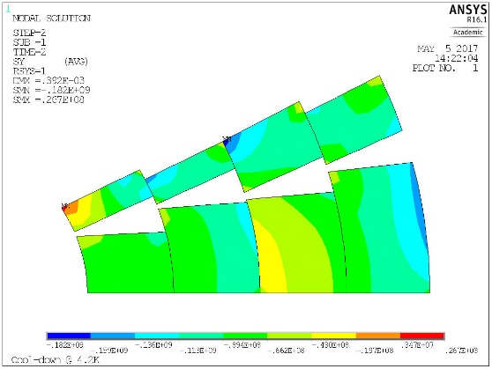
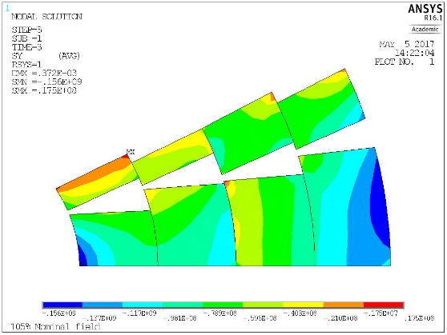
Azimuthal stress in Nb₃Sn coils (v4 single ap.)
Target = contact at Nominal + 5%
+72 MPa
-8 MPa
After key insertion
4.2/1.8 K
105% nominal - 420 T/m
-78 MPa
-182 MPa
-156 MPa
σ_{theta}: Nb₃Sn coil

Slide 12
FCC addendum
Signature: October 2017
Quadrupole task contents:
  Preliminary CDR of the FCC-hh 2-in-1 quadrupole magnet: June 2018
    2D electromagnetic design
    Preminimary 2D mechanical design
    Preliminary 2D protection design
  Final CDR of the of the FCC-hh 2-in-1 quadrupole magnet: December 2020
    Full 3D electromechanical design
    No CAD
It was decided during the kick-off meeting to remove the 3D mechanical analysis from the FCC addendum. See slide 16.

Slide 13
FCC quad consideration
What about the nominal gradient?
  Integrated gradient only matters for optics: 2275 T (optics baseline 380 T/m x 6 m)
  Nominal gradient↘ Length↗: balanced between dipole and quadrupole lengths
  A FCC FODO cell is made of 12 dipoles and 2 quadrupoles (LHC: 6 for 2)
  Dipole optics 15.78 T w.r.t 16 T -> 1.5% margin on length (~20 cm/dipole)
    20 cm length reduction per dipole x 6 dipoles = 1.2 m increase of the quad length
    2275 T / (6 m + 1.2 m) = 315 T/m
    0.1 T dipole central field ~ 30 T/m quadrupole central gradient
-> Is it worth challenging the quadrupole?
Philosophy: Quadrupole in the shadow of the dipoles (manufacture + operation):
  Assembly complexity: 4 layers -> 2 layers
  Loadline margin: 14% -> 20%

Slide 14
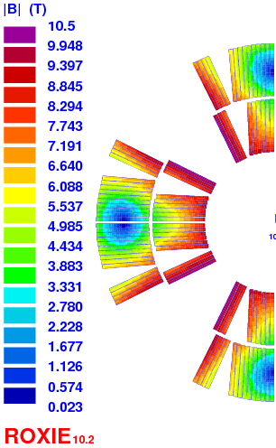
Quadrupole specification
in the frame of the FCC addendum
  2 layers, double aperture, non-graded design
  20 % loadline margin
  Otherwise in-line with ECC spec.
    204 mm interbeam distance
    750 mm inner diameter of the SS shell
      + Intention to put the Al shell dimension in-line with the dipole: ID 600 mm, OD 750 mm
    Nominal current < 20 kA (not mandatory)
  Questions to date:
    Current limitation: I > 20 kA ?
    Cable windability (wide cable with tight bending radius)

Slide 15
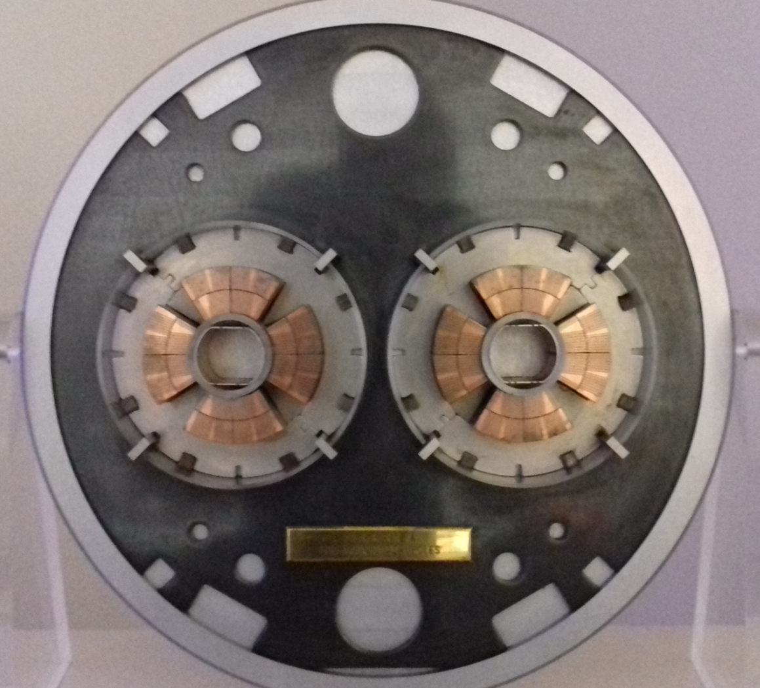
2D work plan
  Emag:
  ECC cosine-theta strand
    + exploration of the strand parameters space (mainly cnc)
  Cable dimension optimisation
    Initiate discussion with cabling expert (CERN, LBNL)
  Field quality (magnetization, sat, geom)
  Freeze a 2D electromagnetic design by end of February 2018 with preliminary protection consideration.
  Protection:
  Quench heater approach
  Investigation on CLIC implementation
  Mechanics:
  Exploration of collar structure (similar to MQ)
  Exploration of alternative structure: shell based, dipole pressing option (cf. MQXA))
  2D mechanical structure design by end of May 2018
  -> 1st draft for the CDR in June 2018

Slide 16
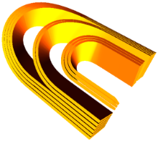
3D work plan
  Emag:
  Coupling Roxie/Opera for modelling (return end design)
    Coil end optimisation (Peak field, field quality)
  Full 3D modelling
    Layer jump, lead connection
  Protection:
  Finalisation of studies (heater configuration)
It was decided during the kick-off meeting to remove the 3D mechanical analysis from the FCC addendum. A 3D electromagnetic design with a 2D mechanical analysis in a 2-in-1 configuration is the new deliverable for Dec 2020.
  Mechanics:
  Ansys 3D modelling of the 2D selected structure
    Axial loading? Tie rod?
  Iteration with the emag design on the coil end design
  3D mechanical structure design by end of Dec 2020

Slide 17

Project team & Ressources
  Ressources required:
  Engineer:
  6 months over 2017
  8 months over 2018
  8 months over 2019
  9 months over 2020
  On board:
  Damien Simon
  Helene Felice
  Clement Lorin
  + one hiring in progress

Slide 18

A slide for fun…?
Going from 100 TeV down to 96.5 TeV (Tevatron operated at 0.98 TeV)
  Dipole from 14.3 m to 13.8 m -> 0.5 m saved for each dipole
  0.5 m x 6 dipoles = 3 additional meters for each quad
  2275 T / (6 m + 3 m) = 250 T/m
One could think going from Nb₃Sn to Nb-Ti for all the FCC quads with a 3.5 TeV energy reduction
  Nb-Ti
  Collar structure
  etc…

Slide 19
List of FCC quad options/parameters
Inputs for the FCC quad optimization are ticked in the open column with associated values/limits/comments.
Some design inputs have already been fixed based on past experience and philosophy approach for the FCC quad.
Optimization input | Open | Fixed | Values/limits/comments
Conductor material |  | x | Nb₃Sn
Layers |  | x | 2
No grading |  | x | no grading
Loadline margin |  | x | 20%
Protection time | x |  | 40 ms , 30 ms
Strand diameter | x |  | < 0.9 mm (R_{bending} ≈ 4-5 mm – test with MQXF (0.85 mm x 40), 11T, (0.7 mm x 40) Fresca2 (1.0 mm x 40) cables to feel the feasibility)
Cable size | x |  | up to 60 strands (US cabling machine)
Cable compaction | x |  | thin edge = 14-18 % ; thick edge = 3-7%
Current | x |  | no limit
integrated gradient |  | x | 2275 T
Copper/NonCopper | x |  | > 0.9
T_{hotspot} adiabatic |  | x | 350 K
peak voltage in magnet |  | x | 1.2 kV
J_{c} |  | x | FCC fit (2250 A/mm² @1.9 K 16 T ) -> 0% cabling deg.
T_{op} |  | x | 1.9 K
aperture diameter |  | x | 50 mm
interbeam (at cold) |  | x | 204 mm
OD st-st shell |  | x | 790 mm
After the kick-off meeting a list of parameters to be explored was defined

Slide 20
EXTRA SLIDES

Slide 21
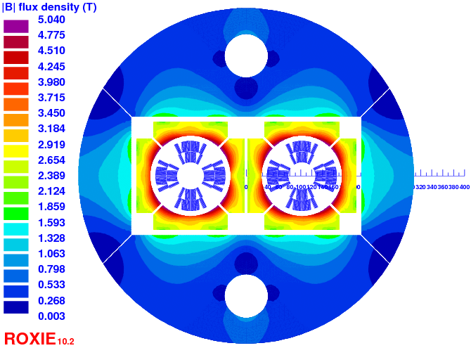
Extra
Quantity | 3rdFCC_v15 | Unit
gradient | 360 | T/m
strand diameter | 0.7 | mm
nb of strands | 51 | N/A
width | 18.63 | mm
average thickness | 1.181 – 1.343 | mm
Cu/nonCu | 2.1 | N/A
I_{nom} | 19480 | A
B_{peak} | 10.5 | T
LL margin (1.9 K) | 19.5 | %
Inductance diff. (2 ap) | 3.1 | mH/m
Stored energy (2 ap) | 617 | kJ/m
Nb of turns | 23 = 6 + 3 + 10 + 4 | -
F_/_ & F // (per ½-coil) | 1.99* & 0.99 | MN/m
Hotspot | 320 | K
Midplane shim | 0.35 | mm
I/Ic max | 0.54 | -
length | 6.3 | m
Conductor area (2 ap) | 72.3 | cm²
750 x length x 8.7 weight | 306 (dip ~7000 ) | tons
*0.8 + 1.2 MN/m per layer [614 mm yoke OD]
Spec:
same strand as ECC
2 layers
20% margin
current < 20 kA
204 mm b-b distance
< 800 mm outer yoke

