Slide 1
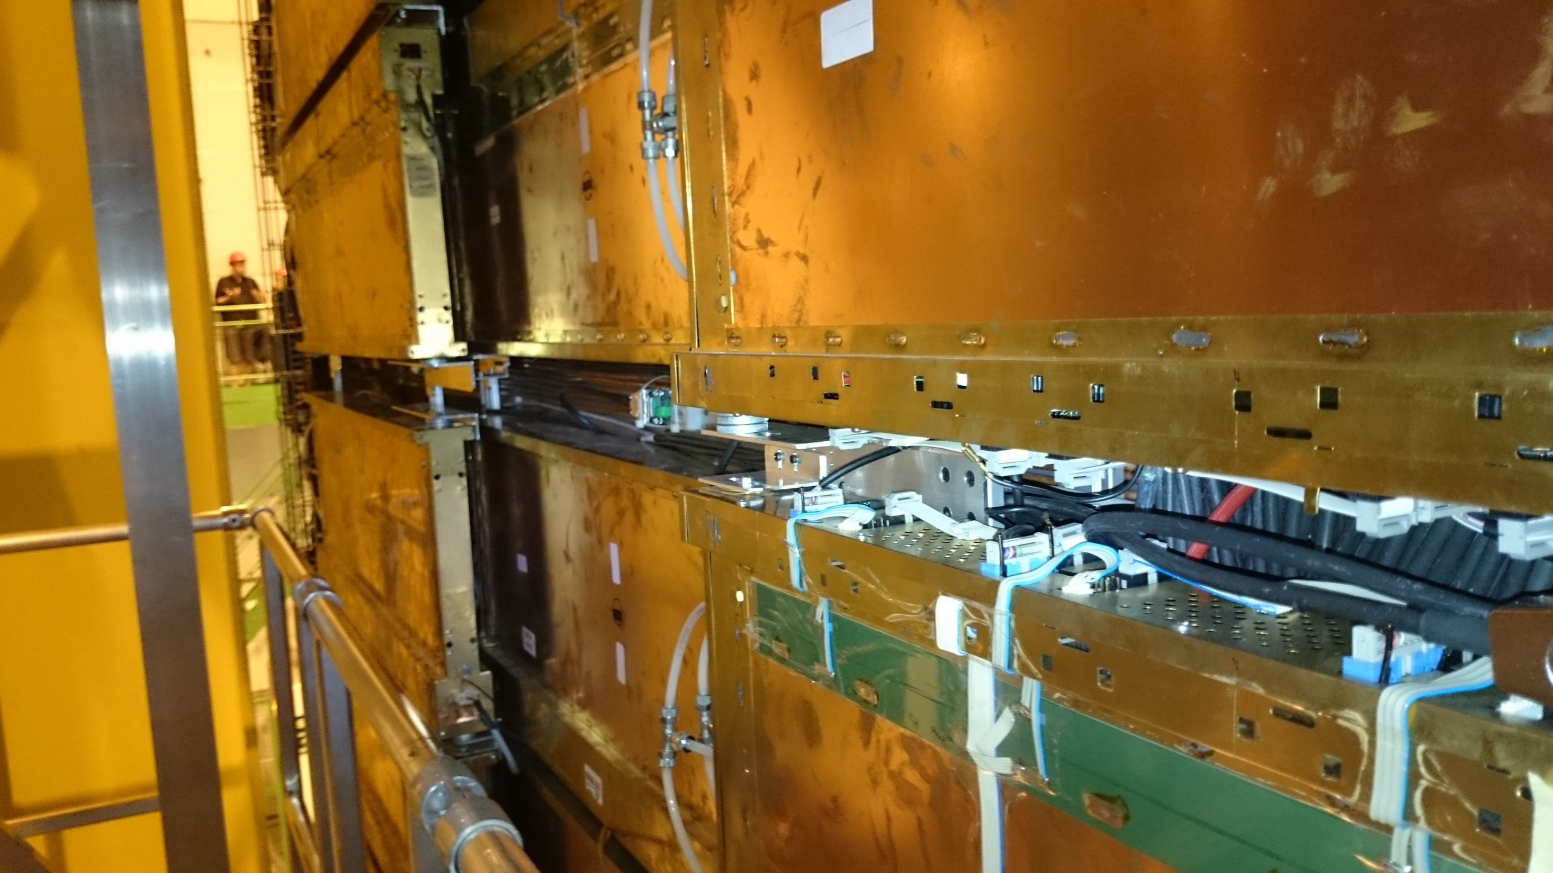
Radiation and Waste Management in LS2
Gloria Corti
Matthias Karacson
16.5.2018

Slide 2

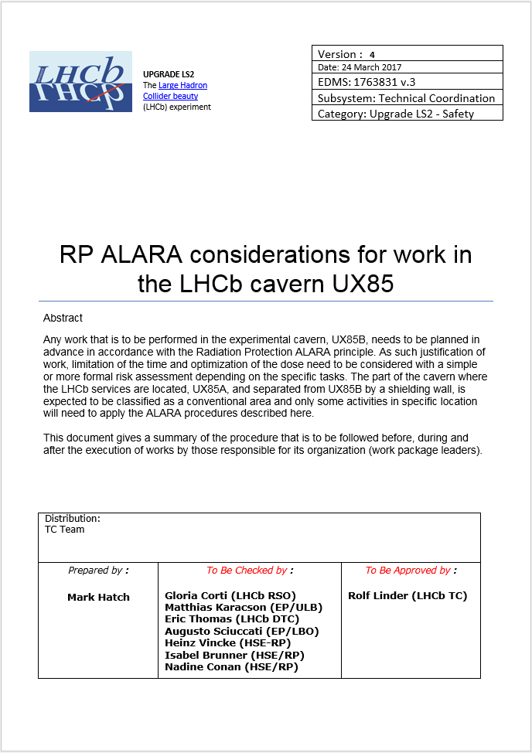
Radiation Protection rules at CERN
Justification
Radiation
Protection
Limitation
Optimization
(Legal Limits)
(ALARA)
Any work that is to be performed in the experimental cavern UX85B needs to be planned in advance in accordance with the Radiation Protection ALARA principle.
Document providing a summary of the procedure that is to be followed before, during and after the execution of works by those responsible for its organization.
RP ALARA considerations for work in the LHCb cavern UX85 (EDMS 1763831)

Slide 3
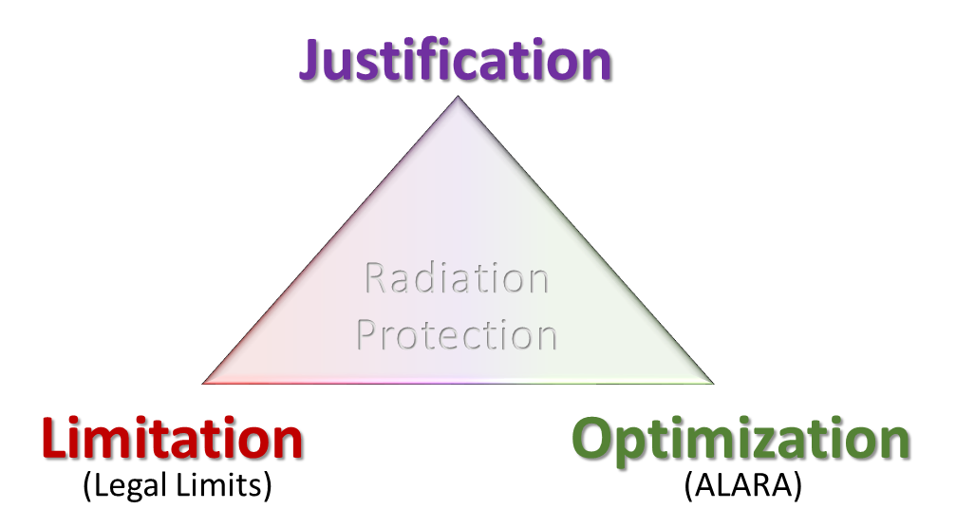

IMPACT and Work Dose Planning (WDP)
software tool for planning work prior to its execution
Approval is mandatory before execution!
Depending on the ALARA level, approval time and pathway may vary.
connects to
DIMR (Dossier Intervention Milieu Radioactive)
Mandatory for all WP in LS2!
WDP (Work and Dose Planning)
Varying level of detail required for var. activities!

Slide 4
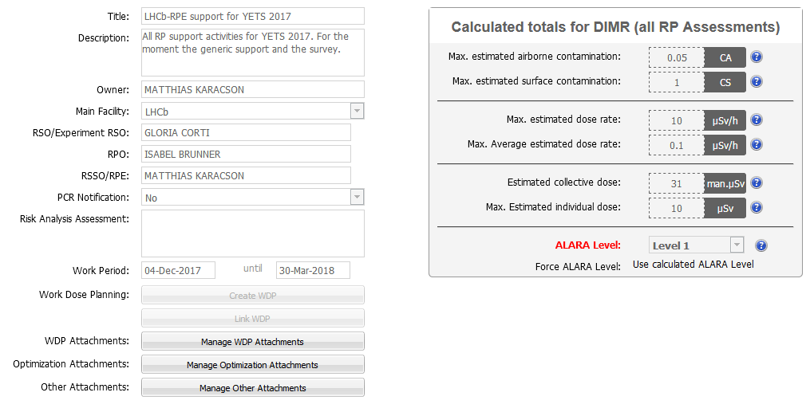
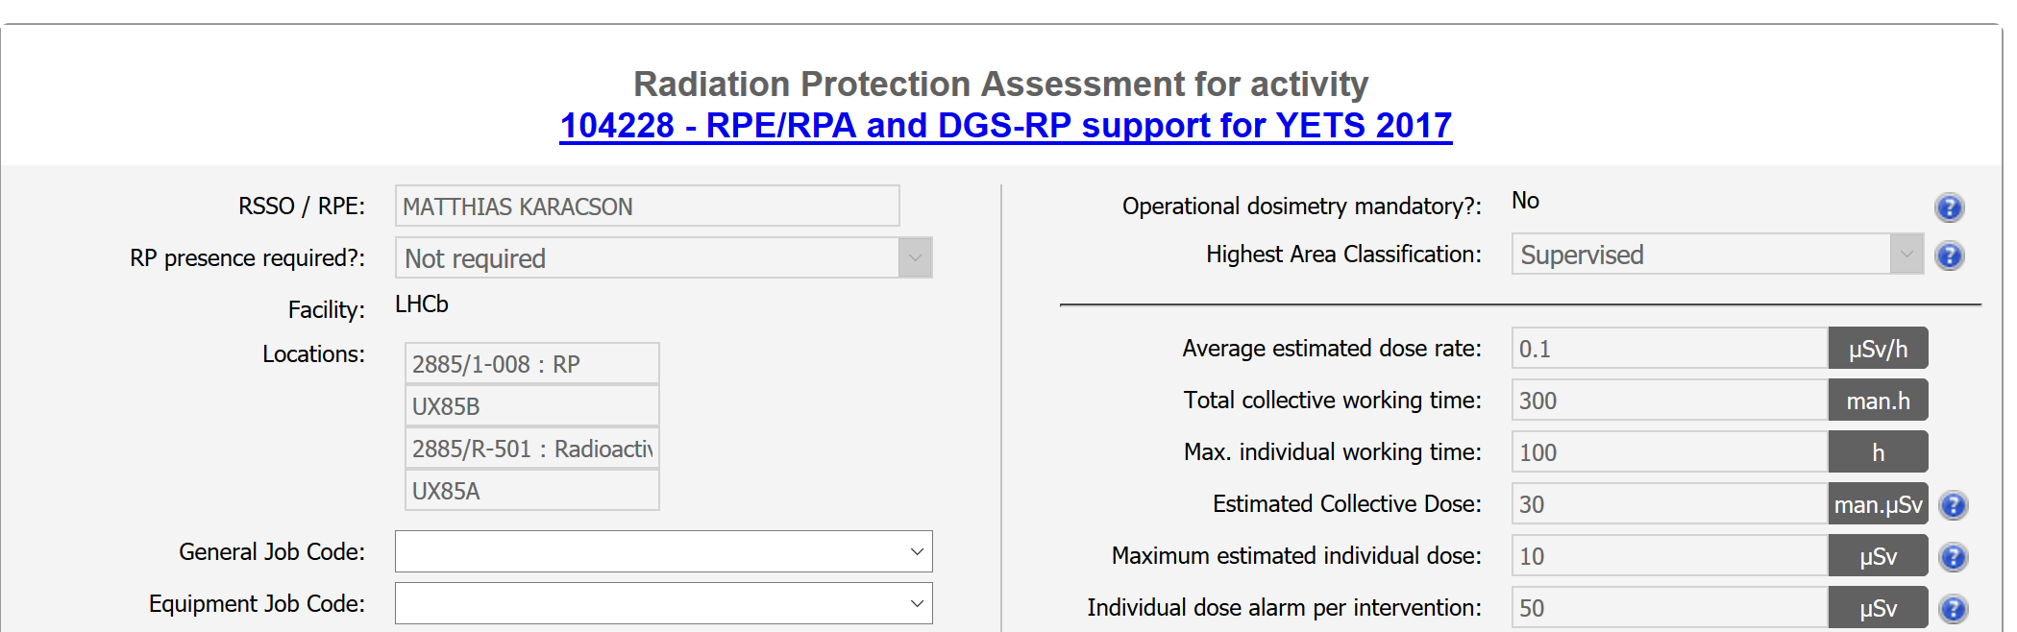
IMPACT and Work Dose Planning (WDP)
DIMR (Dossier Intervention Milieu Radioactive)
Should be initiated by the work package leader
Can contain multiple (connected) IMPACTS
Work dose planning (WDP) can be created from here
WDP should largely follow the steps described in the IMPACTs and WPPs, in a simplified way
WDP can cover multiple IMPACTs, but should only cover one coherent group of activities
Example
Beampipe removal will cover multiple IMPACTs, but can be covered by a single WDP with multiple (sub)steps.
Beampipe installation will be covered in a different WDP.
List of connected IMPACTs
…

Slide 5
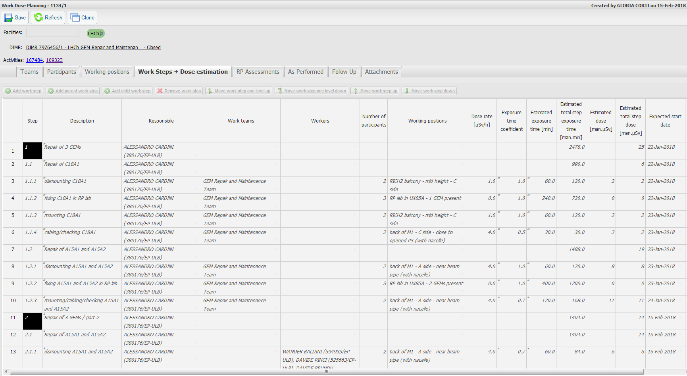
Work and Dose Planning (WDP)
Teams, work steps, work locations, estimated work time and start date to be filled out by subdetector groups based on WPP and IMPACTs
Dose rates will be filled by RPEs after locations are defined.
LHCb RP will provide advice and support for filling WDPs.

Slide 6

IMPACT and Work Dose Planning (WDP)
WDP tool calculates dose estimates and evolution for the whole procedure with follow-up of measured dose.
Values are automatically transferred to the DIMR, indicating initial ALARA Level.
Intervention at ALARA Lv3 is not expected, but we reserved an ALARA committee (3 months before work).
LHCb RP will help in preparing a skeleton for WDPs and provide examples.
Need your info based on WPP and IMPACT:
Workers/Teams
Locations for each step
Duration of steps per location
As in the past, we will ask to wear operational dosimeters for higher risk activities!

Slide 7
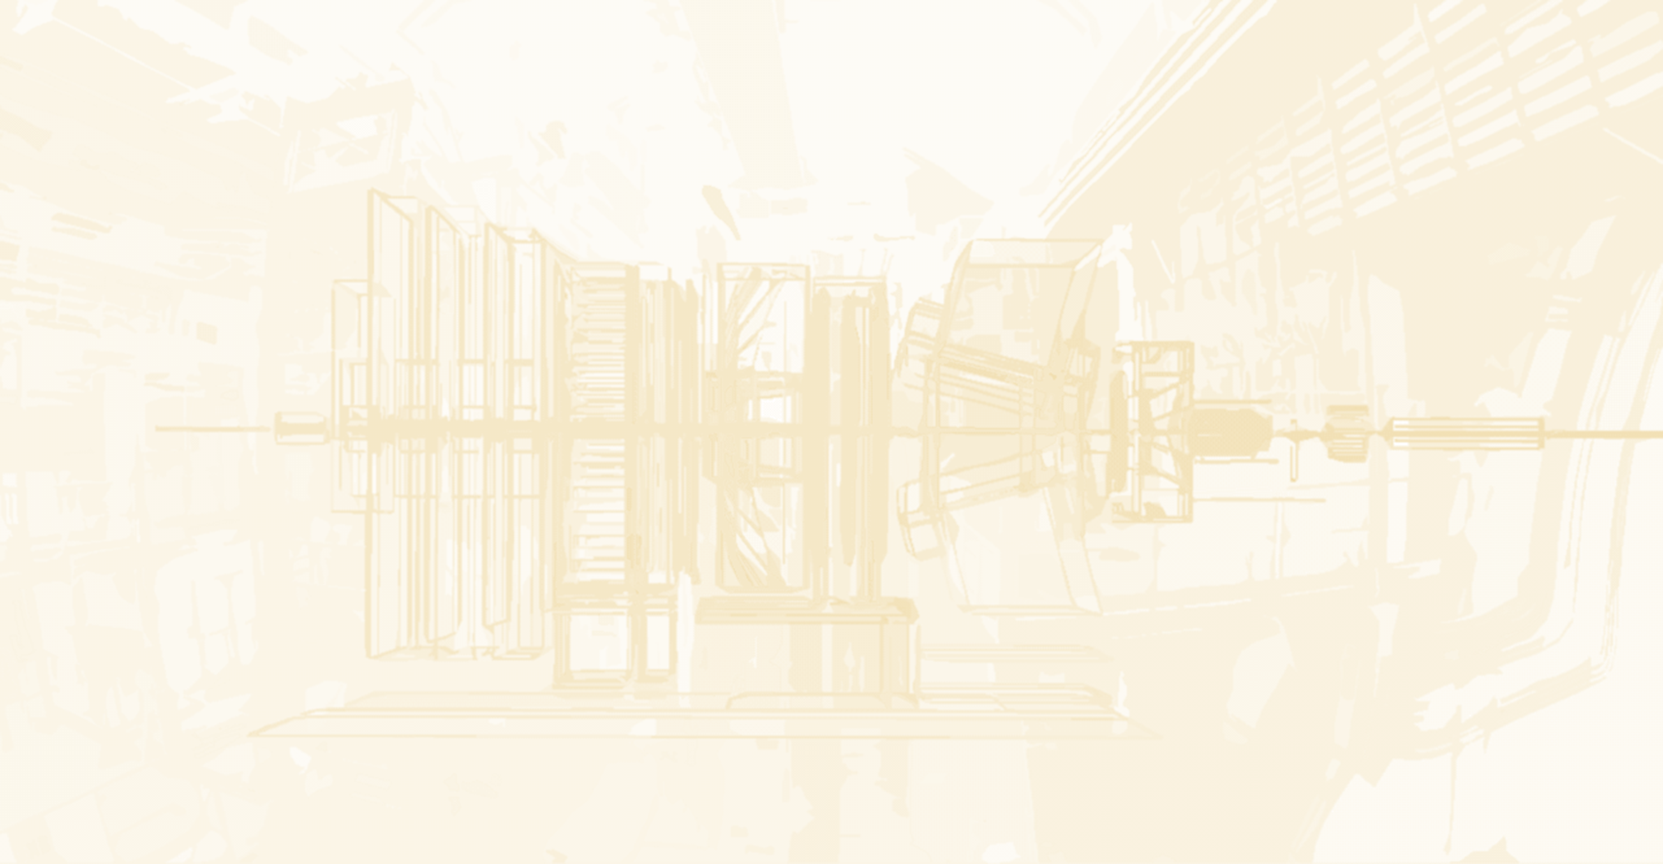
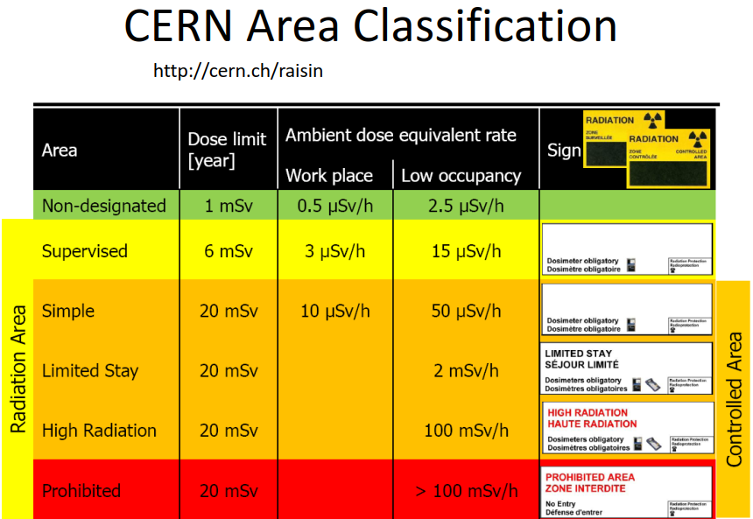
Area classification in LS2
In LS2, HSE-RP area classification will be done according to permanent area workplace rules.
Some areas including VELO alcove as well as the area around the beam line between open calorimeters will be declared simple controlled areas.
Requires delimitation (“fencing”) of the area
and a valid training for access!
Supervised Area < 3 uSv/h
Most of the cavern still compatible.
Everyone must have valid supervised radiation area training (SIR)!
Simple controlled area training: 1 day training in classroom!
( + online refresher for those who already attended more than 3 years ago)
Please prepare well in advance – High demand expected in LS2!

Slide 8
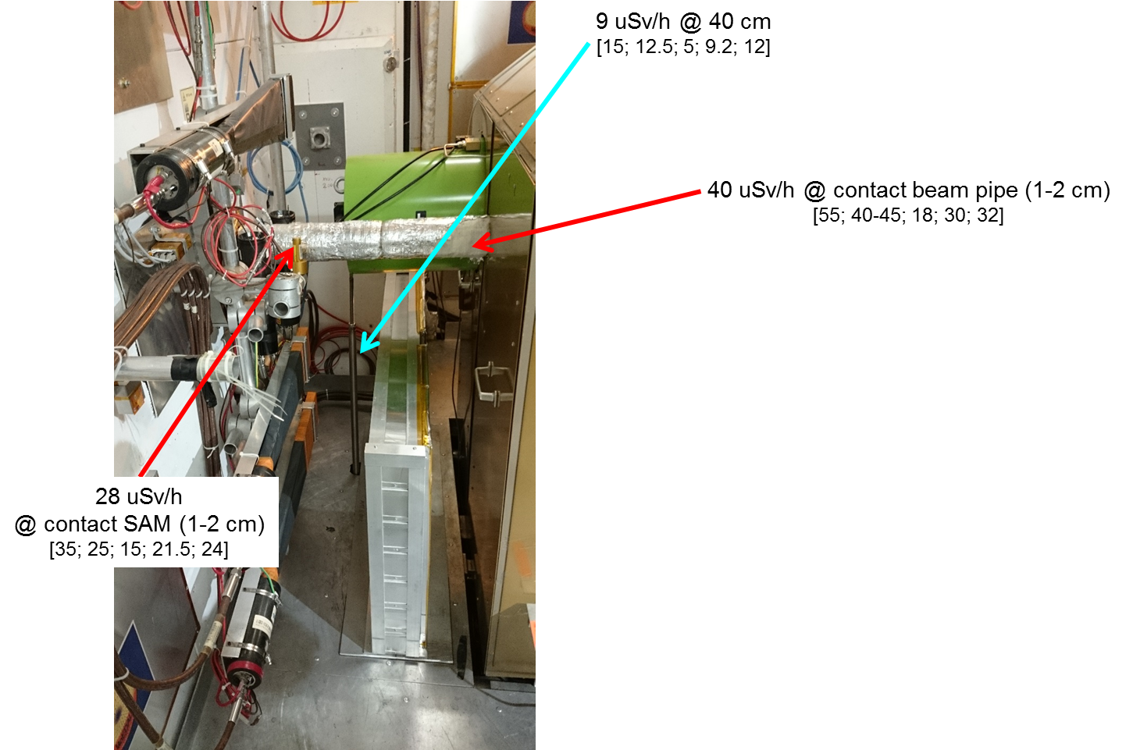
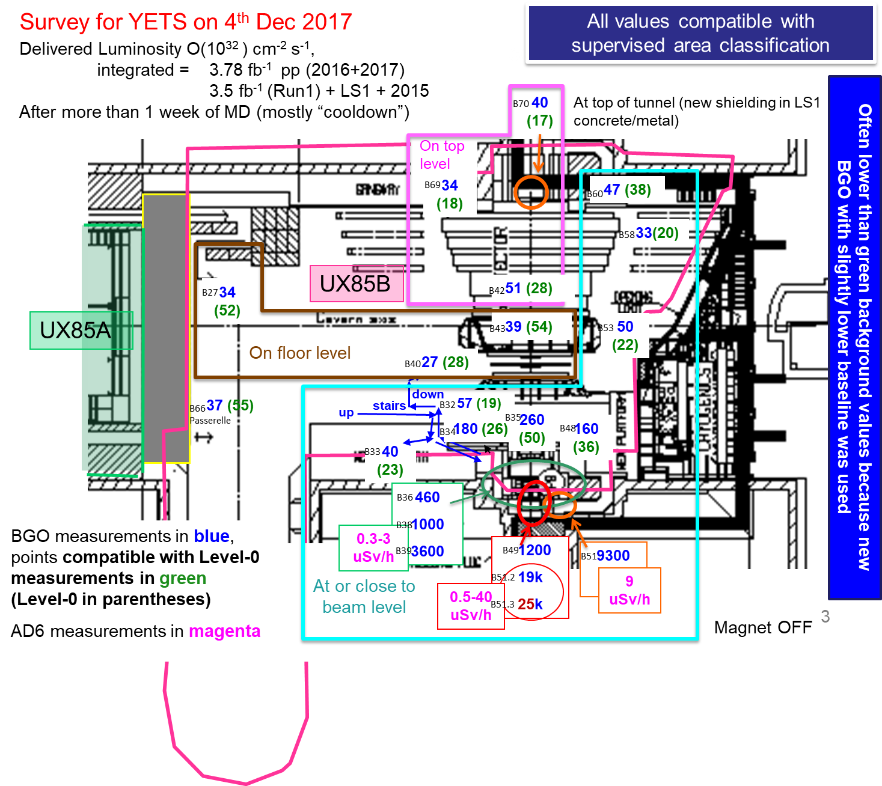
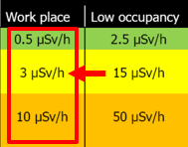
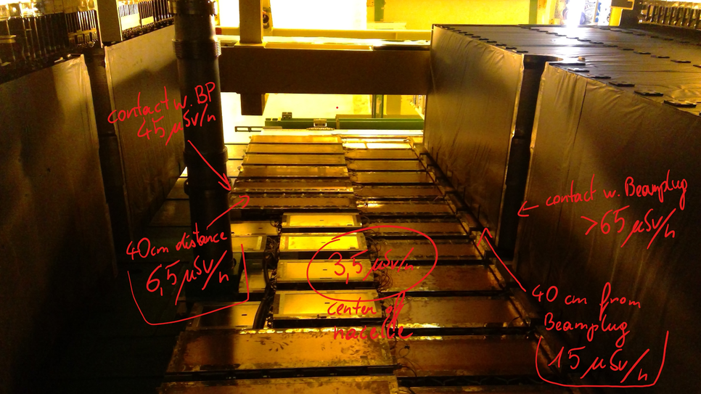
Area classification in LS2
2019 ->
The usual RP surveys will be performed before work is being conducted at the start of LS2 or when the detector configuration changes!

Slide 9
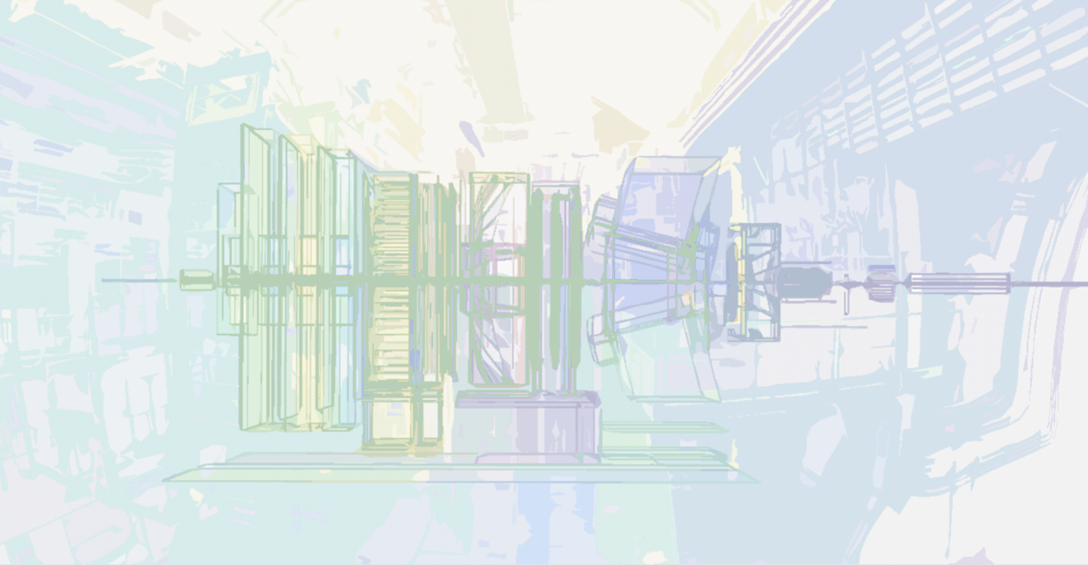
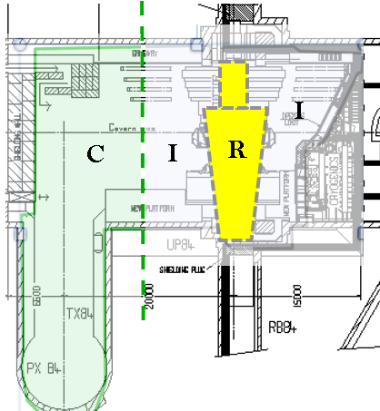
Material classification in LS2
For classification of material UX85B will be partitioned into 3 general zones:
R (Radioactive)
I (Intermediate)
checks require detailed measurements
C (Conventional)
routine checks only
(color coding of I and C may change)
Start and End of Zones will be indicated by different colors (paint/tape) on floor and equipment at the beginning of LS2

Slide 10
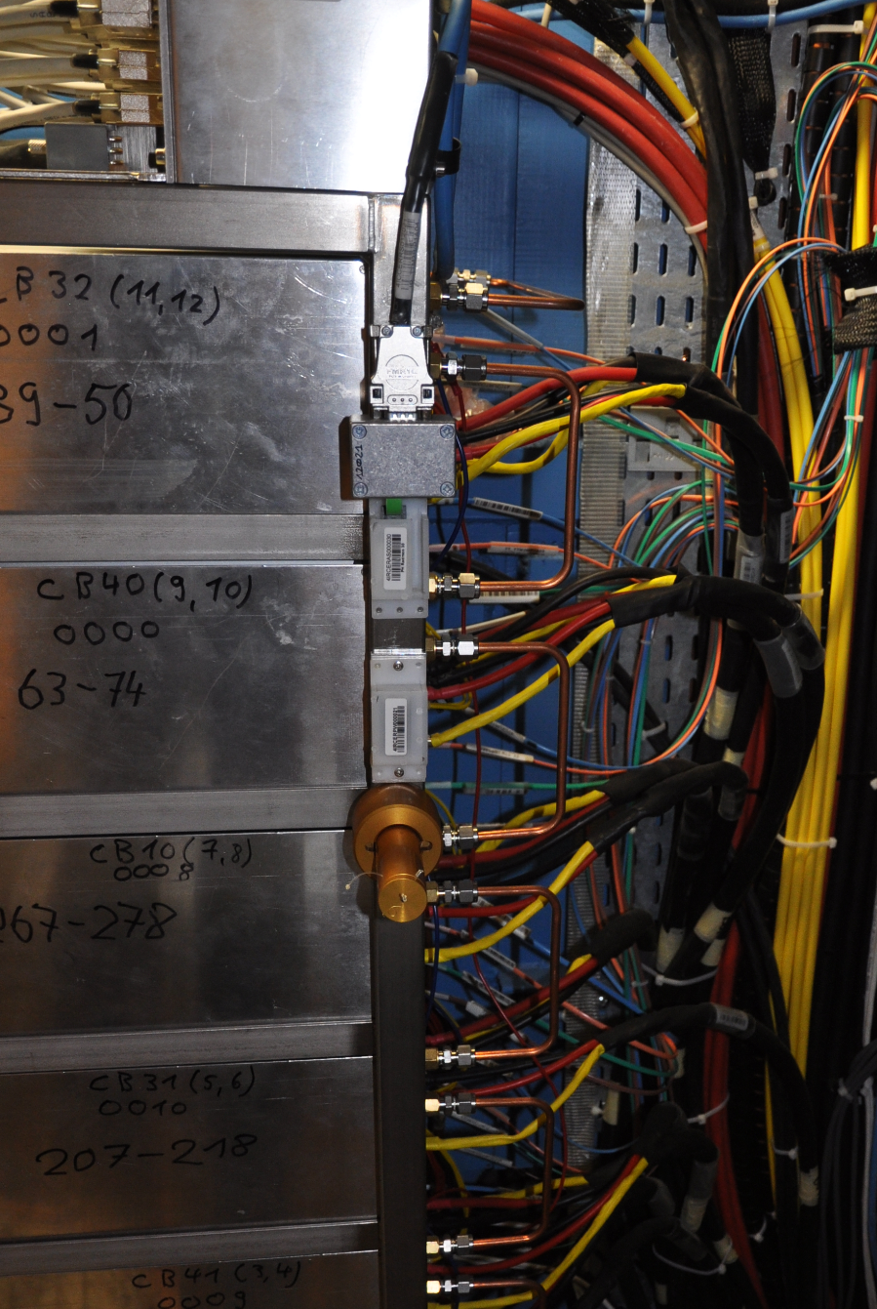
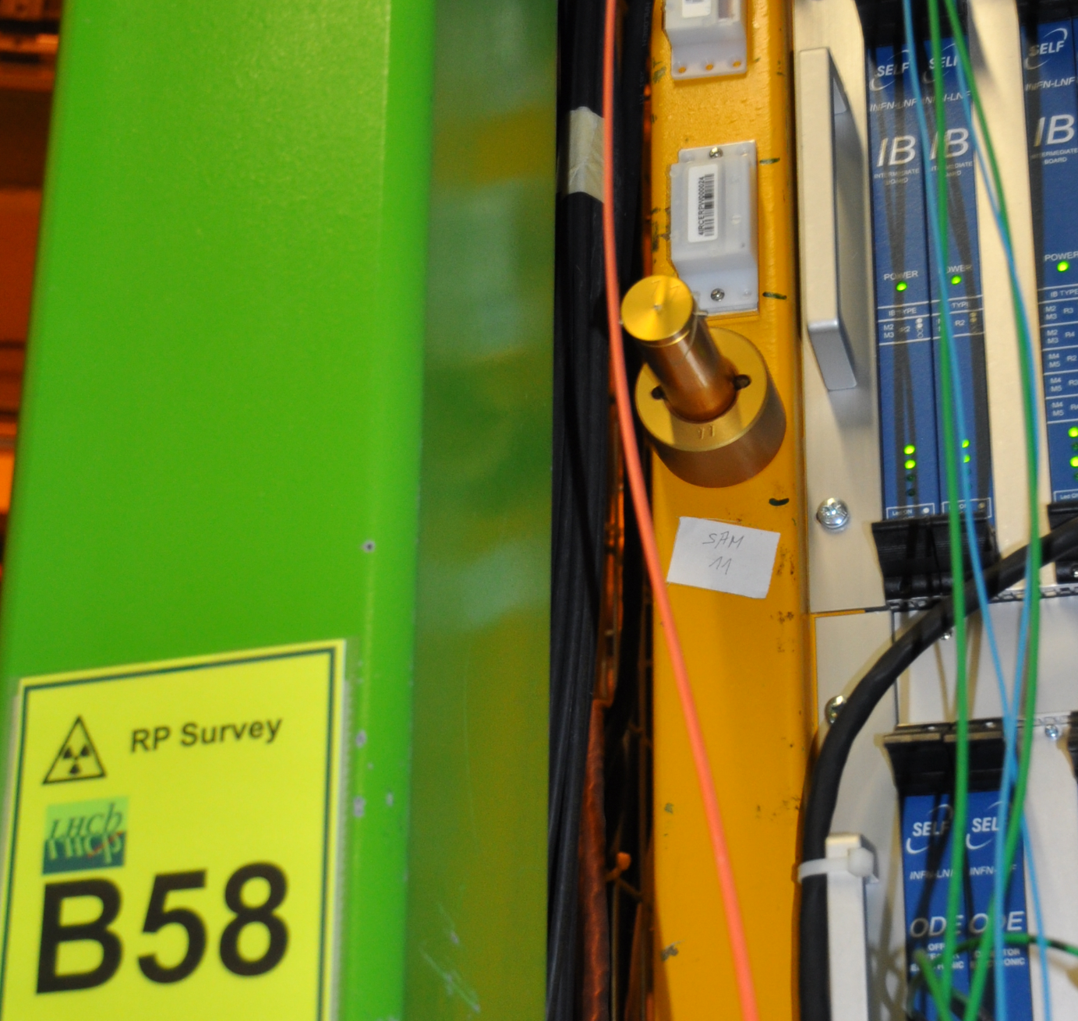
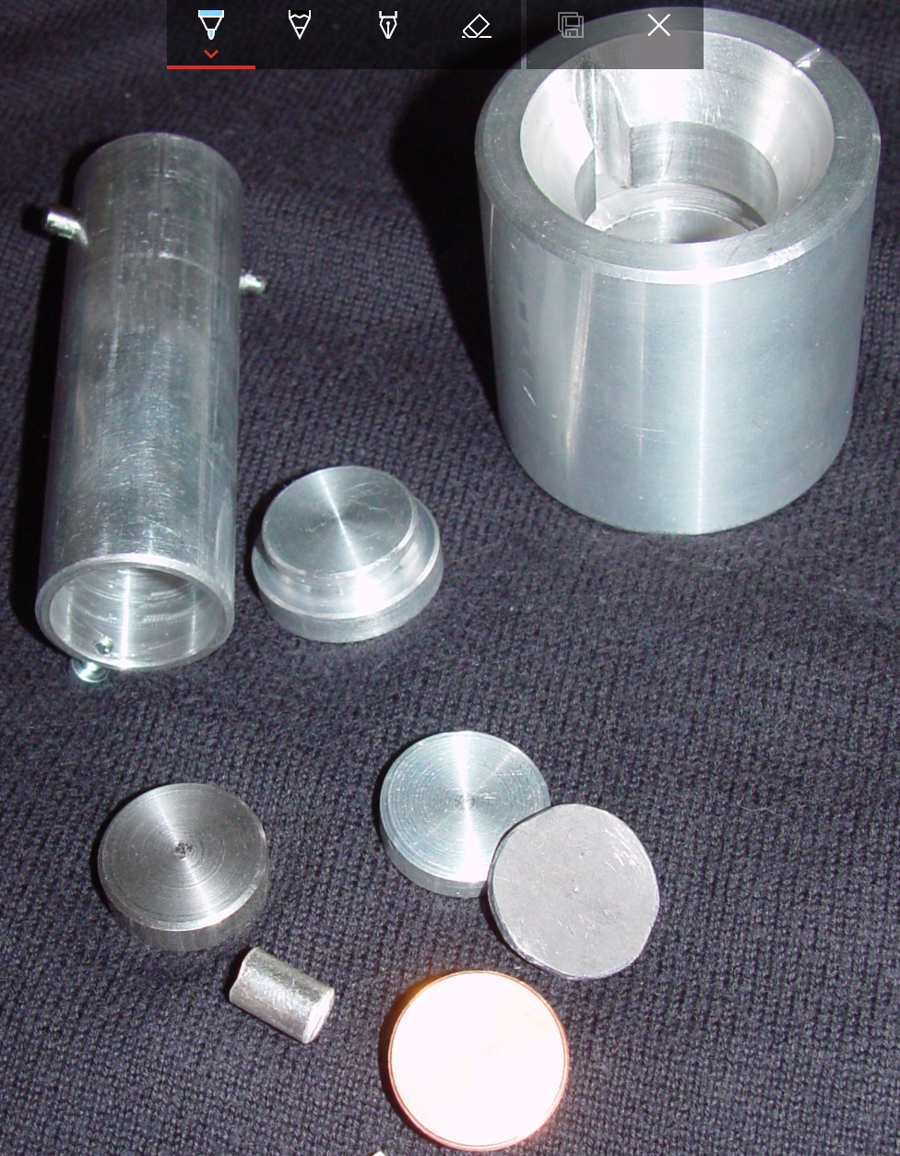

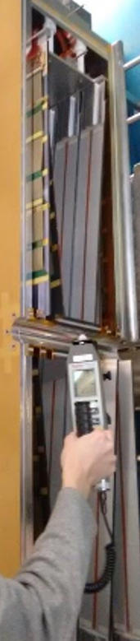
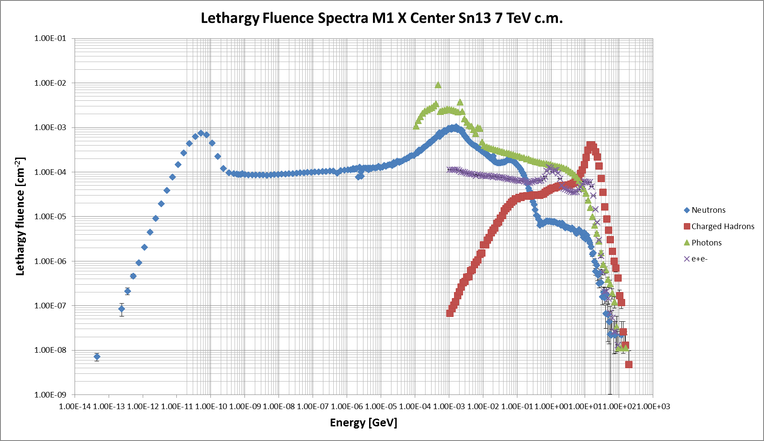
Material classification in LS2
Zoning will be based on
Sample Activation Monitor (SAM) Measurements
in combination with FLUKA / ACTIWIZ Simulations
(which are being post-processed at the moment)
confirmed with measurements at the start of LS2
New and much stricter Legal Limits (LE -> LL) have been introduced in 2018
Zones will be different from current classification of operational/conventional zone
Results of these studies will be given in October

Slide 11
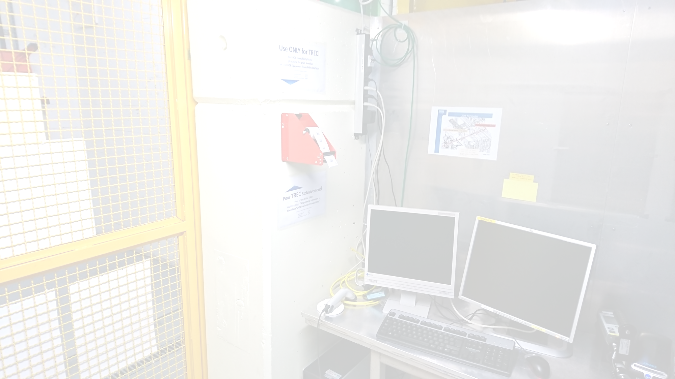
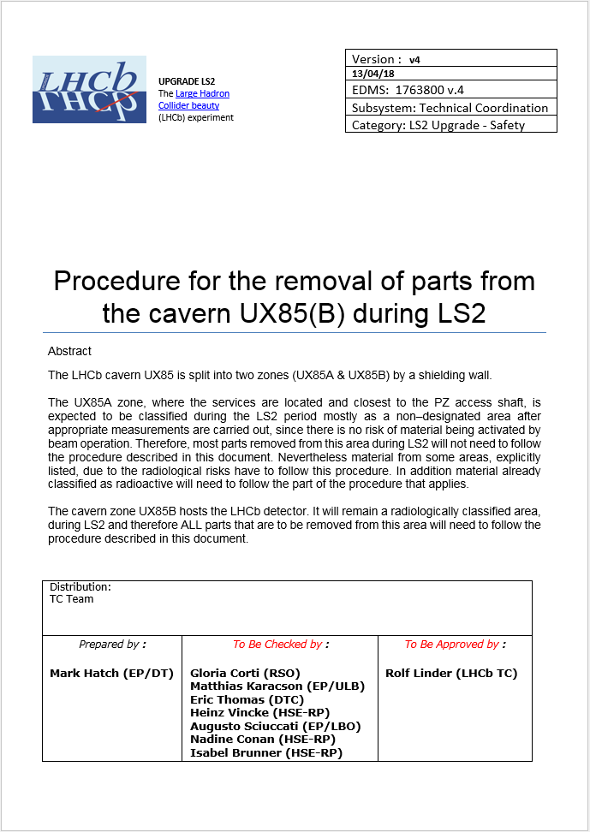
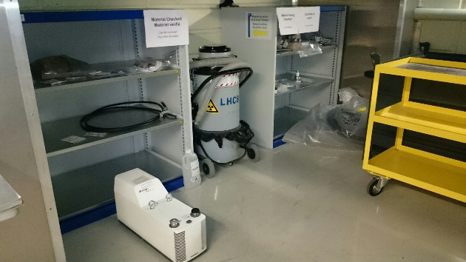
Removal of parts from UX85B
All material leaving UX85B, and some explicitly listed material from UX85A must follow one of the pathways described in this document
New “buffer zone” on surface see next talk (Mark)
Slightly different pathways for waste vs. equipment (flowcharts in document)
Mandatory RP checks in any case!
For large assemblies that need to be transported directly to their final destinations (e.g. VELO to Radioactive Waste and OT cage to Prevessin), measurements will be organized well in advance in collaboration with CERN RP
Procedure for the removal of parts from the cavern UX85(B) during LS2(EDMS 1763800)

Slide 12
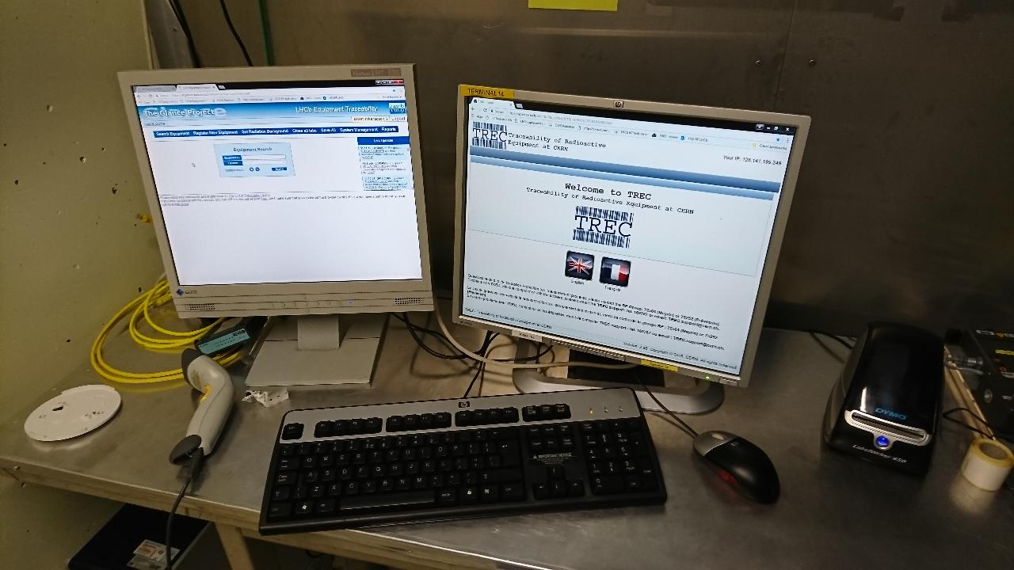
Removal of parts from UX85B
All equipment and waste exposed during beam operation must be registered and labelled before exiting the cavern!
Each label must correspond to an entry in the traceability database!
The entry must have all relevant information on the type of equipment, its original location in the experiment and its destination!
  This information is essential for us to be able to apply the appropriate checks and procedures!
Labels and Printing stations will be provided.
Transport of parts or assemblies to the surface buffer zone has to be organized by WPL.
Transport of waste will be handled by Technical Coordination and Transport team.
Parts/waste of the same type coming from the same area can be labelled in bulk as long as they stay together. Parts removed from such an assembly must be labelled and traced individually!

Slide 13
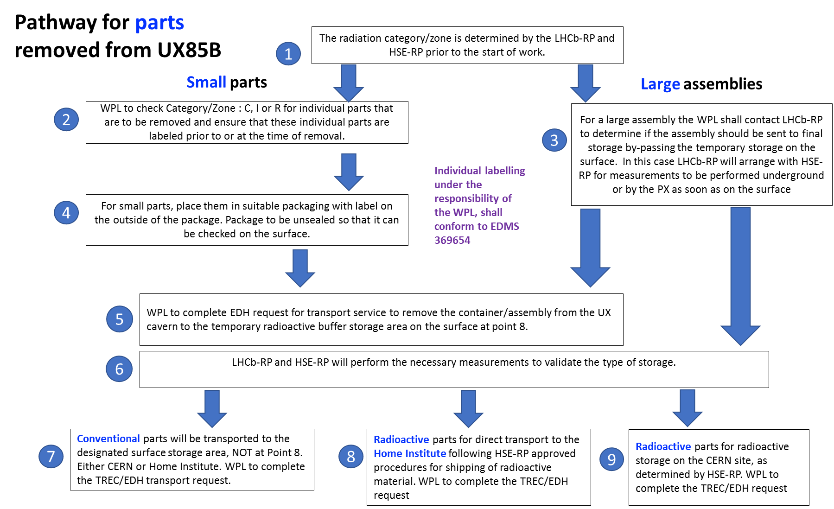
Removal of parts from UX85B

Slide 14
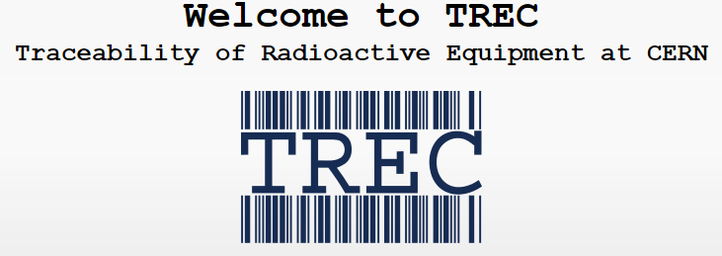
Radioactive Shipping from LHCb
Shipping of parts to external institutes
Make sure that the target institute is registered as eligible to receive radioactive material beforehand!
Even if the material is not 100% expected to be radioactive (Intermediate zone)!
If the intended destination is permanent:
CERN shipping now always asks for a proof of ownership!
Import slip would be best, but a declaration from a responsible person at the institute can suffice.
External shipping of (potentially) radioactive equipment is handled via
LHCb RP can help with organizing, but please let us know of your plans well in advance! (Experience showed that things can get stuck)

Slide 15


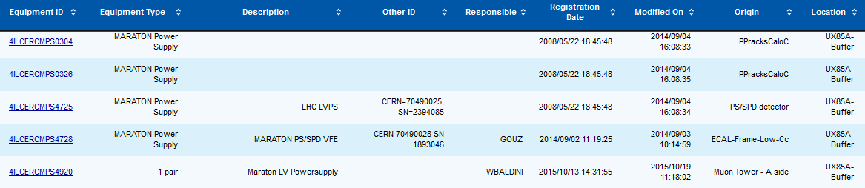
Radioactive Transport, Shipping and waste disposal from LHCb
LHCb Traceability Database is now connected to TREC for transport and shipping.
It is possible to search for LHCb IDs (starting with 4… e.g. 4UGCERGAS00005) in TREC.
Bulk treatment of items in TREC is envisaged for the next version this year.
Parts need correct info on dimensions and weight and some info on material composition!
(automatically transferred to TREC for moving requests)
LHCb traceability will be streamlined in the coming months.
If you experience any difficulties or have any questions about the procedure
please contact LHCb-RP and we will try to help!

Slide 16
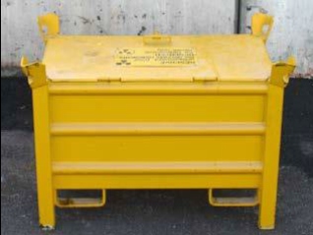
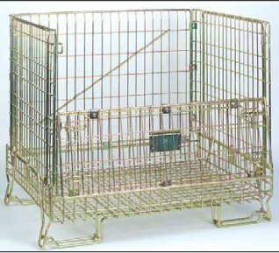
Removal of waste from UX85B
Waste must be sorted according to zoning (R I C) AND according to type (burnable vs metallic)!
Bins will be provided close to the working areas according to the needs defined in the WPPs.
All waste must be labeled with the appropriate barcodes linked to descriptions of their content and origin!
Bulk labelling of sachets or even full bins is recommended if the content is of same type and origin.
For smaller quantities, sachets conforming to color coding of zones will be provided (“mixed RIC” containers).
Final sorting, checking and conditioning of (radioactive) waste will be performed in compliance with CADRA ruleset in surface buffer zone by LHCb-RP and HSE-RP.
Full set of information on type and origin is essential for this task!

Slide 17
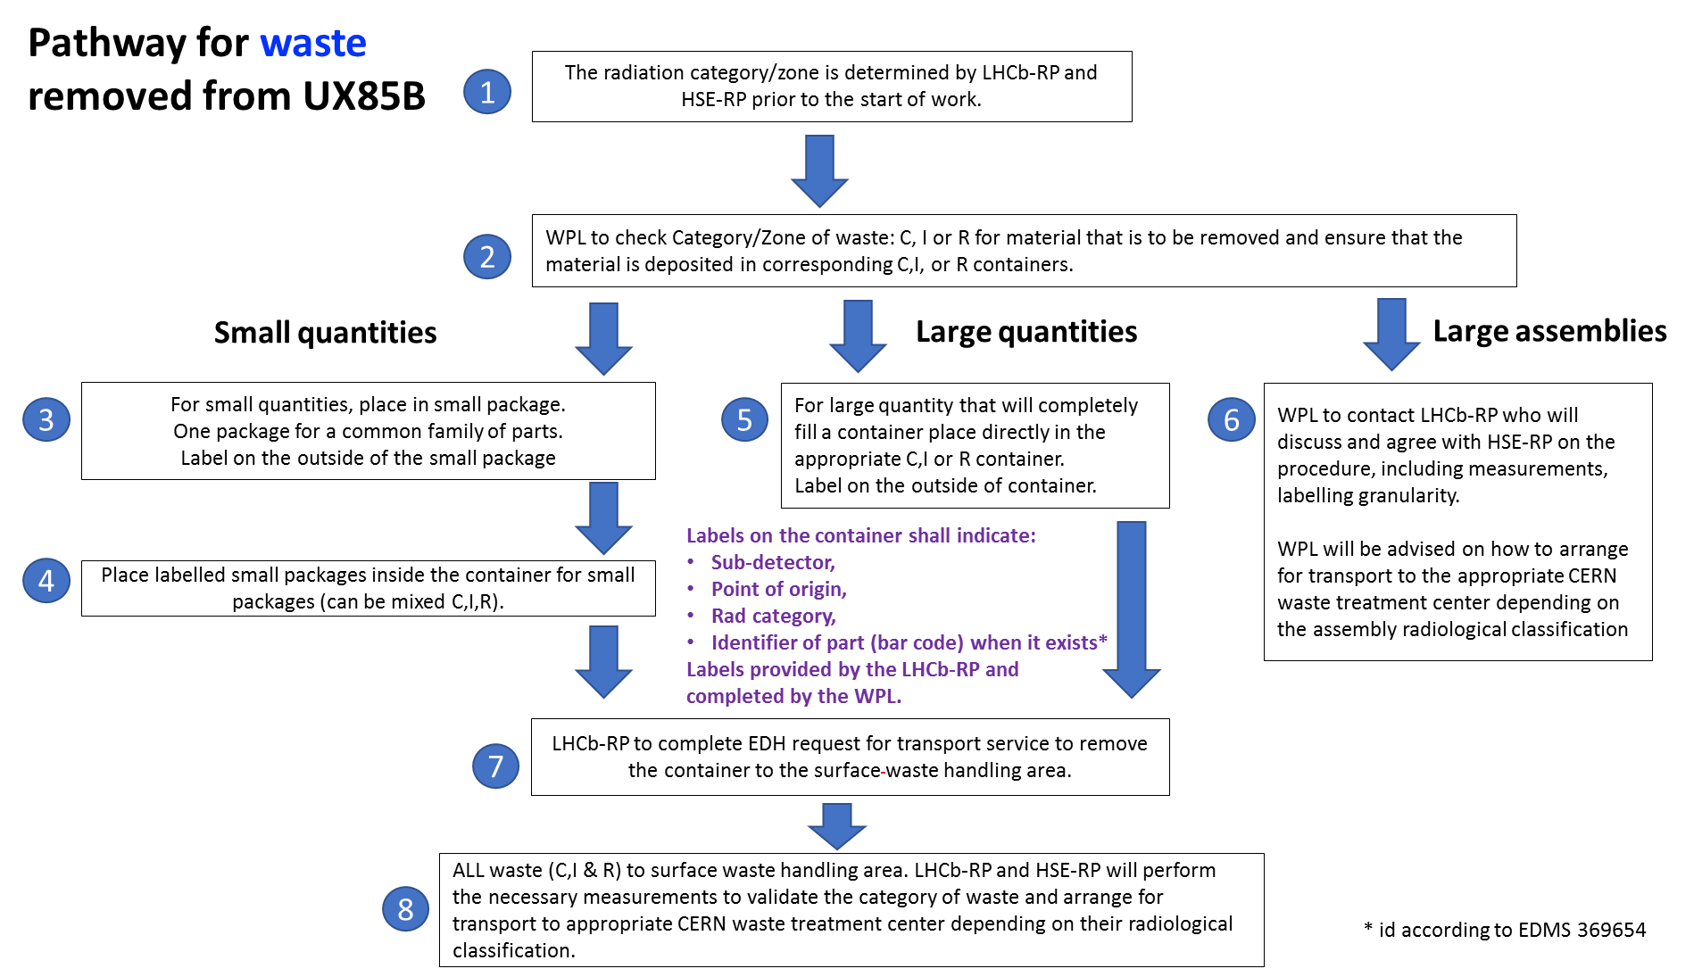
Removal of waste from UX85B

Slide 18
General remarks
Instructions and possibly tailored short trainings on RP safety measures will be provided by LHCb RP before the start of the planned work.
Additional precautions to be agreed on with HSE RP (e.g. plastic floor covers, vacuum cleaners) will be taken for work in R and possibly some I areas to minimize the risk of contamination.
Efforts will be made to group work packages in a way that minimizes contamination of tools and environment (e.g. extract and cut conventional cables first as much as possible).
What is declared waste will be thrown ASAP!
If destructive work is planned, it should be already mentioned in WPPs.
Nonetheless please contact us before and let us know of your plans!

Slide 19
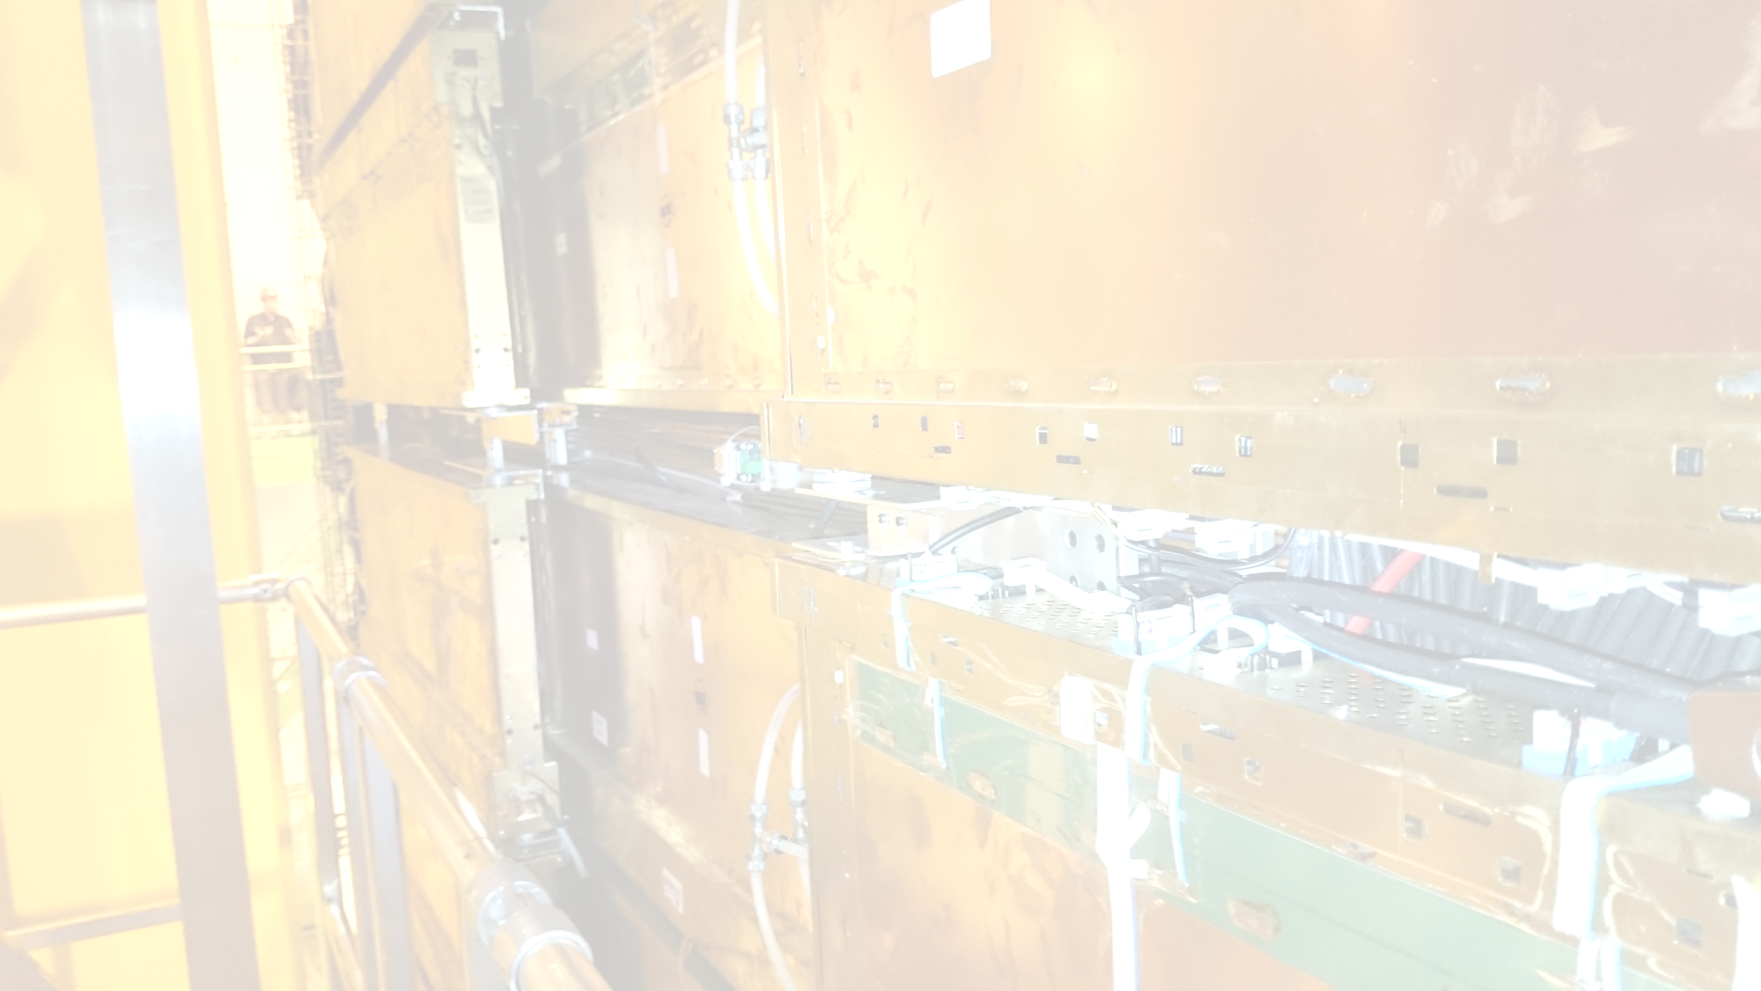
Summary
Documents available describing rules for:
  Compliance with RP ALARA during LS2
  Pathways for PARTS and WASTE leaving UX85B (and in some cases UX85A)
Studies for classification of material (parts and waste) during LS2 are in progress.
Results will be made available in October before verification at the start of LS2.
Work and Dose Plannings for dismantling must be prepared before the end of the year alongside IMPACTs with individual support provided by LHCb RP.
Recommendations for RP safety measures will be given in agreement with HSE-RP.
If in doubt about anything RP related, please contact LHCb RP and we will do our best to help!
We can only help if we know!

Slide 20
Thank You!

