Slide 1

Optimized multi-bunch
J. Komppula, K. Li

Slide 2
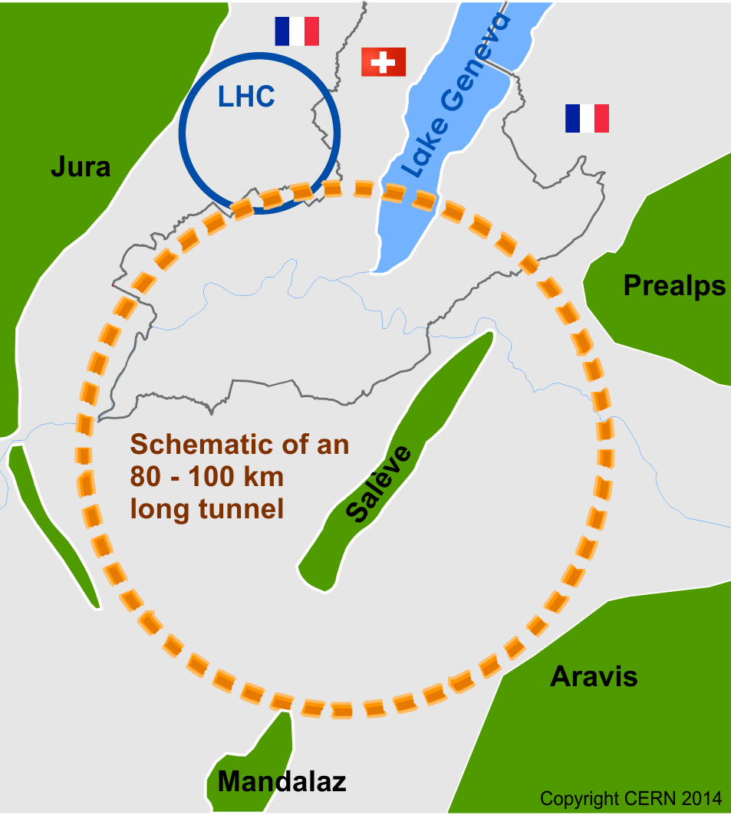
Motivation
Transverse feedback studies for the FCC-hh
  Coupled bunch instabilities, injection oscillations, etc
Realistic models for a beam and a transverse feedback system
→ PyHEADTAIL
  New feedback module
  Multibunch PyHEADTAIL

Slide 3
Challenges
Typical single bunch
PyHEADTAIL simulation:
- 500k macro particles
- 100 slices
- Qp
- wakes
→ ~0.5 s / turn, 500k turns
 | LHC | FCC-hh
Beam energy | 7 TeV | 50 TeV
Circumference | 26.7 km | 97.7 km
Betatron tunes | 64.28/59.31 | 111.31/109.32
RF harmonic | 35640 | 130680
Max N bunches | 3564 | 13068
Linear scaling to the full LHC simulation:
  → 600 cores, 3 s / turn (practical limit)
Local 4 core simulations → ~1000 bunches per core
  → every 1 ms per bunch → 1 s in the total tracking time
This is not easy but...
… O(n^2) algorithms are the absolute evil:
  Each bunch interacts with all the other bunches → O(n^2) algorithm!
  13 068 b ^2 = 170 000 000 times slower! (years per turn)

Slide 4
…some tricks were needed
1st working version: original HEADTAIL style wakes (very generic solution)
  3 nested for-loops and recalculated wake values → limited to ~10-100 bunches
2nd wake approach (precalculated wakes)
  → memory limited to 1000 bunches
3rd wake approach (“precalculated wake database”)
  → no memory problems but still an O(n^2) algorithm
4th wake approach (new FFT based wake algorithm)
  → Success!!
…but still “O(n^2) problems“ in PyHEADTAIL (limit 1k-10k ppb)
Hacking the core
  binary tree algorithm to the beam generator
  beam.split() → beam.split_to_views() → reduced data copying
  New reference z-coordinate system based on h_bunch
  → >500k macroparticles and 100 slices per bunch in the LHC beam
Wake parallelization on the wake object level
  → a factor of 2-7 faster wake calculations (all turns from all wake kicks are calculated in parallel)

Slide 5
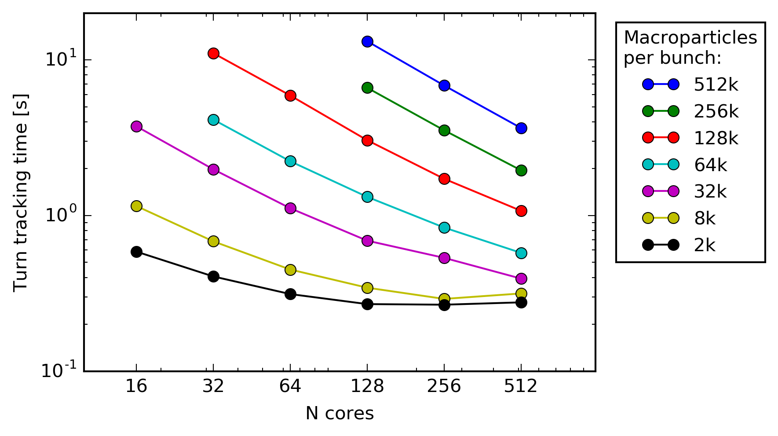
Does it work?
Back of the envelope, LHC beam (wakes, Qp):
  → from 3 s/turn on 600 cores to 1 year/turn
Reality, LHC beam (wakes, Qp):
  → it takes 3.6 s/turn…
on a desktop computer!
Disclaimer: 10k particles and 20 slices per bunch
(but it is a part of the optimization).
CERN HPC-batch
Transverse tracking limited
→ good parallelization
HL-LHC HOM test:
- 3564 bunches
- Qp=10
- 3 turn wakes
- 20 slices per bunch
Wake limited
→ poor parallelization

Slide 6
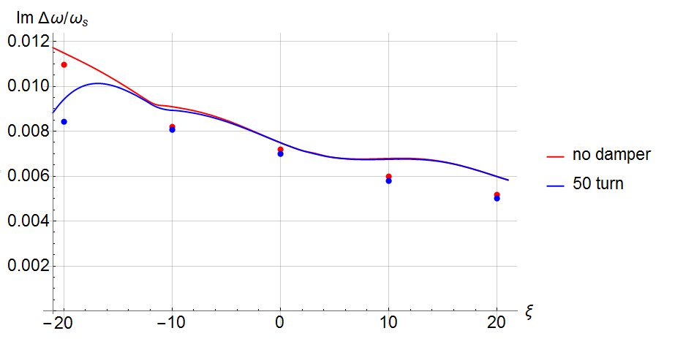
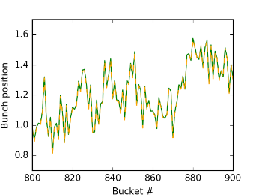
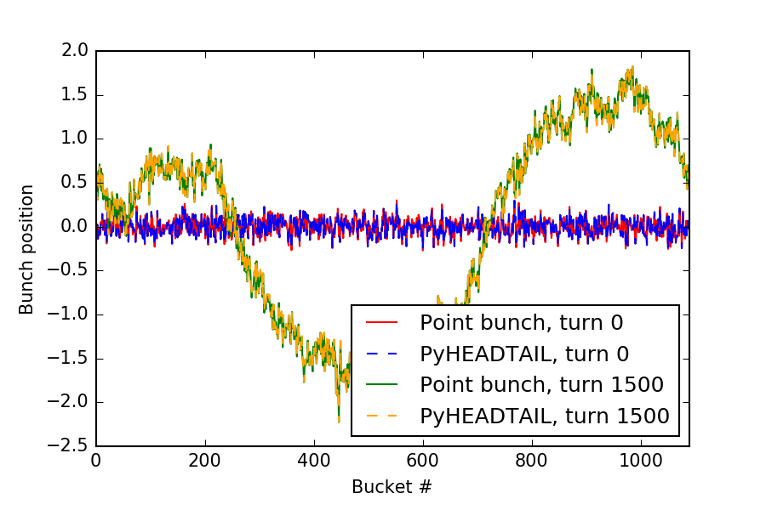
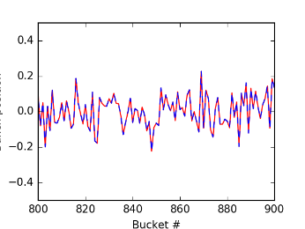
Benchmarking
PyHEADTAIL vs NHT vs theory
B) PyHEADTAIL wakes vs math
1.97 GHz HL-LHC HOM
Minimalistic point-like-bunch code
(tracking and wakes ~10 lines of code)
Cumulative numerical error <0.5% after 1500 turns
C) PyHEADTAIL wakes vs Sacherer
A factor of ~1.5 difference between Sacherer and PyHEADTAIL
However:
PyHEADTAIL wake kick ≈ coef * iFFT( FFT(mean_x) * FFT(wake function) )
≈/= Sacherer modes
≈ beam impedance
Hypotheses: The difference can be understood analytically

Slide 7
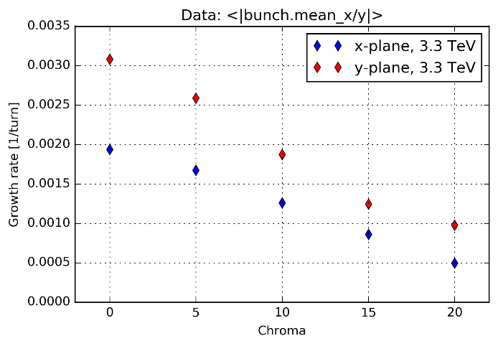
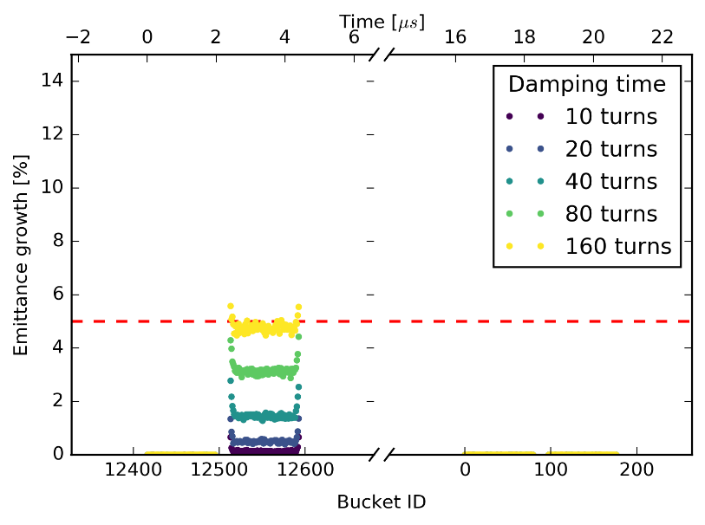
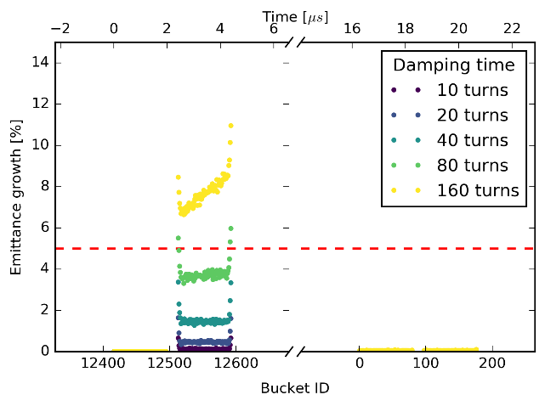
FCC-hh studies
Full FCC-hh beam chroma scan
Injection emittance growth
Qp=5,
without wakes
Qp=5,
with wakes
Injected
batch

Slide 8
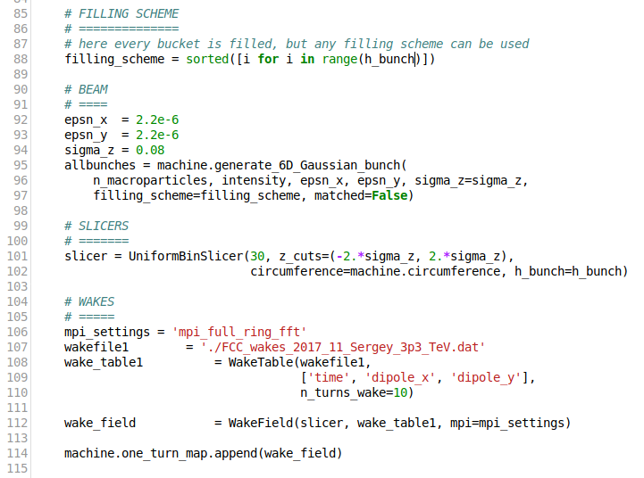
How to use?

Slide 9
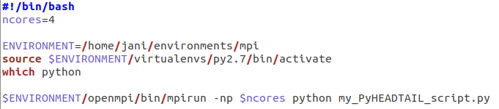
How to use?
Monitors needs the MPI version of the h5py
  I prefer to compile the Python/MPI environment on different clusters (slow but straightforward installation)
  See PyECLOUD wiki
Load MPI module, (possible virtual environment) and run the python script with MPI
  e.g. script for the compiled environment:
Normal Python-script procedure

Slide 10
Status
Performance is sufficient
  Full SPS beam → No problem!
  LHC MD studies → Easy!
  LHC full beam → From easy (10k ppb)
  to if you really need (500k ppb)
  FCC-hh → It was the goal!
Benchmarking promising
  Against other codes → OK
  Against math → OK
  Against Sacherer → In progress
… but the multibunch version is still a development branch
  Bunch monitors are sometimes unstable
  Behind the master branch
  Changes to the core functions were needed :(
  Some parts might need cleaning and reprogramming
→ merging needs some work

Slide 11
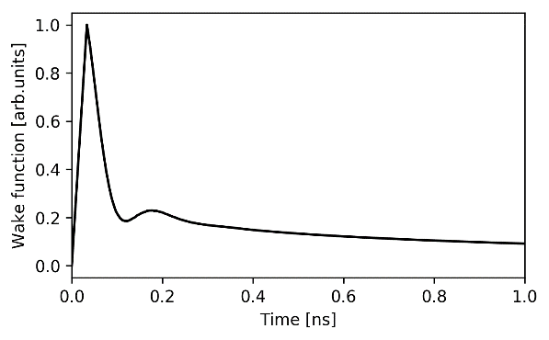
We are “tickling the dragon's tail”
A capacity of an entire supercomputer can be easily filled by one 30 steps LHC chroma scan…
CSC SISU: World top 50 HPC cluster in 2015, 40 608 cores
→ only one core per 2.5 bunches :-(
… but it is also possible to perform same
simulations on desktop computers if less
macroparticles are used (HTCondor).
Slicing of the first nano second
of the wake function!

