Slide 1
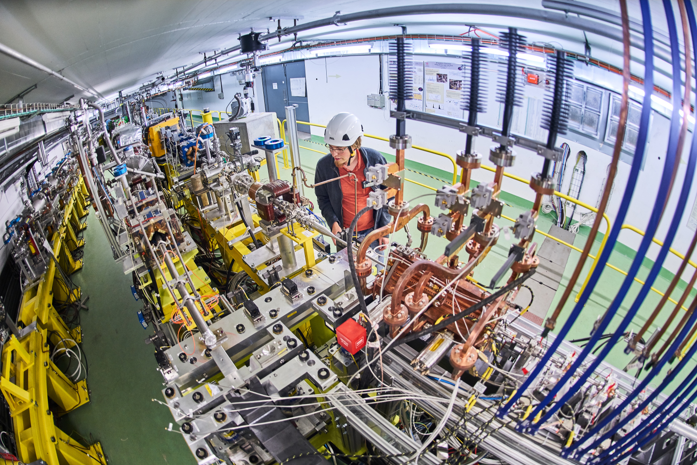
CLEAR status report
R. Corsini for the CLEAR Team

Slide 2
Status as from last CLEAR Newsletter (April 2017)
https://clear.web.cern.ch/content/clear-newsletter-03042017
Hardware preparation:
  The RF network reconfiguration, with two Modulator/Klystrons was ongoing.
  Control and timing: adaptation of old equipment for long term maintenance.
  Beam-line: main modifications were identified, clearance work in CLEX was well advanced.
Experimental preparations for 2017 (program based on CLEAR proposal):
  Experiments which are a continuation of last year activity required only “minor” hardware modifications.
  The first new experiment, a plasma lens experiment from the University of Oslo, DESY and Oxford, was in preparation and scheduled for installation in summer.
  Other planned experiments (e.g., Impedance measurements of wire scanners, THz radiation emission, Electro-Optical BPMs) were being reviewed for detailed scheduling.

Slide 3
Present Status
Hardware modifications took longer than foreseen (about 2 months delay)
  Some lack of resources
  Larger scope than initially planned
  Some mishaps (accidental venting of RF gun, vacuum leaks…)
First Beam on August 18th

Slide 4
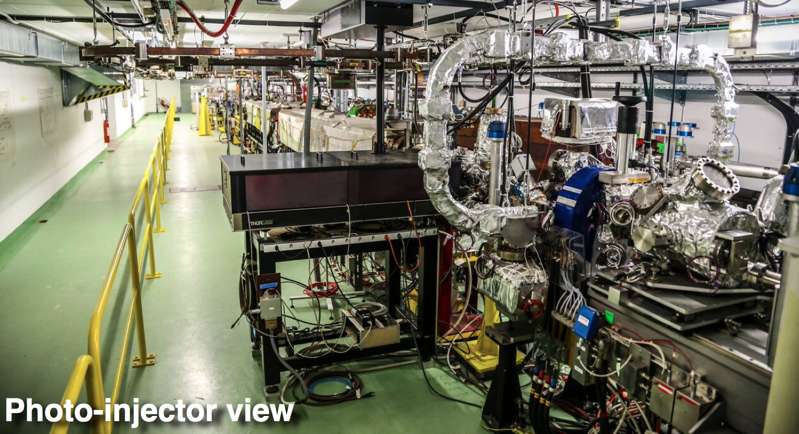
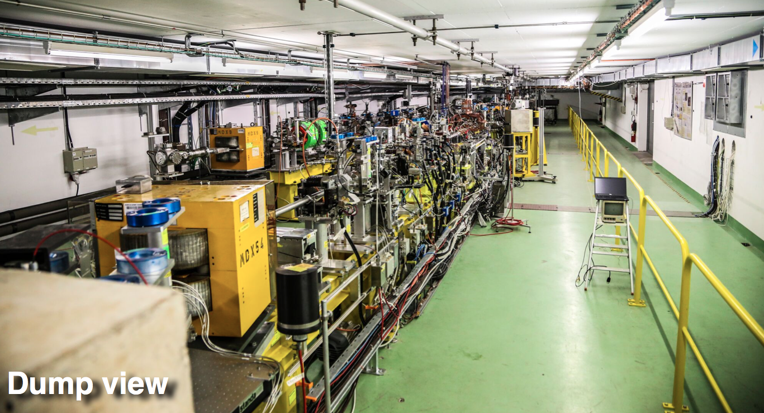
CERN Linear Electron Accelerator for Research

Slide 5
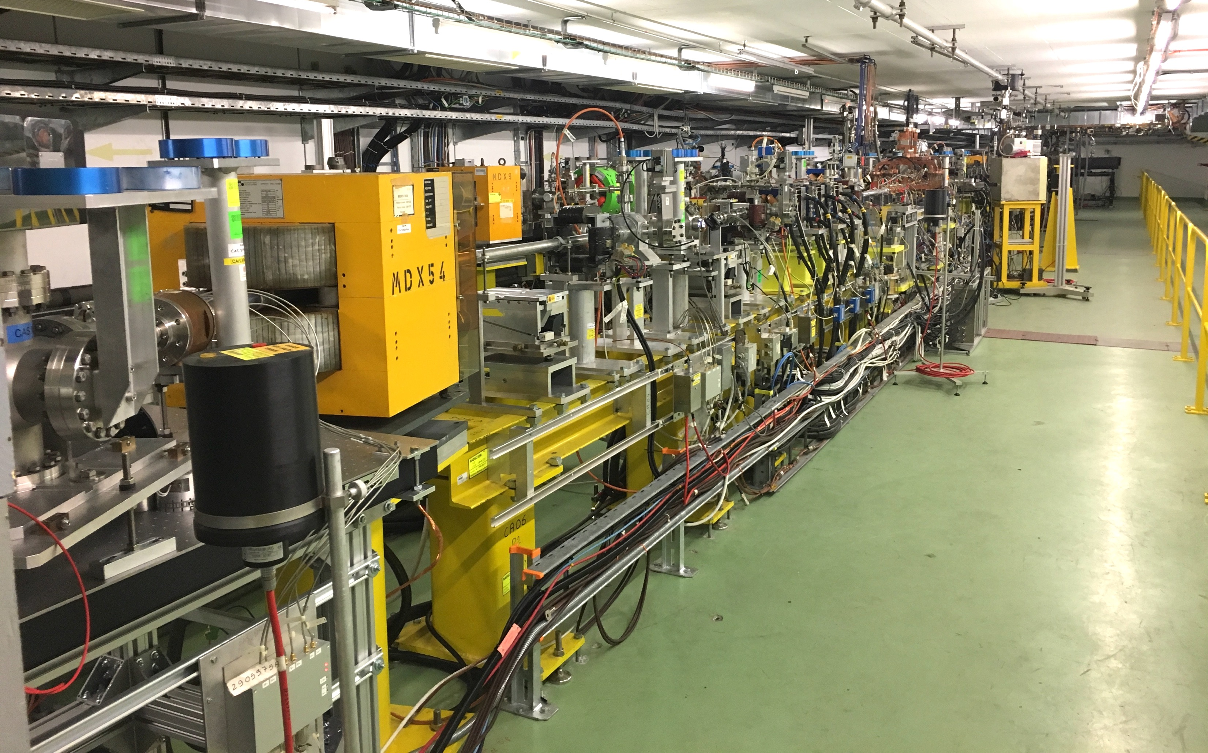
CERN Linear Electron Accelerator for Research
CALIFES
injector
former
CLIC Module
Plasma Lens
Available test space
Spectrometer and in-air test stand

Slide 6
Present Status
Hardware modifications took longer than foreseen (about 2 months delay)
  Some lack of resources
  Larger scope than initially planned
  Some mishaps (accidental venting of RF gun, vacuum leaks…)
First Beam on August 18th
Planned “old” experiments under way, in different stage of advancement:
  VESPER – irradiation of electronic components: many tests, first test in collaboration with ESA/TRAD
  VESPER – irradiation for medical applications: thorough extensions of initial studies for VHEE in CALIFES (University of Manchester)
  CLIC BPMs: fixed hardware problems, testing, now operational
  CLIC structure wake-field studies/wake-field monitors: data taking, ongoing
  Cherenkov diffraction radiation studies: initial tests started
New experiment, planned: Plasma Lens experiment, after some initial problem got extremely good results (see Erik’s report)
New experiments under consideration:
  THz radiation studies: initial tests ongoing, THz radiation mini-Workshop in November
  Impedance studies: still planning for 2018, new doctoral student beginning 2018

Slide 7
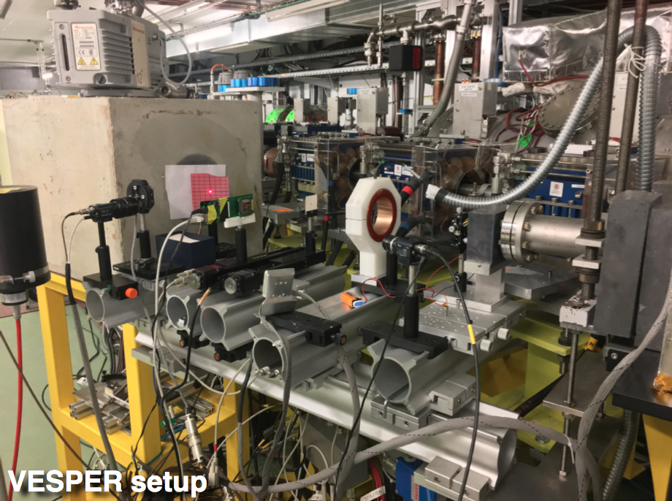
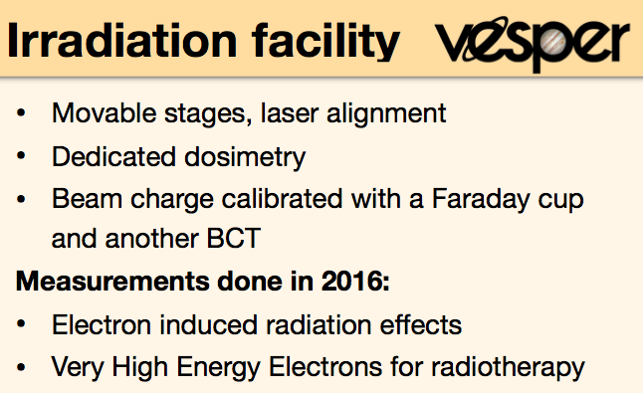
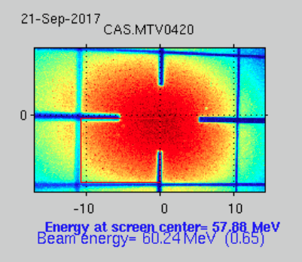
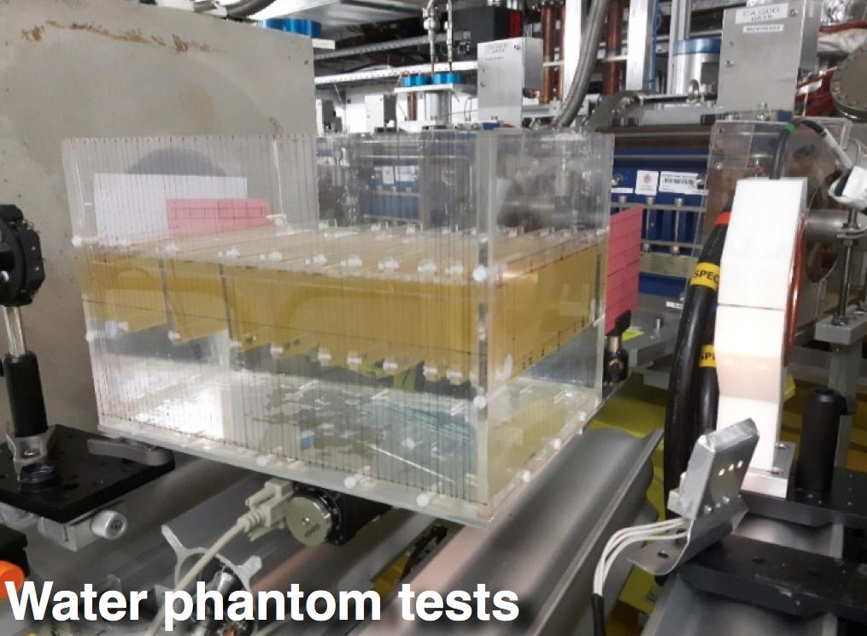
VESPER
M. Talis, R. Garcia Alia,
W. Farabolini et al.
Operation resumed in September:
Using dark current only
10 pC total charge
5 Hz repetition rate
Energy from 60 to 180 MeV
Successful measurements with ESA and TRAD in week 46!
Overnight and over weekend
operation possible.
VESPER for medical applications

Slide 8
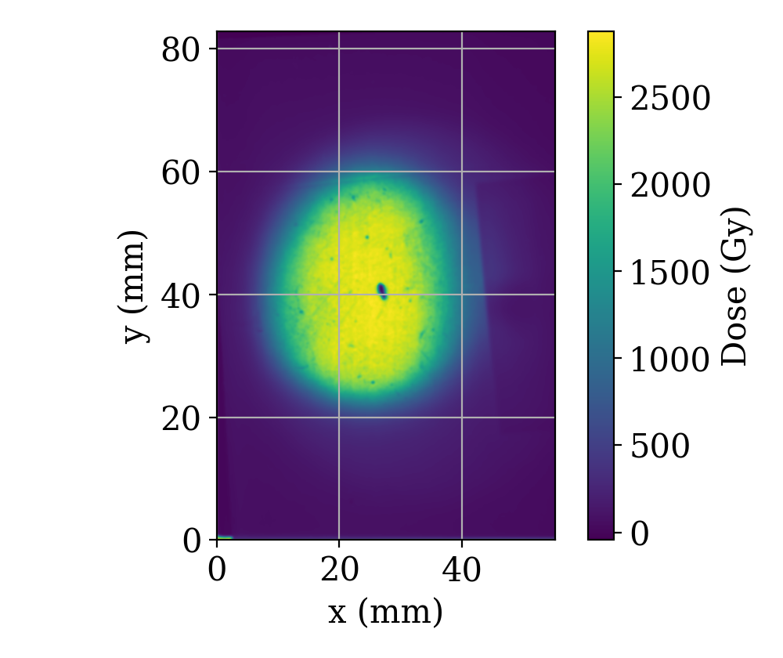
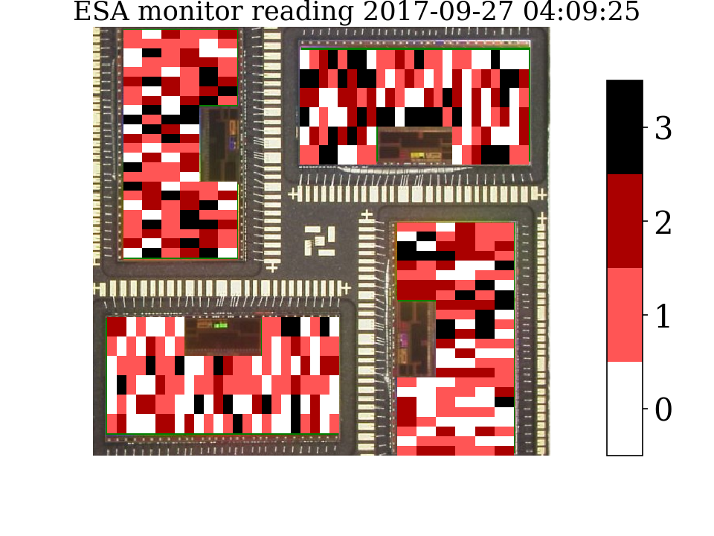
VESPER first tests: European Space Agency (ESA)
Maris Tali et al.
Beam homogenity - 175 MeV, 8 pC/pulse
Radiosensitive film
ESA SEU monitor
First tests have been performed with ESA SEU monitor, results compatible with previous years :
  50, 115, 175 MeV
  ESA SEU monitor + Al
  Radiosensitive films
  Week 46: first test in collaboration with ESA/TRAD

Slide 9
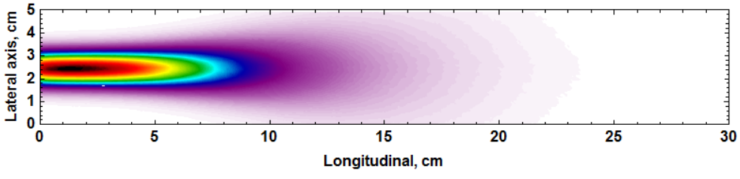
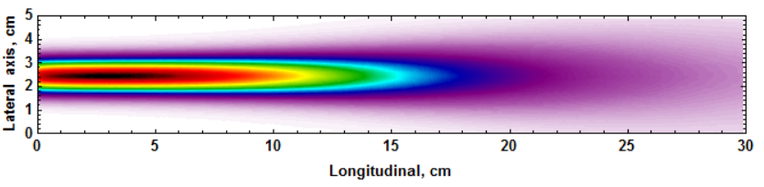
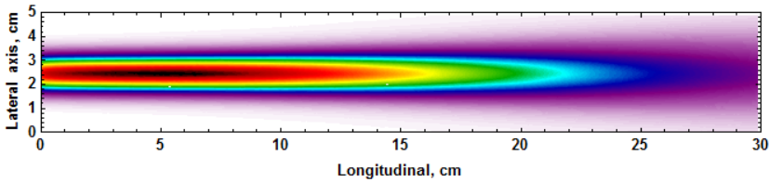
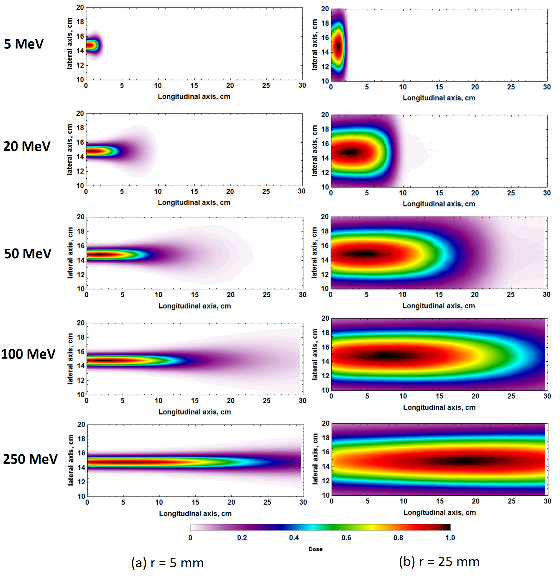


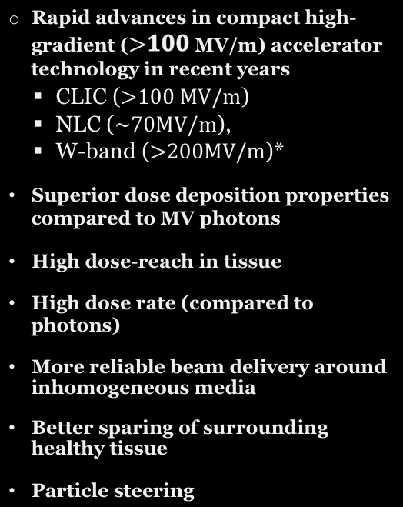



VHEE
VHEE: Very High Energy Electron Radiotherapy
50 MeV
Clinical studies by M. Bazalova-Carter et al. (2015) have compared 100 MeV VHEE with conventional ( and MV) VMAT (Volumetric Modulated Arc Therapy) photon radiotherapy plans
Pediatric brain tumour, lung and prostate cases
VHEE therapy plan showed a decrease of dose up to 70% in surrounding organs-at-risk (OARs)
VHEE plan was found to be more conformal than VMAT plan
Rapid advances in compact high-gradient ( MV/m) accelerator technology in recent years
  CLIC ()
  NLC (),
  W-band ()*
Superior dose deposition properties compared to MV photons
High dose-reach in tissue
High dose rate (compared to photons)
More reliable beam delivery around inhomogeneous media
Better sparing of surrounding healthy tissue
Particle steering
150 MeV
250 MeV
Dose maps of narrow ()
VHEE beams in water
Brain tumour dose maps for 100 MeV VHEE and
6 MV volumetric modulated arc photon therapy (VMAT) .
VHEE
VMAT
Absorbed dose histograms for surrounding organs-at-risk.
*V. Dolgashev, HG2016
Dose maps of wide ()
VHEE beams in water
M. Bazalova-Carter et al, «Treatment planning for radiotherapy with very high-energy electron beams and comparison of VHEE and VMAT plans», Medical Physics, vol. 42(5), 2015.
Manchester University: A. Lagzda, R. Jones and other
- Project to characterize VHEE irradation on radiosensitive films
Notes:
So, how did the interest in VHEE arose?
First, major breakthroughs in accelerator technology in the past decades showed it was possible to achieve compact, high-quality, high-gradient acceleration.
Electron energies of 200 MeV could be achieved in 2 meters, not 20-40.
As a result an interest in using VHEE for radiotherapy arose in 2000 suggesting VHEE may have better dosimetric properties compared to photons.
Since then due to its dose deposition characteristic VHEE beams have ben suggested for treatment of deep-seated tumours such as brain tumours, lung and prostate cancers,.
Some of the advantages of using VHEE highlighted are
…
…
…
…

Slide 10
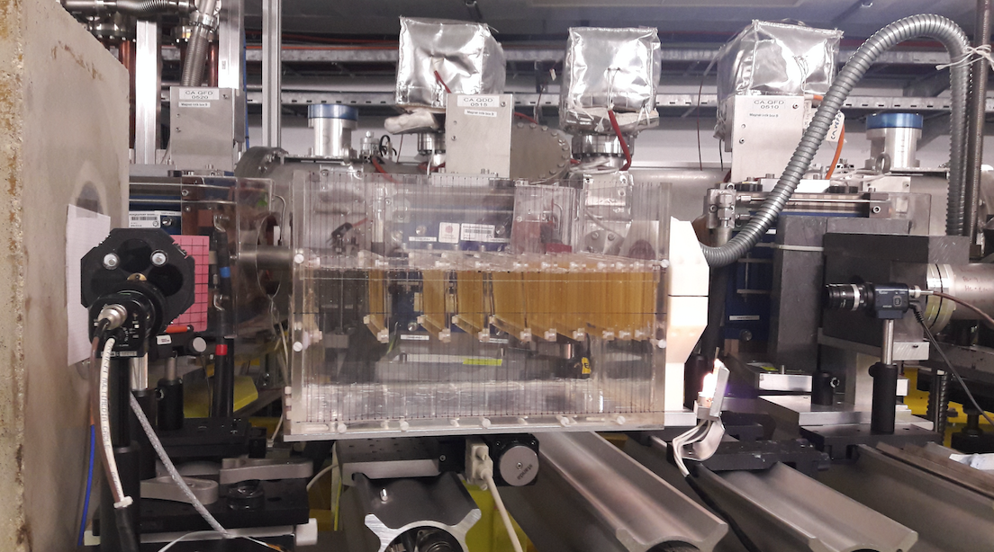
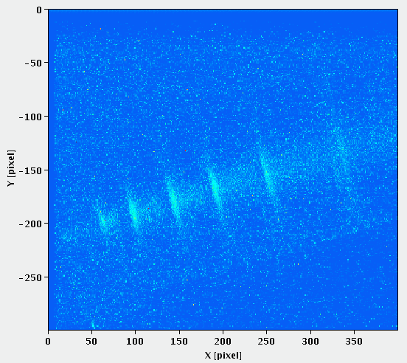
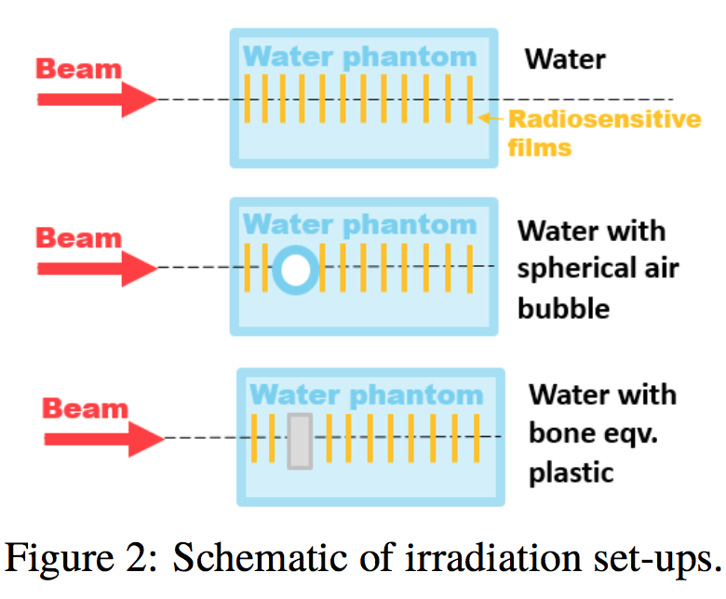
VHEE experiments at CLEAR
Beam dosimetry experiments in water tank with radiosensitive films.
Preliminary studies done December 2016.
Beam parameter (end of linac) | Value range
Energy | 197 MeV
Energy spread | < 0.5 MeV FWHM
Bunch charge | 0.5 nC
Train length | 50 bunches
Beam spot size | 1 mm
Charge Jitter | 20 %
Relative energy spread | 1 %
100 bunches of 50 pC/shot spaced by 1 sec. at 8 cm distance corresponds to 100 Gy.
  Cherenkov light from water phantom
  Week 49: extensive VHEE tests
  Results still to be analysed
A. Lagzda et al.
Notes:
no perturbation of $200$ MeV VHEE beams detected due to presence of an air cavity – simplified algorithms needed for dose predictions

Slide 11
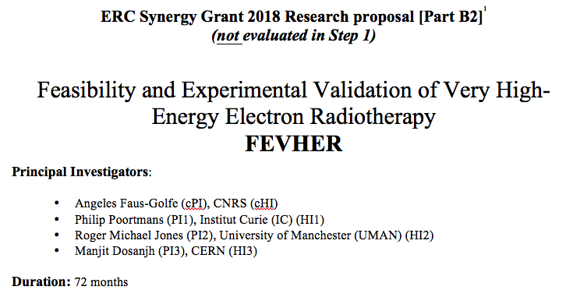
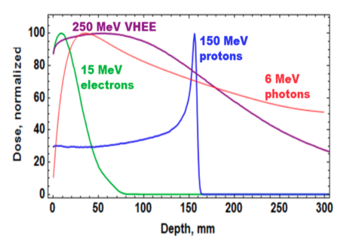
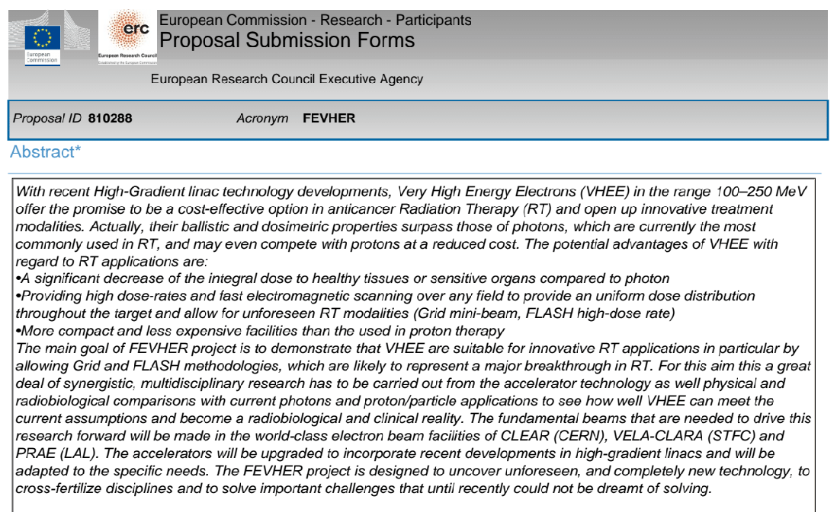
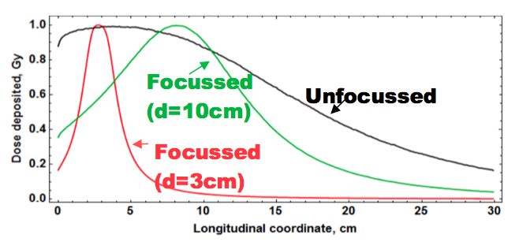
FEVHER EU Synergy Grant proposal

Slide 12
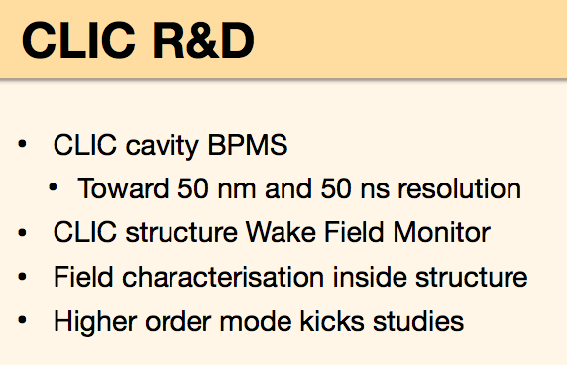
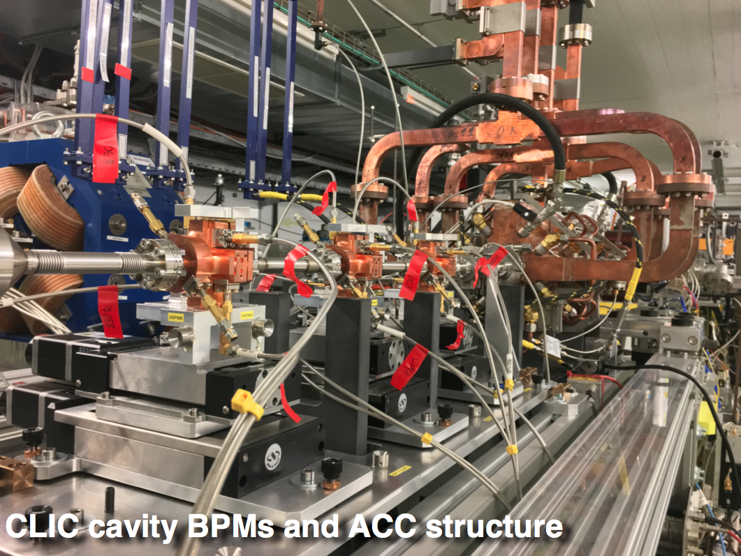
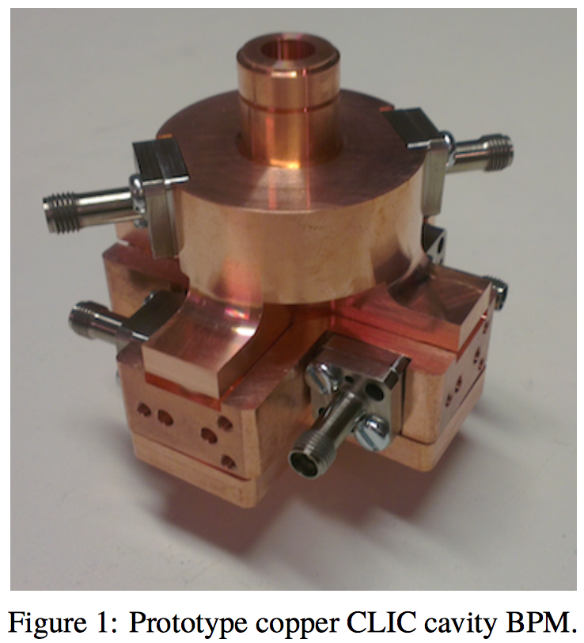
Former CLIC Module
Experiments resumed two weeks ago
A.Lyapin (R. Holloway), J. Nadenau (Juelich), M. Wendt(CERN), R. Lillestøl (Oslo), E. Adli (Oslo), K.N.Sjøbæk (Oslo) et al.

Slide 13
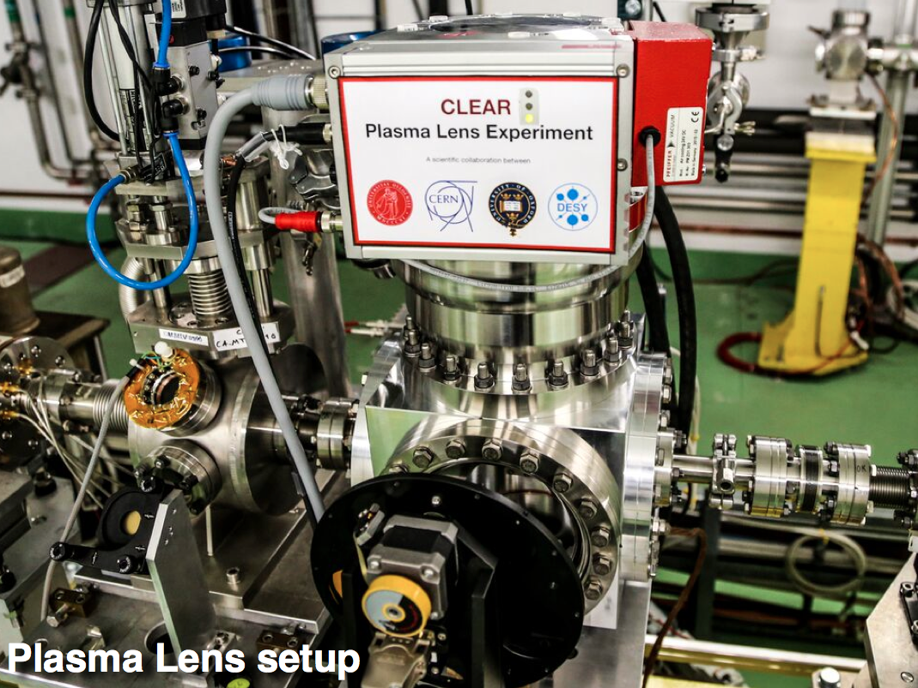
Plasma Lens Experiment
Beam focusing by high-current discharge in plasma
Capillary for (transverse) gas confinement
Gas delivery system 1-50 bar
HV discharge unit (10 kV, few 100 A)
Active alignment system
First beam sent cleanly through capillary end September
Clear measurement of focusing properties two weeks ago
(See Erik’s talk)
Lead by Oslo University
Collaboration with DESY, Oxford and CERN

Slide 14
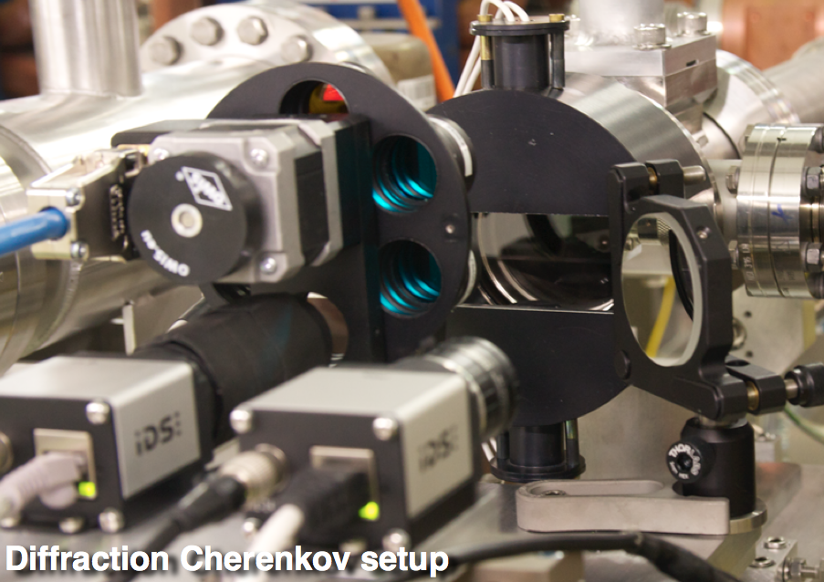
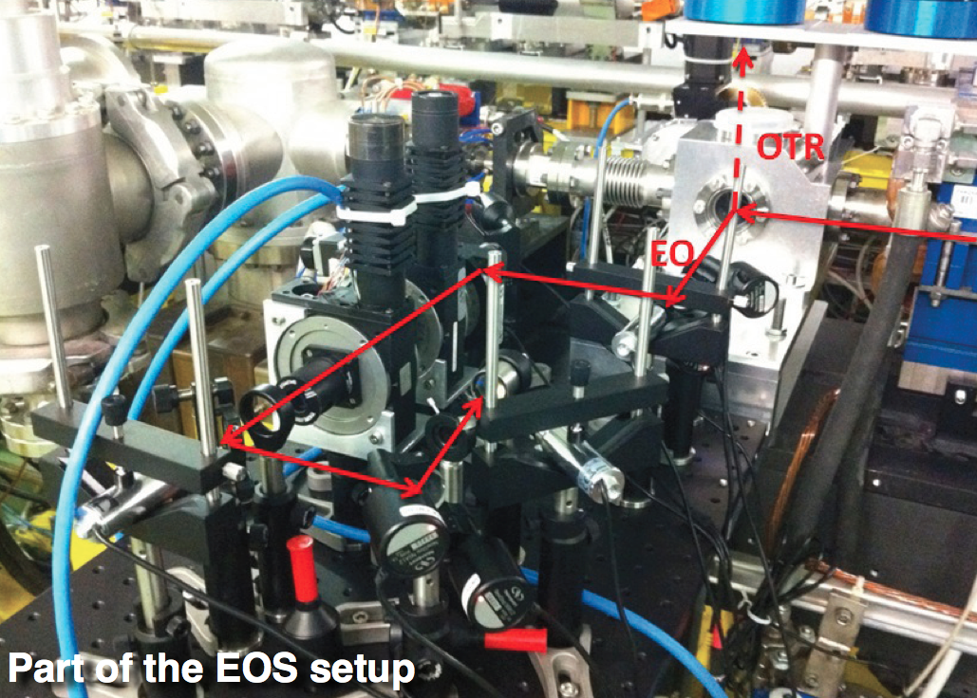
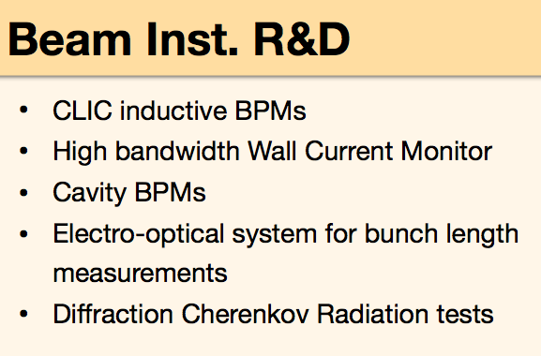
BI Activities
Many activities planned (most ongoing).
Two main goals:
Consolidate and improve beam instrumentation for CLEAR
Diagnostics R&D
T. Lefevre, et al.

Slide 15
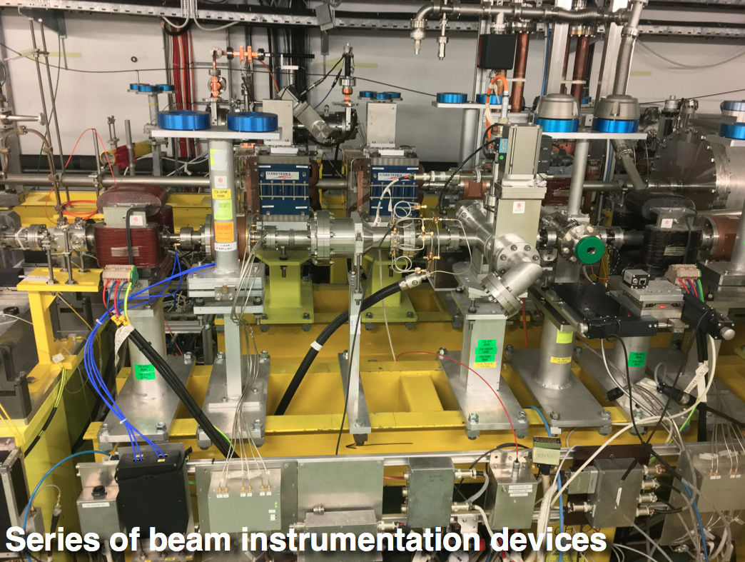
BI Activities
Several beam diagnostics recovered from CTF3, and adapted to CLEAR needs.
Will assess performances, modify if needed, eventually extend numbers.
Inductive
BPM
EO monitor,
(bunch length)
Beam Phase monitor,
WG monitor (bunch length)
WCM
T. Lefevre, et al.

Slide 16
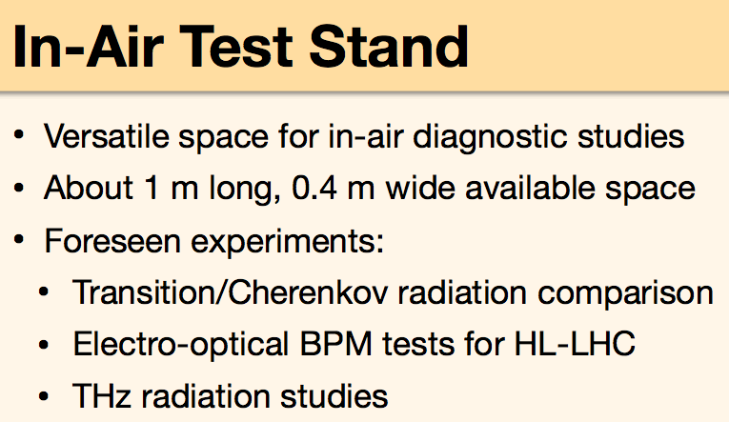
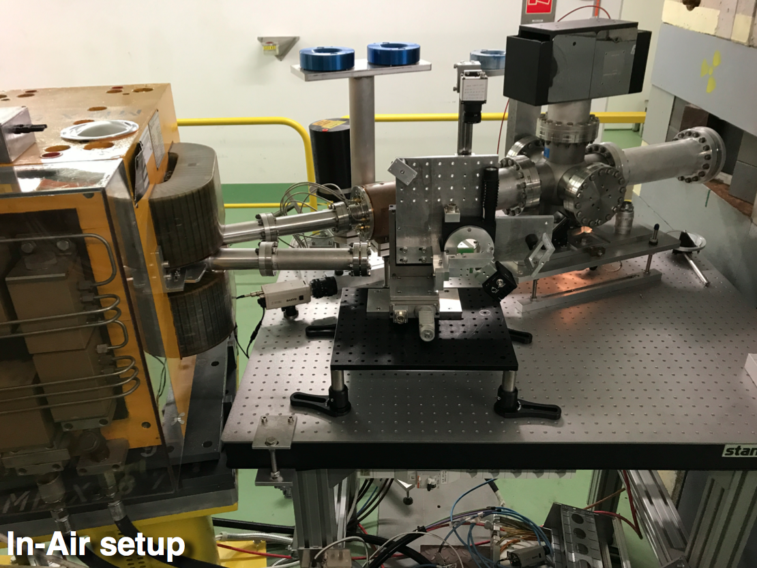
End-of-line in-air test space

Slide 17
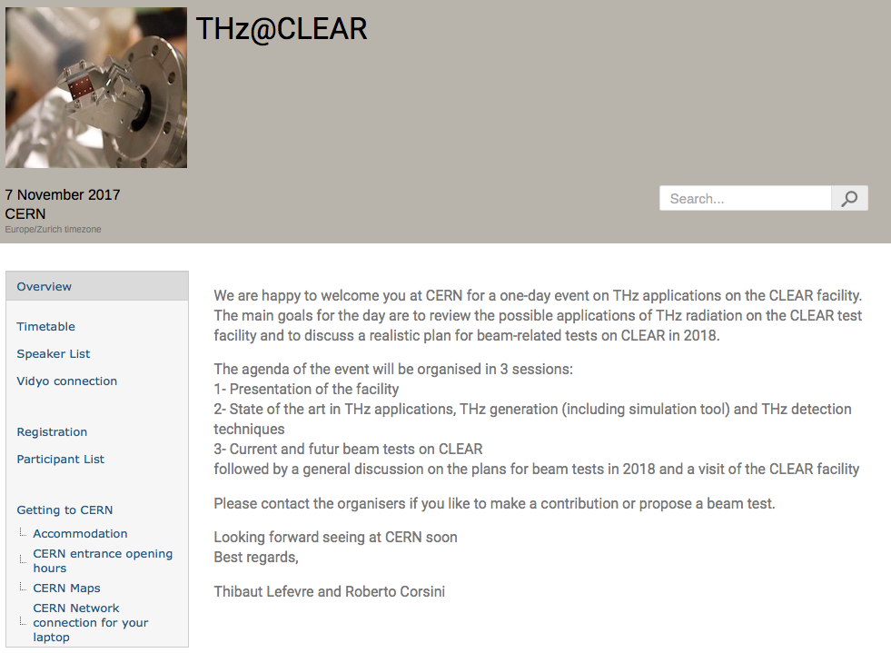
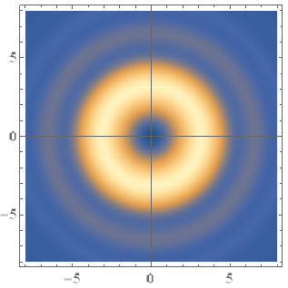
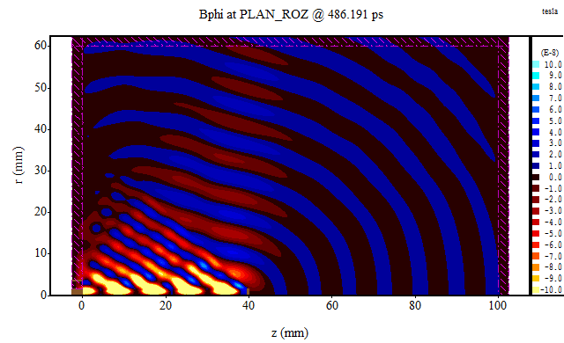
THz Radiation
Begin with characterization of beam-produced THz radiation from TR screen
First tests in sub-THz region started, will use also as bunch length diagnostics
Many possibilities beyond that, with several Institutes involved – Mini-workshop organized on November 7th
First topical CLEAR user workshop:
40 people from 15 institutes – 13 talks
Covering:
Theory
Applications
Simulations
Review of experimental activities
Potential tests in CLEAR
https://indico.cern.ch/event/672235/

Slide 18
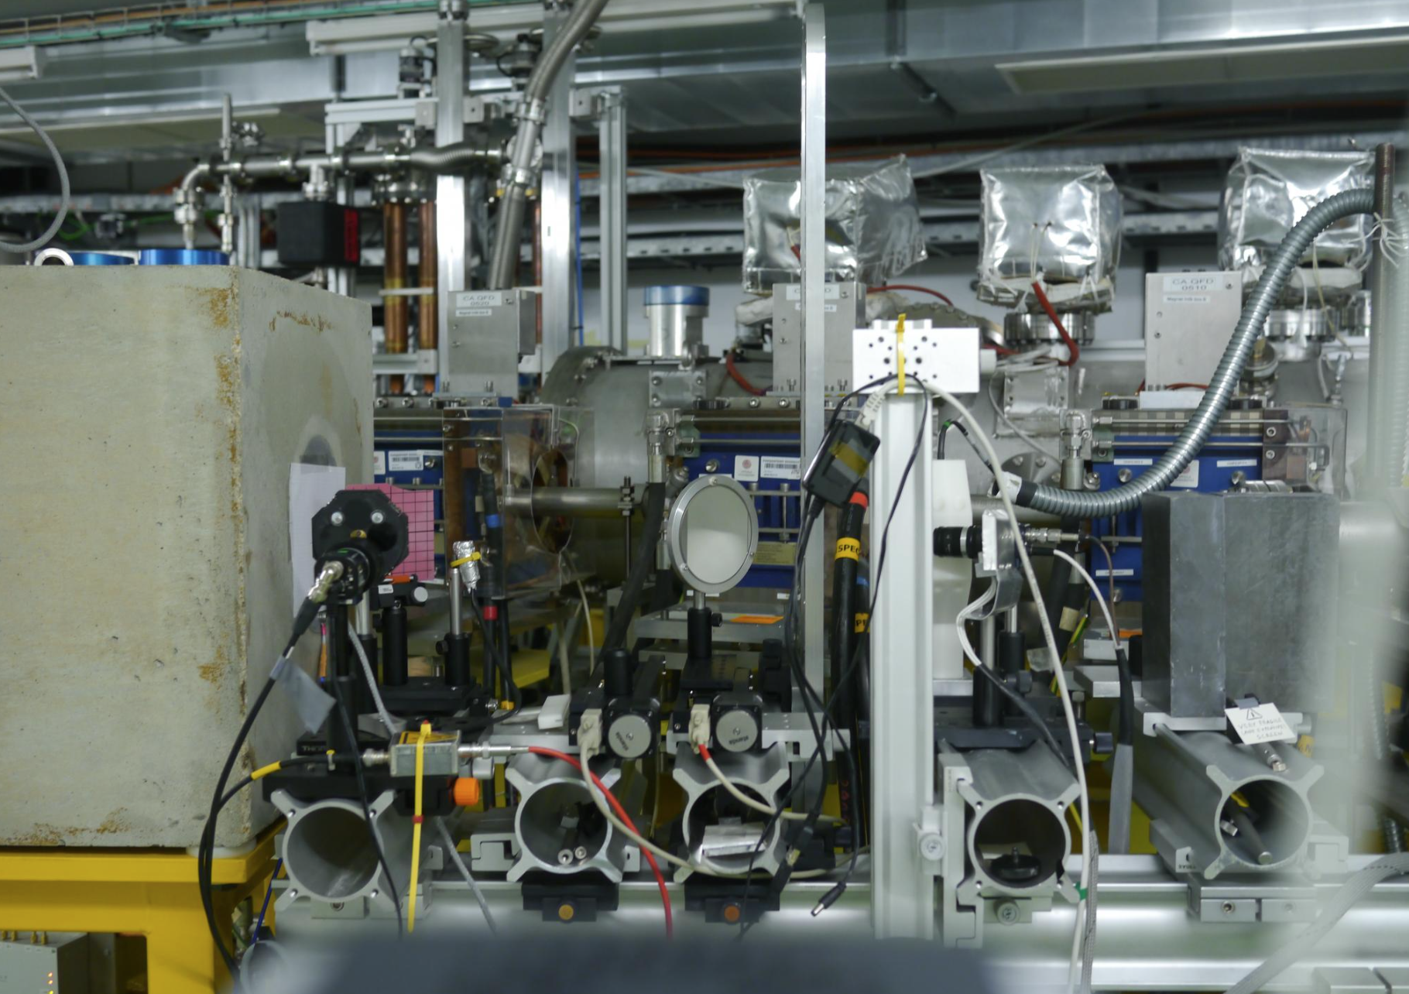
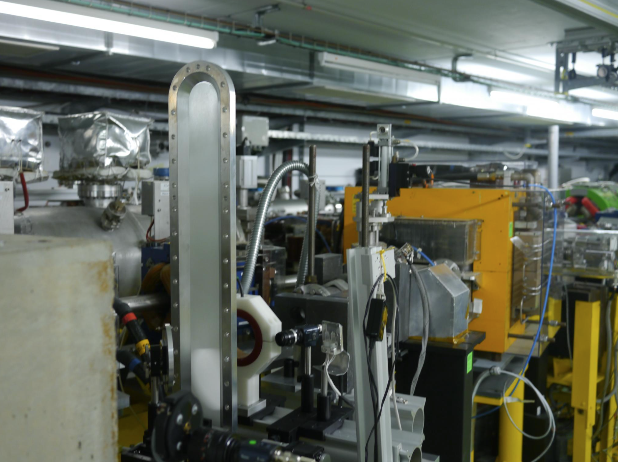
Unforeseen: AWAKE electron spectrometer
Test and calibration of scintillator for AWAKE electron spectrometer.
N.B.: AWAKE BPMs were also tested in CLEAR/CTF.

Slide 19
CLEAR operation in 2017
Week
33 First beam! August 18 | 34 Cont’d commissioning | 35 Cont’d commissioning | 36 First beam to users VESPER
37 Installation of plasma lens | 38 Beam through plasma lens | 39 VESPER | 40 Beam tuning, plasma lens
41 BCM improvement WFM | 42 WFM First spark plasma lens | 43 Inductive BPMs LAL: injector optimisation | 44 Cavity BPMs
45 Laser spot study VESPER | 46 ESA at VESPER THz studies | 47 Combined WFM and Cavity BPMs | 48 AWAKE screen Plasma lens!
49: VHEE
50-51: Plasma lens, instrumentation, THz….

Slide 20
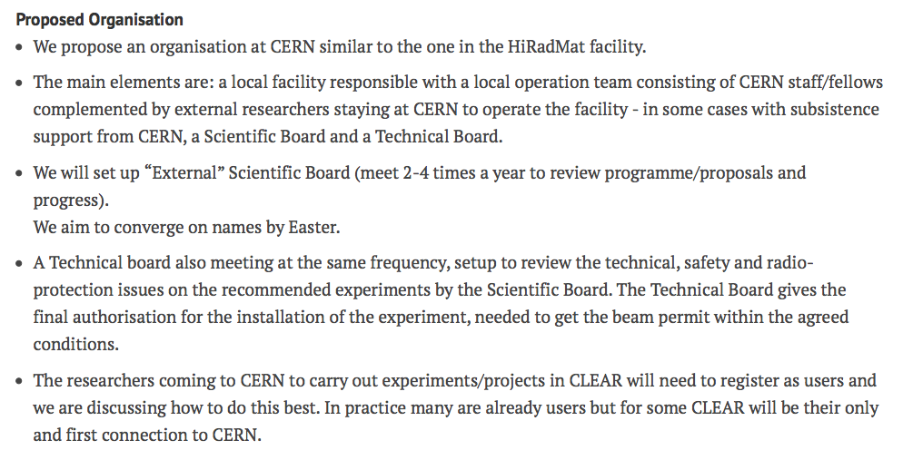
Organizational issues
successful so far
International Scientific Committee nominated
Defining composition
Mainly dealt with on an “ad hoc” basis in 2017
General CERN rules for access to User Facilities under definition
Already used for ESA/TRAD expert access in Week 46
First official Meeting of the International Scientific Committee at CERN in January/February 2018.
Will send out proposed dates before Christmas
One possibility: jointly with CLIC Workshop (22-26 January) – a parallel WG session on CLEAR is already foreseen

Slide 21
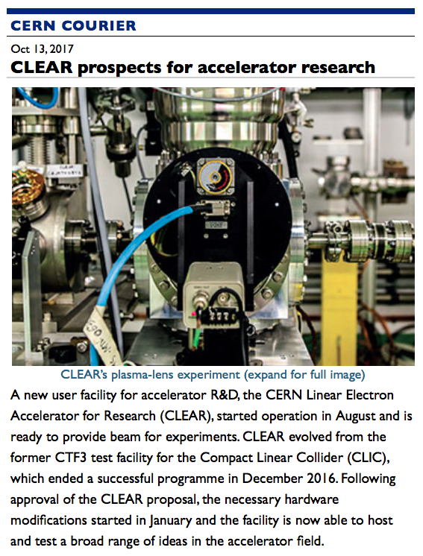

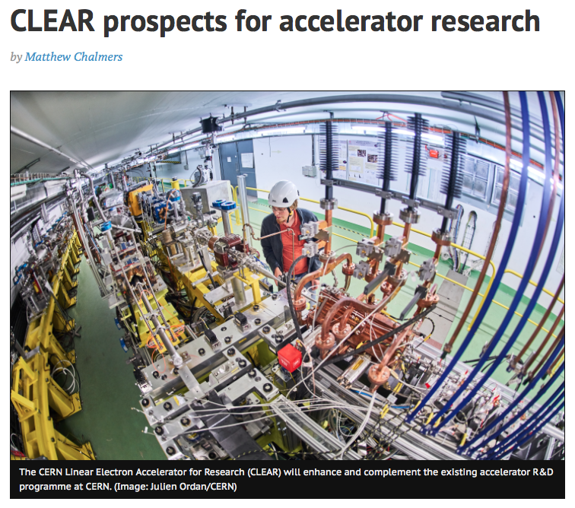
Already making the headlines

