Slide 1
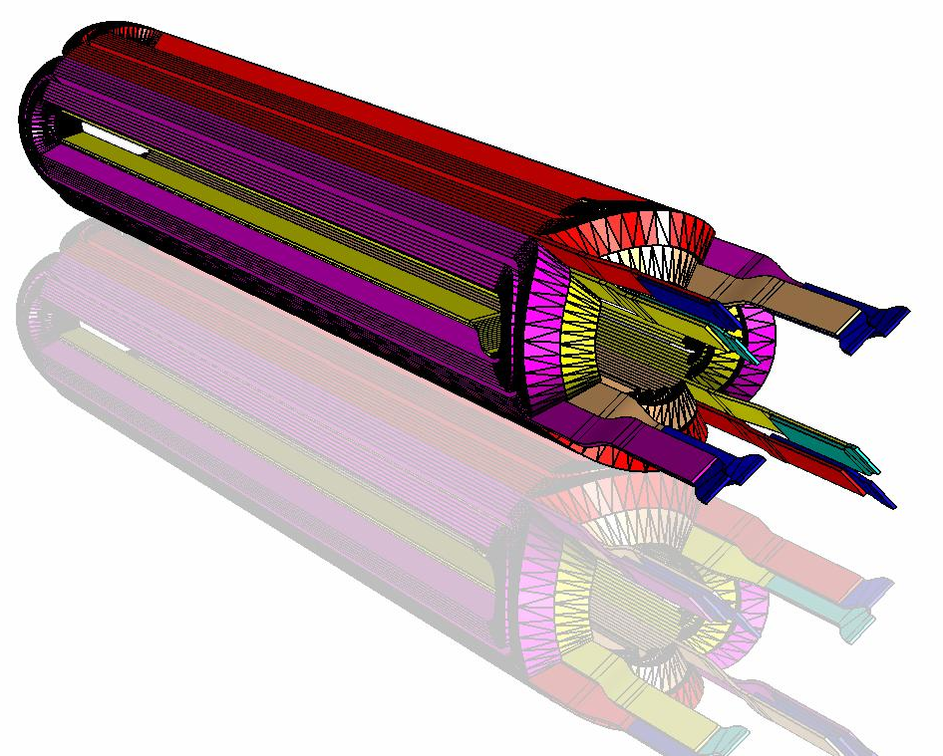
CEA Nb₃Sn quadrupole magnet : test results and future

Slide 2
Content
Magnet design and components
Test results and first interpretations
Magnet cool down
Quench start inside the coil at 4.2K
Quench start in splice region
Standard current cycles
Future actions

Slide 3
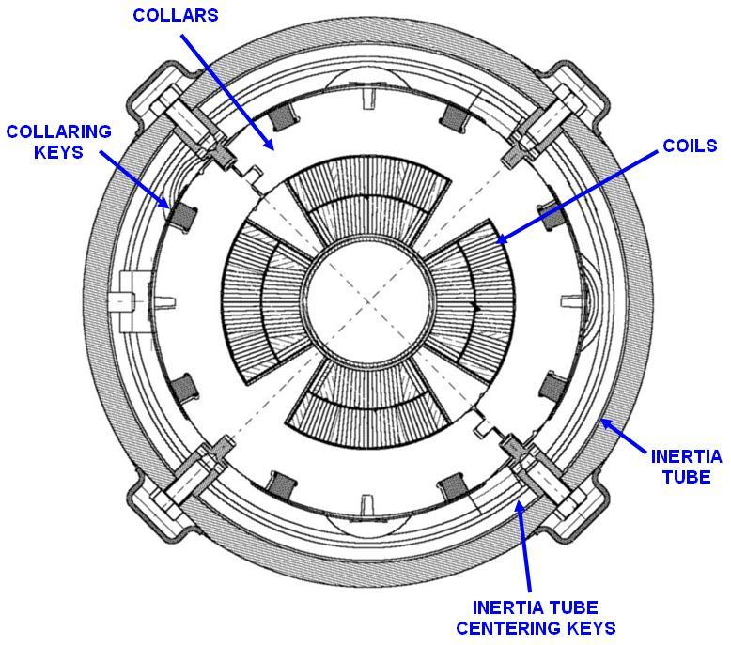
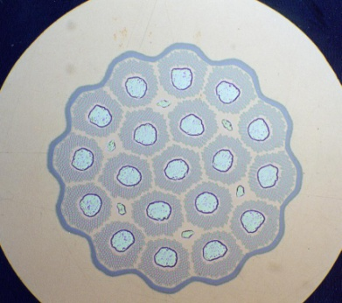
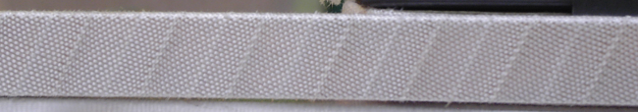
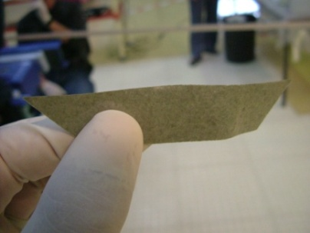
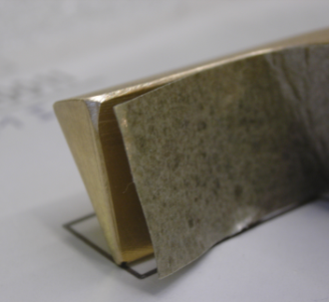
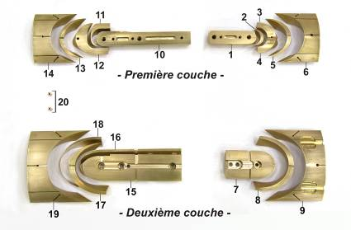
Magnet design
Model design based on the design of LHC arc quadrupole magnets
Rutherford-type cable developed by ALSTOM MSA relying on available Nb₃Sn wires
Strand Ø : 0.825 mm
Jc (4.2K, 7T ) : 1850 A/mm2
Effective filament Ø : 19 µm
Cable insulation relying on S2-glass fiber tape
Angular and End wedges realized in Al-80%wt Cu
End wedges insulation and inter-turn insulation made up of 0.1-mm-thick mica foils

Slide 4
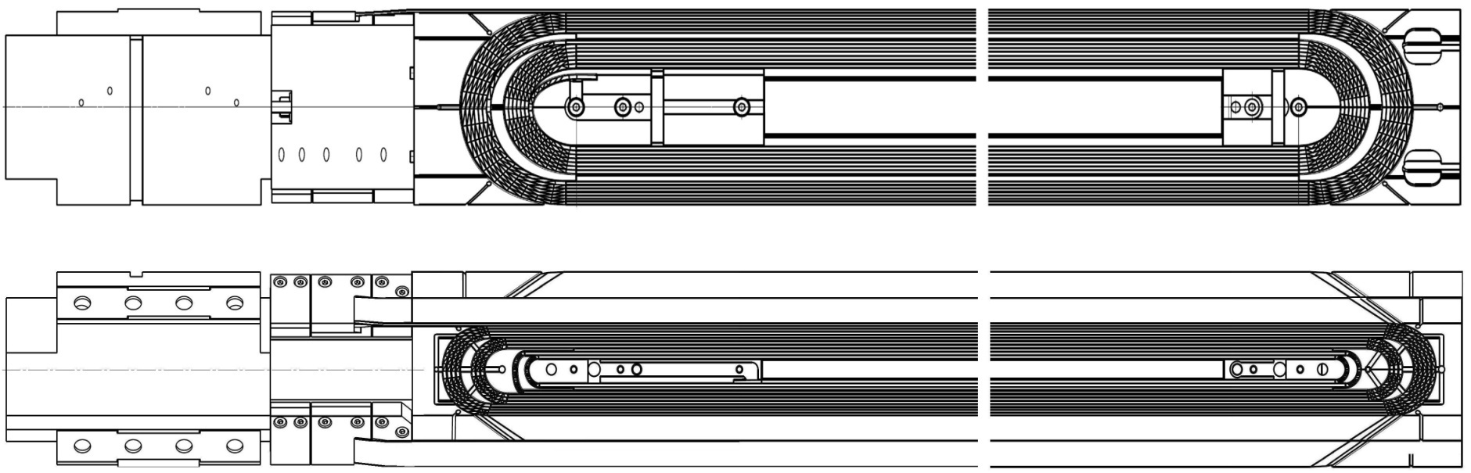
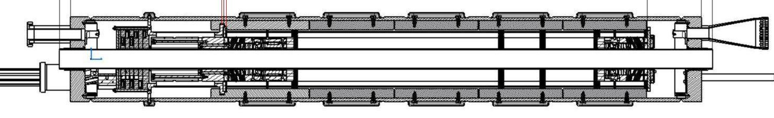
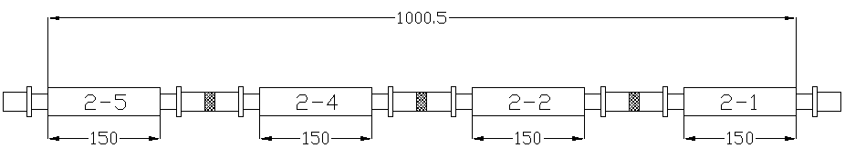
Magnet Instrumentation
13 voltage taps per coil : 9 in the end parts, 4 in splice region
4 Quench antenna and 16 capacitive gauges (coil polar planes)
5
9
8
6
7
10
1
2
0
4
3

Slide 5
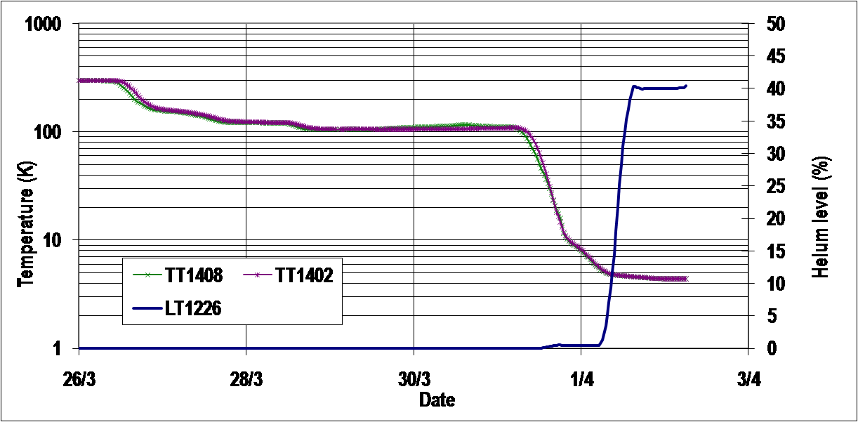
Magnet cool down
The magnet has been cooled down in 6 days, with a plateau at 100K for 3 days.
Measured RRR value for the Nb3Sn part is of about 200.
Coil to ground insulation before and after cool down > 200Mohm at 500V

Slide 6
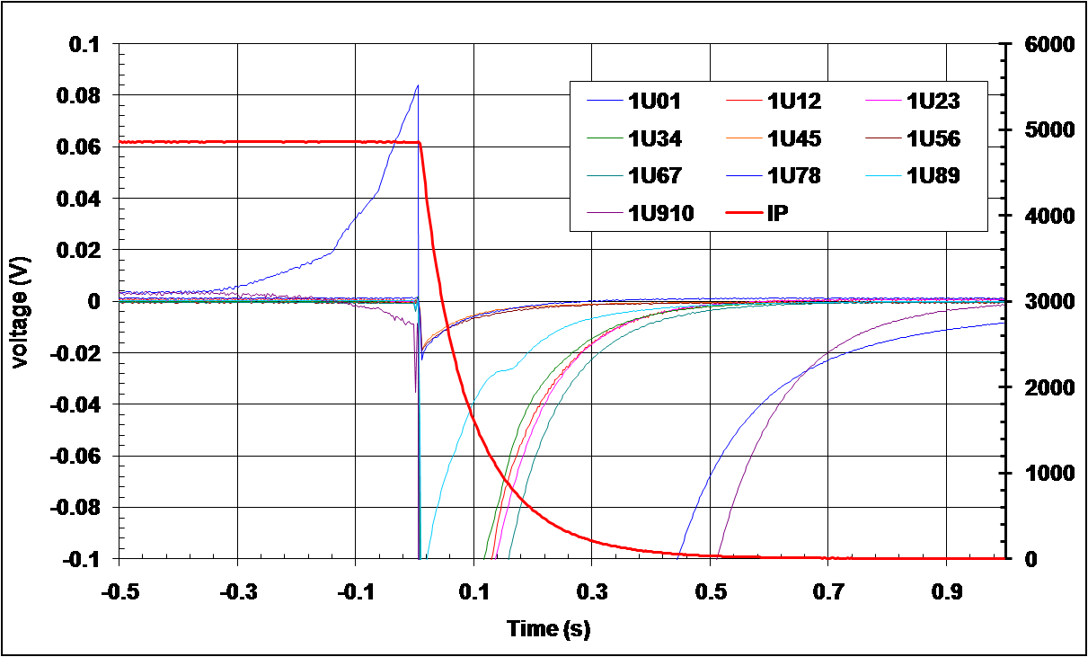
Quench at 4.2K
8/9 quenches started on Pole I, between 4860 and 4920 A
[ Ramps to 5 kA, by steps of 1kA up to 4kA, then 500 A – ramp rate : 10A/s ]

Slide 7
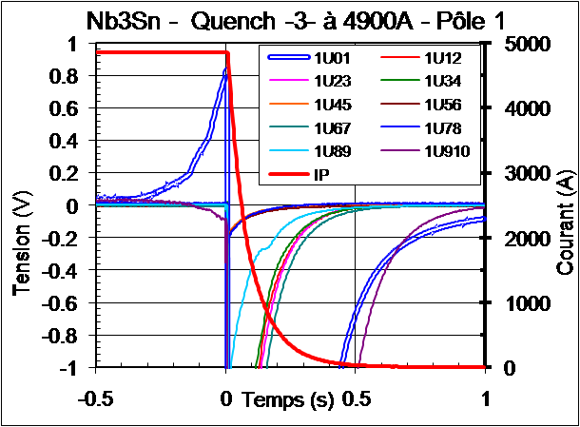
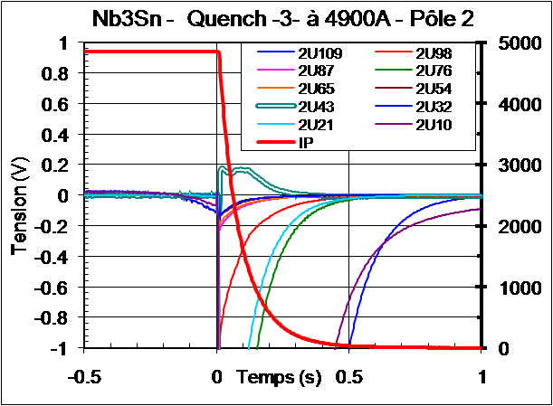
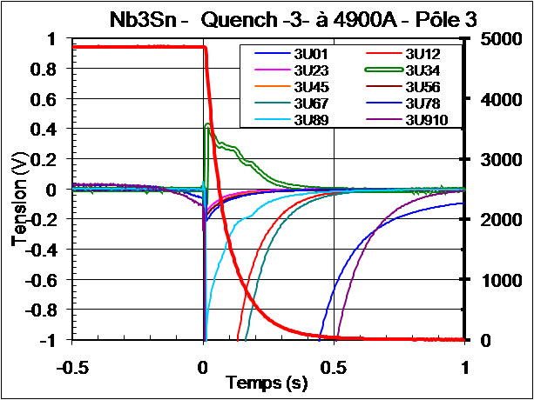
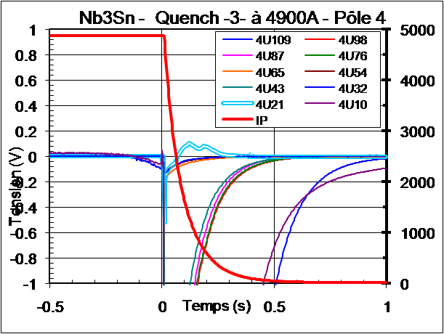
Quench # 3 at 4.2K Iq = 4900A

Slide 8
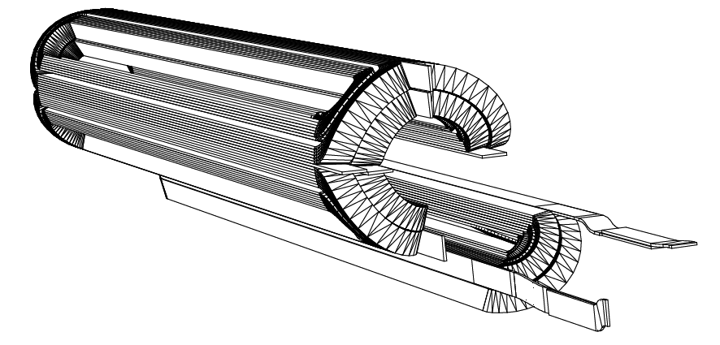
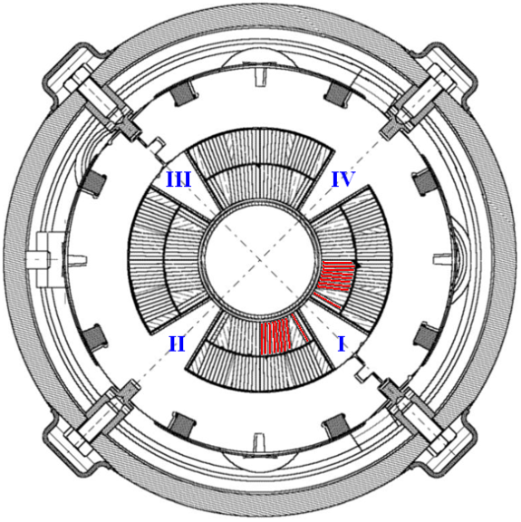
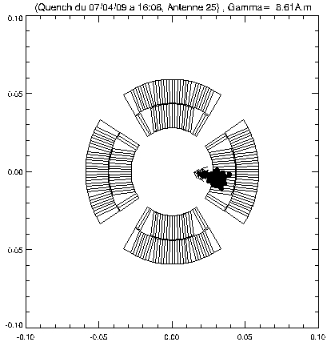
Quench localization
Inner layer
Lead end

Slide 9
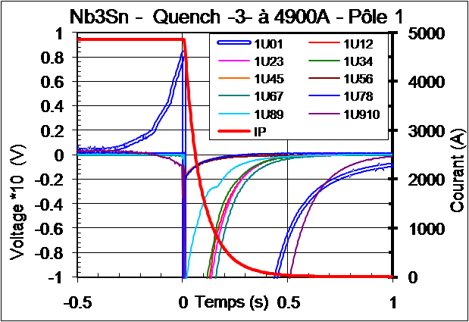
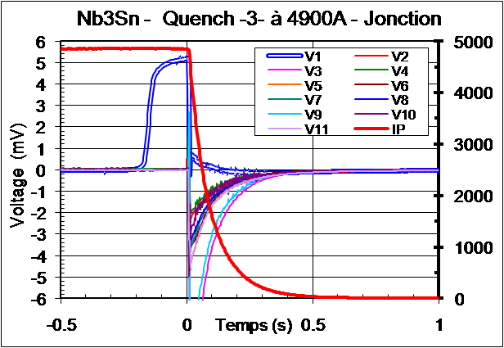
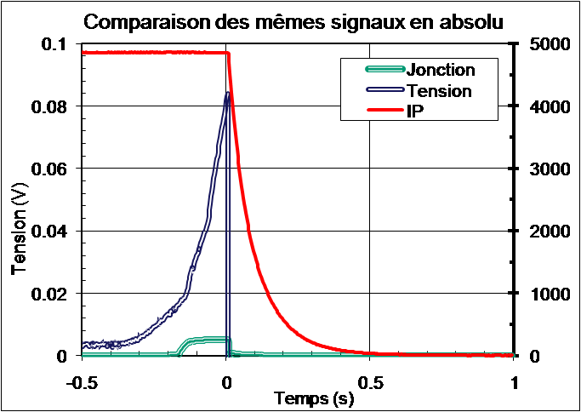
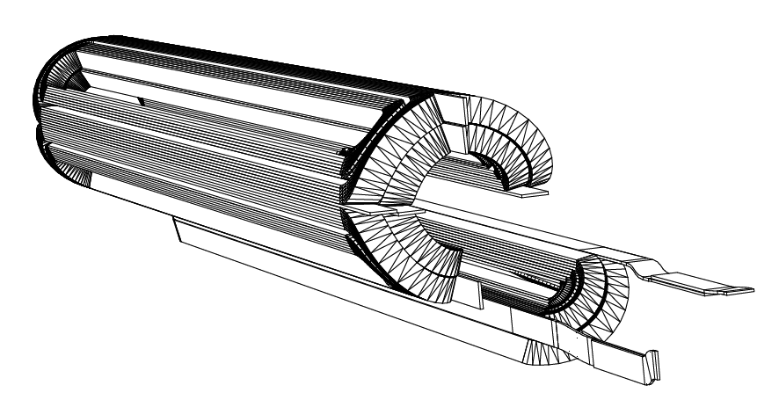
Quench # 3 at 4.2K Iq = 4900A
Quench propagation from coil to Nb₃Sn/ NbTi splice

Slide 10
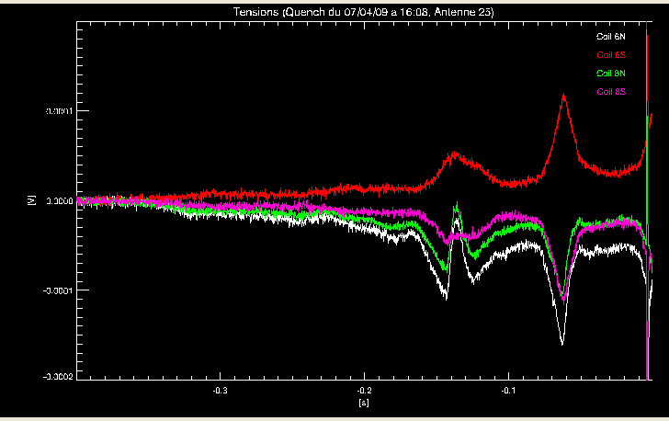
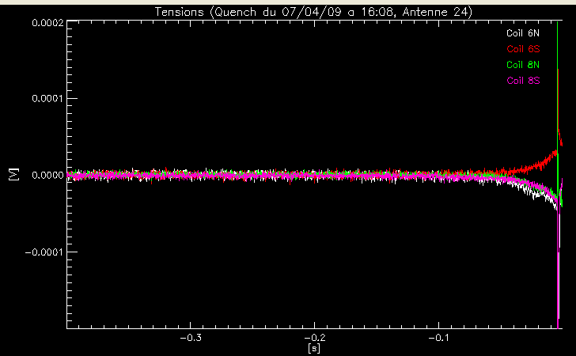
Quench # 3 at 4.2K Iq = 4900A
Quench propagation from the lead end to the center of the magnet
v = 0.95 m/s
Quench antenna 5
Quench antenna 4

Slide 11
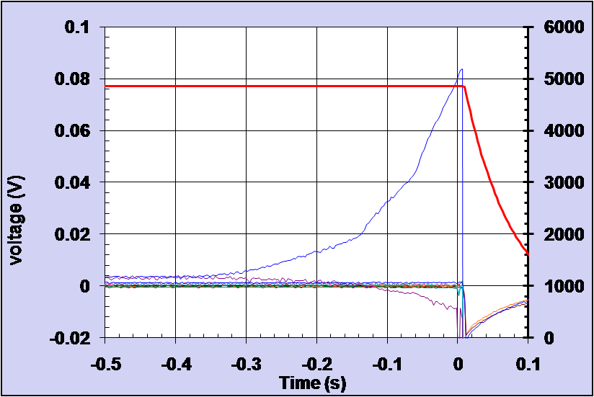
Transverse quench propagation ?

Slide 12
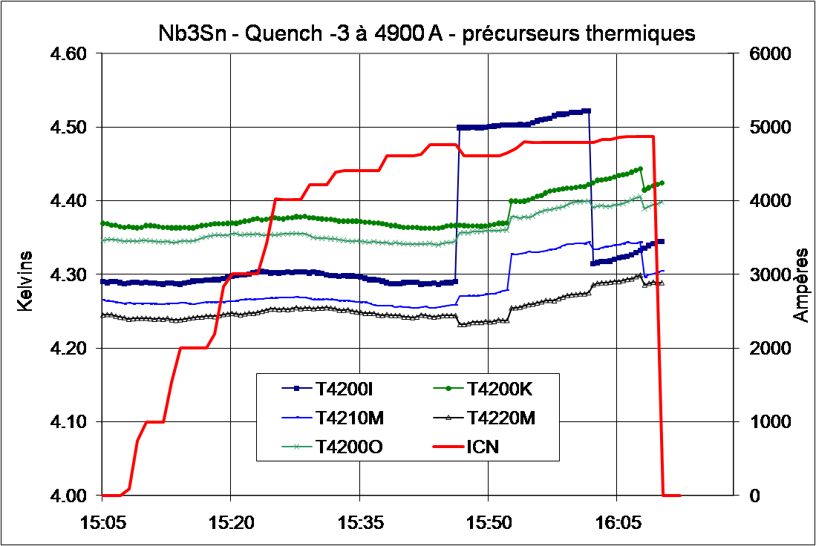
Quench # 3 at 4.2K Iq = 4900A
Temperature rise about 25 min before the quench
ΔT = 0.2 K
Temperature gauges uncovering

Slide 13
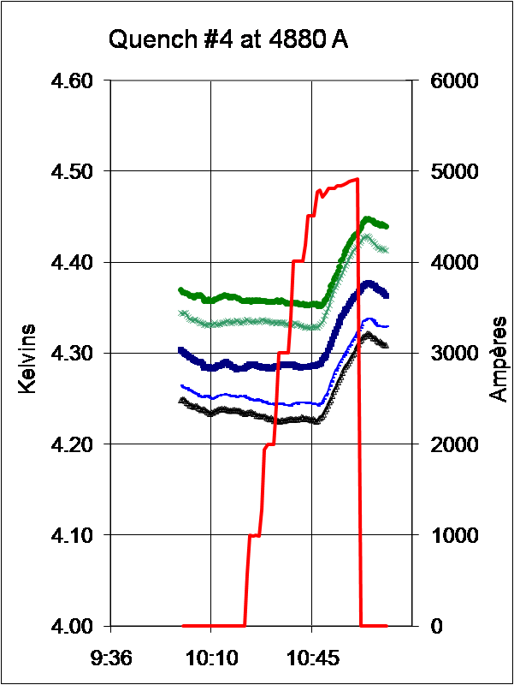
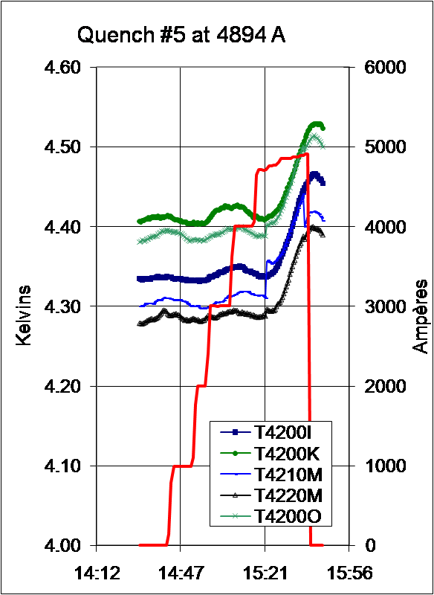
Thermal effects
Heat source is far from temperature gauges but it has an impact on helium bath

Slide 14
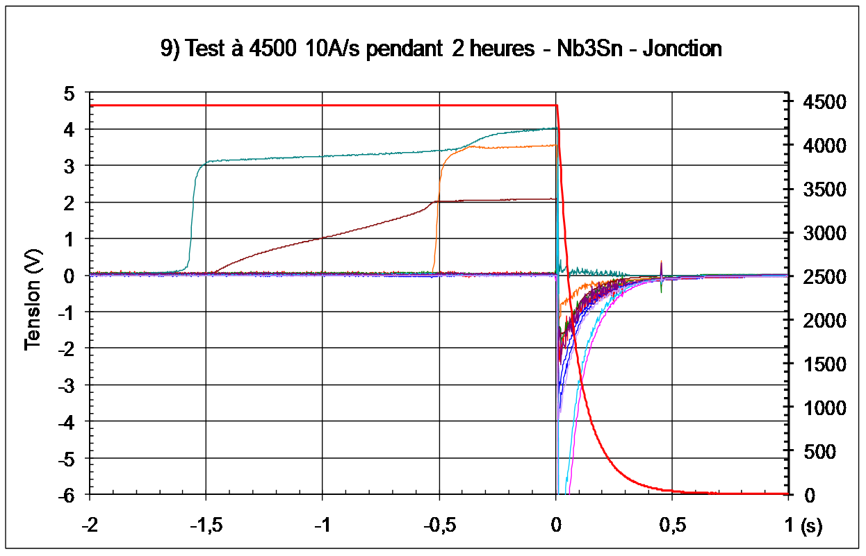
Quench in splice region
Quench started on Pôle III Splice 1, during current plateau at 4500 A
Pôle III Splice #1 (inner layer), then Pole III/Pole II internal connection, then Pôle II Splice 2 (outer layer)

Slide 15
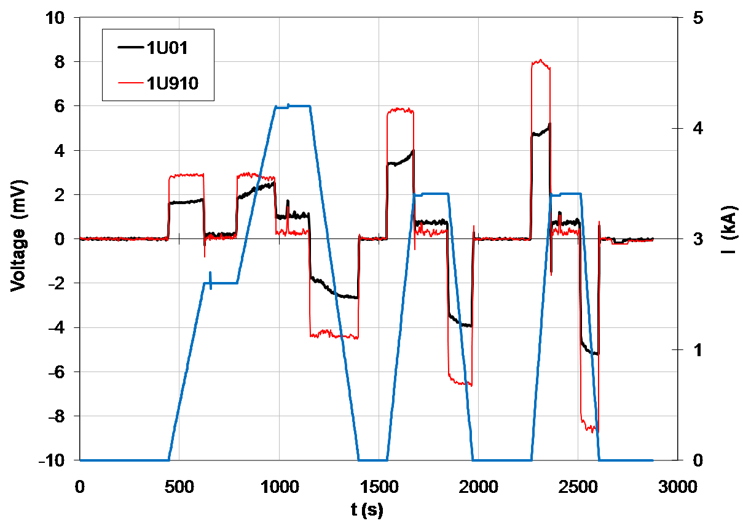
Standard current cycles at 4.2K

Slide 16
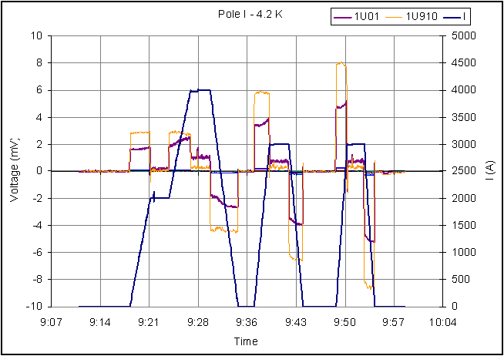
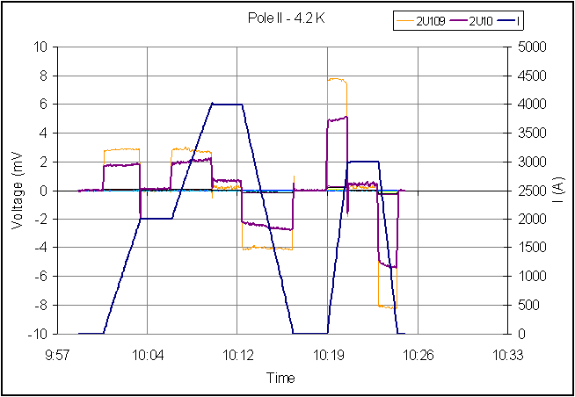
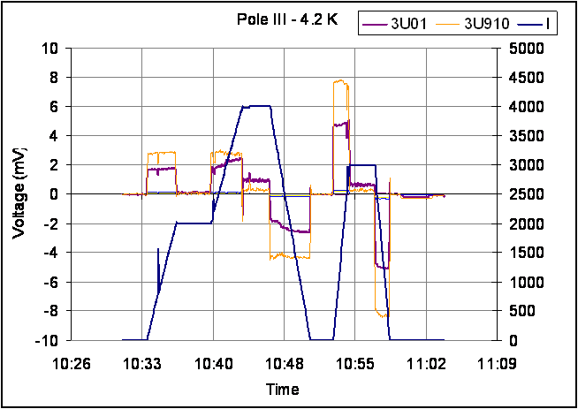
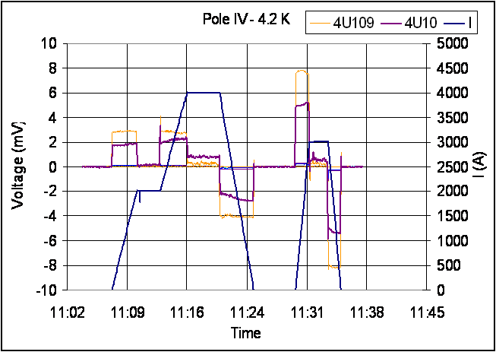
Standard current cycles at 4.2K

Slide 17
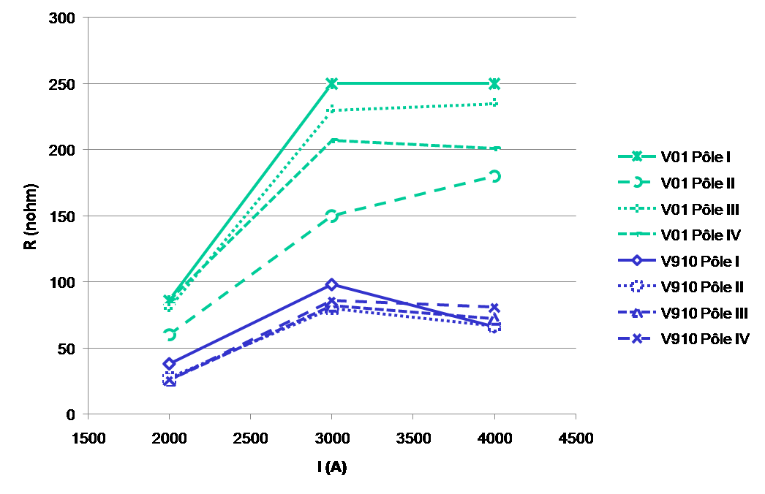
Standard current cycles at 4.2K
R independent from I for I > 2 kA
R = 200-250 nohm, RRR = 200 → Defect length = 3 cm

Slide 18
Future actions
Results analysis has to be completed → october
Discussion with CERN → october
New test campaign ?
Mechanical tests on spare coil ?
Reacted Nb3Sn cable micrographies?
Cable Ic measurements under stress ?
Cold mass dessassembling ?

