Slide 1


EuCARD-WP7-HFM meeting
29 Sept. 2009
Dipole conceptual design
work at CERN
Attilio Milanese
Acknowledgements:
Gijs de Rijk, Ezio Todesco

Slide 2
Agenda
Preliminary considerations
Block design
7 Cos-theta design
Comparison with other dipoles
2 Lorentz forces
2 Next steps, references

Slide 3
Data
40 strands, 1 mm
100 mm
21.4 x 1.82 mm (bare)
21.8 x 2.22 mm (with ins.)
T = 4.2 K
Jc = 2500*0.90 = 2250 A/mm^2 @ 12 T
Jc = 1250*0.90 = 1125 A/mm^2 @ 15 T

Slide 4
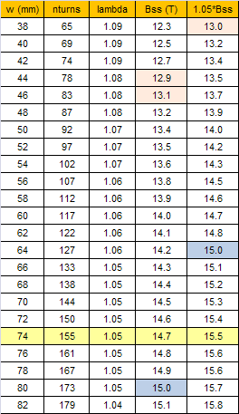
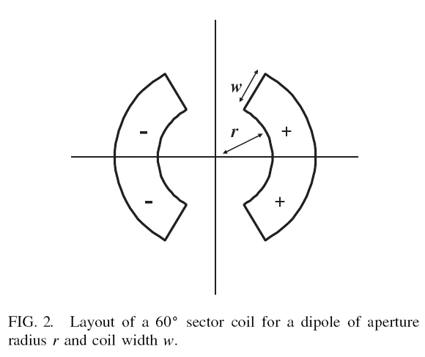
How much cable?
Using the approach of [1]:
r = 60 mm
156 turns
(per quadrant)

Slide 5
(Unconstrained) solution
max field at the center
no constraints on the multipoles
critical surface at infinity
only constraint: A = 156*w*t*4
gamma = central field /
current density
lambda = peak field /
central field
@ R = 2/3*50 mm
b3 140.4
b5 -33.8
b7 6.0
b9 -0.7
b11 -0.0

Slide 6
Block design: n1-n1-n3-n3, 2+1 DOFs
n4=n3
0.5 mm
n3
55 mm
x3
n2=n1
0.5 mm
n1
y1
60 mm

Slide 7
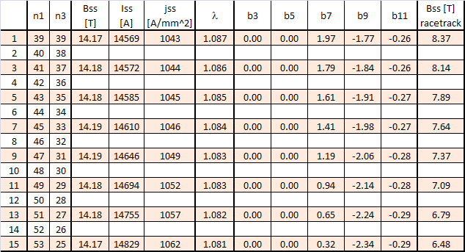
Block design: n1-n1-n3-n3, 2+1 DOFs
Moving around y1 & x3 to optimize b3 & b5:

Slide 8
Block 41-41-37-37

Slide 9
Block 41-41-37-37
@ T = 4.2 K
Bss 14.18 [T]
Iss 14572 [A]
jss 1044 [A/mm^2]
lambda 1.086
gamma 4.71E-08 [T/(A/m^2)]
@ R = 2/3*50 mm
b3 0.0
b5 0.0
b7 1.8
b9 -1.8
b11 -0.2
Inductance 42.2 [mH/m]
Energy 4.5 [MJ/m]

Slide 10
Block design: n1-n1-n3-n3, 5+1 DOFs
n4=n3
Dy 3-4
n3
y3
x3
n2=n1
Dy 1-2
n1
y1
60 mm

Slide 11
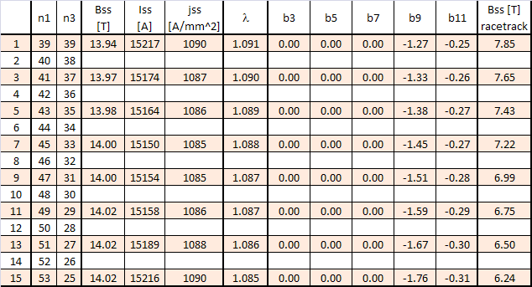
Block design: n1-n1-n3-n3, 5+1 DOFs
Moving around the 5 DOFs to optimize b3 & b5:

Slide 12
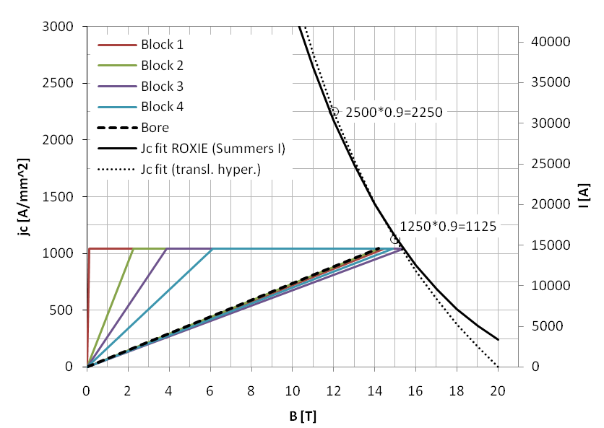
Load line (41-41-37-37, no iron)

Slide 13
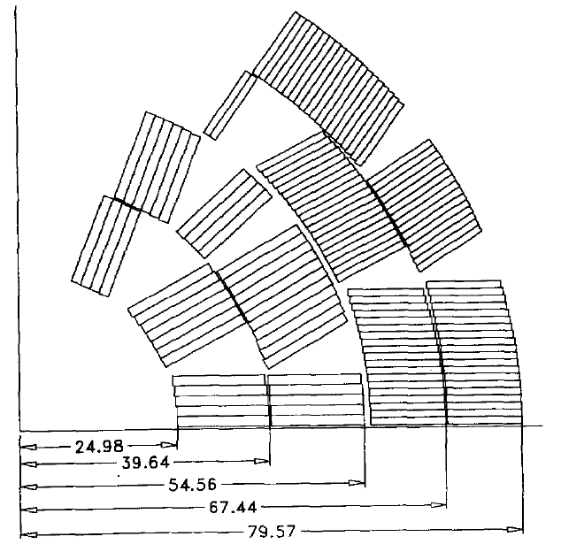
LBNL D20
From [2]

Slide 14

Cos-theta design
2x0.2mm shim
on the midplane
α = φ on the midplane
r1 = 60 mm
r2 = r1 + w + 0.5mm
r3 = r2 + w + 0.5mm
r4 = r3 + w + 0.5mm
r1
r2
r3
r4

Slide 15
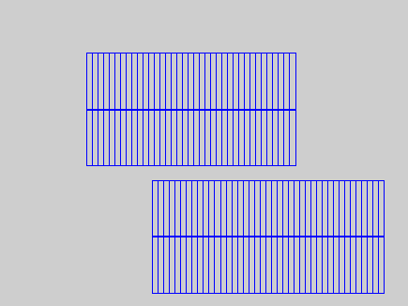
From block to cos-theta
What can be done with the same number of conductors (156)?

Slide 16
Cos-theta 156 conductors

Slide 17
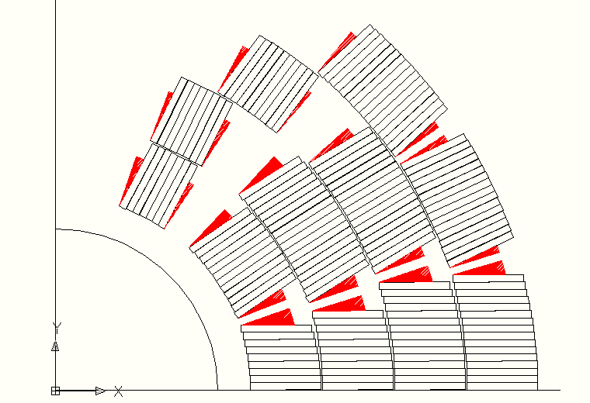
Cos-theta 156 conductors
max |φ−α|
19.5° for blocks on the midplane
14.6° for the others
for D20:
22.2° & 20.2°

Slide 18
Cos-theta 156 conductors
@ T = 4.2 K
Bss 14.57 [T]
Iss 14646 [A]
jss 1049 [A/mm^2]
lambda 1.055
gamma 4.82E-08 [T/(A/m^2)]
@ R = 2/3*50 mm
b3 0.0
b5 0.0
b7 0.0
b9 0.1
b11 0.8
Inductance 41.7 [mH/m]
Energy 4.5 [MJ/m]

Slide 19
Cos-theta 156 conductors
max radial shift 538 μm
multipoles
@ R = 2/3*50 mm
aligning at the inner radius:
b3 0.00
b5 0.00
b7 0.02
b9 0.09
b11 0.82
aligning at the outer radius:
b3 -1.25
b5 0.05
b7 0.11
b9 0.14
b11 0.84

Slide 20
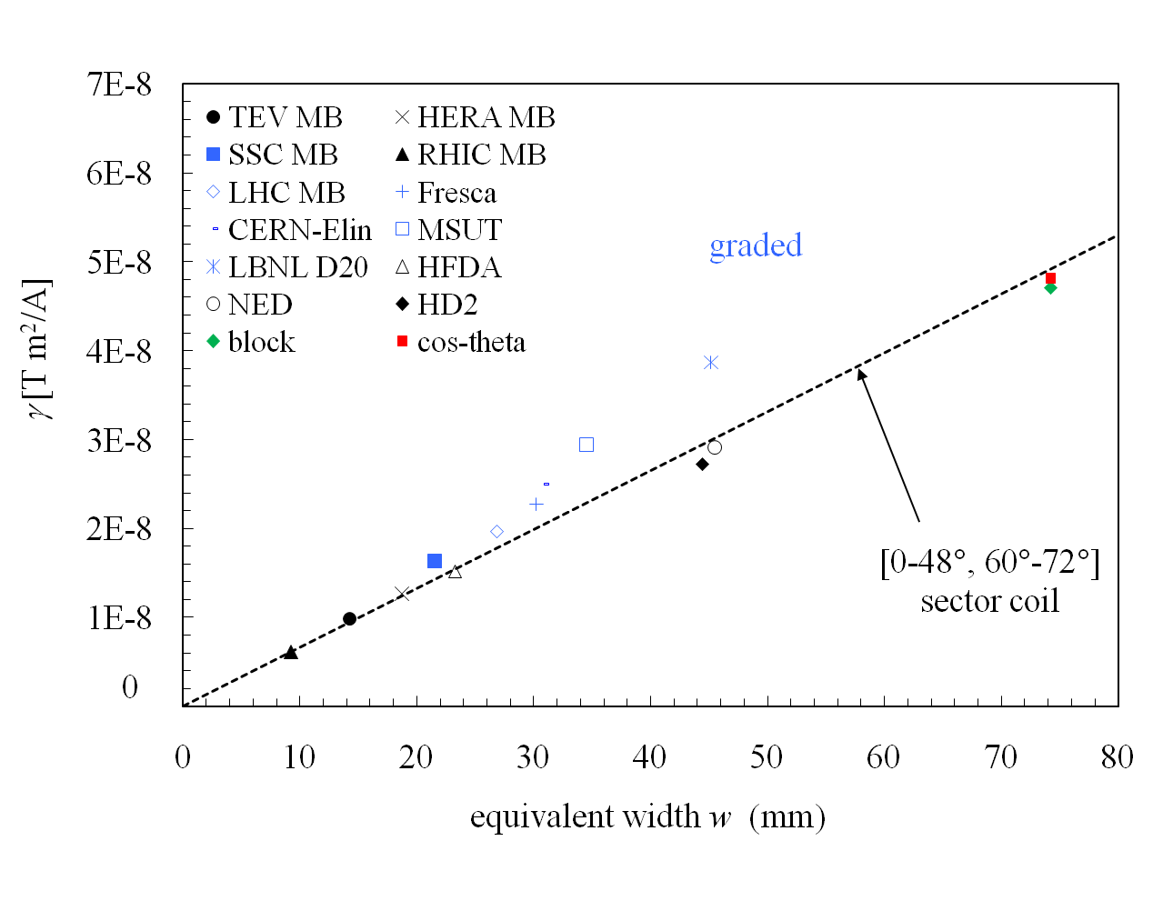
Comparison with other dipoles
γ = central field per unit of current density
Magnets’ data from [1] and [3]

Slide 21
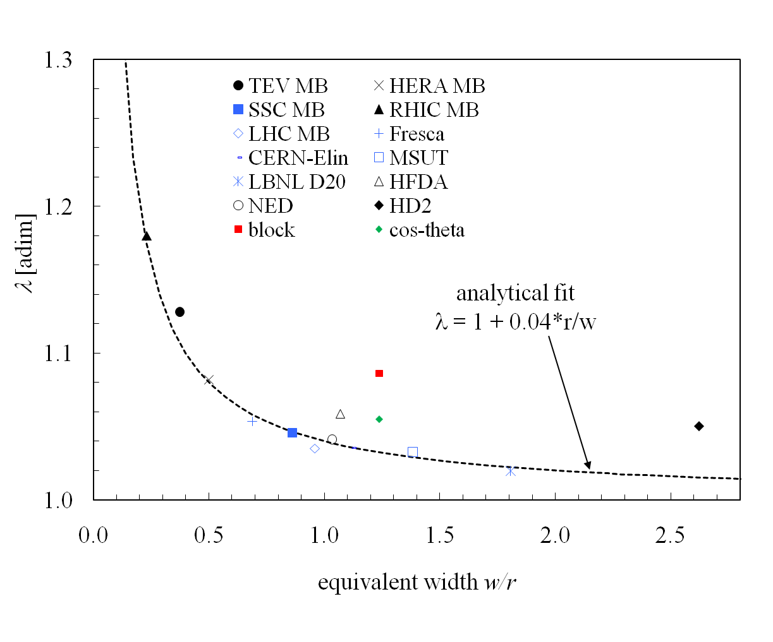
Comparison with other dipoles
λ = peak field / central field
Magnets’ data from [1] and [3]

Slide 22
Iron contribution: block layout
r_iron = 180 mm
μr = 1000
Bss = 15.65 T (+8.2%)
FEM
LHC steel, saturation
Bss = 14.93 T (+5.3%)

Slide 23
Iron contribution: cos-theta layout
r_iron = 180 mm
μr = 1000
Bss = 15.67 T (+7.5%)
FEM
LHC steel, saturation
Bss = 15.27 T (+4.8%)

Slide 24
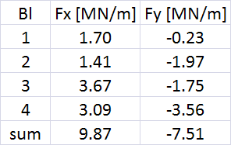

Lorentz forces (per quadrant)
@ short sample
(Bss = 14.2 T, Iss = 14.6 kA)
HD2
@ short sample (4.2 K)
(Bss = 15.0 T, Iss = 17.3 kA)

Slide 25
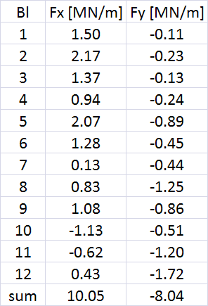
Lorentz forces (per quadrant)
@ short sample
(Bss = 14.6 T, Iss = 14.6 kA)

Slide 26
Next steps
2D stress analysis
magnet ends
...
...

Slide 27
References
[1]
Electromagnetic design of superconducting dipoles based on sector coils
L. Rossi and Ezio Todesco
Phys. Rev. special topics – Accelerators and beams, 10, 112401 (2007)
[2]
Design and fabrication of end spacers for a 13 T Nb3Sn dipole magnet
S. Caspi , D. Dell'Orco, W. B. Ghiorso and A. Wandesforde
IEEE Trans. Appl. Supercond., 5 (1995)
[3]
Electromagnetic efficiency of block design in superconducting dipoles
L. Rossi and Ezio Todesco
IEEE Trans. Appl. Supercond., 19 (2009)

