Slide 1


Compact magnet design
Daniel Schoerling
On behalf of EuroCirCol WP5 and the FCC-hh Magnet Development Program
13th of December 2017

Slide 2
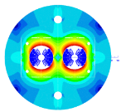
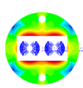
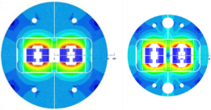
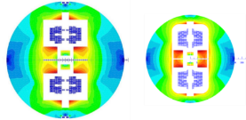
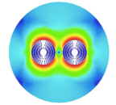
Magnet Design Options
800 mm 600 mm
Magnet length 14.3 m
Free physical aperture 50 mm
Inter-beam distance 204 mm
Field amplitude 16 T
Margin on the load-line @ 1.9K 14 %
Total time margin 40 ms
Critical current density @ 1.9 K, 16T 2300 A/mm²
Conductor fit (J_{c}/B) EuroCirCol fit
Degradation due to cabling 3%
Minimum Cu/nonCu 0.8
Maximum strand diameter 1.2 mm
Maximum stress on conductor at warm 150 MPa
Maximum stress on conductor at cold 200 MPa
Maximum hot spot temp. (@ 105% I_{nom}) 350 K
Maximum number of strands in a cable 40 - 60
Maximum voltage to ground (magnet) 1.2 kV
Maximum TOTAL voltage to ground 2.5 kV
Conductor cost (performance based) 5 Euro/kAm
Cosine-theta (baseline)
Block-type coils
Common-coils
2015 2017
CCT (PSI with LBNL and CERN)

Slide 3
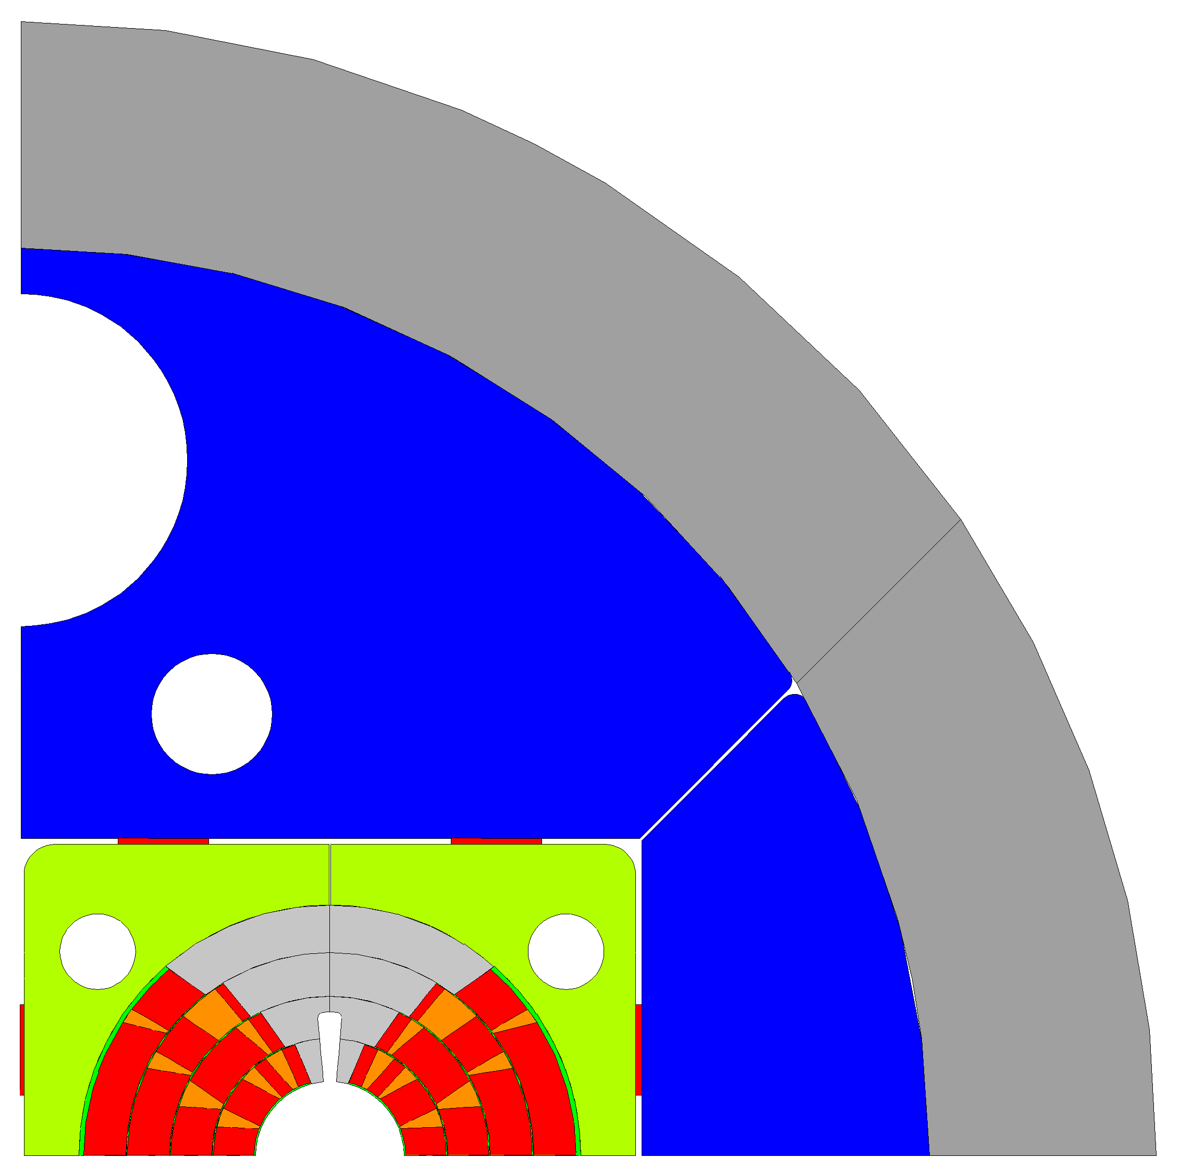
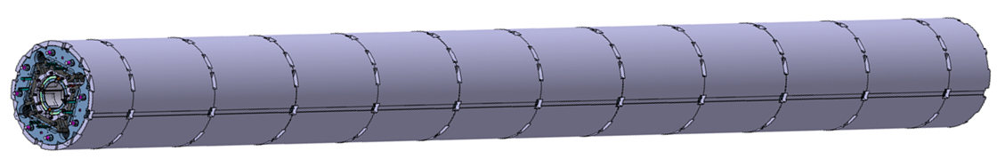
Curved compact dipole magnets
LHC dipole magnets were produced straight and then curved in a press before welding the outer shell
The current baseline foresees a bladder and key structure with approximately 0.8 m long aluminum shells
Making the segments shorter ‘Aluminum collar shell’ may allow bending the structure without concentrating the stress at few positions
Using Invar (FeNi36) as yoke material may allow to replace the Al shell (sufficient pre-stress and compensating the lower magnetic saturation may not allow for smaller overall size, studies are on-going)
Collaring and using yoke materials with larger stress limit may allow to further reduce the overall size (explorative studies will start soon)
Stainless steel shell
Aluminum shell
Iron yoke
Steel pad
Titanium pole
Copper wedges
Conductor
∅ 600 mm
∅ 750 mm
MQXFB
∅ 790 mm

