Slide 1


The Return of
WIMPy
Dark Matter
Nausheen R. Shah
Puebla, Mexico
May 22, 2019

Slide 2
What’s the matter with
Dark Matter?

Slide 3
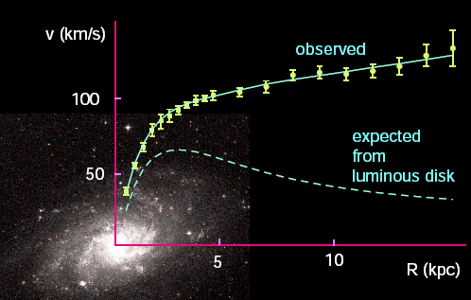

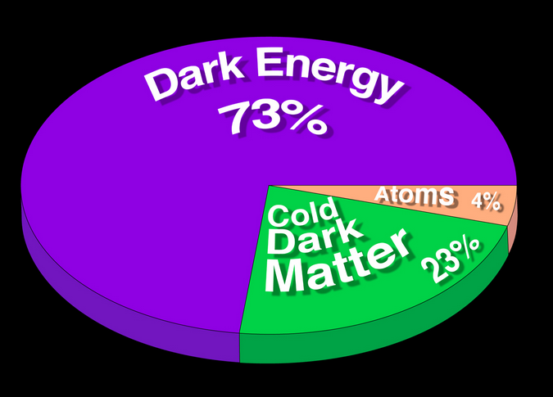
Welcome to the Dark Side!
Wikipedia
http://cosmology.berkeley.edu/Education/CosmologyEssays/Why_Dark_Matter.html
We know both A LOT and VERY LITTLE about Dark Matter
Experimental Observation: Ωh² = 0.1188 ± 0.0011
Planck 2015

Slide 4

Welcome to the Dark Side!
What is Dark Matter?
Is not colored or charged
Interacts gravitationally
Could interact weakly
Stable on Universe
lifetime scales
More than one DM species?
Higgs Interactions?
Neutrinos?? Too Hot:
No Structure formation
Wikipedia
We know both A LOT and VERY LITTLE about Dark Matter
Experimental Observation: Ωh² = 0.1188 ± 0.0011
Planck 2015

Slide 5
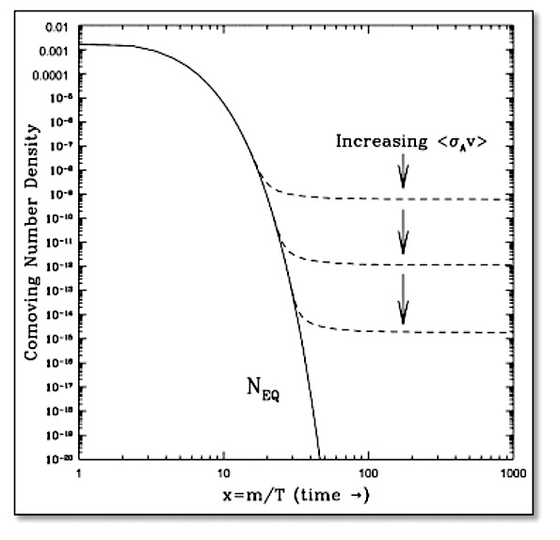
Thermal Relic?
What sets the abundance of the
Dark Matter observed?
Annihilations try to maintain thermal equilibrium.
Universe is Expanding!
At some point a DM particle can’t “find” another DM particle to annihilate with: FREEZE-OUT.
LARGER annihilation rate means LOWER number density.
Hooper, 09

Slide 6
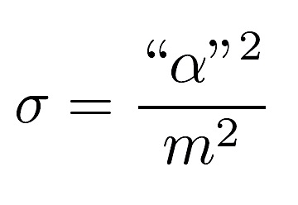
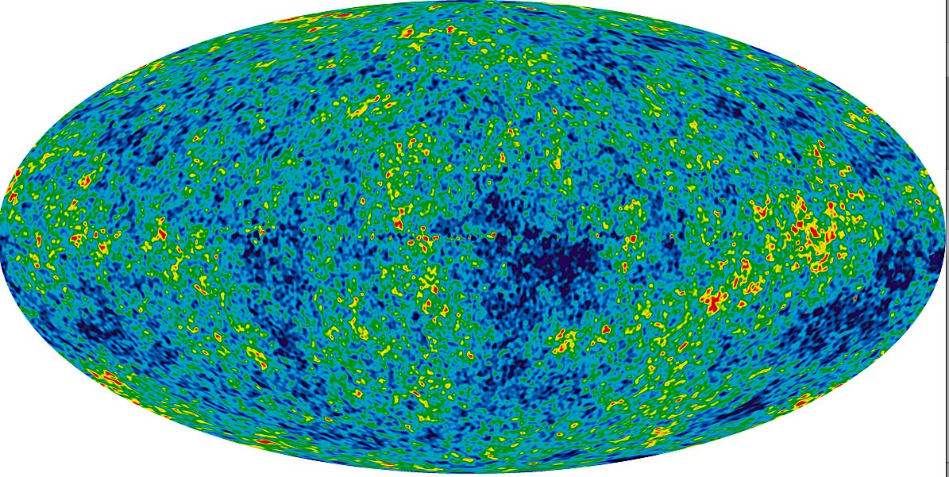
The WIMP Miracle.
Planck 2015
Interestingly, the annihilation cross-section required to give rise to an observationally consistent relic density
is naturally of the right order given weak scale couplings and masses (100 GeV) !

Slide 7
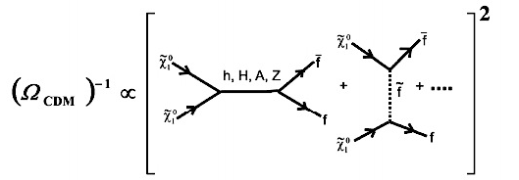


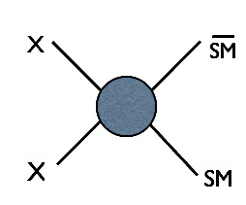
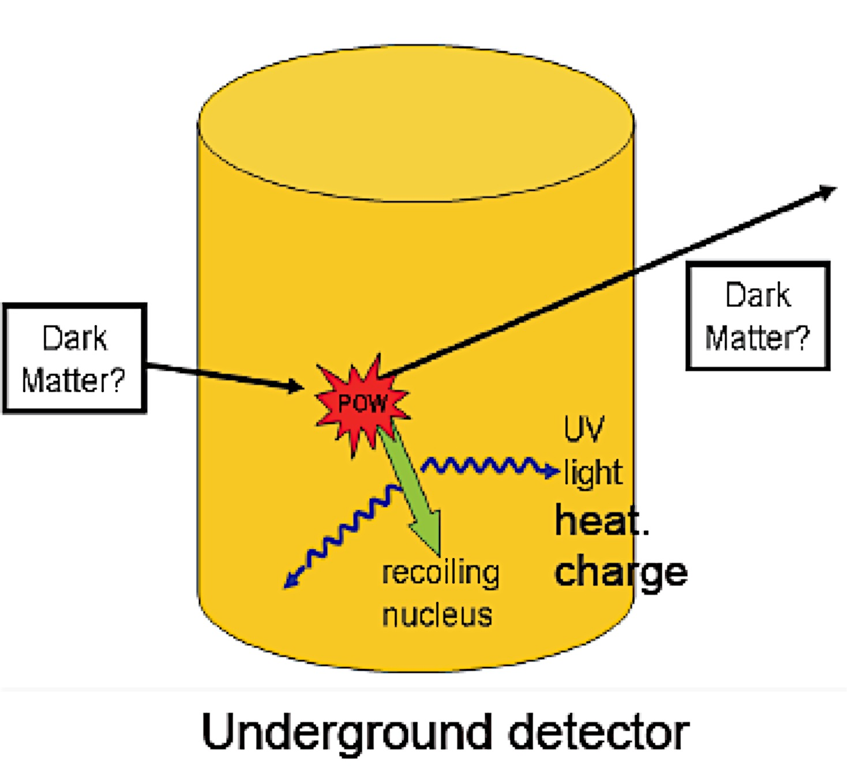

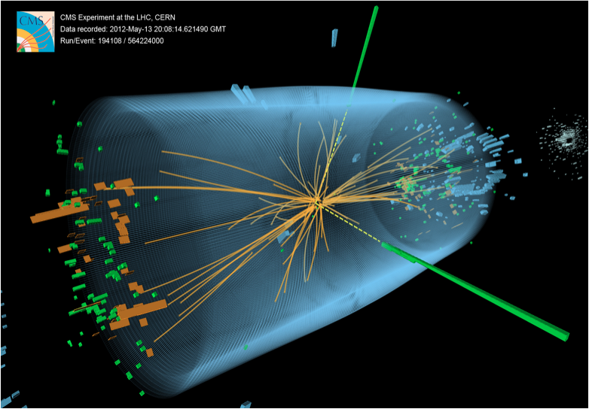

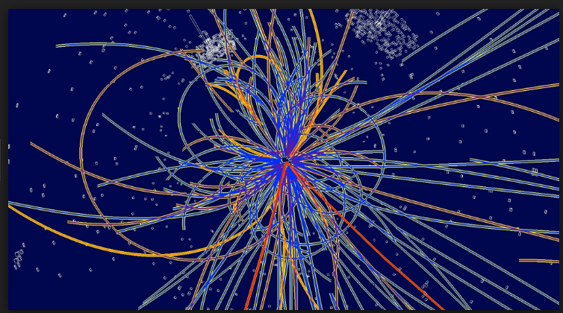
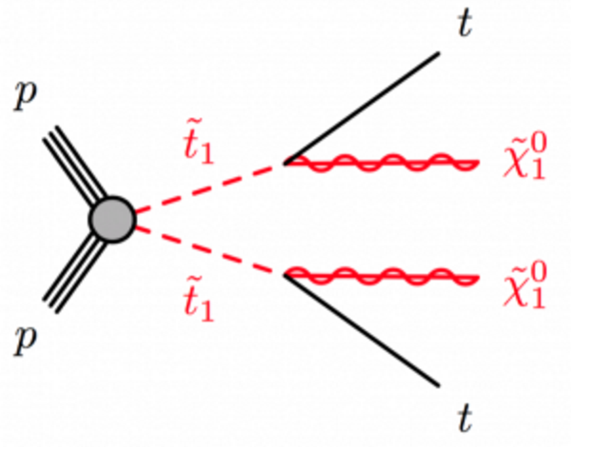
Break it!
Annihilation
Scattering
Shake it!
Collider
Make it!

Slide 8
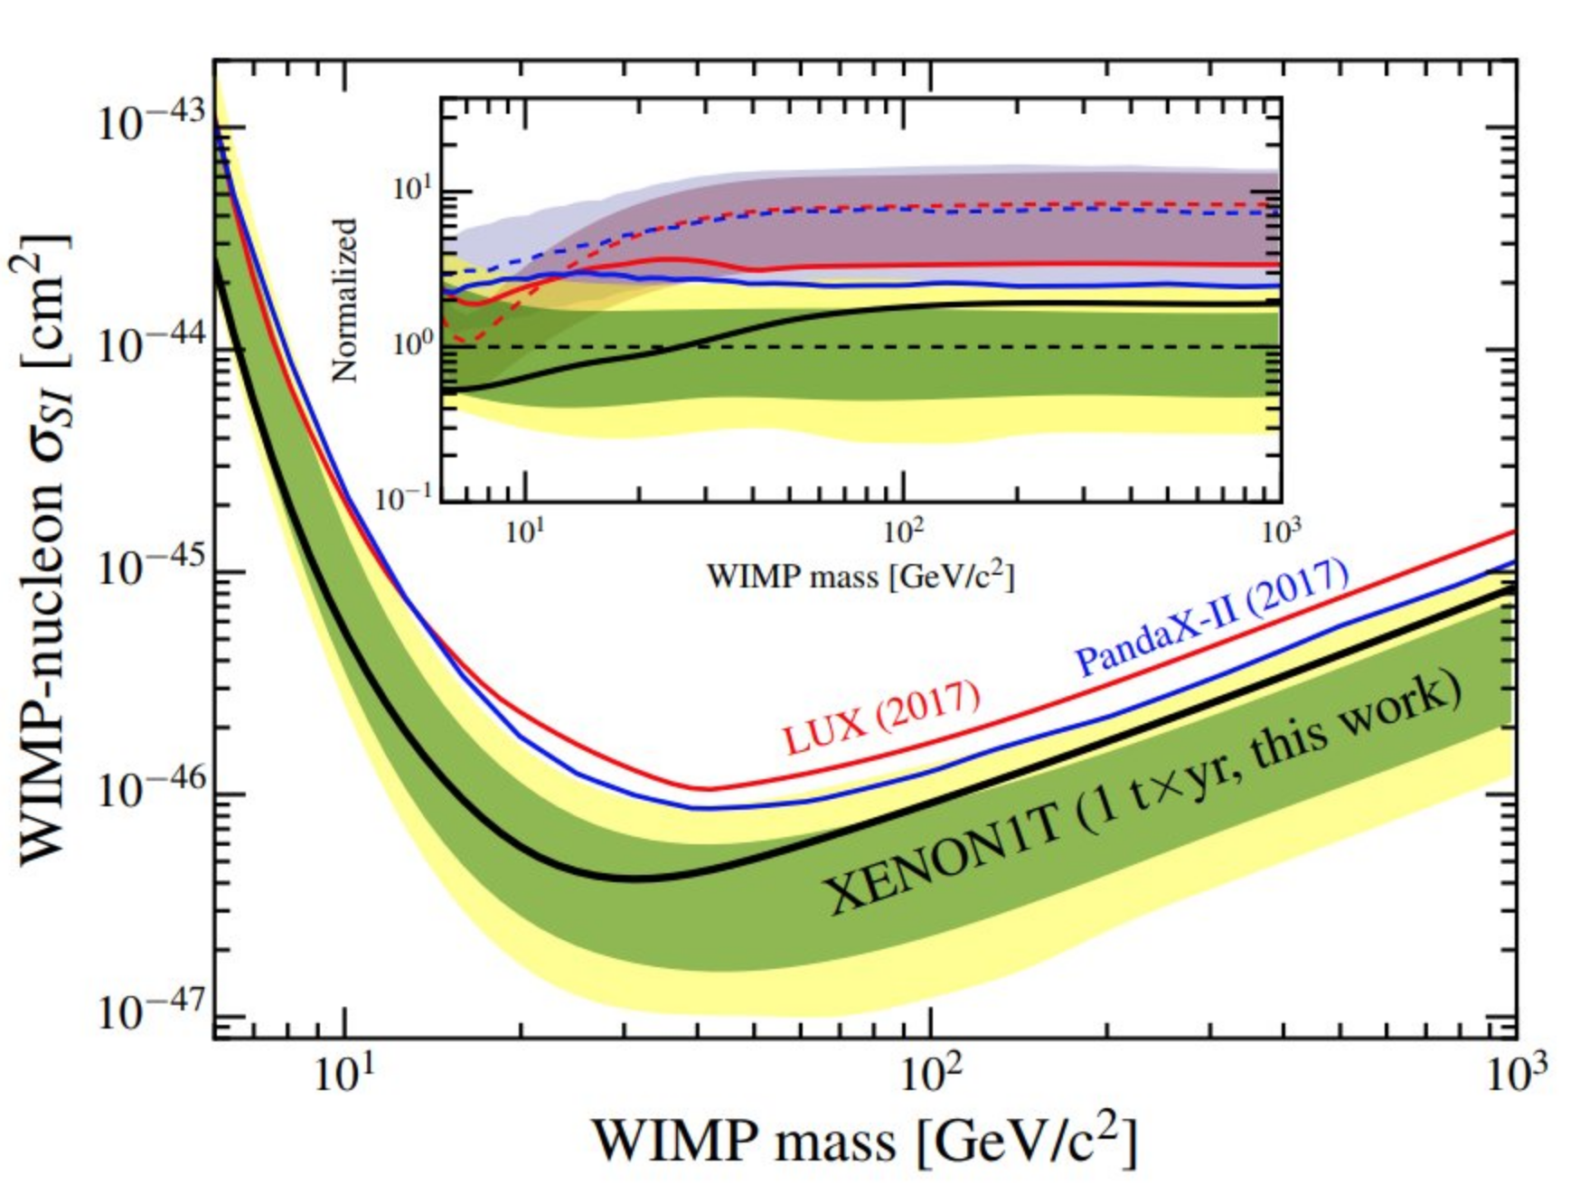
SI DD + Ωh² ??
χ
χ
SI DD
φ_{i}
Ωh²
χ
SM
φ_{i}
SM
SM
χ
SM
XENON1T arXiv:1805.12562
m_{χ} ~ GeV - TeV
Break the Connection!
Co-annihilation/resonance
Multiple mediators for destructive interference

Slide 9
SUPERSYMMETRY: A bouquet of WIMPS

Slide 10
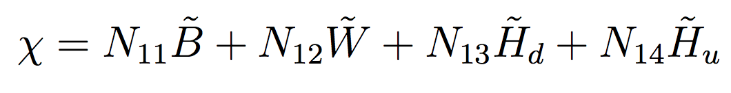
SUSY Dark Matter? Neutralinos!
SM Gauge Bosons and Higgs (2HDM in SUSY) Superpartners
Bunch of weakly coupled neutral Majorana fermions, lightest stable due to R-parity: WIMP!
B: SU(2) singlet
Bino M₁ g₁
{W⁰, W¹, W²}: SU(2) triplet
Winos M₂ g₂
1 neutral, 2 charged
{H_{u} H_{d}}: SU(2) doublets
Higgsinos μ Yukawas etc
2 neutral, 2 charged
MSSM: 4 neutral “Neutralinos”, mixtures of interaction states (Also 2 charged “Charginos”
mixtures of wino and Higgsinos).

Slide 11
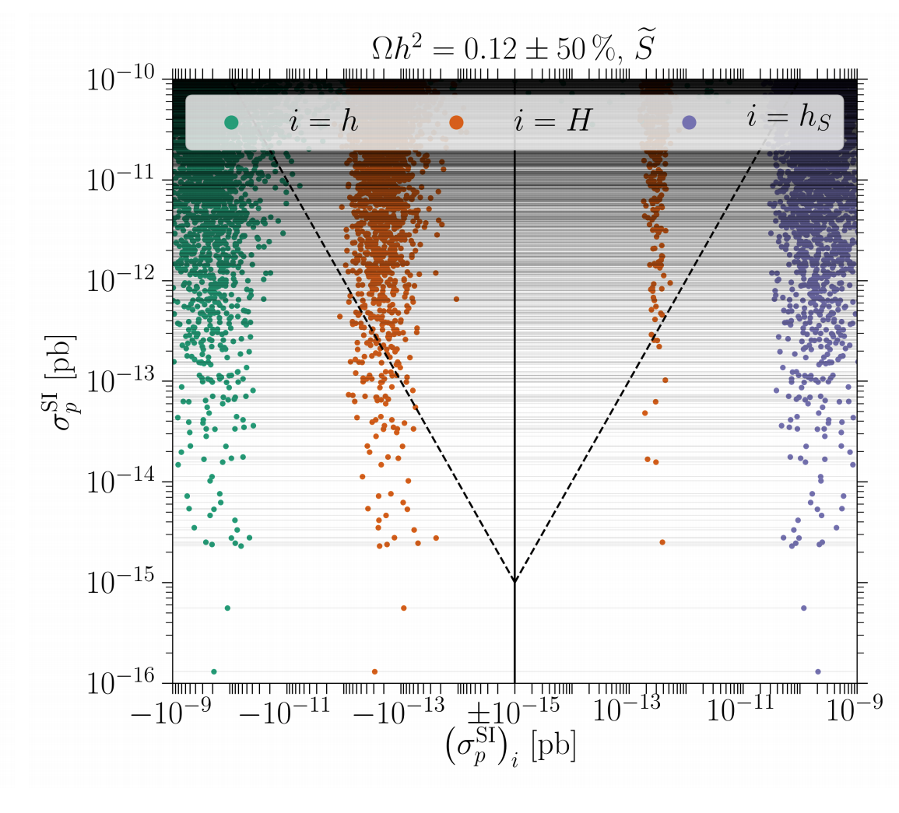
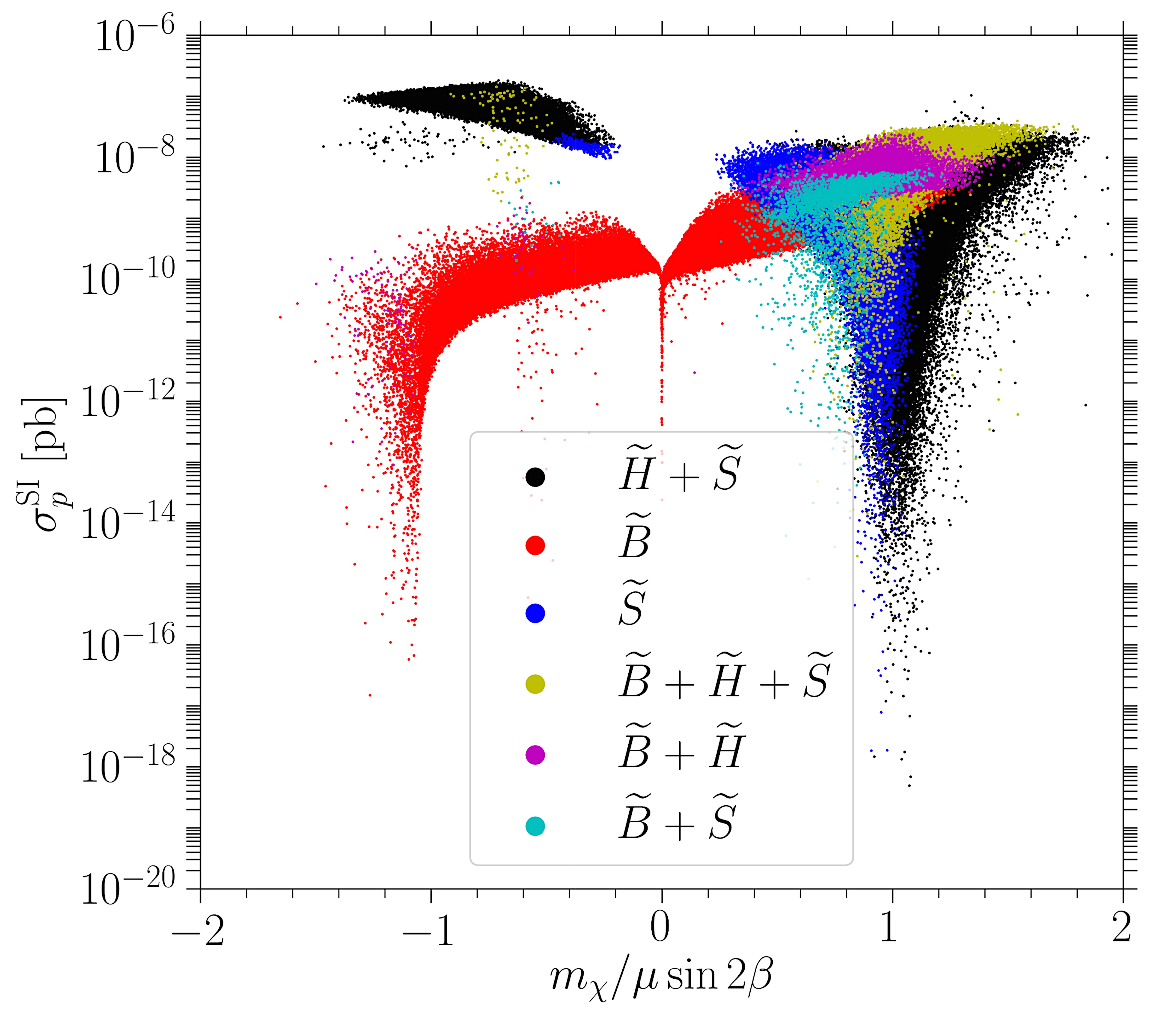
SI Direct Detection?
SI DD mediated by CP-even scalars
(NMSSM shown: extra singlet scalars
and singlino neutralino).
Cheung, Papucci, Sanford, NRS, Zurek, `14;
Huang, Wagner, 2014, etc.
𝘩₁₂₅ χχ coupling suppressed:
m_{χ} = +- μ sin 2β
S. Baum, M. Carena, N.R.S, C. Wagner, ‘17
Destructive interference between CP-even Higgs mass eigenstates

Slide 12
LHC: A New Hope
(Maybe???)

Slide 13
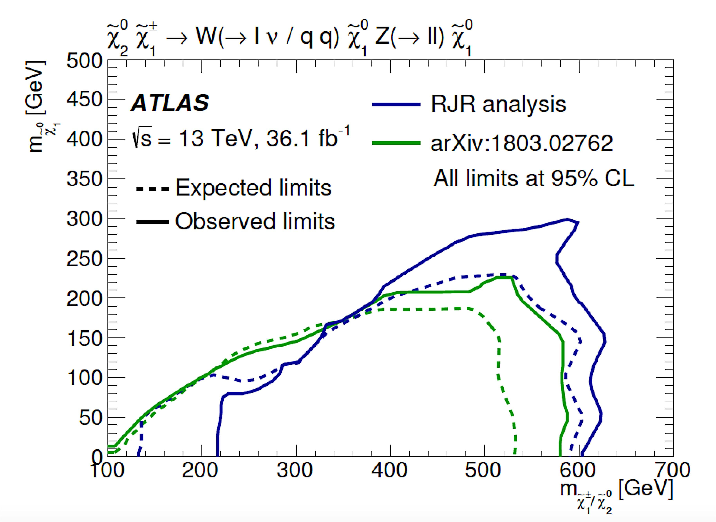
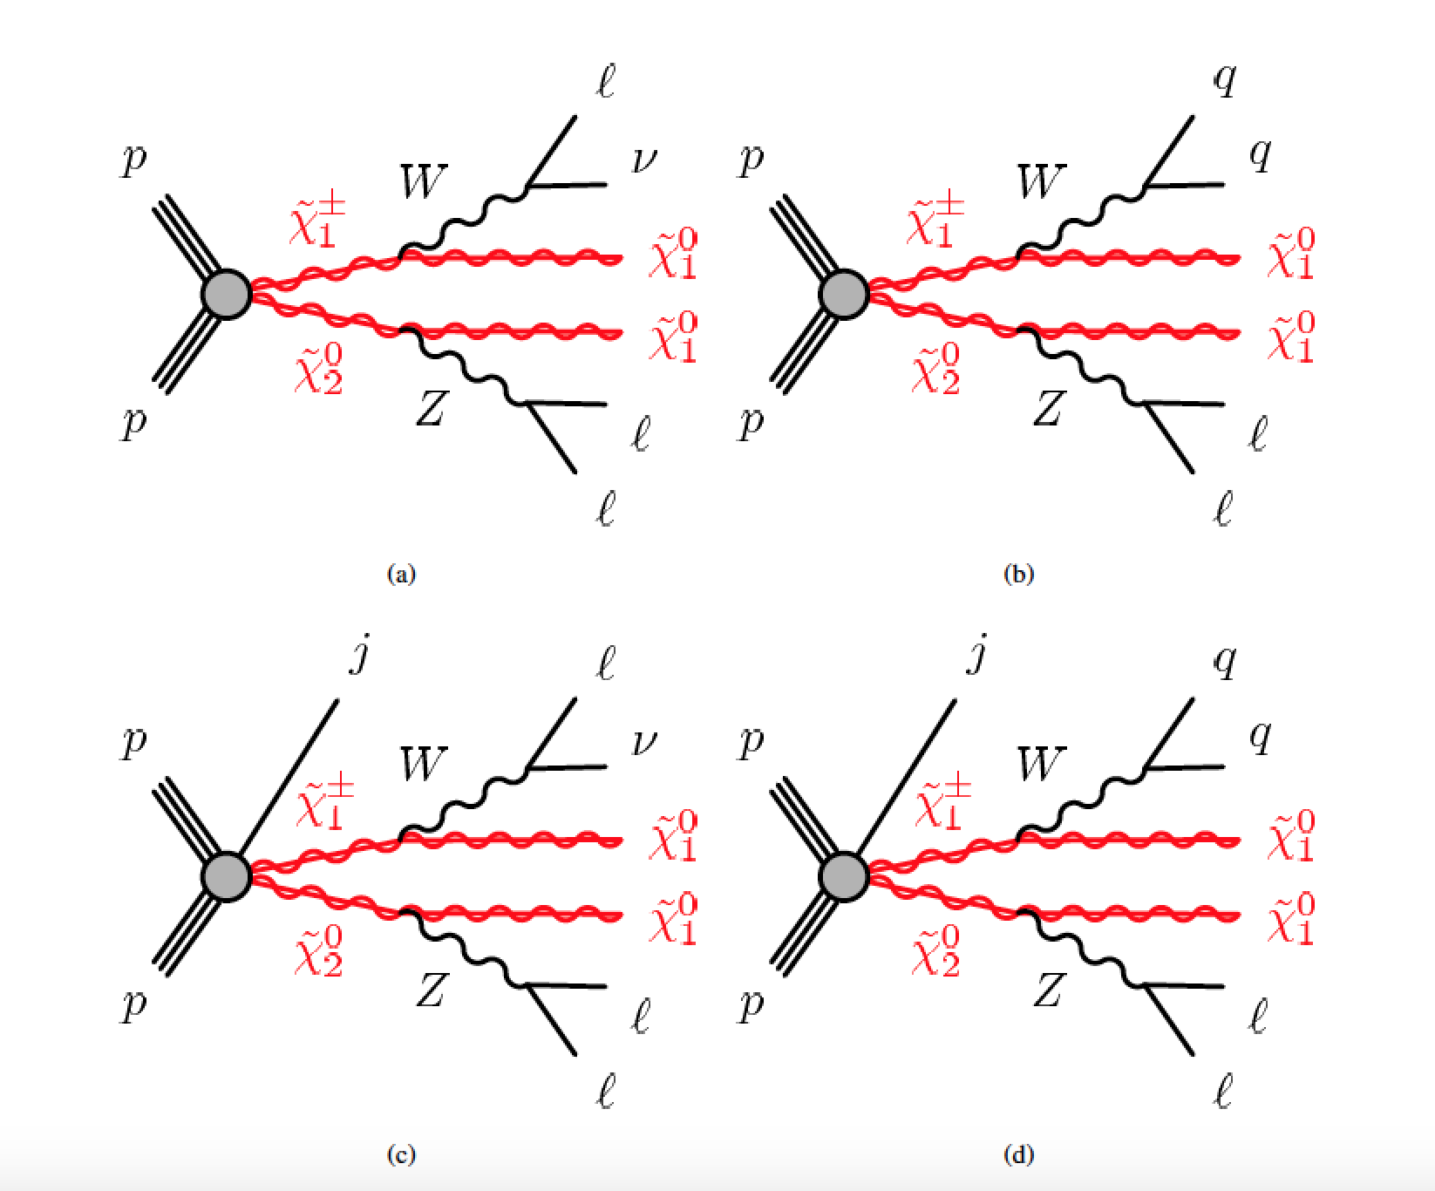
Are we there yet?? Maybe!
Jackson, Rogan, Santoni, ‘16
“Recursive Jigsaw Reconstruction” analysis by ATLAS (related to razor variables).
arXiv:1806.02293
Wino like cross-sections

Slide 14
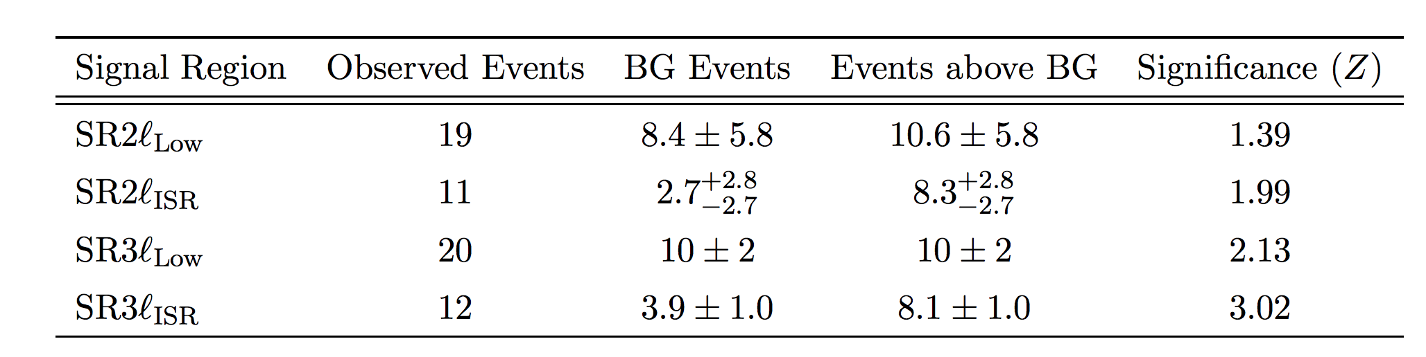
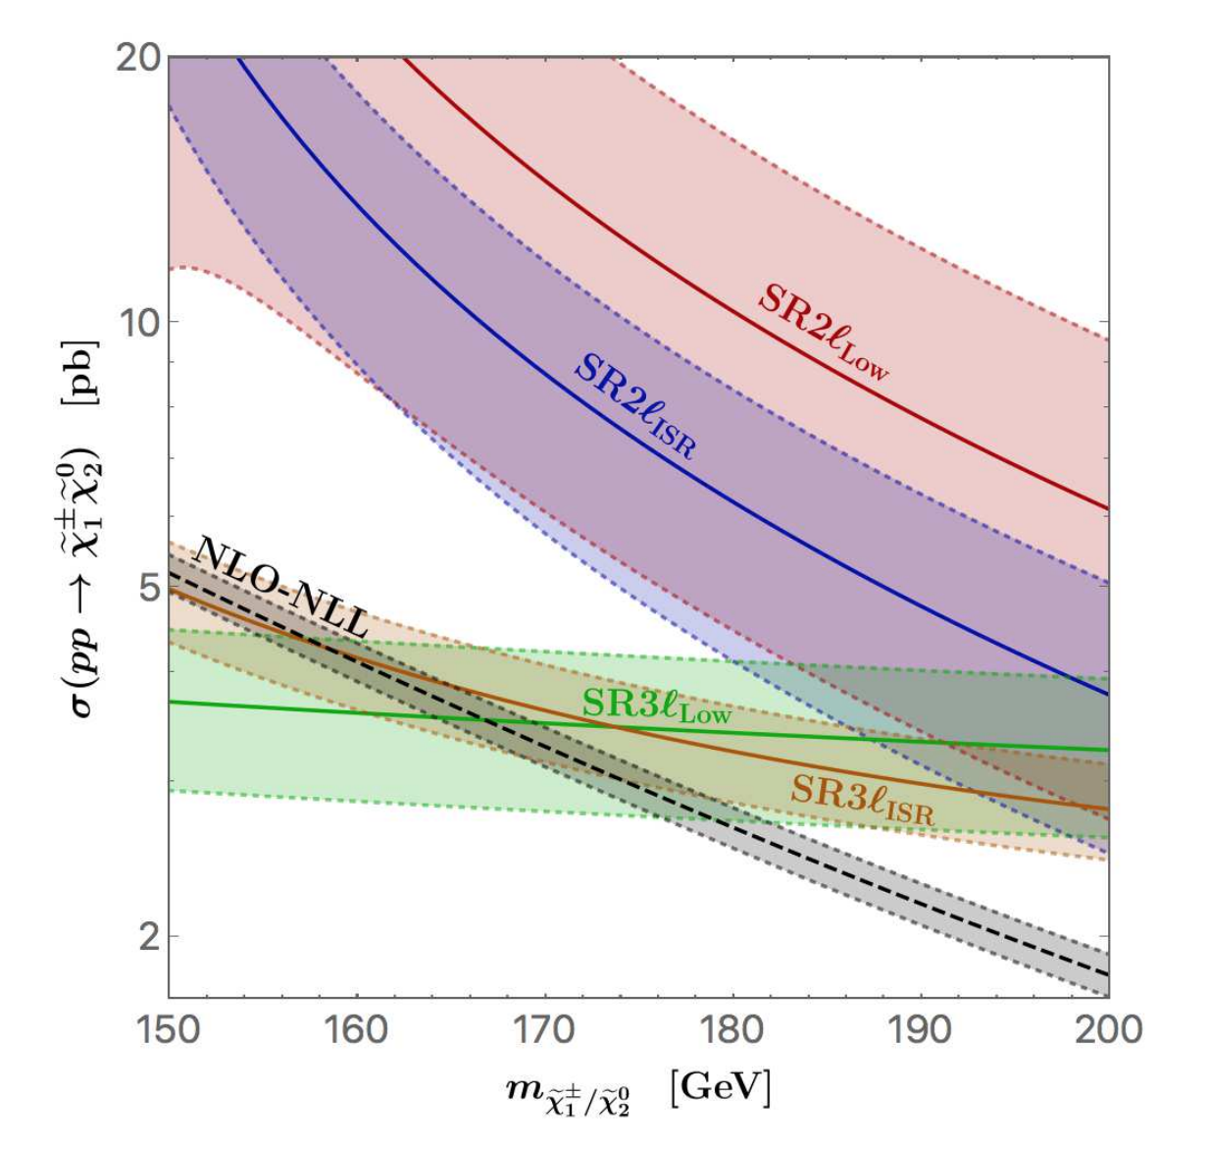
Carena, Osborne, NRS, Wagner, ‘18
arXiv:1806.02293

Slide 15
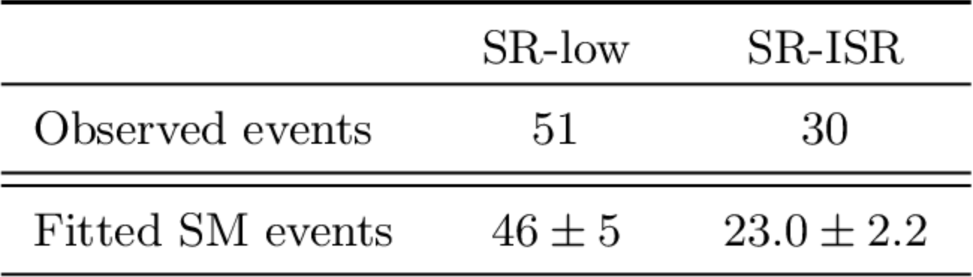
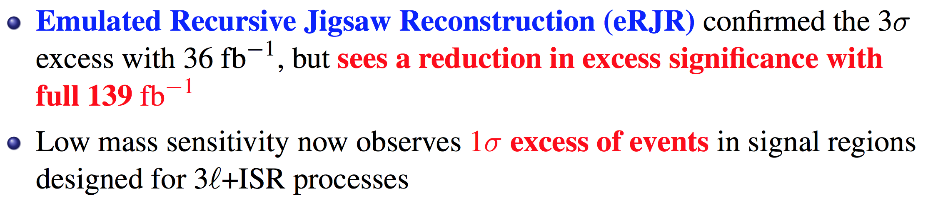
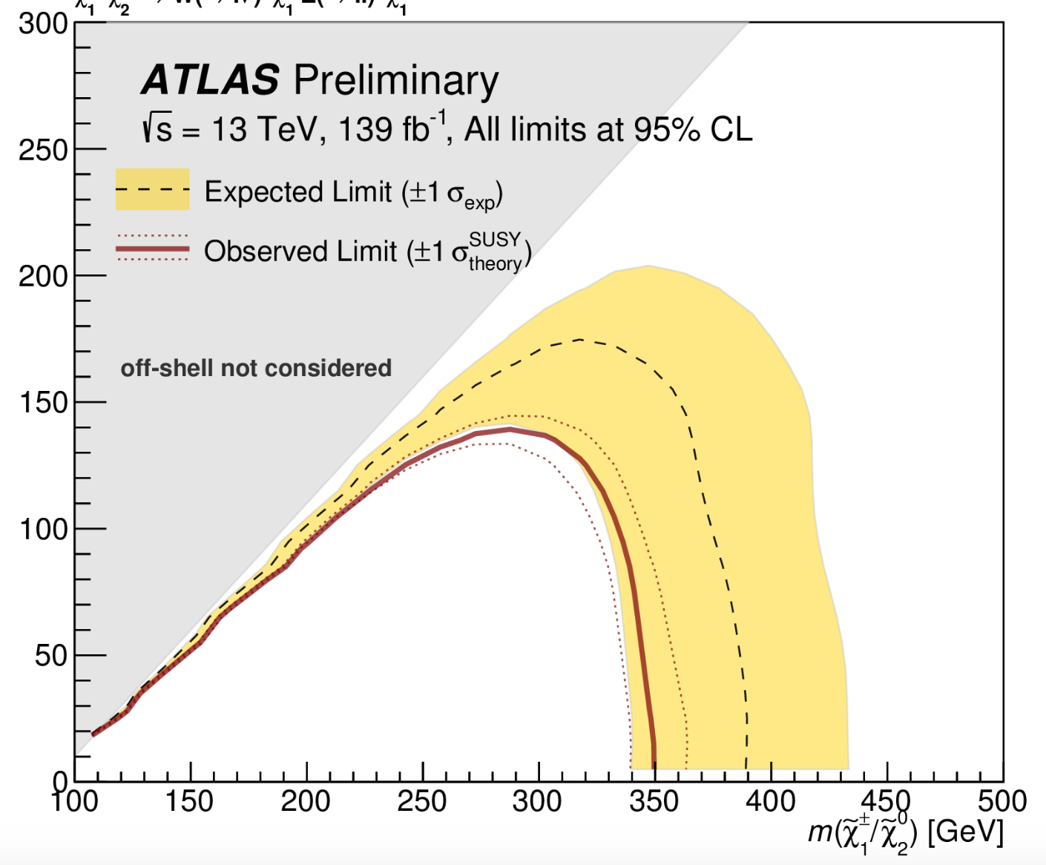
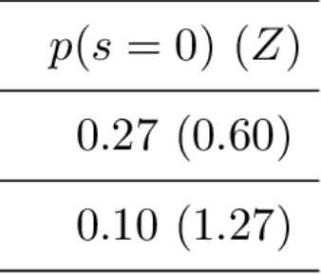
ATLAS-CONF-2019-020
D. Miller Talk at SUSY2019 (yesterday)
SR-low
SR-ISR
Wino like cross-sections

Slide 16
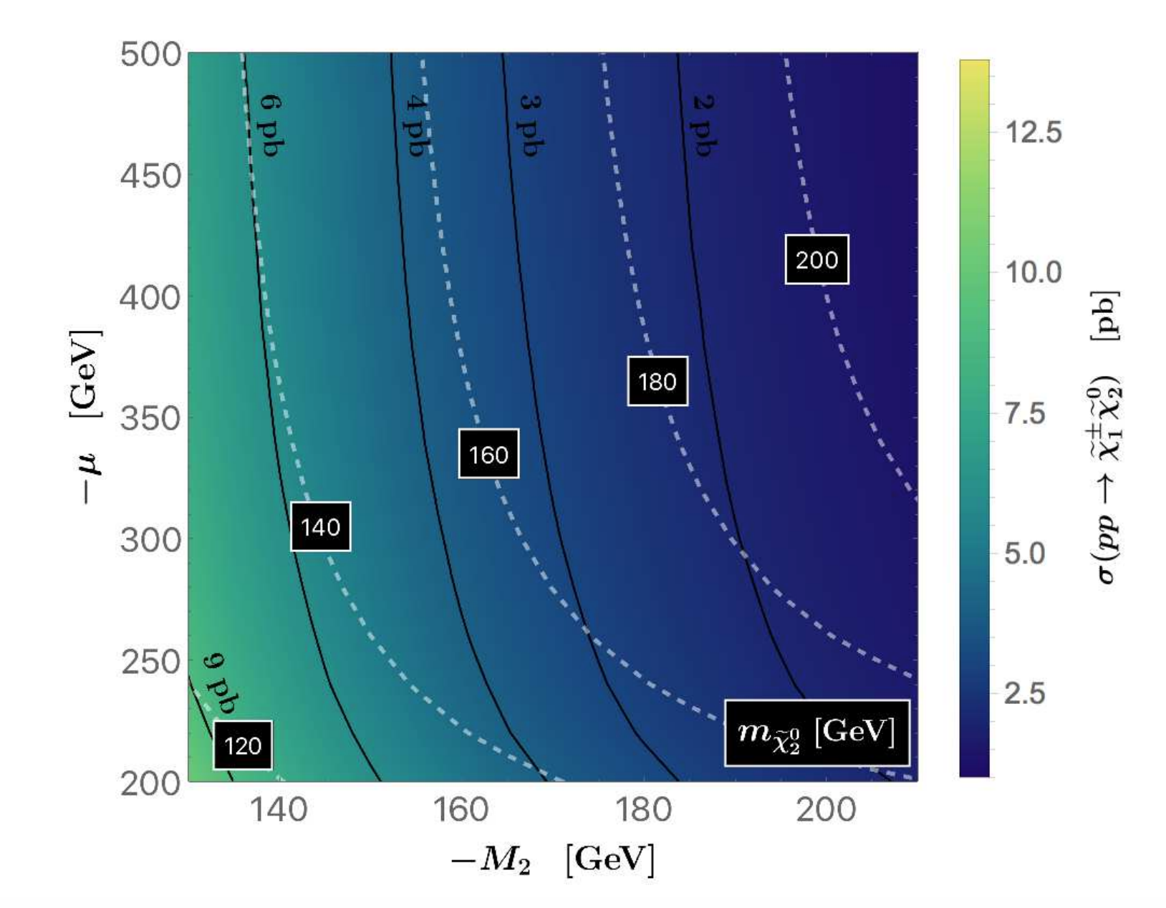
ATLAS/CMS simplified model vs. MSSM/NMSSM:
  Generically expect mixing: wino- Higgsino, reduced reduced LHC cross-section
  Additional states can have cascade decays “contaminating” conventional searches
Carena, Osborne, NRS, Wagner, ‘18

Slide 17
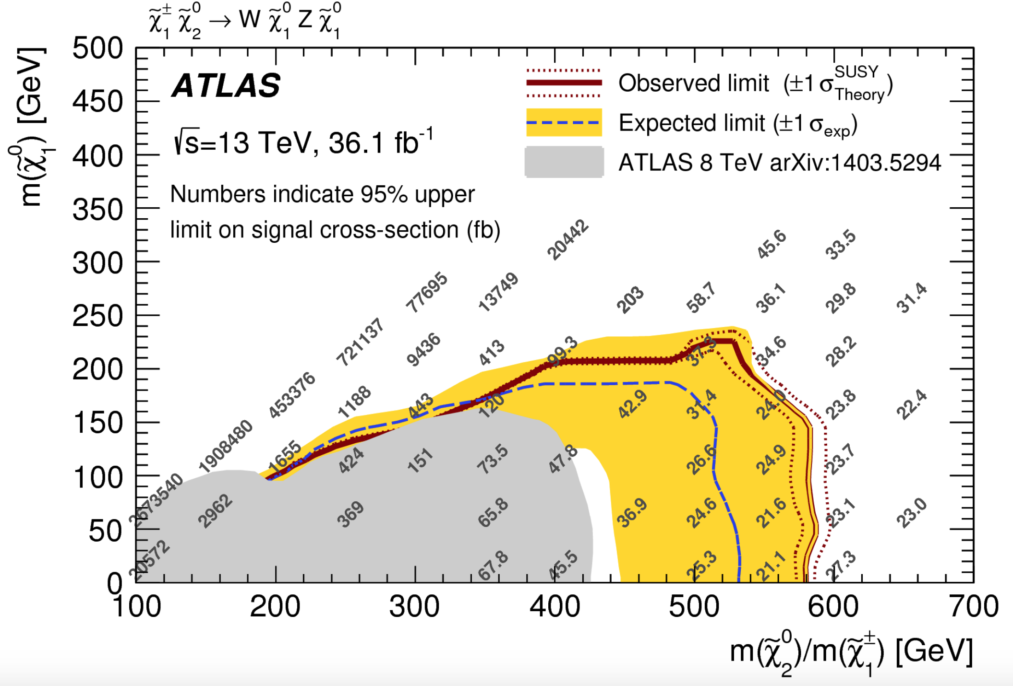
Carena, Osborne, NRS, Wagner, ‘18
MSSM/NMSSM:

Slide 18
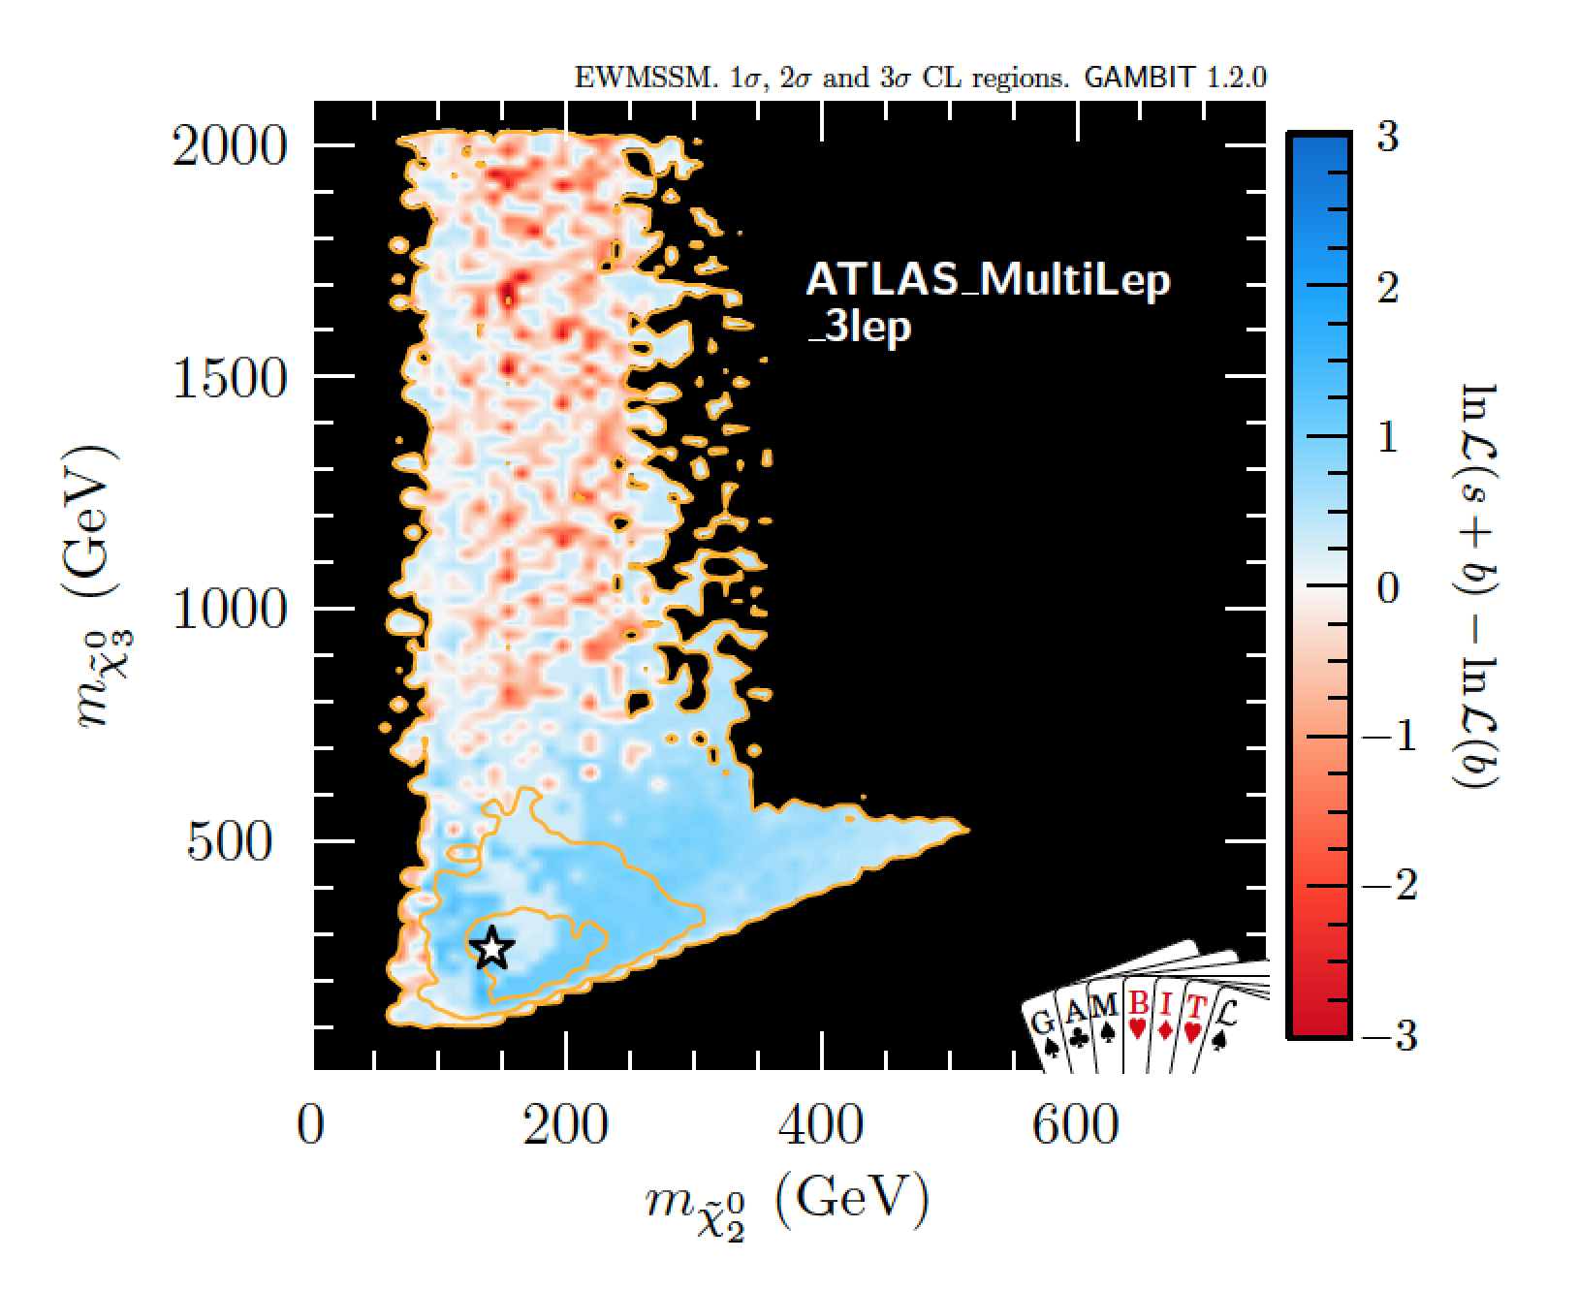
MSSM:
  Additional states can contaminate signal.
  Tension with conventional searches when additional states heavy.
GAMBIT Coll. arXiv: 1809.02097

Slide 19
Spectrum Characteristics?
Δ m = (m_{χ2}- m_{χ1}) ~ 100 GeV
  Kinematically forbid decays to Higgs, but allow W/Z.
|M₂|~ 150 GeV,|μ| ~ 300 GeV
  LHC cross-section ~ 3 pb
  m_{χ2} ~ |M₂|, m_{χ3,} ₄ ~|μ|(and associated charginos)
M₁~ m_{χ1} ~ 50 GeV

Slide 20
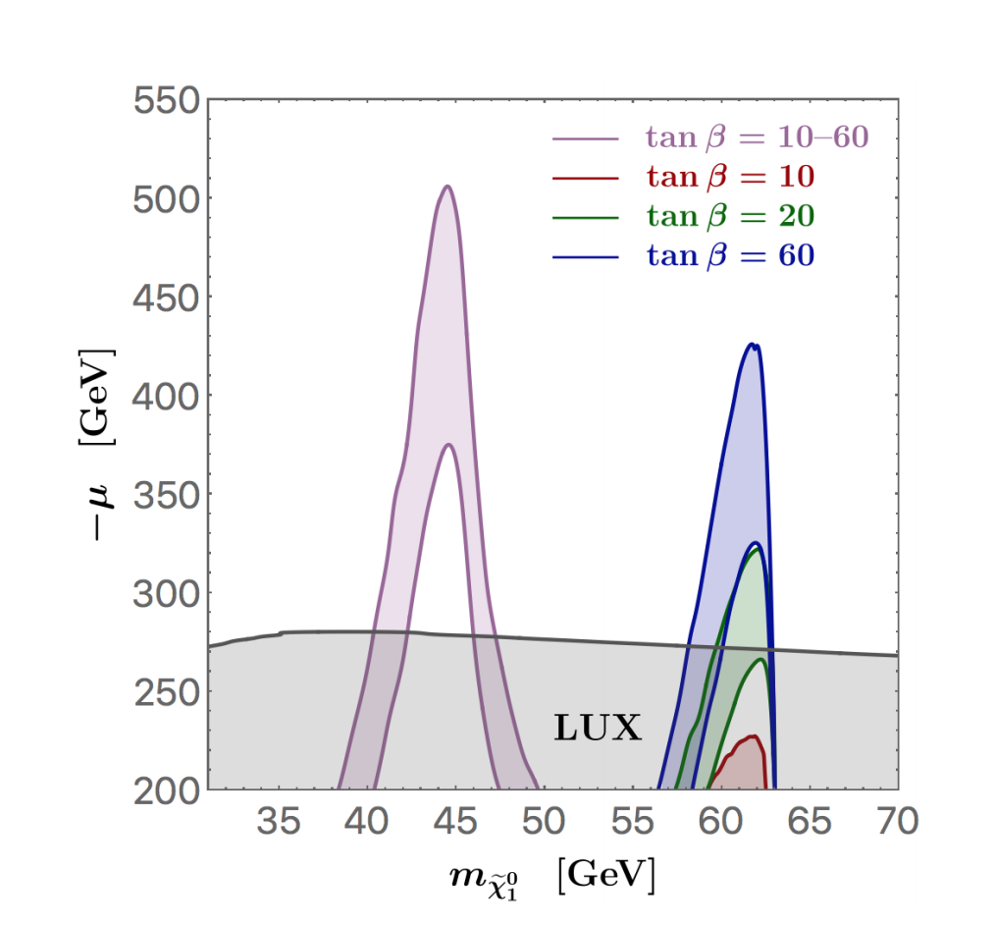
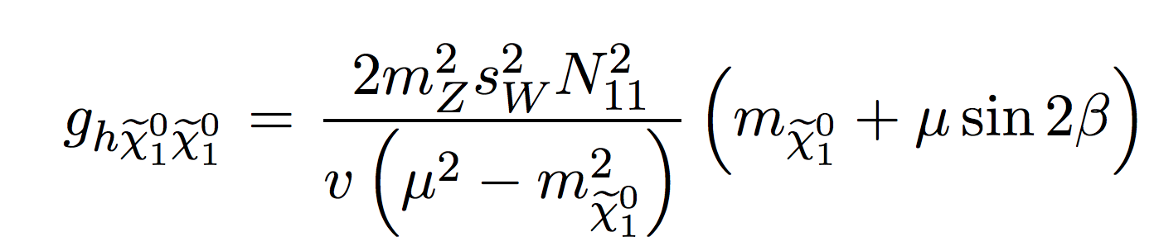
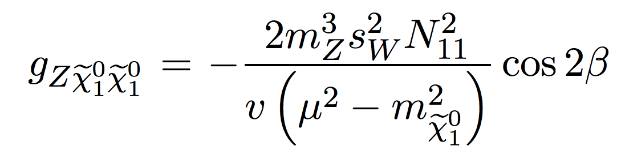
Dark Matter?
M₁~ m_{χ1} ~ 50 GeV
Carena, Osborne, NRS, Wagner, ‘18
M₂ irrelevant!!
Easily obtained via either Higgs or Z resonance, or light staus at large tb, or NSMSSM story.
Higgsino component of Bino fixes Z coupling, hence SD cross-section
SD DD gives strongest
constraints on μ ~> 275 GeV

Slide 21
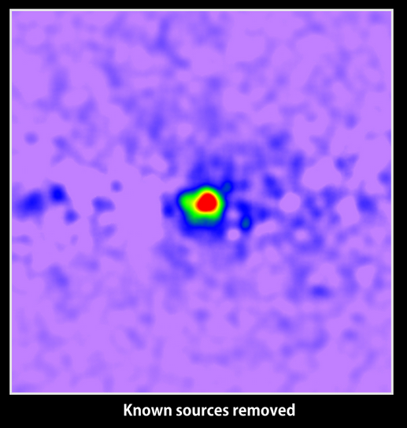
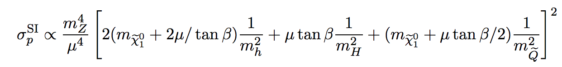


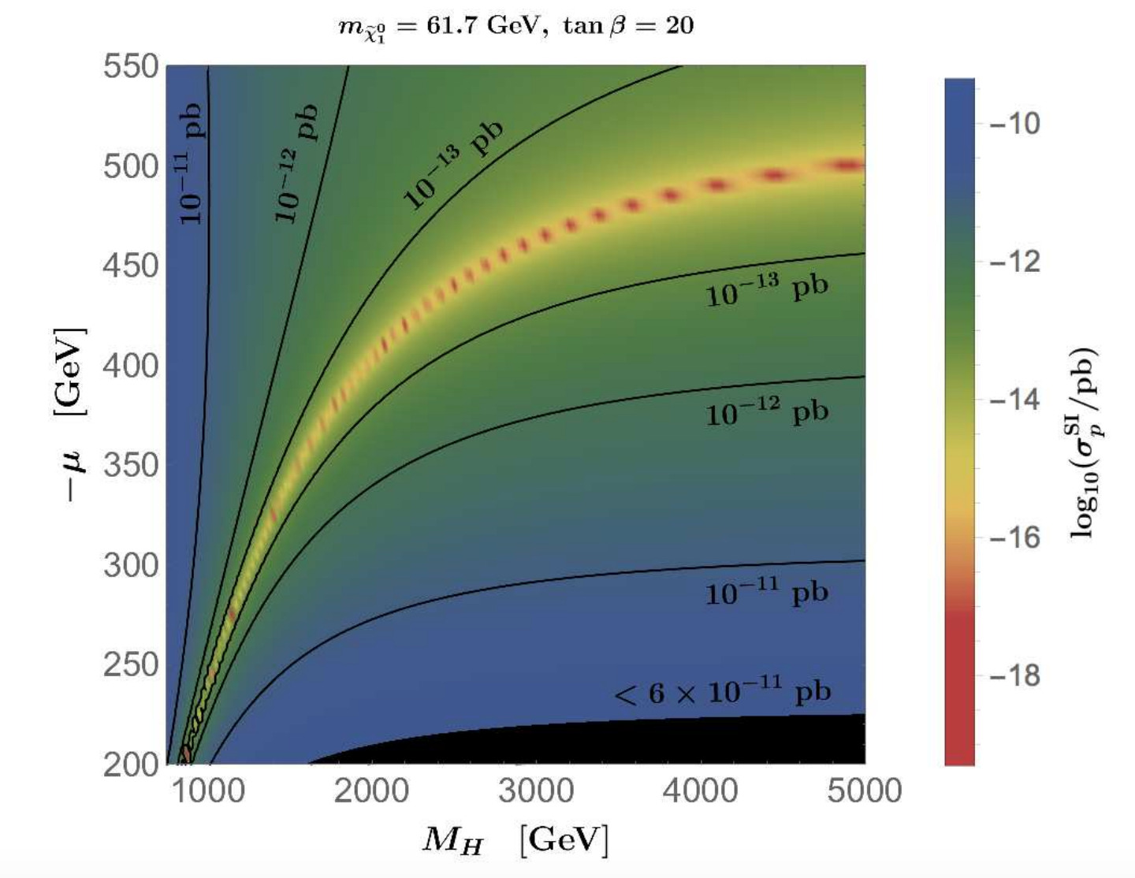
SI Direct Detection
Carena, Osborne, NRS, Wagner, ‘18
AMS sees flux of
antiprotons!
GLOW from the Center of the Galaxy
Suppressed values of SI DD can easily be explained via blind spots.
Both: m_{χ}~ 60 GeV
(1010.2752, 1511.02938,
1904.08430, 1903.02549, …)
Can be easily accommodated in scenario discussed:
eg. light pseudoscalar (NMSSM) or
small CP violation in M_{1.}
(Carena, NRS, Osborne, Wagner, ’19)
XENON1T arXiv:1805.12562

Slide 22
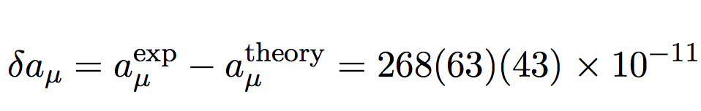
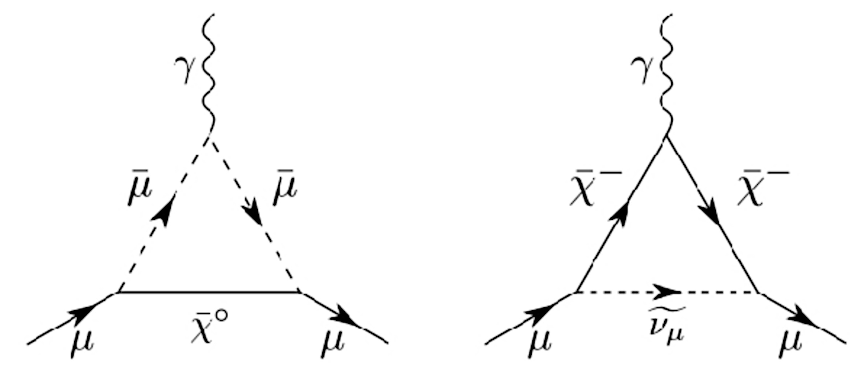
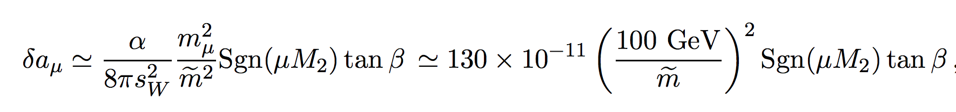
Anomalous Magnetic Moment of the Muon
PDG ‘16
Brookhaven E821 Expt.
~3.5 σ
Upcoming Muon g − 2 Expt. at Fermilab
Requires sleptons ~ few hundred GeV for tb ~ 10.

Slide 23
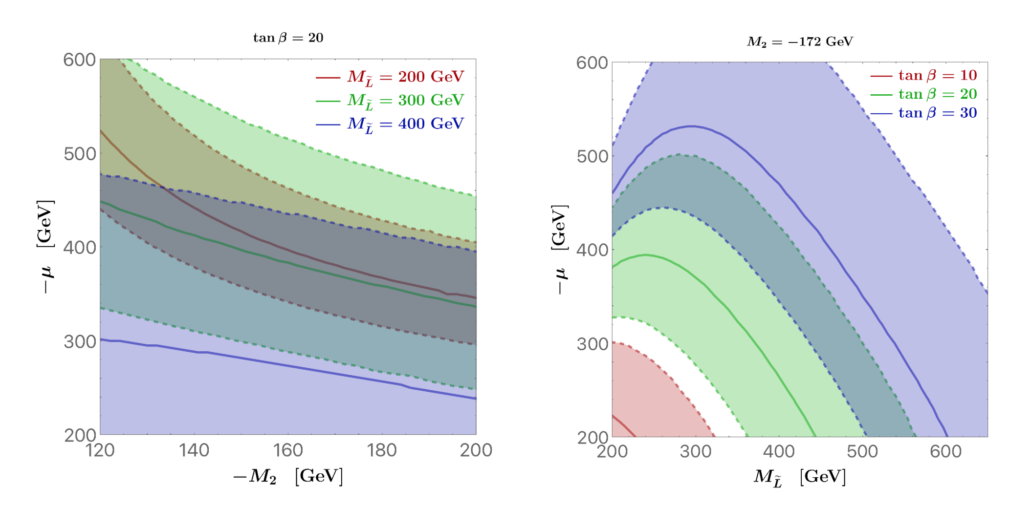
And it works!
LHC bounds considerable weakened: left-handed sleptons cascade decay first to heavier charginos and neutralinos.
M_{L} ~ 400 GeV OK!

Slide 24
So, Where do we stand?
Relic Density & SIDD: Works!
WIMP Paradigm: Alive and Kicking!
Could LHC be seeing it? We need more data!
DM cares only about M₁ and μ
But, Higgsino cross sections ~ ¼ smaller!
Barely constrained at the LHC!

Slide 25

Thank You!
Strong gravitational evidence for the existence of DM
Tantalizing hints in indirect and direct detection + LHC!!!
What are the right questions?
WIMPS???
Data + Theory:
Where to look next!
Data-driven Age:
LHC13/14 + Next generation Astrophysical probes.
“May we live
in interesting times.”

Slide 26
Back up

Slide 27
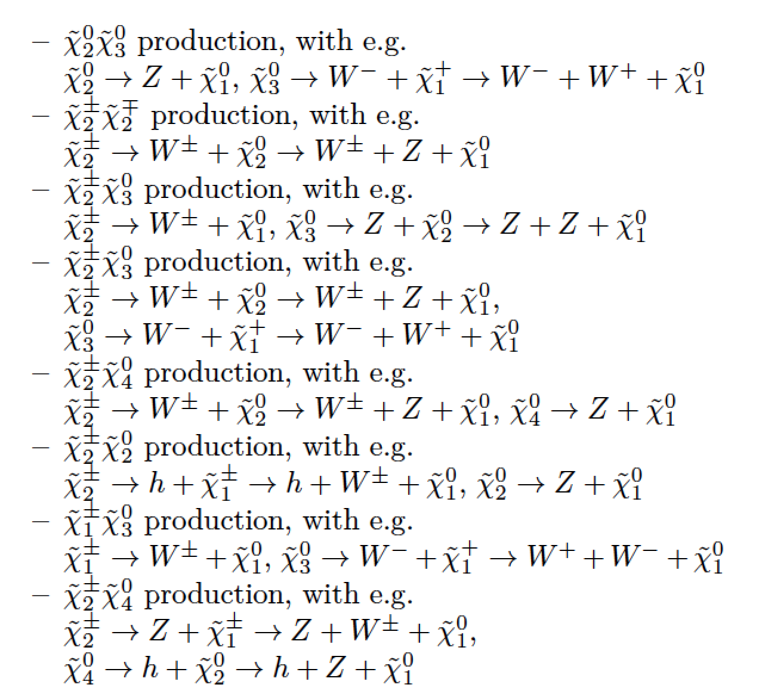
GAMBIT Coll. arXiv: 1809.02097
MSSM produces richer final states than ATLAS/CMS simplified model. Typically generating more gauge bosons, which in turn produce leptons that allow events to pass 3l selection while also producing additional jets.

Slide 28
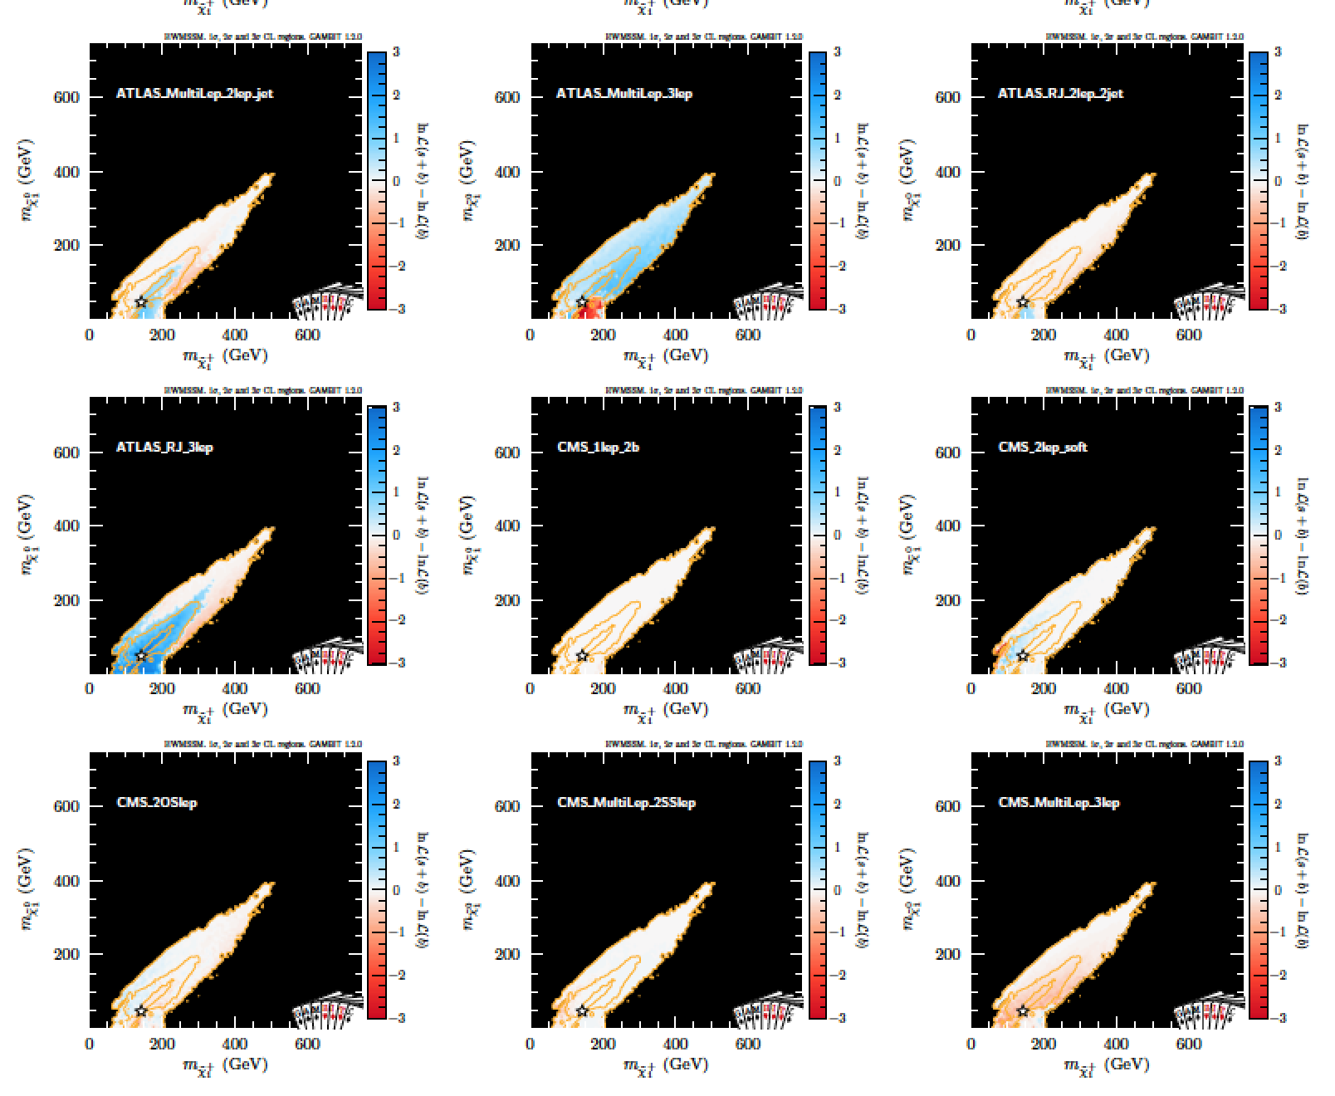

Slide 29
