Slide 1


Digesting the LIU high brightness beam: is this an issue for HL-LHC?
Presenter: G. Iadarola
Points to be covered:
Electron cloud effects and Heat load: back-up scenarios (8b4e and hybrid schemes)
Stability and strategy to stabilize the beam. Is TMCI an issue?
Experience from LHC on emittance blow-up and projections

Slide 2
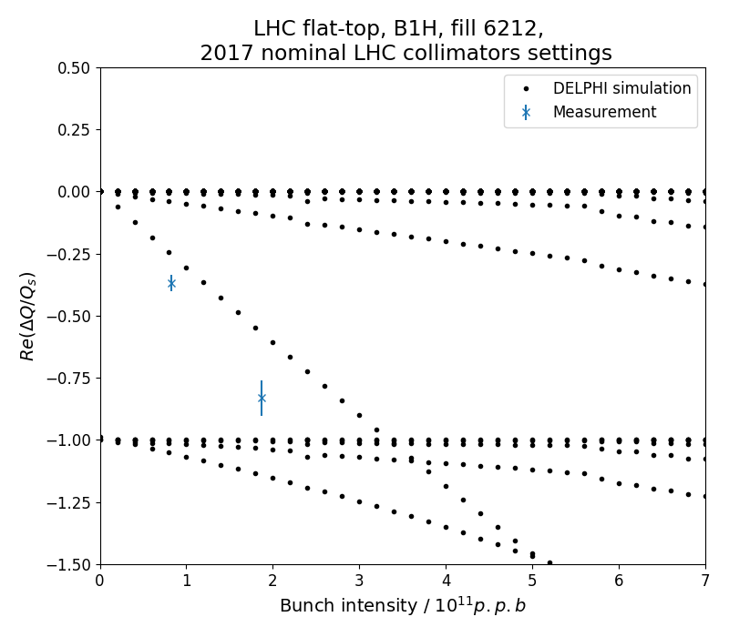
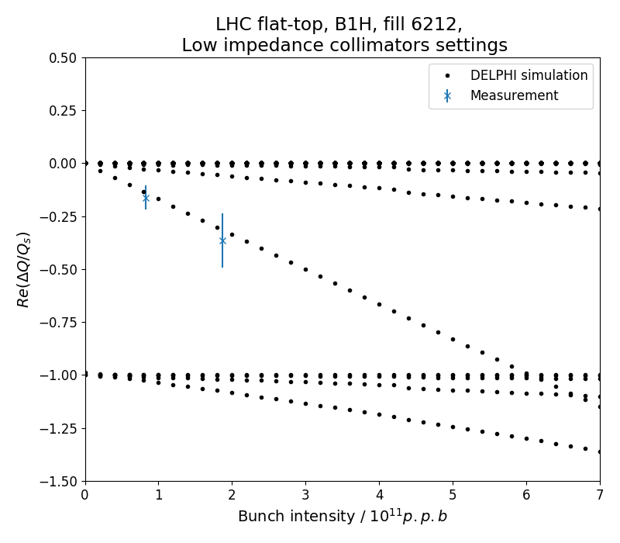
Strategy to preserve beam stability
The impedance reduction of the LHC collimators is part of the HL-LHC baseline (prototype of low-impedance collimator installed and successfully tested in the LHC in 2017). This will allow:
  Increasing the intensity threshold for the Transverse Mode Coupling Instability (TMCI) well above the HL-LHC intensities
    Confirmed experimentally at LHC in 2017
Present LHC impedance
Reduced collimator impedance
Simulated opening collimators (in tests with very small number of bunches)
Instability
Instability
D. Amorim at al.

Slide 3
Strategy to preserve beam stability
The impedance reduction of the LHC collimators is part of the HL-LHC baseline (prototype of low-impedance collimator installed and successfully tested in the LHC in 2017). This will allow:
  Increasing the intensity threshold for the Transverse Mode Coupling Instability (TMCI) well above the HL-LHC intensities
    Confirmed experimentally at LHC in 2017
  Keeping the octupole current required to suppress single bunch heat-tail instabilities below 300 A. This leaves enough margin to operate reliably in the presence of “known unknowns” like:
    Uncertainties on the impedance model
    Interplay with beam-beam and e-cloud (especially during conditioning)
    Loss of Landau Damping due to imperfect control of tunes, linear coupling, machine non-linearities, chromaticity
    Unavailability of a fraction of the octupole circuits
    Present LHC operation heavily relies on these margins
Crab Cavities (High Order Modes) were identified as a potential source of single and coupled bunch instabilities → the design was carefully optimized to keep the impedance within acceptable values
As presently done, instabilities driven by electron cloud especially at injection and during the initial conditioning, will have to be controlled using the full performance of the transverse damper, together with high chromaticity and octupole settings

Slide 4
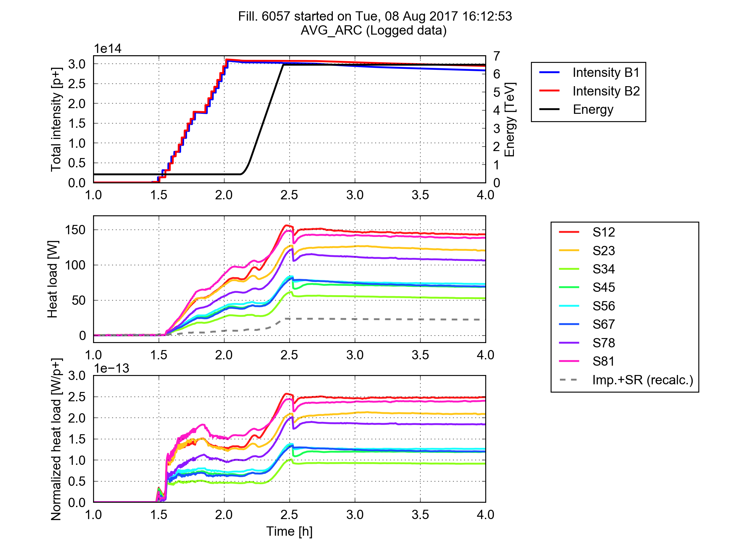
Heat Loads and Electron Clouds
Surface treatment (e.g. aC coating) for e-cloud suppression are foreseen in the Inner Triplets, and possibly in some of the Matching Quadrupoles, of all experimental regions:
  Those around IP1 and IP5 are particularly critical for stability due to the extremely high beta functions (>10⁴ m)
  Those around IP2 and IP8 would subtract significant cooling capacity to the arcs, with which they share common cryo-plants
The arcs (~20 km) will instead stay untouched. Heat loads on the arc beam screens have been a significant challenge for LHC operation with 25 ns in Run 2:
  Large differences observed between sectors
  Several observed features compatible with e-cloud effects
Heat load
per half cell

Slide 5
Heat Loads and Electron Clouds
  When moving to HL-LHC beam intensities (and to 7 TeV) the heat load form impedance and synchrotron radiation increases and the capacity available to cope with e-cloud reduces significantly
  The dependence of the e-cloud on the bunch intensity strongly depends on the surface properties (SEY parameters). With the available model, simulations foresee a relatively mild increase of the heat load from e-cloud when increasing the bunch intensity to HL-LHC values
    This scaling needs to be validated experimentally after LS2 (when LIU beams will be available)
Based on simulations (and assuming that heat load differences are due to different SEY):
  Present conditioning state of the low load sectors (S34, S45, S56, S67) should allow operation with HL-LHC beam parameters within the present available cooling capacity
  The estimated load for the high load sectors (S12, S23 S78, S81) is of the order of 10 kW (more than presently available)
  Ongoing work to identify and suppress the source of these differences is fundamental for HL-LHC
Give the number of unknowns and the potential impact on performance we must have a solid backup plan…

Slide 6
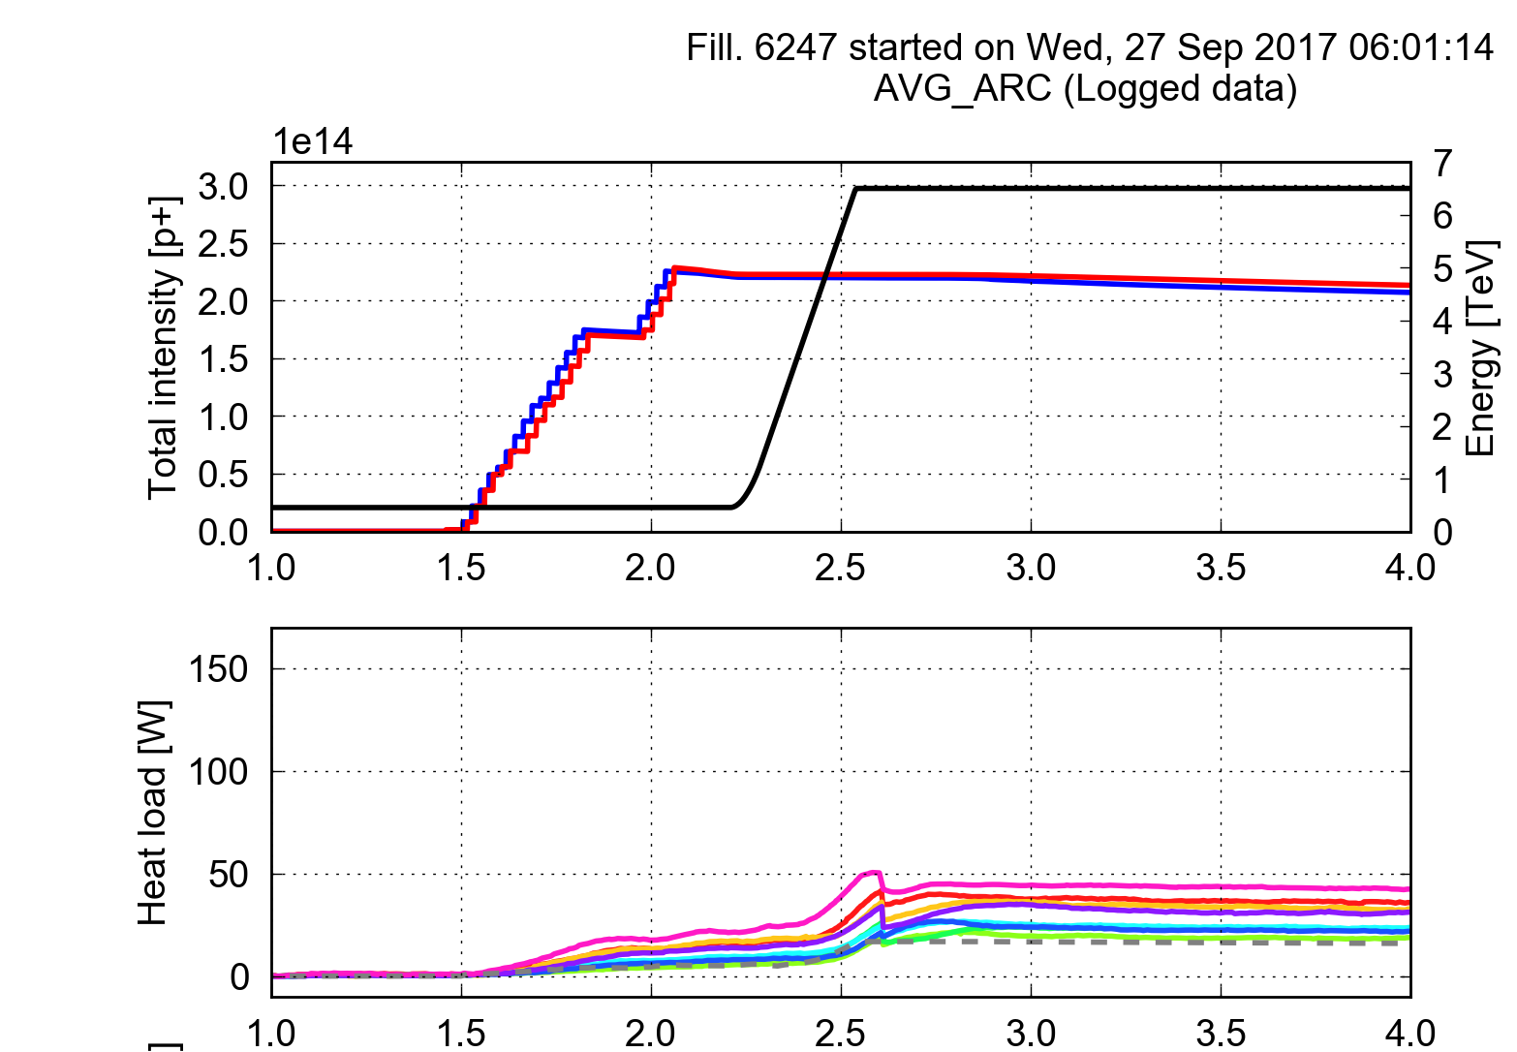
Backup for e-cloud: 8b+4e scheme
Filling pattern designed to suppress the e-cloud build-up (~30 % less bunches w.r.t. 25 ns)
Confirmed experimentally in the LHC in 2015 and used in operation in the last part of the 2017 Run (to mitigate fast losses in 16L2)
Next step: confirm effectiveness for bunch population larger than nominal
  8b+4e with ~1.7e11 p/bunch should be tested in the LHC in 2018 (available from the injectors)
25 ns (2556b)
8b+4e (1916b)

Slide 7
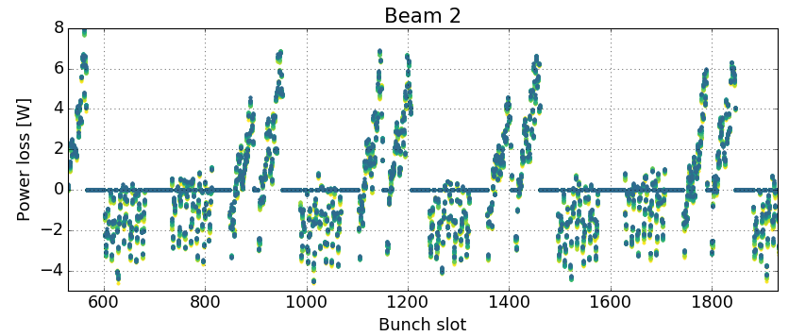
Backup for e-cloud: mixed filling schemes
Standard 25 ns trains and 8b4e trains can be combined in the same filling scheme in order to adapt the heat load to the available cooling capacity (tested in MD in 2016)
8b+4e
25 ns
Measurement J. Esteban Muller

Slide 8
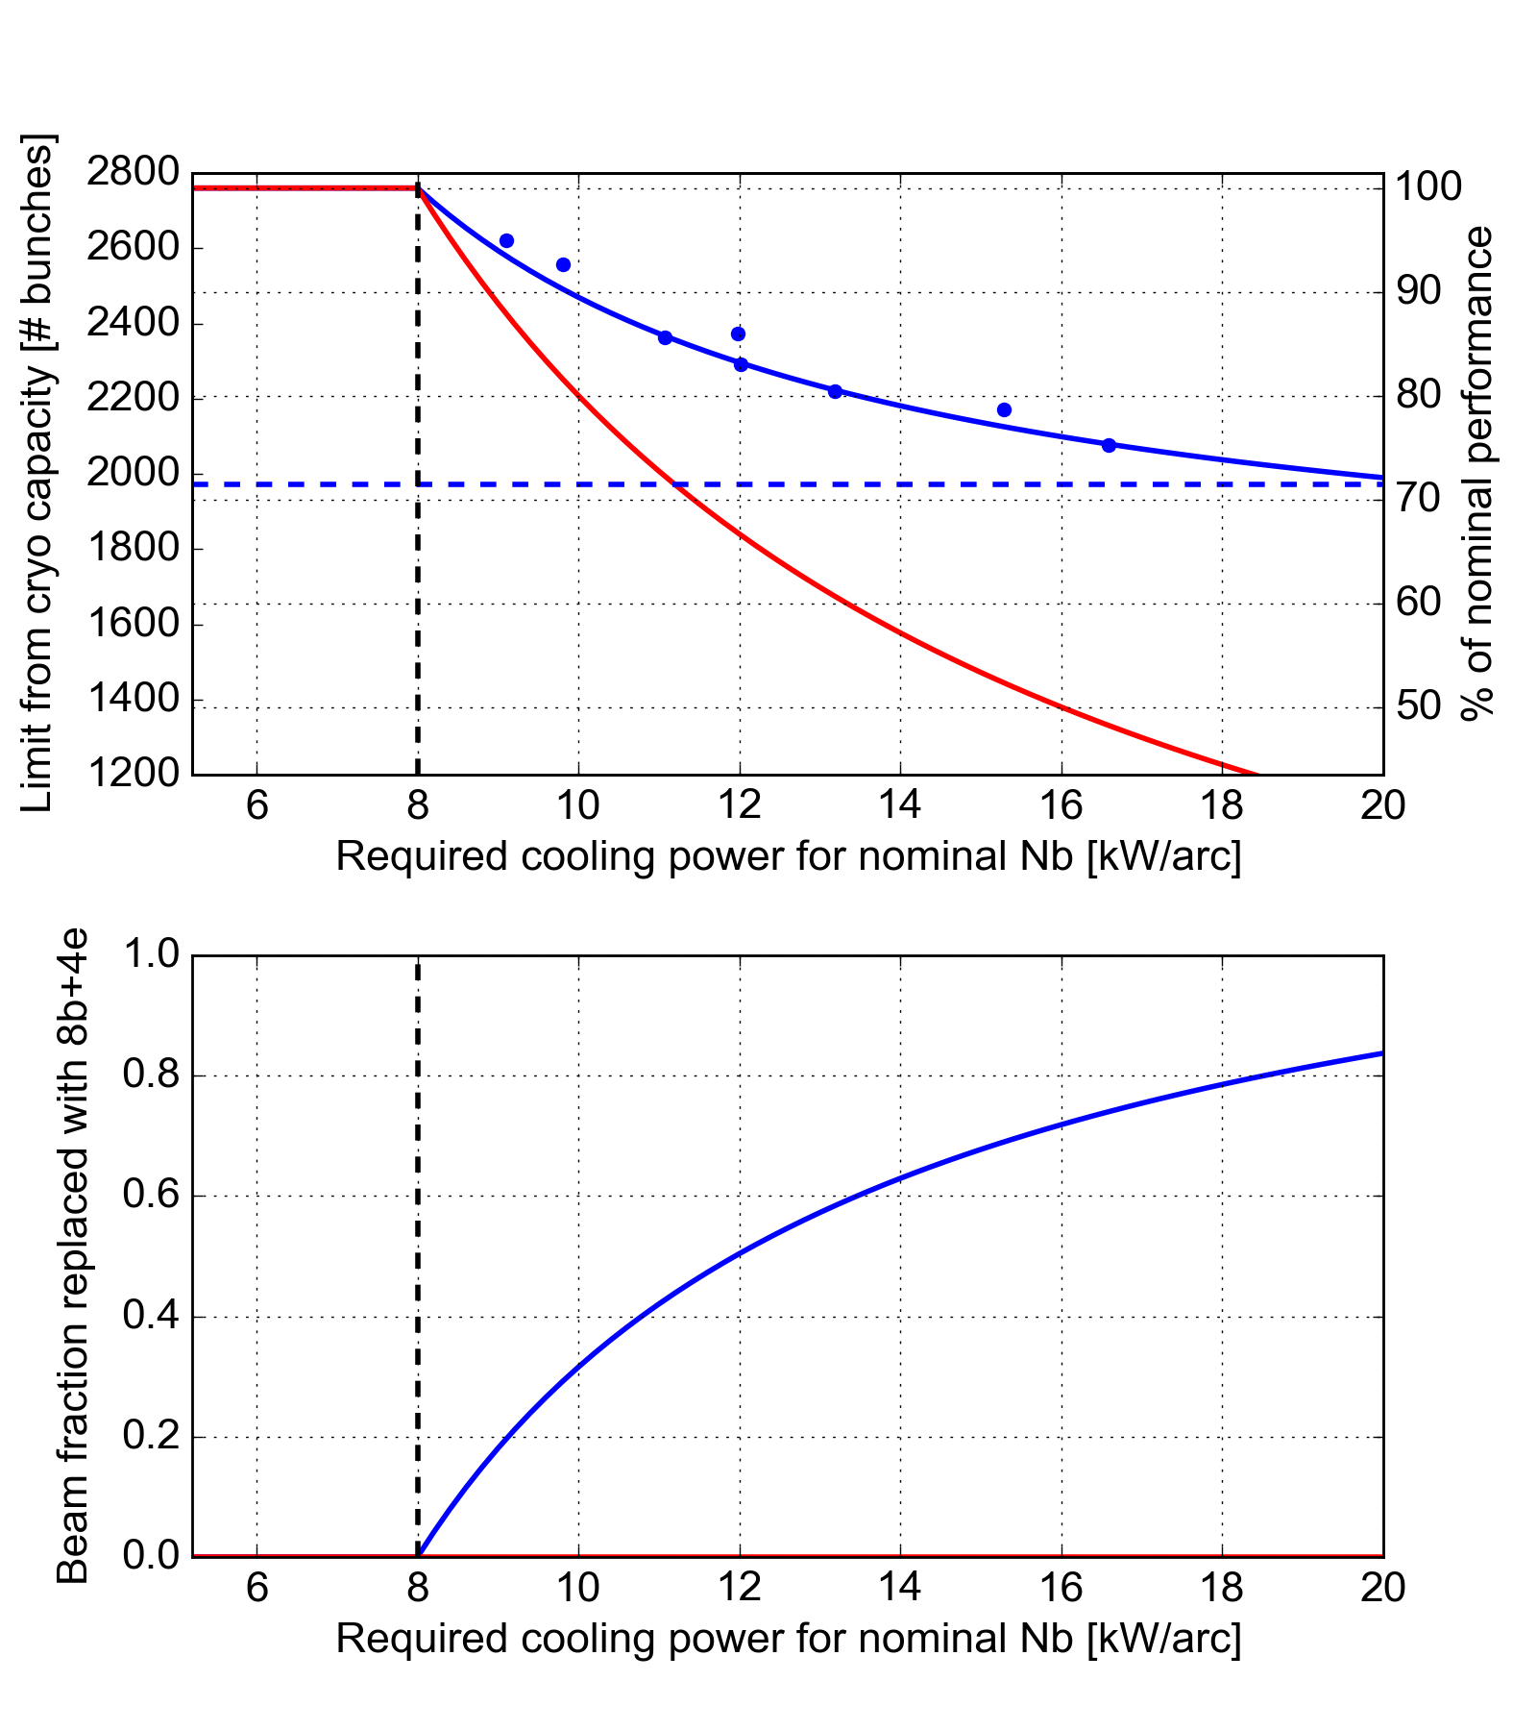
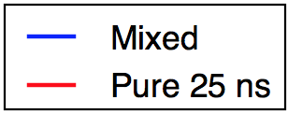
Backup for e-cloud: mixed filling schemes
Standard 25 ns trains and 8b4e trains can be combined in the same filling scheme in order to adapt the heat load to the available cooling capacity (tested in MD in 2016)
Impact on performance
Failure scenario A:
e-cloud scaling with intensity is confirmed by experiment
Present LHC conditioning state cannot be improved
Perf. loss with pure 25ns: ~25 %
Perf. loss with mixed: ~12 %
Pure 8b+4e
Cryo limit
Failure scenario B
e-cloud scaling with intensity is found to be worse than expected
Present LHC conditioning state cannot be improved
Perf. loss with pure 25ns:
from ~25% to very bad
Perf. loss with mixed:
from ~12% to 30%
Cryo limit

Slide 9
Emittance preservation
  Assumptions made for HL-LHC performance estimates:
    Blow-up from Intra-Beam Scattering (IBS) is included in the model
    10% additional blow-up (0.3 μm) is assumed from end-of-injection to collisions
  These are significantly better than presently achieved in the LHC (for nominal intensity):
    Observed increase from injection to collisions ~0.8 μm
    Additional blow-up in collisions (on top of IBS) ~0.07 μm/h
    Close follow-up of the emittances in place during the 2016-17 Runs → fundamental to invest time in understating and calibration of measurement system
    Studies to be continued in 2018 and beyond to better identify the sources and device possible mitigations
In the HL-LHC era stronger head-on beam-beam interactions (larger tune spread) will enhance the emittance growth due to coherent excitations → actions being taken:
  Noise from Power Converters → part of design specifications for new PCs
  Noise introduced by Crab Cavities → dedicated noise suppression feedback
  Noise introduced by the Transverse Damper → improvements foreseen

Slide 10
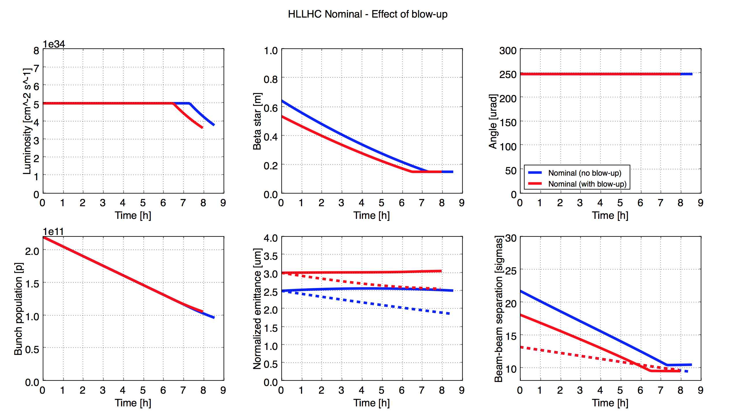
Emittance preservation: impact on HL-LHC performance
The impact of the LHC-like emittance blow-up on the expected integrated luminosity is very small, as during a large fraction of the fill we can use β* to compensate
But with large emittances it can become tricky to ensure the required beam-beam separation…
  Backup plan: inject beams with smaller emittance (BCMS)
Lim. for 6σ DA
L. Medina

Slide 11
Thanks for your attention!

