Slide 1
Data transmitting ASIC for liquid Argon TPC for the DUNE experiment
Davide Braga, Fermilab
Front End Electronics, Jouvence, 21 May 2018

Slide 2
Outline
Cold electronics for DUNE
Requirements for cryogenic operation, HCE and choice of technology
Development of custom cryogenic Spice models
Development of a custom library of standard cells for cryogenic operation
LVDS Transmitter and Receiver
COLDATA
CDP1: COLDATA Prototype chip
  Test setup and results
Conclusions

Slide 3
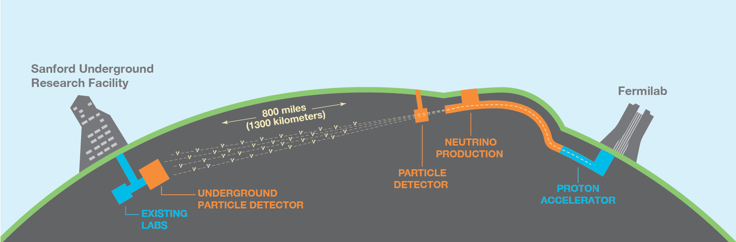
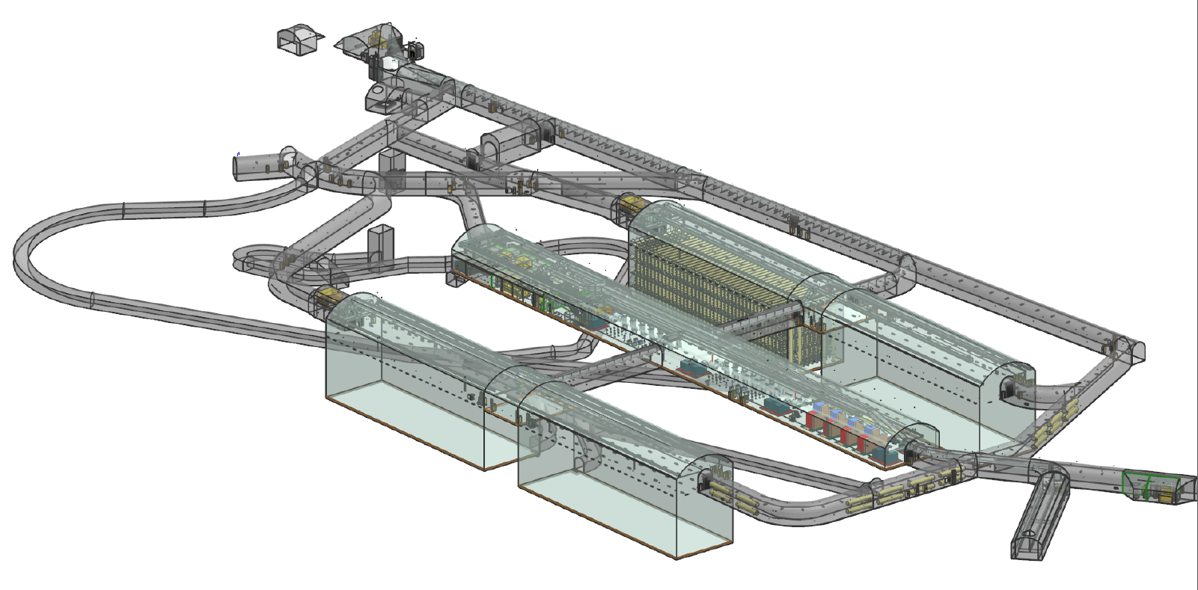
DUNE: Deep Underground Neutrino Experiment
Flagship project for HEP and Fermilab: over 1000 collaborators from 175 institutions in 30 countries plus CERN.
67000 tons of Lar, 1.5km deep
Liquid Argon Time-Projection Chamber (LArTPC) technology

Slide 4
Operation in liquid Argon
Requirements
negligible risk of failure due to the hot carrier effect (less than 0.7% channel failure in 30 years of operation)
a total power consumption of less than 50 mW/channel.
fully functional at both room temperature and liquid argon temperature;
both control and data links must operate with negligible error rate over cables up to ~30m in length.
Benefits of operating in liquid Argon:
The charge carrier mobility in silicon is higher and thermal fluctuations are lower at liquid argon temperature than at room temperature. For CMOS electronics, this results in substantially higher gain and lower noise (by about a factor of two) at liquid argon temperature than at room temperature, which greatly extends the reach of the DUNE physics program.
Mounting the front-end electronics on the anode plane array (APA) frames also minimizes the input capacitance.
Placing the digitizing and multiplexing electronics inside of the cryostat allows for a reduction in the total number of feed-throughs into the cryostat, reducing the expense and complexity of the experiment.

Slide 5
DUNE readout
Element | Quantity
Anode plane array (APA) | 150
Front End Mother Board (FEMB) | 3000
FE ASIC | 24000
ADC ASIC | 24000
COLDATA ASIC | 6000
The basic module for the baseline readout of the single-phase DUNE detector are the Front End Mother Board (FEMB), each of which consists of:
8 16-channel front-end ASICs for amplification and pulse shaping (LArASIC - BNL);
8 16-channel 12-bit ADC ASICs operating at 2 MHz (ColdADC – LBL+BNL+FNAL);
2 64-channel control and communications ASICs (COLDATA – FNAL+SMU)

Slide 6
65nm choice
Process of choice for HEP (LHC upgrades).
Alignment with other projects and sharing of resources (IPs, experience…).
Sufficient speed to accommodate lifetime enhancement guidelines (L, Vdd) without pushing the design.
Long term investment for custom models and libraries.

Slide 7
65nm choice
Process of choice for HEP (LHC upgrades).
Alignment with other projects and sharing of resources (IPs, experience…).
Sufficient speed to accommodate lifetime enhancement guidelines (L, Vdd) without pushing the design.
Long term investment for custom models and libraries.
Normalized change in a) transconductance, b) drain current, and c) increase in threshold voltage with stress time (Vgs=Vds=1.8V; T=77K)

Slide 8
Custom CMOS models for liquid Argon operation
Creation of cryogenic CMOS models by Logix Consulting, Inc. (Texas) based on test structures and data collected by FNAL, SMU, BNL groups.
Macro model: all simulations should point to the 'nch_mac' and 'pch_mac' models.
Valid for T=25C and T=-189C only.
Because of limited test structures, this model is valid for 0.06um < length <=10um.
Flicker noise parameters were verified with low temperature data in this release.
The model supports the following simulation corners: tt, ss, ff, sf, fs and mismatch.
Mismatch variations are from the original foundry model and have not been validated at low temperature.
Validation of the junction capacitances at low temperatures was not possible due to limited test structures. An extra coefficient was included to assist in quantifying the sensitivity of the circuit to the uncertainty in junction capacitance temperature coefficients of the original foundry model.
Notes:
Sets junction capacitance temp. coefficients to zero (pessimistic assumption with increased junction capacitance at low temperature)

Slide 9
Example of Spice model simulation with foundry models vs. measured data.
Thin oxide NMOS, -189°C, V_{BS}=0
Points: measurement ( = custom models)
Lines: foundry models at -189C
The foundry models, when extrapolated to liquid argon temperature, are wildly off-the-mark.
No obvious trend is visible

Slide 10
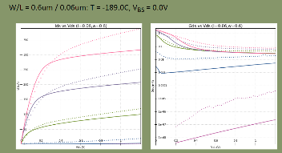
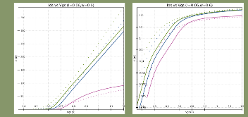
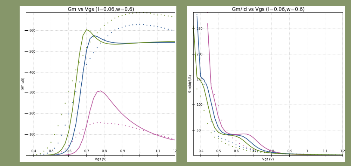
Example of measurement points and model parameter fit
Foundry documentation includes:
I_{DS} vs. V_{DS}
G_{DS} vs. V_{DS}
I_{DS} vs. V_{GS}
G_{m} vs. V_{GS}
G_{m}/I_{D} vs. V_{GS}
For: T 25C
-189C
V_{BS} ±0
±0.6
±1.2
W/L: from 5µm/5µm down to 0.12µm/0.06µm
thin and thick oxide

Slide 11
Custom Standard Cells Digital Library (L=90nm)
A modified version of the standard cell library tcbn65lp from Foundry/IMEC PDK
All lengths increased from 60nm to 90nm to reduce HCE
pMOS also increased to maintain balance
Cells’ height has not changed at 1.8um (9-track)
Cells’ width increased by 10 to 20%
Only M1, pins on grid
Inherently slower/with less drive strength than original 60nm library (30% slower)
All transistors in the schematic have been replaced with their *_mac counterpart, which is needed to simulate the design with the LOGIX custom models
Each cell contains layout, schematic and abstract views.
Design Dimension | Physical Dimension
Drawn Gate Length | 0.09 μm
Layout Grid | 0.005 μm
Vertical Pin Grid | 0.20 μm
Horizontal Pin Grid | 0.20 μm
Cell Power & Ground Rail Width | 0.33 μm
Track Number | 9

Slide 12
Cell categories
Includes ~230 cells
Includes 4 or 5 different drive strengths per logic function
Type | Sub-type | Cells
Combinatorial | Simple Logic | INV, BUFF, BUFT, ND, NR, AN, OR, XNR, XOR
 | Complex Logic | AO, OA, AOI, IAO, IOA, OAI, IND, INR, MUX
Storage | Latch | Latch LH (Latch with High Enable), LN (Latch with Low Enable)
 | Flip-Flop | DF (D Flip-flop), DFK (synchronized set/reset D Flip-Flop), DFN (negative clock trigger D Flip-Flop)
Special | Delay cell | DEL
 | Clock Buffer | CKB, CKN
 | Clock And | CKND2, CKAN2
 | Clock XOR | CKXOR2
 | Adder | FA1 (1-Bit Full Adder), HA1 (1-Bit Half Adder)
 | Antenna Diode | ANTENNA
 | Tie-high / Tie-low Cell | TIEH, TIEL
 | Filler Cell for Core | FILL
 | Decoupling Cell | DCAP, DCAP4, DCAP8, DCAP16, DCAP32, DCAP64

Slide 13
List of cells (in red the cells in the original library not included in tcbn65lp_90nm_mac)
Special Function Cells
ANTENNA | Antenna Diode
BHD | Bus Holder, Bus Repeater Cell
CKBX | Balanced Clock Driver
CKLNQ | Positive-edge Gated Clock Latch with Q Output Only
CKLHQ | Negative-edge Gated Clock Latch with Q Output Only
CKNX | Balanced Clock Driver with Inverted Output
CKND2 | Balanced clock cell for 2 input NAND type
CKAN2 | Balanced clock cell for 2 input AND type
CKXOR2 | Balanced clock cell for 2 input XOR type
CLMUX2 | Balanced clock cell for 2 to 1 multiplexer type
DCAP | De-coupling Cell
DEL | Delay Cell
FA1 | 1-Bit Full Adder
HA1 | 1-Bit Half Adder
FILL | Filler cell for Core
TIEH | Tie-High Cell
TIEL | Tie-Low Cell
Code | Description
AN | AND Gate
AO | AND-OR Gate
AOI | AND-OR-Inverter Gate
BUFF | Non-Inverting Buffer
BUFT | Non-Inverting Tri-State Buffer with High Enable
IAO | Inverter-AND-OR Logic Function Gate
IND | NAND with 1 Inverted Input
INR | NOR with 1 Inverted Input
IIND | NAND with 2 Inverted Inputs
IINR | NOR with 2 Inverted Inputs
INV | Inverter
IOA | Inverter-OR-AND Logic Function Gate
MAOI | Modified AOI Logic
MOAI | Modified OAI Logic
MUX | Multiplexer
MUXxN | Multiplexer with Inverted Output
ND | NAND Gate
NR | NOR Gate
OA | OR-AND Gate
OAI | OR-AND-Inverter Gate
OR | OR Gate
XNR | Exclusive NOR Gate
XOR | Exclusive OR Gate
Combinatorial Elements
Storage Elements
DF | D Flip-flop
DFN | Negative trigger D Flip-flop
DFK | D Flip-flop with Synchronous Clear / Set
DFX | D Flip-flop with 2-Inputs MUX
EDF | Enable D Flip-flop
EDFK | Enable D Flip-flop with Synchronous Clear / Set
LH | Latch with Active High Clock
LN | Latch with Active Low Clock

Slide 14
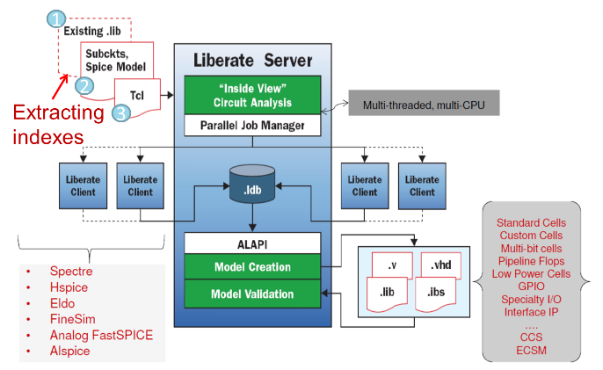
Cadence Liberate Flow
Notes:
Flow:
select existing .lib file to extract indices (matrix of input transition time and output load)
extract RC spice netlist
Liberate controlled with tcl scripts
Run Model Creation (creates a .lib file) or Verification (compares two .lib files)
We used ECSM (Effective Current Source Model – the most accurate)
Liberate supports complex gates (e.g. multi-bit cells) and also analog cells and I/Os

Slide 15
Library Characterization: Essential for Static Timing Analysis (STA)
Cadence Liberate (v15.1) and associated Tcl scripts
LVS/QRC extraction of the cells
  Script to modify the model name (nch → nch_mac, pch → pch_mac)
Foundry and custom model files
Type of library Non Linear Delay Model (NLDM)
  Effective Current Source Model (ECSM)
Timing Combinational
    Delay & Transition Time
  Sequential
    Delay & Transition Time
    Hold and Setup
    Recovery and Removal
Power Leakage
  Internal Power
Data is arranged in Look Up Table (LUT) format
Name | Process | Voltage | Temp | Models
UPenn-TT | tt | 1.2 | 27 | Foundry model
BC | ff | 1.32 | 0 | Foundry model
UPenn | ff | 1.2 | 27 | Foundry Model
WC | ss | 1.08 | 125 | Foundry Model
UPenn | ss | 1.2 | 27 | Foundry Model
TC_COLD | tt | 1.2 | -189 | Logix Model
UPenn | tt | 1.2 | -186 | Logix Model
BC_COLD | ff | 1.32 | -189 | Logix Model
UPenn | ff | 1.2 | -186 | Logix Model
WC_COLD | ss | 1.08 | -189 | Logix Model
UPenn | ss | 1.2 | -186 | Logix Model
Corners Identification

Slide 16
LVDS Transmitter and Receiver for liquid Argon
Designed to comply with LVDS standard (2.5V → thick oxide transistors), but also to operate reliably down to VDD=1.8V
Programmable output current
Non-minimum length transistors for lifetime operation at liquid argon temperature (89K)
Include level shifters to interface to 1.2V core voltage
Both Tx and Rx have been prototyped and proven to work at both room and LAr temperatures, but have yet to be stress tested and characterized. In this prototype, Rx and Tx are linked through a I2C slave block, which limits the data rates.
A dedicated test structure has been manufactured and is expected soon.

Slide 17
LVDS Tx
All L ≥ 90nm
Input voltage: 1.2V (chip core)
Output voltage: 2.5V to 1.8V (I/O)
Compatible with LVDS standard (2.5V supply, +-3.5mA into 100 Ohm external termination, 1.25V typical common mode output (1.125V<=V_{CM}<=1.375V)
Programmable output current for low power operation: +-2mA, +-4mA, +- 6mA, +-8mA.
Temperature range: -189C<=T<=+125C
Output common mode voltage: ½ VDD, stabilized by active common mode feedback (CMFB)
Low profile layout: ~180µm x 65µm (excluding output pads). Top metal is M6 (in MOM capacitors, could go to M4)
External termination

Slide 18
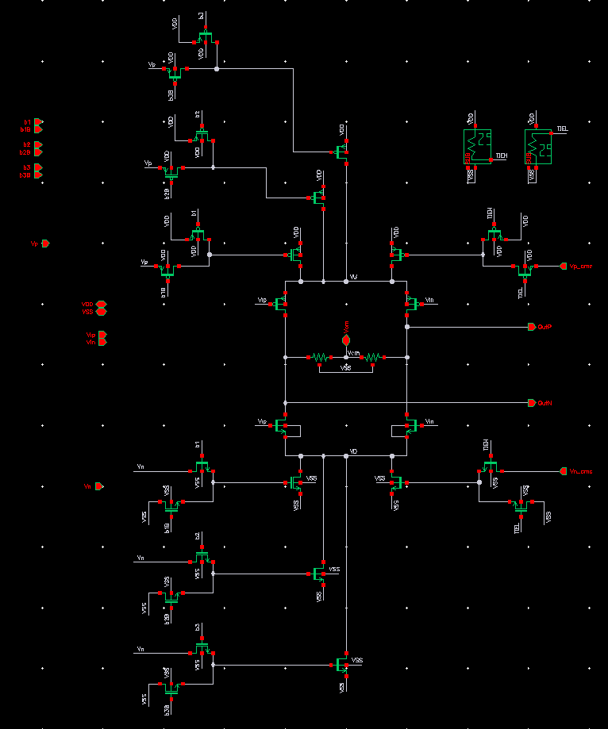
LVDS Tx
Predriver: includes a Vdd_{core}→Vdd_{IO} level shifter + buffers to drive the large capacitive load of the Tx bridge switches
Driver: bridge architecture with selectable current
Common Mode Feedback (CMFB) with resistive sensing (10KΩ) for baseline correction (LVDS spec: 1.125V ≤ V_{CM} ≤ 1.375V)
  PM ϕ~90°, WC ϕ~60° for T=-189C and VDD=1.8V
Level shifters for the configuration bits
PDB2Ax analog I/O pads (as recommended by Foundry), passive protection diodes only for low impedance
Notes:
The transmitter has four bias branches (at top and bottom) to select four selectable output currents. Four identical branches were used, instead of a single device from a selectable mirror, to keep a constant Vsat independently of the current selected.
The output current ranges from 1I_{U} (one of the branches is always ON) to 2, 3 and 4I_{U}, where the nominal unit current I_{U} is 2mA.
The current branches being identical, not weighted, there is a lot of duplication in the 8-symbol register space available. A decoder was not included given the abundance of available register space in CDP1.

Slide 19
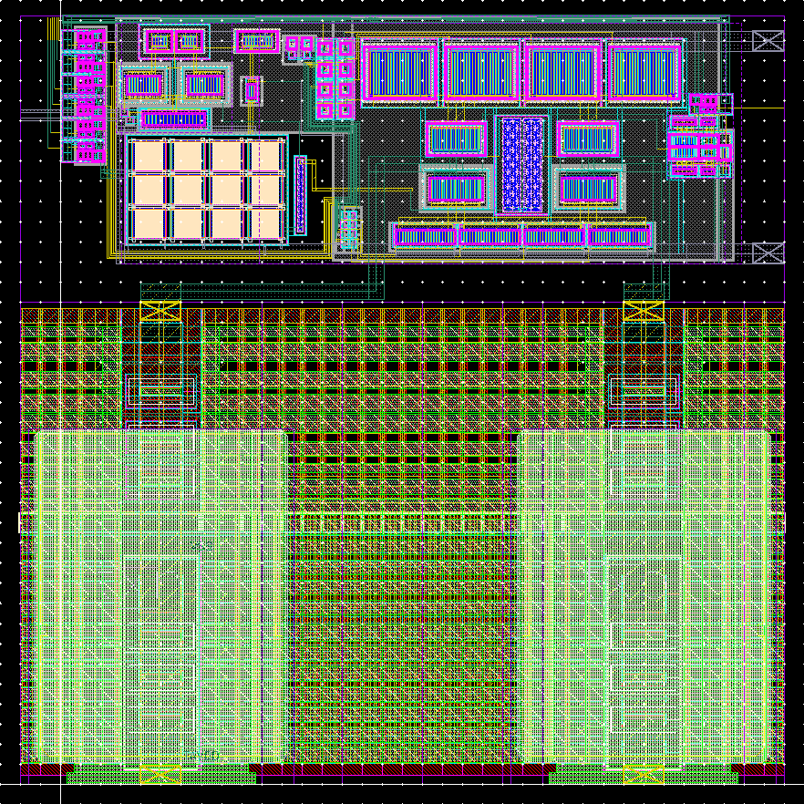
LVDS Tx
180µm
Predriver: includes a Vdd_{core}→Vdd_{IO} level shifter + buffers to drive the large capacitive load of the Tx bridge switches
Driver: bridge architecture with selectable current
Common Mode Feedback (CMFB) with resistive sensing (10KΩ) for baseline correction (LVDS spec: 1.125V ≤ V_{CM} ≤ 1.375V)
  PM ϕ~90°, WC ϕ~60° for T=-189C and VDD=1.8V
Level shifters for the configuration bits
PDB2Ax analog I/O pads (as recommended by Foundry), passive protection diodes only for low impedance
Layout:
DFM + guardrings for all transistors
65µm
120µm
Notes:
The MOM capacitors were chosen for their excellent behavior across temperature and relatively high unit capacitance.
The choice of the resistor is critical for cryogenics operations: unfortunately, the custom device models commissioned for cryogenic operation did not include passive devices, so the only way to gauge the temperature dependence is to hope that the behavior between -40C and +125C in the standard models is indicative of what happens when the simulator extrapolates at liquid argon temperature. Having simulated all available resistors in this process, the N+POLY w/o silicide (rnpolywo) resistor was the best with the small variation across temperature, with P+POLY w/o silicide (rppolywo) also comparable and nwell under STI resistor also good (but this latter has high resistance/square, and might also be more susceptible to degradation).

Slide 20
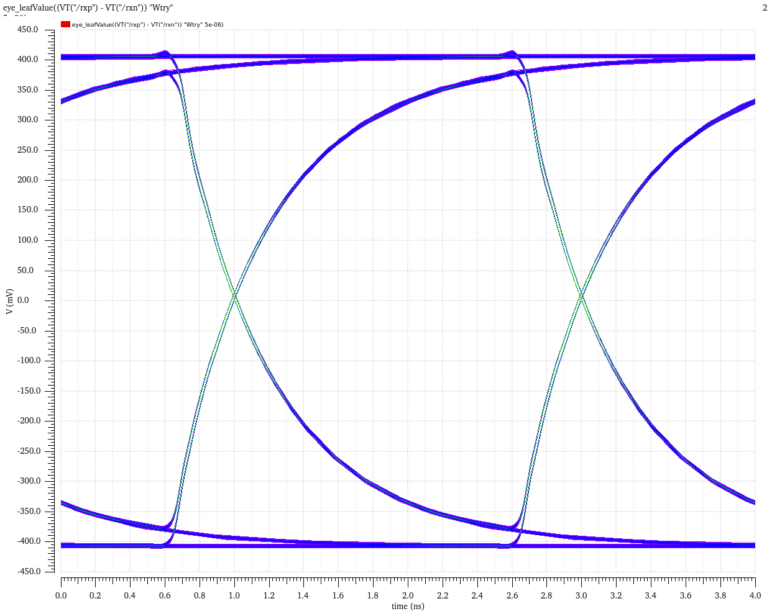
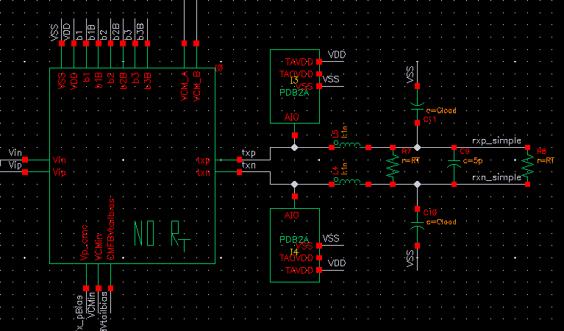
LVDS Tx Performance
To characterize this block, I follow what Texas Instruments does in their LVDS datasheet and use a simple RC load (5pF in parallel to 100 Ohm termination), but still accounting for the wirebonds at both ends (both with or without source termination).
Schematic of the output load following Texas Instruments LVDS Tx datasheets, with just RC load, but including LC to simulate bondwires (with or w/o source termination).
Simulated eye diagram for VDD=2.5V, TT, 27C, Iout=± 4mA, at 500 Mbps.

Slide 21
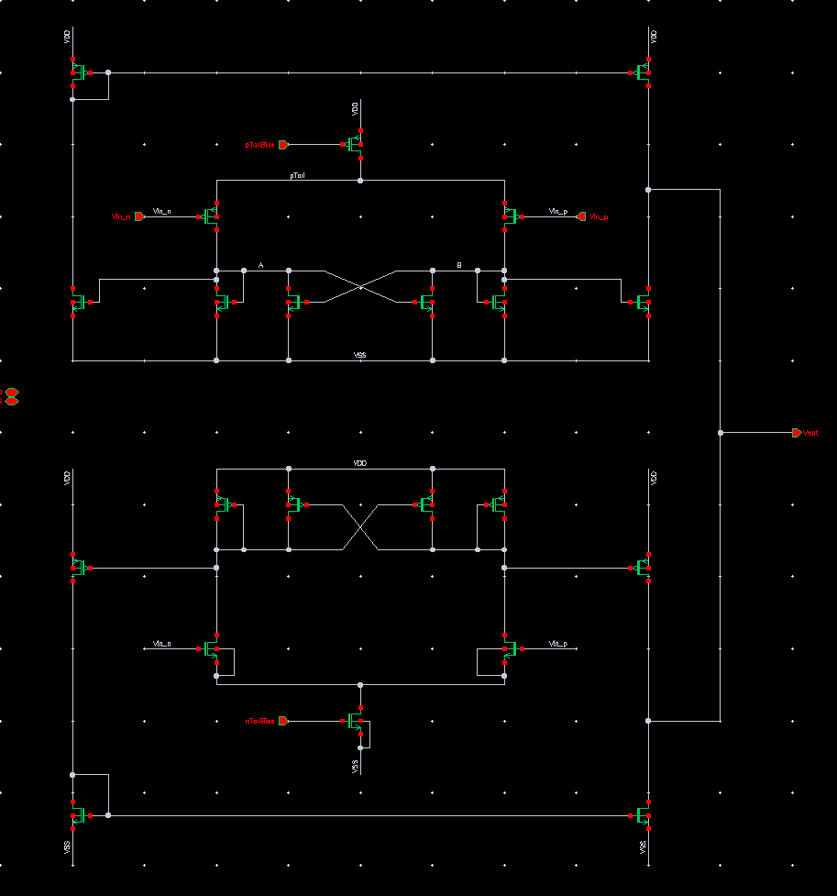
LVDS Rx
All L ≥ 90nm
Input voltage domain: 2.5V to 1.8V (I/O)
Input differential voltageV_{ID} from ±100mV up to rail-to-rail
Output voltage: 1.2V (chip core)
Compatible with LVDS standard (2.5V supply, +-3.5mA into 100 Ohm external termination, 1.25V typical common mode input (1.125V<=V_{CM}<=1.375V)
Temperature range: -189C<=T<=+125C
Low profile layout: ~115µm x 20µm (excluding output pads). Top metal is M4
No Internal termination

Slide 22
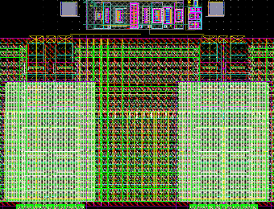
LVDS Rx
Predriver: includes a Vdd_{core}→Vdd_{IO} level shifter + buffers to drive the large capacitive load of the Tx bridge switches
Driver: bridge architecture with selectable current
Common Mode Feedback (CMFB) with resistive sensing (10KΩ) for baseline correction (LVDS spec: 1.125V ≤ V_{CM} ≤ 1.375V)
  PM ϕ~90°, WC ϕ~60° for T=-189C and VDD=1.8V
Level shifters for the configuration bits
PDB2Ax analog I/O pads (as recommended by Foundry), passive protection diodes only for low impedance
Layout:
DFM + guardrings for all transistors
115µm
20µm
120µm
Notes:
The MOM capacitors were chosen for their excellent behavior across temperature and relatively high unit capacitance.
The choice of the resistor is critical for cryogenics operations: unfortunately, the custom device models commissioned for cryogenic operation did not include passive devices, so the only way to gauge the temperature dependence is to hope that the behavior between -40C and +125C in the standard models is indicative of what happens when the simulator extrapolates at liquid argon temperature. Having simulated all available resistors in this process, the N+POLY w/o silicide (rnpolywo) resistor was the best with the small variation across temperature, with P+POLY w/o silicide (rppolywo) also comparable and nwell under STI resistor also good (but this latter has high resistance/square, and might also be more susceptible to degradation).

Slide 23
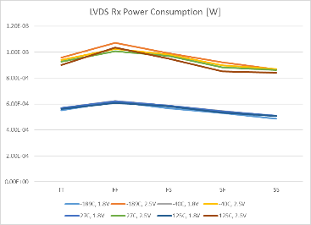
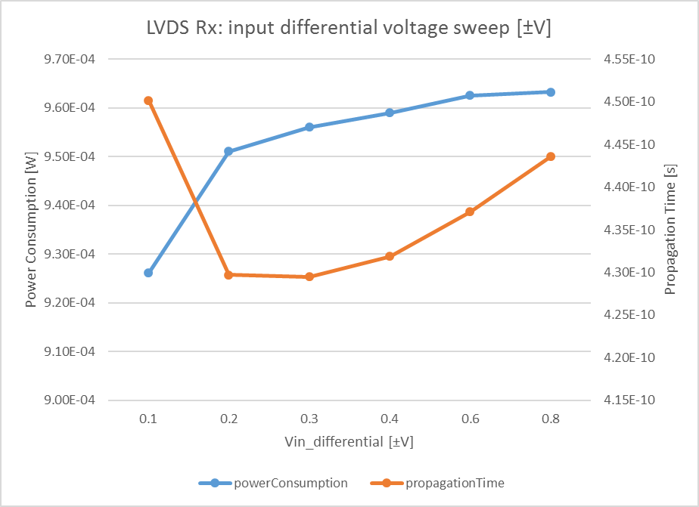
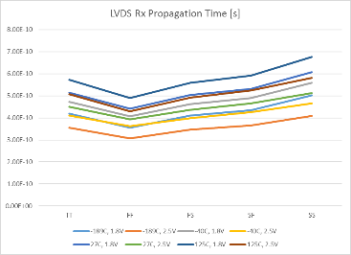
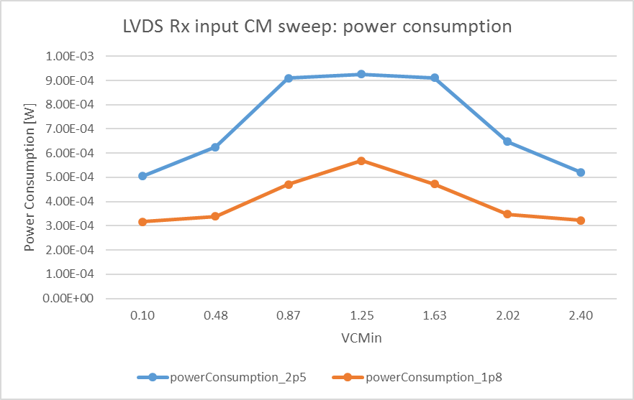
LVDS Rx Performance
Simulations at 1Gbps
power consumption across corners and temperatures for 2.5V and 1.8V supplies.
power consumption and propagation time as function of Vin_{DIFF}.
propagation time across corners and temperatures for 2.5V and 1.8V supplies (Vin_{DIFF}=+-100mV)
power consumption as a function of Vin_{CM}.
Notes:
The input common mode Vin_{CM} is rail-to-rail.
The input differential voltage range goes from ±100mV to rail-to-rail. It is thus possible to operate the receiver with CMOS input signals, provided these are used differentially.
The power consumption values across corners and temperatures for 2.5V and 1.8V supplies are taken for Vin_{CM}= VDD_{I/O}/2, which should be considered the worst case as both nMOS and pMOS input receivers are operational.
The input to output propagation delay is around 0.5ns.
All the results presented are taken at 1Gbps.

Slide 24
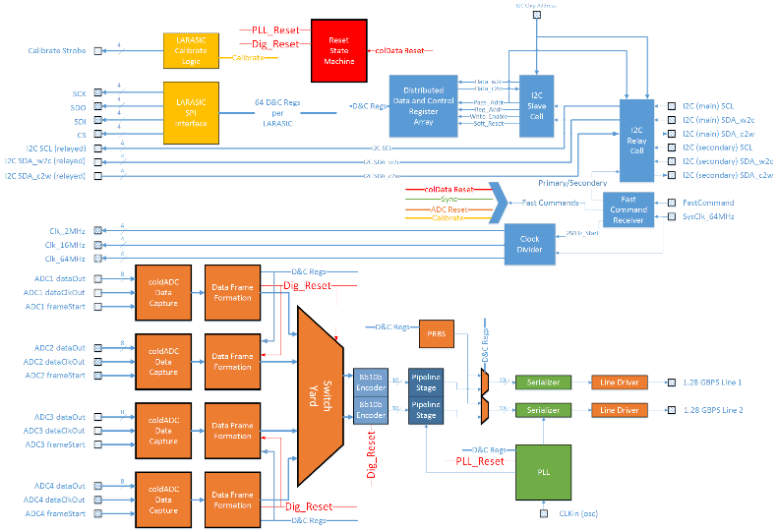
COLDATA
Responsible for all communication between warm and cold.
Receives command and control information.
Provides clocks to the Cold ADC ASICs and relays commands to the LArASIC front-end and to the Cold ADC ASICs to set operating modes and initiate calibration procedures.
Receives data from the ADC ASICs, reformats these data, merges data streams, formats data packets, and sends these data packets to the warm electronics using 1.28 Gbps links. These links are designed for use with 30 m long cables 1 and include line drivers with pulse pre-emphasis.

Slide 25
COLDATA main blocks - 1:
I²C Slave Cell: standard single-master, except for
no clock extension;
LVDS instead of CMOS (→ bidirectional SDA replaced by two lines);
3-word communication (<chipID/page><register address><data>) instead of 2-word communication (<address><data>)
No reset line: resets through Fast Command Interface (+ one from state of SCL & SDA_w2c to reset I2C to “idle”)
I²C Relay Cell:
Relays I²C commands from LVDS to CMOS to the internal and the Cold ADC’s I²C Slave Cells
Can switch between primary and secondary I²C lines (for reliability) via Fast Command Receiver
Fast Command Receiver:
Serial input for commands synchronous to the 64 MHz system clock: Adjust 2MHz Rising Edge, Calibrate, Sync, Switch I2C, COLDATA reset.
Clock Divider: creates the 2MHz and 16MHz clocks from the 64MHz
Notes:
Adjust 2MHz Rising Edge: the 2MHz clock output from the COLDATA chip will rise at the completion of this command. If this command is not given, the 2MHz clock will maintain itself indefinitely
Calibrate: place the COLDATA chip in Calibrate mode. In this mode, the LARASIC calibrate logic will be enable to output calibrate strobes in accordance with constants previously downloaded into the LARASIC and COLDATA chip via I2C
Sync: resets the timestamp counter to zero
Switch I2C: toggle the I2C from primary to secondary
COLDATA reset: forces a reset of the entire COLDATA chip

Slide 26
COLDATA main blocks - 2:
LARASIC Calibrate Logic:
controls the generation of the Calibrate Strobes required by LARASIC in response to the factors and mode commands downloaded to COLDATA
LARASIC SPI Interface:
LARASIC uses a custom control interface for its configuration bits, in an SPI-like configuration. It also implements certain actions like Soft Reset and Hard Reset depending on the state of the four signals. The configuration bits are arranged as one large daisy chain that cannot directly be read out. Instead, to ensure transmission of any new configuration, data must be transmitted twice and read back on the second transmission. The LARASIC SPI Interface in COLDATA implements all the special functions of the LARASIC Interface like Soft Reset and Hard Reset. It also implements a group of 8-bit I2C Control Registers that collectively hold the entire LARASIC SPI daisy chain. Finally, it contains a state machine that when ordered will download the daisy chain bits into LARASIC twice, read back the second transmission and compare the bits read back with the bits transmitted.
ColdADC Data Capture: Each coldADC outputs 256 bits of data every 2MHz period. The interface includes a frame start signal, a data output clock and 8 data output lines, all LVDS. coldADC Data Capture has the job of grabbing whole 256 bit data frames and passing them forward to the Data Frame Formation block.

Slide 27
COLDATA main blocks - 3:
Data Frame Formation:
Every rising edge of the 2MHz clock, the data from two coldADC Data Capture blocks must be stripped of unnecessary bits, packed into a data frame, given a header and given a CRC. The block also implements a Pseudo-Random Binary Sequence (PRBS) that can be used to test the line drivers.
Switch Yard:
For the time being, a place holder only. It may be used to redirect data frames to different line drivers in the event of a loss of viable cables over the lifetime of the experiment.
Serializer:
high-speed parallel to serial conversion (10 to 1)
Line Driver
PLL: This block generates the 128MHz readout clock and the 1.28GHz serializer clock.

Slide 28
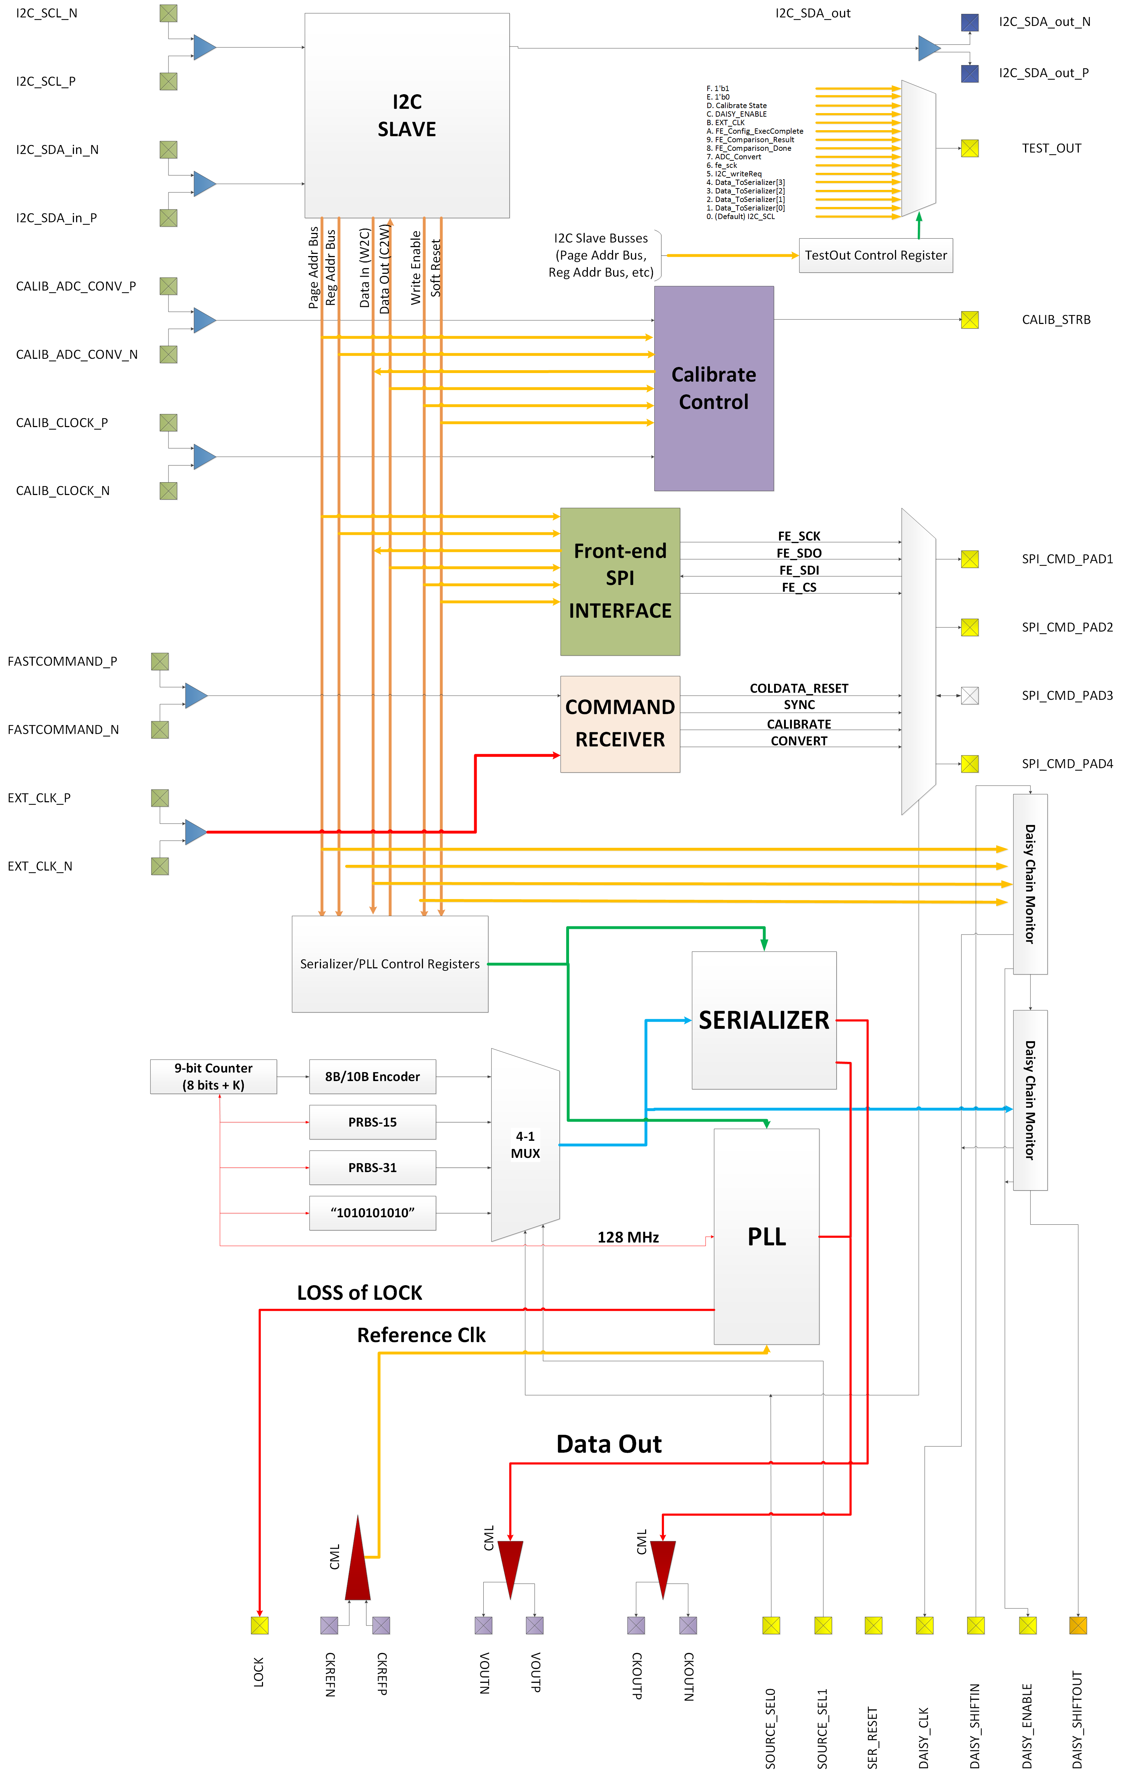
CDP1: COLDATA first Prototype
To advance the project at a time when the specs for COLDATA were still changing, we designed a prototype chip with all the blocks certain to be included in the final full chip.
Left out are the blocks related to the framing of the data from the ADC.
Main blocks:
LVDS Tx & Rx
Slow-control I2C and SPI
Calibration logic for the front end ASICs
Fast command receiver
8b10b encoder
1.285 Gbps serializer
PLL
Digital logic verified through Assertions and UVM
All the registers in the digital logic (I2C, calibration, fast command etc’) are triplicated

Slide 29
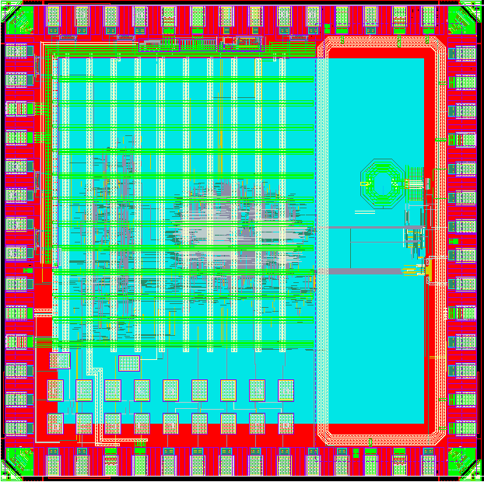
CDP1: COLDATA Prototype 1
2mm
2 x 2 mm, 65nm 9metal
Received and tested in mid-2017
Fully digital assembly
Core logic
2mm
Test transistors, probe pads
PLL + serializer

Slide 30
Fermilab Test Setup
DUT on Cold Board and interface electronics on Warm Board
National Instruments Test System
  PXIe crate: NI PXIe 1085
  FPGA modules: NI-6583 (Digital I/O adapter module) on NI PXIe-7976R (FPGA)
  Source Measurement Unit (SMU) modules: NI-4141 and NI-4145
  Custom LabView VIs
Tektronix Oscilloscope: DSA72004C Digital Signal Analyzer with jitter analysis software
Agilent Oscilloscope MSO7104B
Fermilab 14th floor cryostat (+ LN2 dewars)
Notes:
NI 6583: 200MHz, 32 single-ended and 16 LVDS channels Digital I/O adapter module

Slide 31
CDP1 Test Results
Quick verification of operation in LN2 bath in dewar
  checked power: negligible increase in power supply currents
  checked I2C communication – W/R registers
2. Verified operation at room Temperature
  Serial (I2C) Slave
  PLL/Serializer (Xiaoran, SMU)
  Fast Command Receiver
    All 4 Fast Commands were received and appropriate response was found at the SPI CMD Pads.
  Calibrate Control
  Front-end SPI Interface
3. Verified operation at 77K Temperature
  All operations at Room Temperature repeated
  Tests were repeated with the power cycled off and then on
  Tests were repeated with the power cycled off and then on after 5 minutes
Example of monitoring of the power supplies as temperature was lowered in cryostat (the last two points taken after power down and power up, without waiting and after 5 mins respectively)

Slide 32
Conclusions and Future Developments
COLDATA designed in 65 nm CMOS using “cold” transistor models based on data collected by members of the FNAL, BNL, and SMU ASIC groups.
A special library of standard cells, based on these models and using a minimum channel length of 90 nm, was developed by members of the FNAL and UPENN groups, to eliminate the risk posed by the hot carrier effect.
Both the models and the standard cell library can be made available upon request, provided the NDA with Foundry is in place. Fermilab could manage and maintain such library in a centralized database.
The key circuit elements of COLDATA, including the control interface and the PLL and serializer, were prototyped and tested successfully in 2017. The serializer and the PLL have been extensively characterized. All other blocks were also proven functional at both room and LAr temperatures.
A test structure for speed and stress tests of the LVDS Tx and Rx is expected soon
Submission of COLDATA is expected later this year.

Slide 33
Acknowledgements
Fermilab:
Jim Hoff, Sandeep Miryala, Scott Holm, Grzegorz Deptuch, Alpana Shenai, Albert Dyer, Terri Shaw, David Christian
Southern Methodist University (PLL + serializer):
Ping Gui, Xiaoran Wang, Tianwei Liu
University of Pennsylvania (library characterization):
Mitch Newcomer, Nandor Dressnandt, Paul Keener

Slide 34
Cold ADC ASIC (LBL, BNL, FNAL)

Slide 35
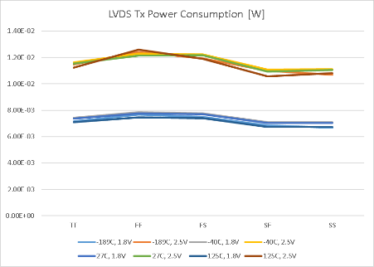
LVDS Tx Rise Time and Power consumption
VDD=2.5V
VDD=1.8V
Tx rise time across corners and temperatures (200Mbps, Iout=+-4mA; no source termination).
Tx power consumption across corners and temperatures (200Mbps, Iout=+-4mA; no source termination) (bias block not included since it can be shared between several Tx).
Notes:
The power consumption is dominated by the output current and data-rate independent (as expected)
Note that these plots are for a output current of +-4mA, which could be doubled to +-8mA.

Slide 36
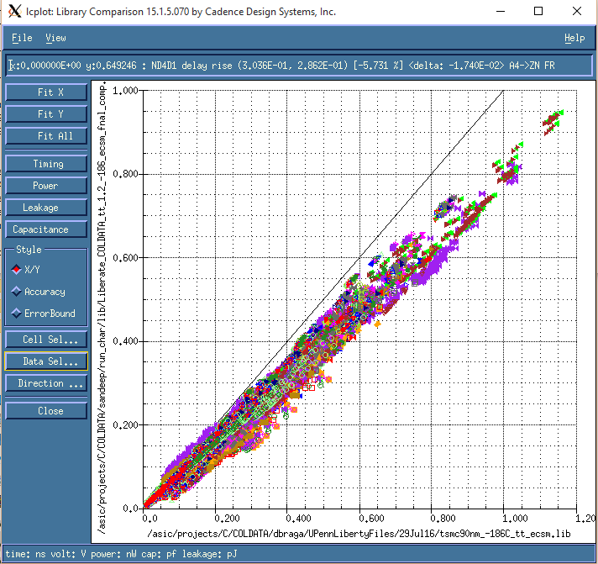
Example of Model Validation with Liberate
Data Type | Entries | Avg Diff % | Sigma % | Max Diff %
Delay | 98553 | -21.35 | 5.98 | -72.23
Transition Time | 98161 | -18.03 | 9.28 | 120.73
Leakage | 1769 | 203.40 | 52.68 | 898.37

Slide 37
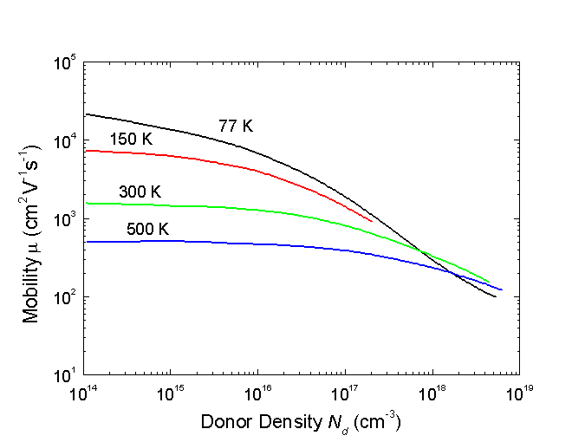
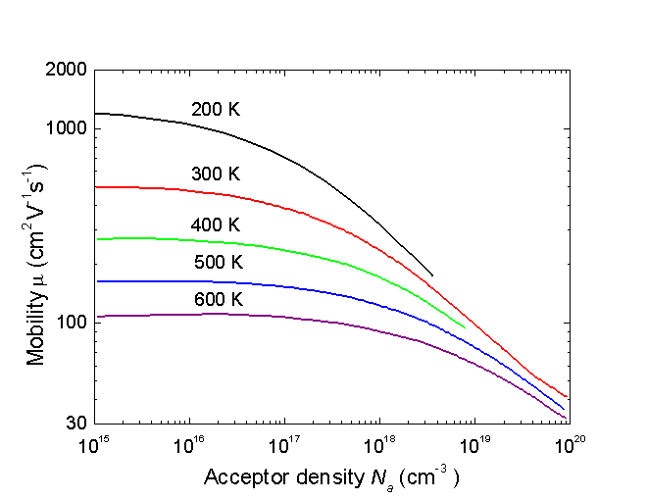
Carrier mobility vs temperature
(from http://www.ioffe.ru/SVA/NSM/Semicond/Si/electric.html)
Electron drift mobility versus donor density at different temperatures (Li and Thumber [1977])
Hole drift mobility versus acceptor density at different temperatures (Dorkel and Leturcq [1981]).
Notes:
The power consumption is dominated by the output current and data-rate independent (as expected)
Note that these plots are for a output current of +-4mA, which could be doubled to +-8mA.

Slide 38
Overview of Hot Carrier effects
(H. Chen, BNL)
Notes:
The power consumption is dominated by the output current and data-rate independent (as expected)
Note that these plots are for a output current of +-4mA, which could be doubled to +-8mA.

