Slide 1

Large area SiPM readout
11th Front End Electronics Meeting
Jouvence, 2018
Alessandro Razeto
Laboratori Nazionali del Gran Sasso

Slide 2
SiPM
The use of SiPM is rapidly increasing both for scientific and for industrial applications
  high gain, high PDE, compact form
SiPM can be read as pixels or as aggregate devices
  Pixels can be as small as the microcell see digital SiPMs
  Several integrated chips can read-out many mm² pixel
These approaches are used for segmented detectors (PET)
For several applications a PMT replacement is desirable
  Aggregating the SiPM to a total surface of many cm²
    But given the high DCR this is typically interesting only at cryogenic temperature
This talk will be based on FBK NUV-HD SiPM read by trans-impedance amplifiers

Slide 3
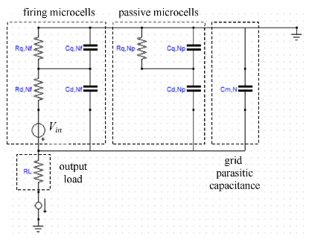
SiPM detailed electrical model
A Single Photon Avalanche Diode operates in Geiger mode
The intrinsic capacitance of the SPAD is named C_{d}
  The intrinsic resistance of the SPAD is named R_{d}
The SPAD has a quenching resistance R_{q} to stop the avalanche
The quenching exhibits a parasitic capacitance C_{q}
At V_{bias} > V_{breakdown} the avalanche is possible
  With gain G = V_{ov} C_{d} where V_{ov} = V_{bias} - V_{breakdown}
A SiPM is a collection of N SPAD of typical size 20-50 um
A signal is generated when N_{f} SPADs are triggered
Accurate electrical models exist to describe the signal and overall electrical parameters of the SiPMs

Slide 4
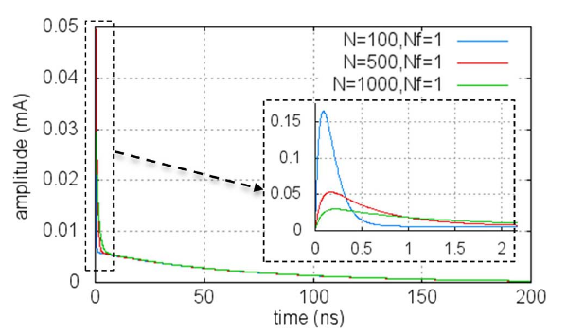
SiPM detailed electrical model
D. Marano et al., IEEE TNS 11,11,13

Slide 5
SiPM detailed electrical model
D. Marano et al., IEEE TNS 11,11,13
Requirements for the amplifier bandwidth & noise

Slide 6
SiPM detailed electrical model
ignored
Small effects
D. Marano et al., IEEE TNS 11,11,13
Limiting the amplifier bandwidth & noise

Slide 7
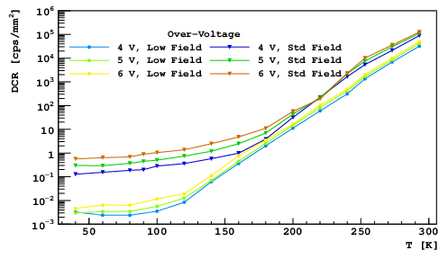
SiPMs at cryogenic temperature
Dark noise reduction by more than 7 orders of magnitude

Slide 8
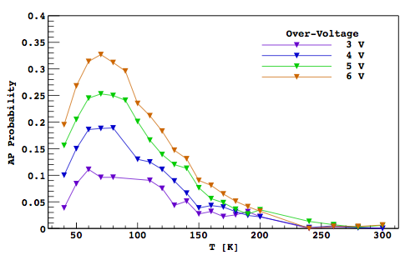
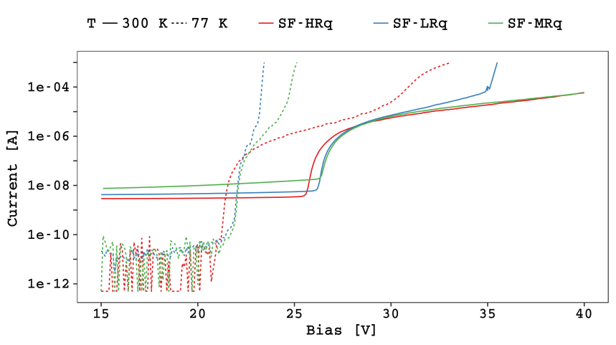
SiPMs at cryogenic temperature
Dark noise reduction by more than 7 orders of magnitude
Increased afterpulse
  Lower gain operation
NUV-HD-SF
At a given temperature and overvoltage
higher Rq -> longer recharge time
-> lower triggering probability in
the same cell
-> lower afterpulse probability
-> lower divergence probability

Slide 9
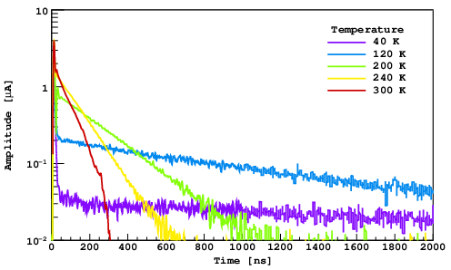
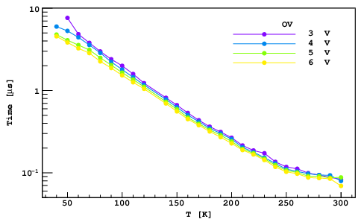
SiPMs at cryogenic temperature
Dark noise reduction by more than 7 orders of magnitude
Increased afterpulse
  Lower gain operation
NUV-HD-SF
For poly-silicon based R_{q}
  R_{q} strongly depends on T
  Pulse shape changes
    longer recharge time

Slide 10
SiPMs at cryogenic temperature
Dark noise reduction by more than 7 orders of magnitude
Increased afterpulse
  Lower gain operation
NUV-HD-SF
For poly-silicon based R_{q}
  R_{q} strongly depends on T
  Pulse shape changes
    longer recharge time
  Smaller peak current
F. Acerbi et al., IEEE TED 64,2,17

Slide 11
SiPM simplified electric model
BW & output noise spectrum depends on the input load

Slide 12
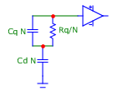
SiPM simplified electric model
BW & output noise spectrum depends on the input load
A simplified model can be used
  Valid if N_{f} << N

Slide 13
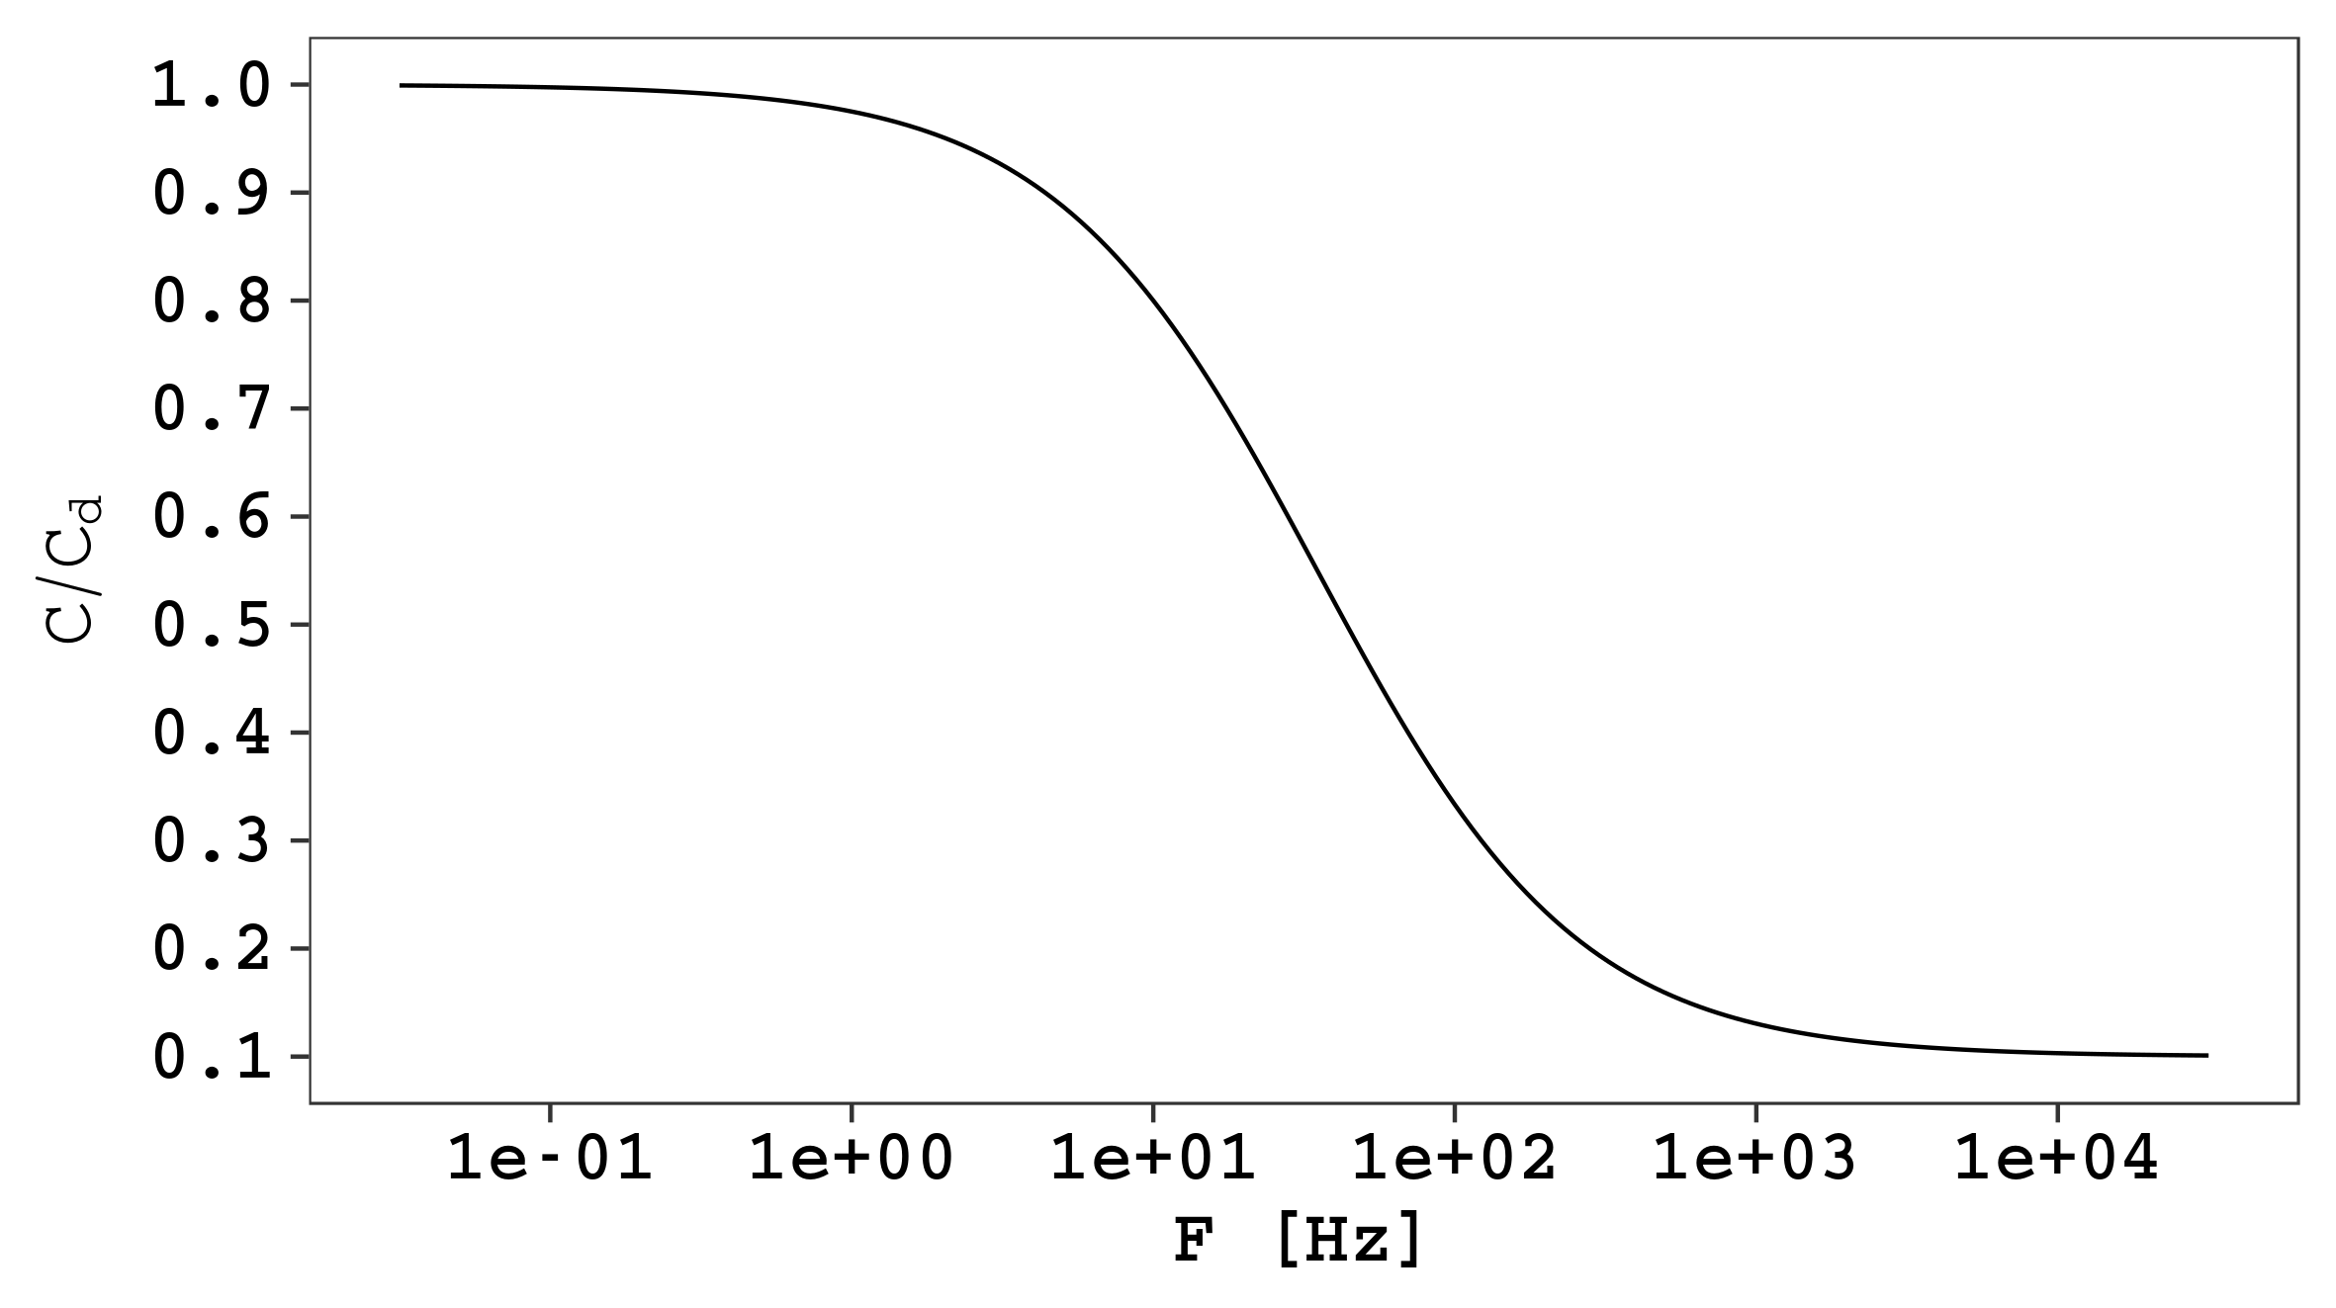
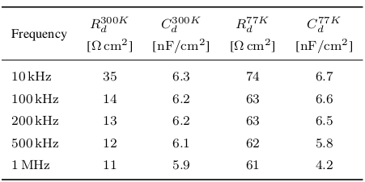
SiPM simplified electric model
BW & output noise spectrum depends on the input load
A simplified model can be used
  Valid if N_{f} << N
A transition happens at F_{T} = 1/(2 π Rq Cq) ~ 20- 30 MHz
N Cd
SiPM seen by a RLC bridge
eq
eq
eq
eq
N Cq

Slide 14

SiPM simplified electric model
BW & output noise spectrum depends on the input load
A simplified model can be used
  Valid if N_{f} << N
A transition happens at F_{T} = 1/(2 π Rq Cq) ~ 20- 30 MHz
  But at cryogenic temperature Rq increases
N Cd
SiPM seen by a RLC bridge
eq
eq
eq
eq
N Cq

Slide 15
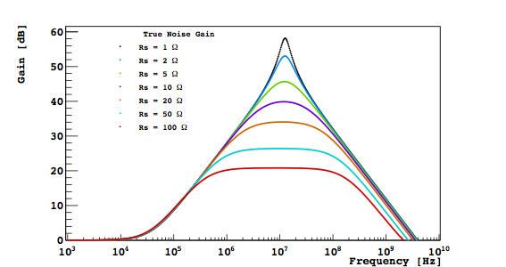
SiPM simplified electric model
BW & output noise spectrum depends on the input load
A simplified model can be used
  Valid if N_{f} << N
A transition happens at F_{T} = 1/(2 π Rq Cq) ~ 20- 30 MHz
  But at cryogenic temperature Rq increases
This transition is important because it affects the noise gain:
  The capacitance decreases GOOD
  The series resistance (Rq/N) vanishes BAD
N Cd
SiPM seen by a RLC bridge
eq
eq
eq
eq
N Cq
Model
Noise

Slide 16
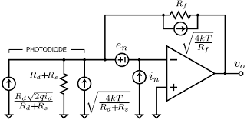
Heterojunction electronics
For fast TIA amplifiers with R_{f} ~ 1-10 kΩ
  n(R_{f}) << e_{n} * NG & i_{n} * R_{f} << e_{n} * NG
MOS technology typically
e_{n} ~ 4 nV/√Hz & i_{n} ~ 10 fA/√Hz
MOS technology may not be the best choice

Slide 17
Heterojunction electronics
For fast TIA amplifiers with R_{f} ~ 1-10 kΩ
  n(R_{f}) << e_{n} * NG & i_{n} * R_{f} << e_{n} * NG
MOS technology typically
e_{n} ~ 4 nV/√Hz & i_{n} ~ 10 fA/√Hz
MOS technology may not be the best choice
Most producers are distributing heterojunction BJT based amplifiers
  For high bandwidth applications GHz
  For very low noise applications sub-nV/√Hz
HBTs are great signal amplifiers at cryogenic temperature
  They are BJT -> very low e_{n}
  Low 1/f noise
  Noise and BW are better at cryogenic temperature

Slide 18
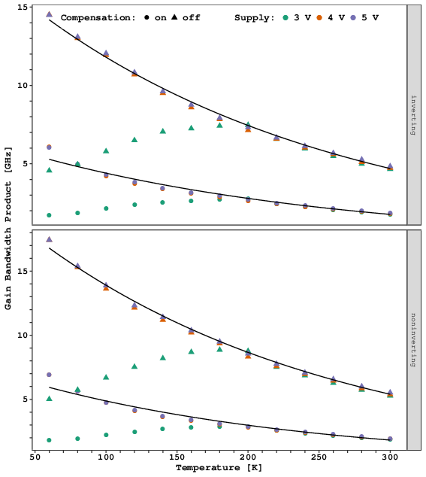
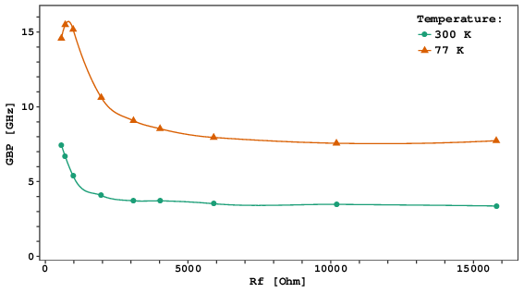
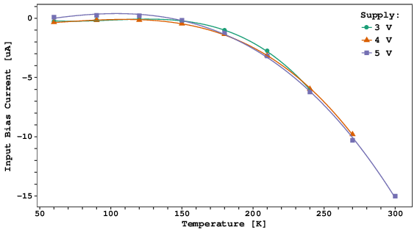
LMH6629 characterization
LMH6629 from TI:
Works down to 40 K
Stable for |Av| > 10
Very high bandwidth
  Increasing at low T
  ~0.2 pF in Fb path
Very low noise
Max bias 5 V
  60 – 80 mW
  P_{out}1dB = 16 dBm
(3.8 Vpp)

Slide 19
LMH6629 characterization
LMH6629 from TI:
Works down to 40 K
Stable for |Av| > 10
Very high bandwidth
  Increasing at low T
  ~0.2 pF in Fb path
Very low noise
Max bias 5 V
  60 – 80 mW
  P_{out}1dB = 16 dBm
(3.8 Vpp)
Thermal pad

Slide 20
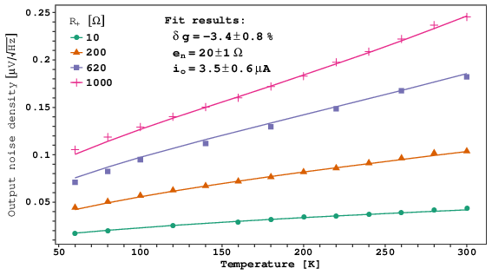

LMH6629 Noise Model
constant
Where:
R_{eq} accounts for all resistors
e_{n} is modeled as a Johnson source
i_{n} is modeled as Shotky noise of |i_{b}| + |i_{o}|
N is the output noise density @ 1MHz
The fit reproduces the data at better than 2.5 %
The voltage noise density of the LMH6629 is equivalent to a 20 Ω resistor
M D’Incecco et al., IEEE TNS 65,4,18

Slide 21
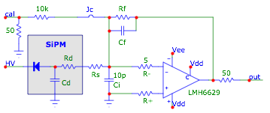
TIA design & results on single SiPMs
Standard Transimpedance design except:
Few tweaks for stabilization
  R₊ , R₋, C_{i}
C_{f} is due to parasitic effects (~0.2 pF)
The series resistor Rs
R_{eq}
C_{eq}

Slide 22
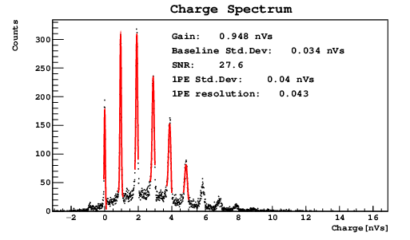
TIA design & results on single SiPMs
R_{eq}
5x5 mm @ 300K
SNR = 27.7 @ 5 VoV
(1.3 10⁶)
C_{eq}

Slide 23
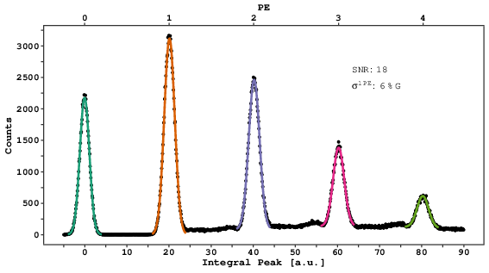
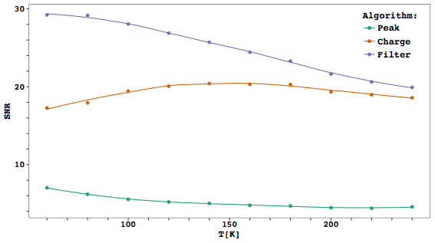
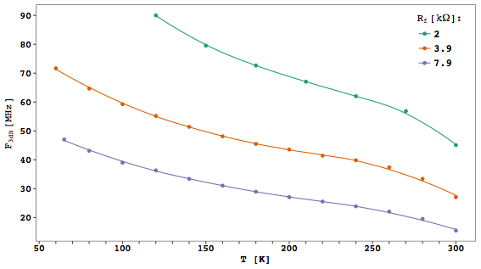
TIA design & results on single SiPMs
R_{eq}
5x5 mm @ 300K
SNR = 27.7 @ 5 VoV
(1.3 10⁶)
C_{eq}
1x1 cm²
SNR = 18
1PE resolution: 0.06
1x1 cm² @ 77K
G = 10⁶
1x1 cm² & G = 10⁶

Slide 24
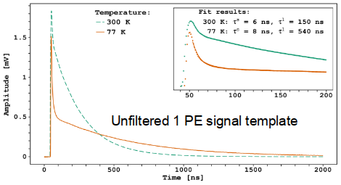
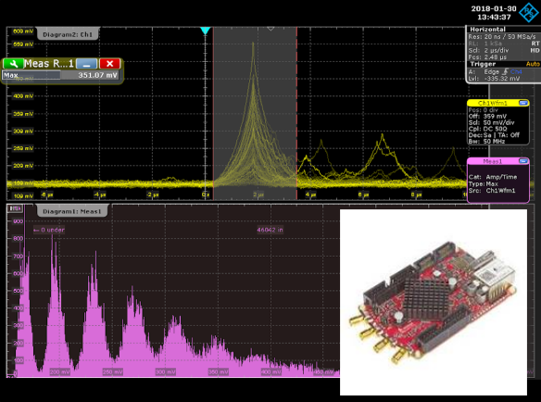
Matched filtering
Matched filter is the optimal linear filter to extract a signal of know shape in the presence of additive stochastic noise.
The filtered signal is obtained by cross-correlating the raw waveform for the signal template
The output is symmetric around the peak, giving a better identification of the timing.
We successfully tested an online FPGA based implementation

Slide 25
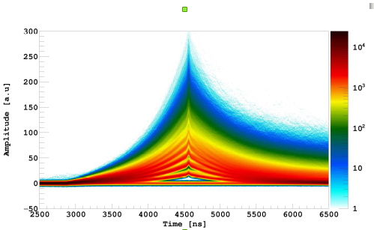
Timing
1 cm² @ 77 K:
Using matched filter
Gain 10⁶

Slide 26
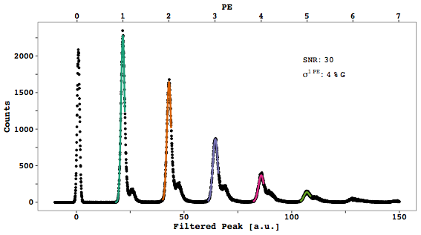
Timing
1 cm² @ 77 K:
Using matched filter
Gain 10⁶
SNR = 30

Slide 27
Timing
1 cm² @ 77 K:
Using matched filter
Gain 10⁶
SNR = 18
1PE resolution: 0.06
SNR = 30

Slide 28
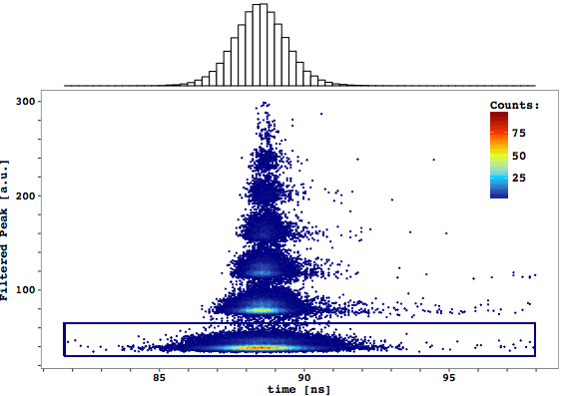
Timing
1 cm² @ 77 K:
Using matched filter
Gain 10⁶
SNR = 30
Jitter = 1 ns

Slide 29


R_{eq}
C_{eq}

Slide 30


R_{eq}
C_{eq}

Slide 31

R_{eq}
C_{eq}

Slide 32
1 cm² @ 77 K:
R_{n} = 20 Ω
R_{s} = 20 Ω
R_{eq} = 60 Ω
Rf = 3.9 k Ω
n_{o} = -141 dBm

Slide 33
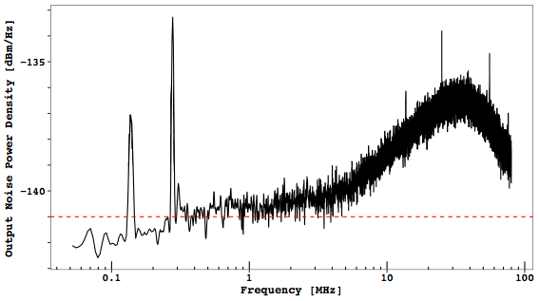
1 cm² @ 77 K:
R_{n} = 20 Ω
R_{s} = 20 Ω
R_{eq} = 60 Ω
Rf = 3.9 k Ω
n_{o} = -141 dBm

Slide 34
10% of noise
1 cm² @ 77 K:
R_{n} = 20 Ω
R_{s} = 20 Ω
R_{eq} = 60 Ω
Rf = 3.9 k Ω
n_{o} = -141 dBm

Slide 35

10% of noise
1 cm² @ 77 K:
R_{n} = 20 Ω
R_{s} = 20 Ω
R_{eq} = 60 Ω
Rf = 3.9 k Ω
n_{o} = -141 dBm
M D’Incecco et al., IEEE TNS 65,4,18

Slide 36
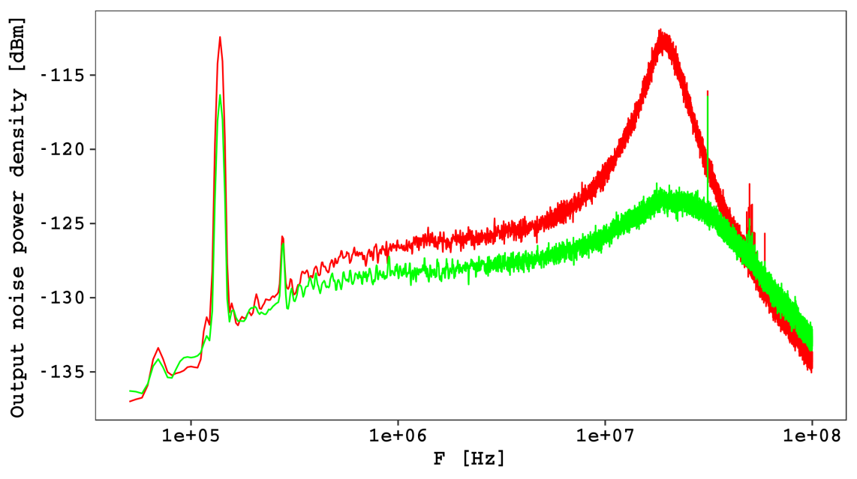
The role of R_{s}
For frequencies > F_{T} the previous model is broken
The presence of Rs limits the noise gain up to the natural bandwidth of the amplifier
The result is an increased SNR
Rs = 0
Rs = 20 Ω

Slide 37
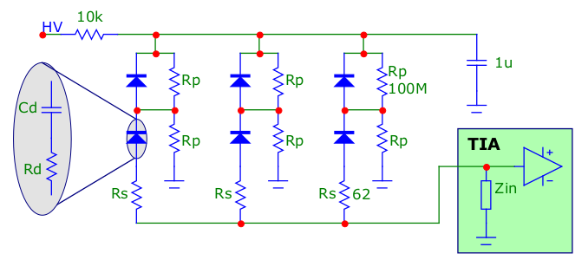
6 cm² SiPM readout
To read more SiPMs with the same amplifier a partial ganging solution is used
This design increases the capacitance seen by the TIA only by 50%
For cryogenic use a precision voltage divider is required
  Otherwise the voltage division will be defined by the leakage current
C_{eq}
R_{eq}

Slide 38

6 cm² SiPM readout
C_{eq}
R_{eq}

Slide 39
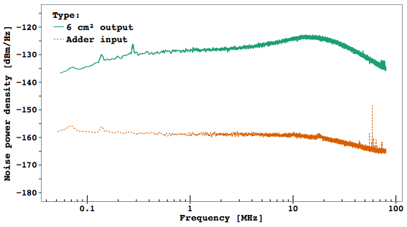
6 cm² SiPM readout
C_{eq}
R_{eq}
6 cm² @ 77 K:
R_{n} = 20 Ω
R_{s} = 60 Ω
R_{eq} = 60 Ω
R_{f} = 10 k Ω
n_{o} = -127 dBm

Slide 40
6 cm² SiPM readout
C_{eq}
R_{eq}
6 cm² @ 77 K:
R_{n} = 20 Ω
R_{s} = 60 Ω
R_{eq} = 60 Ω
R_{f} = 10 k Ω
n_{o} = -127 dBm
15% of noise

Slide 41

6 cm² SiPM readout
6 x 1 cm² independent readout
(with analog sum)
6/√6 ~ 2 times better
C_{eq}
R_{eq}
6 cm² @ 77 K:
R_{n} = 20 Ω
R_{s} = 60 Ω
R_{eq} = 60 Ω
R_{f} = 10 k Ω
n_{o} = -127 dBm

Slide 42
6 cm² SiPM readout
6 x 1 cm² independent readout
(with analog sum)
6/√6 ~ 2 times better
C_{eq}
R_{eq}
6 cm² @ 77 K:
R_{n} = 20 Ω
R_{s} = 60 Ω
R_{eq} = 60 Ω
R_{f} = 10 k Ω
n_{o} = -127 dBm
Open space to integration? It depends
For simple TIA with MOS technology
Typical e_{n} ~ 2 nV/√Hz <-> R_{n}(MOS) ~ 1 kΩ
For smarter designs work in progress
(see slides from Manuel Rolo)

Slide 43
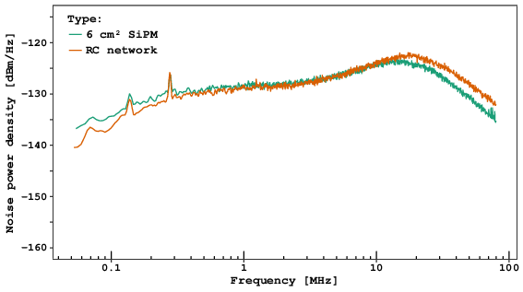
Dummy load
Noise spectrum with 6 cm²
versus a dummy load
Dummy load

Slide 44
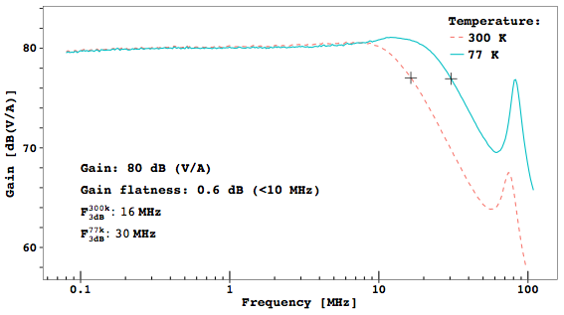
6 cm² @ 77 K

Slide 45
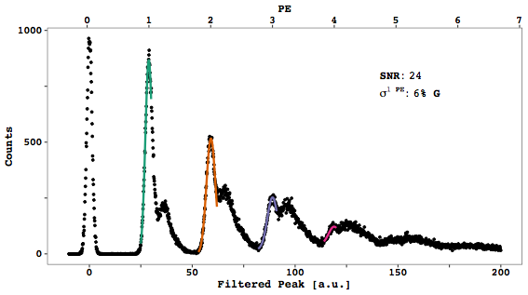
6 cm² @ 77 K
5 VoV = 1.5 10⁶

Slide 46
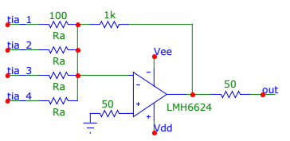
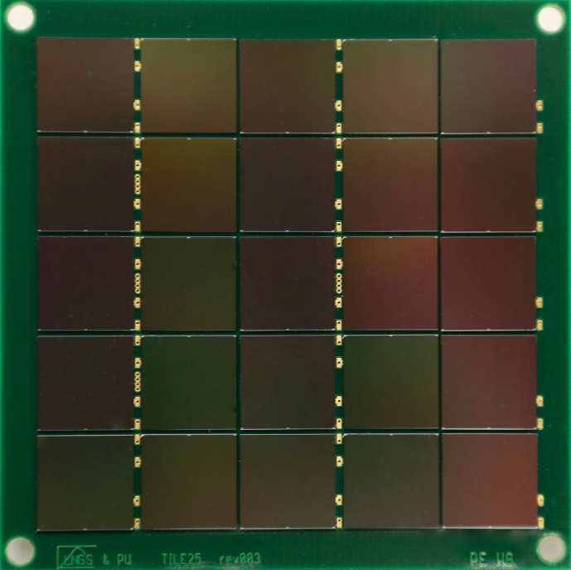
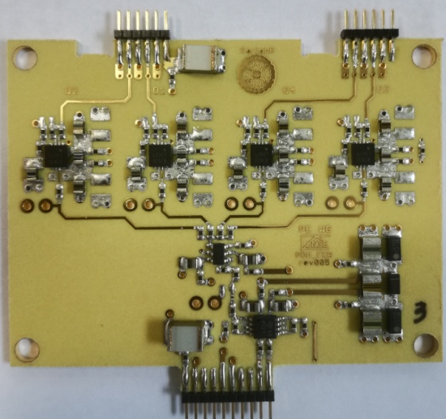
24 cm² @ 77 K
or OPA838
4 x 6 cm² quadrants are aggregated by an active cryogenic adder

Slide 47
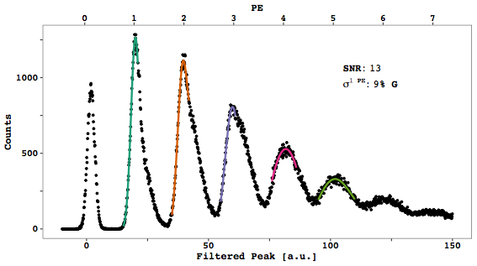
24 cm² @ 77 K
5 VoV <=> 1.5 10⁶
SNR = 13
4 x 6 cm² quadrants are aggregated by an active cryogenic adder

Slide 48
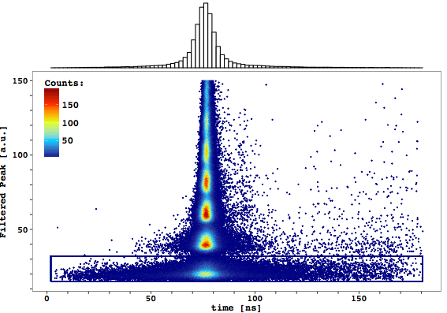
24 cm² @ 77 K
5 VoV = 1.5 10⁶
jitter = 16 ns
SNR = 13
M D’Incecco et al., IEEE TNS 65,1,18

Slide 49
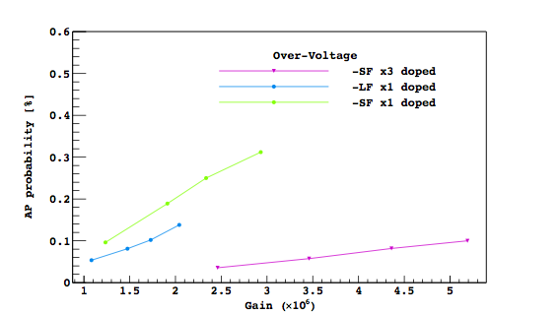
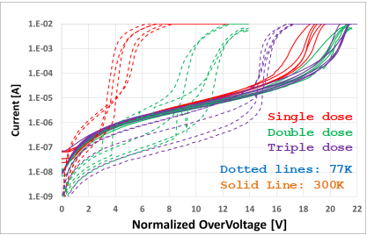
Low AP NUV
Extended Gain SiPM for Cryogenic Application
from FBK
PRELIMINARY
Low afterpulse
Extended Overvoltage at 77 K
> 14 V

Slide 50
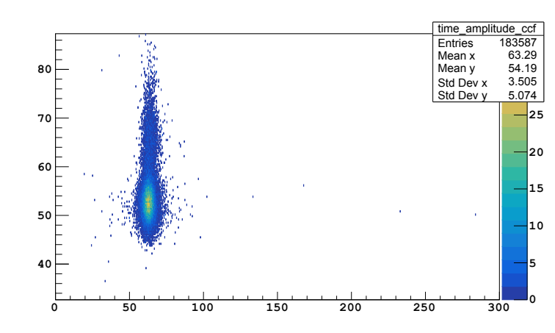

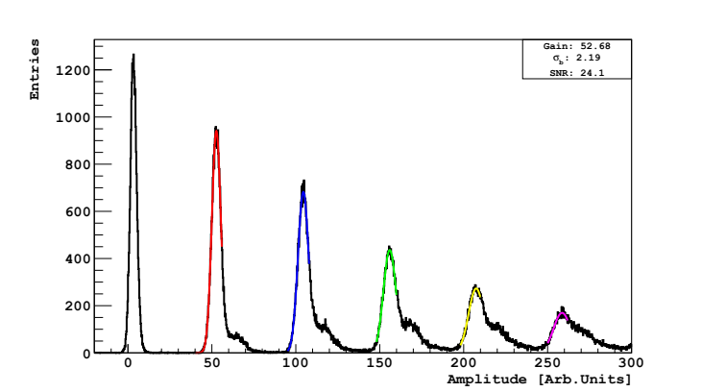
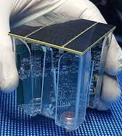

Low AP NUV
Extended Gain SiPM for Cryogenic Application
from FBK
24 cm² @ 77 K 8 VoV
PRELIMINARY

Slide 51
Conclusions
We proved that large SiPM arrays O(25 cm²) can be read with outstanding SNR and timing performances
  SNR >> 10 & timing down to few ns
The cryogenic electronics built on commercial components ready available
  Using radiopure components
What’s next:
  Faster SiPMs will increase the SNR
    A test with Hamamatsu SiPMs is scheduled within the year
  Build larger detectors
An R&D for optical linear signal transmission over fiber is concluding
Stay tuned

Slide 52
Thank you

Slide 53
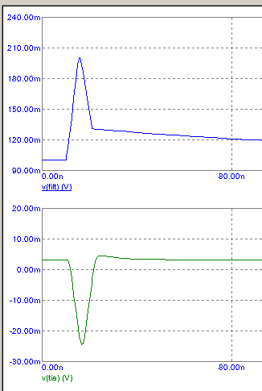
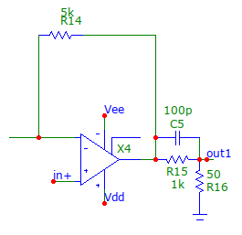
Zero-Pole cancellation
For some application it is better to remove the recharge tail
This can be achieved with zero-pole cancellation
AD800x
This solution does not avoid saturation of the front-end

Slide 54
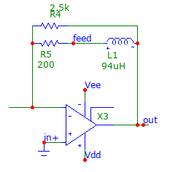
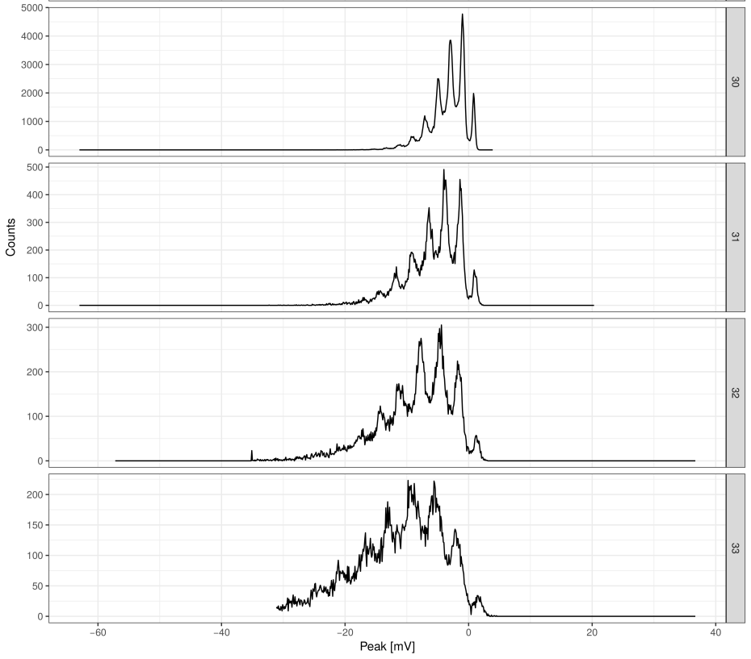
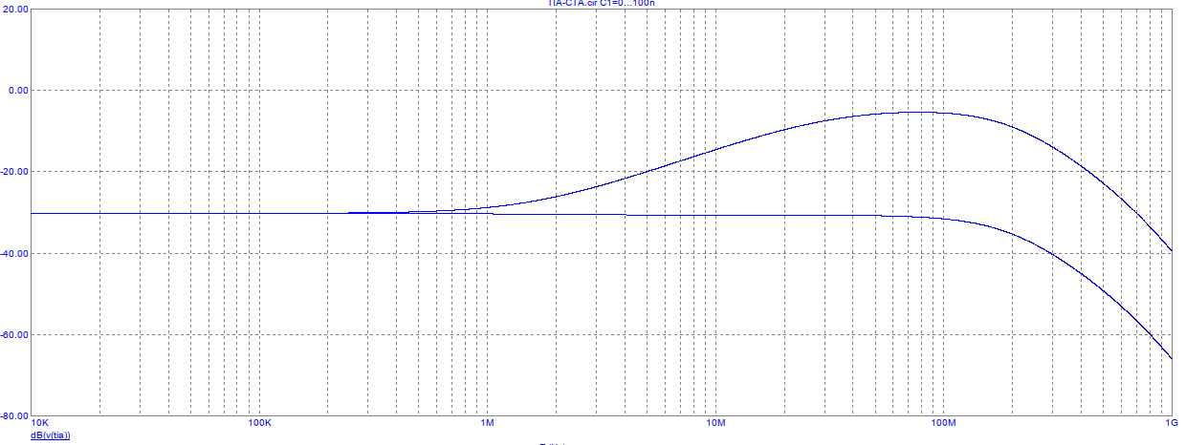
ZPC Results
5x5 mm² NUV-HD
@ 300 K
VoV = 3.5 SNR = 10
The resolution is affected by the DCR
VoV = 4.5
Inductors can not be used in cryogenic
LMH6624
VoV = 5.5
Amplifier
VoV = 6.5
SiPM + Amplifier
F3dB = 160 MHz

Slide 55





Slide 56

6 cm² SiPM readout
C_{eq}
R_{eq}

