Slide 1
Pushing the limits of hybrid pixel detectors in photon science with MÖNCH
Roberto Dinapoli :: Photon Science Detectors Group :: Paul Scherrer Institut
FEE 2018
Notes:
MÖNCH is a 25 μm pitch charge integrating detector aimed at exploring the limits of current hybrid silicon detector technology.
It opens new perspectives for many synchrotron applications where currently the detector is the limiting factor e.g. inelastic x-ray scattering (IXS), Laue diffraction and soft X-ray or high resolution imaging.
The reduced input capacitance allows to obtain a low noise of less than 35 electrons RMS and the high segmentation provides high resolution images.
However, the small pixels present many challenges in terms of bump bond yield, electronics design and data throughput.
At this pitch, the charge produced by single X-rays is almost always shared between neighboring pixels.
This allows to interpolate between channels obtaining ~ micron spatial resolution, but on the other hand deteriorates the energy resolving power of the detector.
The possibility of exploiting the charge sharing to improve the spatial resolution requires detailed modeling and characterization, which can also help to retrieve the energy information.

Slide 2
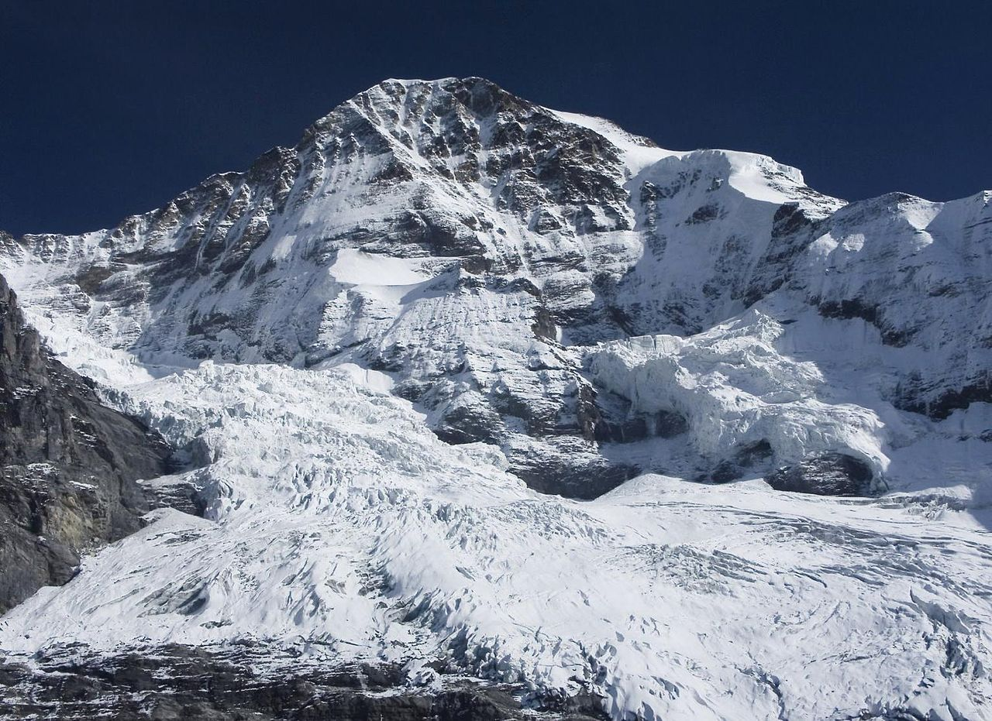
Overview
Hybrid detectors at PSI
MÖNCH introduction
Detector characterization
Applications
MÖNCH 1.0 for Athos
Conclusions & Outlook

Slide 3
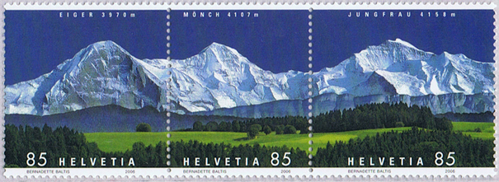
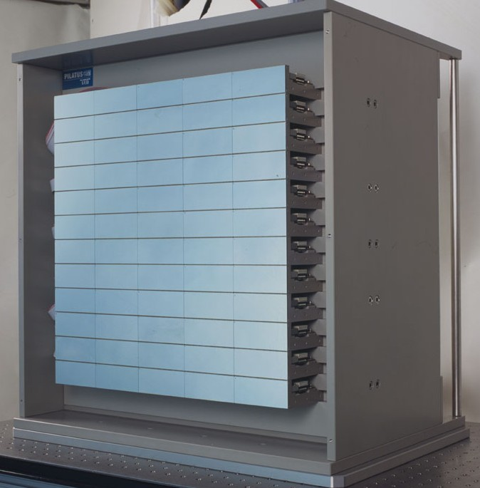
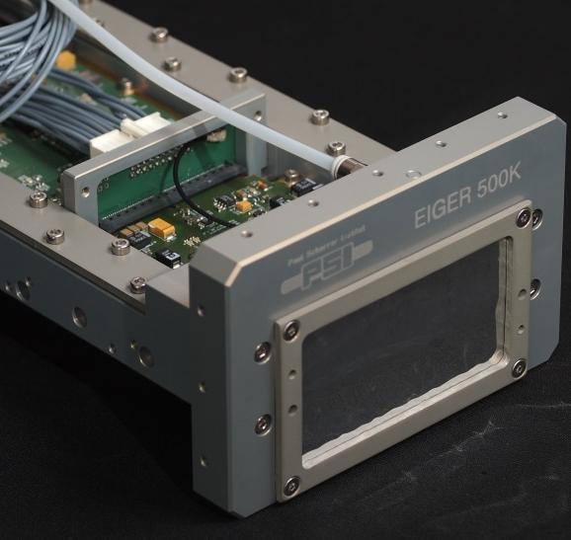



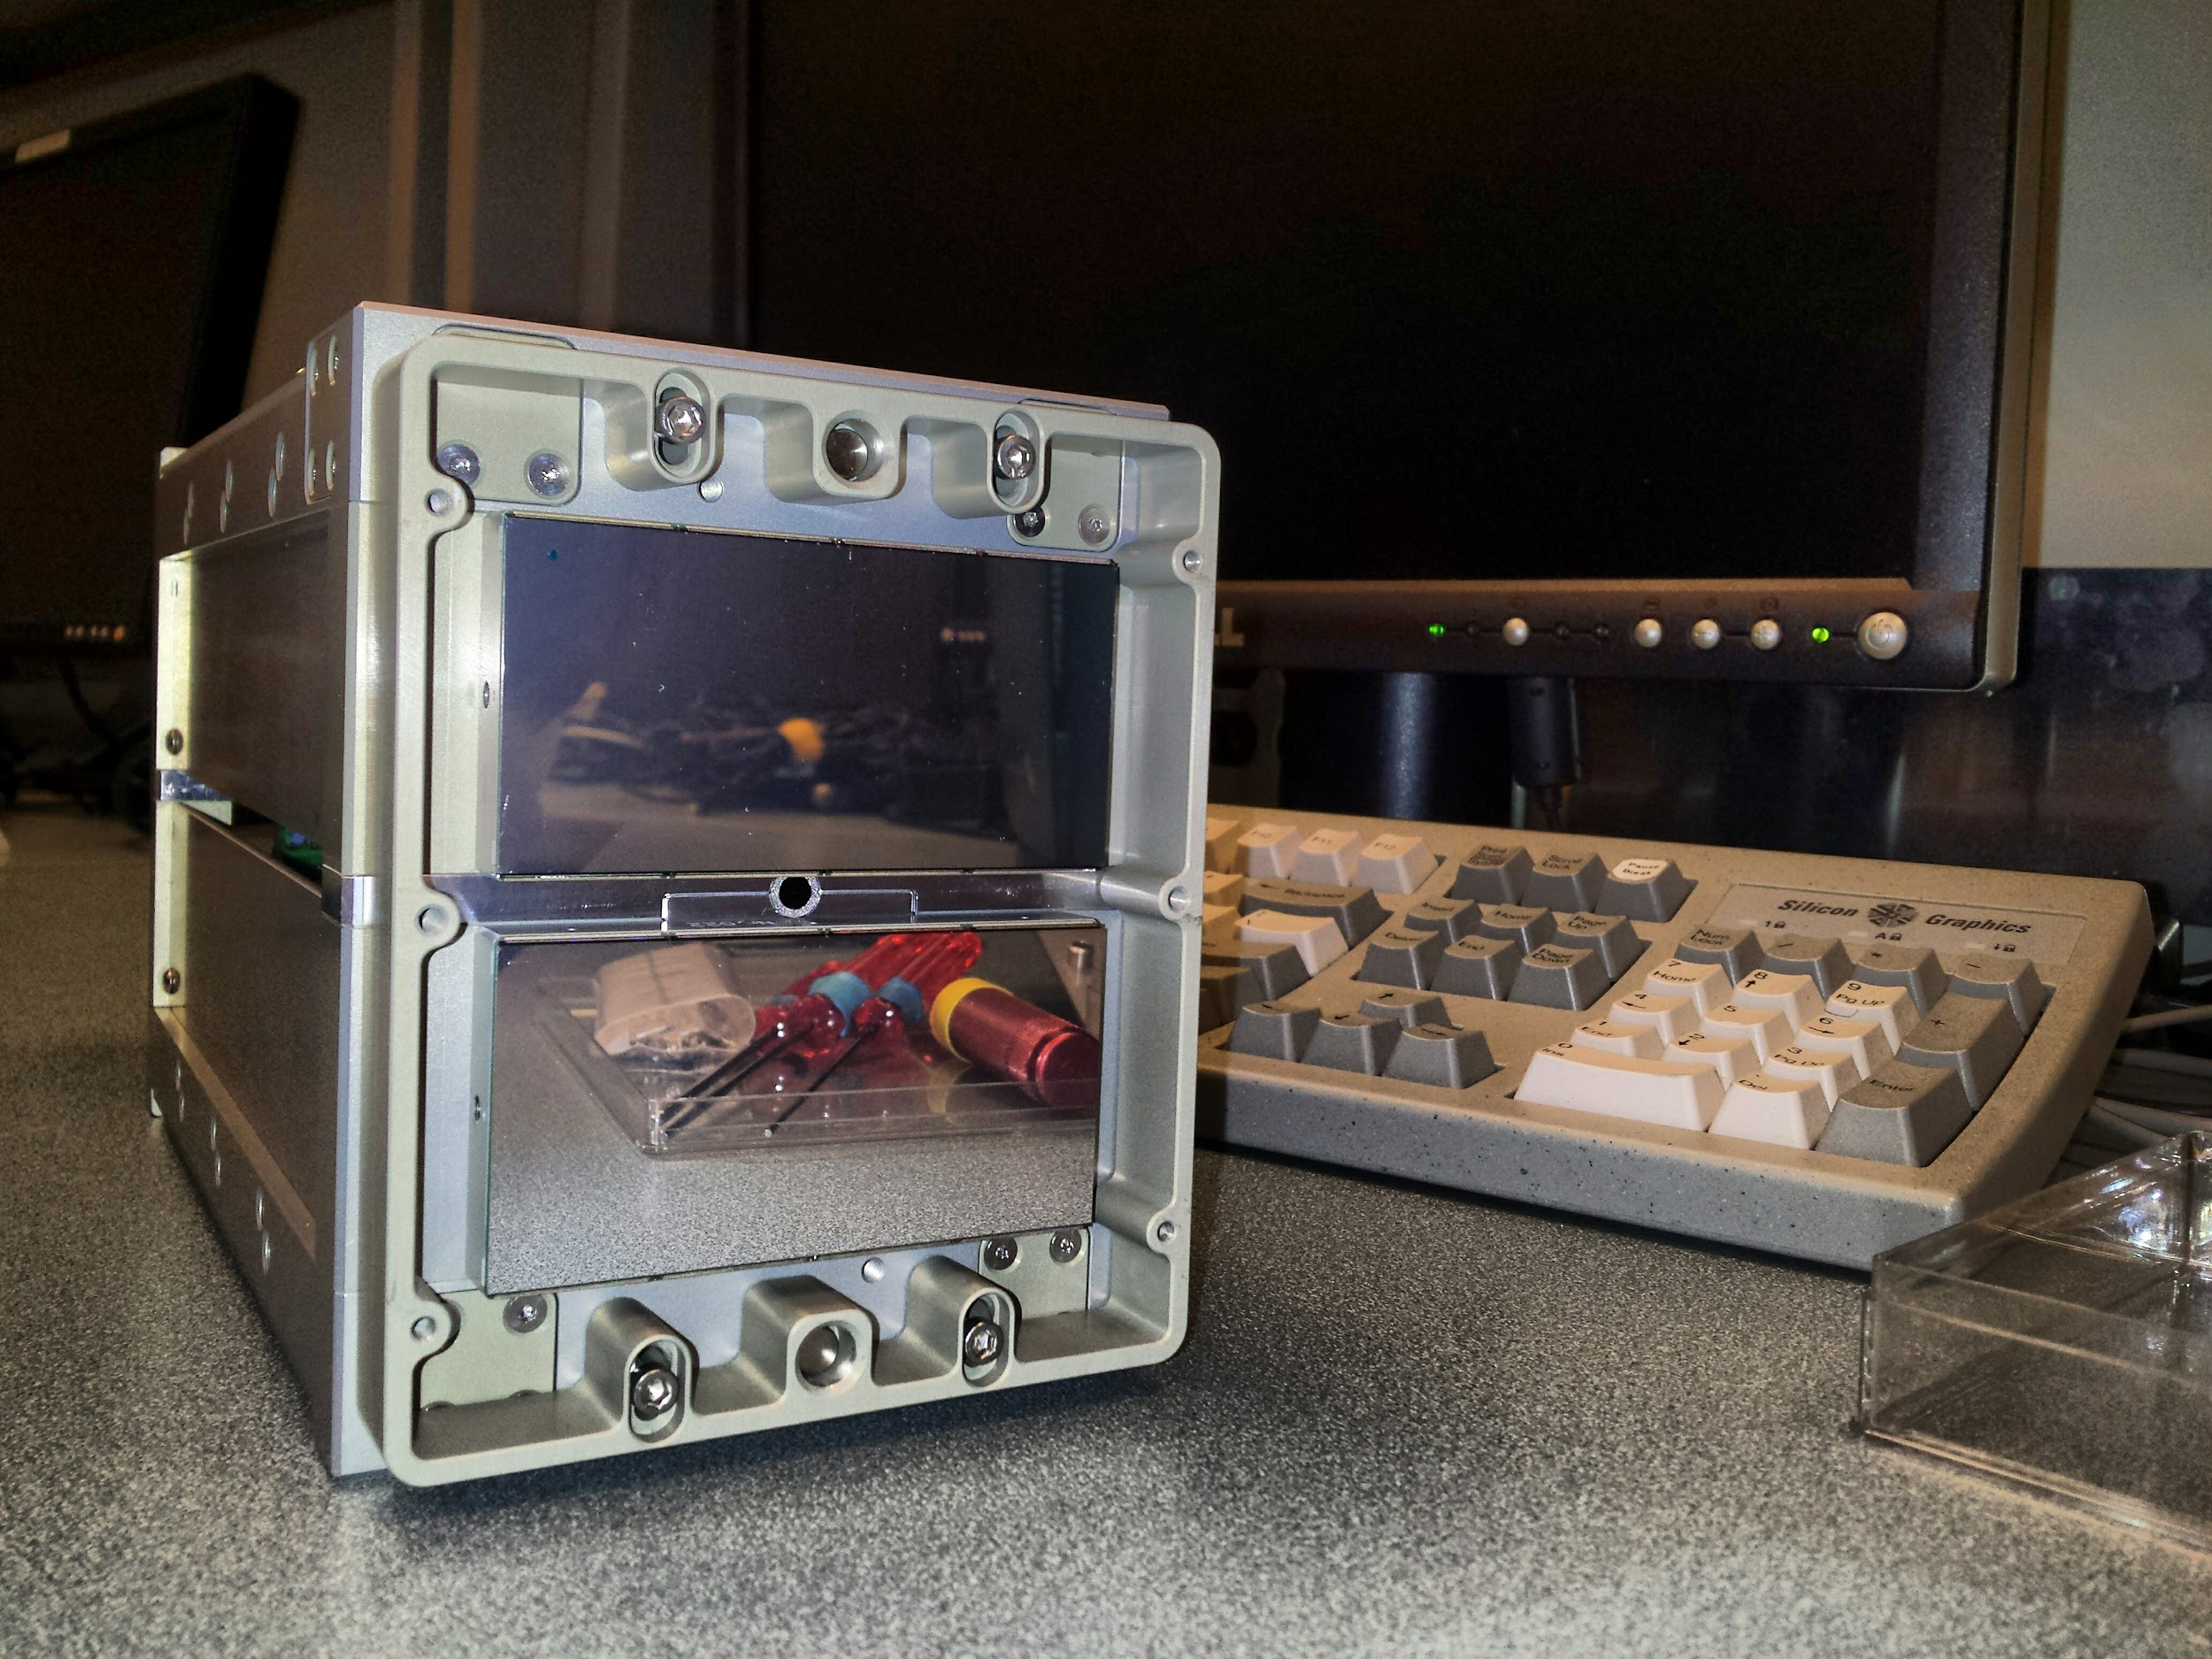

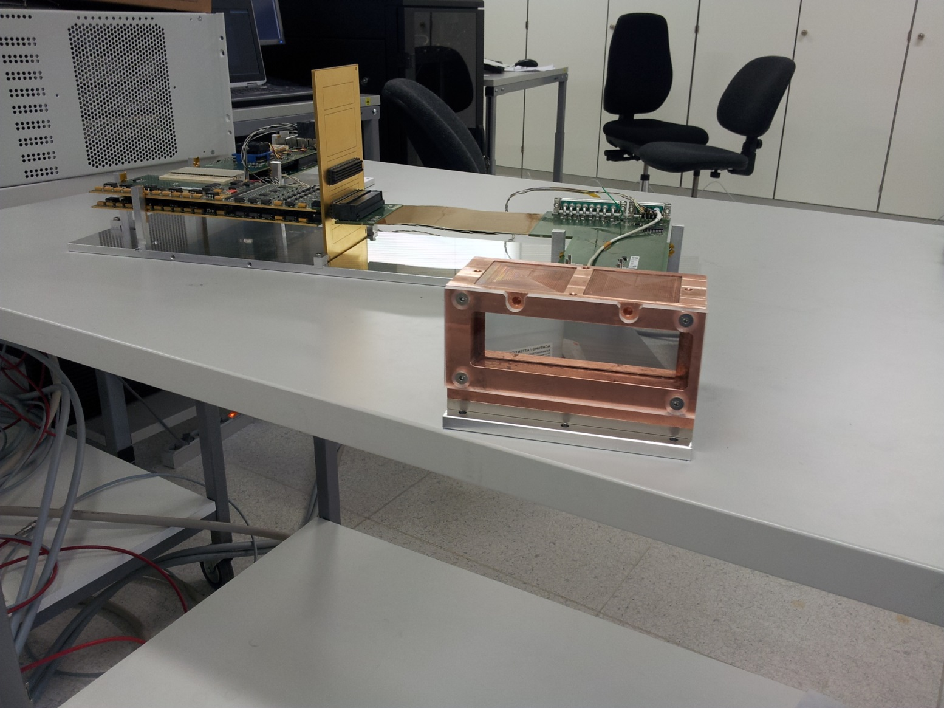
Hybrid Detectors @ PSI
Pixels
172 µm
75 µm
Single
Photon
Counting
PILATUS
EIGER
200 µm
Charge
Integrating
AGIPD
JUNGFRAU

Slide 4
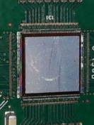
Hybrid Detectors @ PSI
Pixels
75 µm
✗
172 µm
25 µm
Single
Photon
Counting
PILATUS
EIGER
200 µm
Charge
Integrating
AGIPD
MÖNCH
JUNGFRAU

Slide 5
Challenges and applications
High resolution
Low noise
Large dynamic range
Bump bonding yield
100% charge sharing
Sensitive to leakage current
Many pixels per unit area
  Limited resources per pixel
  Data throughput
  Data storage
  Data treatment
25x25 µm²
Pixel

Slide 6
Challenges and applications
High resolution
Low noise
Large dynamic range
HI-res imaging
Laue diffraction
(R)IXS
XRF
Color imaging
Soft X-rays
Electrons
Sensor studies

Slide 7
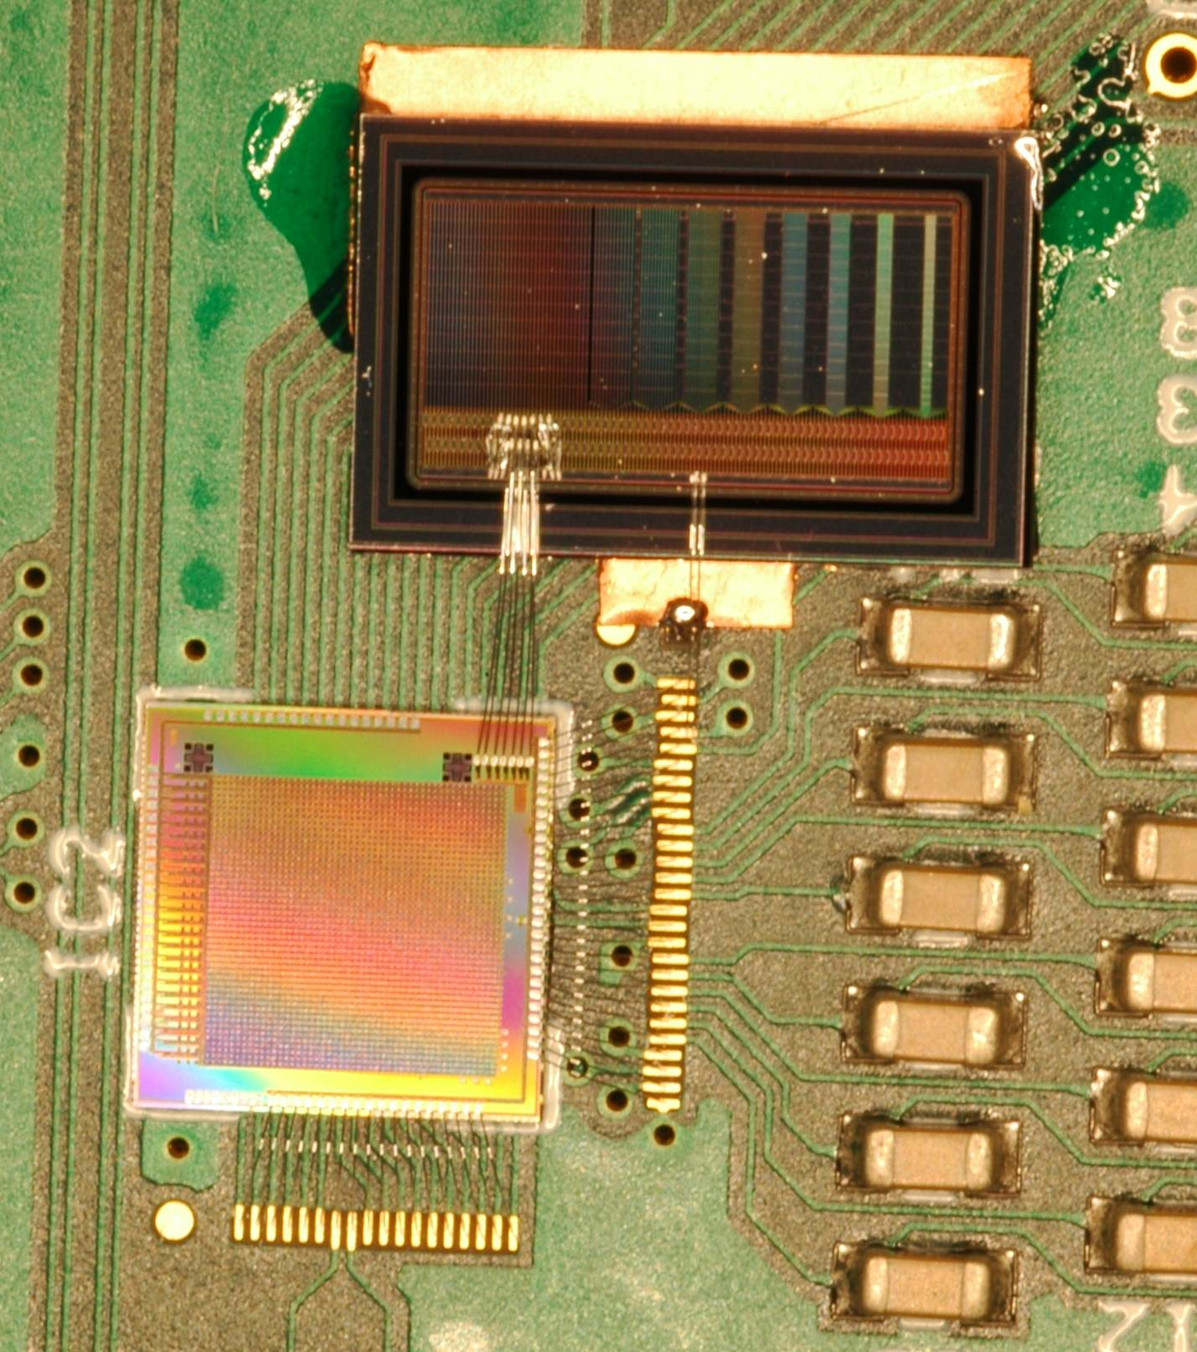
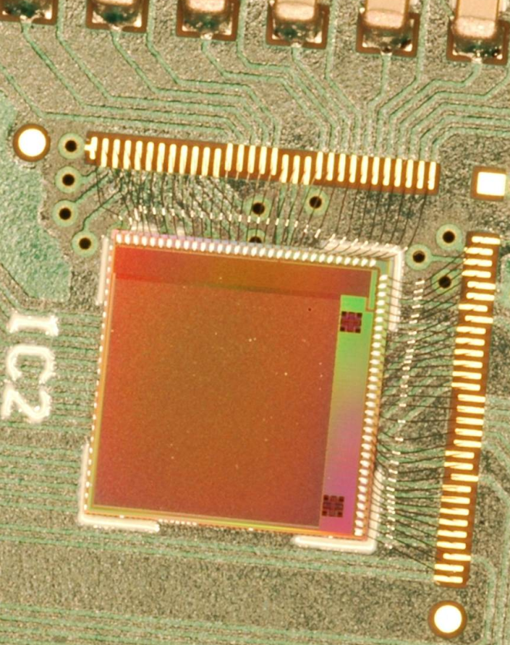
Prototypes
UMC 110nm AE (Al only, shrunk technology, great quality/price)
MÖNCH 01
MÖNCH 02
MÖNCH 01
Multipitch strip sensor
JUNGFRAU01
“Guest” of Jungfrau01 MPW
Test structures
Seven single pixel channels
Wirebonded to a strip detector for calibration
Pixel 25x25 µm²
Area 4x4 mm², 160x160 = 25.6kpixels
Five different pixel architectures
4 analog outputs
2 kHz frame rate (1Gb port)

Slide 8
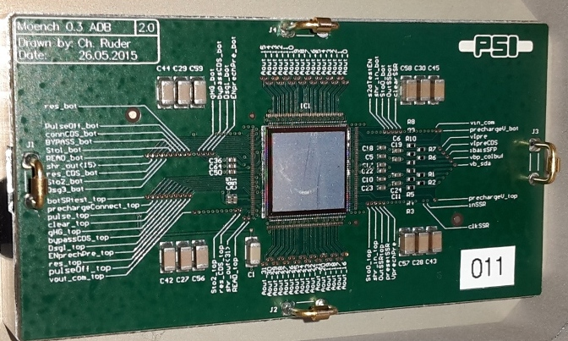
MÖNCH 03
Area 10x10 mm², 400x400 = 160k pixels
Architecture optimized for very low noise (single photon)
32 analog outputs
Currently 2 kHz frame rate (10 Gb port)
Up to 6 kHz by design (960 Mpixel/s)
Region of interest possible (frame rate > 6kHz)

Slide 9
Basic pixel architecture
Preamp
reset
CDS
reset
PIXEL
Column bus
C_{fb}
Off-pixel
buffer
Detector
CS
Preamp
CDS
Stage
Storage
Test
Column
receiver
Calibrate
Column selection
MUX
MÖNCH 02:
Five different sub-blocks
Single ended
to differential
output driver
(1x/25cols)
Pads

Slide 10
Add-ons
Preamp
reset
CDS
reset
PIXEL
Column bus
C_{fb}
Off-pixel
buffer
Detector
CS
Preamp
CDS
Stage
Storage
Caps
Test
Column
receiver
Calibrate
Column selection
MUX
Low
Gain
(static)
C_{f2s}
C_{fb}
Static gain selection
Single ended
to differential
output driver
(1x/25cols)
Pads

Slide 11
Add-ons
Preamp
reset
CDS
reset
PIXEL
Column bus
C_{fb}
Off-pixel
buffer
Detector
CS
Preamp
CDS
Stage
Storage
Caps
Test
Column
receiver
Calibrate
Column selection
MUX
Selectable CDS Gain
Two storage caps
Single ended
to differential
output driver
(1x/25cols)
Pads

Slide 12
Add-ons
Preamp
reset
CDS
reset
PIXEL
Column bus
C_{fb}
Off-pixel
buffer
Detector
CS
Preamp
CDS
Stage
Storage
Caps
Test
Column
receiver
Calibrate
Column selection
MUX
Selectable CDS Gain
Two storage caps
CDS can be bypassed
Single ended
to differential
output driver
(1x/25cols)
Pads

Slide 13
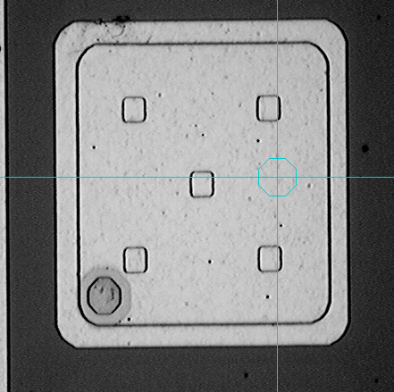
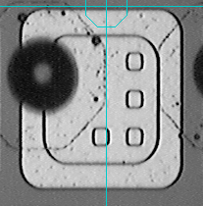
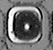
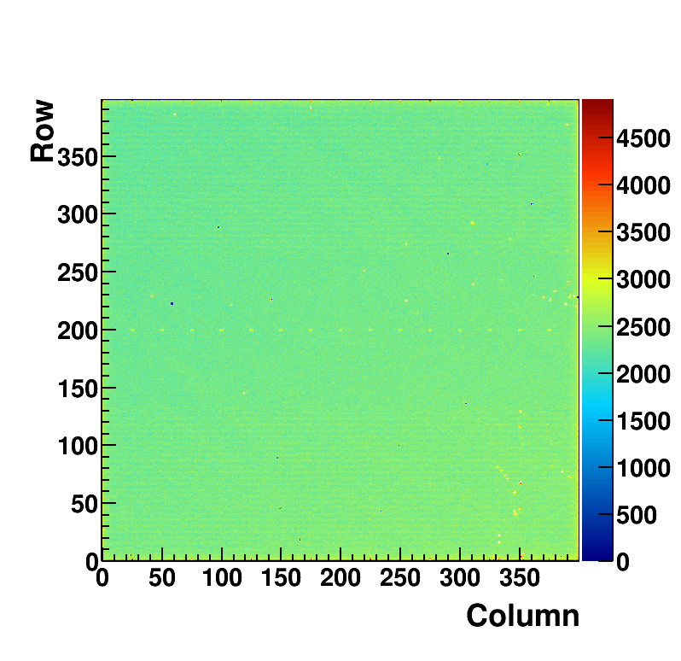
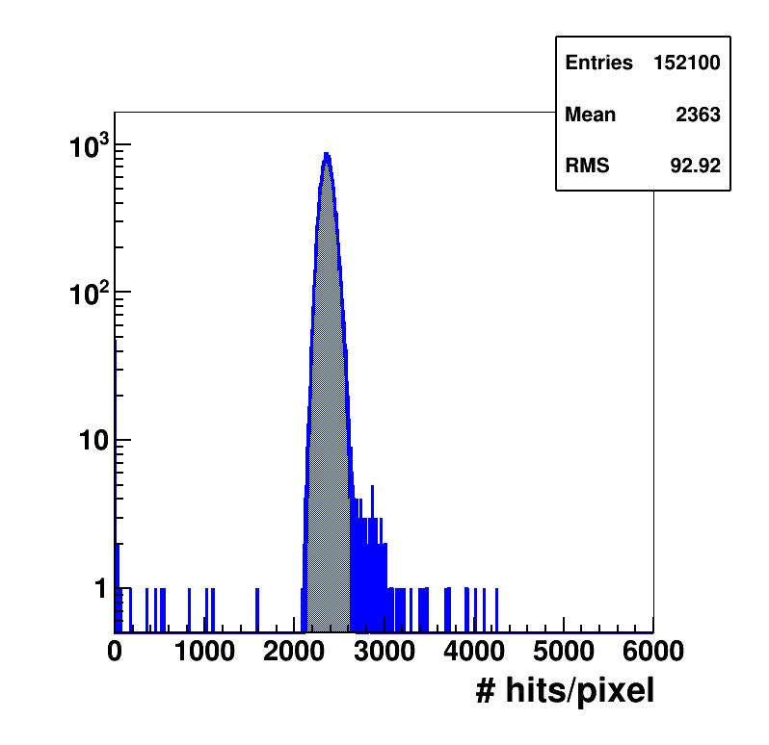
Bump bonding at PSI
Pilatus 172 μm
Eiger 75 μm
Mönch 25 μm
In house:
Under-Bump-Metallization
Indium deposition
Bump bonding
x47
x5.3
Hit map from Ge Kα fluorescence
Hits per pixel distribution
Yield > 99.95%
MÖNCH 0.3
1x1 cm2, 160 kpixel
25 µm pitch
Bad bump bonds
Neighbour pixels

Slide 14
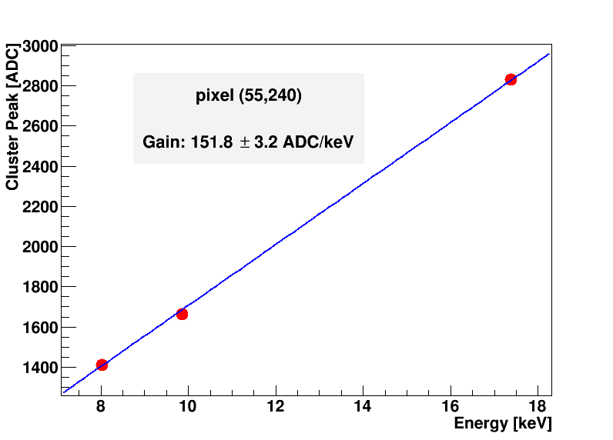
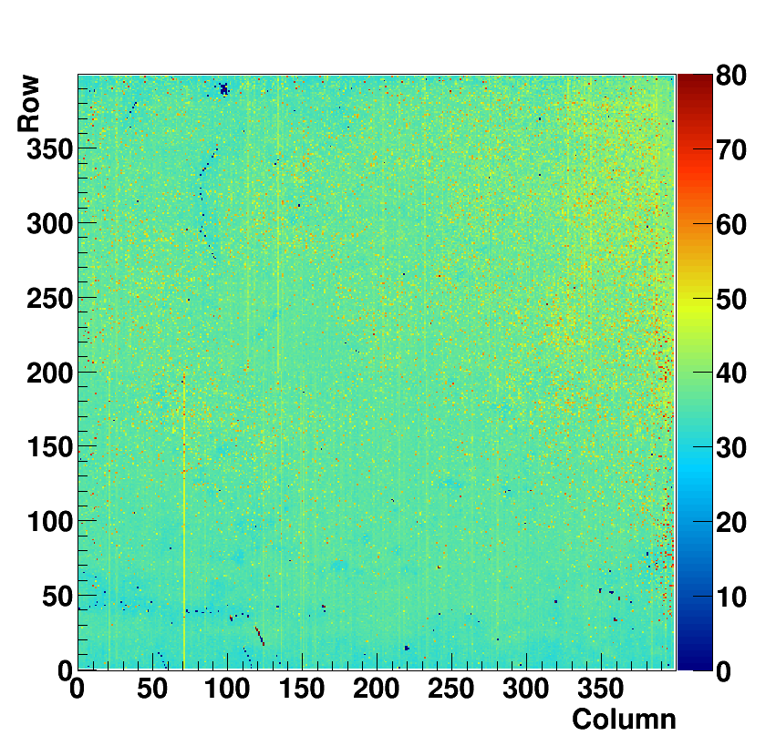
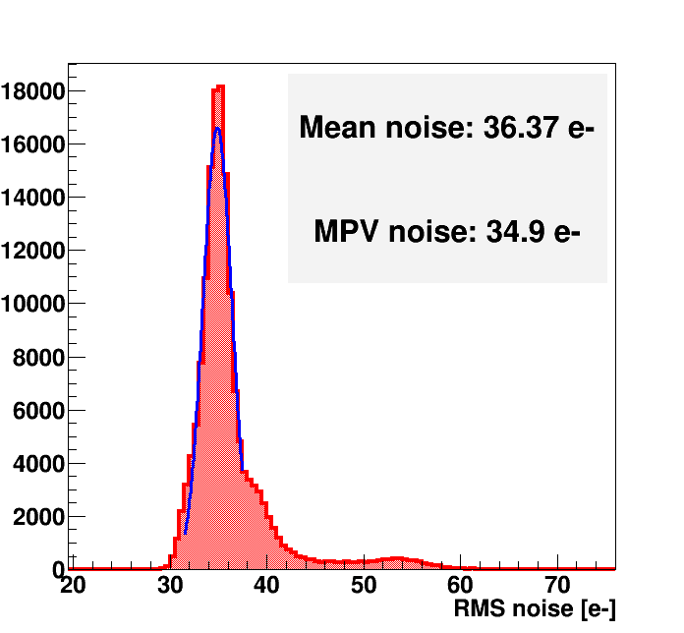
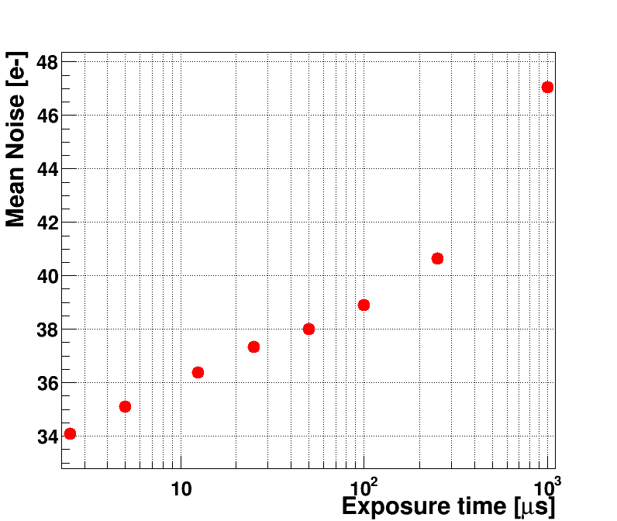
Gain and Noise
Mo
Acquisition at different energies
  (e.g. K_{α} fluorescence)
Gain from linear fit
Noise from pedestal RMS
Cu
  Dynamic range up to ≈1800 ∙ 1keV γ, ≈150 ∙ 12keV γ
Ge
S/N=1 at 130 eV
260 eV for a 2x2 cluster
Distribution of RMS noise across the sensor
Water cooled, 25 µs integration time

Slide 15
Position interpolation
Division of charge between pixels is strongly position dependent
Can improve the spatial resolution
  Pitch ≈ charge sharing distance
    320 µm thick Si, 120V ≈ 20 µm
    Depends on the drift time:
      Applied bias voltage
      Absorption depth
        Sensor thickness
        X-ray energy
  High SNR
    Low noise
  Isolated photons
    Fast frame rate
    Low flux
Charge sharing
Low resolution analog image
Clustering+2D ETA algorithm
High resolution digital image
  Max. 100 photons/mm²/frame to separate single photons
  @10 kHz frame rate => 10⁶ photons/mm²/s
A. Bergamaschi, ICXOM24

Slide 16
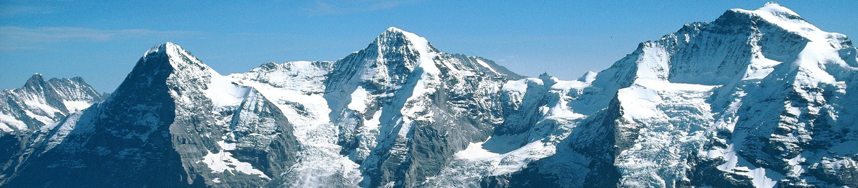
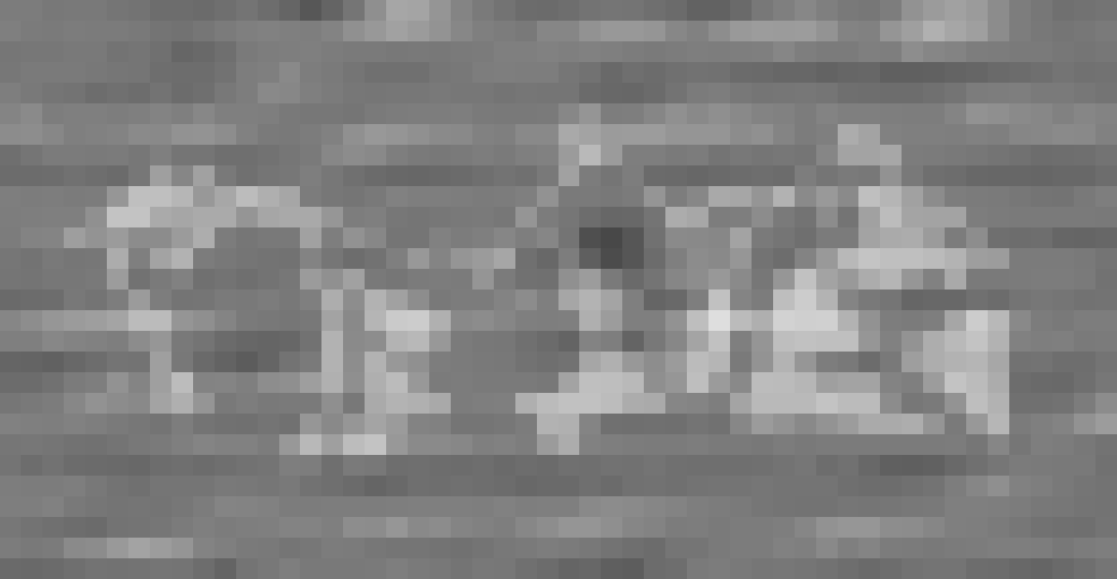
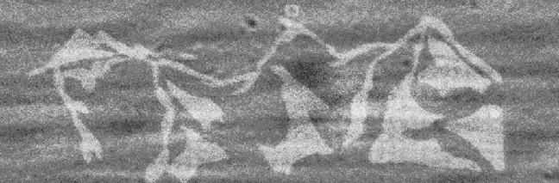
Does it work?
Eiger Mönch Jungfrau
100 um
Gold on Silicon sample by M. Lebugle, Acquired at MS beamline, 8keV, with MÖNCH
100 um

Slide 17
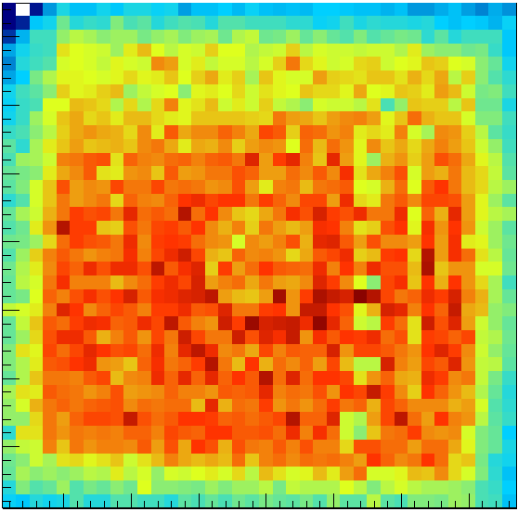
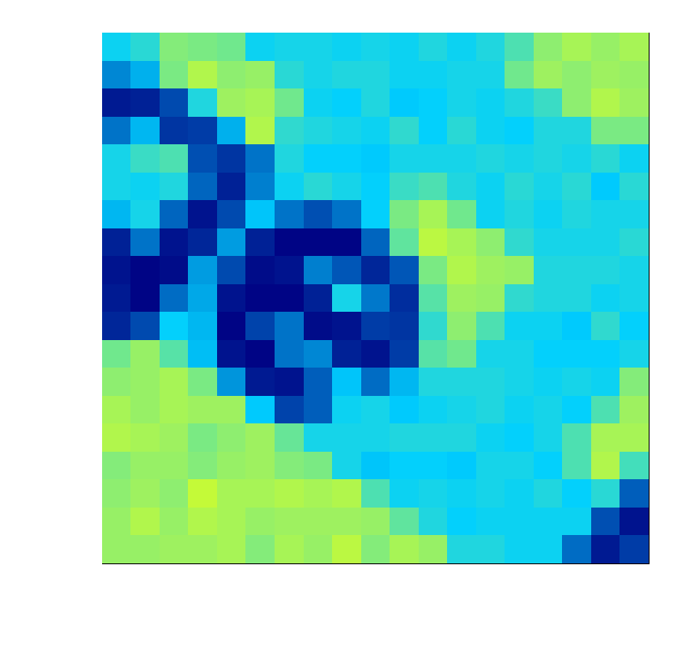
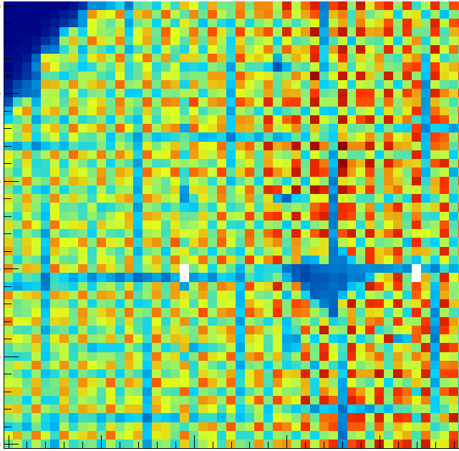
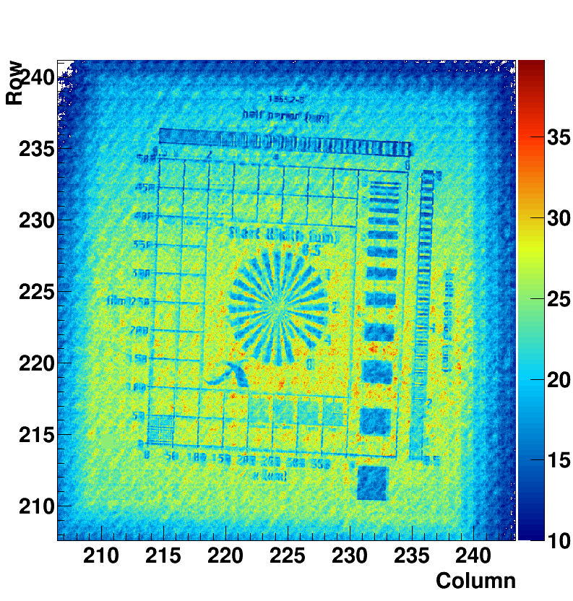
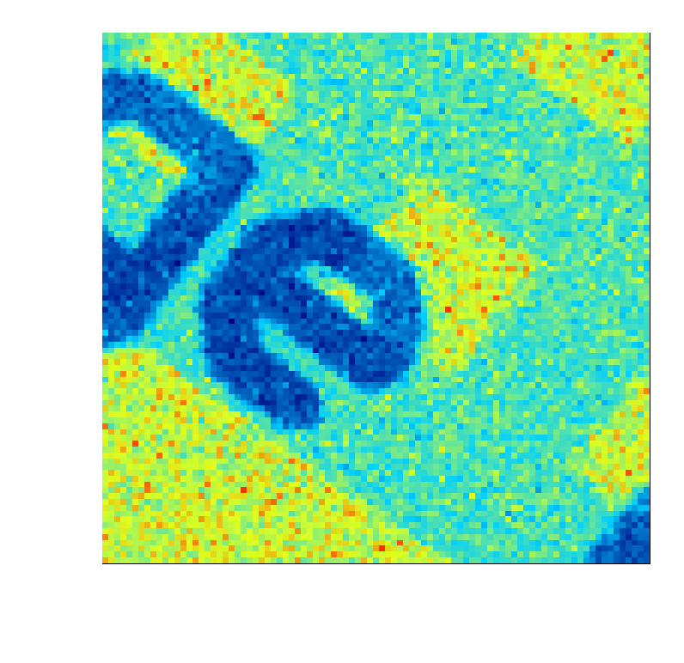
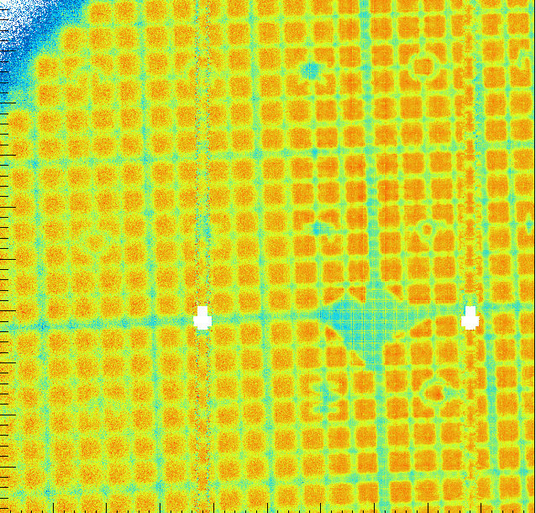
High resolution imaging with MÖNCH
Synchrotron
X-ray tube
Low energy
25 µm pixels
Interpolated
SOLEIL, Nanoscopium
11 keV
Siemens star
2 µm bins
W-tube
55kV
EIGER HDI
5 µm bins
SLS, PHOENIX
2 keV
61µm pitch metal grid
1 µm bins
100µm

Slide 18
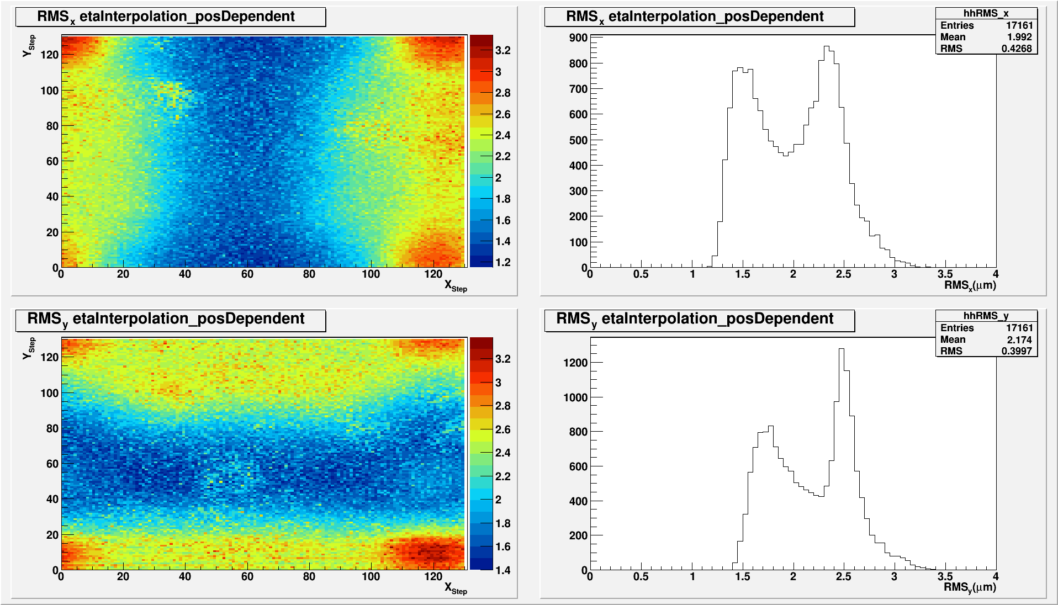
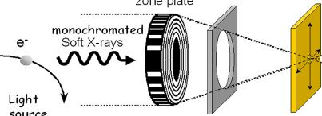
Spatial resolution
Horizontal resolution
3.3
1.2
The spatial resolution is higher in the corner between pixels than in the center of the pixels due to limited charge sharing
Energy dependent
  Higher energies, higher SNR
  Lower energies, larger charge sharing
Possible improvements
  Smaller pitch
  Thicker sensors
  Lower bias voltage
µm
Vertical resolution
3.3
1.4
µm
Pencil beam scan
experiment
@ cSAXS beamline, SLS
6 keV

Slide 19
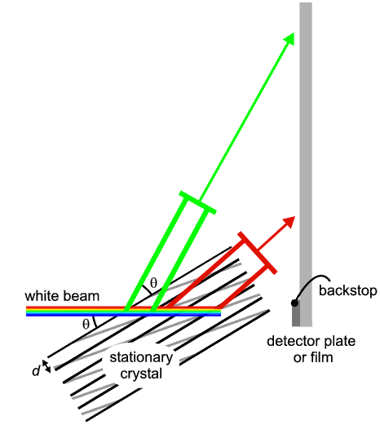
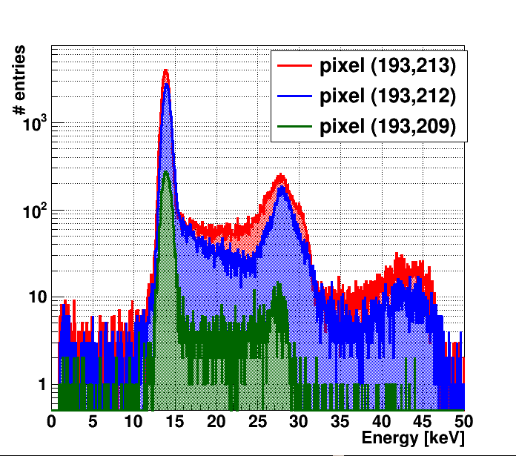
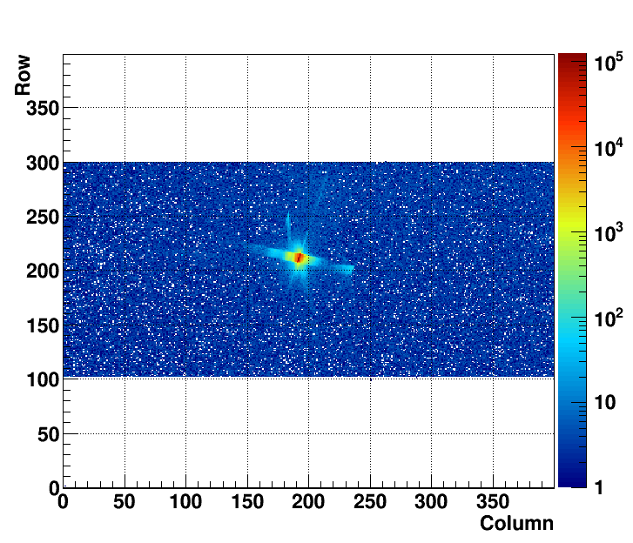
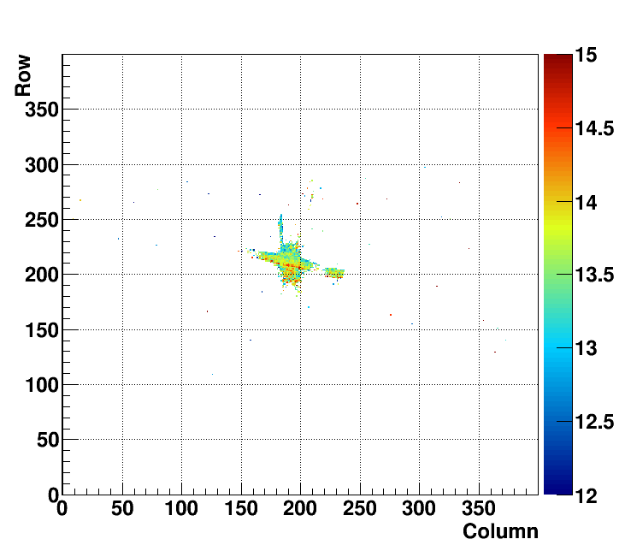
Laue diffraction
Simultaneous position and energy measurements
1 ph.
2 ph.
http://pd.chem.ucl.ac.uk
3 ph.
Photon counts
Energy
White beam at
microXAS beamline, SLS
Stressed Si wafer
# of photons
Energy (keV)

Slide 20
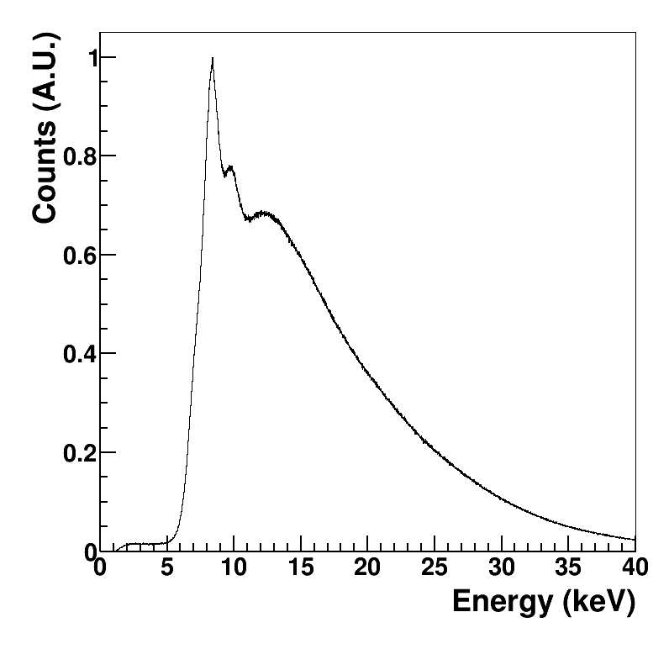
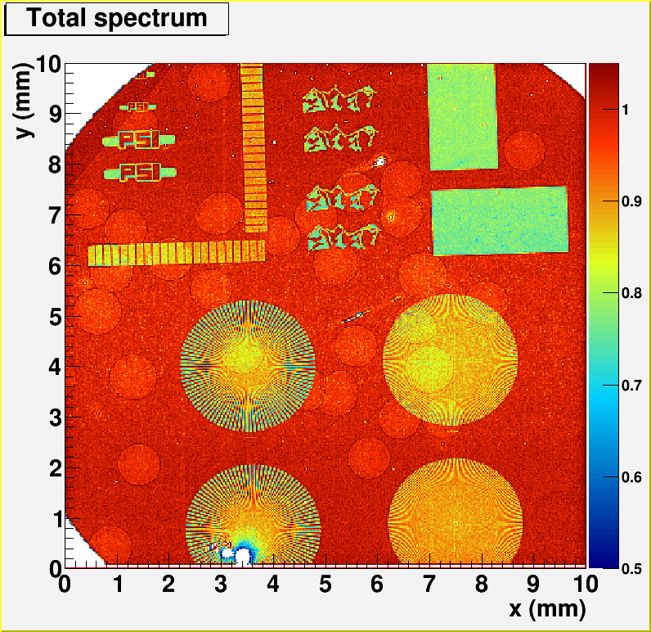
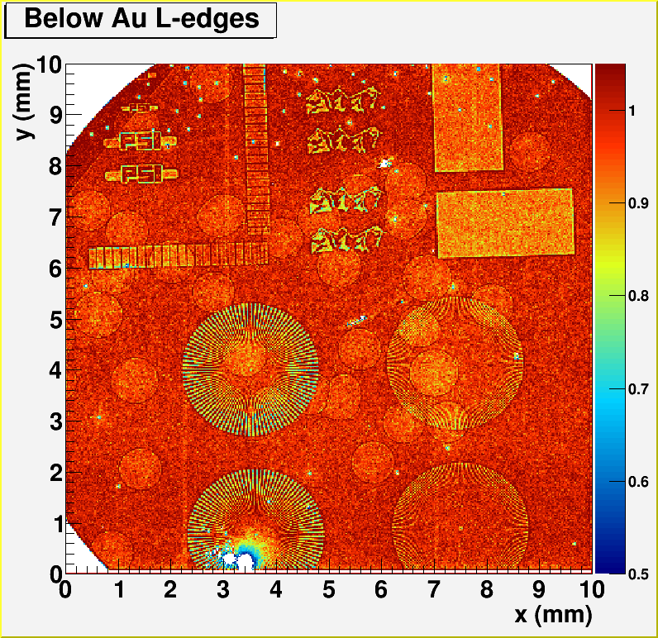
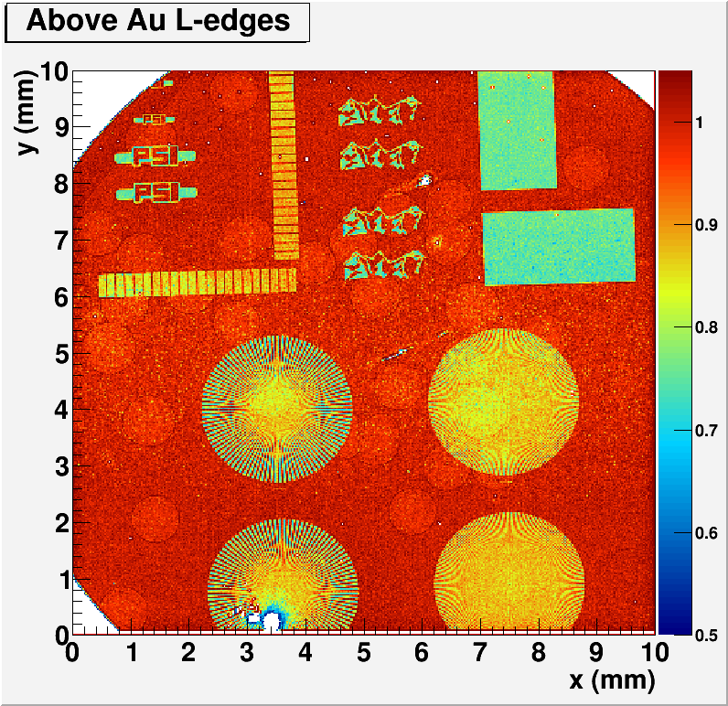
Color Imaging
Measured spectrum of
W-tube
2x2 clusters
Ca. 30 s
K-edge subtraction
Fluorescence detection and rejection
Removal of beam hardening
Gold structures on silicon wafer fabricated at PSI with silicon microspheres

Slide 21
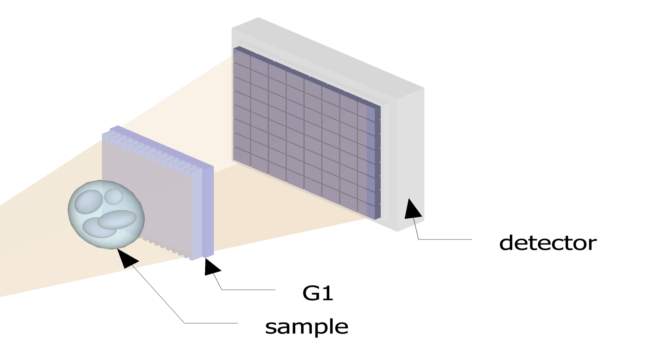
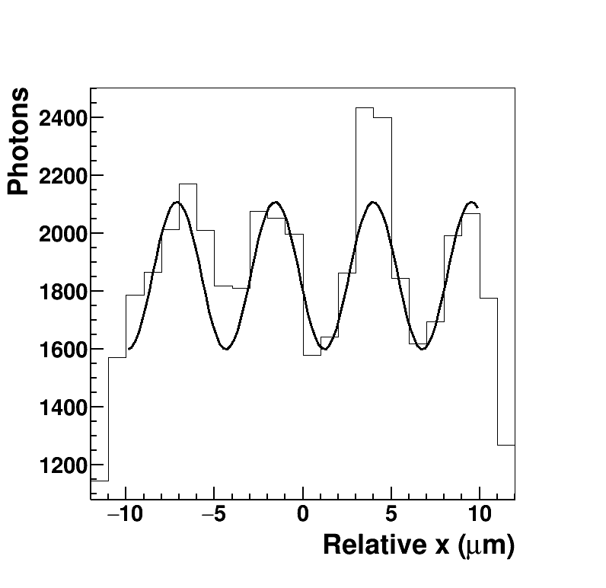
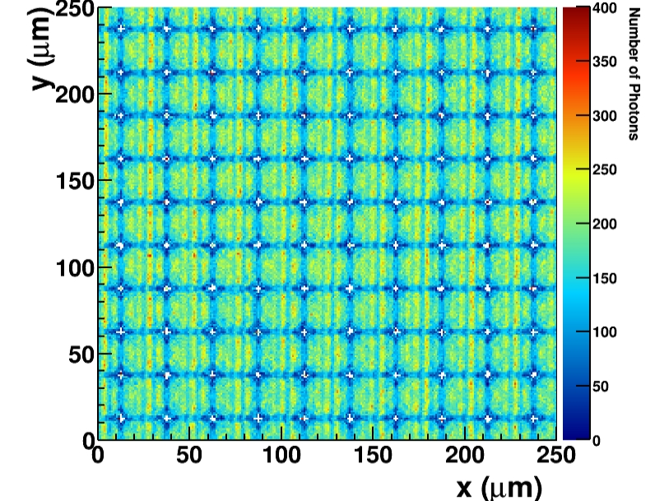

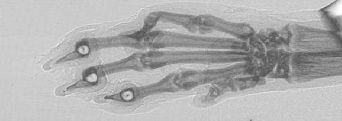
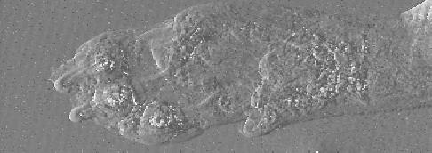
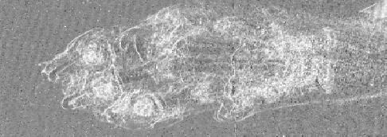
G2-less grating interferometry with MÖNCH
6 µm pitch gratings
16.7 keV beam @ TOMCAT
1 mm
Absorption
No stepping
  Lower dose
  Shorter exposure
  Simpler mechanics
Avoid G2 manufacturing issues
Differential Phase Shift
S. Cartier et al., JOURNAL OF SYNCHROTRON RADIATION 23, 1462-1473 (2016).
Dark field
Notes:
The fringes are integrated in the direction of the gratings to improve statistics

Slide 22
Towards MÖNCH 1.0
Baseline: the low energy ATHOS beamline at the SwissFEL needs a detector.
SPECIFICATIONS (as good as physicists can give them to you)
Energy range: 250eV-2keV
Single photon resolution
Dynamic range: 10000 x 700eV photons (Qmax=1.95Me⁻), data quality limited by poissonian fluctuations of the source
>50% quantum efficiency down to 500 eV
Total area required: 2 x (4x3cm²)
Frame rate 100 Hz (God bless the Swiss)
  ASIC rad-tolerance not a problem
  Frame rate and data throughput less demanding
  Hi spatial resolution not needed

Slide 23
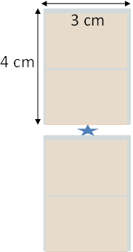
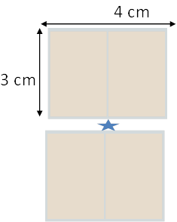
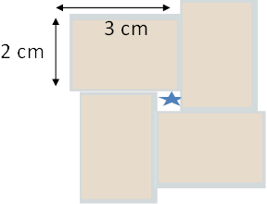
Possible ASIC and detector arrangements
Large area MÖNCH (Low noise, high dynamic range)
  ASIC 2 x 3 cm² (768 x 1024 channels ~800k pixel)
  Modules up to 4 x 3 cm² (~ 1.6M pixel)
  Almost 1G pixel after interpolation (not needed for ATHOS)
= Beam position

Slide 24
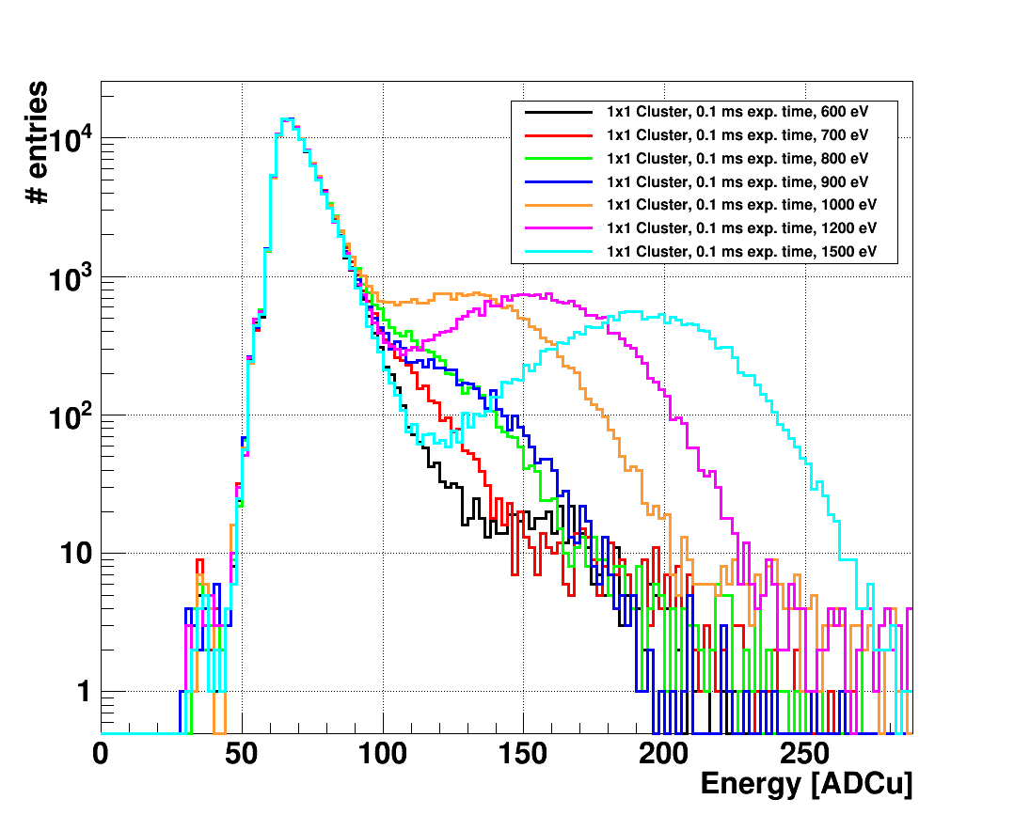
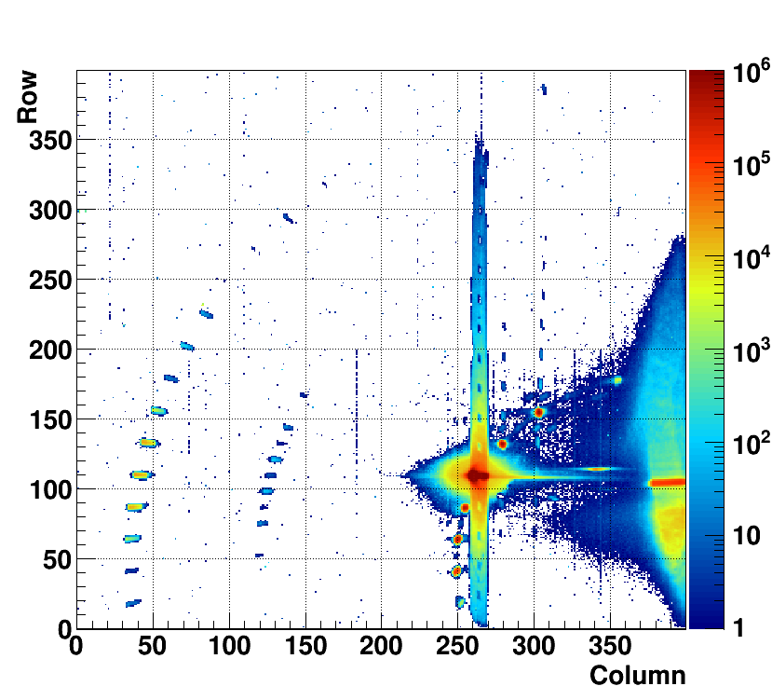
Soft X-ray diffraction
Soft X-rays
  Single photon resolution down to about 800 eV
Large dynamic range
  Simultaneous imaging of direct beam, Bragg peaks and low intensity signal
Bragg
peaks
Direct
beam
Magnetic
peaks

Slide 25
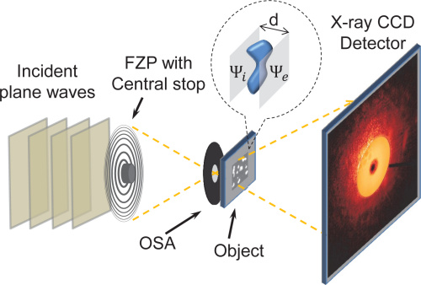

Soft X-ray Ptychography at PolLux
MÖNCH 03 at PolLux beam line at PSI
Out of focus beam
zero order suppressed
The target is scanned with overlapping regions
Shape is reconstructed from the diffraction patterns created (low flux)
Total photons per pixel
# of photons
Soft X-rays
Fast frame rate
Large dynamic range
Sample: 40 nm pitch grating
1 keV photon energy
2 ms exposure time/frame
1000 frames per point

Slide 26
Noise
Improve control/readout system
LGAD sensor (collaboration with FBK)
Optimize preamp gain/CDS gain
Multisampling: Noise= Noise/ sqrt(Nsamples)
  Off chip-Off pixel (bottom of the column)-On pixel
CDS
reset
Pixel
buffer
CDS
Stage
Storage
Caps, N=4

Slide 27
Dynamic gain switching
Preamp
reset
CDS
reset
PIXEL
Column bus
C_{fb}
Off-pixel
buffer
Detector
CS
Preamp
CDS
Stage
Storage
Caps
Test
Column
receiver
Calibrate
Column selection
MUX
C_{fb2}
DGS
C_{fb}
Single ended
to differential
output driver
(1x/25cols)
V_{th}
S
Q
R
reset
Pads

Slide 28
Dynamic gain switching
Already implemented in Gotthard,
Jungfau and AGIPD. However:
Very low power and area budget
Not implemented in Moench 0.3
Only 1 switching feasible:
ratio of capacitors crucial
C_{fb2}
DGS
C_{fb}
V_{th}
S
Q
R
reset
preamp
ADC#
Additional pixel output (digital)
Pixel and readout chain connected in “Test pulse mode”
DGS activates
Channel without DGS
Channel with DGS
Test pulse

Slide 29

DGS at work with an IR laser
DGS mechanism for synchrotron and FEL applications
  single photon resolution
  high dynamic range
JUNGFRAU
AGIPD
GOTTHARD
One half-supercolumn of MÖNCH 02 features a preliminary DGS design
Characterization is ongoing (FEL beam now available)
DGS supercolumn under IR laser
Pixel 92,16

Slide 30

Droop
The chip frame rate will be lower, more droop. Biggest contributor: gate leakage current of off pixel buffer.
  Input transistor of Off-pixel buffer: p-type, smaller
  Additional switch
CDS
reset
Off-pixel
buffer
Bypass 1: switch kept closed
Bypass 2: switch operated
CDS
Stage
Storage
Caps
STO 1
MMC
STO 2
NCAP25

Slide 31

Droop: pedestal shift
Comparing the pedestal of each single pixel at different waiting times for the 6 cases
Results: droop is halved operating the switch
    2 caps help
    NCAP leaks more
NCAP25 only
Switch not operated
To be done:
Same measurements but with signal on caps
MMC+NCAP25
Switch operated
Δ Pedestal = Pedestal_{t} – Pedestal_{ref}

Slide 32



Thin entrance window
Quantum Efficiency
Sensor backplane illuminated
Entrance window reduces quantum efficiency
photon
pixels
entrance
window
Sensor not optimized for low energies
1.5 µm thick entrance window
Collaboration with FBK
Tests ongoing on different types of backside (20-200nm thickness; LGAD)
As implant
(low energy)
Irradiation at 1400 eV (bias 90V)
As implant
P implant
P diffusion

Slide 33


Vacuum compatibility
We have a vacuum compatible system to test MOENCH 0.3 for electrons detection
System for ATHOS will be very different
Vacuum from 10⁻⁵ mbar downward
Heat dissipation of the electronics

Slide 34
Conclusions and outlook
A 25 µm pixel pitch hybrid detector is both feasible…
  Good bump-bond yield, Low noise, Large dynamic range
  CHALLENGING (still work in progress)
… and useful
Many applications already tested:
  HI-res imaging; Laue diffraction; (R)IXS; XRF; Color imaging; Soft X-rays
  More to come (Electrons, Sensor studies)
We are working on a detector system for Swissfel (low energy)
    Specifications defined, down to 250eV
    Large area ASIC
    Hi dynamic range with DGS
    Thin backplane sensors (FBK), 20-200nm entrance window
    Vacuum compatibility
    Capability to handle big data amount (for use at synchrotrons)

Slide 35


The PSI Photon Science Detector Group
M. Ruat, B. Schmitt, S. Redford, A. Mozzanica, E. Fröjdh
J. Zhang, C. Lopez-Cuenca, M. Andrä, R. Barten, M. Brückner, C. Ruder, D. Greiffenberg, S. Vetter
X. Shi, D. Thattil, G. Tinti, A. Bergamaschi, M. Ramilli, R. Dinapoli, D. Mezza, S. Chiriotti-Alvarez

Slide 36




Thank you!

Slide 37
Thank you

Slide 38



Clustering
With charge integrating readout in single photon regime, we can retrieve the full charge by clustering
  Photon counting –like performance
  Preserves spectral information
    Suppresses charge sharing
    Noise is increased depending on the size of the cluster
MÖNCH 25 µm
JUNGFRAU 75 µm
MÖNCH 3x3 25 µm
Raw data
Clusters

Slide 39










Iterative correction method
The bins of the η-distribution histogram are assigned to position bin within the pixel
  η flat distribution gives flat flatfield image
Iterative algorithm defines η bins map to obtain flat distribution
Algorithm converges once the flat field image is flat
η bin map
Flat field
1
10
20
30
40

Slide 40


Nanoscope imaging
Magnification: ~80x
No Zernike phase dots
Si111 and 40 μm Cu
Siemens star test images
80μm
MÖNCH02
25μm pixel
interpolation
5 x stitching
not cooled
Photonic Science CCD
4μm pixel
2 x stitching
cooled

Slide 41


Charge sharing
The charge diffuses while drifting
  The charge can be collected by several pixels
  Charge sharing ≈ 20 µm in 320 µm thick Si, 120V bias
    Depends on the drift time:
      Bias voltage,
      Sensor thickness,
      X-ray energy
X-ray
Photon counting detectors lose counts in the pixel corners
Photon counting does not make sense without charge summation for pitches below 40 µm
Artefacts when structures smaller than pixels size
  Corner effect in protein crystallography
Pixel
Photon counting
Charge integrating
20keV pencil beam scan

Slide 42



Linear charge collection model
d
p
Full charge collection
Charge sharing
Sides
Corners
Noise convolution
α : d_{chargeSharing} /pitch
Q₀ : total charge
Q : collected charge
σ : electronic noise ENC_{rms}
A : number of photons

Slide 43



Dynamic range for MÖNCH 03
IR laser
ND filters
Highest Gain Setting
Lowest Gain Setting
3 keV photons
Kapton thickness
Highest Gain Setting
Dynamic range:
600 3 keV photons at lowest gain setting
18 3 keV photons at highest gain setting
  non-linearity due output buffer saturation
  optimize chip settings

Slide 44

Energy resolution
MÖNCH02 20keV monochromatic data.
The fluorescence lines come from the detector itself.
No spectral information from single pixel with no cuts
Clustering increases the noise
Cuts to charge sharing as “offline collimation”
  99% rejection rate
Use larger pixels
Main beam
20 keV
Compton
Edge
1.45 keV
In
3.3 keV
Au
9.7 keV
Si escape
18.2 keV
Ni
7.4 keV
Ti
4.5 keV
Cu
8.0 keV
Br
11.9 keV
Rb?
13.3 keV

Slide 45


Subpixel interpolation
The signal is fully contained in a 2x2 pixels cluster
We analyze the ratio between neighbors
  $η_{x}$=$\frac{0∙Left+1∙Right}{Right+Left}$
  $η_{y}$=$\frac{0∙Bottom+1∙Top}{Bottom+Top}$
Custom algorithms must be developed to correct for non linear charge sharing
T/(T+B)
R/(R+L)
Notes:
If we look more in detail, the charge sharing is usually in a 2x2 pixels cluster. To interpolate, we analyze the ratio of the right pixels compared to the total for the horizontal coordinate, and of the top to the total for the vertical, which we call eta x and y respectively.
What happens is that if a photon come in the center of the bottom right pixel, the eta will be located in the bottom right position, if it come between two pixels in vertical of horizontal the eta will be about 0.5 in that coordinate and if the photon comes in the corner between the pixels, the eta will be in the center of the distribution plot.
If charge sharing would be linear and uniform, the eta would represent the relative position within the cluster. However some more advanced algorithm is required to correct for the non uniform charge sharing, in particular for the regions in the center of the pixels where there is no charge sharing, as you can see from the peaks in the eta distribution.

Slide 46



Energy calibration
Developed linear model to deal with 100% charge sharing
Gain used to convert pedestal distribution into noise in e⁻
Width of the photon peak given by
ENC and Fano Noise
Dynamic range and linearity still to be fully characterized

Slide 47


Grating-based phase contrast imaging
~ 5 um
No sample
G2 Analyzer grating
G1 Phase grating
Absorption
Darkfield
Sample
Phase shift
A detector with sufficient spatial resolution and SNR allows to remove G2
Lower dose
Shorter exposure
No stepping
Larger area
Higher energies
Creates periodic
intensity
modulations
Makes fringes
visible on large
detector pixels

Slide 48


Omnidirectional grating interferometry
100 µm
M. Kagias, et al. (2016) Phys. Rev. Lett. 116, 093902
Circular gratings can be detected using MÖNCH
  25 µm pitch, 5 µm period
Tests with a sample to detect DPC not yet performed
A. Bergamaschi, XNPIG 2017
Notes:
X-ray grating interferometry (GI) can provide simultaneously three complementary contrasts: absorption, differential phase, and small-angle scattering [1–3] also known as dark-field. The phase signal is highly sensitive to the electron density variations in the sample and can reveal differences between materials with similar absorption properties. The dark-field signal is able to access unresolved structural variations of the sample in the (sub)micrometer scale, which is beyond the resolution capability of the imaging modality. It has been demonstrated that both differential phase and dark-field signals can provide valuable information additional to the conventional absorption contrast in medical imaging [4–6], material science, and nondestructive testing [7]. Especially, the dark-field signal has drawn great attention due to its success in providing quantitative or inaccessible structural information in radiographic applications [8–12]. In general, the dark-field signal exhibits highly directional behavior if the underlying microstructure of the sample is anisotropic. However, up to now GI has mainly been composed of linear gratings and the dark-field sensitivity is therefore only perpendicular to the grating lines. To obtain multiple-direction dark-field sensitivity, either the sample or the interferometer needs to be rotated [13–14], which is a time-consuming procedure. The usage of 2D gratings can mitigate the issue but can only provide dark-field sensitivity in up to four directions. Moreover, the noise performance is not the same in all directions due to the different modulation orders of the phase stepping curves [15]. An alternative speckle scanning technique [16–17] is proposed to sense the dark-field signal by scanning a membrane in the direction of interest; however, only two directions can be obtained. To cope with samples containing structures with an unknown orientation, it would be favorable to achieve an omnidirectional dark-field sensitivity with a straightforward imaging setup, without requiring motion of the sample or the optical elements. This would ensure that all microstructures, highly oriented or not, can be detected. In this work, we propose a single-shot imaging method with 2D-ominidirectional dark-field sensitivity using a grating design consisting of a 2D repetition of a small pitch circular grating. To achieve single-shot imaging, the self-image of the grating is recorded with sufficient spatial resolution. Local fringe analysis is then performed to obtain the dark-field signal of the sample in all directions of the imaging plane. In addition, the differential phase contrast (DPC) in the vertical and horizontal directions can also be retrieved.

Slide 49


Laue-Indexing of complex samples
Sample is translated to illuminate different grains
No rotation required
http://pd.chem.ucl.ac.uk
Ni
Ti
Photon counts
Energy
White beam at
microXAS beamline, SLS
Stressed TiNi alloy
# of photons
Energy (keV)

Slide 50




White-beam Laue diffraction
Diffraction pattern identified by:
Peak position
Peak energy
Ge
Elastic distortion matrix
Undistorted orientation matrix
twares XMAS and LaueTools
A_{m} = T R A₀
Ice, G. E., & Pang, J. W. L. (2009). Tutorial on x-ray micro-Laue diffraction. Materials Characterization, 60(11), 1191–1201.
Angular rotation matrix
Notes:
And, well, just a few words about The Laue Method, to understand why and how Laue can give us the information on the crystilline nature, deformation and orientation of materials, here goes a very very short explanation:
Basically described by the Bragg’s law;

Slide 51



Pilot test with Resonant Soft X-ray Scattering
Scattering at 708 eV (Fe L_{III}-edge) – used to probe spin and angular momenta
Bragg peaks (high intensity)
Other structures due to resonant magnetic scattering (low intensity: ~ 1ph/s/pixel)
CCDs are commonly used but:
Bragg peaks need to be blocked to avoid damage to the detector
Masks specific for each experiment must be built and carefully placed
Circular +
3σ noise cut
Circular +
C+/C-
Charge/frame [ADCu]
Integral(C+)/Integral(C-) = 1.07
can detect a ~5% variation in the Bragg peaks intensity

