Slide 1
Towards a new generation of Medipix and Timepix ASICs
  X. Llopart,
  On behalf of the Medipix Collaborations
22nd May 2018
Front-End Electronics 2018

Slide 2
Medipix3 Collaboration
University of Canterbury, Christchurch, New Zealand
CEA, Paris, France
CERN, Geneva, Switzerland,
DESY-Hamburg, Germany
Albert-Ludwigs-Universität Freiburg, Germany
University of Glasgow, Scotland, UK
Leiden University, The Netherlands
NIKHEF, Amsterdam, The Netherlands
Mid Sweden University, Sundsvall, Sweden
IEAP, Czech Technical University, Prague, Czech Republic
ESRF, Grenoble, France
Universität Erlangen-Nurnberg, Erlangen, Germany
University of California, Berkeley, USA
VTT, Information Technology, Espoo, Finland
KIT/ANKA, Forschungszentrum Karlsruhe, Germany
University of Houston, USA
Diamond Light Source, Oxfordshire, England, UK
Universidad de los Andes, Bogota, Colombia
University of Bonn, Germany
AMOLF, Amsterdan, The Netherlands
Technical University of Munich, Germany
Brazilian Light Source, Campinas, Brazil

Slide 3
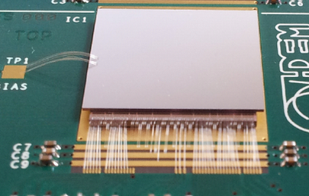
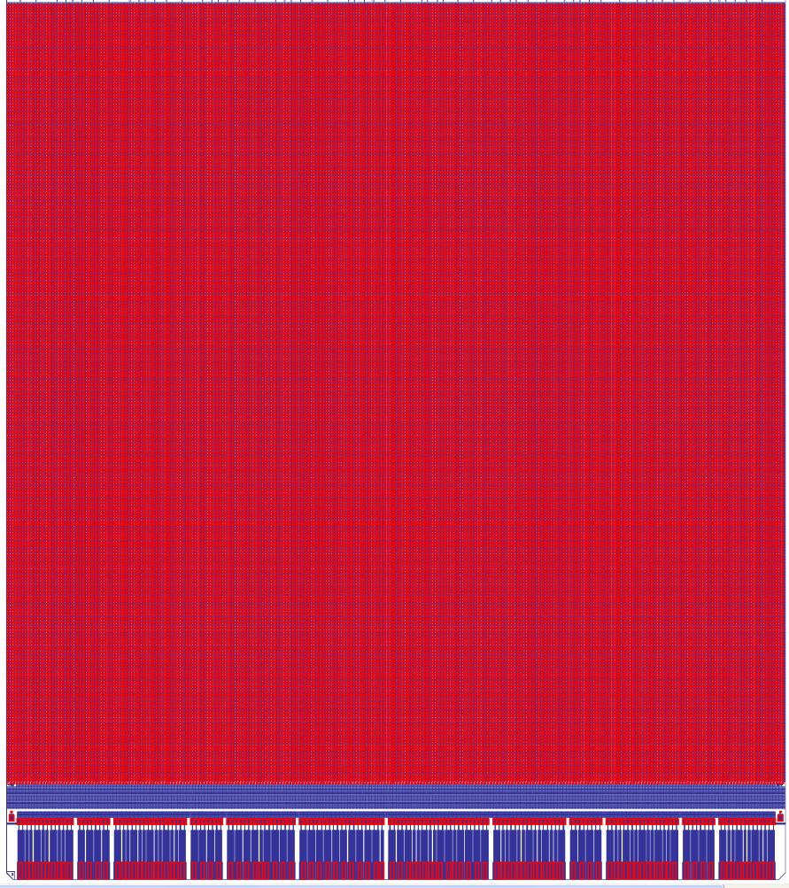
Medipix3RX (2011)
Application | Photon counting Colour imaging
Technology | IBM 130nm DM 4-1
Pixel size | 55 x 55 / 110 x 110 µm²
Pixel arrangement | 256 x 256
Acquisition modes | Single Pixel Mode (55/110) Charge Summing Mode (55/110)
Readout Type | Frame-based (up to 24-bit) Continuous RW (up to 12-bit)
Minimum threshold | ~ 500 e- (SPM) ~ 1000 e- (CSM)
Power consumption | <1W @1.5 V
Number of Thresholds | Frame-based 2/4/8 Continuous RW 1/4
Floorplan | 3 sides buttable and minimum periphery
TSVs possibility | YES. With 0.8mm periphery
Max Count Rate [E.Frojdh JINST/2014] | 614 x 10⁶ hits/mm²/s (SPM 55) 114 x 10⁶ hits/mm²/s (CSM 55) 130 x 10⁶ hits/mm²/s (SPM 110) 29 x 10⁶ hits/mm²/s (CSM 110)
Output bandwidth | 1 to 8 LVDS @ 320MHz each
14100 µm
Sensitive Area (14080 µm)
15880 µm

Slide 4
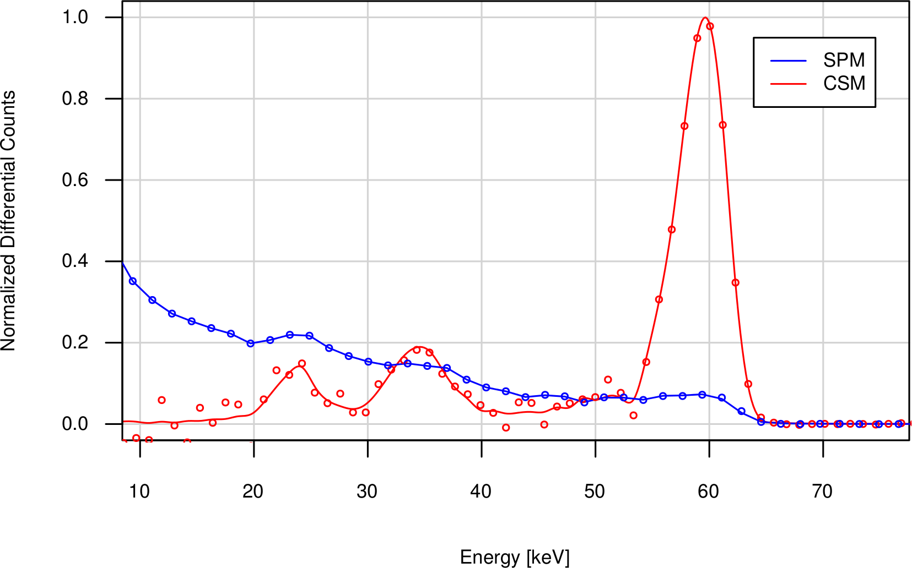
Measurement (60keV, 110µm pitch, 2mm CdTe)
T. Koenig
~4.4KeV FWHM
Fluorescence photons are included in charge sum if their deposition takes place within the volume of the pixels neighbouring the initial deposition
No offline correction, all chip hits added up
Energy resolution limited by the pixel-to-pixel gain mismatch and linearity

Slide 5
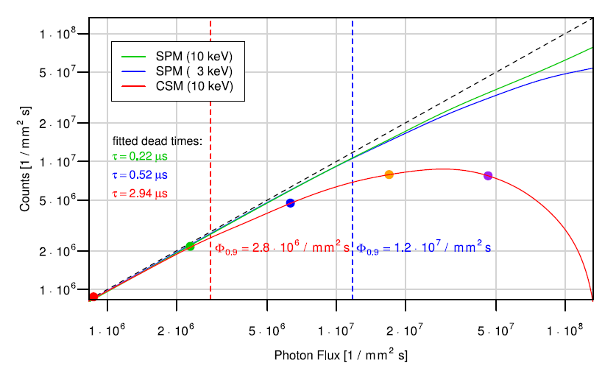
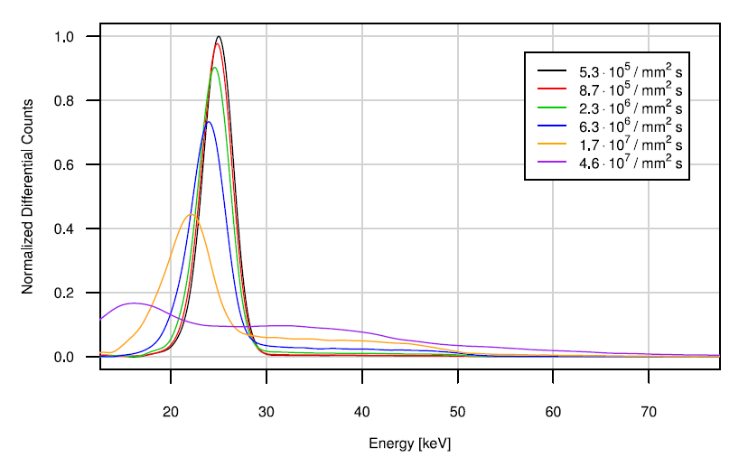
Count rate measurements 110x110 µm pixel
Measurements: T. Koenig
Energy resolution degraded by count rate
110µm pitch, 2mm CdTe
Notes:
The idea behind this slide is that in order to have a “reasonable” spectrum the incoming flux should be at least 5 times lower than the dead time.

Slide 6
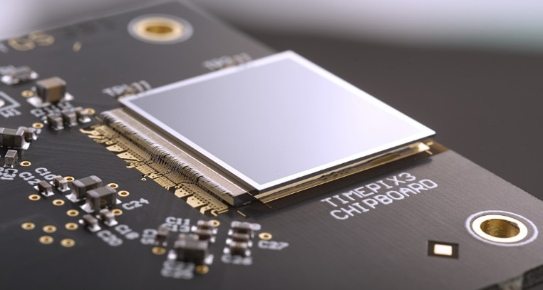
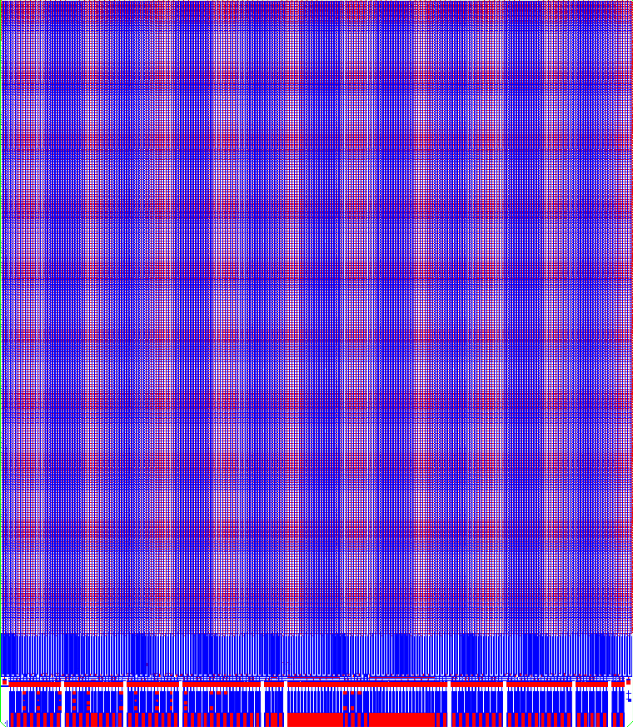
Timepix3 (2013)
Application | General Purpose particle tracking
Technology | IBM 130nm DM 4-1
Pixel size | 55 x 55 µm²
Pixel arrangement | 256 x 256 (2x4 superpixels)
Acquisition modes | Time (TOA) AND Charge (TOT) Time (TOA) PC & integral charge (iTOT)
Readout Type | Data driven (Shutter-less) Frame-based (Shutter)
Thresholds | 1
Minimum threshold | > 500 e-
Time resolution (TOA) | 1.562 ns
Energy Resolution (TOT) | ~2 keV_{FWHM}
Power consumption | <1.5W @1.5 V
Floorplan | 3 sides buttable and minimum periphery
TSVs possibility | YES. With 1.2mm periphery
Count Rate | Data-Driven: ~0.43 x 10⁶ hits/mm²/s Frame-based: 826 x 10⁶ hits/mm²/s
Output bandwidth | 1 to 8 SLVS DDR @640Mbps each
14100 µm
Sensitive Area (14080 µm)
16210 µm

Slide 7
Trigger-less event-by-event data driven and zero-supressed readout
Shutter
Acquisition time
Qin
DataOut
48bit
48bit
48bit
48bit
48bit
48bit
0xB
Address[16-bit]
Data[28-bits]
0x71
0xB0
ChipID [32b]
Data Packet (48 bits)
End of Command (48 bits)
Achievable count rate:
  uniformly distributed events → ~40 Mhits/s/cm² @5.12Gbps
Full matrix readout: ~800 µs @5.12Gbps

Slide 8
Pixel Operation in TOA & TOT
Tpeak < 25ns
Preamp Out
Disc Out
Clk (40MHz)
Pixel Readout Starts (475ns→ 19 clock cycles)
Global TOA (14-bit)
16382
16383
16384
0
1
2
3
4
VCO Clk (640MHz)
FTOA (4 bits)=7
TOA (14-bit)
X
16383
TOA (14 bits)=16383
TOT Clk (40MHz)
TOT (10 bits) =4

Slide 9
Am²⁴¹ Spectrum with a Si 300µm
Threshold ~= 1.8 KeV
Threshold ~= 9 KeV

Slide 10
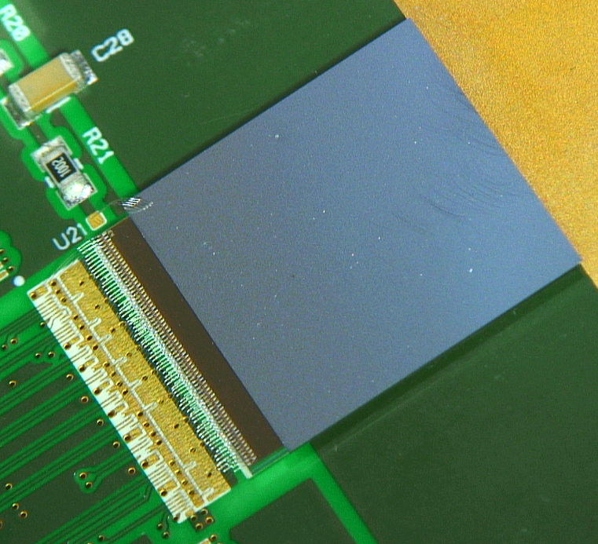
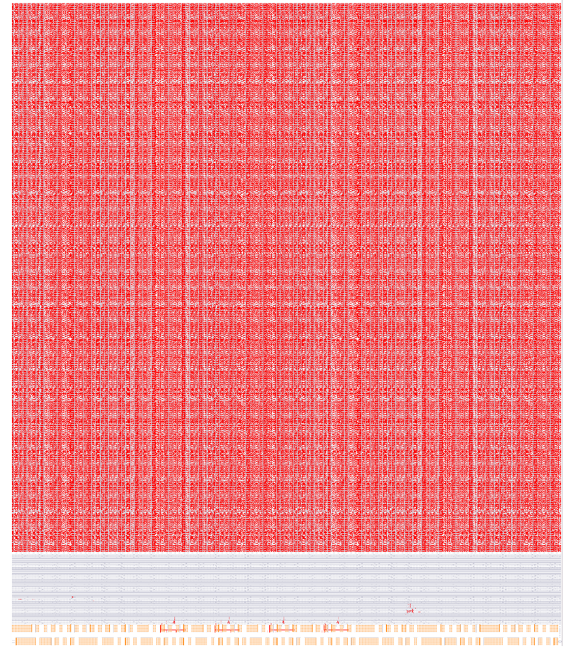
Velopix (2016)
Application | LHCb Vertex Locator upgrade
Technology | CMOS 130nm
Pixel size | 55 x 55 µm²
Pixel arrangement | 256 x 256 (2x4 superpixels)
Acquisition modes | Time (TOA) PC or charge (TOT) 6-bits
Readout Type | Data driven (Shutter-less) Frame-based (Shutter)
Thresholds | 1
Minimum threshold | > 500 e-
Time resolution (TOA) | 25 ns
Power consumption | <1.5W @1.2 V
Floorplan | 3 sides buttable and minimum periphery
TSVs possibility | YES. Multi-dicing scheme as Medipix3
Count Rate | Data-Driven: ~5 x 10⁶ hits/mm²/s
Output bandwidth | 4 serializers @ 5.12 Gbps each
14140 µm
Sensitive Area (14080 µm)
16600 µm

Slide 11
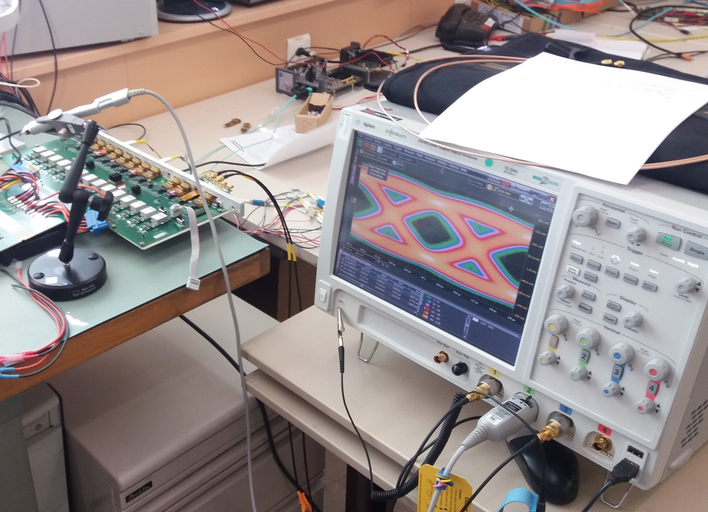
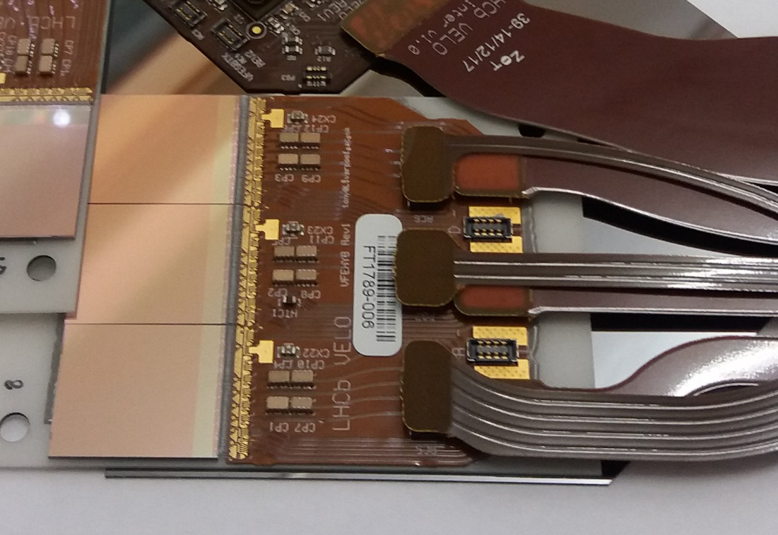
5.12 Gbps Velopix High Speed link
Full link 3-chip module with all links at 5.12 Gbps over a 1m copper line

Slide 12
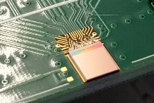
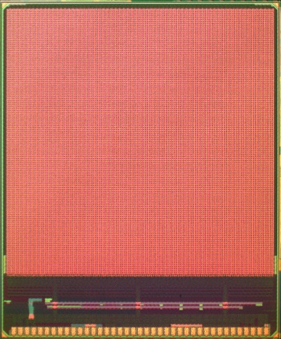
ClicPix2 (2017)
Application | CLIC Vertex detector prototype
Technology | CMOS 65nm
Pixel size | 25 x 25 µm²
Pixel arrangement | 128 x 128 (2x8 superpixels)
Acquisition modes | Time (TOA) 8-bits and Charge (TOT) 5-bits PC or charge (iTOT) 13-bits
Readout Type | Full Frame Zero compression (pixel, super-pixel and column skipping)
Thresholds | 1
Minimum threshold | > 500 e-
Time resolution (TOA) | 10 ns
Power consumption | < 80mW @1.2 V (power-pulsing 156ns/20ms)
Floorplan | 3 sides buttable and minimum periphery
TSVs possibility | NO
Readout | < 800 µs
Output bandwidth | 1 CML @ 640 Mbps
3340 µm
3700 µm
Sensitive Area (3200 µm)

Slide 13
Pixel detectors ASICs developed @CERN
ClicPix (2013)
ClickPix2 (2016)
Timepix3 (2013)
VeloPix (2016)
Medipix3RX (2011)
Timepix (2006)
Dosepix (2010)
Medipix2 (2004)
Medipix1 (1998)

Slide 14
Through Silicon Via (TSV)
The goal is to develop a reliable "Via-last" TSV (Though Silicon Via) process for the Medipix Hybrid Pixel Detectors
The main benefit is to limit the need of classical wire bonding to sensor biasing only → Large area tiling with high percentage of active area
Medipix3RX, Timepix3 and Velopix are TSV compatible chips
TSV process development by CEA-LETI
Sensor fabrication and flip-chip assembly ADVACAM
CERN Medipix TSV project supported by AIDA, CERN-LCD and Medipix3 collaboration
“TSV last for hybrid pixel detectors: Application to particle physics and imaging experiments”, D. Henry, et al, (ECTC), 2013 IEEE 63rd

Slide 15
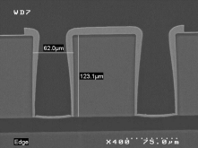
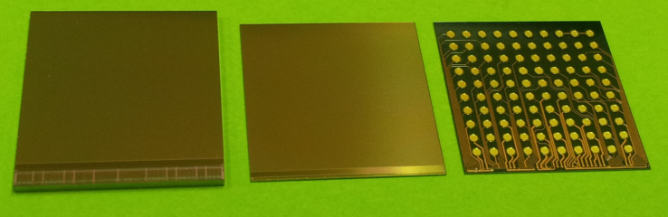
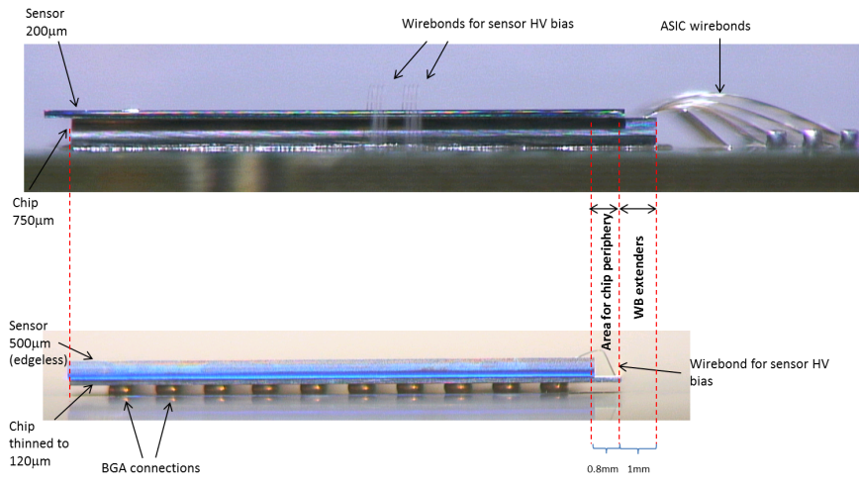
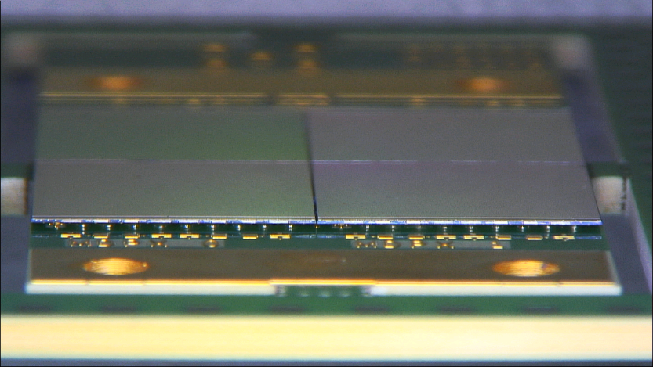
TSV Process
MEDIPIX3 pixel side native thickness
TSV processed chip
“BGA” bottom distribution
SEM cross section of TSVs (CEA-LETI)
First 2x2 TSV Medipix3RX (ESRF)

Slide 16
Medipix4 Collaboration
Medipix4 Collaboration is set to provide the next generation of Medipix4 family chips (Medipix4 and Timepix4)
Main characteristics:
  Use of a commercial 65nm CMOS technology
  4-side buttable architecture → periphery integrated inside the pixel matrix
  Performance improvements from previous generation:
    Medipix4: Count rate, gain linearity
    Timepix4: Count rate, TOA and TOT resolution
  Larger ASICs
  Digital-On-Top design methodology
Agreement signed on May 2016
Today already 14 groups

Slide 17
Medipix4 Collaboration
CEA, Paris, France
CERN, Geneva, Switzerland,
DESY-Hamburg, Germany
Diamond Light Source, Oxfordshire, England, UK
IEAP, Czech Technical University, Prague, Czech Republic
JINR, Dubna, Russian Federation
NIKHEF, Amsterdam, The Netherlands
University of California, Berkeley, USA
University of Houston, USA
University of Maastricht, The Netherlands
University of Canterbury, New Zealand
University of Oxford, England, UK
University of Geneva, Switzerland
IFAE, Barcelona, Spain (In signature process)

Slide 18
Pixel detectors ASICs developed @CERN
ClicPix (2013)
ClickPix2 (2016)
Medipix4 Timepix4
Timepix3 (2013)
VeloPix (2016)
Medipix3RX (2011)
Timepix (2006)
Dosepix (2010)
Medipix1 (1998)

Slide 19
Timepix3 → Timepix4
Timepix4: A 4-side tillable large single threshold particle detector chip with improved energy and time resolution and with high-rate imaging capabilities
 |  |  | Timepix3 (2013) | Timepix4 (2018/19)
Technology |  |  | CMOS 130nm – 8 metal | CMOS 65nm – 10 metal
Pixel Size |  |  | 55 x 55 µm | 55 x 55 µm
Pixel arrangement |  |  | 3-side buttable 256 x 256 | 4-side buttable 512 x 448
Sensitive area |  |  | 1.98 cm² | 6.94 cm²
Readout Modes | Data driven (Tracking) | Mode | TOT and TOA
 |  | Event Packet | 48-bit | 64-bit
 |  | Max rate | < 43 Mhits/cm²/s | 178.8 Mhits/cm²/s
 | Frame based (Imaging) | Mode | PC (10-bit) and iTOT (14-bit) | CRW: PC (8 or 16-bit)
 |  | Frame | Zero-suppressed (with pixel addr) | Full Frame (without pixel addr) CRW (8-bit / 16-bit) Up to 44 KHz frame @8b
 |  | Max count rate | 82 Ghits/cm²/s | ~800 Ghits/cm²/s
TOT energy resolution |  |  | < 2KeV | < 1Kev
Time resolution |  |  | 1.56ns | ~200ps
Readout bandwidth |  |  | ≤5.12Gb (8x SLVS@640 Mbps) | ≤81.92 Gbps (16x @5.12 Gbps)
Target global minimum threshold |  |  | <500 e⁻ | <500 e⁻
3.5x
33%
4x
10x
2x
8x

Slide 20
4-side buttable: Motivation
Sensor
ASIC
PCB
Build large area detectors by combining smaller modules

Slide 21
4-side buttable: Challenge
FC
FC
Sensor
Sensor
BGA
ASIC Pixel Matrix
ASIC
TSVs
ASIC Periphery
Wire Bonding
PCB
PCB
The through-silicon vias (TSVs) are the key technology for this paradigm shift

Slide 22
3-side vs 4-side
Advantages:
  Build large area detectors without dead area
  Better power distribution on chip (TSV) → Larger single ASICs
  Mechanically more robust (no wire-bonds)
Disadvantages:
  Periphery hidden or integrated in the pixels → RDL between sensor and pixel input
    RDL → Increase input capacitance and crosstalk (~30-50fF)
  Top metal layers “blocked” → No MiMCaps, Inductors…
  Devices are only available after TSV processing (no wire-bonds)

Slide 23
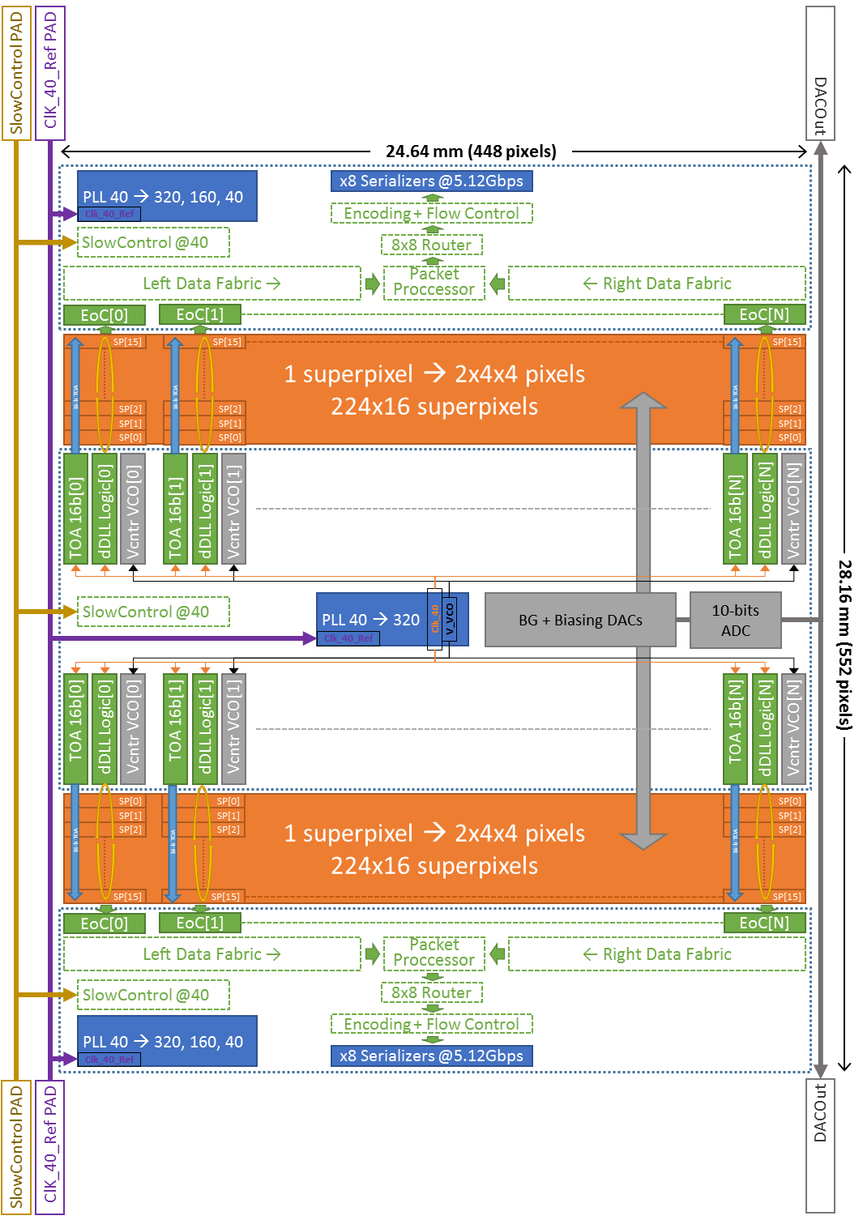
Timepix4 Floorplan
Chip size 28.16mm x 24.64 mm (no Wirebonds)
512 x 448 → 229376 pixels
Pixel size 55µm x 55µm
Analog Periphery (< 800 µm):
  BandGap + Temperature sensor
  Biasing DACs
  Monitoring ADC
  Analog supply
  Digital supply
2 x Digital Periphery ( < 400 µm):
  8 x 5.12Gbps serializers (configurable)
  PLL(s)
  Analog supply
  Digital supply
2 x Pixel matrix (13.28 mm x 24.64mm):
  256 x 448 pixels 55 µm x 51.875 µm
  5.68% smaller than 55 µm x 55 µm
  RDL to compensate up to 400 µm

Slide 24
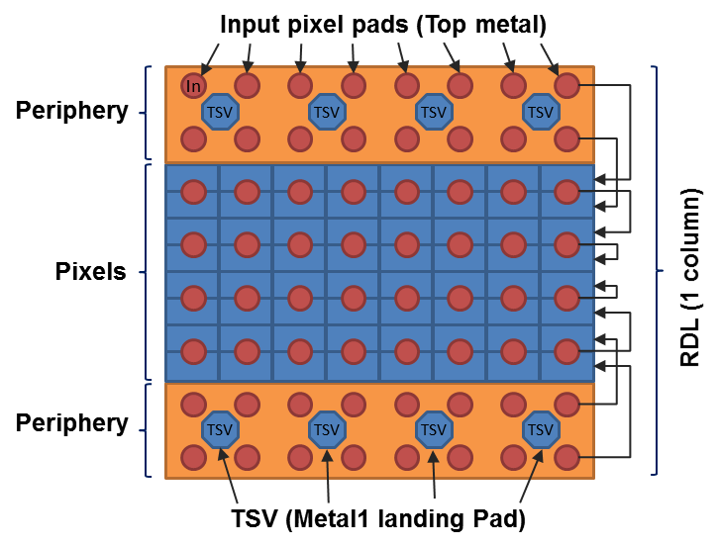
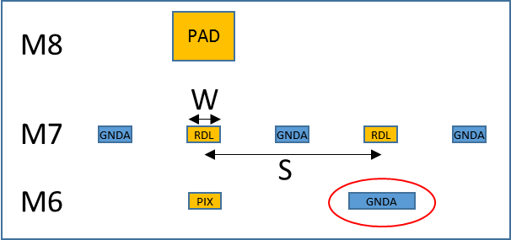
On-chip pad to pixel RDL
Use of 10 metal option (1p9m + RDL)
Use of internal metal layers for vertical redistribution:
  Equalized Cin for all pixels → ~40 fF increase in Cin for a 400 µm periphery
  Shielding of RDL layers to minimize/eliminate cross-coupling
RDL routing over analog pixel circuitry and periphery → M6 used as shield
384 µm periphery → 55 µm/52 µm pixel
~0.1fF/µm [0.1/1.2/GNDA]

Slide 25
Timepix4 Pixel Schematic
1 pixel
8 pixels
32 pixels
Front-end
Front-end
Super pixel
SPG
8-bits
Leakage
Current
compensation
Counters
&
Latches
 | bits
ADDR | 9
ToA | 16
ufToA_r | 4
ufToA_f | 4
fToA_r | 5
fToA_f | 5
ToT | 12
Pileup | 1
8-bits
Clock
local
Sync
Readout
ADB
Input
pad
2.5fF
Synchronizer
&
Clock gating
Preamp
TestBit
~50mV/ke⁻
MaskBit
14-bits
VCO
@640MHz
8-bits
8
5-bit Local
Threshold
4
3fF
640MHz
TpA
TpB
Time stamp
OP Mode
Control
voltage
Data out
to EOC
clock
(40MHz)
Global threshold

Slide 26

Pixel Operation in TOA & TOT [DD]
Tpeak < 25ns
Preamp Out
Disc Out
Clk (40MHz)
Global TOA (16-bit)
65533
65534
65535
0
1
2
3
4
VCO Clk (640MHz)
FTOA_R (4 bits)=7
FTOA_F (4 bits)=11
TOA (16-bit)
X
65534
TOA (16 bits)=65534
TOT Clk (40MHz)
TOT (10 bits) =4
UFTOA_Start (4-bits)
X
0
UFTOA_Stop (4-bits)
X
8

Slide 27
On-pixel < 200ps time resolution
FE + discriminator jitter < 50 ps_{rms}
Column dDLL to distribute the 40 MHz
  Controlled skew on the stop signal (<100ps)
  Minimizes noise from pixel matrix clock distribution
Share an on-pixel 640 MHz VCO among 8-pixels:
  Oscillation frequency locked (Vcntrl) with periphery PLL for PVT control
  1.56 ns resolution (as in Timepix3)
  195 ps obtained latching the internal VCO phases

Slide 28
Timepix4 FE
The Timepix4 chip front-end has to be versatile in order to be used:
  With different types of sensors:
    Bipolar detection and <10nA leakage currents (high-Z materials)
  In tracking and as well in imaging:
    Imaging at high rates (e.g. synchrotrons) imposes a minimum pulse width. In order to be at the state of the art in terms of rate capability, the dead time of the front-end should be smaller than ~200ns.
    Tracking applications impose an input jitter in the front-end below 50ps_{rms} (time bin 200ps)
FE architecture follows the “classic” Medipix approach (Krummenacher FE)
  Gain adjustment (log gain in hole collection)
  Improved for low jitter and fast count-rate when required → power
Q_{in}=2.2ke⁻
I_{KRUM}=20nA

Slide 29
Timepix4 FE summary
 | e⁻ collection | h⁺ collection | h⁺ collection (log gain)
Gain | ~50 mV/ke- | ~50 mV/ke- | ~25 mV/ke-
ENC (@Cin=50fF) | ~60 e-_{rms} | ~60 e-_{rms} | ~65 mV/ke-
Minimum threshold | < 400 e- | < 400 e- | < 450 e-
TOA Jitter | <40 ps _{rms} Qin > 10Ke-
TOT linearity | < 250 ke- | < 200 ke- | < 800 ke-
Pixel analog power | <7.5uA (@1.2V, 9 µW)
ENC vs Cin slope ~0.3 e⁻/fF
ENC vs Ileak slope ~4 e⁻/nA

Slide 30
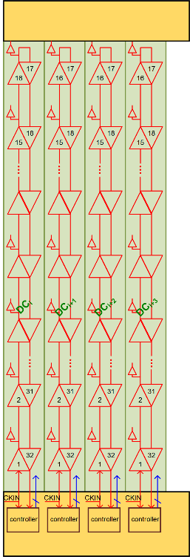
dDLL for the reference pixel clock distribution
Design of a digital delay-locked loop (dDLL) to control the clock phases (40 MHz) that arrive in every SPG (Super Pixel Group, 2x16 pixels) → Robust to PVT variations
1 complete dDLL every double column: 32 Delay stations over ~2.7cm (!) → Target station delay 781.25 ps
Digital design:
  Custom designed cells characterized using Liberate using 4 corners → Full double column verification possible (functional, dynamic power)

Slide 31
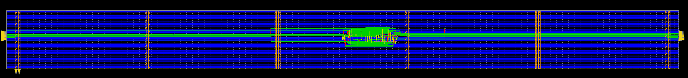
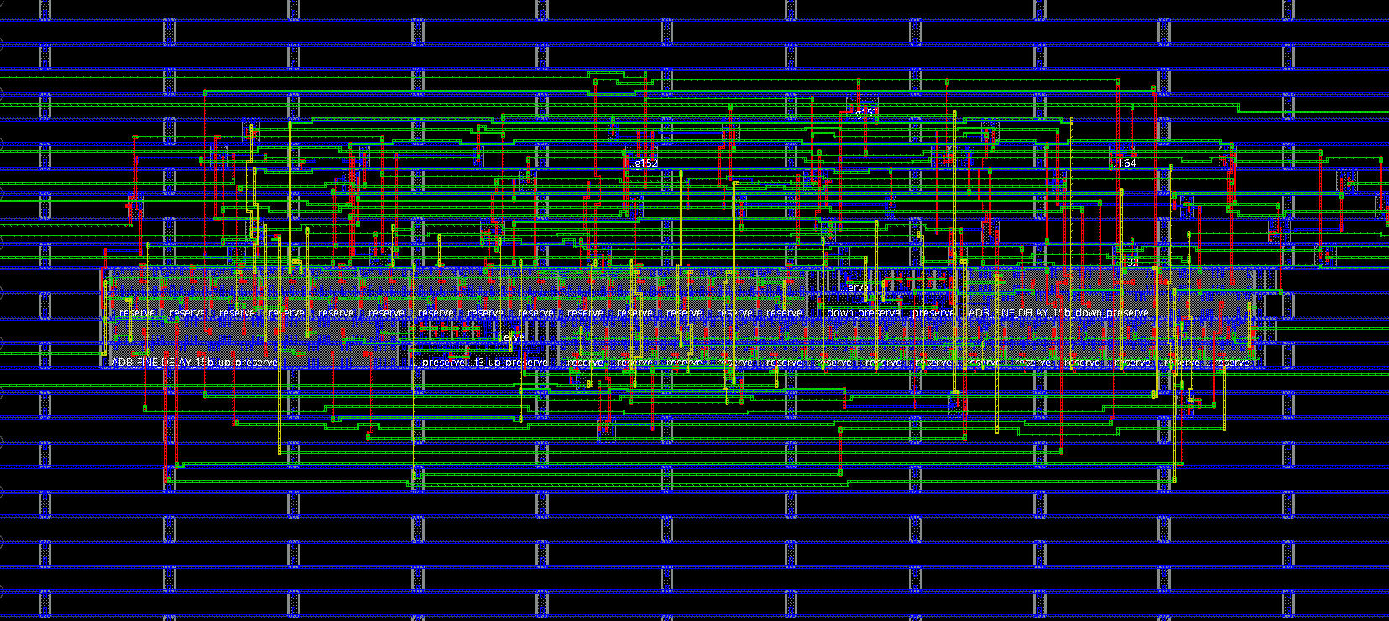
Super Pixel Group dDLL
~ 800 µm
70 µm
Area <0.75% of 16x2 SPG
Clock down
Clock up

Slide 32
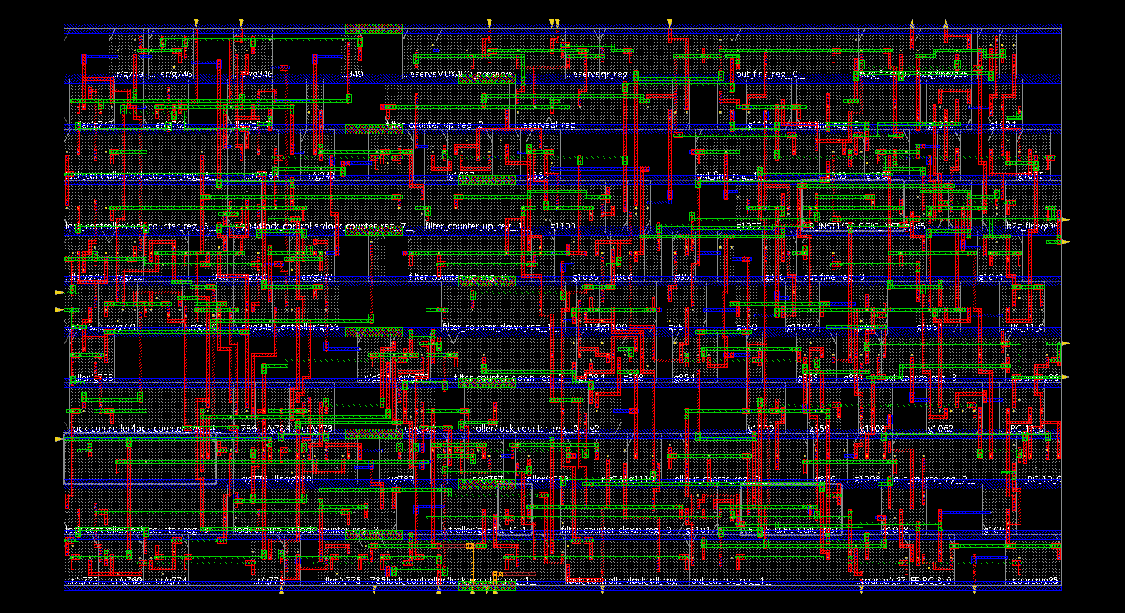
dDLL controller (Periphery)
Synthesized using tcb65lp library
Digital “noise” filter → 8 consecutive clocks with same UP or DN update direction
Lock detector with 8-bit programmable threshold
Programmable lock window
Bypass coarse and fine control words (not yet implemented)
coarse[3:0]
ckout
fine[3:0]
ckin
DLL Controller
35.4 µm
lockWindow [1:0]
thresholdLock [7:0]
bypassCode [7:0]
preliminary
19.8 µm
lockStatus
ckin
bypass
reset

Slide 33
Digital-domain simulation @ TC corner with noise
0
25
50
75
100
125
150
175
200ps_{rms}
Δ(ideal-simulated)
Δ(ideal-simulated)
lockStatus
coarse & fine
time [µs]
* Specification for the absolute jitter of input clock is 5 ps_{rms}

Slide 34
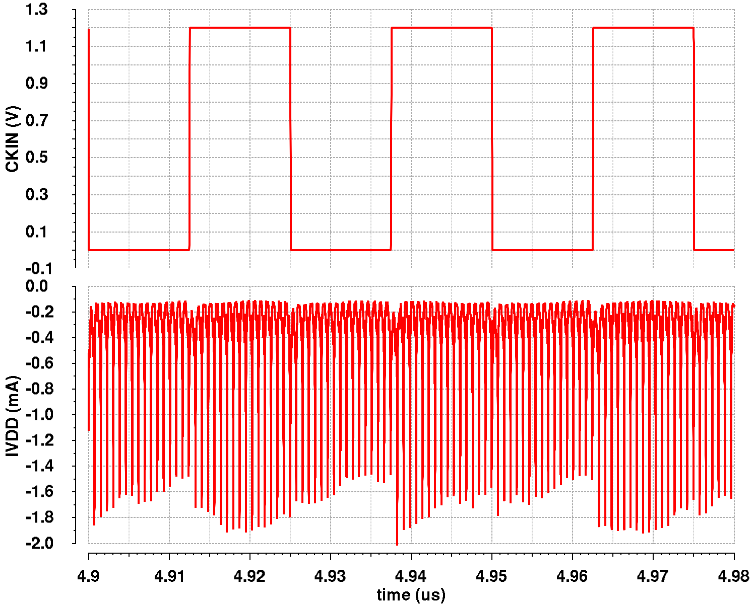
dDLL Power breakdown
Block | Total power | Total
Single controller (TYP corner) | 32 µW
All controllers (1 per Double Column) | 224x2x20 µW | 14.3 mW
Single double Column delay line (TYP corner) | 16x20 µW
All double Column delay lines | 224x2x320 µW | 143.3 mW
Full chip dDLL | 224x2x352 µW | 157.6 mW
22.7 mW/cm² to distribute a 40MHz clock with a 100 ps_{rms}
Dynamic digital power consumption is distributed across the clock period
This not include all the local on-pixel clock distribution
Timepix3 @40MHz clock distribution is ~200mW (almost 4 times the area)

Slide 35
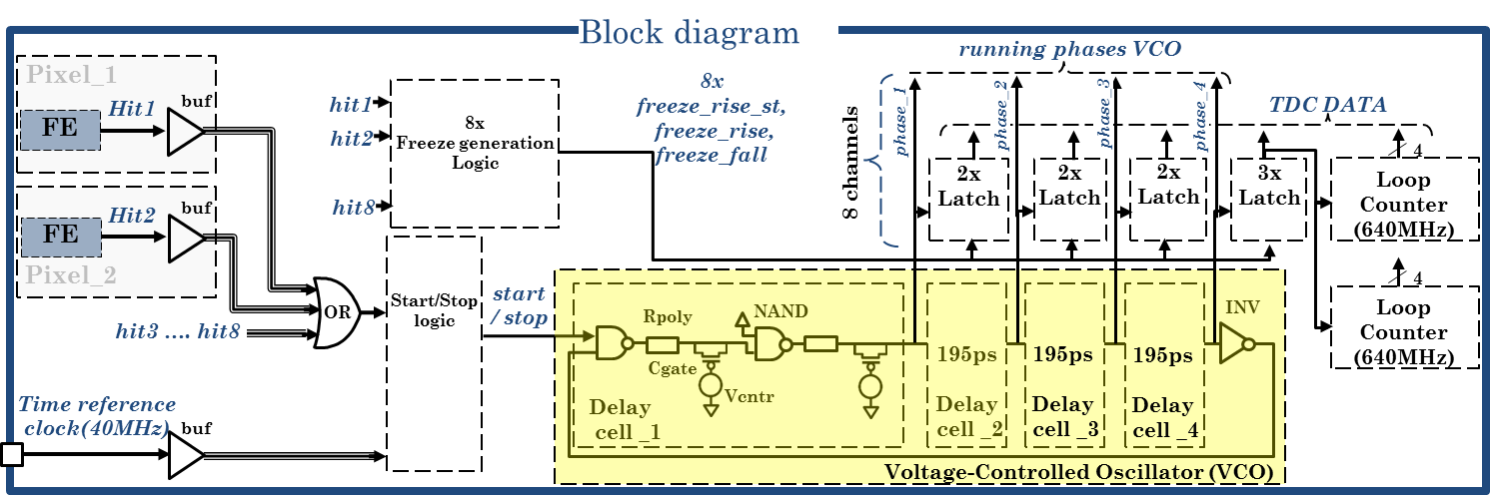
On-Pixel TDC
Full digital Superpixel TDC implementation:
  VCO:
    full-custom designed (as in Timepix3) and characterized using Liberate
    640 MHz nominal frequency with 4-bit frequency adjustment (~40MHz range)
    Nominal consumption ~600 µW (enabled)
  Full digital integration with the rest of digital pixel
VCO Oscillation pattern
stage | Phase[3] | Phase[2] | Phase[1] | Phase[0]
0 | 1 | 1 | 1 | 1
1 | 1 | 1 | 1 | 0
2 | 1 | 1 | 0 | 0
3 | 1 | 0 | 0 | 0
4 | 0 | 0 | 0 | 0
5 | 0 | 0 | 0 | 1
6 | 0 | 1 | 1 | 1
7 | 0 | 0 | 1 | 1

Slide 36
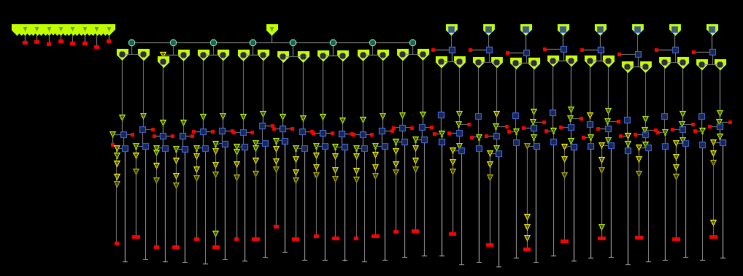
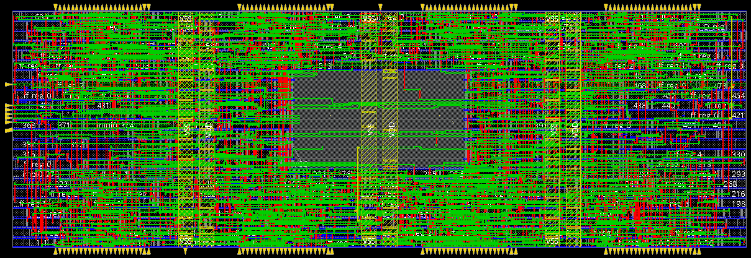
Timepix4 Super Pixel (4X2) TDC
VCO
8 pixels TDC:
  Hit synchronization
  Clock40 clock gating
  FTOA counters:
    5-bit FTOA_rise
    5-bit FTOA_fall
  UFTOA latches
    4-bit UFTOA_rise
    4-bit UFTOA_fall
~25% of available digital area
33.6 µm
104 µm

Slide 37
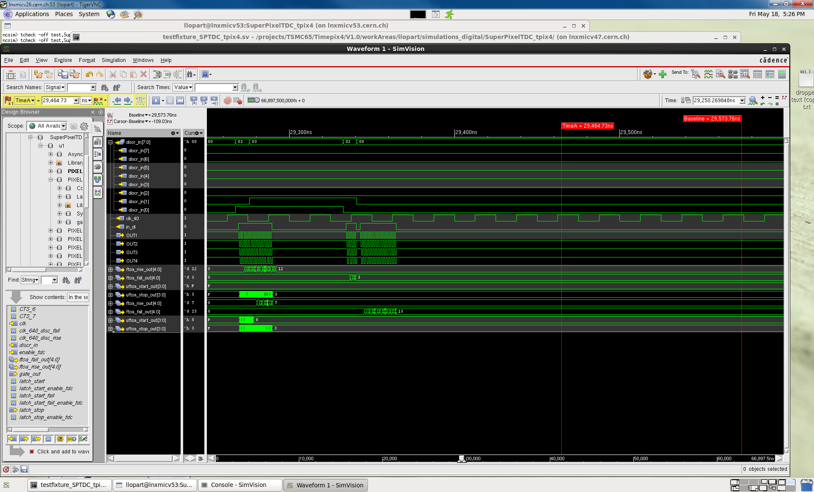
Post-layout TDC simulations
VCO only enabled when required (~600 µW/hit/50ns)
@Max rate (178 Mhits/cm²/s) → ~15 mW average
Pix[0]
Pix[1]

Slide 38
Post-layout TDC simulations (TYP)

Slide 39
TDC post-layout digital simulations
Post-layout simulation (TYP) → 57 ps_{rms} TOA resolution (VCO LSB/sqrt(12))
  Ideal FE
  Ideal 40 MHz
Simulation of 1 input random arrival
Limited pixel-to-pixel insertion delay mismatch < 80ps_{peak-to-peak}

Slide 40
Medipix4 Improvements
Medipix4: A 4-side tillable multiple threshold charge summing imaging chip with improved energy resolution and count rate
 | Medipix3RX | Medipix4 (2019)
Technology | CMOS 130nm | CMOS 130nm
Pixel Size | 55/110 µm | 70/140 µm
Pixel arrangement | 3-side buttable 256 x 256 | 4-side buttable ≥256 x 256
Thresholds | 2/4/8 Sequential RW 1/4 Continuous RW | Not yet defined
 | Sequential RW & Continuous RW
Maximum Count Rate | 376 x 10⁶ ph/mm²/s (SPM 55) 29 x 10⁶ ph/mm²/s (CSM 110) | 100 x 10⁶ ph/mm²/s (CSM 140)
Dynamic Range | 25 Ke- | 32 Ke-
CSM energy resolution | ~ 4KeV (CSM 110) | ~ 2KeV (CSM 110)
Readout bandwidth | <1.6 Gbps (8x LVDS) | 1,2 Serializers @5.12 or 2.56 Gbps
Power | <1W @1.5V | <1W/cm² @1.2V

Slide 41
Expected Count Rate Medipix4 and Timepix4
Target Timepix4 in Imaging
Target Medipix4
Target Timepix4 in Data-Driven
R.Ballabriga, SpecXray 2015

Slide 42
Conclusions
Hybrid Pixel Detectors (HPD) profit better from the continuous miniaturization in CMOS technologies independently from the sensor developments
The use of 3D-IC bonding techniques will bring to live 3D developments and large area detectors with no dead area
The Medipix4 Collaboration aims to design 2 4-side buttable ASICs:
  Medipix4 (2019/20)
    Pixel <70/140 µm
    Improved energy resolution (½) and count-rate (x5) compared to Medipix3RX
    Number of thresholds not defined
  Timepix4 (2018/19):
    Particle tracker AND Imaging chip with 1 threshold
    Improved energy resolution (x2), arrival time resolution (x8) and count-rate (x4) compared to Timepix3

Slide 43
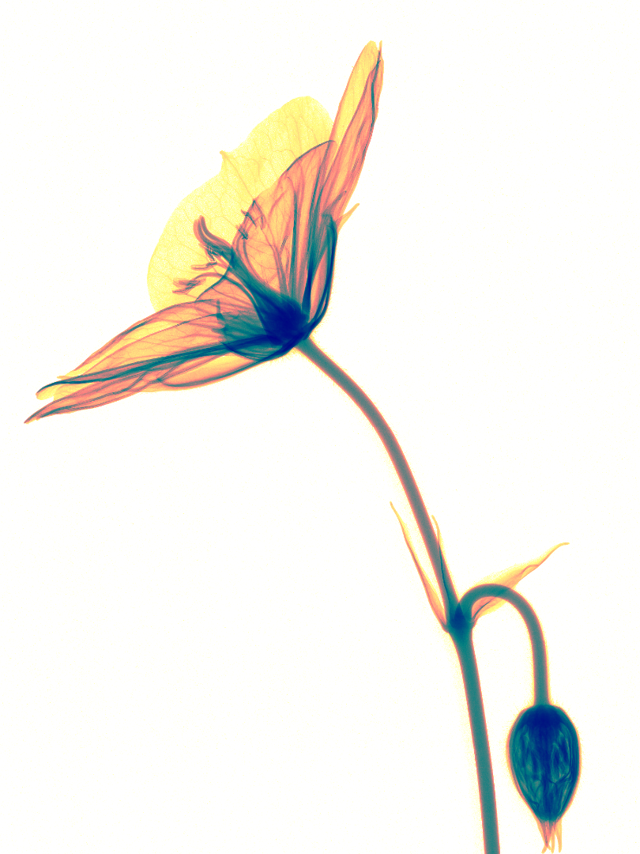

Acknowledgments
Medipix2/3/4 Collaborations
Linear Collider Detector group
LHCb Collaboration

Slide 44
Frame Based CRW:
[Minimum output bandwidth before counter overflow]
8-bit @ 1Gc/mm²/s > 10.24 Gbps
16-bit @ 8Gc/mm²/s > 640 Mbps
16-bit @ 1Gc/mm²/s > 80 Mbps

Slide 45
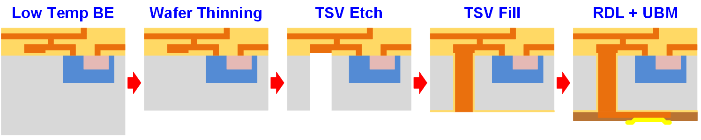
TSV Process
Wafers thinned to 50-120 µm (limits the via aspect ratio)
TSV and RDL (Re-Distribution Layer) patterning
Final passivation and back side UBM (Under Bump Metallization)
Wafer is removed from temporary carrier and place on another specifically adapted for dicing and ejection
Sensor bump bonding to TSV processed chip
CEA-LETI

Slide 46
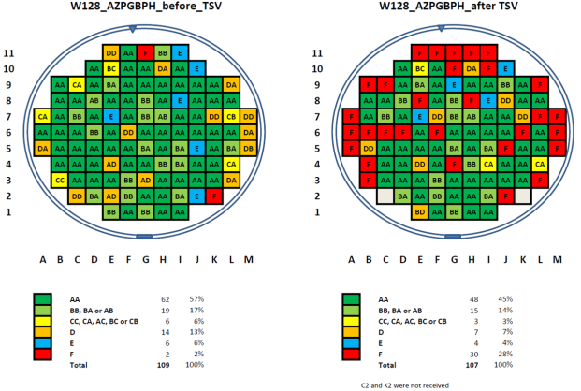
TSV Yield
Original wafer probing results (Foundry yield)
After foundry production and TSV added process the final yield is 45% of fully functional chips

Slide 47
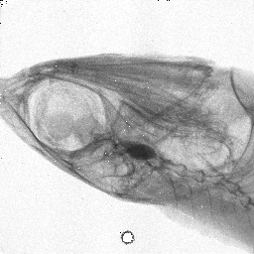
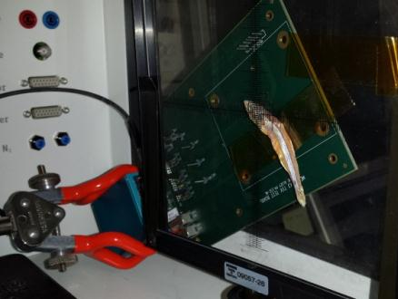
CERN Medipix TSV PROJECT – First run – X-Ray Imaging
Hybrid Pixel Detector was positioned in front of the X-Ray beam
A biological sample (fish) placed before the detector
X-Ray chamber 35kV, 1mA
First irradiation setup using a Medipix 3.1 TSV assembly
First image obtained with a TSV processed hybrid pixel detector (flat field corrected)
R.Ballabriga and J.Alozy

Slide 48
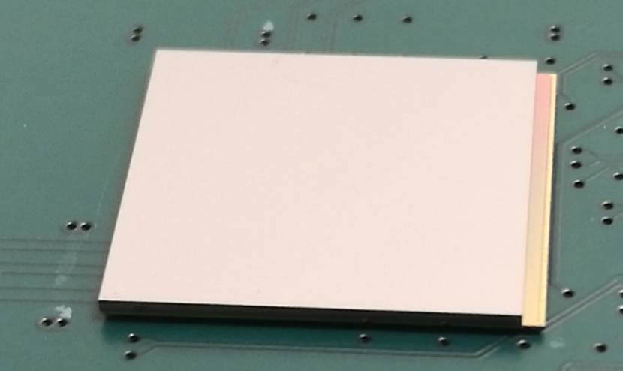
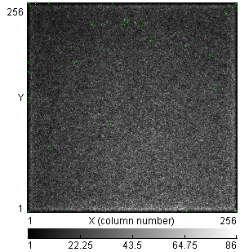
Latest TSV results
120 µm Medipix3RX with TSVs and bumped to a 500 µm thick P-on-N edgeless sensor
Sr⁹⁰ Acquisition
400nA @150V
Full functional device !
J.Alozy
Advacam

Slide 49

Jitter versus input charge
$$\frac{dv_{out}\left(0\right)}{dt}\sim \frac{Q_{0} g_{m}}{C_{I}\left(C_{L}+C_{M}\right)}$$
C_{IN}=25fF-50fF
C_{L}=15fF
C_{M}=3fF
g_{m}=90uS (I~3uA)
Noise ~70e- r.m.s.
Notes:
Input is a delta dirac
Slope of the time waveform is taken at maximum (at t=0) (as if threshold set to 0)
No limitation for the slope of the signal (no slew rate effects)
Preamplifier output (Discriminator not accounted for)
Conclusions:
For 5ke⁻ signal (and 50fF C_{IN}) the limit is 50ps
For 10ke⁻ signal (and 50fF C_{IN}) the limit is 24.5ps

Slide 50
Jitter versus input charge
C_{IN}=25fF-50fF
C_{L}=15fF
C_{M}=3fF
g_{m}=90uS (I~3uA)
Noise ~70e- r.m.s.
Notes:
Slope of the time waveform is taken at maximum (at t=0) (as if threshold set to 0)
No limitation for the slope of the signal (no slew rate effects)
Preamplifier output (Discriminator not accounted for)
Preamplifier output simulation (threshold at ~800e⁻ (negative polarity)
Conclusions:
For 5ke⁻ signal (and 50fF C_{IN}) the limit is 50ps
For 10ke⁻ signal (and 50fF C_{IN}) the limit is 24.5ps

Slide 51
Jitter versus input charge
C_{IN}=25fF-50fF
C_{L}=15fF
C_{M}=3fF
g_{m}=90uS (I~3uA)
Noise ~70e- r.m.s.
Notes:
Slope of the time waveform is taken at maximum (at t=0) (as if threshold set to 0)
No limitation for the slope of the signal (no slew rate effects)
Preamplifier output (Discriminator not accounted for)
Comparator output jitter simulation
Preamplifier output jitter simulation (threshold at ~800e⁻ (negative polarity)
Conclusions:
For 5ke⁻ signal (and 50fF C_{IN}) the limit is 50ps
For 10ke⁻ signal (and 50fF C_{IN}) the limit is 24.5ps

