Slide 1
Performance of a digital-SiPM readout chip.
Inge Diehl, Karsten Hansen, Christian Reckleben, Yuan Yao
DESY-FEC, Hamburg, Germany
11th Front-End Electronics Meeting
Jouvence, 20. May – 25. May 2018

Slide 2
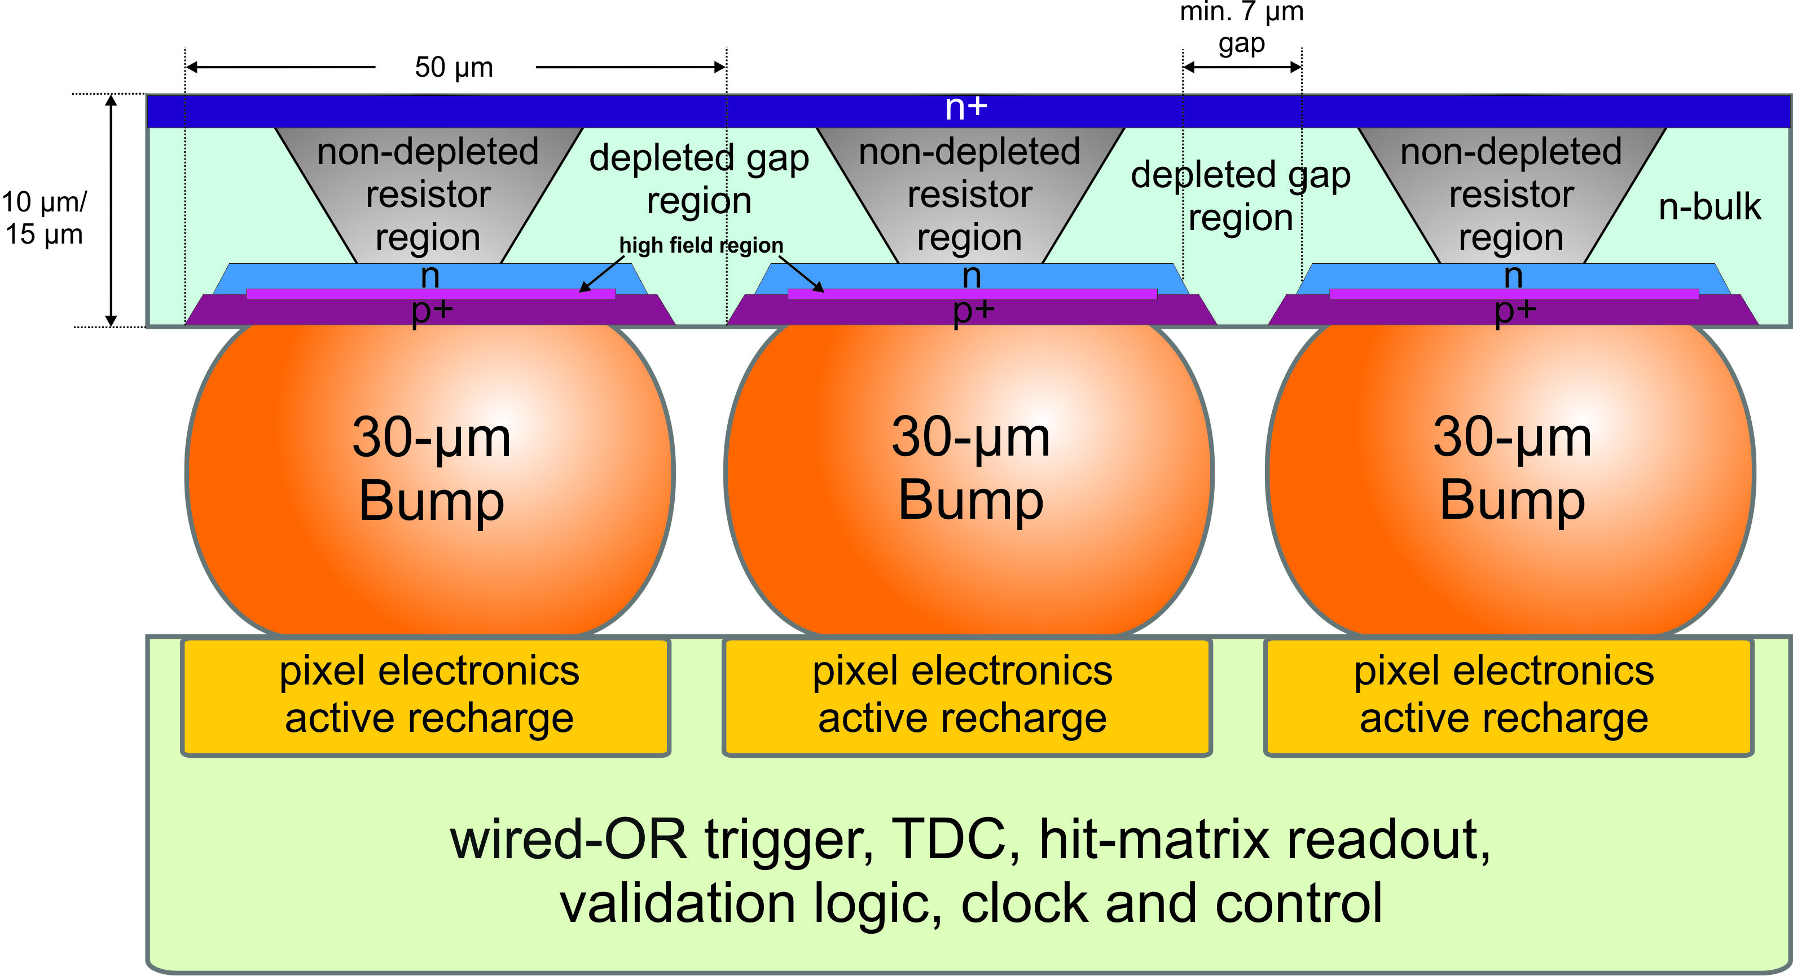
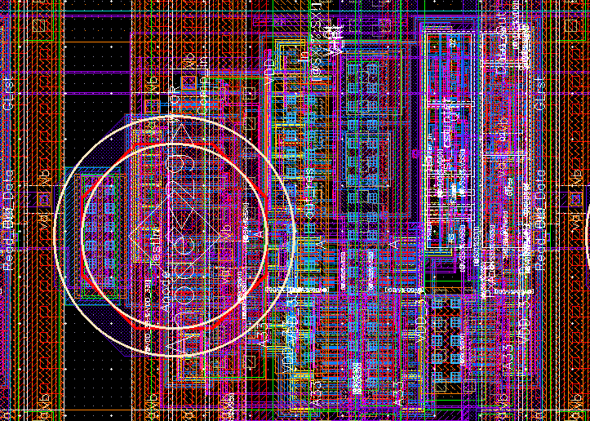
Readout concept: hybrid approach
ultra-thin sensor + fast readout ASIC
sensor with small bulk resistor – fast recharging
low over-bias voltage (3.3-V mosfets)
pixel-wise readout – digital signal (no analog sum)
high fill factor
active quenching & recharging circuitry (AQRC)
adjustable recharge start/hold-time (pile-up rejection)
masking of noisy pixels
hit counting
wired-OR trigger
dSiPM-array
(HLL-dSIMPl)
ASIC designed by DESY
pixel electronics
AQRC
anode
serializer
2 bit
    1st application:
    particle tracking
1.2 V
V_{qt}
hold time
hit counter
V_{rt}
quench
wired-OR
recharge
masking
3.3 V

Slide 3
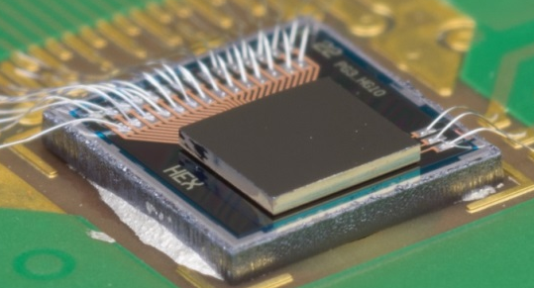
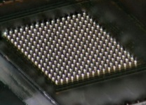
Readout concept: macro pixel
    16-by-16 pixel unit, 50-µm pitch
    interleaved row-wise 16-to-1 multiplexing
    12-bit TDC (5-bit fine, 7-bit coarse)
    validation logic with comparators
  adjustable thresholds
  row reference: 1 … >4 pixel
  column reference: 1 … >2 rows
    21-bit bunch counter
    serialized time stamp / validation flag / frame number
controller
  clock division & distribution
  status control register
≤ 3.3-MHz bunch clock scheme
≤ 450 MHz fast clock for MUX & TDC
sustained data throughput @ 3 MHz
  fast LVDS links
  816-Mbps hit data
  102-Mbps timing data
dSiPM-array
macro pixel
controller
5
clocks
initials
16
16 x pixel electronics
+
16:1 MUX
hit data
-
16
16 x pixel electronics
+
timing data
fast
wired-OR
12-bit
TDC
-
16x16
x16
flag bit
1
21 bit
slow
wired-OR
16
validation
logic
16 x pixel electronics
bunch counter
prototype
macro pixel
sensor (4x4 mm²) with handle wafer
ASIC (2x2 mm²) on top
130-nm GF 8M1P CMOS
30-µm SAC solder spheres by using the laser-assisted jetting technique

Slide 4
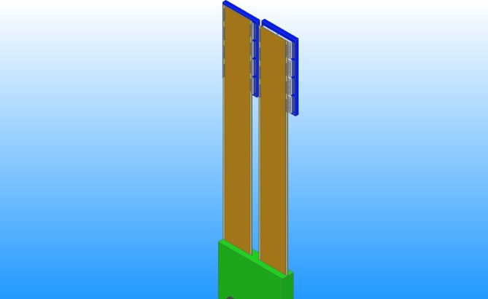
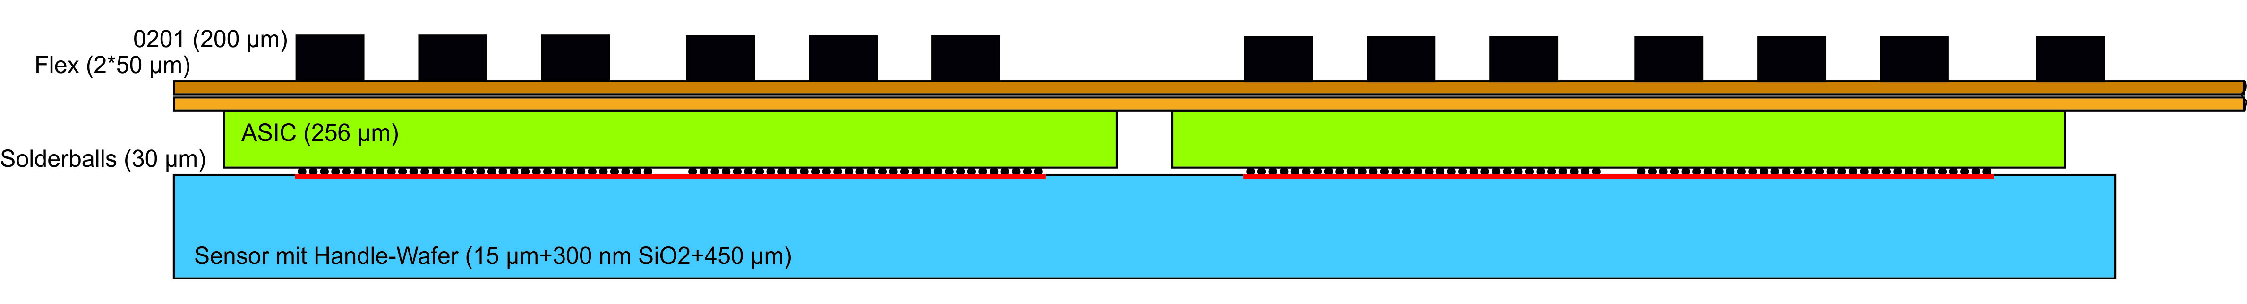
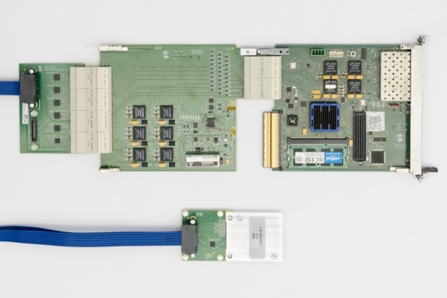
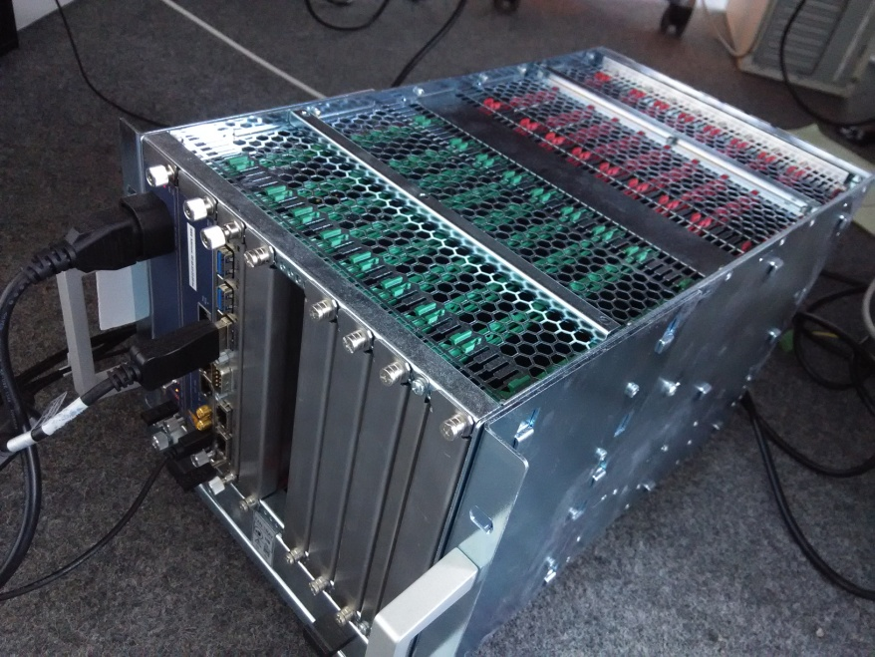
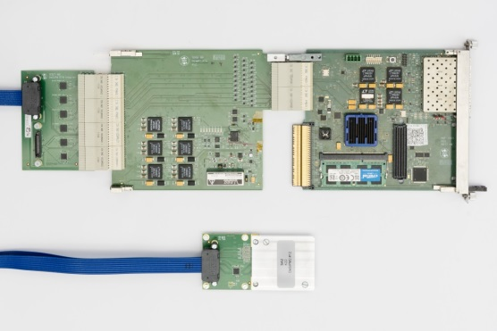
Readout concept: detector system
integration concept
interconnection board
LVDS repeater
clock distributor
decoupling
connector
cable
flexible carrier (termination/filtering)
ASIC (read-out)
flex cable
sensor
30-µm solder balls
MTCA.4
RTM
final ASIC:
16 x macro pixel
HGF-AMC
signal conditioning/distribution & power supply
(application specific)
digital signal processing
(generic)
DAQ-system
    modular structure
    building of large-scale pixel detectors
    DAQ-system based on MicroTCA.4 standard
    application specific designed RTM
    ~14 Gbps data throughput per ASIC @ 3MHz
1HGF-AMC processes 128 macro pixel

Slide 5
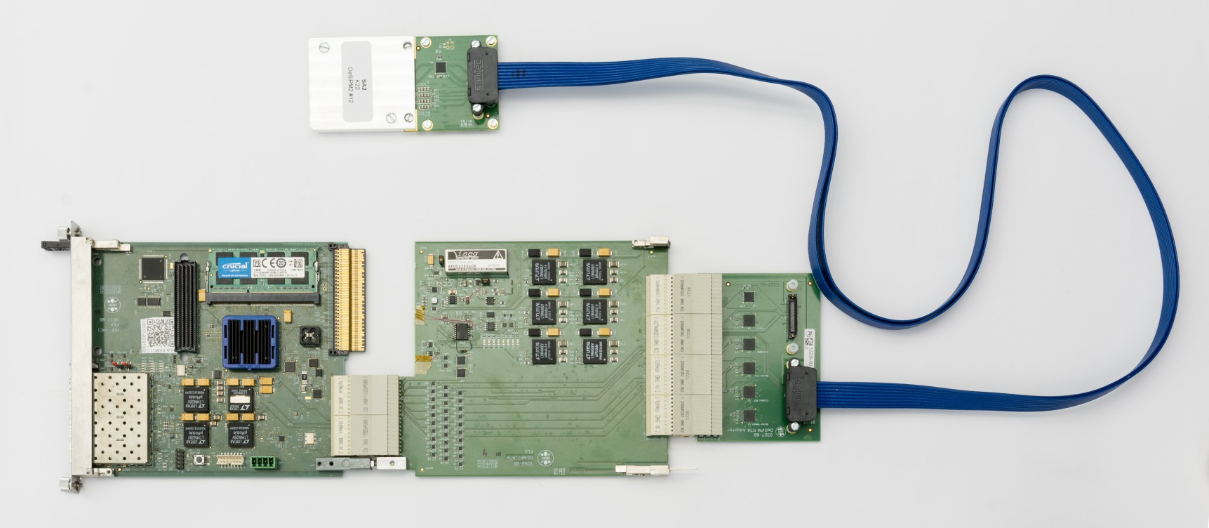
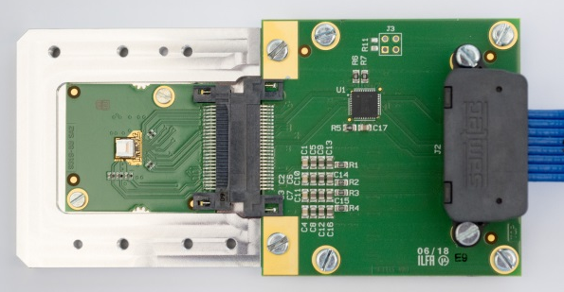
DAQ system: status
testboard
plug-in module
with prototype
adapterboard
testboard
    board design and assembly ready
    FPGA programming in progress
    DAQ system available soon
    testboard with plug-in modules
plug-in module
with prototype
MTCA.4

Slide 6
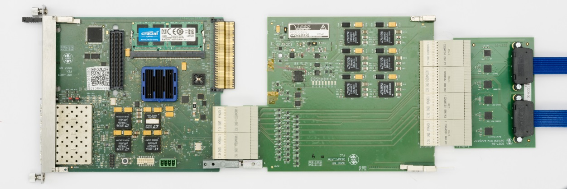
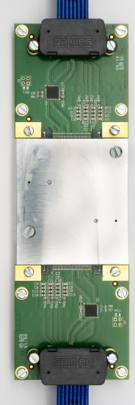
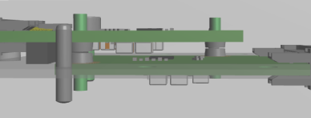
DAQ system: beamline setup
testboard
adapterboard
2 plug-in module
e⁻
    measurement of charged particles
    2 prototypes on top of each other
    coincidence measurements
    rejection of dark events
MTCA.4

Slide 7
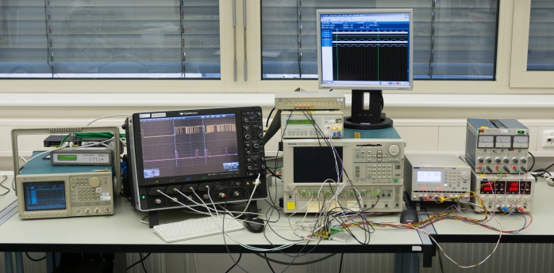
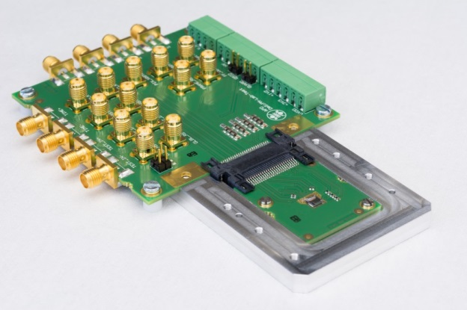
Test setup: prototype
test setup at the moment
testboard
scope
power Supply
DTG
DG
    lab instruments:
      pattern generator, oscilloscope, data-timing generator, power supply
    1 testboard with plug-in modules
    2 output streams:
      hit data
      timing data (valid bit, TDC out, frame number)
    ASIC-behavior test independently of the sensor possible by using a test input
    prototype performance tests only with dark events
plug-in module
with prototype
ASIC behaves as expected
verification of timing characteristics, validation logic, in-pixel hit counting and data processing

Slide 8
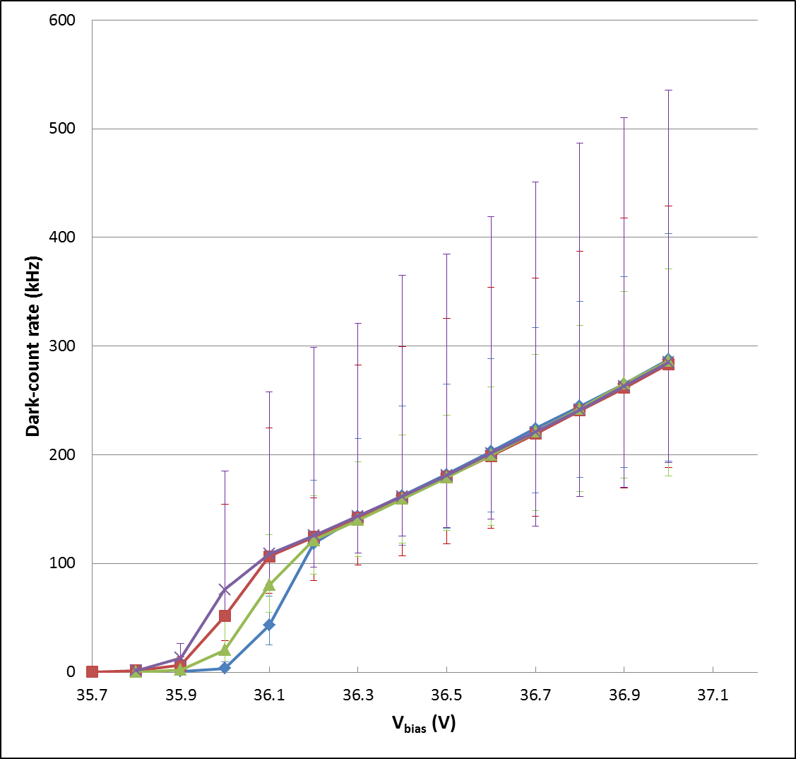
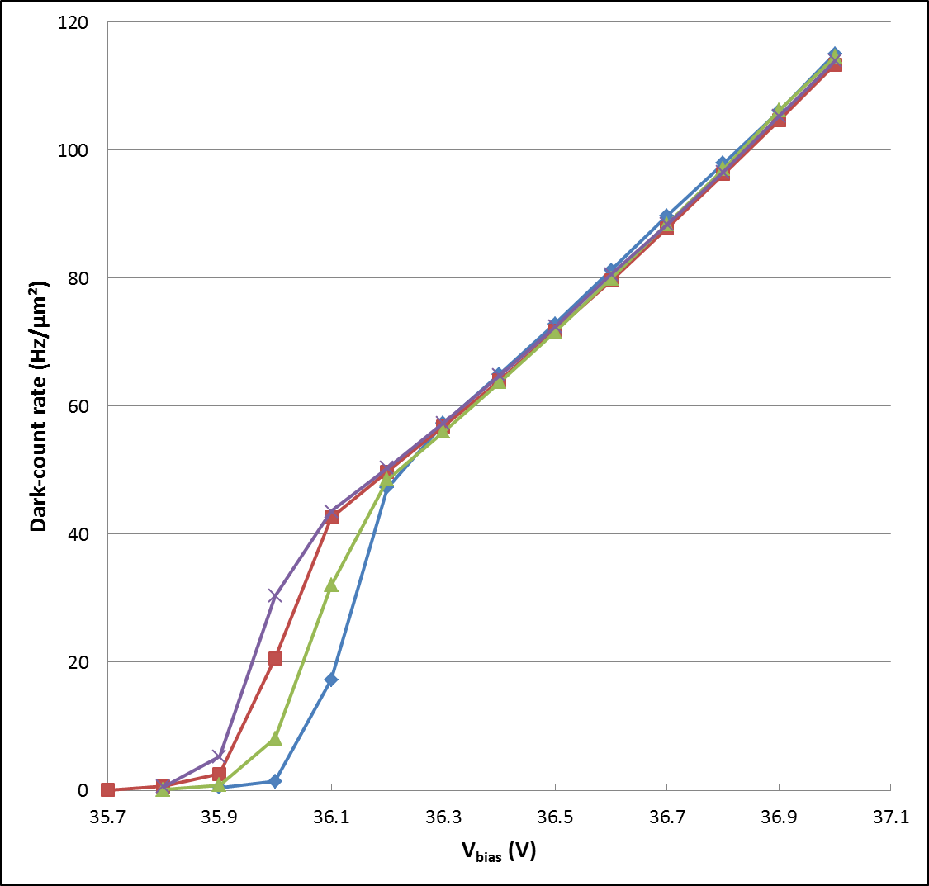
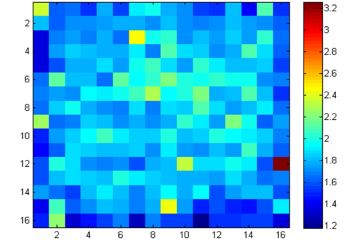
Results prototype: hit data
dark-count rate as function of the sensor-bias voltage
    record time: ~12.5 ms
    1-hit counting per frame (3 MHz-frame rate)
dark-count rate per pixel
dark-count rate per area
x 10⁵ cps
red sample

Slide 9
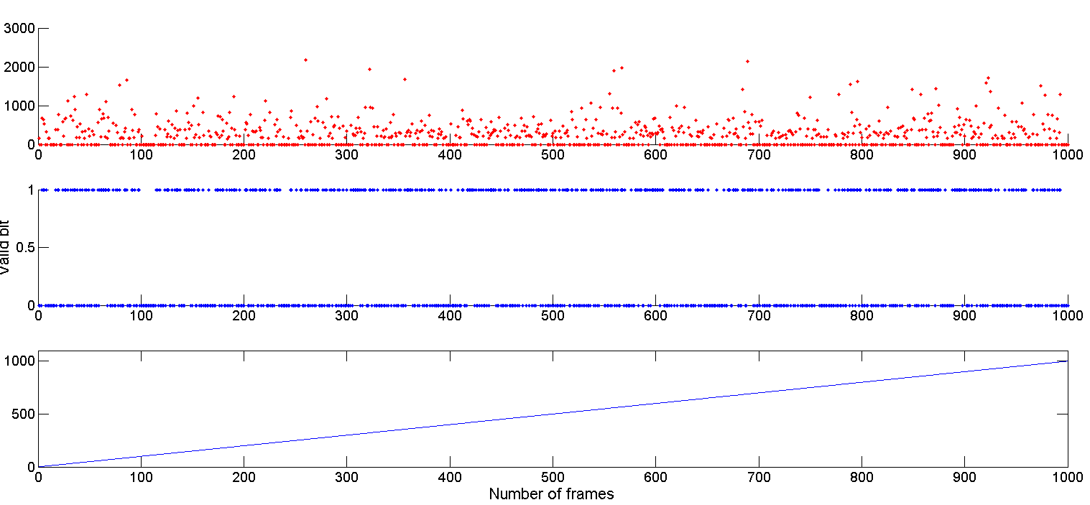
Results prototype: timing data
timing data in every frame
    time window: 333 µs = 1000 frames @ 3 MHz
    V_{bias} = 36.5 V
TDC value
time stamp
valid bit
dark-count rate reduction
frame number

Slide 10
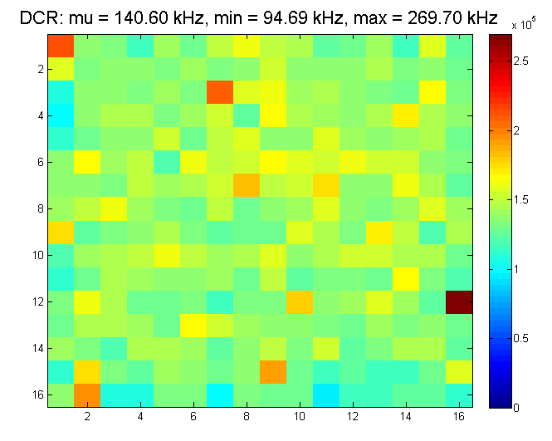
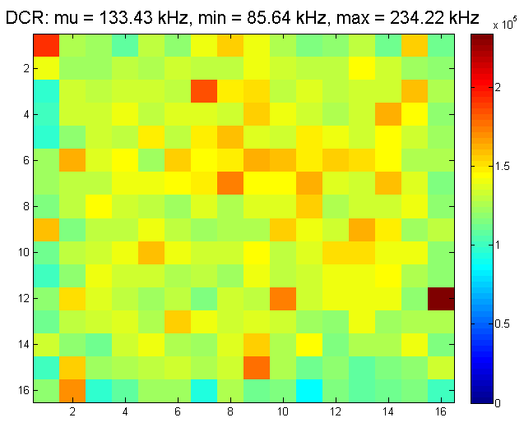
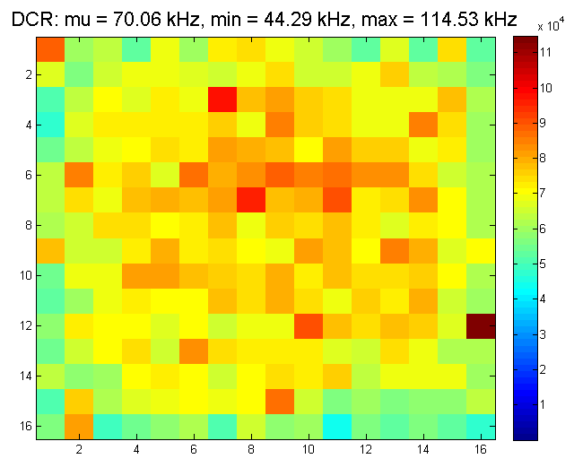
Results prototype: validation-logic performance
dark-count rate with consideration of valid bit
    record time: ~12.5 ms (~38000 frames @ 3 MHz)
    1-hit counting per frame
    V_{bias} = 36.5 V
validation thresholds:
row: 2, col: 1
row: 3, col: 1
row: 4, col: 1
    DCR can be significantly reduced (compare: DCR w/o validation = 180 kHz)
    crosstalk problematic shown

Slide 11
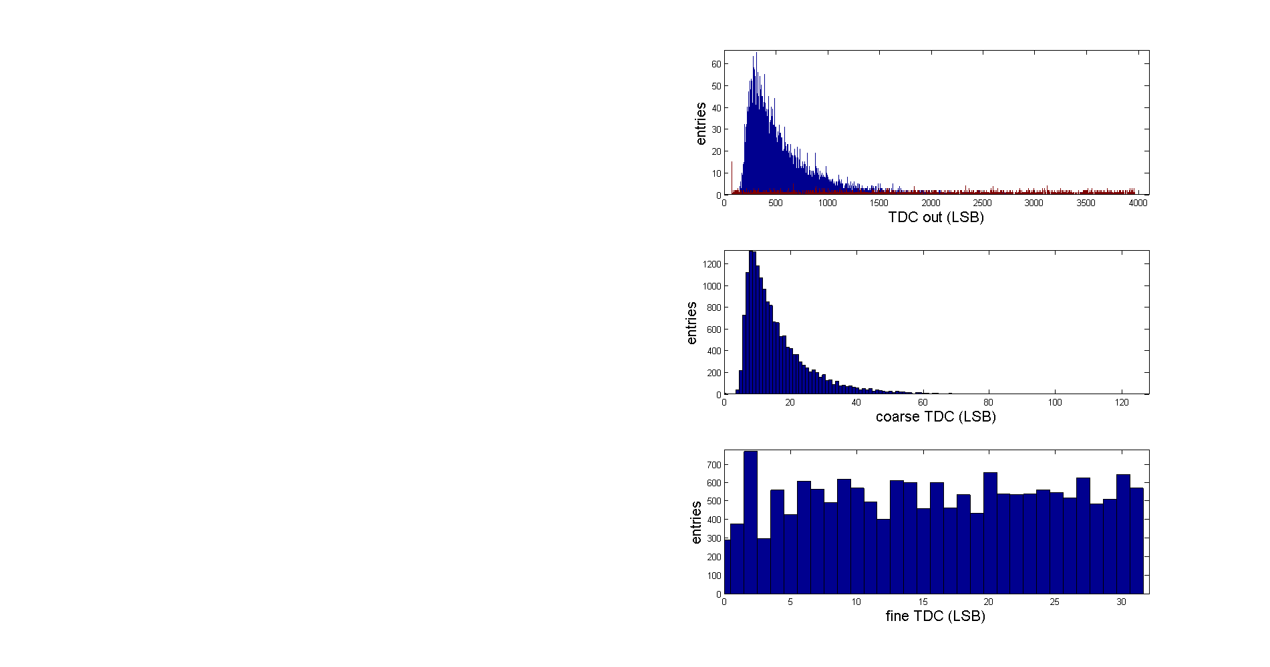
Results prototype: TDC performance
histogram of the TDC values
time stamp of 1st event
    record time: ~12.5 ms (~38000 frames @ 3 MHz)
    V_{bias} = 36.5 V
    ‘0’ suppression by consideration the valid bit
    mean peak of TDC values at the beginning
      probability higher by enabling all pixel
      for 1 pixel enabled it is nearly equal distributed

Slide 12
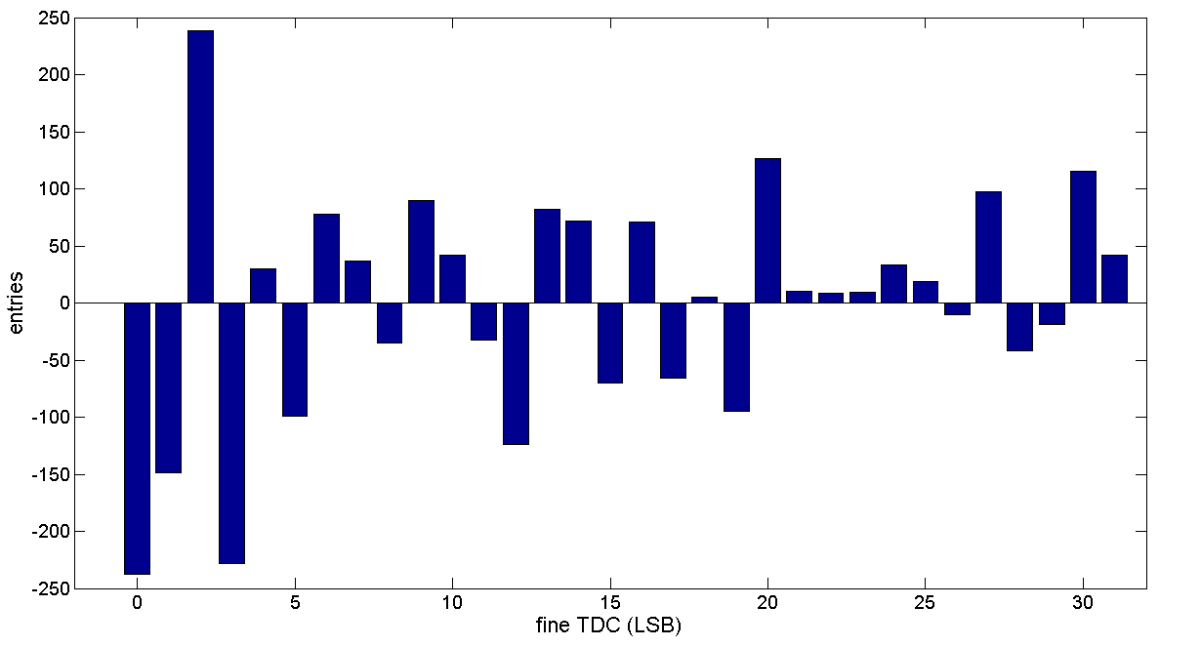
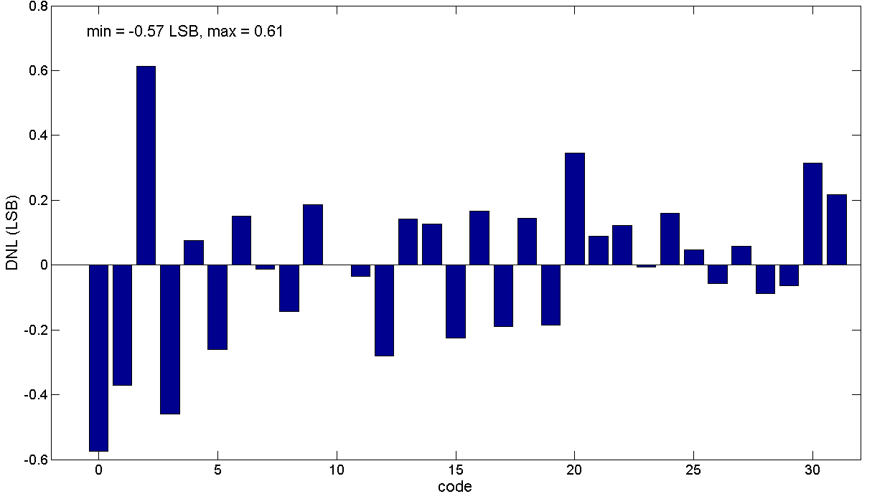
Results prototype: fine TDC performance
Distribution of the fine TDC output values for random dark events
Mean value
    in good agreement with the fine-TDC DNL
      determined by using the test input
      max. DNL error: +0.61/-0.57 LSB

Slide 13
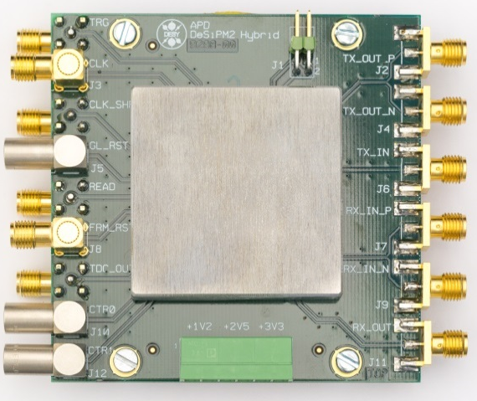
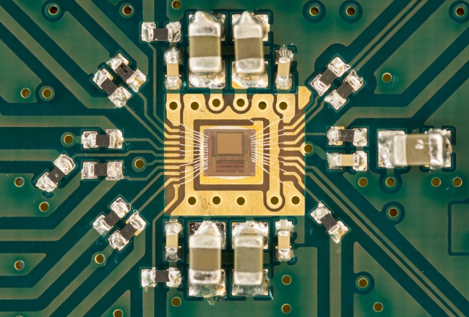
Test setup: ASIC - separate test circuits
additional performance tests
TC testboard
scope
power Supply
DTG
DG
    lab instruments: pattern generator, oscilloscope, data-timing generator, power supply
    1 testboard with 1 ASIC sample
    test of separate circuits:
      1 TDC
      1 LVDS transceiver

Slide 14
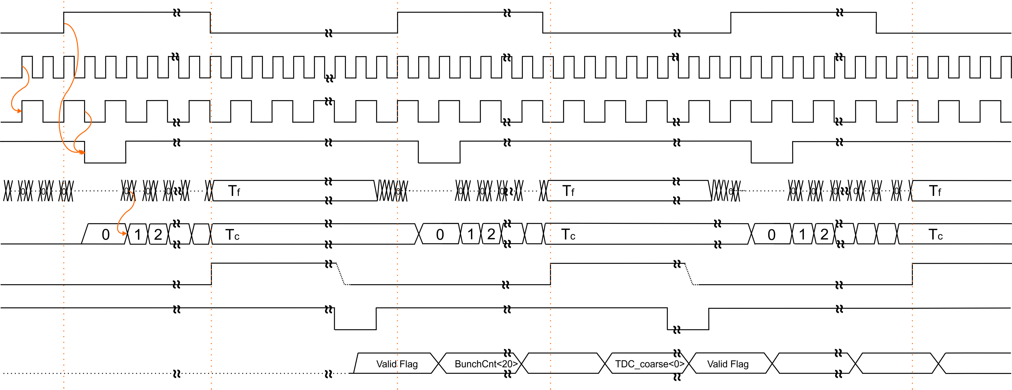
Results test circuits: time-to-digital converter
requirements
3-MHz bunch clock
→ 408-MHz reference clock
timing resolution <90 ps
working principle
delay lock loop (fine TDC)
  32 delay elements
  ~77-ps timing resolution
  32-to-5 bit encoder
ripple counter (coarse TDC)
→ time stamp: 1st hit
5 bit
encoder
reg
reg
reg
reg
7 bit
trigger
ripple counter
latch
latch
latch
latch
clock
D
C
Q
_
Q
D
C
Q
_
Q
D
C
Q
_
Q
32-element diff. delay line V_{control}
phase / frequency detector &
current pump
DLL
bunch clock
reference clock
valid
internal half clock
frame reset
fine TDC
coarse TDC
trigger
read
timing data

Slide 15
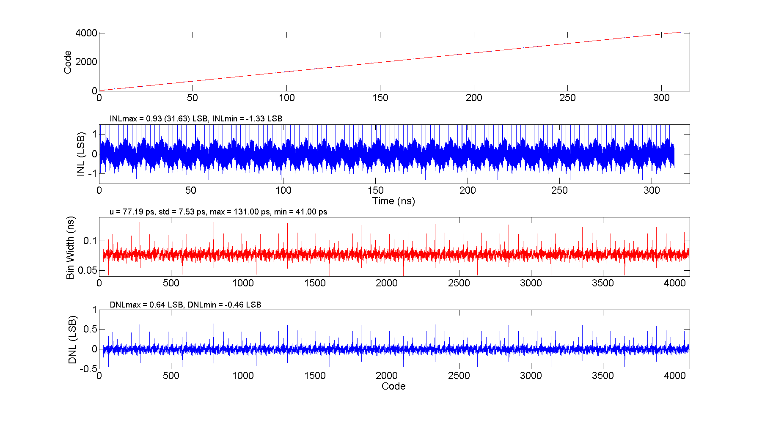
Results test circuits: time-to-digital converter
5 bit
20-ps time conflict
linearity measurement
determination of INL, DNL and bin width
small bug, caused by registers setup/hold-time
→ can be improved by small design change
encoder
reg
reg
reg
reg
7 bit
trigger
ripple counter
latch
latch
latch
latch
clock
D
C
Q
_
Q
D
C
Q
_
Q
D
C
Q
_
Q
32-element diff. delay line V_{control}
phase / frequency detector &
current pump
DLL
coarse-TDC DNL

Slide 16
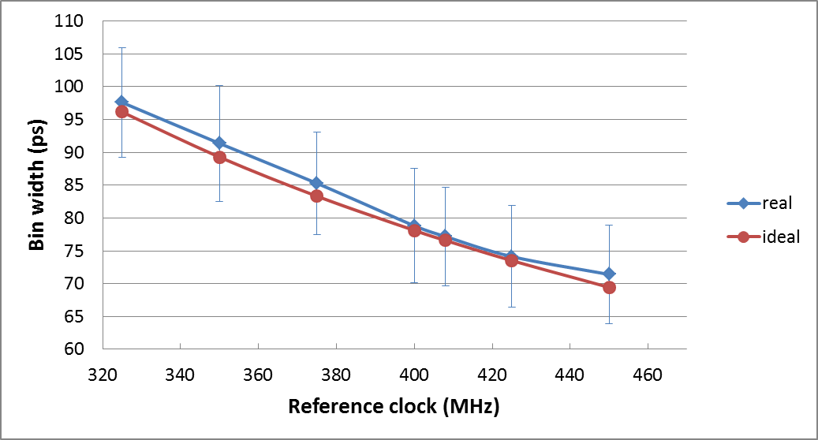
Results test circuits: time-to-digital converter
408-MHz reference clock
    TDC is designed for target frequency 408 MHz
    mean bin width is in good agreement with ideal value
    upper limit ≤450 MHz

Slide 17
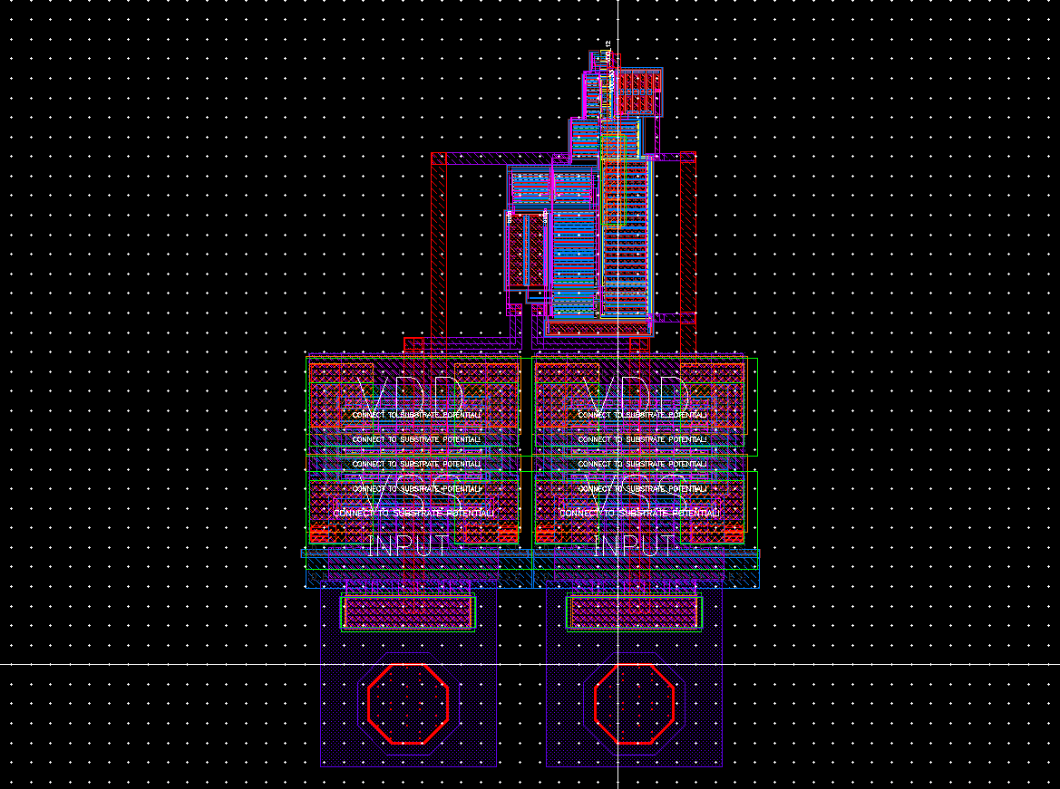
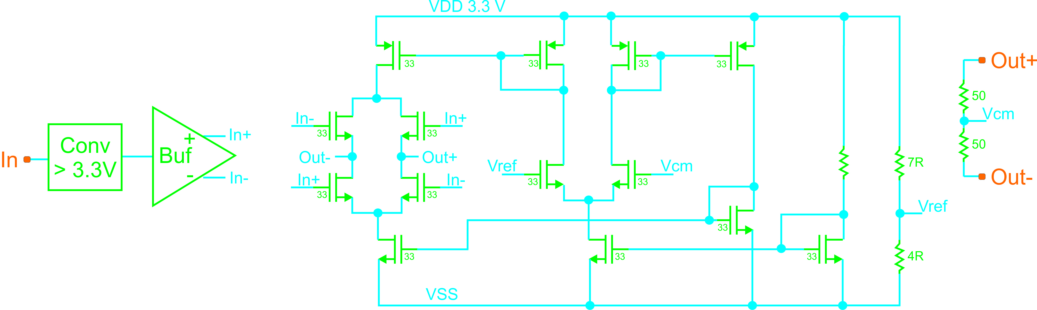
Results test circuits: LVDS transceiver
working principle
voltage conversion
phase splitting
current switching with CMFB
termination R_{T} = 100 Ω on TX and RX
V_{cm} = 1.2 V
transceiver
I_{out}
R_{T-T}
100 Ω
differential probe
    eye-diagram measurements
    determination of bit-error rate (BER)
V-conversion
phase splitting
current switching
CMFB
valid

Slide 18
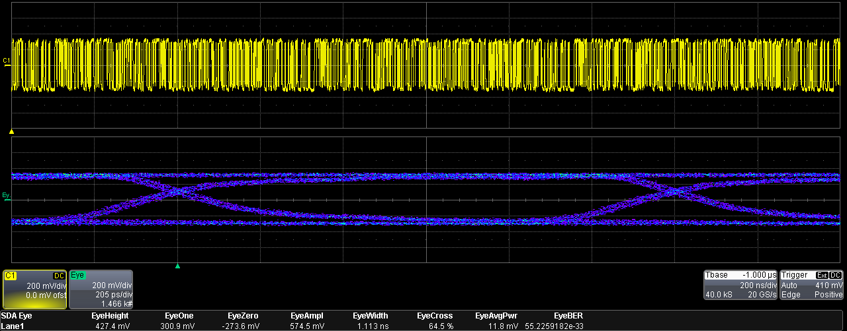
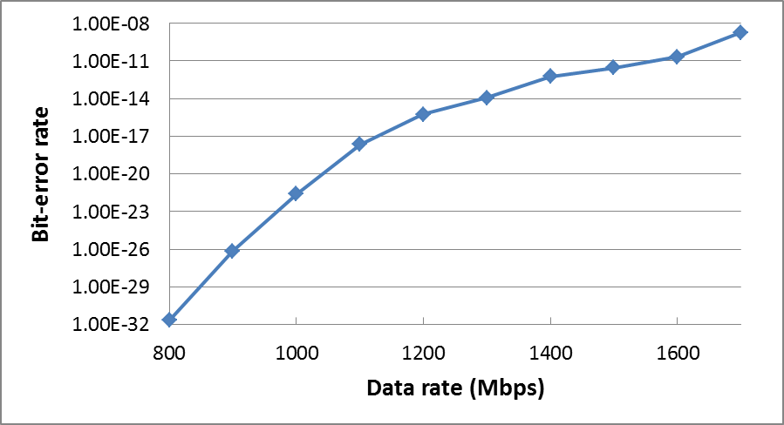
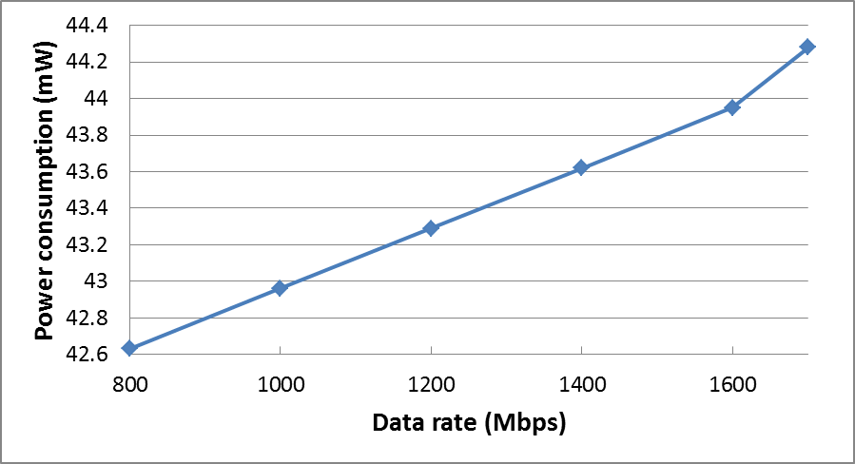
Results test circuits: LVDS transceiver
eye diagram measurements
TX diff. output
816 Mbps

Slide 19
Summary
readout concept and detector system presented
successfully prototype assembly with 30-µm solder spheres at 50-µm pitch
functionality of sensor-ASIC prototype tested
  dark-count rate evaluated versus bias voltage
  hit detection and time stamping of first hit in macro pixel demonstrated at 3-MHz frame rate
  basic performance of validation logic using random dark events
  good agreement of fine-TDC DNL determined by dark image histogram and test input
12-bit TDC fulfills the targeted linearity requirements up to 3.3-MHz frame rate
bit-error rate remains below 10⁻⁹ up to 1.6 Gbps: link reduction by a factor of 2 is possible
next steps:
  test with DAQ system
  test with particles
outlook:
  improve TDC
  sensor with improved dark-count rate
  design transfer into new technology necessary

Slide 20
Thank you!

