Slide 1


Analog Front-ends for Cold Experiments
M. Dabrowski¹,
G. Carini¹, H; Chen¹, A. D’Andragora², Y. Mei¹, S. Li¹,
V. Radeka¹, S. Rescia¹ and E. Vernon¹
Brookhaven National Laboratory, Upton, New York, USA
Fondazione Bruno Kessler, Trento, Italy
FEE-18, May 20, 2018
Contact: mdabrowski@bnl.gov

Slide 2
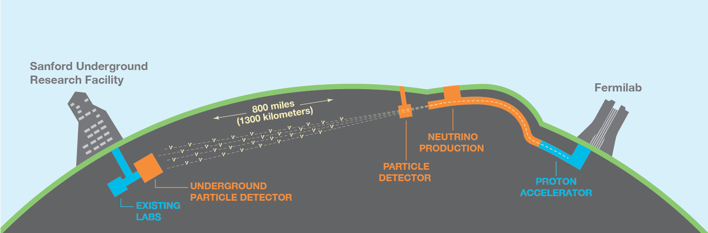
Noble Liquid Time Projection Chamber based experiments
  MicroBoone
  Short Baseline Neutrino Detector (SBND)
  proto-DUNE
  DUNE
  nEXO
  DARK SIDE
Deep Underground Neutrino Experiment
(4x 10kton TPCs, 600k wires)
SOURCE: dunescience.org

Slide 3
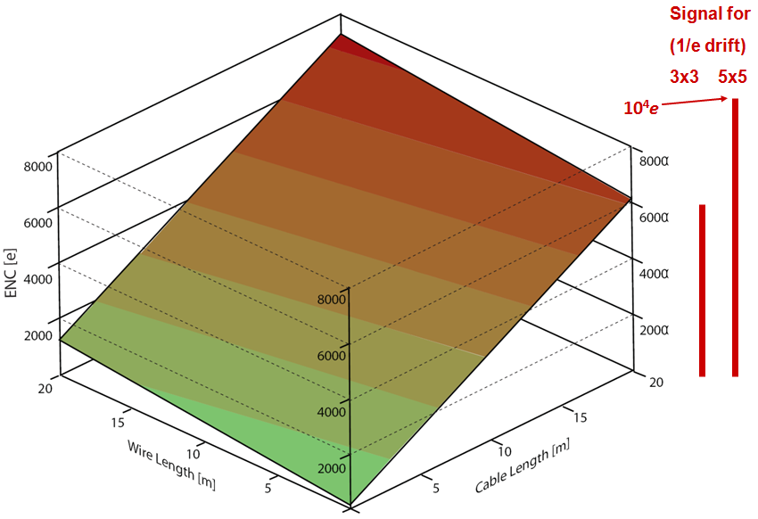
ADVANTAGES OF PLACING ELECTRONICS IN THE CRYOSTAT
ENC vs TPC wire length and feedthrough cable length
DUNE with warm electronics (300K). ENC~6x10^3 e rms
(MIP for 3x3 mm and 5x5 mm spacing)
CMOS at cryo T:
ENC< 10³ e rms
MicroBooNE
ENC~400 e rms
Placing electronics in warm environment yields ENC ~ MIP.

Slide 4
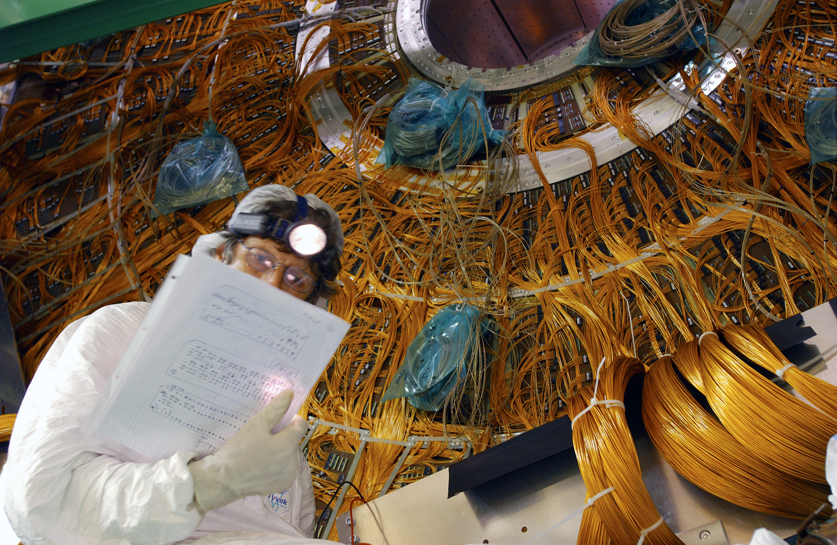
Liquid Argon Calorimeter in the ATLAS Experiment
(200k+ wires)
SOURCE: CERN website - http://cdsweb.cern.ch/record/636674

Slide 5
LIFETIME OF THE ELECTRONICS
Processes that impact the lifetime of CMOS circuits:
  Electromigration
  Stress migration
  Thermal cycling
  Time-dependent dielectric breakdown
  Hot-Carrier Effect
First four are thermally activated processes (exponential dependence on temperature) and become negligible at cold temperatures.
The process that impacts the lifetime at cold is ONLY Hot-Carrier Effect.
One can perform accelerated lifetime tests on devices to understand the impact of this effect.

Slide 6
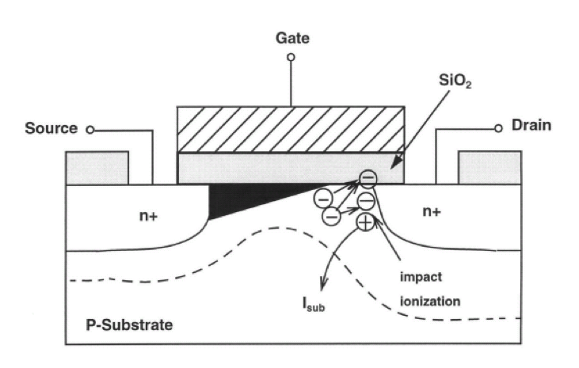
LIFETIME OF THE ELECTRONICS
- HOT CARRIER EFFECT
Hot-Carried Effect deteriorates the performance of devices by creating interface states or trapping charge in the dielectric.
Some hot electrons exceed the energy required to create an electron-hole pair, resulting in impact ionization. Electrons proceed to the drain. The holes drift to the substrate yielding substrate current.
A very small fraction of hot electrons exceeds the energy required to create an interface state at the Si-SiO₂ interface: 3.7eV for electrons, ~4.6eV for holes.
Hot Carrier Effect primarily affects performance of NMOS transistors.
Electric field is the strongest
near the drain

Slide 7
LIFETIME (AGING) OF THE ELECTRONICS
LIFETIME*CURRENT DENSITY vs 1/V_{DS}
EXTRACTED FROM THE STRESS MEASUREMENTS
For NMOS:
L=180nm,
W=10um;
It was found for 180nm, 130nm and 65nm technologies that reducing the V_{DS} at cryogenic temperature by ~6% makes the lifetime equal to that at 300K (x10 improvement).
Increasing the device length (thus decreasing electric field) also increases the lifetime.

Slide 8
PARAMERTERS OF CMOS TRANSISTORS AT CRYOGENIC TEMPERATURE
INPUT-REFERRED NOISE PSD @300K
INPUT-REFERRED NOISE PSD @77K
White thermal noise reduced by a factor of two.
1/f noise of the PMOS reduced by a factor of two.
Using a PMOS as an input device yields much lower noise.

Slide 9
PARAMERTERS OF CMOS TRANSISTORS AT CRYOGENIC TEMPERATURE
I_{D} vs V_{GS}
TRANSCONDUCTANCE vs CURRENT DENSITY
At cryogenic temperature, charge carrier mobility in silicon increases thus g_{m} increases and thermal fluctuations decrease, resulting in a higher gain and lower electronic noise.

Slide 10
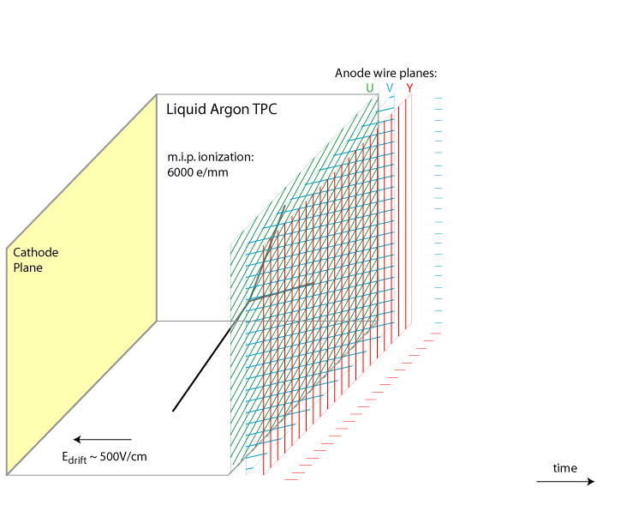
LIQUID ARGON TIME PROJECTION CHAMBER
LAr TPC allows full 3D track reconstruction and it comprises three planes of sense wires:
- two induction planes (U, V)
- one collection plane (Y)
Sense wires up to 10m long; 35k wires/kton;

Slide 11
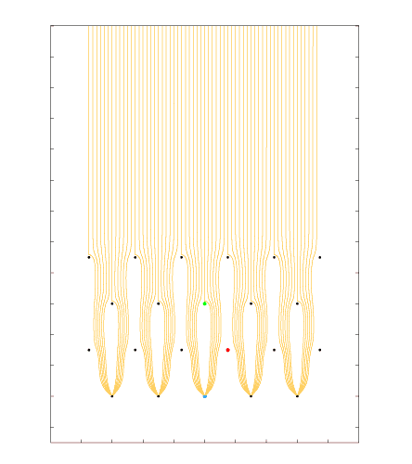
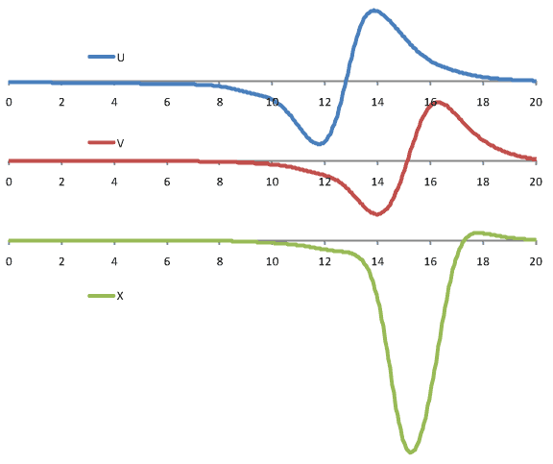
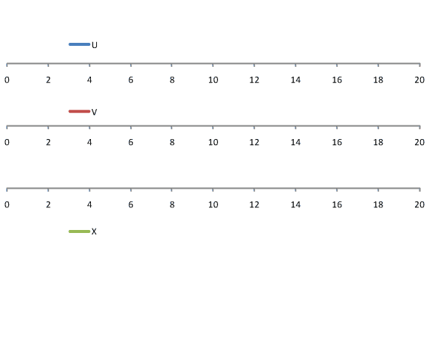
(drift velocity ~ 1.6 mm/µs)
LIQUID ARGON TIME PROJECTION CHAMBER
- SIGNAL FORMATION
[µs]
DUNE style wire arrangement: 3 instrumented wire planes + 1 grid plane;
Raw current waveforms convolved with a 0.5 µs gaussian (~1/2 drift length) to mimic diffusion.

Slide 12
(drift velocity ~ 1.6 mm/µs)
LIQUID ARGON TIME PROJECTION CHAMBER
- SIGNAL FORMATION
INDUCTION
INDUCTION
COLLECTION
[µs]
DUNE style wire arrangement: 3 instrumented wire planes + 1 grid plane;
Raw current waveforms convolved with a 0.5 µs gaussian (~1/2 drift length) to mimic diffusion.

Slide 13
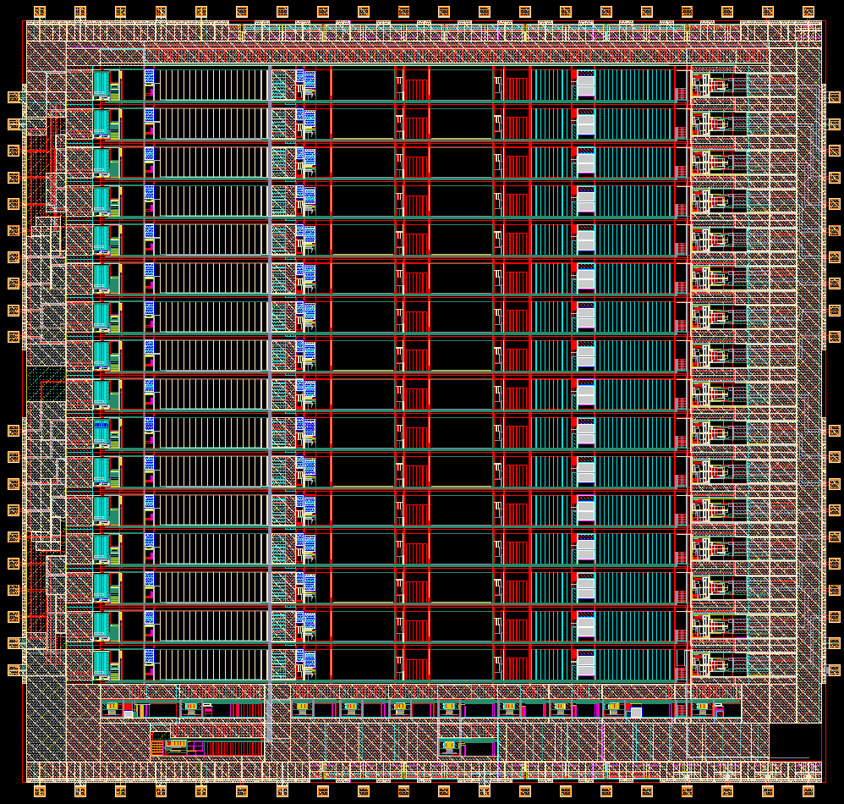
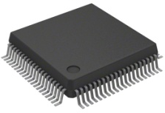

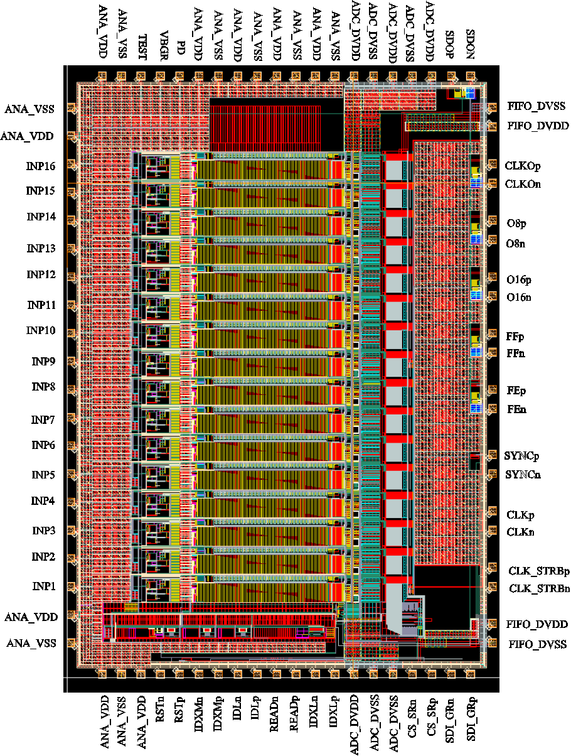
FRONT-END ASIC IN EXPERIMENTS
DIGITAL LINKS
DAQ
MicroBooNE
FE ASIC
COTS ADC
FPGA
DIGITAL LINKS
DAQ
proto-DUNE
FE ASIC
ADC
FPGA
DIGITAL LINKS
SBND
DAQ
FE ASIC
COTS ADC
FPGA
DIGITAL LINKS
DUNE
DAQ
FE ASIC
CUSTOM/COTS
ADC
COLD DATA
ASIC
88K
300K

Slide 14
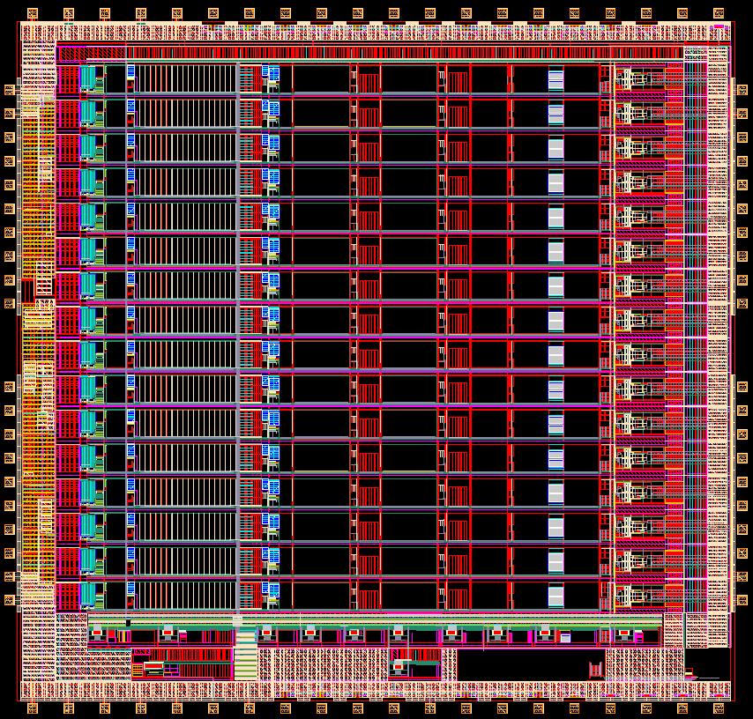
THE FRONT-END ASIC
LARASIC
180 nm technology, 1.8 V
16 channels with resolution of 12 bits with programmable gain and filter time constant.
Selectable collection/non-collection mode.
Selectable dc/ac coupling (100µs).
build in pulse generator with 6-bit DAC.
build in analog monitoring output.
Total power consumption: <100 mw.
5.7 mm
6 mm
Recently, we have submitted a new version of the chip.

Slide 15
THE FRONT-END CHANNEL
FULL FRONT-END CHANNEL*
x 2
x 2
Pul.
Gen.
STRONG
DRIVER
DUAL STAGE CHARGE AMPLIFIER
5TH ORDER SEMI-GAUSSIAN SHAPER
AC/DC
Power consumption: 5.5 mW (3.9mw in the input transistor, R_{EQ}=15 Ohm)
Programmable gain: 4.7, 7.8, 14 and 25 [mV/fC] (55, 100, 180, 300 [fC] ranges).
Programmable peaking time: 0.5, 1, 2, 3 us
Selectable: collection/non-colledtion mode; AC/DC coupling; high/low driving strength.
* This figure doesn’t show the exact architecture. More detailed schematics are provided in the next slides.

Slide 16
THE CHARGE AMPLIFIER
DUAL STAGE CHARGE AMPLIFICATION STAGE
x 20
x 20
x 3, 5, 9, 16
CHARGE IN
CHARGE OUT
x 3, 5, 9, 16
1st stage.
Fixed charge gain of 20
2nd stage.
Variable charge gain (1-16)
The preamplifier provides an amplified replica of the input charge (limited by the bandwidth of the amplifier).
Gain of the first stage is fixed to 20.
Charge gain adjustment in the second stage (3 - 16).

Slide 17
THE SHAPER
5th ORDER SEMI-GAUSSIAN SHAPER
x 2
1st pole
Two pairs of complex conjugate poles
The theoretical optimum signal processing weighting function is triangle.
However, 5th order semi-gaussian shaper yields ENC within 10% of the triangular one.

Slide 18
MEASURED NOISE OF THE LAr ASIC
MEASUREMENTS OF ENC vs T_{P}
Measurements prove a clear advantage of placing the electronics in cold temperature.
  White thermal noise (dominant at short T_{P}) reduced by a factor of two.
  1/f noise of the PMOS (limiting the resolution) is also lower.

Slide 19
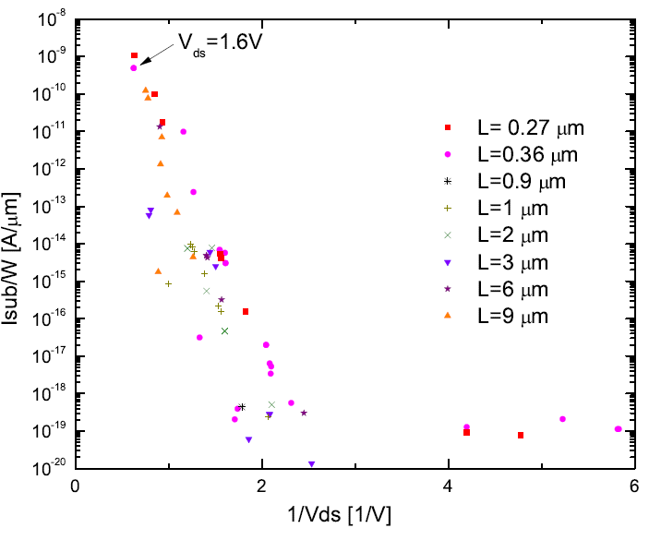
LIFETIME OF TRANSISTORS IN THE FRONT-END ASIC
LIFETIME OF MORE THAN 10k years
1 [V]
In the front-end ASIC, all transistors operate well below nominal voltage (which is 1.8V) and are longer than the minimum length (180nm).

Slide 20
THE FRONT-END CHANNEL – NEXT VERSIONS
VERSION 7 OF THE FRONT-END CHANNEL
x 2
v7
x 2
Pul.
Gen.
v8
DUAL STAGE CHARGE AMPLIFIER
5TH ORDER SEMI-GAUSSIAN SHAPER
AC/DC
SDC
Version 7 (recently submitted): DC biasing scheme was modified (top current source removed)
Version 8 (under design): includes single-to-differential conversion block – fully differential output

Slide 21
ADC IN THE FRONT-END CHAIN
High performance ADC operating at cryogenic temperature is an essential element of the front-end chain.
A custom current-mode domino architecture ADC has been developed, however it didn’t fulfill requirements imposed by the experiment.
Currently, there are three separate efforts:
- characterization of Commercial off-the-shelf components
- all of them based on SAR architecture
- development of Pipeline ADC
- common effort between BNL, LBNL and Fermilab
- development of SAR ADC by BNL (Yuan Mei’s talk)
CUSTOM ADC

Slide 22
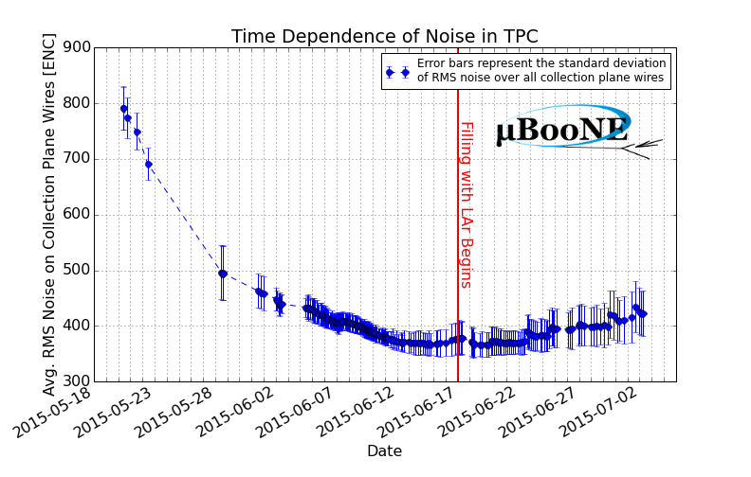
COLD ELECTRONICS IN MICROBOONE
MicrobooNE: 80 tons of LAr; 8.3k senses wires. Cool with gaseous argon, then fill
with liquid argon.
DESIGN VALUE
GAS COOLDOWN
LAr filling
ENC ~400 e- has improved the SNR by more than factor of 3 compared to previous large scale LArTPC experiments, which used room temp. electronics.
ENC decreases as the TPC is cooled with argon gas; then increases in LAr due to dielectric constant of LAr (ϵ’=1.5).

Slide 23
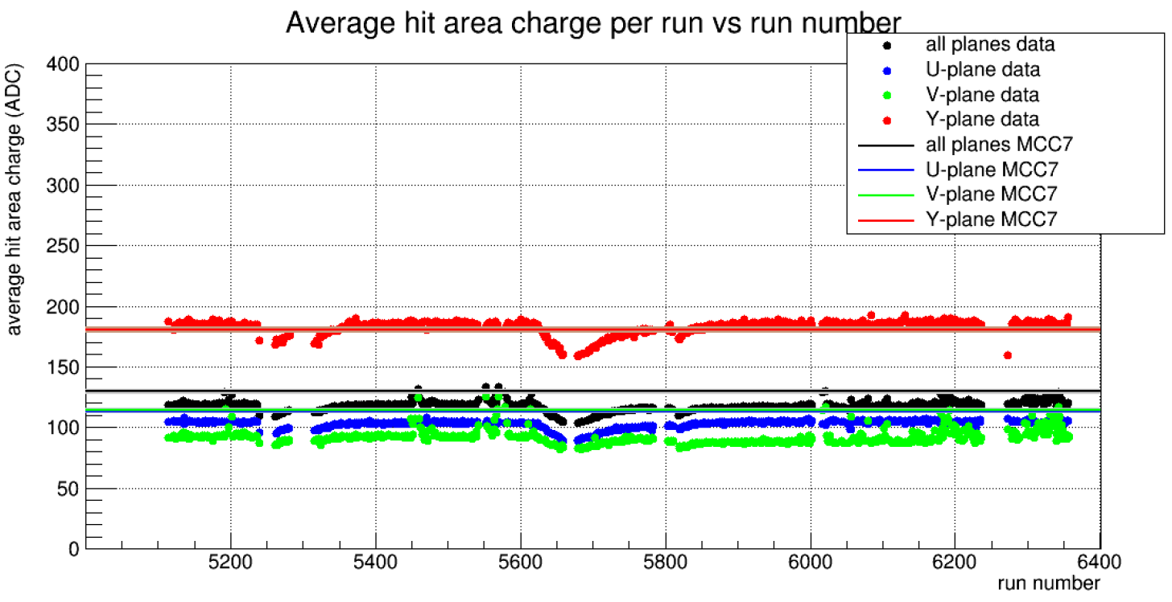
COLD ELECTRONICS IN MICROBOONE
MicroBooNE long term stability of average MIP response
(incl. argon purity variations)
Front-end ASICs in LAr for over 2 years: <0.2% gain variation

Slide 24
COLD ELECTRONICS IN MICROBOONE
MicroBooNE long term stability of average MIP response
(incl. argon purity variations)
ARGON PURITY VARIATIONS
Front-end ASICs in LAr for over 2 years: <0.2% gain variation

Slide 25
CONCLUSION
Noble liquid based Time Projection Chambers are high resolution imaging detectors ideal for neutrino studies.
Electronics placed inside the cryostat gives much better SNR as well as allows a design of “Giant” TPCs (DUNE 4x 10kton modules).
Aging of electronics at cold temperatures has been studied and is relatively well understood. If the circuits are carefully designed (longer transistors, lower V_{DS}) one can ensure the same device lifetime achieved for room temperatures.
Over the years, BNL has developed a series of low-noise, high-resolution front-end ASICS that are being successfully used in cold experiments.
New versions of the Front-end ASIC are still being developed that expand its functionality.

Slide 26
REFERENCES
V. Radeka, H. Chen, G. Deptuch, G. De Geronimo, F. Lanni, S. Li, N. Nambiar, S. Rescia, C. Thorn, R. Yarema, and B. Yu, “Cold electronics for “giant” liquid argon time projection chambers”. 1st International Workshop towards the Giant Liquid Argon Charge Imaging Experiment, volume 308 of Journal of Physics: Conference Series, 2011.
G. De Geronimo, A. D’Andragora, S. Li, N. Nambiar, S. Rescia, E. Vernon, H. Chen, F. Lanni, D. Makowiecki, V. Radeka, C. Thorn, and B. Yu, “Front-end ASIC for a liquid argon TPC,” IEEE Trans. Nuclear Science, vol. 58, no. 3, pp. 1376-1385, June 2011.
HOT CARRIER EFFECT:
S. Li, J. Ma, G. De Geronimo, H. Chen, and V. Radeka, “LAr TPC electronics CMOS lifetime at 300 K and 77 K and reliability under thermal cycling,” IEEE Trans. Nuclear Science, vol. 60, no. 6, pp. 4737-4743, Dec. 2013.
Jie Ma, "Hot Carrier Study of MOSFET at 300K and 77K", Ph.D. Dissertation, Stony Brook University, Stony Brook, NY, USA, 2015
J. R. Hoff, R. Aroar, J. D. Cressler, G. W. Deptuch, P. Gui, N. E. Lourenco, G. Wu, and R. J. Yarema, “Lifetime studies of 130 nm nMOS transisors intended for long-duration, cryogenic high-energy physics experiments,” IEEE Trans. Nuclear Science, vol. 59, no. 4, pp. 1757-1766, Aug. 2012.
S. A. Kim, "Hot Carrier Reliability of MOSFETs at Room and Cryogenic Temperature", Ph.D. Dissertation, MIT, Cambridge, MA, USA, 1999
K. K. Ng and G. W. Taylor, “Effects of hot-carrier trapping in n- and p-channel MOSFET’s”, IEEE Tran. Electron Devices, vol. ed-30, no. 8, pp. 871-876, Aug. 1983.
C. Hu, S. C. Tam, F.-C. Hsu, P.-K. Ko, T.-Y. Chan, and K. W. Terrill, “Hot-electron-induced MOSFET degradation-model, monitor, and improvement”, IEEE Journal of Solid-State Circuits, vol. sc-20, no. 1, pp. 295-305, Feb. 1985.
T. Chen, C. Zhu, L. Najafizadeh, B. Jun, A. Ahmed, R. Diestelhorst, G. Espinel, and J. D. Cressler, “CMOS reliability issues for emerging cryogenic Lunar electronics applications,” Solid-State Electronics, vol. 50, pp. 959-963, 2006.
V.-H. Chan and J. E. Chung, “Two-stage hot-carrier degradation and its impact on submicron LDD NMOSFET lifetime prediction”, IEEE Tran. Electron Devices, vol. 42, no. 5, pp. 957-962, May 1995.
P. K. Hurley, E. Sheehan, S. Moran, and A. Mathewson, “The impact of oxide degradation on the low frequency (1/f) noise behavior of p channel MOSFETs”, Microelectronics Reliability, vol. 36, no. 11/12, pp. 1679-1682, laar, “Hot-Ca1996.
R. Brederlow, W. Weber, D. Schmitt-Landsiedel, and R.Thewes, "Hot-carrier degradation of the low-frequency noise in MOS transistors under analog and RF operating conditions“, IEEE Transactions on Electron Devices, vol.49, no.9, pp.1588,1596, Sep 2002

