Slide 1
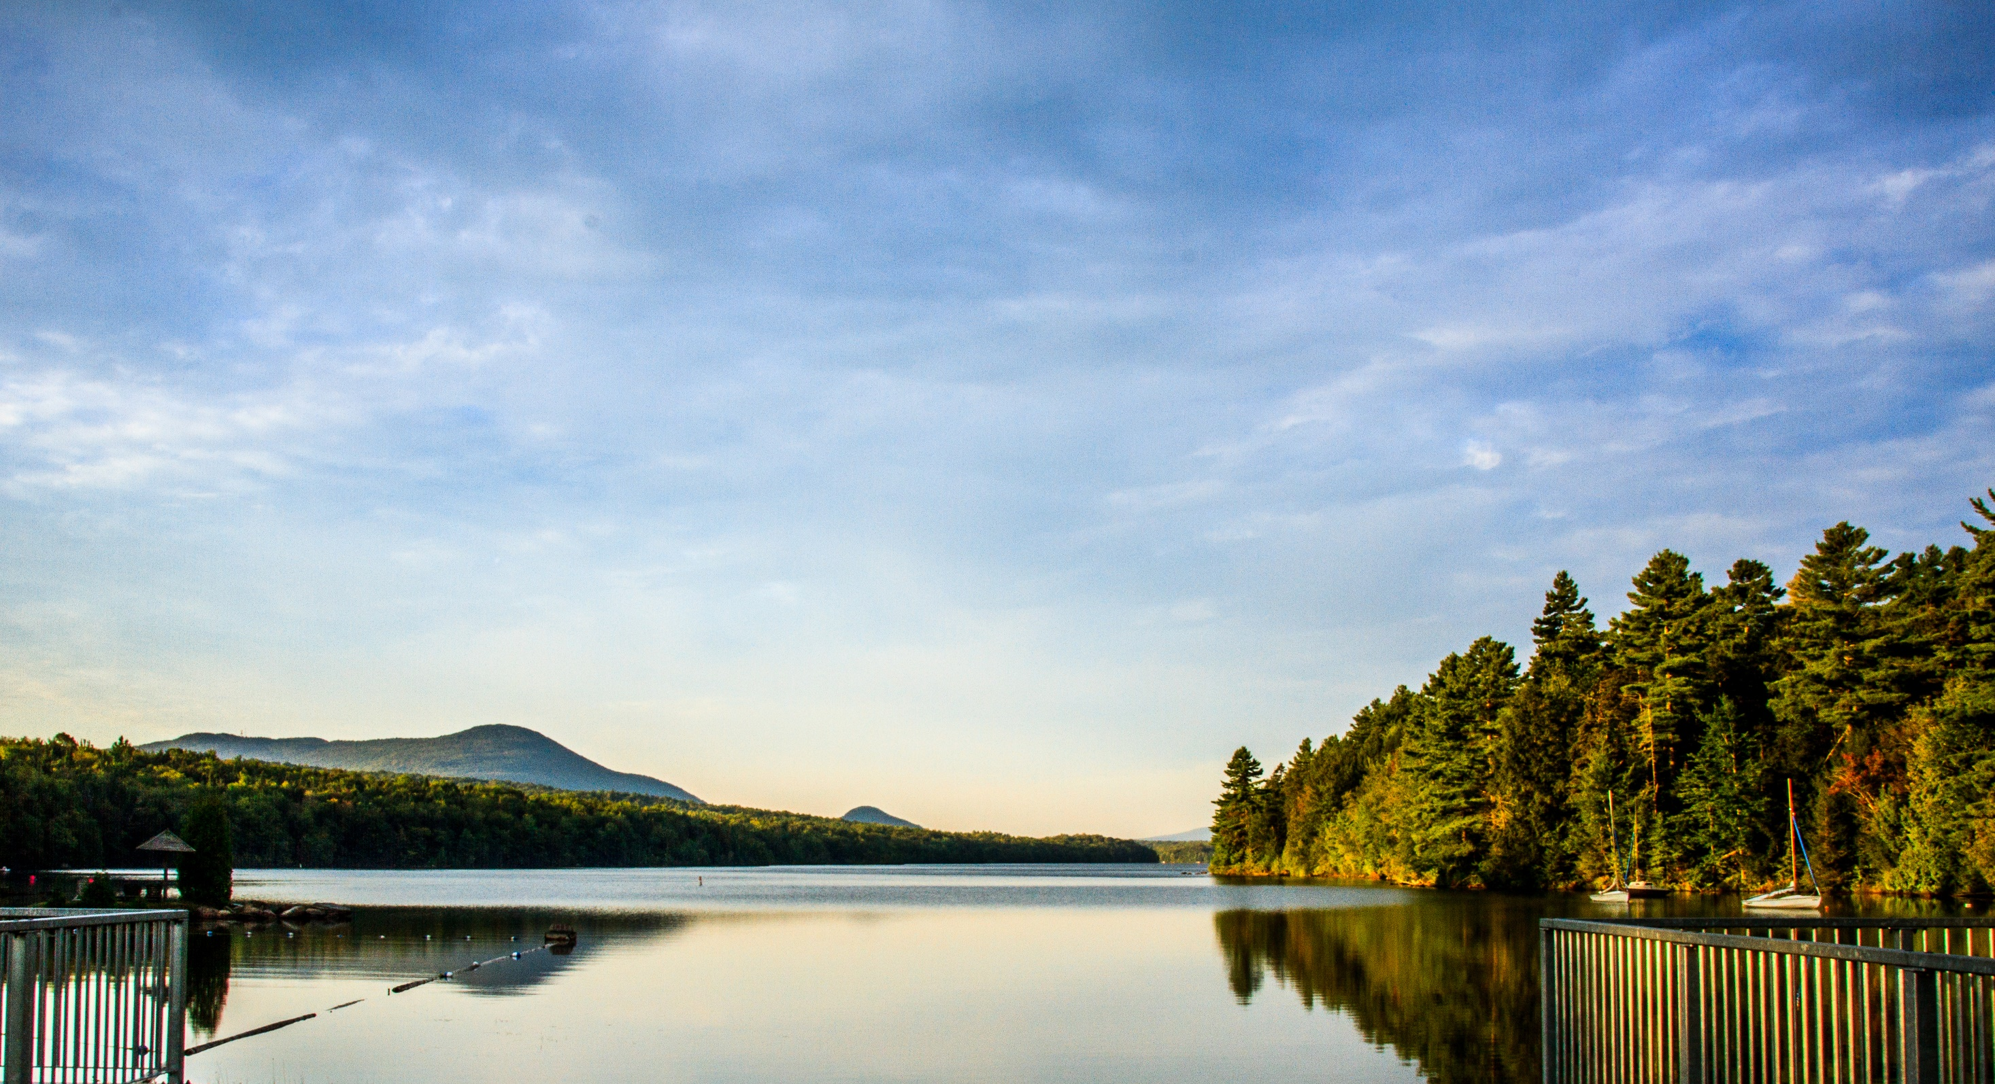
Bonjour et bienvenue au
11th Front-End Electronics Workshop

Slide 2
Monday
Group picture before lunch break. Follow the graduate students.
Dinner – Méchoui: Meat cooked over fire pit. Go have a look at the afternoon break.
Bonfire started at 20h around the yellow cabins.

Slide 3
Tuesday
Invited talk: Sam Fok
  “CMOS Neuromorphic System Communication: 30 Years of Evolution”
Beer and food pairing starts at 17h in dinning room.
  Finger food for vegetarian available

Slide 4
Wednesday
International and Organizing Committees meeting:
  Lunch time
  Room « La Rotonde » (right hand side of dining room – water front)

Slide 5
Thursday
Special session on interposer
  Round table format
  You can upload a few slides or send them to:
    Serge.Charlebois@usherbrooke.ca
Goal: Open discussion on specifications, actual solutions and development directions
  collaboration

Slide 6
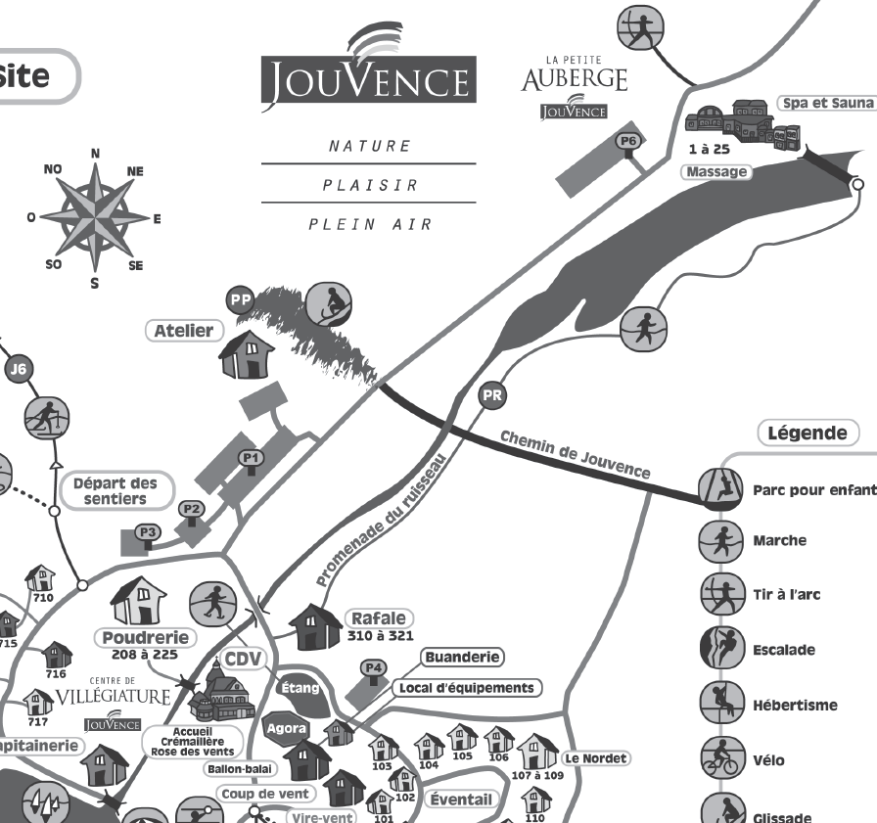
Thursday – Boat excursion
Be at parking P1 for 17h40 sharp
For the return, look for “Sevigny” buses.
BUS

Slide 7
General information
Coffee ready at 6h30, breakfast at 7h.
Water and coffee available at the back of the room.
Coffee break in the dinning room.
Lunch box available (example to go to the airport on Friday,…).
  Need to be requested 24h ahead at Jouvence’s registration

Slide 8
General information
Upload your talk on Indico

Slide 9
Available activities
Canoe
Pedal boat
Obstacle course in the forest (opposite side of the bridge)
Fat bike (15$/2h)
Jacuzzi – reservation mandatory at Jouvence registration desk.
  Northern spa:
    Sauna
    River ;-)
    Jacuzzi

Slide 10
Available activities
Volleyball
Basquetball
Playroom in the CountryInn (Auberge)
Bonfire in many areas available.
Relaxing with the lake view…

Slide 11


Merci!
11th Front-End Electronics Workshop
Organized by

