Slide 1
Achromatic Telescopic Squeezing (ATS) scheme: principle, by-products and experience with beams
S. Fartoukh (BE/ABP)
Chamonix Talk outlines, TCC, 21/12/2017

Slide 2
Content
Recap: ATS principle, by-products and MD’s in Run I
ATS MD’s in 2016/2017 (round & flat optics)
2017 ATS LHC optics: Check-up after one operational year (2017 vs. 2016)
ATS driven limitations for future LHC operation

Slide 3
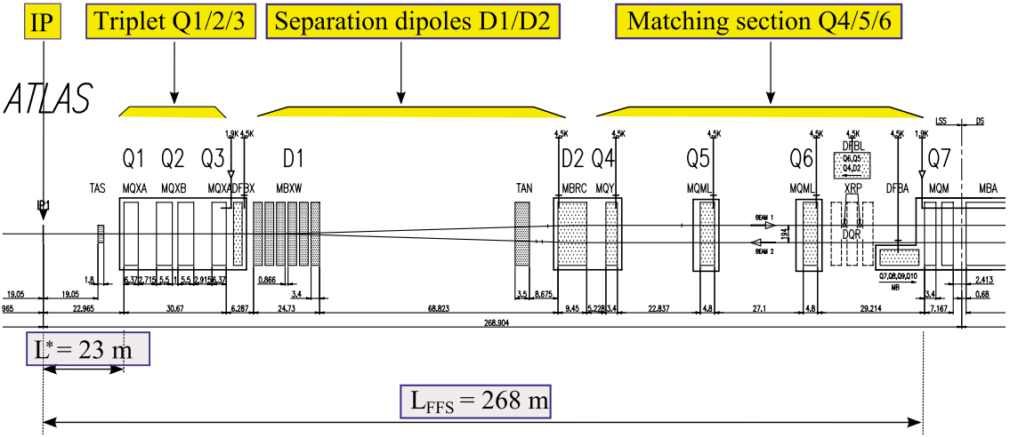
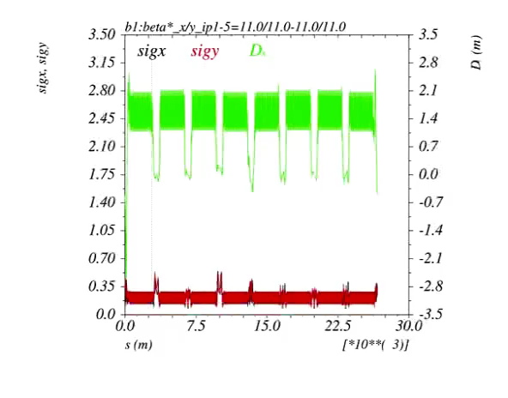
Recap: ATS principle, by products, MDs in Run I
The ATS scheme is the most cost-effective, if not the only way, to reach the targeted HL-LHC β* of 10-15 cm
→ Why: To be focused at the IP, the beam must first be widely expanded in the triplet, something intrinsically limited by the finite length of the matching section
→ How: a squeeze in two steps
1. An “almost” standard squeeze, the Pre-squeeze:
acting on the matching quads of IR1 and IR5 with new
matching constraints on the left/right IR phase,
→ till reaching some limits on matching quads (or sextupoles)
2. A further reduction of β*, the Tele-Squeeze:
→ acting only IR2/8 for squeezing IR1 and IR4/6 for IR5,
→ inducing β-beating bumps in s81/12/45/56 to boost the sextupole efficiency, but also the octupoles (see later).
Beam size [mm] @ 7 teV (γε=3 μm)
IP4
IP5
IP6
IP8
IP1
IP2

Slide 4
Recap: ATS principle, by products, MDs in Run I
By-products coming from the (controlled) β-beating induced in the IR1/5 adjacent arcs, and from the phasing of these arcs w.r.t the triplet
  Q’ correction at constant sextupole strength: β_{MS} 1/β*
  → no β∗ limits from Q’ correct-ability
  Very clean compensation of chromatic aberrations, such as off-momentum β- beating, non-linear chromaticity, spurious dispersion from crossing angle
    → preservation of off-momentum triplet aperture, IR7 hierarchy preservation over the RF bucket (no degradation of TCP/TCS retraction), control of chromatic tune spread (Q”, Q’’’,..), other exotic effects avoided like strong pacman effect on Q’
  Lattice octupoles boosted at constant strength: ΔQ_{spread}  (β_{MO})² 1/β^{*2}
    → More Landau damping to cope with impedance/intensity increase,
    → Using the octupoles in SB for BBLR mitigation → X-angle reach

Slide 5
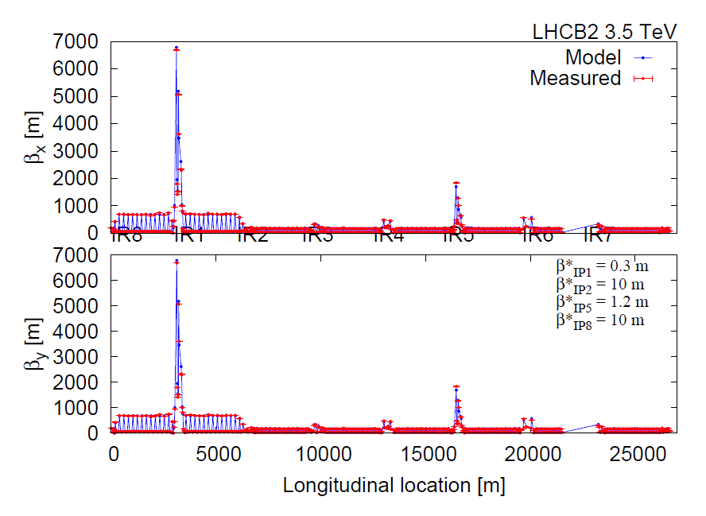
First demonstration with beam in 2011 (.. already with 30 cm β* !)
→ Telescopic principle (×4) demonstrated in IR1
Thanks to G. Vanbavinckhove & OMC team

Slide 6
Highlights from ATS MD’s in 2016/2017
ATS MD’s in Run I (2011-12) demonstrated the basics,
down to 10 cm β* (in non-operational machine conditions, e.g. w/o X-angle) with
(i) low intensity beams and
(ii) not always with state of the art optics correction
ATS MD’s in Run II (2016-17-..18) developed a new version of the ATS optics (optimized for machine protection aspects) on 3 fronts
Round telescopic optics with pushed pre-squeezed β* (40 cm), limiting the high intensity tests to “small” tele-index
→ for LHC (r_{tele} ~ 4/3 @ β* ~ 30 cm)
2. Round telescopic optics with larger pre-squeezed β* (1 m),
enabling high intensity tests @ large tele-index
→ for (HL-)LHC (r_{tele}~ 3 @ β* ~ 30 cm)
3. Flat optics (just started) → for (HL-)LHC

Slide 7
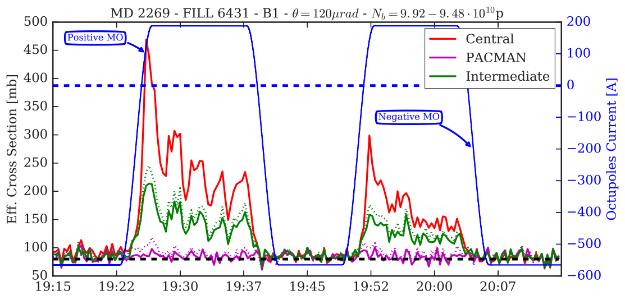
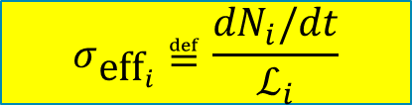
Tele index of 3 @ β*=35 cm (tele-squeeze from 1 m)
→ First demonstration of BBLR mitigation with octupole (MO)
$$σ_{{\text{eff}}_{i}}≝\frac{{dN}_{i}/dt}{ℒ_{i}}$$
Courtesy of A. Poyet, G. Sterbini, and Beam-Beam team

Slide 8
2017 ATS LHC Optics vs. 2016: check-up after 1 year
Optics correct-ability: as excellent as before
Collimation: even improved (not due to the ATS but to the tighter collimator settings)
Luminosity Life time: qualitatively very similar (even slightly improved)
Integrated Performance .. we know: of course not only the 30 cm helped, but at least the ATS did not degrade !
Also take into a account the many other changes:
  New beam types from injector in 2017 (8b4e, 8b4e BCS)
  X-angle change (150 mrad in 2017 vs. 185/140 mrad in 2016)
  X-angle anti-levelling in 2017 with ≥ 4 steps (150/140/130/120)
  Lumi Levelling with parallel separation

Slide 9
Limitations for future operation and mitigation
Operation at 7.0 TeV: magnet strength limitations
  → None except some RSD circuits @600A++ and Q5.L6
Target currents (w/o margin) for various cases | LHC: round optics (20 cm) Telescope (x2Hx2V) | HL-LHC: round optics with Telescope (x4Hx4V) | LHC: Flat optics (15/60 cm) Telescope (x3-4Hx1V) | HL-LHC Flat optics with Telescope (x5Hx2V)
Q5.L6b1 | < 3610 A | ~ 3800 A | ~3700-3800 A | ~ 3900 A
Q5.L6b2 | < 3610 A | ~ 3700 A | <3610 A | ~ 3700 A
  Various options, HW tests requested asap to take decisions
Operation with LIU beam and large telescope
→ The β’s are moving in IR6 (@TCDQ) during the tele-squeeze,
→The TCDQ gap is limited to 3.6 mm (or larger) at full bunch intensity
→ A definite cure exists (on paper) via
    (i) an upgrade of the BETS to enable TCDQ movement at flat top (in SB)
    (ii) a running scenario with combined β* - TCDQ (& TCT) levelling

