Slide 1

Digesting the LIU high brightness beam: is this an issue for HL-LHC?
Asked to cover:
  Beam stability
  Electron cloud effects
  Emittance preservation
Here most of the messages and material, I still need to:
  Organize
  Compress
  Remove “technicalities”
  Acknowledge!

Slide 2
Beam stability
[Introductory slide with overview of the work done and some references]
Main points reported in the following…

Slide 3
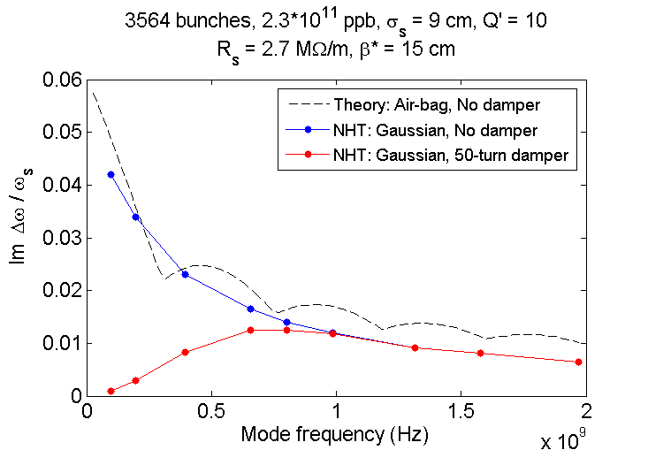
Coupled bunch instabilities
Presently driven mainly by resistive-wall impedance
The beam is stabilized using the transverse damper → no problem expected for HL-LHC (there is room to increase damper gain)
Crab cavity High Order Modes (large beta) identified as additional source for CB instabilities and damper ineffective for high frequency HOM
  Impedance carefully optimized by the design team in collaboration with the impedance team
Growth rate of the most critical CB mode
1 HOM, Q’ = 10, d = 100 turns
Picture illustrating
HOM optimization
CC HOMs
Growth rate (arb. un.)

Slide 4
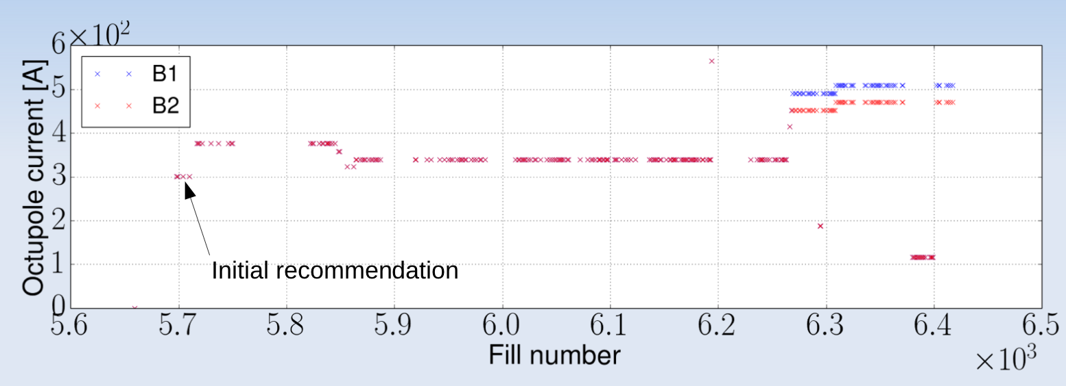
Impedance-driven head-tail instabilities
Part of today’s LHC life:
  Single-bunch (head-tail) instabilities controlled by damper and a large enough tune spread (Landau damping) relying on:
    Octupole magnets in the arcs
    Beam-beam effects (when in collision)
  Octupole current required to operate reliably (i.e. also in real-life non ideal conditions) is significantly larger than expected from model
    we should keep these margins!
Main instability source is the impedance from collimators:
  Impedance reduction is part of the HL-LHC baseline
Octupole currents at 6.5 TeV during the 2017 run
Maximum current for octupole circuits
BCS beams
Requirement from model

Slide 5
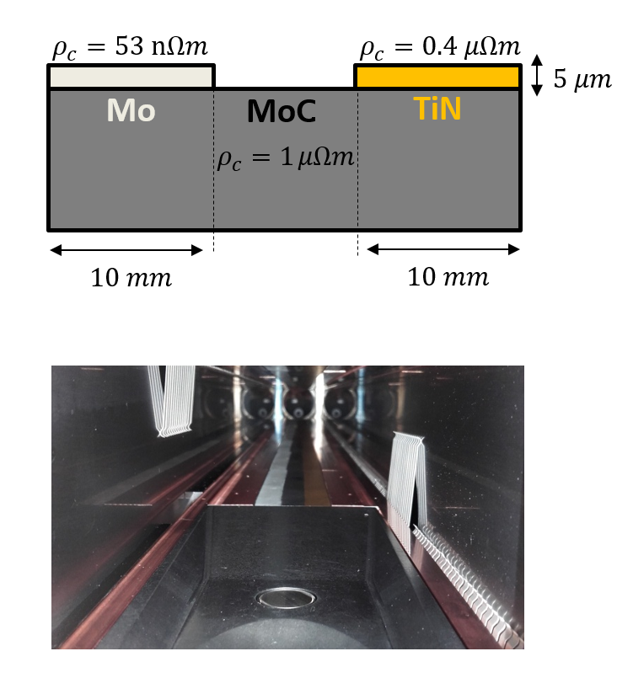
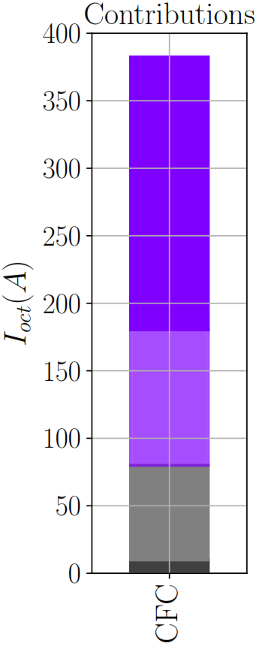
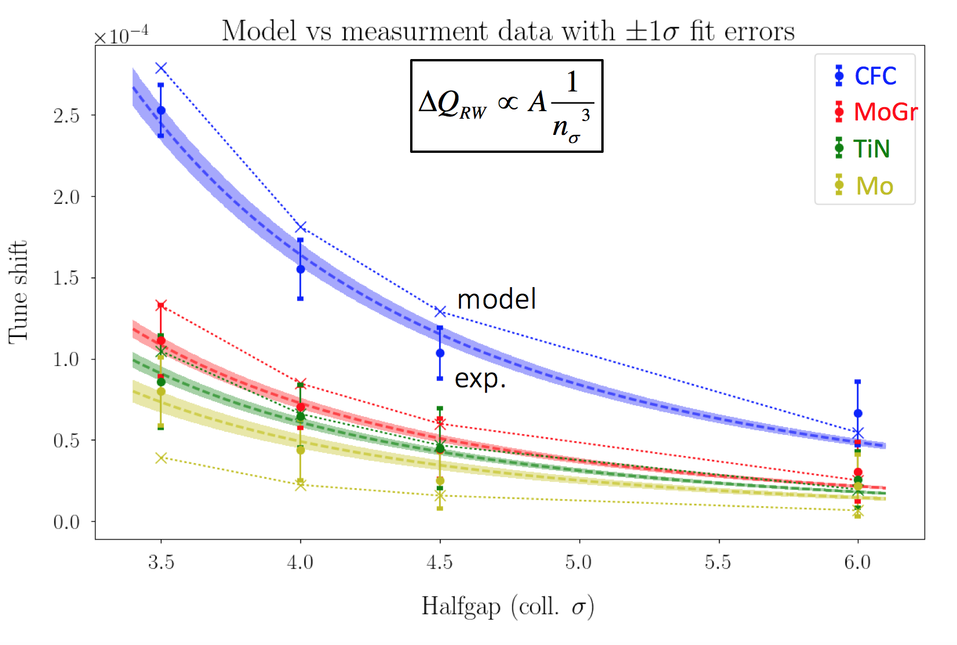
Low impedance collimators
Impedance reduction for the collimators is part of the LHC baseline
11 secondaries in IR-7 - 200 A
4 primaries - 100 A
All other collimators - 70 A
Everything else - < 10 A
Low impedance design confirmed experimentally by prototype installed in the LHC in 2017

Slide 6
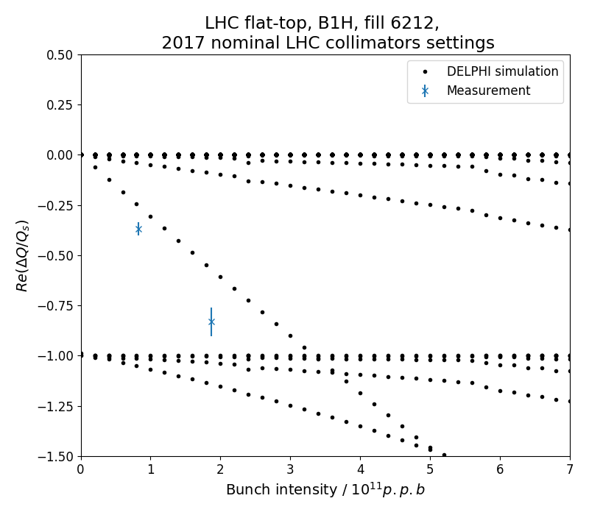
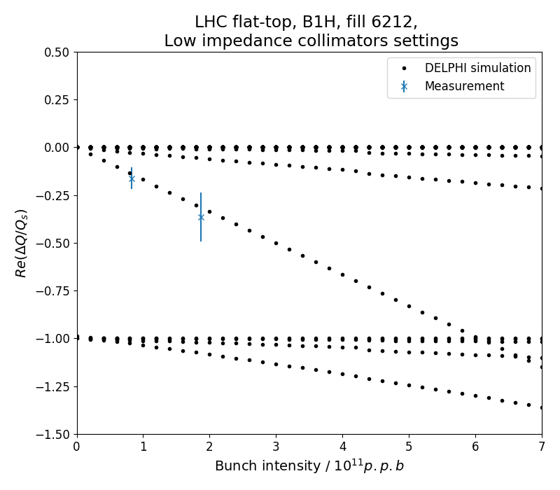
Transverse Mode Coupling instability (TMCI)
More critical at high energy due to tighter collimator gaps
Coupling between mode 0 and mode -1 is the most critical
No instability observed up to 1.9e11 p/bunch (with no margins we hand 2e11 ~1.5um in collision)
TMCI threshold can be inferred from mode-0 tune shift (instab. thresh: ΔQ = Q_{s})
HL-LHC impedance
(after collimator impedance reduction)
Present LHC impedance
Simulated opening collimators (in tests with very small number of bunches)
Instability
Instability

Slide 7
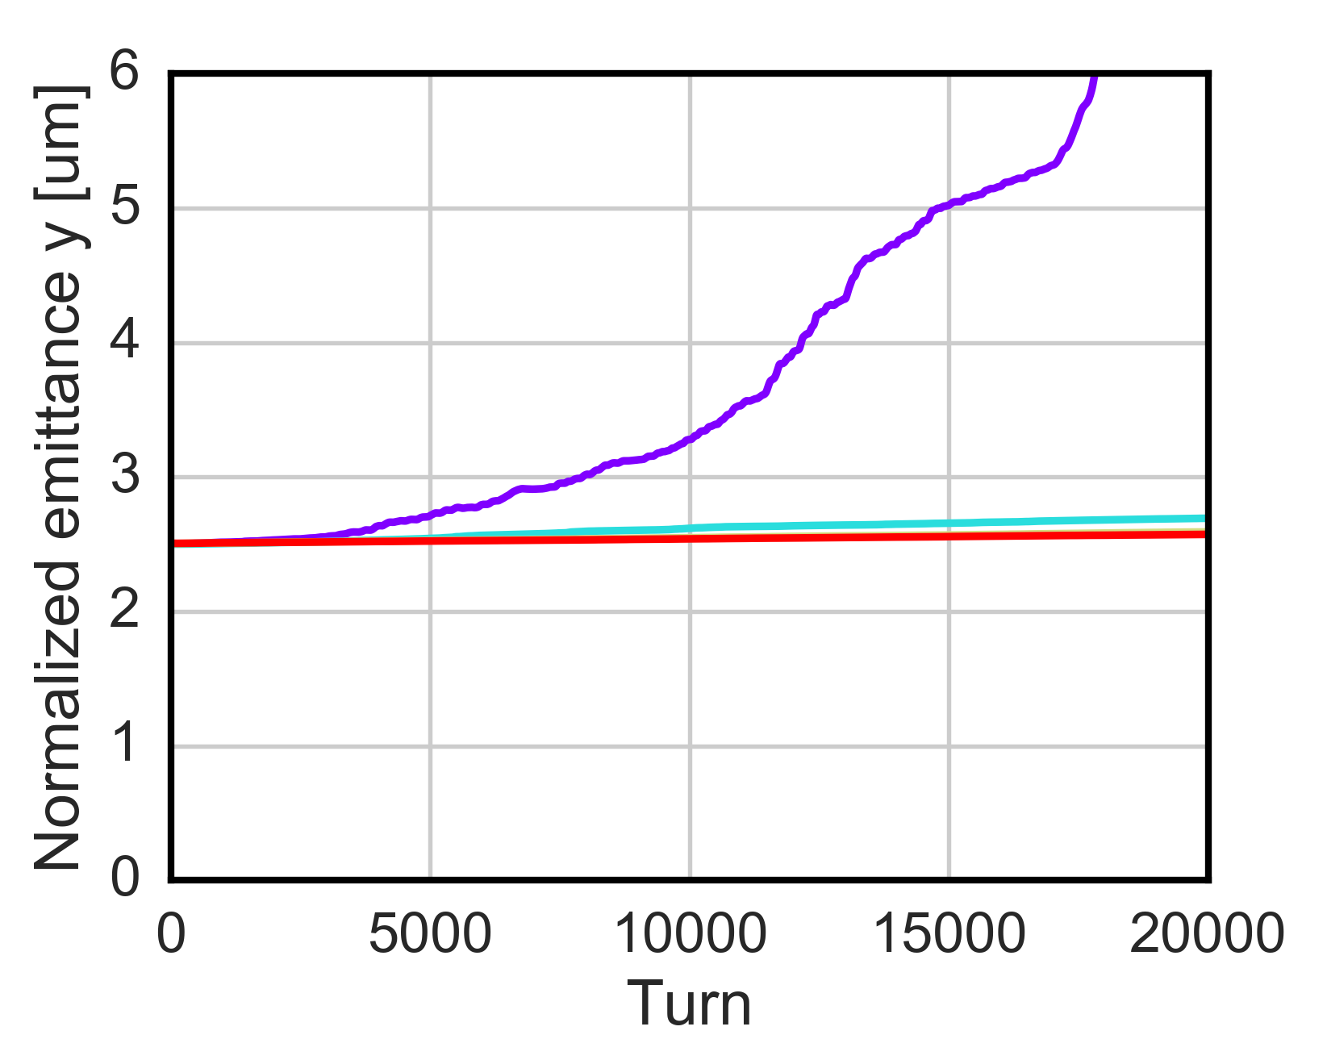
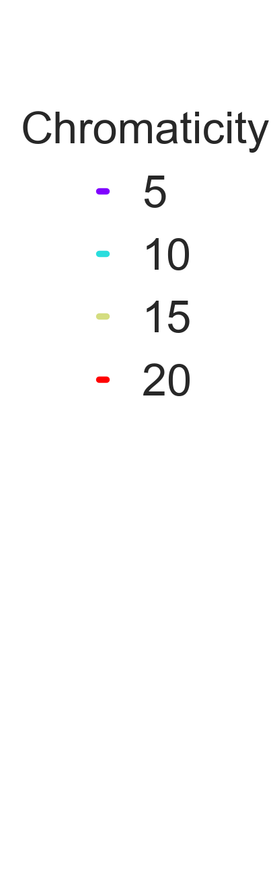
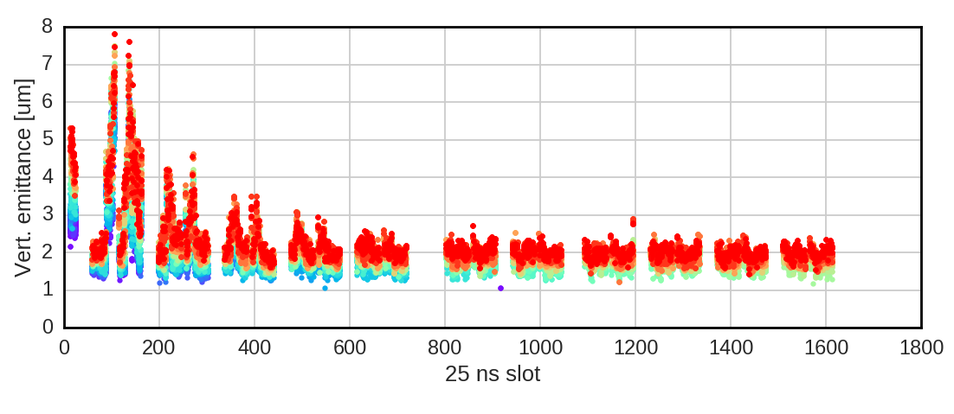
Electron cloud instabilities
  EC in quadrupoles (7% of the machine) alone is a key driver of instabilities at the LHC injection energy
    Simulations allowed explaining instabilities observations → large chromaticity values, relatively high octupoles current and a fully functional feedback system were needed to reach a satisfactory emittance preservation
    instability suppressed when increasing the beam energy up to 6.5 TeV due to the increased beam rigidity
Bunch-by bunch emittance measurements
PyECLOUD-PyHEADTAIL
simulation studies
Oct [A]
Chromaticity
6.5
5/5
13
5/5
13
10/10
13
15/15
26
15/15
52
15/15
52
10/15
52
20/15
(1) A. Romano et al., “Electron cloud induced instabilities in the LHC”, presentation at the Joint Ecloud-PyHEADTAIL Meeting

Slide 8
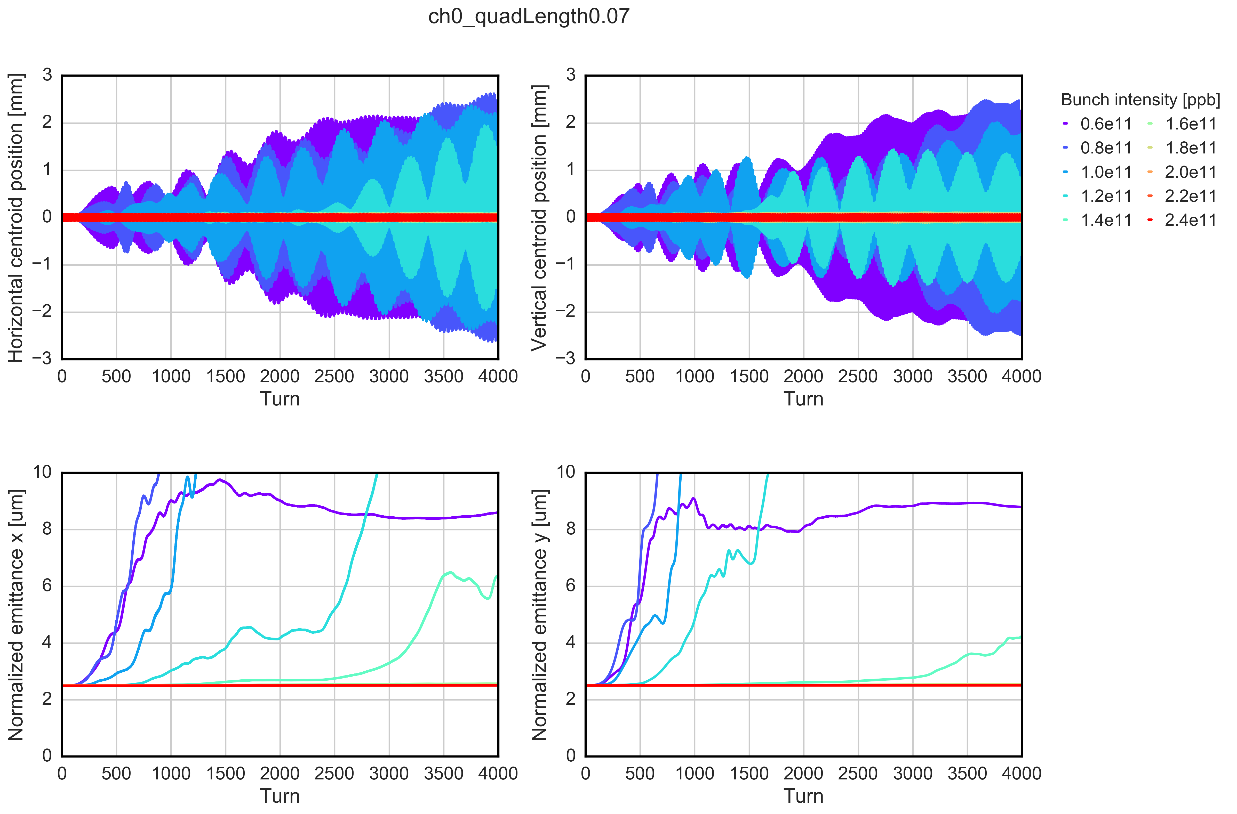
Electron cloud instabilities
  Simulation results show that the beam intensity increase foreseen by the HL-LHC has a beneficial impact on the beam stability
  Unlike LHC, the EC in quadrupoles in HL-LHC is not expected to drive the beam unstable both at injection and flattop energy after conditioning → provided that intensity dependence from build-up simulations is confirmed experimentally
    Psotential mitigation strategies have been investigated → strong stabilizing effect from large chromaticity values and mild effect from octupoles and damper

Slide 9
Impact of optics control on transverse stability
Importance of controlling:
  Tunes
  Linear coupling
  Amplitude detuning
  “a4 wall”
  Linear and non-linear chromaticity
More challenging with low β* and can be impacted in non-trivial ways by beam-beam, e-cloud, etc…
More in rogelio’s talk…
[Add some example]

Slide 10
Electron cloud effects
[Introductory slide with overview of the work done and some references]
Main points reported in the following…

Slide 11
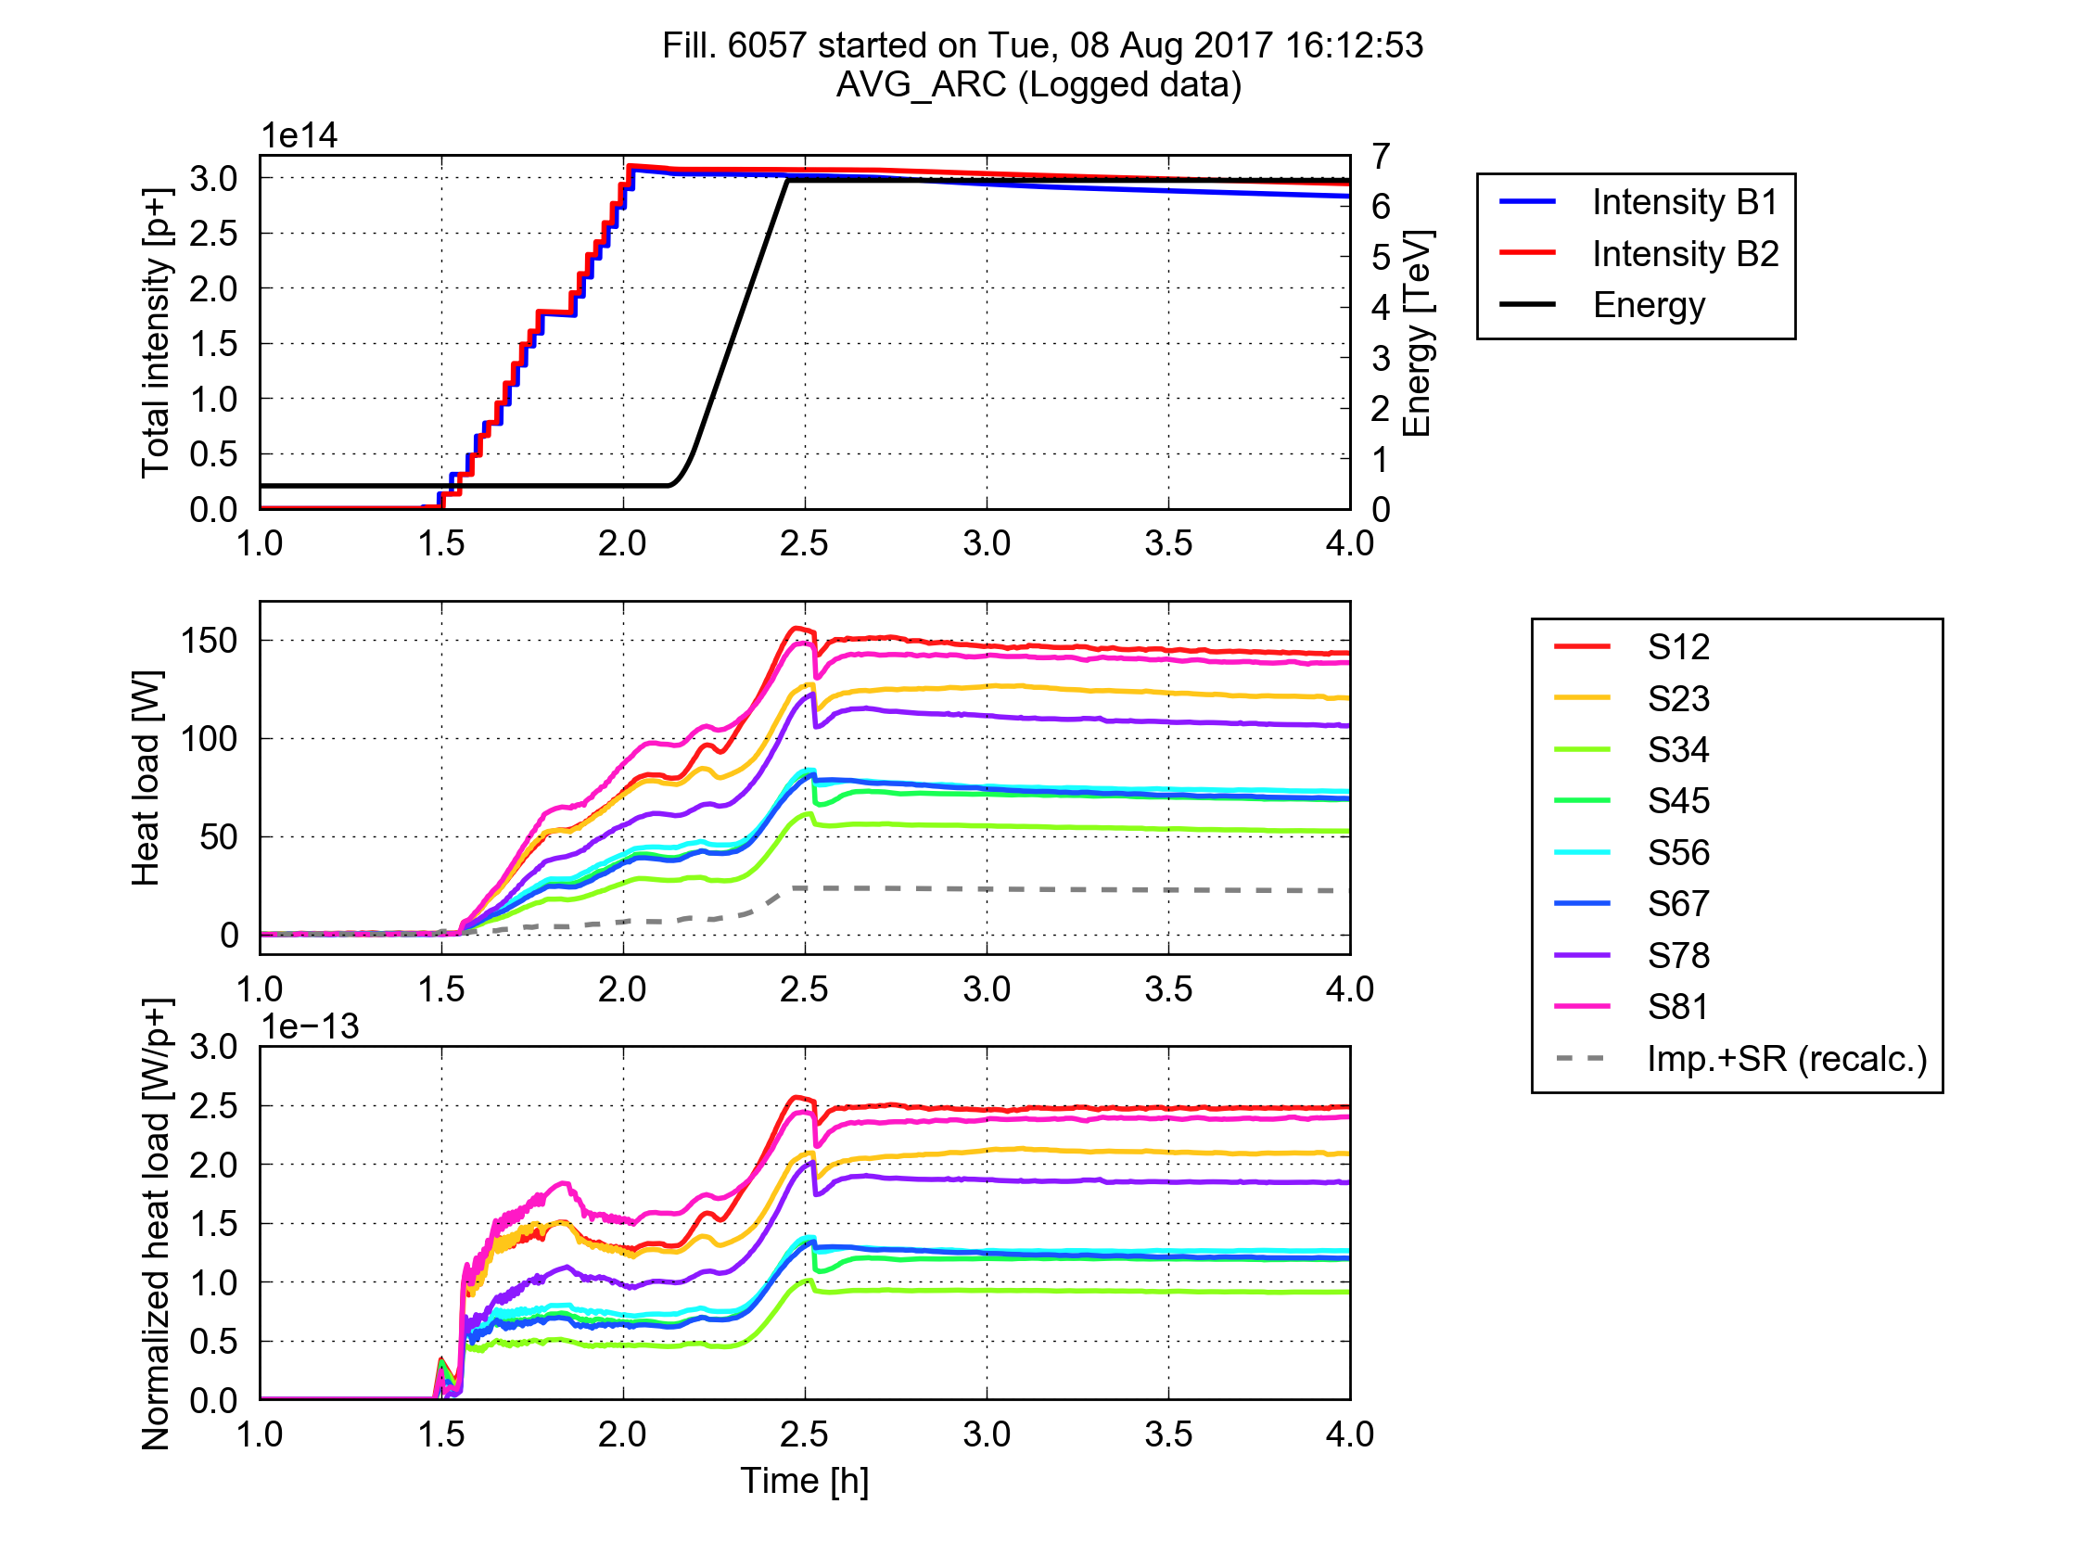
LHC experience
A challenge for LHC operation with 25 ns in Run 2: total load on the cryo-plants dominated by beam induced heating on arc beam screens
Much larger than expected from impedance and synchrotron radiation
Large differences observed between sectors
Several observed features compatible with e-cloud effects
Being followed-up by dedicated Task Force led by L. Tavian
Heat load
per half cell
More info can be found here

Slide 12
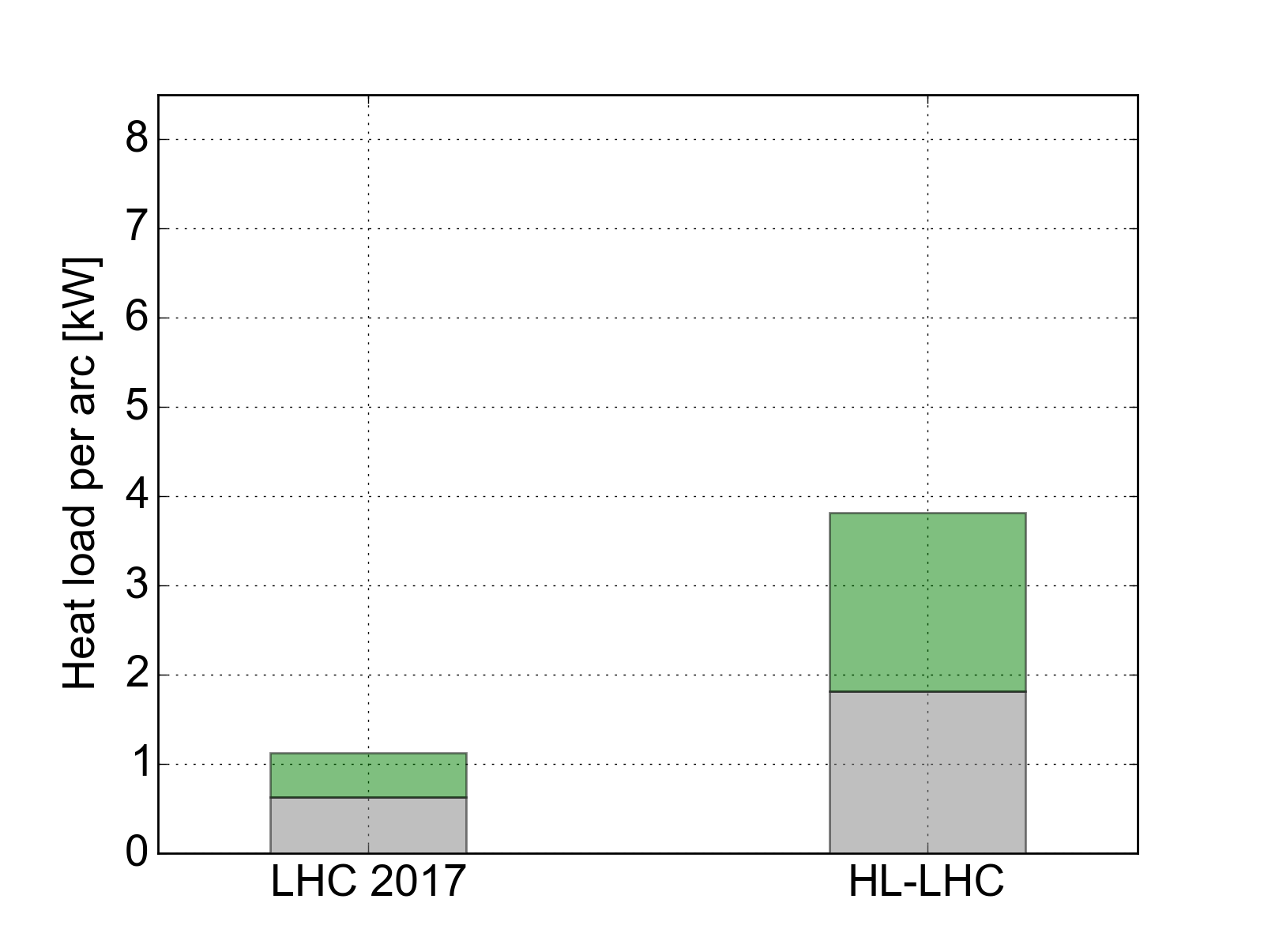
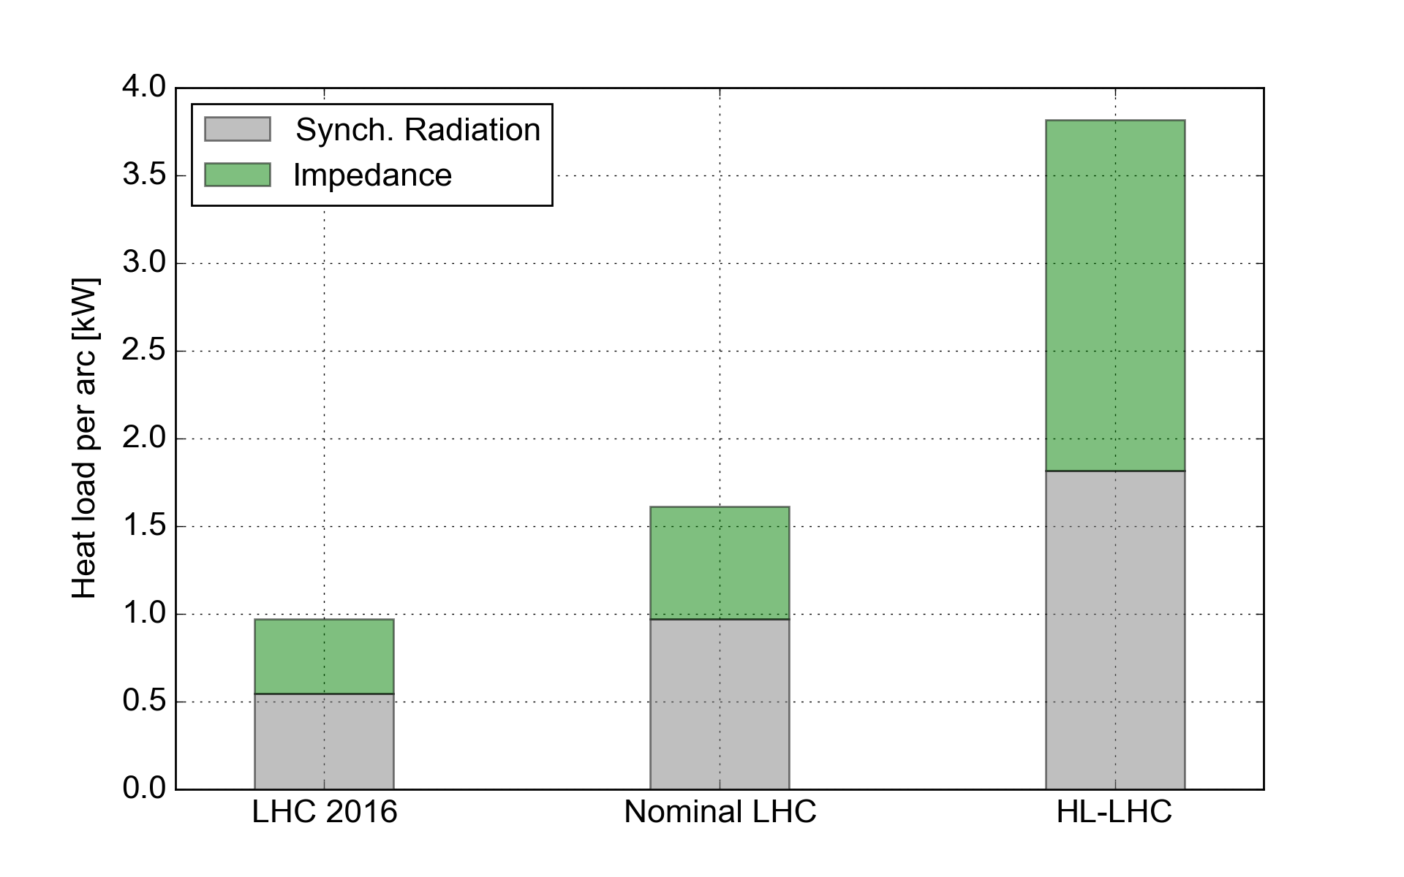
Arc heat loads from impedance and synchrotron radiation
In Run 2 configuration: small contributions from impedance and synchrotron radiation → used large available margins to cope with e-cloud
When moving to larger beam intensities (and to 7 TeV) the margin reduces strongly
Maximum allowed by cryogenics
Margin
~7 kW
Margin
~4 kW
e-cloud S12
(2017)
~6 kW
e-cloud S34
(2017)
~2kW
2556b
1.1e11 p/bunch
6.5 TeV
2748b
2.2e11 p/bunch
7 TeV

Slide 13
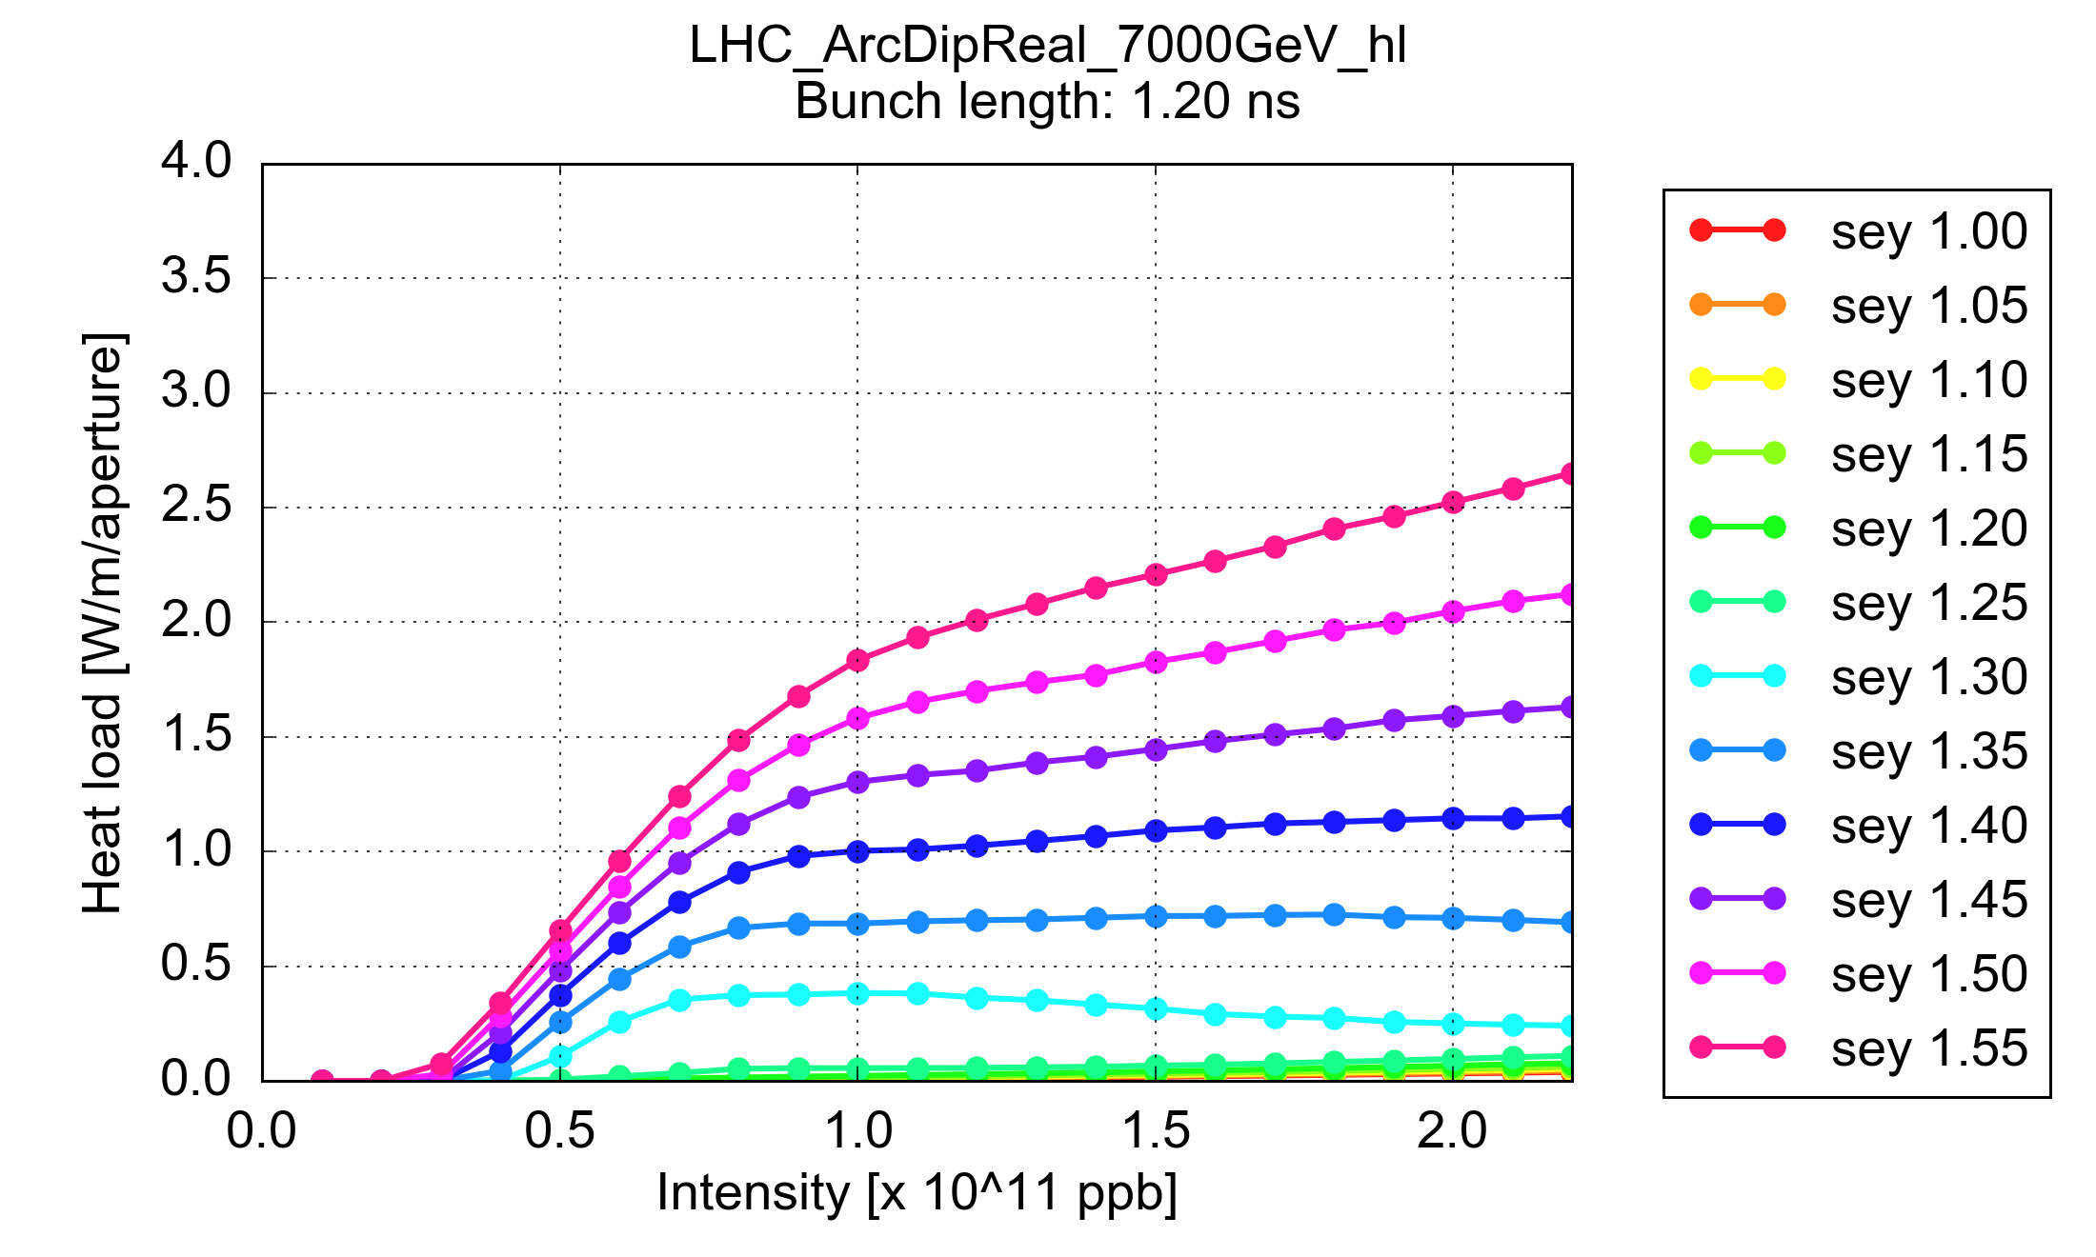
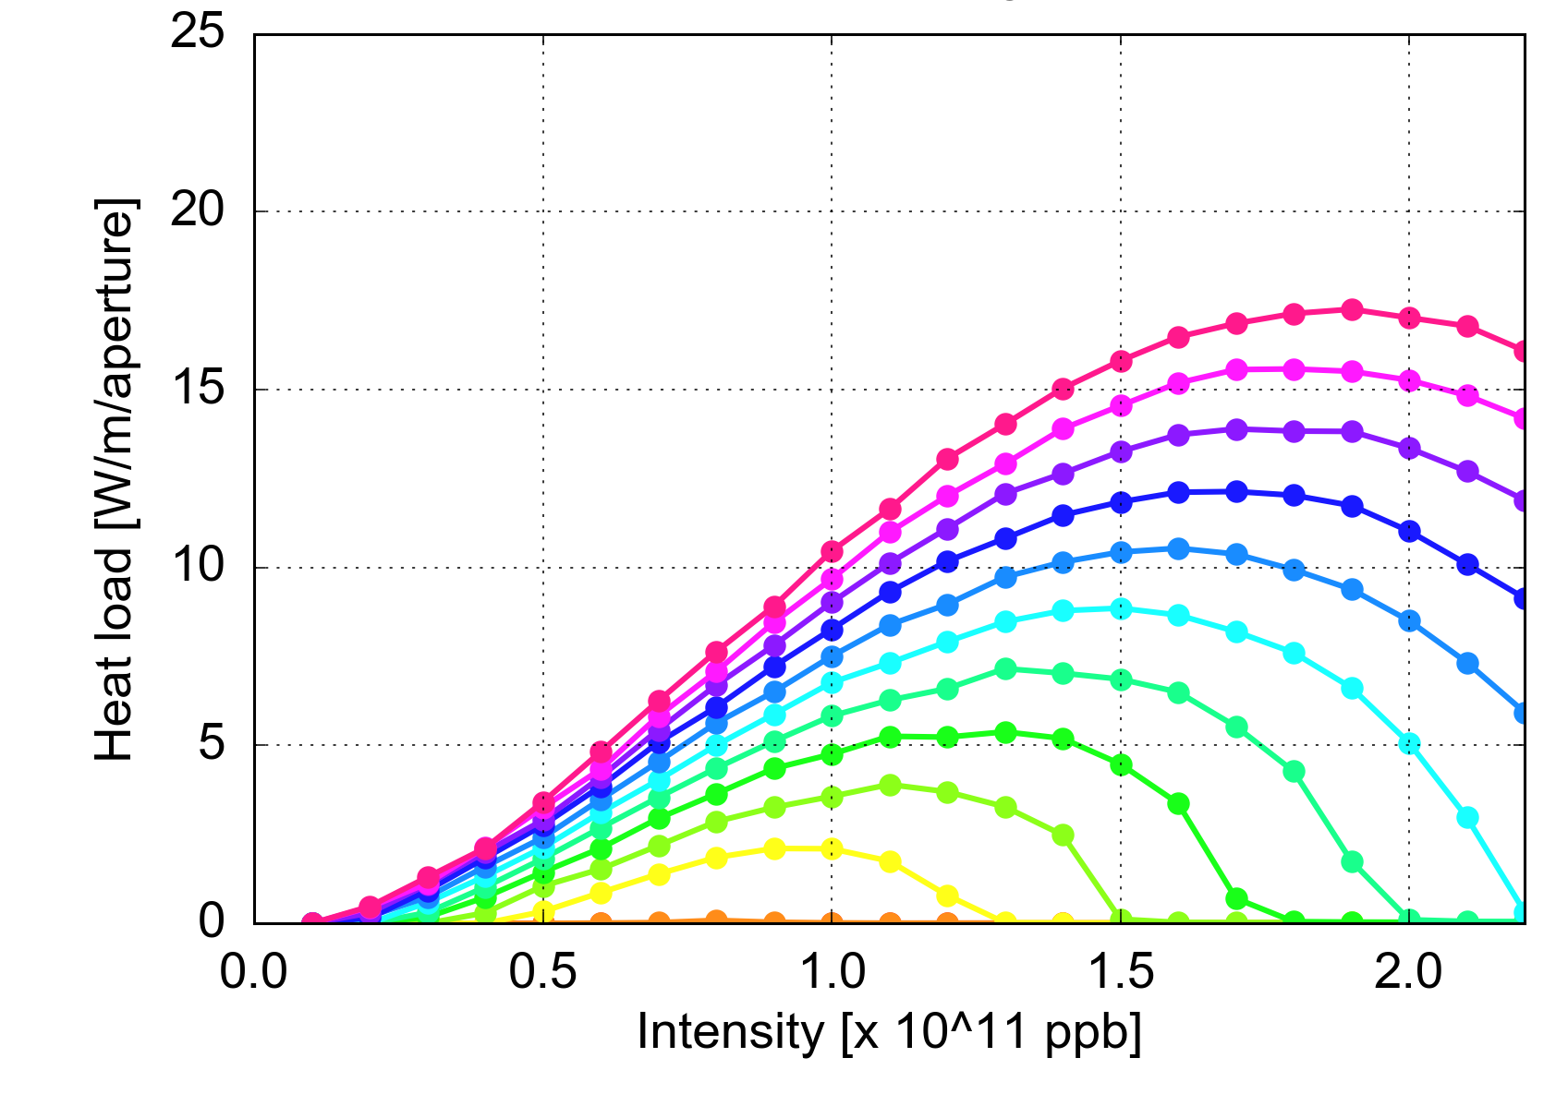
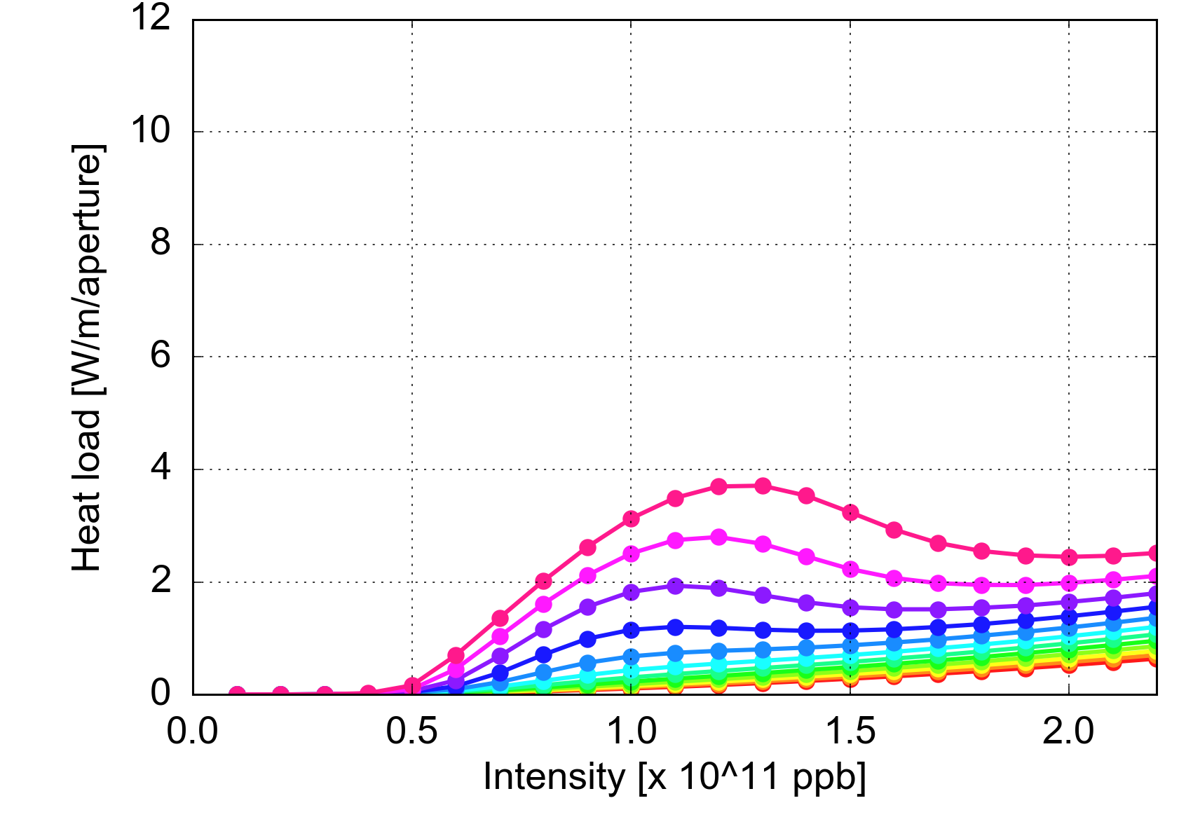
Arc heat loads – effect of bunch intensity
Dipole
  Assessed with PyECLOUD simulations:
  The dependence of the heat load on the bunch intensity strongly depends on the surface properties (SEY parameter)
  The expected dependence on the bunch intensity is strongly non linear
  Full experimental validation of these curves possible only after LS2
Quadrupole
Drift

Slide 14
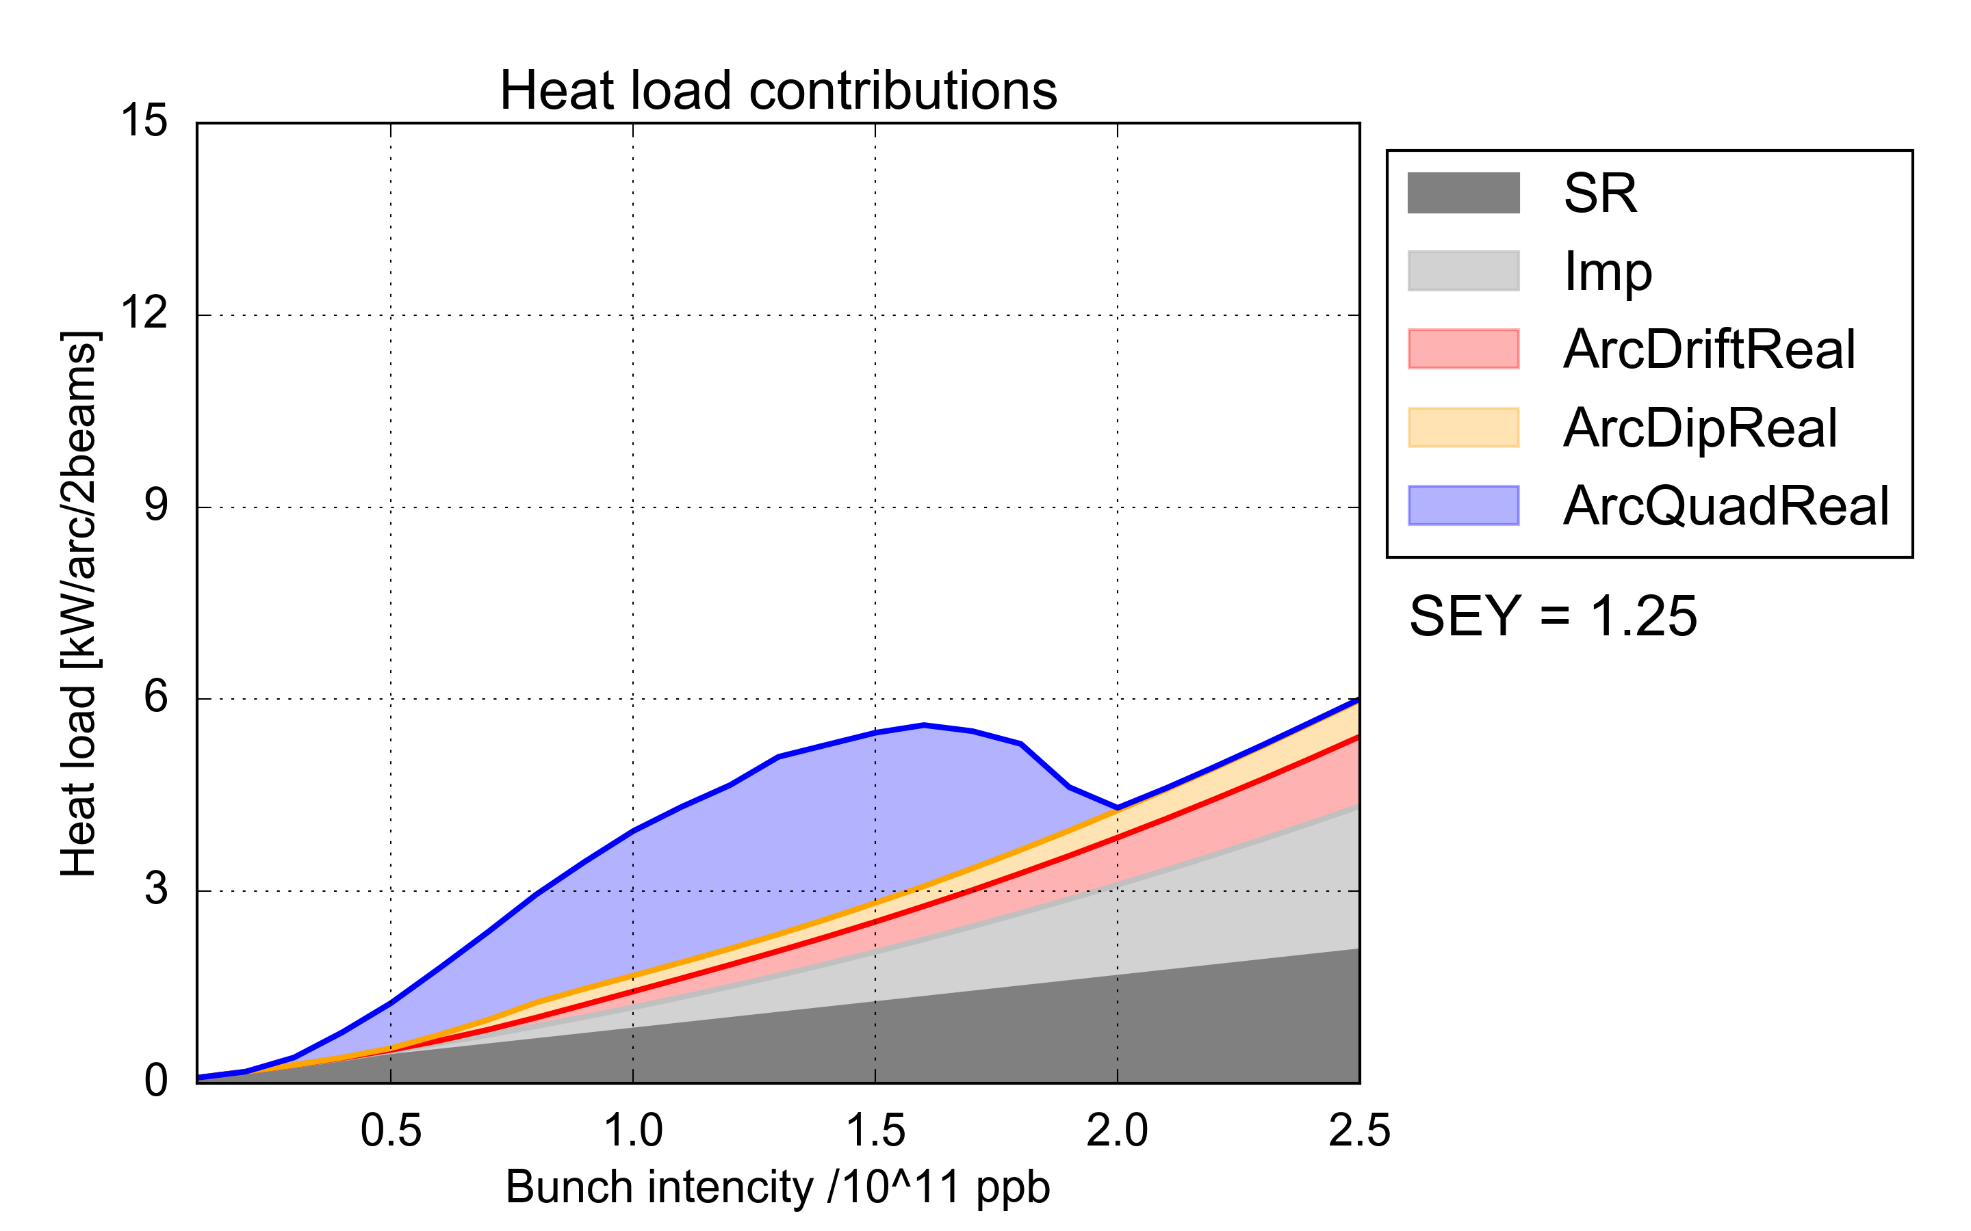
Arc heat loads: simulations for HL-LHC
Synchrotron radiation
Impedance
  HL-LHC
e-cloud in drifts
e-cloud in dipoles
e-cloud in quadrupoles
  8 kW/arc (~160W/hcell)
  Present situation in the low-load sectors
  For high bunch intensity significant heat load is observed already for low SEY (from impedance, synchrotron radiation, photoelectrons in the drifts)
  Present conditioning achieved in the low-load sectors is compatible with HL-LHC

Slide 15
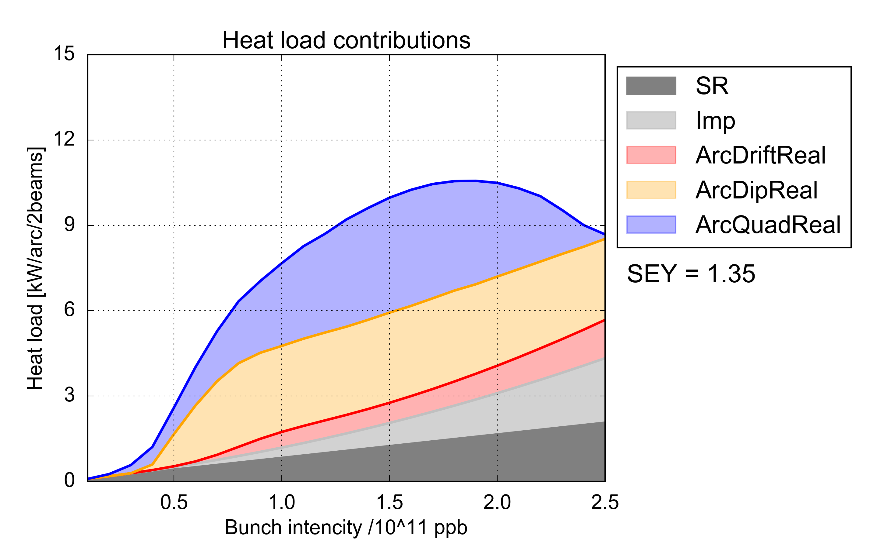
Arc heat loads: simulations for HL-LHC
Synchrotron radiation
Impedance
  HL-LHC
e-cloud in drifts
e-cloud in dipoles
e-cloud in quadrupoles
  8 kW/arc (~160W/hcell)
  Present situation in the high-load sectors
  For high bunch intensity significant heat load is observed already for low SEY (from impedance, synchrotron radiation, photoelectrons in the drifts)
  Present conditioning achieved in the low-load sectors is compatible with HL-LHC
  Expected heat load for the high-load sectors is ~10 kW/arc → not acceptable for HL-LHC
    Ongoing work to identify and suppress the source of differences among arcs is very important for HL-LHC
[Mention also importance of coatings in ITs and SAMs]

Slide 16

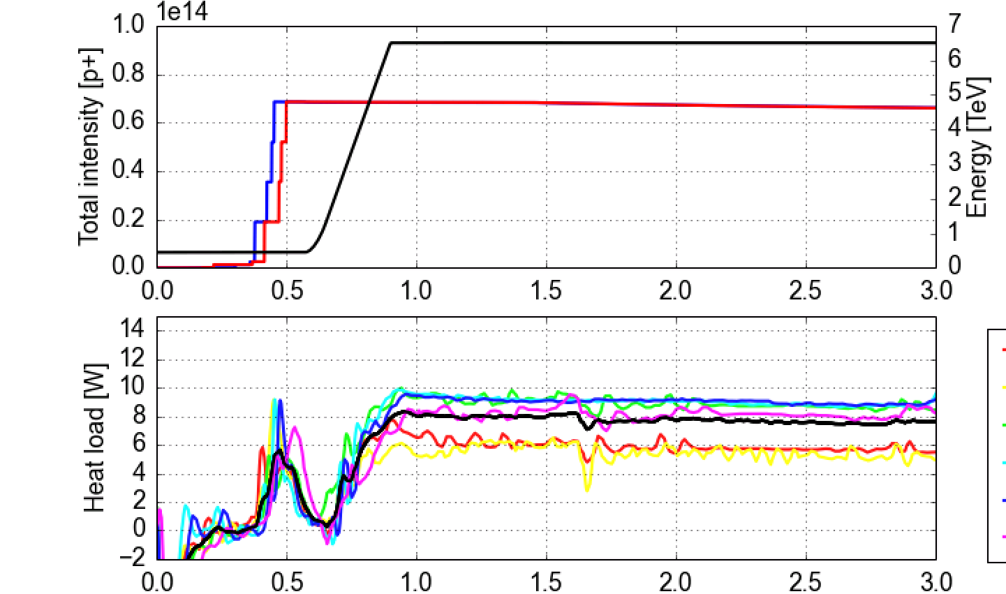
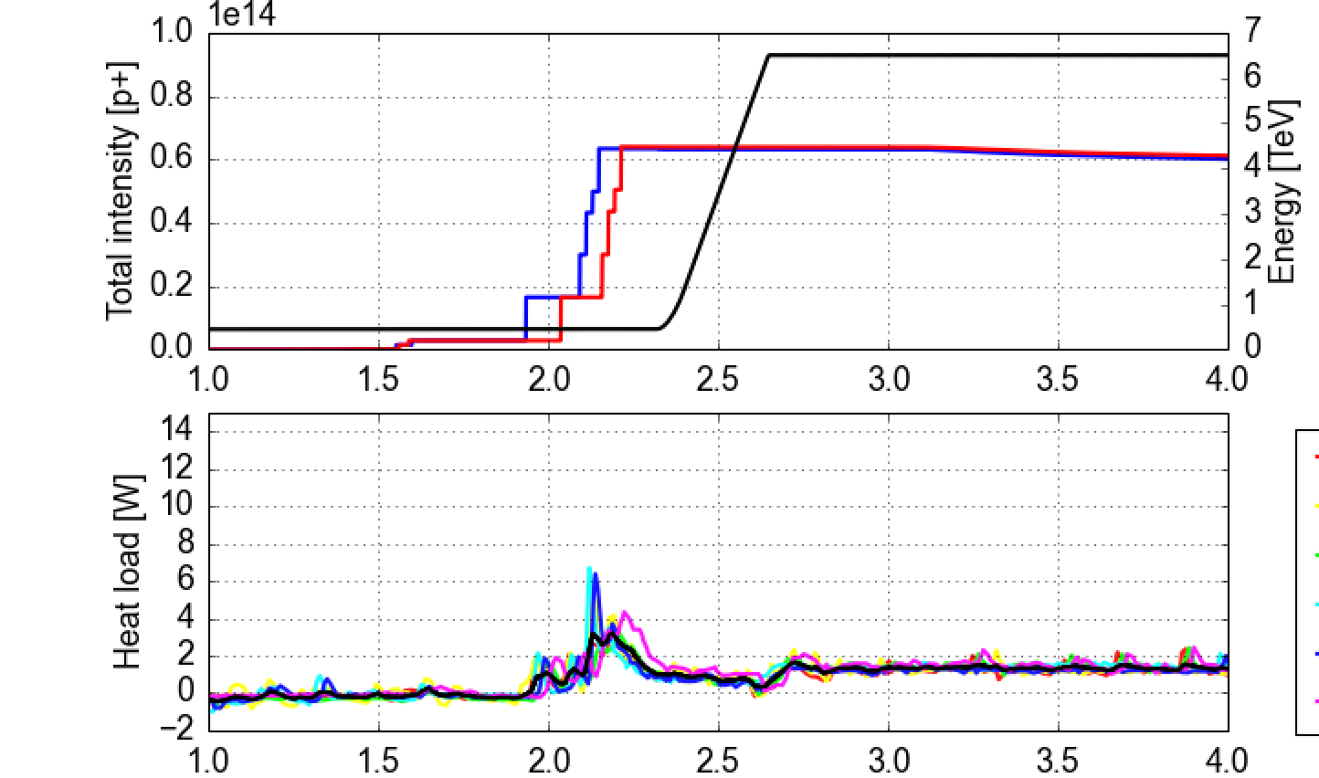
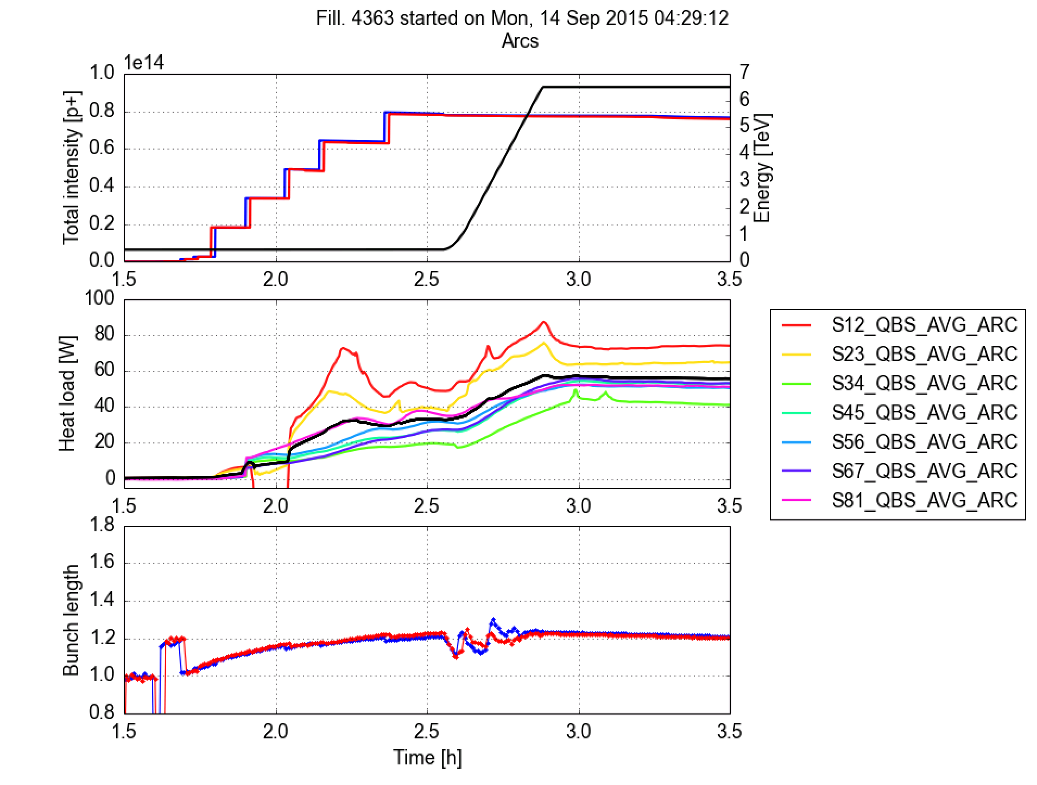
8b+4e scheme
Filling pattern designed to suppress the e-cloud build-up (~30 % less bunches w.r.t. nominal)
Confirmed experimentally in the LHC in 2015 (for 1.1e11 p/bunch)
  Tests with ~1.7e11 p/bunch should be conducted in 2018
Included in the HL-LHC TDR as backup scenario in case issues with e-cloud
Standard 25 ns beam
“8b+4e” beam
Dipoles (instrumented cells in S45)
Dipoles (instrumented cells in S45)
Average
Impedance+synch. rad

Slide 17
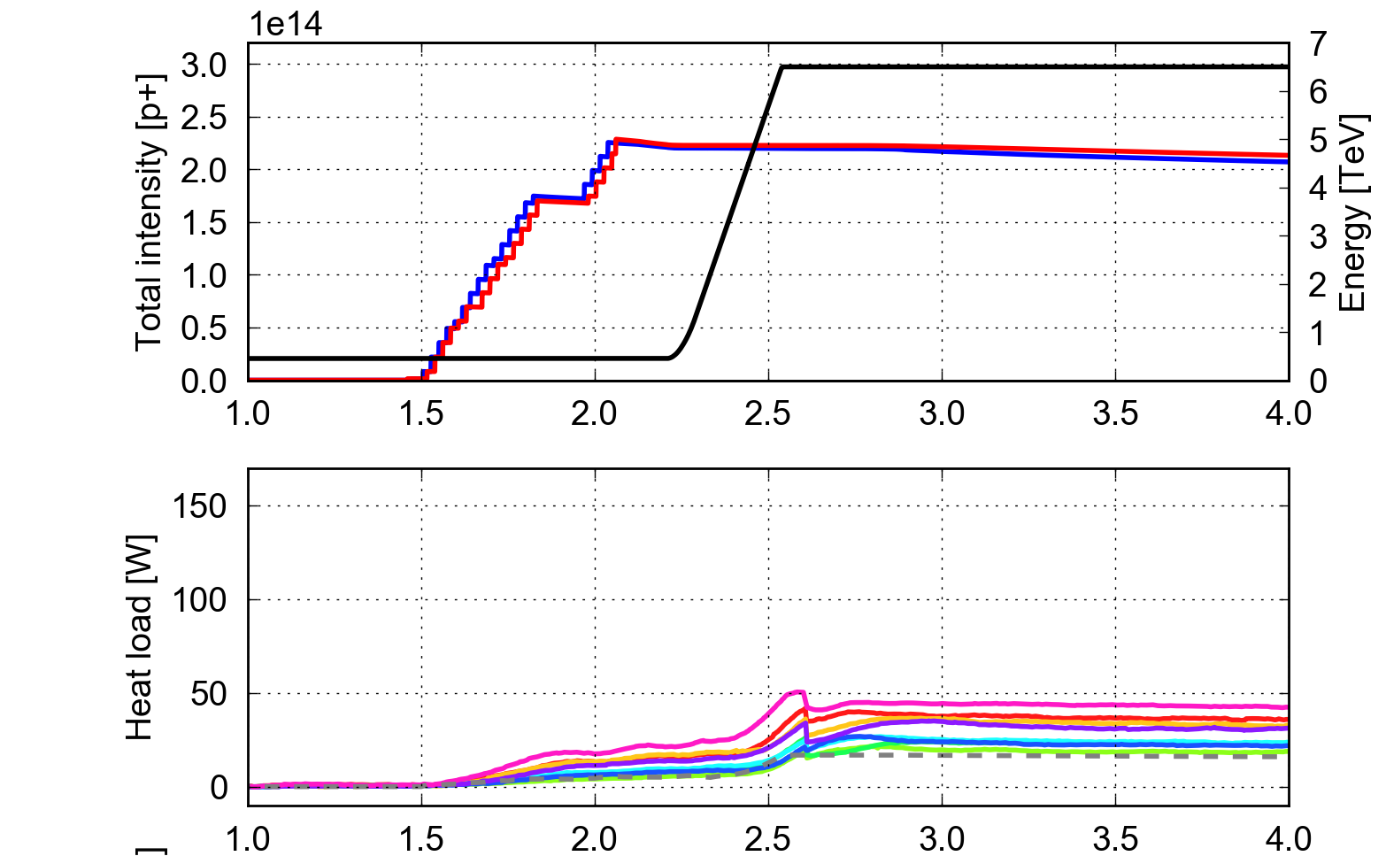
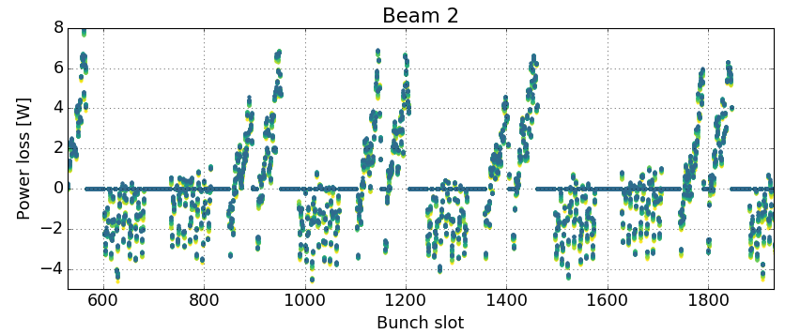
8b+4e scheme
Used in operation in the last part of the 2017 Run (to mitigate fast losses in 16L2)
25 ns (2556b)
8b+4e (1916b)
Standard 25 ns trains and 8b4e trains can be combined in the same filling scheme in order to adapt the heat load to the available cooling capacity (tested in MD in 2016)
8b+4e
25 ns
Measurement J. Esteban Muller

Slide 18
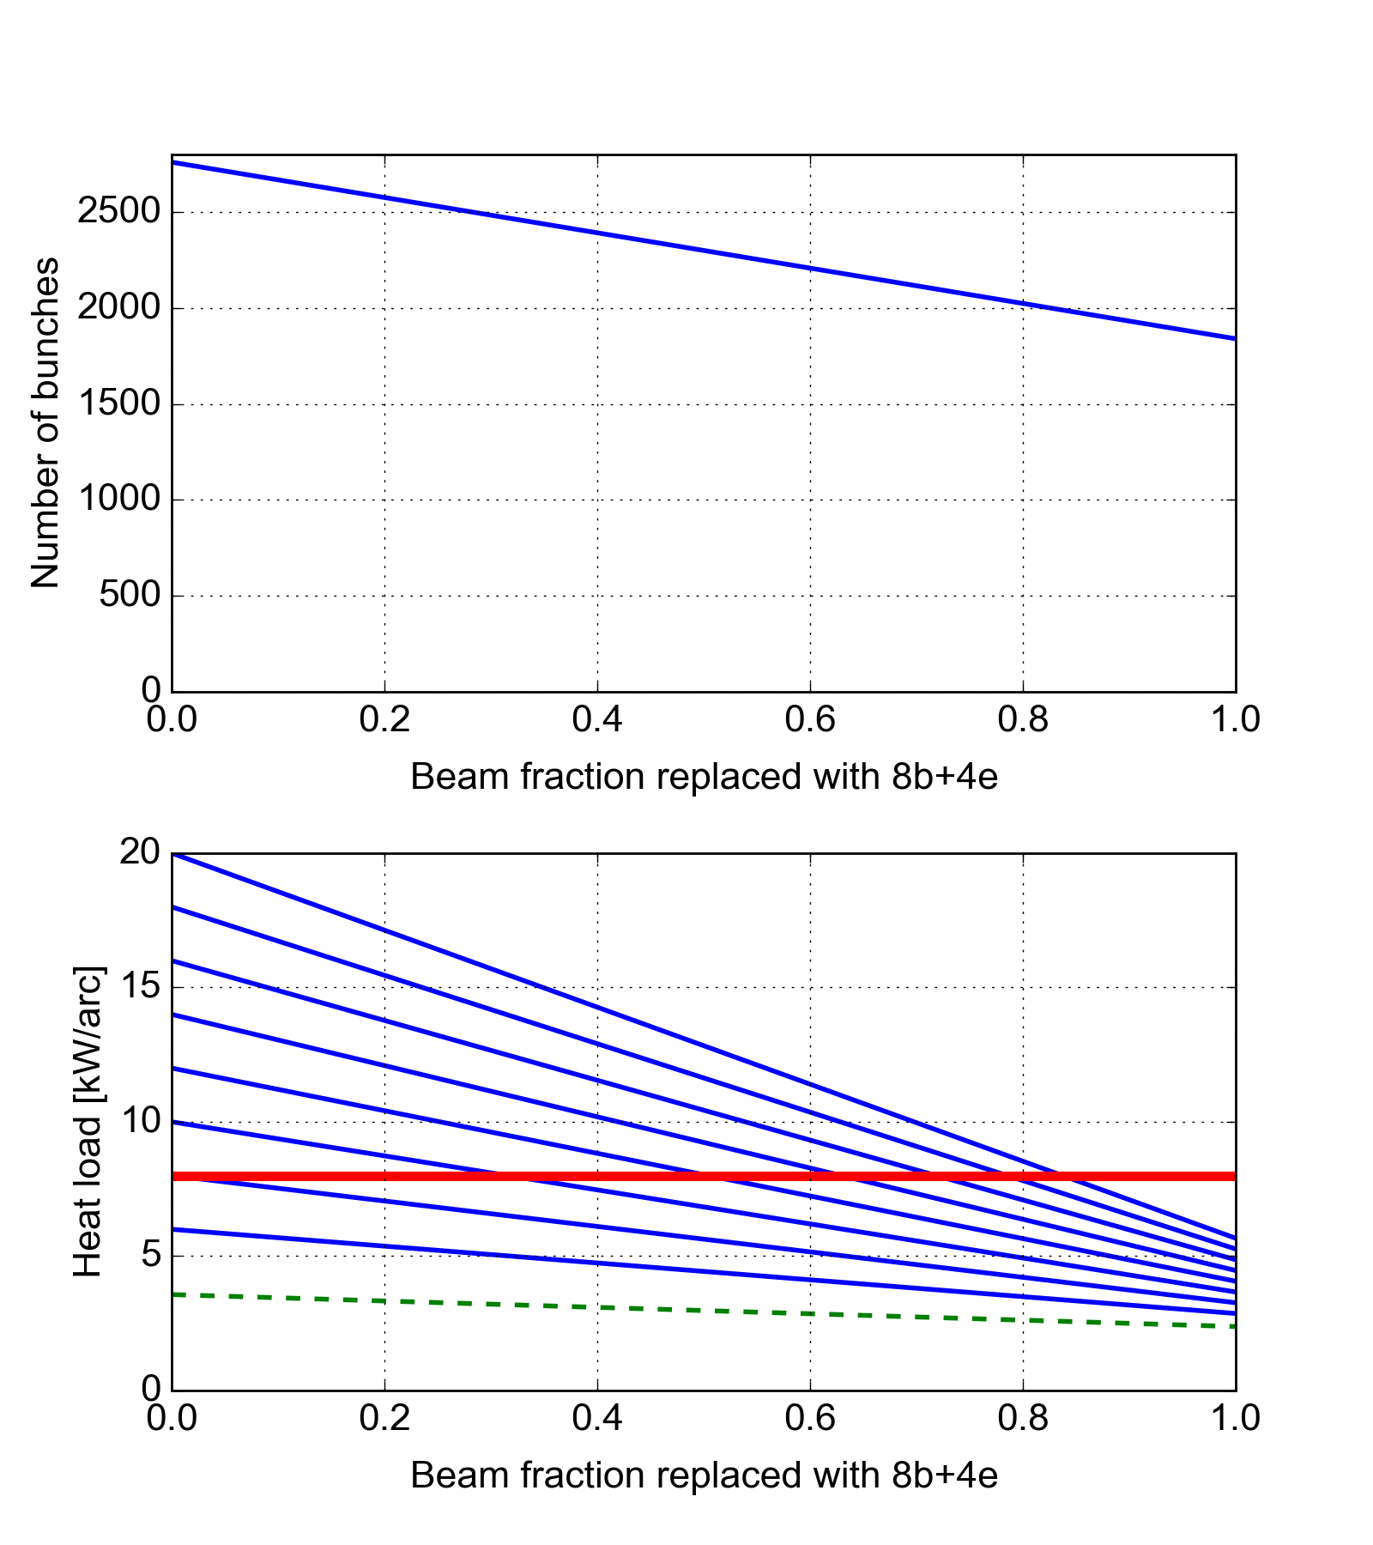
Mixed filling schemes
Built a simple model to optimize the “mixed scheme” to the available cooling capacity
Heat load from impedance and synchrotron radiation
Total heat load including e-cloud for different surface states
Cryogenics limit
Assumed e-cloud suppression factor with 8b+4e as observed in the worst sector (S81) in 2017

Slide 19
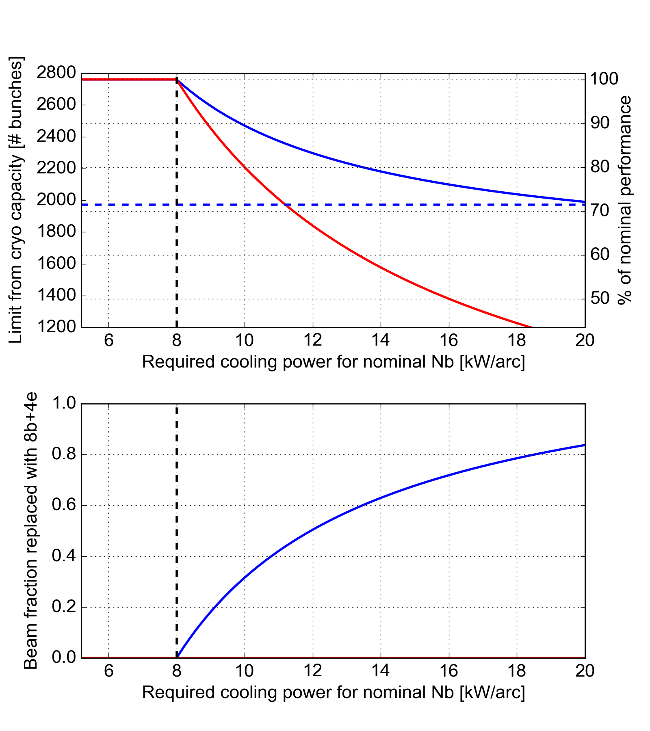
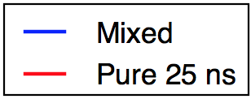
Mixed filling schemes
Built a simple model to optimize the “mixed scheme” to the available cooling capacity
Pure 8b+4e
Cryo limit
Cryo limit

Slide 20
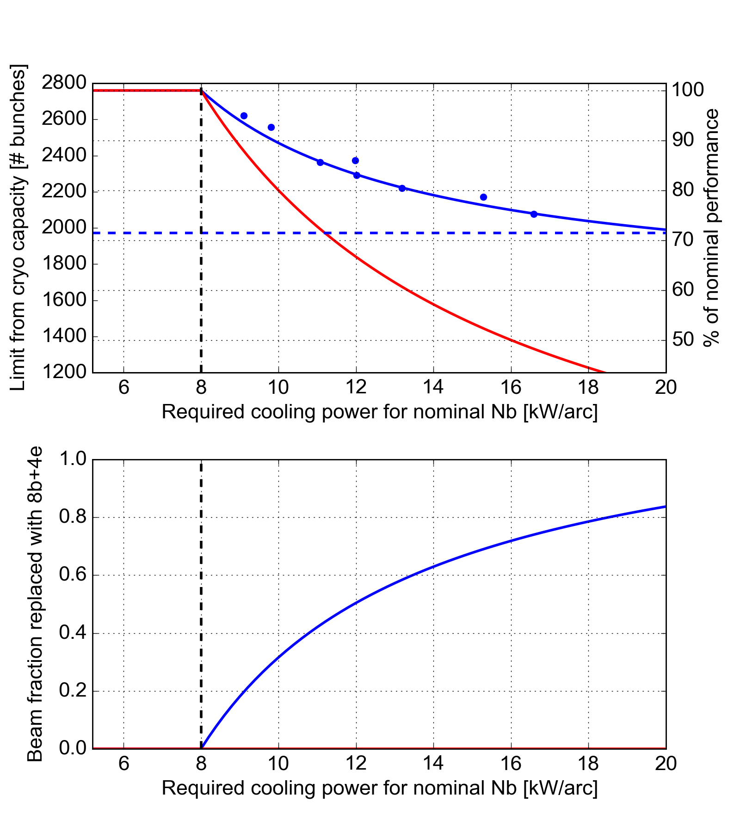
Mixed filling schemes
Built a simple model to optimize the “mixed scheme” to the available cooling capacity
Failure scenario A:
e-cloud scaling with intensity is confirmed by experiment
Present LHC conditioning state cannot be improved
Perf. loss with pure 25ns: ~25 %
Perf. loss with mixed: ~12 %
Pure 8b+4e
Cryo limit
Failure scenario B
e-cloud scaling with intensity is found to be worse than expected
Present LHC conditioning state cannot be improved
Perf. loss with pure 25ns:
from ~25% to very bad
Perf. loss with mixed:
from ~12% to 28%
Cryo limit

Slide 21
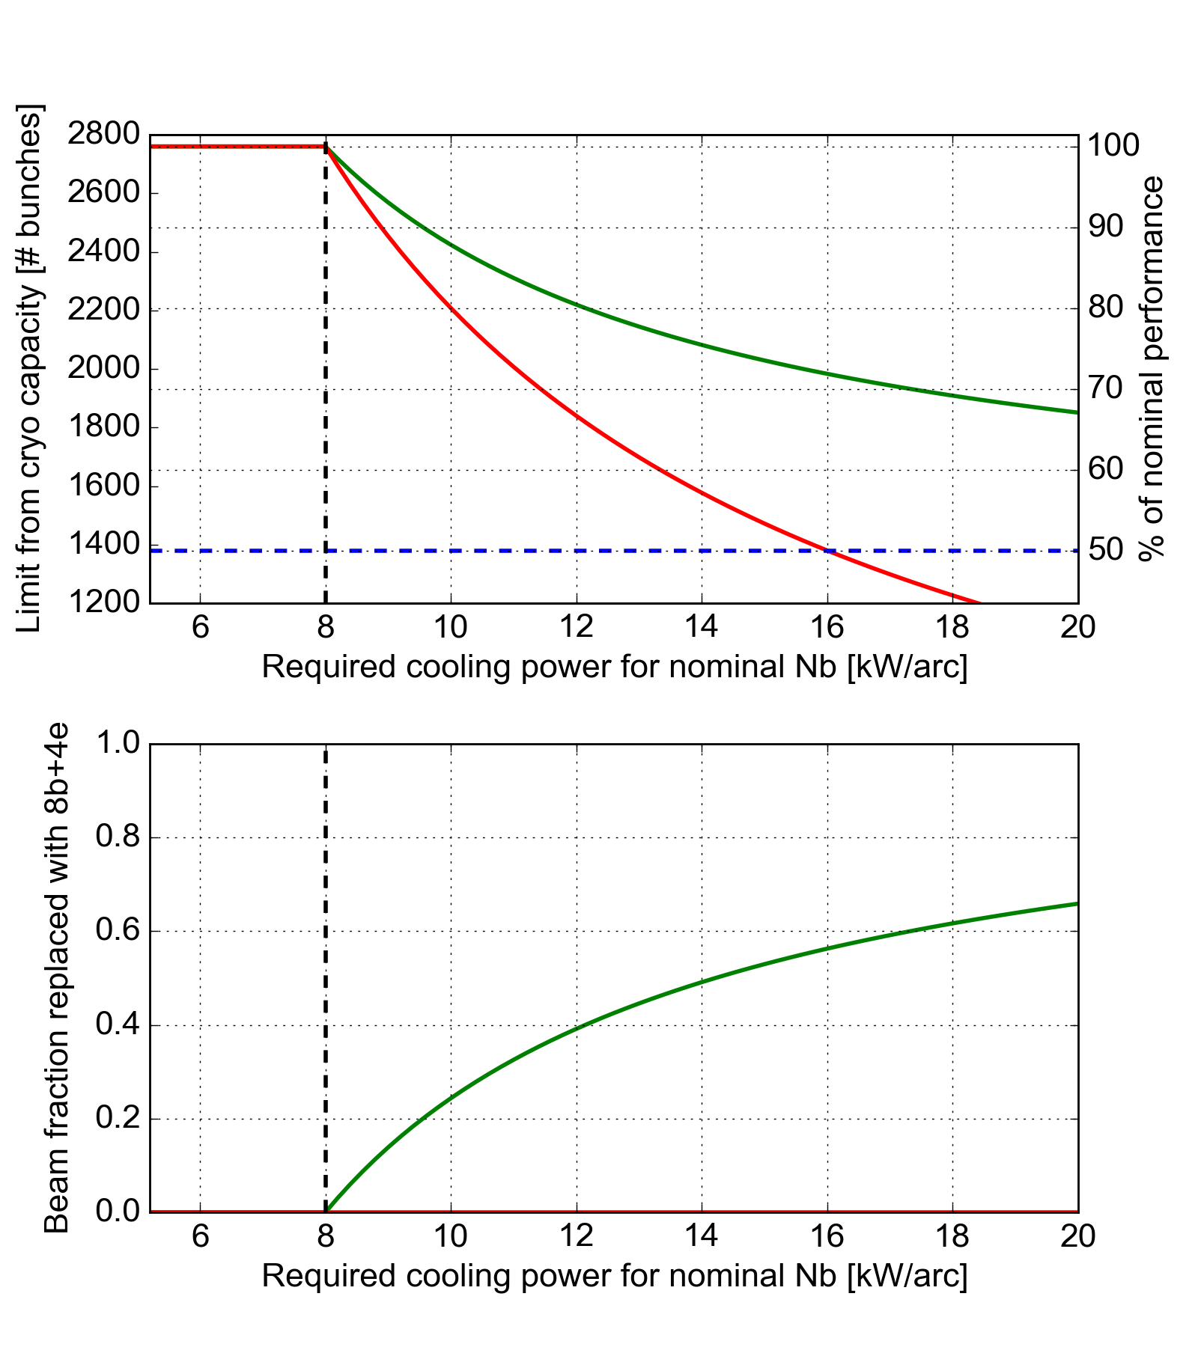
Mixed filling schemes
Built a simple model to optimize the “mixed scheme” to the available cooling capacity
Considered also 50ns/25ns mixed scheme:
Assumed ideal e-cloud suppression for 50 ns
We know from Run1 that e-cloud is suppressed with 50 ns for I_{b}<=1.7e11 p/bun (but at 4 TeV…)
Performance is only slightly worse than 25ns/8b+4e
Can be considered as backup for a “Failure scenario C” in which e-cloud suppression with 8b+4e is found to degrade with bunch charge
Pure 8b+4e
Mixed 8b+4e/25ns
Mixed 50ns/25ns
Cryo limit
Pure 50 ns
Cryo limit

Slide 22
Emittance preservation
[Introductory slide with overview of the work done and some references]
Main points reported in the following…

Slide 23

Emittance preservation
  Assumptions made for HL-LHC performance estimates:
    Blow-up from Intra-Beam Scattering (IBS) is included in the model
    10% additional blow-up (0.3 μm) is assumed from end-of-injection to collisions
  These are significantly better than presently achieved in the LHC (for nominal intensity):
    Observed increase from injection to collisions ~0.8 μm
    Additional blow-up in collisions (on top of IBS) ~0.07 μm/h
  These figures are observed to be practically independent on the injected intensity/brightness
  Studies to be conducted in 2018 to better identify the sources and device possible mitigations
  To assess possible performance degradation applied LHC observed blow-up to HL-LHC cases:

Slide 24
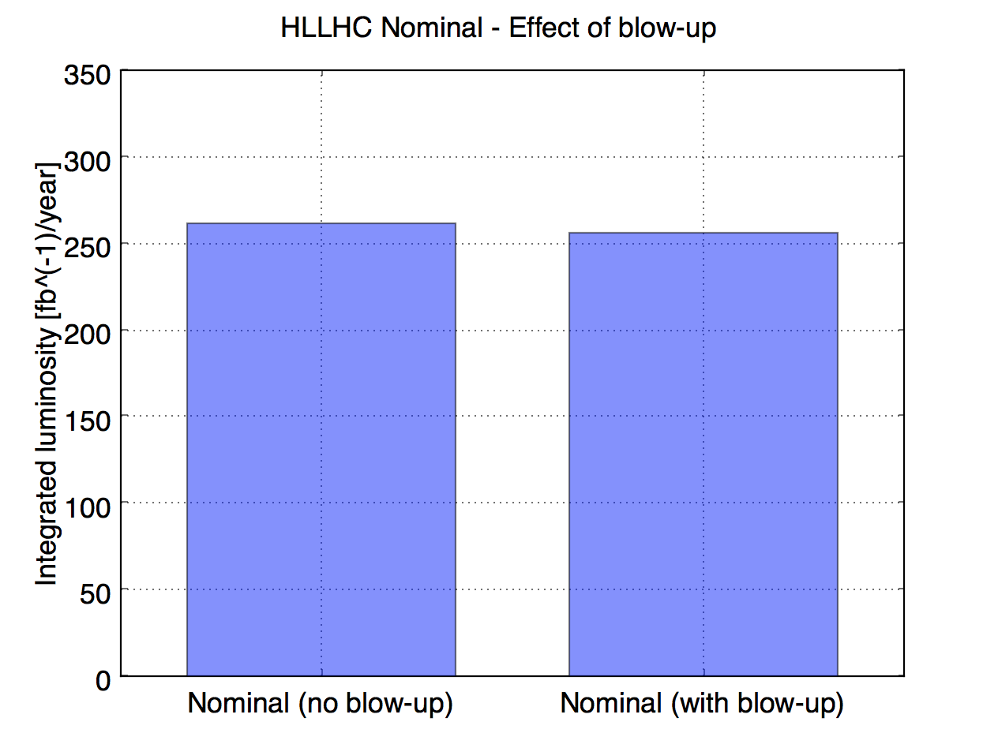
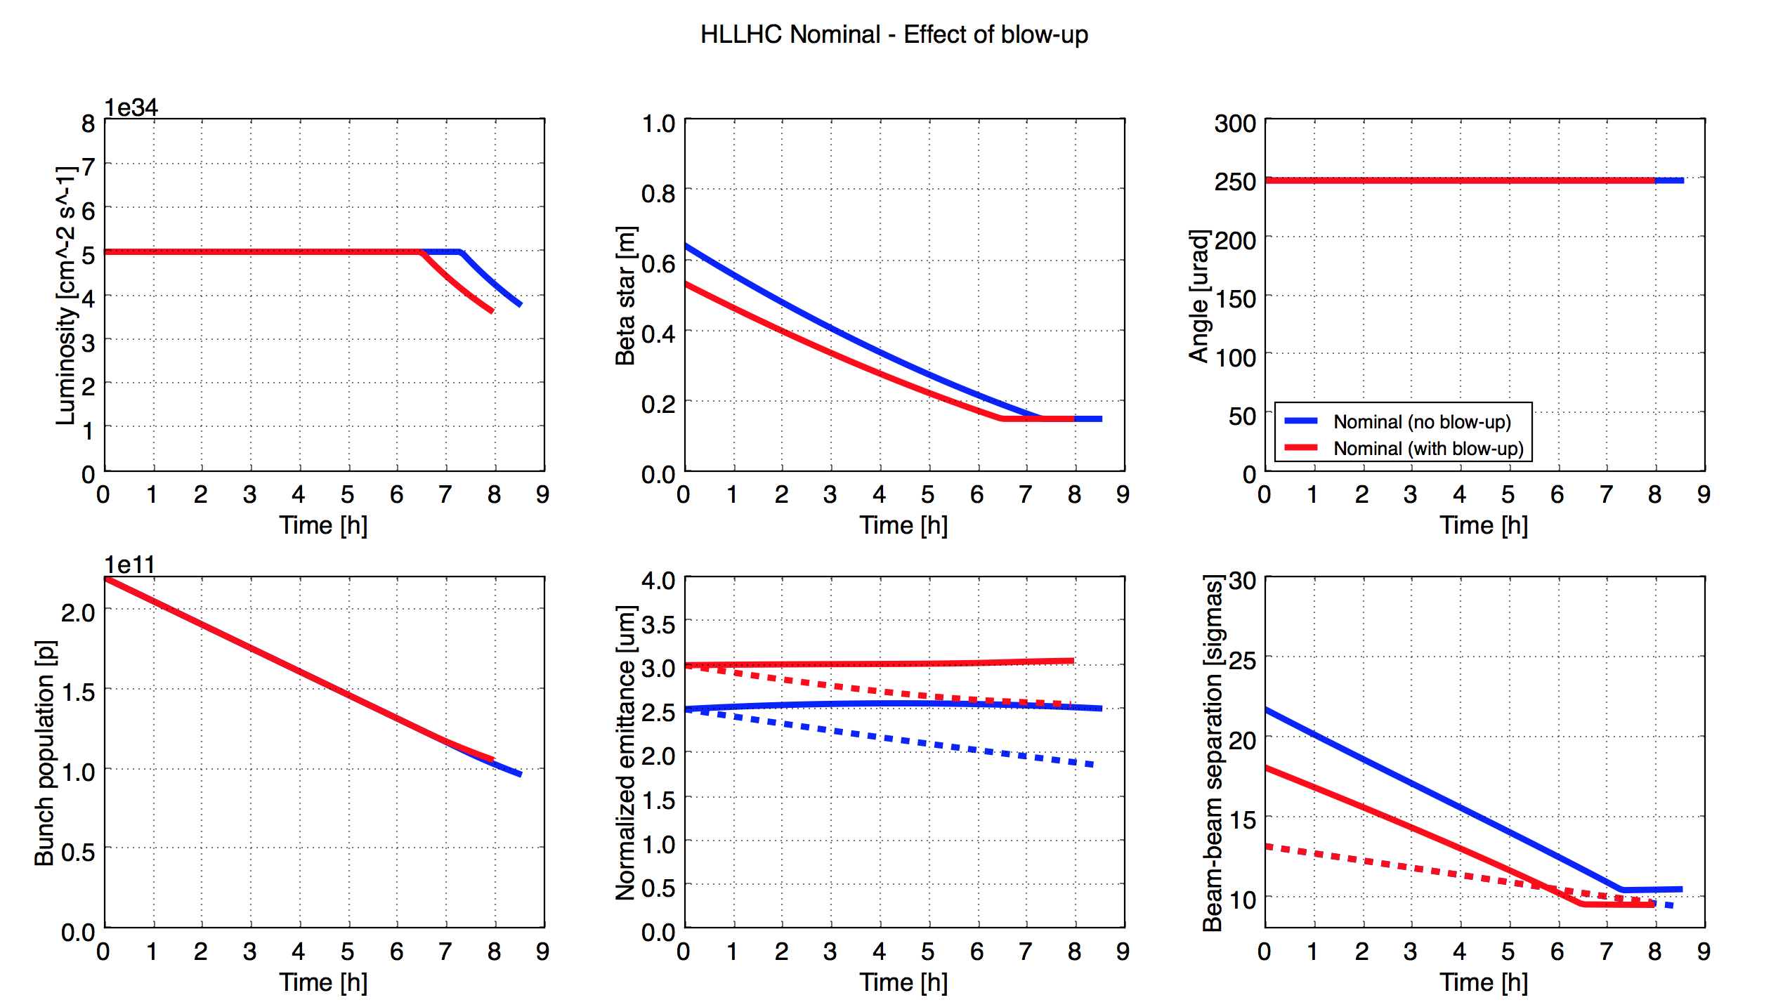
Emittance preservation: impact on performance
The impact of the extra blow-up on the expected performance is very small, as during a large fraction of the fill we can use β* to compensate
But with large emittances it can become tricky to ensure the required beam-beam separation…
Lim. for 6σ DA

Slide 25
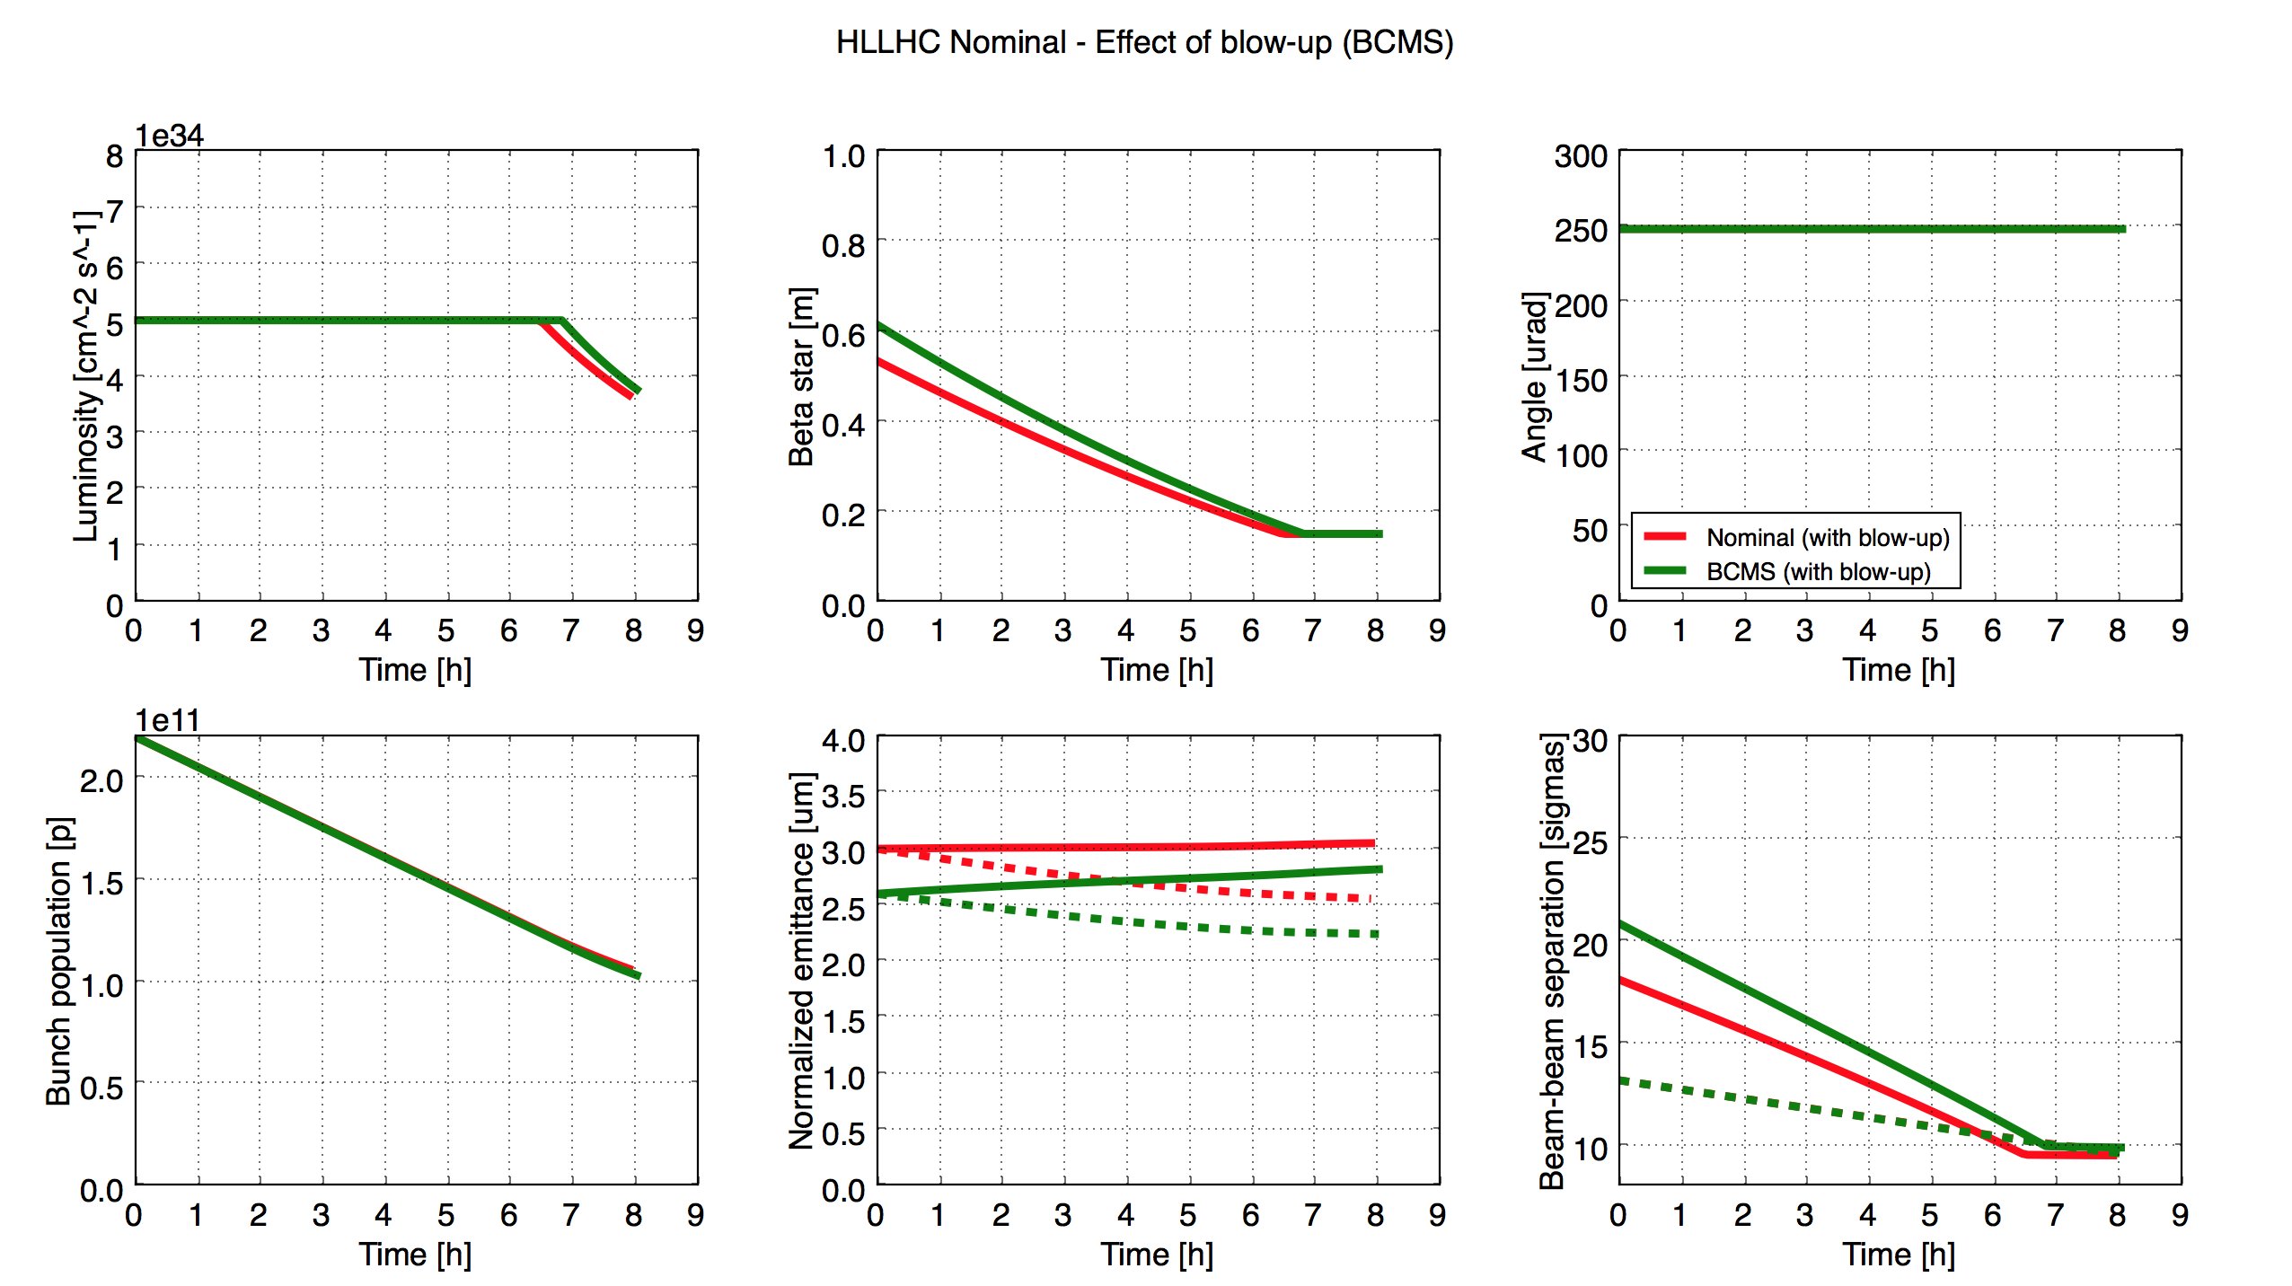
Emittance preservation: backup scheme (BCMS)
Low emittance beams from the injectors (BCMS) can be used to restore the required beam-beam separation

Slide 26
Filling schemes: standard vs BCMS
Standard (288b./inj.)
25ns_2760b_2748_2494_2572_288bpi_13inj_800ns_bs200ns
BCMS (288b./inj.)
25ns_2748b_2736_2251_2375_288bpi_12inj_800ns_bs200ns
BCMS (240b./inj.)
25ns_2748b_2740_2250_2376_240bpi_13inj_800ns_bs200ns
Easier for the injectors: less time at SPS flat-bottom, less demanding for protection devices
With 200 ns and 800 ns kicker gaps the three schemes are practically equivalent

Slide 27
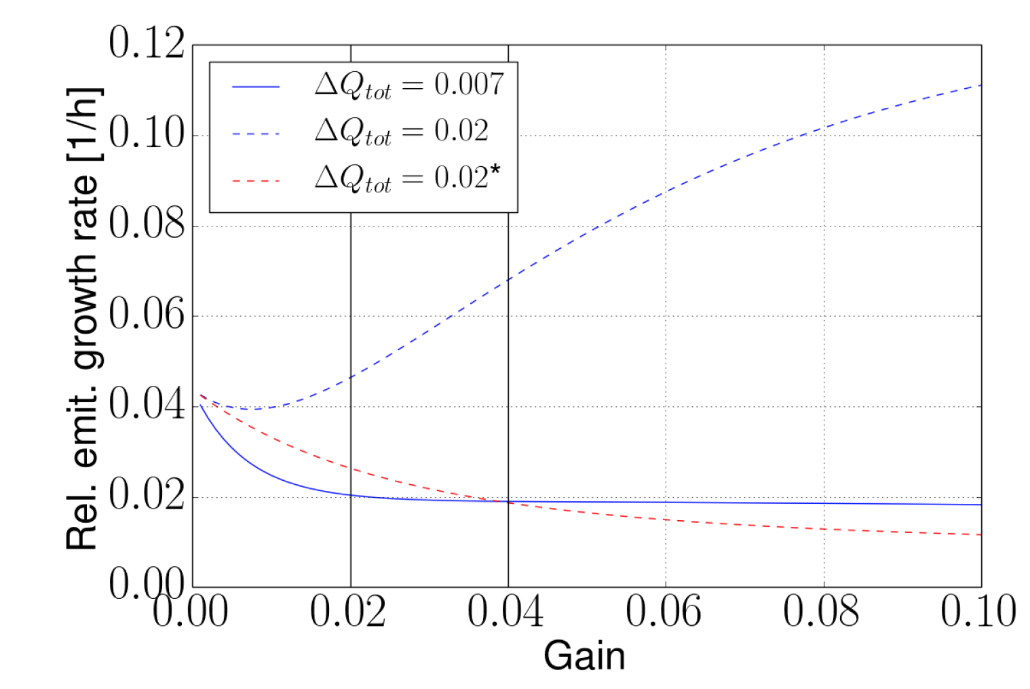
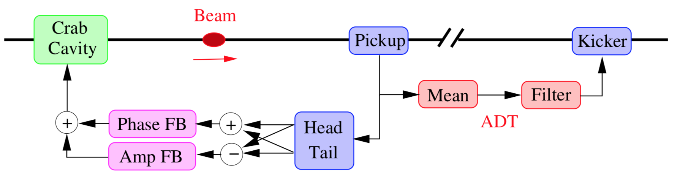
Emittance preservation in collisions
Stronger head-on beam-beam interactions (larger tune spread) will enhance the emittance growth due to coherent excitations → wen need to be careful with:
Noise from Power Converters → part of design specs for the new ones
Noise introduced by Crab Cavities
  A dedicated feedback is being designed
Noise introduced by the Transverse Damper
  Improvements are under study: use of a larger number of pickups and improved electronics
If needed, further mitigation can be obtained by introducing a small separation (~1σ) at the main IPs in the first part of the fill (no impact on lumi as it is during β* leveling)
Damper & noise
Crab Cavity noise feedback
HL-LHC present ADT
LHC
For more info: T. Mastoridis, “Crab cavity RF noise mitigation”, HL-LHC WP2 meeting, 22 Aug 2017
HL-LHC improved ADT
For more info: X. Buffat, “Beam stability and quality in the presence of beam beam and transverse damper”, HL-LHC Annual Meeting, Madrid, 15 Nov 2017

Slide 28
Thanks for your attention!

Slide 29

DA [σ]
Luminosity [${10}^{34}Hz/{cm}^{2}$]
Relaxed (6σ)
Aggressive (5σ)
Ultimate Relaxed (6σ)

Slide 30
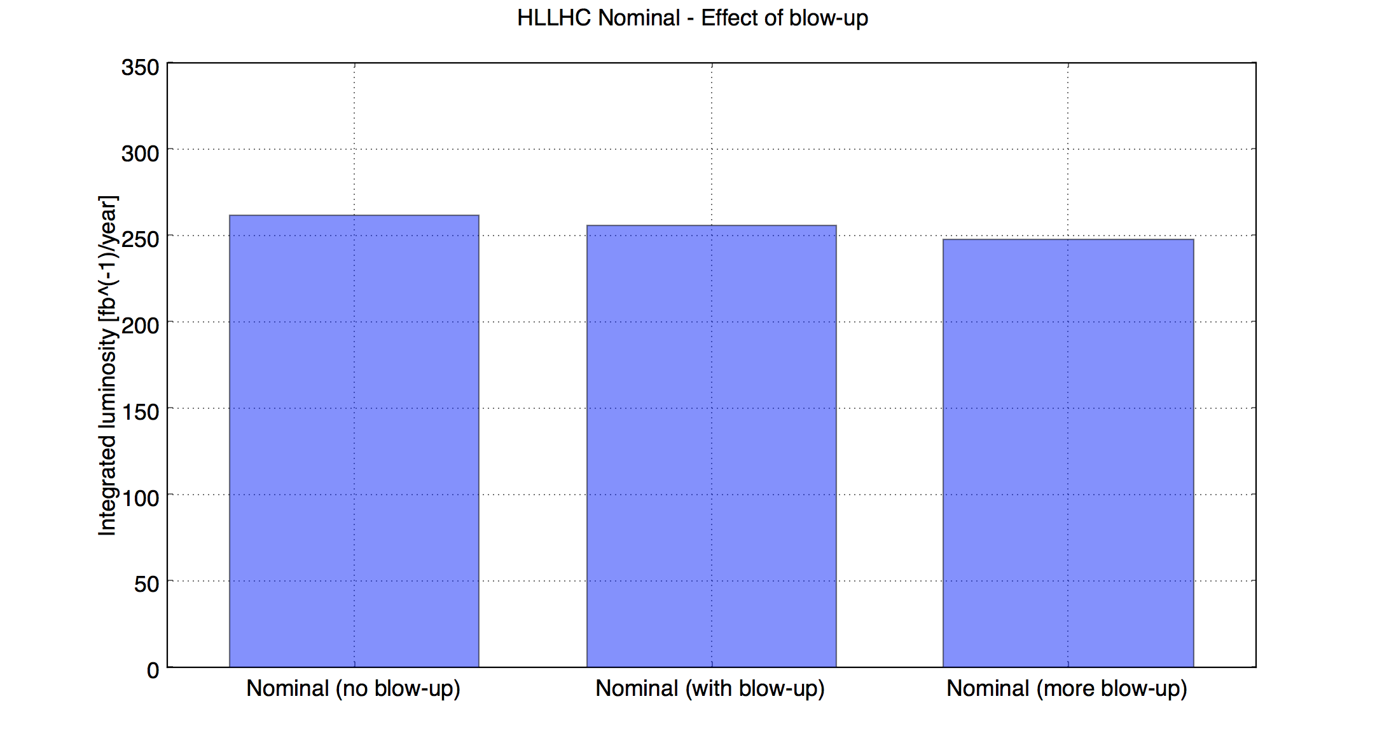
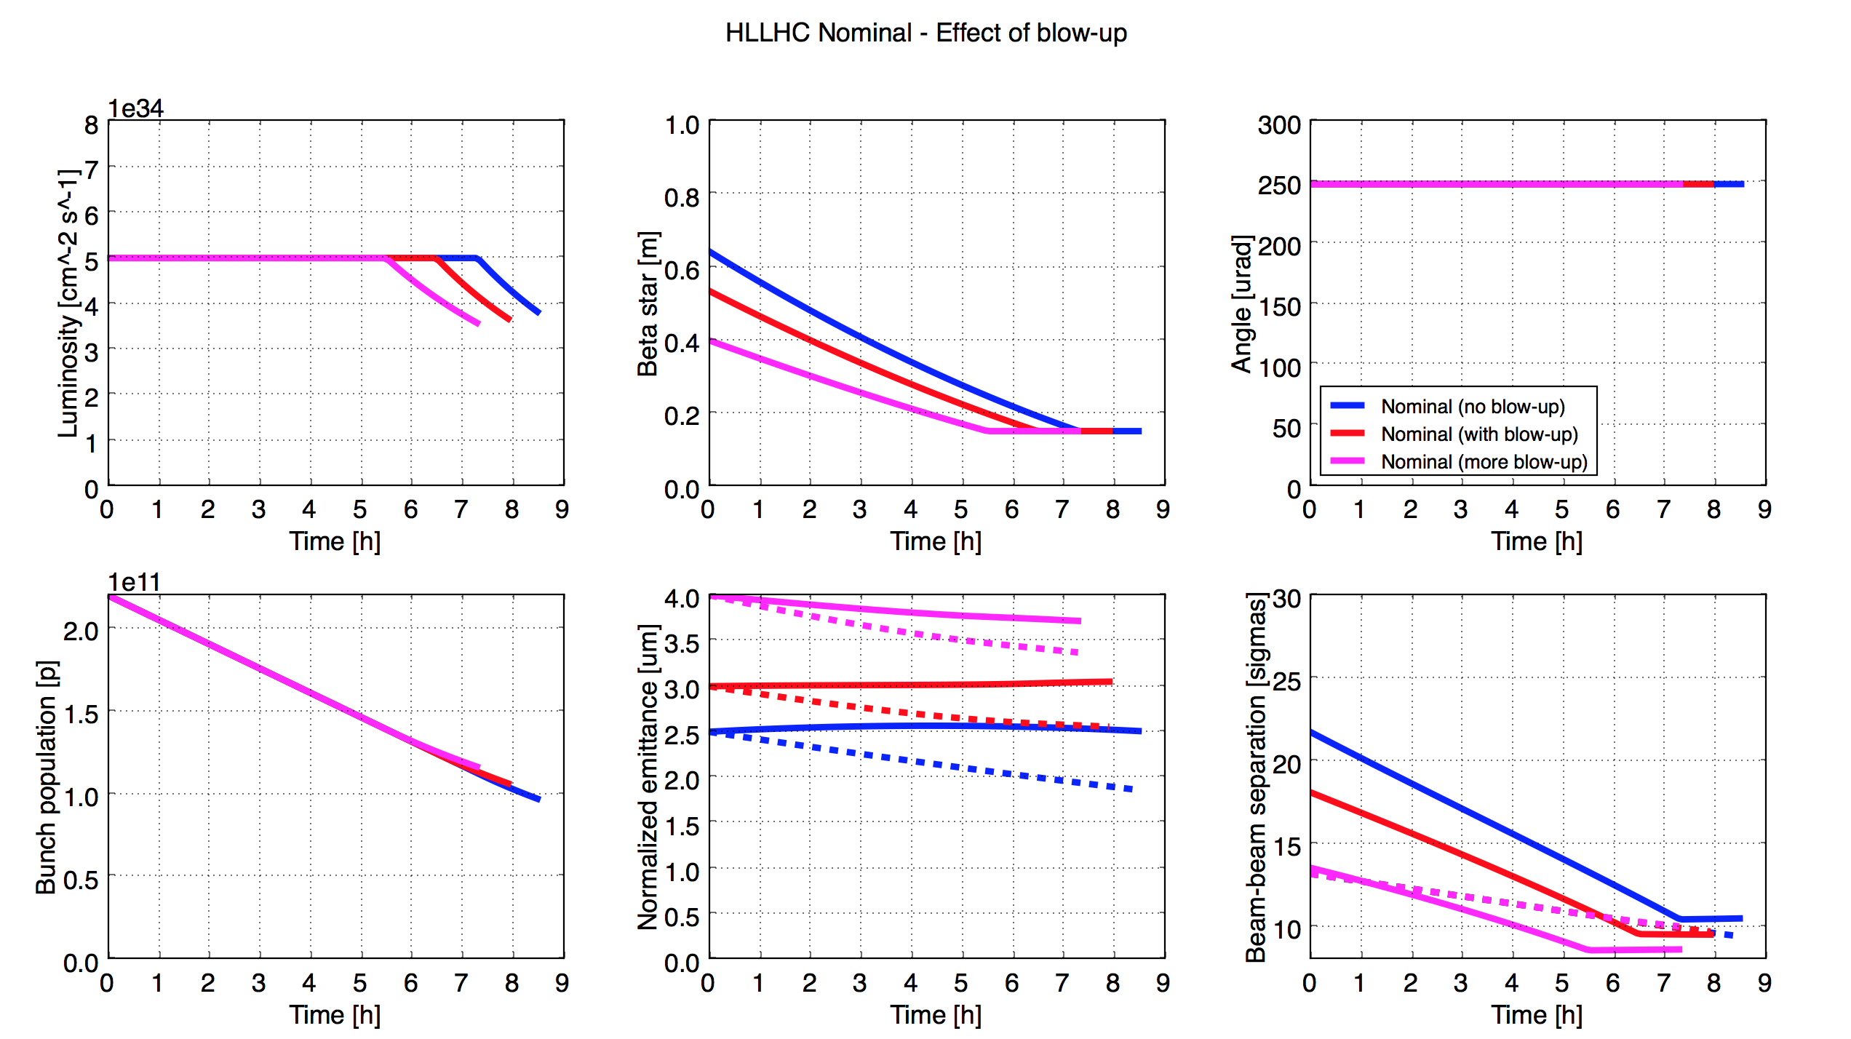

Slide 31


