Slide 1
Introduction to PSI-ID team
Marco Calvi & Thomas Schmidt :: SwissFEL IDs :: Paul Scherrer Institute
Compact Light source – WP5 meeting
December 18, 2017

Slide 2
Paul Scherrer Institute
Alps
SLS
SwissFEL
Aare

Slide 3
SLS – 2.4 GeV Light Source

Slide 4
SwissFEL

Slide 5
SwissFEL Project
phase 1 (2013-2016)
phase 2 (2017-2020)
ATHOS 0.65-5nm
user
stations
BC1
BC2
2.9-3.4 GeV
Injector
Linac 1
Linac 2
Linac 3
0.35 GeV
2.0 GeV
3.15 GeV
2-5.8 GeV
ARAMIS 0.1-0.7 nm
2-7 GeV
PORTHOS 0.03-0.7nm
phase 3 (2025-2029)

Slide 6
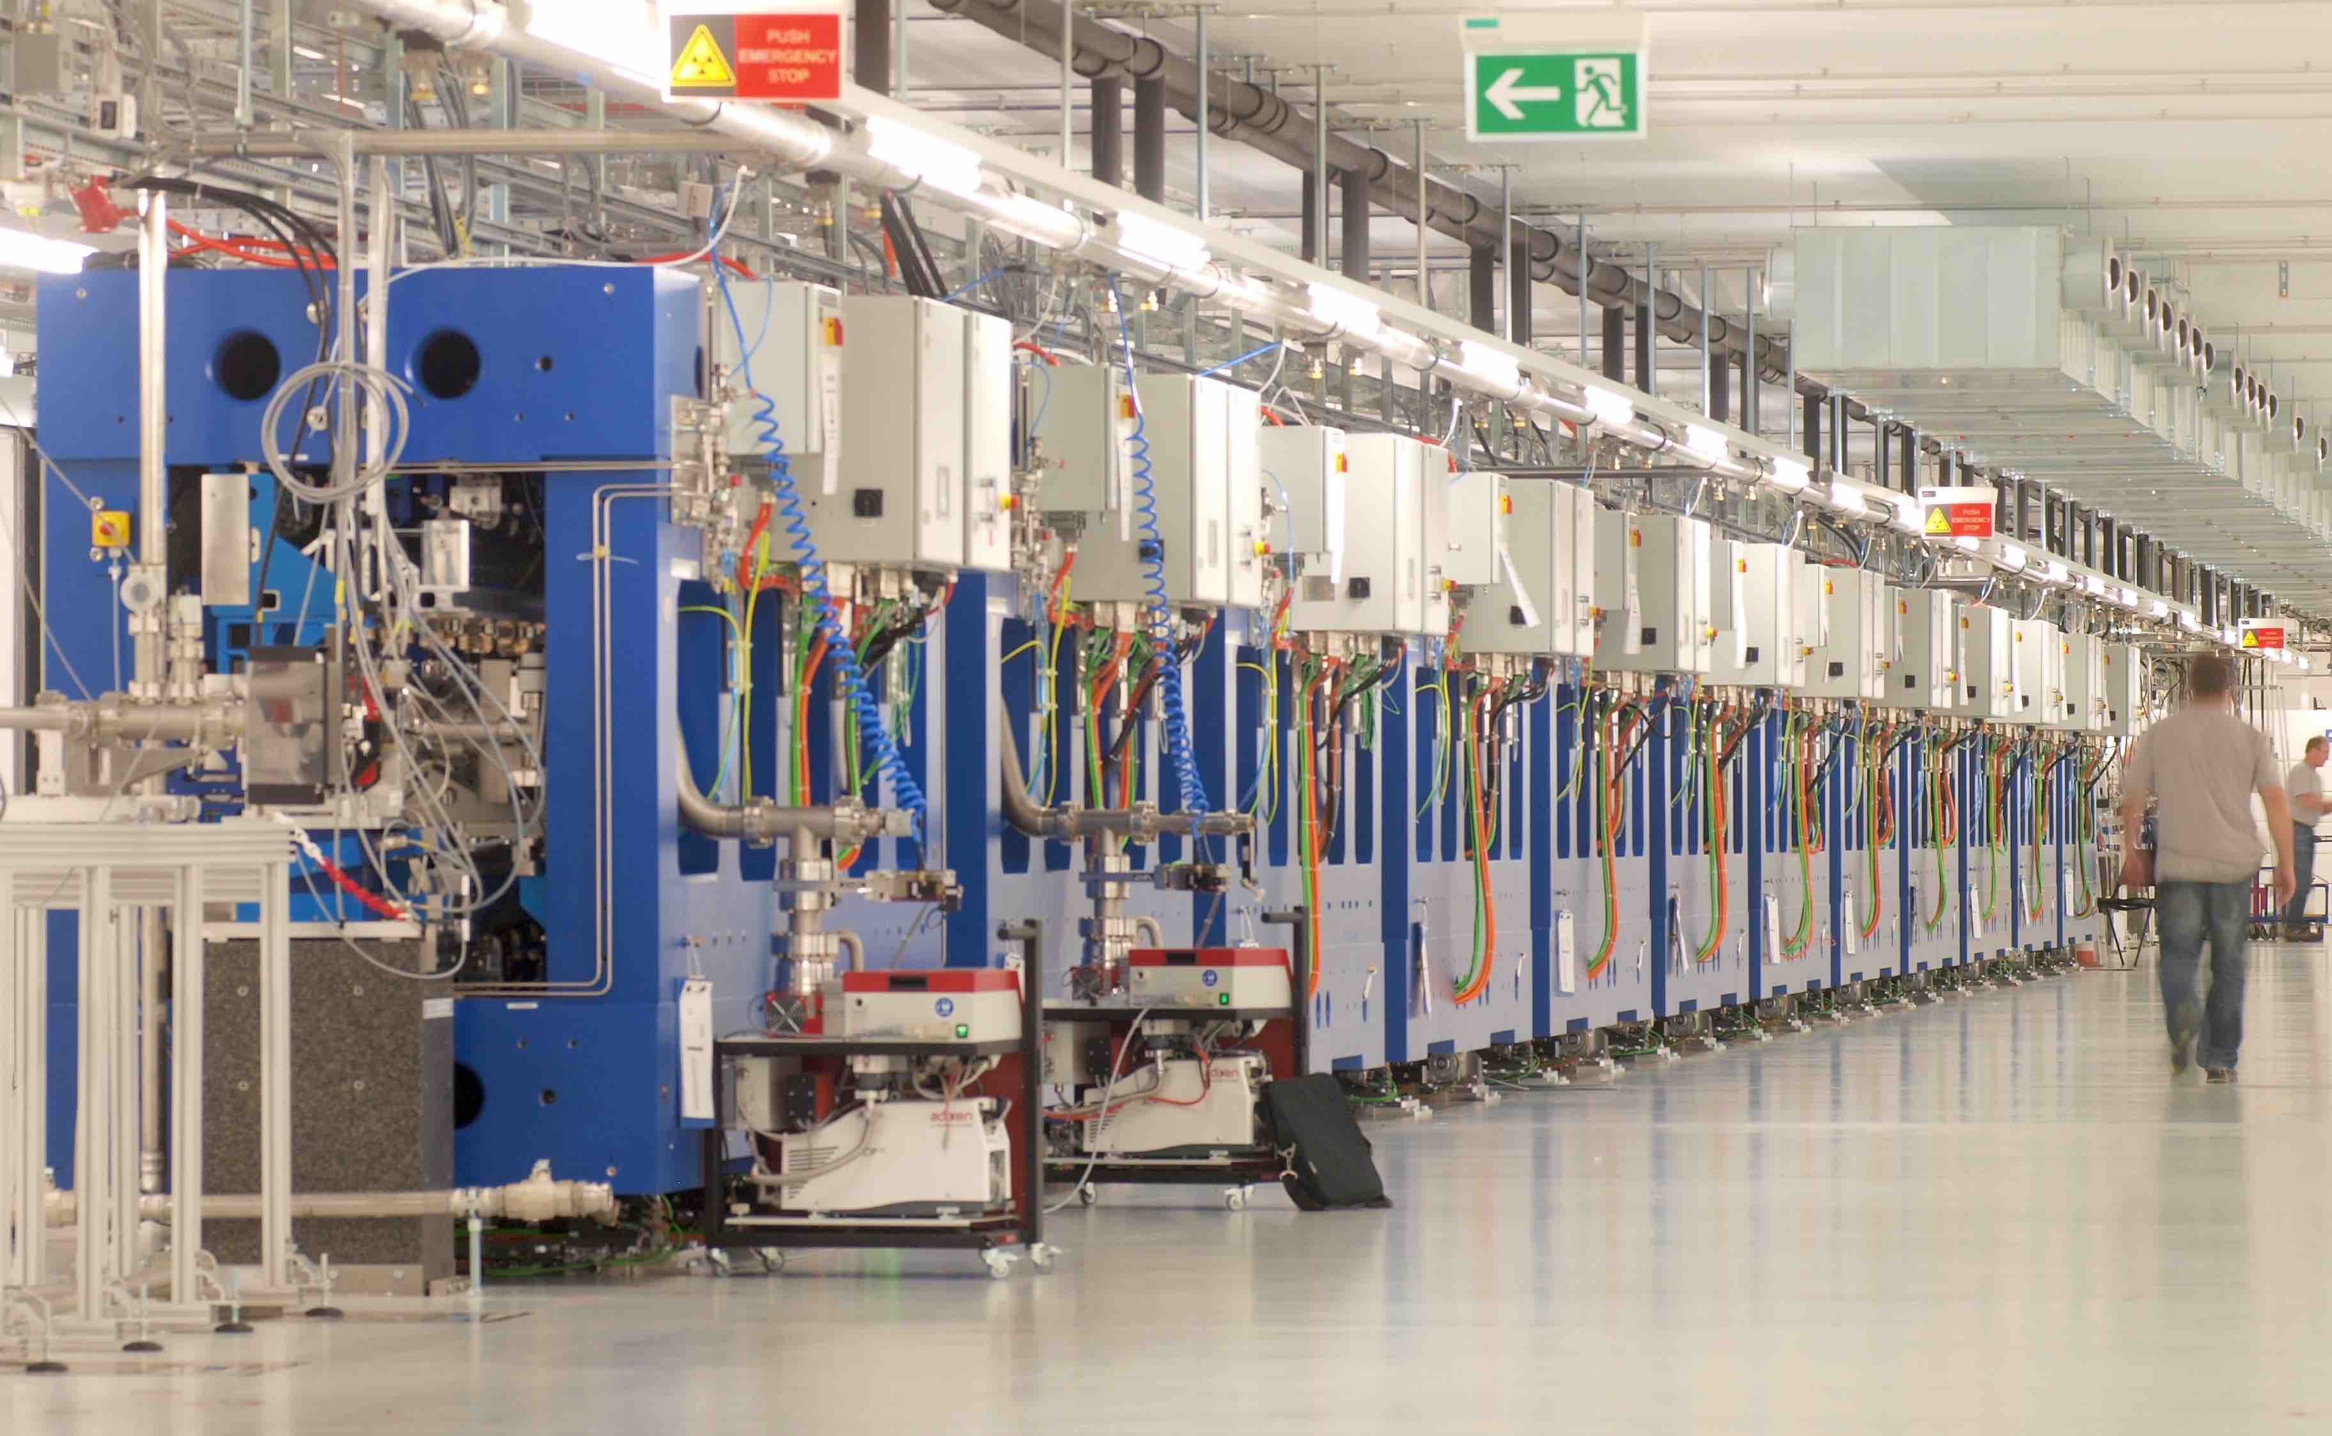
Aramis Undulatots
λu = 15mm and K ≤ 1.8
Permanent magnet (hybrid) in-vacuum undulators

Slide 7
Athos Undulators

Slide 8
Athos Undulators

Slide 9
Porthos Undulators?
λ_{u} = 10mm
gap = 4.0mm
T_{op} = 6.0 K
R.Kinjo et al., Applied Physics Express 6 (2013) 04270

Slide 10
Wir schaffen Wissen – heute für morgen
Thanks for your attention

