Slide 1
STFC WP5 Contributions
Jim Clarke
18/12/17

Slide 2
STFC
Expertise
  Familiar with most types of undulator technology and design
  Have worked on superconducting undulators for many years
Our Goals for WP5
  Application of SC undulators to FELs
  Develop understanding of limitations
    Technological (NbTi)
    Accelerator physics (wakefields)
    FEL output

Slide 3
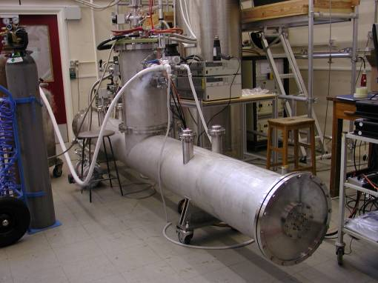

Example Helical Undulator
ILC Positron Source undulator under test at RAL (2009)
11.5mm period, Bx=By=1.1T successfully demonstrated
4m module contains 2 x 1.75m helical undulators, circular beam aperture diameter = 5.25mm
+
-
D J Scott et al, Phys Rev Lett, 107, 174803 (2011)

Slide 4
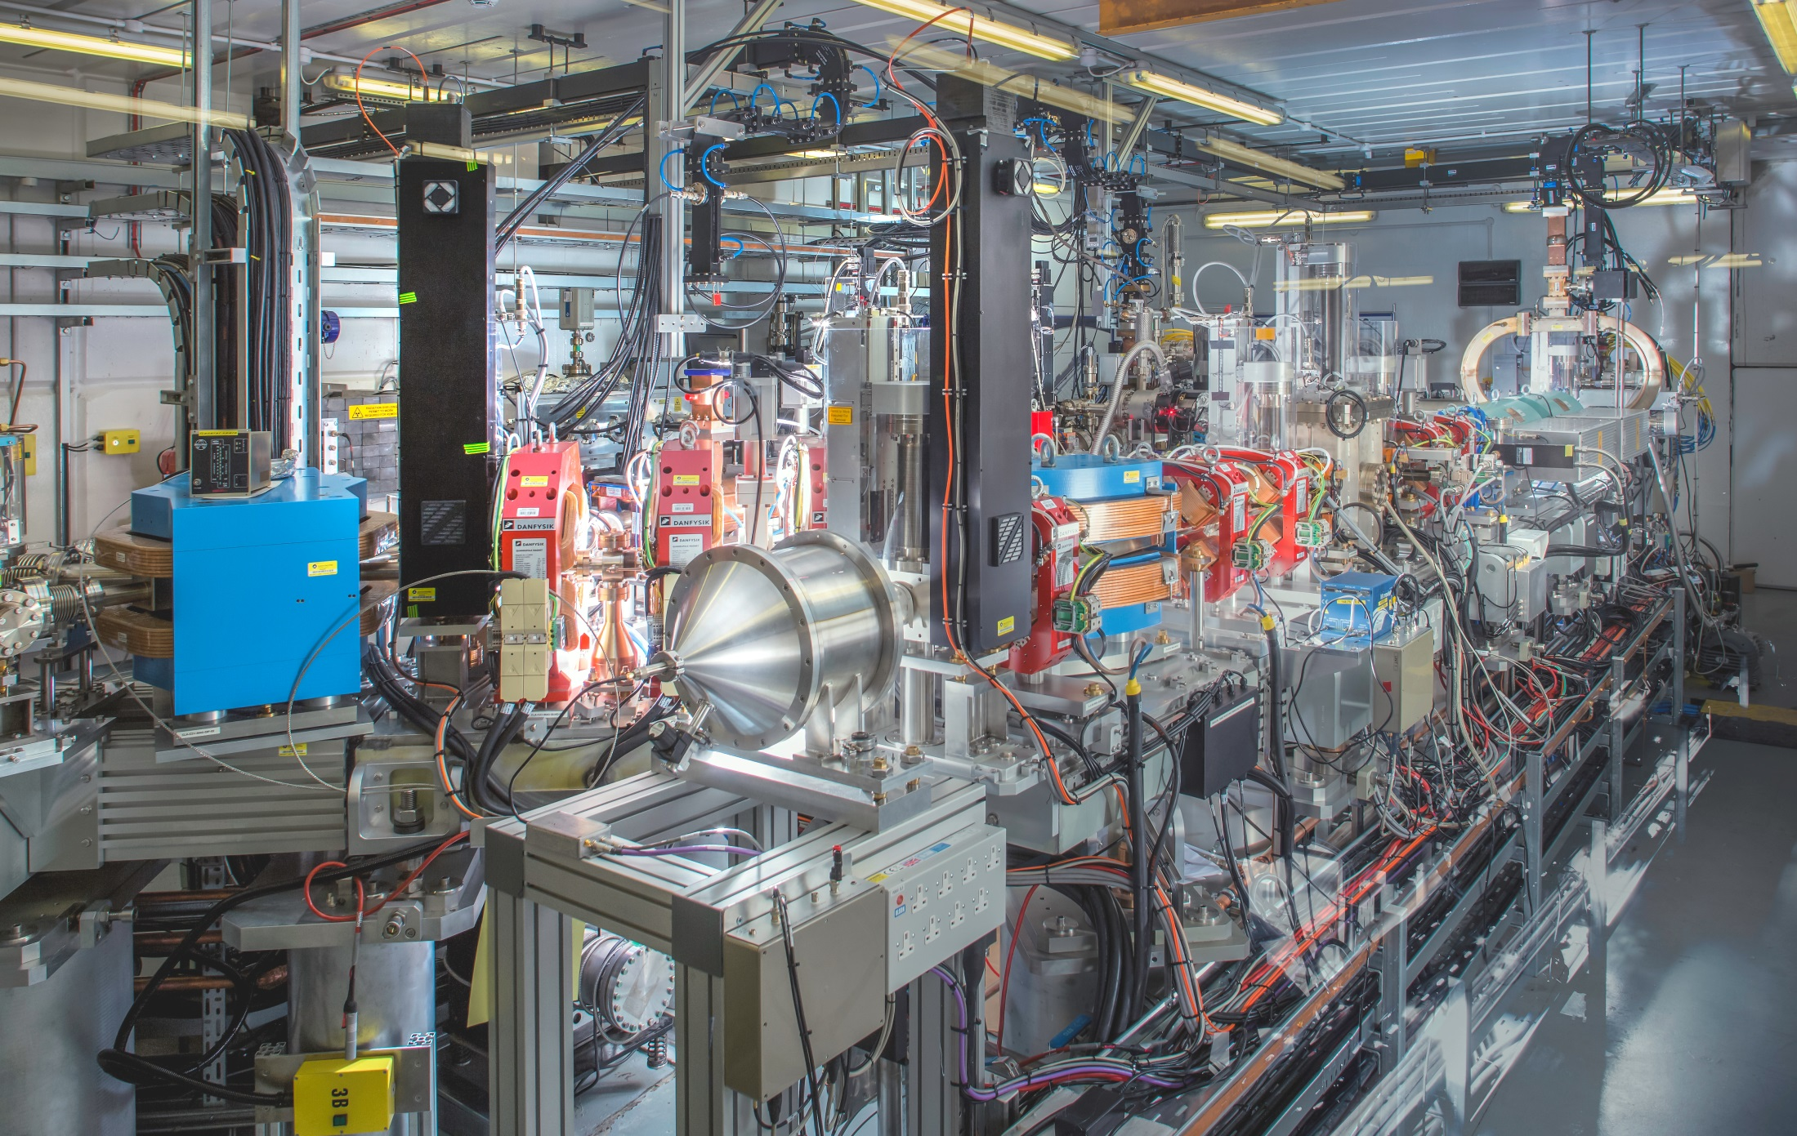
CLARA Phase 1: 50 MeV/10Hz gun (+ 400Hz gun)

Slide 5
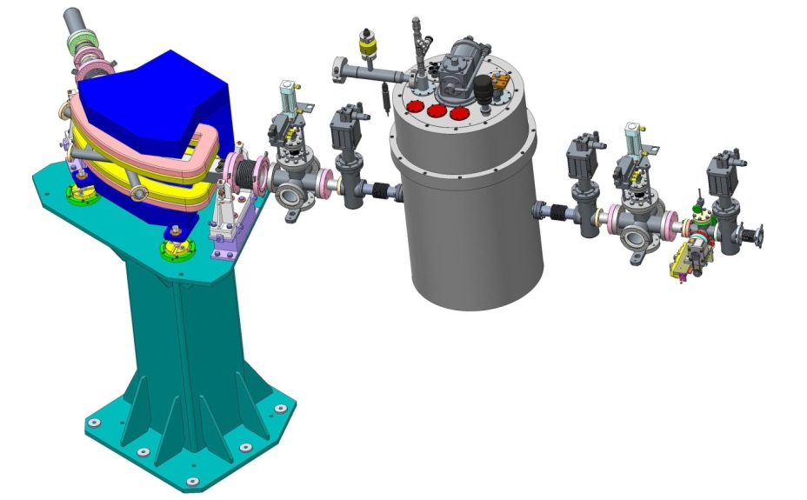
FEL SCU Demo on CLARA
We are now assembling a 30cm SCU Demo
15.5mm period, 7.4mm gap, B = 1.25T, K = 1.8
Install and test on CLARA FEL Test Facility at Daresbury
Electron beam

