Slide 1
F2D2
- Design Options -
E. Rochepault
12/12/2017

Slide 2
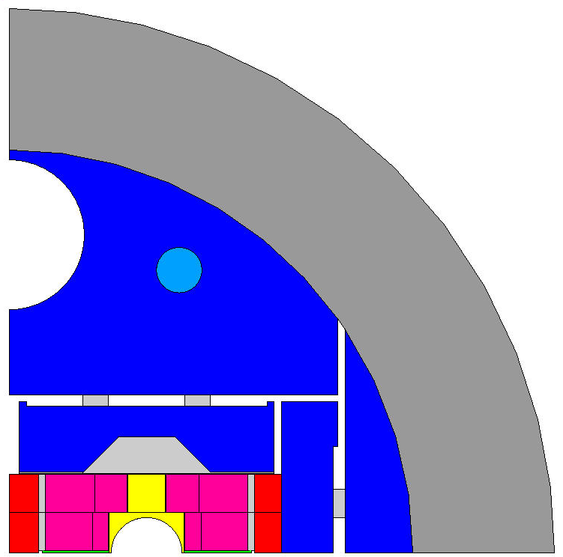
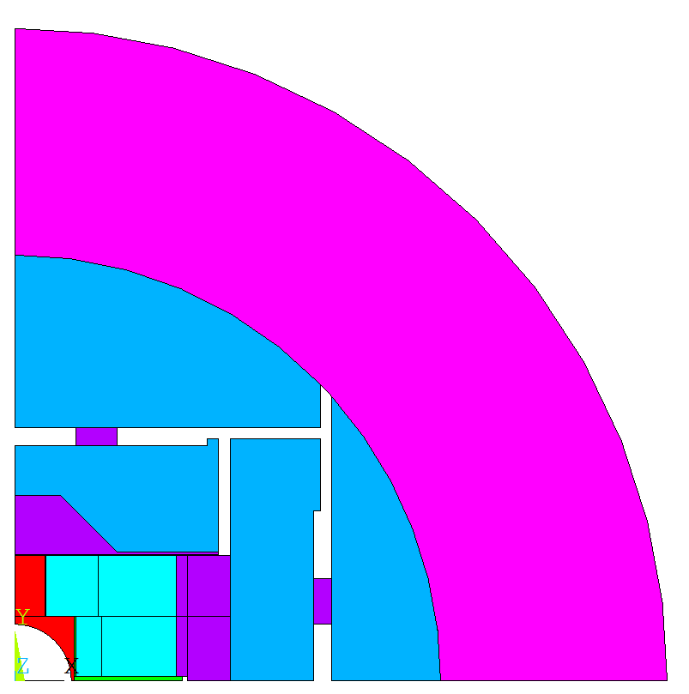
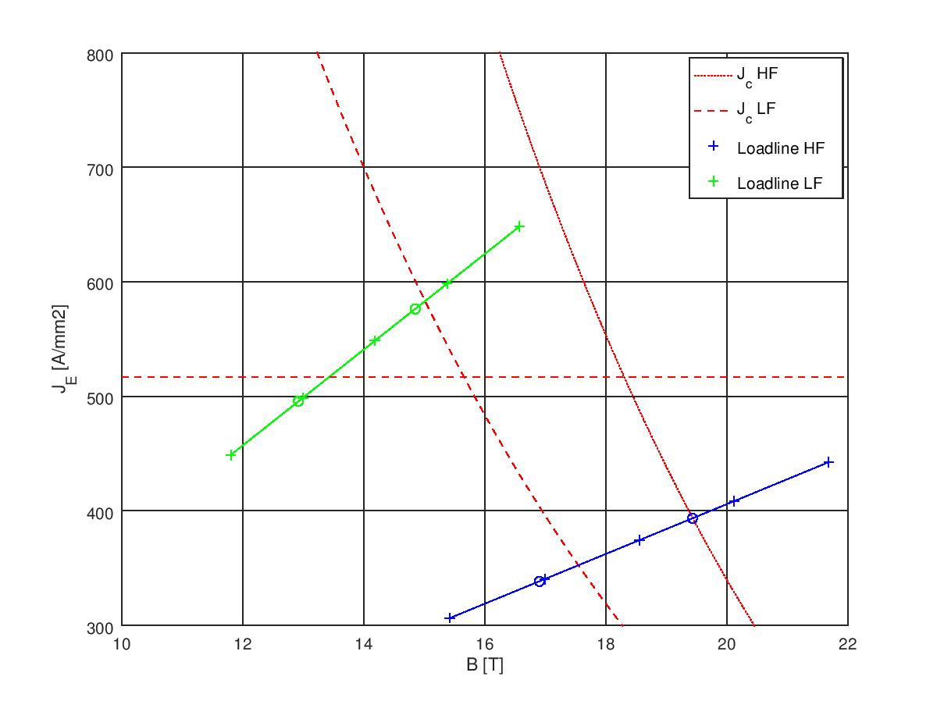
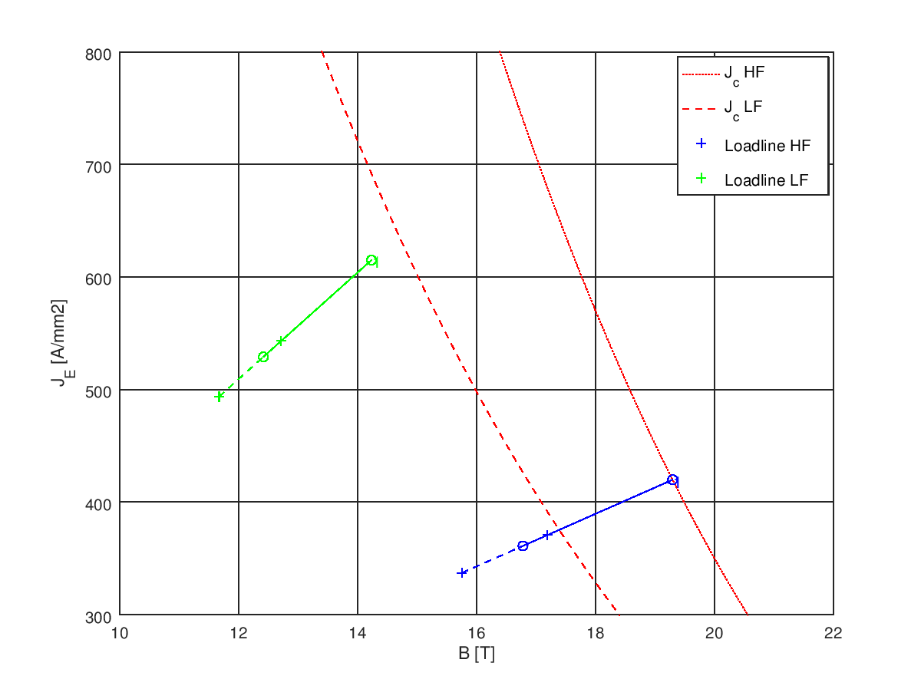
V1: from double to single aperture
ECC double aperture
Translation in a single aperture
Ø770 mm
Ø576 mm
97 mm
interbeam
100 mm
15,8 T @ 86 %
16,1 T @ 86 %
100 mm
Available margin
J_{E} = 496 A/mm²
J_{Cu} = 1151 A/mm²
J_{E} = 528 A/mm²
J_{Cu} = 1206 A/mm²

Slide 3
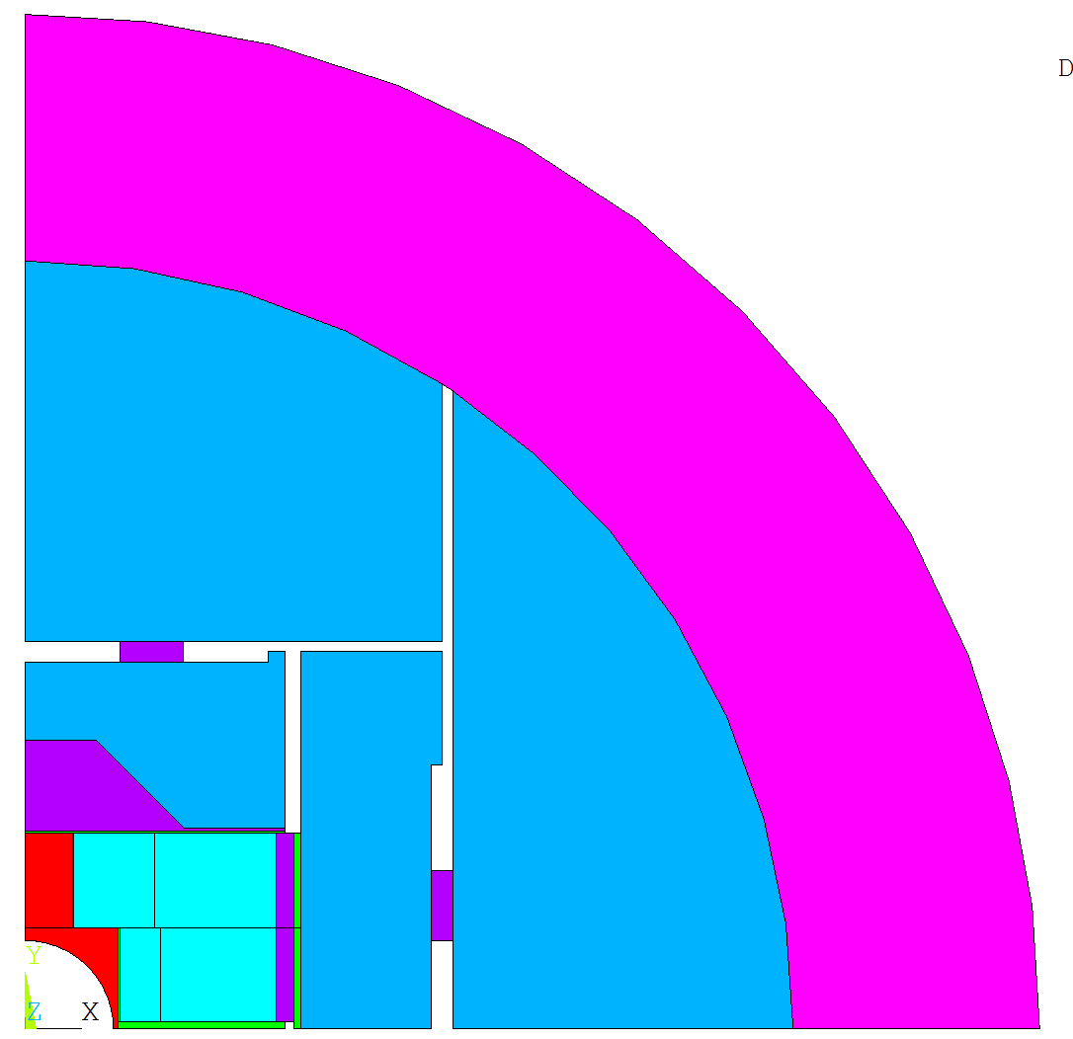
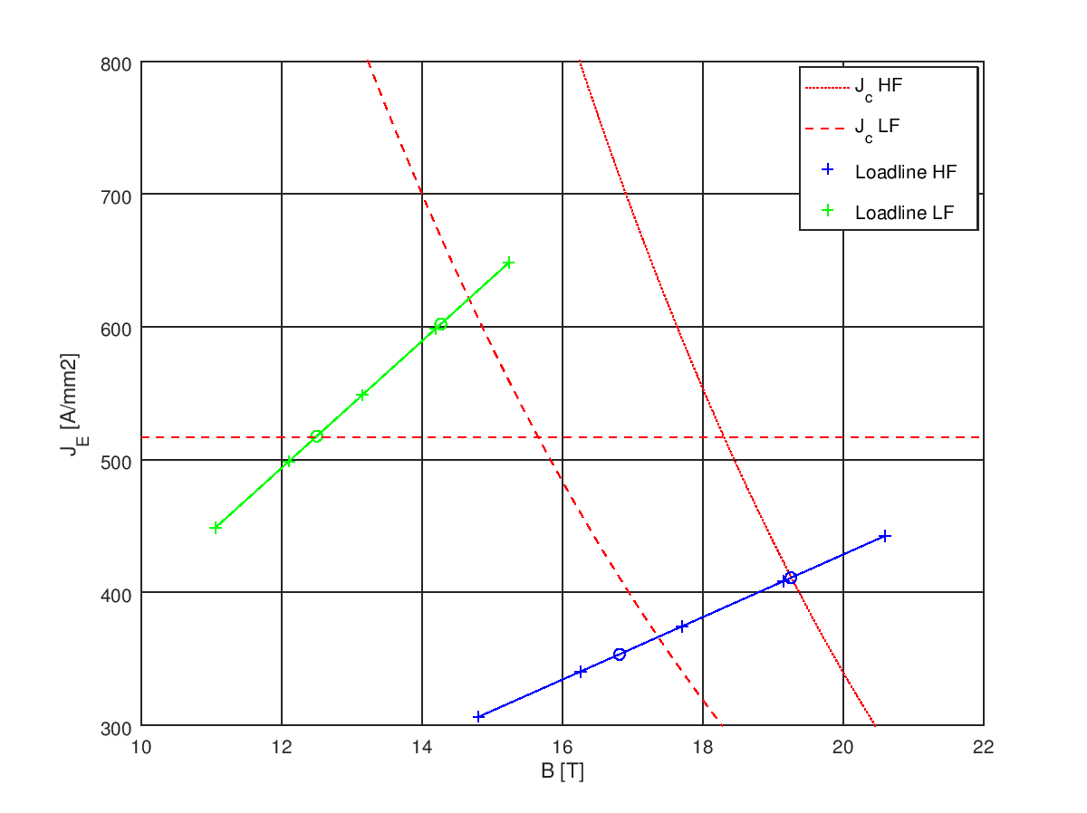
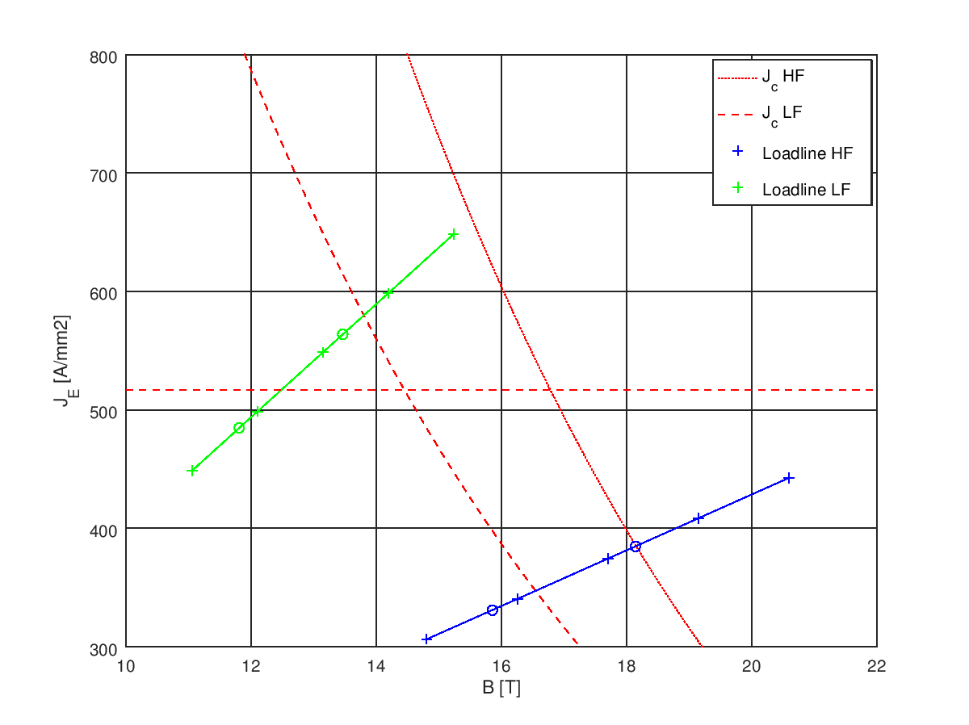
V2: Starting Point of the Optimization
Same coil
Same OD
Reduced shell 100 → 70 mm
Reduced rail 18,6 → 2 mm
Reduced keys 5 → 3 mm
Ø576 mm
70 mm
1500 A/mm2 @ 16 T, 4,2 K
0,8 Cu:nCu HF
16,0 T @ 86 %
1200 A/mm2 @ 16 T, 4,2 K
1,0 Cu:nCu HF
15,1 T @ 86 %
J_{E} = 518 A/mm²
J_{Cu} = 1202 A/mm²
J_{E} = 485 A/mm²
J_{Cu} = 1126 A/mm²

Slide 4
Summary
Version | Jc @ 16 T, 4,2 K | Cu:nCu, HF | Quadrant area | Field at 86 % of LL | J_{Cu,HF}
V1 double (ECC) | 1500 | 0,8 | 2734x2 | 16,1 | 1151
V1 single | 1500 | 0,8 | 2734 | 15,8 | 1206
V2, FCC strand | 1500 | 0,8 | 2734 | 16,0 | 1202
V2, DEM strand | 1200 | 1 | 2734 | 15,1 | 1126
V2.1, margin optimization | 1200 | 0,9 | 2734 | >15,1 | <1200
V2.2, field optimization | 1200 | 0,9 | >2734 | 16,0 | <1200

Slide 5
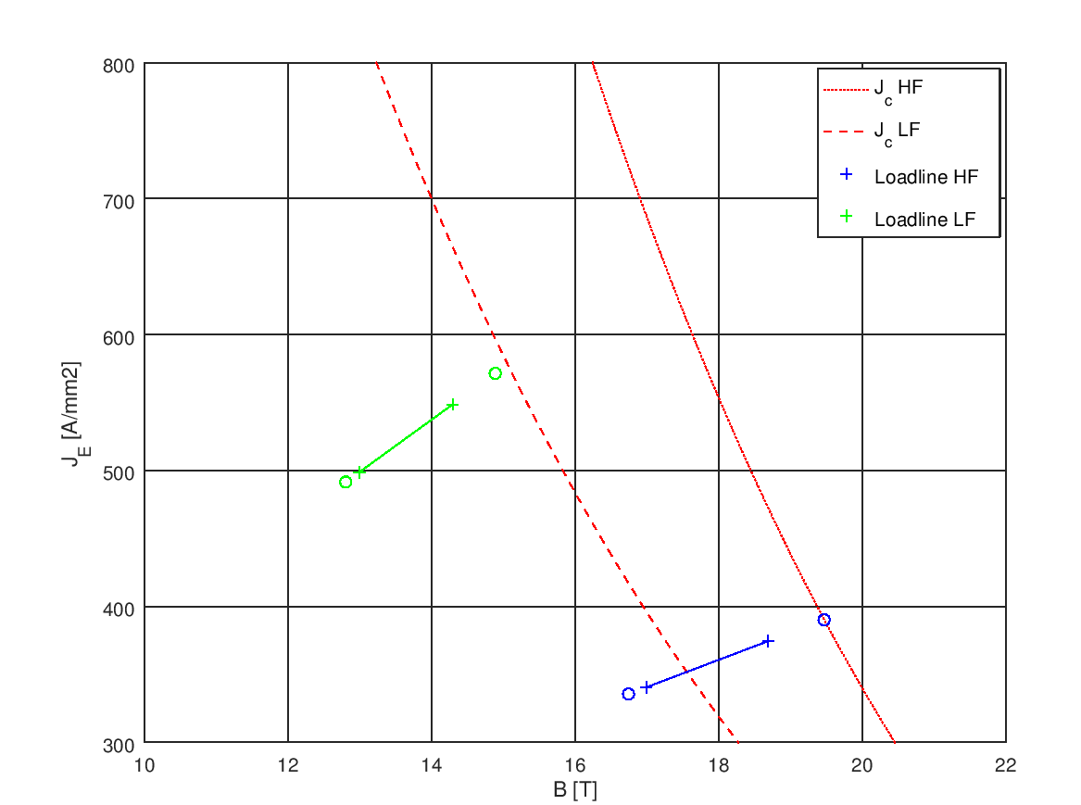
Double Aperture, Short Sample evaluation
Linear trend with 2 adjacent points
(J = aB+b):
16,1 T @ 86 %
Margins at 10 kA = 13% HF / 14% LF
Linear trend starting from 0
(J = aB):
15,9 T @ 86 %
Margins at 10 kA = 13% HF / 16% LF
100 mm
14,9 T
576 A/mm2
14,9 T
571 A/mm2
19,4 T
393 A/mm2
12 kA
19,5 T
390 A/mm2
10 kA
11 kA
10 kA+10%
10 kA

Slide 6
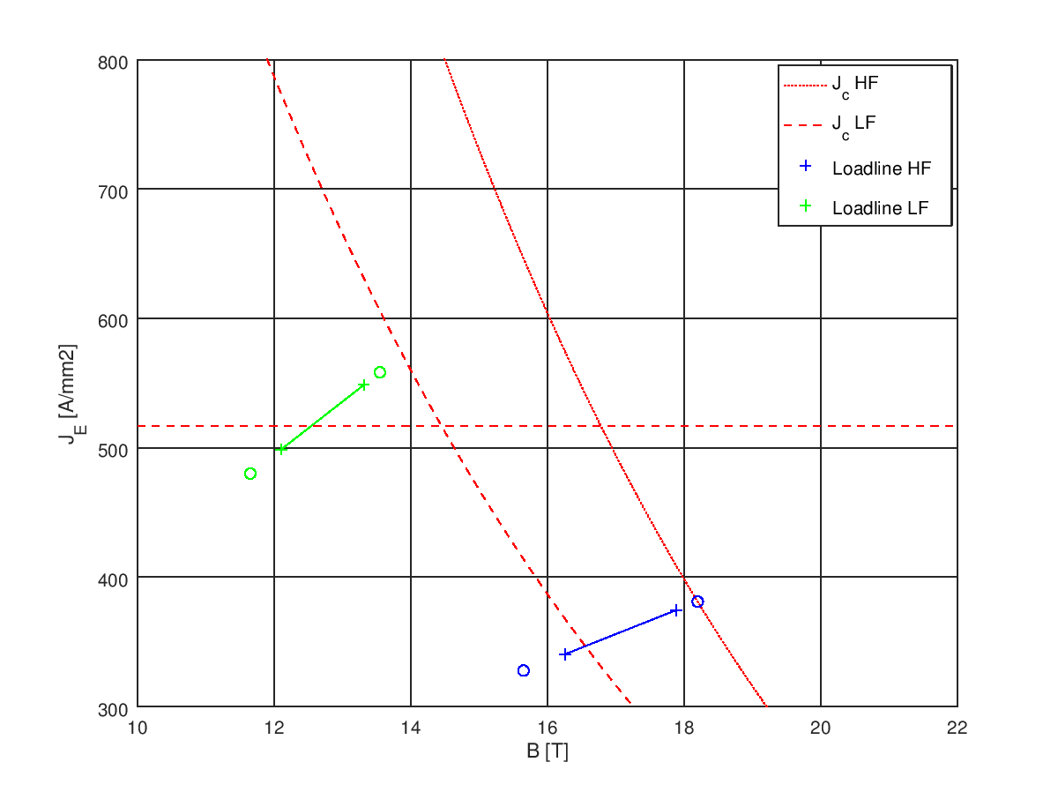
Single Aperture V2, Short Sample evaluation
Linear trend with 2 adjacent points
(J = aB+b):
15,1 T @ 86 %
Linear trend starting from 0
(J = aB):
14,9 T @ 86 %
100 mm
13,5 T
564 A/mm2
13,5 T
558 A/mm2
18,1 T
385 A/mm2
18,2 T
381 A/mm2

