Slide 1


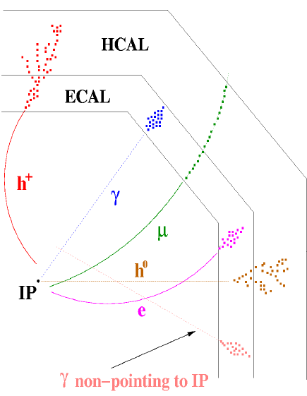
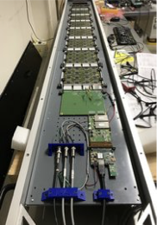
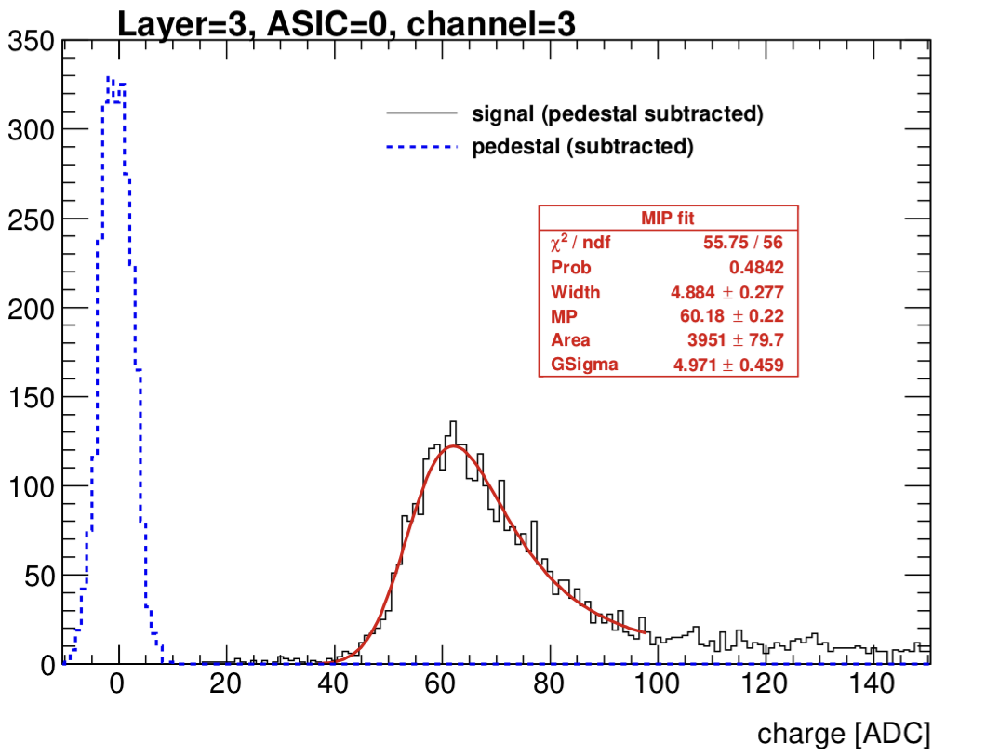
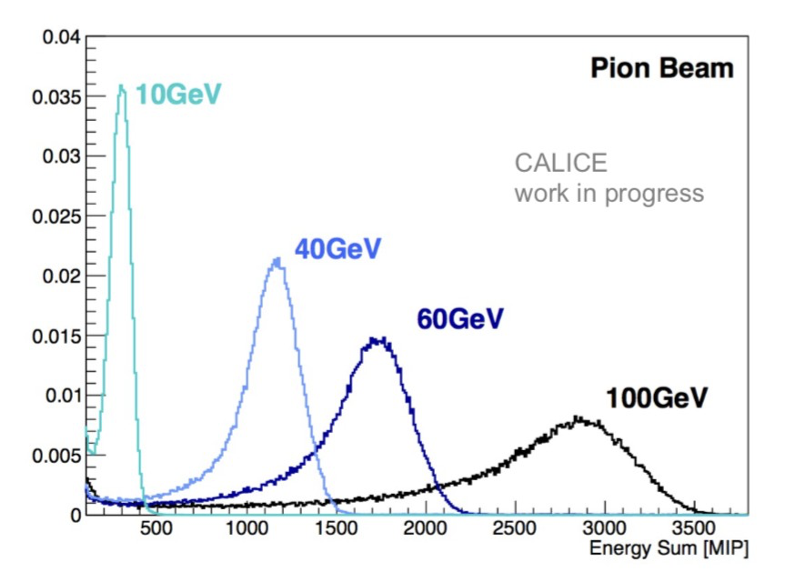
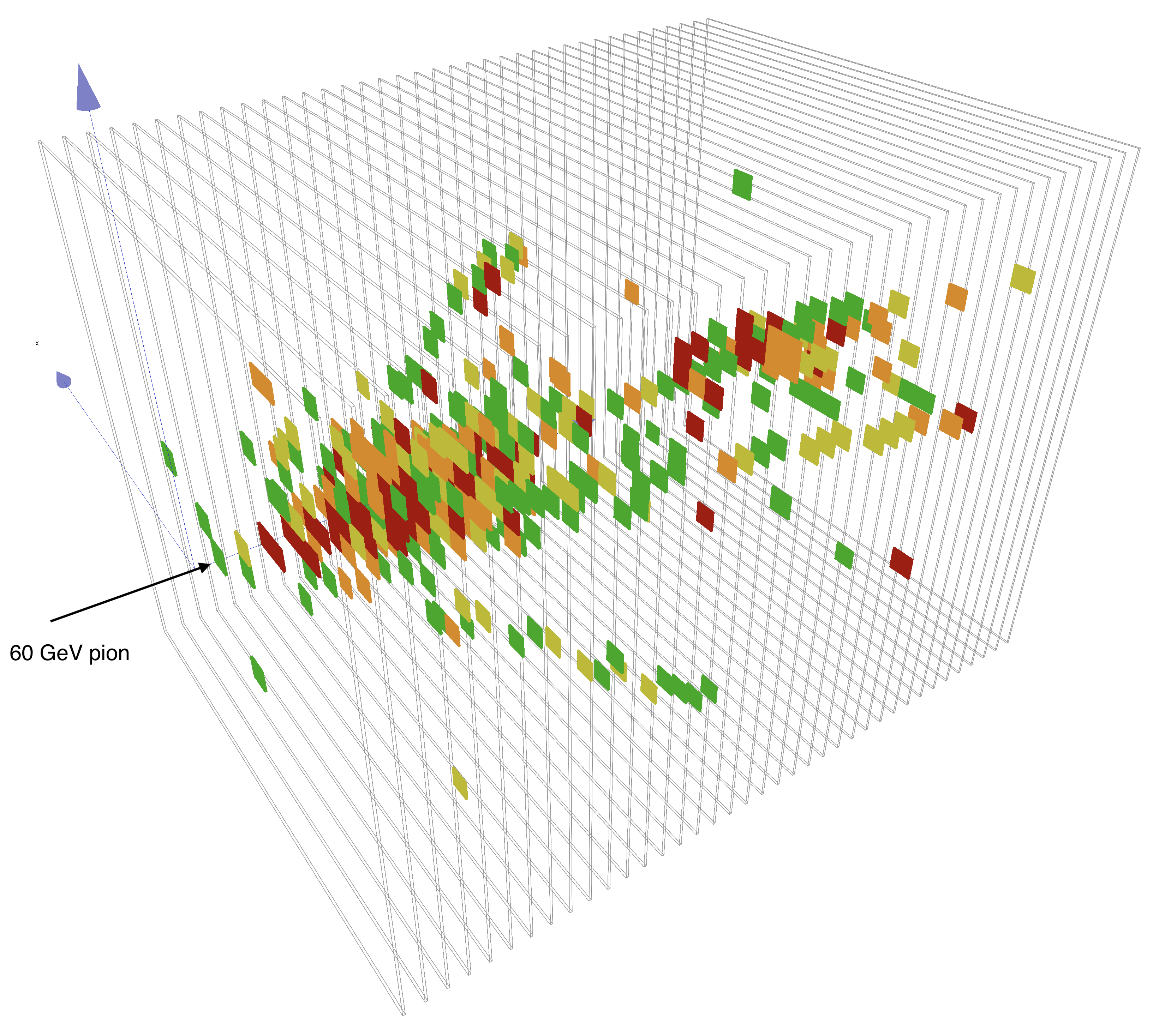
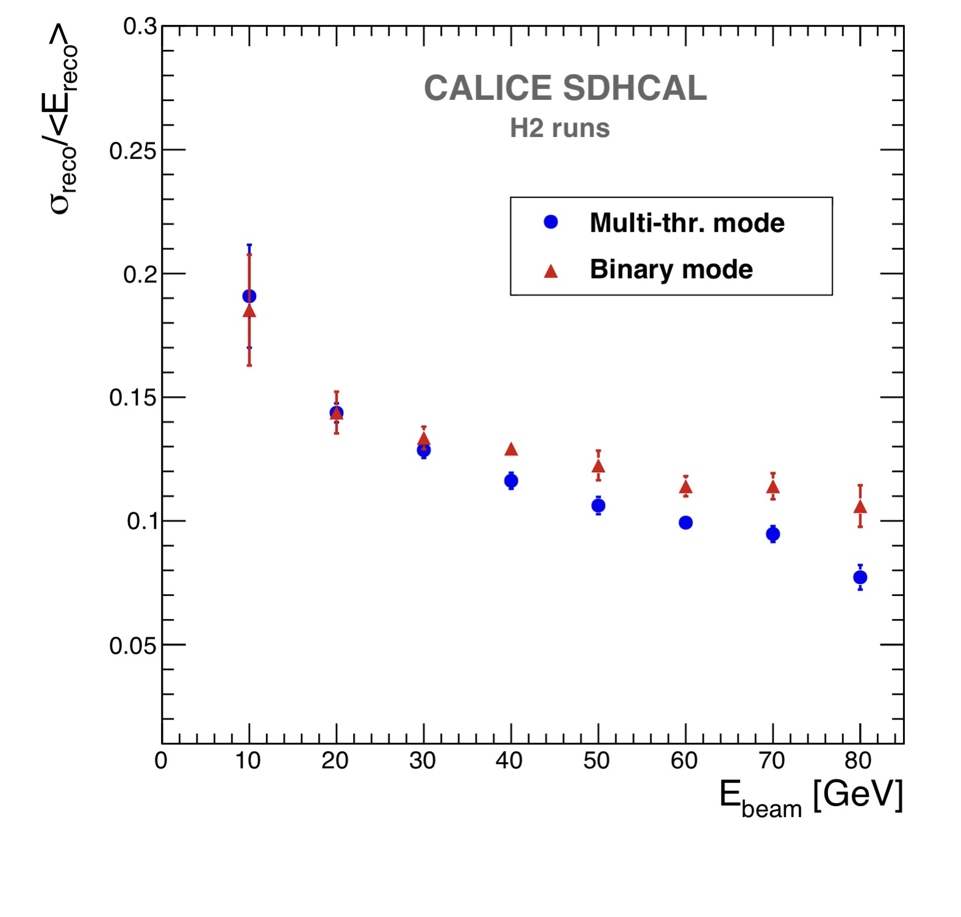
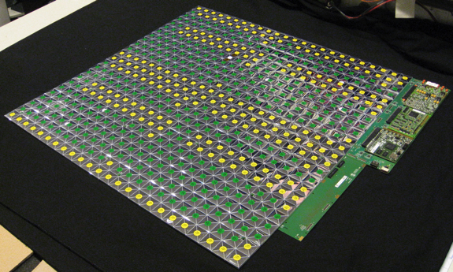
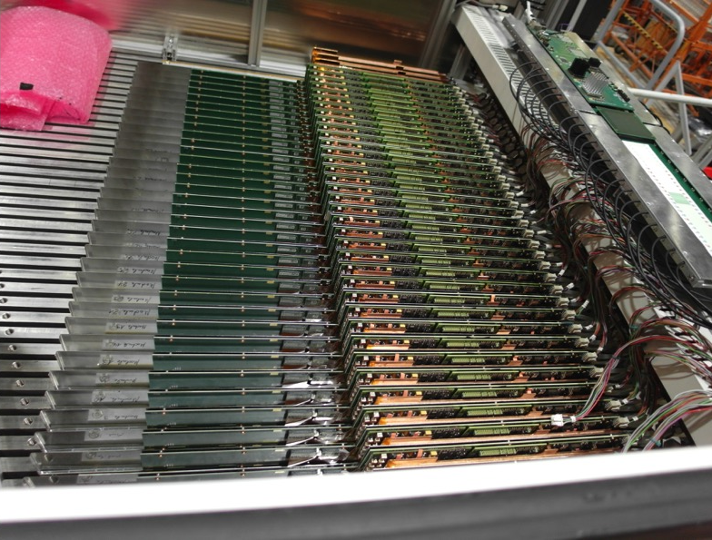
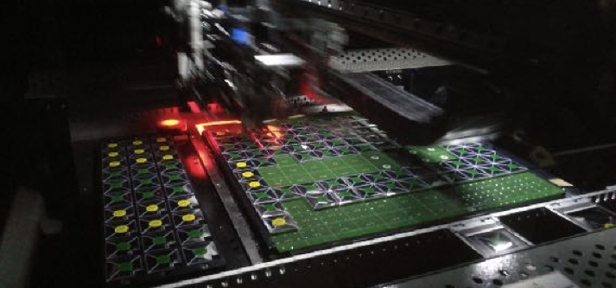
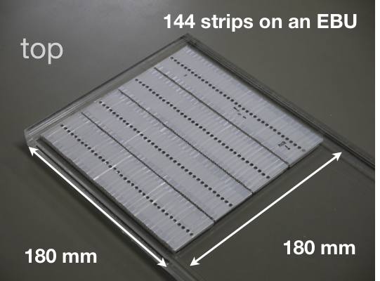
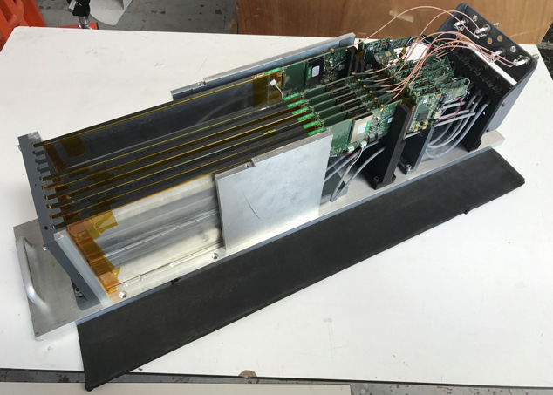
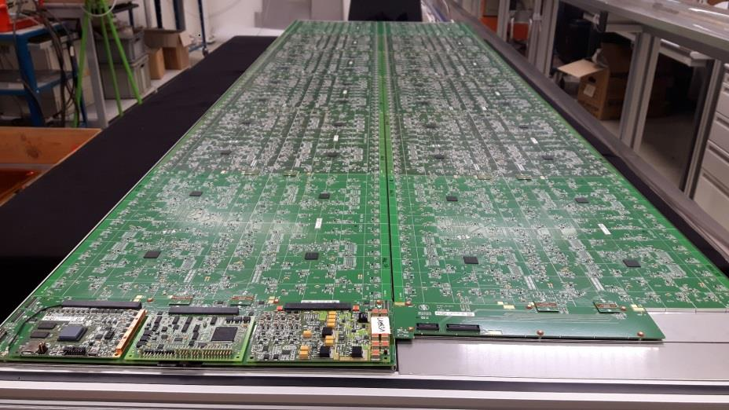
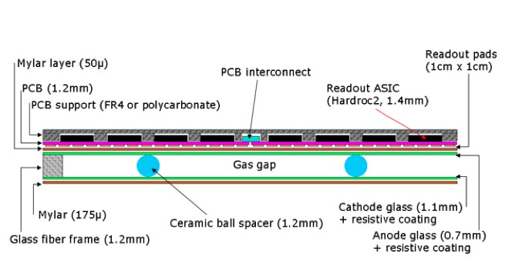
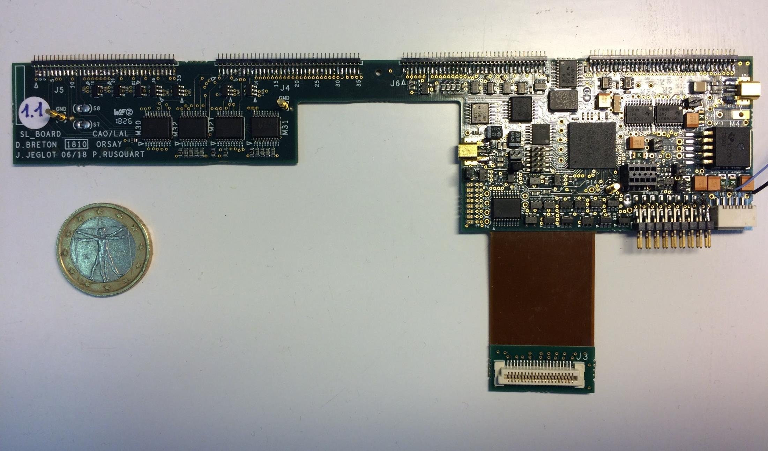
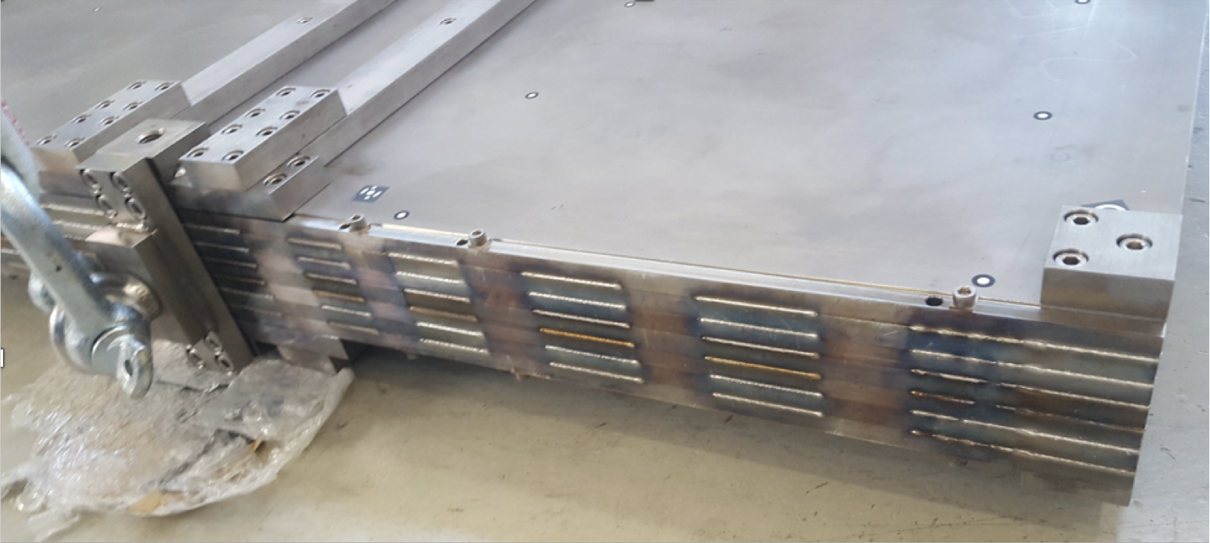
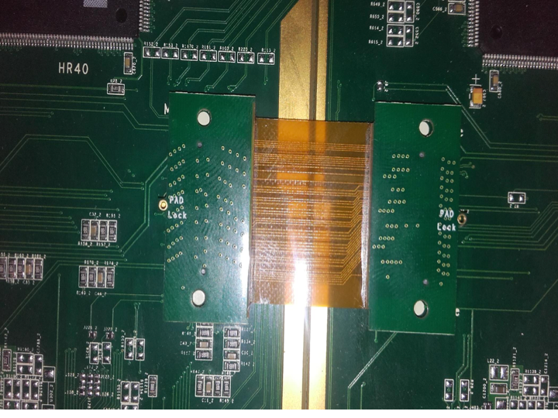


Towards Realistic Implementations of Large Imaging Calorimeters
The CALICE Program
Development of highly granular electromagnetic and hadronic calorimeters for particle flow reconstruction in future collider experiments. Key steps:
  Validation of the concept of high granularity with physics prototypes ✓
  Technical realization of detector systems satisfying collider constraints - Technological prototypes with fully embedded electronics tested in particle beams
  Application of CALICE expertise and technology in running experiments e.g. CMS HGCal
Particle Flow Calorimetry
High sampling frequency and granularity in calorimeters to separate particle showers
Avoid dead material between tracker and calorimeters
➤ Calorimeters have to be inside the magnet coil
Requires the design of very compact service electronics and active layers sensitive to the MIP level
Requires precise mechanical assembly of the calorimeter structure allowing only small tolerances over large areas
A key element: Use of common technologies and infrastructure, such as a common ASIC family (SKIROC, SPIROC, HARDROC) to facilitate combined running.
Silicon Readout
ECAL with tungsten absorber (SiW ECAL):
Silicon pixels as active material
9x9 cm² wafers with 5.5x5.5 mm² cell size
Achievements
Signal to Noise ratio = MPV_{MIPS}/𝜎_{Noise} ~20 in the SiW ECAL:
Ability to trigger on and read out small signals (MIPS) demonstrated
Timing on a single cell level:
~3.3ns for the AHCAL in test beam mode, higher time resolution possible with faster clock setting
Single base units (ASU‘s) validated at low energies
16 ASICs and 1024 channels per ASU
Full QA and assembly chain
Validation of up-scalability to long slabs of 8 chained modules (barrel ECAL)
Successful single cell MIP calibration of the full AHCAL prototype:
Good overall detector response
Signal to Noise ratio = MPV_{MIPS}/𝜎_{Noise} ~50
Beam Tests of Technological Prototypes
Assembly of ~1 m² prototypes with fully embedded electronics
Testing of binary versus multi threshold mode of the GRPCs:
Two bit multi threshold mode improves energy resolution in SDHCAL
SiPM-on-Tile
Analogue HCAL (AHCAL):
Scintillator tiles with individual MPPC readout
3x3 cm² segmentation
Rigorous testing of all technologies at TB facilities at CERN/DESY
Automated assembly of large layers by pick and place machines
𝜋⁻
60 GeV AHCAL Event
QA assurance of all modules
Sample testing of MPPC batches
AHCAL prototype with 39 layers
SiW ECAL prototype with 15 layers
SDHCAL prototype with 48 layers
Integration
Small scale detector interfaces (DIF) as link between ASICS and DAQ system
Similar technology used for a scintillator strip ECAL:
High effective granularity achieved by crossed strips in adjacent layers
AHCAL
Gaseous Readout
GRPC based hadronic
calorimeter (SDHCAL):
binary and two bit readout
1 cm² pad size
Key developments towards scalability to full size experiments
Precision mechanics to assemble structural components, e.g. Electron beam welding of absorber structure for excellent surface flatness and minimal deformation over large areas
Compact SL-board and low profile connectors as interface for slow control and readout of up to 15 chained slabs
SDHCAL
SiW ECAL
Improved gas flow for new 1x2 m² GRPC plates
Development of flat interconnections between detector modules to facilitate compact layers
SDHCAL
Author: Lorenz Emberger (emberger@mpp.mpg.de)
Max-Planck-Institute for Physics
Föhringer Ring 6
80805 Munich
Presenter: Kiyotomo Kawagoe (kawagoe@phys.kyushu-u.ac.jp)
Department of Physics and RCAPP
Kyushu University
744 Motooka Nishi-ku Fukuoka, 819-0395 Japan
for the CALICE Collaboration
Notes:
11

