Slide 1
ISVHECRI2018 SPC+IAC discussion
20 Dec 2017 SPC+IAC
Y.Itow

Slide 2
IAC, SPC
SPC and IAC collaborate to arrange program
IAC
  Suggest overall agenda, program structure
  Suggest invited talks, speakers directly
SPC = Conveners
  Propose talks and speakers in each session
  Arrange programs and contact speakers in each session
  Also discuss among all the conveners to look over the sessions.
  Select contribution talks

Slide 3
Conveners (SPC)
UHECR/HECR | Lorenzo Cazon (LIP), Hiroyuki Sagawa(ICRR), Yusaku Katayose (YNU)
Accelerator | David Berge (DESY), Hiroaki Menjo (Nagoya)
Gamma-ray | David Berge (DESY), Takashi Sako (ICRR)
Neutrino | Seon-Hee Seo (SNU), Yoshinari Hayato (ICRR)
Balloon/Space | Naoya Inoue (Saitama) + (TBA)
Model/hadron theory/particle thoery | Tanguy Pierog (KIT), Stefan Gieseke (KIT), Kazuki Itakura (KEK) + (TBA)
Astro-theory | Kota Murase (Penn State) + (TBA)

Slide 4
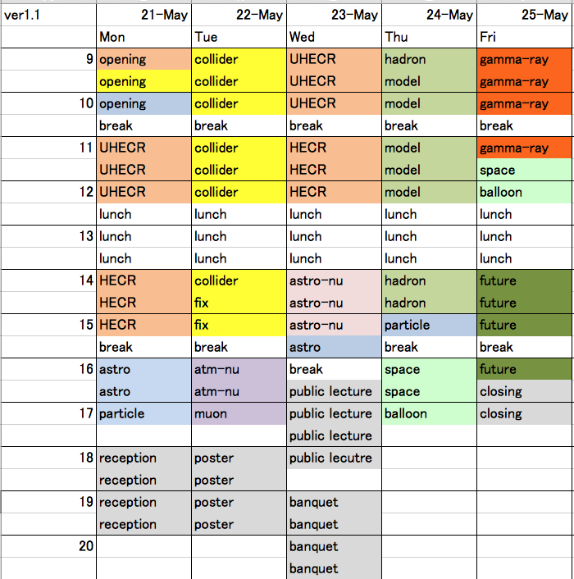
Program structure

Slide 5
Topics
Overview (CR exp/CR theory/Hadron) (1.5hrs)
UHECR/HECR (3hrs)
Neutrinos (2.5 hrs)
Gamma-rays (ground) (2 hrs)
Direct CR (balloon/space) (2hrs)
Accelerator experiments (4.5hrs)
Interaction models/hadron theory (4 hrs)
Astrophysics/particle Theory (2.5 hrs)
Future project (2 hrs)

Slide 6
Talks/Posters
Oral: Mainly invited + 10-30% for contribution
Rest of contribution will be poster
Invited Highlight talk (30-45min.)
Invited topical talk (20min.)
Contributed talk (20min.)
C.f. proceedings: 8p(oral 30-45min), 6p(oral 20min.),

Slide 7
Detail of sessions

Slide 8
Overview (Mon)
Overview session to define the scopes, motivate the meeting
  Overview of ISVHECRI series
  Overview of cosmic rays and astrophysics
  Overview of accelerator and models
  Maybe Some more overview talks here, multi-messenger, GW, etc., etc.
  Assume mostly theoretical overview
UHECR/HECR session #1
  Main results from UHECR/HECR expmnt’s. Spectrum, composition
  Review or experiment-dedicated ?
  Some contributed talk from experiments also.
Astro-theory session
  More topical CR- / astro-theory talks.
  Maybe some contributed talks
Reception at evening (on-site)

Slide 9
Overview (Tue)
Most of day dedicated for accelerator experiments
  Review or experiment-dedicated ? Prefer review + some specific topics from experiments.
  Review topics;
    particle production, (very) forward physics, pp cross section , strange/charm production, QGP/collective motion, cold nuclear matter effect, fix-target program, etc.
  Specific topics;
    Gas-get at LHCb, ALICE-ZDC, etc.
  Some talks from recent RHIC
  Encourage contribution for cosmic-ray dedicated experiment.
Neutrinos and leptons
  Low-E atmospheric neutrino flux modeling
  Include low energy fix target for atmospheric neutrinos
  Super-K/Hyper-K
  Underground muons
Poster session at evening (on-site)

Slide 10
Overview (Wed)
First half: UHECR/HECR #2 topical session
  Modeling air shower development
  Surface muons
  Interaction study using air shower
  Variety of air shower experiments
  Encourage contributions from air shower exp.
Late afternoon: Astro-neutrino
  IceCube and ANTARES main results
  Include IceTop results
  Neutrino production and hadron interactions
  Maybe neutrino interaction also
Public lecture by Prof. Kajita
  Dedicated for public audience, in Japanese
  Special tour to emulsion facility for meeting participants
Banquet at evening (at hotel)

Slide 11
Overview (Thu)
Morning dedicated for interaction models
  Review of Gribov-Regge theory at the beginning
  Talks by Model developers
  Application of interaction models
  Contribution for various hadron theory
Early Afternoon: Theory session
  Naturally hadron theory here
  Or maybe shared with astro-theory/direct CR exp
Late afternoon: balloon/space (direct charged CR exp.)
  Electron/positron review
  Primary CR spectra
  Balloon ECC and interaction study
Exotics
  Monopole, strangelets, other exotic search
  Dark photon, dark matter related
No official activity in the evening

Slide 12
Overview (Fri)
Gamma-ray session
  Review of air cherenkov exp
  Air shower gamma-ray exp., Tibet/Alpaca, HAWC, LHASSO, etc..
  Photo-production and muon-less showers
  Recent Fermi review
  Grain ECC gamma-rays
  Galactic gamma-ray production model
  LPM
Future
  Review of future projects
  Future UHECR, future accelerator, future neutrino, future gamma-ray
Closing
  Concluding remark

Slide 13
Post-conference (Sat-Sun)
Free tour day in Nagoya, Kyoto, Ise, and Tokyo organized by you.
Maybe organized 1day bus trip to Kamioka
Maybe travel agency desk at the site is need ?

Slide 14
Important dates
IUPAP document Nov 2017
1st Circular/web Dec 2017
Program definition early Dec 2017
SPC form/Conveners early Dec 2017
Speaker contact By end of 2017
Speaker nomination By mid Jan 2018
2nd Circular Feb 2018
Registration open Feb, 2017
Abstract deadline 15 Mar, 2018
Contribution selection early Apr
Registration close 7 May, 2018
Meeting date 21-25 May, 2018

Slide 15
Schedule
Settle key-speakers by mid Jan
  Propose talks/speakers among SPC with suggestion from IAC
  Start to contact key-invited speakers (i.e. overview, highlight etc) ASAP
  Start to contact speakers board of large experiments (i.e LHC, RHIC, IceCube, Auger/TA) ASAP
  Define theoretical talks and contact speakers
  Detail discussion among conveners will follow up in small Vidyo meetings.
1st Circular at the end of Dec
  Basic program structure appears in Indico
Registration open at 1st Feb (2nd Circular)
  Start to accept contribution until mid of March
  Show confirmed talks/speakers in Indico
Define contribution talks by early April and announce

