Slide 1
SUPERCONDUCTING MAGNET DESIGN
Tim van Dijk, Ole Grootes en Daniël Norbart
With thanks to Erwin Bielert (EP-ADO) and his team (Bryan and Nikolay)

Slide 2

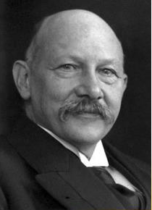
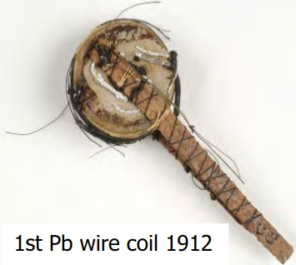
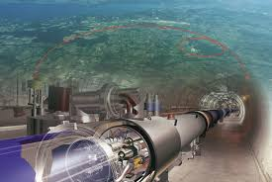
Superconductivity
1911
1970’s
2008
Heike Kamerlingh Onnes (NL)
liquefied Helium
First superconductive magnet
Biggest accelartor with
superconductive magnets: LHC

Slide 3
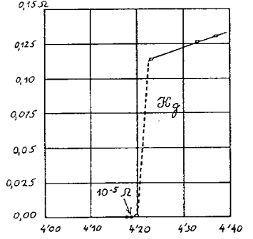
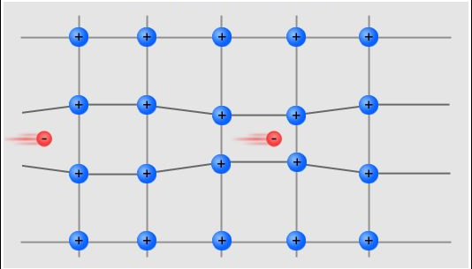
Superconductors

Slide 4
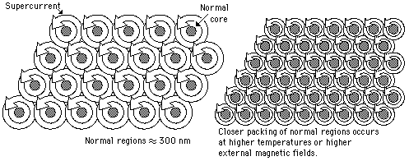
Superconductors

Slide 5
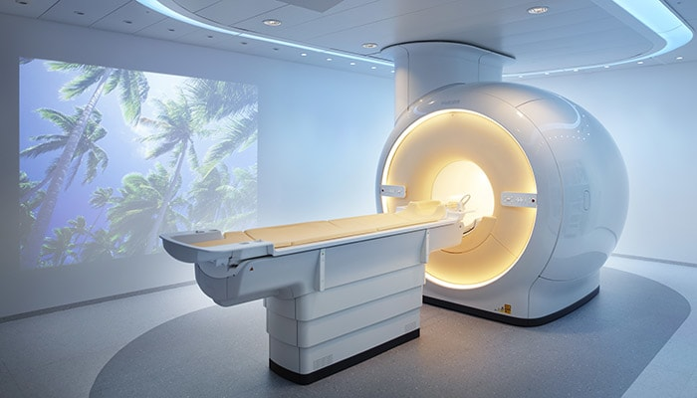
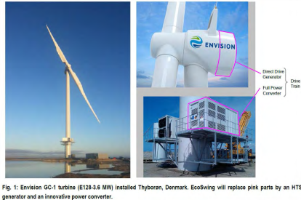
Use of magnets

Slide 6
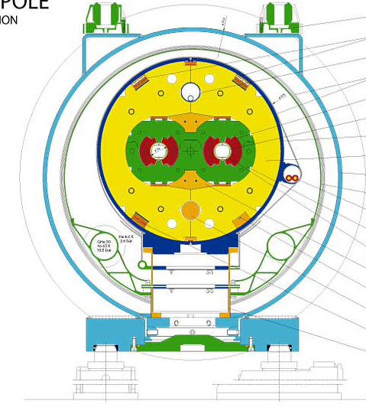
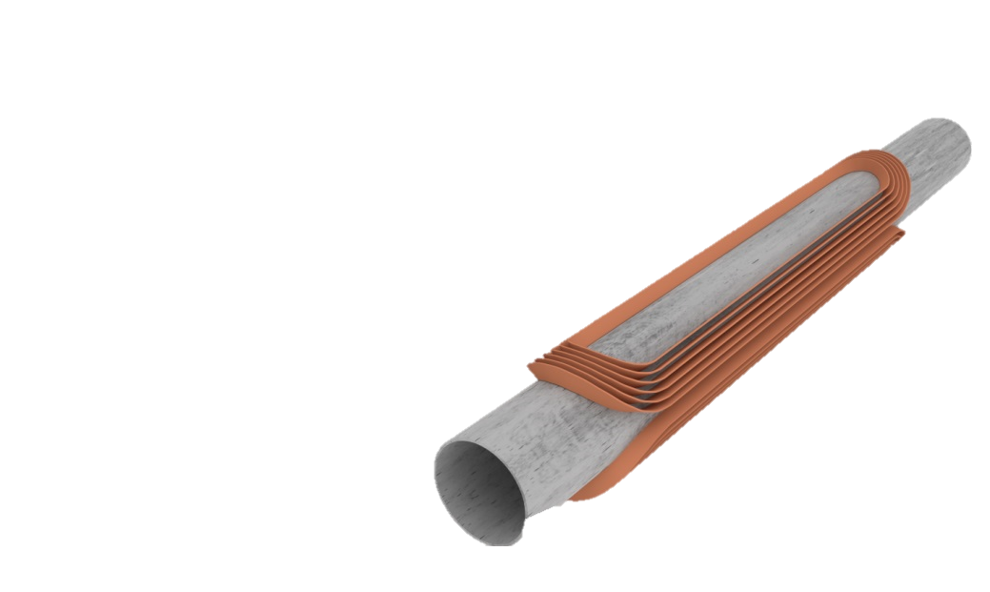
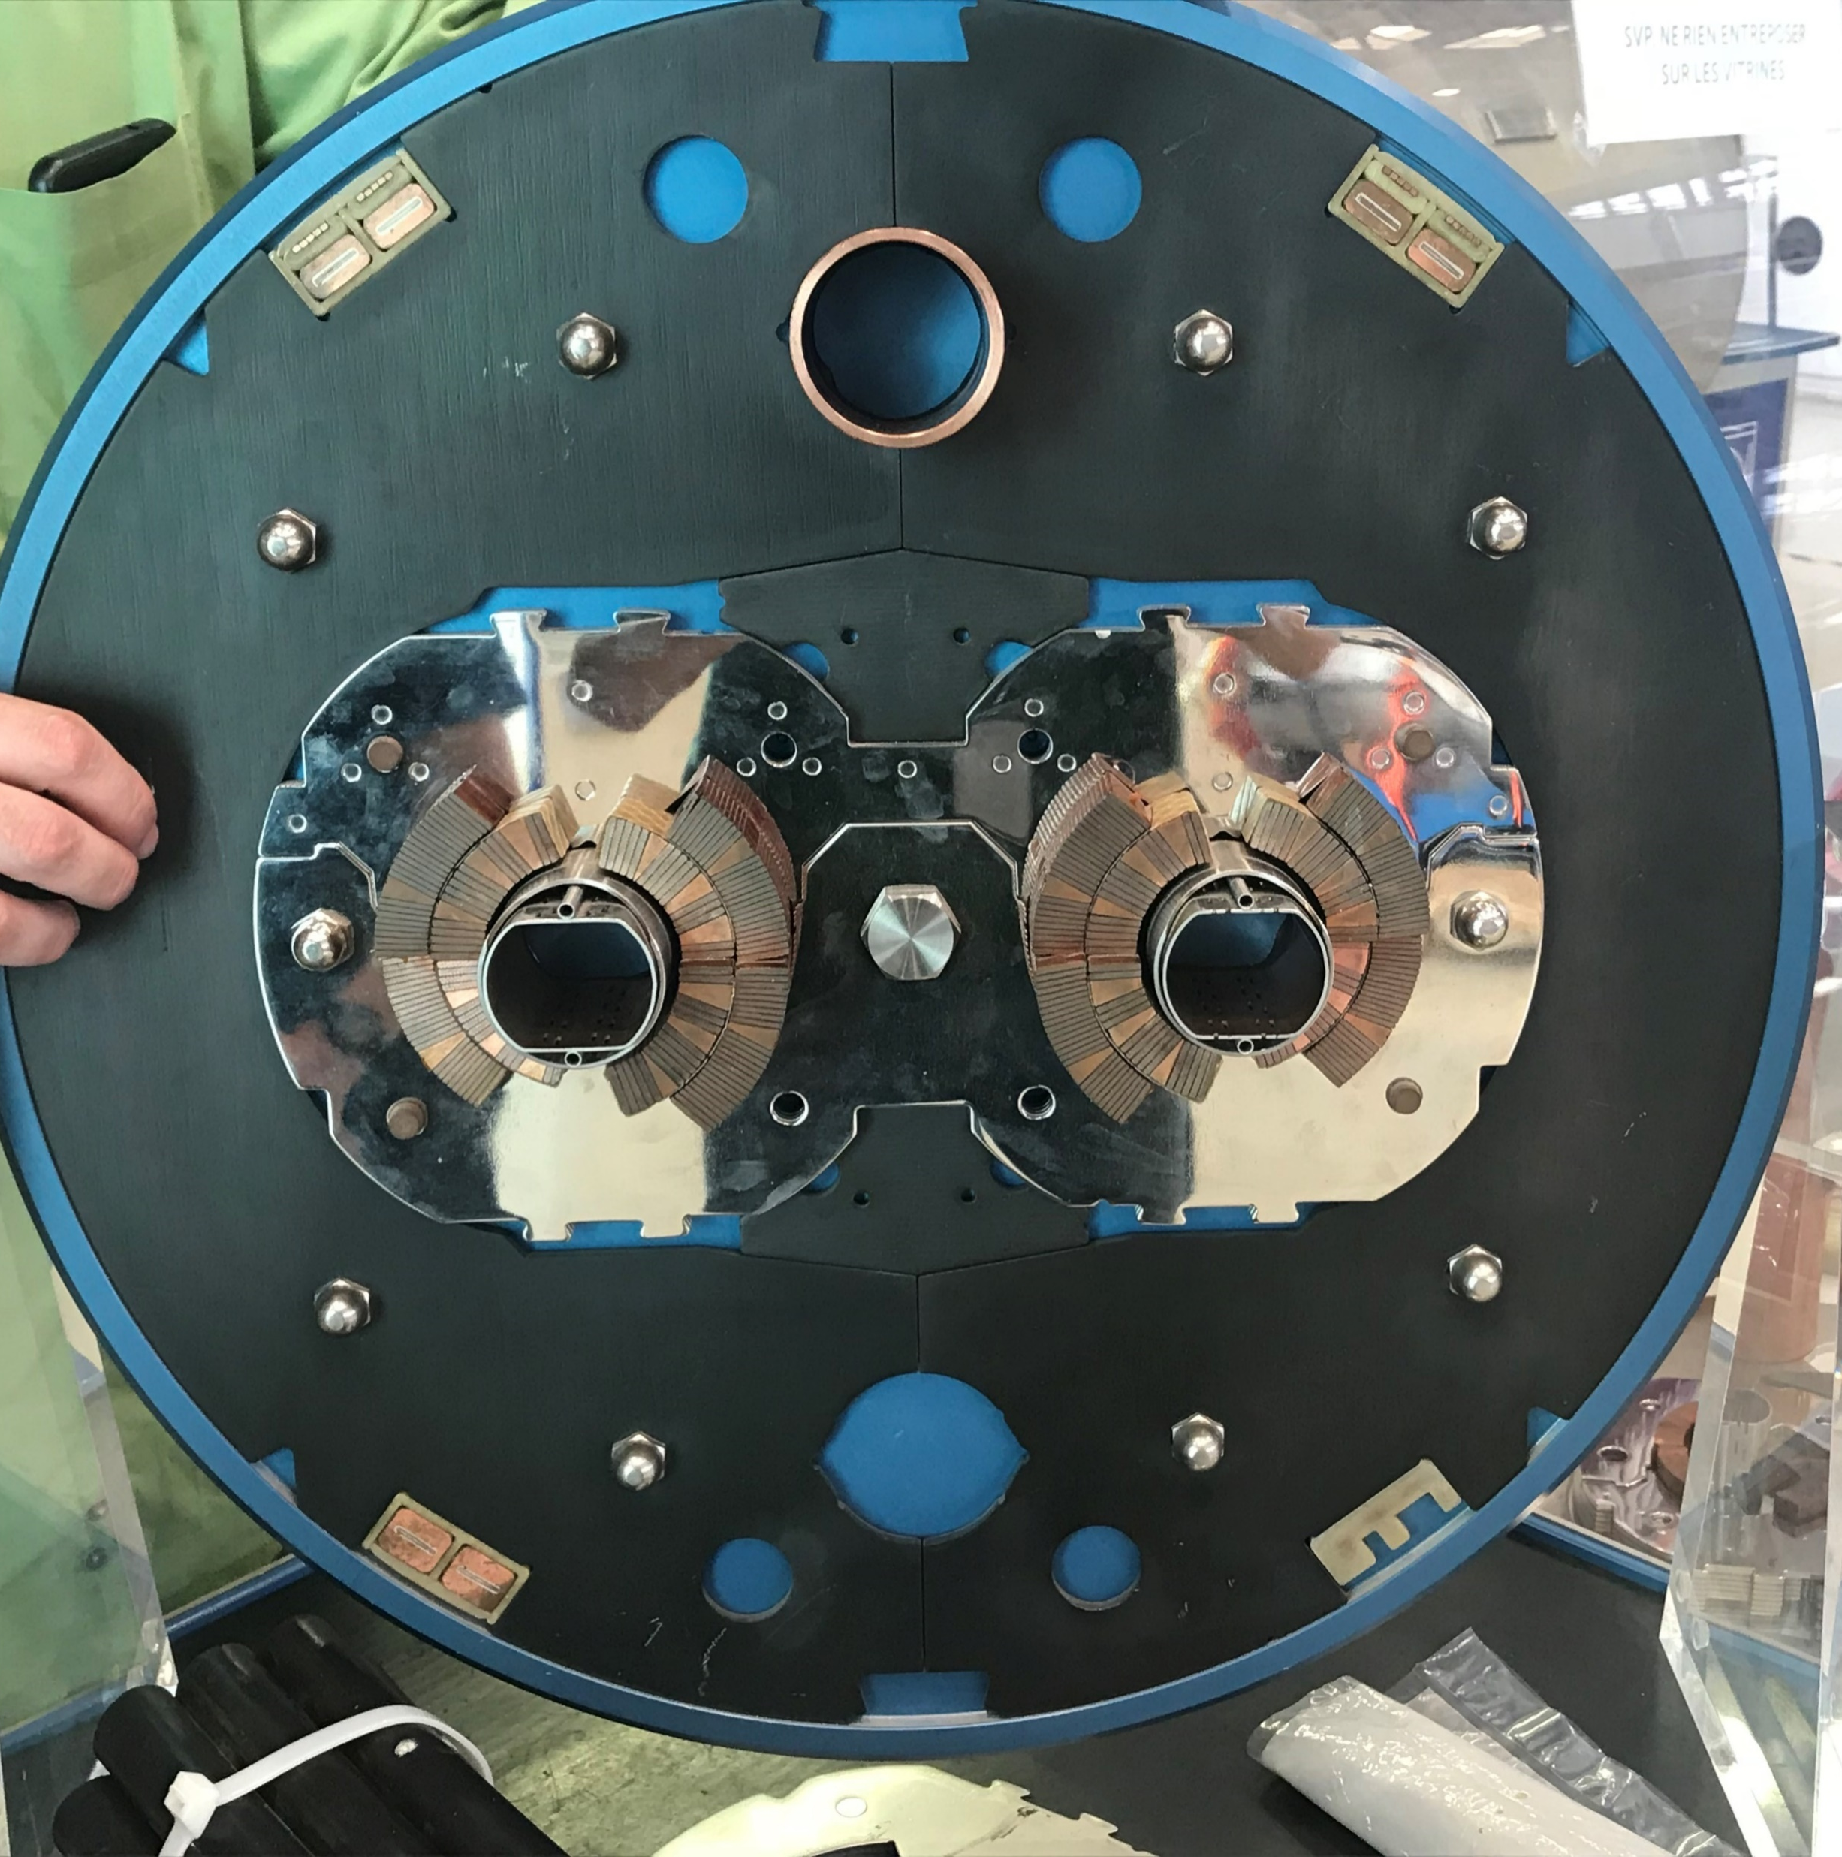
Magnets in the LHC: Dipole magnets

Slide 7
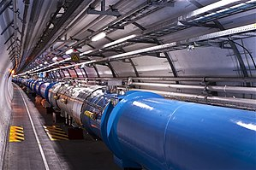
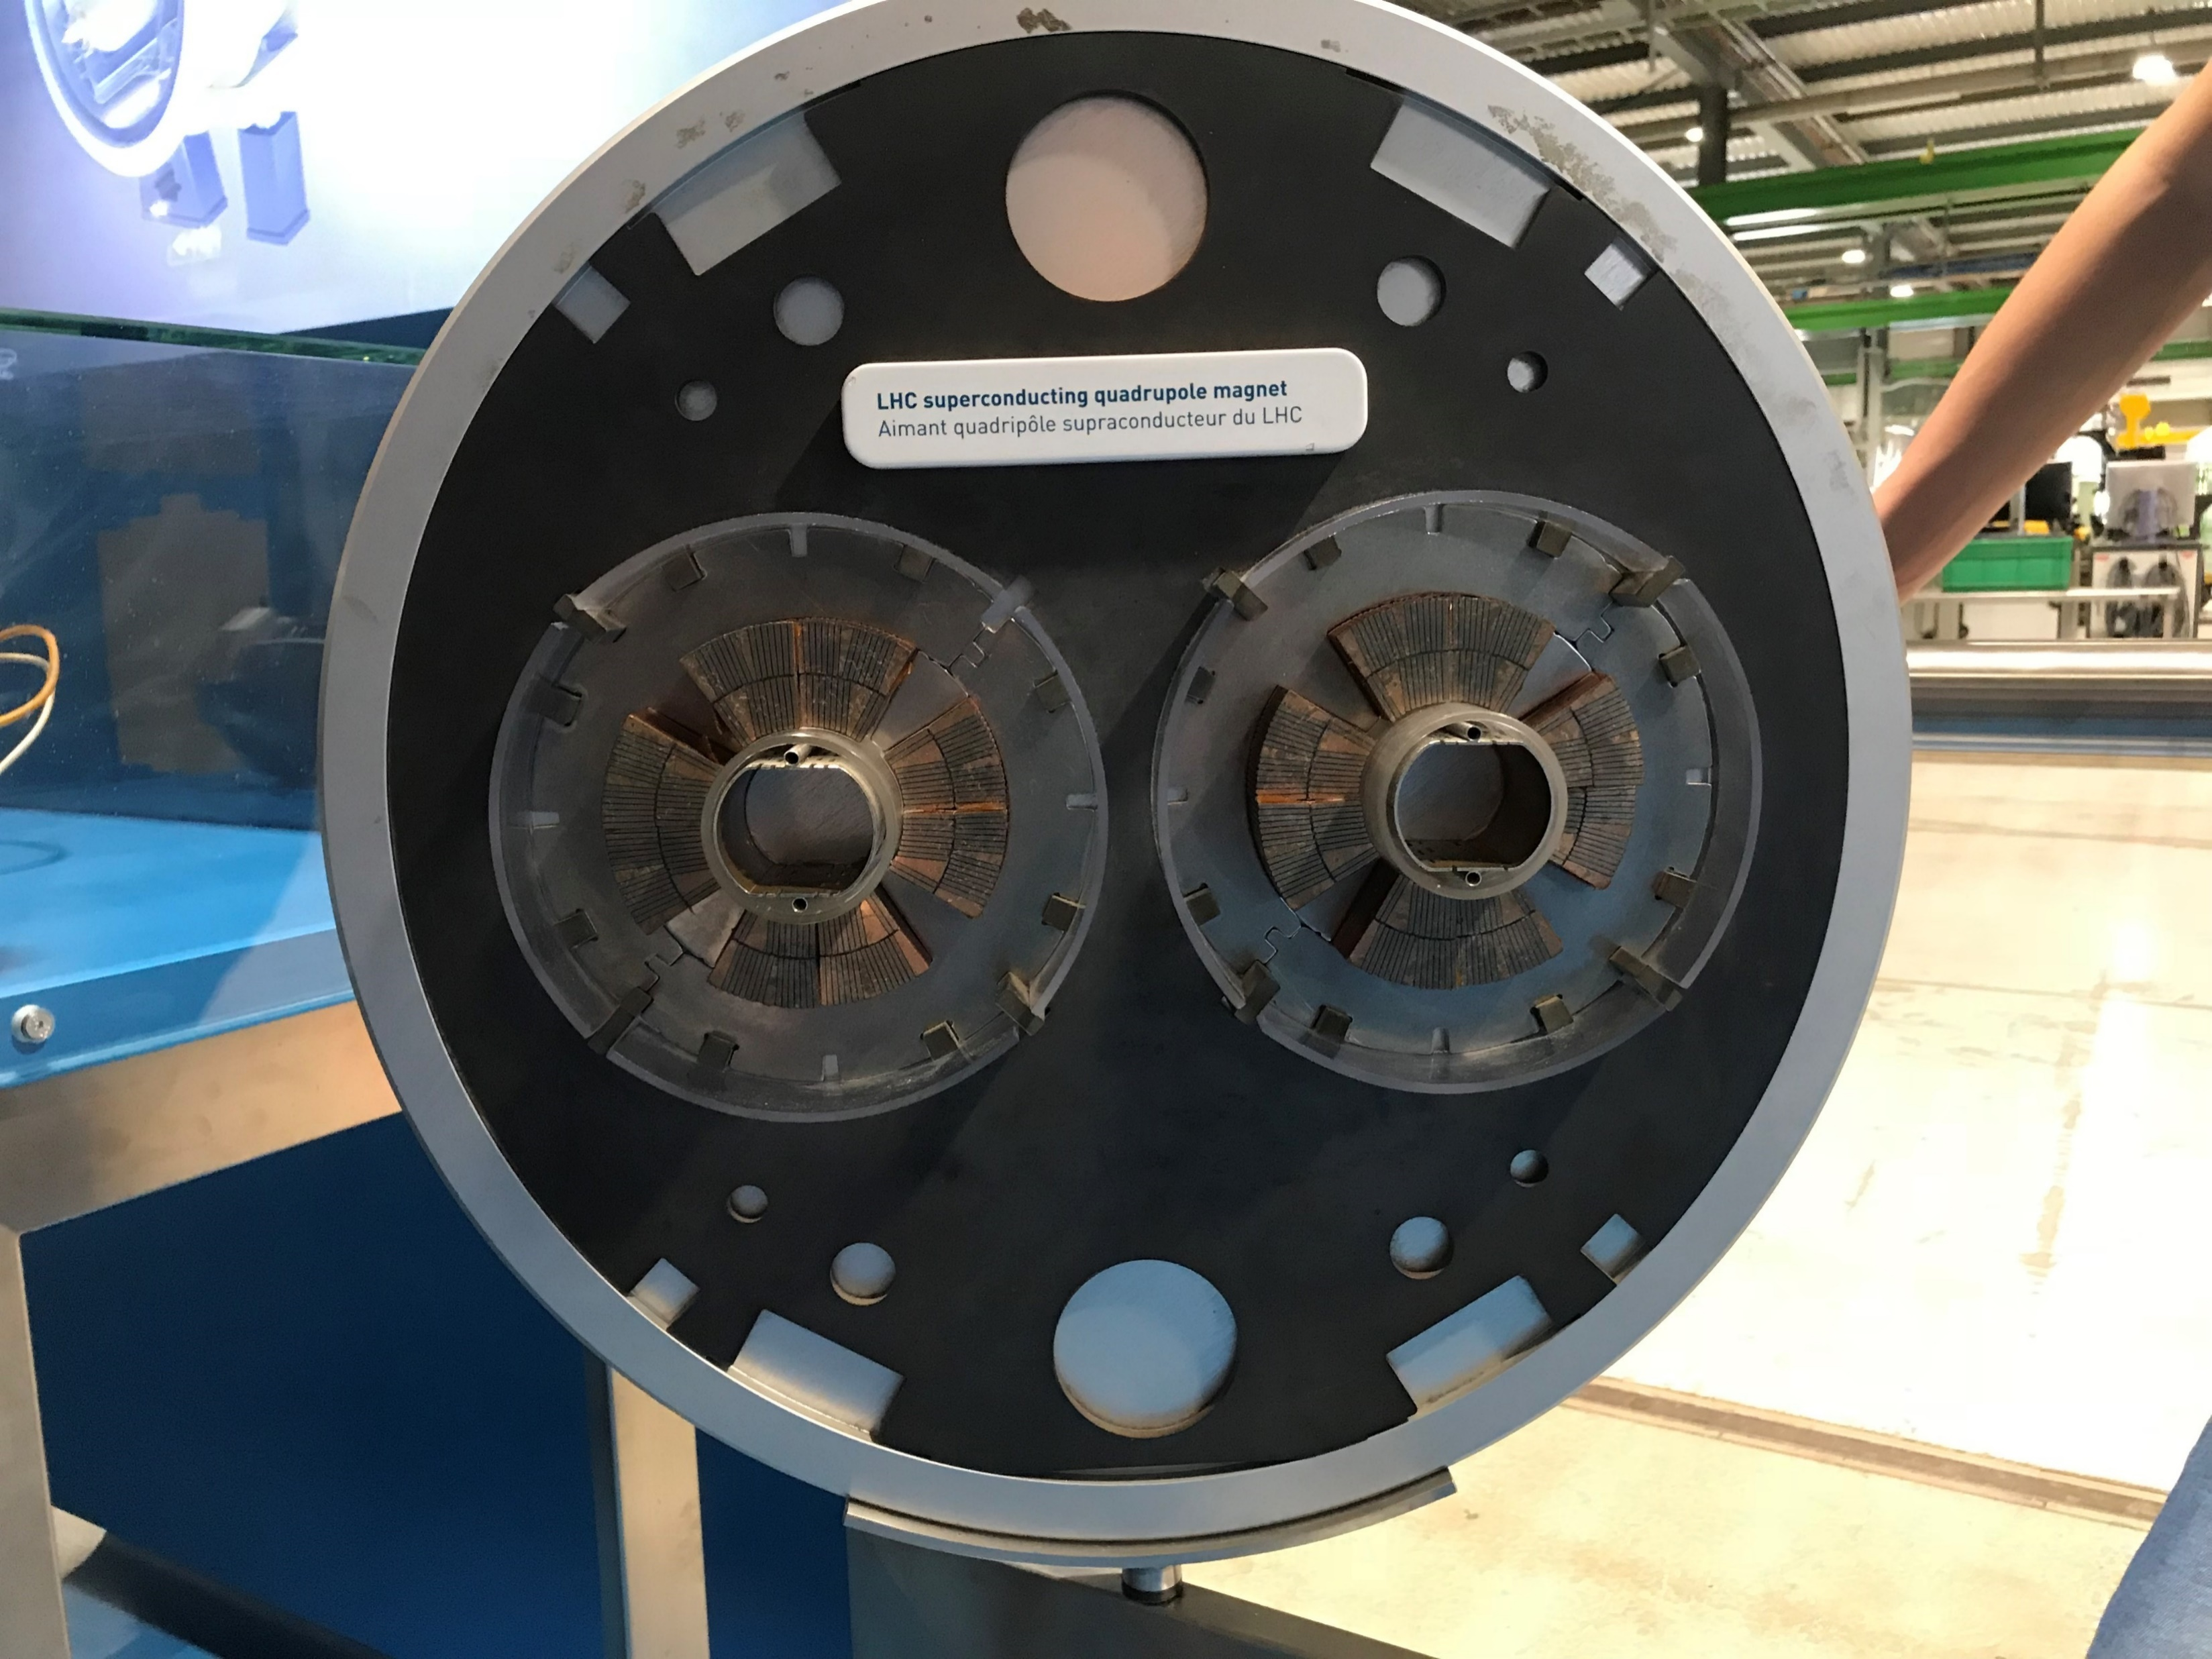
Magnets in the LHC: Quadrupole magnets

Slide 8

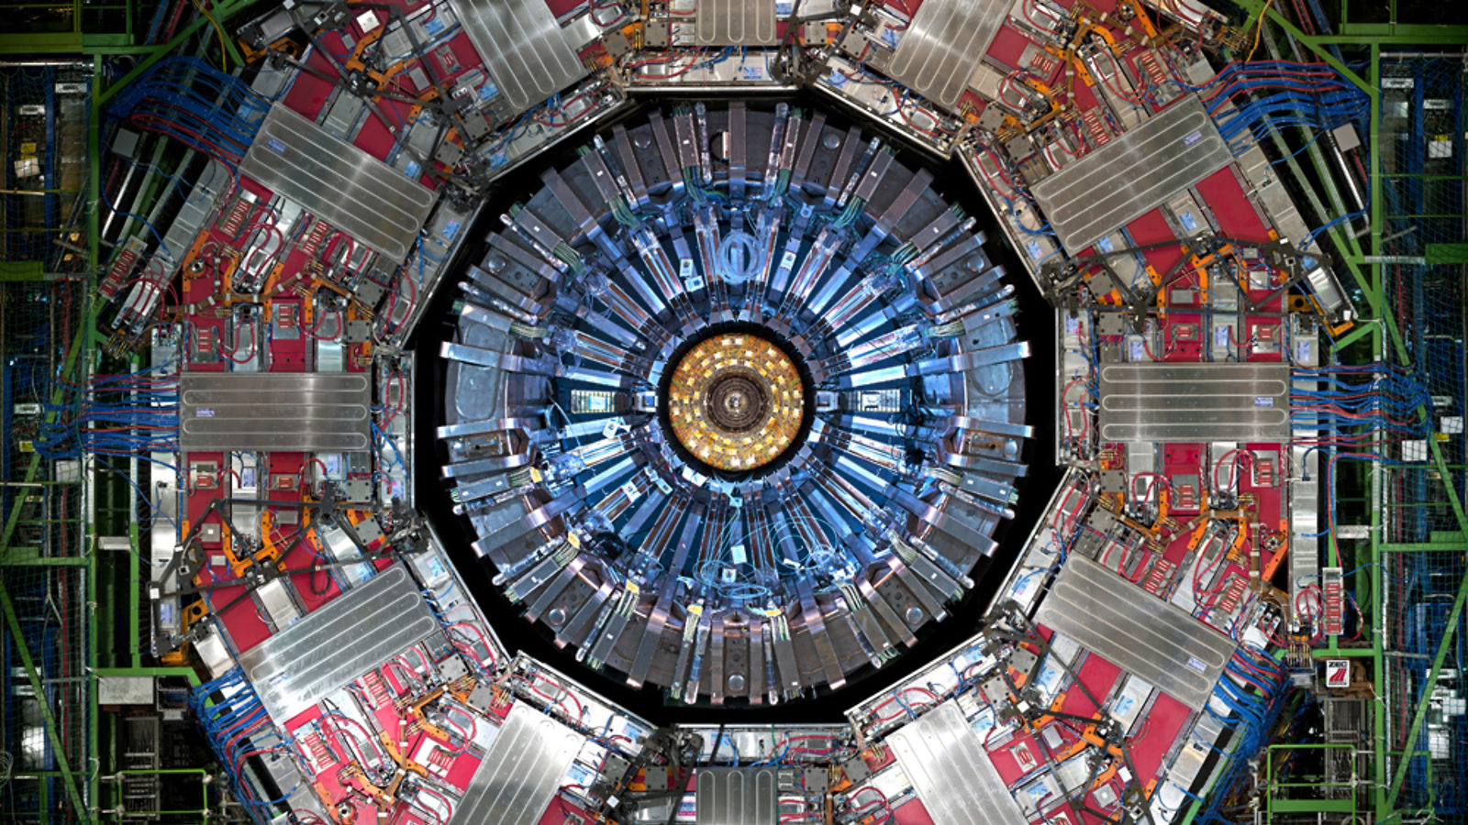
Magnets in the LHC: Detector magnets
Main experiments: ATLAS and CMS

Slide 9
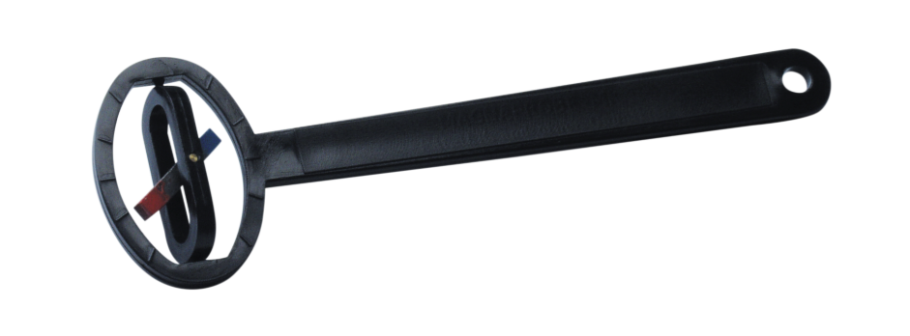
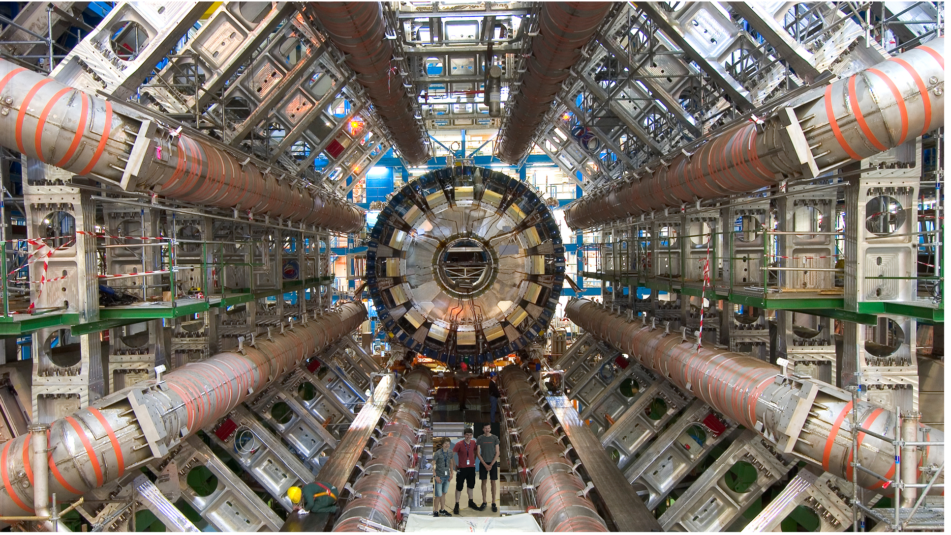
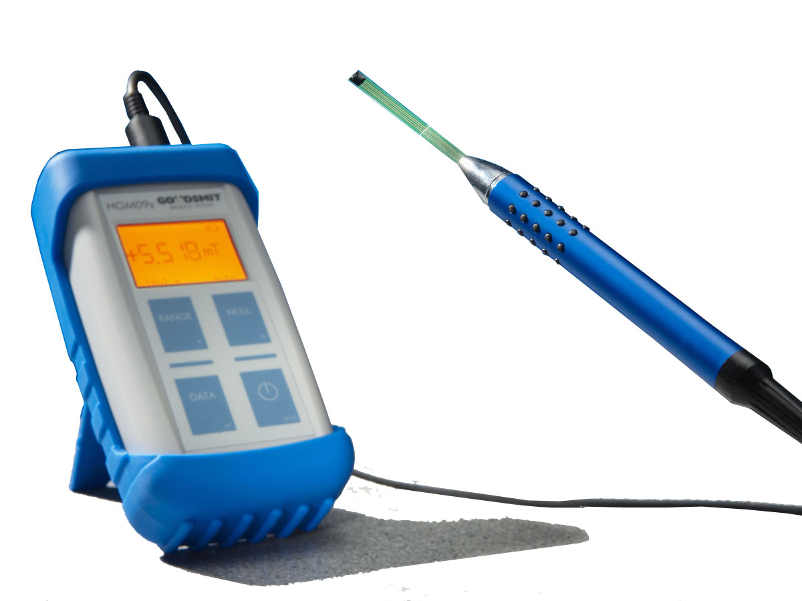
Experiment in ATLAS
Measurments strength and direction of the magnetic field

Slide 10
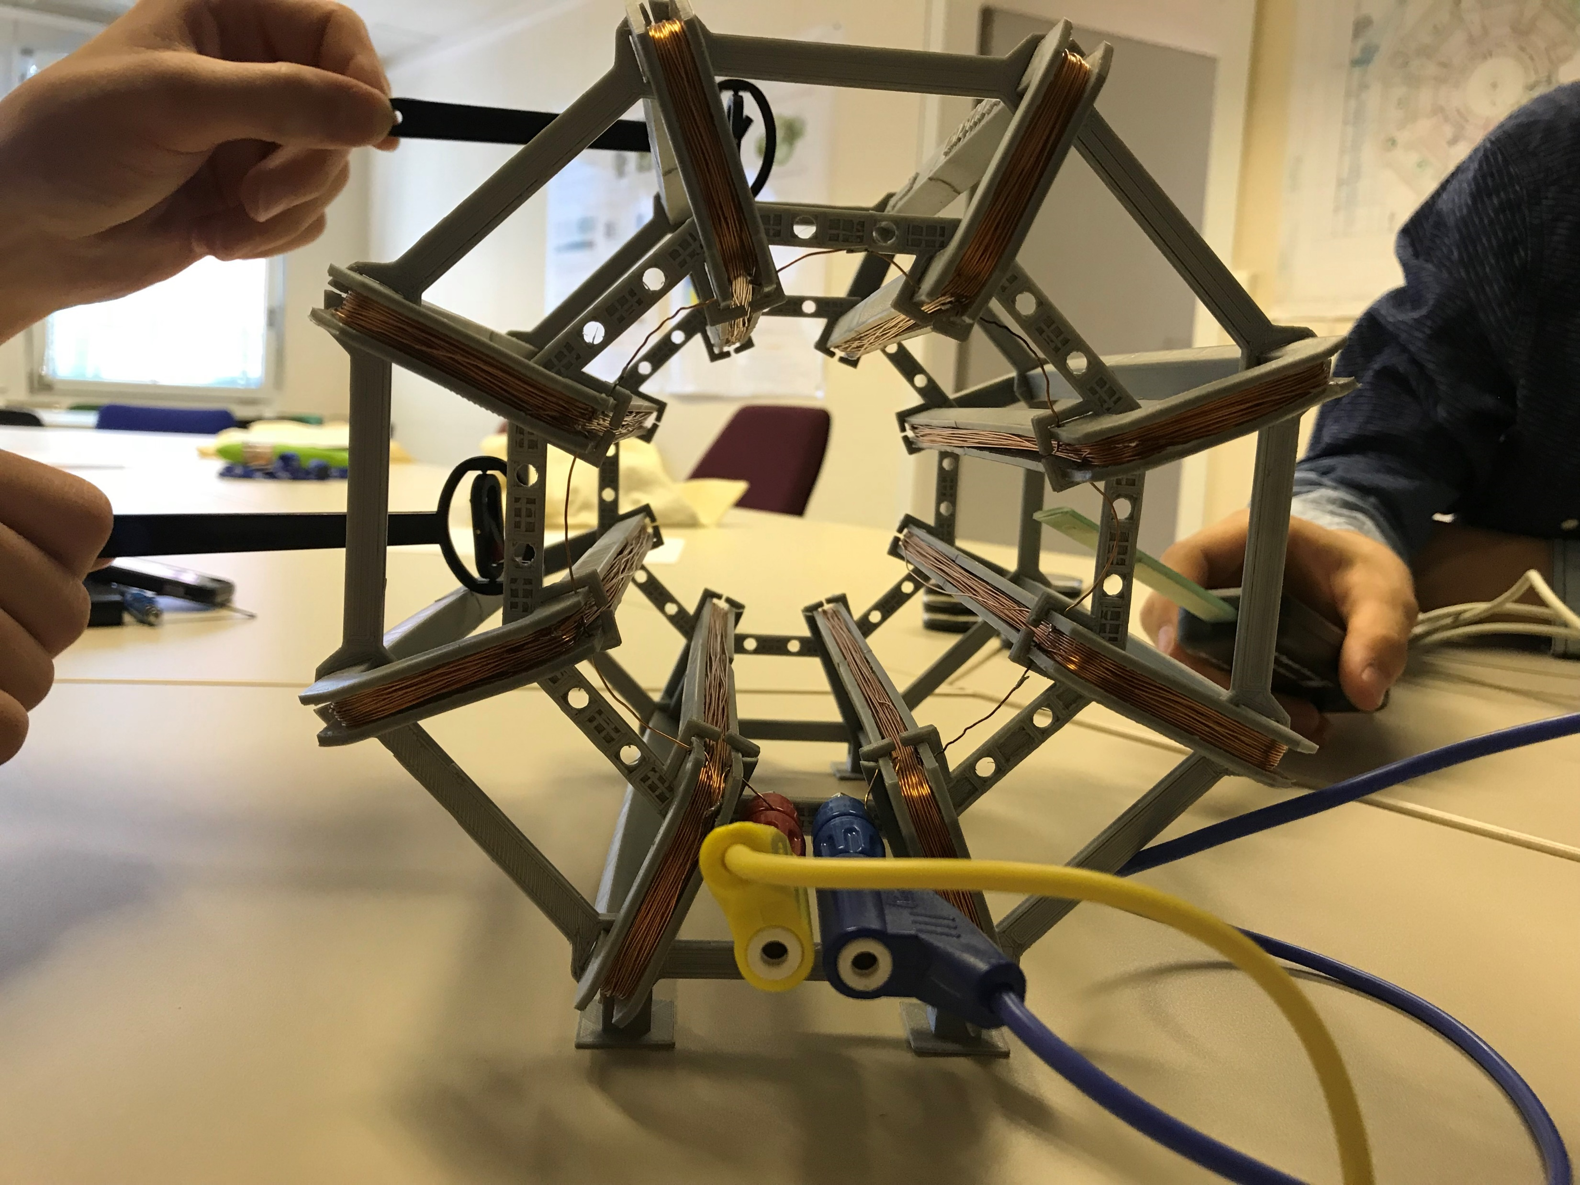
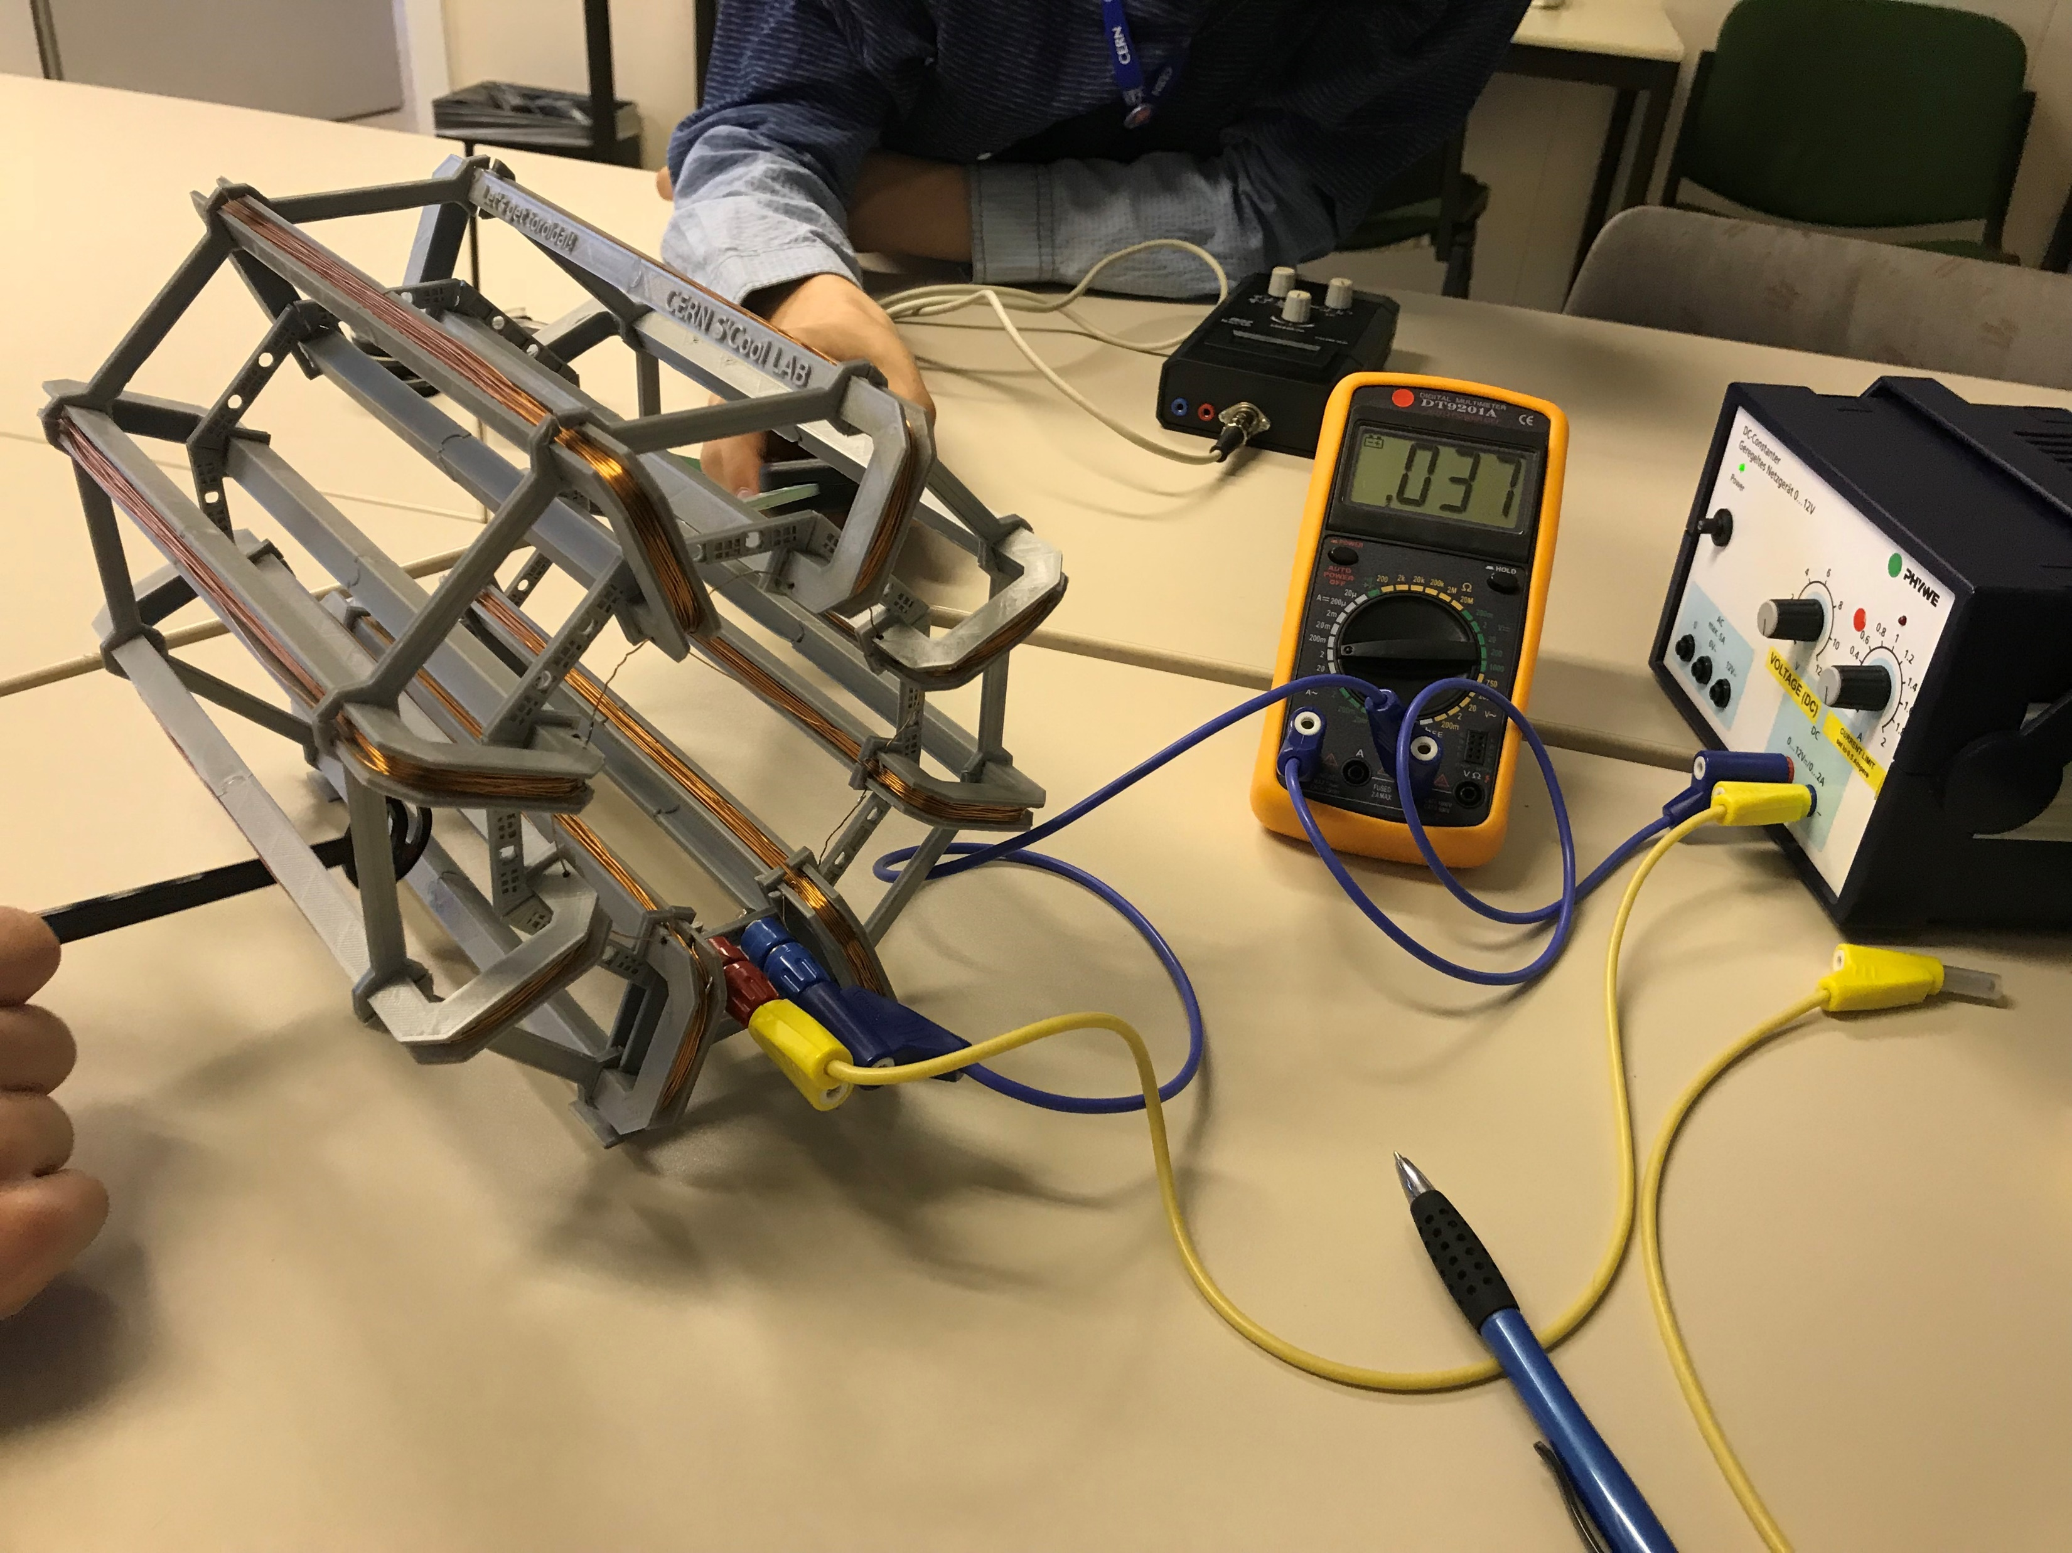
Experiment with ATLAS

Slide 11
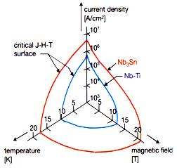
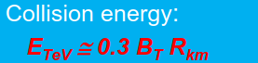
Design of magnets
Different aspects:
Electrical
Magnetic
Mechanical
Thermal

Slide 12
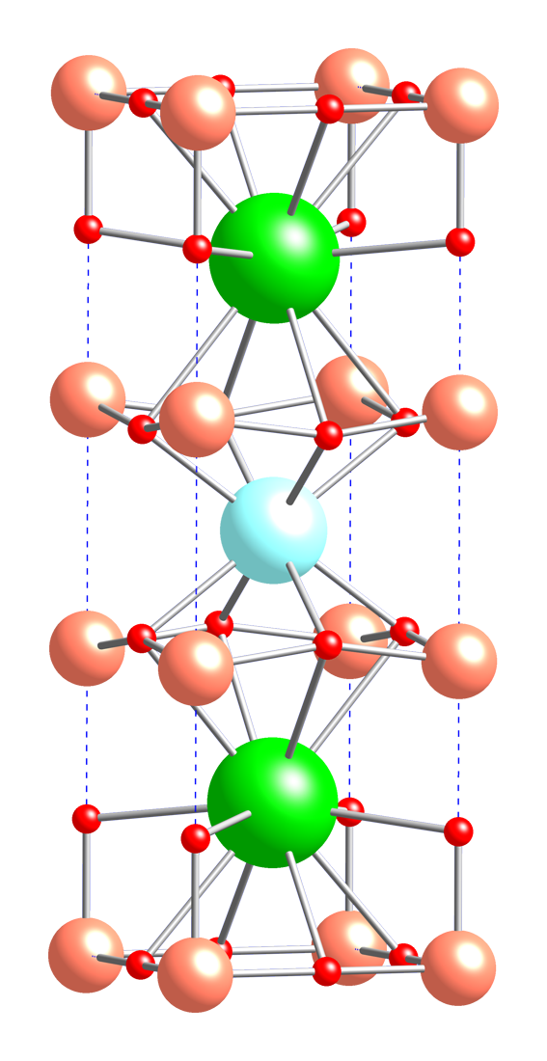
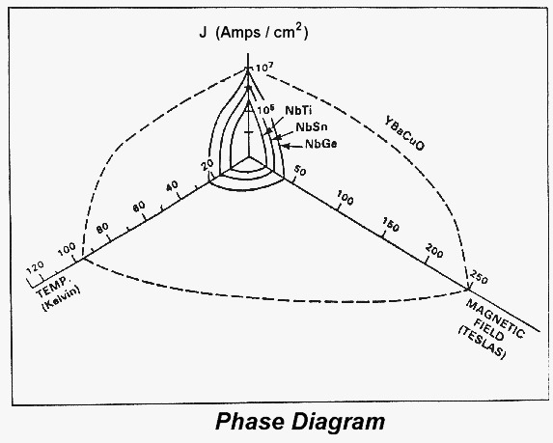
High temperature superconductivity
77 Kelvin
Keramic material
We used:
YBCO = YtriumBarium- CopperOxide

Slide 13
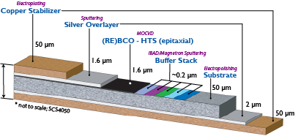
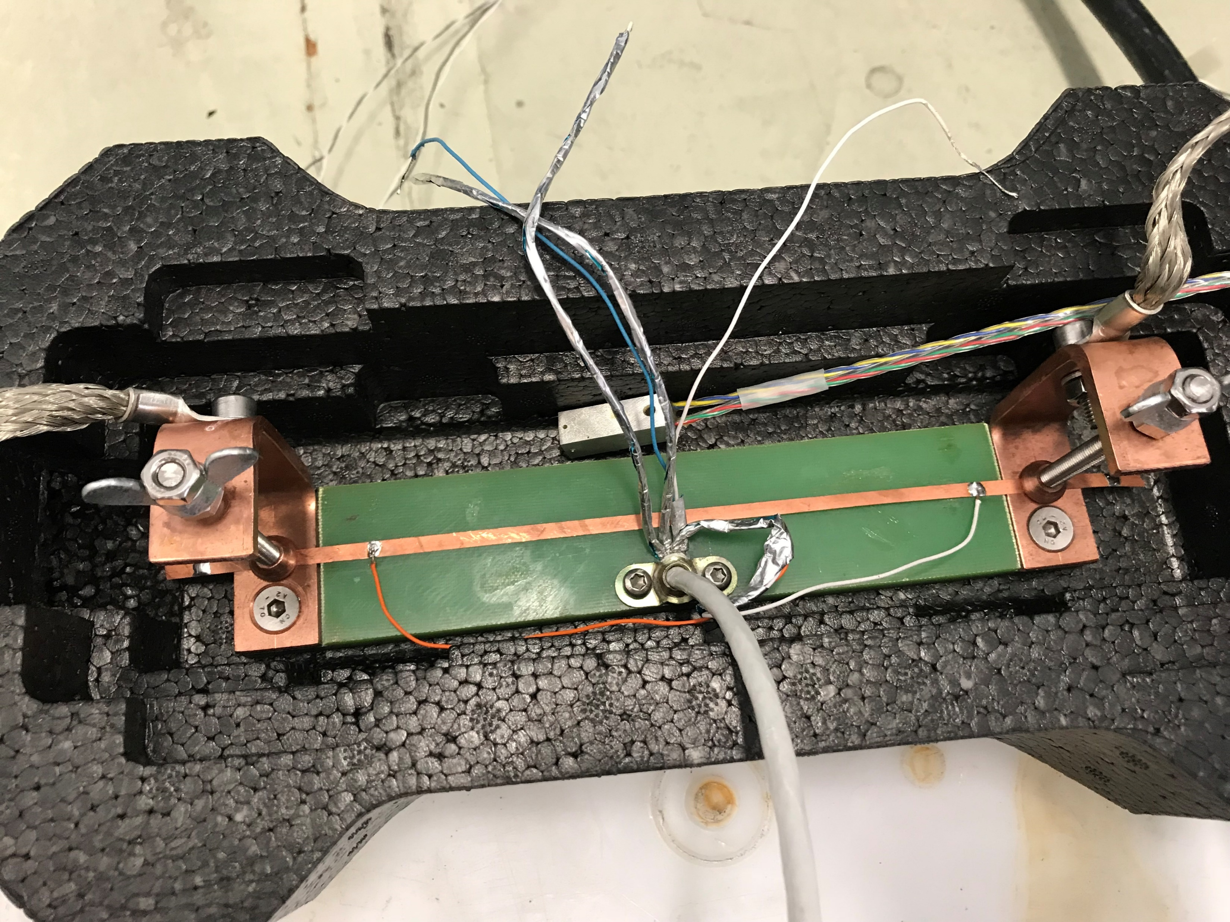
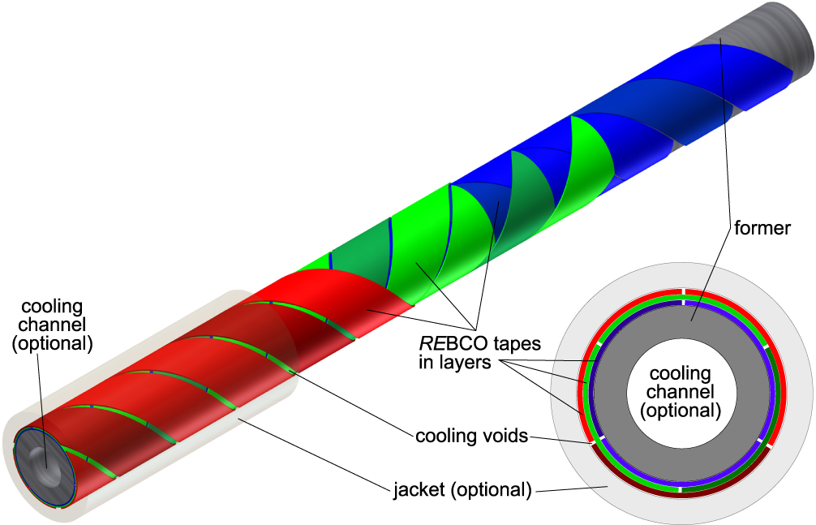
Experiment with HTS-tape

Slide 14
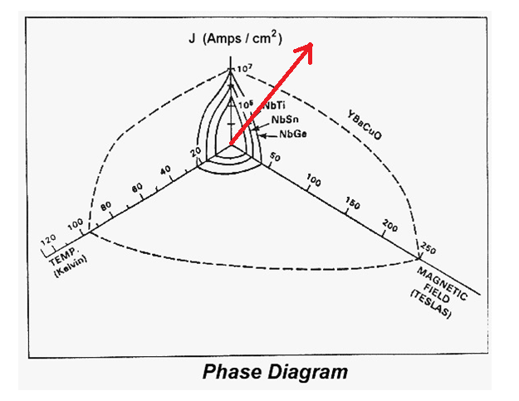
Results: Burnout
Temperature 79 K
Current up

Slide 15
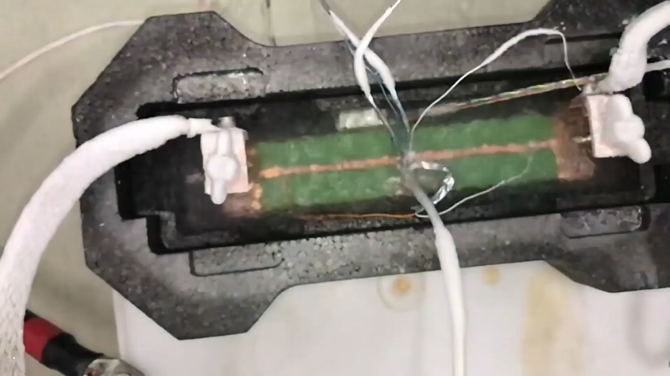
Results: Burnout
Temperature 79 K
Current up

Slide 16
Results: Current
Temperature 79 K
Current up, but with safety limt on 50 mV

Slide 17
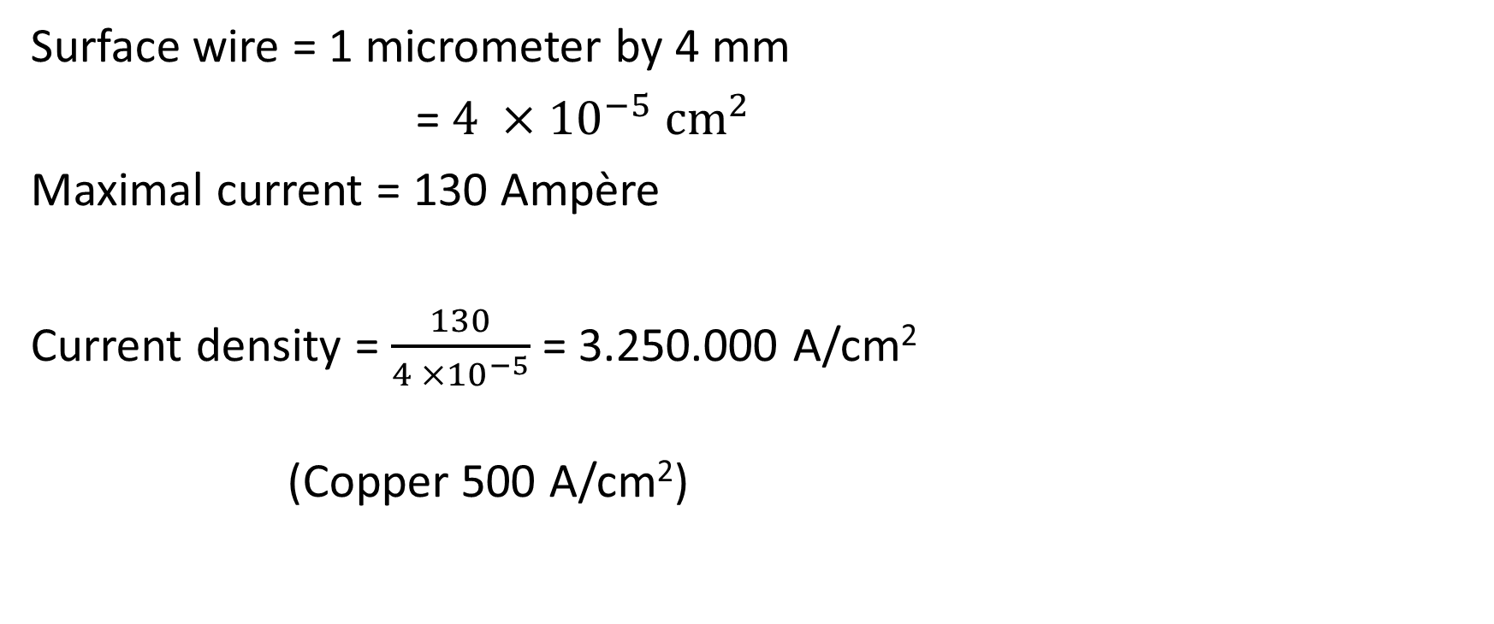
Maximal current density
Surface wire = 1 micrometer by 4 mm
= $4 ×{10}^{−5} {cm}^{2}$
Maximal current = 130 Ampère
Current density = $\frac{130}{4 ×{10}^{−5}}$ = 3.250.000 A/cm²
(Copper 500 A/cm²)

Slide 18
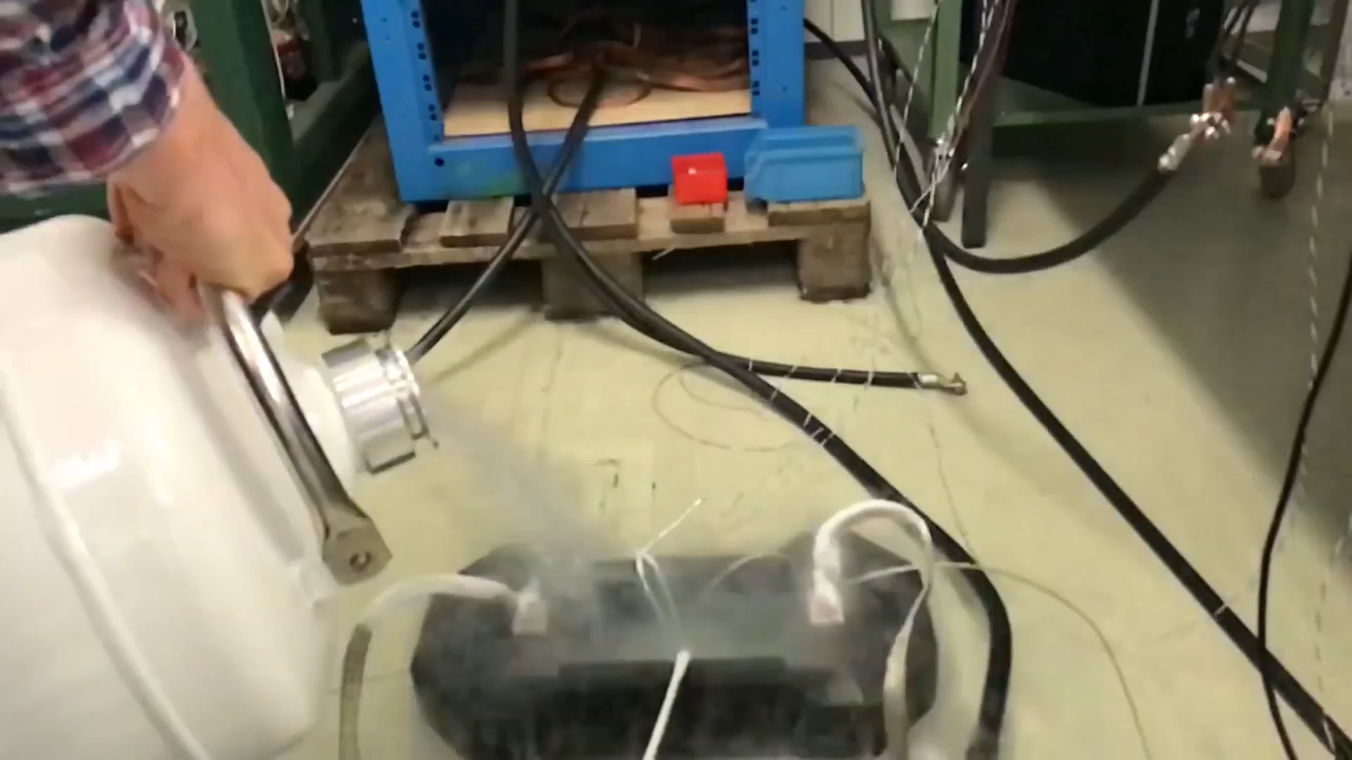
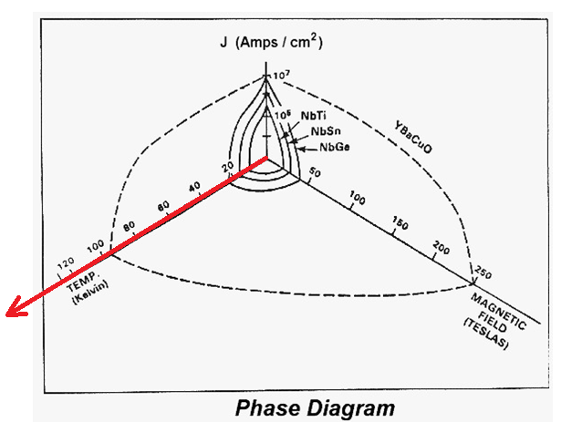
Results: Temperature
Current 5 Ampère
Temperature from 79 K to 293 K

Slide 19
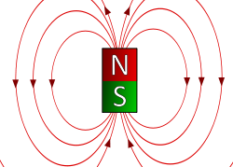
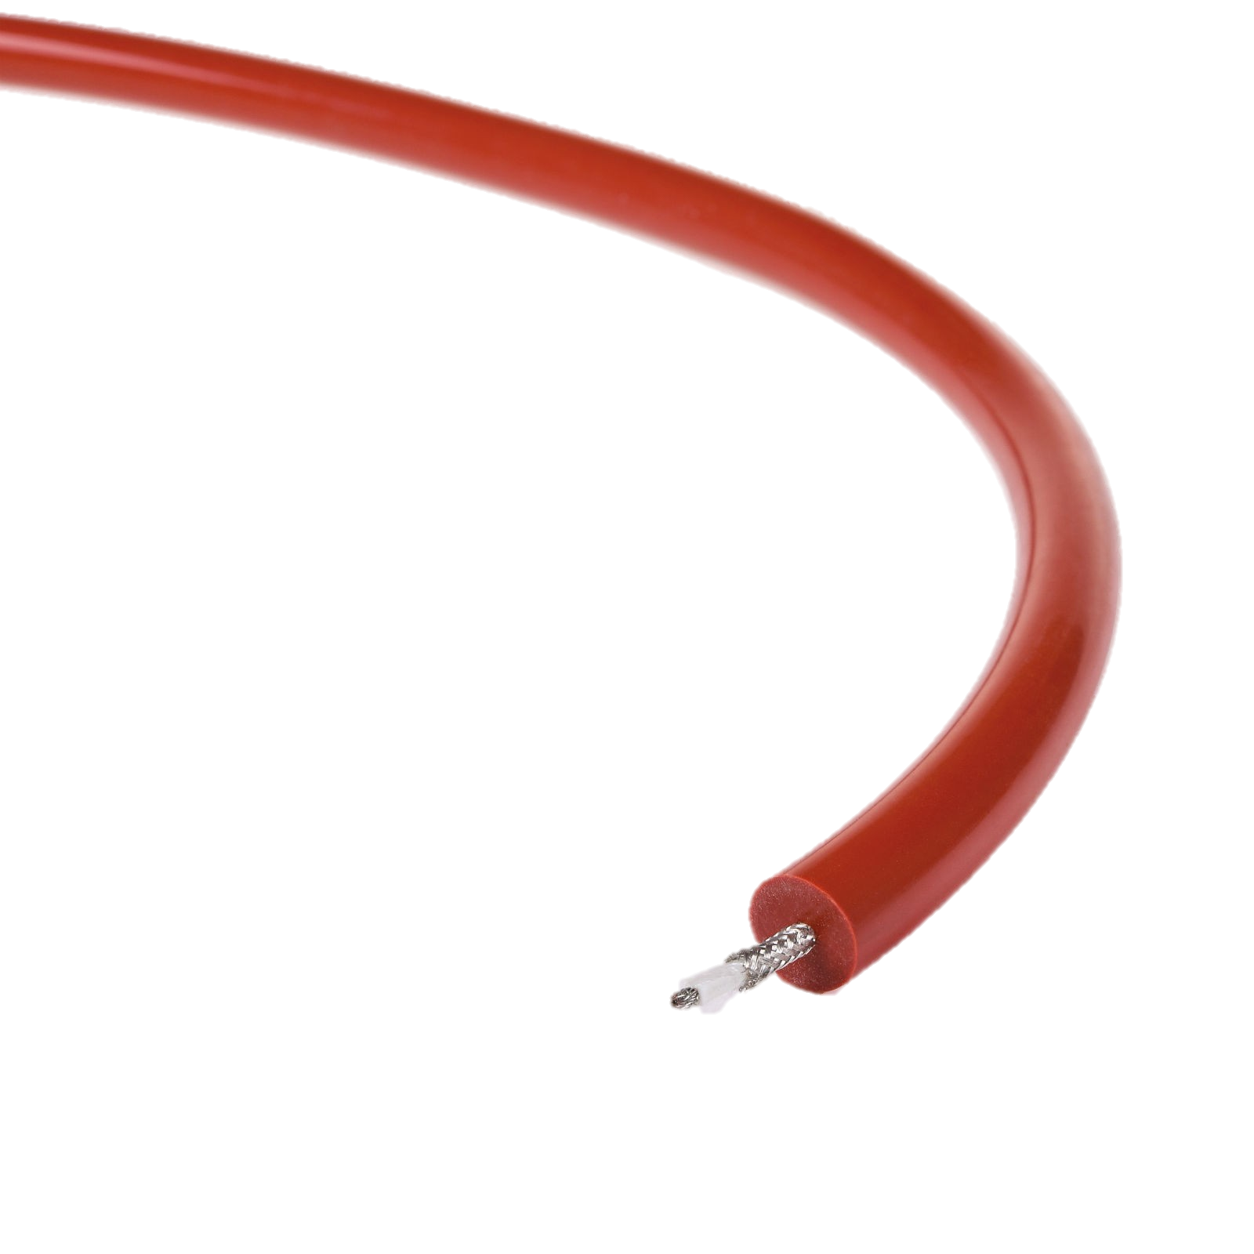
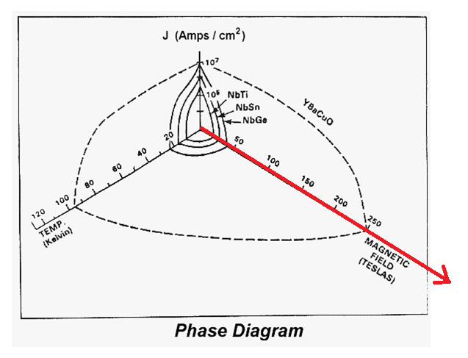
Results: Magnetic field
Temperature 79 K
Current 120 Ampère
Magnet of 0,5 T

Slide 20
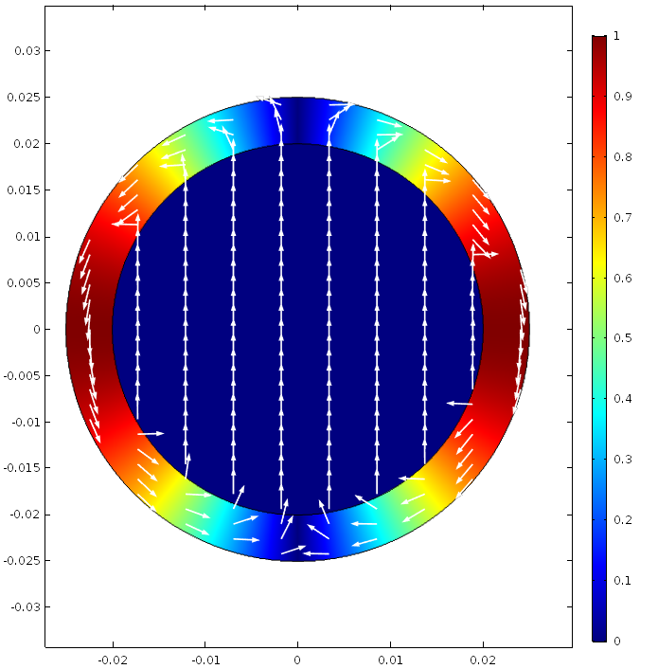

Different magnet designs
Cosine Theta
Ideal magnet
Now used in the LHC

Slide 21
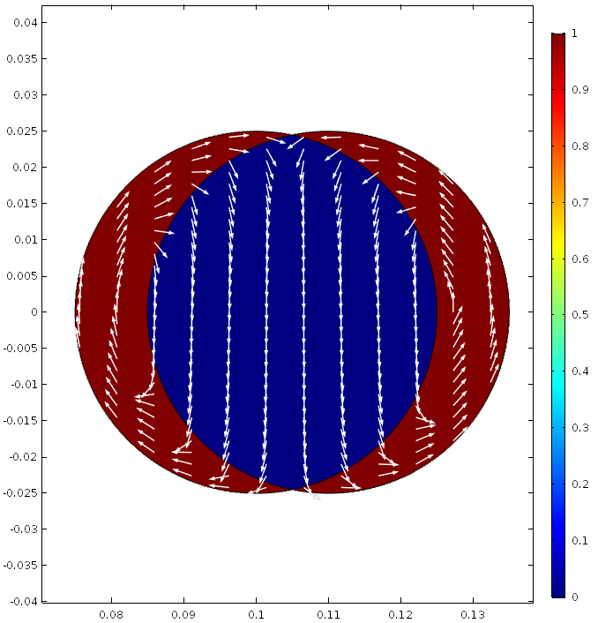
Different magnet designs for the FCC
Overlaping circles

Slide 22
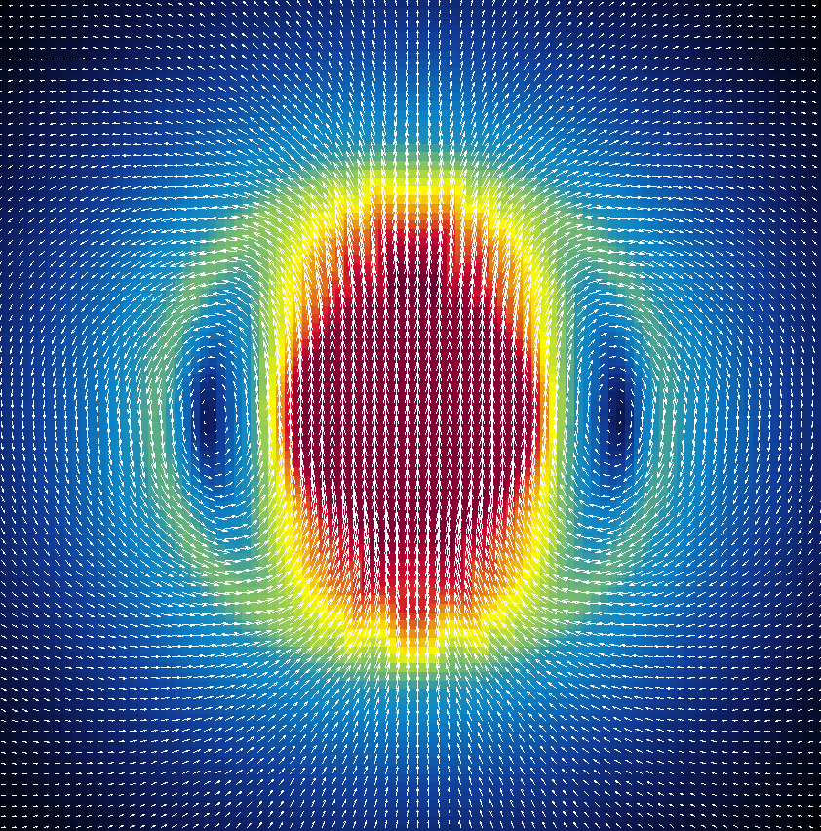
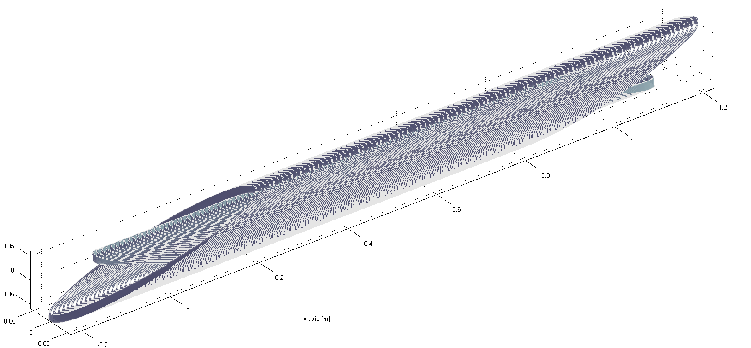
Different magnet designs
Dipole: Canted Cosine Theta
Horizontal fields cancel each other out

Slide 23
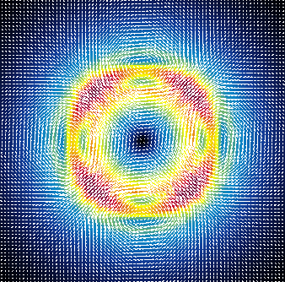
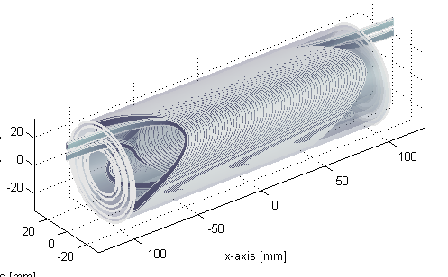
Different magnet designs
Quadropole: Canted Cosine Theta

Slide 24
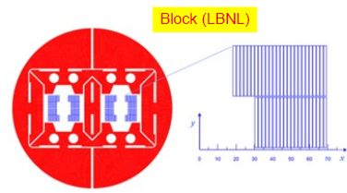
Different magnet designs for the FCC
Block coil

Slide 25
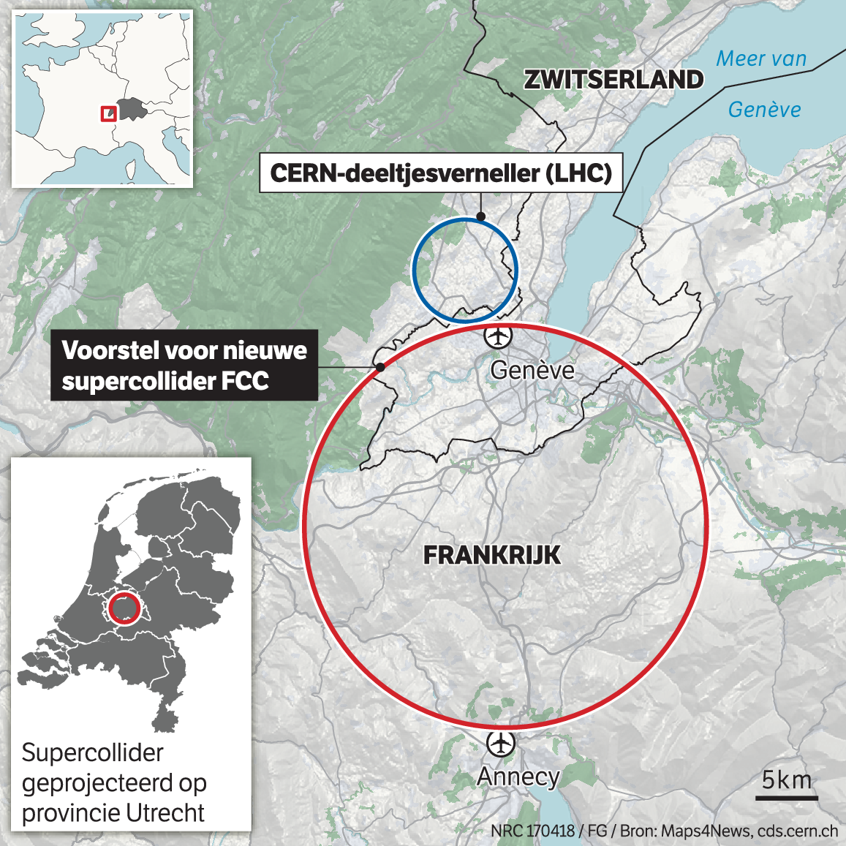
Future Circular Collider
100 TeV c.o.m.
100 km circumference
16 T magnets -> how?
14 T en 100 km length (R=16 km)
→ 67 TeV

Slide 26
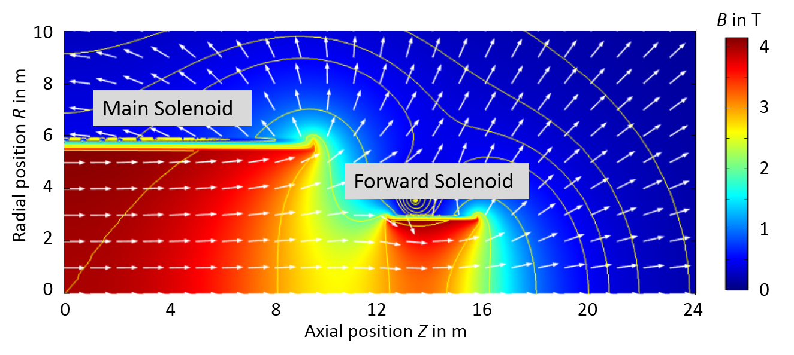
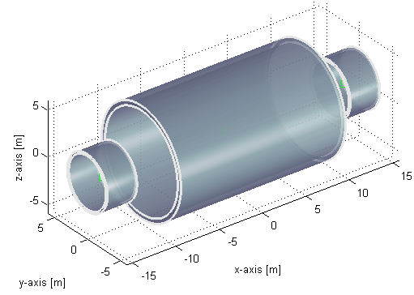
Detector FCC
Main solenoid with 4 T
Forward solenoids to extend the bending capacity
→ Simple design and low costs

Slide 27
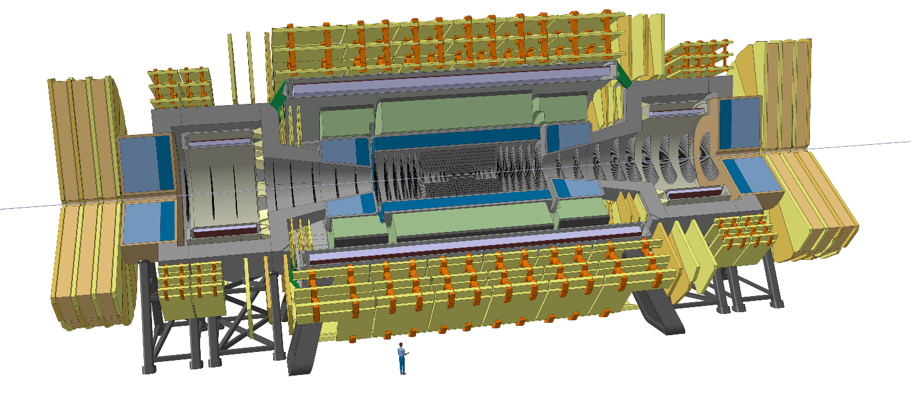
Detector FCC

Slide 28
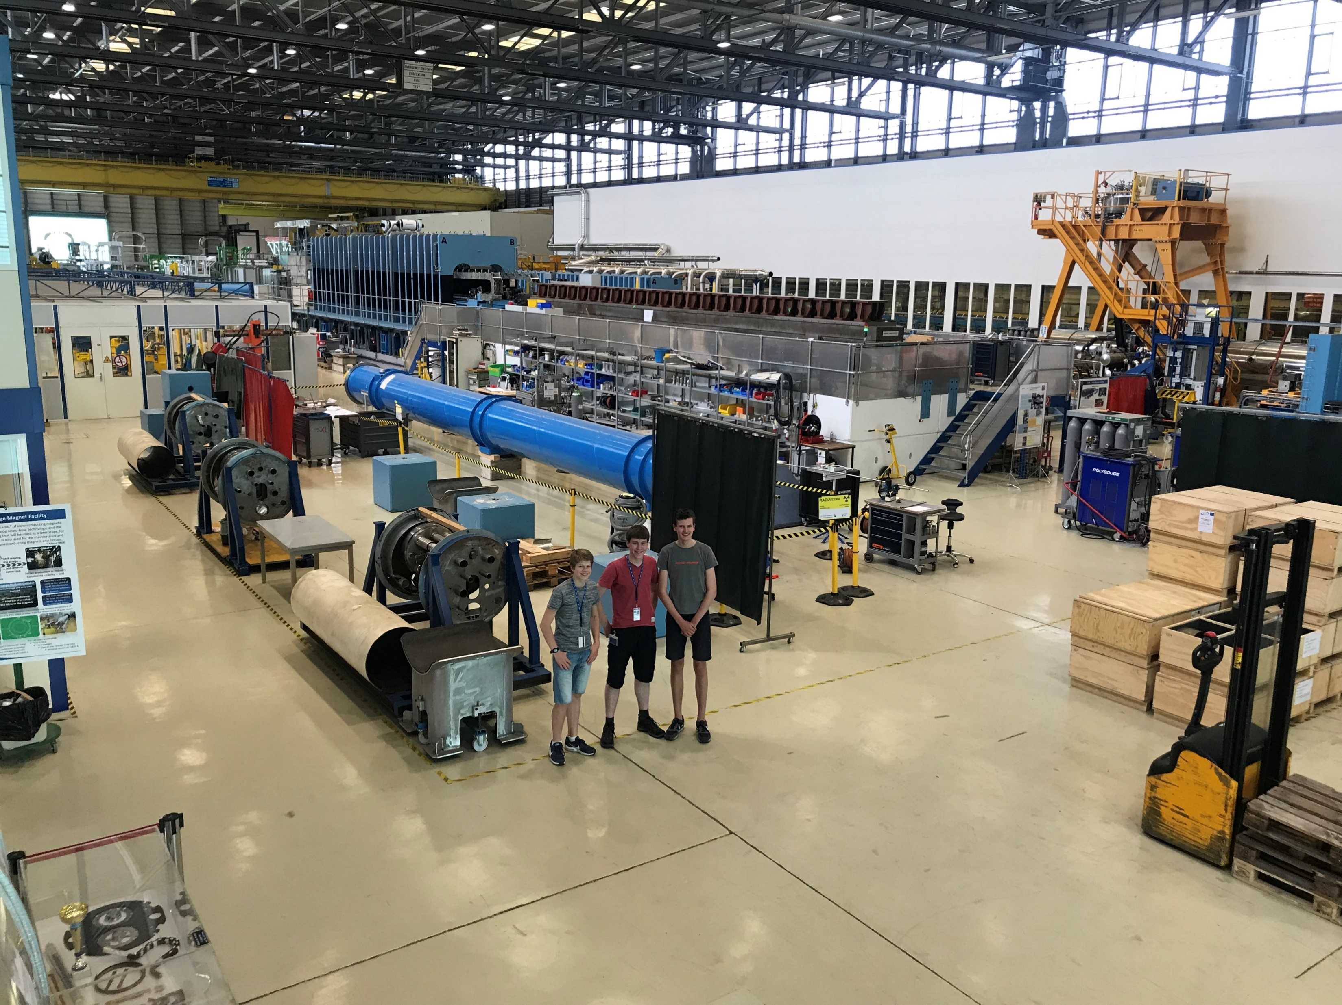
Thanks for your attention
And thanks Erwin

