Slide 2

Closure of the HSSIP-NL-2018

Slide 3
It was a real pleasure to have you here !!!
…and to share some of our our experience with you

Slide 4
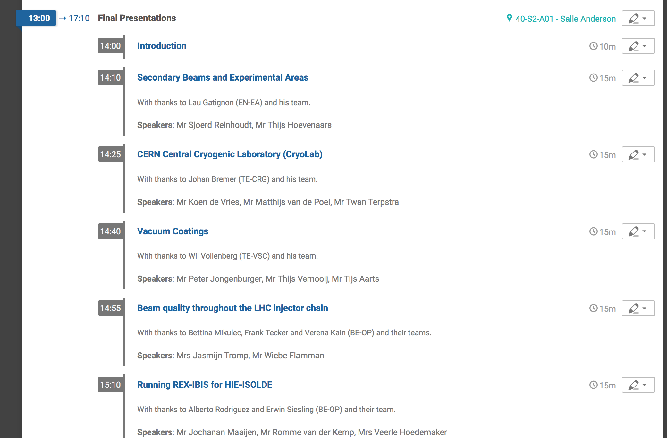
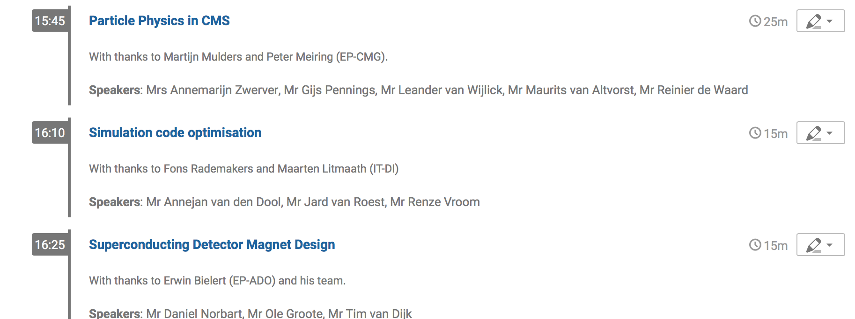
It was a busy, but hopefully interesting programme…
Thanks for your very nice and professional presentations
Please, used them also in your schools if you can…

Slide 5
For this CERN wants to thank and congratulate you…

Slide 6
A big thanks to:
The HSSIP Management team:
  Ines Knäpper, Mojdeh Abtahi and Stavroula Kotsi
The NL organising committee:
  Marcel Vlastuin, Ad Mooldijk, Enno van der Laan, Eric Laenen and Erwin Bielert

Slide 7
A big thanks to:
The CERN organising committee:
  Erwin Bielert, Johan Bremer, Lau Gatiginon, Maarten Litmaath, Martijn Mulders. Fons Rademakers, Arjan Verweij
The Project / Stage supervisors:
  Erwin Bielert, Johan Bremer, Lau Gatiginon, Verena Kain, Maarten Litmaath, Peter Meiring, Bettina Mikulec, Martijn Mulders. Fons Rademakers, Alberto Rodriguez, Erwin Siesling, Frank Tecker, Wil Vollenberg

Slide 8
And a special thanks to:
Johan de Geus
Tiuri Konijnendijk
René Martens

Slide 9
We all wish you a safe journey back home
Make the best of your studies
….and we hope to see you back in the future

