Slide 1
Beam Physics and beam loss

Slide 2
Our project - Akcelerony
To get acquainted with rules and methods of controlling the beams in the LHC accelerator taking into account basic parameters like luminosity, emittance and lifetime of the beam.
The frequency spectrum analysis of the beam loss in the context of the ground movements and possible accelerator shock.
HSSIP at CERN
See how work at modern research facilities looks like from the “inside”. Get introduced to CERN, its technologies and physics, as well as learn through workshops and by shadowing, observing, and working with a member of the personnel.

Slide 3
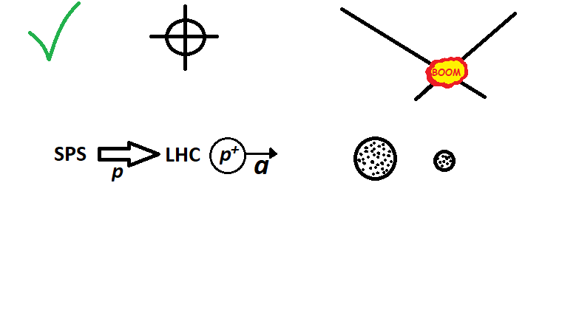
LHC cycle
INJECTION
STABLE BEAMS
RAMP
ADJUST
SQUEEZE
FLATTOP

Slide 4
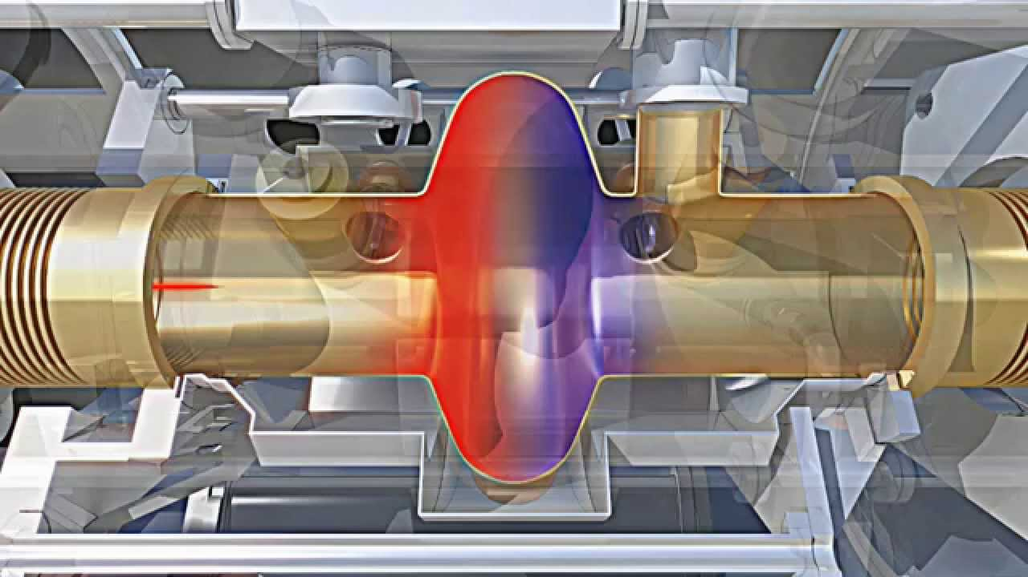
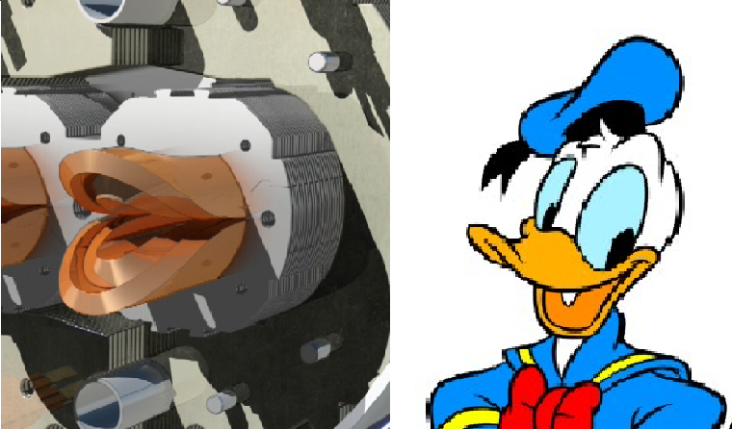
Beam control
Acceleration
Dipole bending
Active during:
WHOLE CYCLE
Active during:
WHOLE CYCLE
Changing during RAMP
Higher energy during RAMP
Quadrupole focusing
Active during:
WHOLE CYCLE
NOT ENOUGH
to fully control the beam
Changes during SQUEEZE

Slide 5
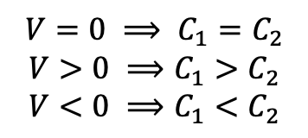
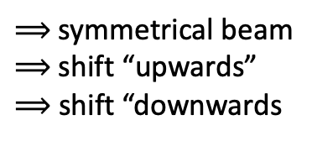
Beam position
$$V=0 ⟹ C_{1}=C_{2}$$
$$V>0 ⟹C_{1}>C_{2}$$
$$V<0 ⟹C_{1}<C_{2}$$
$⟹$ symmetrical beam
$⟹$shift “upwards”
$⟹$ shift “downwards
Additional dipole magnets:
Large oscillations correction

Slide 6
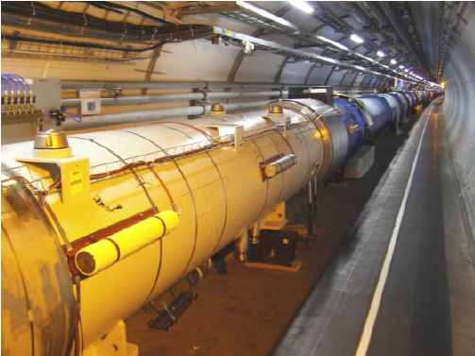
Beam loss
Particle cloud interactions:
Intermolecular
Residual gases
Interaction with the second beam
Gravitational
46mm
36mm

Slide 7
Beam Loss Monitor
BLM
BLM
BLM
BLM
BLM
BLM

Slide 8
Model LHC cycle
RAMP
SQUEEZE
Typical beam behaviour
FLATTOP

Slide 9
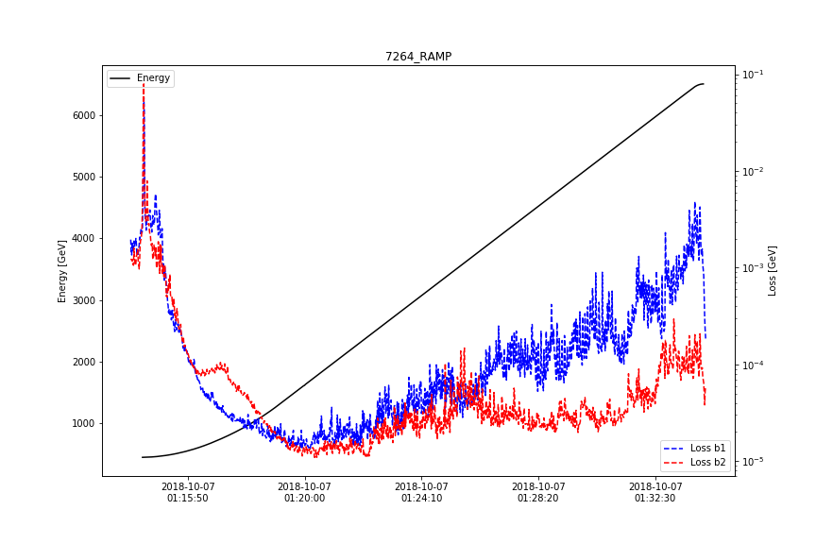
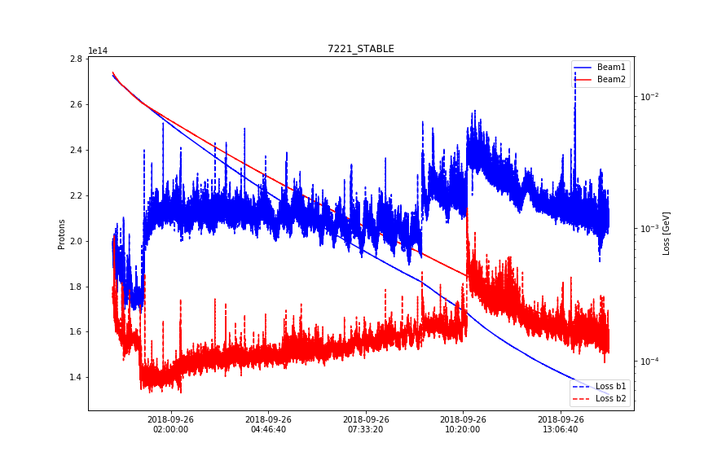
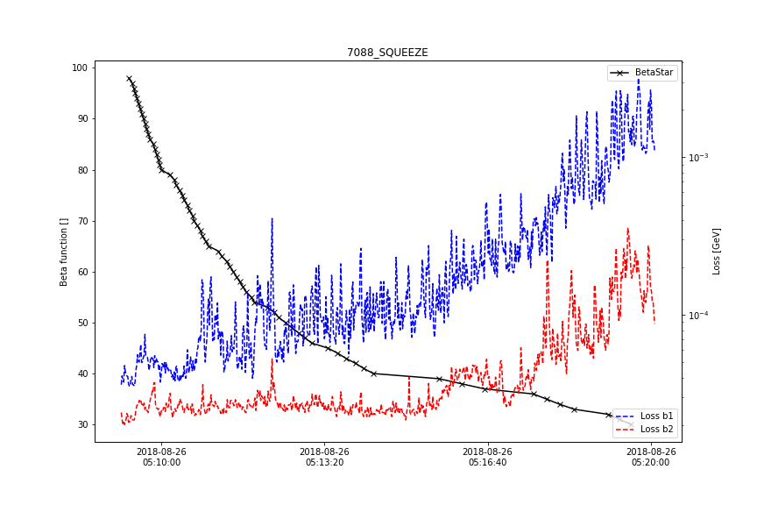
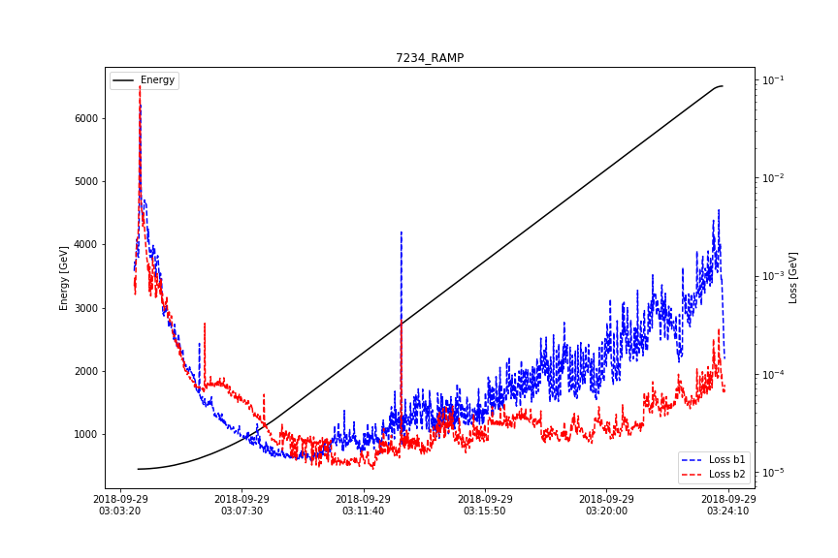
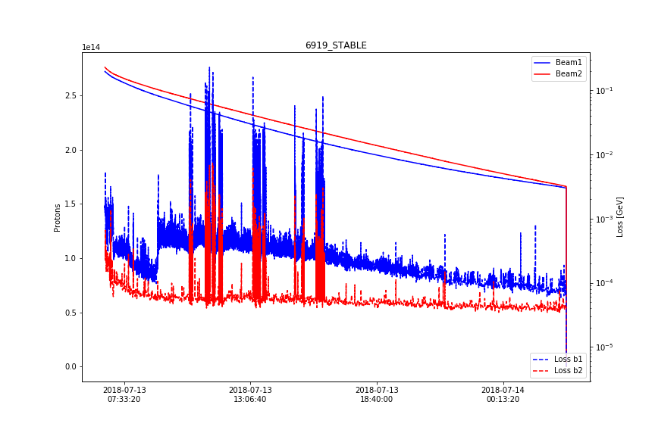
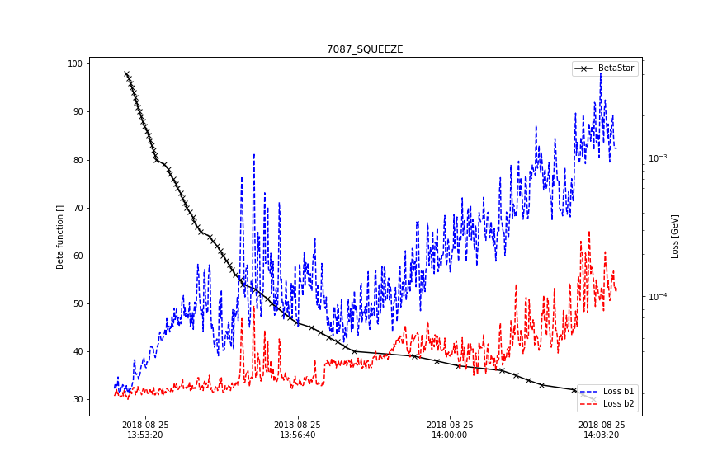
Unexpected beam loss
RAMP
STABLE
SQUEEZE

Slide 10
LHC data
Periodicity
in the loss signal and oscillation of the beam
Position of the beam

Slide 11
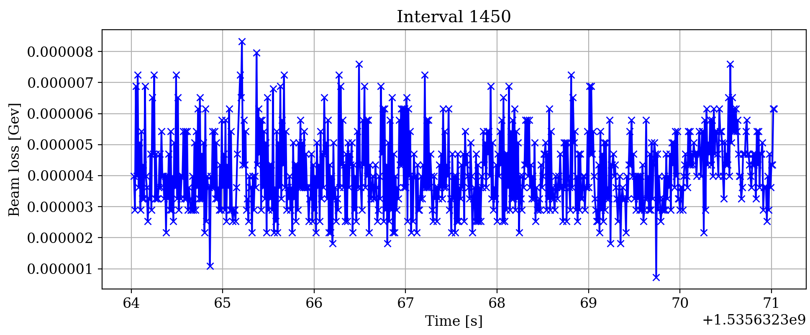
Beam loss frequency spectrum

Slide 12
Unusual peaks

Slide 13


Sources of additional losses
Potential internal
sources of resonance:
Power converters
$\sim 50$ Hz
Pumps
$\sim …$ Hz

Slide 14
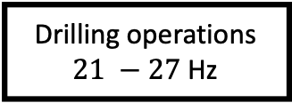
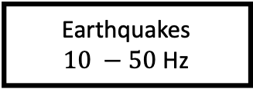
Sources of additional losses
Potential external
sources of resonance:
Drilling operations
$21 −27$ Hz
Earthquakes
$10 −50$ Hz

Slide 15
New frequencies

Slide 16
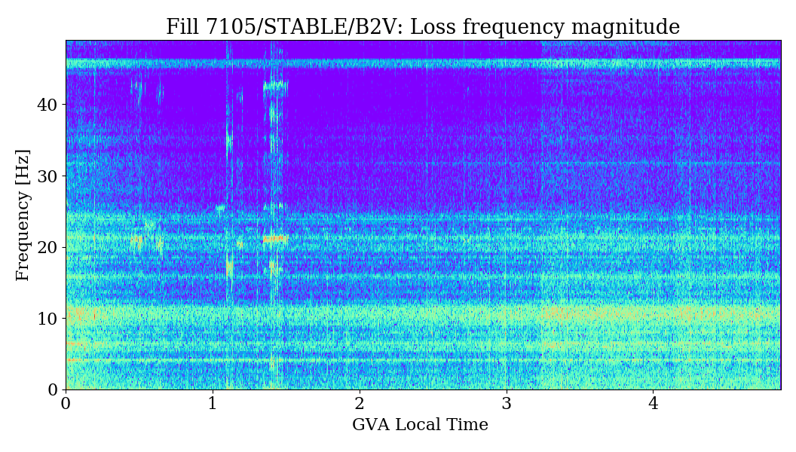
To get acquainted with rules and methods of controlling the beams in the LHC accelerator taking into account basic parameters like luminosity, emittance and lifetime of the beam.
The frequency spectrum analysis of the beam loss in the context of the ground movements and possible accelerator shock.

Slide 17
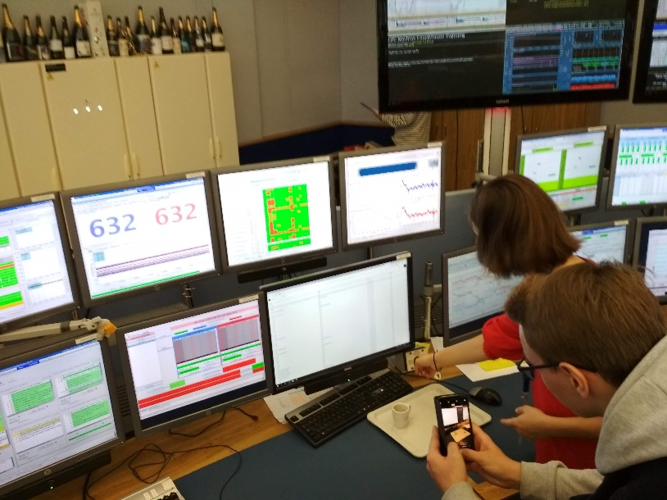
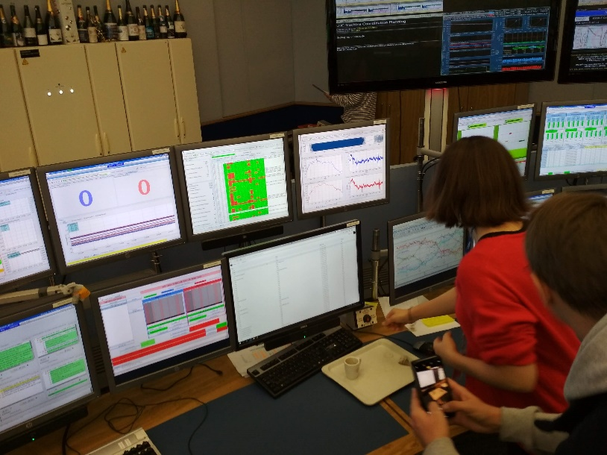
Beam dump!

Slide 18

Simon Baird „Accelarators for pedestrians” CERN-PS-OP-Note-95-17-Rev-2
Arkadiusz Andrzej Gorzawski „Luminosity control and beam orbit stability with beta star leveling at LHC and HL-LHC” CERN-THESIS-2016-193
Ritchie Vink „Understanding the Fourier Transform by example” https://www.ritchievink.com
*photo by
Ula Rybałtowska

Slide 19
Python
RED BUTTON
Mirror - window

Slide 20
Fast Fourier Transform

Slide 21
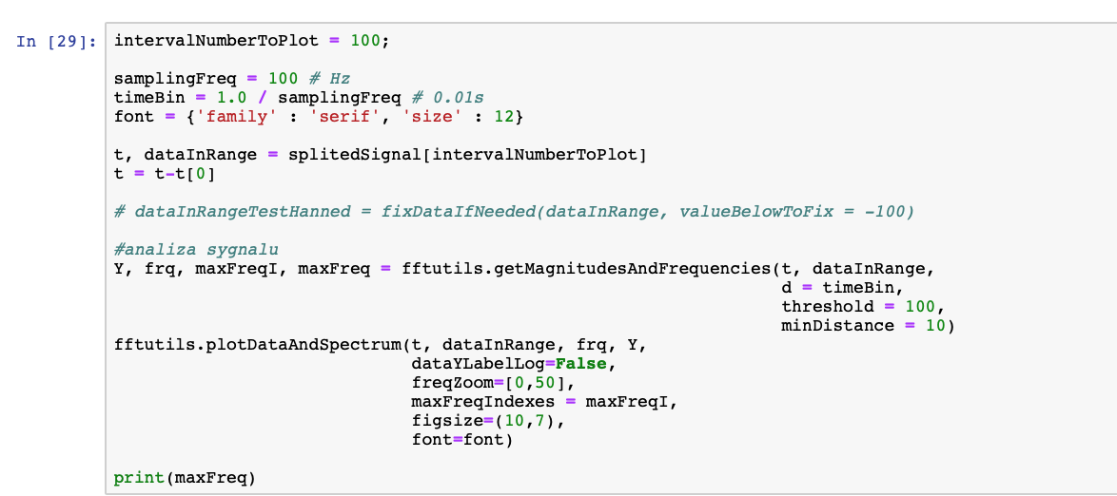
FFT in Python 3

Slide 22
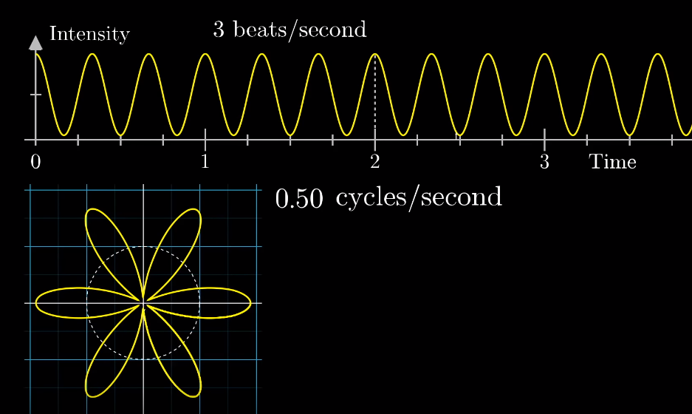
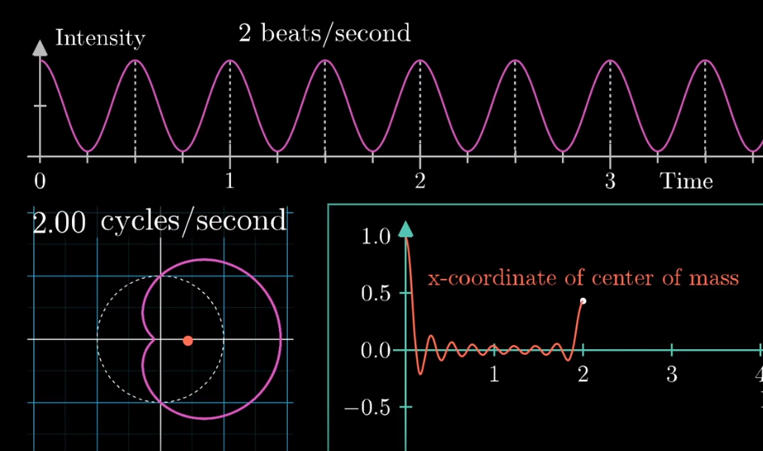
Fourier spectrum analysis

