Slide 1

Thermions
Work Overview at EP-DT,
Karolina Klimek
Adam Wątroba
Kamil Iwanowski
HSSIP November 2018

Slide 2
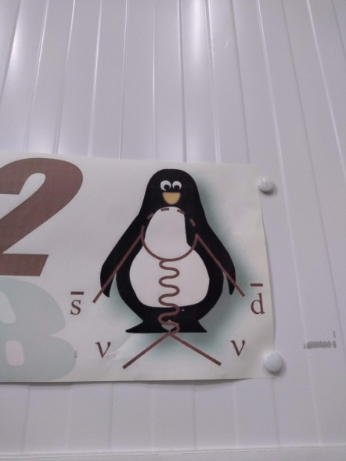
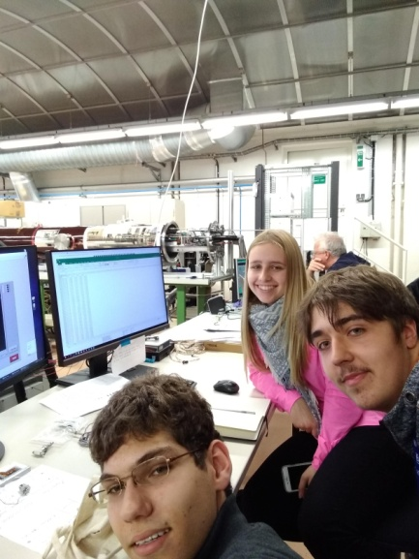
Work timeline
Neil laboratory
Microtubes
CO2 cooling
Types of trackers
Fiber optic thermal sensors
Wiktor Byczyński,
microchannel
for LHCb Velo Detector
Michael Brodski, heater test at Crystal Palace @ LUCASZ plant
CMS Phase II mechanics – Kamil Cichy
@ Neil laboratory
9/11
12/11
14/11
15/11
6,13 /11
12/11
13/11
15/11
Desiree Hellenschmidt micro scale tests with TRACI CO2
Loic Davoine, introduction to CO2 detector cooling & controls
Wojciech Hulek & Natalia Koss CO2 DAQ racks b.153 – hands on control system, sensor calibration
Tiago Neves - Fiber Optics Temperature and Humidity sensors

Slide 3
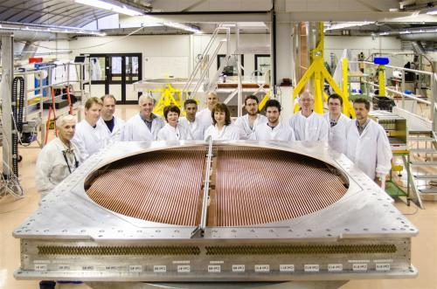
Our master and teacher - Neil

Slide 4
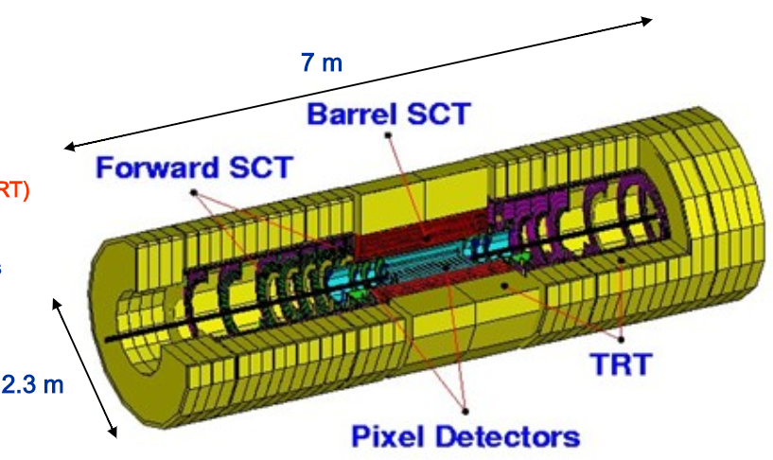
Transition Radiation Tracker (TRT)
3 types of trackers
Pixel detector
Semiconductor tracker (SCT)
TRT ( Barrel and End-cap)

Slide 5
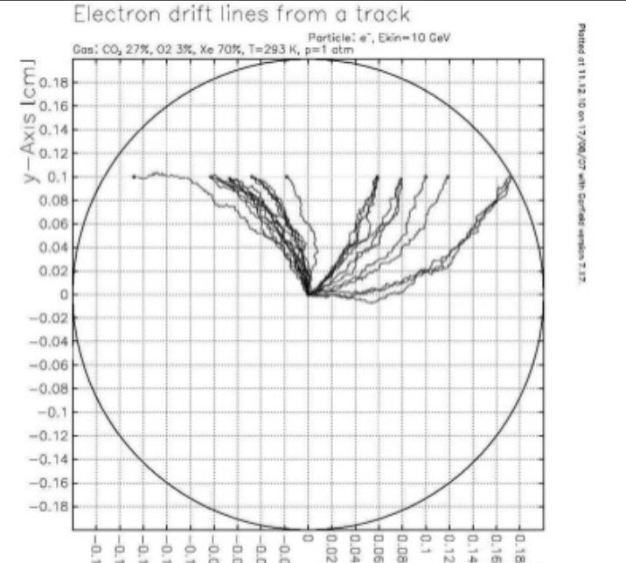
How it works?
Geiger - Mueller scheme
Ionisation of the gas
Amplification of the current( High voltage)
Current measurement

Slide 6
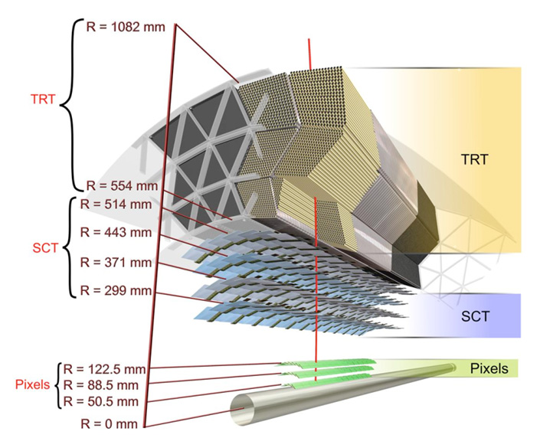
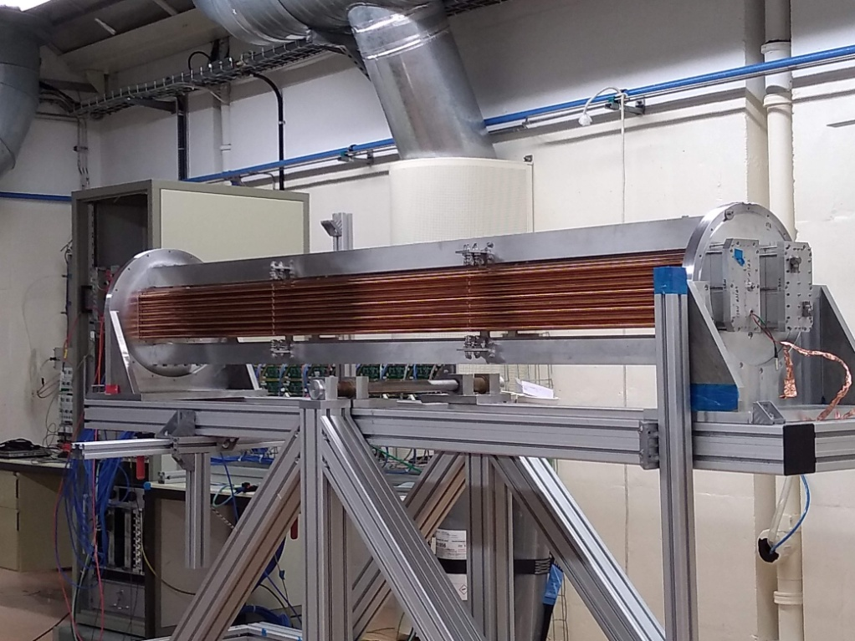
Different position -> different structure
Positioned near the IP, designed to detect particles moving perpendicular to the beam(Barrel).

Slide 7
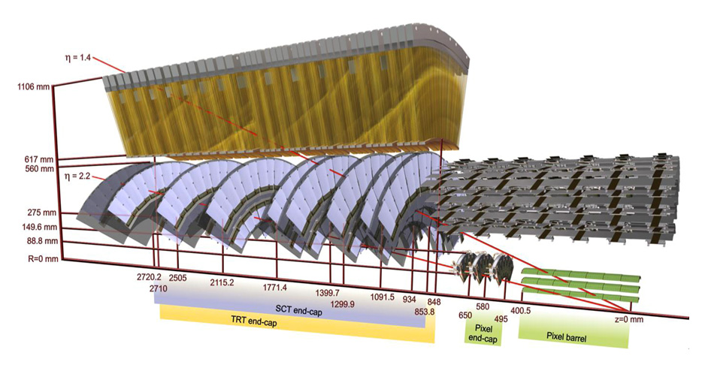
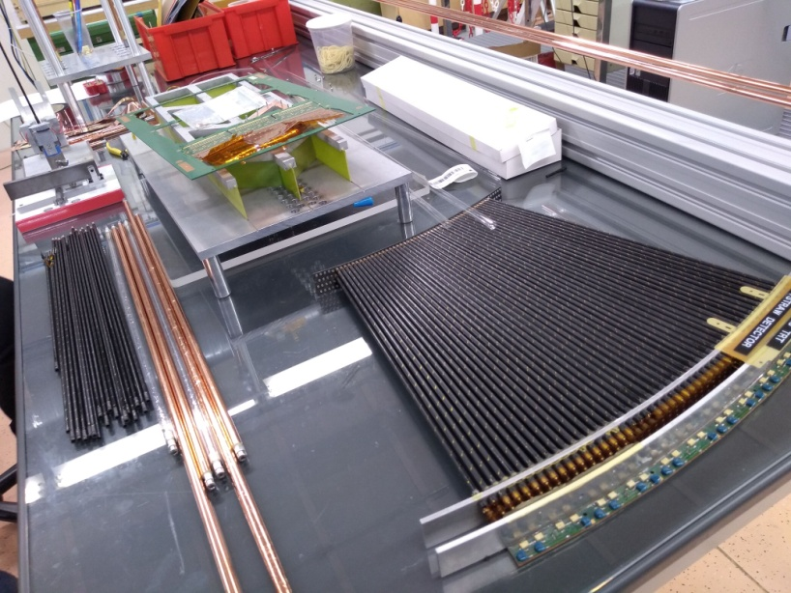
Different position -> different structure
Positioned further from IP, designed to detect particles moving parallel to the beam(End-cap).

Slide 8
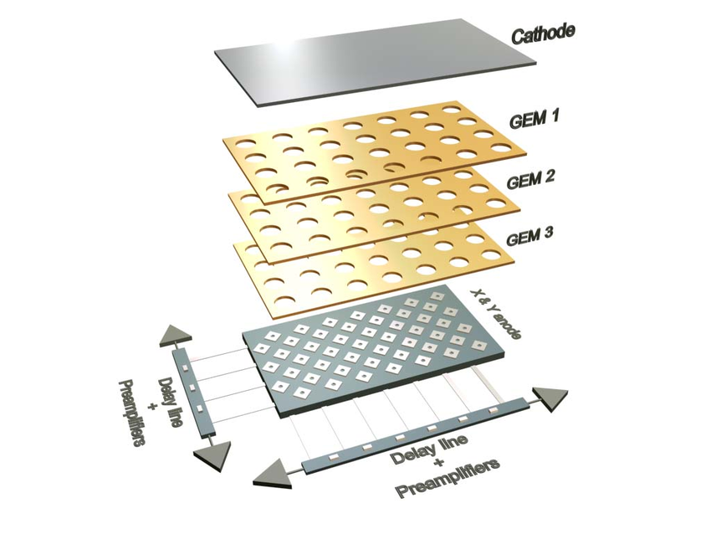
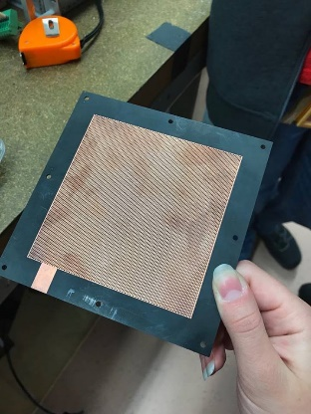
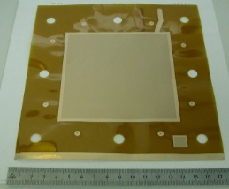
GEM detectors- gas electron multiplier
A gas electron multiplier (GEM) consists of a thin, metal-clad polymer foil, chemically pierced by a high density of holes. On application of a difference of potential between the two electrodes, electrons released by radiation in the gas on one side of the structure drift into the holes, multiply and transfer to a collection region.

Slide 9
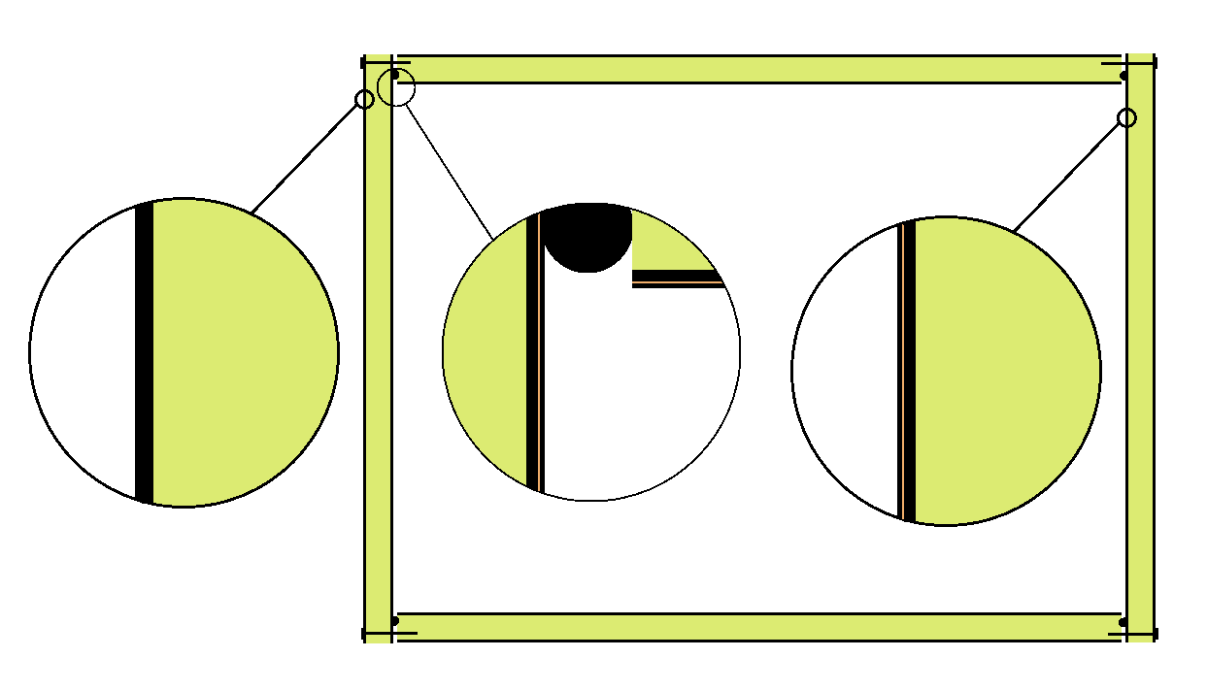
Heat conductivity measurements
Detecter thermal isolation
Faraday’s cage
Temp. gradient up to 50 K
Isolation needed because of the water vapour condensation
Existing thermal bridge

Slide 10
Heat conductivity measurements
Detecter thermal isolation
Faraday’s cage
Temp. gradient up to 50 K
Isolation needed because of the water vapour condensation
Existing thermal bridge removal

Slide 11
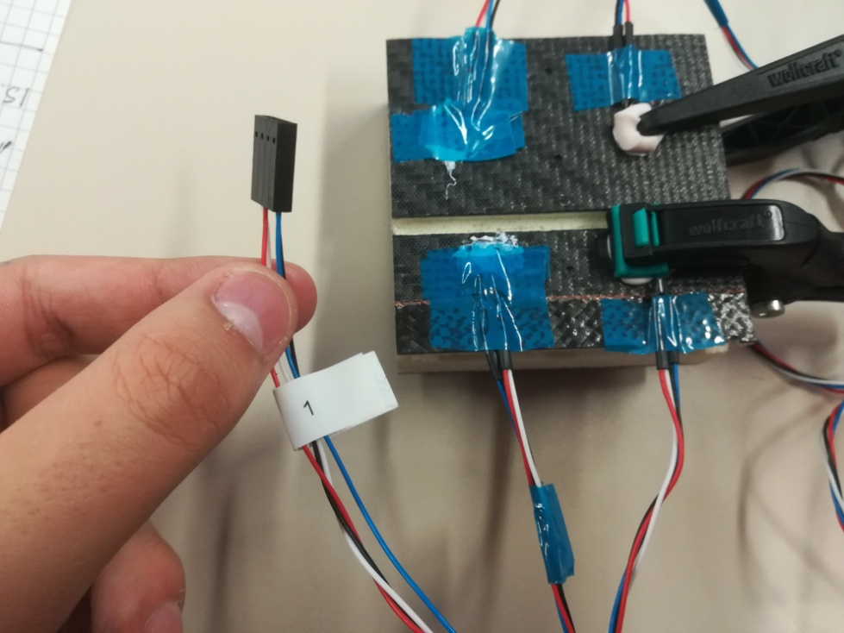
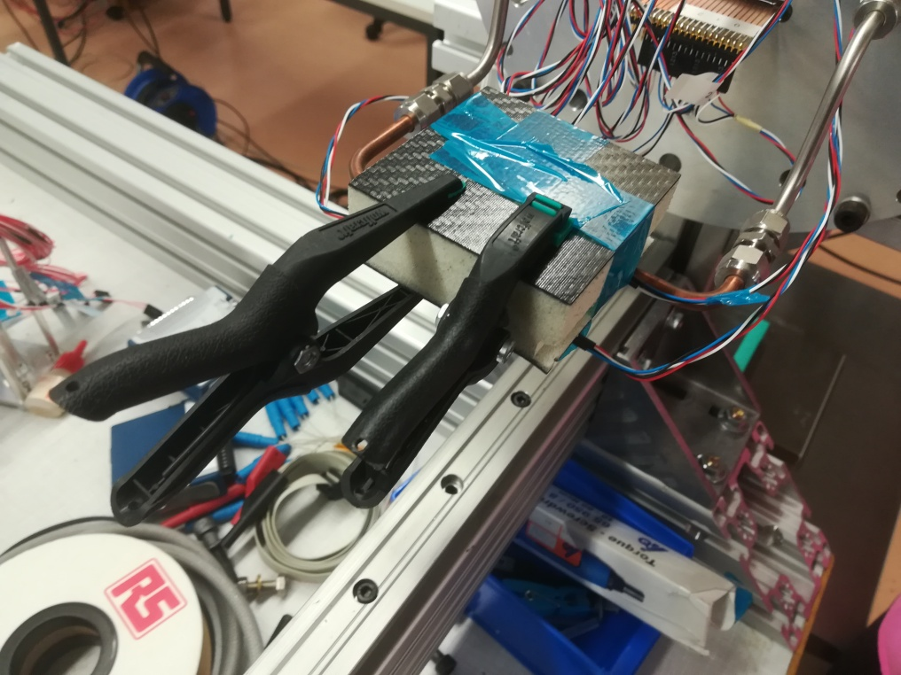
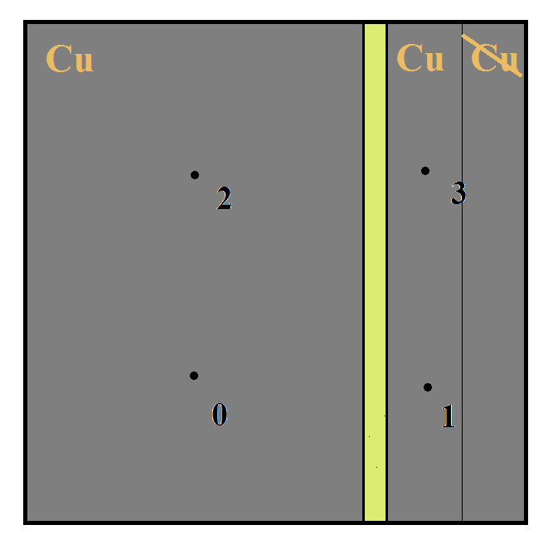
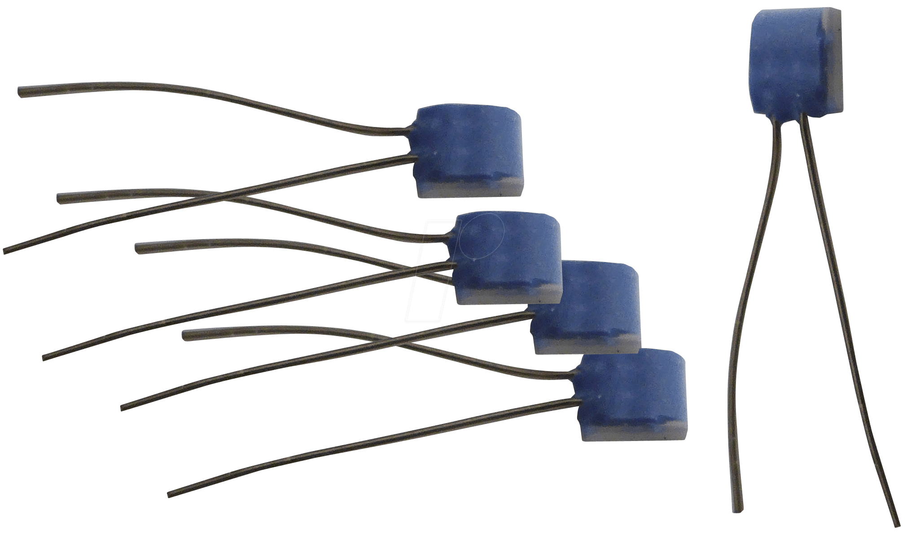
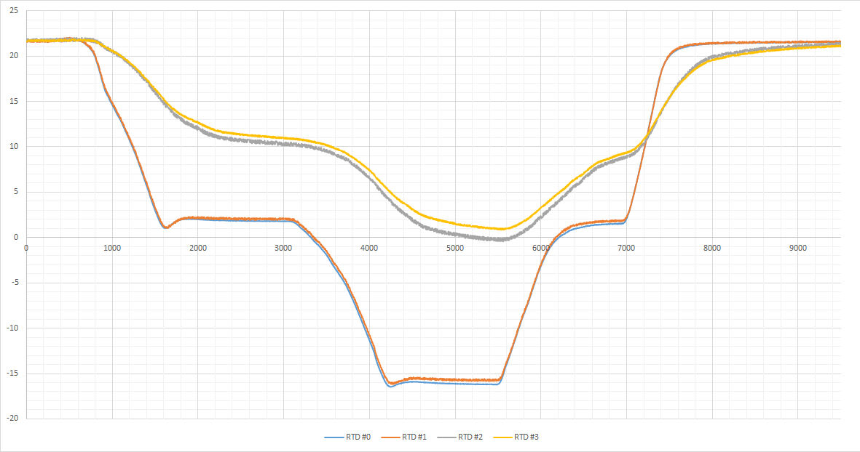
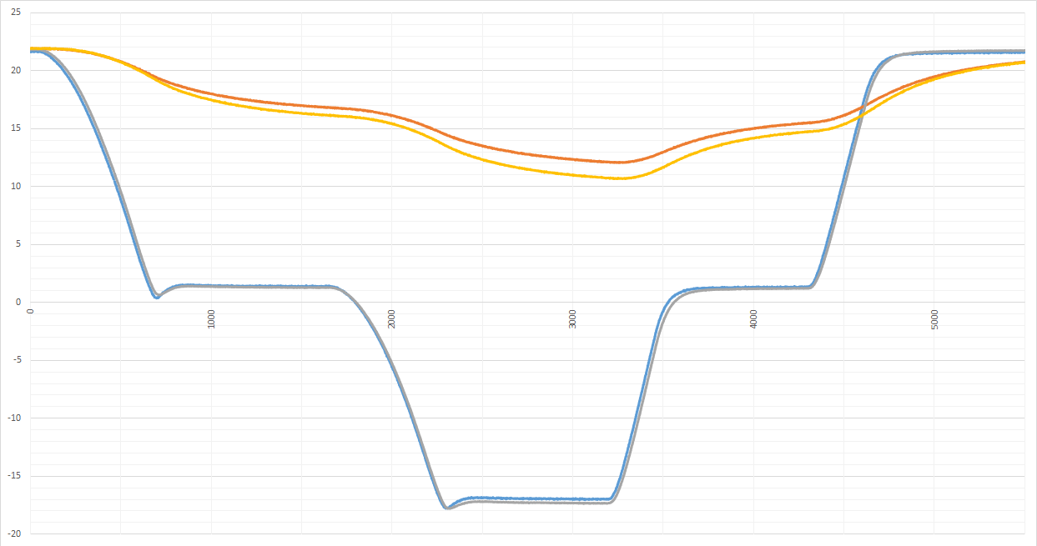
Heat conductivity test @ detector laboratory - 3days
PT 100(resistance temperature detector - RTD) sensor
PT100
PT100
PT100
PT100
1st measurement
2nd measurement
With thermal bridge
Without thermal bridge

Slide 12
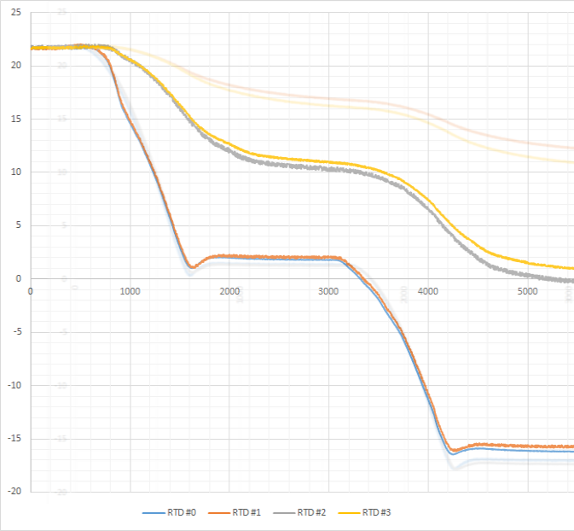
Visible difference in gradient
Temperature increase due to thermal bridge removal. Temp. is much higher.
Radiation influence
(4 K diff.)

Slide 13
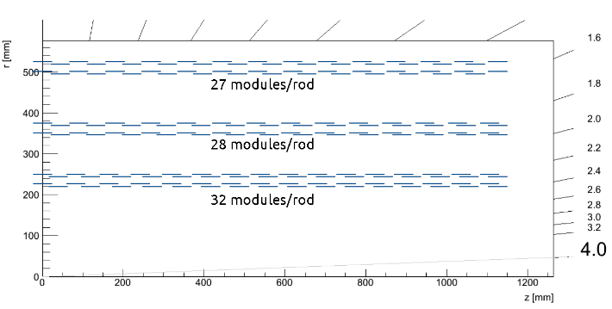
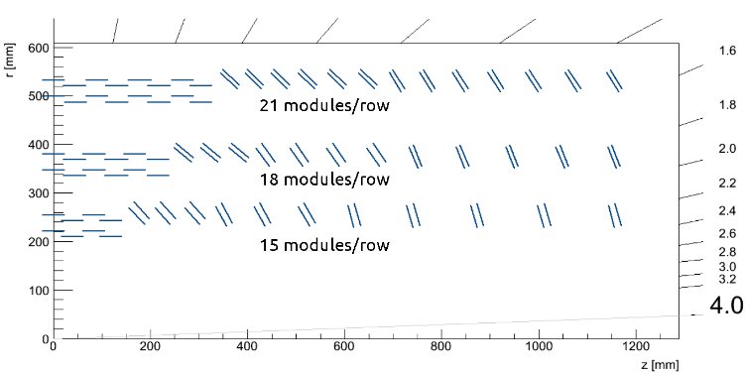
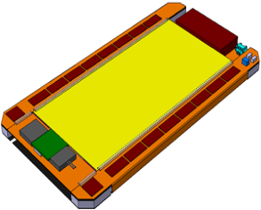
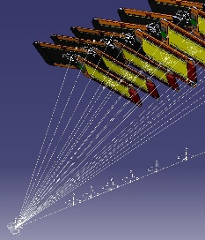
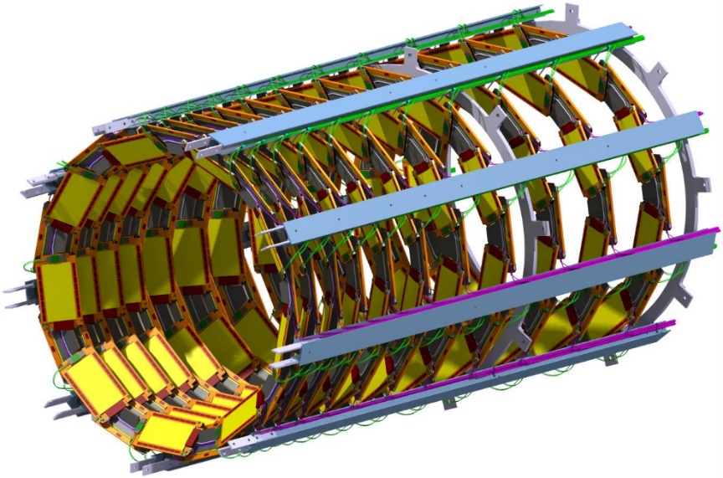
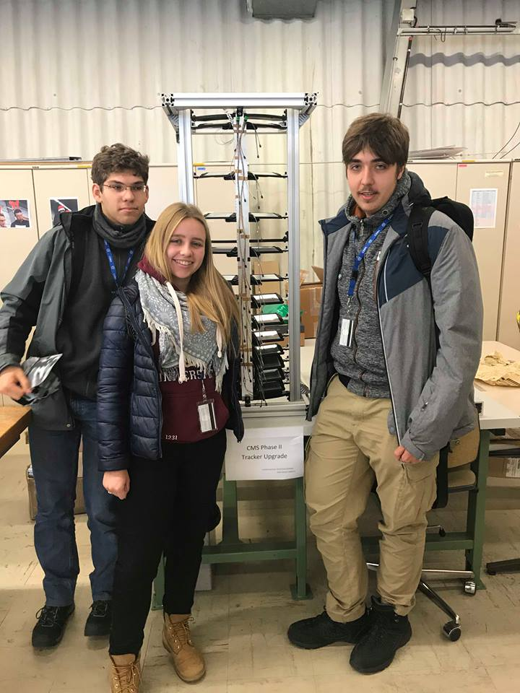
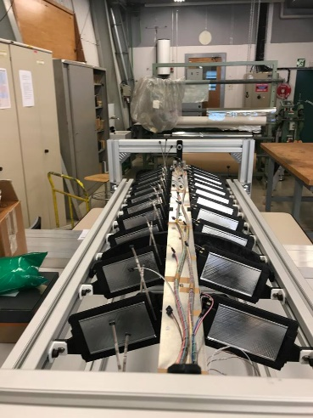
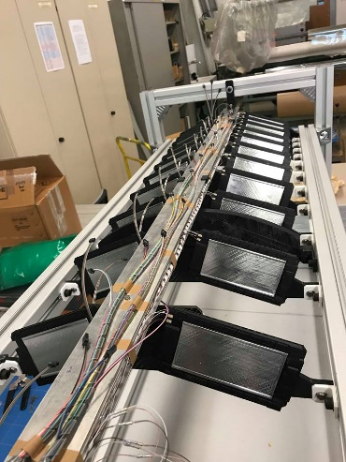
Kamil Cichy- CMS Phase II mechanics
Pixel + Strip semiconductor silicon sensors
Preparation models in Catia
Less means better- new model of detectors for CMS
Sensors are located on different angles
and because of that we are able to catch every particle
There are less sensors so the weight is smaller – really important
You don’t need as much cooling part as before
Project in Catia
Real model made by using 3D printer
Our group next to the prototype.

Slide 14
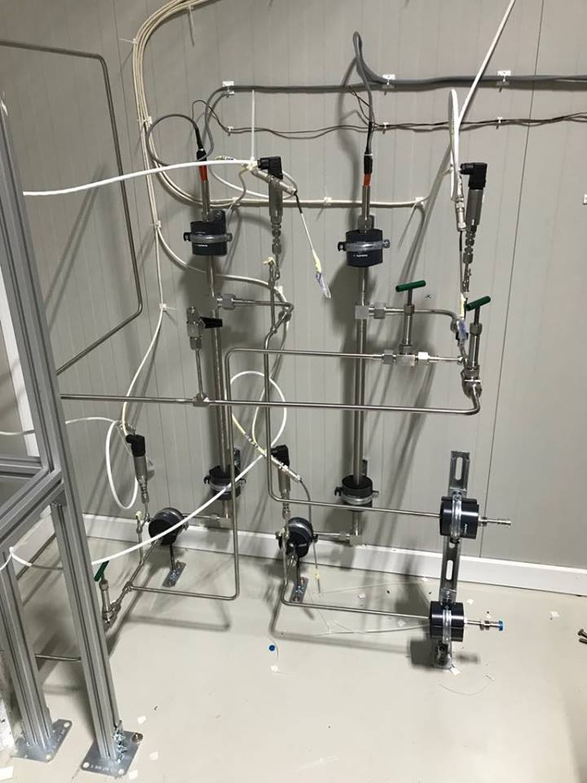
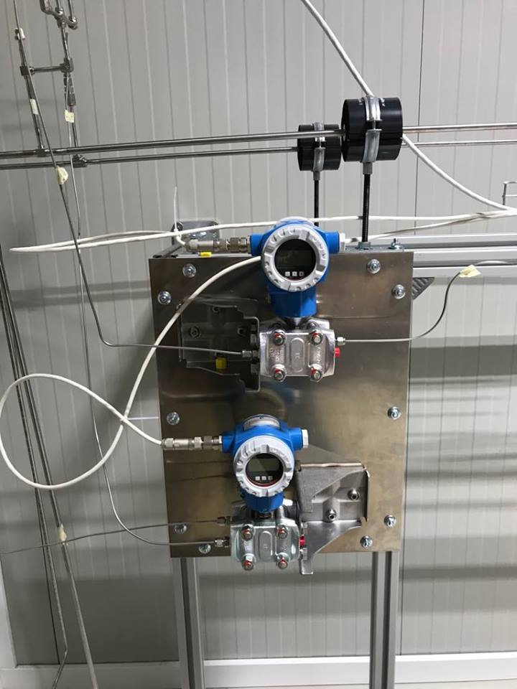
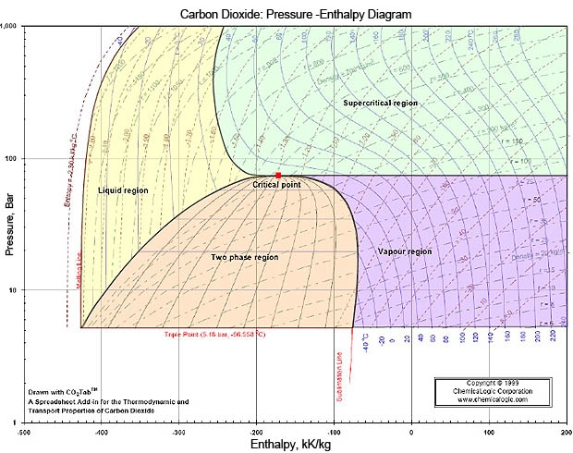
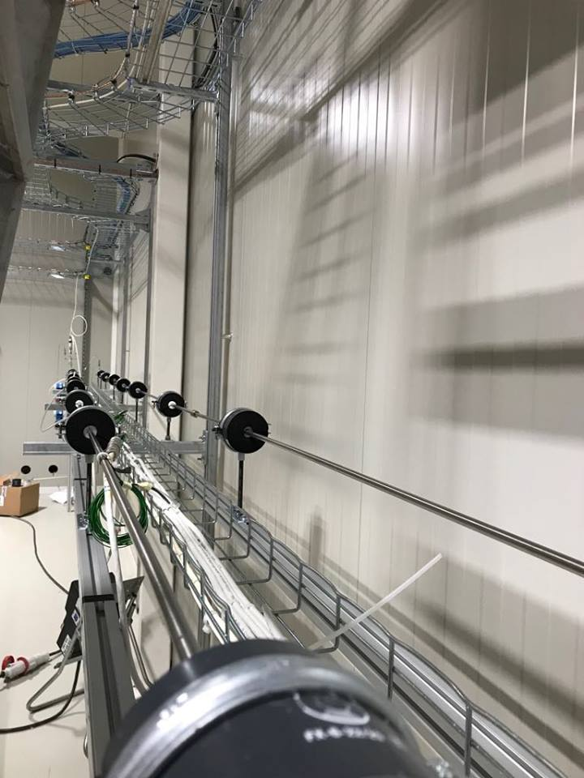

CO2 DAQ racks – Data Acquisition
At the beginning of the experiment
we want to have specific enthalpy of$CO_{2}.$
This setup is projected for measuring pressure loss along the horizontal pipe
Every meter along this pipe we can also measure temperature using sensors RT100
In the future similar experiments are going to be conducted in vertical position

Slide 15
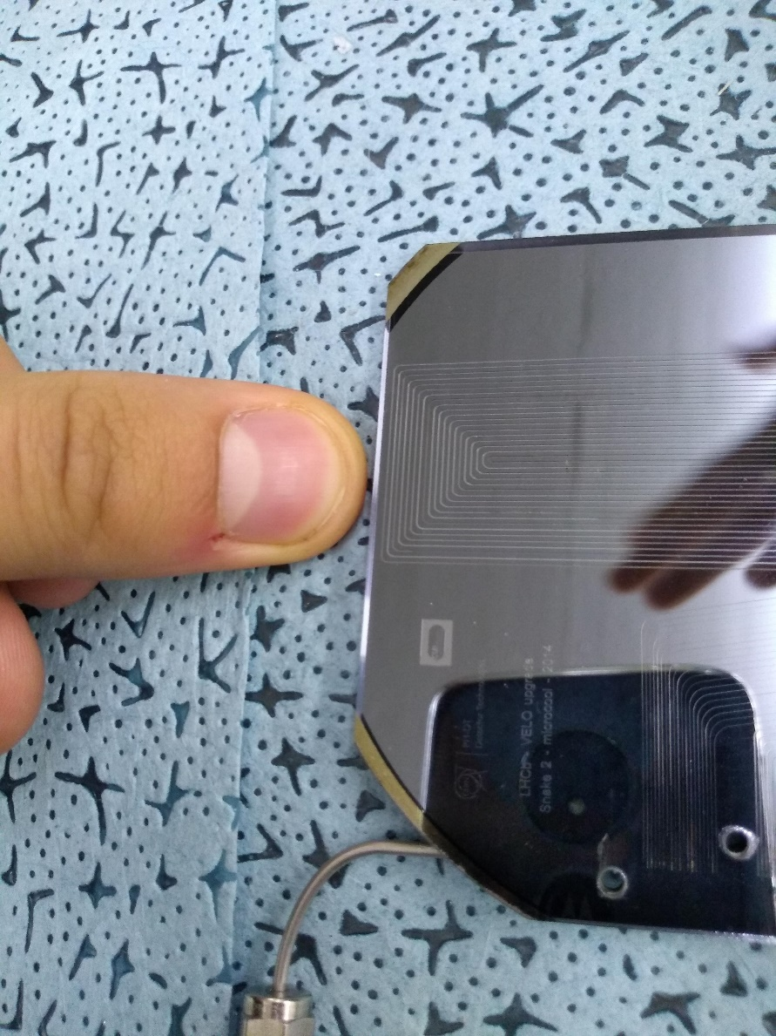
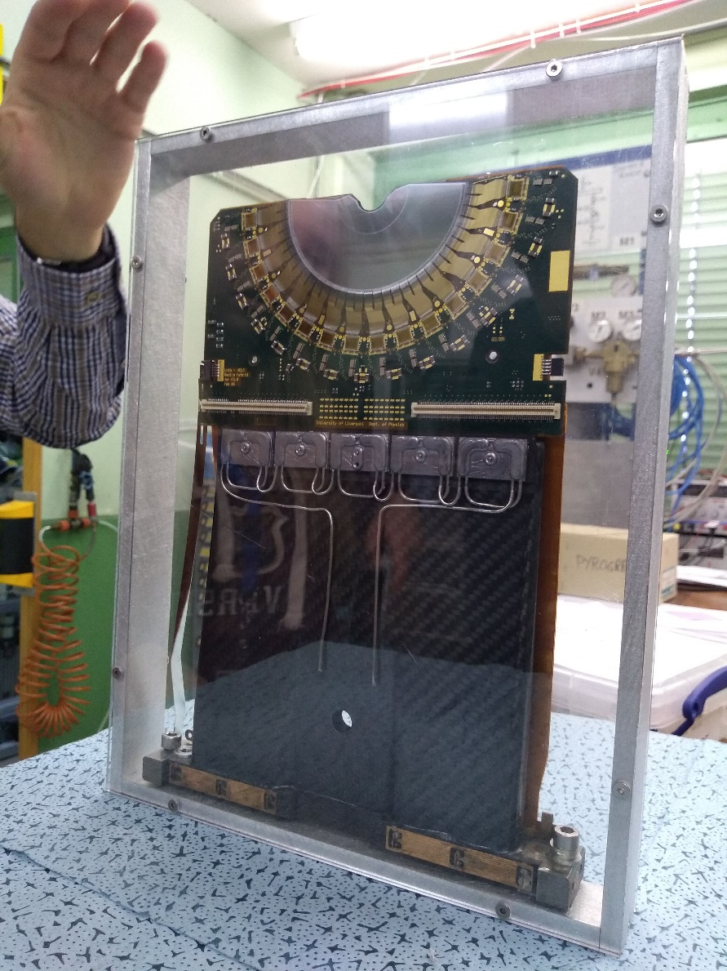
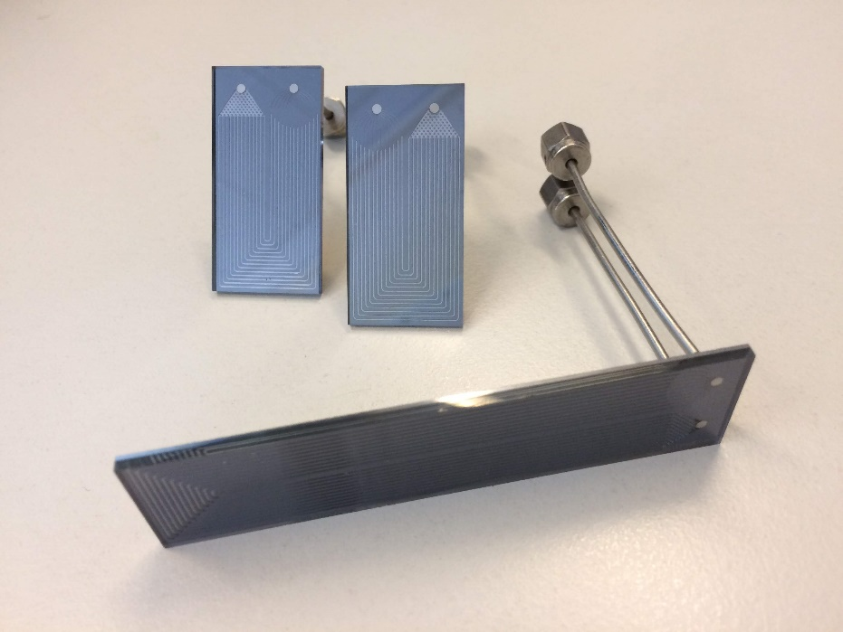
Wiktor Byczyński, microchannel for LHCb Velo Detector
Cooling integrated with silicon wafle
By using CO2 evaporation to cool circuits, this method is very efficient and eco – friendly
New parts will be installed during LHC LS2

Slide 16
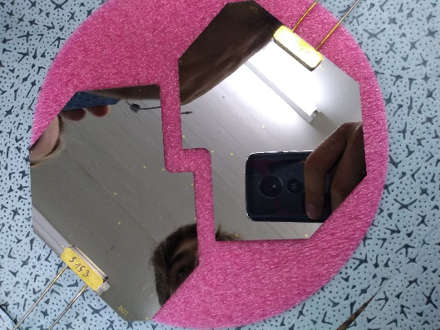
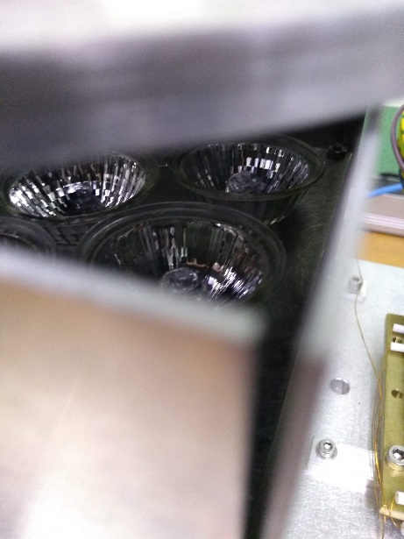
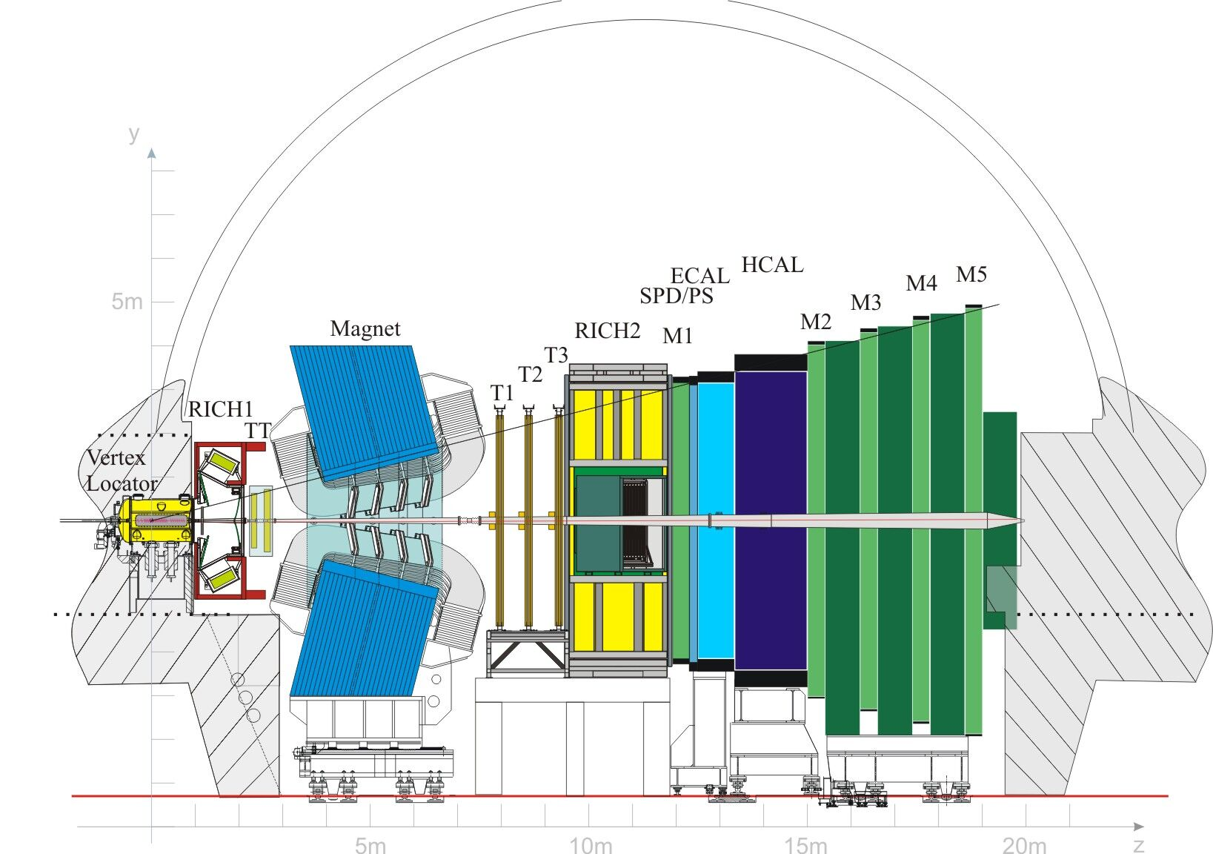
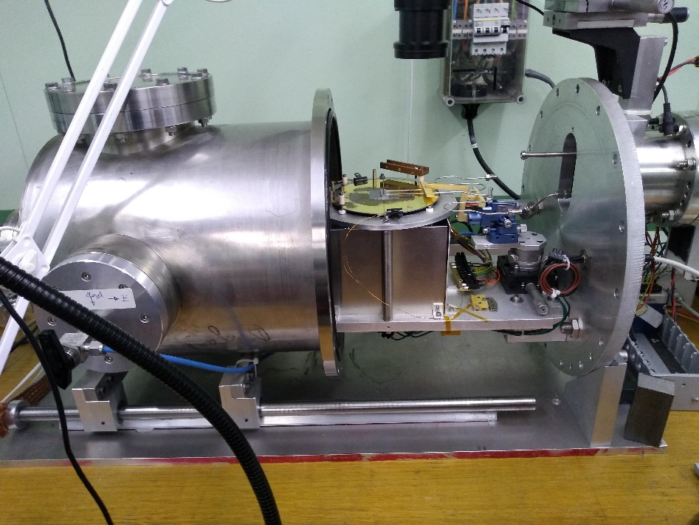
Wiktor Byczyński, microchannel for LHCb Velo Detector
Professional heater – 4 lightbulbs from Leroy Merlin
Cooling needs to be verified with tests involving using 150 bar pressure
Of course, it needs to keep its properties – even in extreme condotions
Planned for LHC LS2
Amateur vacuum chamber – not from Leroy Merlin

Slide 17
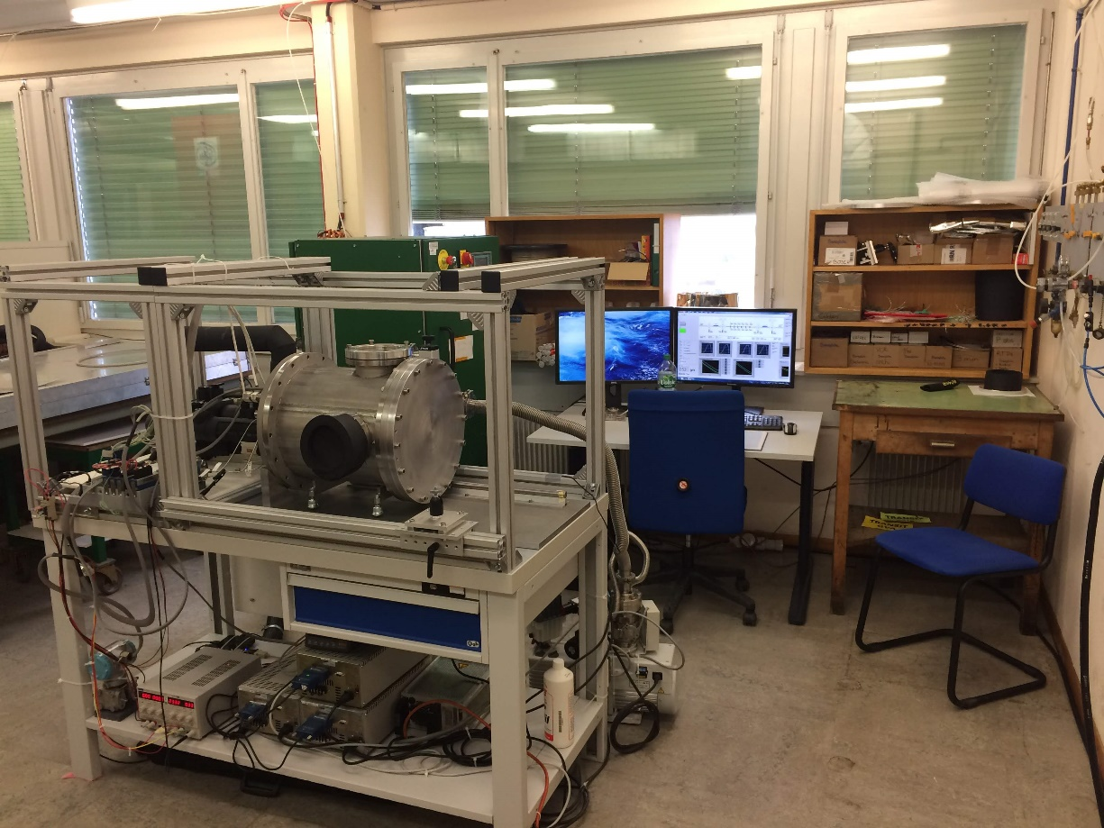
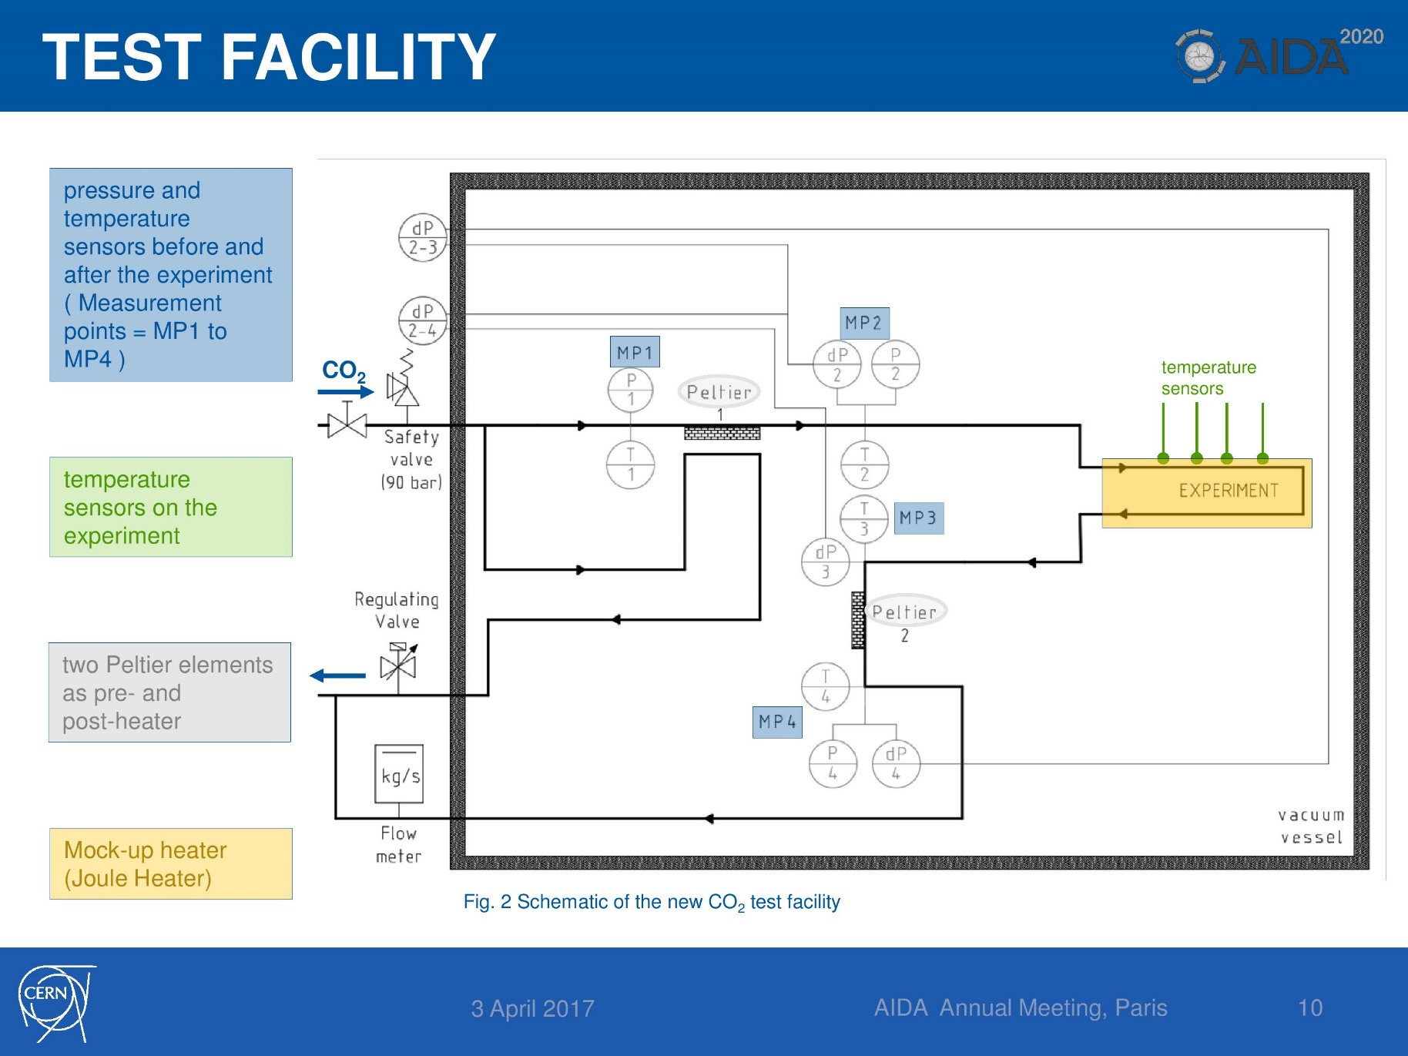
Desiree Hellenschmidt - micro scale tests with TRACI CO2
Micro – pipe test contraption
Test chamber scheme

Slide 18
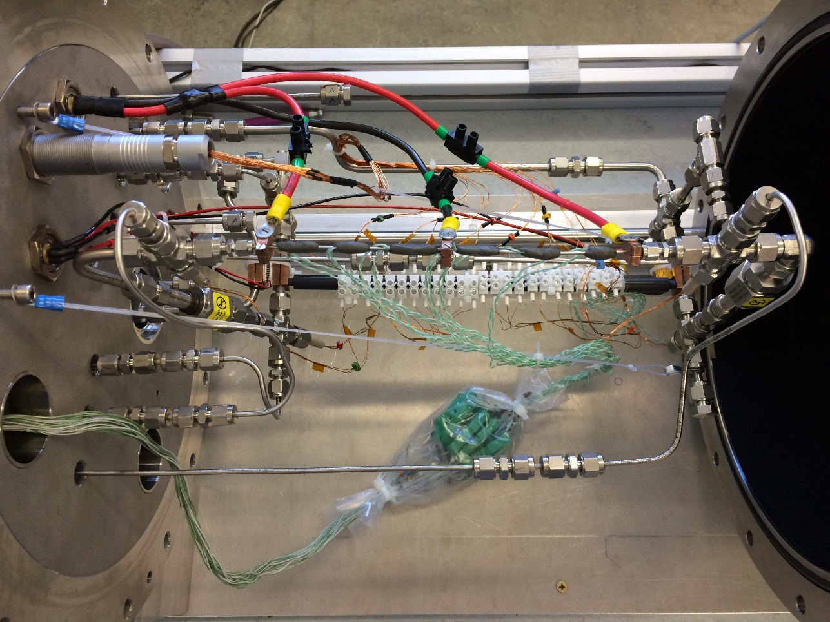
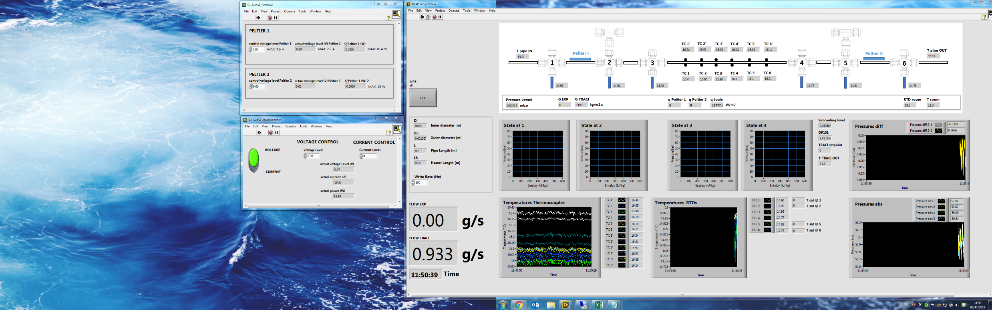
Desiree Hellenschmidt - micro scale tests with TRACI CO2
Heater cables
We can predict one – phase flow in both macro- and micro- tubes
Two – phase flow in macro – tubes is not a problem too
But we have no idea how two – phase liquid behaves in micro – tubes!
Tests about that are currently in progress
Micro – pipe (1mm diameter) with temperature sensors
Pressure sensors and precise heaters

Slide 19
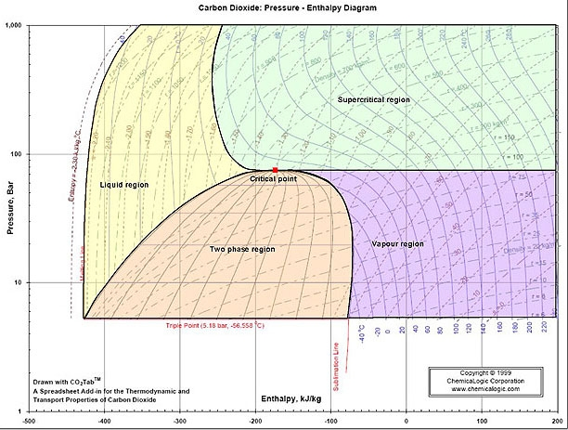
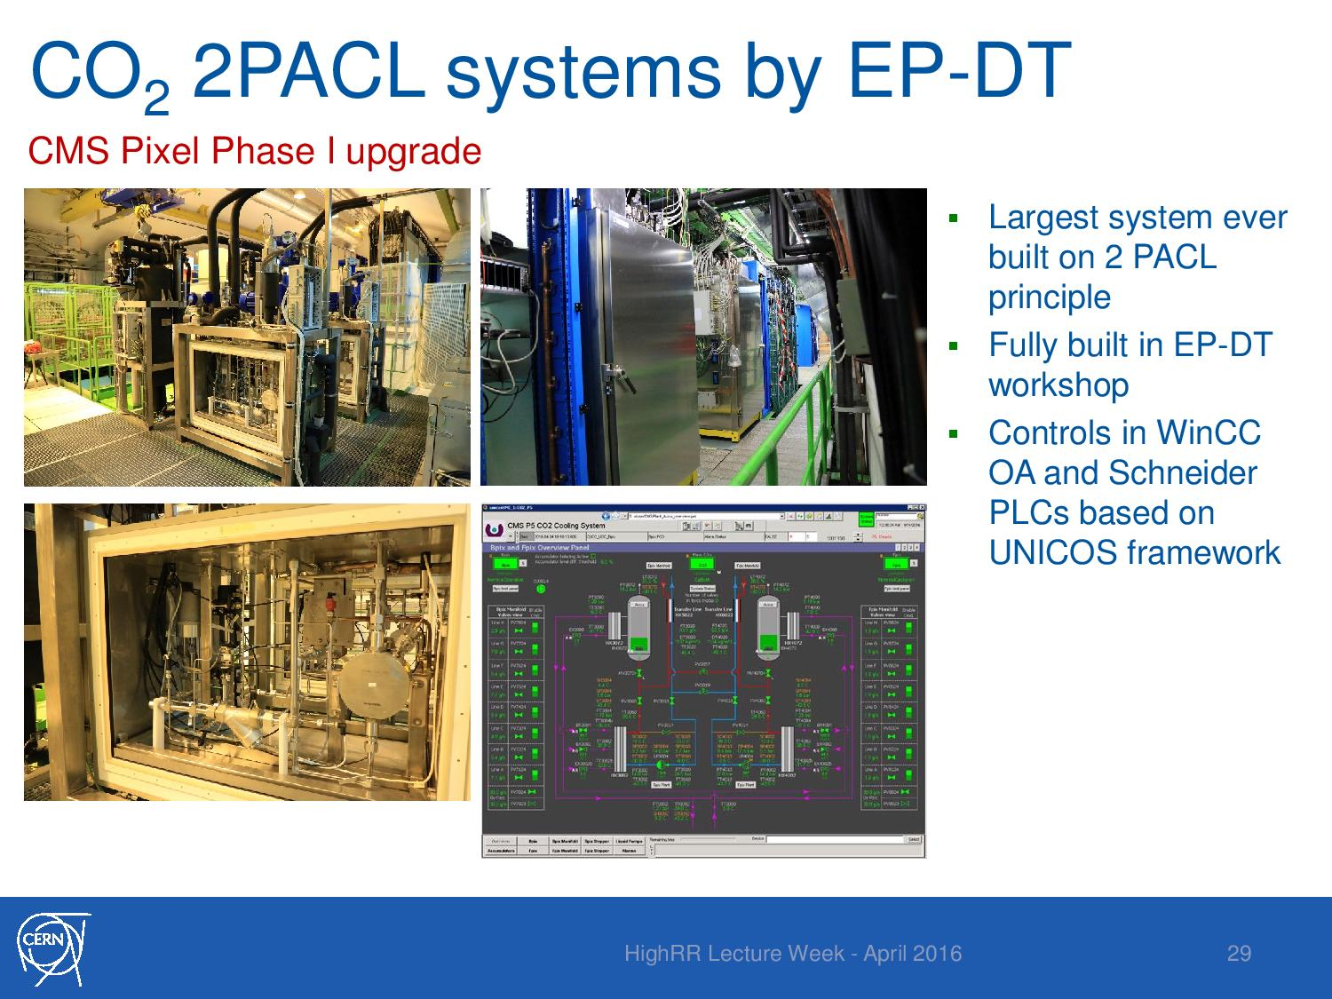
Loic Davoine, introduction to CO2 detector cooling & controls
Basically, CO2 cooling works pretty similar to out kitchen fridges – it’s just a bit oversized
Also, it is staged – first stage cools down using R404, and second stage uses CO2
Carbon Dioxide: Pressure – Enthalpy Diagram

Slide 20
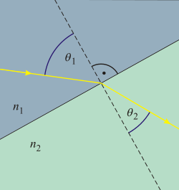
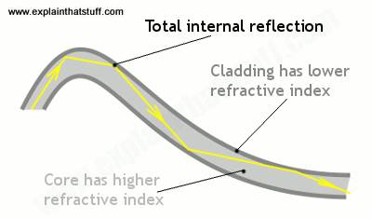
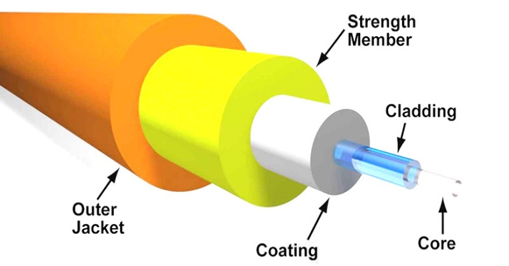
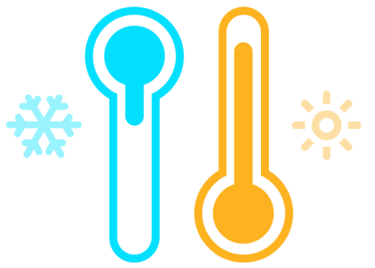


Fiber optics sensors
Propagation of light in the fiber, difference in refractive indexes
Optic fiber structure
Snell’s law
Dependence on:
Temperature
Mechanical strains/ pressure
Radiation

Slide 21




FBG, LPG, Continuous sensors
Fiber Bragg Grating
Sensitive to radiation, existence of safety zones, required adequate calibration
Grating made by laser
Best suited as temperature sensor
Multiplexing
-> more sensors(up to 14!!)
-> different grating periods
Coating to measure the stress
-> humidity measurement

Slide 22


FPG, LPG, Continuous sensors
Long Period Grating
more sensitive to Relative Humidity (RH)
lack of ability to multiplex efficiently (maximum of 3/4 sensors on one fiber)
Light propagation in LPG
Leakage of the light to the cladding enables it to be more sensitive to outside conditions.

Slide 23

FPG, LPG, Continuous sensors
Distributed Continuous Sensors
Using the imperfections in the fiber structure we can derive the information about the temperature along the fiber.
Used method:
We send a short pulse of light
When the light passes through mediums of different refractive indexes some of it reflects.
The amount of reflected light depends on the temperature
The reflected light can be distinguished by the different time of arrivals, which precisely tells us the position of the imperfection
Therefore we can use the structure as a continuous temperature sensor

Slide 24

Thanks for your attention

