Slide 1
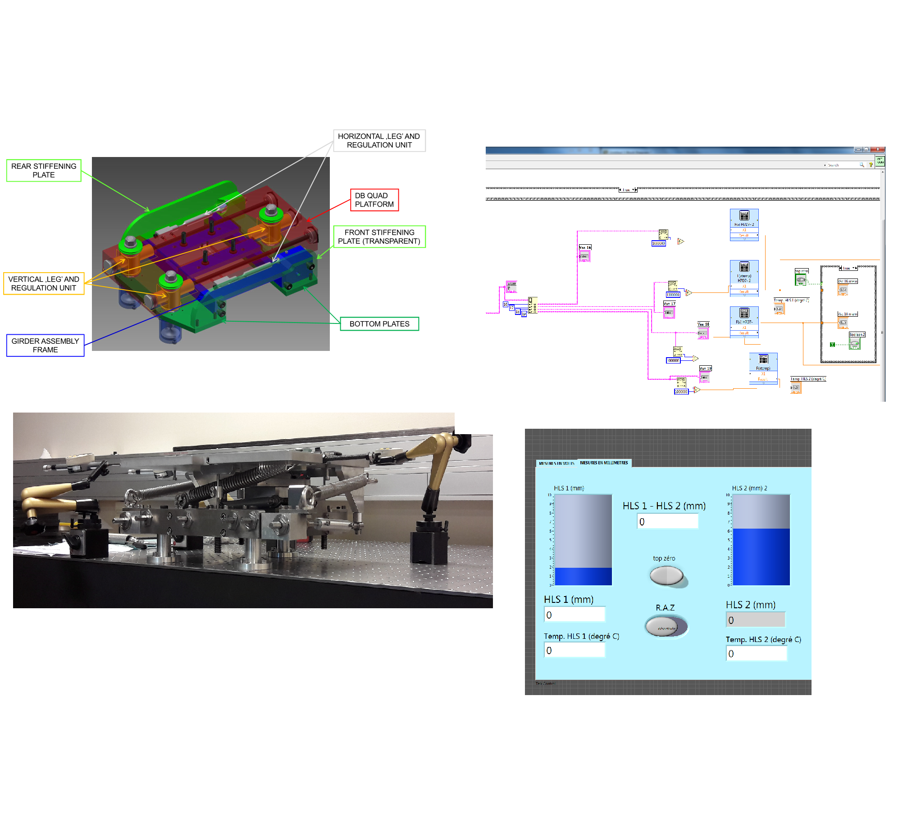
„Robotons”
Jakub Grzyb & Mikołaj Miszczak

Slide 2
Where are we working?

Slide 3
SMM – Survey Mechatronics Measurments
High Precision Aligment Technologies

Slide 4
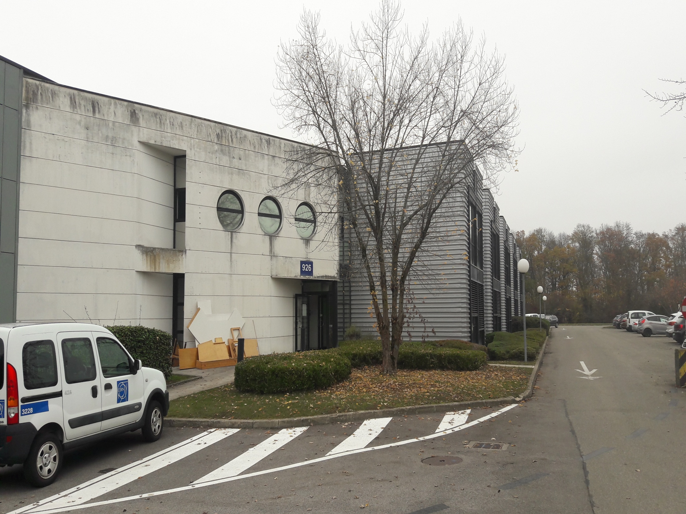

Slide 5
My work
Getting to know the platform
Preparing measurments
Making three directional stiffness measurment series
Under supervision of Mateusz Sosin and Tomasz Błaszczyk

Slide 6
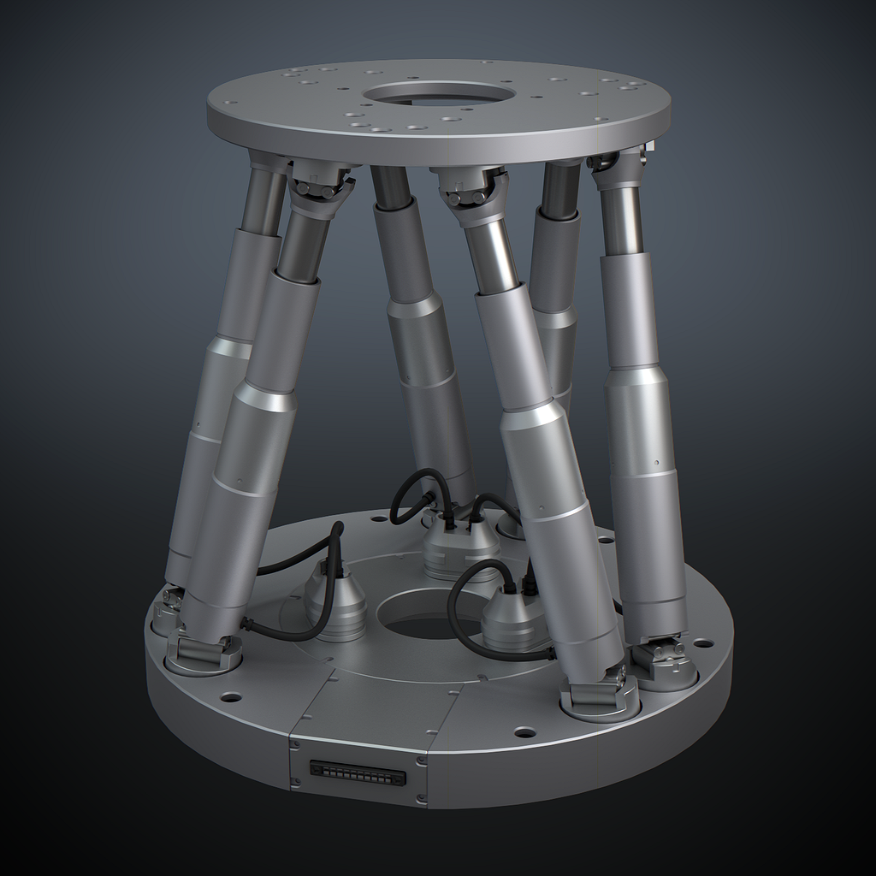
Stewart Platform

Slide 7
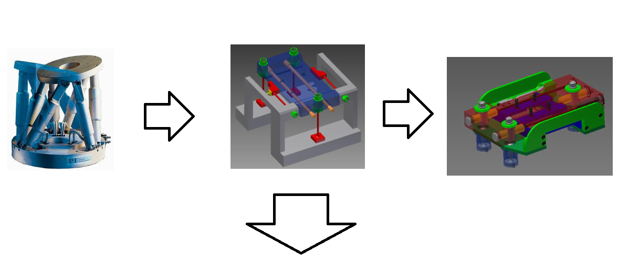
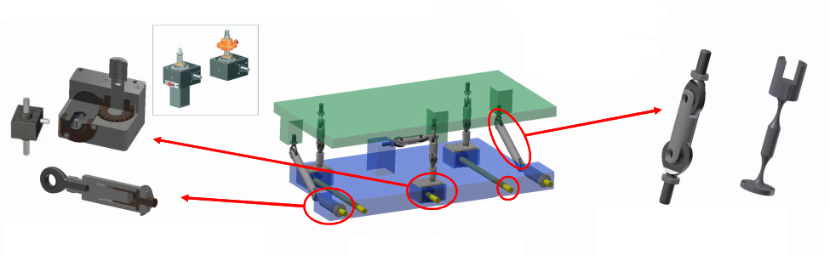

Slide 8
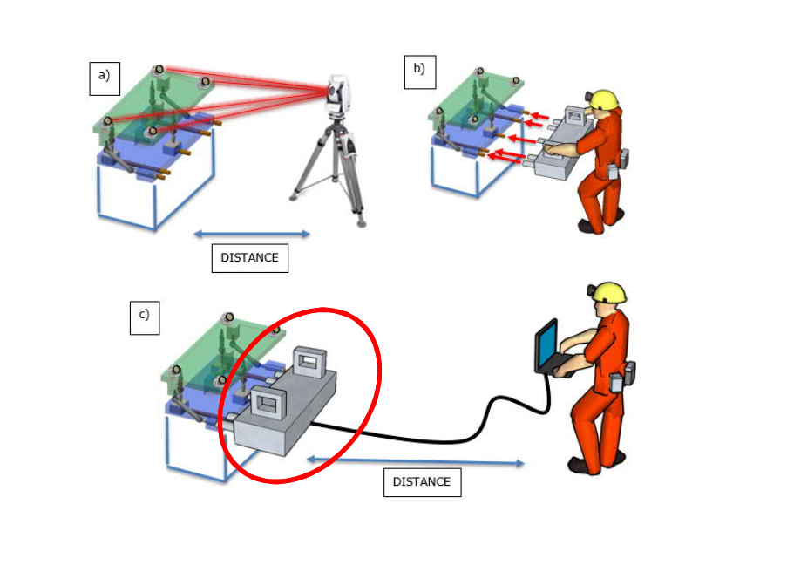

Slide 9
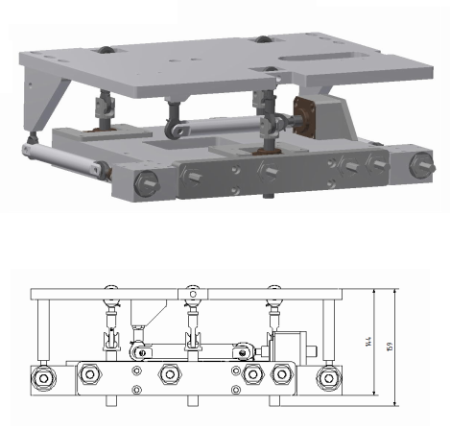
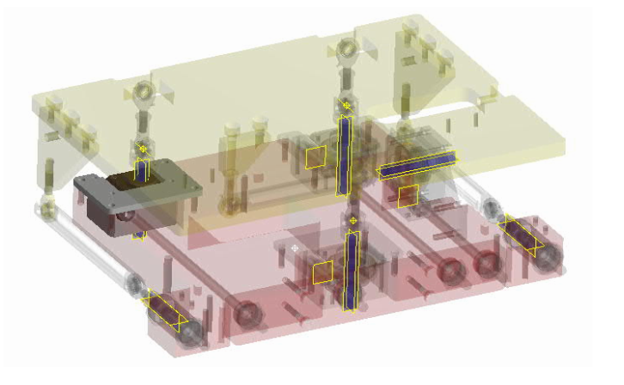
Standardized adjustment solution

Slide 10
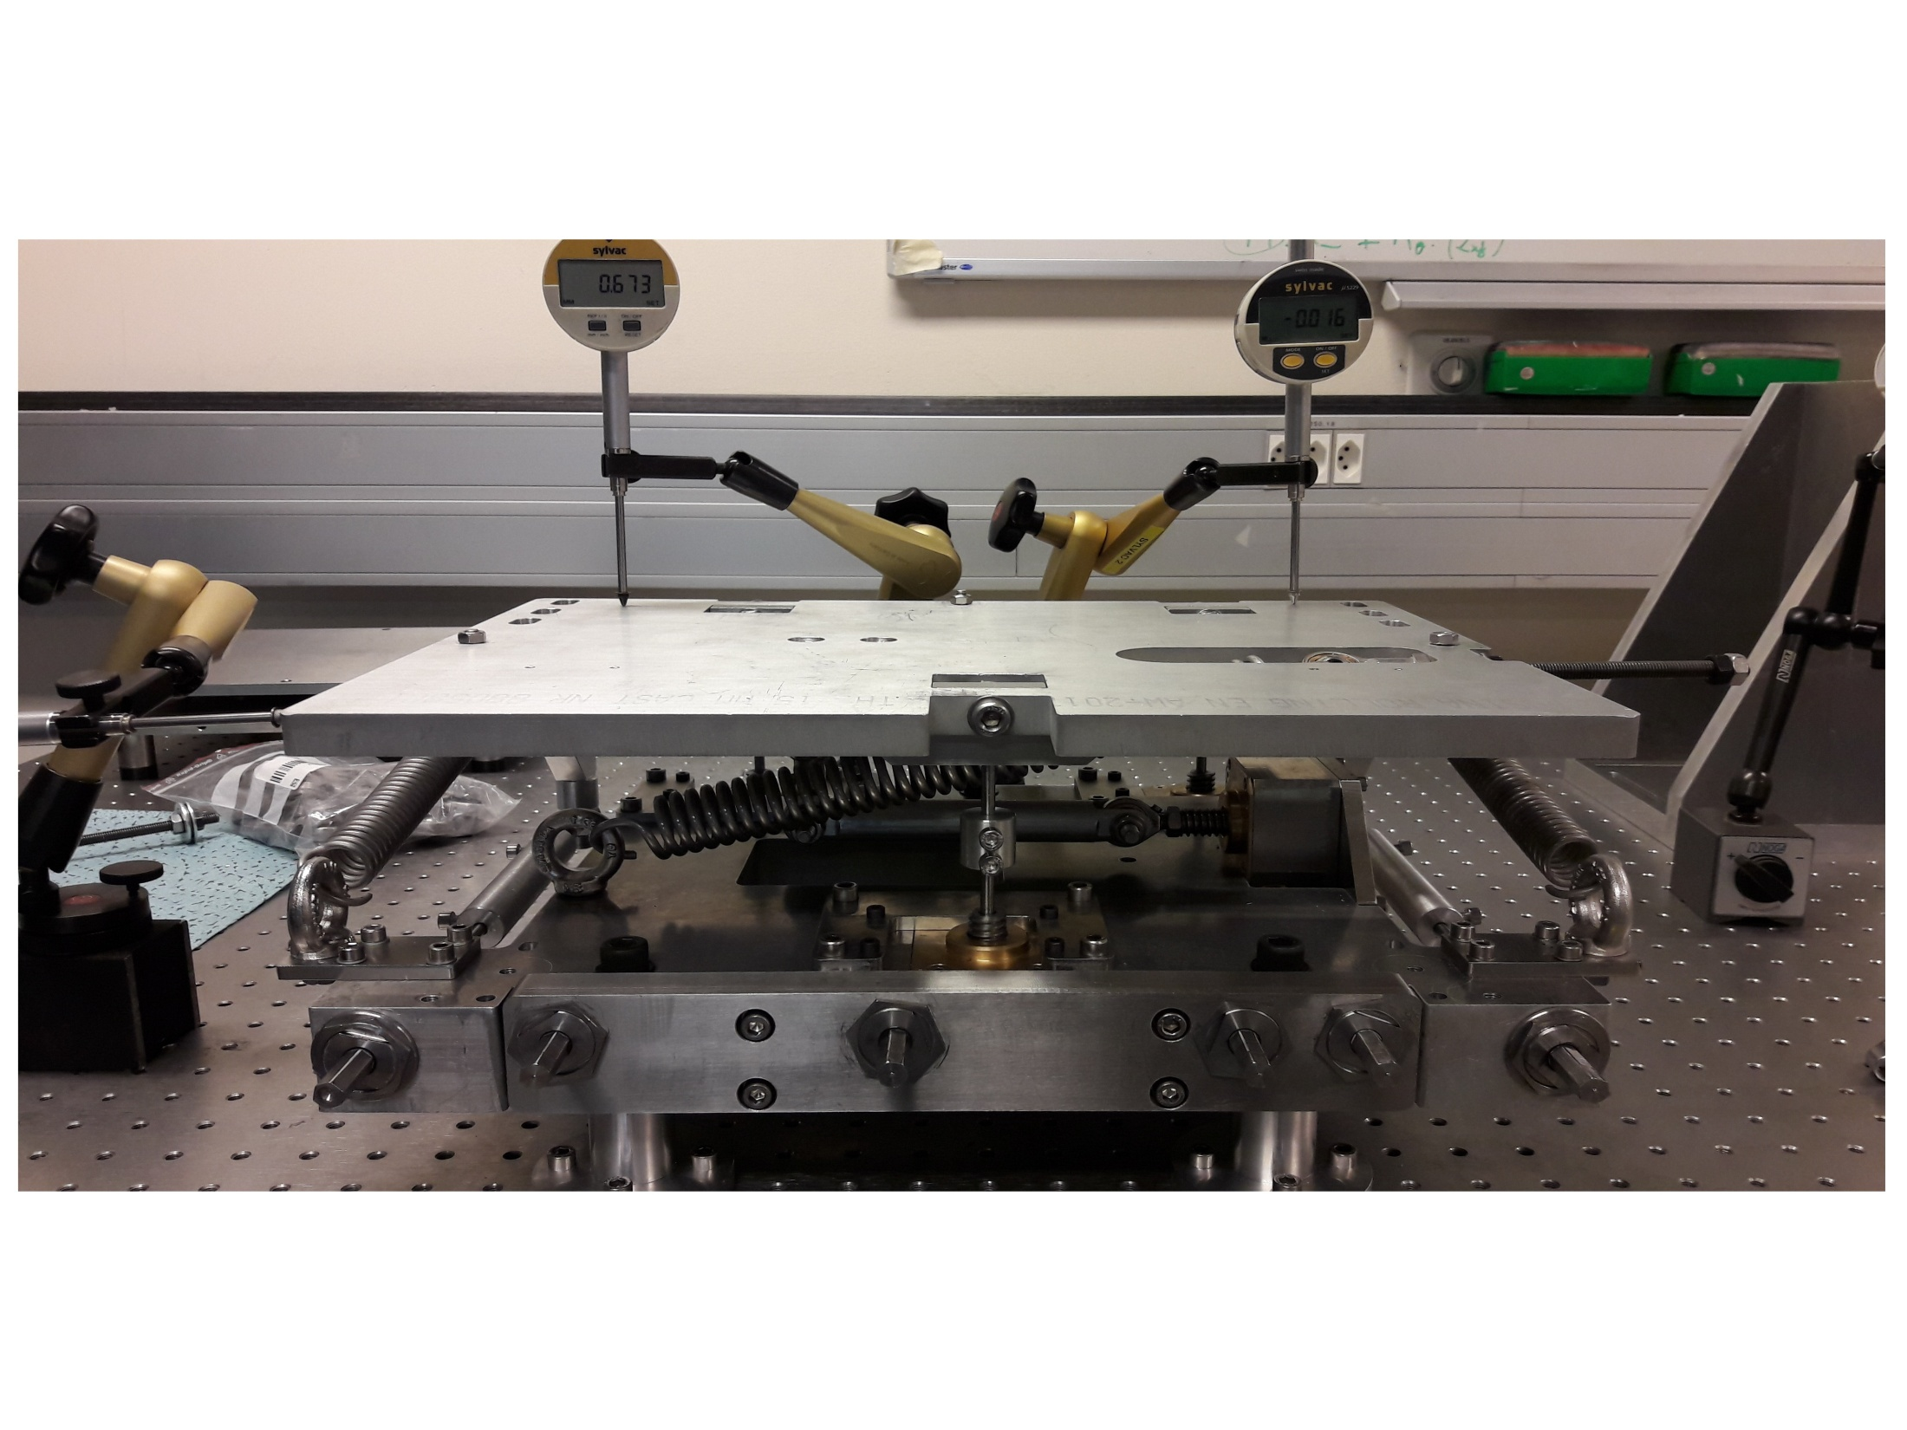

Slide 11
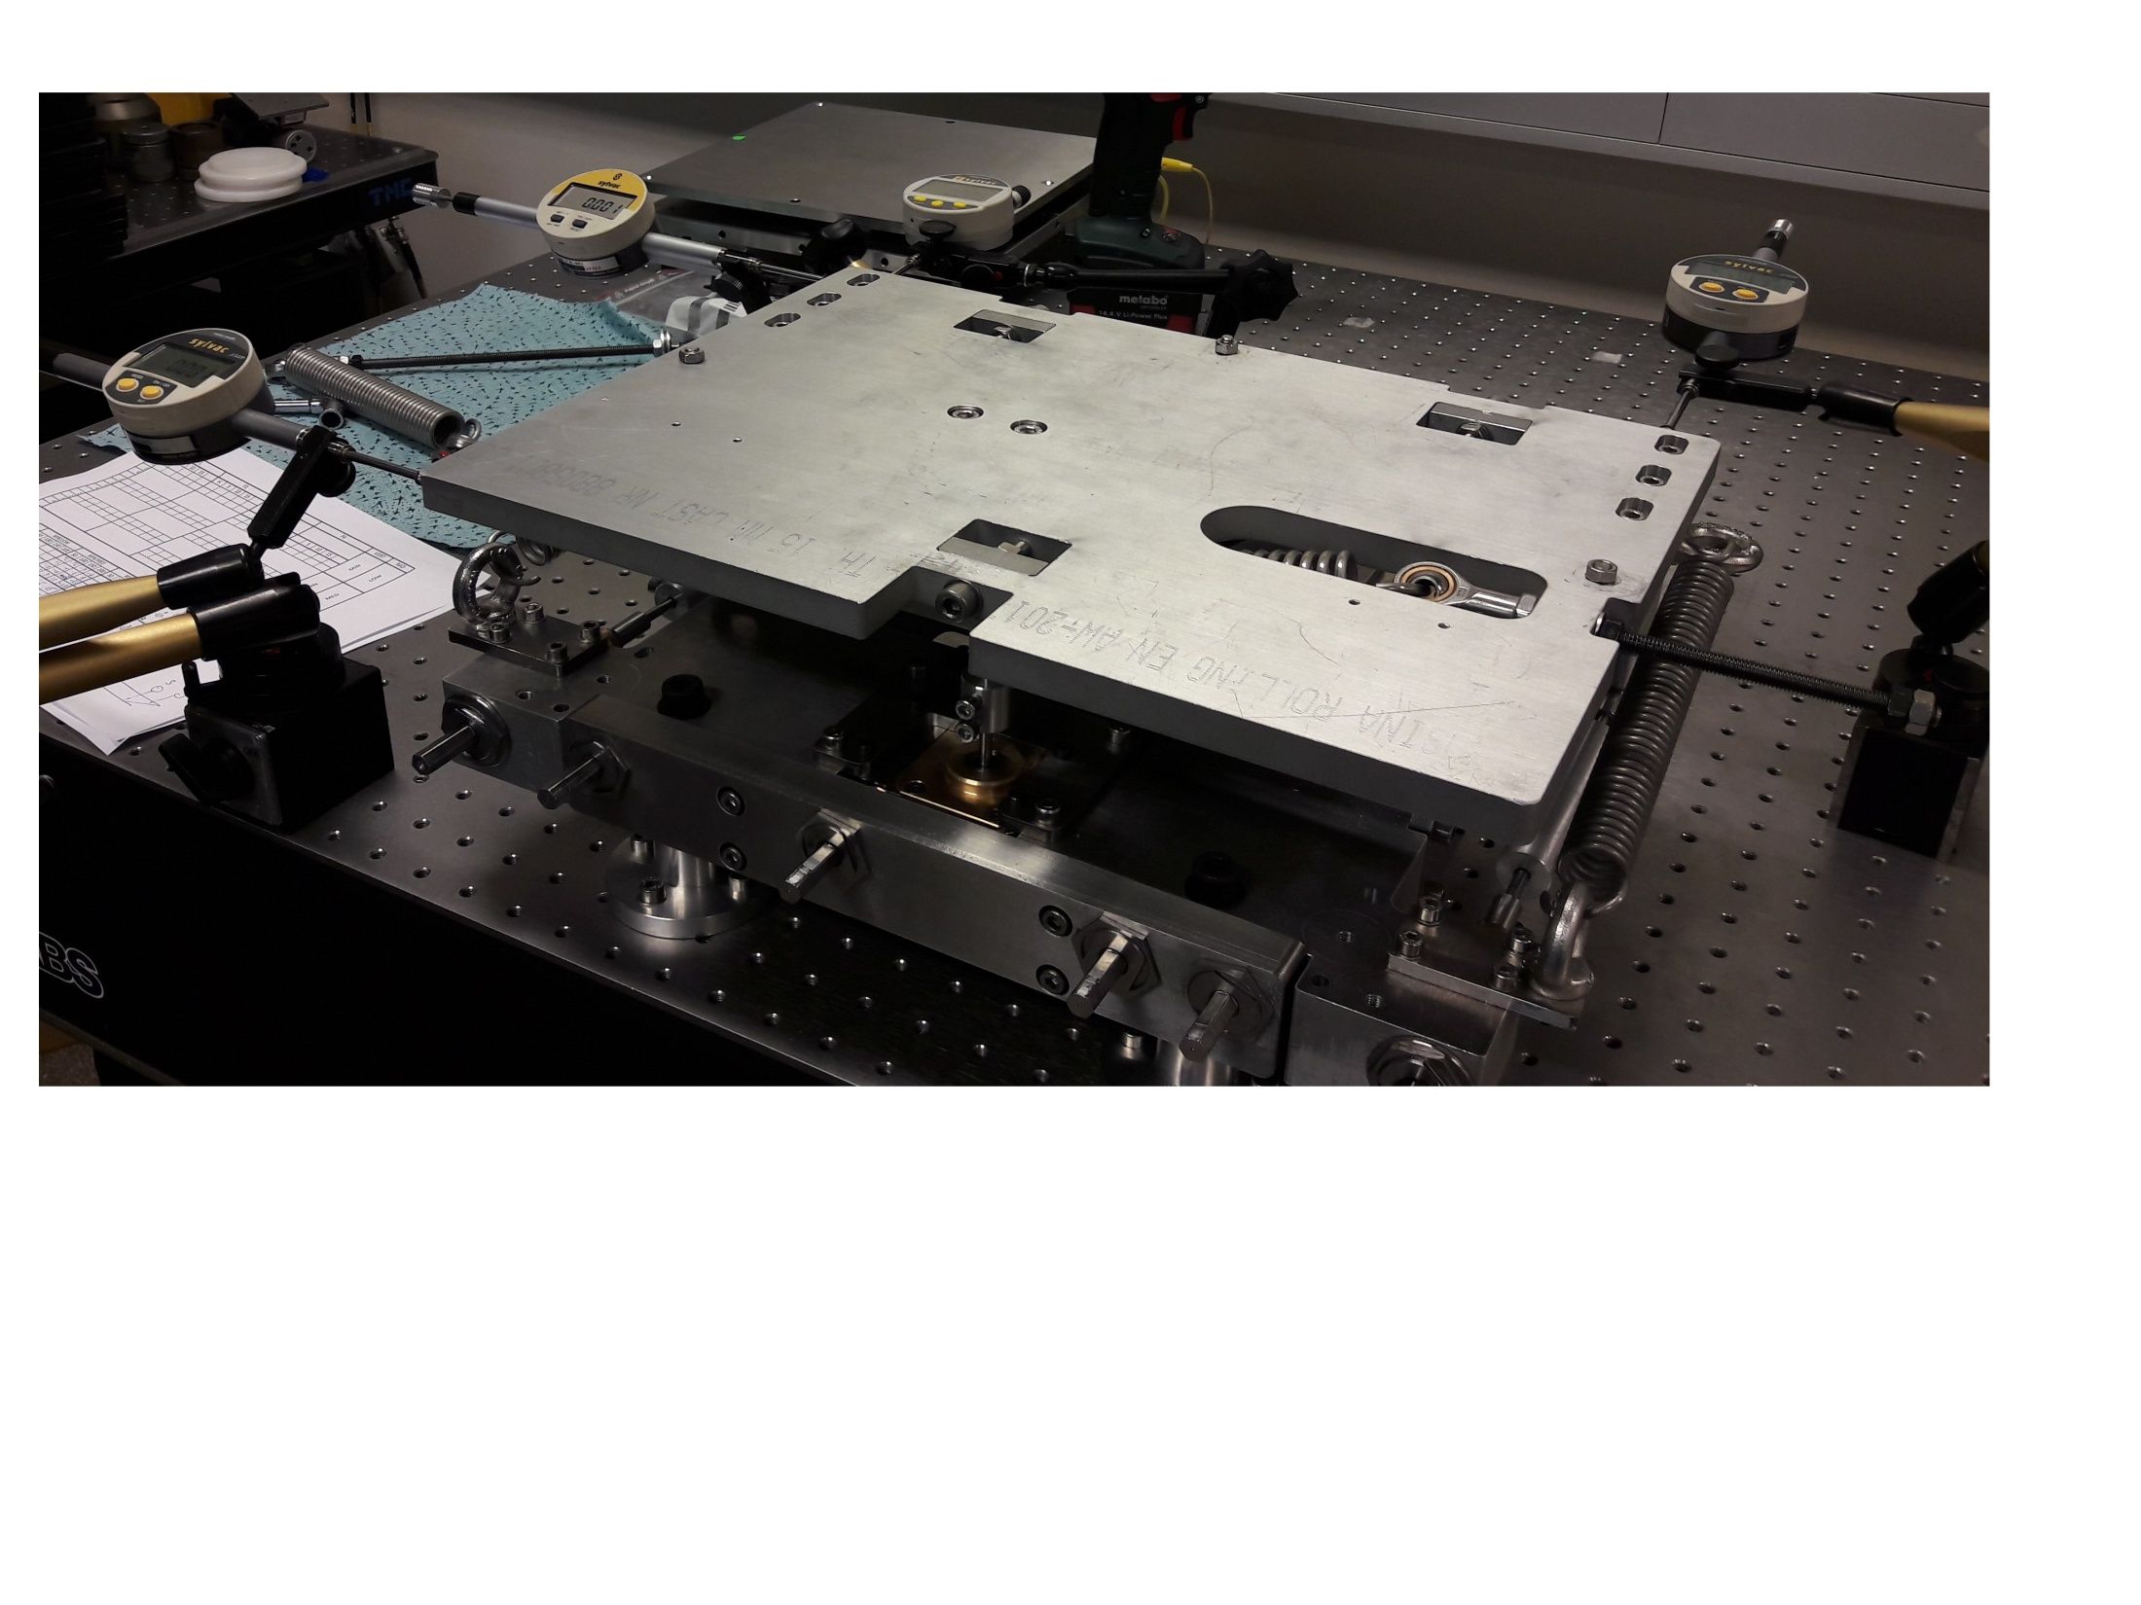
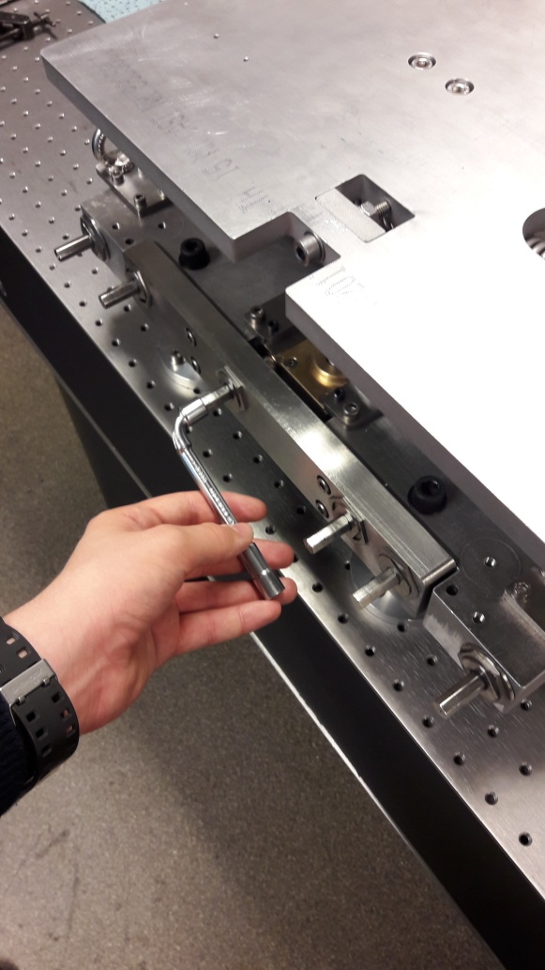
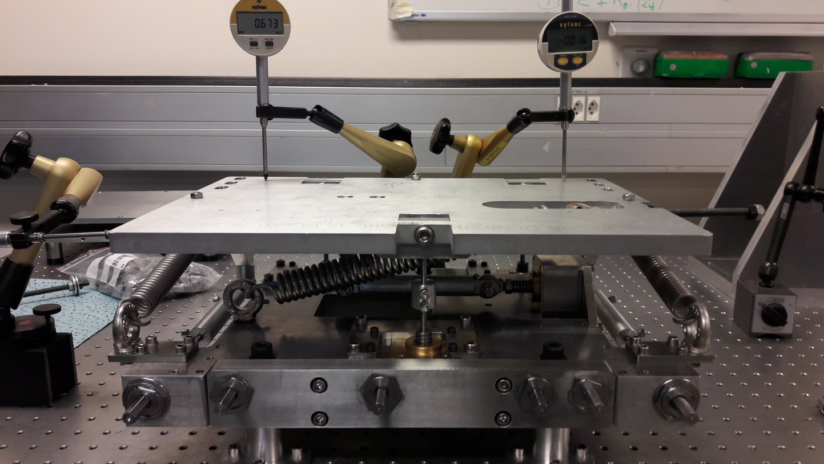

Slide 12
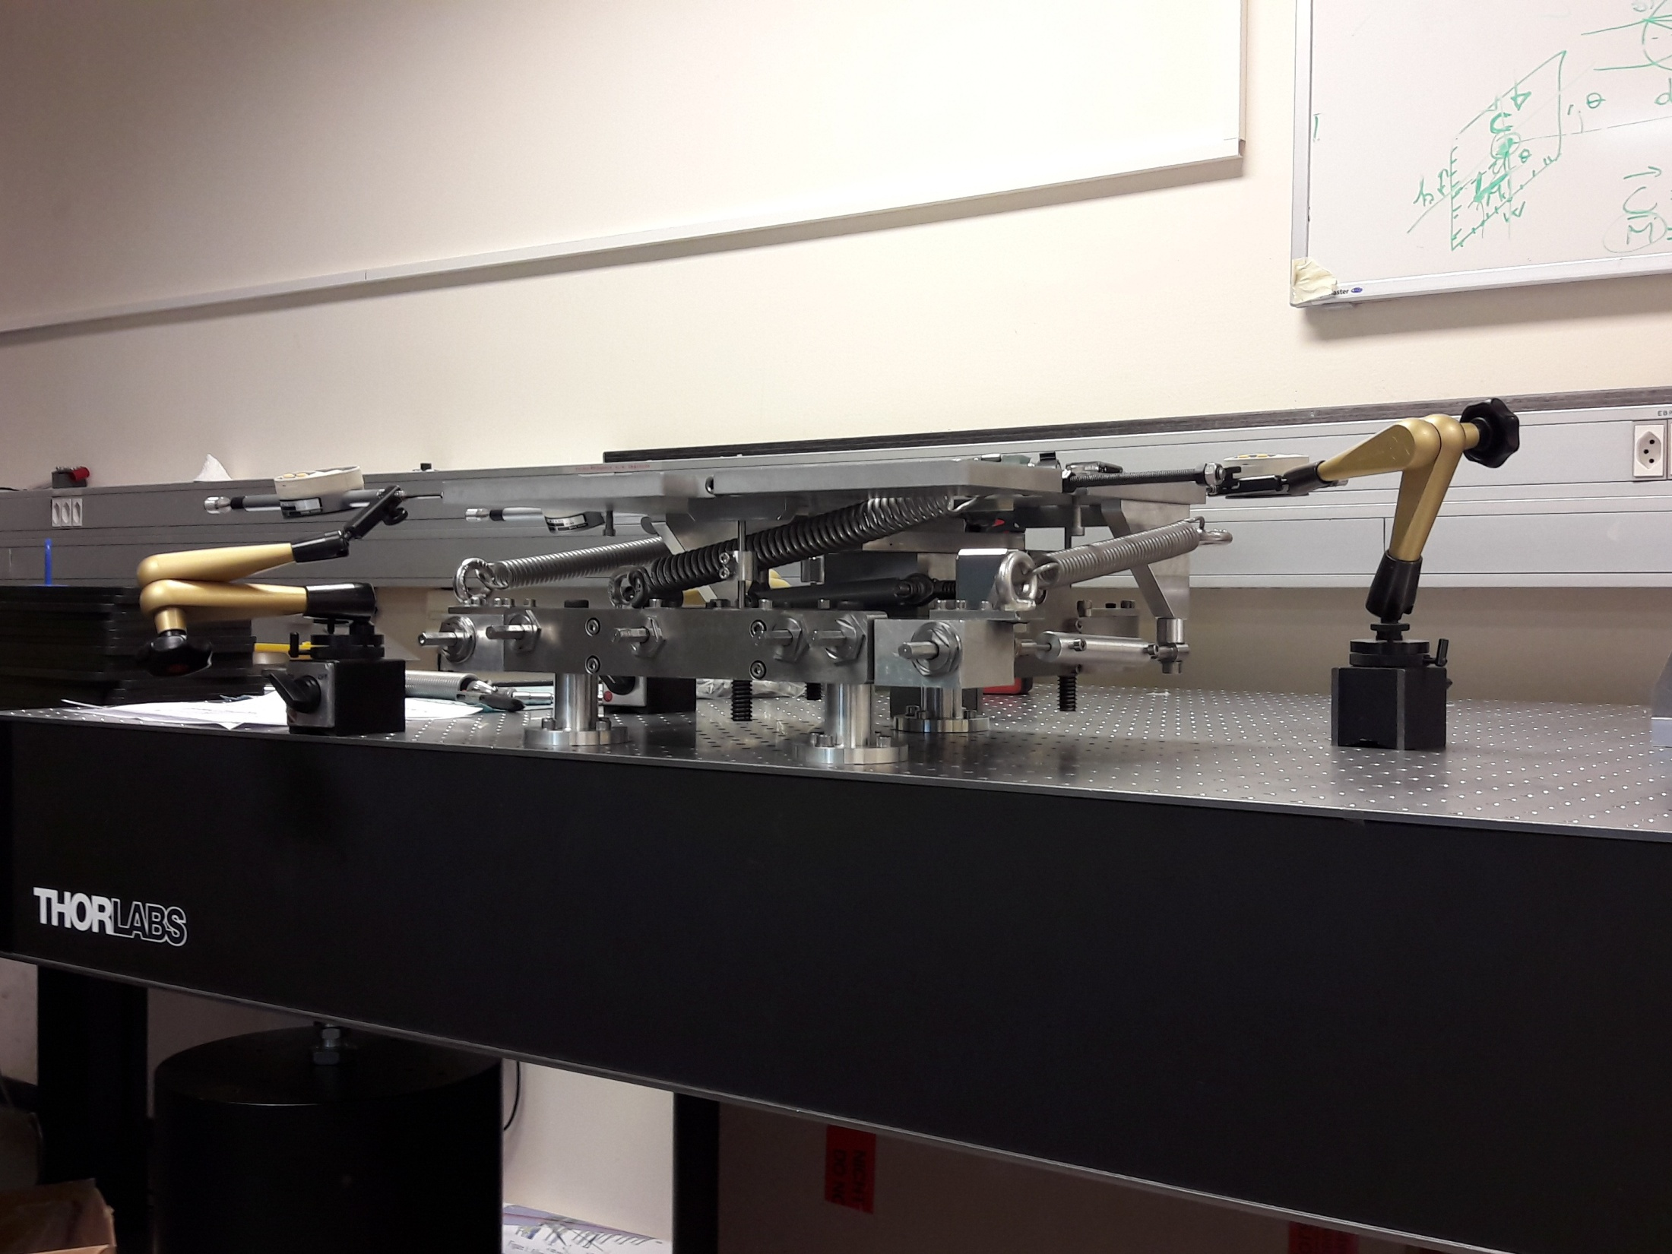

Slide 13
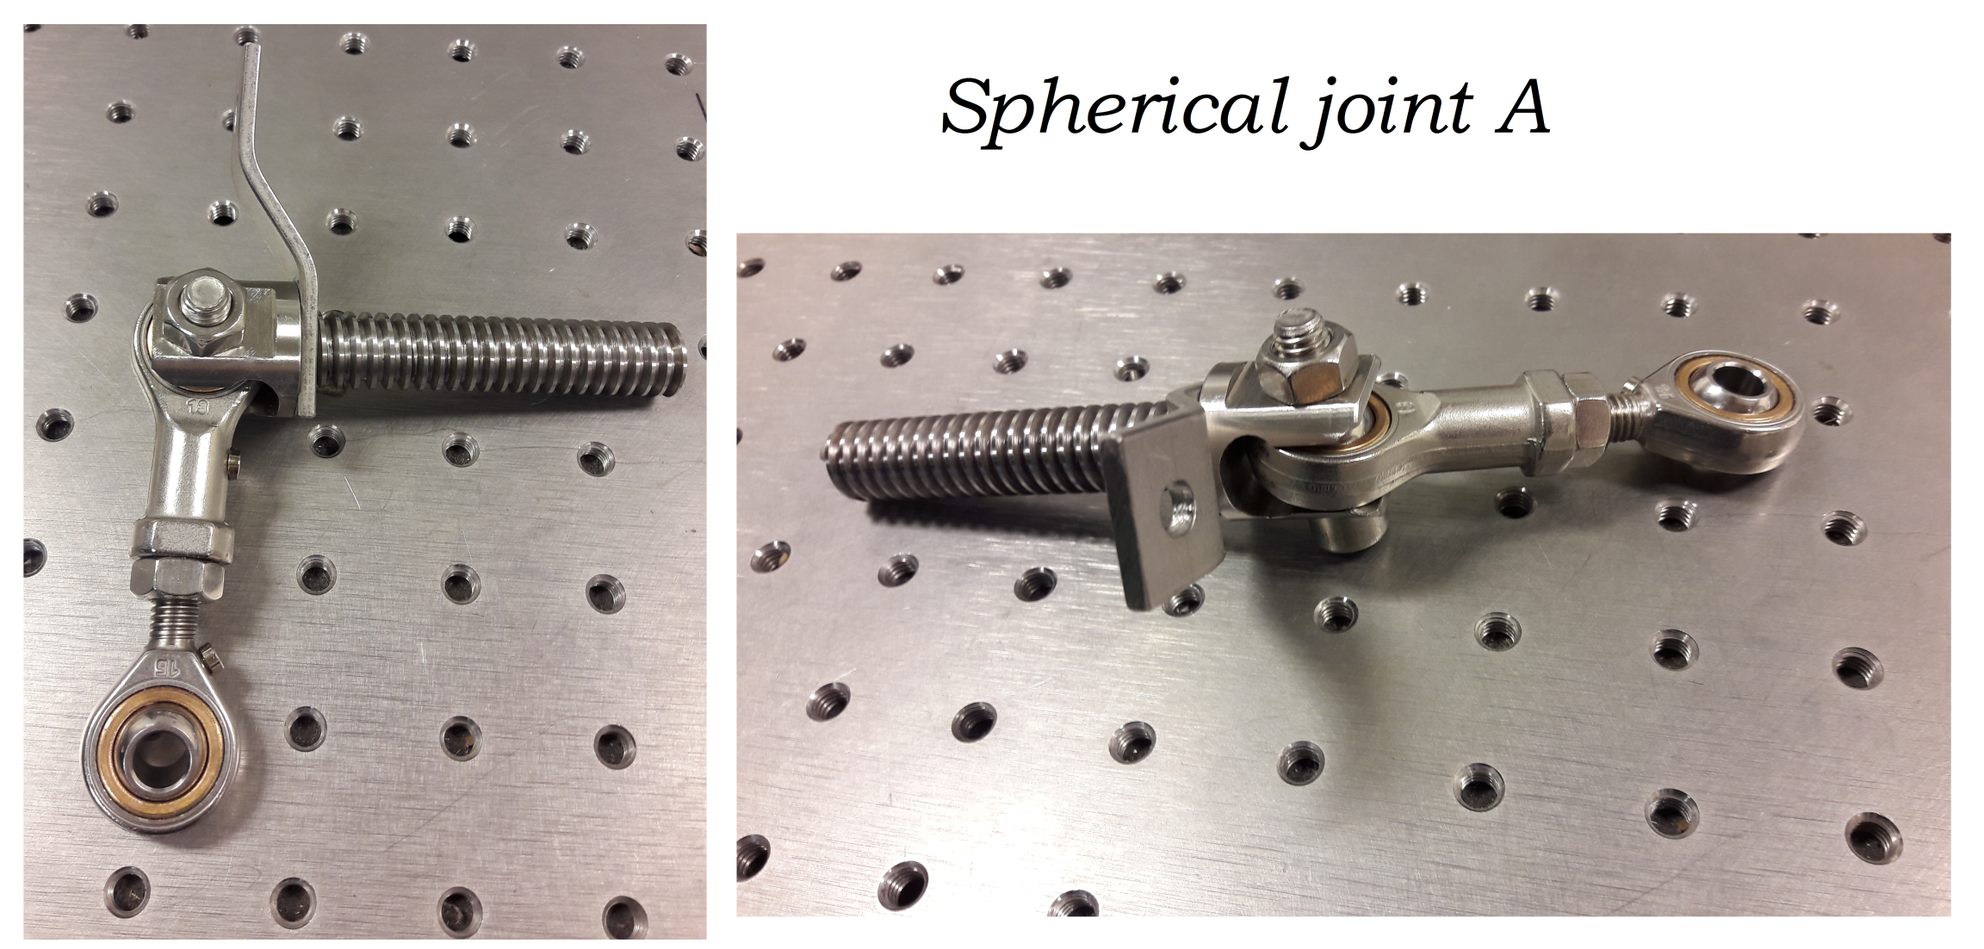

Slide 14
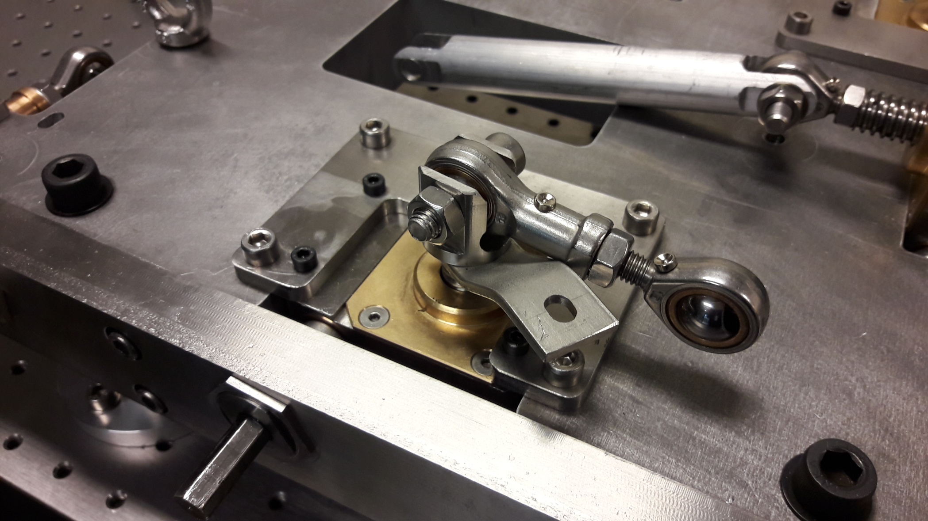

Slide 15
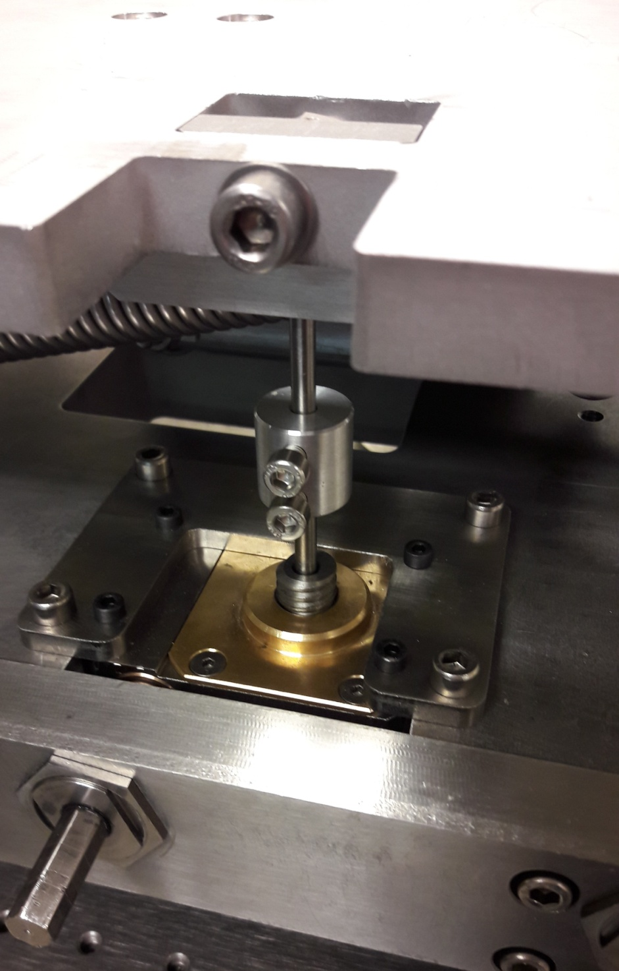
Spherical
Joint B

Slide 16
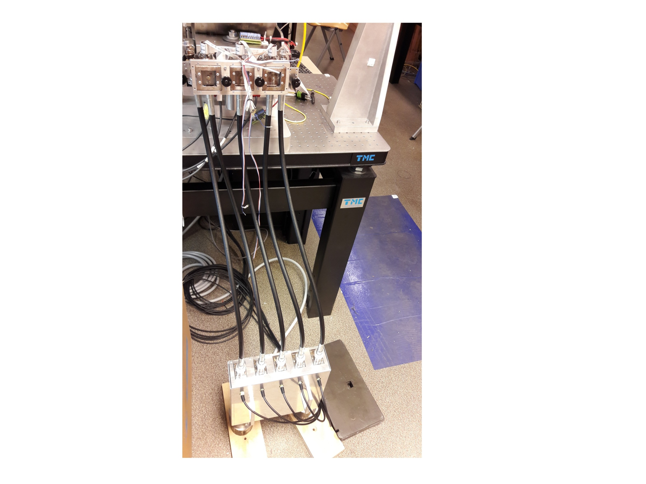

Slide 17
Measurments
In order to verify the performance of the platform prototype, the series of basic mechanical parameters measurments are needed
My part of work was directional stiffness

Slide 18
Maesuring tool

Slide 19
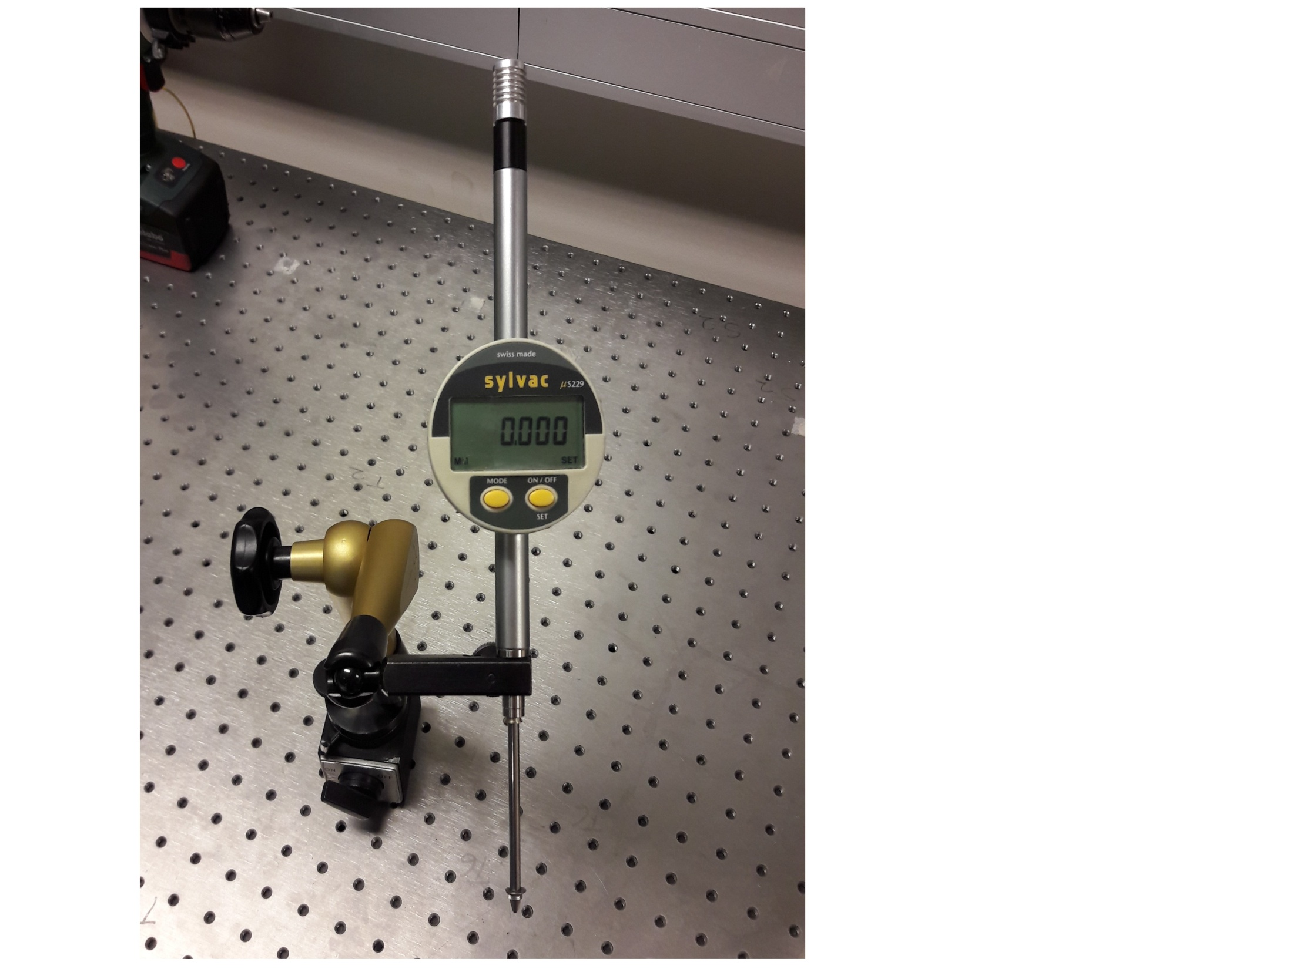
Tool’s scale: 50mm
Tool’s precission: 0,001 mm

Slide 20
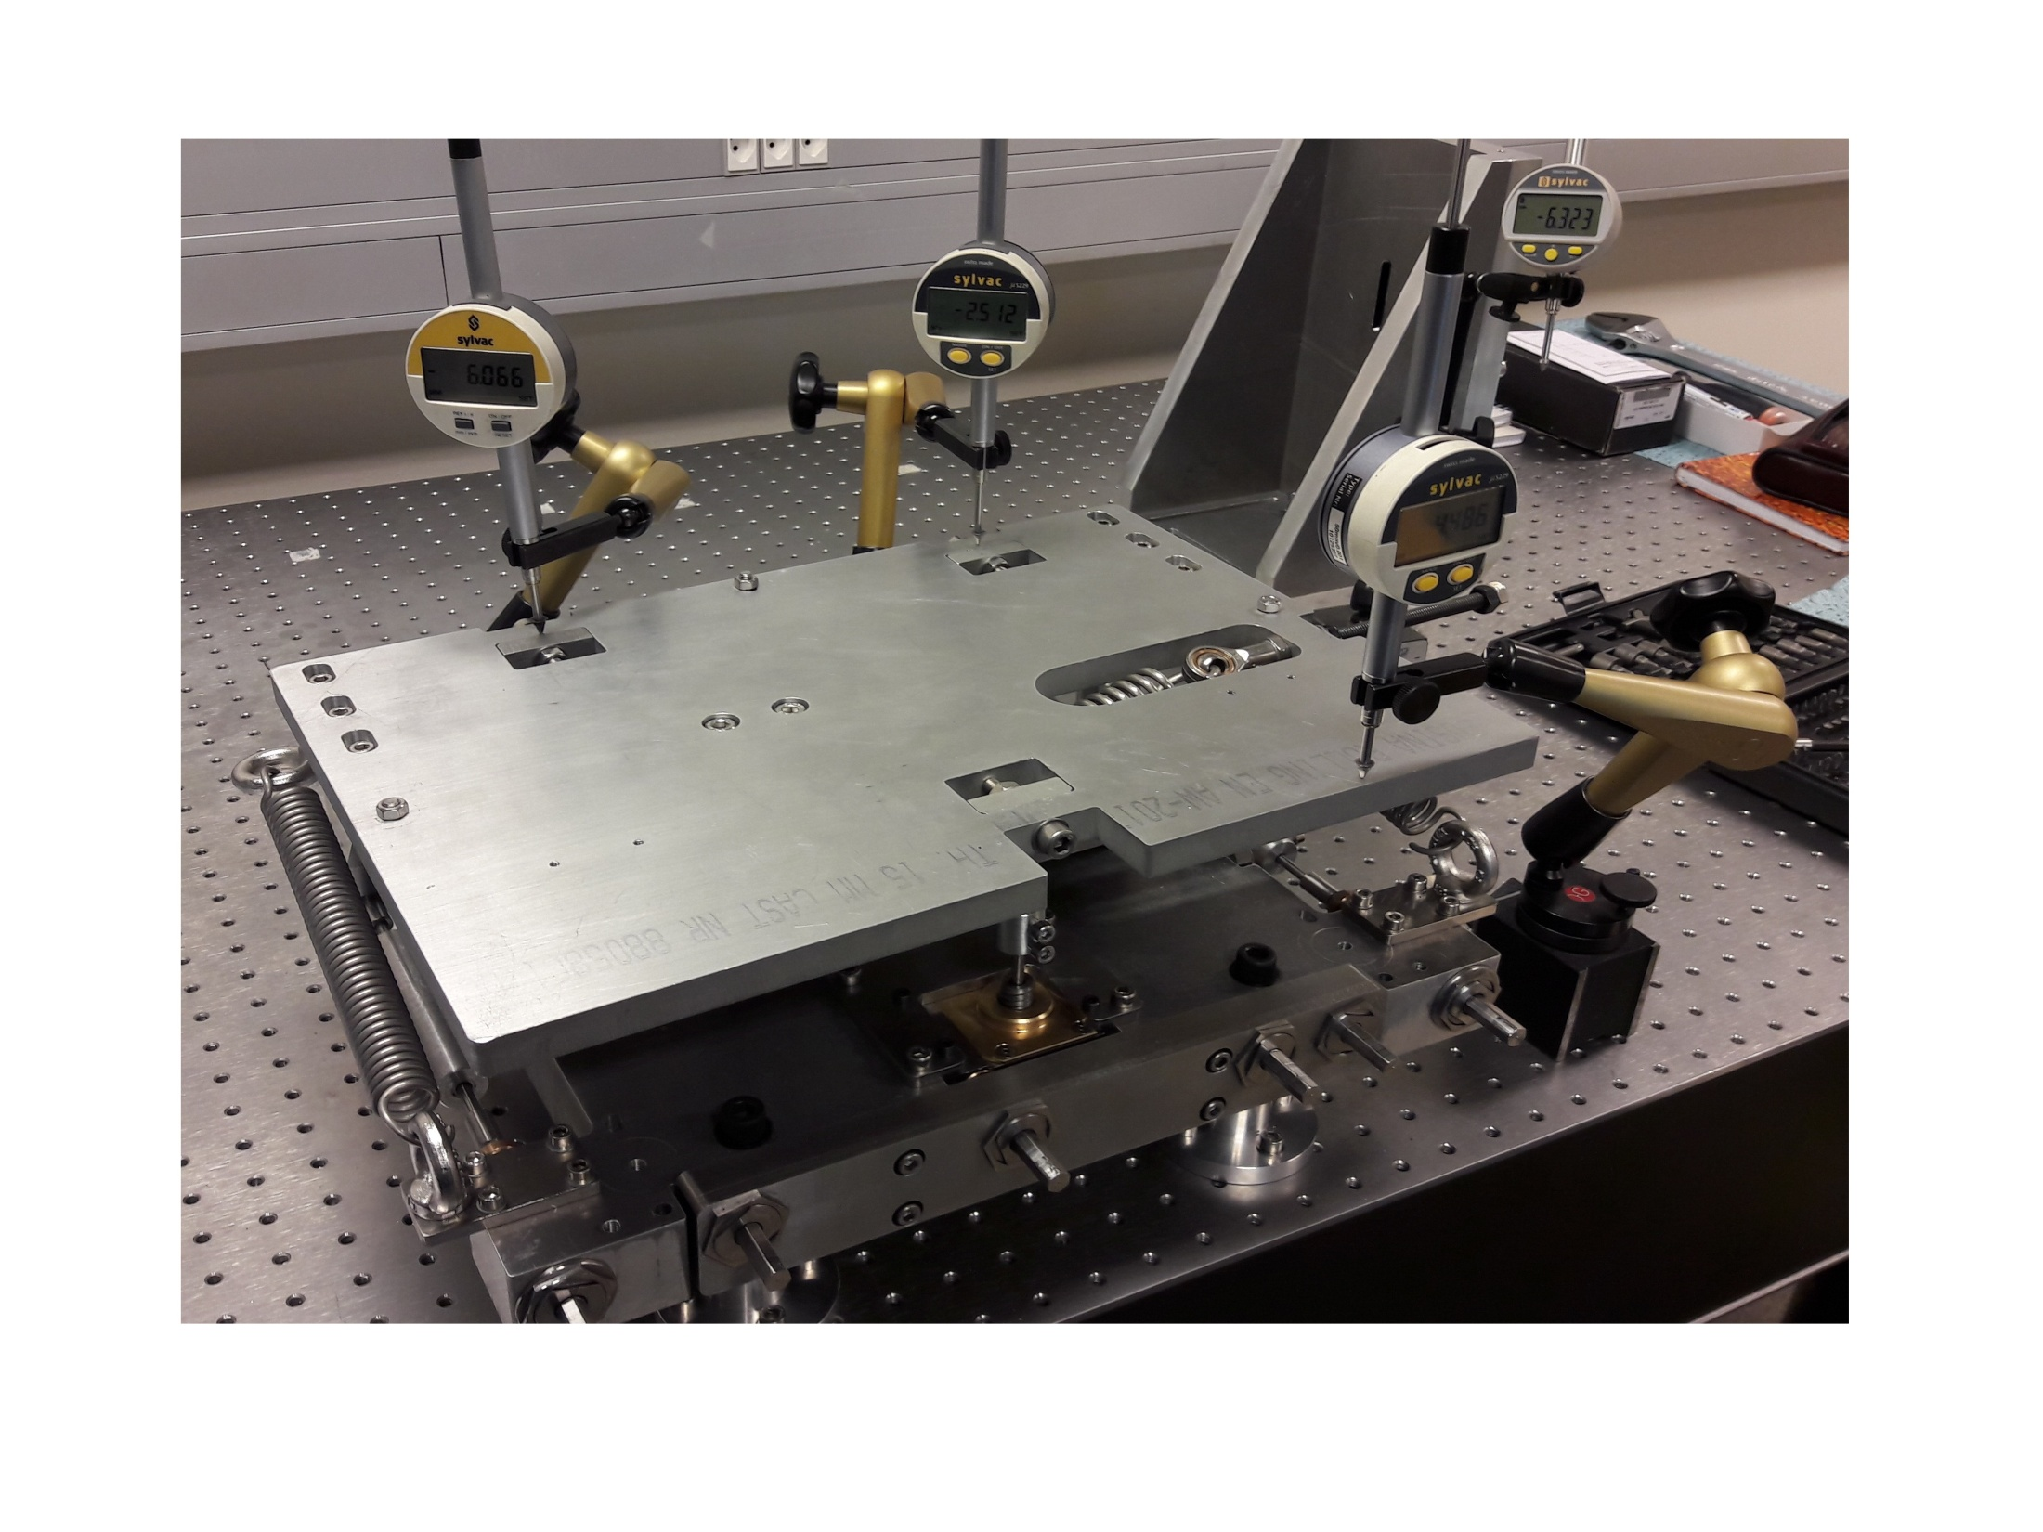
….

Slide 21
Putting 200 kg on platform, then checking platform displacement on different directions
Puting force horizontally on platform; 50N, 100N, 150N, then checking platform displacement on different directions
Mounting joints B and modifying platform
Repeating 1st series of measurments on spherical joints B

Slide 22
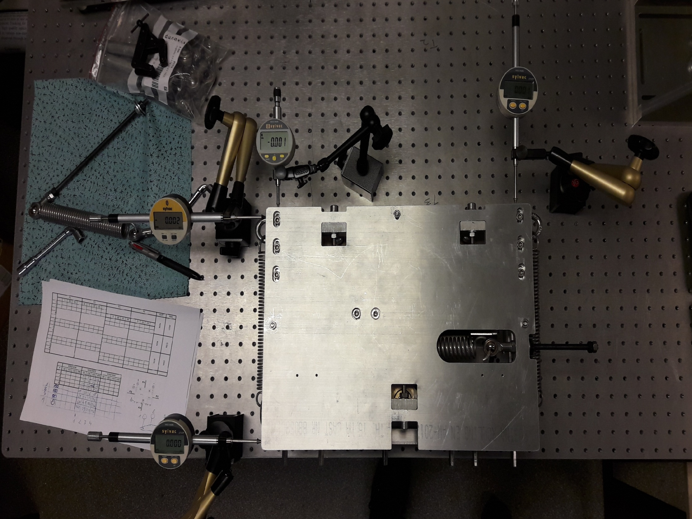

Slide 23
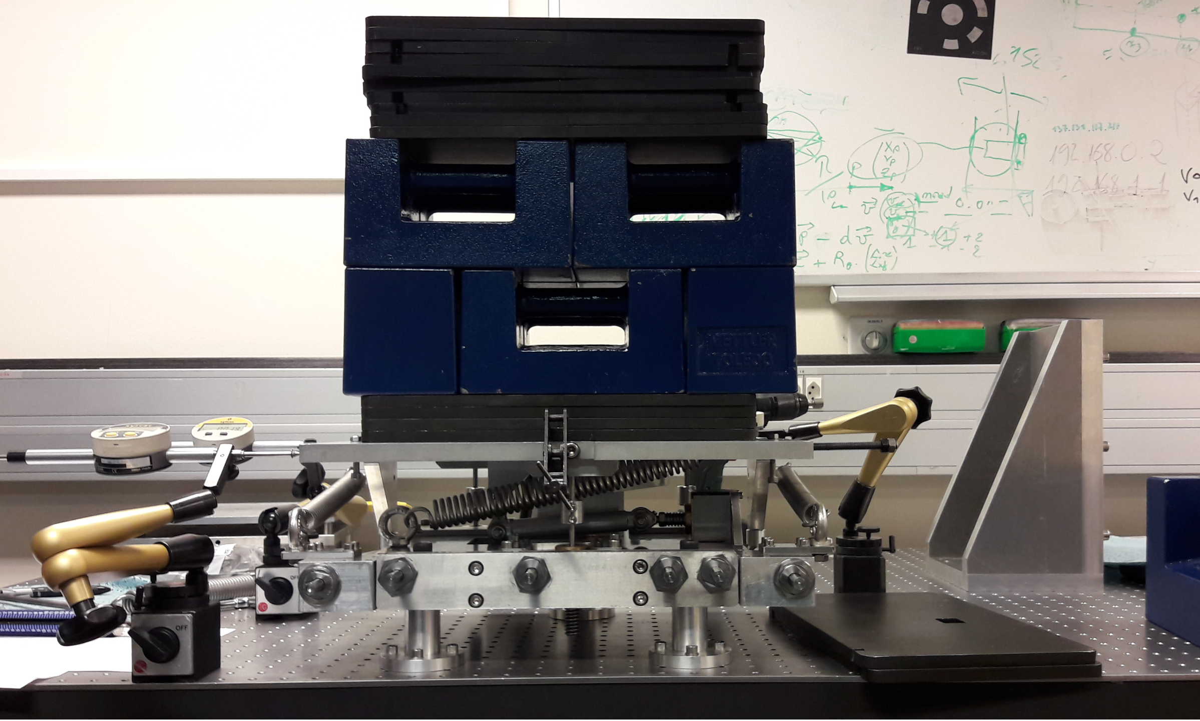

Slide 24
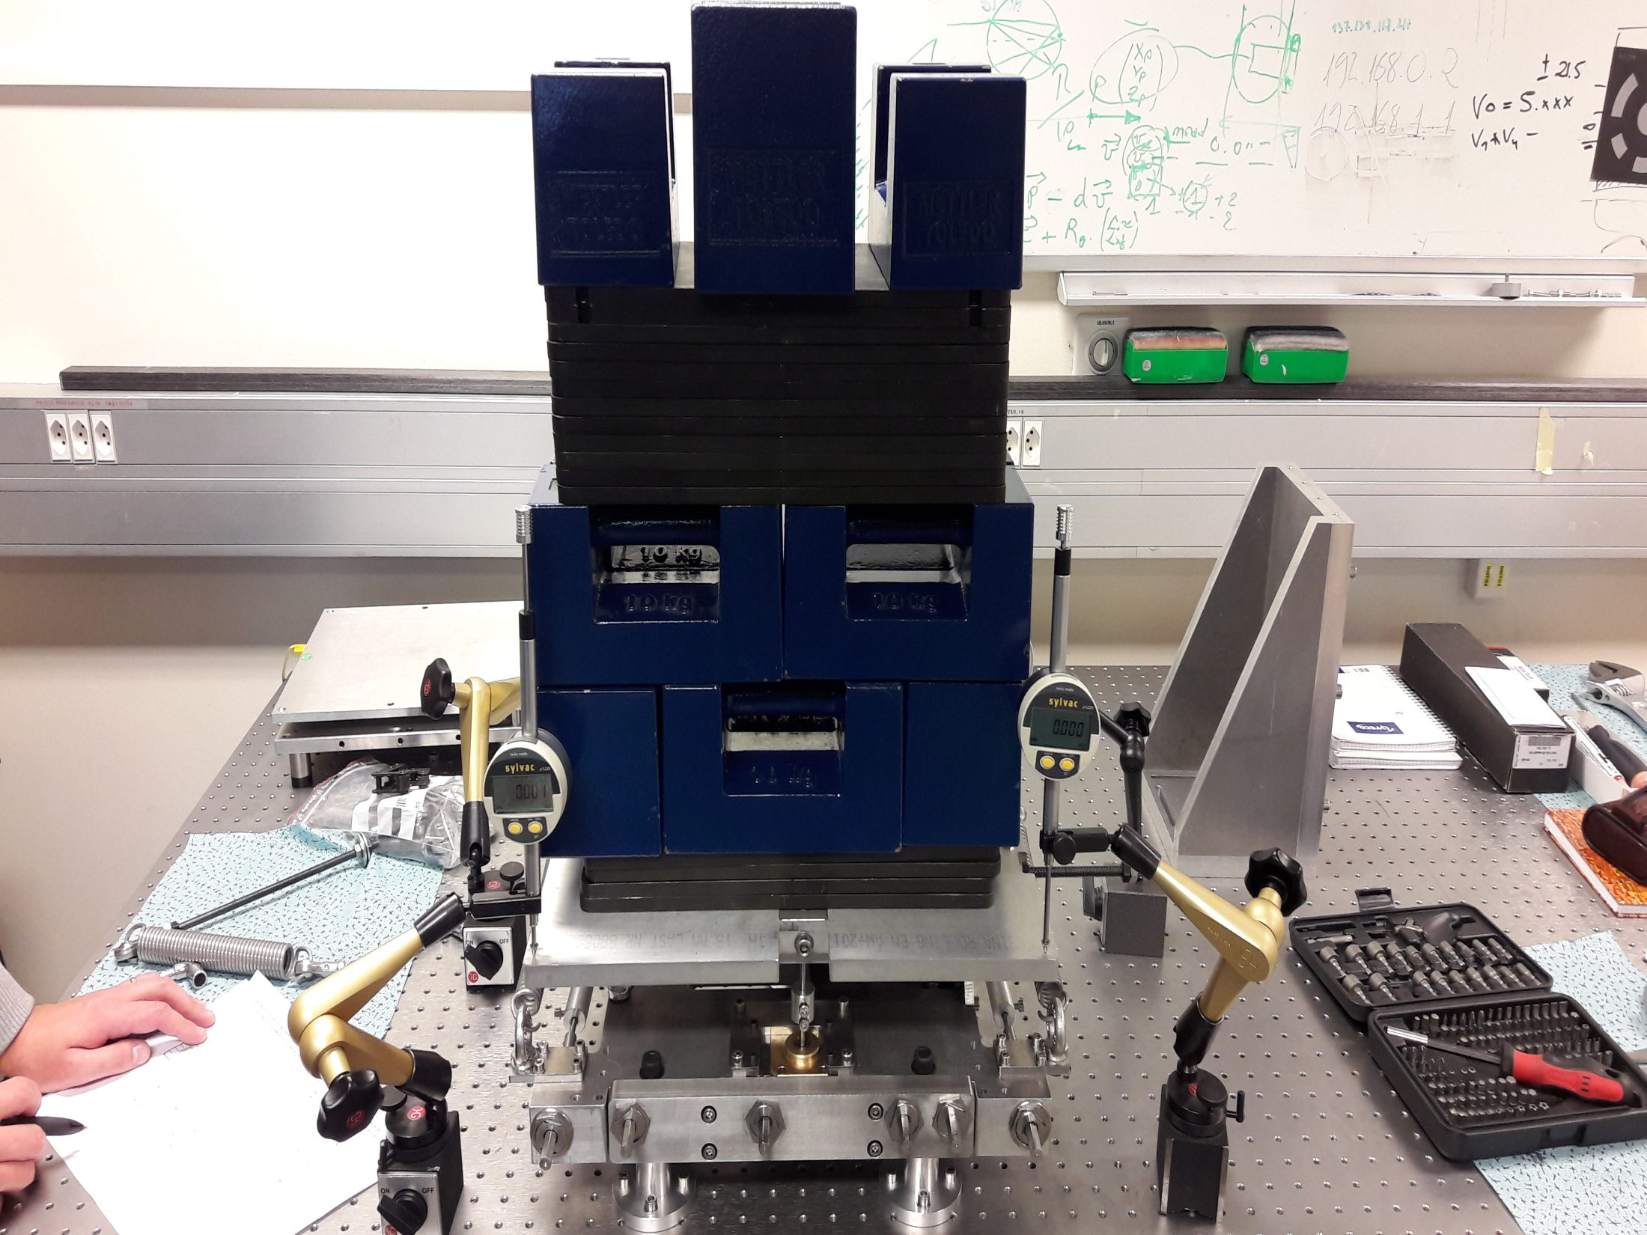

Slide 25
Conslusions
Platform bends disproportionately to weight/force put on it
Platform has a tendency to bend more when the force is put horizontally
Platform has a tendency to bend more on its left side - with both type of joints
Platform with joints A bends more, than with joints B

