Slide 1


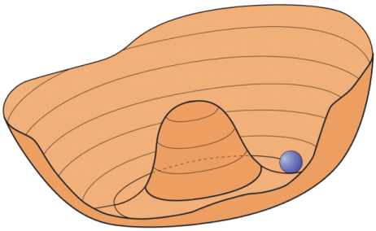
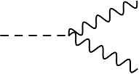



Dark Matter Axion & ALP searches:
Status and future Prospects
Béla Majorovits,
MPI für Physik, Munich, Germany
Explaining Dark Matter
Motivation & DM Axion mass ranges
How to detect axions?
Haloscopes I: Cavity experiments
Haloscopes II: dielectric discs
LSW and helioscope
$$γ$$
$$a$$
$$γ$$

Slide 2
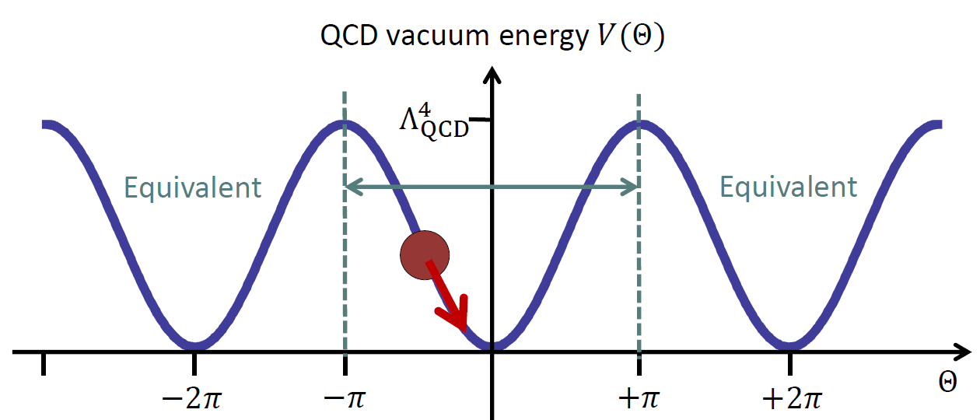
Motivation: solution to strong CP problem
Strong force (nearly?) invariant under CP while
weak force CP violating
Generically: QCD Lagrangian contains „arbitrary“ CP violating angle θ → induced neutron EDM: d~θ 10⁻¹⁶ e cm
Experimentally: d < 10⁻²⁶ e cm
→ θ < 10⁻¹⁰
Peccei Quinn mechanism:
Add dynamical, spontaneously broken field
→New pseudoscalar particle: Axion (oscillation around minimum)

Slide 3
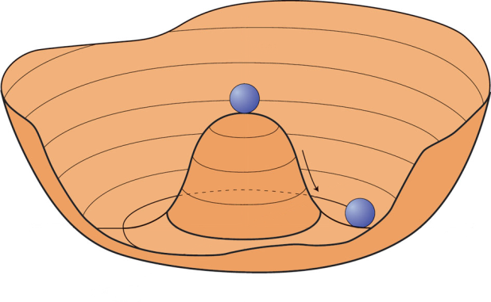
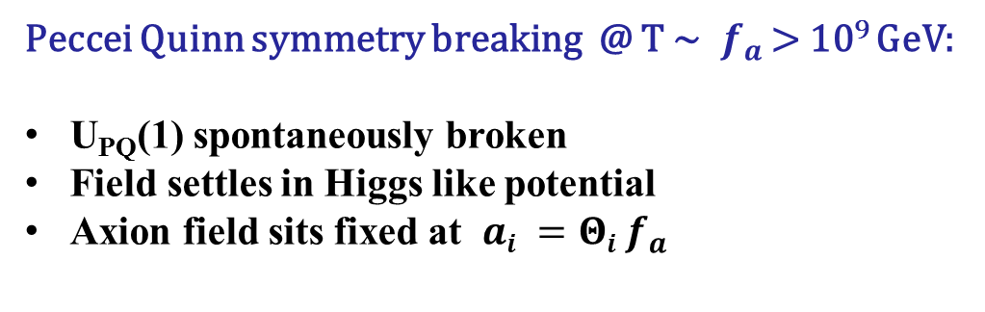


Solving the strong CP problem: the Axion
Peccei Quinn symmetry breaking @ T ~ $f_{a}$ > 10⁹ GeV:
U_{PQ}(1) spontaneously broken
Field settles in Higgs like potential
Axion field sits fixed at $ai =Θi f_{a}$
$$V(a)$$
$$a$$
3

Slide 4


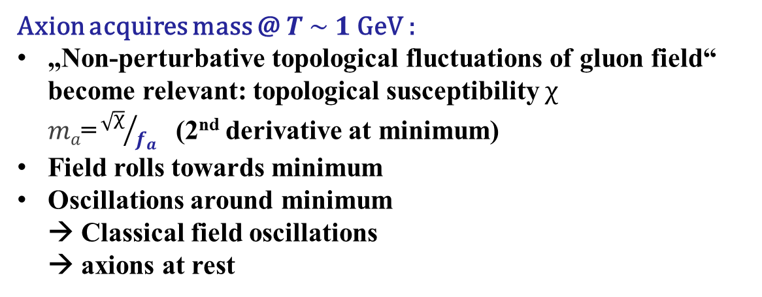


Solving the strong CP problem: the Axion
Axion acquires mass @ $T \sim 1 \text{GeV}$:
„Non-perturbative topological fluctuations of gluon field“ become relevant: topological susceptibility $χ$
$ma\text{=}{\sqrt{χ}}/{f_{a}}$ (2nd derivative at minimum)
Field rolls towards minimum
Oscillations around minimum
→ Classical field oscillations
→ axions at rest
$$V(a)$$
$$a$$
$$\overline{Θ}=0$$
Taken from G. Raffelt
4

Slide 5
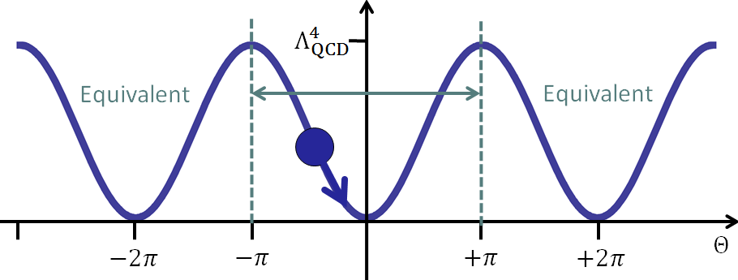

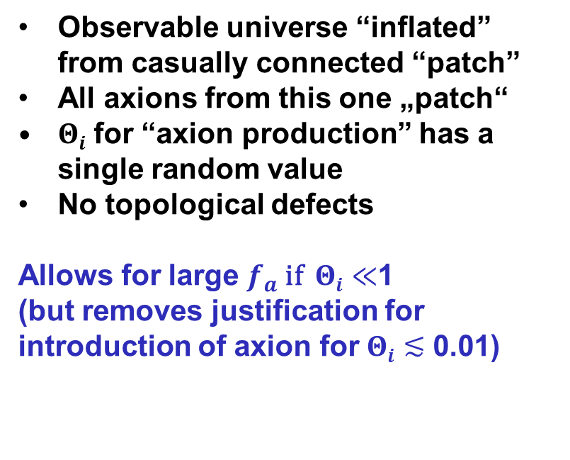
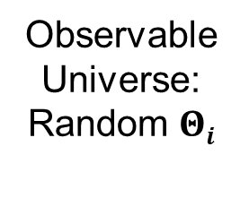
Axion DM: Pre-inflationary PQ breaking
Observable universe “inflated” from casually connected “patch”
All axions from this one „patch“
$Θi$ for “axion production” has a single random value
No topological defects
Allows for large $f_{a}$ if $Θi≪$1
(but removes justification for introduction of axion for $Θi$ $≲$ 0.01)
Observable Universe: Random $Θi$

Slide 6
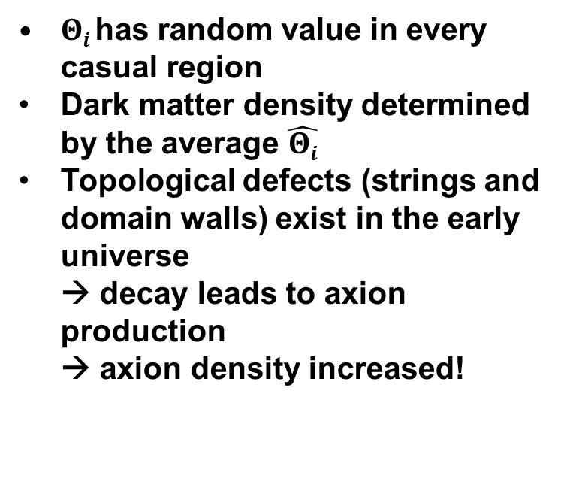
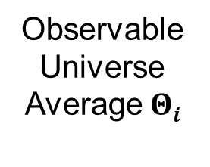
Axion DM: Post-inflationary PQ breaking
$Θi$has random value in every casual region
Dark matter density determined by the average $\hat{Θi}$
Topological defects (strings and domain walls) exist in the early universe
→ decay leads to axion production
→ axion density increased!
Observable Universe Average $Θi$

Slide 7

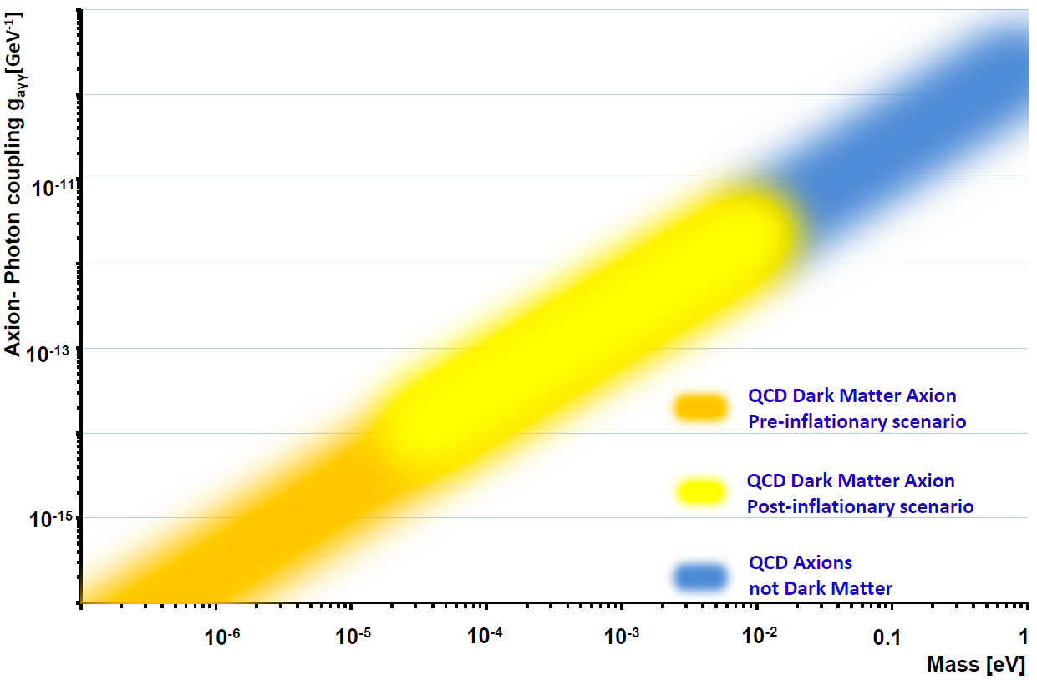
Motivation: solution to strong CP problem
T h e D M a x i o n l i v e s h e r e

Slide 8
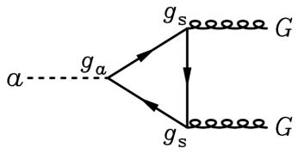
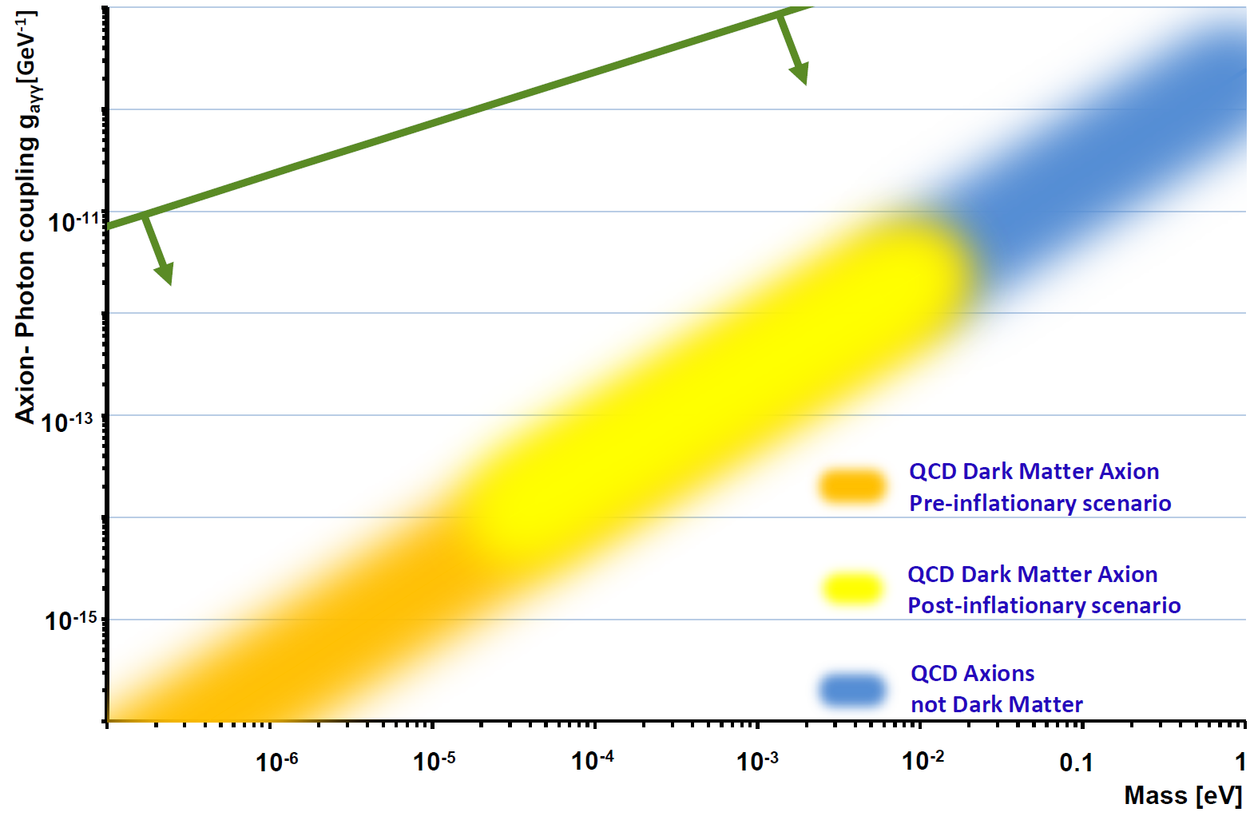


Generic Axion Like Particles:
Works for any spontaneously broken U(1) symmetry
$$γ$$
f
$$a$$
$$γ$$
f
A L P s can explain
Dark Matter
T h e D M a x i o n l i v e s h e r e

Slide 9
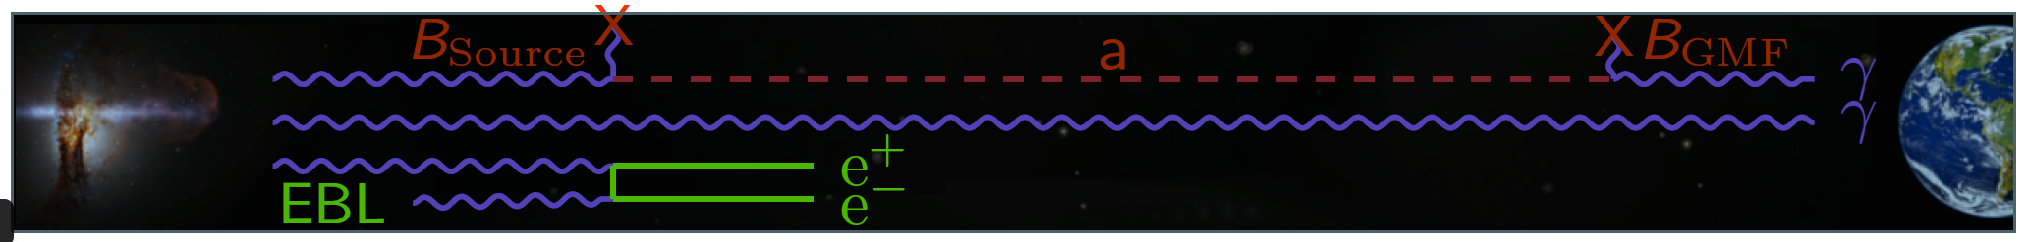
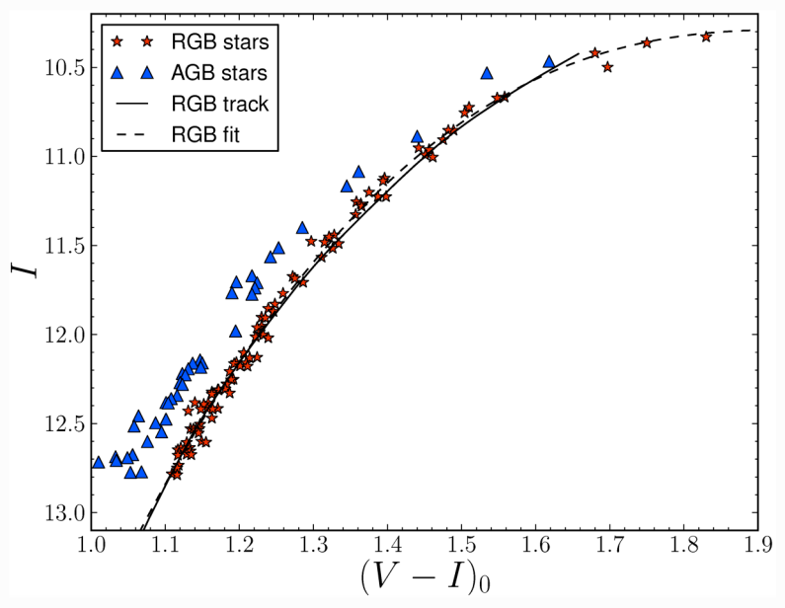
ALPs as solution to astrophysical hints?
TeV transparecncy hint: ALPs
arXiv:1302.1208
Prone to systematics of source?
Stellar cooling: Could be due to QCD axions
Brightest red giants
measured nonstandard energy loss
Statistically evidence for deviation from expectation
Could be due to ALP cooling
arXiv:1512.08108
How well do we understand standard stellar cooling?

Slide 10
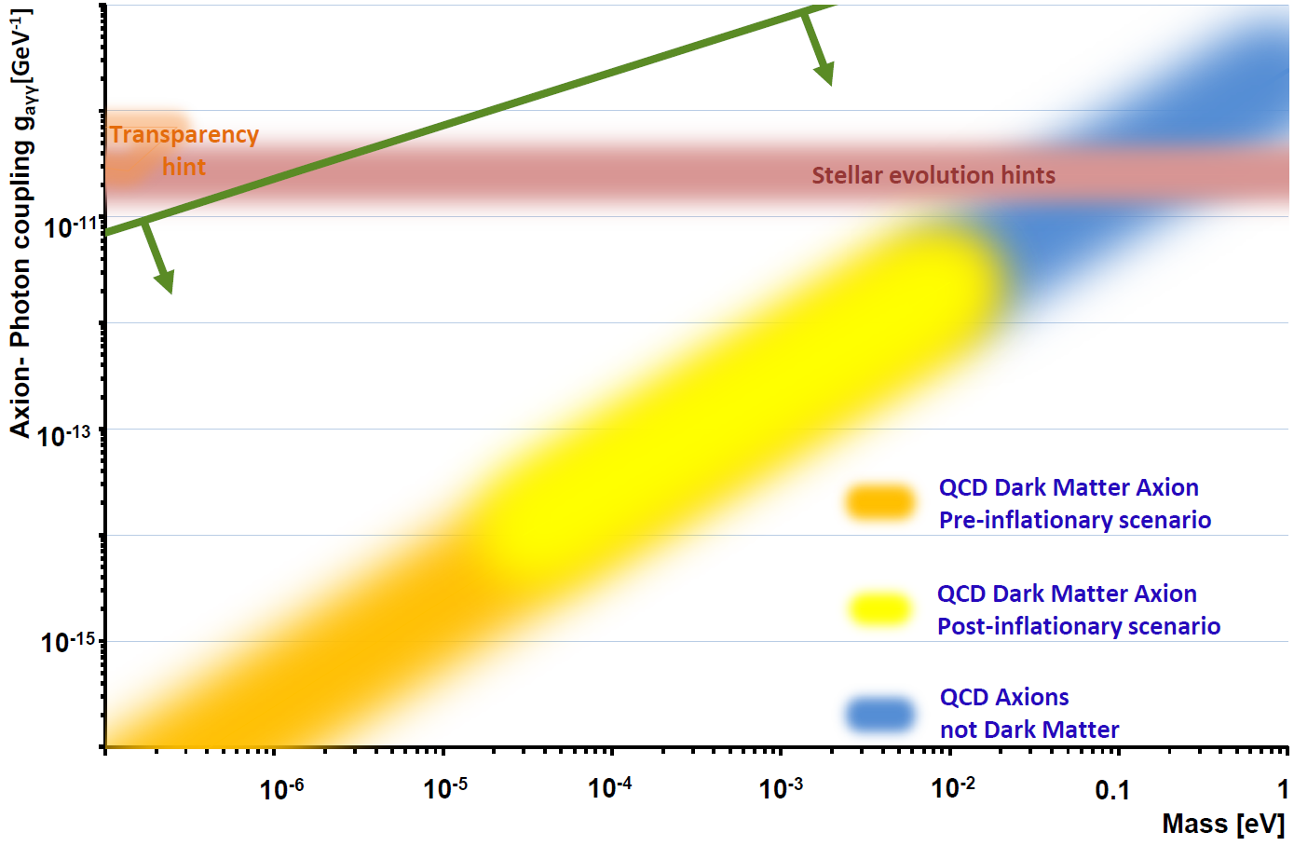
Motivations for axions and ALPs
TeV transparency / stellar cooling
strong CP problem
Axiverse
(string theory)
Dark Matter
A L P s can explain
Dark Matter
T h e D M a x i o n l i v e s h e r e

Slide 11
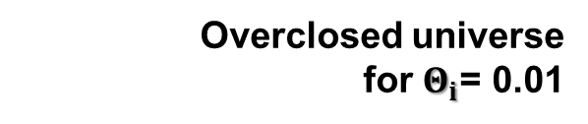
Putting DM axion properties into scale
Pre-
inflationary
Post-inflationary
Astrophysical bounds
→ Axions not DM
Overclosed universe
for $Θ_{i}$= 0.01
m_{Planck}
f_{a}
10¹⁸
10¹⁵
10¹²
10⁹
10⁶
GeV
peV
neV
μeV
meV
eV
m_{a}
kHz
MHz
GHz
THz
ν_{a}
λ_{de Broglie}
1000km
1km
1m
1mm
Pre-inflationary scenario
Θ_{i} could be anything –π – π
(“anthropic range”)
Post-inflationary scenario
Experiment fits inside the particle!
11

Slide 12
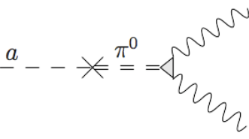
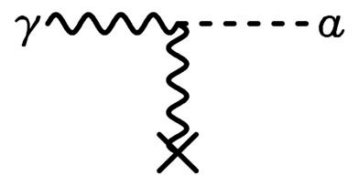




Interactions of axions and ALPs
With nucleus
Primakoff effect
$$γ$$
a
$$γ$$
Mixing with photons
$$γ$$
$$B$$
f
With Electron shell
f

Slide 13
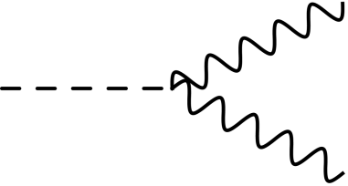


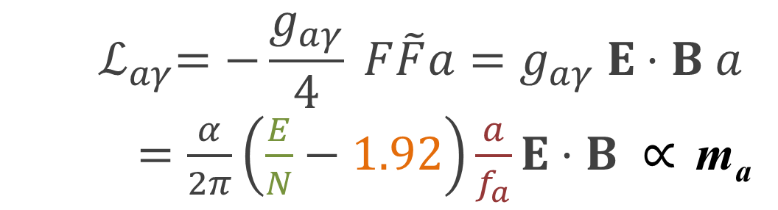


Axion to photon coupling
Experimental approaches:
$$γ$$
$${ ℒ}_{aγ}=−\frac{g_{aγ}}{4} F\tilde{F}a=g_{aγ} E⋅B a$$
$=\frac{α}{2π}\left(\frac{E}{N}−1.92\right)\frac{a}{f_{a}}E⋅B ∝$ m_{a}
$$a$$
$$γ$$
Modifies Maxwell equations: Additional source term
$∇×B−\dot{E}=J+g_{aγ}$ $B\dot{a}$
Oscillating!
in an external B-field the axion sources an E-field

Slide 14

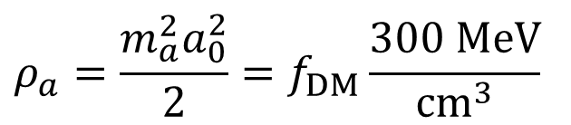
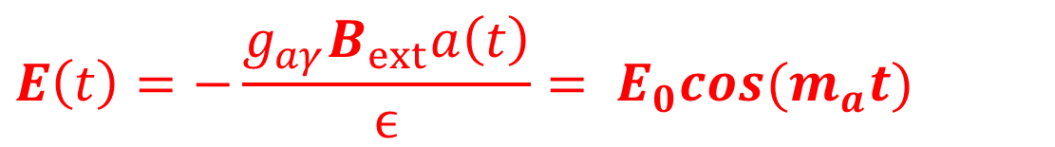
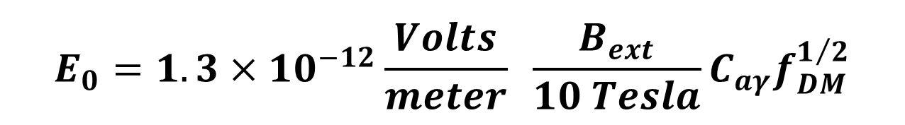
Axion to photon coupling
Experimental approaches:
$$γ$$
$$E\left(t\right)=−\frac{g_{aγ}B_{ext}a\left(t\right)}{ϵ}= E_{0}cos(m_{a}t)$$
$$a$$
$$γ$$
$ε:$dielectric constant
With local dark matter density:
$$ρ_{a}=\frac{m_{a}^{2}a_{0}^{2}}{2}=f_{DM}\frac{300 MeV}{cm^{3}}$$
$$E_{0}=1.3×{10}^{−12}\frac{Volts}{meter} \frac{B_{ext}}{10 Tesla}C_{aγ}f_{DM}^{1/2}$$

Slide 15
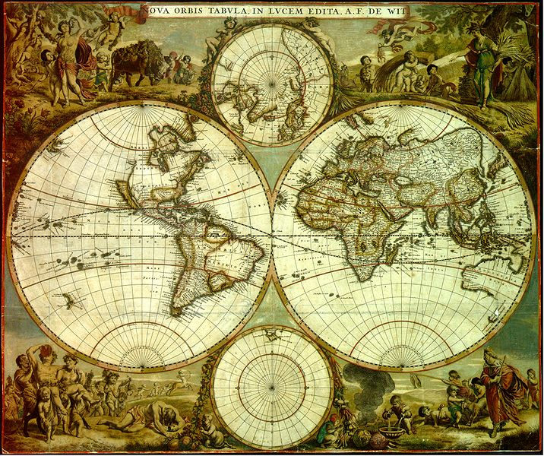
Experimental efforts worldwide
CAST, OSQAR
CERN
Haystac
ABRACADABRA
Yale
ALPSII, IAXO,
MADMAX
ADMX
Seattle
ARIADNE
Reno
For sure not complete!
Tokyo
KLASH,
QUAX Frascati
ORGAN/ BEAST
CAPP:
CULTASK

Slide 16
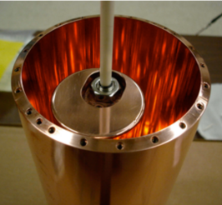
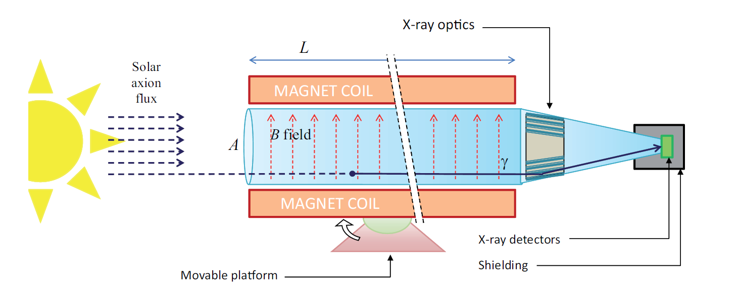
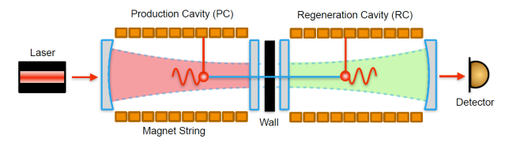
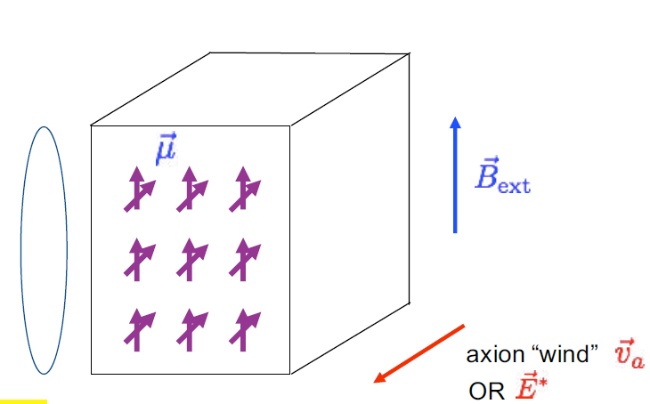

Experimental approaches:
Haloscopes - DM
Cavity Dish antenna
Dielectric haloscope
Helioscope – solar axions
Lab experiments - ALPs
Light shining through walls
LC circuit
NMR methods
Beam dump
5th force
Long range forces,
atomic transitions,…
Primakoff effect
$$B$$
Other couplings

Slide 17
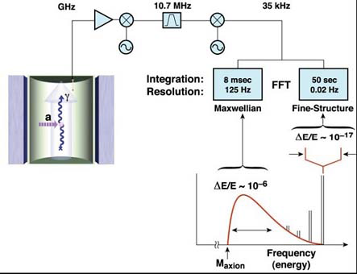




Experimental approaches
Cavity haloscope:
Primakoff effect
DM axion in static B field
Coherent E-field oscillation
In resonant cavity: enhancement of photon signal
by quality factor of cavity
a
$$γ$$
$$B$$
$$P_{sig}=\left(B^{2}V Q_{cav}\right)\left({g_{aγγ}}^{2}m_{a}{ ρ}_{a}\right)$$
ADMX:
Q-factor $\sim {10}^{5} B=8 T$
$$P_{sig,ADMX}≈{10}^{−22} Watts$$

Slide 18
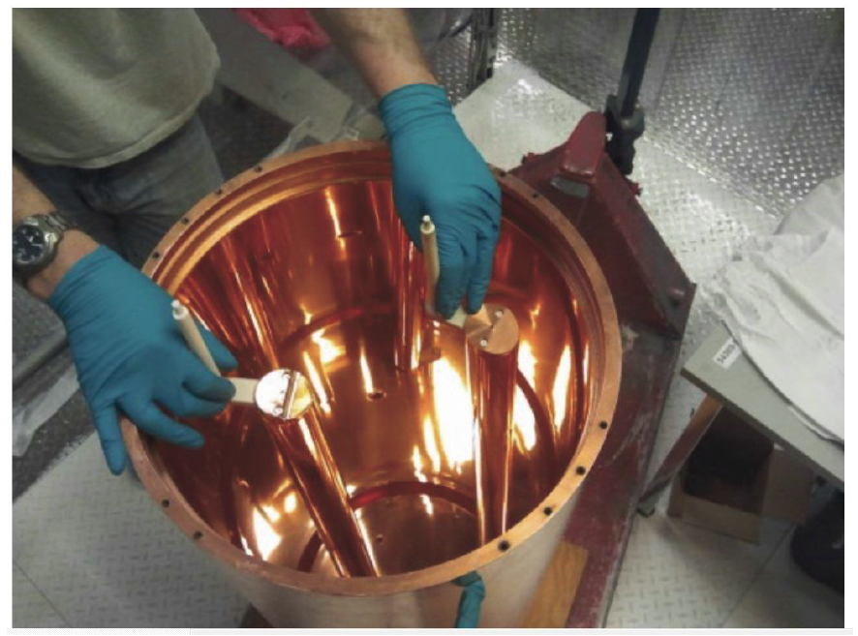
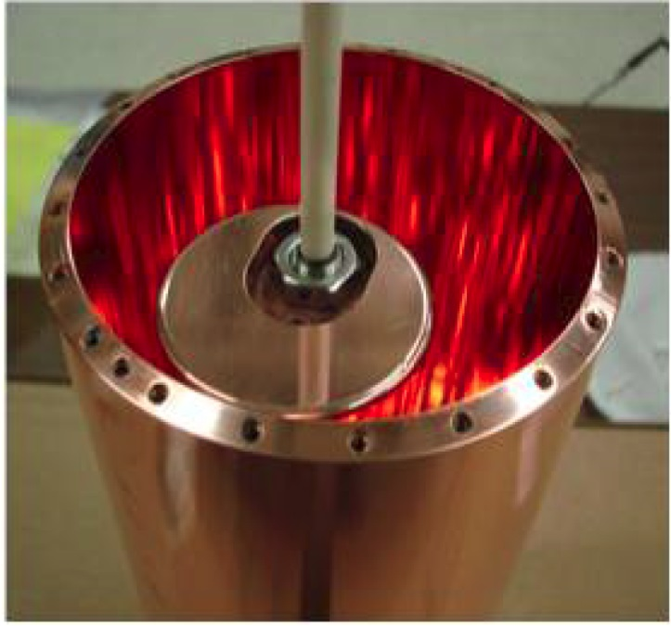
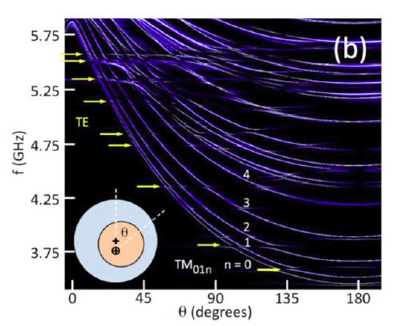
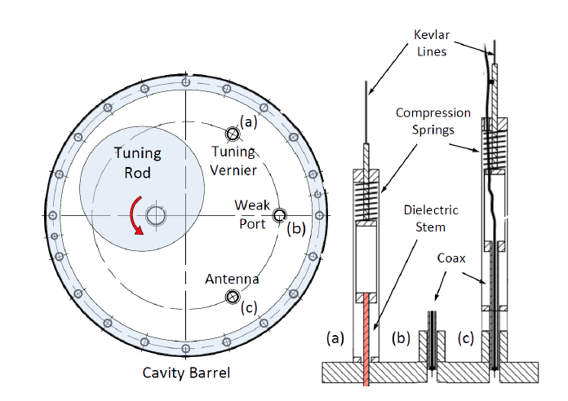
ADMX and Haystack cavity experiments
ADMX
HAYSTAC
Taken from G. Rybka, presentation at ECT, Trento workshop Axions at the crossroads: QCD, dark matter, astrophysics
20 Nov, 2017 to 24 Nov.
Brubaker et al., Phys. Rev. D 96, 123008 (2017)
Tune cavity resonance frequency by turning tuning rod

Slide 19
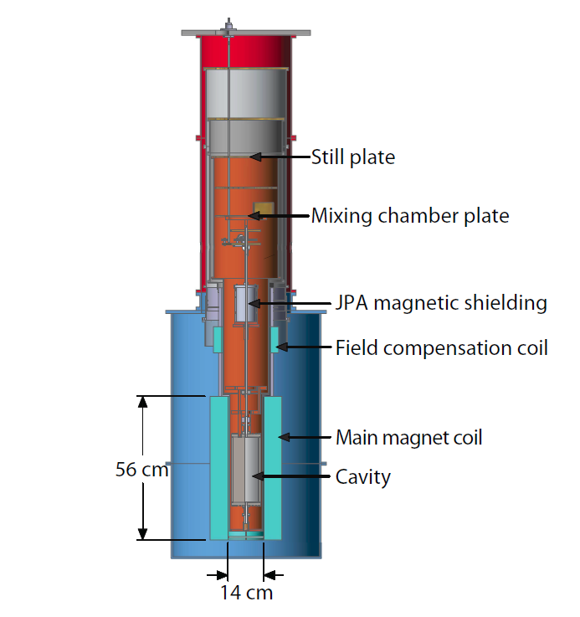
ADMX and HAYSTAC experiments
Axion Dark Matter eXperiment
Haloscope at Yale Sensitive to Axion CDM
HAYSTAC
ADMX
B₀ = 9 T @3.6K
Q-factor ~ 3·10⁴
LLNL, U. Washington, U. Florida,
U.C. Berkeley, NRAO, Sheffield U.
Preamps near quantum noise limit: Operate at ~50 mK

Slide 20
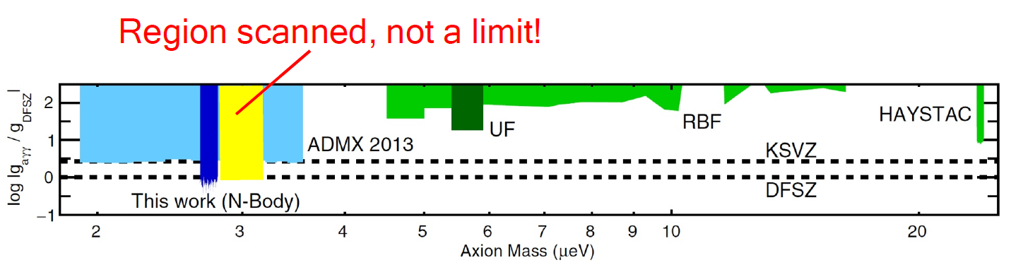
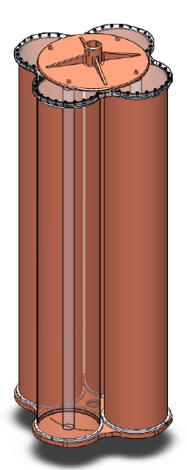
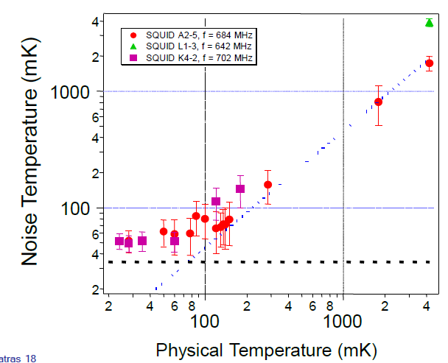
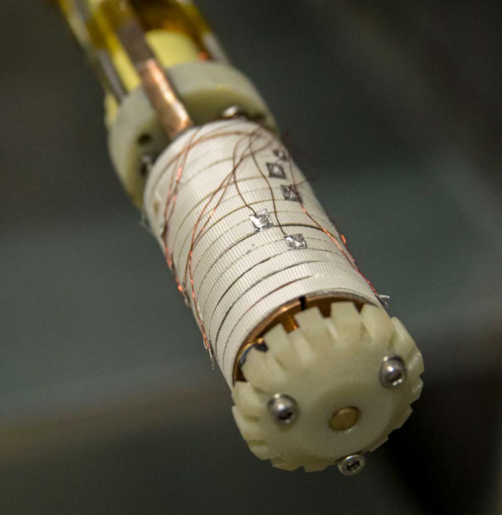
ADMX and Haystack cavity experiments
HAYSTAC Limit
ADMX Limit Region scanned
Brubaker et al., Phys.
Rev. D 96, 123008 (2017)
1-10 GHz region: ~6 yr
2019; new
tuning rod
ADMX/HAYSTAC: 32T magnet, mulit-rod cavities, squeezed states
ADMX: 2020: four cavity array
Taken from
Higher frequencies:
new hardware, no new R&D

Slide 21
Axion searches in South Korea
Center for Axion and Precision Physics Research
Institute for Basic Science
CAPP Ultra Low Temp. Axion Search in Korea - CULTASK
High B-field magnets up to 25T
Quantum limited amplifiers
High Q Superconducting cavities
Large Volume Multi-cell cavities
Experimets:
CAPP haloscopes - CULTASK
CAST-CAPP - cavity in helioscope
ARIADNE g_{aN}
srEDM, GNOME, …
RENATA Thematic meeting on Dark Matter @ LSC 2018, Feb. 5-7

Slide 22
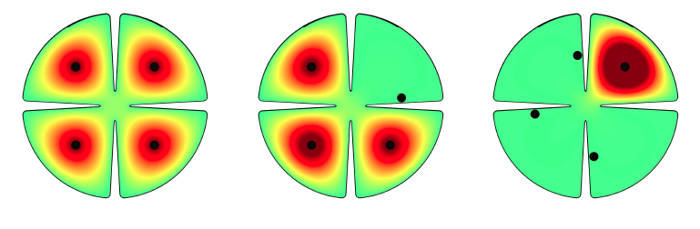

Cavities for higher frequencies:
Higher frequency → smaller cavity
→ smaller Q-factor → less sensitivity
Investigtion of way around:
Phase matched multi cavity experiments: „Pizza cavity“ to reach higher masses:
CAPP / ORGAN / ADMX
See for example:

Slide 23
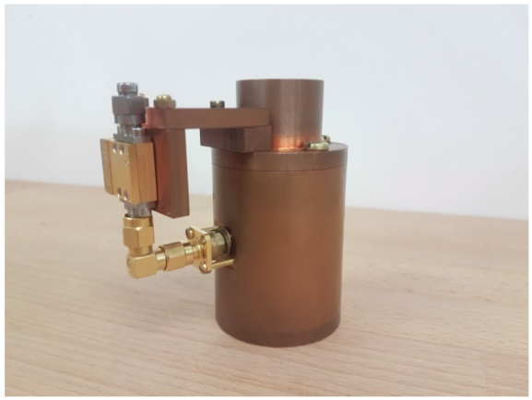
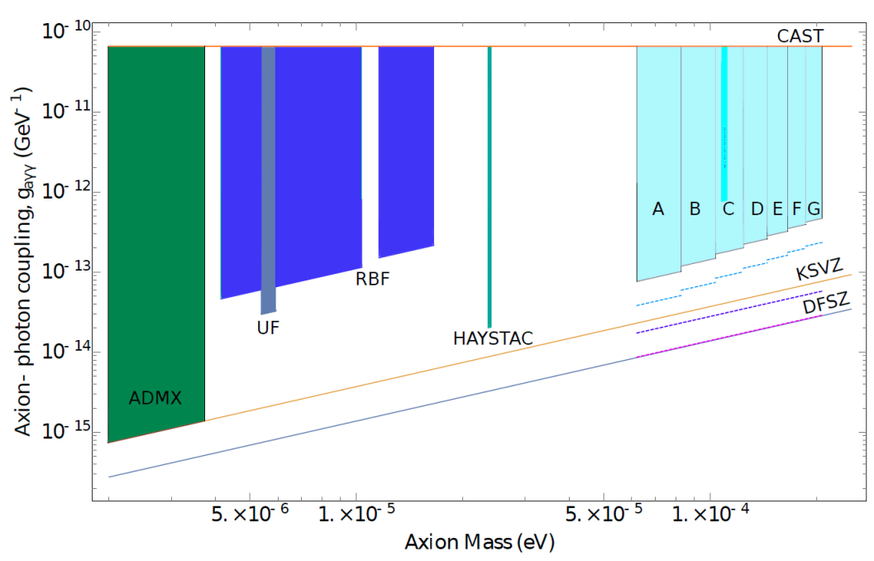
Organ cavity experiments
Oscillating Resonant Group AxioN
Perth, Australia
Stage I:
B=14 T, t= 1 yr Tsys=10K (HEMT), Q=50.000,
tuning with dielectric rod, → 26.1-27.1 GHz
Possible upgrades:
T_{sys}= quantum limites,
B=28T，T_{sys}=sub quantum (squeezed vacuum)
Multiple cavity approach for higher frequencies
Stage I: 1 year
Stage II: 6 yr,
quantum limit
Stage II with 28T
Sub quantum limit 14T
Sub quantum limit 28T

Slide 24
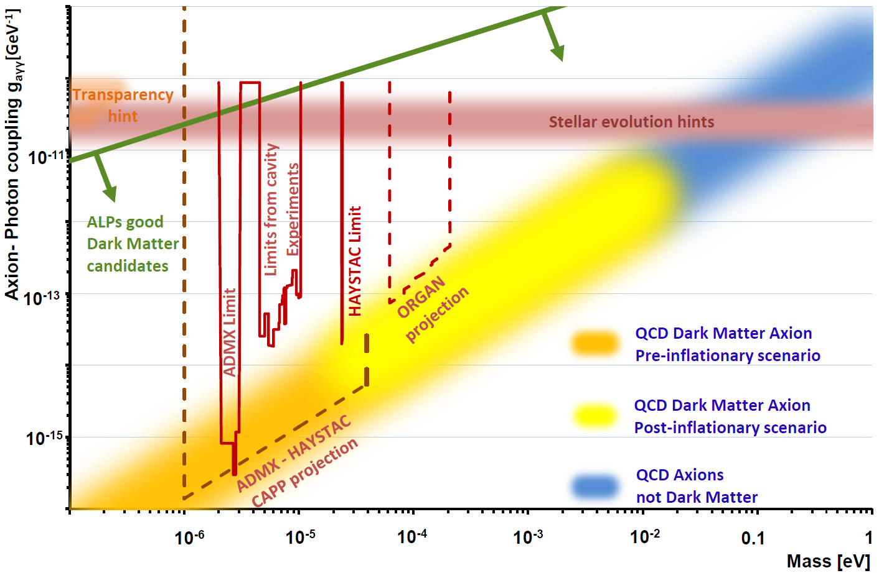

Slide 25
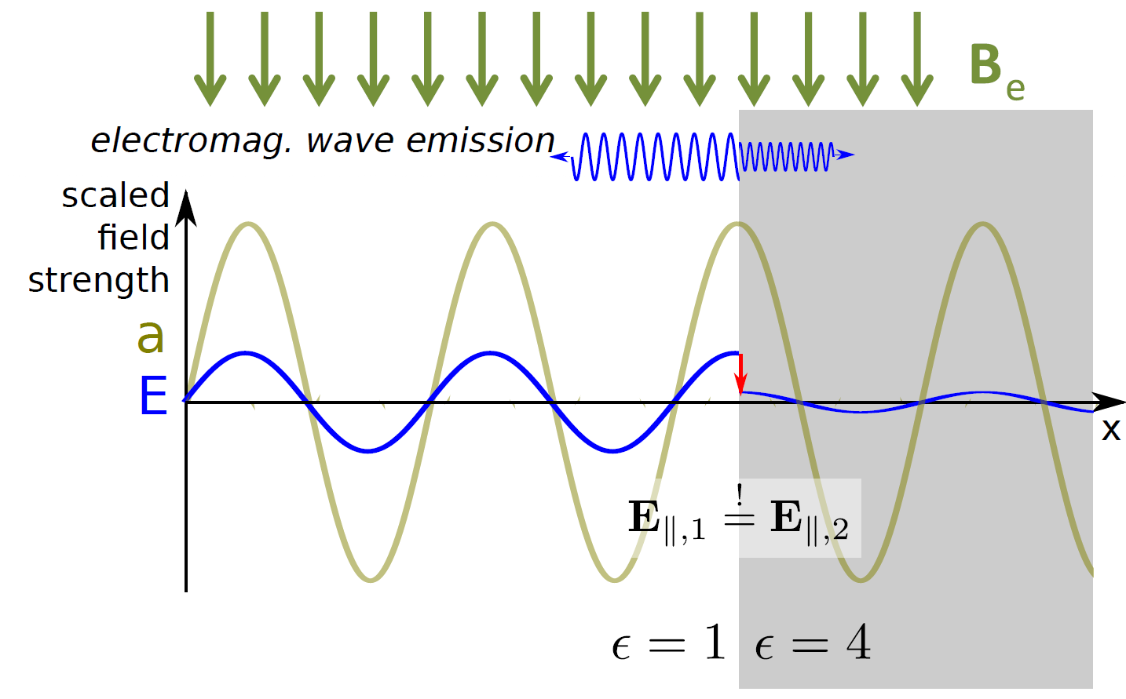

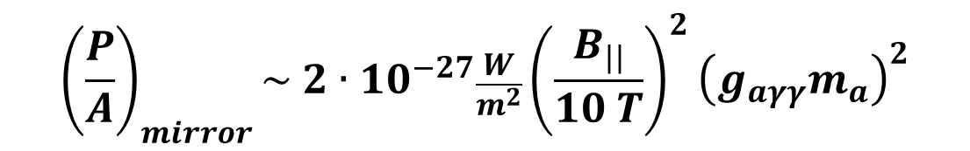
Effect of Dielectric
a
$$B$$
Axion in B field
→ oscillating E-field
At surfaces with transition of ε:
→ Discontinuity
of E-field
→ Emission
of photons
$${\left(\frac{P}{A}\right)}_{mirror}\sim 2∙{10}^{−27}\frac{W}{m^{2}}{\left(\frac{B_{||}}{10 T}\right)}^{2}{\left(g_{aγγ}m_{a}\right)}^{2}$$
D. Horns, J. Jaeckel, A. Lindner, A. Lobanov, J. Redondo
and A. Ringwald JCAP 1304 (2013) 016 [arXiv:1212.2970].
25

Slide 26
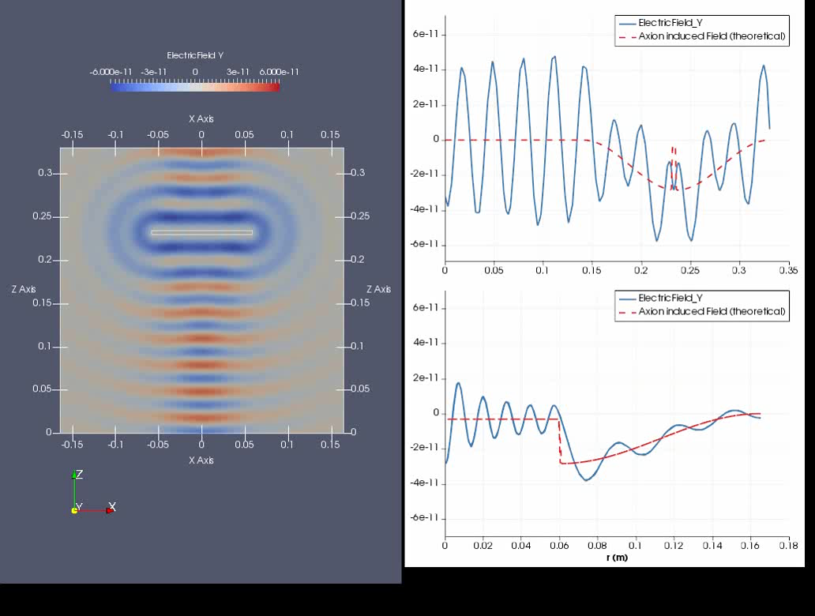
Simulation performed with ELMER
https://www.csc.fi/web/elmer
Emitted wave
Axion induced electric field oscillation

Slide 27
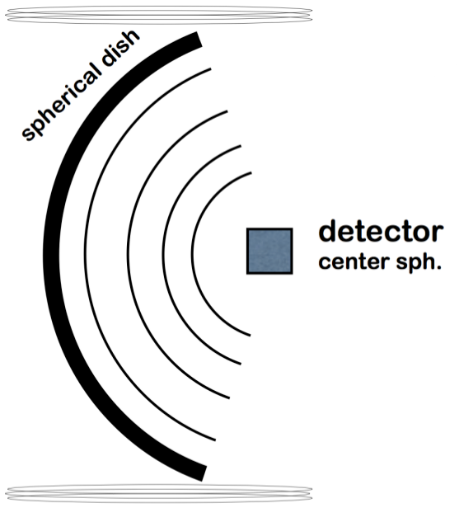

Dish antenna haloscope:
$$B$$
Broadband approach
Also works for kinetic mixing
→ Hidden photon search:
no B-field needed
For axion search:
Need large area or
Extremely sensitive detector
[BRASS @ Uni Hamburg/DESY]

Slide 28
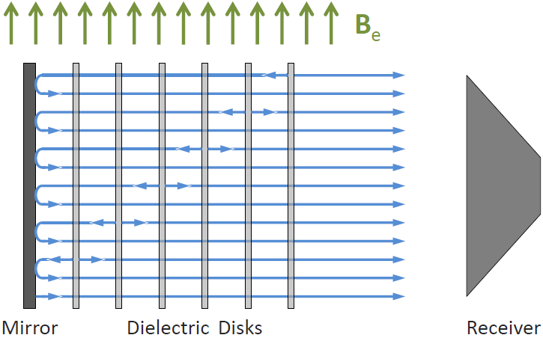
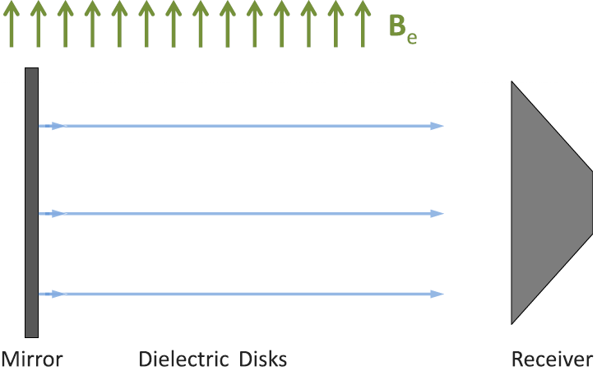


Dielectric haloscope:
$${\left(\frac{P}{A}\right)}_{cavity}\sim 2∙{10}^{−27}\frac{W}{m^{2}}{\left(\frac{B_{||}}{10 T}\right)}^{2}{\left(g_{aγγ}m_{a}\right)}^{2}β^{2}$$
$$β^{2}=\frac{P_{cavity}}{P_{mirror}}$$
28

Slide 29

Dielectric haloscope:
Power boost of >10⁴ achievable with 80 discs of LaAlO3
“Quasi broadband” approach
The MADMAX Working Group:
Phys. Rev. Lett. 118,
091801 (2017)
arXiv:1611.05865

Slide 30

Dielectric haloscope:
Tuning of sensitive frequency range:
Disk spacings
The MADMAX Working Group:
Phys. Rev. Lett. 118,
091801 (2017)
arXiv:1611.05865

Slide 31

MADMAX
MAgnetized Disc and Mirror Axion eXperiment
~2m
Mirror
10 T dipole magnet
Horn antenna
(+ receiver)
80 adjustable dielectric discs
⊘: ~1m
Separate cryogenic volume
Parabolic Mirror

Slide 32



Collaboration forming at DESY, Hamburg
Site: DESY Hamburg,
hall north
8 Institutes from
France, Germany, Spain

Slide 33




    : Prototype setup
Measurements of transmissivity and Reflectivity:
Confirmed simulations
Sensitivity:
HEMT pream @ LHe:
detect 10⁻²³W signal in 7 days
Understand neede precision
reproducibility ok
Prototype setup partly funded as seed project by:

Slide 34


MADMAX: The magnet
Innovation partnership with Böhringer Noell & CEA IRFU, Saclay
→ develop feasible magnet with FoM 100T²m²
Latest result: Can be done using NbTi with 9T, 1.25 m² aperture
2018: Finish magnet design & proof of principle investigations
~ 2021: Run prototype (3T, 30cm diameter) until 2021
→ first physics results (ALPs Hidden photons

Slide 35


Slide 36


IAXO Helioscope:
Worldwide first “large scale” Axion experiment.
Combine expertise:
CAST, magnets for colliders, X-ray optics from satellites, ultra-low background X-ray detectors.
Toroidal 8-coil magnet L=~20m, 600mm bore, ~6T

Slide 37


IAXO collaboration:
Collaoration founded in July 2017 at DESY
17 institues from 8 countries
DESY offered to host IAXO
First step: babyIAXO by 2021:
Toroidal ~6T magnet
L=~20m, 600mm bore

Slide 38





Experimental approaches
Light shining through the wall:
Primakoff effect twice
Convert photons into axion
and reconvert behind wall
Detect regenerated photon behind wall
$$B$$
$$B$$
$$P_{a→γ→a}=\frac{1}{16}(g_{aγγ}Bl)^{4})\frac{sin(\frac{1}{2}\left(p_{γ}−p_{a}\right)l)}{\frac{1}{2}\left(p_{γ}−p_{a}\right)}$$

Slide 39









ALPS II at DESY:
Main challenges:
Magnet – straighten 20 HERA dipoles 200m,
Optics – LIGO related concepts,
Detector – TES, heterodyne in development
Timeline:
• Cleared HERA tunnel
• ALPS IIc optics commissioning beginning 2019
• ALPS IIc data runs in 2020
ALPS II is a joint effort of

Slide 40


Slide 41







C O N C L U S I O N S
Axions in mass range ~1-400 μeV could solve strong CP & Dark Matter problems
Generic ALPs motivated by stellar cooling and transparency anomalies
Cavity haloscope experiments probe DM axion masses ~ 1 – 40 µeV
Dielectric haloscope could be sensitive in the range ~ 40 – 400 µeV
Helioscopes and LSW experiments have sensitivity to DM ALPs motivated by stellar cooling
Magnet issue seems solvable (price?)
Very complementary axion and ALP search community!
Next 10 years could be very exciting!

Slide 42


ADMX and Haystack experiments
Dicke’s radiometer equation:
Quantum noise:
>1/2 photon per resolution bandwidth
→Use amplifiers near this limit
→Operate at 50 mK

Slide 43




Phys. Rev. D 91, 011701(R) (2015)
ORPHEUS R&D
University of Washington, US
Match E and B fields, use dielectric discs to shorten wavelength
Design Target

