Slide 1
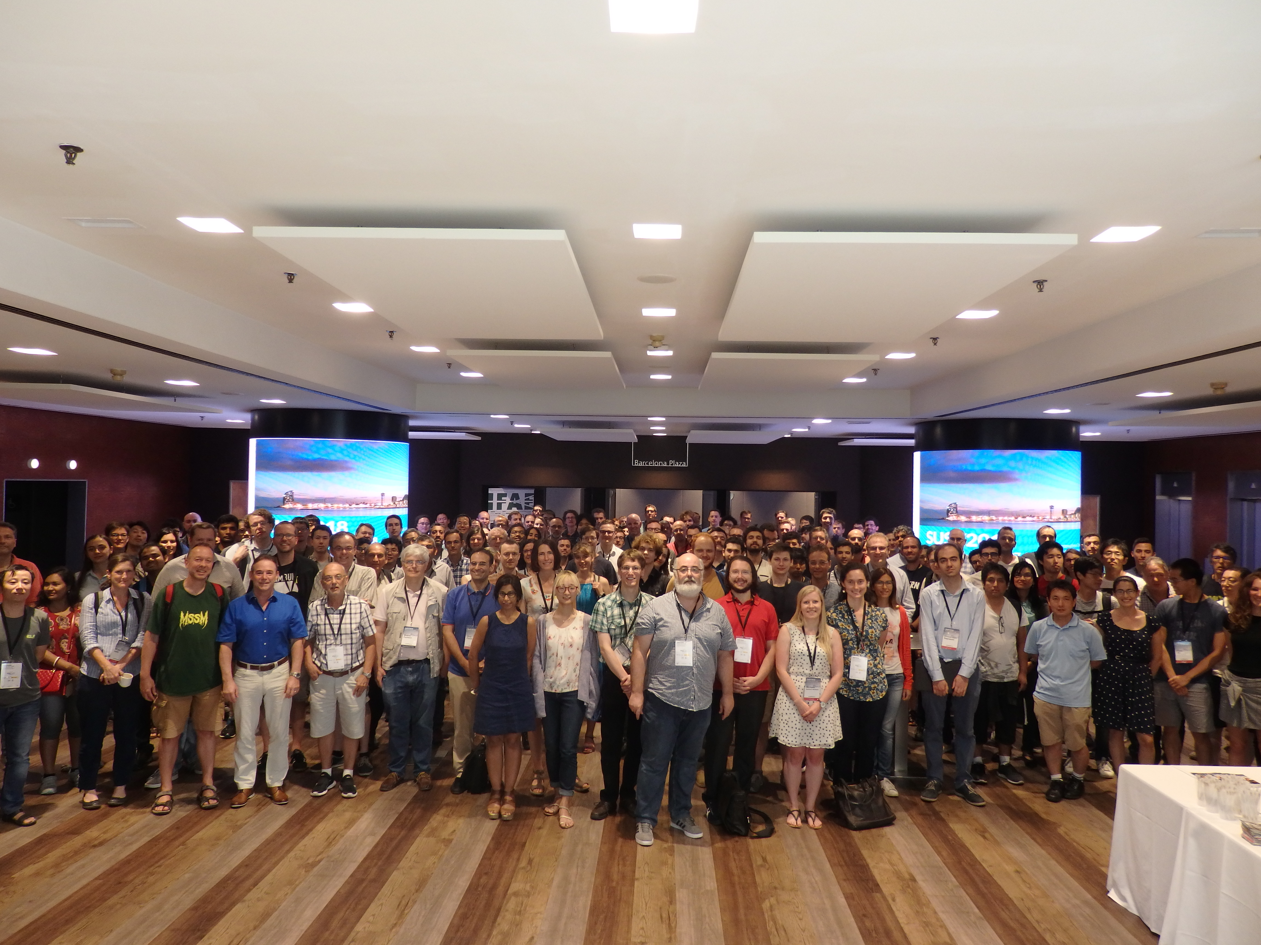
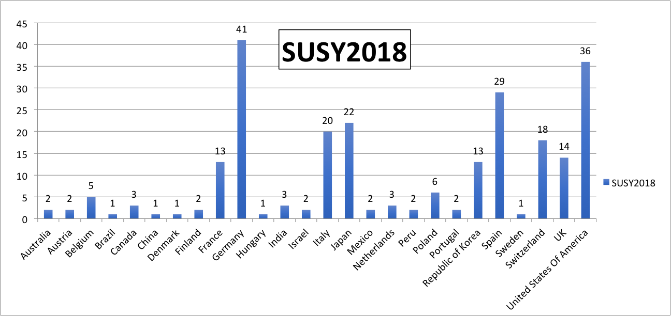

SUSY 2018 in #s
245 Participants (not including ~20 Local Organizing Committee Members)
From 26 countries
37 Plenary talks
181 Parallel talks
15 Posters
245
33 persons (13%) partially supported
SUSY Master (M. Quirós)
Thanks to all of you !
If you liked the Wi-Fi thank A.Pacheco
Secretariat

Slide 2
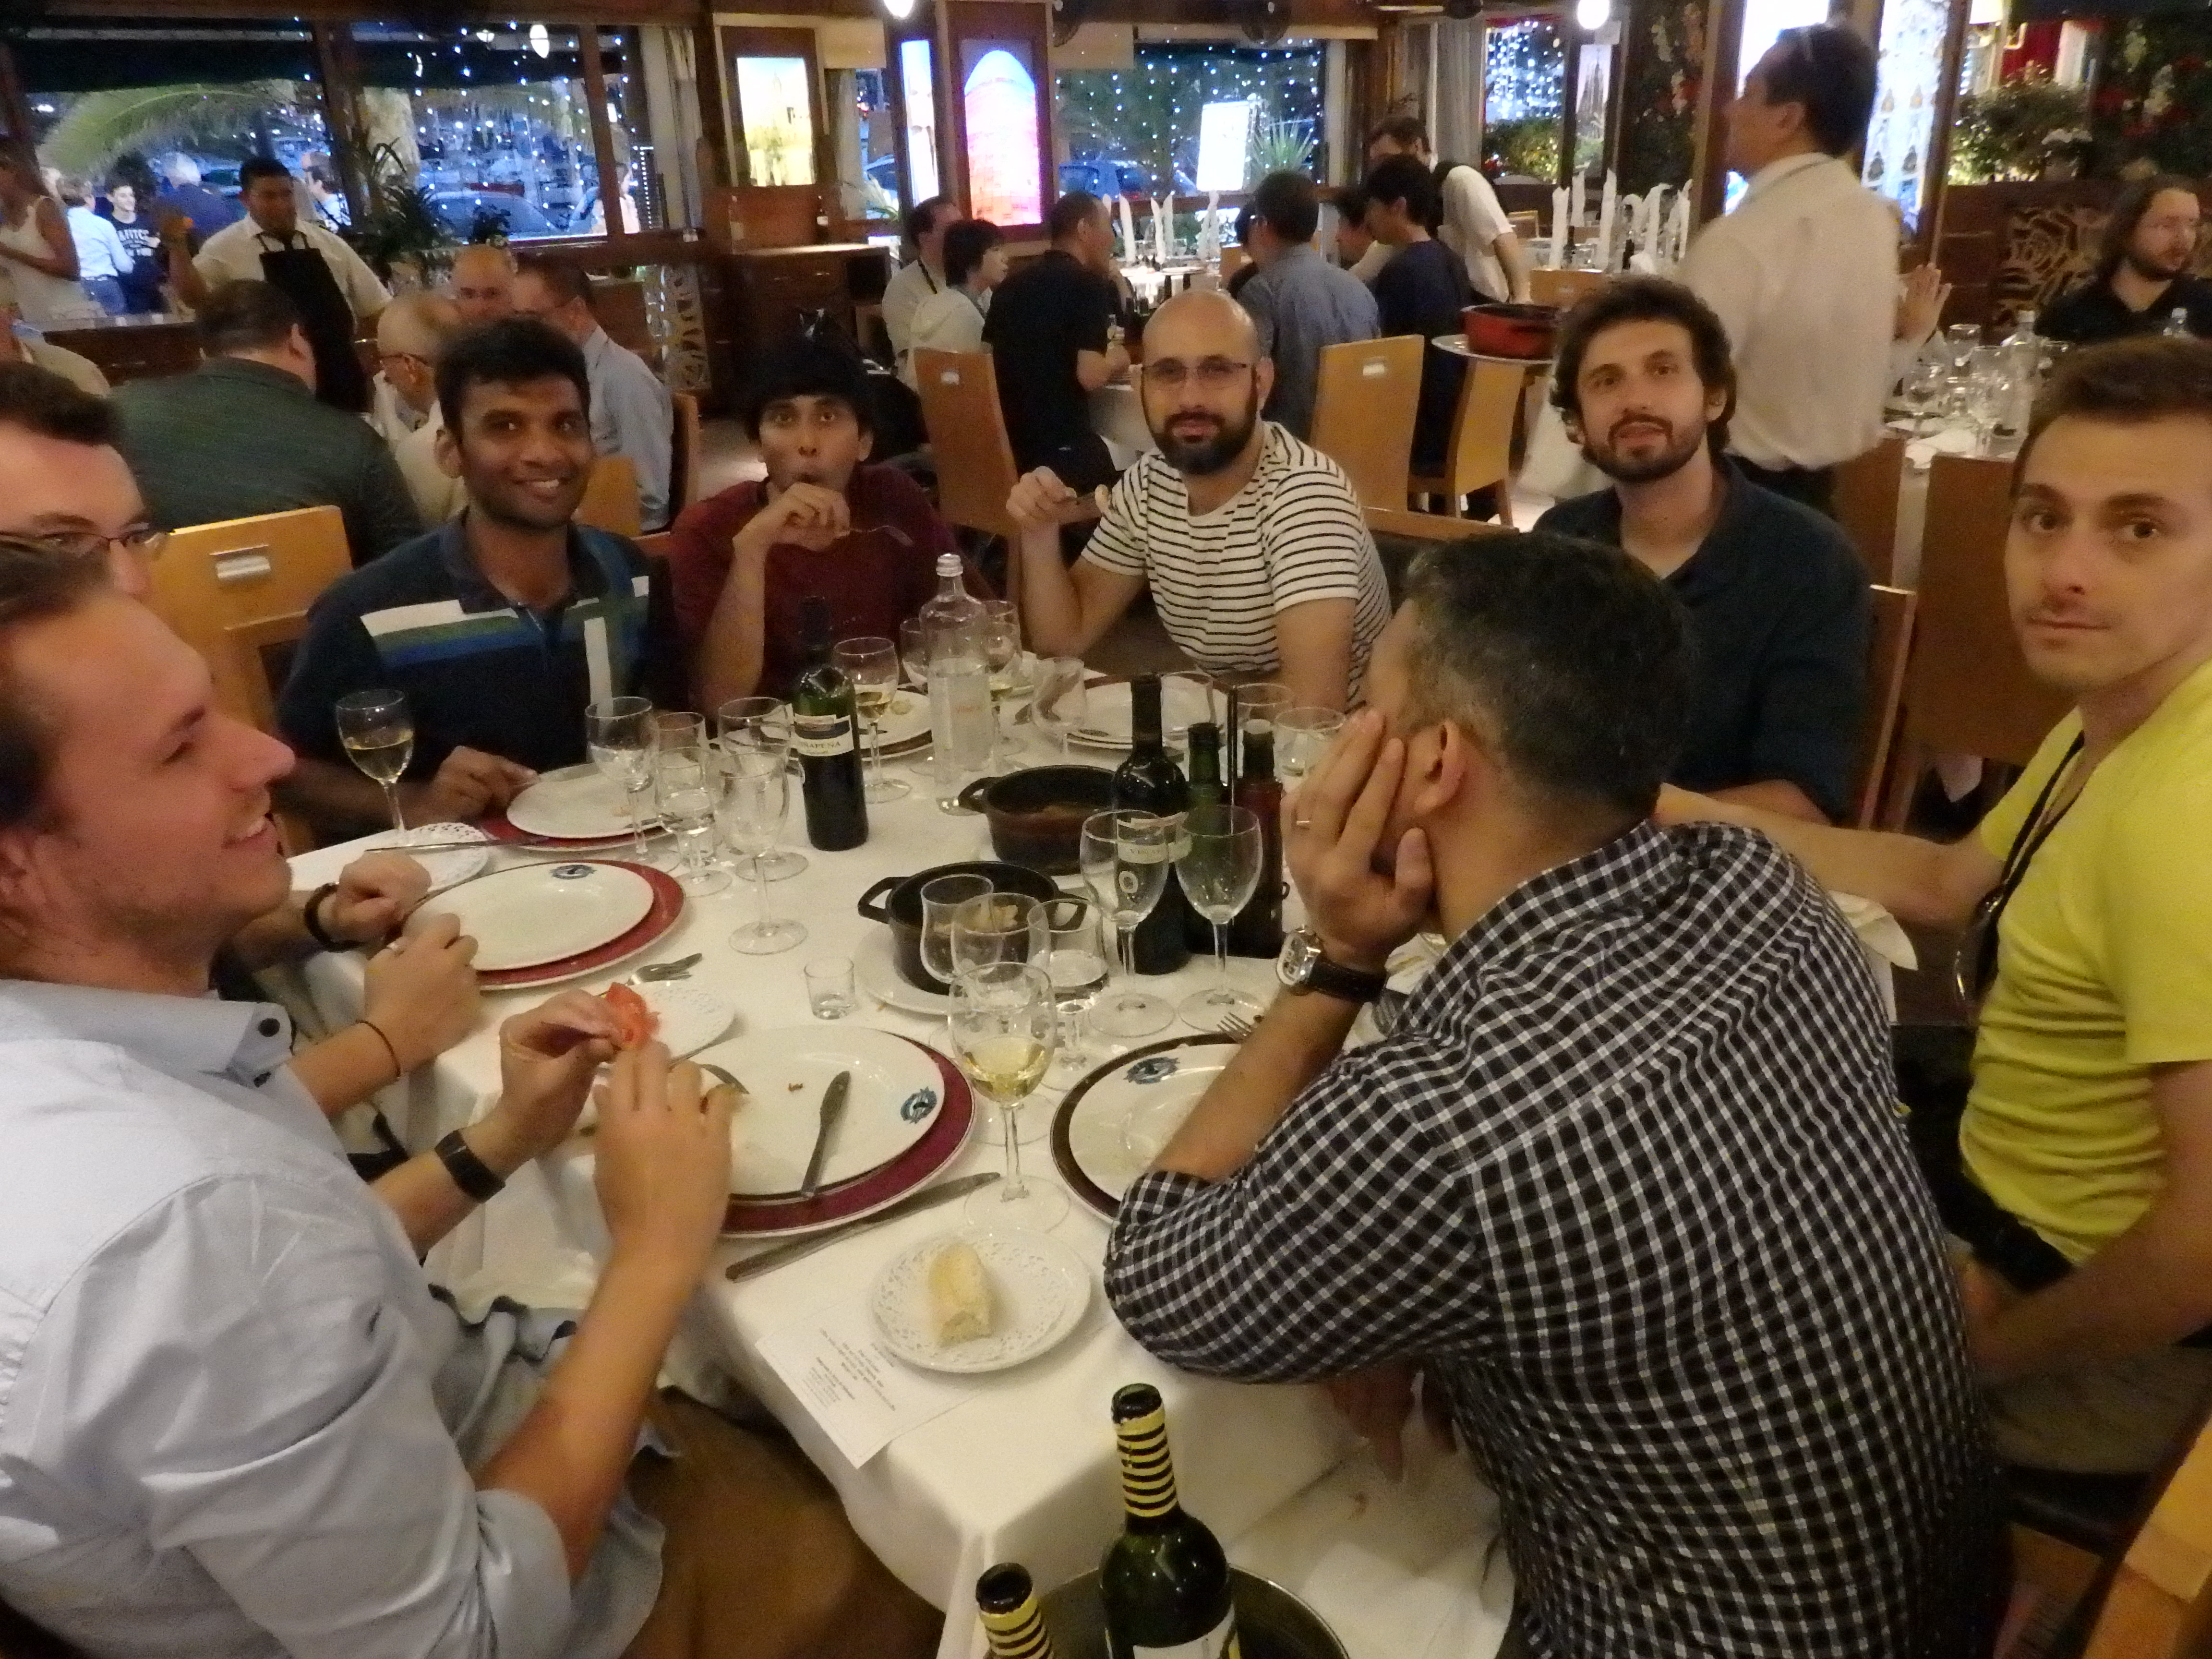
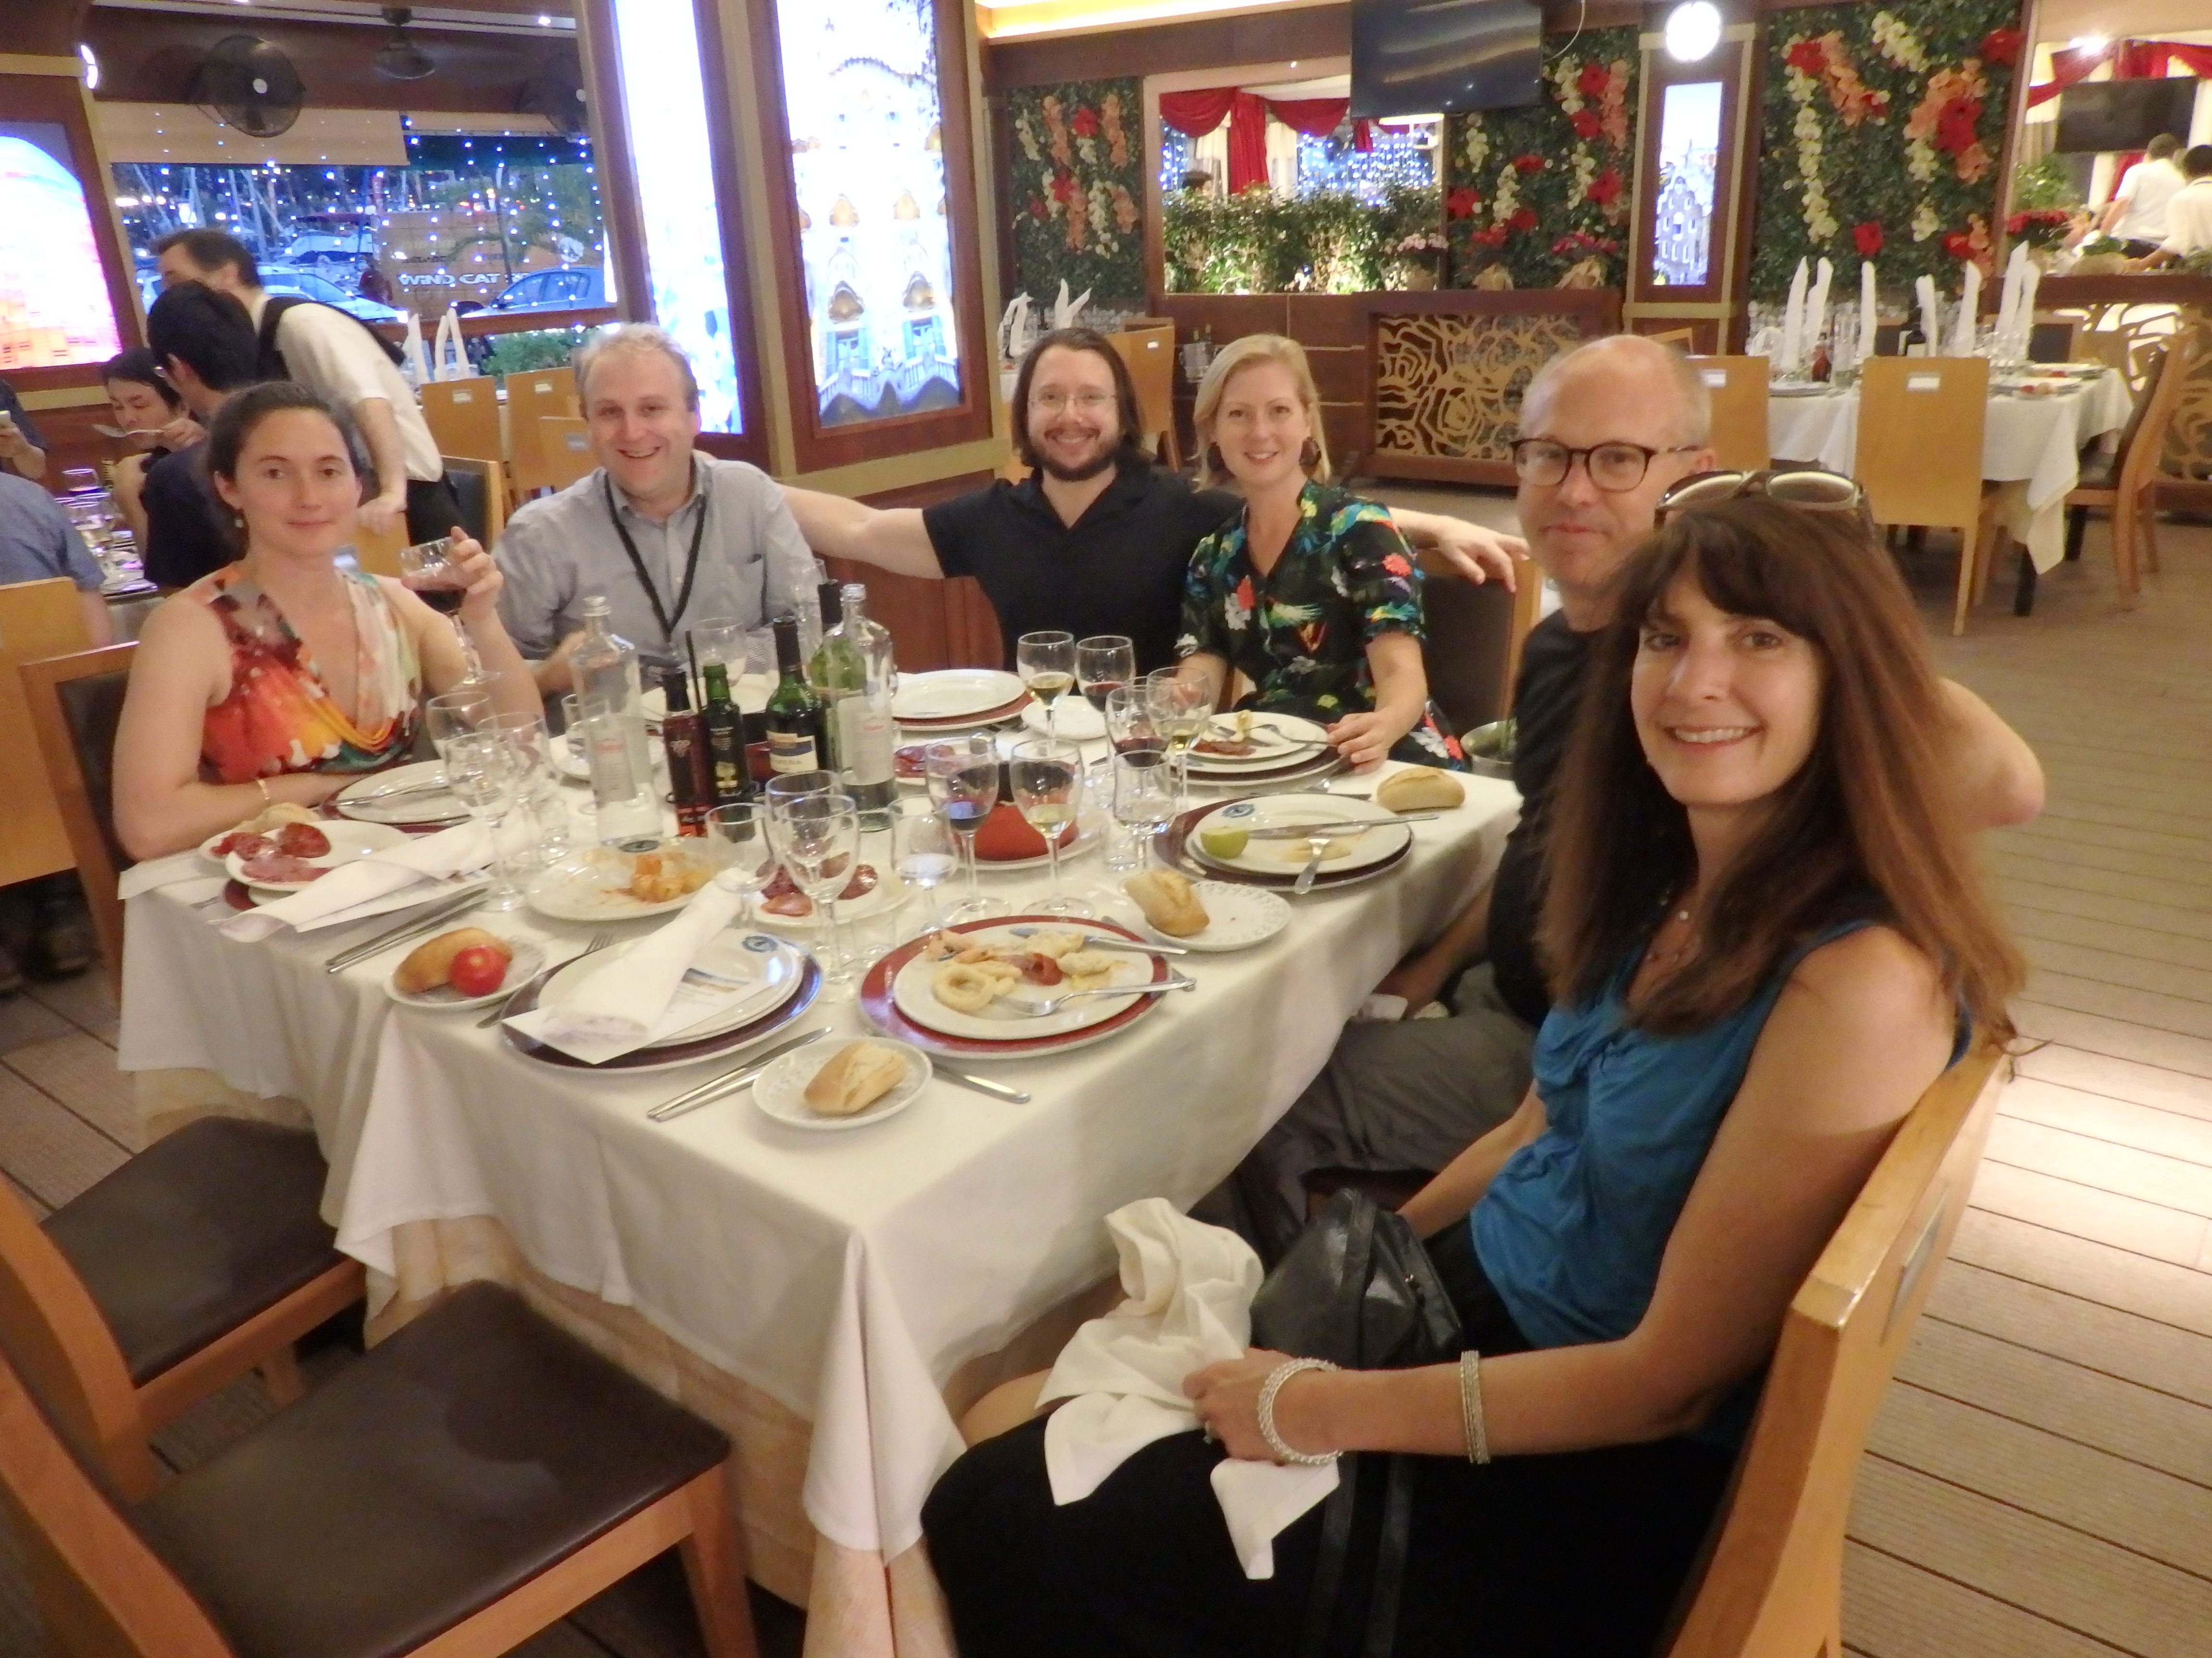
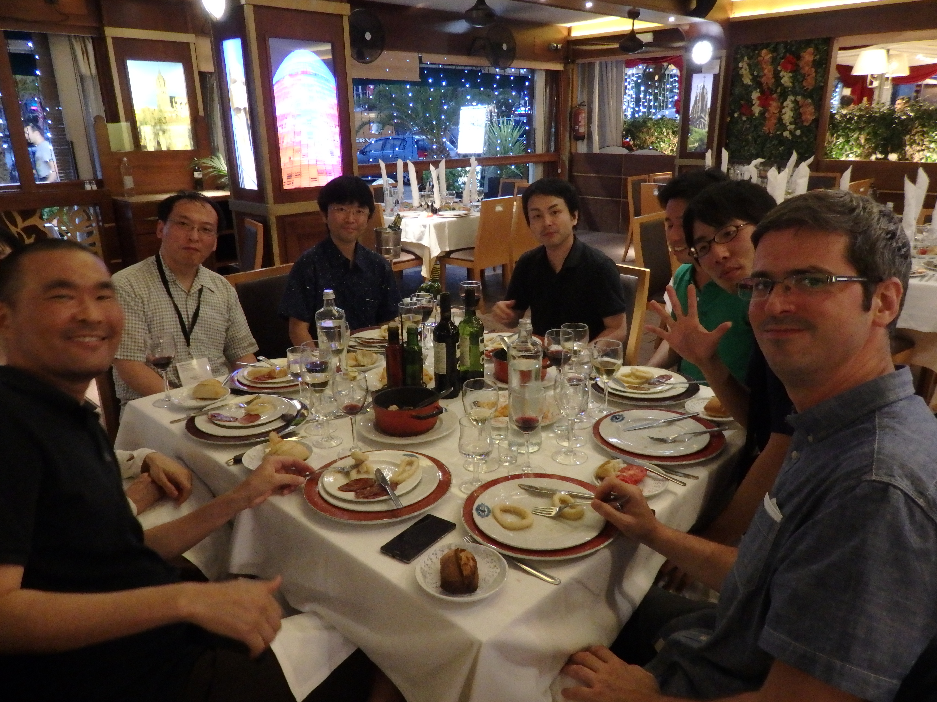
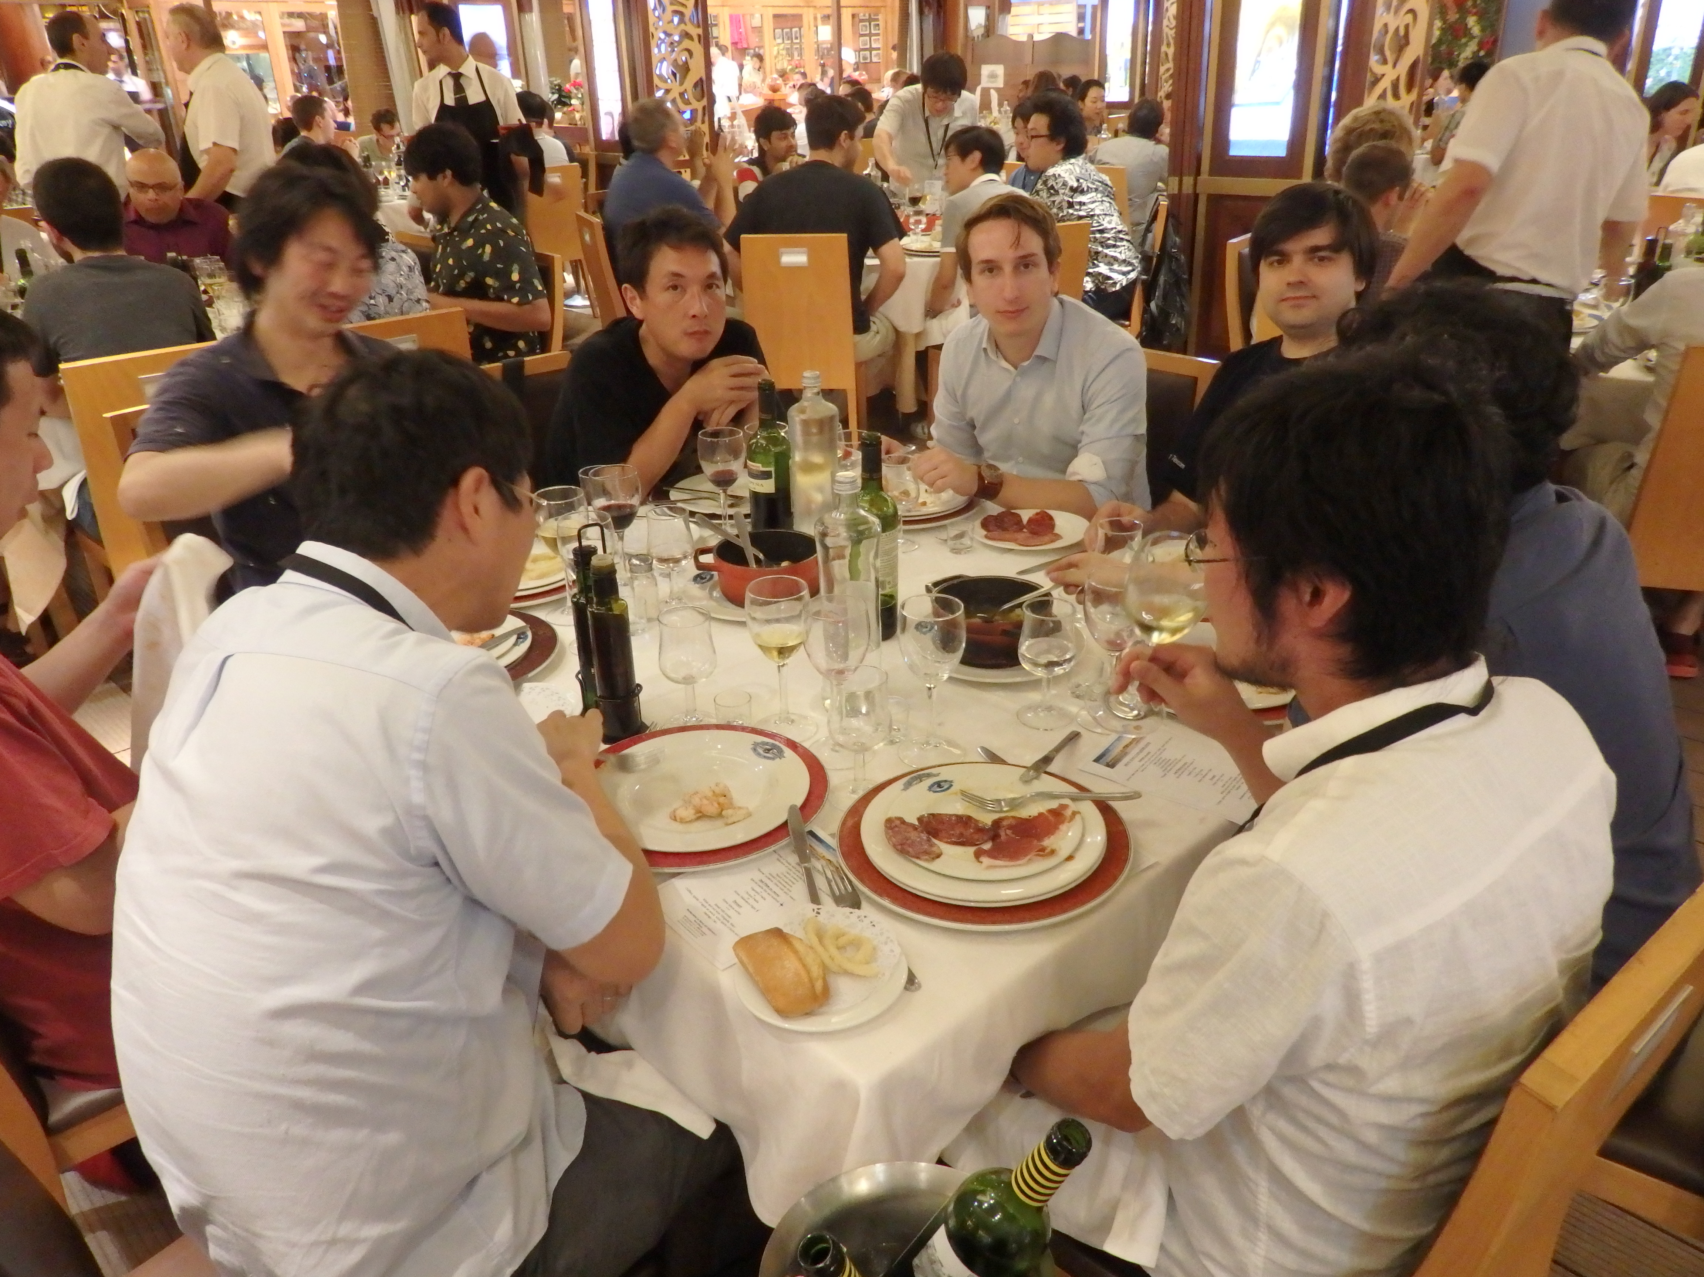
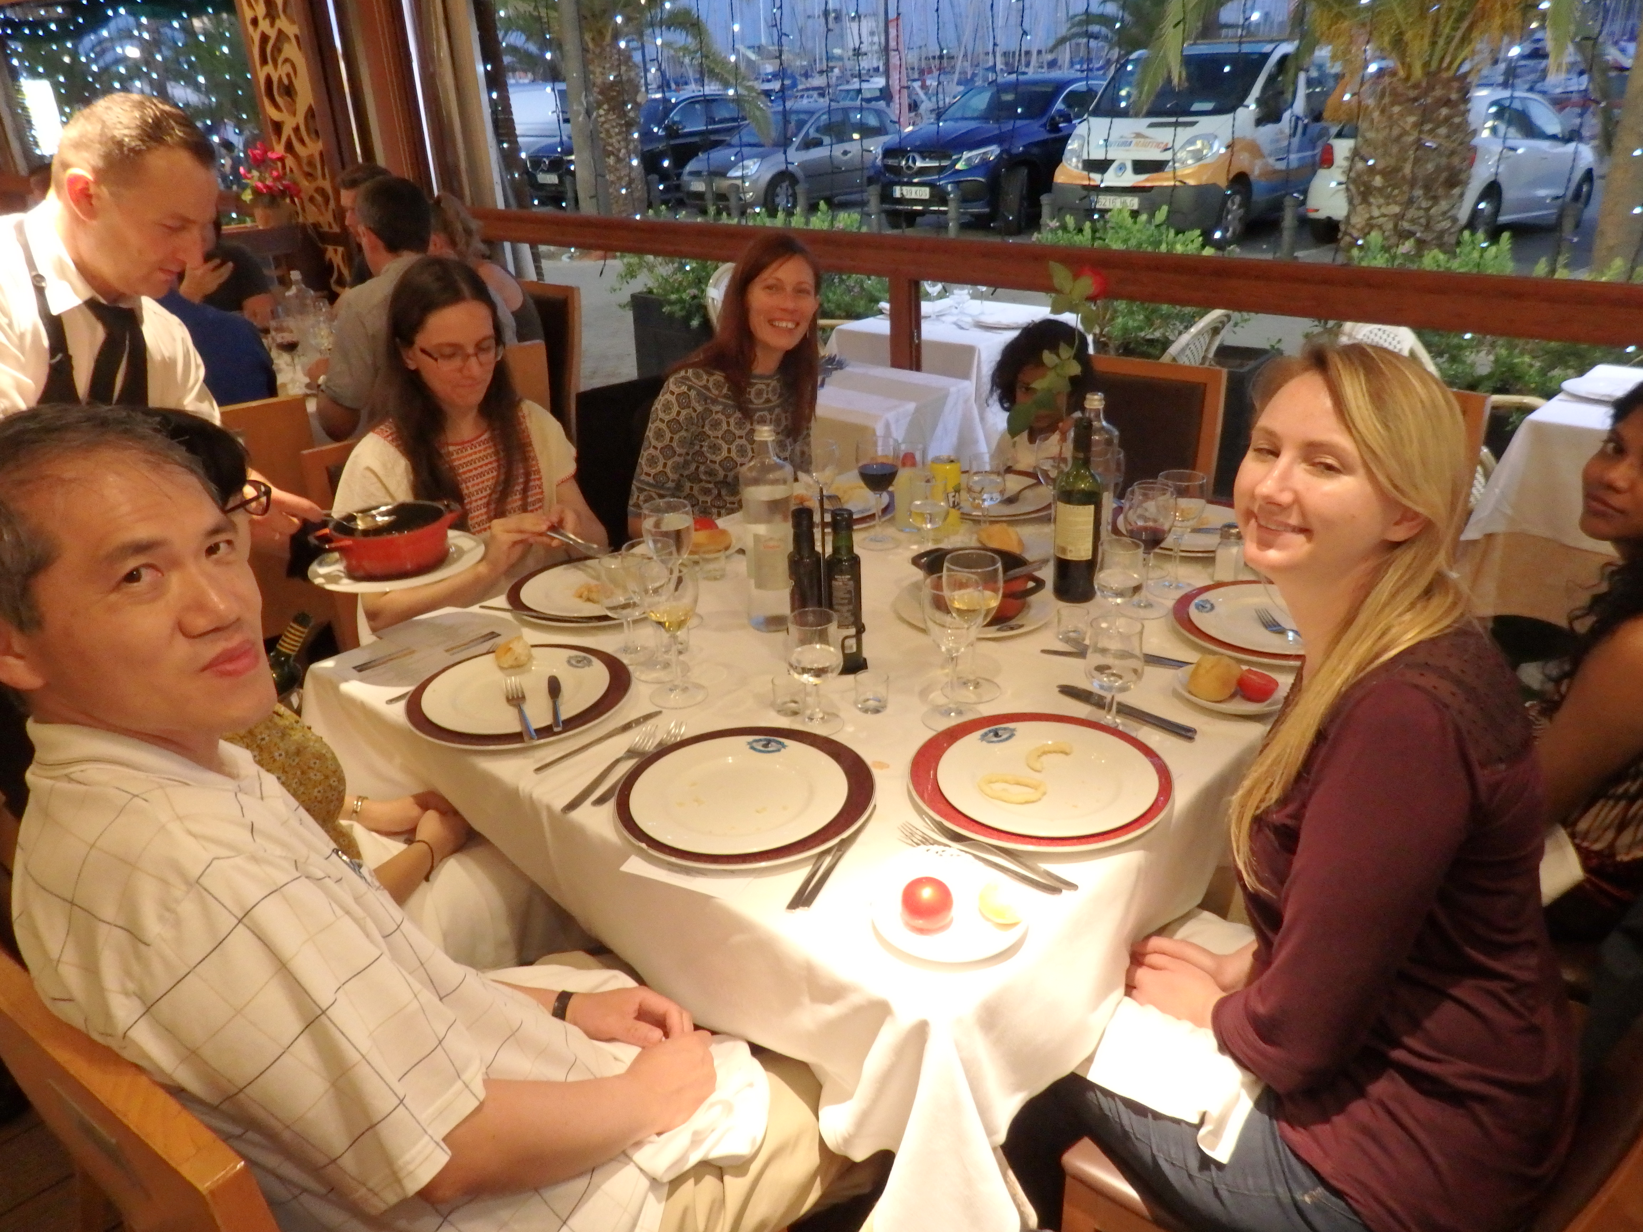
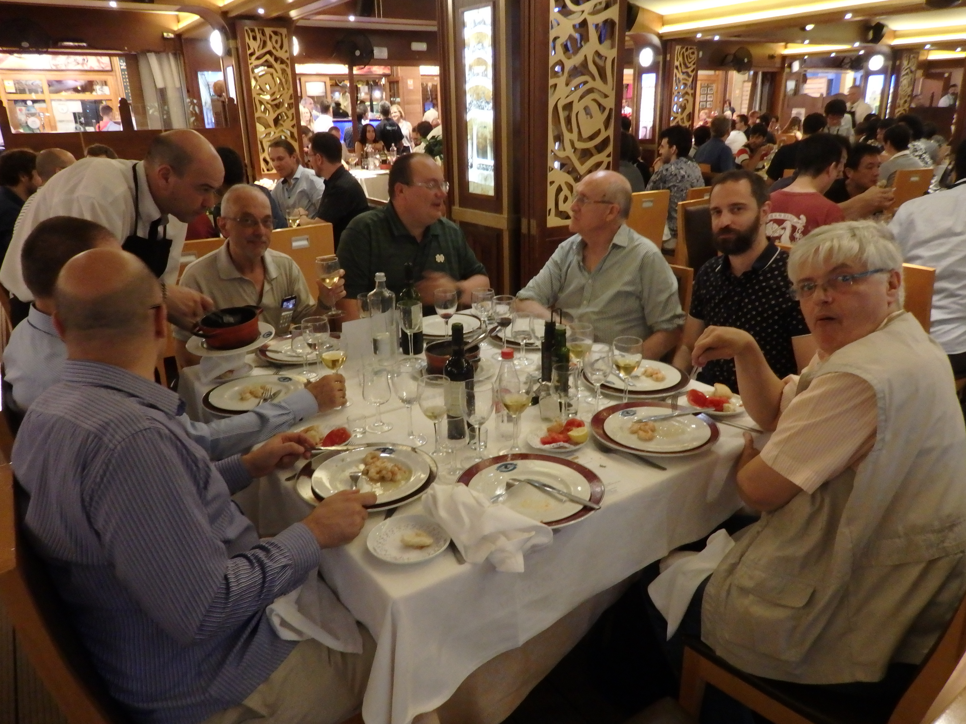
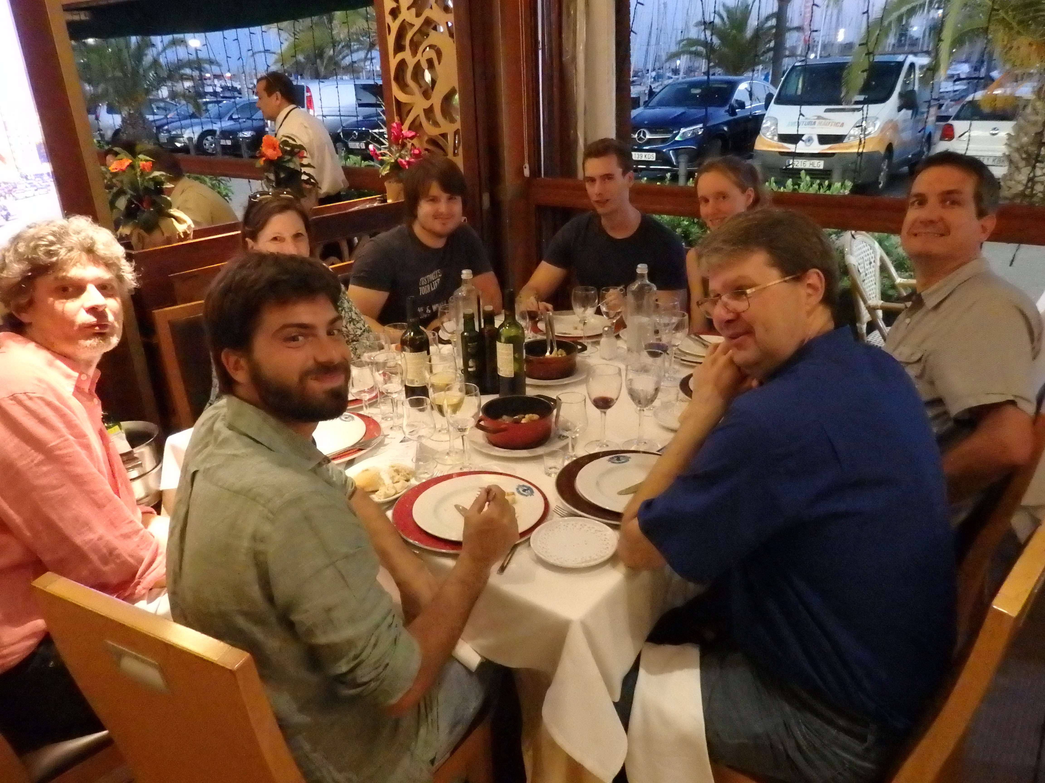
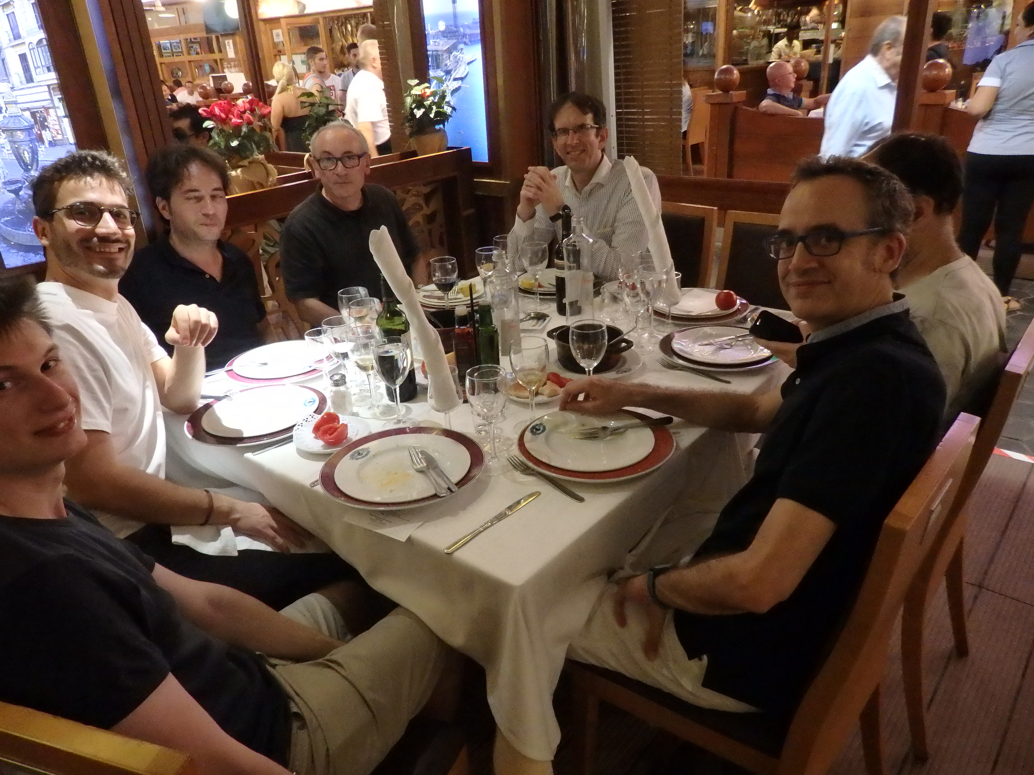
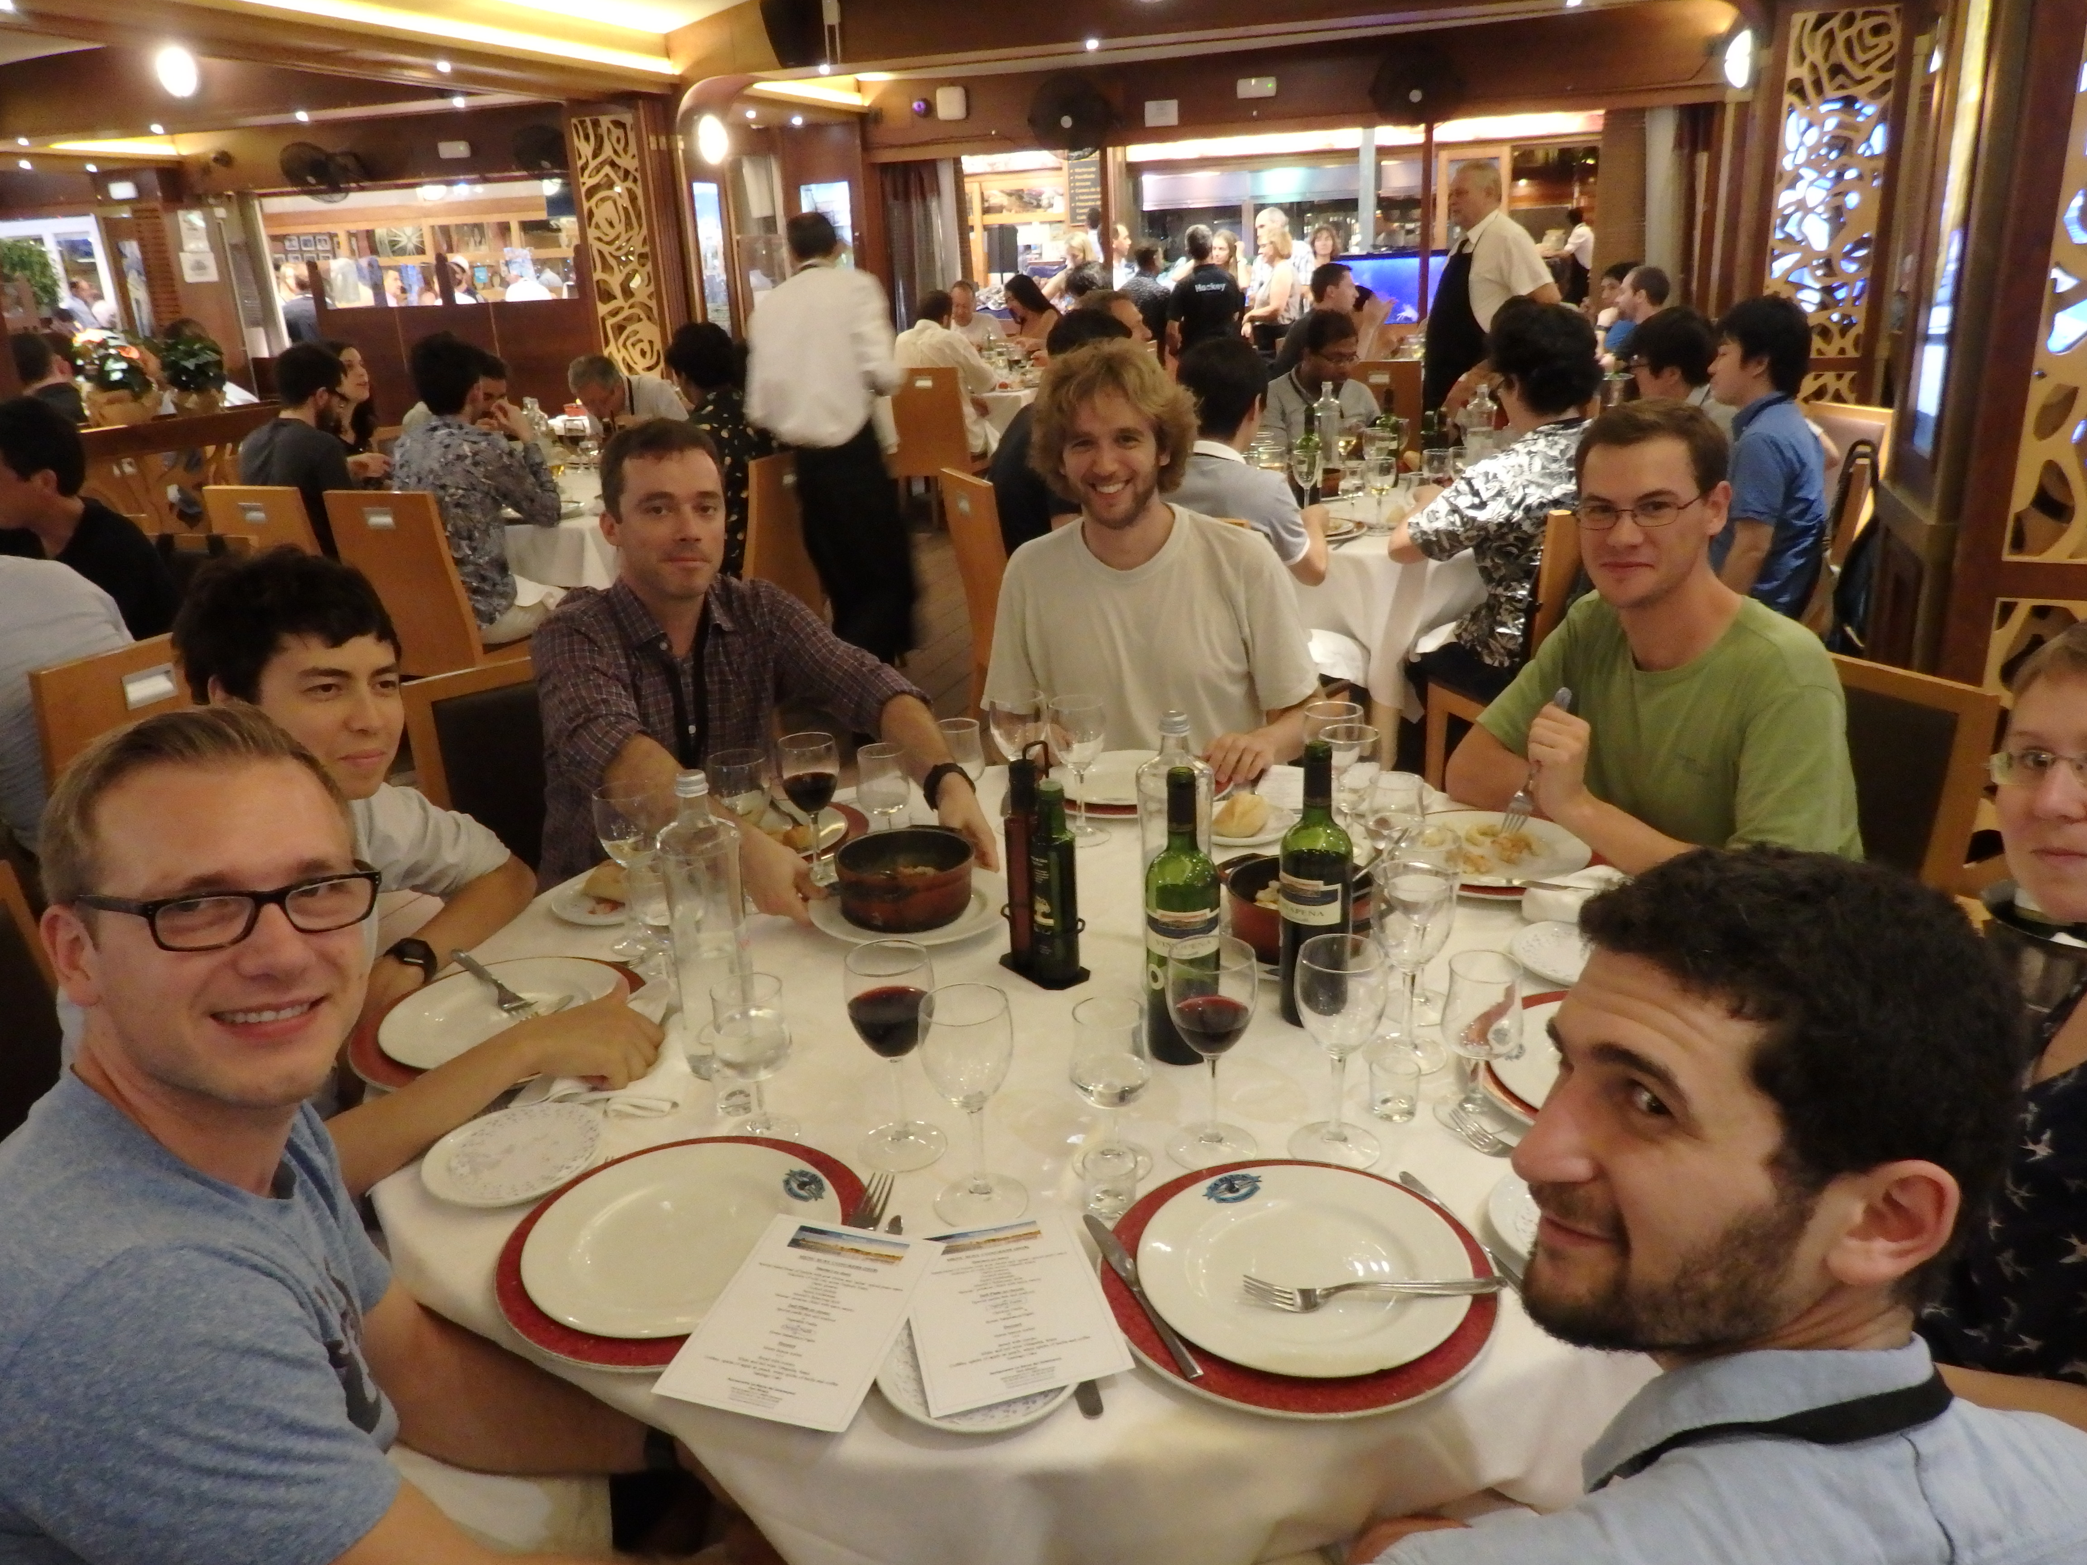

Slide 3
Good luck to SUSY2019
No SUSY (yet) …but LOTS OF SEAFOOD

Slide 4
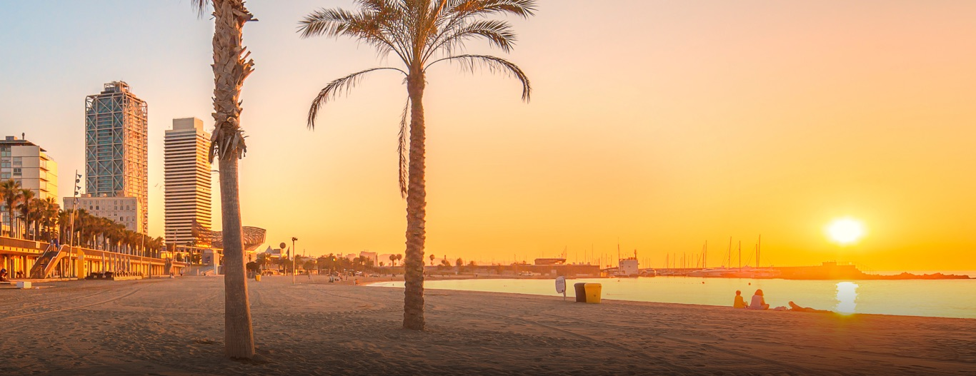






Have a safe trip back !
SUSY LOC (tomorrow)

Slide 5
The End

