Slide 1

Knowledge Transfer @ CERN
Giovanni.Anelli@cern.ch
Knowledge Transfer Group Leader
IPT Department

Slide 2
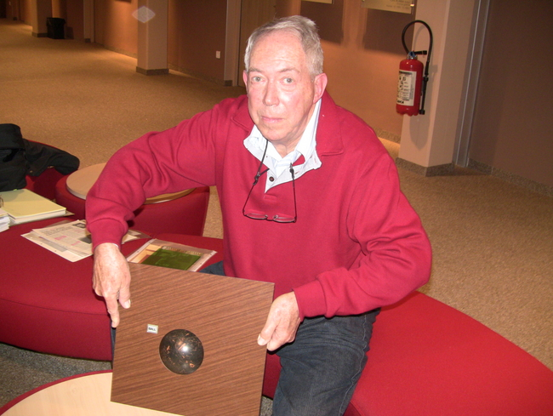
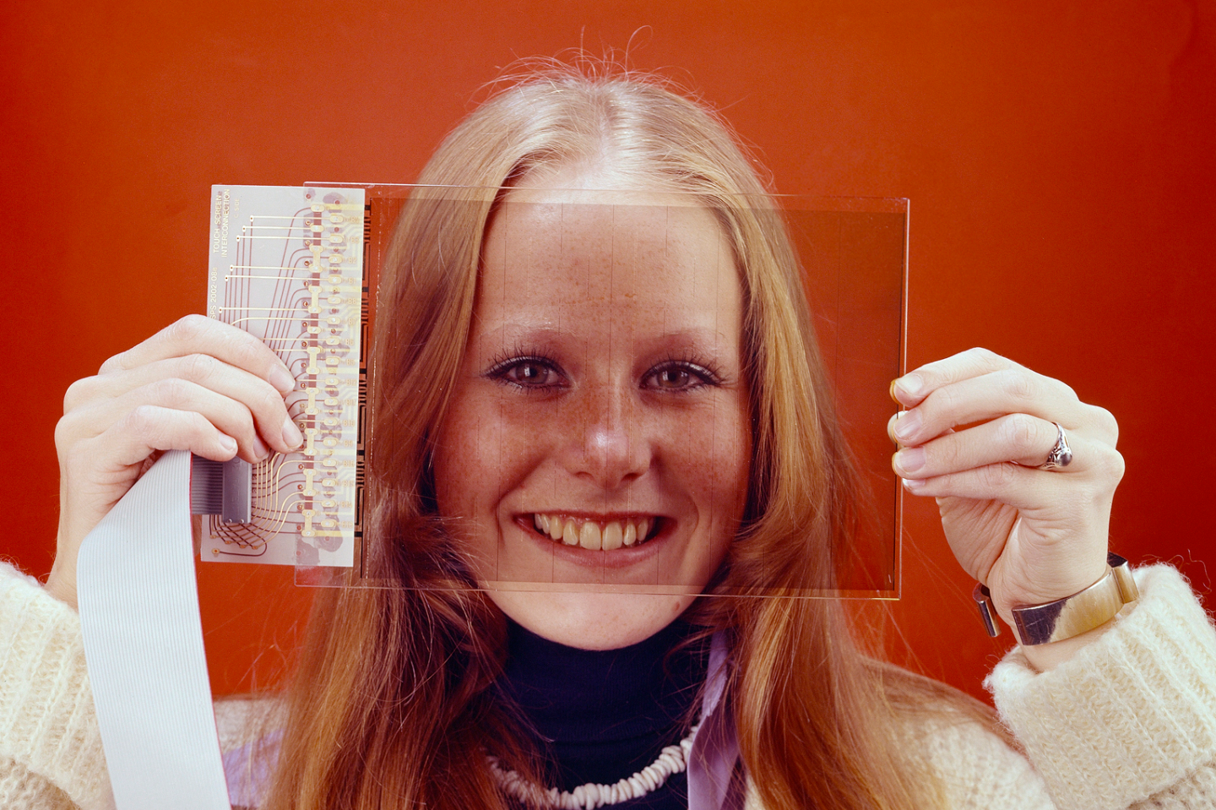
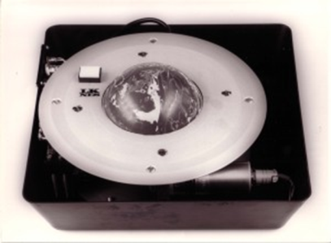
Did you know?

Slide 3
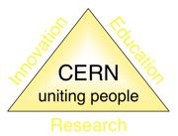
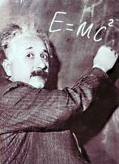

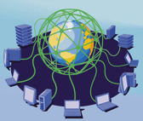
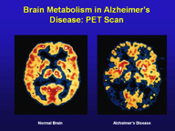
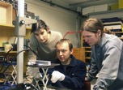
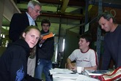
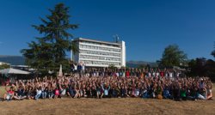
The Mission of CERN
Push back the frontiers of knowledge
E.g. the secrets of the Big Bang …what was the matter like within the first moments of the Universe’s existence?
Develop new technologies for accelerators and detectors
Information technology - the Web and the GRID
Medicine - diagnosis and therapy
Train scientists and engineers of tomorrow
Unite people from different countries and cultures
Notes:
3

Slide 4
KT Mission
Maximize the technological and knowledge return to society, in particular through Member States industry
Promote CERN’s image as a center of excellence for technology and innovation
Demonstrate the importance and impact of fundamental research investments
Key words are dissemination and impact

Slide 5
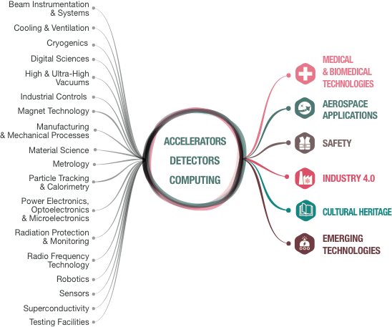
From CERN Technologies …
… to Society
Notes:
CERN’s mission extends beyond science: it also aims to advance the frontiers of technology, to train the next generation of scientists and to bring nations together. The transfer of CERN technologies and know-how to society – grouped under the concept of Knowledge Transfer – is an integral part of each of these activities.

Slide 6
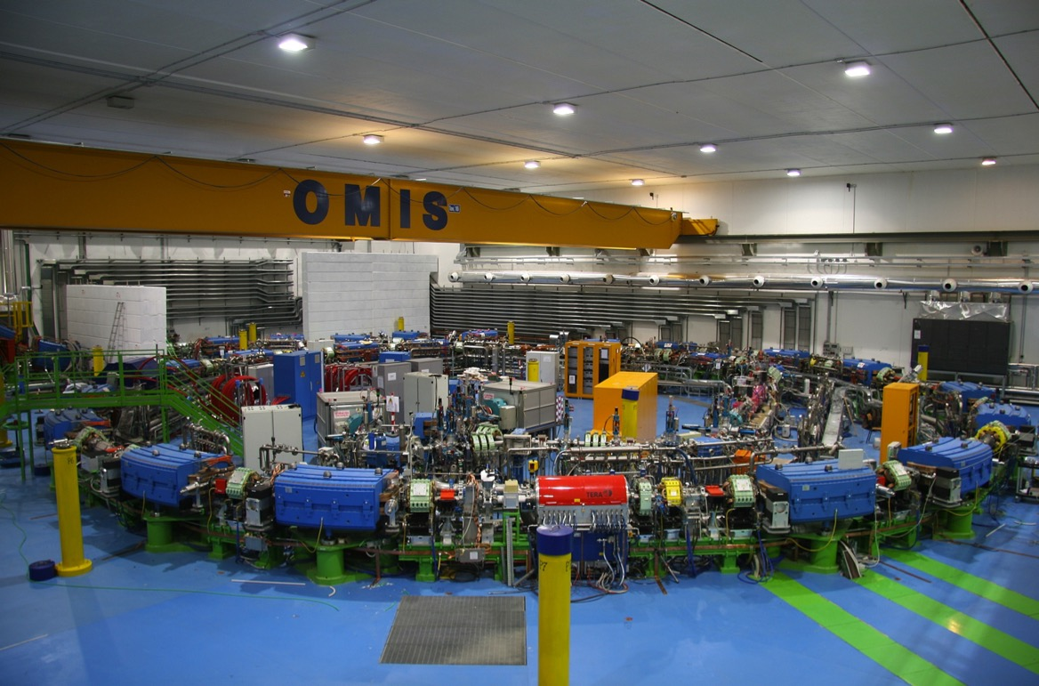
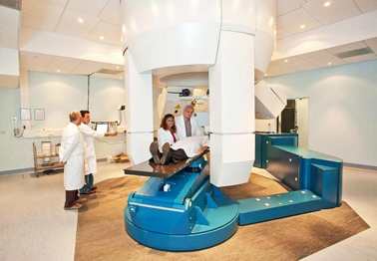

Slide 7
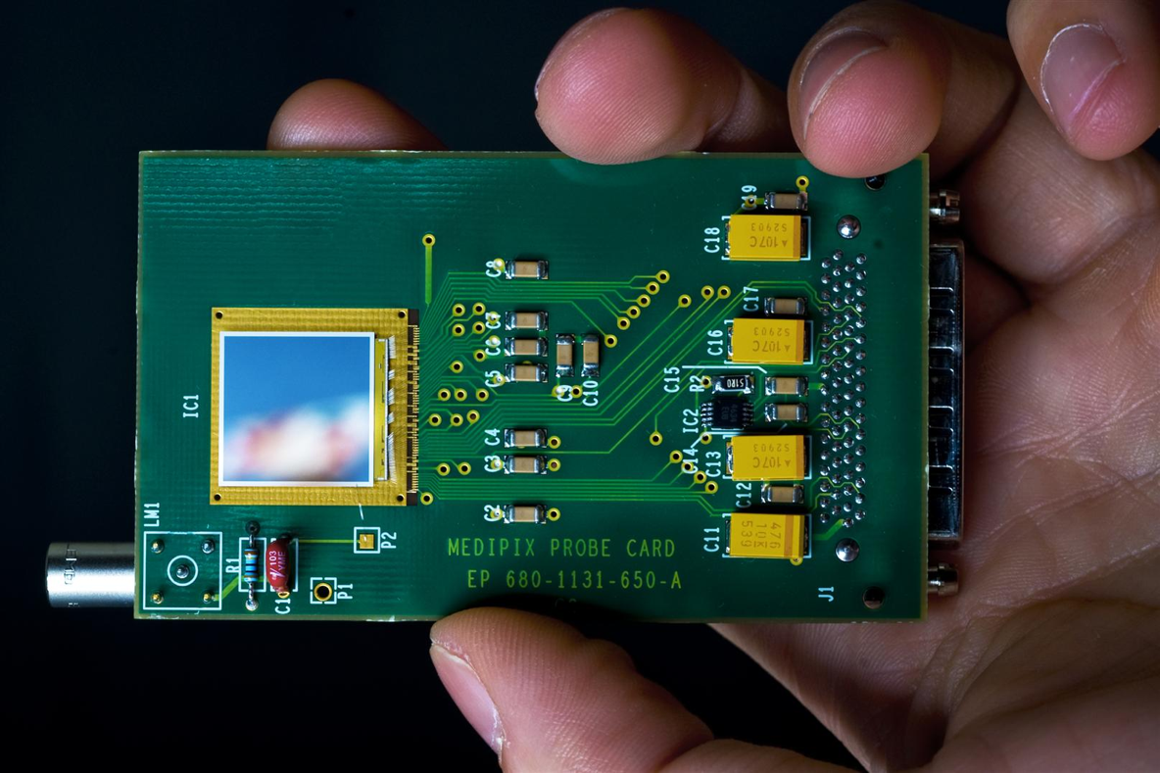

Slide 8
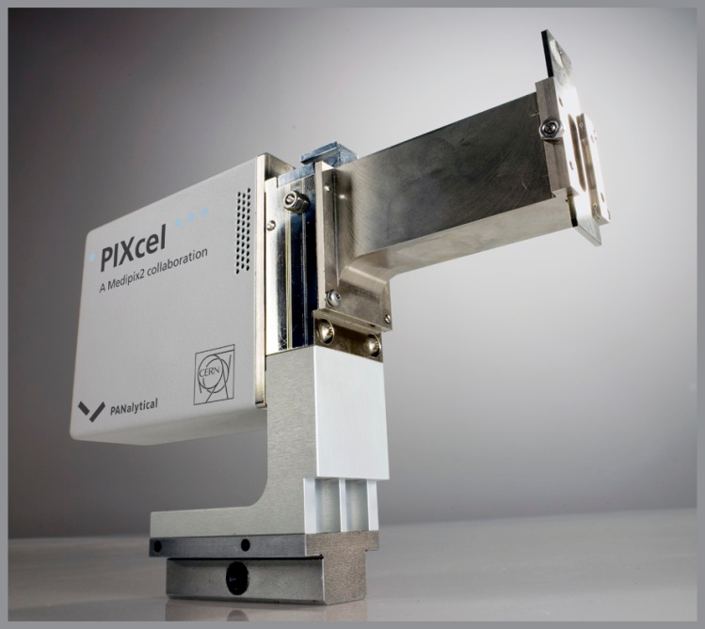

Slide 9
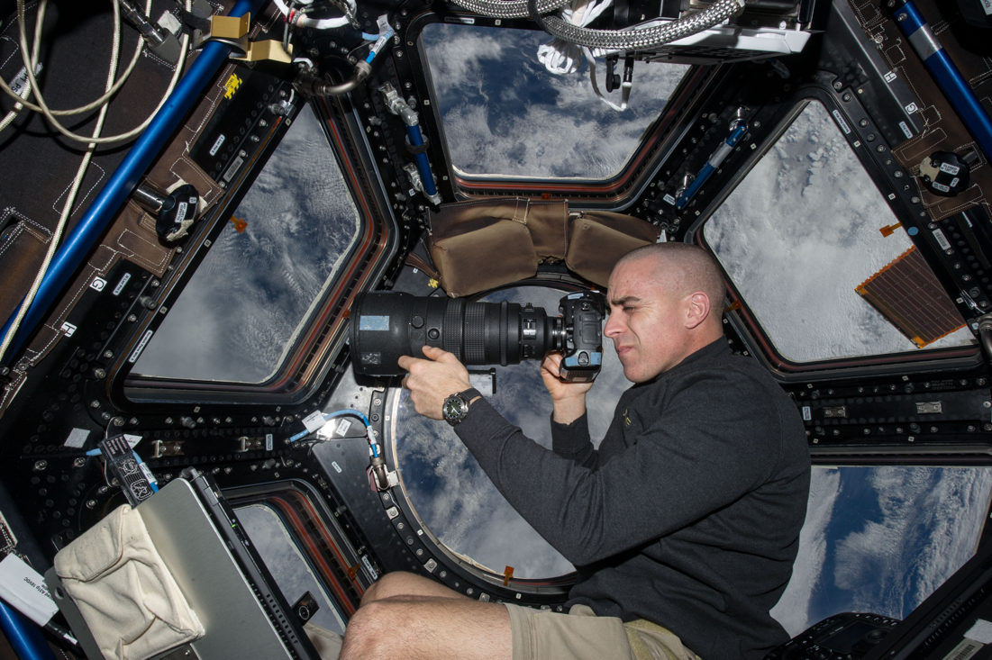

Slide 10
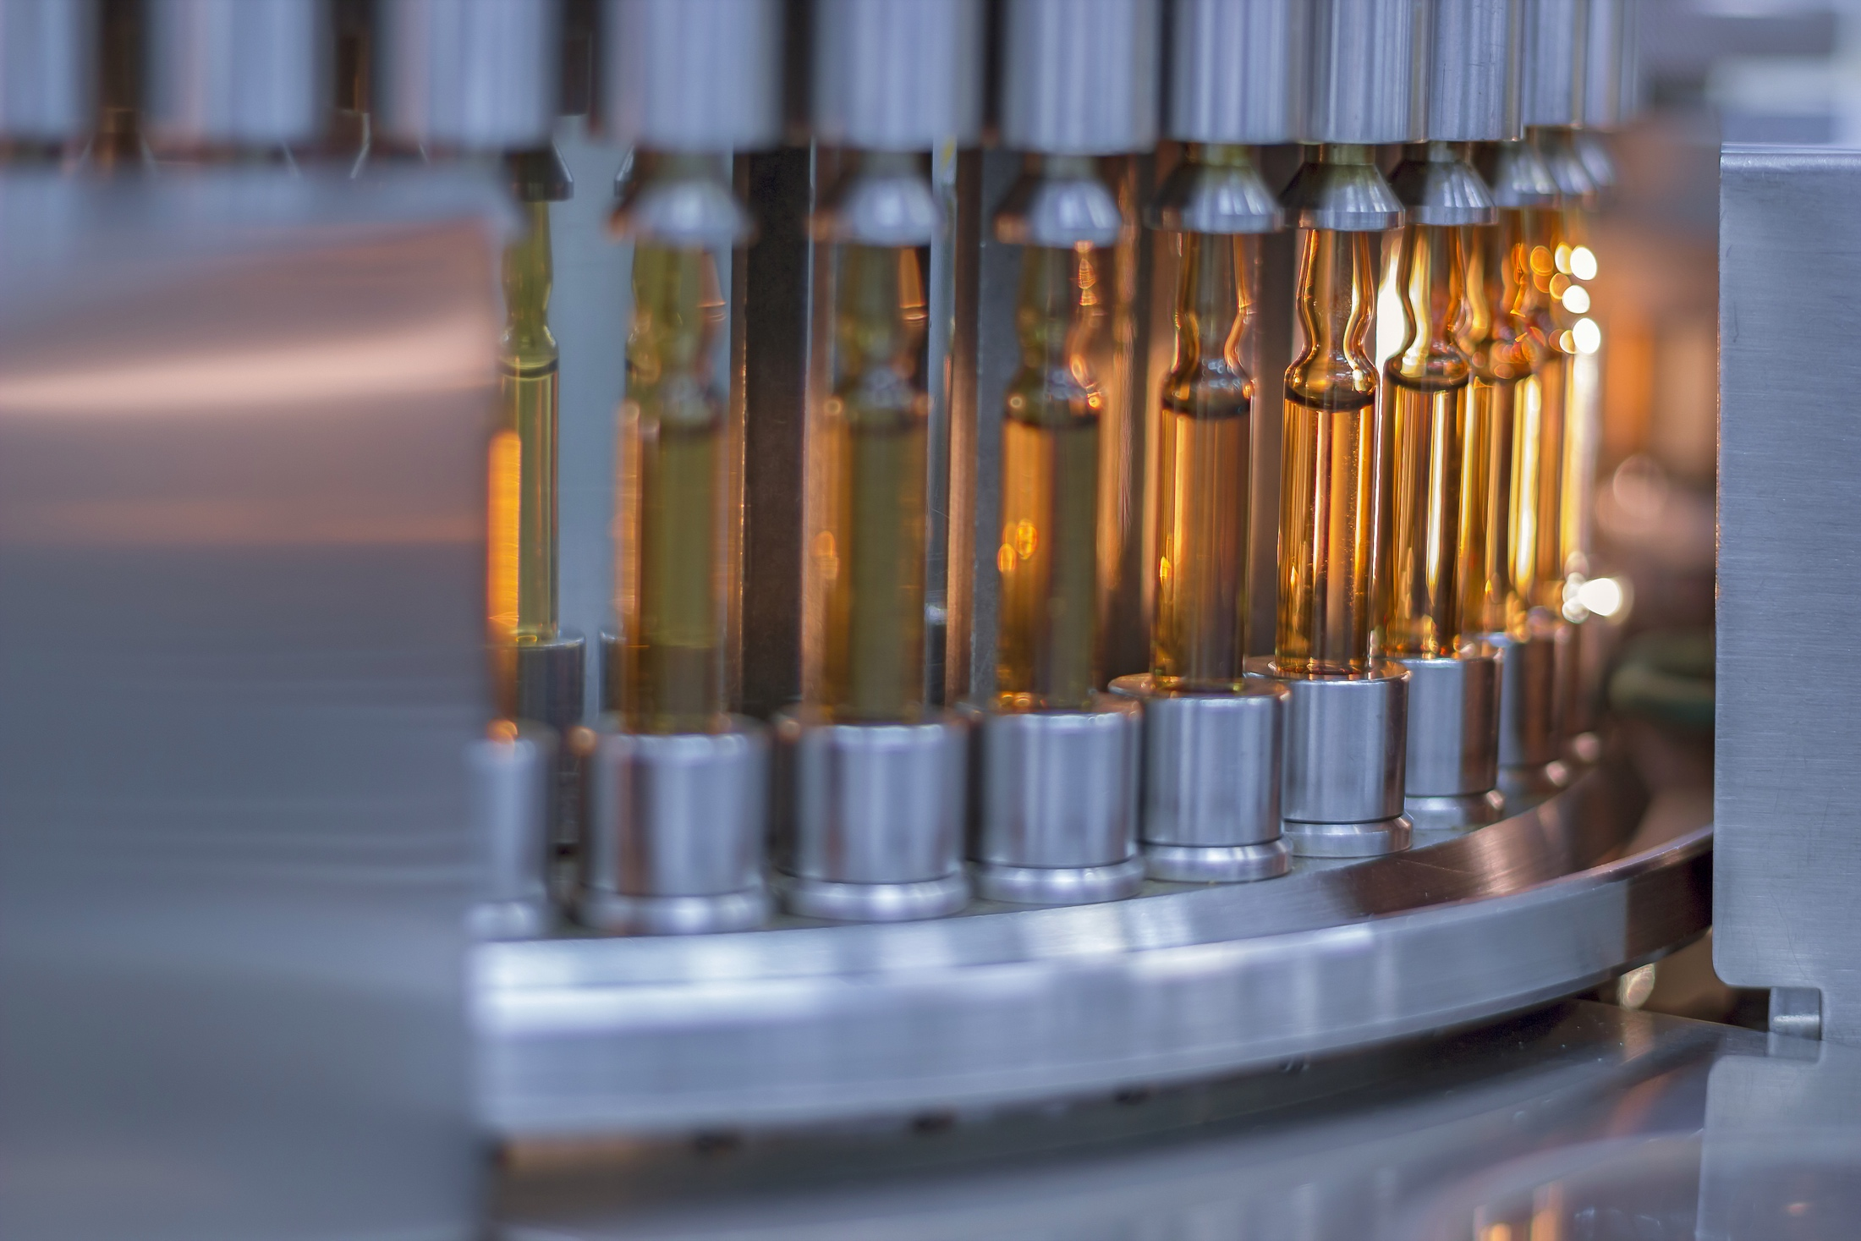
“How can machine learning improve vaccine production?”
CERN - Sanofi
Notes:
Example 1 - Medtech
CERN experts train Sanofi in machine learning - potential application in their vaccine production
Training was in 2017

Slide 11
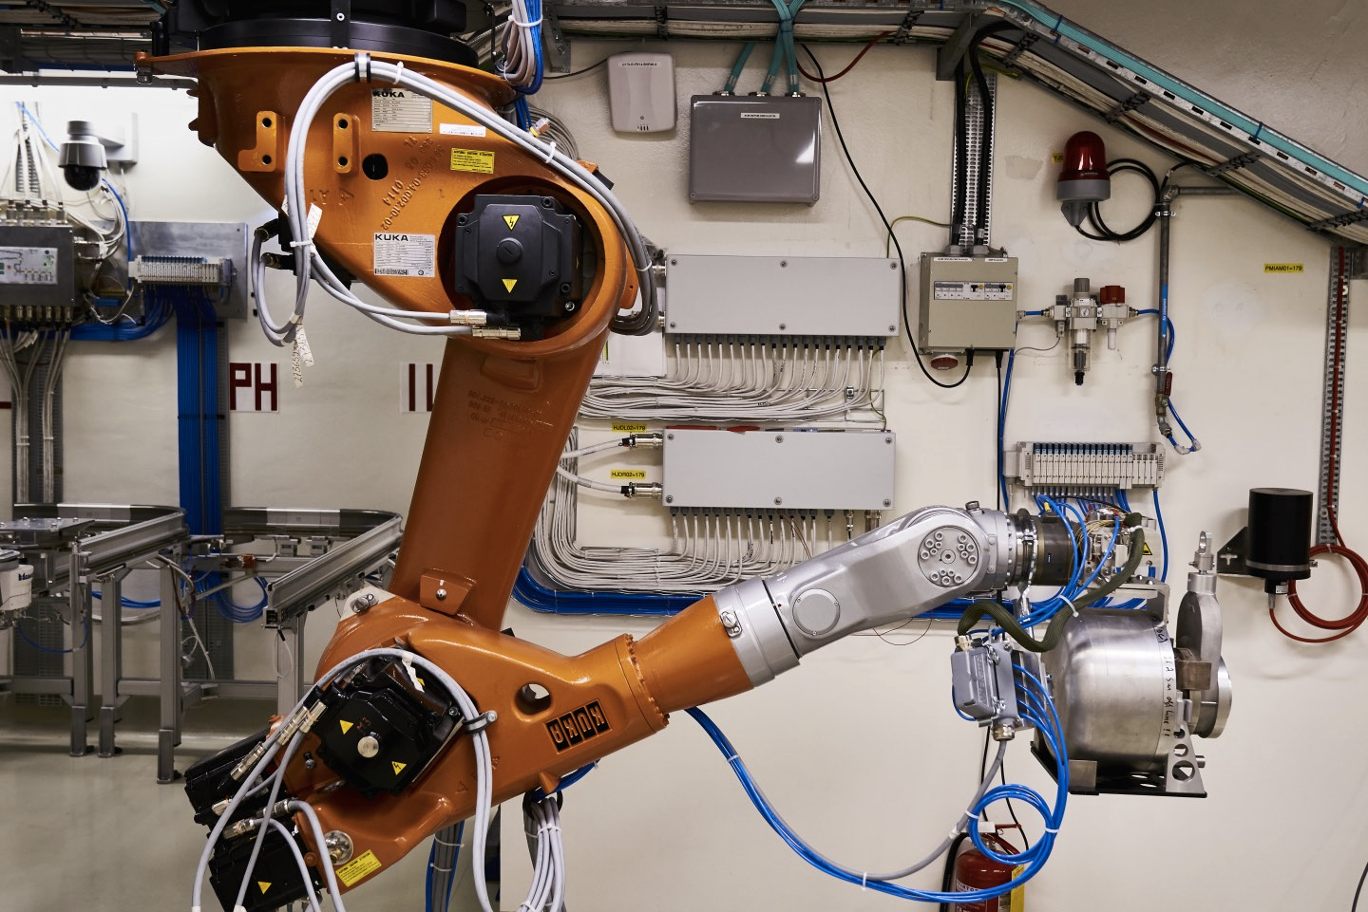
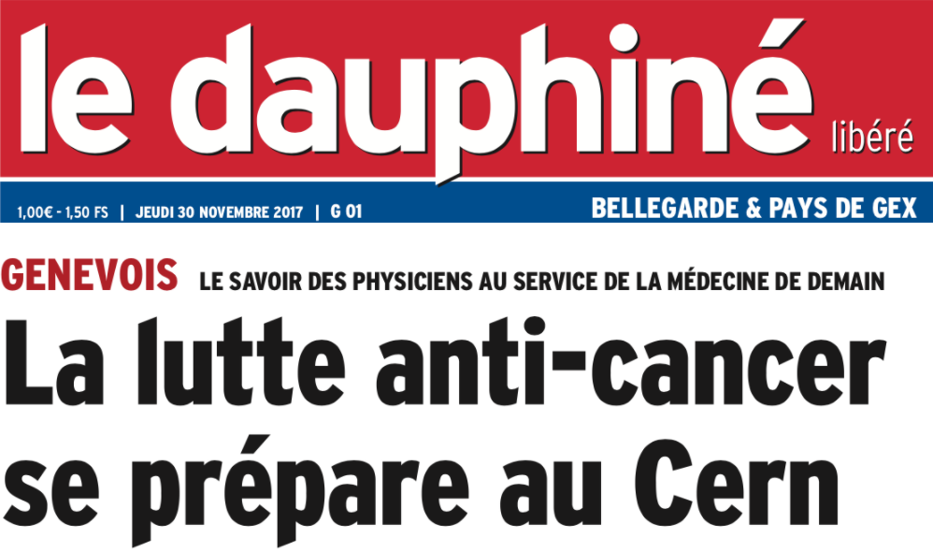
CERN-MEDICIS
First medical isotopes produced

Slide 12
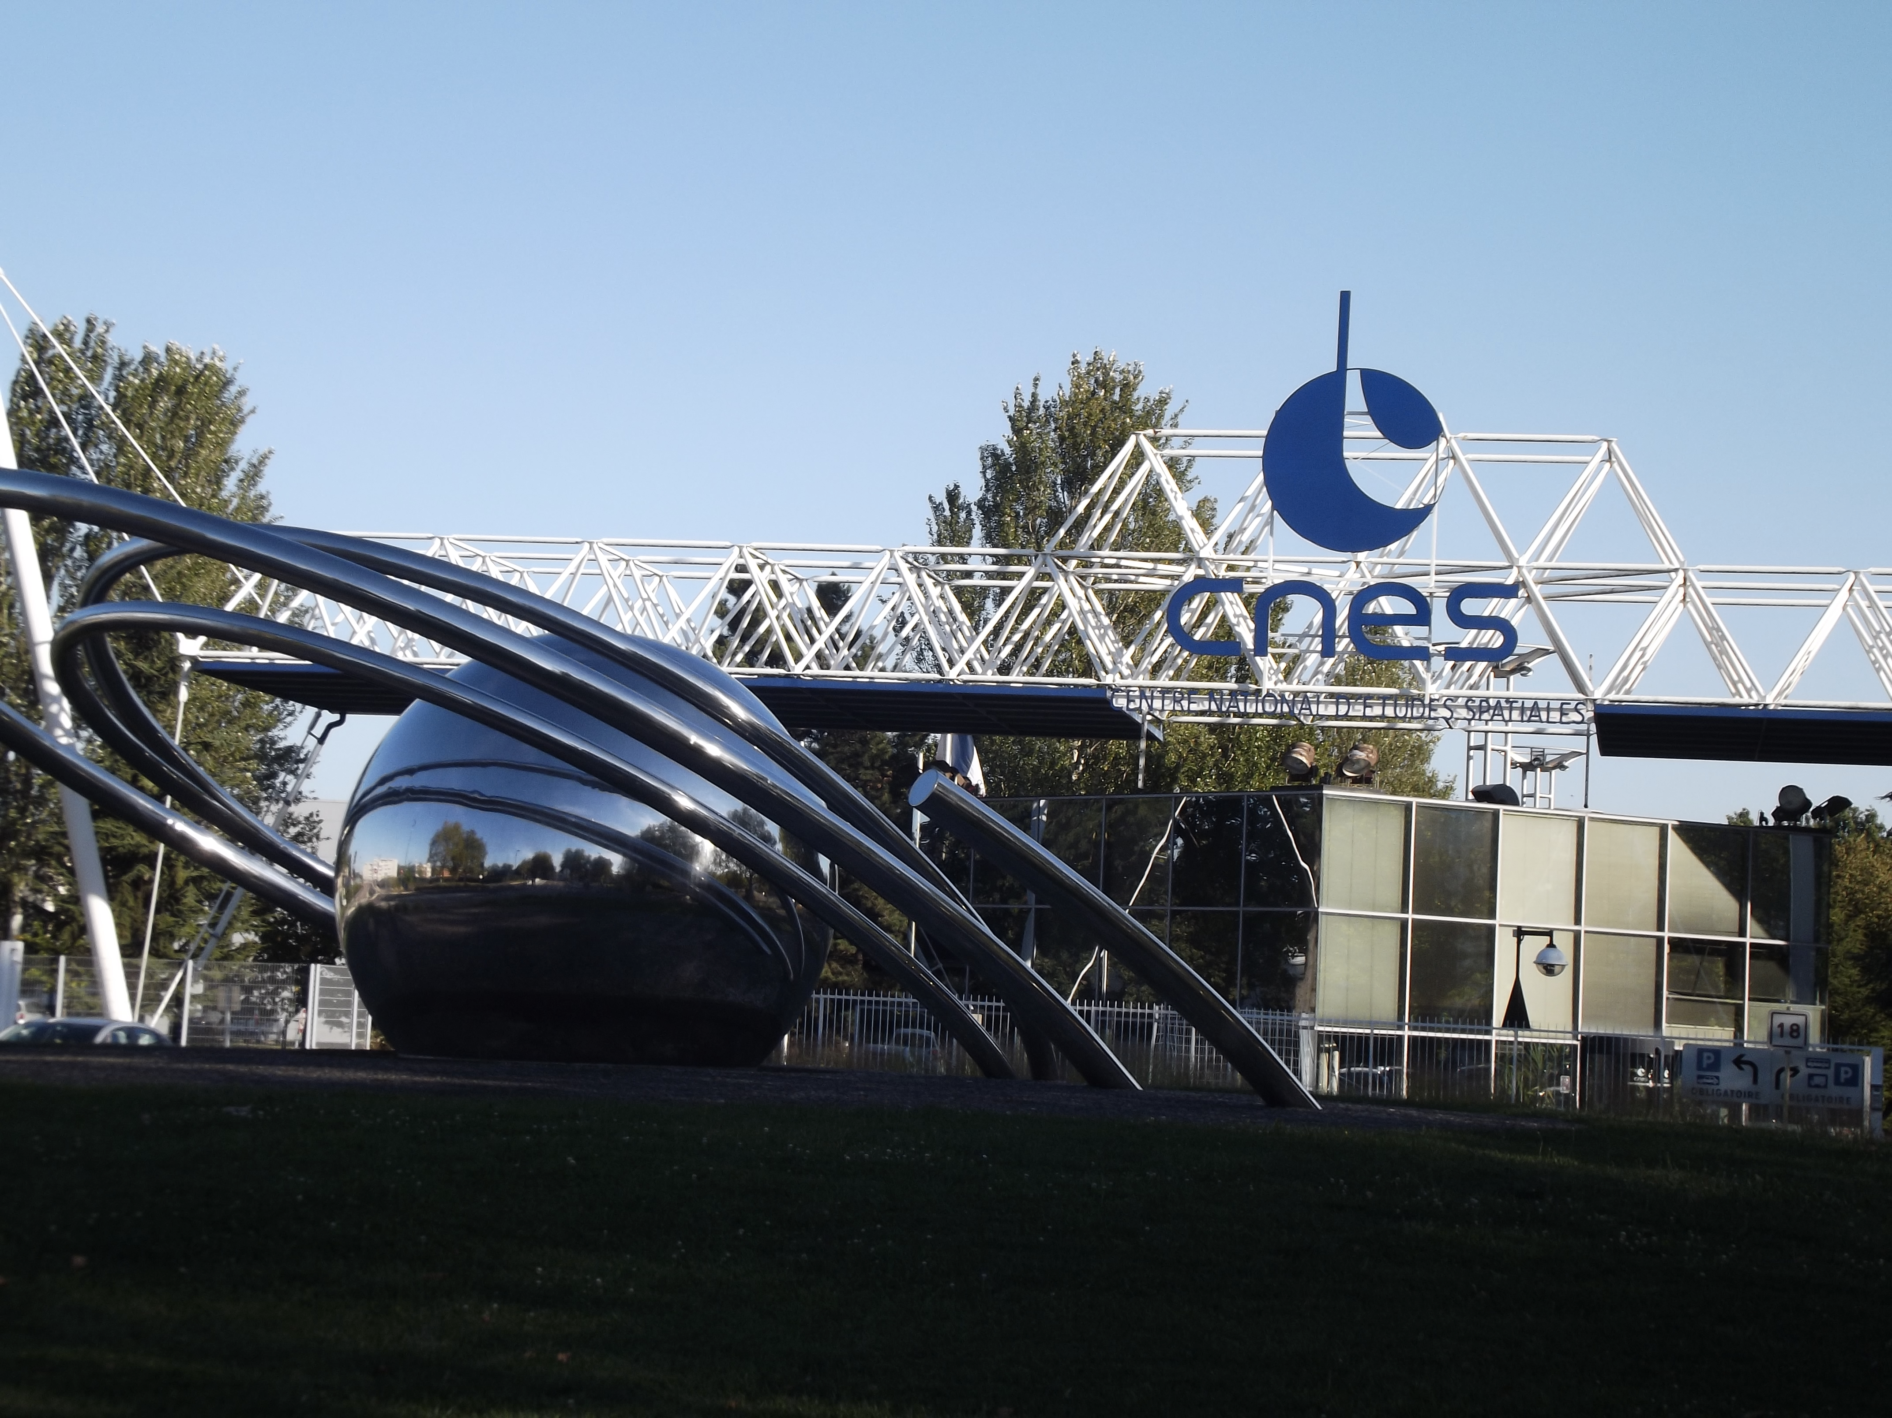
Centre Nationale Etudes Spatiales - CNES partnership with CERN
Notes:
In April 2017, the French space agency CNES (Centre National d'Etudes Spatiales) and CERN signed an important framework cooperation agreement. Three projects formalised by the agreement have already begun, in part with the support of the CERN Knowledge Transfer Fund. They include radiation tests of the Eyesat nanosatellite in the CHARM facility, the use of a Radmon based secondary payload on NIMPH, and the development of fibre optic radiation and temperature sensors.

Slide 13
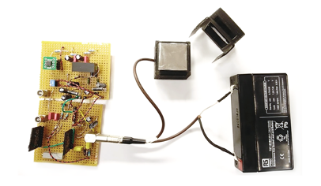
Neasens -
A start-up to tackle radon gas risk

Slide 14
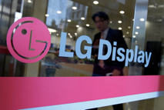
CERN’s controls middleware software for worldwide factory automation.

Slide 15
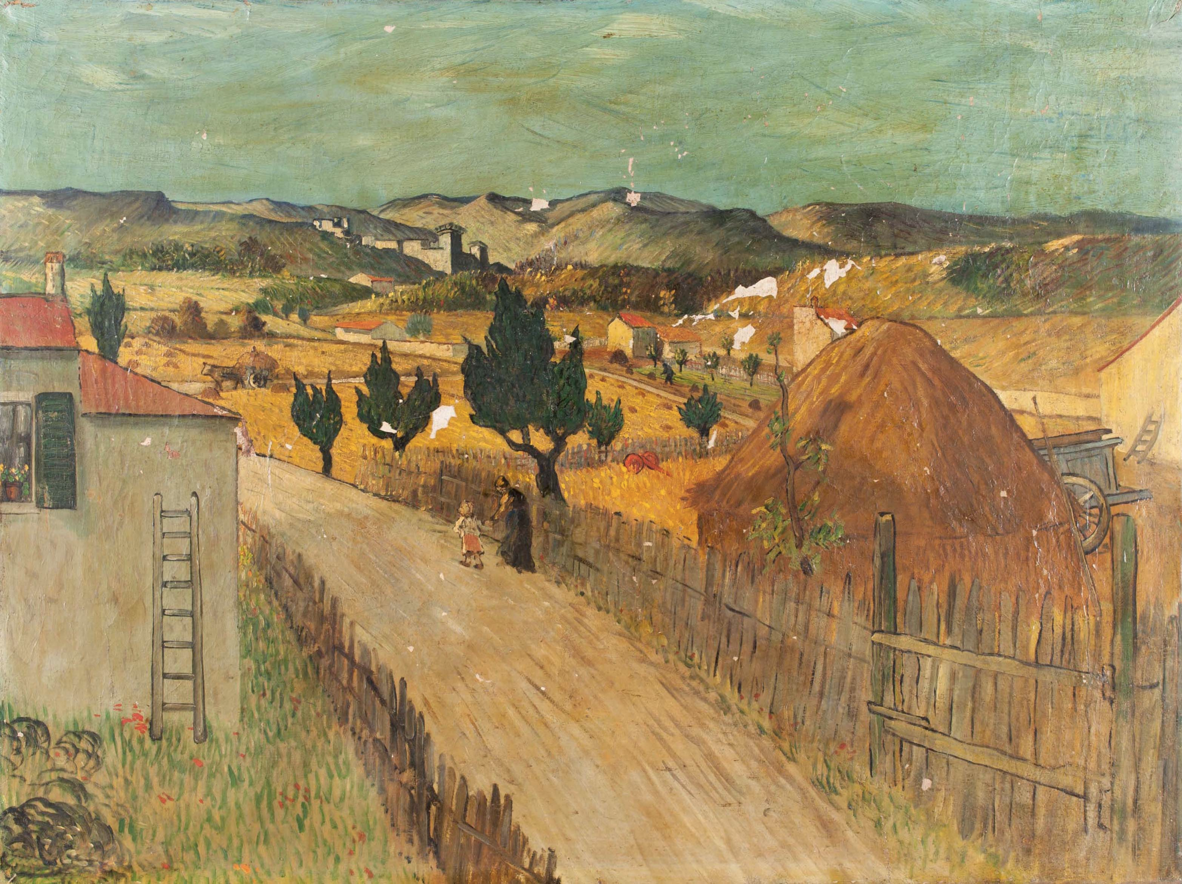
#EuropeForCulture
X-ray eyes for cultural heritage - Medipix chip
Notes:
#EuropeForCulture = because 2018 is the European Year for Cultural Heritage.
Note: Cultural Heritage is defined as: “Cultural heritage takes many forms: from the tangible legacy of monuments, artwork and books, to digital resources, either newly created or used to ensure cultural preservation. The concept also includes intangible (such as language and oral traditions) and natural elements (such as flora and fauna). This heritage may seem remotely connected to CERN's technological advances, yet the opposite is true: in 2018, several projects related to art restoration and digital preservation are using CERN technology.”

Slide 16
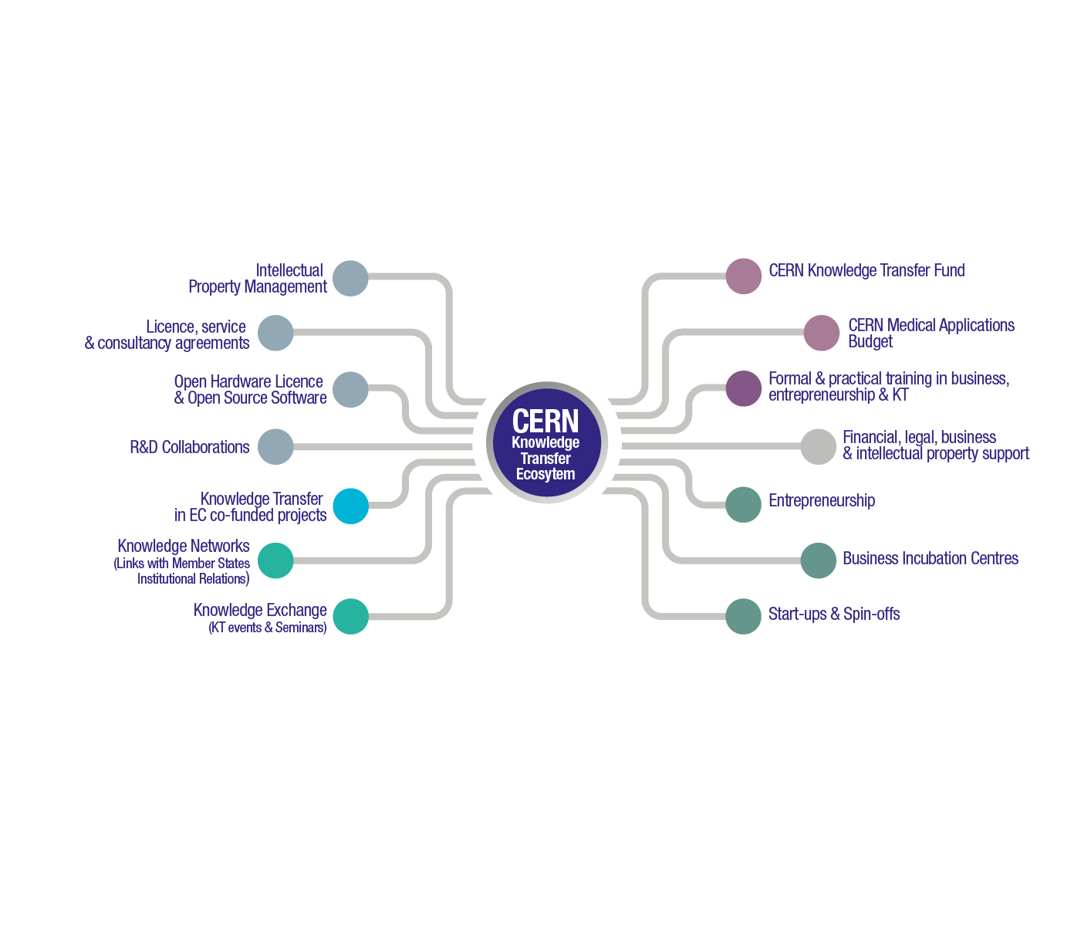
Building an Ecosystem
Notes:
This slide needs to be updated

Slide 17
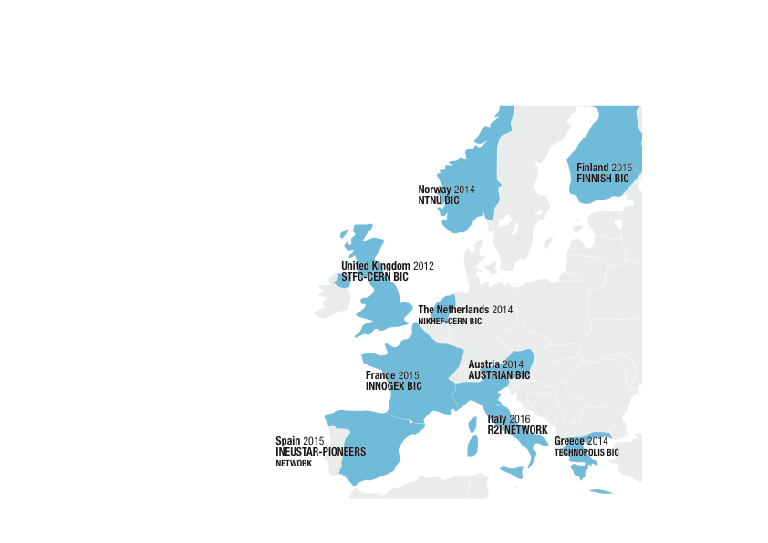
CERN BICs
CERN Network of 9 Member State Business Incubation Centres

Slide 18
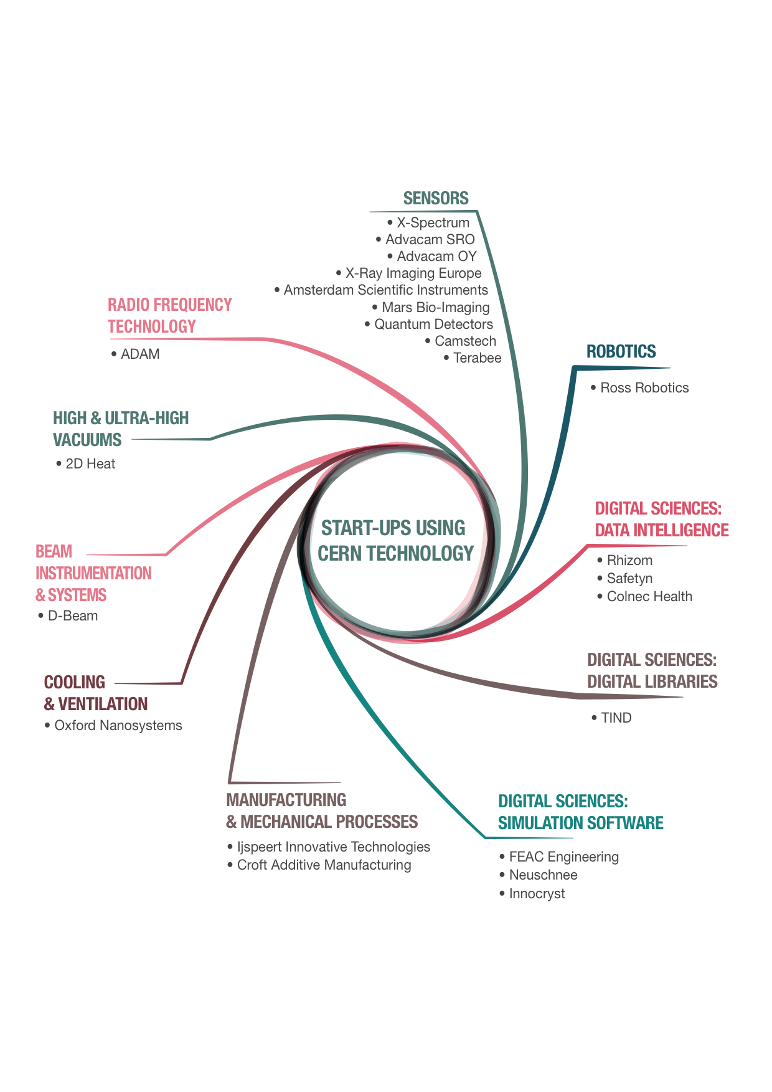
Notes:
Stats = currently 23 start-ups using CERN technology.
Fields from medtech to aersopace, and from industry 4.0 to cultural heritage.

Slide 19
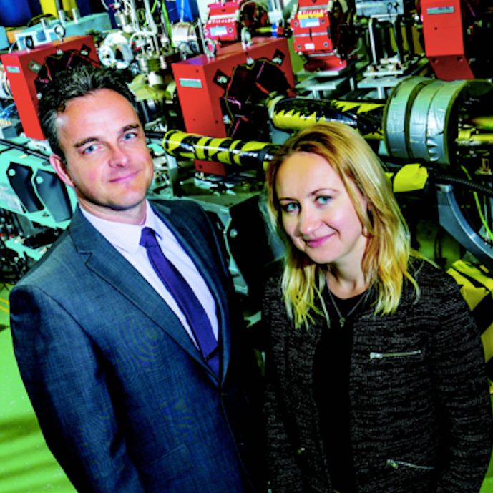
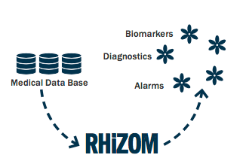

Start-ups accepted in Member State Business Incubation Centres in 2017
D-beam
STFC-CERN BIC
FEAC Engineering
Technopolis BIC
RHiZOM
InnoGEX BIC
Safetyn
InnoGEX BIC
ADVACAM Oy
Finnish BIC
Notes:
D-beam: based in STFC
Based in STFC.
D-Beam has world leading expertise in particle beams diagnostics, developed through intense and long lasting research collaborations with CERN.
A Cockcroft Institute spin-out founded by Professor Carsten Welsch and Dr Alexandra Alexandrova.
“D-Beam will be able to translate cutting edge research into commercially available tools that will improve our understanding and control of particle beams."
Particle beams are used in cancer treatment – such as the new proton therapy service due to open Liverpool's Knowledge Quarter in 2019 as announced recently – as well as facilities such as the Large Hadron Collider and European Spallation Source. This is an emerging area and D-Beam will offer a step-change in precision for the hundreds of large accelerators and synchrotron light sources that are currently in operation worldwide.
FEAC Engineering: based in Technolopolis BIC
FEAC Engineering is a leading solutions provider in Simulation Driven Engineering.
Rhizom: based in Innogex
Connecting medical devices and harvesting data
RHiZOM provides a medical cloud platform and electronic modules development to deliver state of the art IoT solutions to your medical business
Safetyn: based in Innogex
We are developing disruptive and personalized Life Preservation Solutions designed to:
- Safeguard Pilots against being irremediably drawn into the spiral of fatal accidents
Constantly assist Pilots in refining their Safety Situational Awareness & Acumen
Advacam:
Advacam s.r.o., A spin-off from the Medipix collaborations, bringing the next generation of radiation imaging detectors to the scientific and industrial market. All their cameras count individual photons in each pixel while measuring energy of the detected radiation. To achieve this they use the technologies from Medipix2, Medipix3 and Timepix3. In 2016 Advacam delivered a small particle tracking detector to NASA, scheduled to fly to the International Space Station in March 2017.

Slide 20
Why this training?
Increase visibility of KT within CERN and illustrate what services we offer within the Organization
Patents are an important source of information in addition to scientific publications, and can help you in you research project
Patents are an important topic in industry
What the course will cover: very brief intro to IP, more specific intro to patents, how to search in patent databases
What the course will not cover: specifics of how to draft a patent, how to apply for a patent.

Slide 21
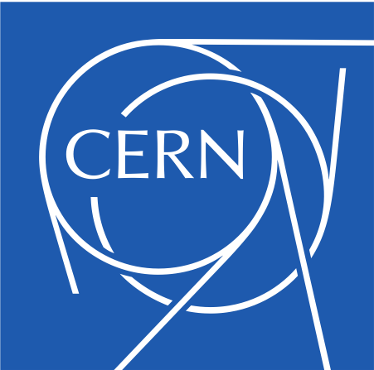
Find out more at kt.cern

