Slide 2

Correlations of direct ionization effects from low-E protons to energetic heavy ions
RADSAGA Training Workshop – March 2018

Slide 3
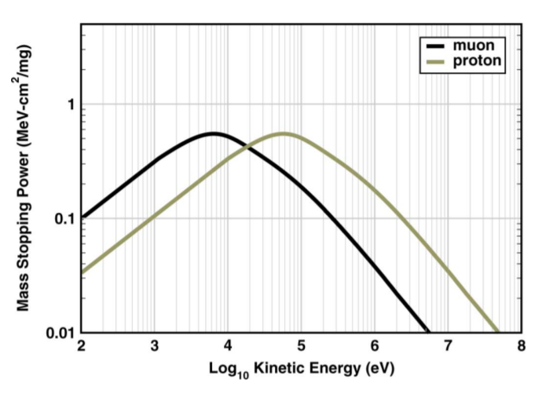
Introduction
Goal: Correlations between low-E protons and energetic heavy ions direct ionization effects
Comparison of same LETs
  Protons, (muons) and heavy ions
Can energetic heavy ions be surrogates for low E protons?

Slide 4
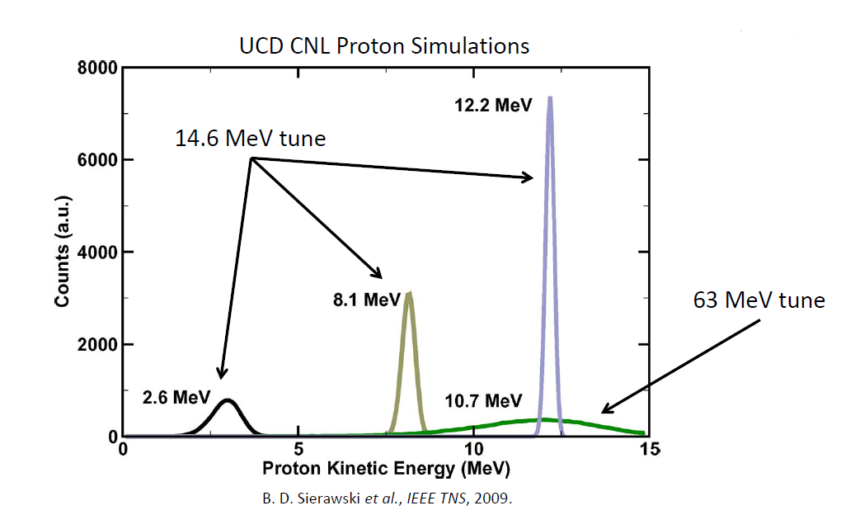
Introduction
Goal: Correlations between low-E protons and energetic heavy ions direct ionization effects
Comparison of same LETs
  Protons, (muons) and heavy ions
Can energetic heavy ions be surrogates for low E protons?

Slide 5
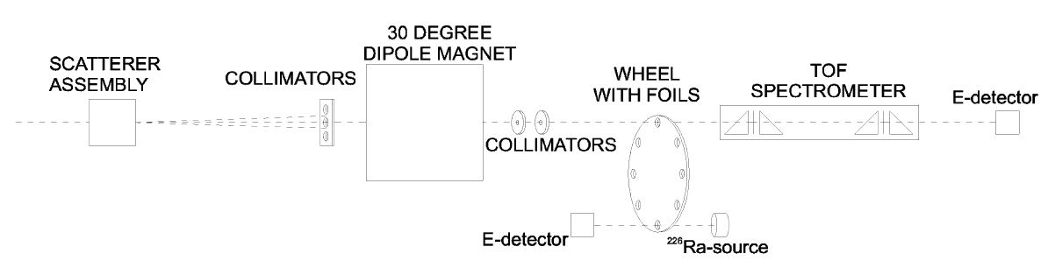
LET TOF measurements
LET of 12.5 and 16.2 MeV/u Kr, Xe in Si
  Characterization of Si-Wafers
    10 – 50 µm thickness (measured precisely)
  TOF for energy loss

Slide 6
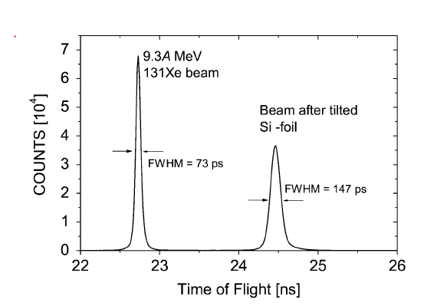
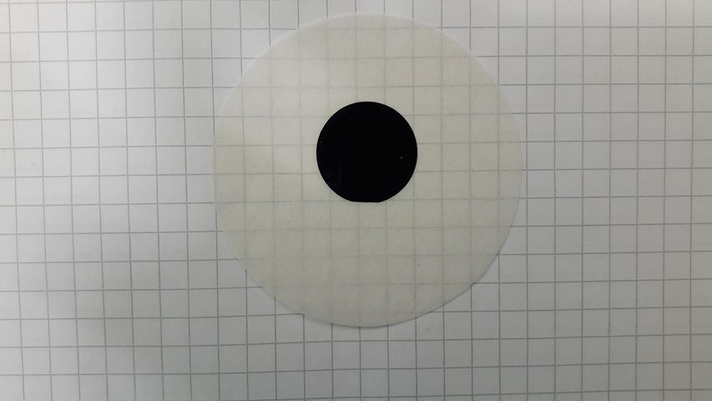

Slide 7
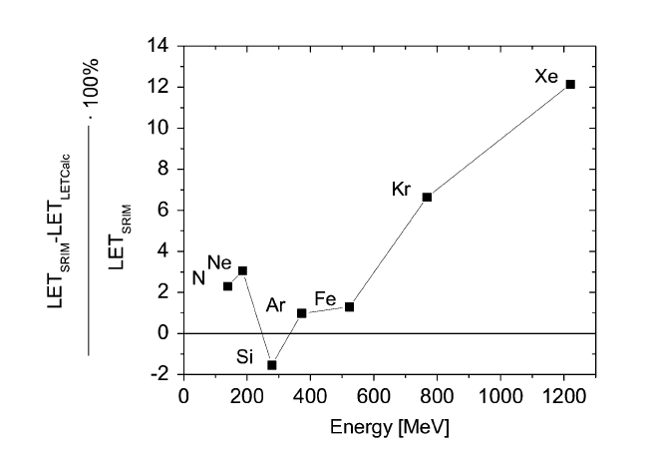
ECIF LET Calculator
Update and maintenance of JYU ECIF LET calculator website
Improve calculation model by extending database
Providing standalone software

Slide 8
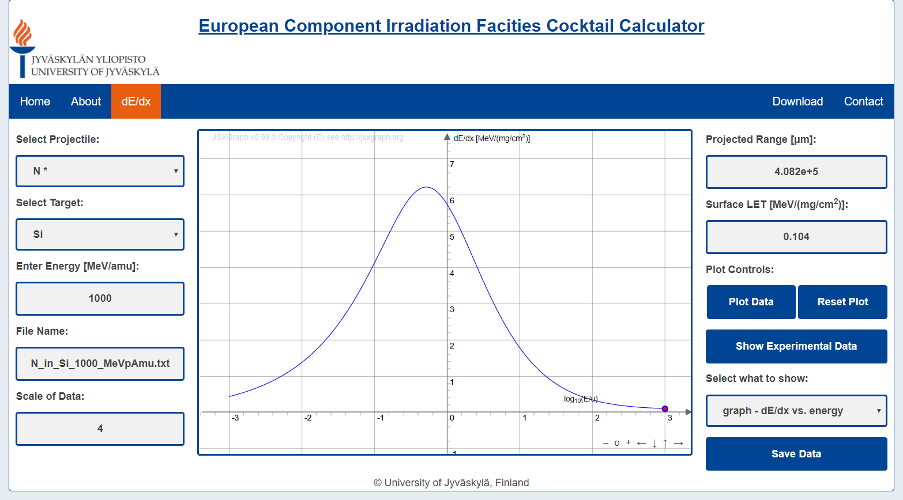
ECIF LET Calculator
L

Slide 9
Other Projects/Training
FPGA programming
MC-Simulation (FLUKA)
Machine Learning
Cluster programming

Slide 10
Secondments and Cooperations
Measurements at CERN and GANIL
Secondment at PSI
Support of ESR02

Slide 11
Sources
Test Guidelines for Evaluating Low-Energy Proton-Induced Single-Event Effects in Space Systems: Jonathan Pellish, 2012
Linear Energy Transfer of Heavy Ions in Silicon: A. Javanainen et al., IEEE Transaction on Nuclear Science 2007
Muon-Induced Single Event Upsets in Deep-Submicron Technology: Brian D. Sierawski et. al., IEEE Transaction on Nuclear Science 2010

Slide 12
Who am I
M. Sc in Engineering Physics (Sep 2017)
  Biomedical Physics and Acoustics
Master thesis on response function of radiation monitor
  Collaboration with ESA and Vanessa Wyrwoll (ESR 04)
Started as ESR in Oct. 2017 at JYU

Slide 13
Where am I
RADiation Effects Facility (RADEF) at JYU
Official ESA test site since 2005
Heavy ions, protons, electrons and X-rays
Main Involvement in heavy ions and protons

Slide 14
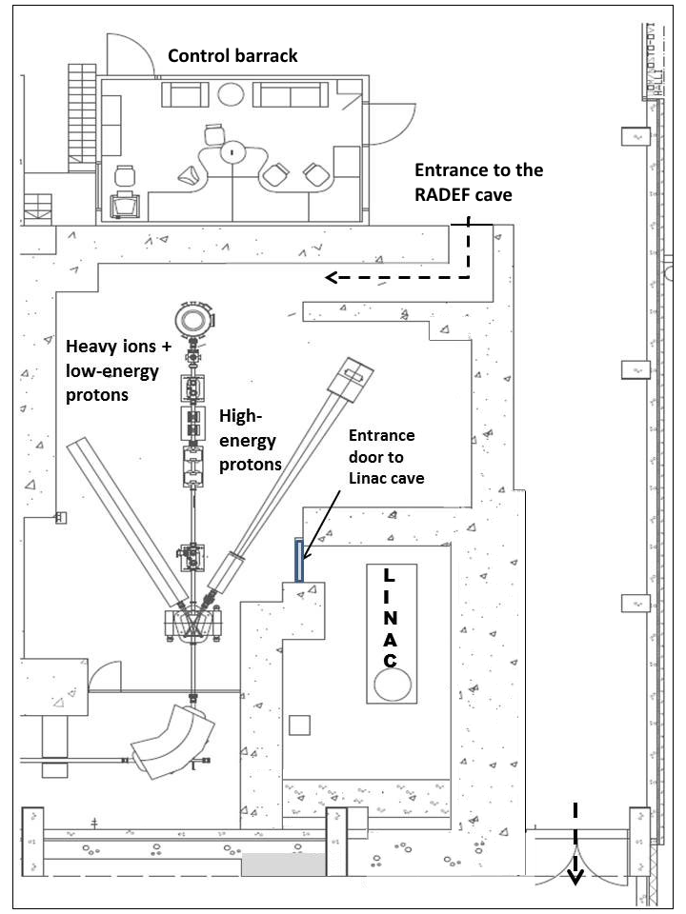
Ions and Protons at RADEF
Protons: 500keV – 55MeV
Ions:
  9.3 MeV/u (12.5 MeV/u and 16.2 MeV/u)
  4 MeV/u possible
  N, Ne, Si, Ar, Fe, Kr and Xe
Movable DUT platform in vacuum for main line
High energy proton tests in air

